Slide 1
Particle Physics Faculty Meeting
Agenda
News/Update
Roundtable

Slide 2
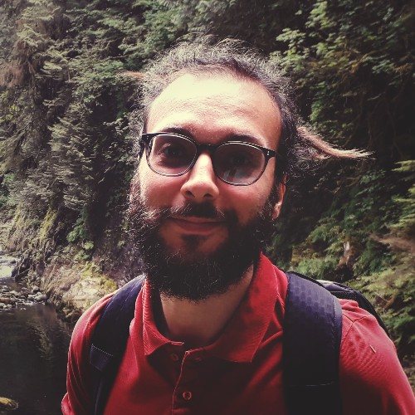
BAE Hire
ALPHA BAE position filled
Andrea Capra is the successful candidate
Postdoc at TRIUMF since 2016 in
working on ALPHA(-g) and Darkside-20k
PhD from York University in 2016

Slide 3
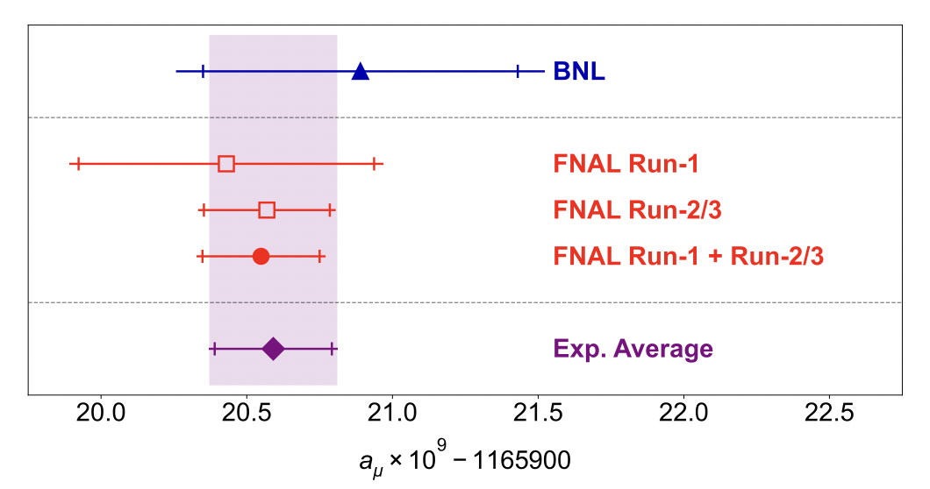
Fermilab g-2

Slide 4
Science Week
Thanks to all the speakers for excellent talks!
5 Year plan
Pre-budget submission
https://www.triumf.ca/sites/default/files/2023-PBS-Pages-01%20%281%29.pdf
“Complementing the new frontiers of science that will be unlocked with ARIEL and IAMI, the pivot towards mission-driven centres of excellence in areas, such as quantum, green technologies, detectors, and data / artificial intelligence, will position Canada to quickly and effectively respond to emergent challenges”

Slide 5
IN2P3 Visit
August 28th tour and talks
The delegation will include
Reynald Pain, IN2P3 director
Ursula Bassler, IN2P3 scientific director in charge of international collaborations
Marcella Grasso, IN2P3 scientific director for nuclear physics
Arnaud Lucotte, IN2P3 scientific director for accelerators and technology
Focus is on Accelerator and Nuclear Physics
Asked to give a 20+10min talk on Particle Physics
Plan on highlighting connections to IN2P3 and France in general, so please let me know if you have existing collaborations, items of interest

Slide 6
Today’s seminar/colloquium
Speaker: Marc Fortin (NSERC) Title: NSERC: How do we fund discovery? Abstract: We invite researchers for a short summary on the latest news from NSERC and a discussion/consultation on funding discovery, research, and students. Dr. Marc Fortin, Vice-President, Research Grants and Scholarships Directorate at NSERC, will present a summary of NSERC's funding for discovery grants and scholarship programs. The presentation will be followed by a general discussion about ways to build funding for discovery research.

Slide 7
AOB

Slide 8
Round Table
ATLAS
T2K/HyperK
TUCAN
ALPHA
SuperCDMS
DarkLight
n-EXO / PHORWARD
PIONEER
NA62
P-One
SNO+
HALO
g-2
Belle
Theory

Slide 9
Next Meeting
Sep 14th

