Slide 1
Interaction Cross Sections and Neutron Skin Thicknesses of Ni Isotopes
Dept. of Physics, Osaka University, Japan
Miki Fukutome
Collaborators
M. Tanaka,² M. Fukuda,¹ M. Takechi,³ D. Nishimura,⁴ T. Suzuki,⁵ G. Takayama,¹ R. Taguchi,¹ S. Ishitani,¹ M. Mihara,¹ K. Matsuta,¹ T. Moriguchi,⁶ T. Ohtsubo,³ A. Ozawa,⁶ T. Yamaguchi,⁵ N. Fukuda,² T. Izumikawa,⁷ H. Sakurai,^{2,8} T. Sumikama,² H. Suzuki,² H. Takeda,² Y. Yanagisawa,² K. Yoshida,² T. Sugisaki,¹ N. Norihide,³ Y. Kobayashi,³ Y. Tazawa,³ A. Yano,⁶ C. Fukushima,⁴ M. Amitani⁴ + sigma collaborations
¹ Dept. of Physics, Osaka University, Japan
² RIKEN Nishina Center, Japan
³ Dept. of Physics, Niigata University, Japan
⁴ Dept. of Physics, Tokyo City University, Japan
⁵ Dept. of Physics, Saitama University, Japan
⁶ Inst. of Physics, University of Tsukuba, Japan
⁷ Inst. for Research Promotion, Niigata University, Japan
⁸ Dept. of Physics, University of Tokyo, Japan
NN2024, 19/08/2024
Notes:
Thank you for introduction.
I’m Miki Fukutome from Osaka University, in Japan.
Today, I’d like to talk about “Interaction Cross Sections and Neutron Skin Thicknesses of Ni Isotopes”.
These are collaborators of this study.

Slide 2
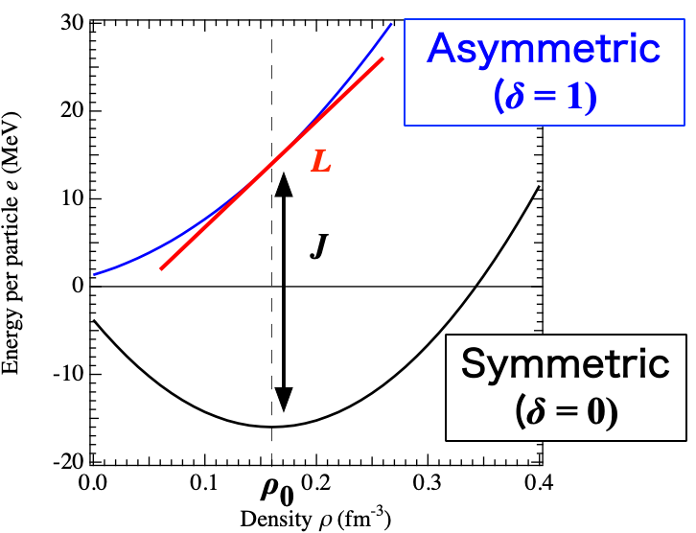
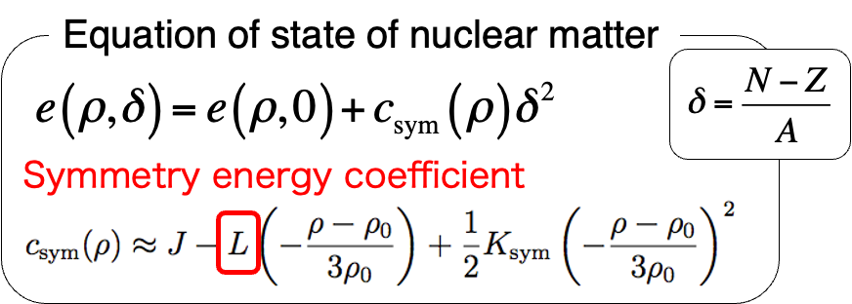
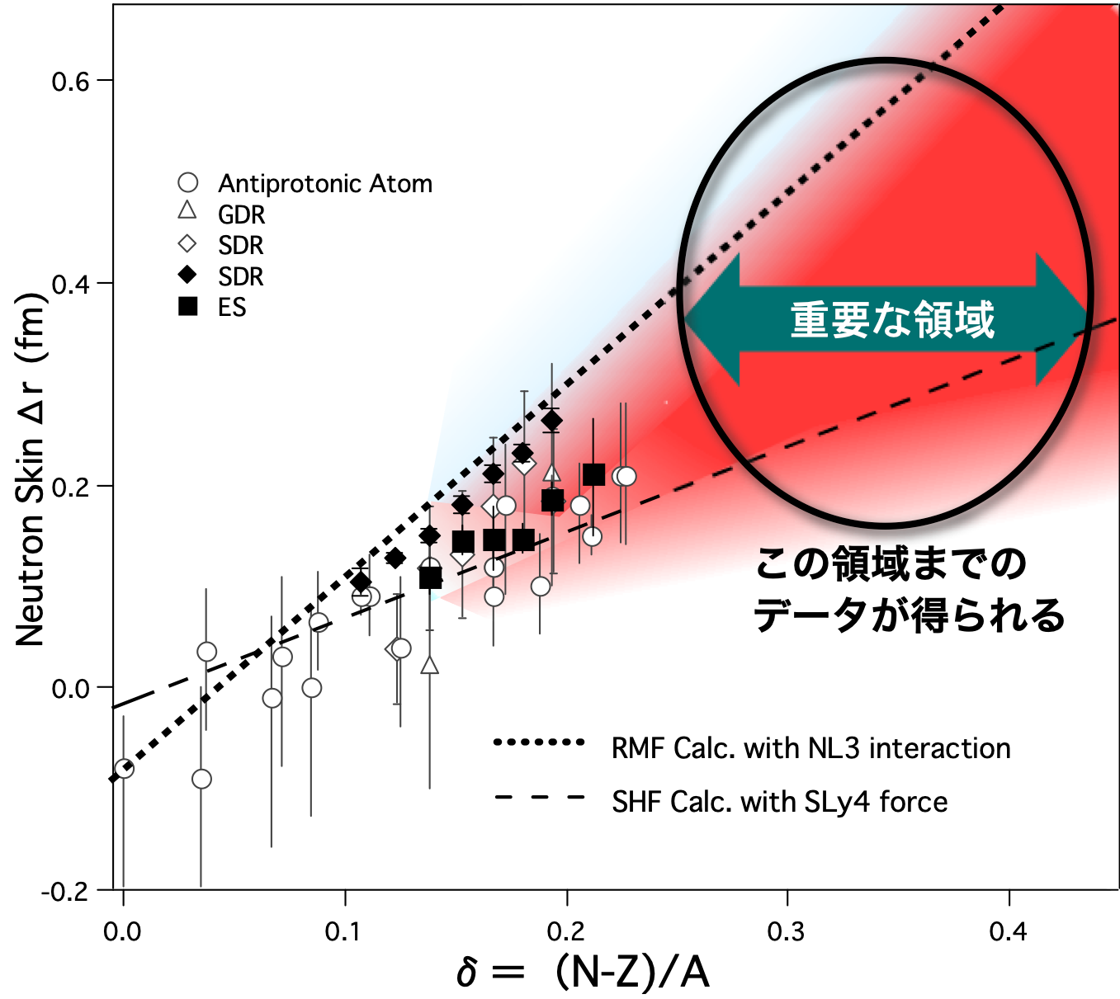
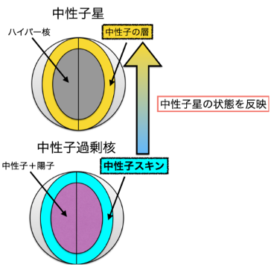
1. Introduction
The equation of state (EOS) of nuclear matter
→Contribute to the solution of various problems in astrophysics, such as structure of neutron stars and the process of supernova explosions.
Neutron Star
Hypernucleus
Neutron Layer
Key Region
Reflecting the state of neutron stars
Neutron-rich Nucleus
Neutron + proton
Neutron Skin
ΔR
NN2024, 19/08/2024
M. Centelles et al., Phys. Rev. Lett. 102 (2009) 122502.
Notes:
In this work, we are interested in the equation of state, EOS, of nuclear matter, which is thought to be able to contribute to solve several problems in astrophysics, such as the structure of neutron stars and the process of supernova explosions.
This figure shows theoretical predictions of EOS for symmetric and asymmetric nuclear matter.
The slope of the neutron matter at rho zero, L, is an important parameter in EOS, but has not yet been determined experimentally well.
The thickness of neutron skin is one of the effective experimental observables in order to determine L.
L can be directly determined from the slope of the proton-neutron asymmetry δ dependence of the neutron skin thickness, which has been measured in several previous studies.
However, the values of neutron skin thickness have been measured only in the region of small δ near the stability line, and the value varies depending on the measurement method.

Slide 3
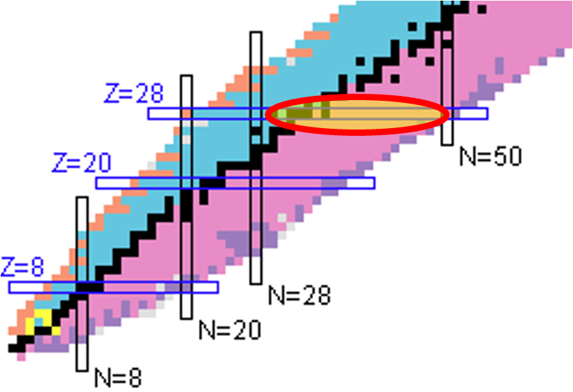
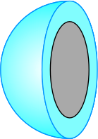
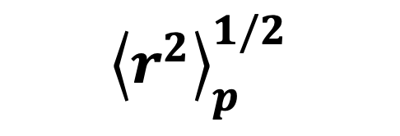
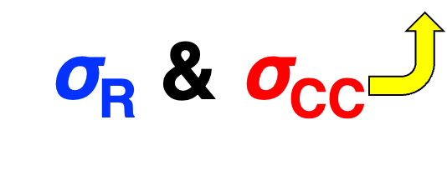
1. Introduction
⁵⁶Zn | ⁵⁷Zn | ⁵⁸Zn | ⁵⁹Zn | ⁶⁰Zn | ⁶¹Zn | ⁶²Zn | ⁶³Zn | ⁶⁴Zn | ⁶⁵Zn | ⁶⁶Zn | ⁶⁷Zn | ⁶⁸Zn | ⁶⁹Zn | ⁷⁰Zn | ⁷¹Zn | ⁷²Zn | ⁷³Zn | ⁷⁴Zn | ⁷⁵Zn | ⁷⁶Zn | ⁷⁷Zn | ⁷⁸Zn | ⁷⁹Zn | ⁸⁰Zn
⁵⁵Cu | ⁵⁶Cu | ⁵⁷Cu | ⁵⁸Cu | ⁵⁹Cu | ⁶⁰Cu | ⁶¹Cu | ⁶²Cu | ⁶³Cu | ⁶⁴Cu | ⁶⁵Cu | ⁶⁶Cu | ⁶⁷Cu | ⁶⁸Cu | ⁶⁹Cu | ⁷⁰Cu | ⁷¹Cu | ⁷²Cu | ⁷³Cu | ⁷⁴Cu | ⁷⁵Cu | ⁷⁶Cu | ⁷⁷Cu | ⁷⁸Cu | ⁷⁹Cu
⁵⁴Ni | ⁵⁵Ni | ⁵⁶Ni | ⁵⁷Ni | ⁵⁸Ni | ⁵⁹Ni | ⁶⁰Ni | ⁶¹Ni | ⁶²Ni | ⁶³Ni | ⁶⁴Ni | ⁶⁵Ni | ⁶⁶Ni | ⁶⁷Ni | ⁶⁸Ni | ⁶⁹Ni | ⁷⁰Ni | ⁷¹Ni | ⁷²Ni | ⁷³Ni | ⁷⁴Ni | ⁷⁵Ni | ⁷⁶Ni | ⁷⁷Ni | ⁷⁸Ni
⁵³Co | ⁵⁴Co | ⁵⁵Co | ⁵⁶Co | ⁵⁷Co | ⁵⁸Co | ⁵⁹Co | ⁶⁰Co | ⁶¹Co | ⁶²Co | ⁶³Co | ⁶⁴Co | ⁶⁵Co | ⁶⁶Co | ⁶⁷Co | ⁶⁸Co | ⁶⁹Co | ⁷⁰Co | ⁷¹Co | ⁷²Co | ⁷³Co | ⁷⁴Co | ⁷⁵Co | ⁷⁶Co | ⁷⁷Co
ΔR
mass region : A = ⁵⁸⁻⁷⁷Ni (0.03 < δ < 0.28)
Key Region
ΔR
ΔR
or
Rc
I
Interaction
cross section
Charge-changing
cross section
Charge radii
by isotope shift method
M. Centelles et al., Phys. Rev. Lett. 102 (2009) 122502.
NN2024, 19/08/2024
Notes:
So, in the present study, we measured interaction cross sections for Ni isotopes, mass number 58 to 77, and derived root-mean-square matter radii.
On the charge radii, these were determined by isotope shift method for isotopes up to mass number 70 in the previous studies. In this study, we measured the charge-changing cross sections in order to determine charge radii for more neutron-rich isotopes. We haven’t finalize the analysis of the charge changing cross sections and also due to the short presentation time, I will focus on the results of interaction cross sections here.
Then, we can extract neutron-skin thickness in a wide range of the asymmetry parameter, δ from 0.03 to 0.28 by combining these two radii.

Slide 4
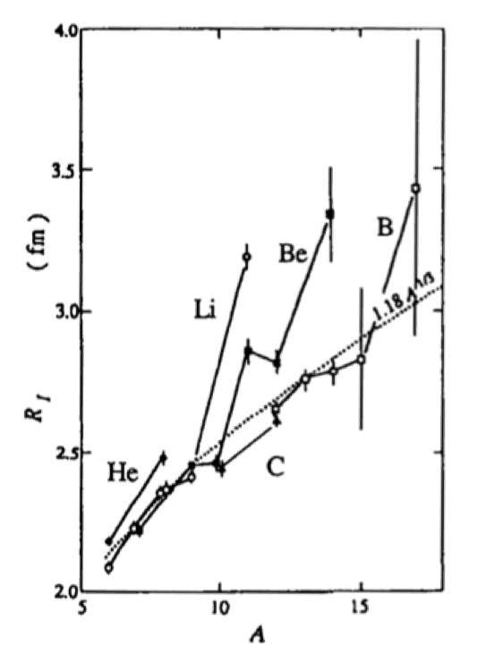
2. Interaction cross section σI → Matter radius
Interaction cross section σI
Total nuclide-changing (N or Z) reaction
$$σ_{I}∼π(r_{m}+r_{T})^{2}$$
Projectile
Well established method to deduce rm using the Glauber model.
Large cross section (~1 b) → Applicable to low-intensity RI beam.
Matter radius
Matter radius
rm
rm
Target
rT
rT
σI
¹⁴Be
¹¹Li
Interaction radius (fm)
¹¹Be
∝ A^{1/3}
ex.) halo structure of ¹¹Li I. Tanihata et al., PRL 55, 2676 (1985).
NN2024, 19/08/2024
Notes:
In the following, I will show you the details of the principle of experiment.
At first, measurement of the interaction cross section, which is a total cross section of nuclide-changing reactions is one of the powerful tools to probe the matter radius of unstable nucleus.
In a naive picture, nuclide-changing reactions occur in the overlap region of colliding nuclei, like this.
So, the interaction cross section can be described roughly like this equation.
This method is well established to deduce matter radius from the sigma-I data using the Glauber model.
And this cross section is quite large, like an order of 1 barn.
Therefore, we can measure interaction cross sections even with a low-intensity RI beam, namely a nucleus far from the stability line.

Slide 5
3. Experiment
Non-reaction rate
σI measurement
~Transmission method~
$$Γ_{in}=\frac{N_{2}^{in}}{N_{1}^{in}}$$
Reaction
target
Non-nuclide-changing (N, Z) = (N_{inc.}, Z_{inc.})
Detector1
Detector2
Incident particles
N₁^{in}
Non-reacting particles
N₂^{in}
$$σ_{I}=-\frac{1}{t}ln\left(\frac{Γ_{in}}{Γ_{out}}\right)$$
Thickness: t
Detector1
Detector2
Incident particles
N₁^{out}
Non-reacting particles
N₂^{out}
$$Γ_{out}=\frac{N_{2}^{out}}{N_{1}^{out}}$$
Correct events reacted in detectors
NN2024, 19/08/2024
Notes:
In this work, we measured the cross sections by the transmission method.
In this method, the number of incident particles are counted before the reaction target, and the number of non-reacting particles is counted after the reaction target.
In the case of interaction cross section measurements, non-nuclide-changing particles are regarded as non-reacting particles.
Moreover, the effect of reactions in detectors can be corrected by the measurement without the target.

Slide 6
4. Setup & Particle identification
Beam
PPAC
BigRIPS fragment separater @RIBF | RIKEN
PL
F3
MUSIC
²³⁸U + Be → ⁵⁸⁻⁷⁷Ni
PPAC
Primary: ²³⁸U 345A MeV
Secondary: ⁵⁸⁻⁷⁷Ni 280A MeV
Reaction target:
Wedge-shaped C target (1.803 g/cm², 9 mrad)
F5
PL
¹²C target
MUSIC
F7
MUSIC
PL
NN2024, 19/08/2024
Notes:
The experiment was performed at RIKEN RI beam factory by using the BigRIPS fragment separator.
The Ni isotopes with mass numbers 58 to 77 were produced from a 350 MeV/u uranium beam bombarding on a beryllium production target.
The wedge-shaped carbon reaction target was installed at F5 momentum dispersive focal plane.

Slide 7
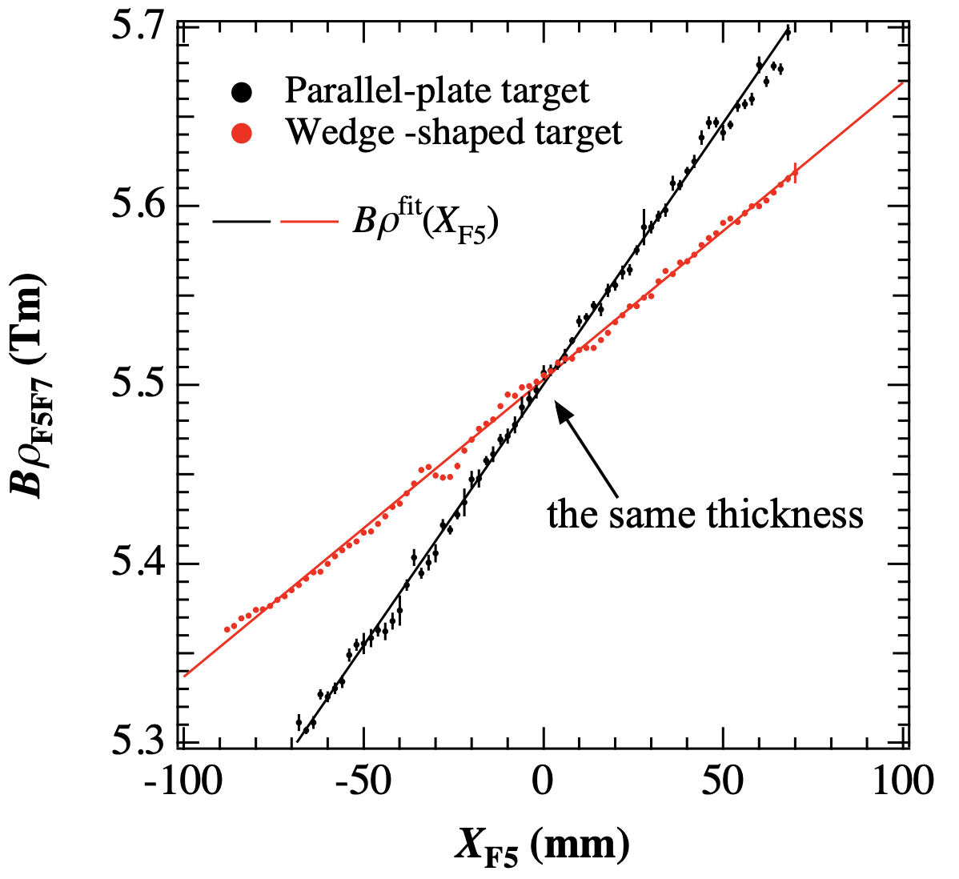
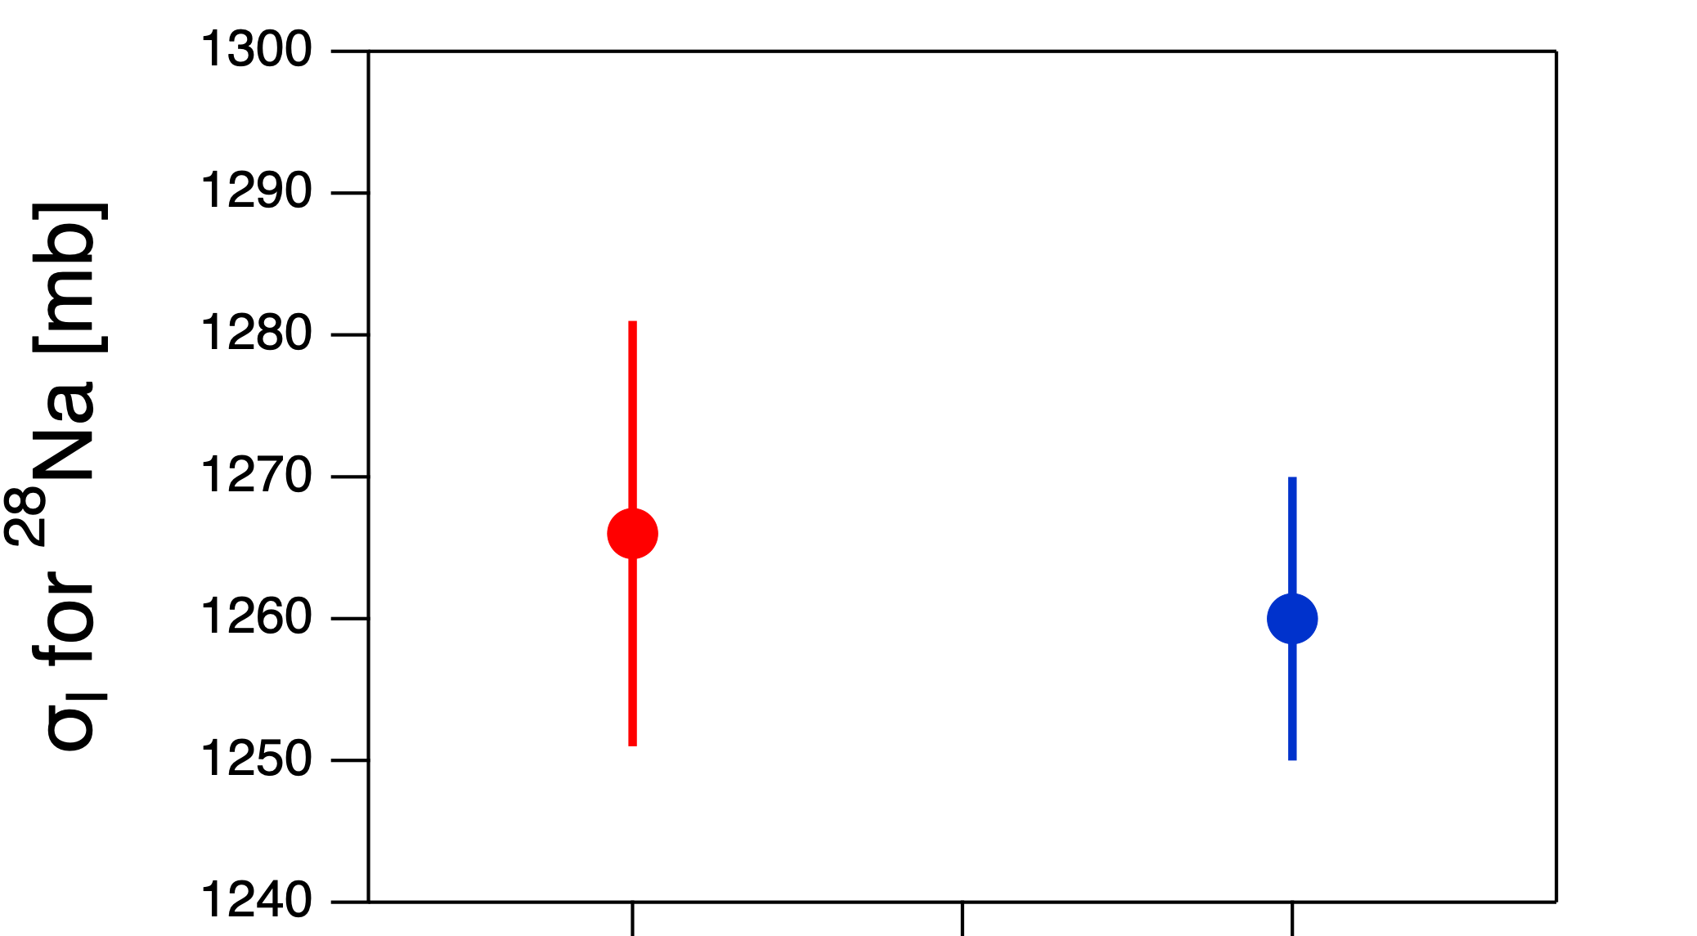
4. Setup & Particle identification
Beam
PPAC
・Profile of wedge-shaped target
PL
F3
MUSIC
PPAC
F5
PL
¹²C target
MUSIC
parallel-plate
1266(15)
wedge-shaped
1260(10)
F7
MUSIC
PL
S. Suzuki, Niigata Univ., 2012, Ph. D. thesis.
Notes:
F5 is a momentum-dispersive focal plane, so we used wedge-shaped target. By using a wedge-shaped target, the momentum dispersion downstream of the target can be preserved, but the reaction rate varies depending on the position of the incident particle passing through the target. Therefore, in this experiment, we calibrated the target thickness at the X position of F5 by comparing the energy losses for wedge-shaped target and for parallel-plate target. Then, we calculated the weighted-mean thickness of the wedge-shaped target by using actual beam distribution. This method has been validated in previous measurements for sodium isotopes by our group, where the interaction cross-sections obtained using both the parallel-plate target and the wedge-shaped target were found to agree with each other within the error.

Slide 8
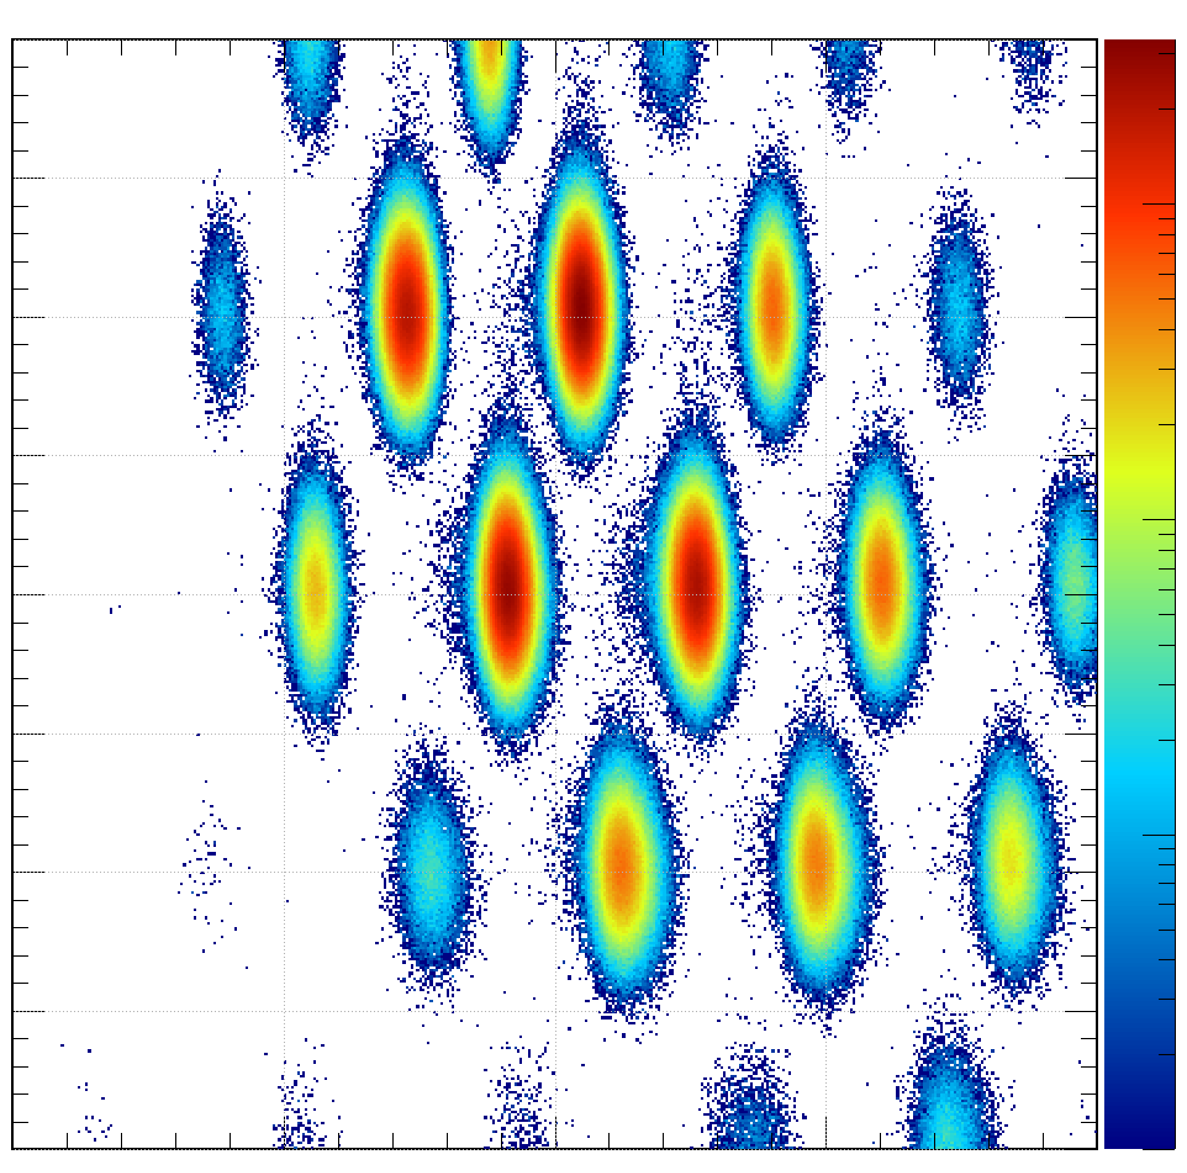
4. Setup & Particle identification
Beam
PPAC
BigRIPS fragment separater @RIBF | RIKEN
PL
²³⁸U + Be → ⁵⁸⁻⁷⁷Ni
F3
MUSIC
PPAC
Identification before target (F3-F5)
Bρ—TOF—ΔE → A/Q vs Z
30
10³
F5
PL
29
¹²C target
10²
MUSIC
Z | F3MUSIC
28
27
10
⁷²Ni
F7
26
1
2.50
2.60
MUSIC
PL
A/Q | F3-F5
NN2024, 19/08/2024
Notes:
The particle identification before the reaction target was performed by the Brho-TOF-deltaE method between F3 and F5 focal planes.
This is an example of the particle identification plot before the reaction target for 72Ni beam.

Slide 9
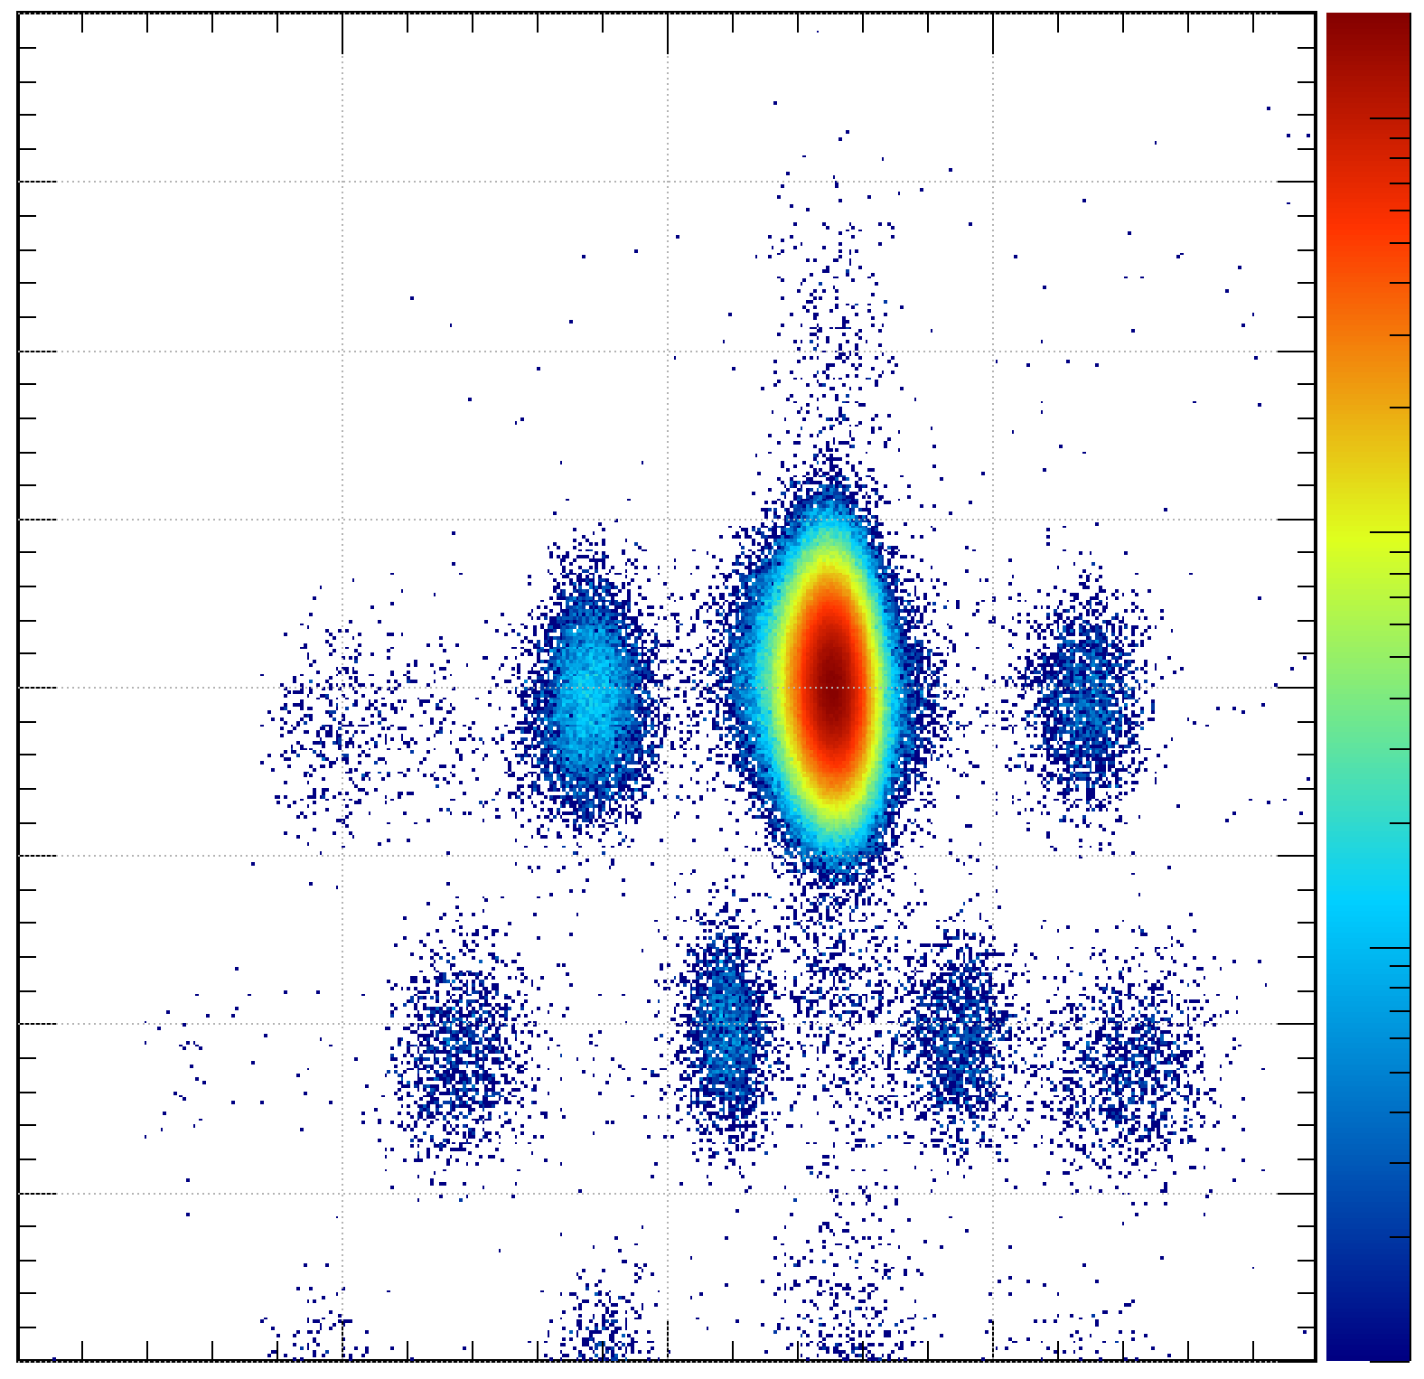
4. Setup & Particle identification
Beam
BigRIPS fragment separater @RIBF | RIKEN
PPAC
PL
²³⁸U + Be → ⁵⁸⁻⁷⁷Ni
F3
MUSIC
PPAC
Identification after target (F5-F7) for σI
Bρ—TOF—ΔE → A/Q vs Z
30
10³
F5
PL
29
¹²C target
Non-reacting
10²
MUSIC
Z | F7MUSIC
28
10
27
⁷²Ni
F7
26
1
2.50
2.60
MUSIC
A/Q | F5-F7
PL
NN2024, 19/08/2024
Notes:
After the reaction target, the particle identifications were also performed by the brho-tof-deltaE method between F5 and F7.

Slide 10
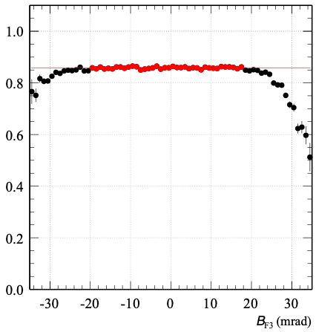
4.1 Constraint of beam emittance
×
Detector
Target
Detector
Data in constant region were used.
Constrain the emittance of incident particles
in X, Y, θ_{X} , θ_{Y} , momentum (X_{F5})
Derived from upstream detectors
Non-reaction rate
Assure the full acceptance
in the final focal plane, F7.
Ex.) θ_{Y}
θ_{Y} (mrad)
NN2024, 19/08/2024
Notes:
The BigRIPS fragment separator has a large angular and momentum acceptance.
However, all of non-reacted particles cannot be transported to the final focal plane, F7 because of the larger beam emittance like this. Therefore, we confirmed the dependence of non-reaction rate on position, angle, and momentum.
Here, the positions, angles, and momentum were obtained from upstream position sensitive detectors.
In order to assure the full acceptance in the final focal plane, F7, we used the data in constant region represented by red circles.

Slide 11
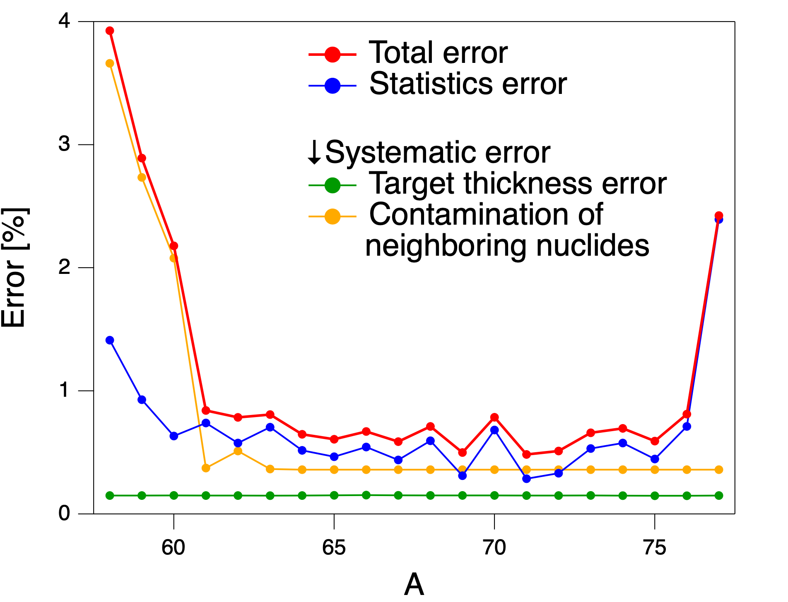
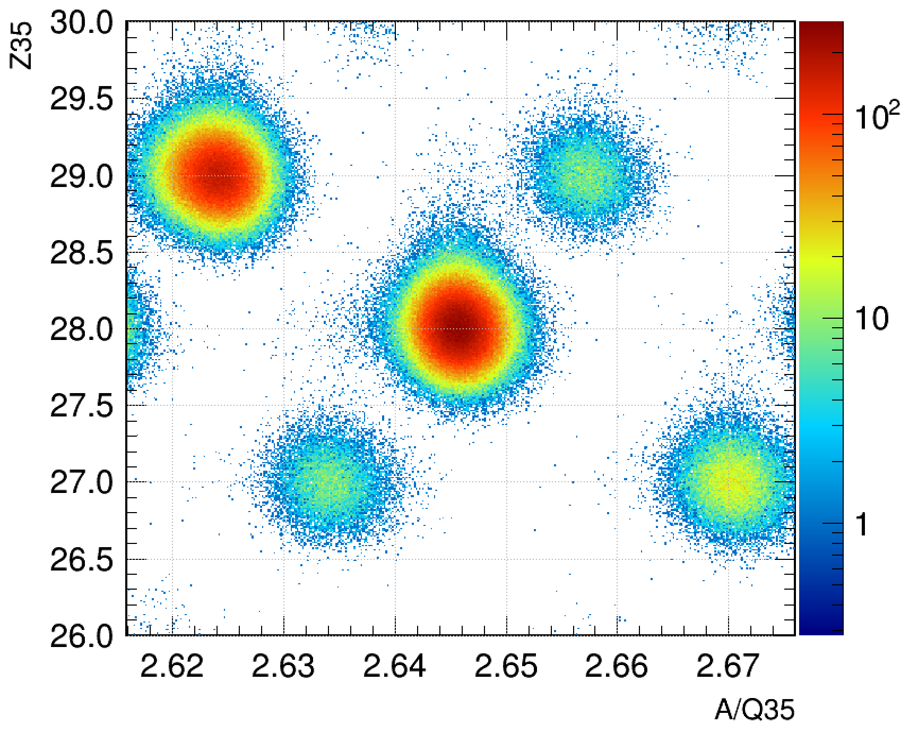
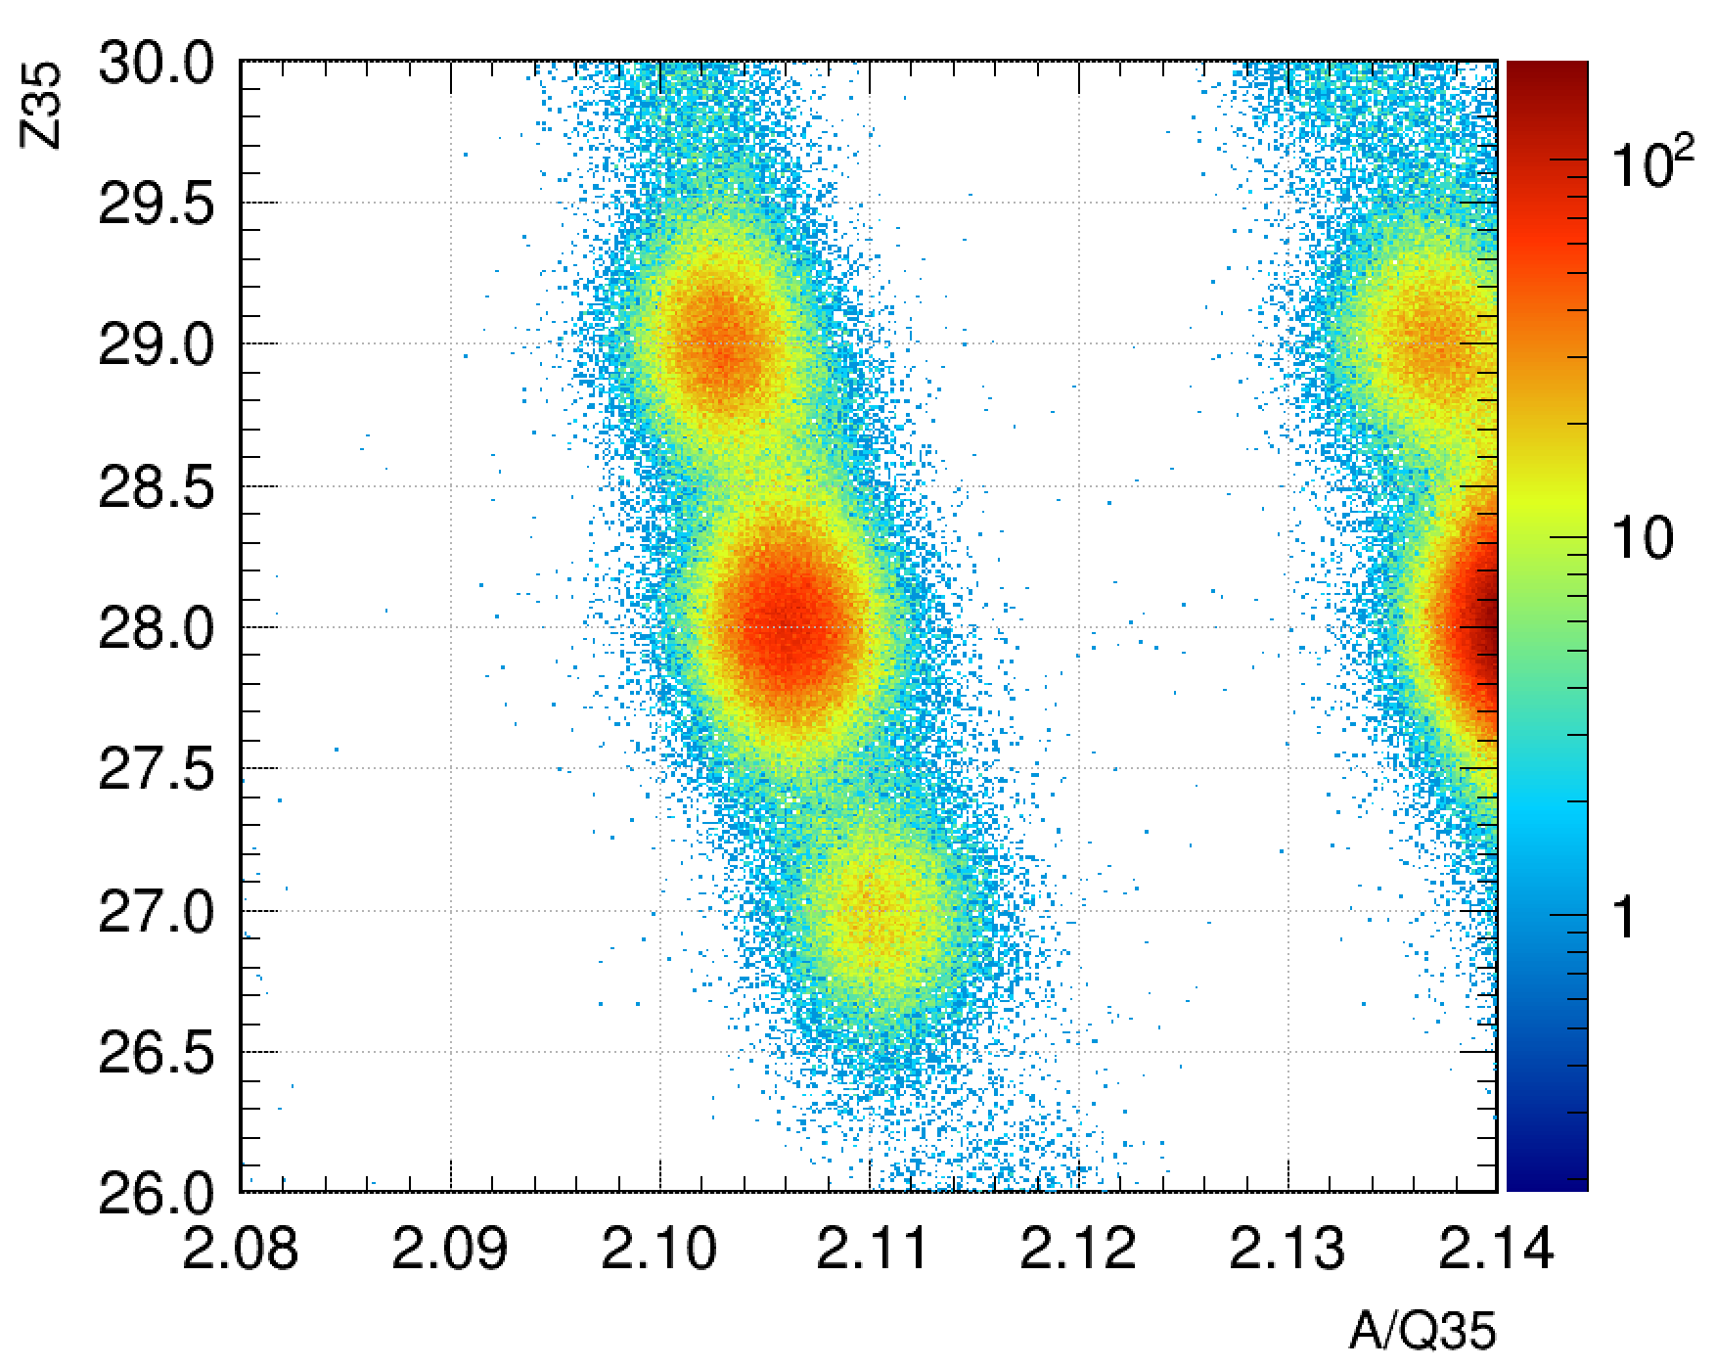
4.2 Estimation of Systematic Error
Emittance Cut Dependence
Multiple Scattering
・ Reproducibility of Beam Profile in F7 between Target-in and Target-out Measurements
Large-Angle Scattering via Elastic Process
Charge State
~ negligible
・Contamination of neighboring nuclides
(i) ⁶⁴⁻⁷⁷Ni ~ Good separation
(ii) ⁵⁸⁻⁶³Ni ~ Bad separation
・Target thickness ~ 0.15 %
⁷⁶Cu
⁶¹Cu
⁷⁴Ni
⁵⁹Ni
⁵⁷Co
⁷²Co
→contamination rejection
NN2024, 19/08/2024
Notes:
Let me explain the errors in this experiment. This figure shows the errors for Ni isotopes. The red points show the total errors, the blue points show the statistical errors, the green points show the errors of target thickness, and the yellow points show the systematic errors from the analysis.
For systematic errors, we examined these effects but found they were negligible. The error in target thickness is about 0.15%.
The origin of the systematic error in the analysis is the contamination from neighboring nuclei. In the neutron-rich region, good separation from neighboring nuclei leads to the negligible systematic errors. However, in the region near stable nuclei, the separation of Z is bad. Therefore, in this region, it is necessary to eliminate the effects of contamination from neighboring nuclei.
For 58-60Ni, the effects of contamination from neighboring nuclei is very large, so this results in the large systematic errors. But these systematic errors can be reduced by elaborating analysis in the future.

Slide 12
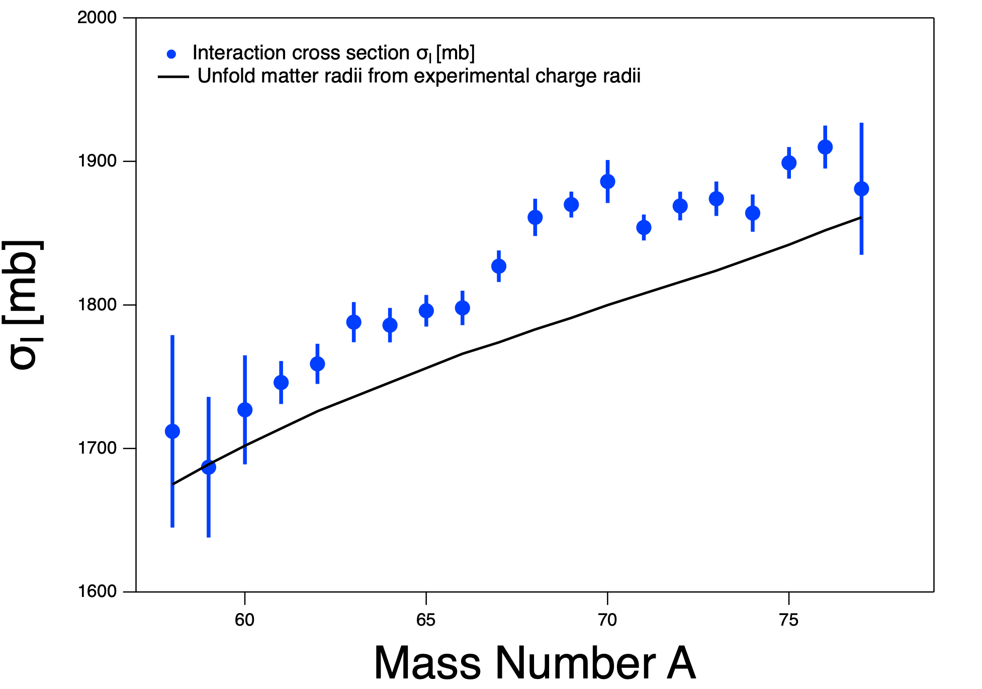
5. Experimental Results & Theoretical calculation
Preliminary
σR | Ni + ¹²C @280 MeV/u
NN2024, 19/08/2024
Notes:
Next, I will explain the results of interaction cross sections.
The blue points in this figure are the present experimental results of interaction cross sections.

Slide 13
5. Experimental Results & Theoretical calculation
Preliminary
σR | Ni + ¹²C @280 MeV/u
Phylogeny of stable nuclei
(assuming proton-neutron symmetry)
NN2024, 19/08/2024
Notes:
The black line is the calculation with the nucleon densities based on the charge radii of stable nuclei.
This calculated value underestimates the experimental results.

Slide 14
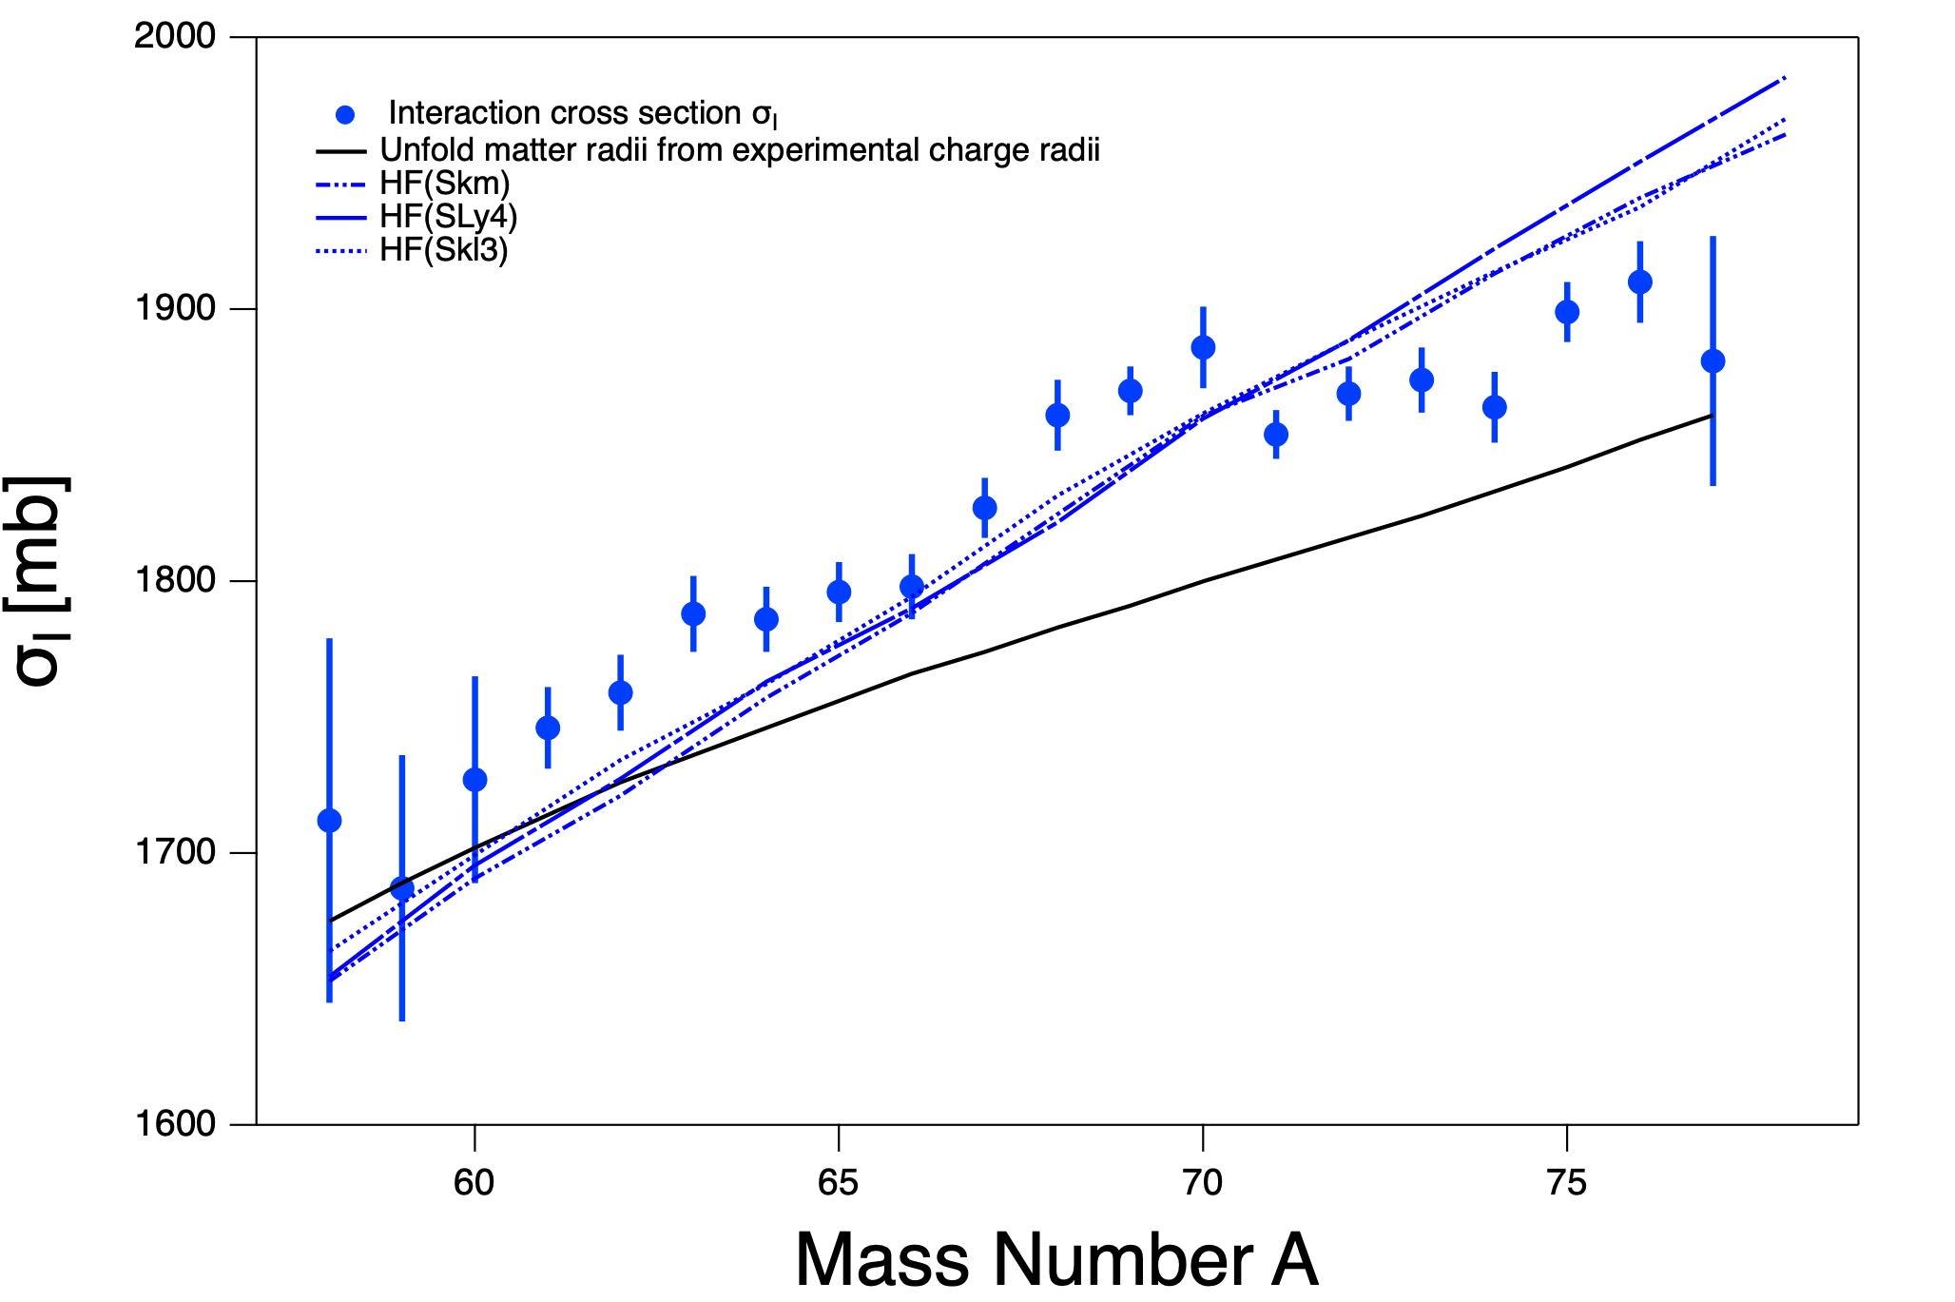
5. Experimental Results & Theoretical calculation
W. Horiuchi et al., PRC93, 044611 (2016)
Preliminary
σR | Ni + ¹²C @280 MeV/u
NN2024, 19/08/2024
Notes:
On the other hand, these blue lines are the Glauber calculation based on the matter radii of Hartree-Fock calculations by Mr. Horiuchi. They better reproduce the experimental results, but the slope looks a little bit steeper. This shows the densities from the HF calculation seems to be better than those based on the charge radii of the stable nuclei.

Slide 15
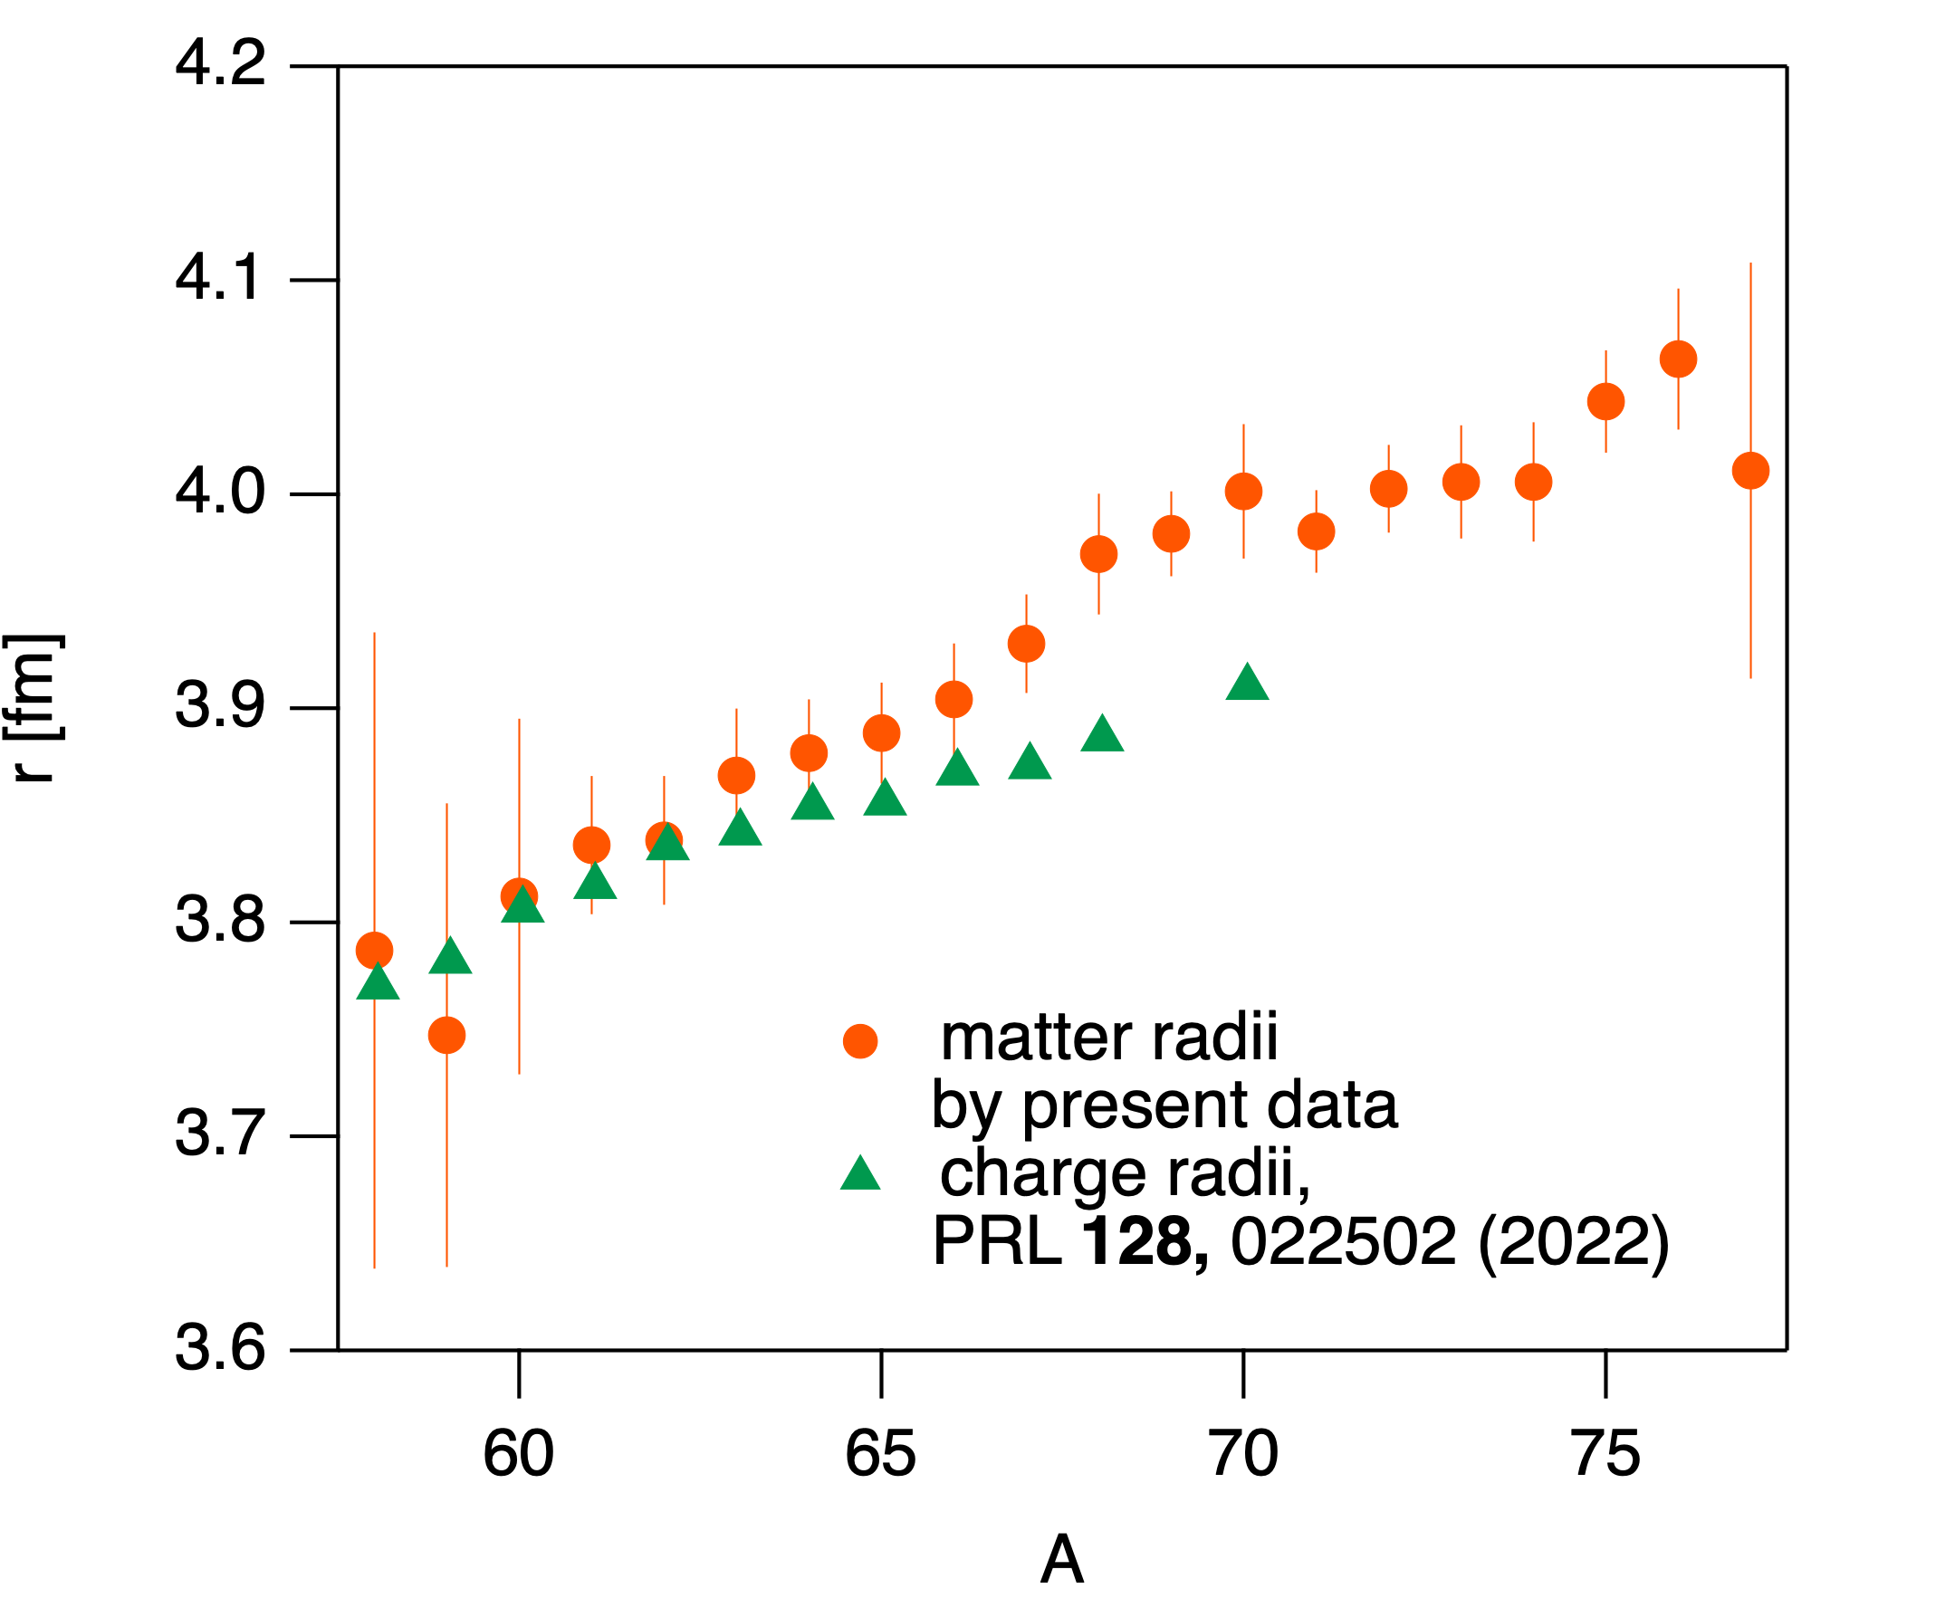
6. Neutron Skin Thickness
Key Region
Neutron Skin Thickness
Δr = rm - rc
matter radius
by σI
charge radius
by isotope
shift method
Preliminary
Notes:
Finally, using the interaction cross sections measured in this experiment, we determined the matter radii by Glauber calculations. We then combined these with the charge radii previously determined by the isotope shift method to calculate the neutron skin thickness. The red line indicates the slope of the neutron skin thickness with respect to the nuclear asymmetry parameter, δ. We will determine the parameter L quantitatively using more detailed analyses and calculations in the future.

Slide 16
6. Summary
•Simultaneous measurement of σI and σCC were performed at RIBF.
⁵⁸⁻⁷⁷Ni + C ~270A MeV @ BigRIPS (σI & σCC)
→ Derived RMS matter radii and charge radii.
•Interaction cross section
Experimental results $σ_{I}$ does not match the calculated value estimated by extending the matter radius of the stable nucleus.
These are in good agreement with the HF calculations.
Key Region
Preliminary
Preliminary
NN2024, 19/08/2024
Notes:
let me summarize my talk. Thank you for your attention.

Slide 17
Back Up

Slide 18
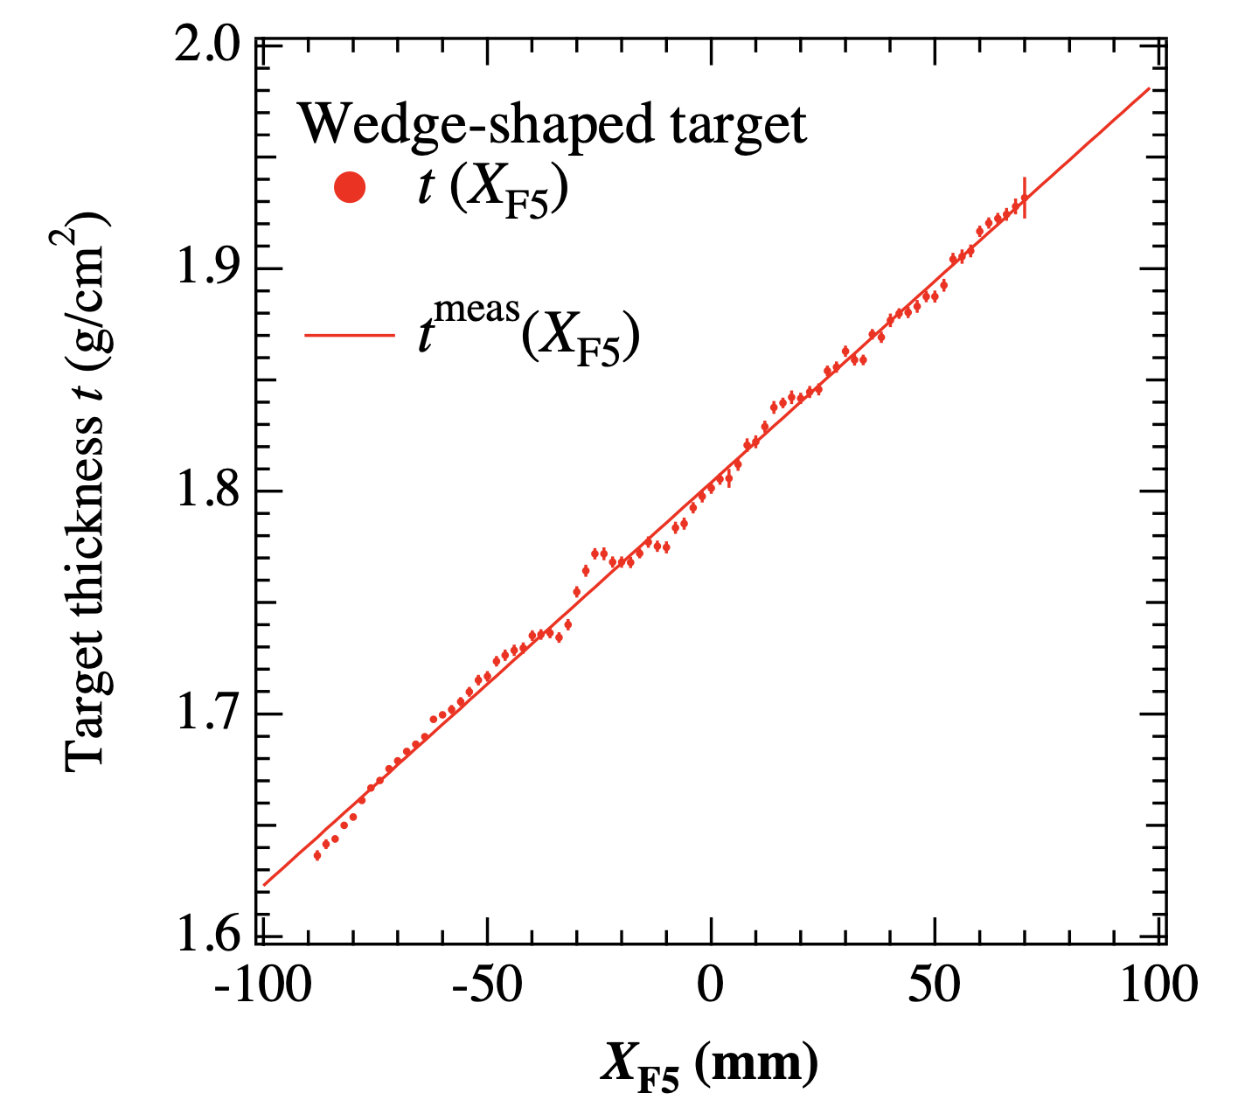
Determination of Target Profile
Notes:
We employed a wedge-shaped C target as a reaction target installed at F5. Though the thickness of reaction target has been measured as eq.(4.8), the actual thickness of the target as a function of horizontal position at F5 t^{meas}wedge (XF5) also depends on the mount position onto target-ladder. Therefore, we determined t^{meas}wedge (XF5) from the comparison with the parallel-plate wedge
C target in terms of BρF5F7 information. The target thickness of parallel- plate target has been also measured as (4.9). Figure 4-25 shows the measured BρF5F7 distribution with respective targets with the same beam condition as a function of XF5. Since the crosspoint of respective data shown in Fig. 4-25 corresponds to the point of the same target thickness, we can derive t^{meas}wedge (XF5) from this crosspoint in harmony F5 with Eq. 4.8 as (4.10). On the other hand, as shown in Fig. 4-25, there is a slight nonuniformity on BρF5F7(XF5) distribution for the wedge-shaped target, which results from the nonuniformity of target thickness compared to one given by Eq. (4.10). This nonuniformity corresponds to the approximately 0.25% deviation in unit of g/cm2 from Eq. (4.10). If we use Eq. (4.10) as a function of target thickness, this deviation have to be taken into account as a systematic error. Therefore, in order to avoid this systematic error, we utilized the distribution of target thickness, twedge(XF5) directly derived from the BρF5F7(XF5) distribution in accordance with the following equation: (4.11). The obtained distribution of wedge-shaped target thickness is shown in Fig. 4- 26. In the present study, we employed this target thickness distribution in order to derive σI. The error of target thickness in each point is at most 0.15%, which is much smaller in comparison with the most precise statistical error in the present study of approximately 0.5%.

Slide 19
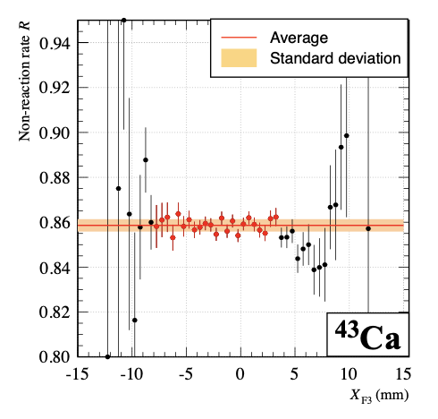
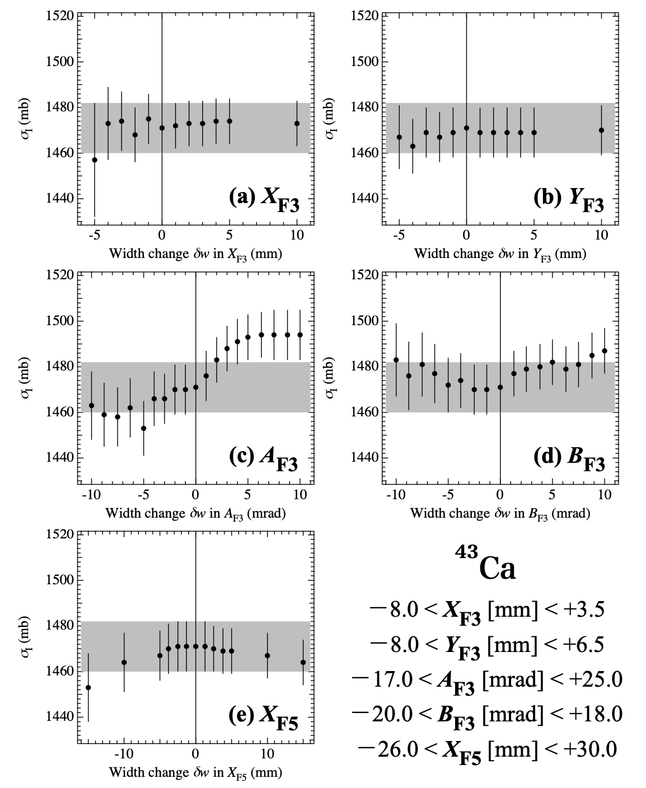
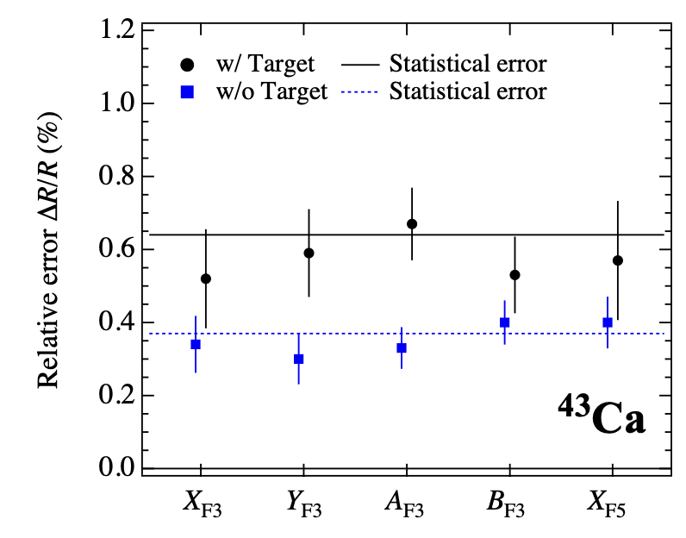
Emittance Cut Dependence

Slide 20
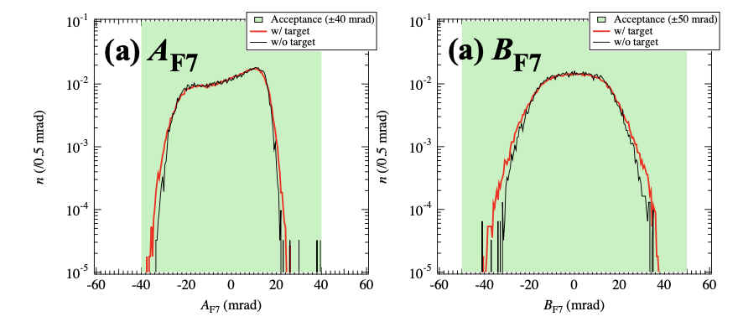
Multiple Scattering

Slide 21
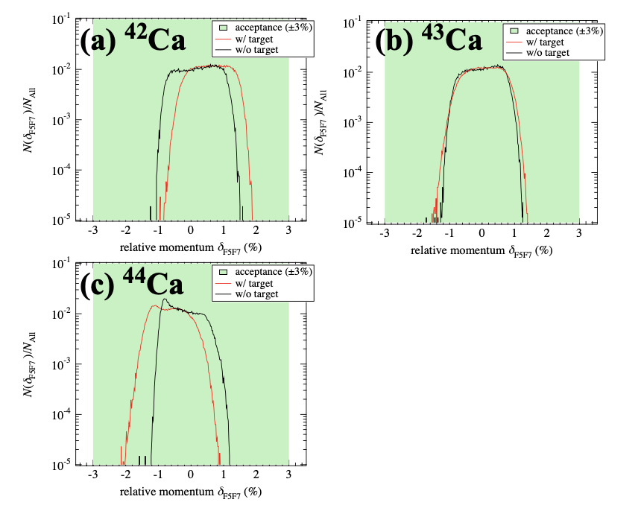
Reproducibility of Beam Profile in F7 between Target-in and Target-out Measurements

Slide 22
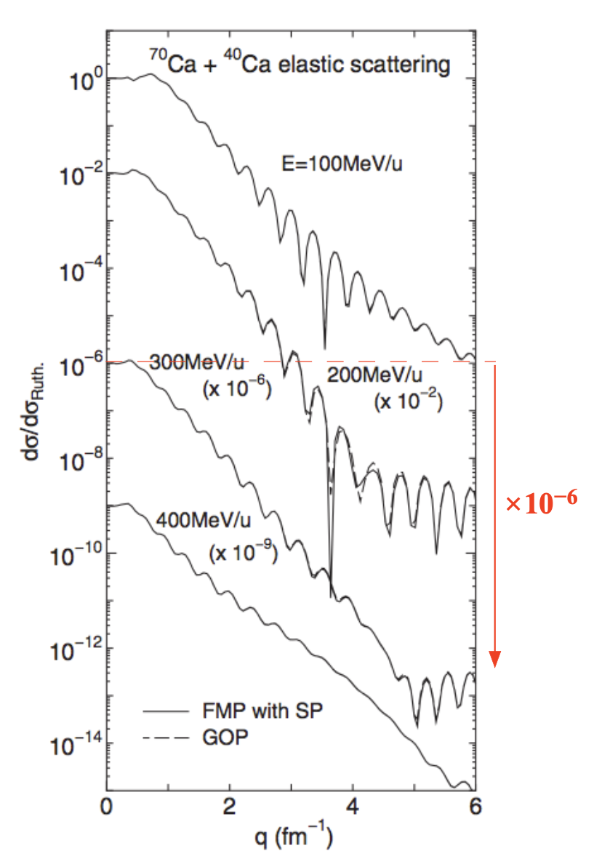
Large-Angle Scattering via Elastic Process

Slide 23
Charge State

Slide 24
2. Charge-changing cross section σCC → Proton radius
Interaction cross section σI
Projectile
Total nuclide-changing (N or Z) reaction
Matter radius
$$σ_{I}∼π(r_{m}+r_{T})^{2}$$
Matter radius
rm
rm
Target
Well established method to deduce rm using the Glauber model.
Large cross section (~1 b) → Applicable to low-intensity RI beam.
rT
rT
σI
Analogy
Analogy
Charge-changing cross section σCC
Proton radius
Proton radius
rp
rp
Total charge (Z)-changing reaction
rT
$$σ_{CC}∼π(r_{p}+r_{T})^{2}$$
rT
If this picture is true…,
σCC
Possible candidate
to extract rp of unstable nucleus
NN2024, 19/08/2024
Notes:
On the other hand, the charge-changing cross section, which is the cross section of total atomic-number changing reactions, is one of the possible methods to extract the charge radius of very neutron-rich nucleus.
This cross section is similar to interaction cross sections.
In analogy with the relation between matter radius and interaction cross section,
charge-changing reactions might occur by the overlap between point-proton density of projectile nucleus and nucleon density of target nucleus.
If this picture is true, the charge-changing cross section is a possible candidate to extract point-proton radius of unstable nucleus far from the stability line.

Slide 25
3. Experiment
Non-reaction rate
σCC measurement
~Transmission method~
$$Γ_{in}=\frac{N_{2}^{in}}{N_{1}^{in}}$$
Reaction
target
Non-Z-changing (N, Z) = (N’., Z_{inc.})
Detector1
Detector2
Incident particles
N₁^{in}
Non-reacting particles
N₂^{in}
$$σ_{I}=-\frac{1}{t}ln\left(\frac{Γ_{in}}{Γ_{out}}\right)$$
Thickness: t
Detector1
Detector2
Incident particles
N₁^{out}
Non-reacting particles
N₂^{out}
$$Γ_{out}=\frac{N_{2}^{out}}{N_{1}^{out}}$$
Correct events reacted in detectors
NN2024, 19/08/2024
Notes:
and in the case of charge-changing cross section measurements, non-reacting particles mean non-atomic number-changing particles.

Slide 26
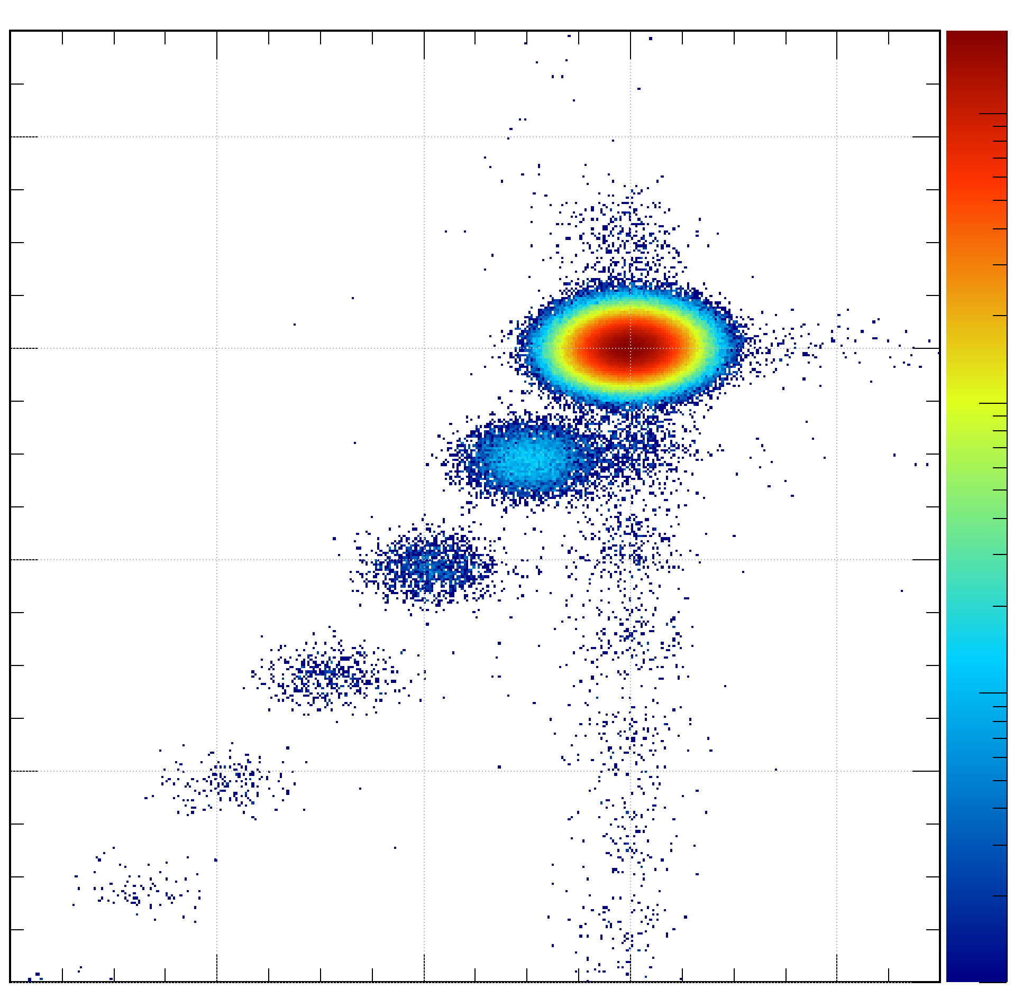
4. Setup & Particle identification
Beam
BigRIPS fragment separater @RIBF | RIKEN
PPAC
PL
²³⁸U + Be → ⁵⁸⁻⁷⁷Ni
F3
MUSIC
PPAC
Identification after target (F5-F7) for σCC
Detect in F7 | ΔE of F5&F7 MUSICs
Detect in F7
F5
PL
¹²C target
30
10³
MUSIC
Ni
28
10²
26
Z | F7MUSIC
10
24
F7
1
MUSIC
24
26
28
30
PL
Z | F5MUSIC
NN2024, 19/08/2024
Notes:
In the case of the measurement for charge-changing cross section, the identification of atomic number of outgoing particles was performed using multi-sampling ionization chambers.
The particles transported to the F7 focal plane were counted in the 2 dimensional plot of atomic numbers determined by the ionization chambers at F5 and F7 focal planes.

Slide 27
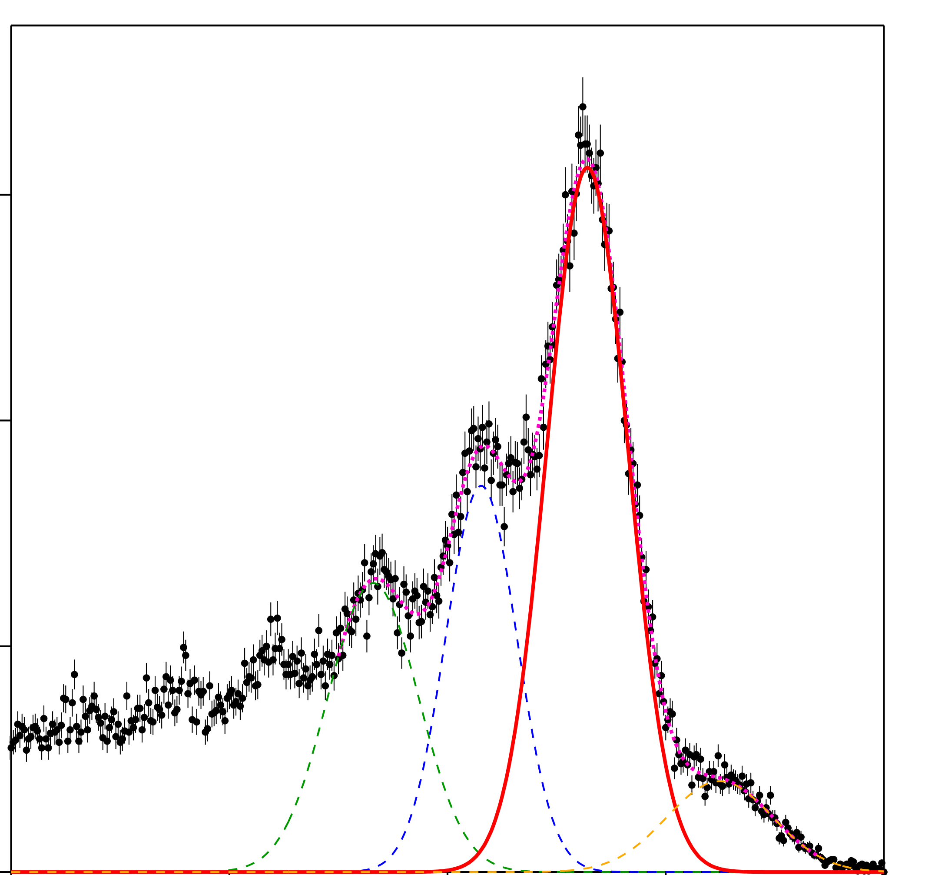
4. Setup & Particle identification
Beam
PPAC
BigRIPS fragment separater @RIBF | RIKEN
PL
²³⁸U + Be → ⁵⁸⁻⁷⁷Ni
F3
MUSIC
PPAC
Identification after target (F5-F7) for σCC
Detect in F7 | ΔE of F5&F7 MUSICs
F5
PL
Detect in F7
Not detect in F7
¹²C target
30
10³
MUSIC
600
Ni
Ni
28
10²
400
26
N
Z | F7MUSIC
10
200
24
F7
1
0
28
MUSIC
24
26
28
30
24
26
Z | F5MUSIC
PL
Z | F5MUSIC
NN2024, 19/08/2024
Notes:
On the other hand, the particles not transported to F7 focal plane were counted in the 1 dimensional atomic number plot by the F5 ionization chamber.
Here, only less than 4% of total non-atomic-number changing particles were counted in this 1 dimensional plot.

Slide 28
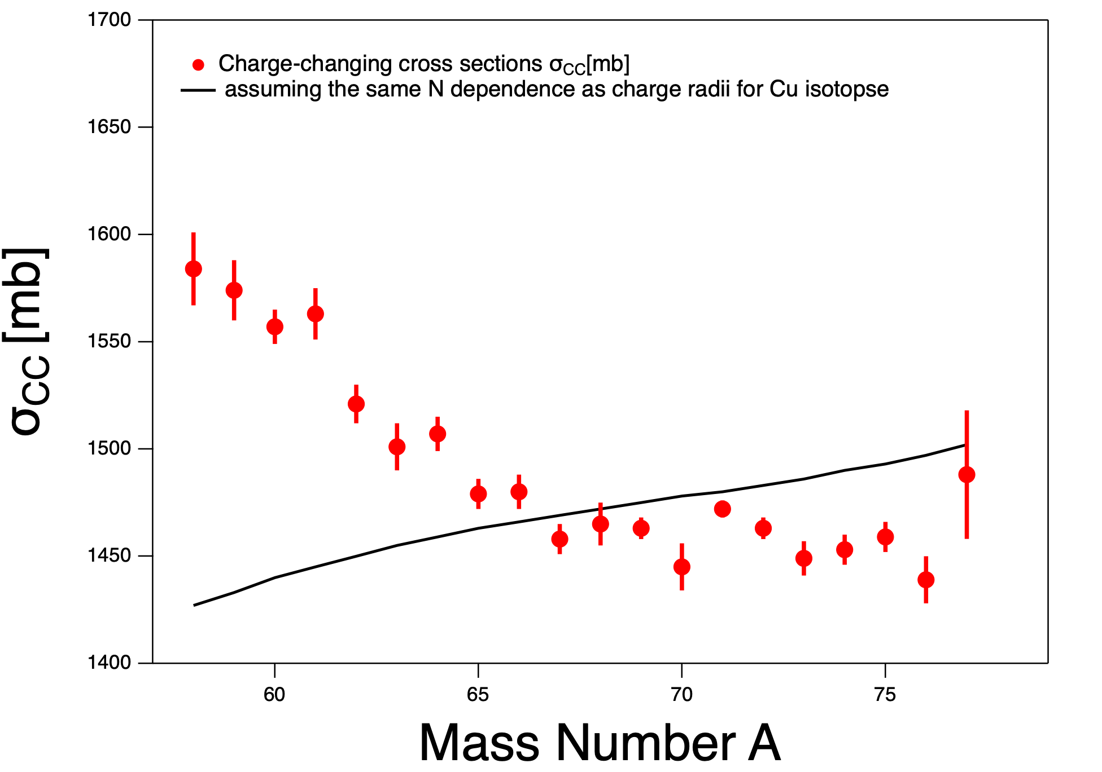
5. Experimental Results & Theoretical calculation
σCC | Ni + ¹²C @280 MeV/u
Preliminary
NN2024, 19/08/2024
Notes:
In the following, I will show you the experimental results.
The red points in this figure are the present experimental results of charge-changing cross sections for Ni isotopes on carbon target as a function of mass number. The reaction energy is 280 MeV/nucleon.
The black line is the result with the simple Glauber calculation,

Slide 29
5. Experimental Results & Theoretical calculation
σCC | Ni + ¹²C @280 MeV/u
Assuming the same N dependence as Rp of Cu
Preliminary
NN2024, 19/08/2024
Notes:
charge radii were estimated assuming that the neutron number dependence is the same as that for Cu isotopes, charge radii of which are already known.

Slide 30
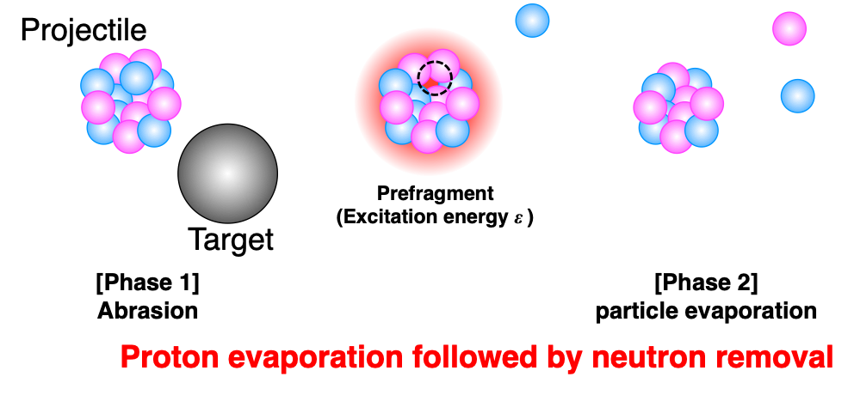
5. Experimental Results & Theoretical calculation
σCC | Ni + ¹²C @280 MeV/u
Preliminary
M. Tanaka et al., Phys. Rev. C 106 (2022) 014617
proton
evaporation
effect
NN2024, 19/08/2024
Notes:
In the region near the stability line, we know that charge-changing cross section is increased by charged-particle evaporation effect introduced by neutron-removal reaction.

Slide 31
5. Experimental Results & Theoretical calculation
σCC | Ni + ¹²C @280 MeV/u
Preliminary
$σ_{CC}$ in the neutron-rich rigion of Ni isotopes are not affected by proton evaporation effect.
NN2024, 19/08/2024
Notes:
On the other hand, the evaporation effect reduces for very neutron rich nuclei.
So, this results show that this effect is negligible in the neutron-rich region.

Slide 32
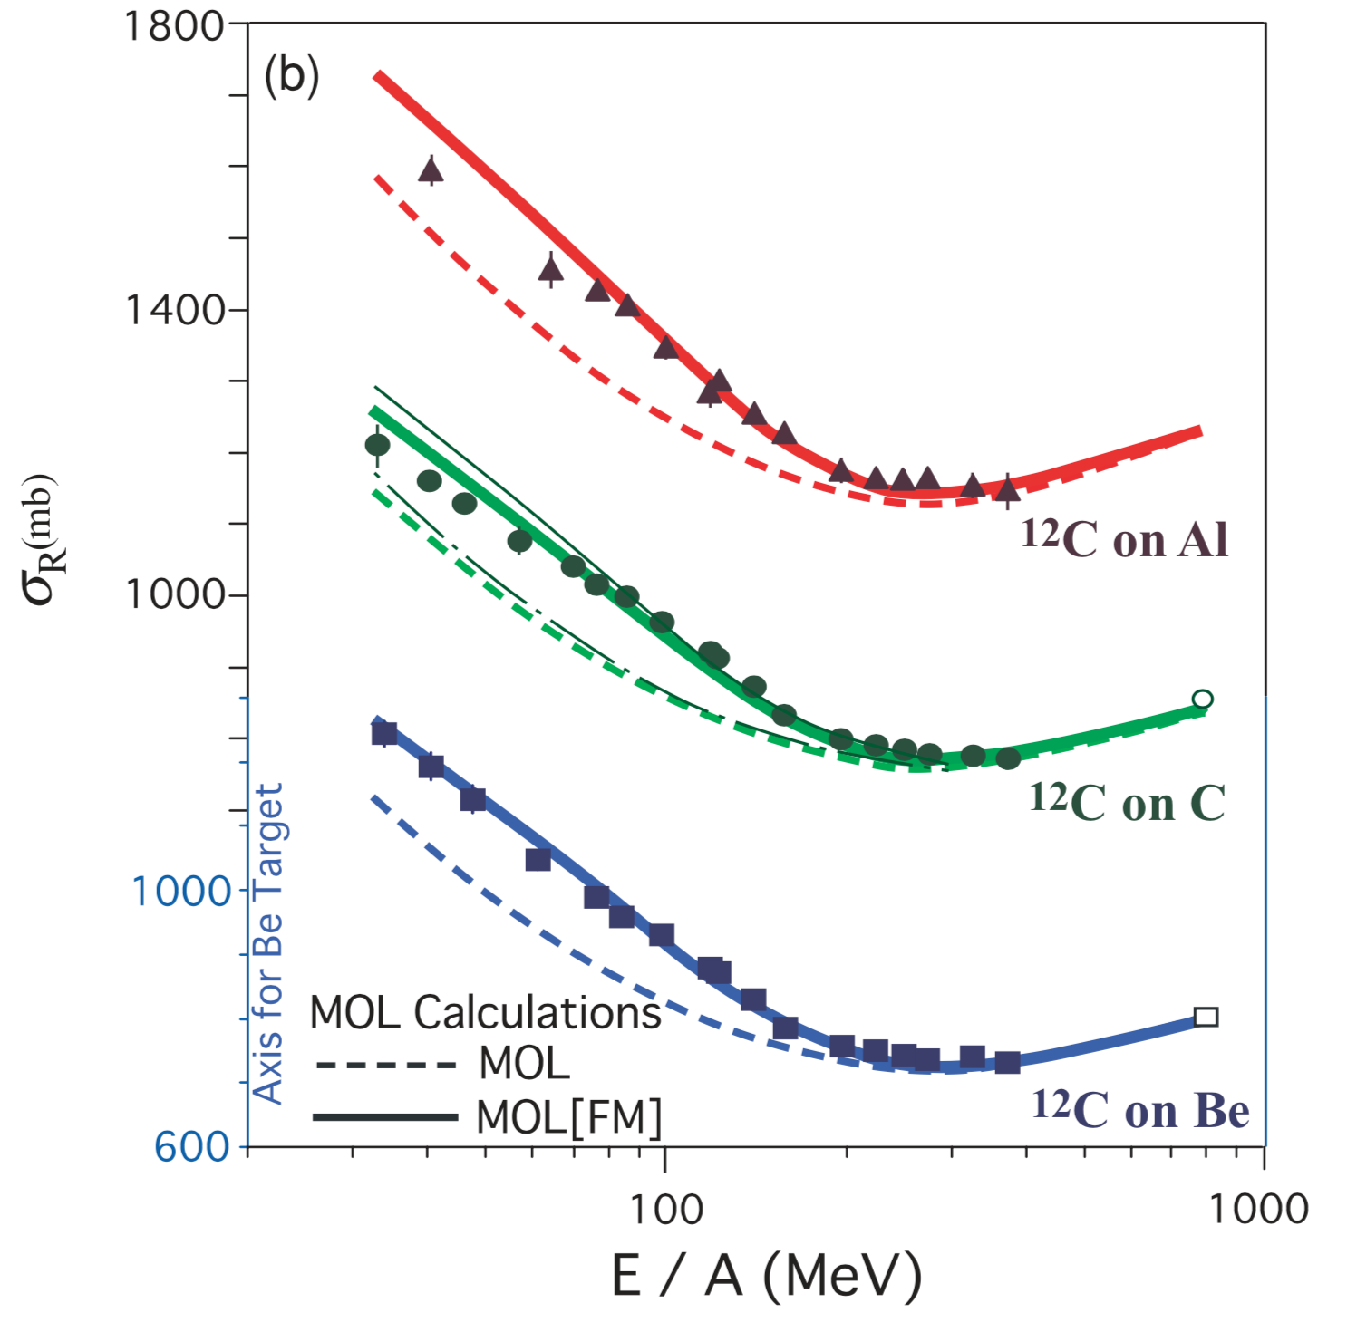
Derivation of Matter Radius
σR ~ σI at E > ~100A MeV
Glauber model calculation (Zero range optical limit approx.)
$$σ_{I/R}(E)=∫db\left[1-exp\left(-∫ds\underset{i,j=(porn)}{∑}σ_{i,j}(E)ρ^{T(j)}(s-b)ρ^{P(i)}(s)\right)\right]$$
3 quantities
σ_{NN}(E) Nucleon-nucleon total cross section
ρ^{T}(r) Target nucleon density
ρ^{P}(r) Projectile nucleon density
Determined precisely
12C : Well known
Adopted Glauber calc.
Assuming Fermi-type function
¹²C+²⁷Al
RMS Matter radius
σR/I (mb)
σ_{I}
¹²C+¹²C
$$⟨r^{2}⟩_{m}^{1/2}=∫r^{2}ρ^{P}(r)dr$$
¹²C+⁹Be
Excellent reproduction
at E = 200A-300A MeV
Present : 285A MeV
200
300
M. Takechi et al., PRC 79, 061601(R) (2009)
E/A (MeV)

Slide 36
PHYSICAL REVIEW LETTERS 124, 132502 (2020)
PHYSICAL REVIEW LETTERS 128, 022502 (2022)

