Slide 1

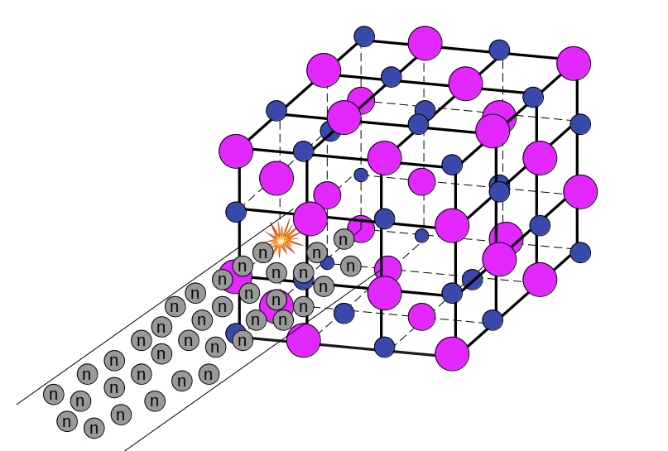


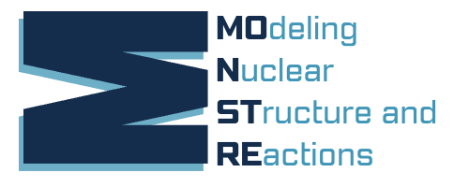
Reviving Nuclear Fusion Reaction Cycles in Solido
14th International Conference on Nucleus-Nucleus Collisions
Aug 2024 - Whistler, Canada
Lorenzo Fortunato
Univ. Padova & INFN
Italy
An old idea is reappraised:
Nuclear fusion cycles
Fusion -in solido- and not -in plasma-
New data and modern computational techniques
We obtain high yields and energy output
Might represent an alternative route to fusion
NEW: after introducing Bethe-Block energy loss, the stopping power quenches the secondary reaction!
NEW: the net outcome is still worth investigating

Slide 2
Collaborators
Lorenzo FORTUNATO – Prof. Univ. Padova and INFN-Sez. Padova
Andres Felipe LOPEZ LOAIZA – M.Sc. Thesis Univ. Padova 2023
Giulio ALBERTIN – B.SC. Thesis Univ. Padova 2022
Enrico Fragiacomo – INFN Trieste – GEANT simulations
Idea
We have found a series of papers and lab reports that have almost gone forgotten amid cold-war era documents and might as well be lost.
We studied the problem from a modern perspective, including new ideas, new tools and new data, finding out that the topic deserves more attantion that it has received.
It might significantly impact fusion energy research.

Slide 3
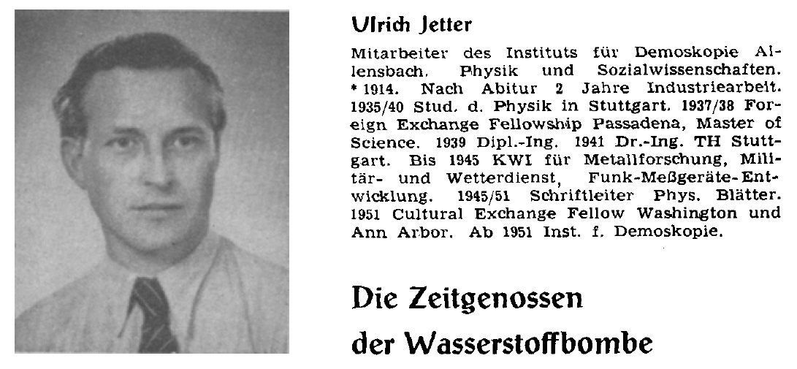
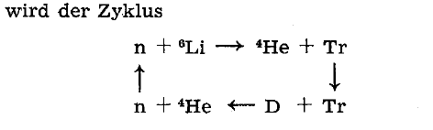

History-1
1950 Ulrich Jetter publishes a paper in which, in connection with warfare uses of nuclear energy, he introduces a fusion cycle
With the idea of igniting nuclear reactions with a small amount of initial neutron plus the emitted neutrons from the secondary reactions.
The calculations are simple energy estimates and do not contain any cross-section or dynamical information.
U. Jetter , Physikalische Blätter - Mai 1950 - Die sogenannte Superbombe

Slide 4
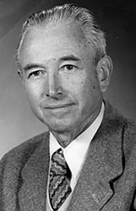

History-2
1956 Richard F. Post (Livermore, USA) takes into account also the proton cycle and has a better control over reaction dynamics, but the considered reaction are still in plasma
The first reaction has a Coulomb barrier that makes it less probable than the neutron induced one.
R.F.Post, Rev. Mod. Phys. 28 (1956) 338

Slide 5
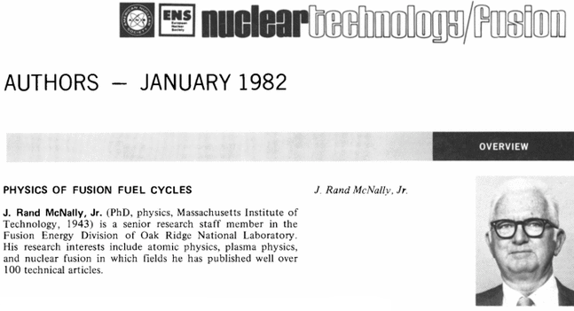
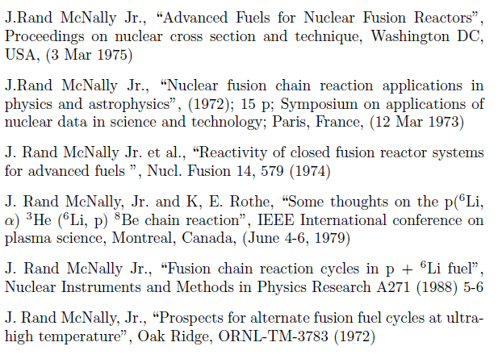
History-3
J. Rand McNally Jr. (Oak Ridge, USA) in a series of published and unpublished papers and lab-reports (covering 1972-1988) that have been released only after the cold-war era, exhamines all the cycles and attempts a dynamical reaction calculation, including losses and other effects, aiming at controlling the main parameters of a plasma containing 6LiD fuel and other alternative fuels.

Slide 6
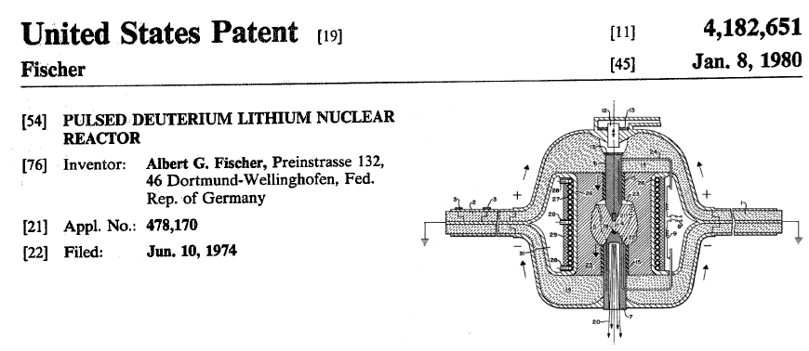
History-4
The closest idea to ours is that of “wet-wood burners" of Dawson, Furth and Tenney : the burning of a “nuclear controlled fire" might happen in a small irradiated portion of a larger fuel material in solido.
Albert G. Fisher patented in Germany and in USA a device called FISCATRON that is based on a sudden electric discharge that should initiate a micro thermonuclear explosion that then propagates into a solid 6LiDT fuel pellet, burning it as if it was a chemical reaction.

Slide 7



Fusion cycles : Jetter + Post and coupling reaction
Jetter cycle
Post cycle
Coulomb barrier here!
The two cycles can be coupled through the endothermic neutron-induced deuteron breakup reaction.
More effective at intermediate-high energy

Slide 8
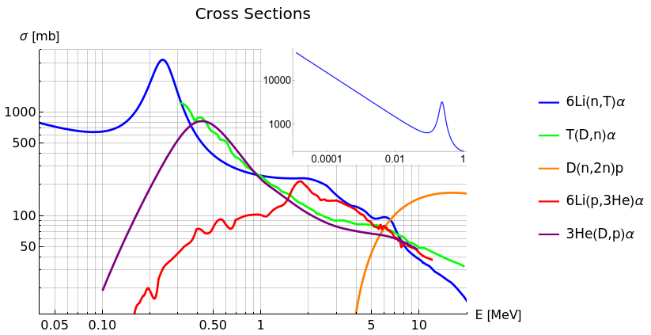

Cross-section data – digging the databases
The cross-section data for the neutron-induced reactions grows at low energy, this means you can extract a lot of energy without putting to much energy into neutron motion!

Slide 9
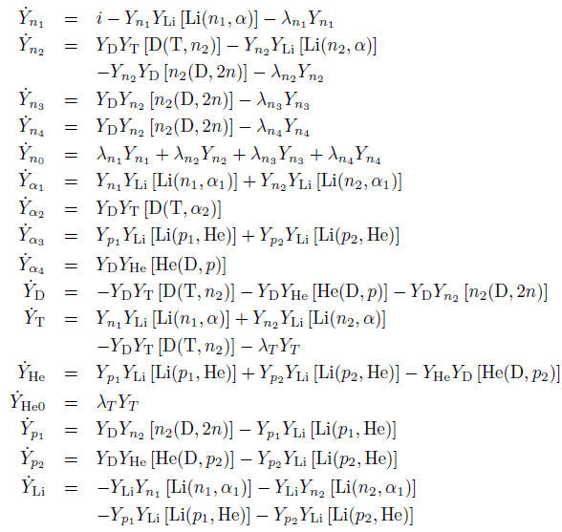

Reaction calculations - taming of a little monster
We have written and set up a code that calculates the fulll reaction dynamics, solving a system of coupled first order differential equations, taking into account the abundancies Yi and the reaction rates with Non-thermal energy distributions (most of the fragments come out from binary reactions splitting the Q-value energy according to the mass proportions).
Reactions
forming i
Reactions
consuming i
Decays to and from

Slide 10
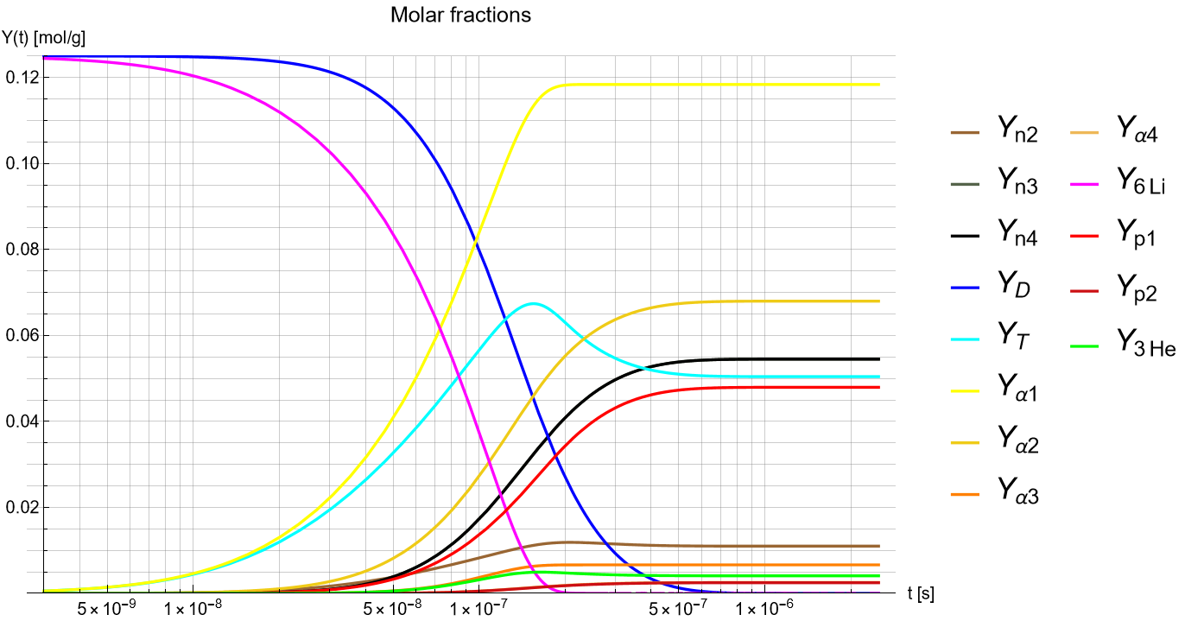
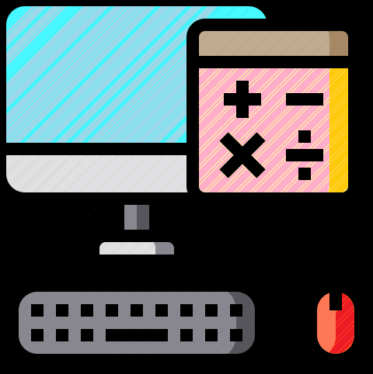
Typical results of our calculations (at some 0.24 MeV neutron injection energy)
Time scale for complete burnout can be extracted from graph

Slide 11
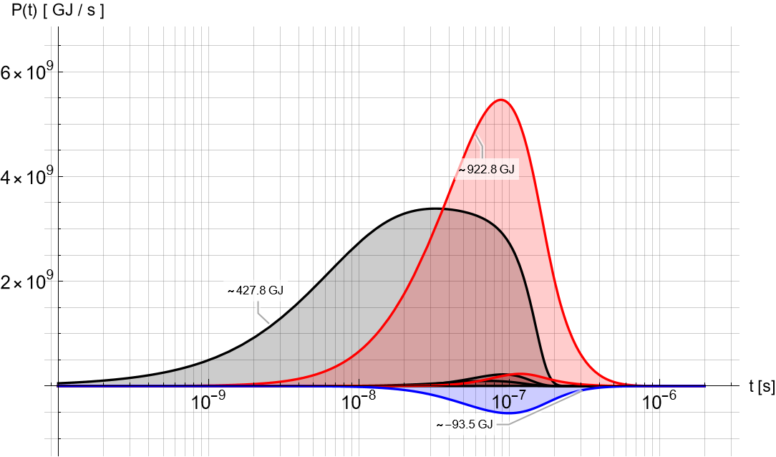


Specific Power – these reactions would produce a huge energy output
Density
in solido
>> plasma
Q-value
Integrated ∼1300 GJ for a mole of material (assuming it is completely burnt)

Slide 12
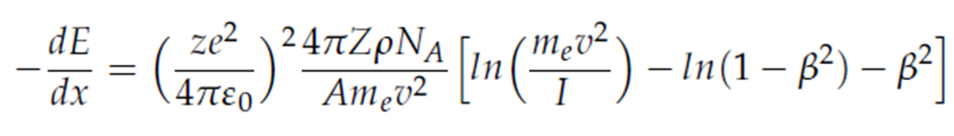
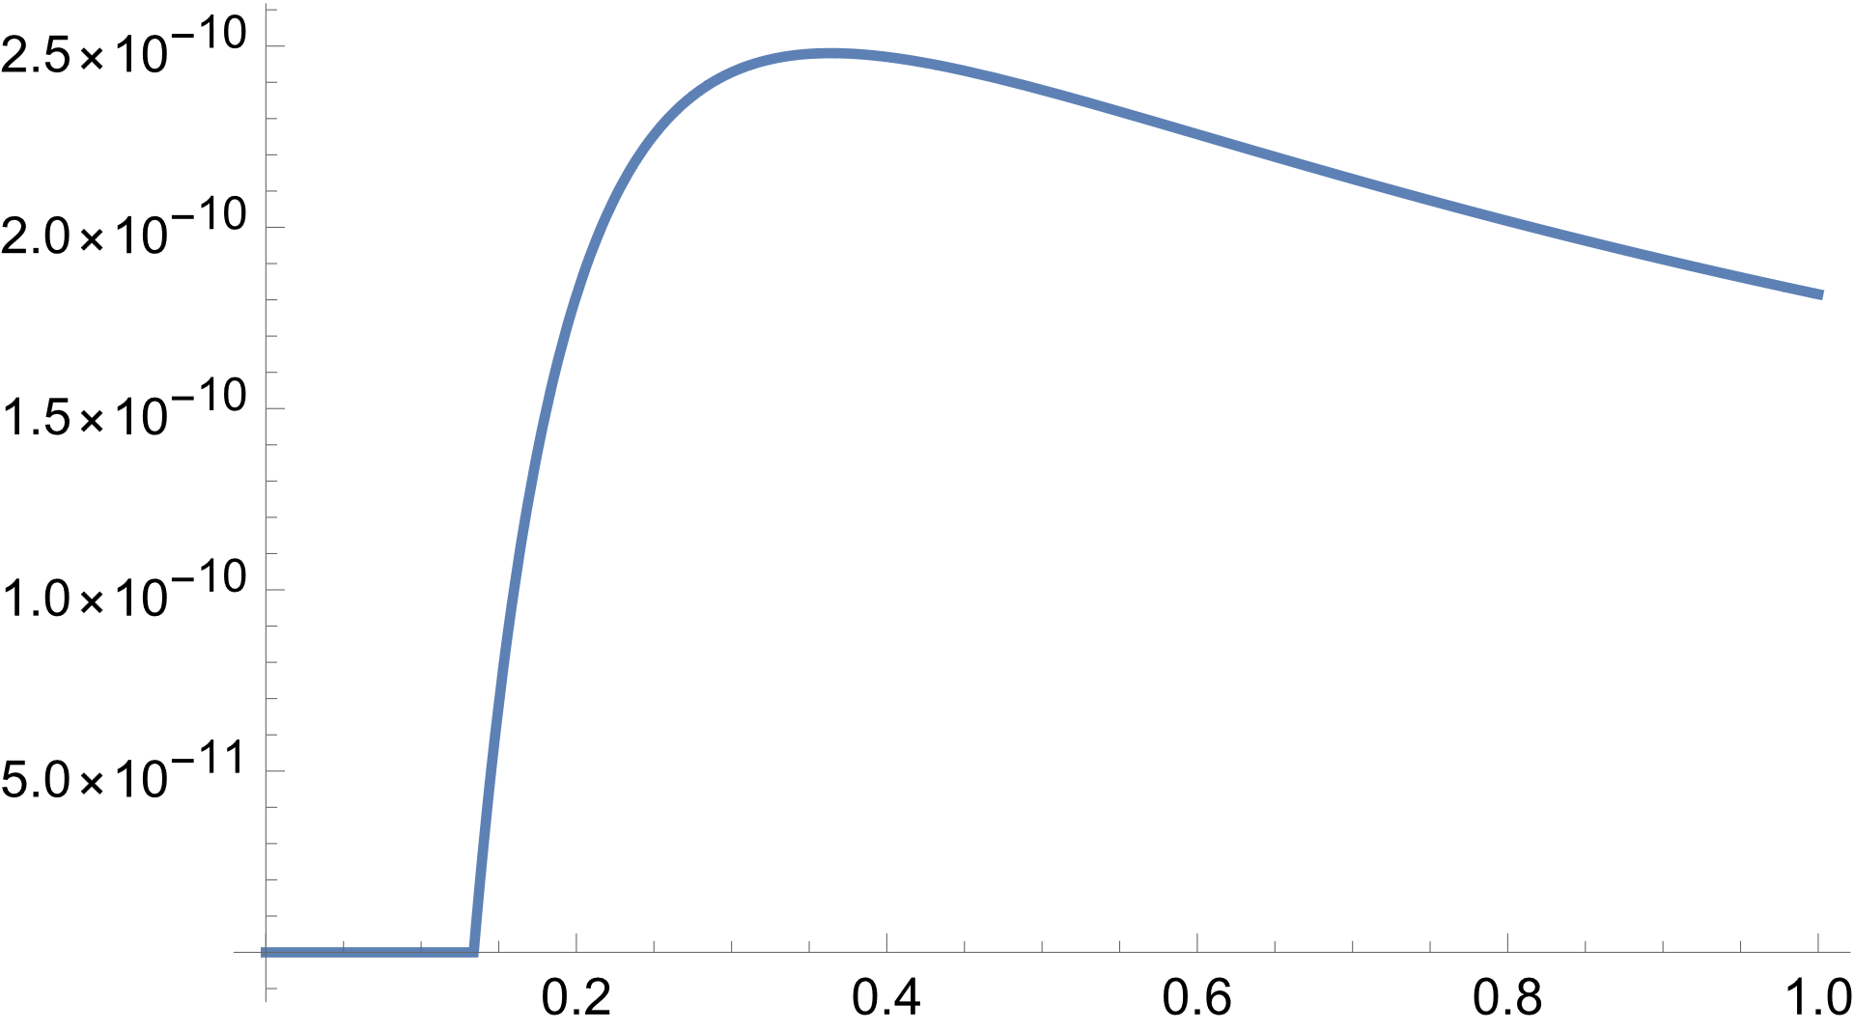
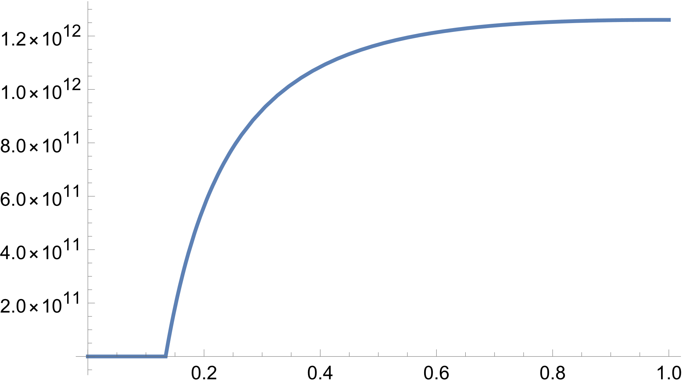

Now seriously… -dE/dx → -dE/dt
When fast chaged particles travel through matter, they loose energy by ionising the material they travel in, before igniting the secondary reactions.
This can be modeled with the Bethe-Bloch formula:
dE/dx
dE/dt
At these energies, ranges are of the order of a few tens of μm
NOTE: Bethe-Bloch Stopping power as it appears on Krane's book and Segré's book. Check Seltzer & Bergen. (High Z correction of Barkas and Bloch, not implemented, not valid below min validity)

Slide 13
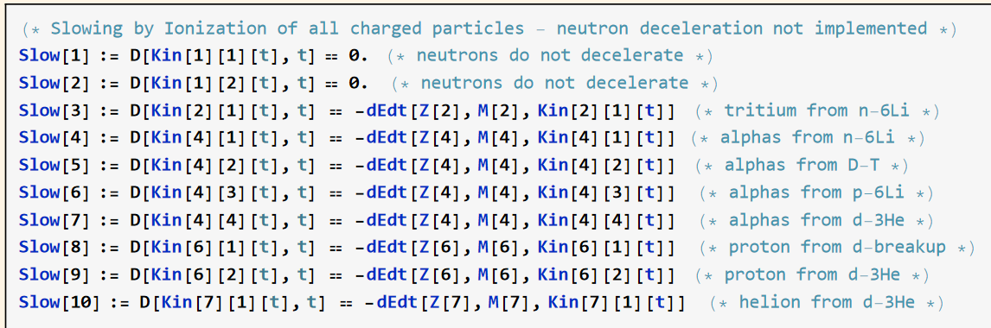

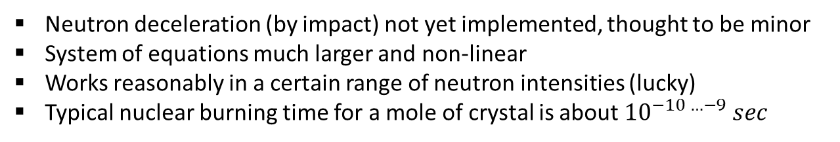
New system of differential equations (stiffer than before)
The MonsteR grows horribly !
Neutron deceleration (by impact) not yet implemented, thought to be minor
System of equations much larger and non-linear
Works reasonably in a certain range of neutron intensities (lucky)
Typical nuclear burning time for a mole of crystal is about ${10}^{−10 …−9} sec$

Slide 14
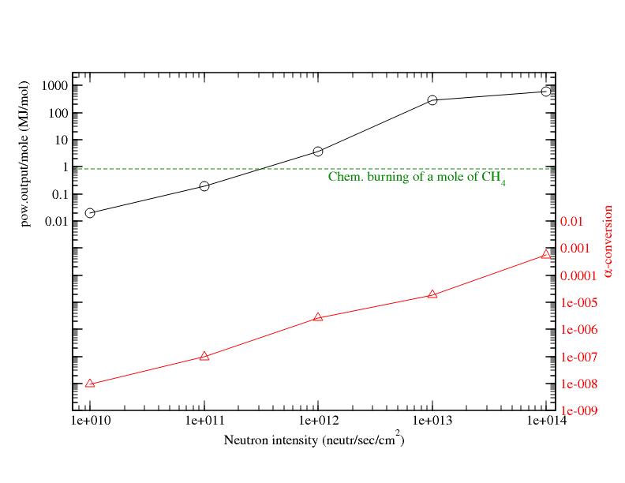
Specific Power –new results including energy loss by ionization
Should still be advantageous if compared with chemical burning of CH₄ fuel!
It leads mainly to alpha particles !
Take this parameter more or less as a burning efficiency.

Slide 15



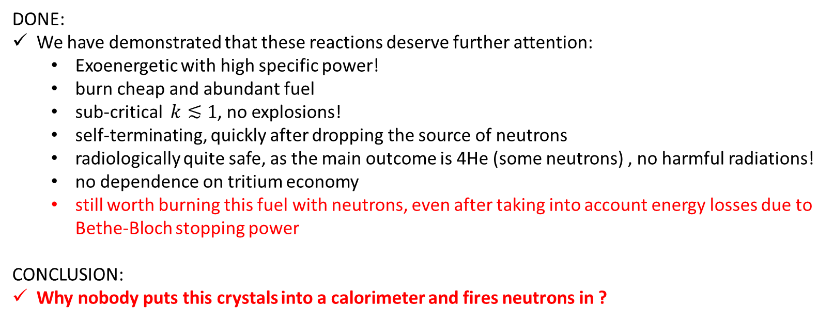
Summary and outlook
DONE:
We have demonstrated that these reactions deserve further attention:
  Exoenergetic with high specific power!
  burn cheap and abundant fuel
  sub-critical $k≲1$, no explosions!
  self-terminating, quickly after dropping the source of neutrons
  radiologically quite safe, as the main outcome is 4He (some neutrons) , no harmful radiations!
  no dependence on tritium economy
  still worth burning this fuel with neutrons, even after taking into account energy losses due to Bethe-Bloch stopping power
CONCLUSION:
Why nobody puts this crystals into a calorimeter and fires neutrons in ?
TO DO LIST:
Another 80 reactions or so can be implemented, but they have small cross-sections and often data on reactions involving tritium are very scarce
Find people interested in trying some experimental setup

Slide 16
Back up slides – GEANT range simulations
– Courtesy of Enrico Fragiacomo (Trieste)
GEANT simulations (statistical) confirm the range calculated by integration of the Bethe-Bloch formula.

