Slide 1
Heavy Element Research at Texas A&M University
Cody Folden
Cyclotron Institute and Department of Chemistry
Texas A&M University, College Station, Texas
NN2024
August 22, 2024

Slide 2
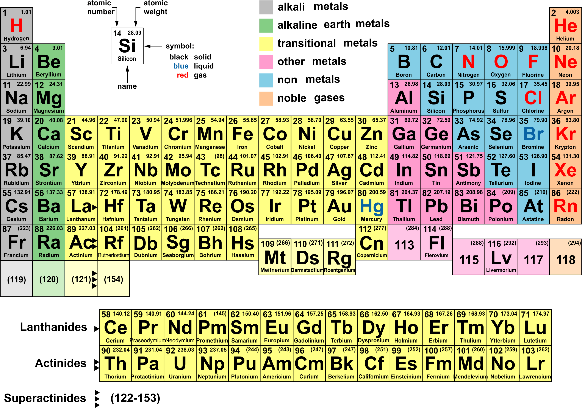
The Periodic Table Today
The heaviest elements are all produced artificially!

Slide 3
Current and Future History of Elements Above Oganesson (Z = 118)
The great question is, “What reaction is most likely to lead to the discovery of the next new element?”
Recently, actinide elements have been irradiated with ⁴⁸Ca.
A number of reactions have been studied using projectiles heavier than ⁴⁸Ca, but none have succeeded:
  ⁵⁸Fe + ²⁴⁴Pu → ²⁹⁸120 + 4n
  ⁵⁴Cr + ²⁴⁸Cm → ²⁹⁸120 + 4n
  ⁵⁰Ti + ²⁴⁹Cf → ²⁹⁵120 + 4n
  ⁶⁴Ni + ²³⁸U → ²⁹⁸120 + 4n
  ⁵⁰Ti + ²⁴⁹Bk → ²⁹⁵119 + 4n
  ⁵¹V + ²⁴⁸Cm → ²⁹⁵119 + 4n

Slide 4
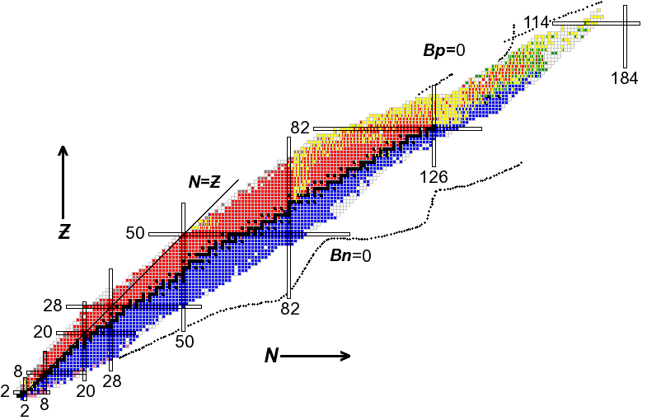
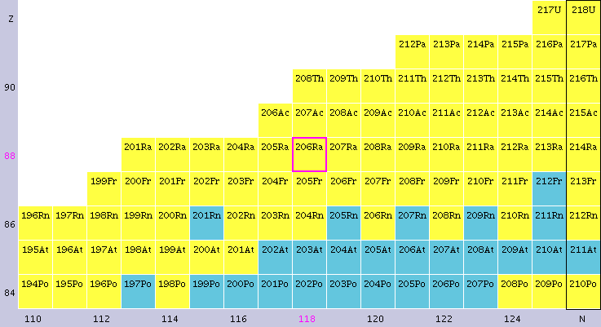
Projectiles with Z ≥ 20 Reacting with Lanthanide Targets
MOTIVATION:
Prospects of SHE
Synthesis with Z_{p} > 20
²¹⁶Ra →
Beams:
⁴⁰Ar CN
⁴⁴Ca CN
⁴⁸Ca CN
⁴⁵Sc CN
⁴⁸Ti CN
⁵⁰Ti CN
⁵⁴Cr CN

Slide 5
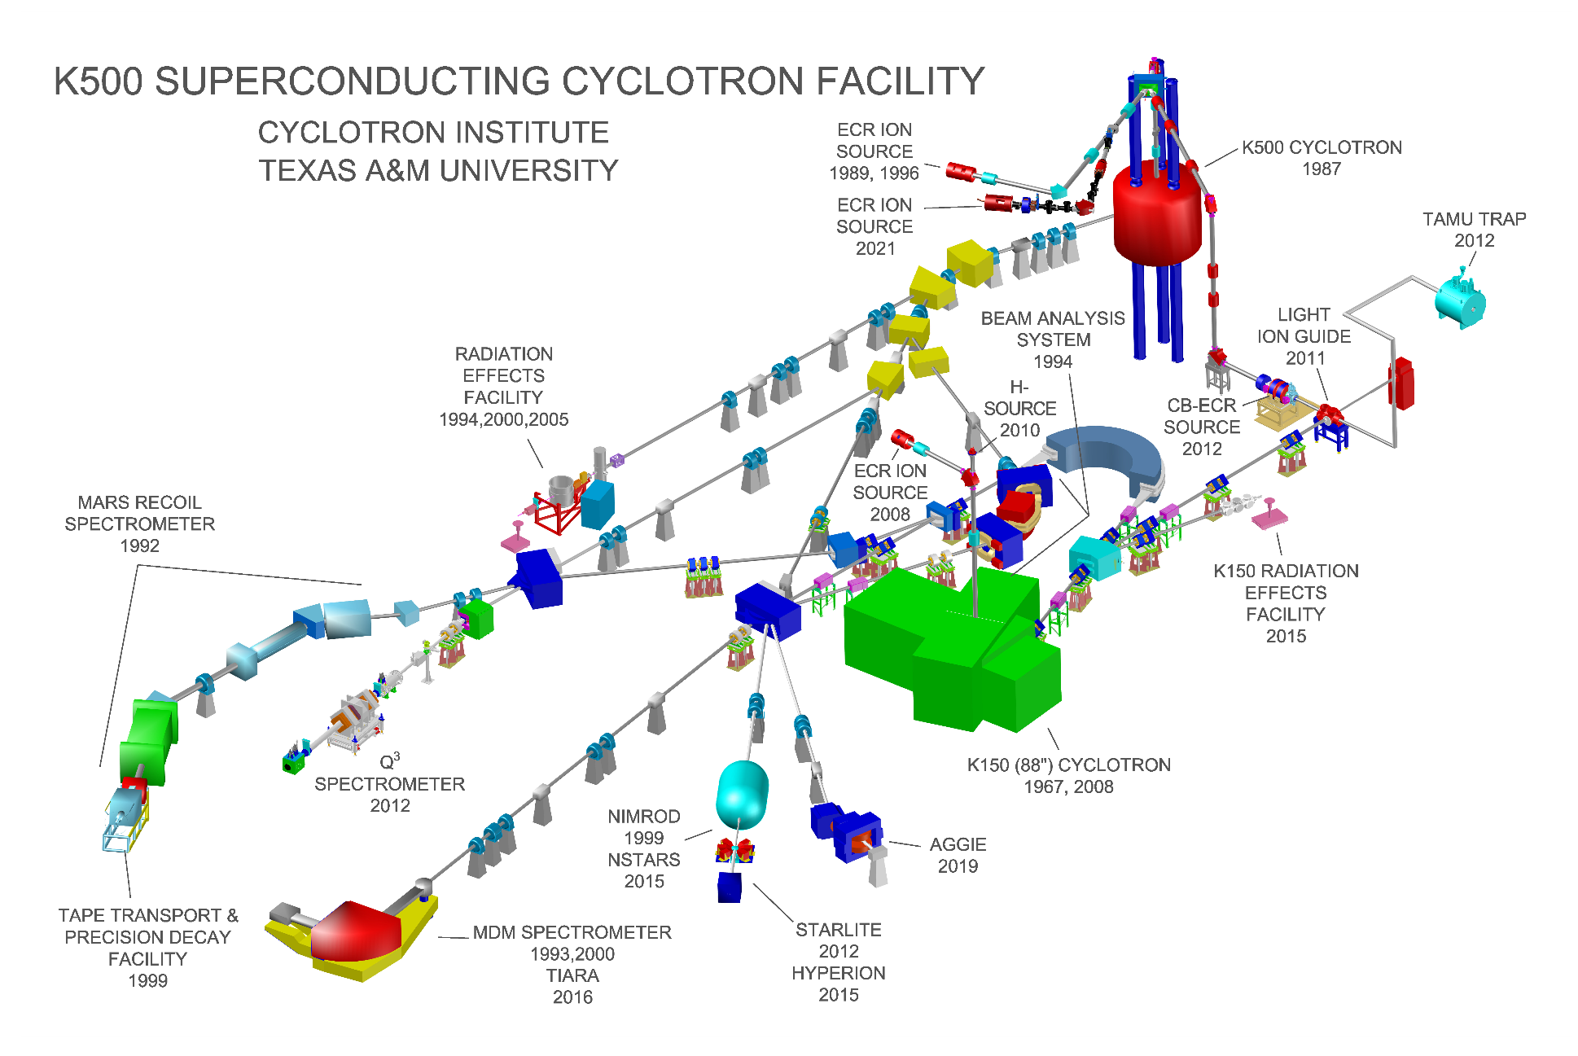
Cyclotron Institute Layout

Slide 6
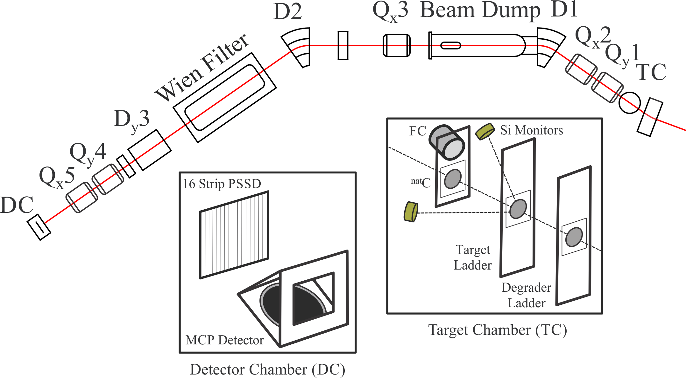
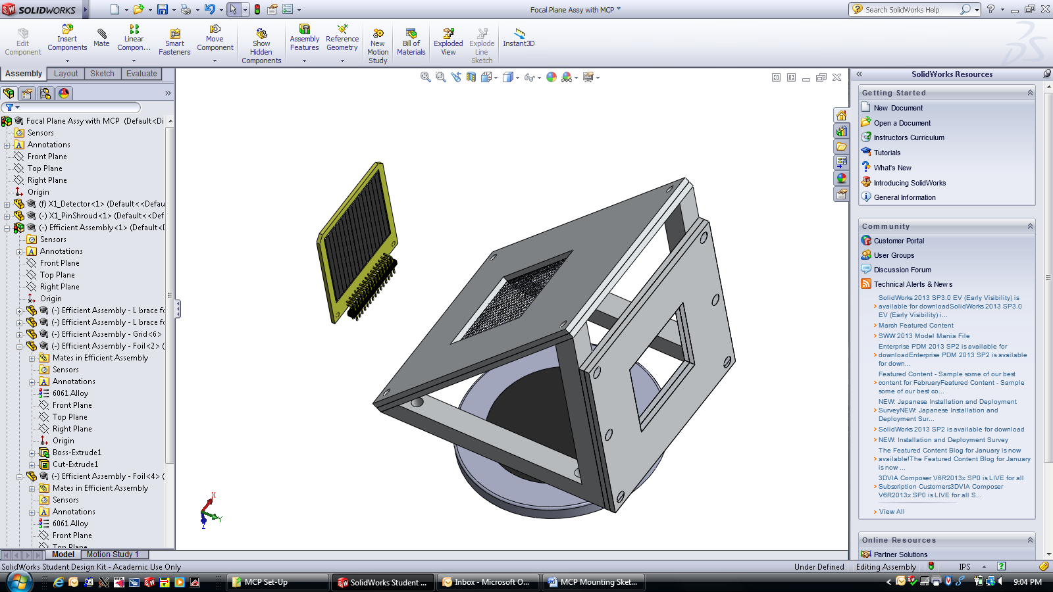
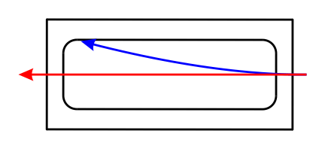
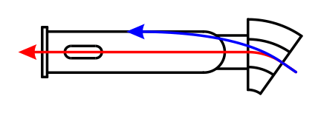
Momentum Achromat Recoil Spectrometer (MARS)
Detector
Chamber (DC)
Beam
Other Species
Products of Interest
Products
R. E. Tribble, R. H. Burch, and C. A. Gagliardi, Nucl. Instrum. Methods A 285, 441 (1989).
CMF et al., Nucl. Instrum. Methods A 678, 1 (2012).

Slide 7
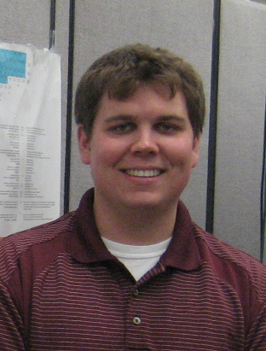
Summary of ⁴⁴Ca + ^{154,156,157,160}Gd
Tyler Werke
T. A. Werke et al., Phys. Rev. C 106, 054615 (2022). doi:10.1103/PhysRevC.106.054615

Slide 8
The Big Picture: Influence of B_{f} – S_{n}
Survival appears to be the dominant factor in heavy element production.
T. A. Werke et al., PRC 92, 034613 (2015); D. A. Mayorov et al., PRC 90, 024602 (2014).
D. A. Mayorov et al., PRC 92, 054601 (2015); T. A. Werke et al., PRC 92, 054617 (2015).
T. A. Werke et al., Phys. Rev. C 106, 054615 (2022).

Slide 9
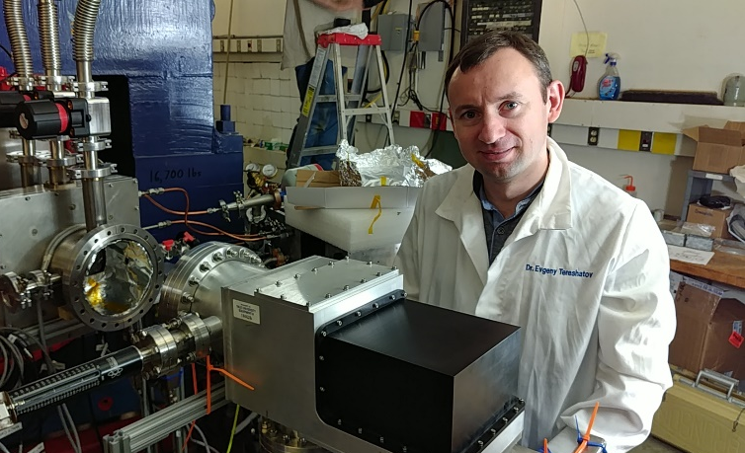
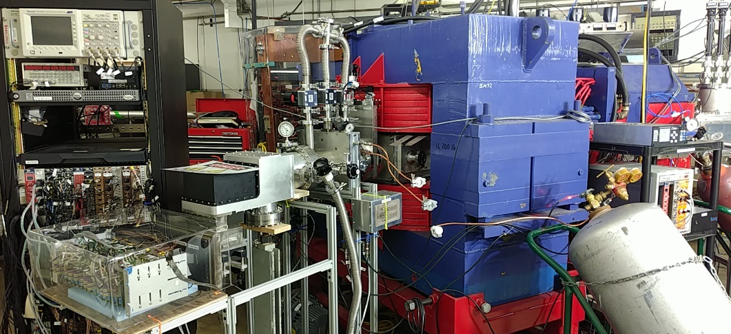
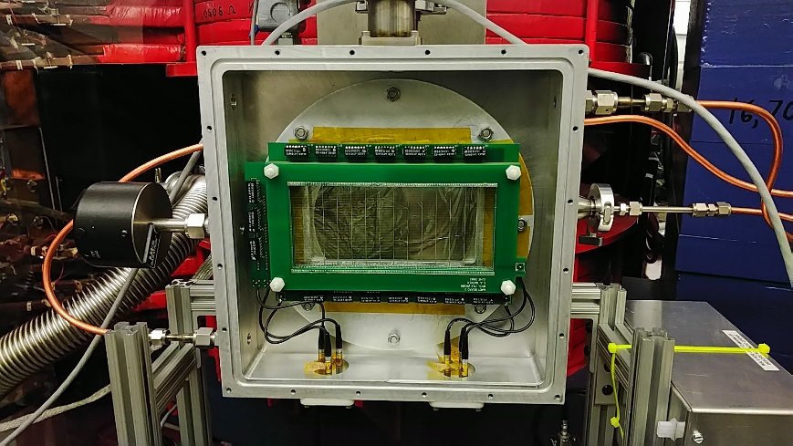
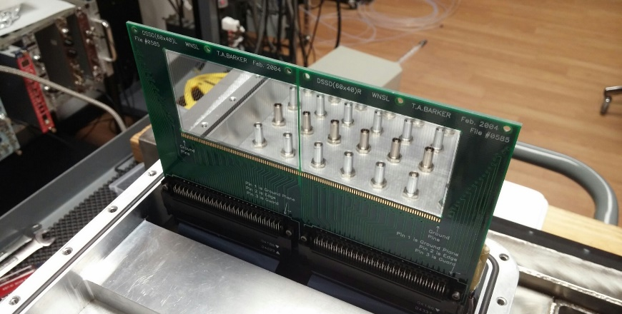
AGGIE (Al Ghiorso’s Gas-filled Ion Equipment) Separator
The new AGGIE separator has increased our sensitivity for heavy elements experiments.
Using the K150 cyclotron has also helped.

Slide 10
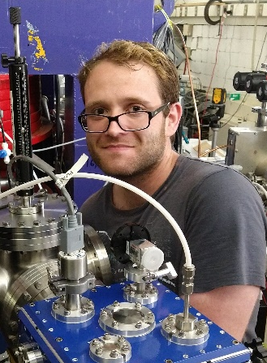
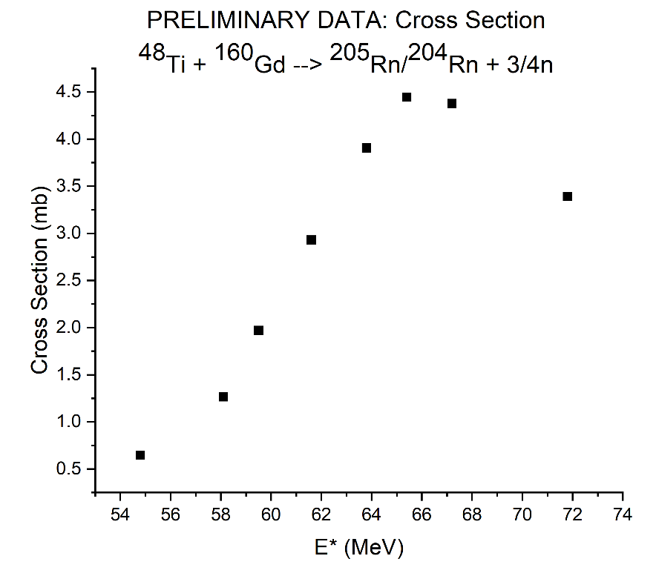
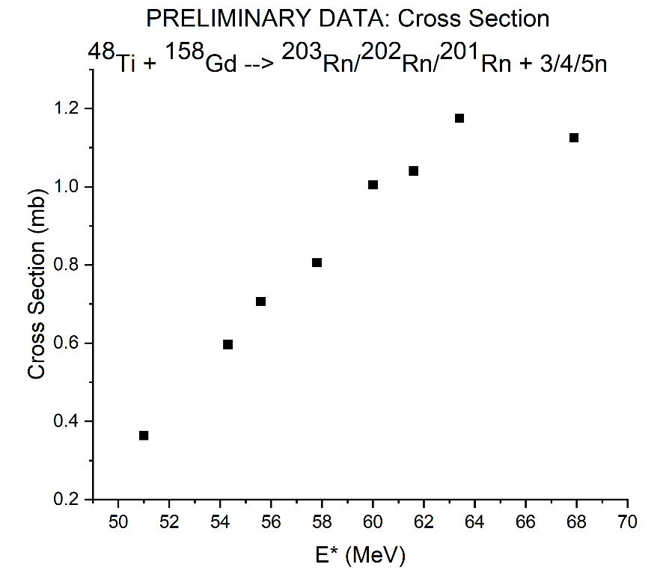
⁴⁸Ti + ^{156-158,160}Gd, ¹⁶²⁻¹⁶⁴Dy (Preliminary Data)
In 2023, we studied the influence of CN deformation on survival using ⁴⁸Ti + ^{156-158,160}Gd, ¹⁶²⁻¹⁶⁴Dy.
First production experiment using MIVOC.
Jordan Mildon

Slide 11

Kinetic Displacement of the Reaction (KDR, Preliminary Data)
Predicted excitation functions for elements 120 and 119 vary partly because of the different mass tables used.
Christa Pritchard

Slide 12
The Most Important Questions
Over one year of beamtime has been spent on discovering elements 119 and 120. No decays chains have been reported.
Theoretical predictions show a wide variation in cross section and optimum energy.
What are the most important questions?
  What are the fission barriers for superheavy nuclei?
  What is the influence of angular momentum, both in the entrance channel and on the fission barrier?
  How does P_{CN} change with any parameter?

Slide 13
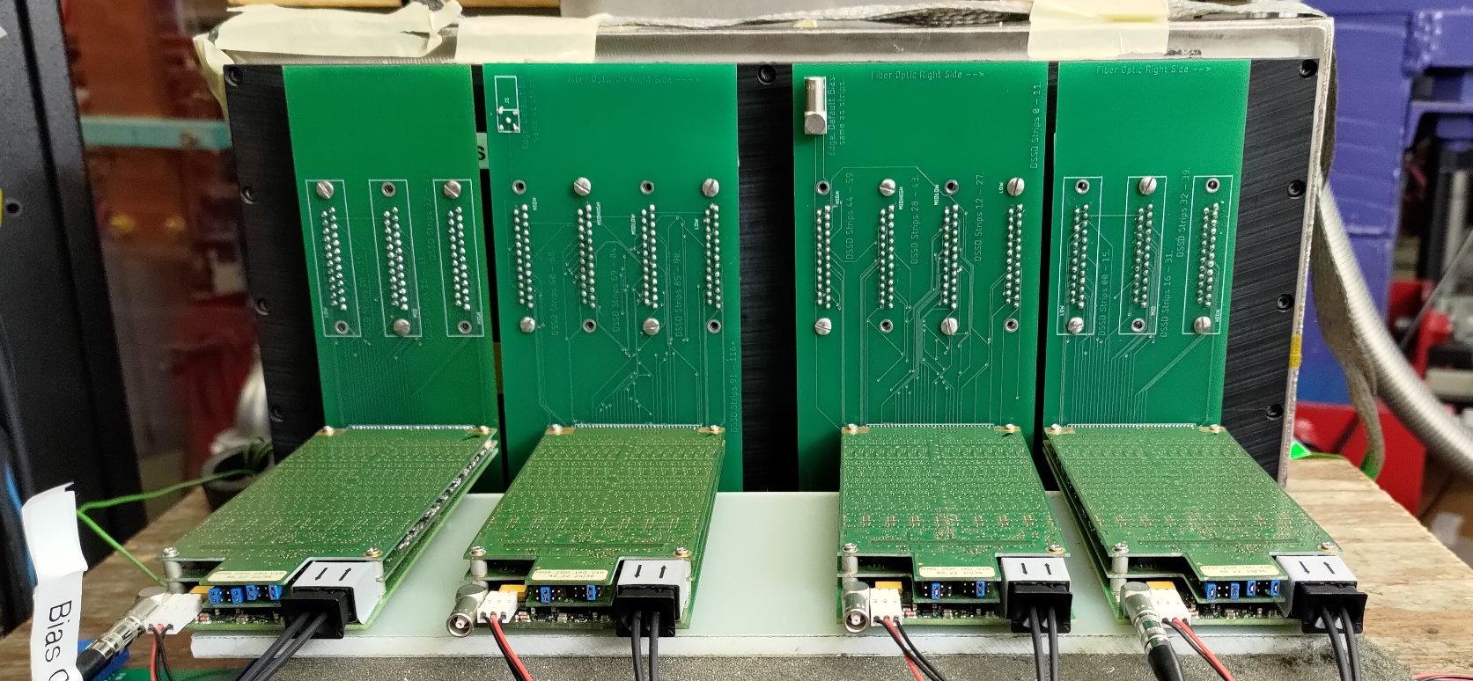
AGGIE Upgrades
We recently implemented an electronics upgrade to increase efficiency and make it easier to calibrate.
We are developing a MWAC for implantations.
We are also discussing a magnetic rigidity upgrade.

Slide 14
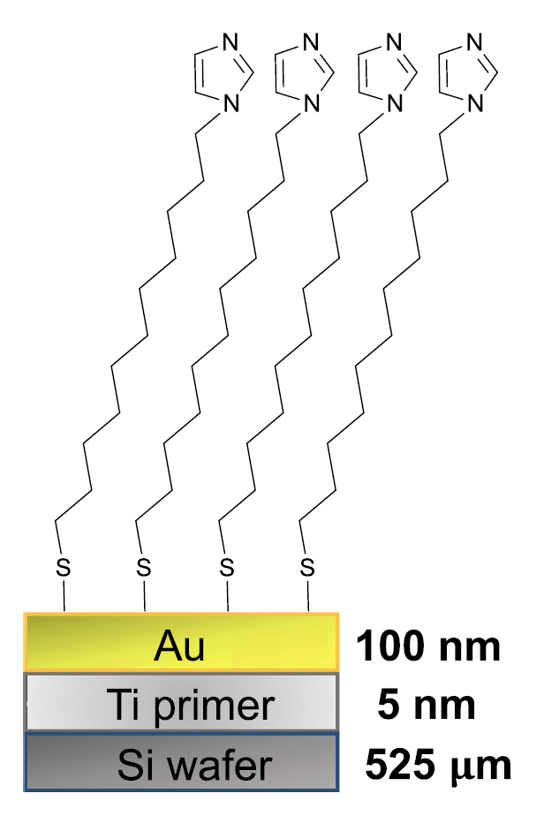

Functionalized Detector Surfaces
Im-C₁₁-SH:
4.5 × 10¹⁴/cm²
Vera Zakusilova
Sulfur 2p XPS for Im-C₁₁-SH SAMs Adsorbed on Au
Quantitative coverage [(99± 6)%] of Au-coated Si chips with
1-(11-mercaptoundecyl)imidazole (Im-C₁₁-SH) molecules.
Self-Assembly of
Im-C₁₁-SH Molecules
V. Zakusilova et al., Appl. Surf. Sci. 642, 158356 (2024). (link)

Slide 15
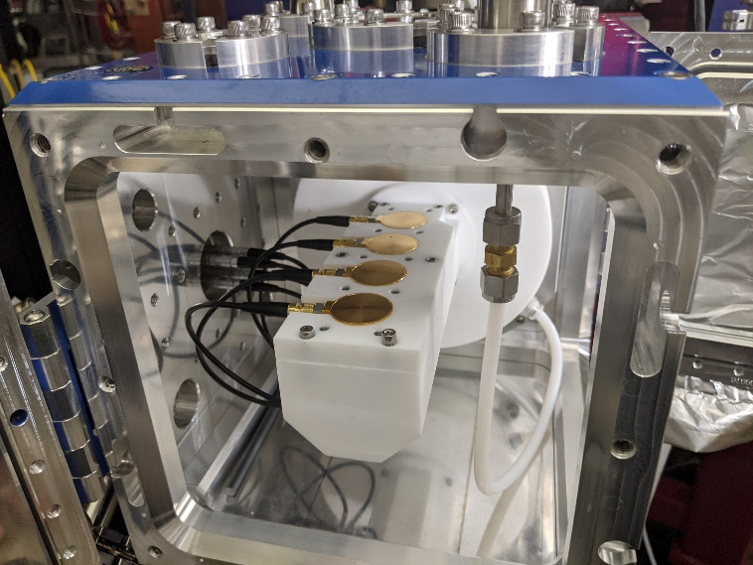
Functionalized Detector Surfaces (Preliminary Data)
We have measured the adsorption of Er, At, and Ir on functionalized Si detectors.
Vera Zakusilova
V. Zakusilova et al., in preparation (2024).
Notes:
We are modifying Si detector surfaces using a thin Ti primer layer followed by a thicker Au layer. Thiol molecules are bonded to the surface, and this allows us to make almost any surface we want, thus creating what is effectively an active chromatography column. This has been used for gas-phase chemistry experiments, and the figures show the results of the online experiments. These figures have a lot of details and a lot of subtlety. I would just say that we have observed differences in adsorption based on chemistry, the data are being analyzed, that you will forward any questions to me.

Slide 16

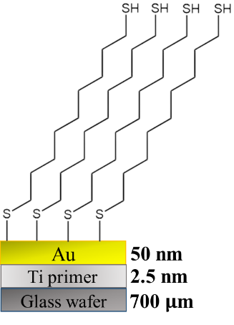
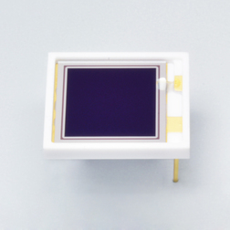
Chemically-Tunable Detectors for Chromatography of Po
Self-assembled monolayers (SAMs) can be used to create chemically tunable surfaces for studying gas-solid interactions.
Po (Z = 84), a lighter homolog of Lv (Z = 116), is being studied on a 1,9-nonanedithiol (NDT) surface.
Amelia Kirkland
He Flow
Polonium atom
Au
Ti
Not to Scale
SAMs
Si

Slide 17
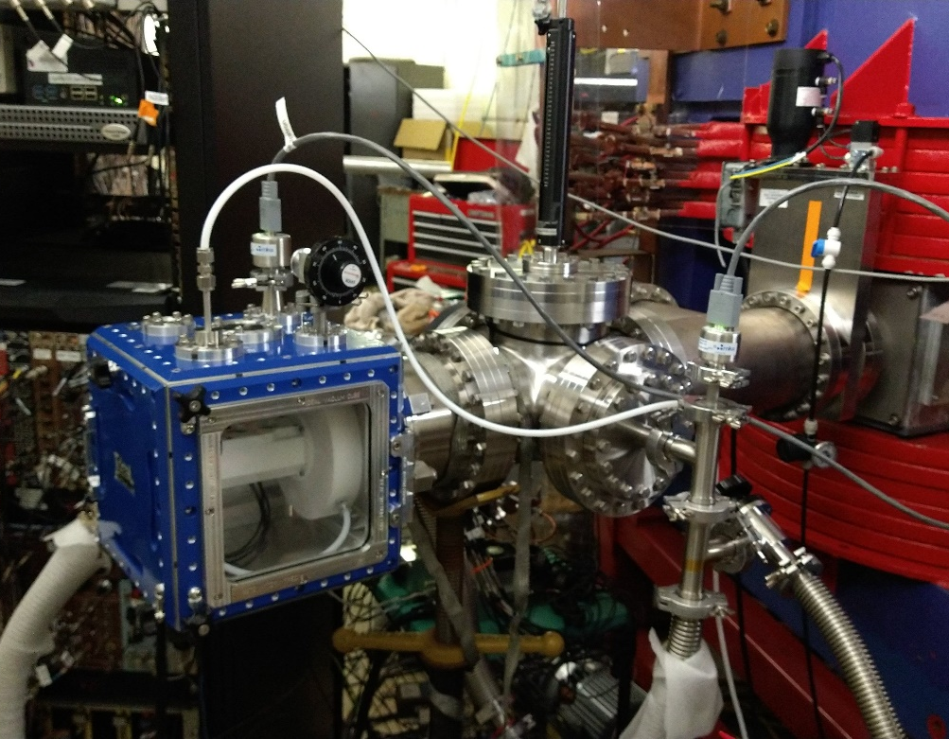
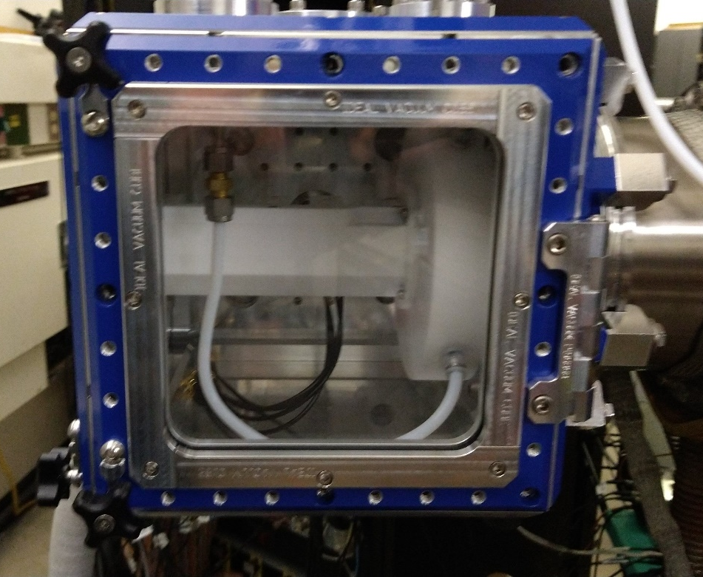
Simplified Recoil Transfer Chamber
We have designed a new recoil transfer chamber for our functionalized detector surface experiments.
Characterization is ongoing.

Slide 18

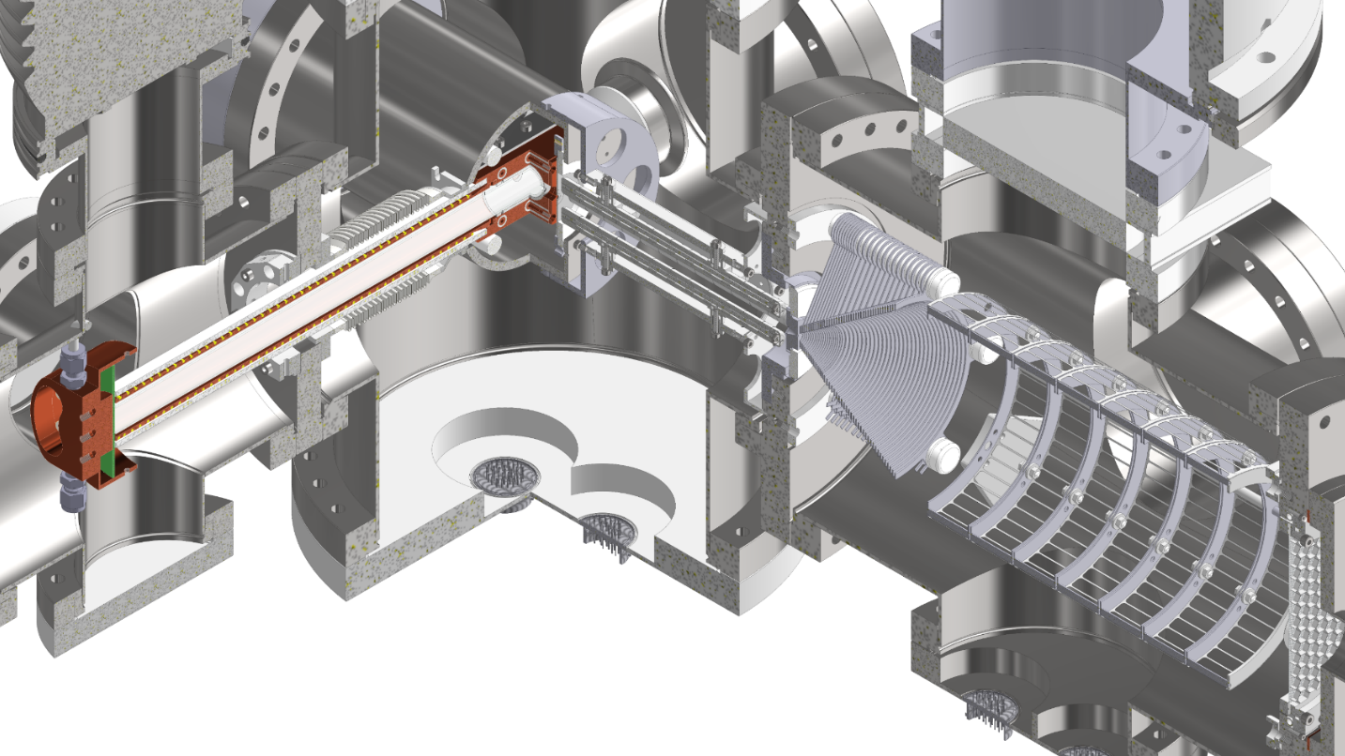
Vacuum Chromatography for Short-Lived SHE
Isotopes of SHEs beyond Fl are in the sub-second domain → Wanted: New experiments!
Isothermal vacuum chromatography tested.
(2) RFQ
Georg Tiebel
(3) IVAC
(1) Gas buffer cell
May 2024:
¹⁴⁷Sm(³⁶Ar, 5n)¹⁷⁸Hg
t_{½} = 266 ms
Slide prepared by P. J. Steinegger.

Slide 19
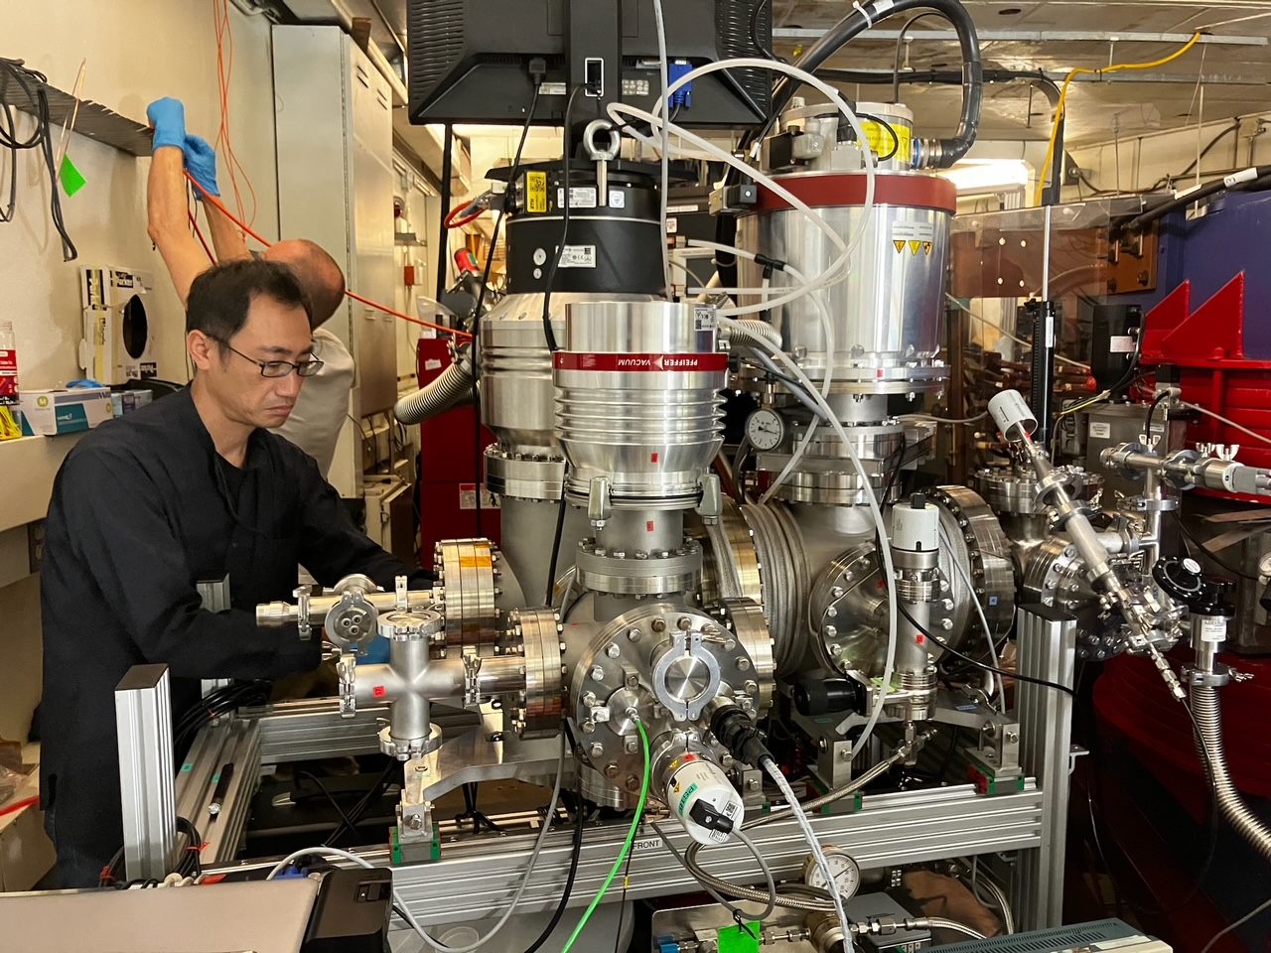
Vacuum Chromatography for Short-Lived SHE
Georg Tiebel
May 2024:
¹⁴⁷Sm(³⁶Ar, 5n)¹⁷⁸Hg
t_{½} = 266 ms
Slide prepared by P. J. Steinegger.
Notes:
Tetsuya Sato is in the foreground.

Slide 20
AGGIE Magnetic Rigidity Upgrade
It is known that Bρ = mv/q and q ∝ vZ^{1/3} in gas.
⇒ Bρ ∝ m/Z^{1/3}.
m varies more quickly than Z^{1/3}. In practice, Bρ ∝ m.
Example Reactions:
  ¹¹⁸Sn(⁴⁰Ar, 5n)¹⁵³Er: Bρ = 1.35 T m
  ¹⁶⁵Ho(⁴⁰Ar, 5n)²⁰⁰At: Bρ = 1.59 T m
  ²⁰⁸Pb(⁴⁸Ca, 2n)²⁵⁴No: Bρ = 2.04 T m
  ²⁰⁸Pb(⁵⁵Mn, n)²⁶²Bh: Bρ = 2.16 T m
We are currently limited to Bρ ~ 1.7 T m. A power supply upgrade is in progress to bring us to ~2.2 T m.
Theory: See H.-D. Betz, Rev. Mod. Phys. 44, 465 (1972) (link) and references therein.
Charge States in He: K. E. Gregorich et al., Phys. Rev. C 72, 014605 (2005). (link)

Slide 21
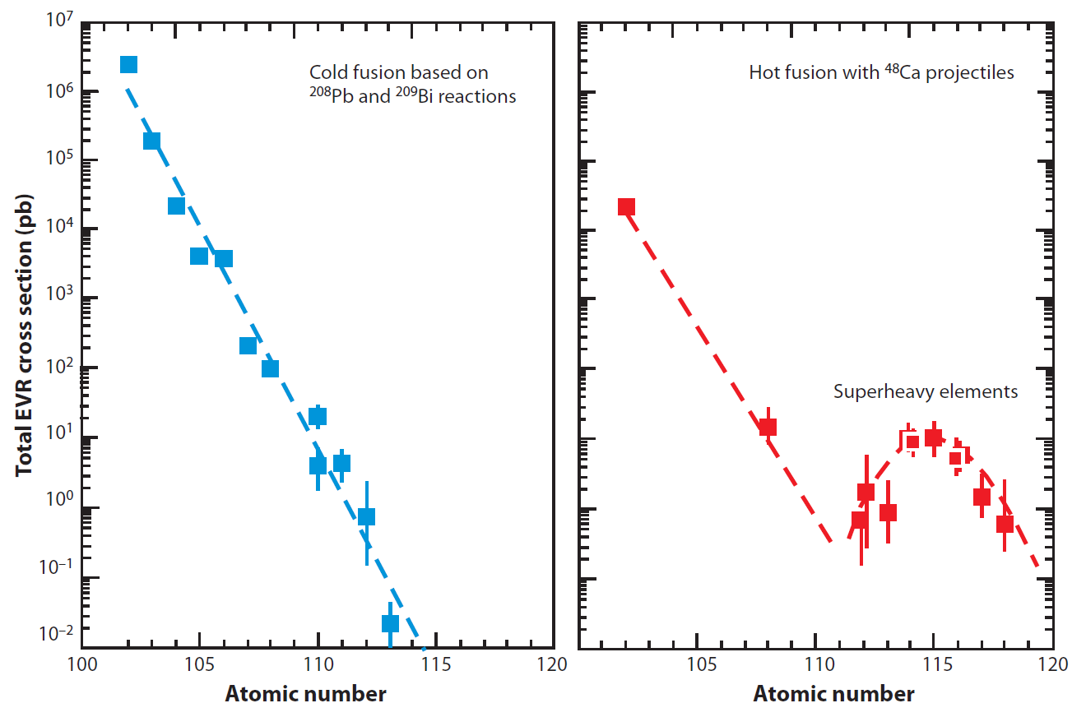
New Element Discoveries ca. 1980-2010
One per sec
One per min
One per hr
One per day
One per wk
One per mo
J. H. Hamilton et al., Ann. Rev. Nucl. Part. Sci. 63, 383 (2013). doi:10.1146/annurev-nucl-102912-144535

Slide 22
New Element Discoveries ca. 1980-2010
One per sec
R ∝ N_{t}I
⇒ R = σN_{t}I
One per min
One per hr
One per day
One per wk
One per mo
J. H. Hamilton et al., Ann. Rev. Nucl. Part. Sci. 63, 383 (2013).

Slide 23
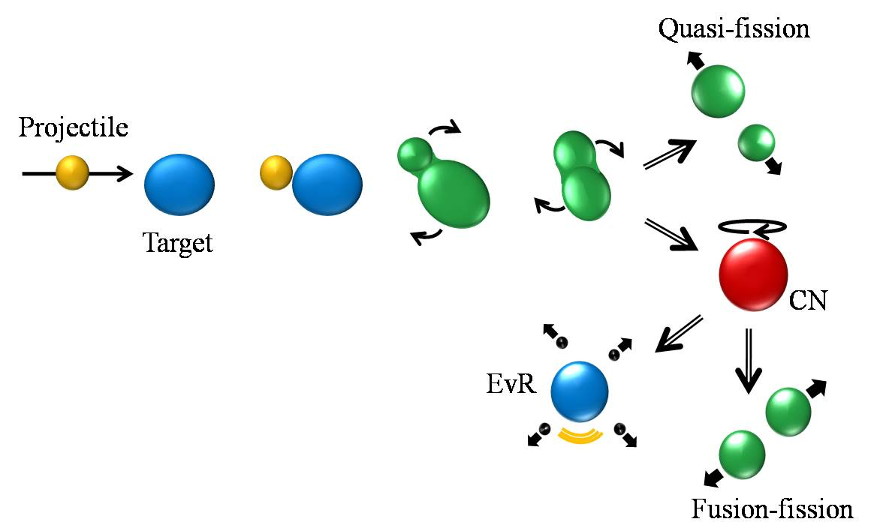
How does the nuclear reaction work?
σ_{cap}
P_{CN}
Overall, a fusion reaction is described by:
W_{sur}

Slide 24
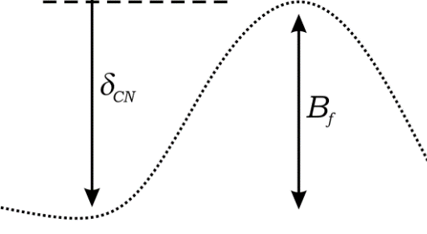
How do you make a heavy nucleus?
The production of a heavy nucleus is a competition between neutron emission and fission.
The evaporation residue cross section can be written as:
Fission
Fission
Fission

Slide 25
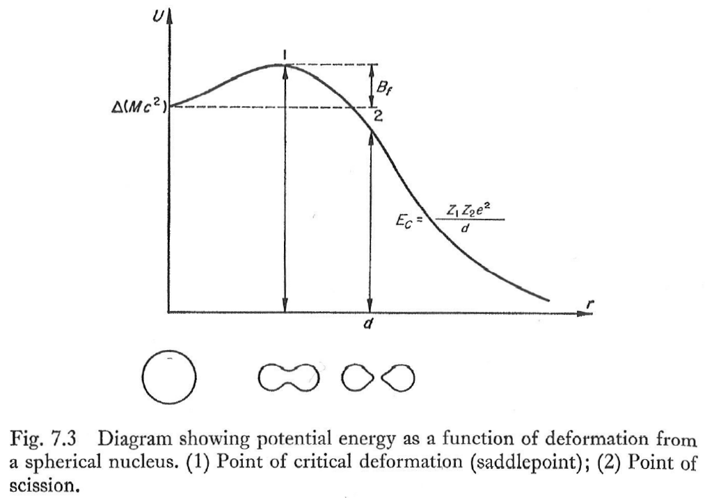
The Fission Barrier
B_{f} is the fission barrier.
It is caused by a change in the surface and Coulomb energies at constant volume and density.
⋅ 4πε₀

Slide 26
Ideas in Our Model
Sub-barrier fusion though a distribution of barriers.
Subtraction of energy unavailable due to (rigid body) rotation and pairing.
Fade-out of shell effects with increasing excitation energy.
Influence of collective effects.
Reduction of angular momentum during the emission of neutrons, protons, and alpha particles.
Influence of angular momentum on the fission barrier.
Reduction of the proton emission barrier compared to a priori estimates.

Slide 27
Our Model
Capture cross section according to the Diffused Barrier Formula from Świątecki et al.
P_{CN} according to Siwek-Wilczyńska et al.
Use the thermal energy instead of excitation energy:
Temperature: T = (U₀/a₀)^{1/2}
Angular momentum limited to 25ħ.
W. J. Świątecki et al., Phys. Rev. C 71, 014602 (2005).
K. Siwek-Wilczyńska et al., Int. J. Mod. Phys. E 17, 12 (2008).

Slide 28
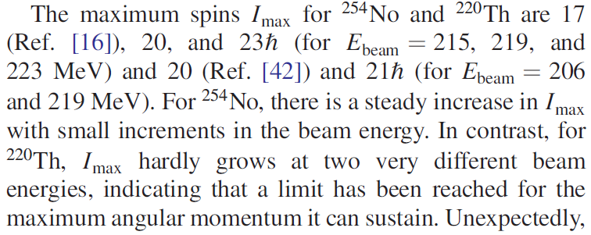
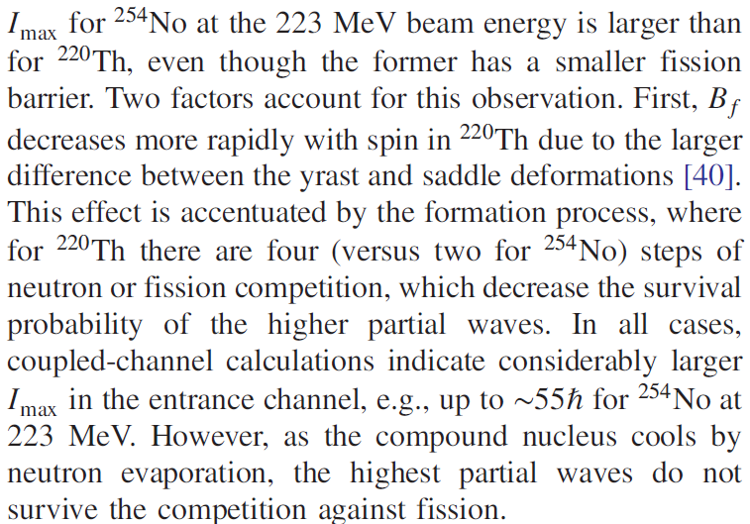
Influence of Angular Momentum
The question of angular momentum and its influence on compound nuclei is complex.
Several groups have suggested that angular momentum needs to be reduced to realistically represent what actually contributes to the cross section.
G. Henning et al., Phys. Rev. Lett 113, 262505 (2014).

Slide 29
Our Model
Level density parameters a_{n} and a_{f} as suggested by Ignatyuk et al. with d = 18.5 MeV:
according to Reisdorf.
Influence of angular momentum on the fission barrier according to Sierk.
Reduction of angular momentum with particle emission.
Reduction of proton emission barriers compared to a priori estimates according to Parker et al.
V. Ignatyuk et al., Sov. J. Nucl. Phys. 21, 255 (1975); W. Reisdorf, Z. Phys. A 300, 227 (1981).
A. J. Sierk, Phys. Rev. C 33, 2039 (1986); W. C. Parker et al., Phys. Rev. C 44, 774 (1991).

Slide 30
Our Model
Enhancement of the level density:
  K_{coll}(U, β₂) = K_{rot}f(U)φ(β₂) + K_{vib}f(U)φ(1 – β₂)
Fermi function and smoothing function:
Rotation enhancement factor (K_{rot} ≈ 100 – 150):
Vibrational enhancement factor (K_{rot} ≈ 1 – 10):
K_{vib} = exp[0.0555A^{2/3}(T/MeV)^{4/3}]
V. I. Zagrebaev, Fusion-Evaporation Codes of NRV, http://nrv.jinr.ru/nrv.
Notes:
E_{crit} = 40 MeV and d_{crit} = 10 MeV. β₂⁰ = 0.15 and Δβ₂ = 0.04. μ₀ = 931.494 Μες/χ².

Slide 31
Ideas in Our Model
Sub-barrier fusion though a distribution of barriers.
Subtraction of energy unavailable due to (rigid body) rotation and pairing.
Fade-out of shell effects with increasing excitation energy.
Influence of collective effects.
Reduction of angular momentum during the emission of neutrons.
Influence of angular momentum on the fission barrier.
Reduction of the proton emission barrier compared to a priori estimates.

Slide 32
Our Model
Capture using the Diffused Barrier Formula from Świątecki et al.
P_{CN} as suggested by Siwek-Wilczyńska et al.
Thermal Energy instead of excitation energy:
Temperature: T = (U/a)^{1/2}
Angular momentum limited to 25.
W. J. Świątecki et al., Phys. Rev. C 71, 014602 (2005).
K. Siwek-Wilczyńska et al., Int. J. Mod. Phys. E 17, 12 (2008).

Slide 33
Our Model
Level density parameters a_{n} and a_{f} as suggested by Ignatyuk et al. with d = 18.5 MeV:
according to Reisdorf.
Influence of angular momentum on the fission barrier.
Reduction of angular momentum with neutron emission.
Reduction of proton emission barriers compared to a priori estimates.
A. V. Ignatyuk et al., Sov. J. Nucl. Phys. 21, 255 (1975).
W. Reisdorf, Z. Phys. A 300, 227 (1981).

Slide 34
Our Model
Enhancement of the level density:
  K_{coll}(U, β₂) = K_{rot}f(U)φ(β₂) + K_{vib}f(U)φ(1 – β₂)
Fermi function and smoothing function:
Rotation enhancement factor (K_{rot} ≈ 100 – 150):
Vibrational enhancement factor (K_{rot} ≈ 1 – 10):
K_{vib} = exp[0.0555A^{2/3} (T/MeV)^{4/3}]
V. I. Zagrebaev, Fusion-Evaporation Codes of NRV, http://nrv.jinr.ru/nrv.
Notes:
E_{crit} = 40 MeV and d_{crit} = 10 MeV. β₂⁰ = 0.15 and Δβ₂ = 0.04. μ₀ = 931.494 Μες/χ².

Slide 35
Collective Effects
The addition of vibrational and rotational states increases the level density, making fission more likely:
n
fission
n
fission

Slide 36
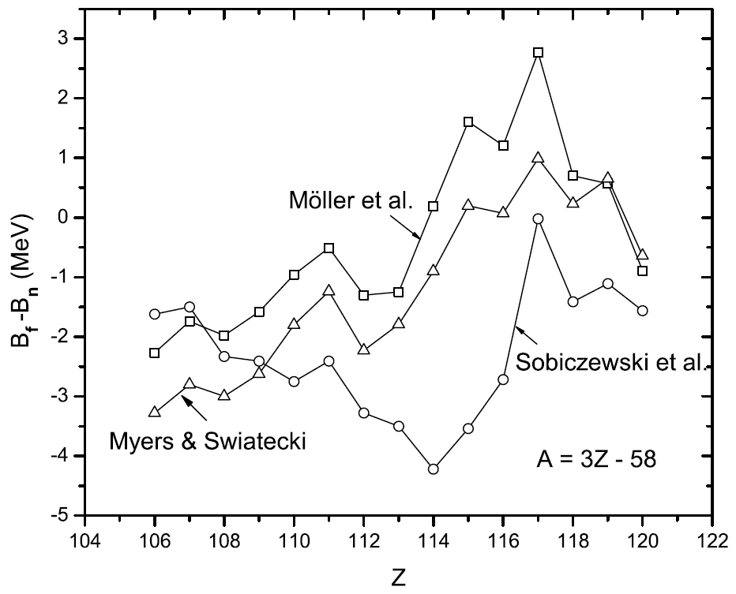
Dependence of B_{f} – S_{n} on Model
The model in use has a dramatic impact on B_{f} – S_{n}.
This has a dramatic impact on calculated cross sections.
K. Siwek-Wilczyńska et al., Int. J. Mod. Phys. E 18, 1079 (2009).

Slide 37

Acknowledgements: Coworkers and Funding Agencies
M. C. Alfonso
M. Yu. Boltoeva
K. L. Childers
R. Eichler
K. J. Glennon
J. R. Garcia
I. W. Haynes
D. Herrmann
A. S. Kirkland
Y. Ito
D. A. Mayorov
J. A. Mildon
C. D. Pritchard
A. Rubio Reyes
C. S. Salas
T. Sato
P. J. Steinegger
E. E. Tereshatov
G. A. Tiebel
M. F. Volia
A. Vögele
T. A. Werke
D. M. Wright
Thank you to our funding agency:

