Slide 1
Functionalized Detectors for Superheavy Element Homolog Chemistry Experiments
Amelia S. Kirkland
Texas A&M University
^{08.22.2024}
^{NN2024}

Slide 2
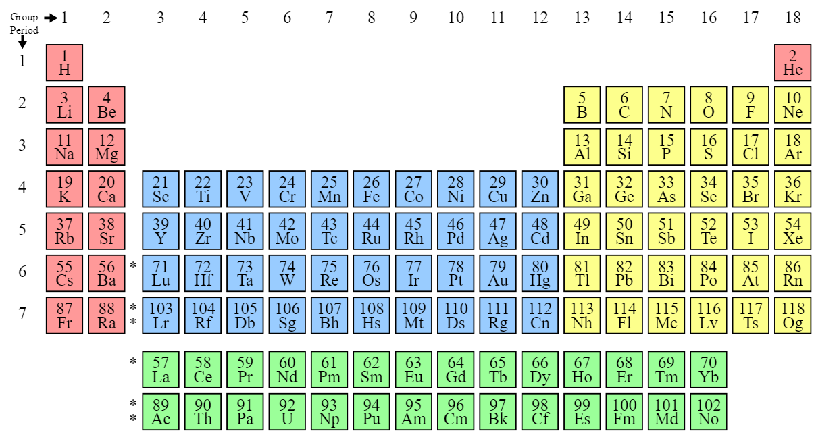
Superheavy Elements
Transactinide Elements (Z ≥ 104)
Short half-lives, low production cross sections
Single-atom-at-a-time chemistry
A. Yakushev et al., First Study on Nihonium (Nh, Element 113) Chemistry at TASCA, Front. Chem. 9 (2021). doi:10.3389/fchem.2021.753738

Slide 3
Lighter Homologs
Lighter homologs of elements can serve as models for superheavy element reactivity
Ideal lighter homologs have similar half-life and decay properties, but higher production rates
Previous work in the group focuses on Ir and Rh as homolog of Mt
This work focuses on Po as a homolog of Lv
A. Yakushev et al., First Study on Nihonium (Nh, Element 113) Chemistry at TASCA, Front. Chem. 9 (2021). doi:10.3389/fchem.2021.753738

Slide 4
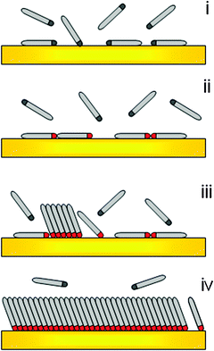
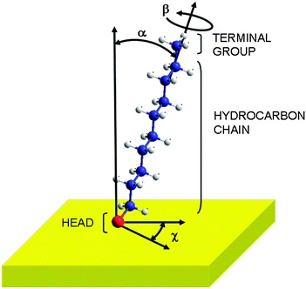
Self-Assembled Monolayer
Physisorption
Lying-down Phase Formation
Nucleation of the Standing-up Phase
Completion of the Standing-up Phase
C. Vericat et al., Self-assembled monolayers of thiols and dithiols on gold: new challenges for a well-known system, Chem. Soc. Rev. 39, 1805-1834 (2010). doi:10.1039/B907301A
H. Hamoudi et al., On the self assembly of short chain alkanedithiols, Phys. Chem. Chem. Phys. 10, 6836-6841 (2008). doi:10.1039/B809760G

Slide 5
Functionalized Detectors
He Flow
Atom
Au
SAMs
Ti
Si
Not to Scale

Slide 6
Functionalized Detectors
He Flow
Atom
Au
SAMs
Ti
Si
Not to Scale

Slide 7
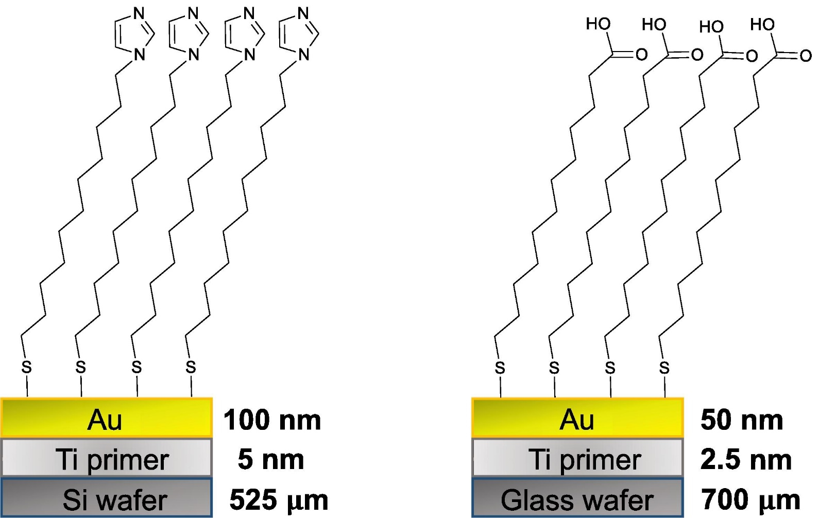
Chemically Tunable Detector Surfaces
Previous work in the group studied interactions of Ir, At, and Er on two different SAMs surfaces
Rh adsorption from solution with imidazole-based SAMs was 81.3 ± 3.8%
Ir adsorption from solution with imidazole-based SAMS was 77 ± 12%
V. Zakusilova et al., Characterization and application of alkanethiolate self-assembled monolayers on Au-Coated chips for Ir(IV) and Rh(III) sorption, Applied Surface Science 642, 158356 (2024). doi:10.1016/j.apsusc.2023.158356

Slide 8
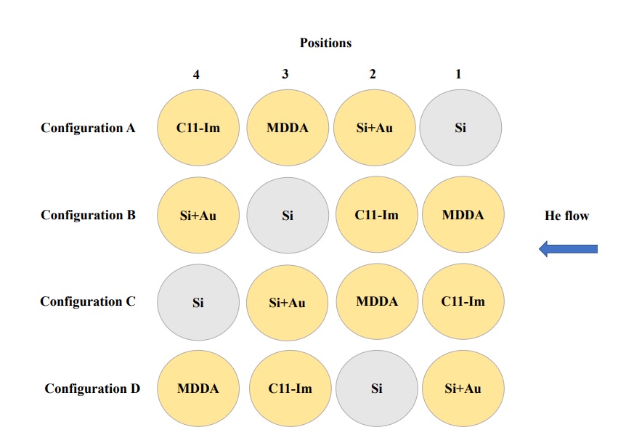
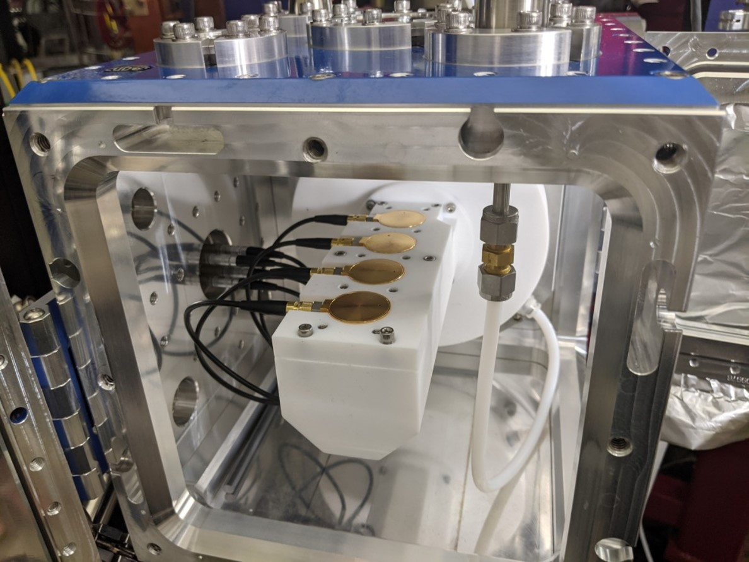
Chemically Tunable Detector Surfaces
V. Zakusilova et al., in preparation (2024).

Slide 9
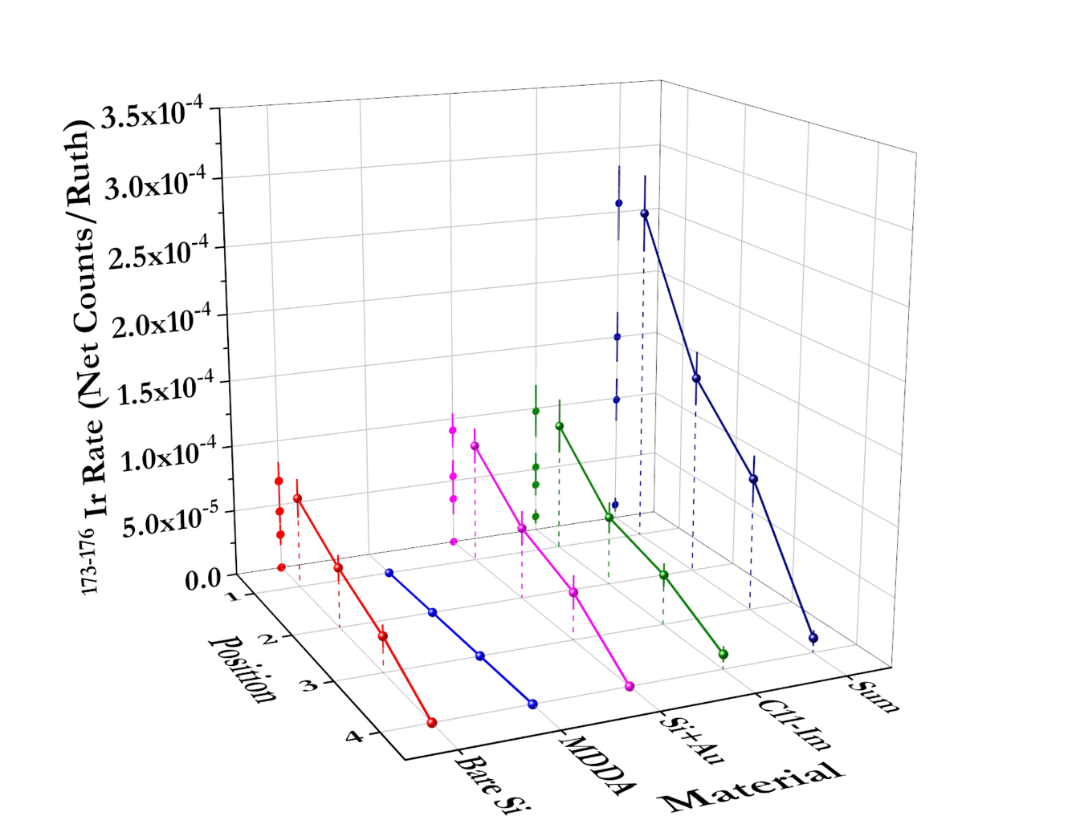
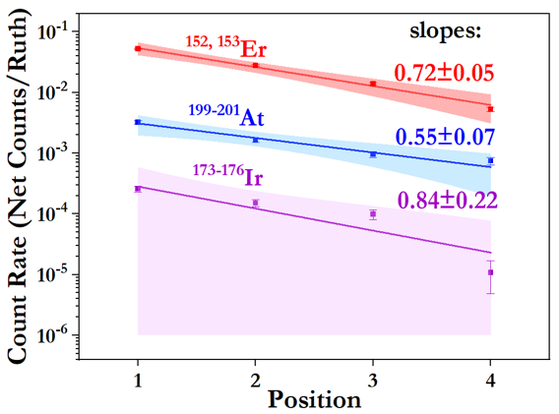
Chemically Tunable Detector Surfaces
¹¹⁸Sn(⁴⁰Ar, xn)^{158-x}Er
¹⁶⁵Ho(⁴⁰Ar, xn)^{205-x}At
¹⁴¹Pr(⁴⁰Ar, xn)^{181-x}Ir
¹⁷⁶Ir α-branching ratios are both low
V. Zakusilova et al., in preparation (2024).

Slide 10
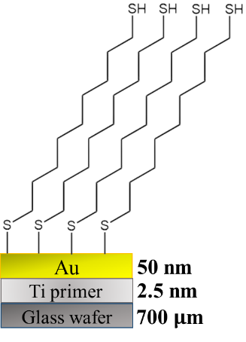
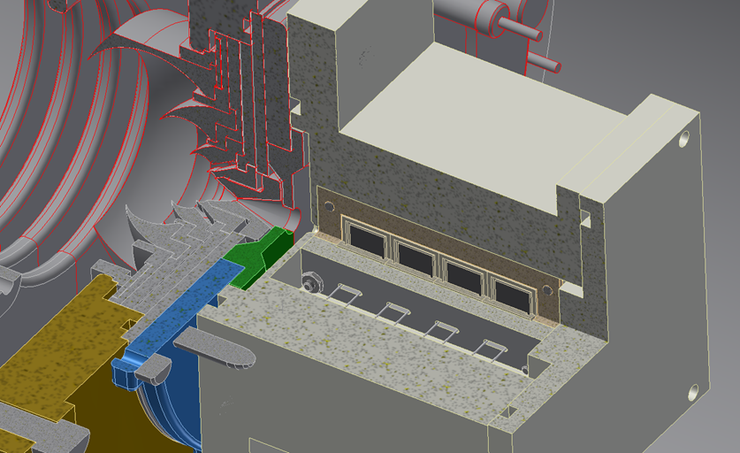
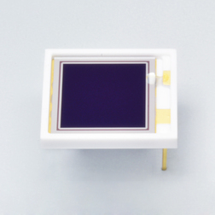
Functionalized Detectors
Large-area Si PIN photodiode for direct radiation detection, retrieved 2/7/2022, available at https://www.hamamatsu.com/jp/en/product/optical-sensors/photodiodes/si-photodiodes/S14605.html.
C. Vericat et al., Self-assembled monolayers of thiols and dithiols on gold: new challenges for a well-known system, Chem. Soc. Rev. 39, 1805-1834 (2010). doi:10.1039/B907301A
H. Hamoudi et al., On the self assembly of short chain alkanedithiols, Phys. Chem. Chem. Phys. 10, 6836-6841 (2008). doi:10.1039/B809760G

Slide 11
Characterization of Monolayer
How thick is the monolayer?
What is the coverage of the monolayer?
How long does the monolayer last?
What is the surface roughness?
V. Zakusilova et al., Characterization and application of alkanethiolate self-assembled monolayers on Au-Coated chips for Ir(IV) and Rh(III) sorption, Applied Surface Science 642, 158356 (2024). doi:10.1016/j.apsusc.2023.158356
Spectroscopic Ellipsometry
Nano-projectile Secondary Ion Mass Spectrometry
X-ray Photoelectron Spectroscopy
Atomic Force Microscopy

Slide 12
Characterization of Monolayer
How thick is the monolayer?
What is the coverage of the monolayer?
Spectroscopic Ellipsometry
Measured thickness is 1.56 ± 0.017 nm
Nano-projectile Secondary Ion Mass Spectrometry
The coverage was measured to be 83 ± 15 %
How long does the monolayer last?
What is the surface roughness?
X-ray Photoelectron Spectroscopy
Studies ongoing
Atomic Force Microscopy
Bare Au has a surface roughness of 1.17 nm
NDT on Au has a surface roughness of 0.983 nm
V. Zakusilova et al., Characterization and application of alkanethiolate self-assembled monolayers on Au-Coated chips for Ir(IV) and Rh(III) sorption, Applied Surface Science 642, 158356 (2024). doi:10.1016/j.apsusc.2023.158356
Spectroscopic Ellipsometry
Nano-projectile Secondary Ion Mass Spectrometry
X-ray Photoelectron Spectroscopy
Atomic Force Microscopy

Slide 13
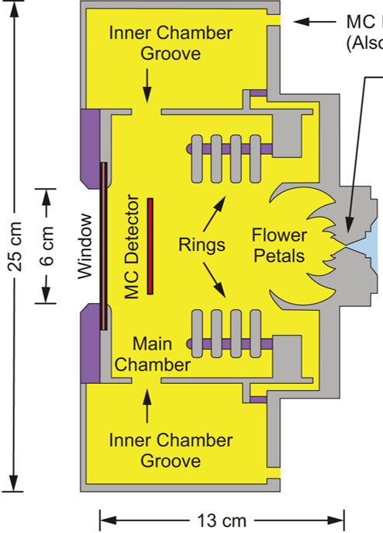

Recoil Transfer Chamber (RTC)
Detector array design at the end of the RTC
M. C. Alfonso et al., New recoil transfer chamber for thermalization of heavy ions produced in fusion-evaporation reactions, Nucl. Instrum. Methods Phys. Res., Sect. A 798, 52-61 (2015). doi:10.1016/j.nima.2015.07.004

Slide 14
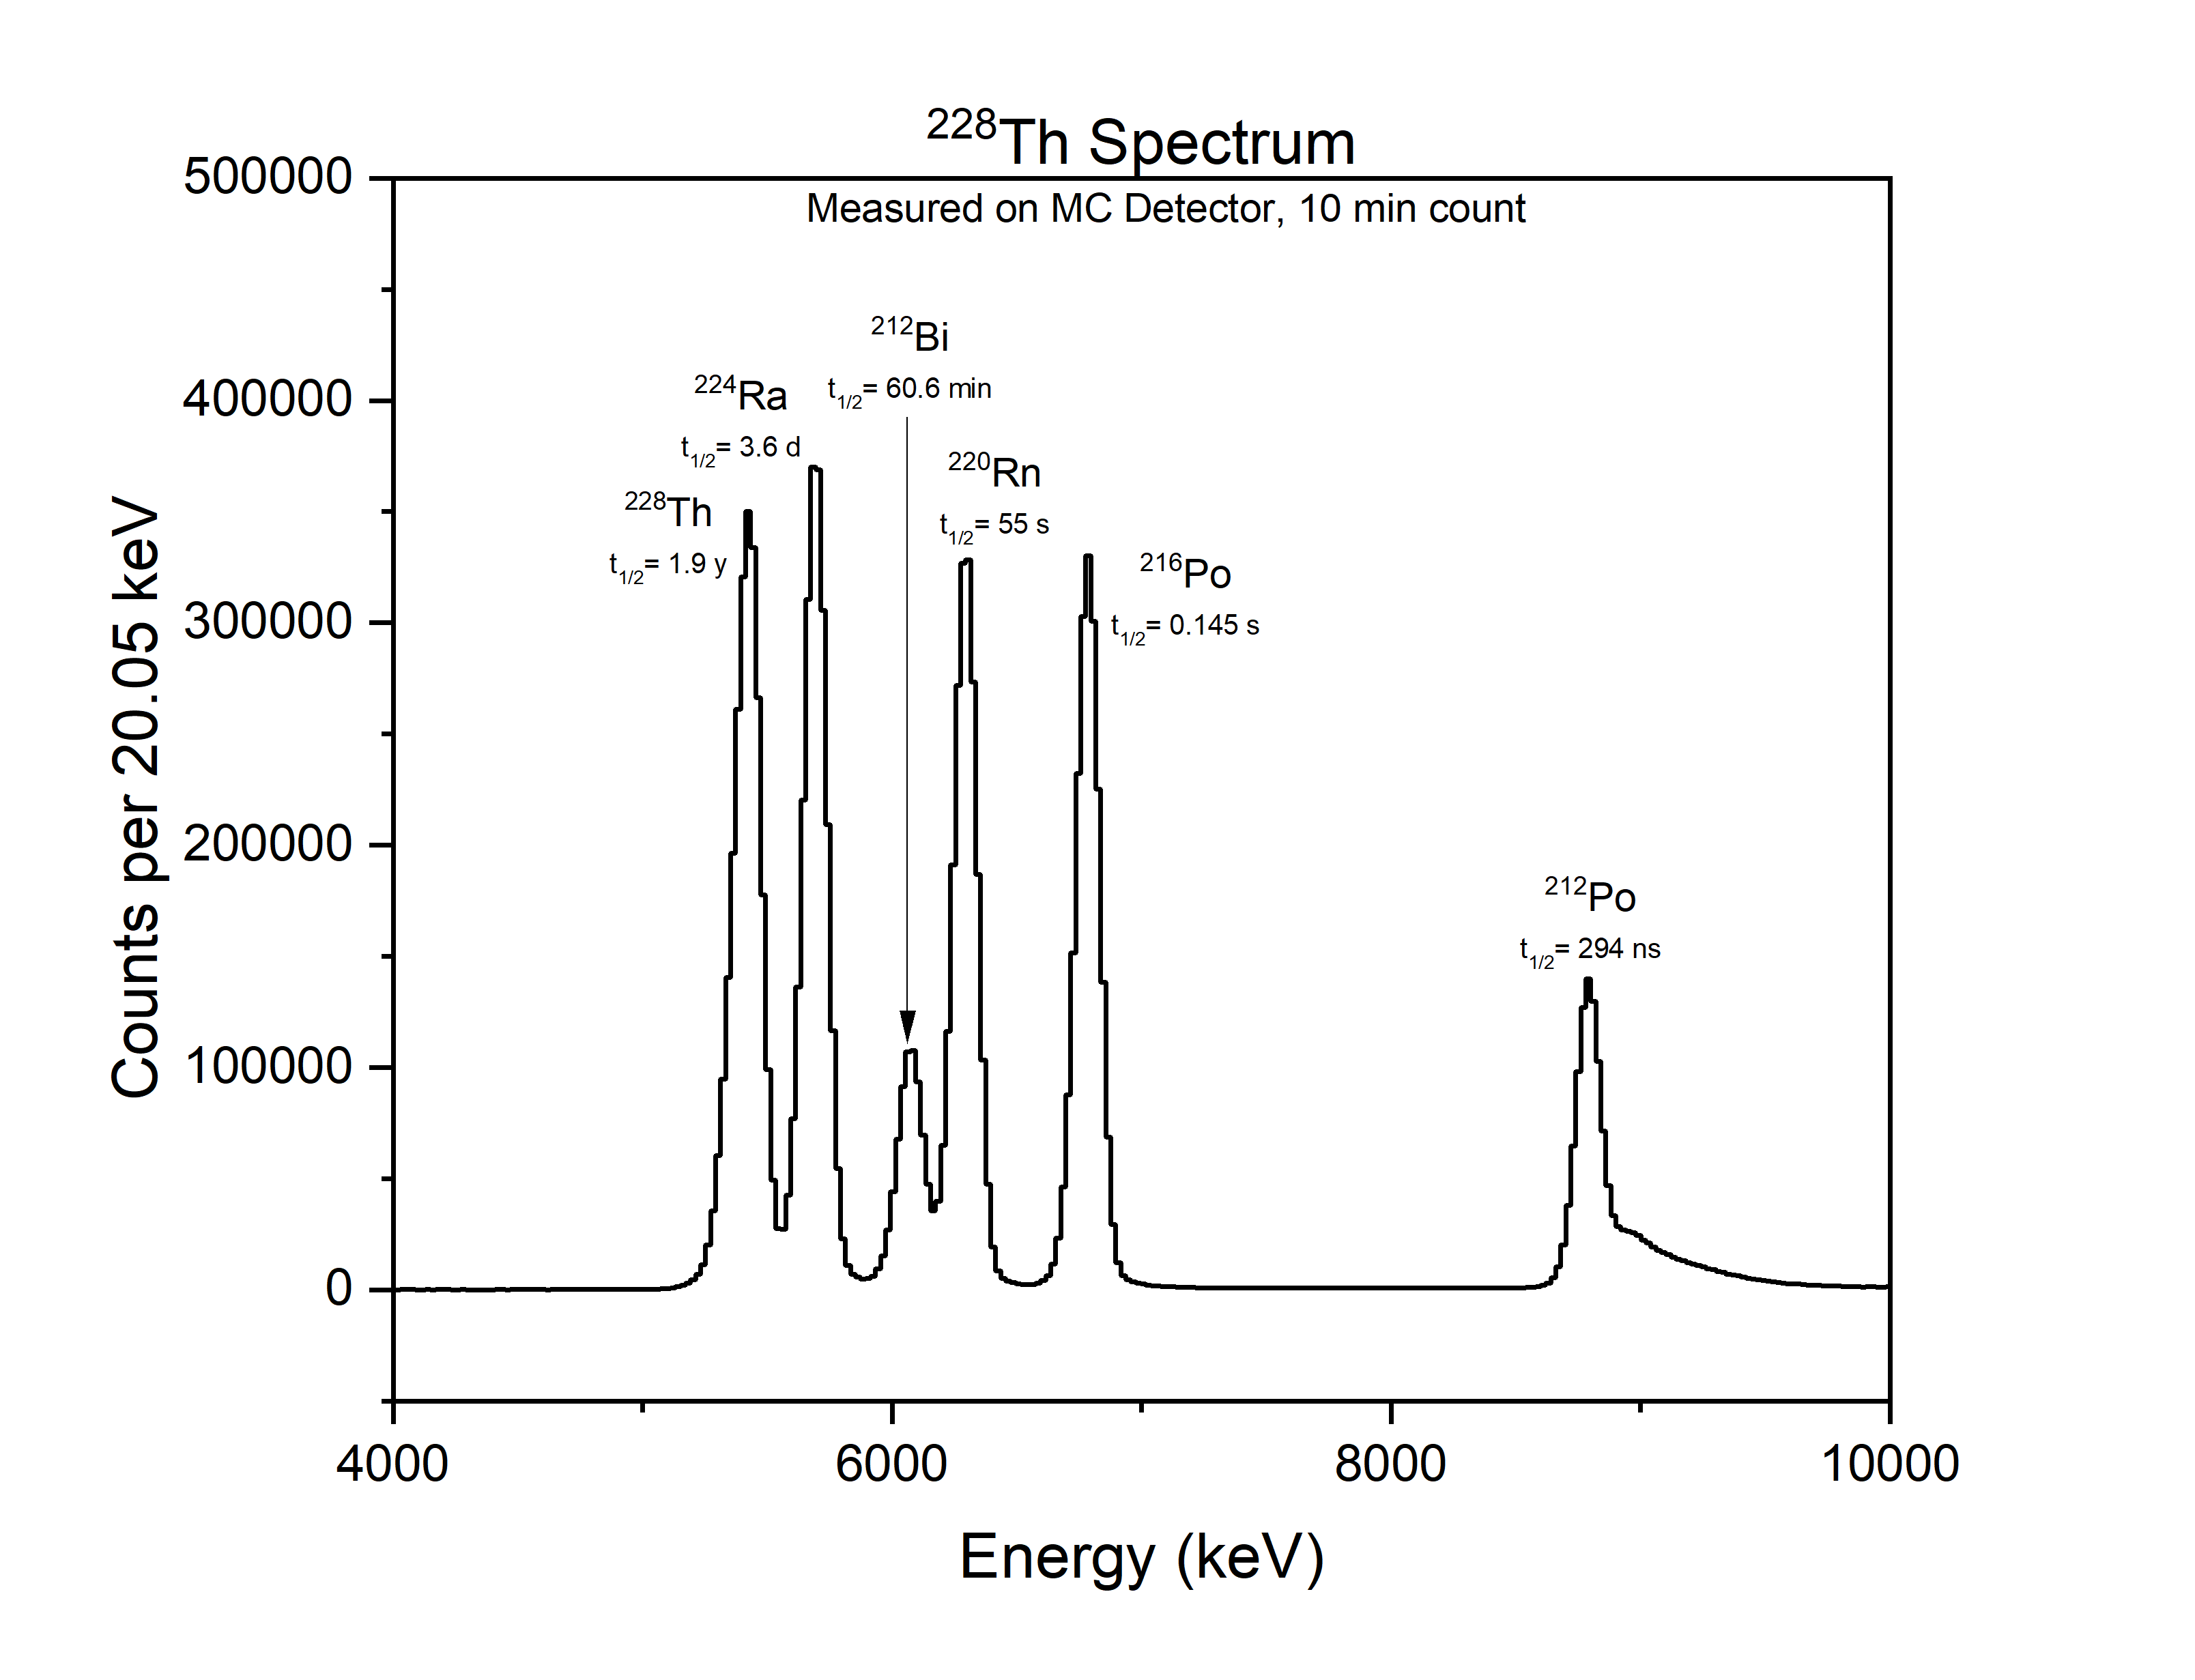
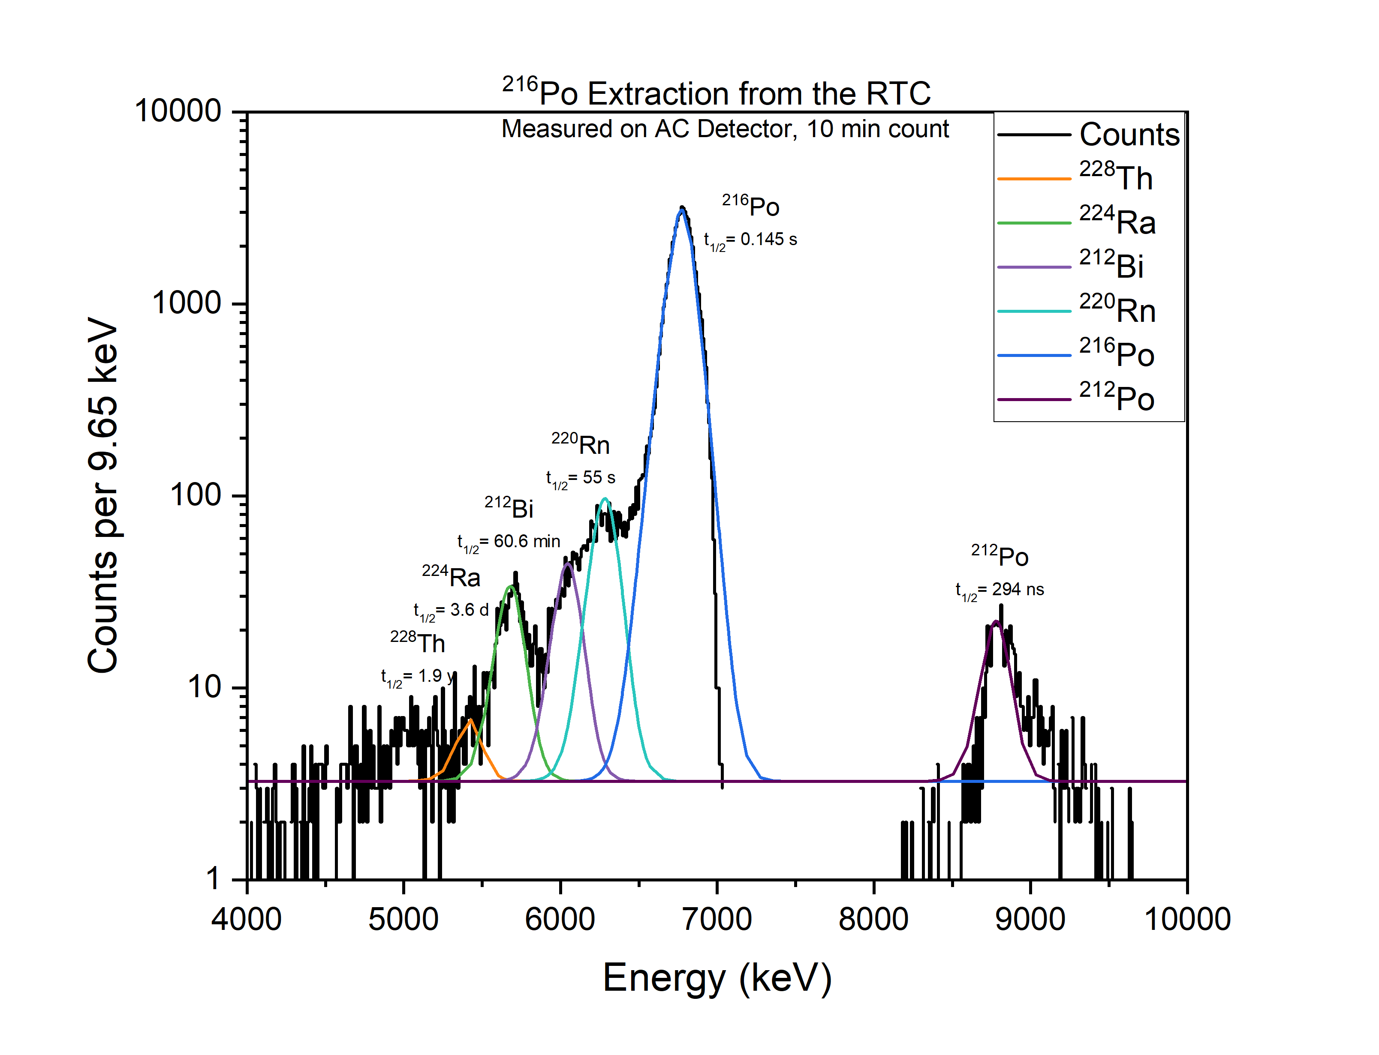
²¹⁶Po Extraction with RTC
Preliminary Data

Slide 15
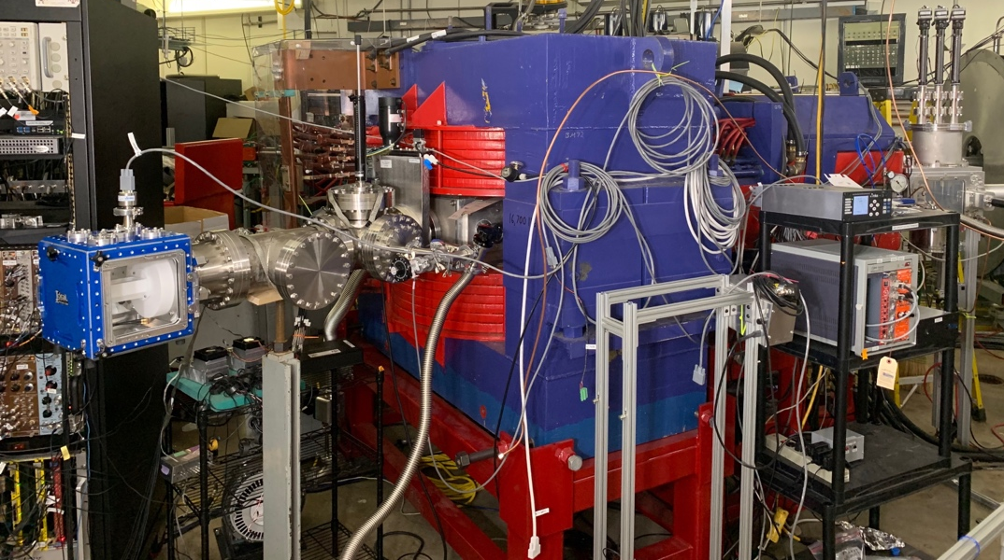
Al Ghiorso’s Gas-filled Ion Equipment (AGGIE) and the sRTC
AGGIE is a D_{v}Q_{h}D_{y} type separator
AGGIE is operated at 0.5 torr He to equilibrate charge states
sRTC used to thermalize evaporation residues once they have been separated from the beam
Detector array will be present in the sRTC

Slide 16
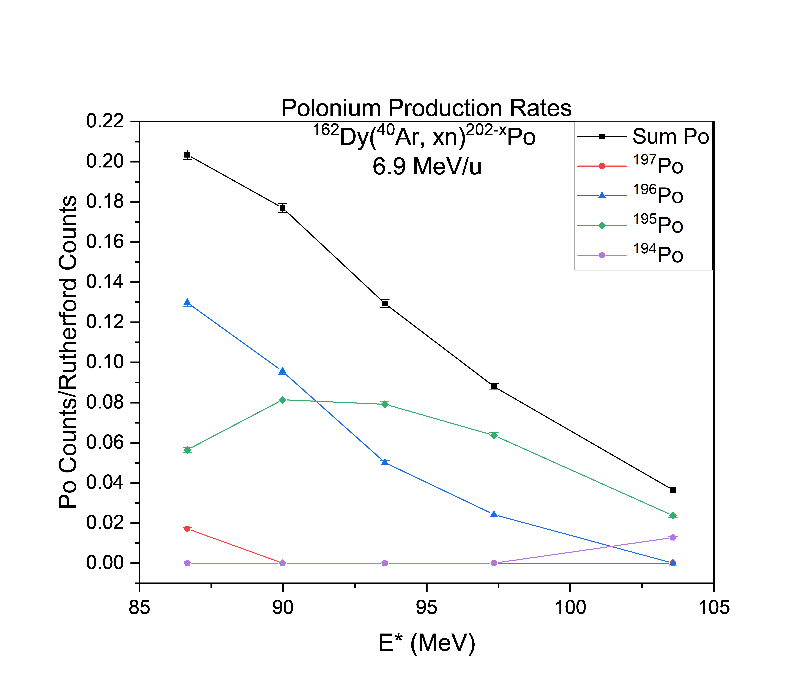
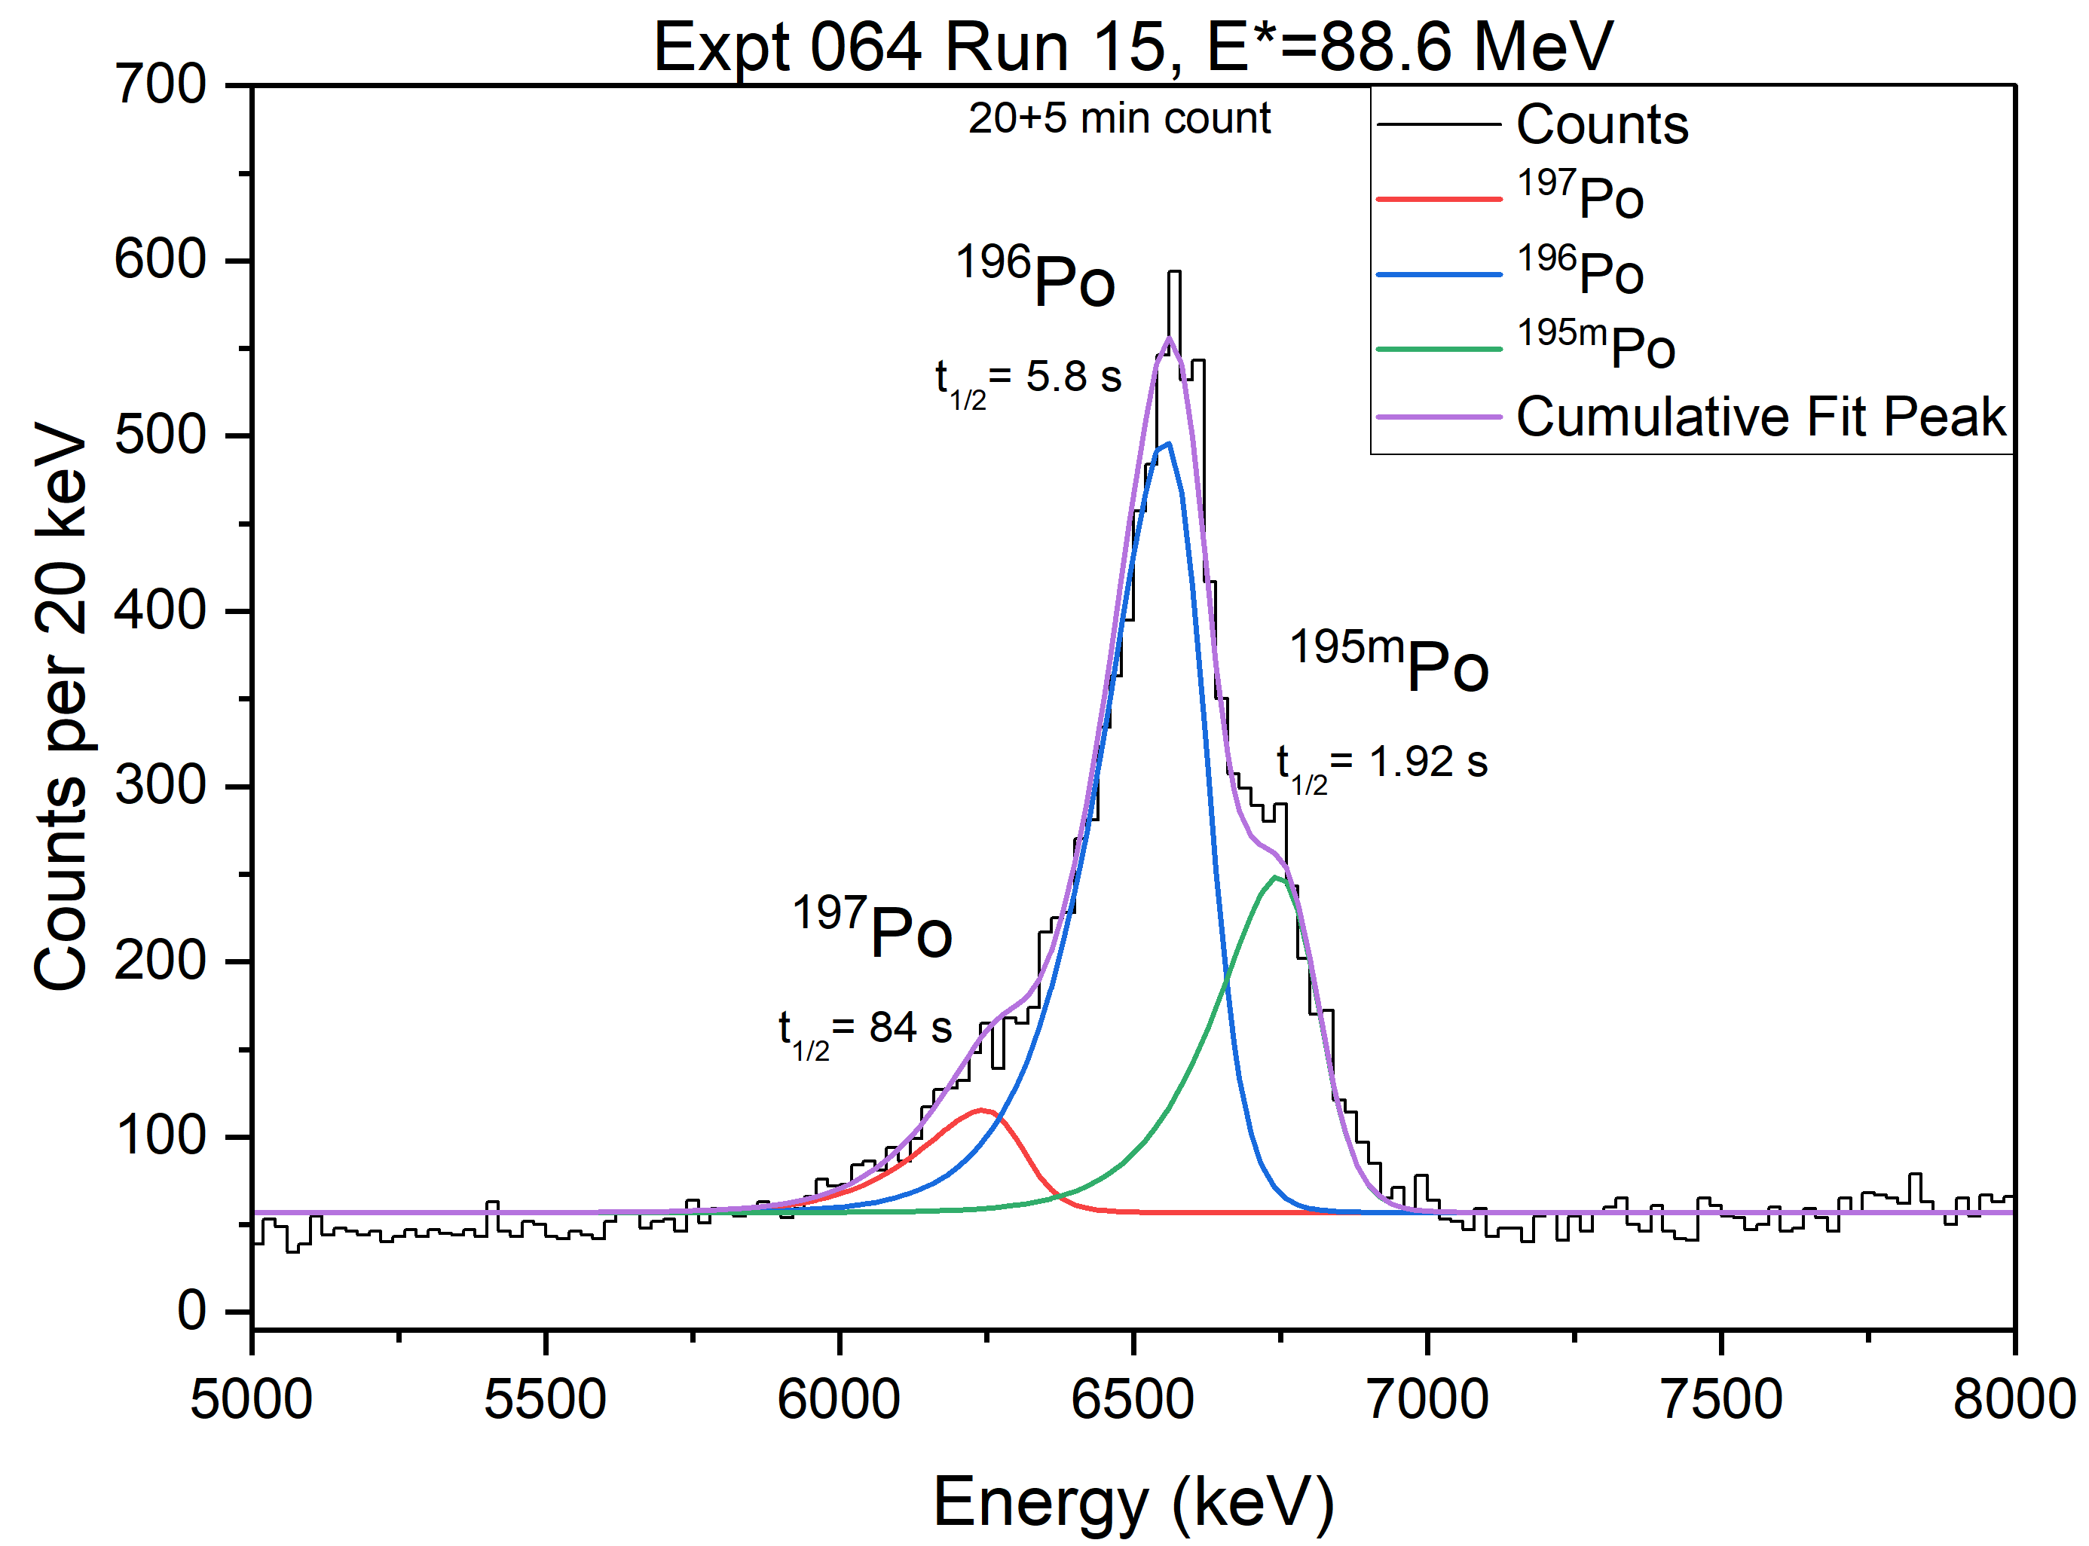
Nuclear Reaction Based Po Production
Preliminary Data

Slide 17
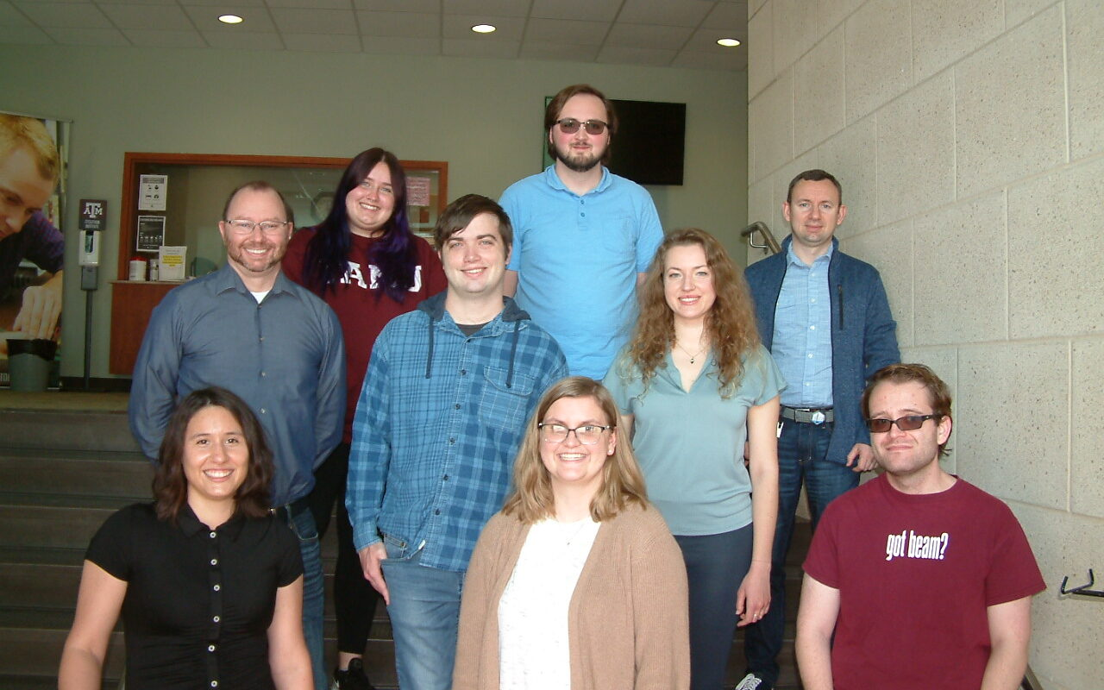


Thank you for your attention!
Many thanks to:
Anna M. Bukowski, Robert Eichler, Jenna R. Garcia, Isaac W. Haynes, Jordan A. Mildon, Patrick Steinegger, Evgeny E. Tereshatov, Georg Tiebel, Vira Zakusilova, and Charles M. Folden III
Award No. DE-FG02-93ER40773
SNF Award No. 204701020001

Slide 18
Supporting Information

Slide 19
Energy Loss of Alpha Particles in SAMS and Au
Isotope | E_{α} (keV) | E_{loss} 50 nm Au (keV) | E_{loss} 1 nm SAMs (keV)
¹⁹⁶Po | 6521.9 | 20.2 | 0.068
²¹⁶Po | 6778.3 | 19.7 | 0.065

Slide 20
Superheavy Elements

Slide 21
Fusion-evaporation Reaction
Target
Projectile
Di-nuclear System
Compound Nucleus
Evaporation Residue
Proposed Nuclear Reactions
⁴⁰Ar + ¹⁶²Dy → ¹⁹⁶Po + 6n
D. A. Mayorov, Doctor of Philosophy, Synthesis of Shell-Stabilized Nuclides in Fusion-Evaporation Reactions Induced by ⁴⁸Ca, ⁵⁰Tl, or ⁵⁴Cr Projectiles, Thesis, Texas A&M University (2015).

Slide 22
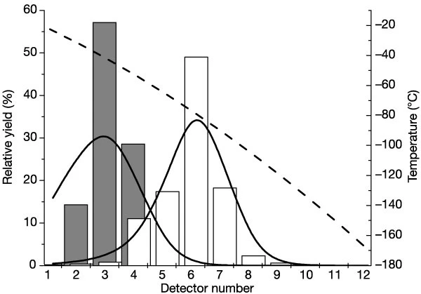
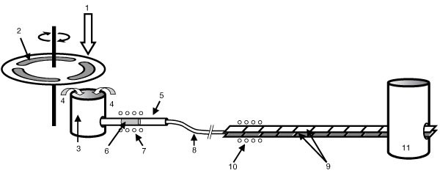
Chemistry Experiments of Superheavy Elements
Growing need to further functionalize detector surfaces
C. E. Düllmann et al., Chemical investigation of hassium (element 108), Nature 418, p. 859-862 (2002). doi:10.1038/nature00980

Slide 23
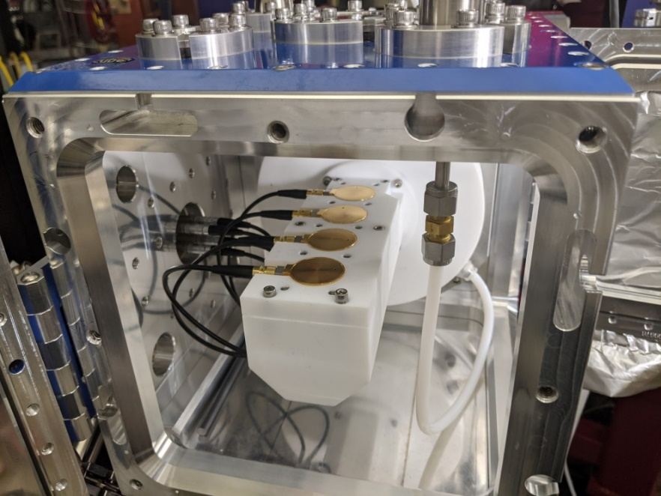
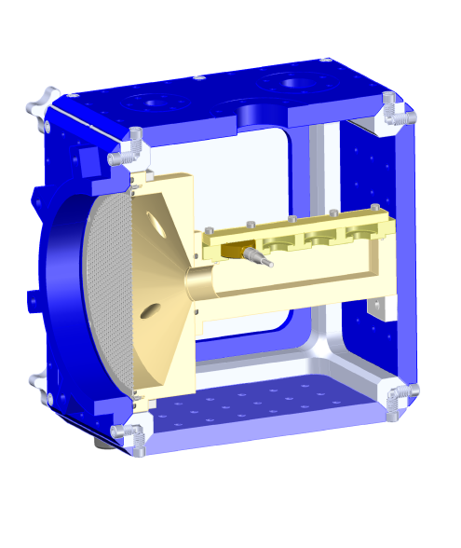
sRTC

Slide 24
Decay Properties and Production Methods of Livermorium and Polonium
Methods of Livermorium Production
Heavy-ion induced fusion-evaporation reactions
Methods of Polonium Production
Naturally through the decay chains of ²³⁸U and ²³²Th
Neutron irradiation of Bi in a reactor
Fusion-evaporation reactions
Element | Isotope | Half-Life | Decay Modes (Intensity)
Livermorium | ²⁸⁹Lv | – | –
 | ²⁹⁰Lv | 15 ms | α (100%)
 | ²⁹¹Lv | 6.3 ms | α (100%)
 | ²⁹²Lv | 18 ms | α (100%)
 | ²⁹³Lv | 53 ms | α (100%)
Polonium | ¹⁹⁶Po | 5.8 s | α (98%) ε (2.00%)
 | ²¹⁶Po | 0.145 s | α (100%)
Data from NuDat 3.0

Slide 25
Decay Properties and Production Methods of
Polonium
Methods of Polonium Production
Naturally through the decay chain of ²²⁸Th
Fusion-evaporation reactions
  ¹⁶²Dy(⁴⁰Ar, xn)^{202-x}Po
  ¹⁶⁰Dy(⁴⁰Ar, xn)^{200-x}Po
  ¹⁶²Dy(³⁶Ar, xn)^{198-x}Po
Production Mode | Isotope | Half-Life | Decay Modes
²²⁸Th decay | ²¹⁶Po | 0.145 s | α (100%)
Fusion-Evaporation | ¹⁹⁸Po | 1.760 min | α (57%) ε (43%)
Fusion-Evaporation | ¹⁹⁷Po | 84 s | ε (56%) α (44%)
Fusion-Evaporation | ¹⁹⁶Po | 5.8 s | α (98%) ε (2.00%)
Fusion-Evaporation | ¹⁹⁵Po | 4.64 s | α (94%) ε (4.00%)
Fusion-Evaporation | ¹⁹⁴Po | 0.392 s | α (100%)
Data from NuDat 3.0

Slide 26

Fusion Evaporation Reaction
Target
Di-nuclear System
σ_{cap}
P_{CN}
Compound Nucleus
Projectile
$$σ_{EvR}= σ_{cap}P_{CN}W_{xn}$$
W_{xn}
Quasi-fission
Fusion-Fission
Evaporation Residue
D. A. Mayorov, Doctor of Philosophy, Synthesis of Shell-Stabilized Nuclides in Fusion-Evaporation Reactions Induced by ⁴⁸Ca, ⁵⁰Tl, or ⁵⁴Cr Projectiles, Thesis, Texas A&M Univeristy (2015).

Slide 27
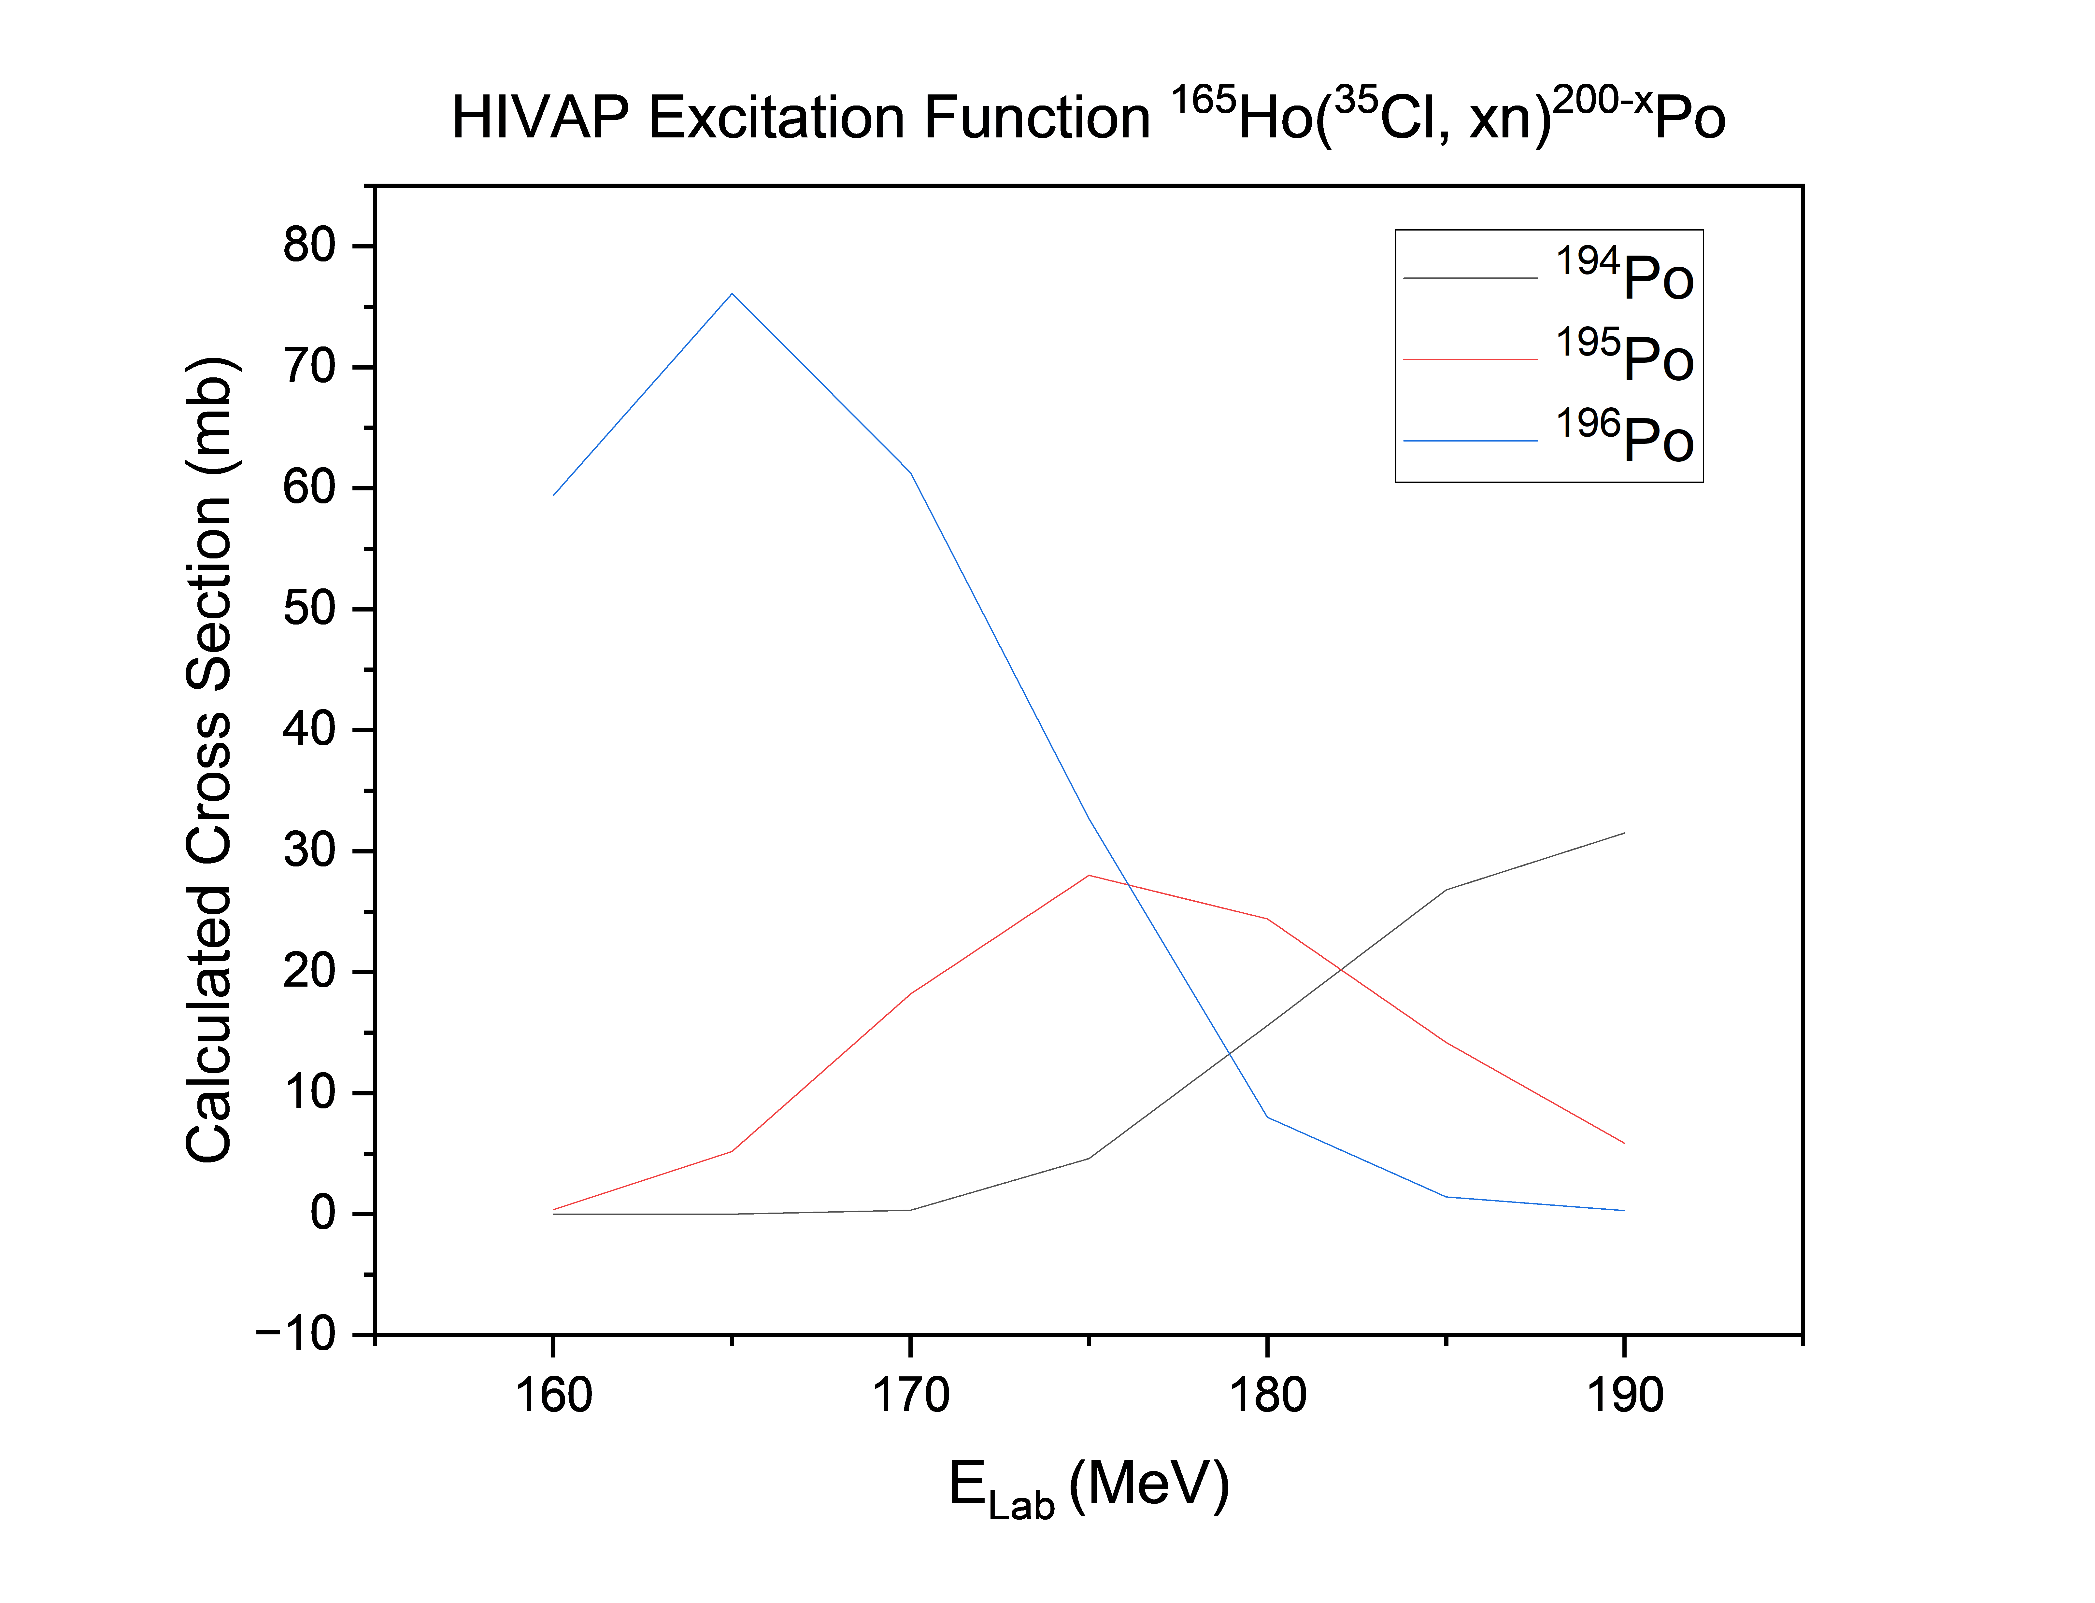
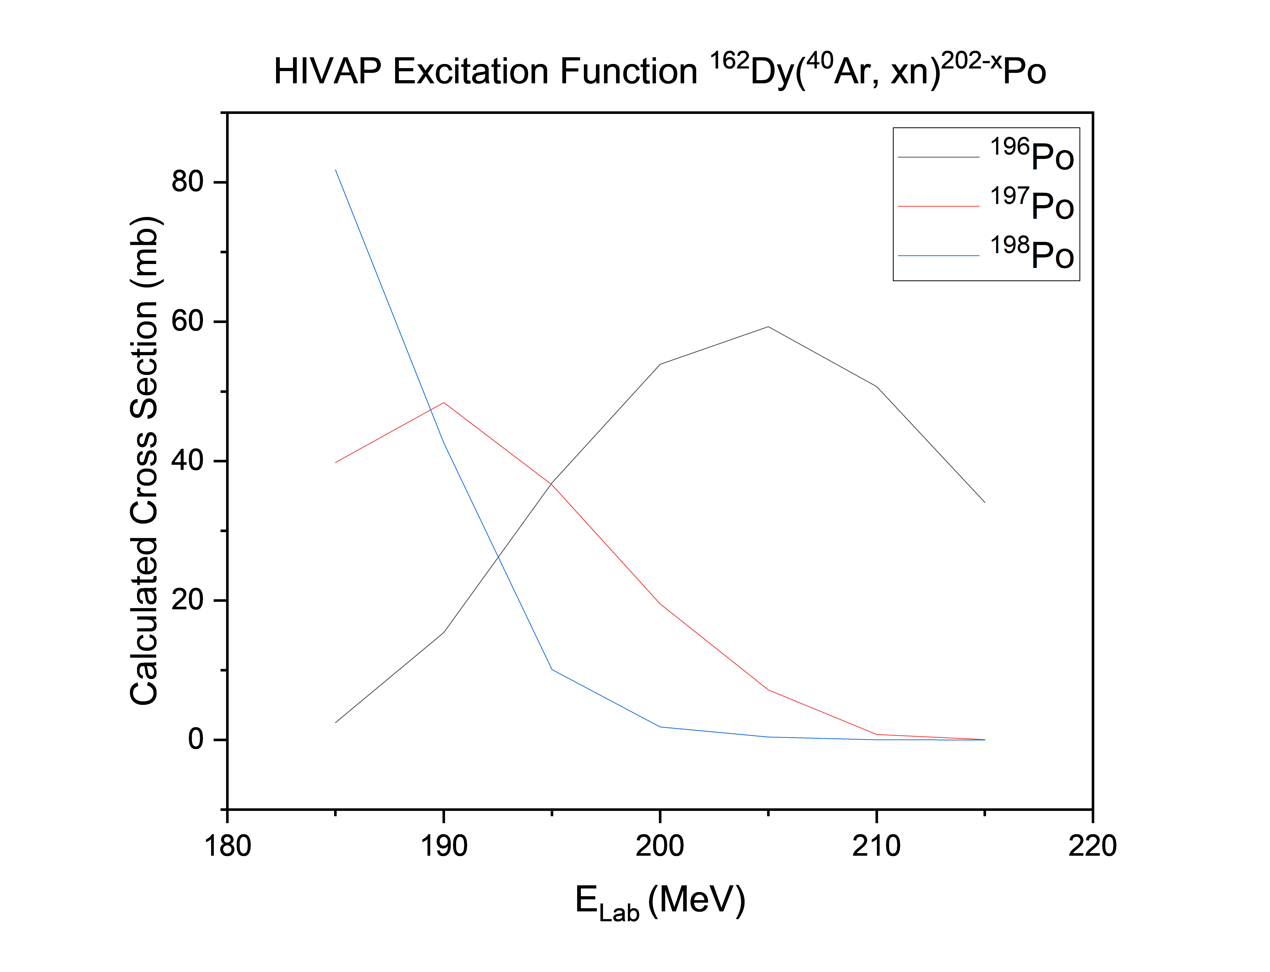
HIVAP Excitation Functions
¹⁶⁵Ho(³⁵Cl, 4n)¹⁹⁶Po
¹⁶²Dy(⁴⁰Ar, 6n)¹⁹⁶Po
Two reactions that have not been published in the literature

Slide 28
Thiol Functional Group
Choice of monolayer: 1,9-nonanedithiol
Acid-base interactions
~ 1 nm in thickness
Challenging assembly process
H. Hamoudi, Z. Guo, M. Prato, C. Dablemont, W. Q. Zheng, B. Bourguignon, M. Canepa, and V. A. Esaulov, On the self assembly of short chain alkanedithiols, Phys. Chem. Chem. Phys. 10, p. 6836-6841 (2008). doi:10.1039/B809760G

Slide 29
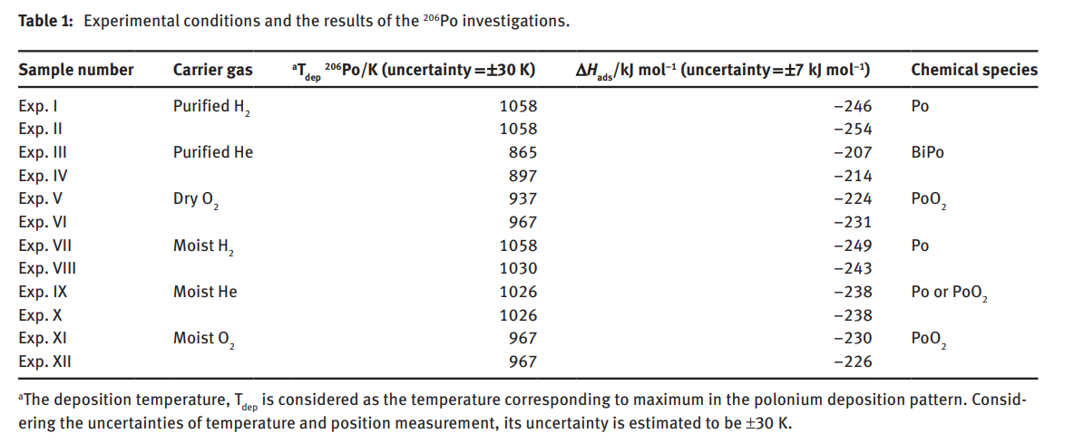
Polonium Adsorption on Metallic Surfaces Under Different Gas Atmospheres
E. A. Maugeri, J. Neuhausen, R. Eichler, R. Dressler, K. Rijpstra, S. Cottenier, D. Piguet, A. Vogele, and D. Schumann, Adsorption of volatile polonium and bismuth species on metals in various gas atmospheres: Part I - Adsorption of volatile polonium and bismuth on gold, Radiochim. Acta 104, p. 757-767 (2016). doi:10.1515/ract-2016-2573

Slide 30
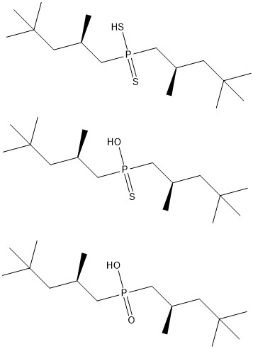
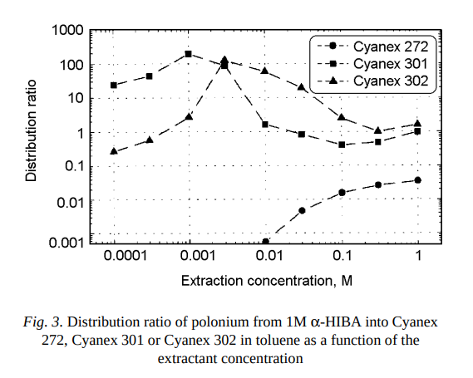
Polonium Adsorption Literature- Cyanex
Cyanex-301
Cyanex-302
Cyanex-272
M. Johansson, R. Malmbeck, B. Wierczinski, and G. Skarnemark, Extraction of polonium from aqueous alpha-hydroxyisobutyric acid solutions using dioctyl sulphide, Cyanex 272, Cyanex 301 or Cyanex 302 in toluene, J. Radioanal. Nucl. Chem. 250, p. 437-443 (2001). doi:10.1023/A:1017932602308

Slide 31
²²⁸Th Decay and Big RTC

Slide 32
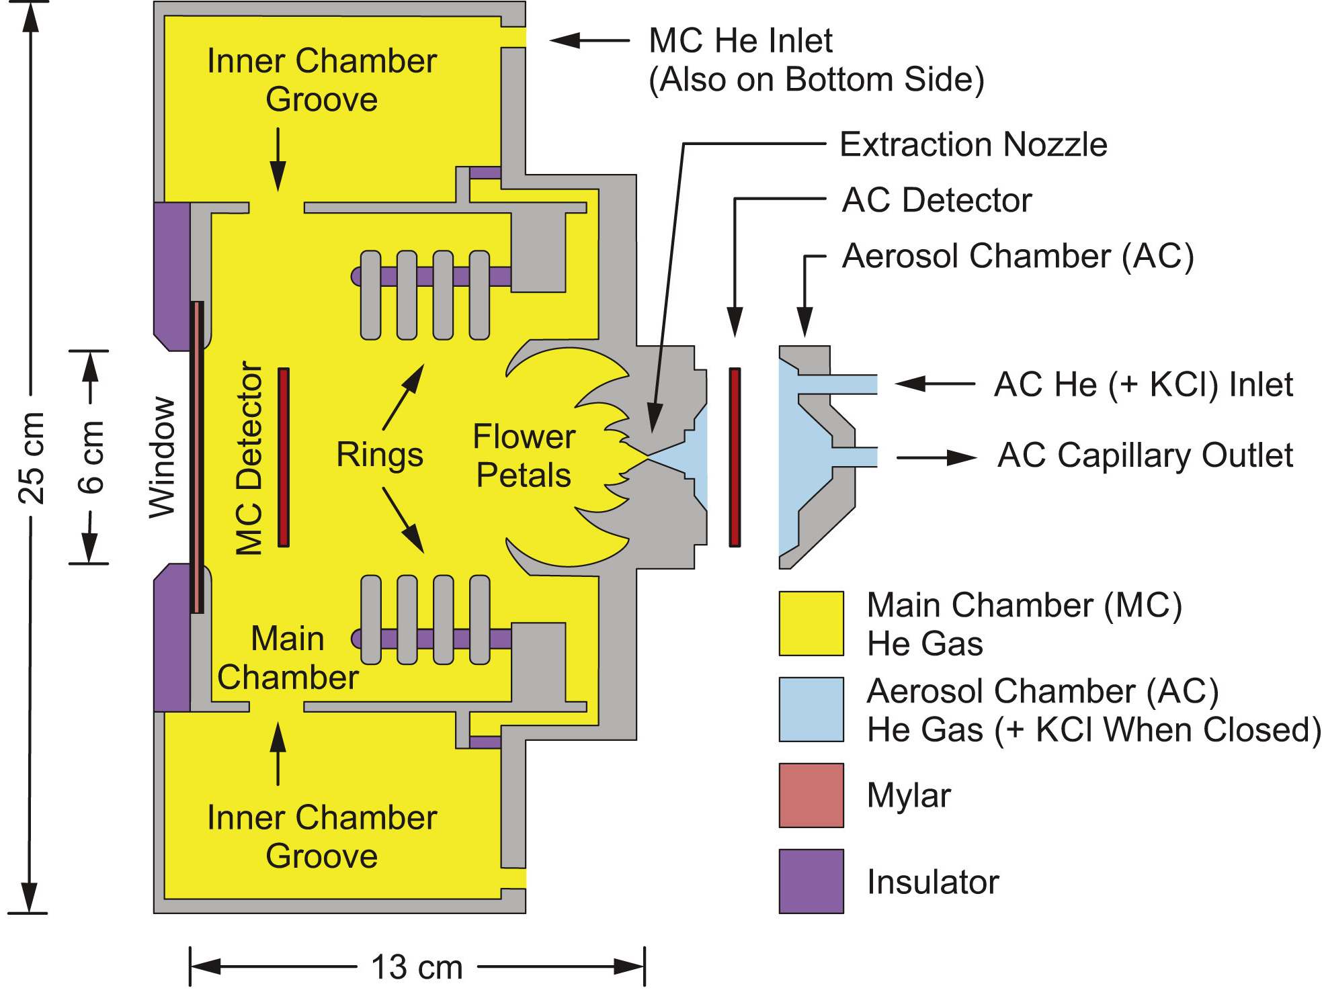
“Big” Recoil Transfer Chamber (RTC) Schematic
M. C. Alfonso, E. E. Tereshatov, M. J. DeVanzo, J. A. Sefcik, M. E. Bennett, D. A. Mayorov, T. A. Werke, and C. M. Folden III, New recoil transfer chamber for thermalization of heavy ions produced in fusion-evaporation reactions, Nucl Instrum Meth A 798, p. 52-61 (2015). doi:10.1016/j.nima.2015.07.004

Slide 33
²²⁸Th Decay Scheme
²²⁸Th
t_{1/2}: 1.9 Y
α
²²⁴Ra
t_{1/2}: 3.6 d
α
²²⁰Rn
t_{1/2}: 55 s
α
Neutron Number
²¹²Po
t_{1/2}: 294 ns
²¹⁶Po
t_{1/2}: 0.14 s
β⁻
²¹²Bi
t_{1/2}: 60.6 min
α
α
²⁰⁸Pb
Stable
β⁻
²¹²Pb
t_{1/2}: 10.6 h
²⁰⁸Tl
t_{1/2}: 3.1 min
α
β⁻
Proton Number
Data from NuDat 3.0

Slide 34
Alpha Energies in ²²⁸Th Spectrum
Isotope | Alpha Energy (keV) | Intensity (%)
²²⁸Th | 5423.15 | 73.4
 | 5340.36 | 26.0
²²⁴Ra | 5685.37 | 94.92
 | 5448.6 | 5.06
²²⁰Rn | 6288.08 | 99.886
²¹⁶Po | 6778.3 | 99.9981
²¹²Bi | 6050.78 | 25.13
 | 6089.88 | 9.75
²¹²Po | 8784.86 | 100
All alpha energies with a intensity <1% were omitted
Data from NuDat 3.0

Slide 35
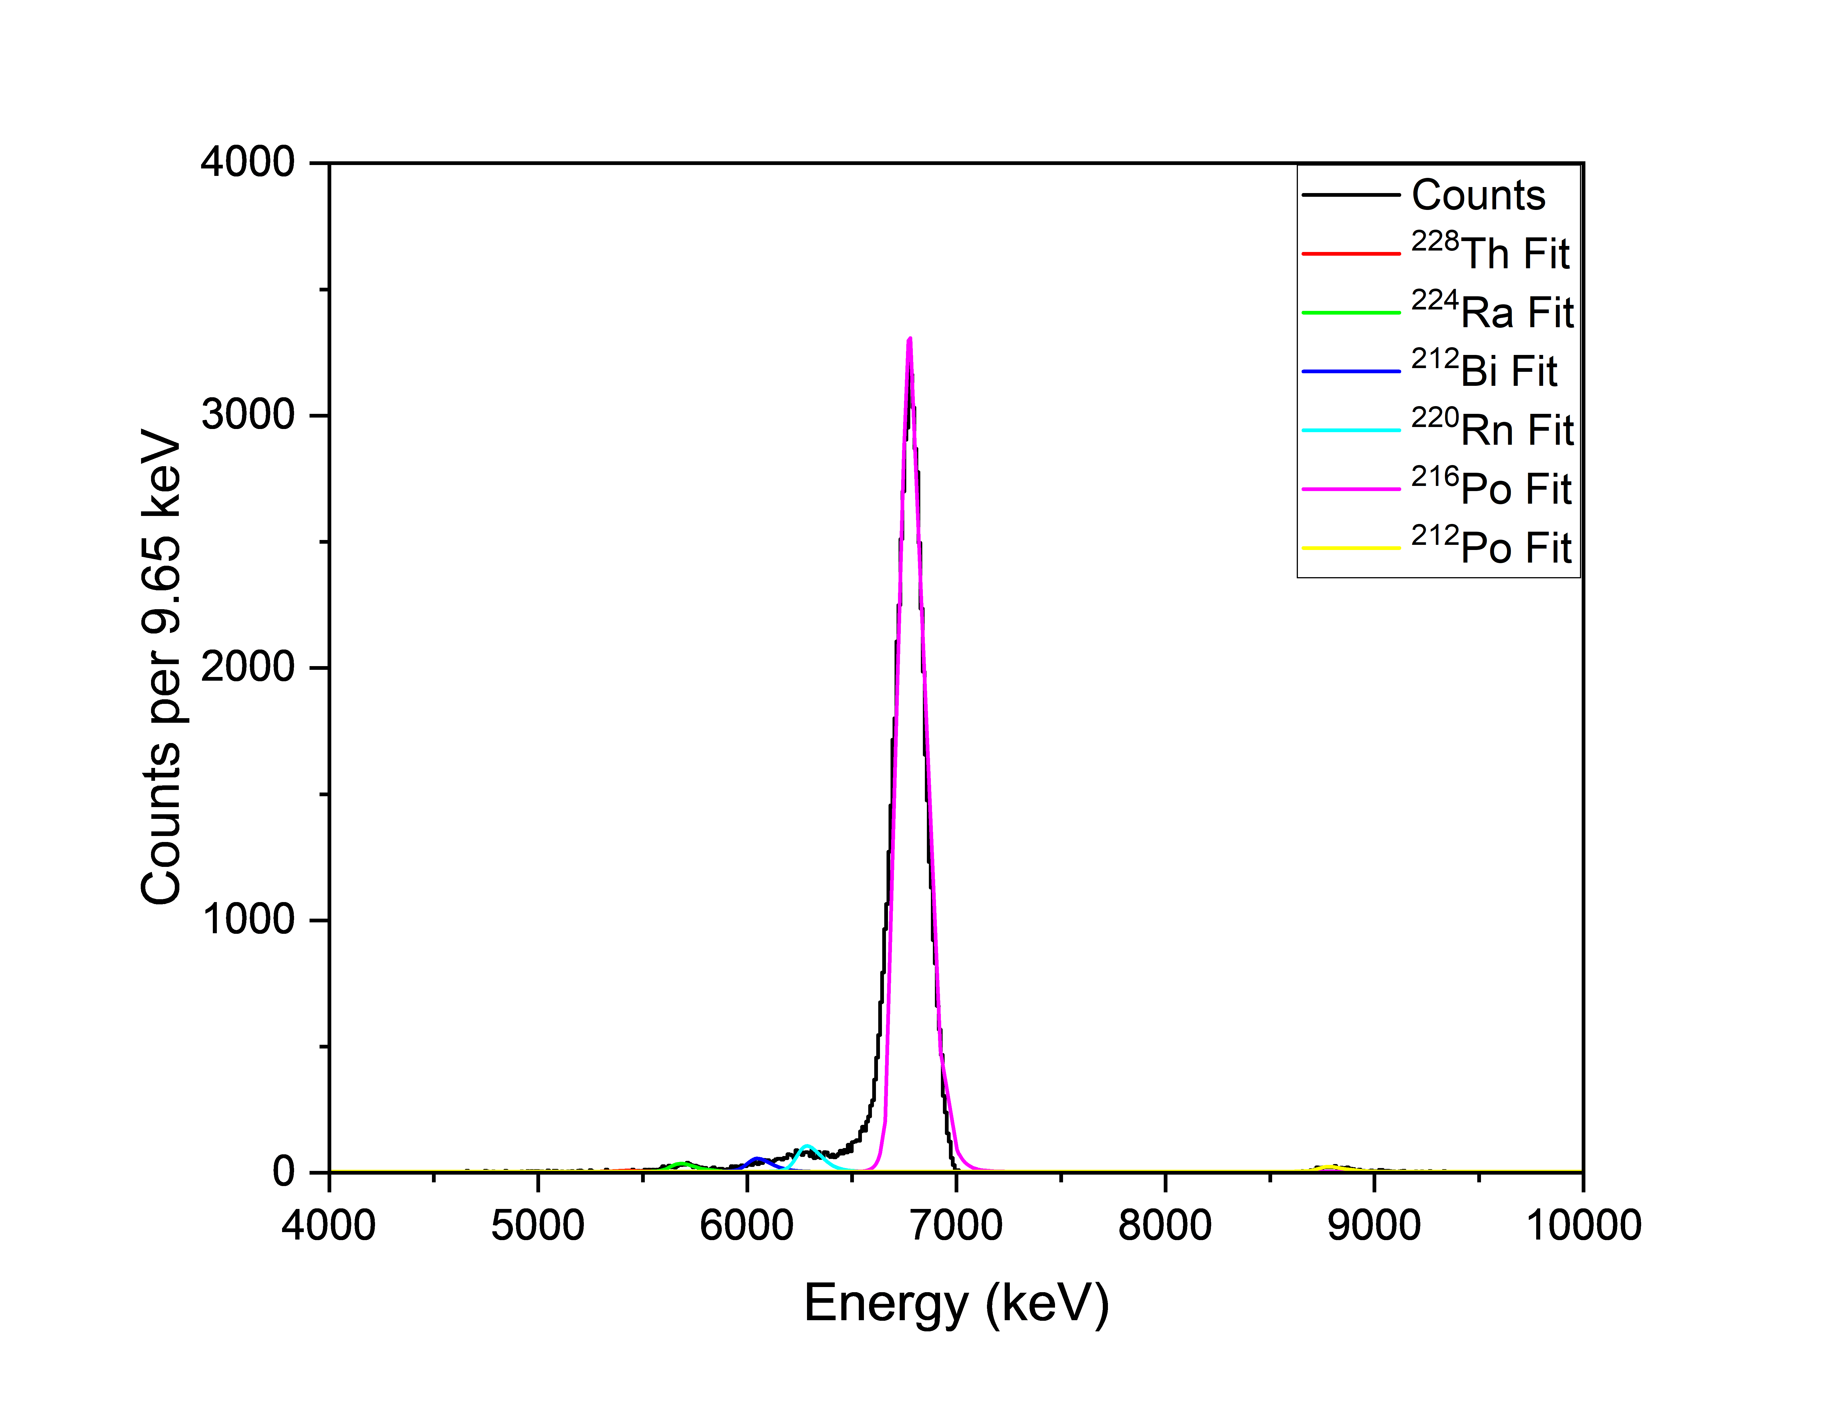
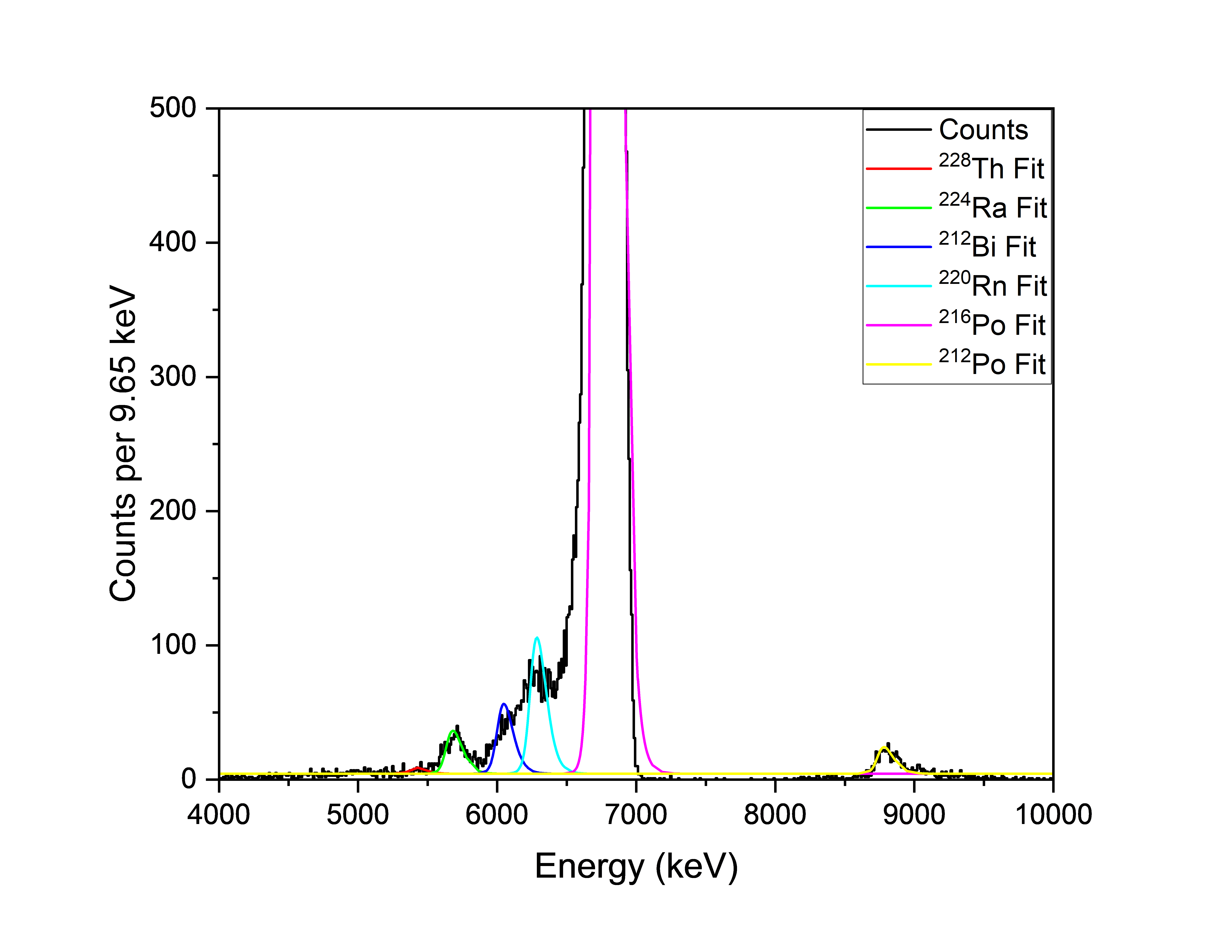
AC Detector ²²⁸Th Spectrum
²¹⁶Po
²¹⁶Po
²²⁰Rn
²¹²Bi
²²⁴Ra
²¹²Po
²²⁸Th
Preliminary Data

Slide 36
Comparison of Full RTC Settings and No RTC Settings
Electrode Status | Gas Pressure Status | ²²⁸Th Count Rate (s⁻¹) | ²²⁴Ra Count Rate (s⁻¹) | ²²⁰Rn Count Rate (s⁻¹) | ²¹⁶Po Count Rate (s⁻¹) | ²¹²Bi Count Rate (s⁻¹) | ²¹²Po Count Rate (s⁻¹)
On | On | 0.11 ± 0.01 | 0.86 ± 0.04 | 2.65 ± 0.07 | 91.80 ± 0.39 | 1.31 ± 0.05 | 0.54 ± 0.03
Off | Off | 0.27 ± 0.003 | 1.74 ± 0.01 | 1.23 ± 0.01 | 1.32 ± 0.01 | 3.60 ± 0.01 | 4.46 ± 0.01
Preliminary Data

Slide 37
Self-Assembled Monolayers

Slide 38
Self-Assembled Monolayer
4 Major Components
Surface Metal
Head Group
Alkyl Chain
Terminal Group
C. Vericat, M. E. Vela, G. Benitez, P. Carro, and R. C. Salvarezza, Self-assembled monolayers of thiols and dithiols on gold: new challenges for a well-known system, Chem. Soc. Rev. 39, p. 1805-1834 (2010). doi:10.1039/B907301A

Slide 39
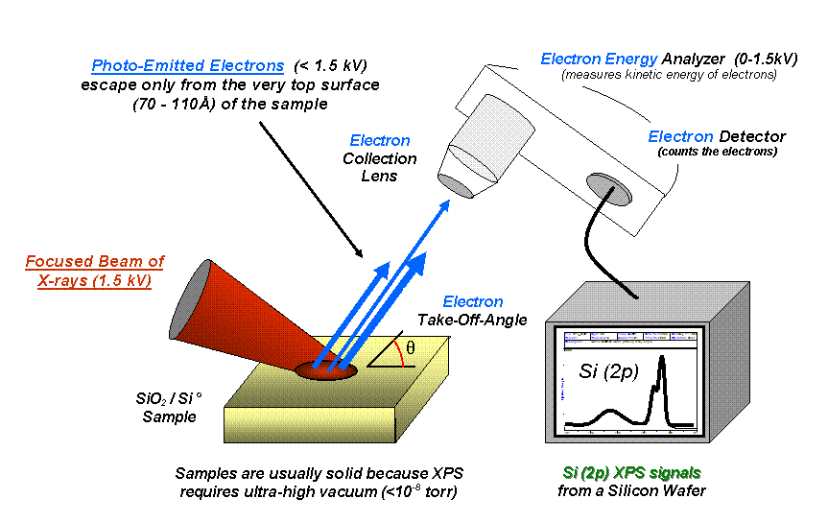
X-ray Photoelectron Spectroscopy

Slide 40
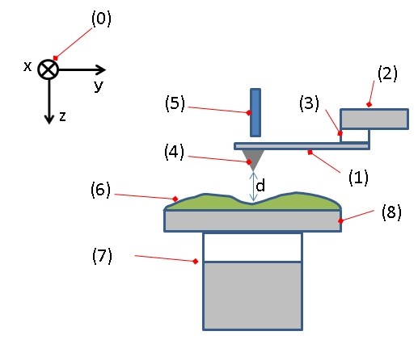
Atomic Force Microscopy
Typical configuration of an AFM.
(1): Cantilever, (2): Support for cantilever, (3): Piezoelectric element (to oscillate cantilever at its eigen frequency), (4): Tip (Fixed to open end of a cantilever, acts as the probe), (5): Detector of deflection and motion of the cantilever, (6): Sample to be measured by AFM, (7): xyz drive, (moves sample (6) and stage (8) in x, y, and z directions with respect to a tip apex (4)), and (8): Stage.
https://en.wikipedia.org/wiki/Atomic_force_microscopy

Slide 41
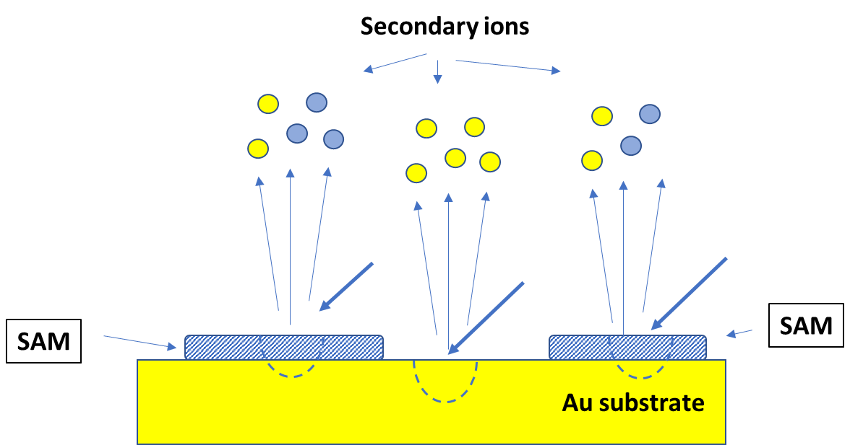
Nano-projectile Secondary Ion Mass Spectrometry

Slide 42
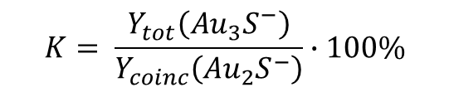
NP-SIMS
To measure the coverage of SAMs, the Surface Analysis and Mapping of Projectile Impacts (SAMPI) software can be used
A characteristic par of Au-S cluster ions are chosen (Au₂S⁻ and Au₃S⁻) are selected to perform calculations.
A total spectrum with all detected ions per impact can be measured
Au₃S⁻ is chosen to form a coincidence spectrum, to see all ions that are co-emitted with it.
The total yield of Au₂S⁻ and the yield of it in the coincidence spectrum can be calculated using SAMPI, and the surface coverage can be calculated from these yields
$$K= \frac{Y_{tot}\left({Au}_{3}S^{−}\right)}{Y_{coinc}\left({Au}_{2}S^{−}\right)}∙100\%$$

Slide 43
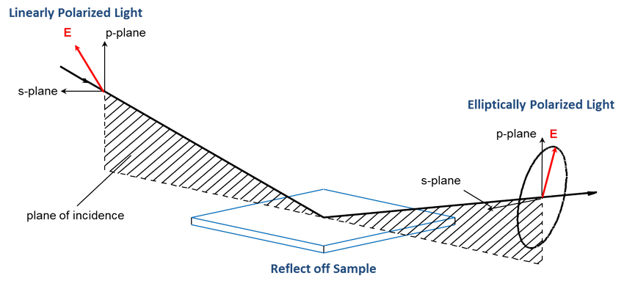
Spectroscopic Ellipsometry
“Ellipsometry measures a change in polarization as light reflects or transmits from a material structure. The polarization change is represented as an amplitude ratio, Ψ, and the phase difference, Δ. The measured response depends on optical properties and thickness of individual materials.”
https://www.jawoollam.com/resources/ellipsometry-tutorial/what-is-ellipsometry

