Slide 1

Development of
The Detector Array for
Photons, Protons, and Exotic Residues
Alan B. McIntosh
Texas A&M University
NN2024

Slide 2
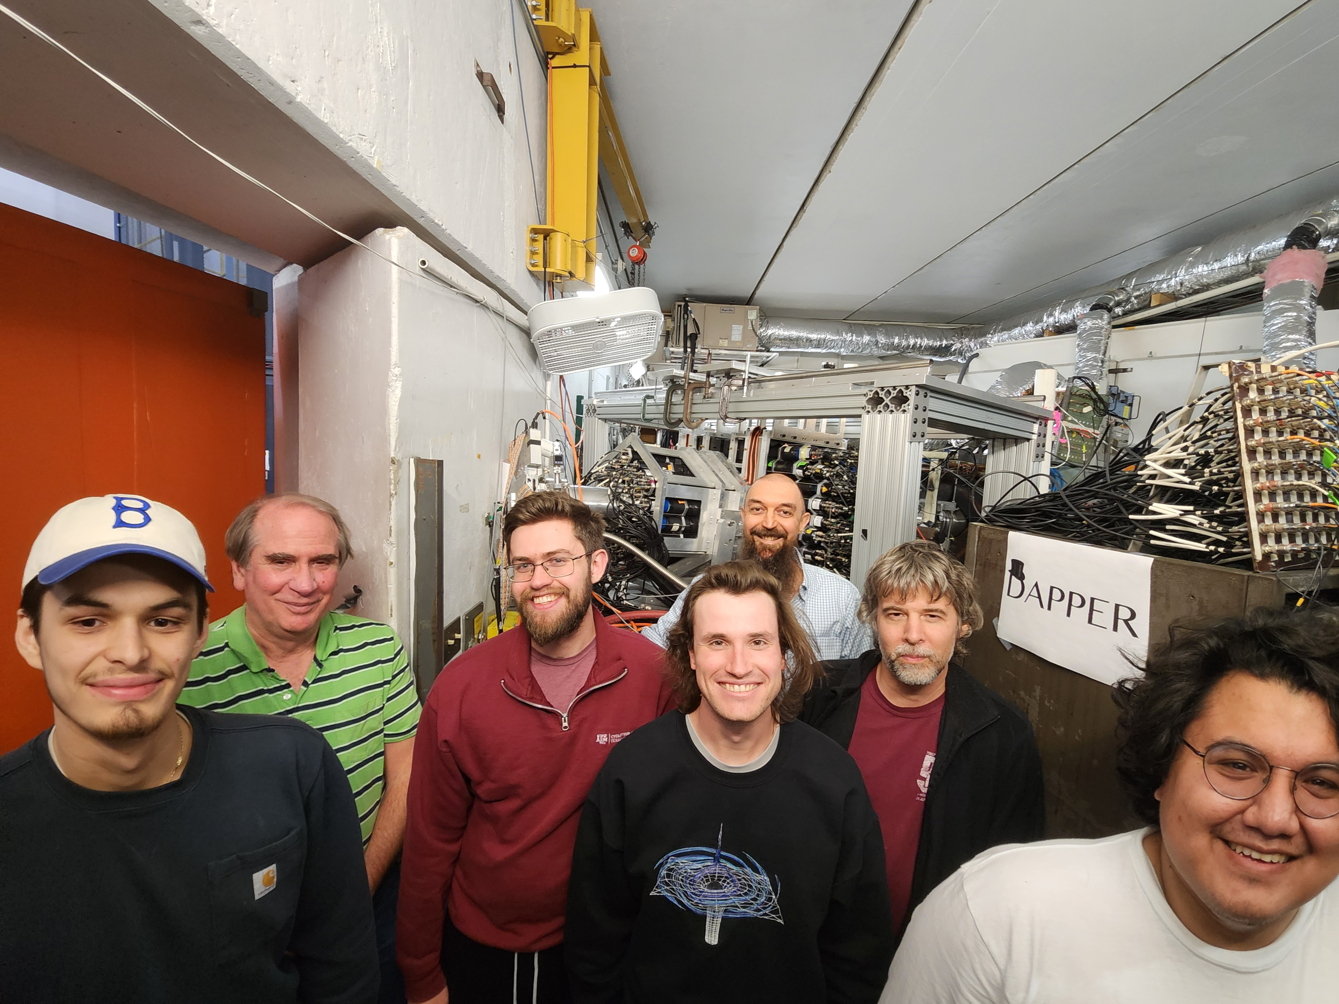
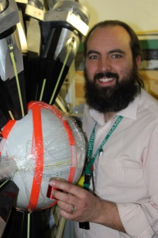












Acknowledgements
Austin Abbott (Ph.D. 2024)
Arthur Alvarez
Aaron Couture (LANL)
Jerome Gauthier
Kris Hagel
Alan McIntosh
Shuya Ota (now BNL)
Steve Pain (et al ORNL)
Ratkiewicz (et al LLNL)
Anna Simon (Notre Dame)
Grigory Potel (LLNL)
Sebastian Regener
Andrea Richard (LLNL/Ohio)
Maxwell Sorensen (Ph.D. Thesis in prep)
Sherry J. Yennello
NNSA: CENTAUR: DE-NA0003841, DE-NA0004150
DOE-NP: DE-FG02-93ER40773

Slide 3
A
A+1*
n
A
n
Impact:
Fundamental science
Nuclear astrophysics
Nucleosynthesis
Stockpile science
Nuclear forensics
Reactor design
Photon Strength Function
A description of the bulk quantum mechanical component of photon emission.
Stronger PSF
More “survivors”
A
A+1*
A+1
n

Slide 4
A
A+1*
n
A
n
Impact:
Fundamental science
Nuclear astrophysics
Nucleosynthesis
Stockpile science
Nuclear forensics
Reactor design
Photon Strength Function
A description of the bulk quantum mechanical component of photon emission.
Stronger PSF
More “survivors”
A
A+1*
A+1
n
p
p
p
Surrogate reaction: (d,p) as proxy for (n,g)
Produce many E* from single energy beam
Determine E* from proton energy and angle
Can be used for unstable nuclei

Slide 5
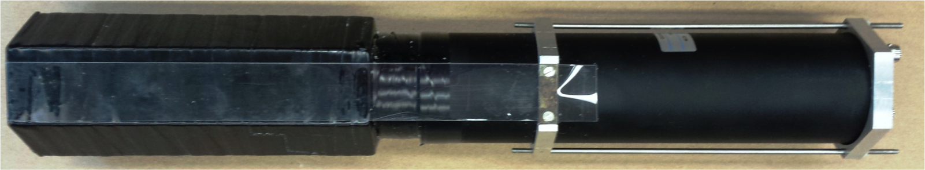
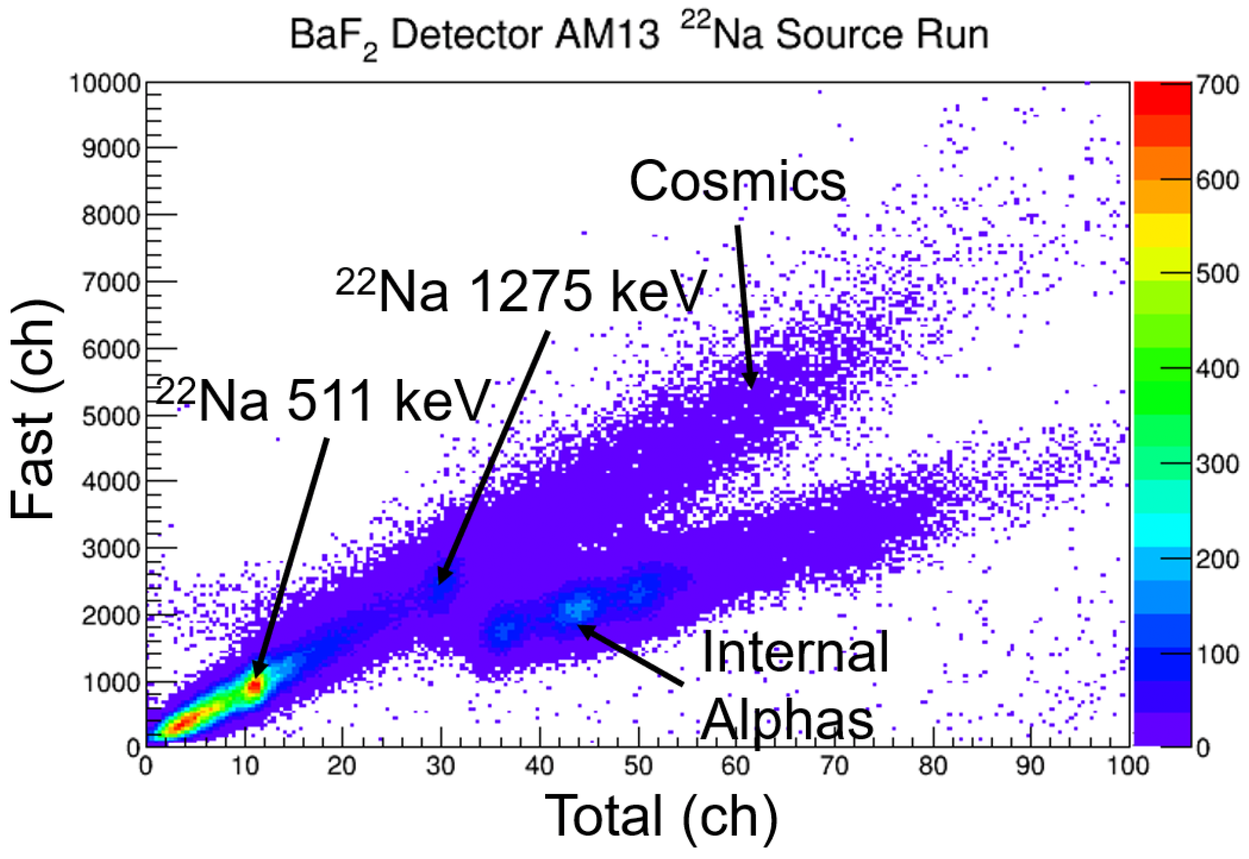
Barium Fluoride
128 modules
TAMU/ORNL BaF2
crystal 20 cm x 6.5 cm
silicone oil coupling, quartz window, PMT

Slide 6
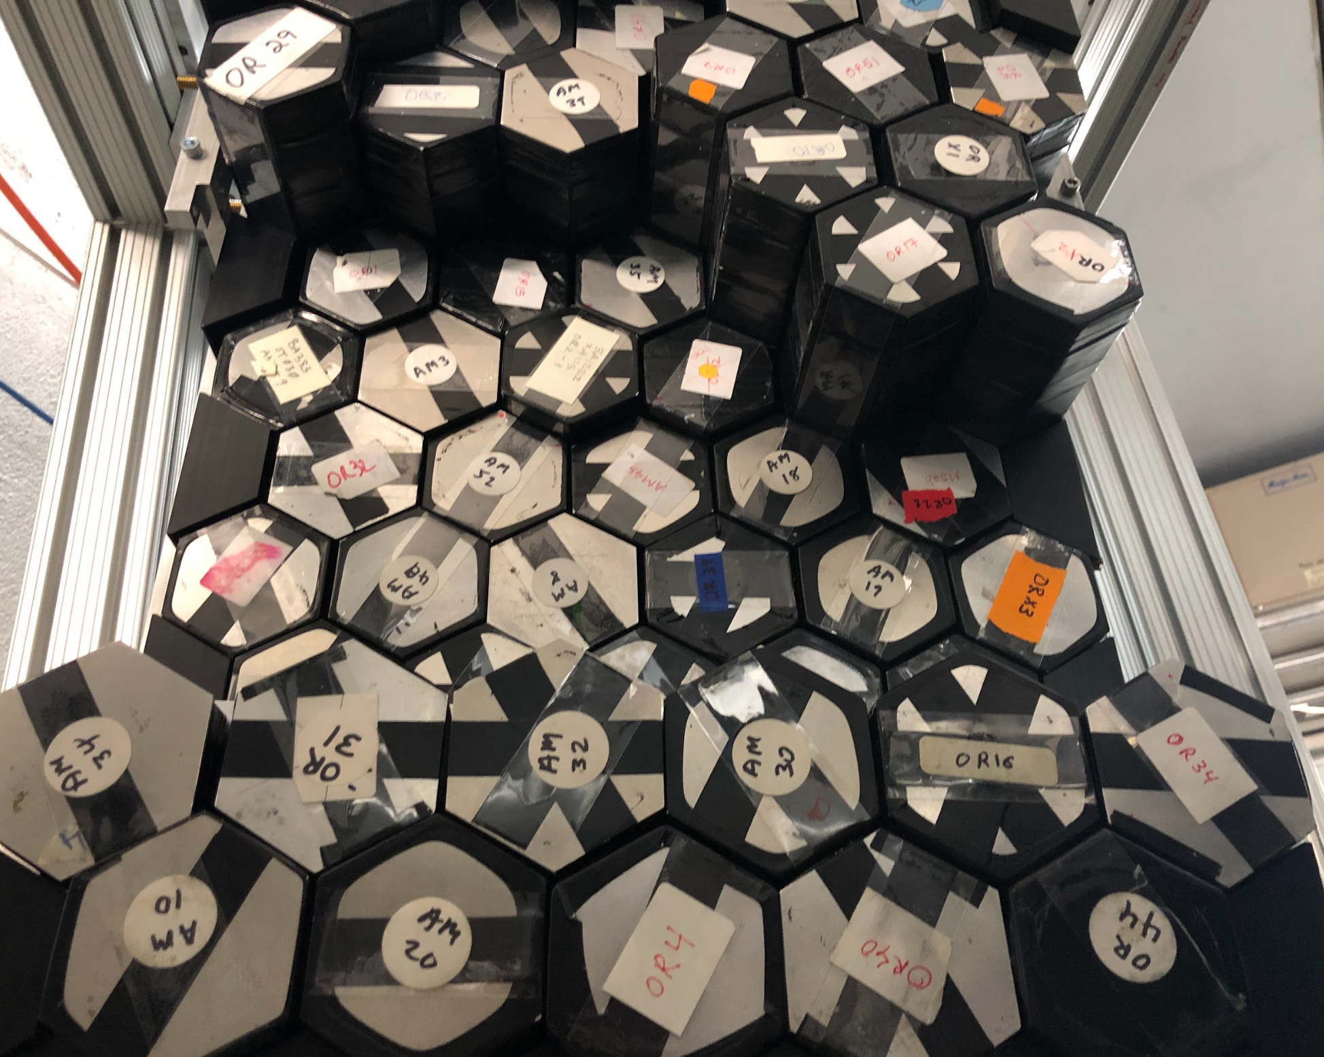
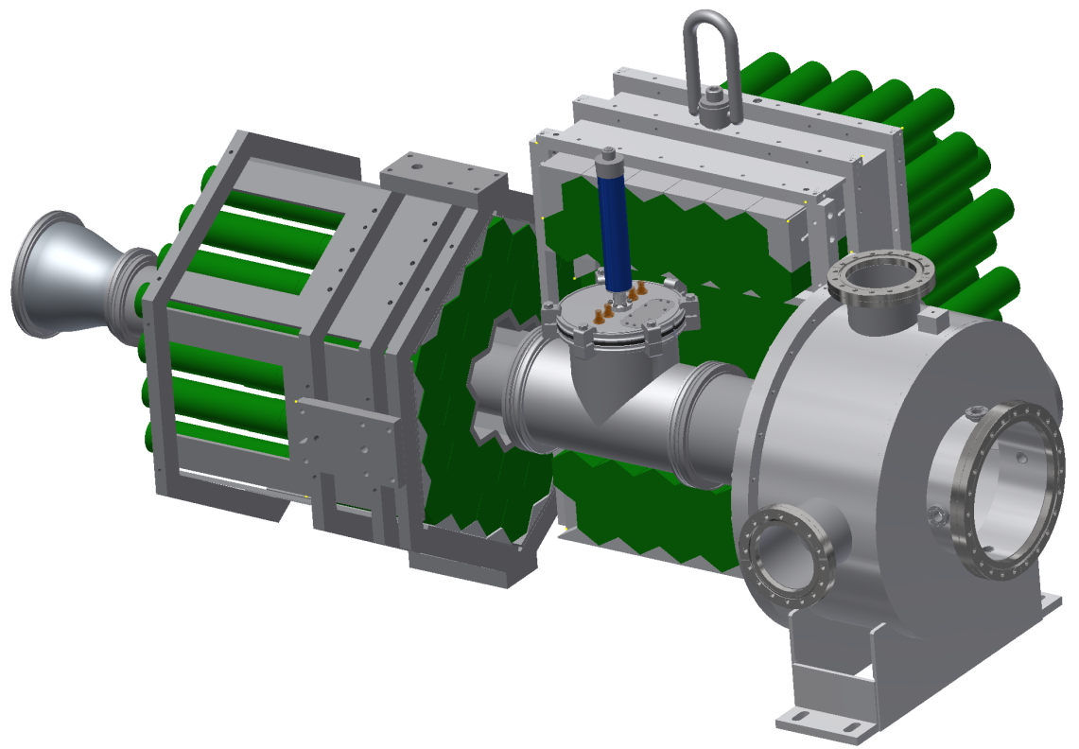
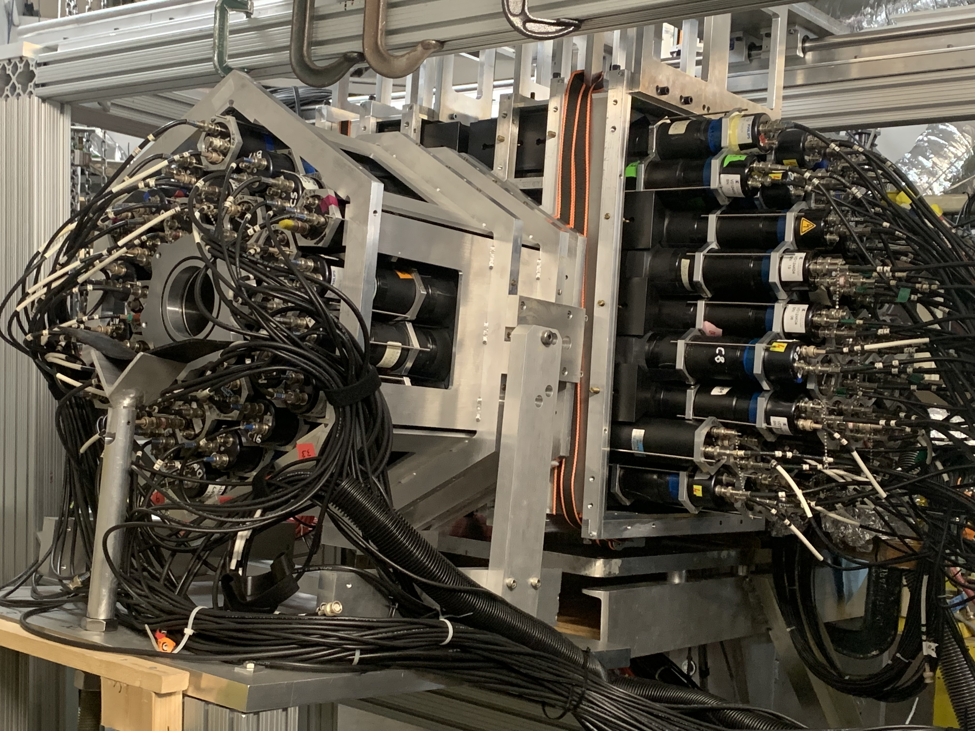
(d,p) as (n,g) proxy
highly segmented → Inverse kinematics → RIB
Highly segmented, high efficiency
  Excitation energy
  Gamma multiplicity
  Total gamma energy
  Individual gamma energies
  Accurate Doppler
one side-pack not shown for clarity
Photon strength function
Improve neutron capture model predictions

Slide 7
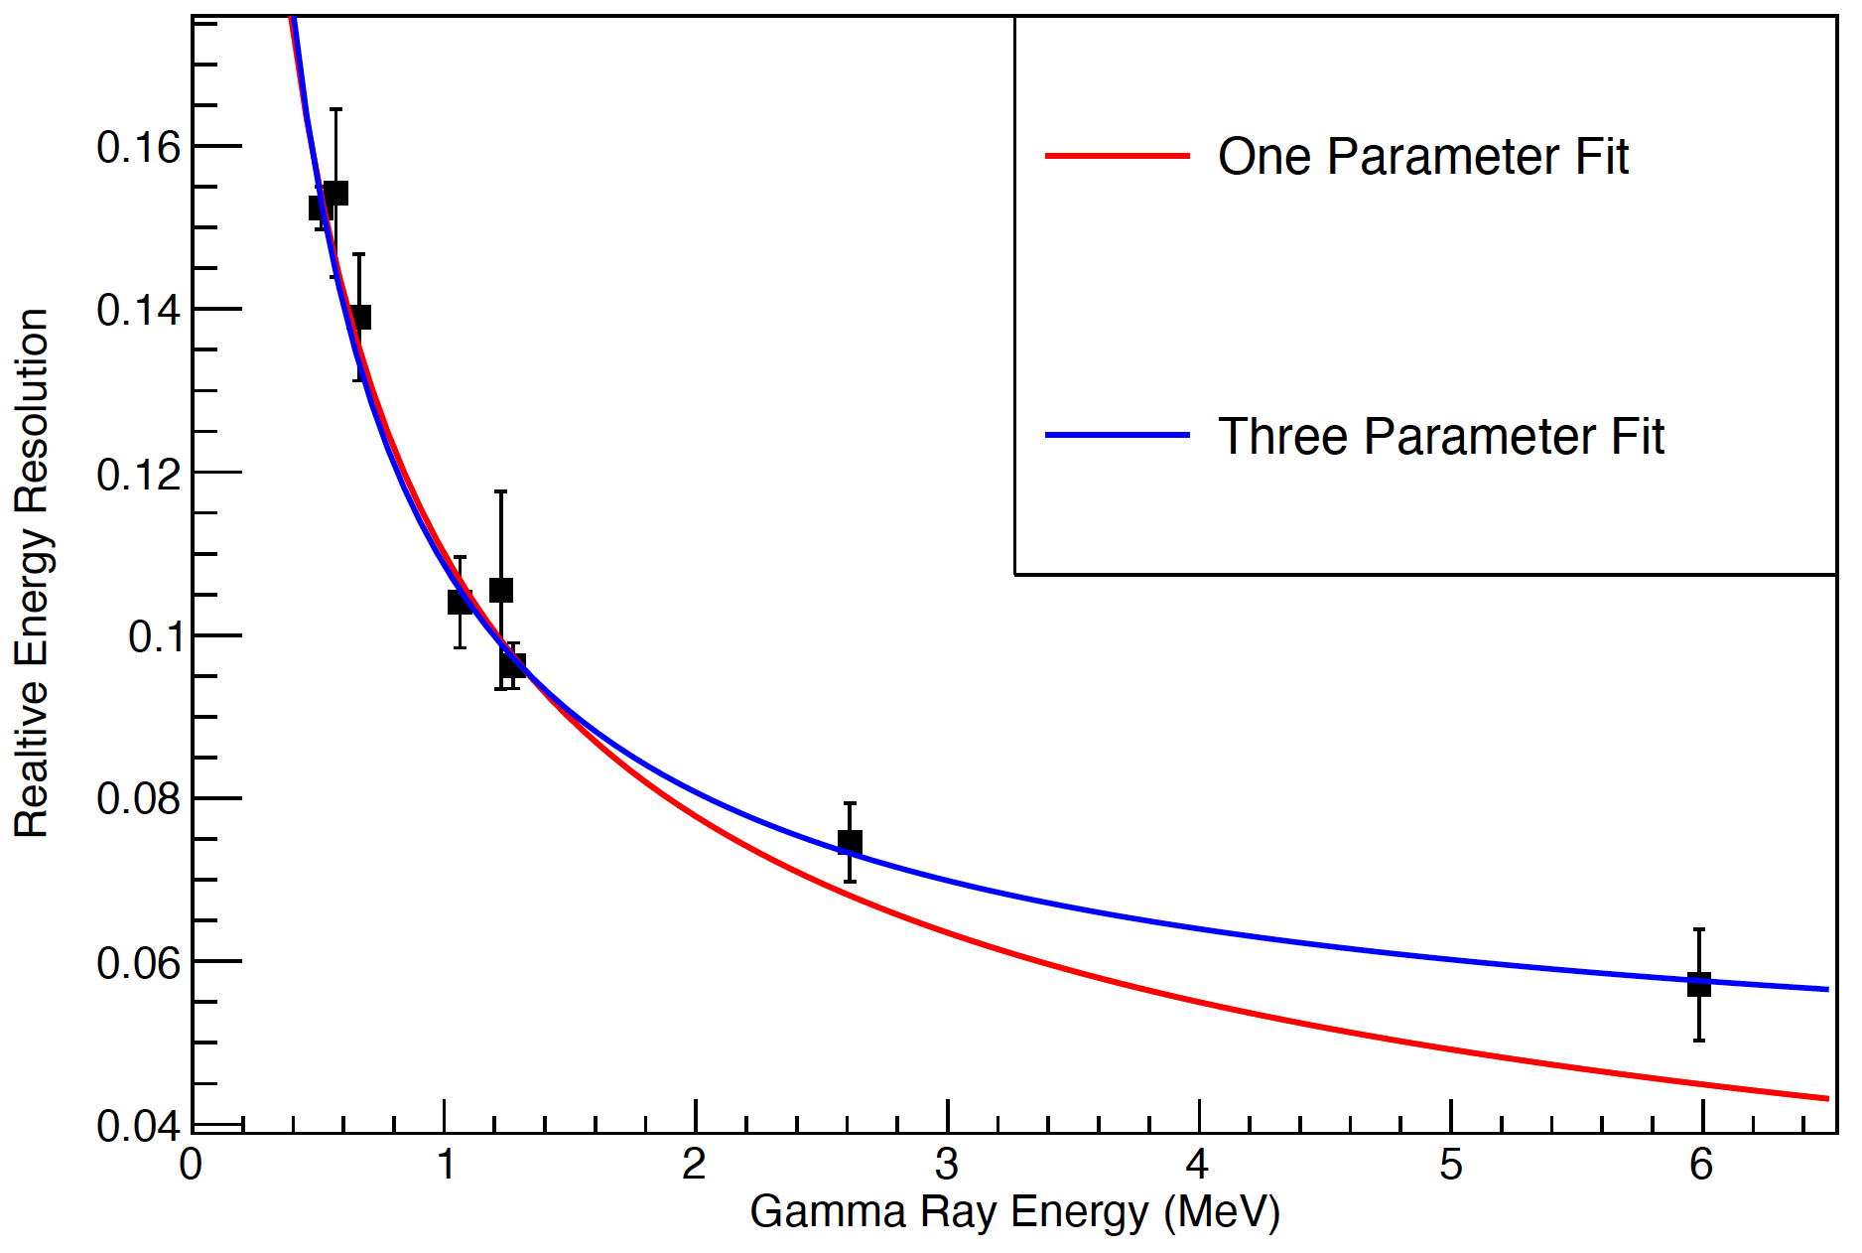
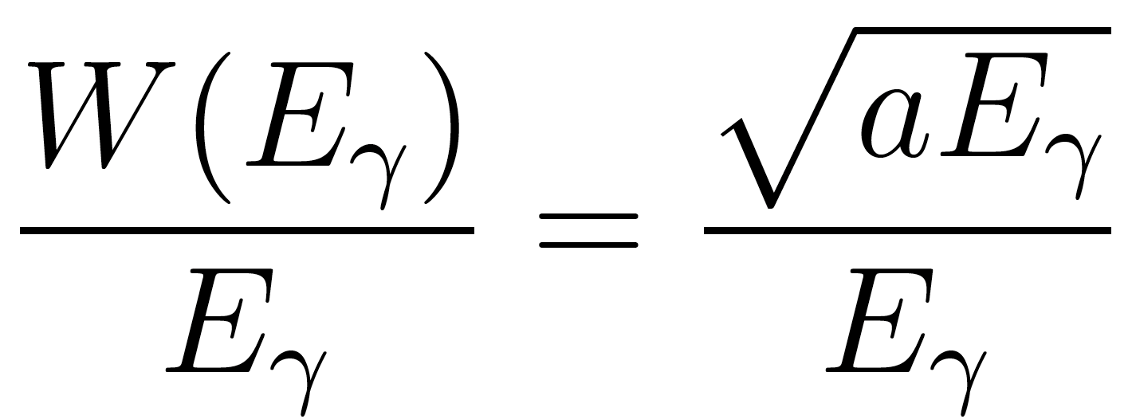
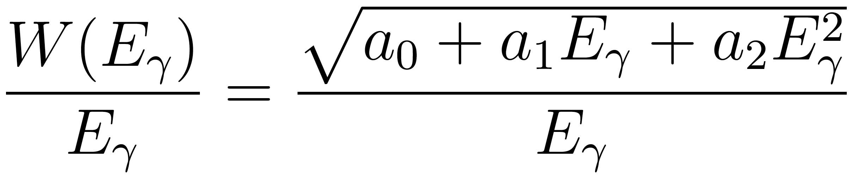
Energy Resolution of DAPPER
A typical good detector
232U
(208Tl)
13C(d,p)
Nearly all detectors
between 10-20% at 1 MeV.

Slide 8
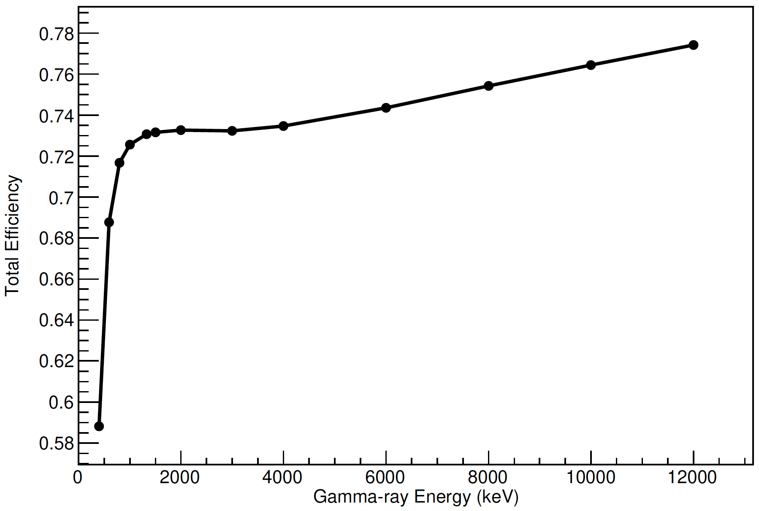
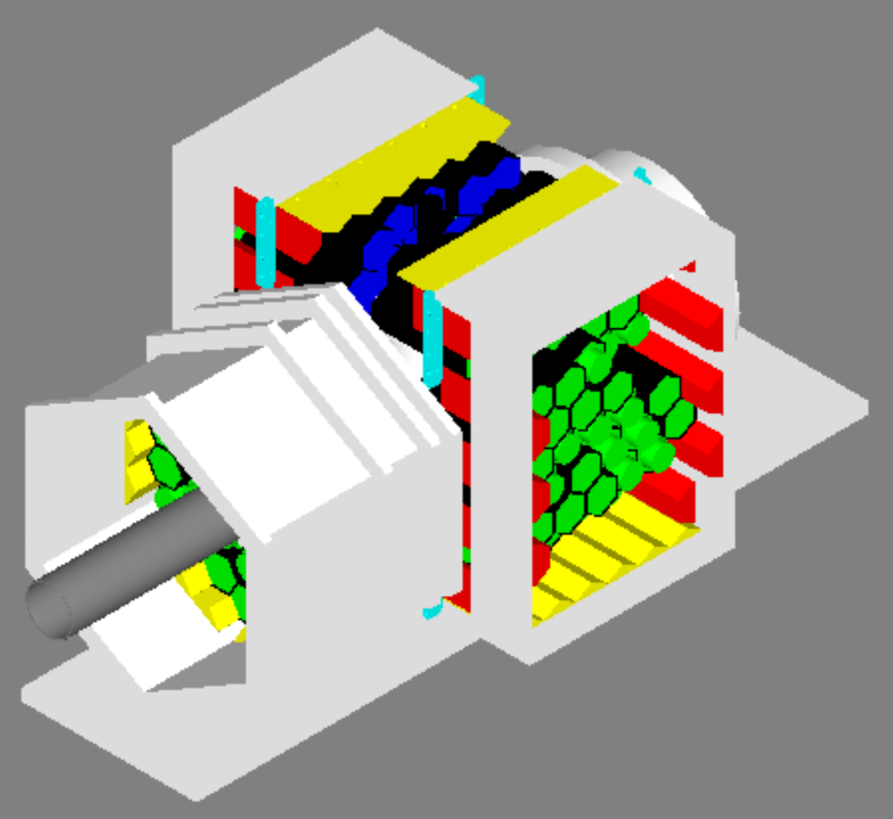
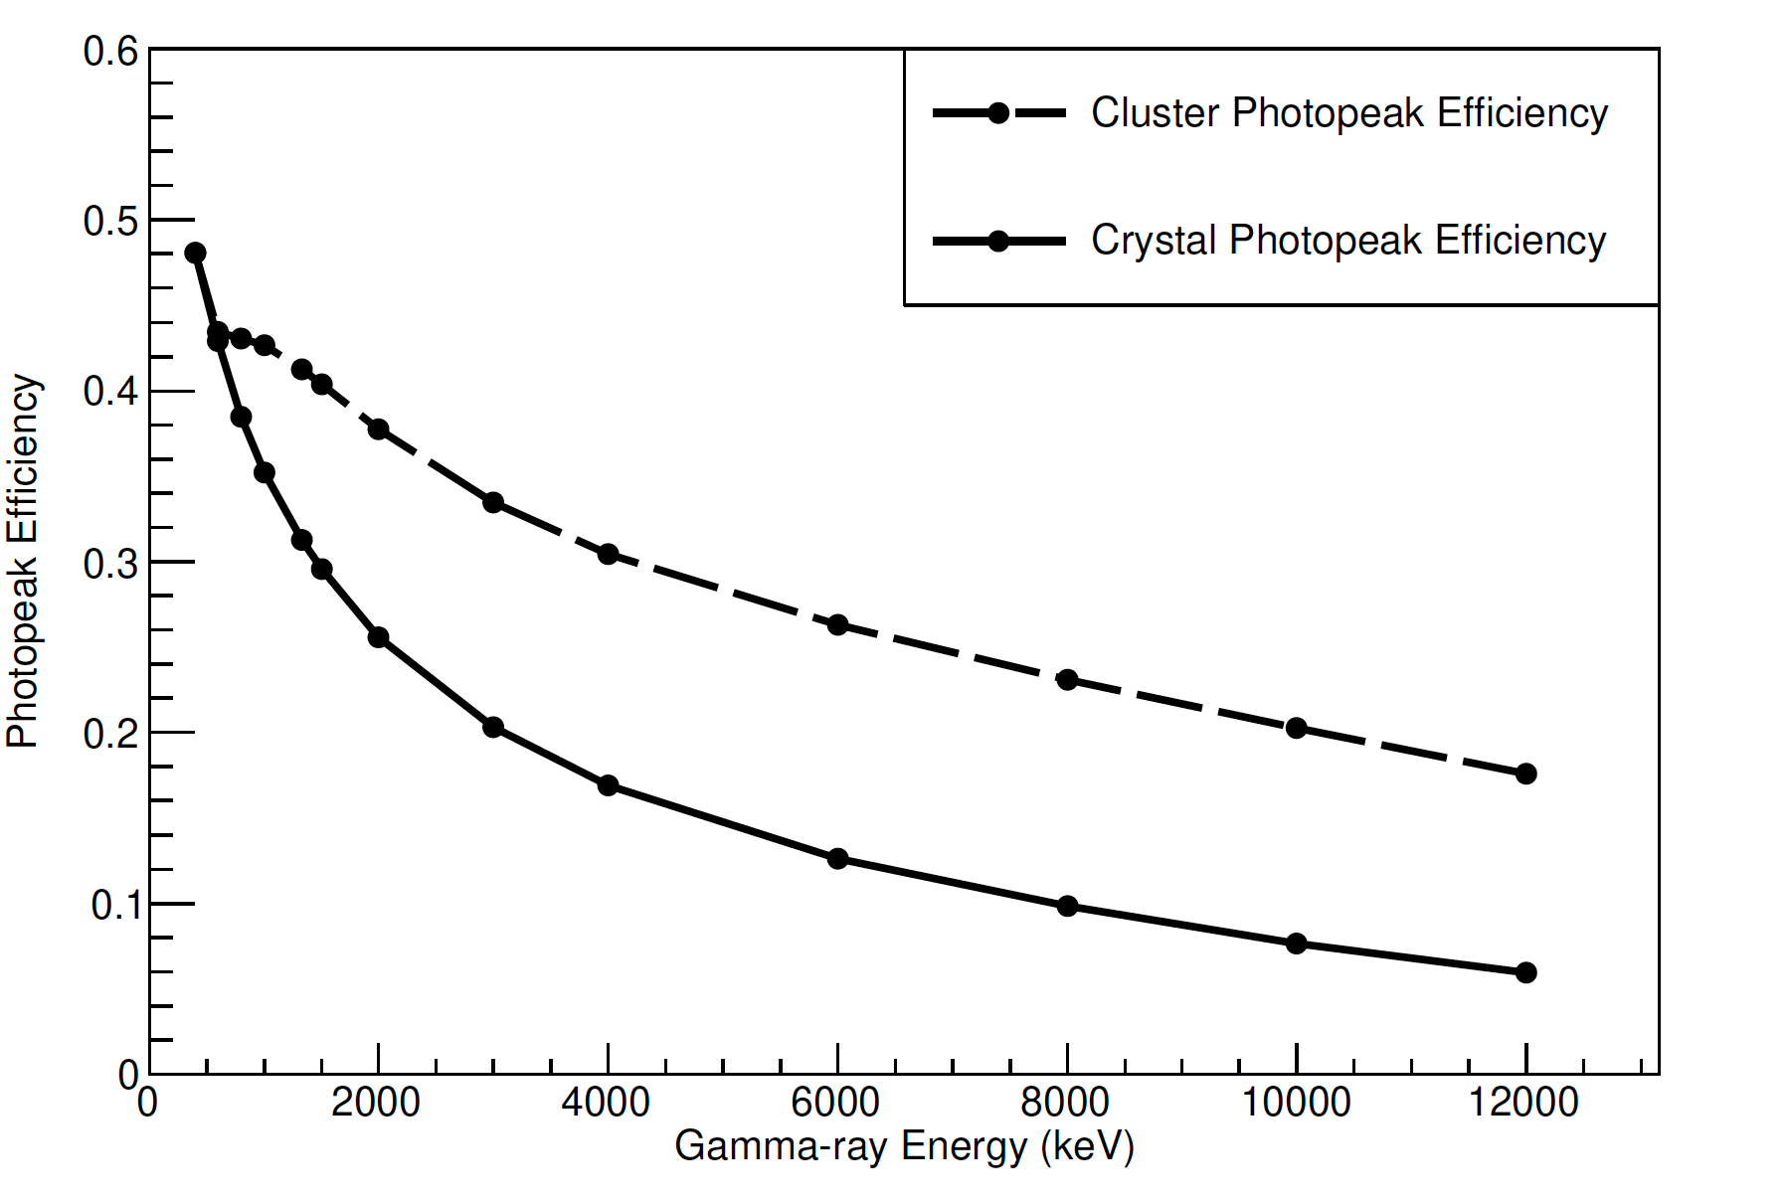
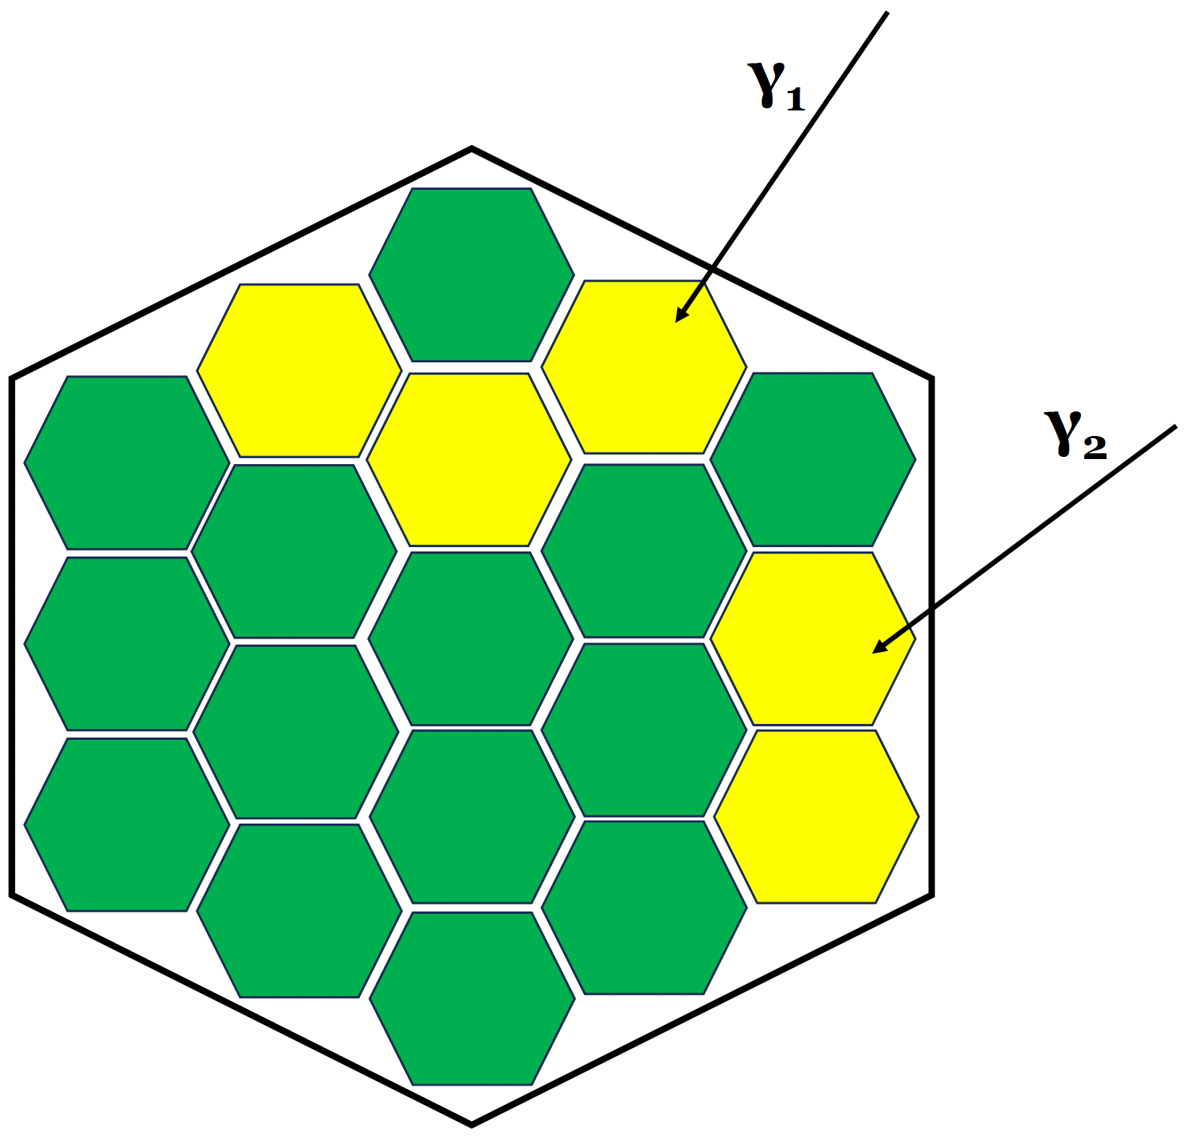
Efficiency of DAPPER
eff >70%
disc threshold

Slide 9
Commissioning and First Physics Measurement: 2021
57Fe(d,pg)

Slide 10
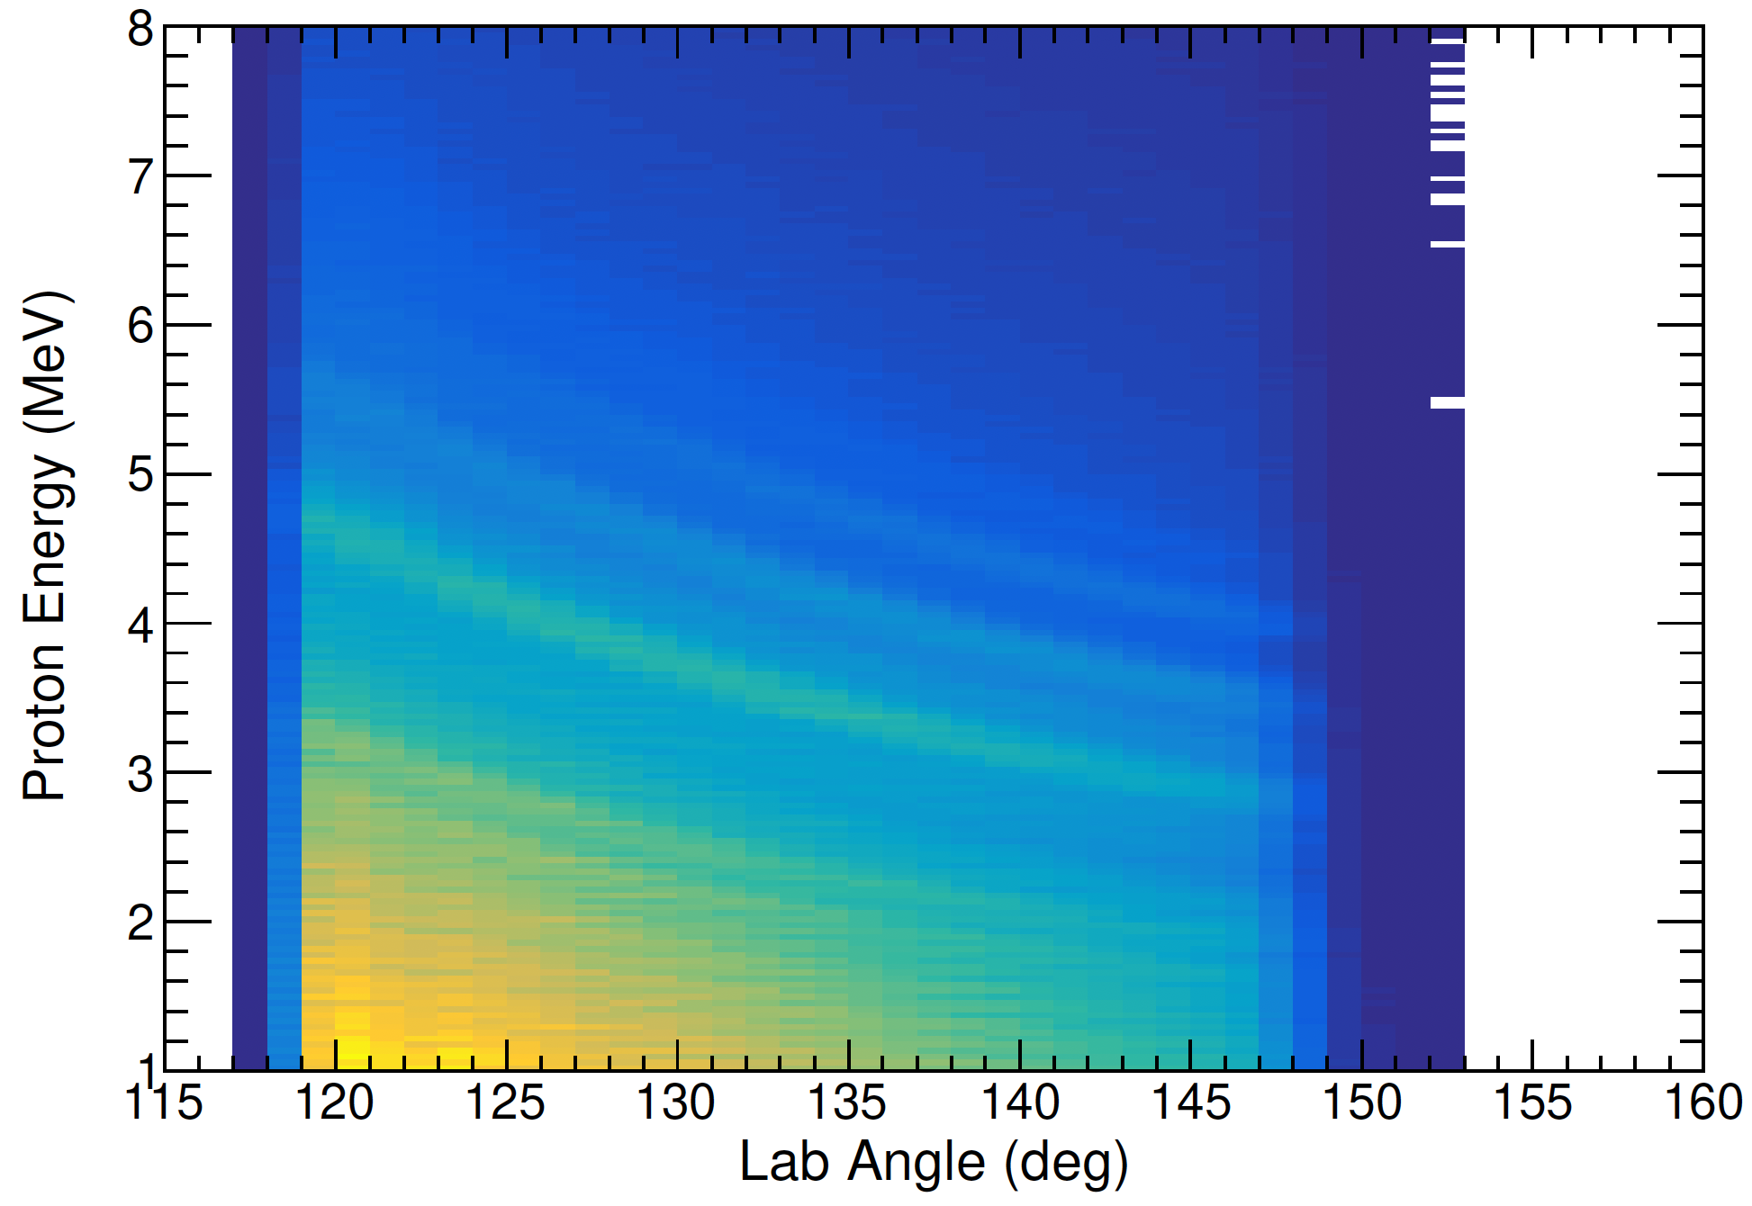
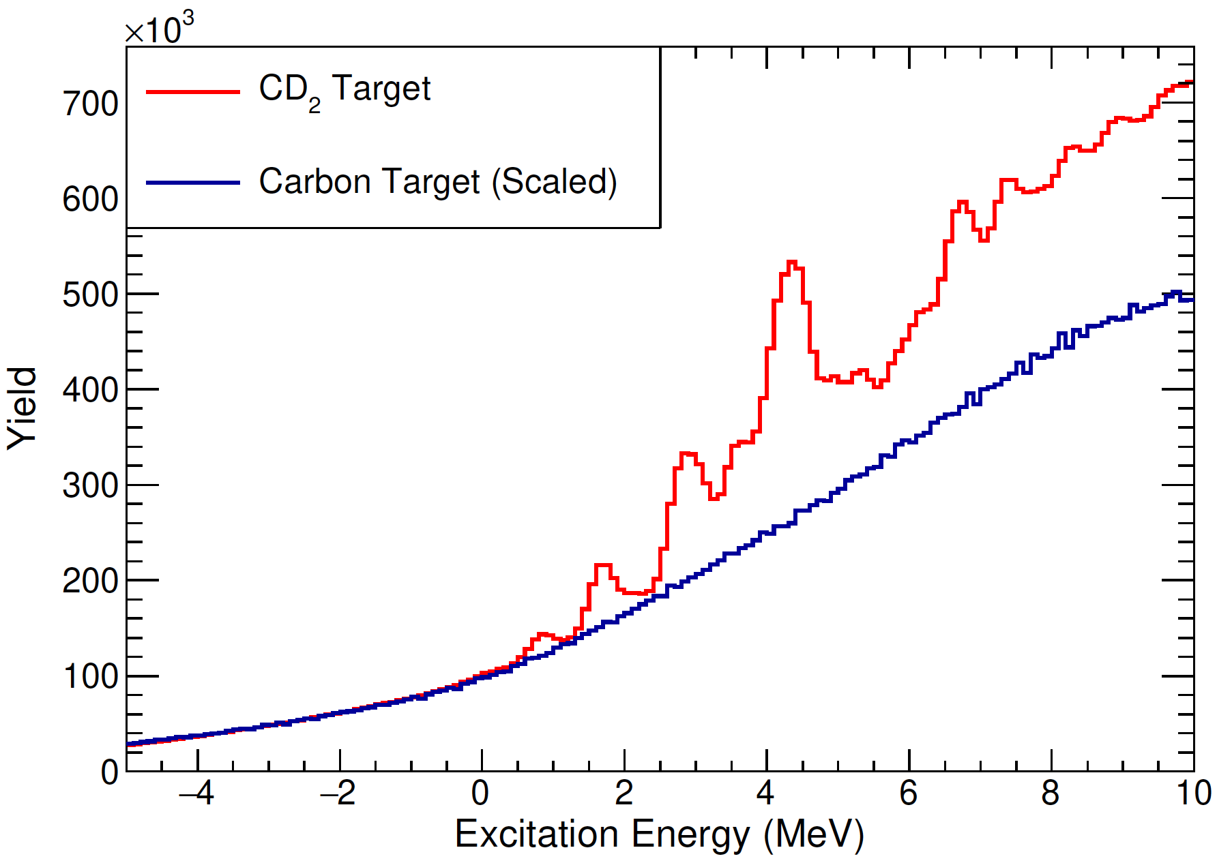
Excitation Energy
Silicon (S3) coverage 120-150 degrees
Kinematic selection of transfer, not fusion-evaporation
57Fe(d,pg)
~500 keV E* resolution
target thickness
beam diameter

Slide 11
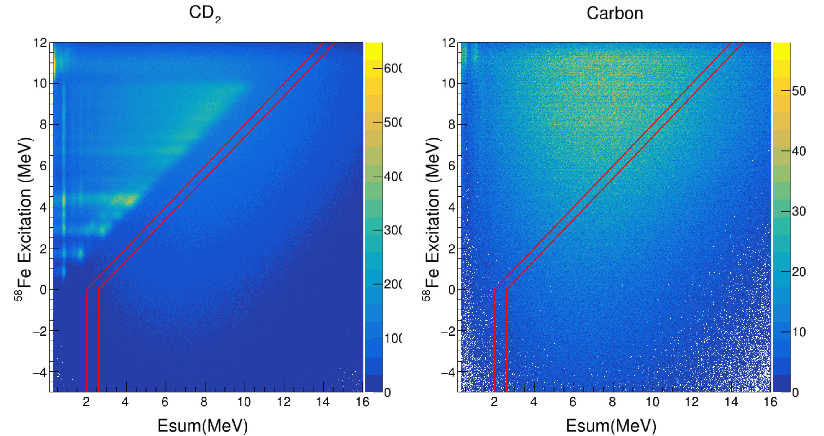
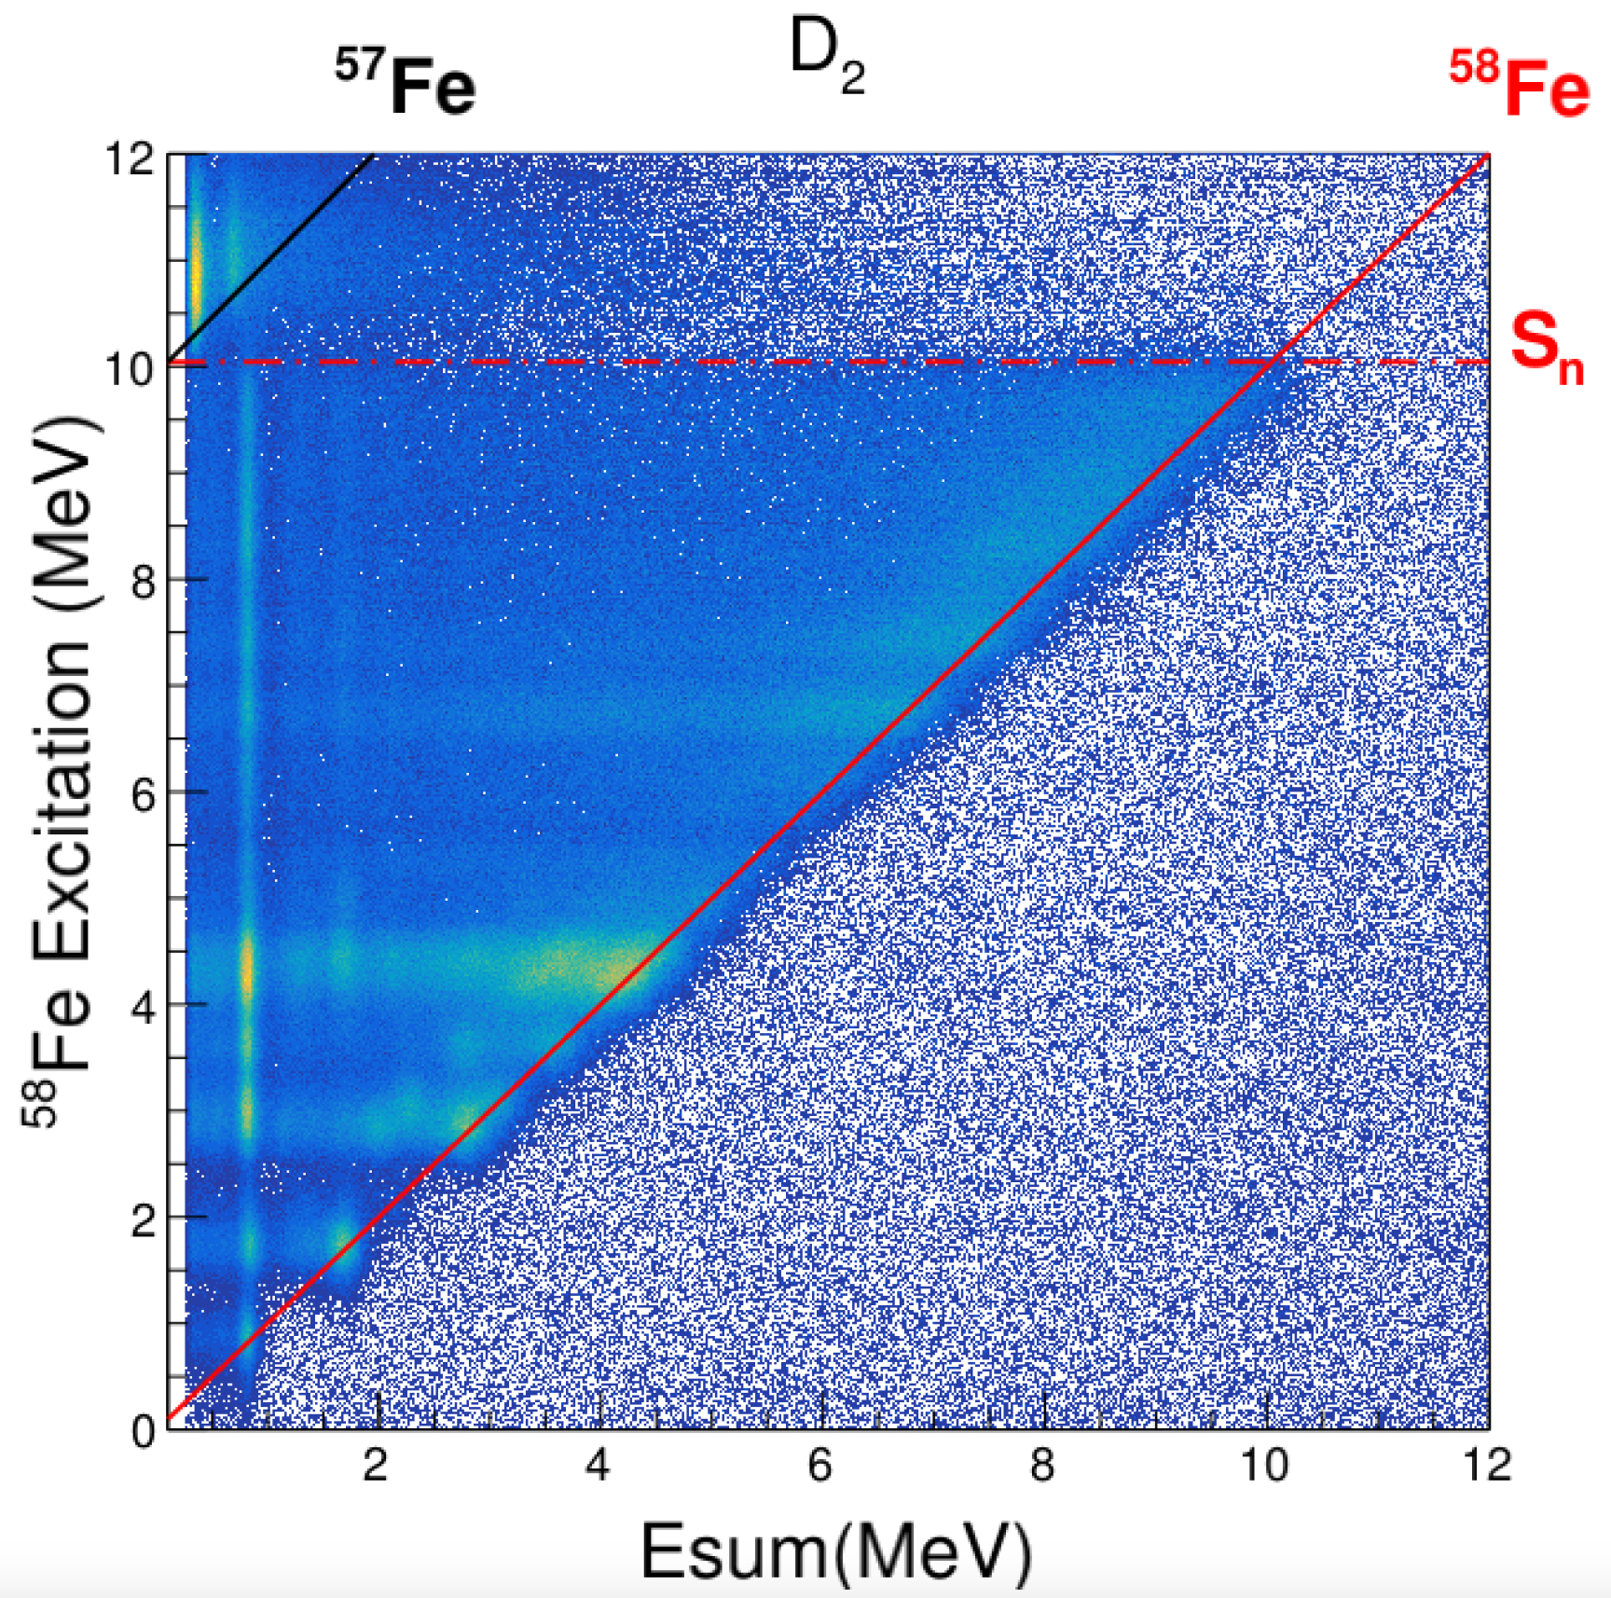
57Fe(d,pg) @ 7.5 MeV/u
in DAPPER

Slide 12
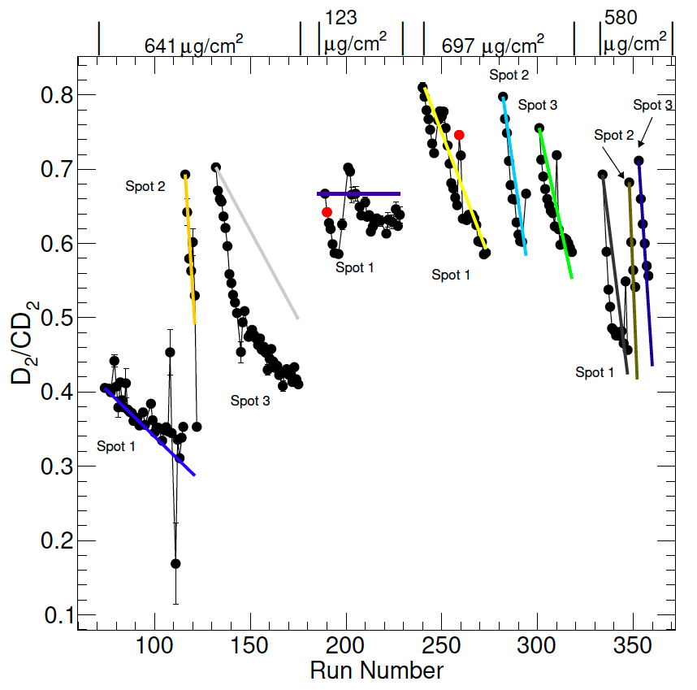
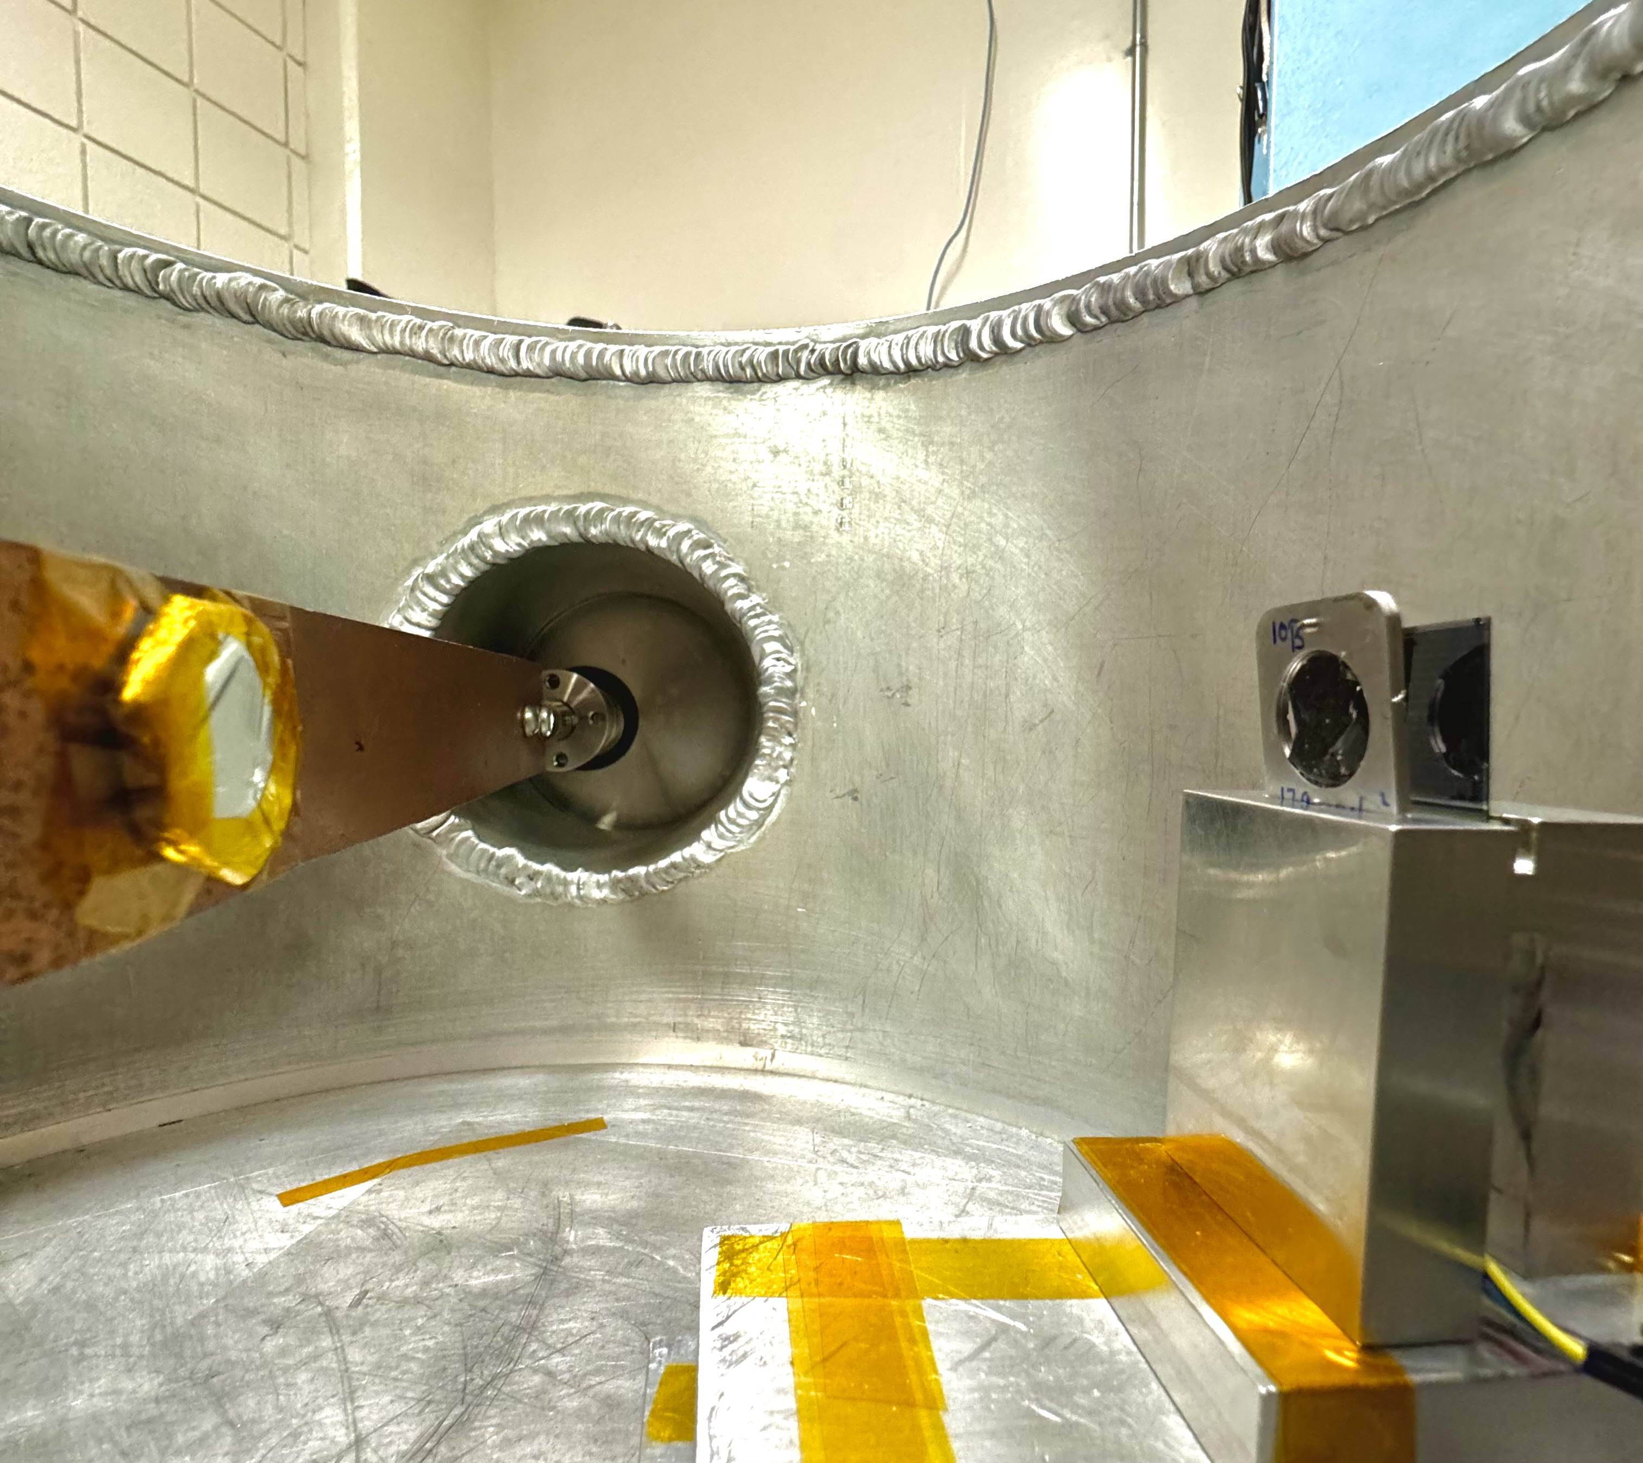
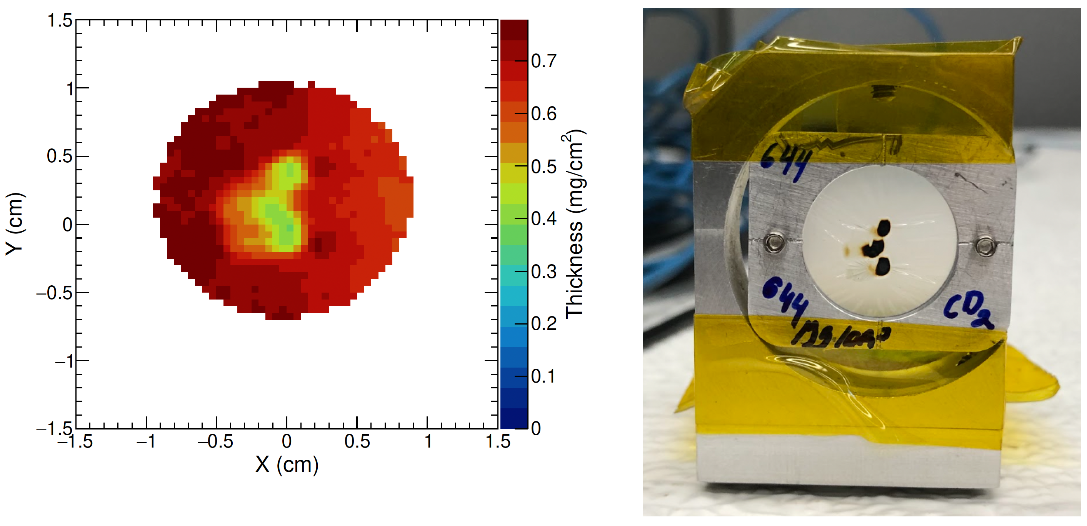
Correction for target thickness
silicon
228Th
target
Deuterated plastic target after beam
Deuterium loss over time
Deduced from peak (D2)
to peak+bkg (CD2)

Slide 13
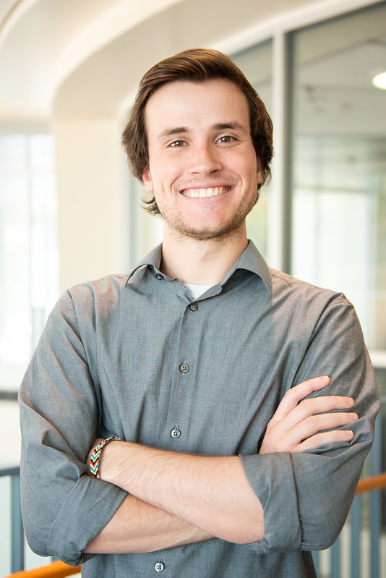
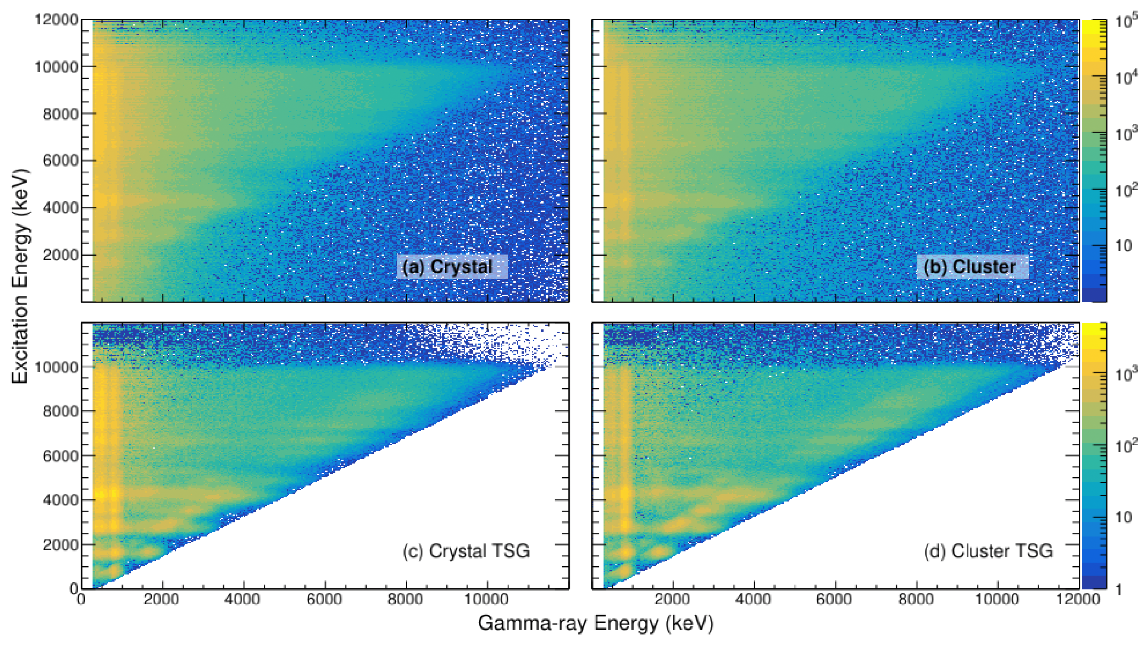
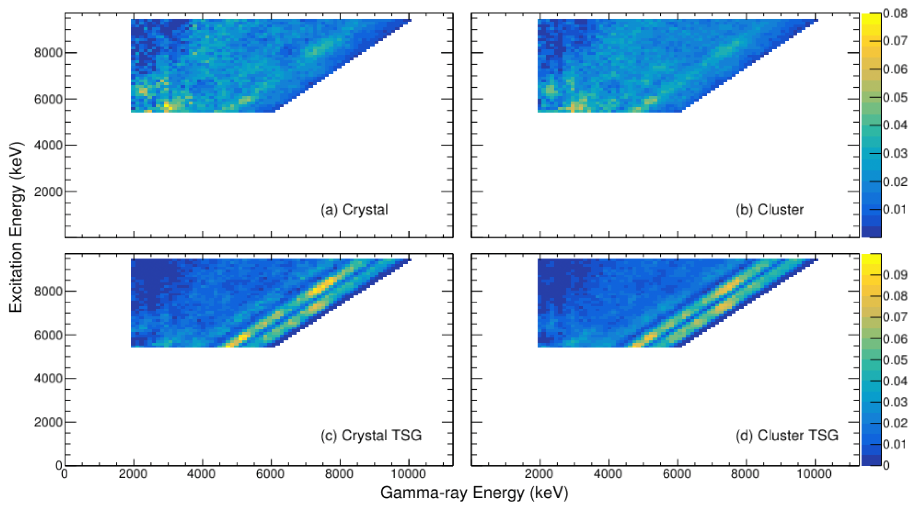
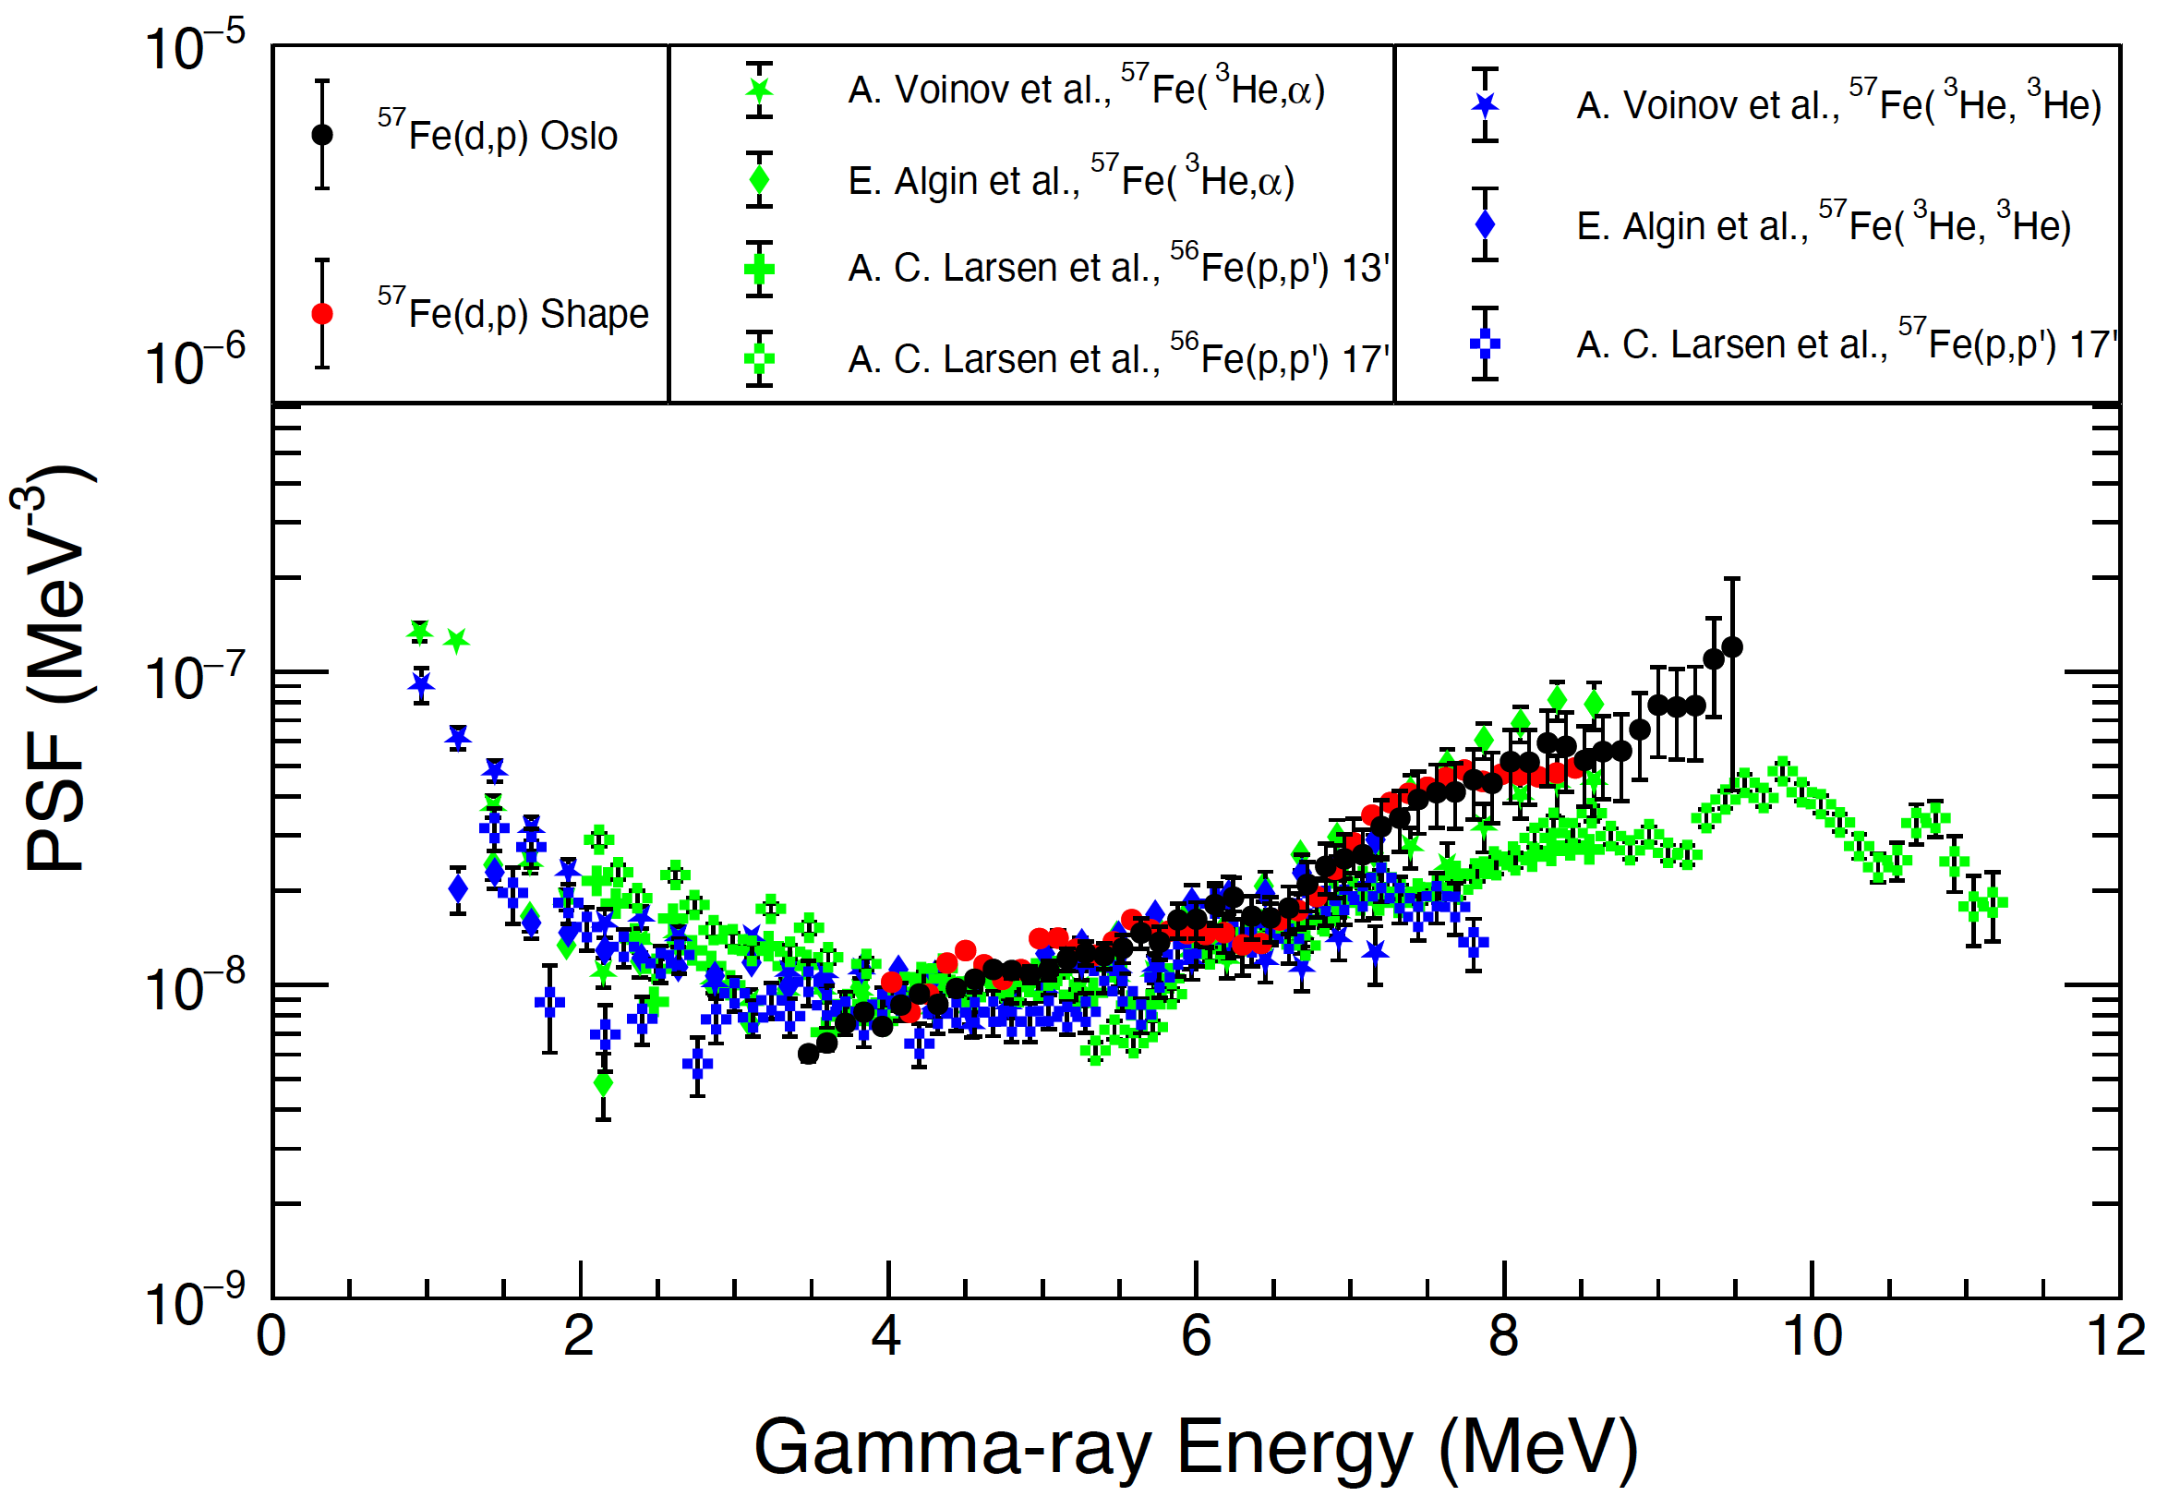
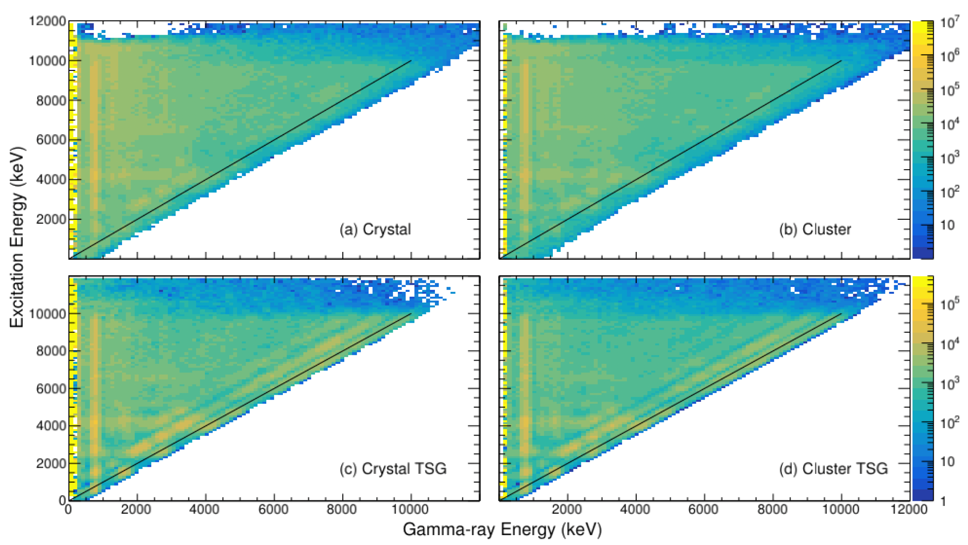
57Fe(d,pg)58Fe@ 7.5 MeV/u
Oslo Method: 58Fe Photon Strength Function
A. Abbott, Ph.D. Thesis, TAMU (2024)
1. raw
3. primary gamma rays only
A. Abbott
2. Doppler corrected “unfolded” remove detector response
Doppler: 22% variation!
DAPPER segmentation allows inverse kinematics
Statistical uncertainties shown here
possible upgrade → LaBr3(Ce) at select angles

Slide 14
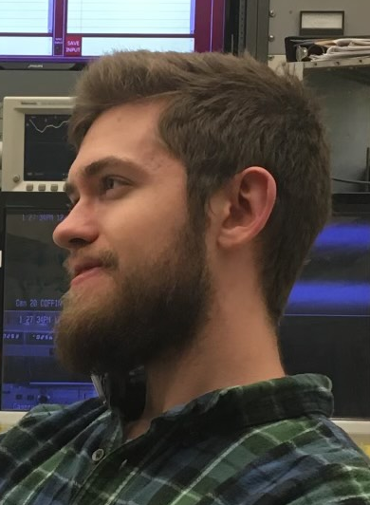
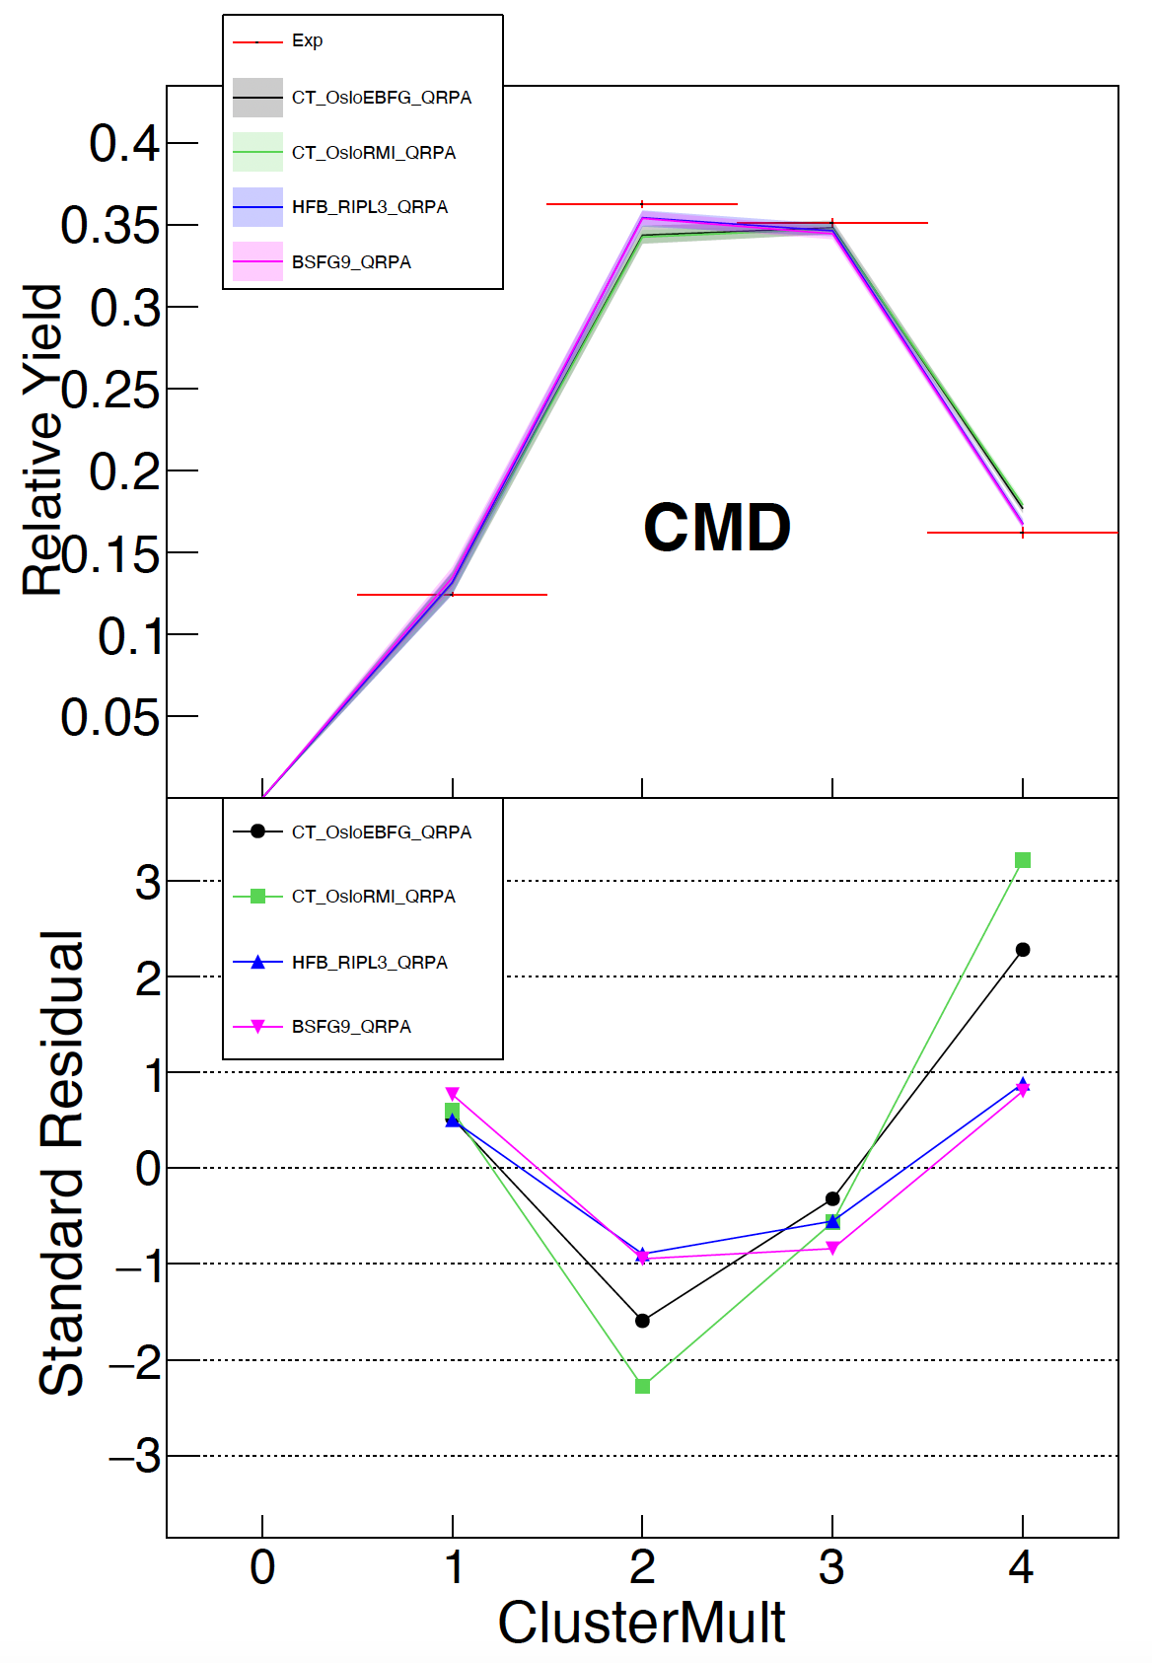
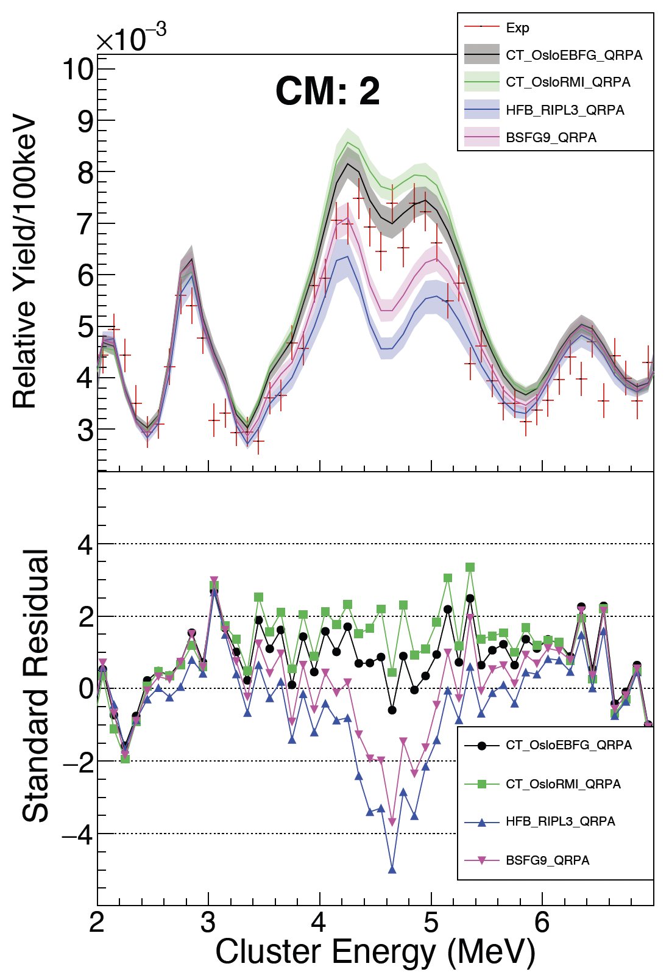
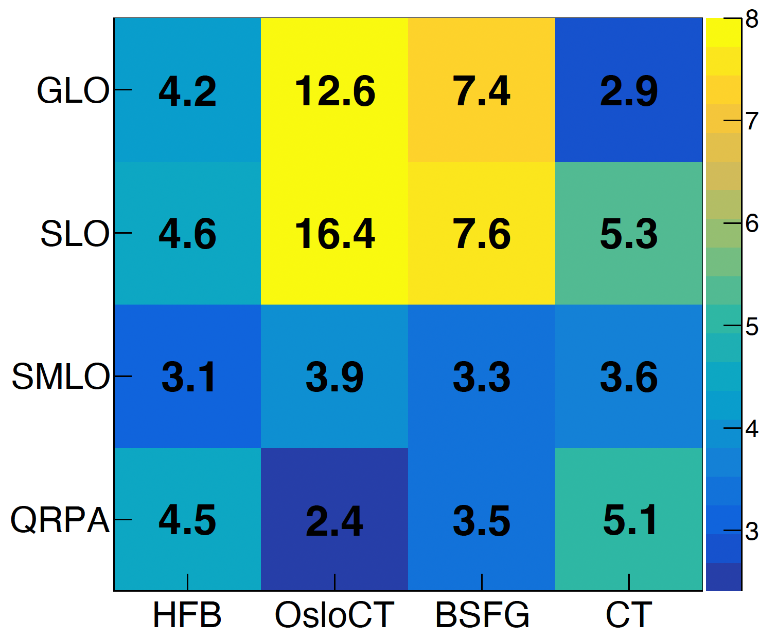
Forward Method: 58Fe Photon Strength Function
M. Sorensen Ph.D. Thesis, TAMU (2024 in prep)
Forward Method
M. Sorensen
57Fe(d,pg)58Fe@ 7.5 MeV/u
1a) Pick a PSF
1b) and pick a NLD
2) Simulate many 58Fe nuclei deexciting
3) Filter with detector response
4) Compare sim to exp:
also compare:
Energy Dist for Mult=3
Energy Dist for Mult=4
Model Agreement: χ2/N
Strength Function Model
Level Density Model

Slide 15
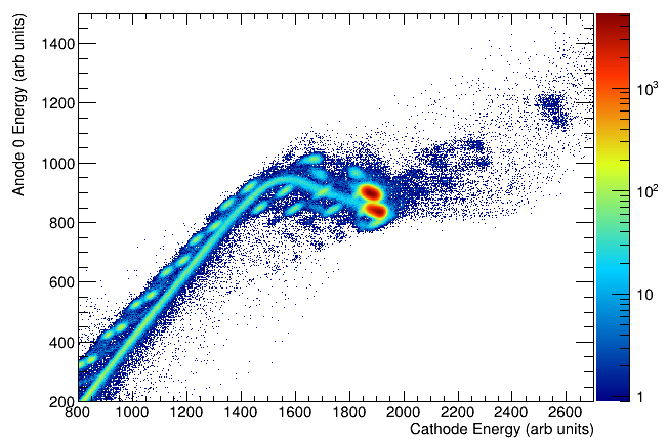
Zero-degree ionization chamber
In collaboration with S. Pain (ORNL) et al., GODDESS IC
S. Pain, T.T. King, M. Grinder, S. Balakrishnan (ORNL)
A. Ratkiewicz, R. Ghimire (LLNL)
Nov 2023 Measurement @ TAMU
Fe/Co cocktail beam
A1
A2
X
Y
Energy Loss
Co
Fe
K
~100 Torr C4H10
Wire planes, 99% transmission
Close spacing of wire planes
Fast preamplifiers, fast shapers
→ High Rate
Total Energy
Unit Z separation
> 5e5 pps
dE-E technique
other <= 1% features
slit-scattering
stopping in wires
pile-up
combinations of these

Slide 16

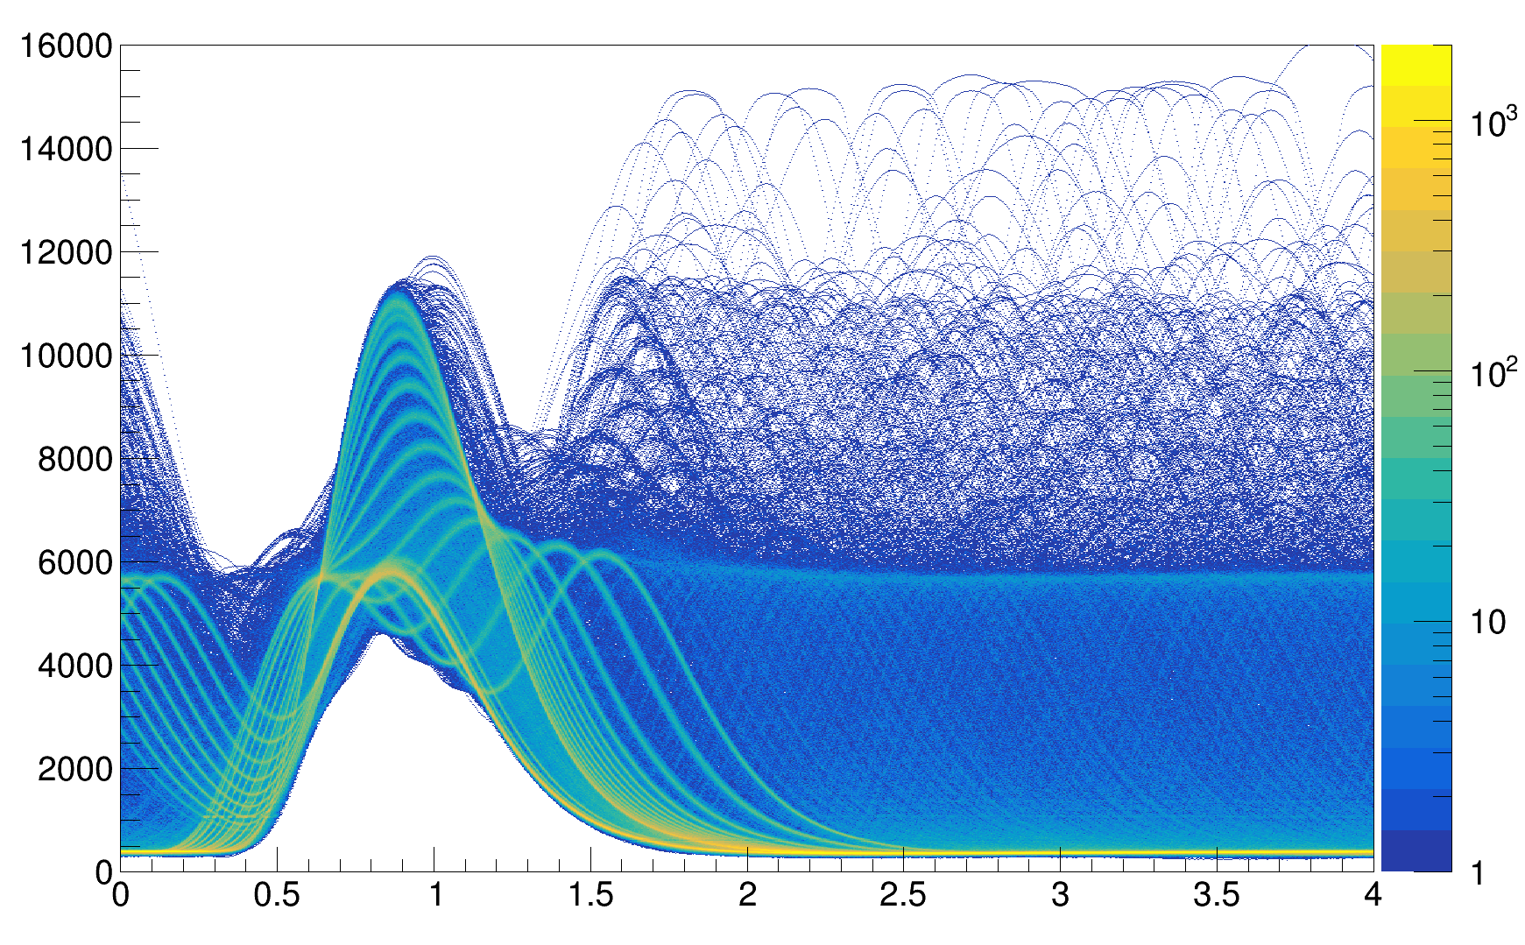
Zero-degree ionization chamber
December 2023
Measure 54Fe(d,pg)55Fe with DAPPER
Residues at 0 deg in IC
Arthur Alvarez
54Fe + CD2 @ 7.5 MeV/u @ ~5e5pps
GODDESS IC Cathode (tot ene)
-> Preamplifier
-> Shaper
-> Waveform Digitizer
Amplitude (arb units)
Pileup Clearly Observed
and distinguishable
Deconvolute to improve efficiency at high rate
time (us)

Slide 17
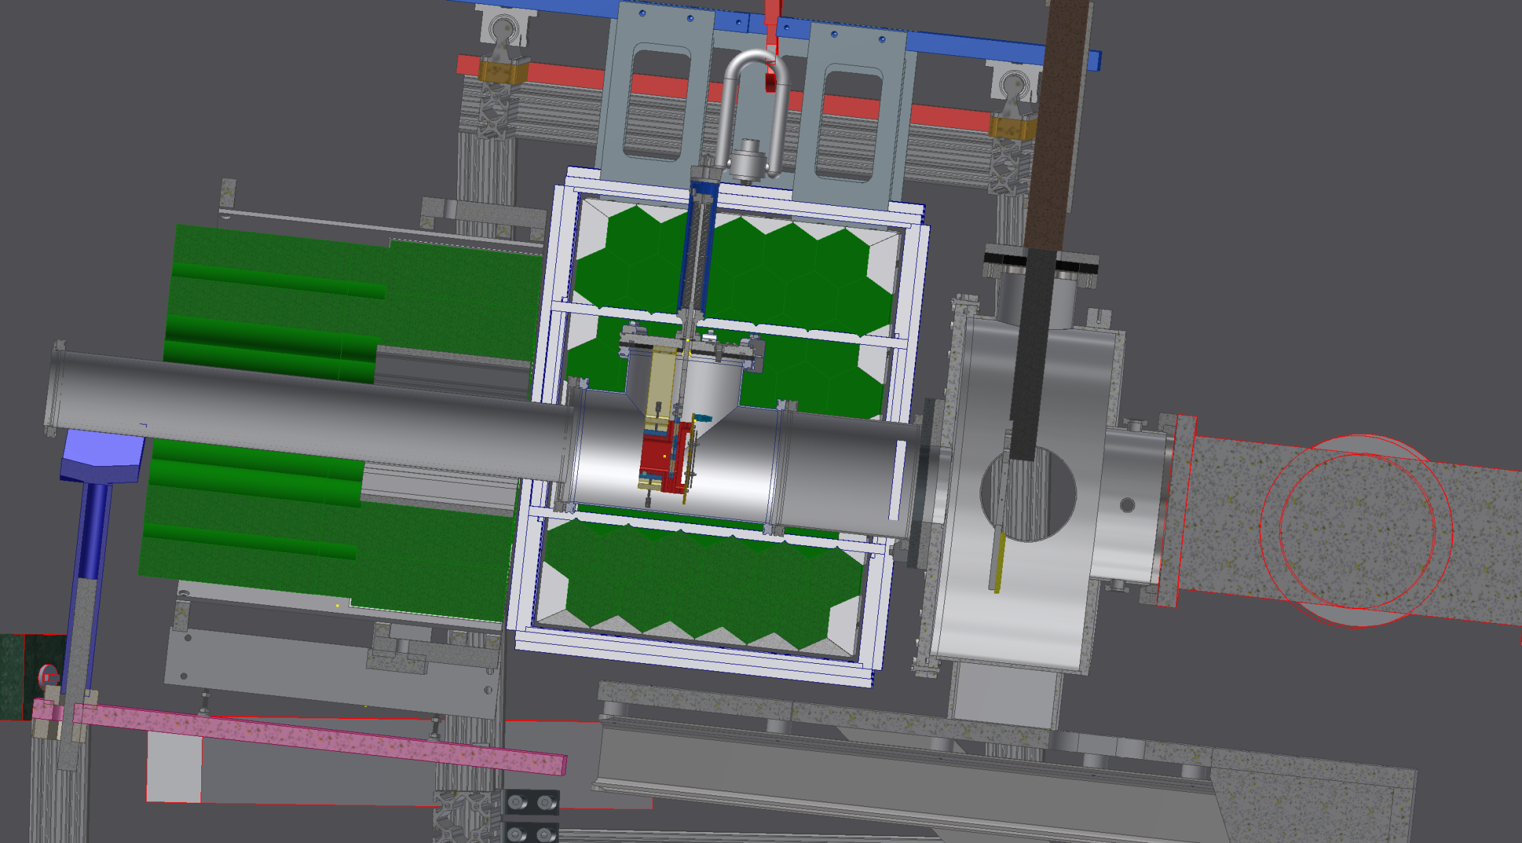

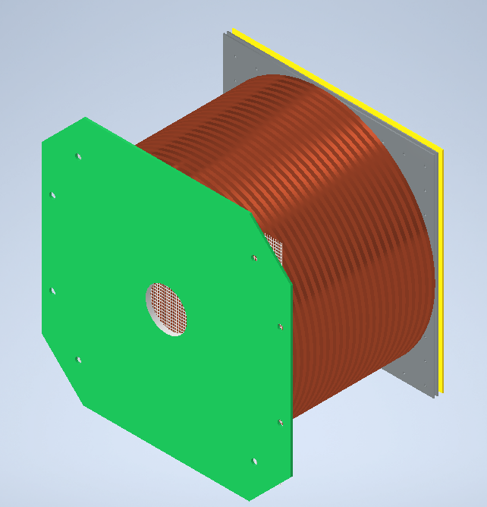
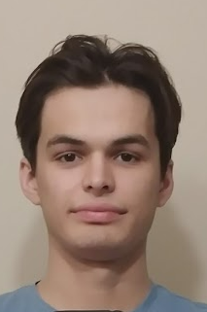
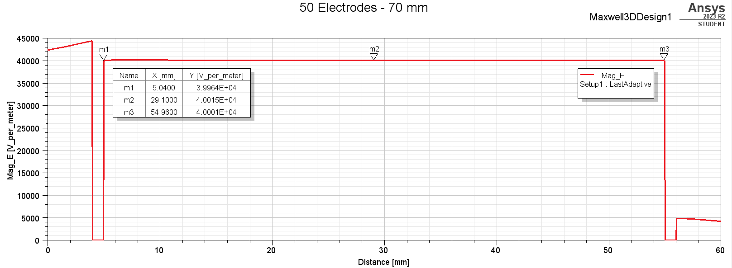
TPC for DAPPER
Simulations in progress
10cm length x 10cm dia
no fusion-evaporation background
no target degradation
higher density of deuterium
improved E* resolution (energy loss and angle)
γ
pad plane
field cage
6” diameter
TPC vessel
S3 silicon
⁵⁸Fe
p⁺
⁵⁷Fe @ 7.5 MeV/u
Sebastian
Regener

Slide 18
Capabilities
High Gamma Ray Efficiency
High Granularity
Total Gamma Energy
Gamma Multiplicity
Individual Gamma Energy
Good Doppler Correction
Inverse Kinematics
Secondary Beams
Unit-Z for Residues at High Rate

Slide 19
Fin

Slide 20
Backup slides

Slide 21

Detector Array for Photons,
Protons, and Exotic Residues
BaF2
(d,p) as (n,g) proxy
highly segmented → Inverse kinematics → RIB
Highly segmented, high efficiency
  Excitation energy
  Gamma multiplicity
  Total gamma energy
  Individual gamma energies
  Accurate Doppler
Photon strength function
Improve neutron capture model predictions
BaF2
Si
one side-pack not shown for clarity

Slide 22
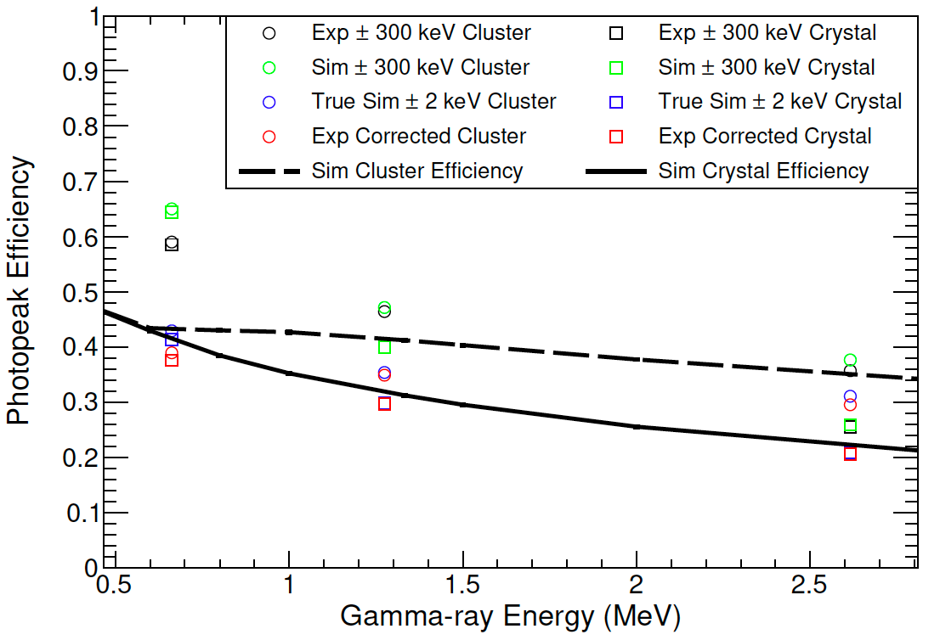
many evenly spaced energies
137Cs
22Na
232U
(208Tl)
measured. includes some Compton scattering
simulation, to compare to measured
simulation. narrow gate to exclude all Compton
experiment corrected by /

Slide 23
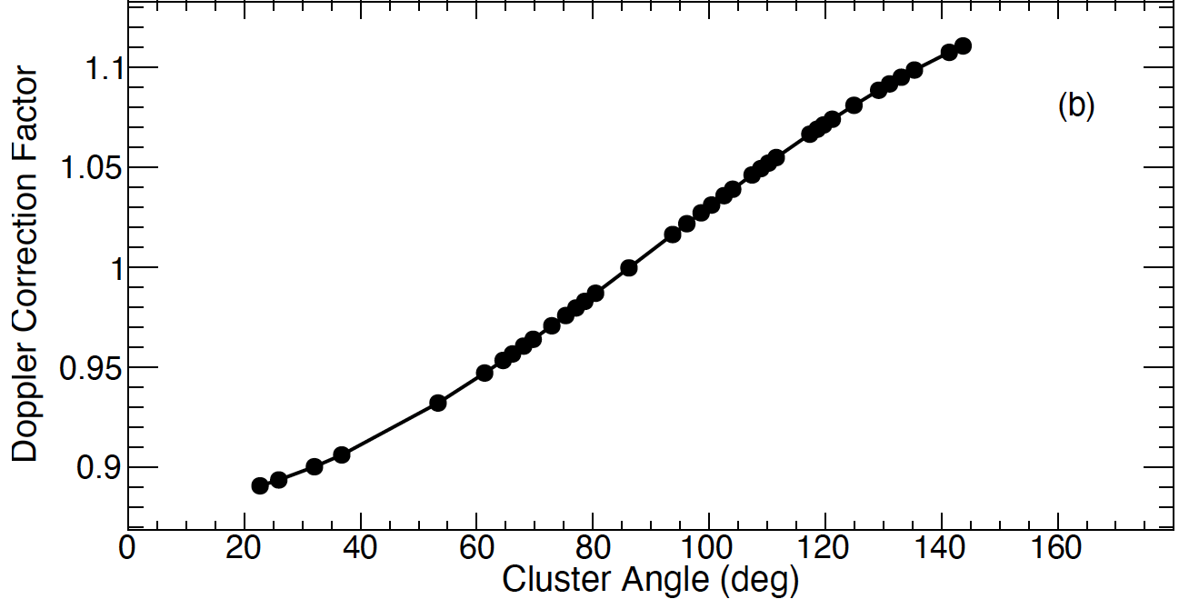
Doppler: 22% variation
1. raw
2. Doppler corrected
“unfolded” remove detector response

Slide 24
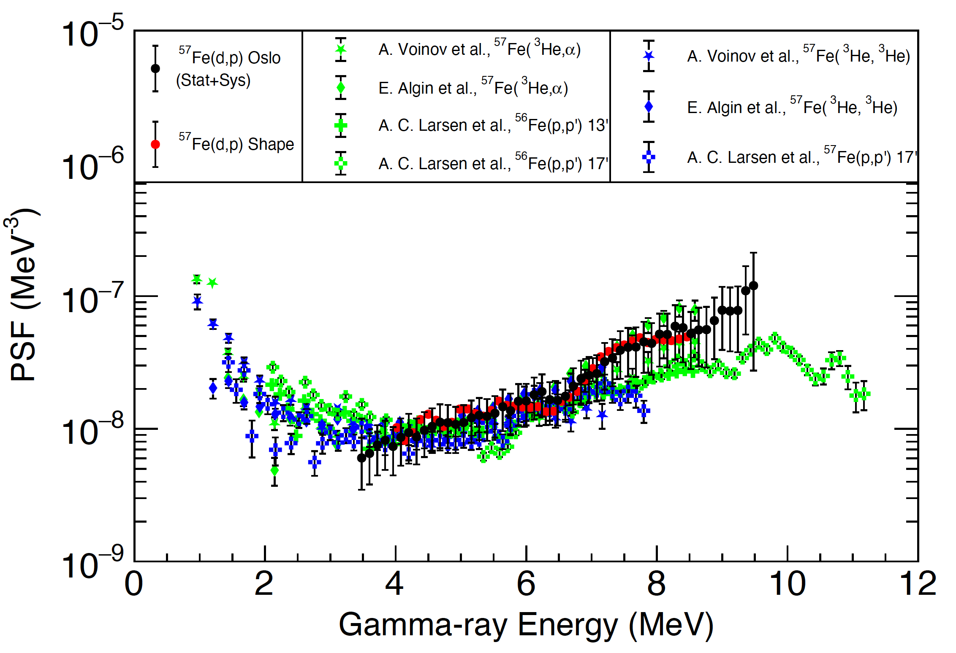
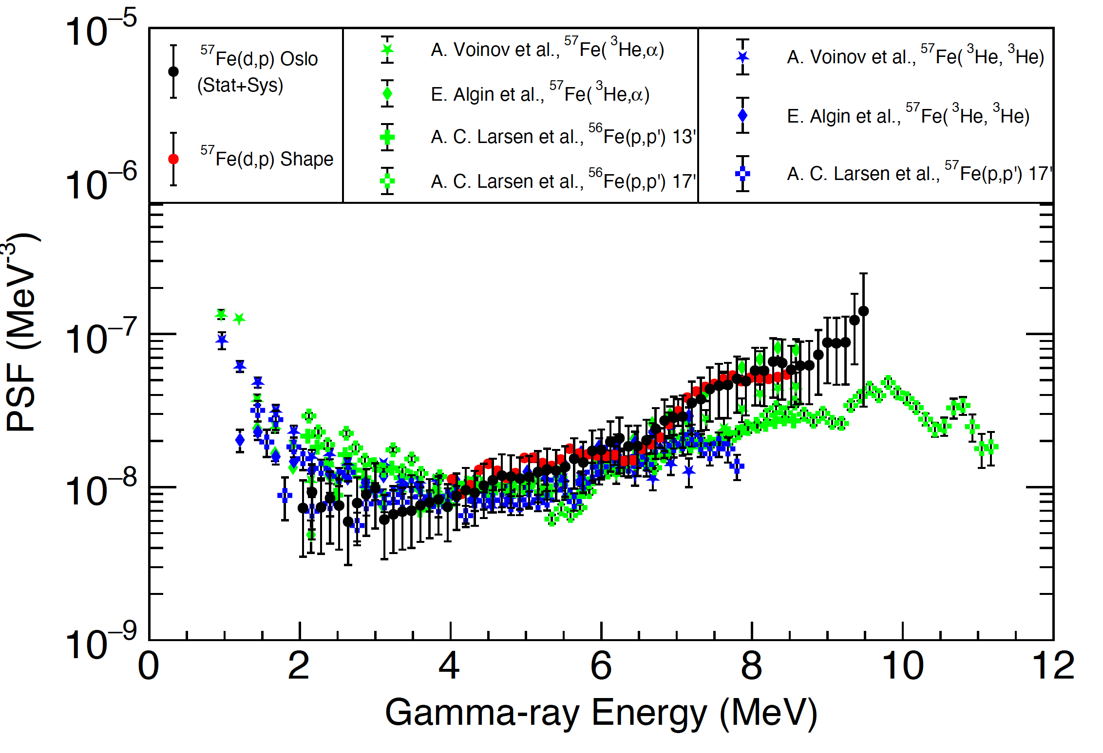
58Fe Photon Strength Function
A. Abbott, Ph.D. Thesis, TAMU (2024)
see also M. Sorensen Ph.D. Thesis, TAMU (2024 in prep)
A. Abbott
Inclusion of data down to 3.5 MeV
Inclusion of data down to 2 MeV
TAMU: stat+sys
Others: stat only
no evidence of low-energy enhancement down to 2.0 MeV, though non-statistical population of low states may obscure
no evidence of low-energy enhancement down to 3.5 MeV

Slide 25
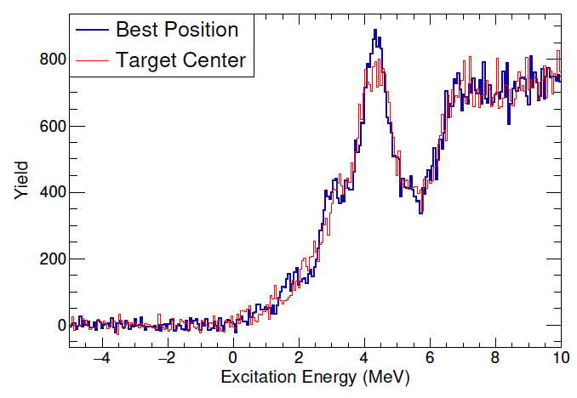
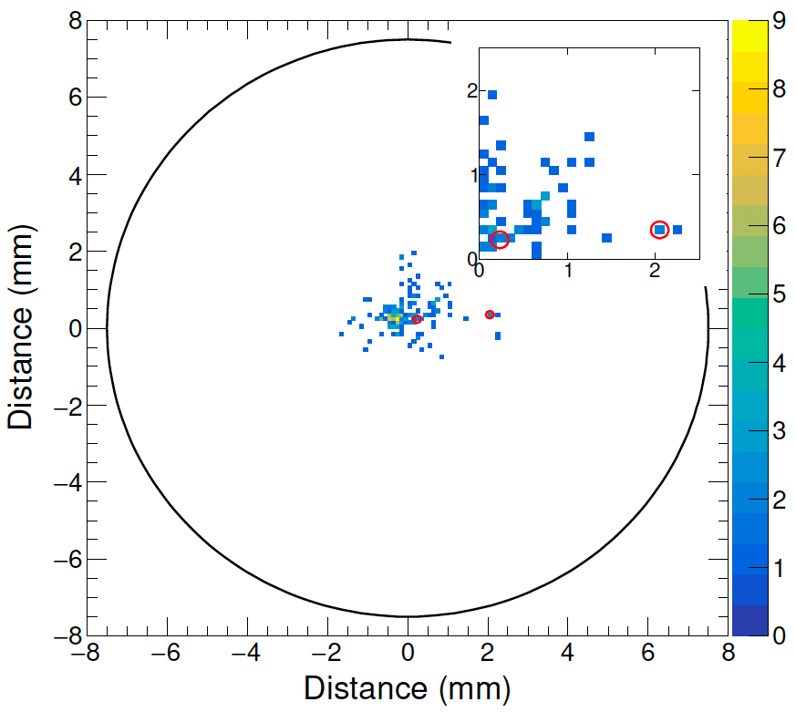
beam
nominal
actual
target
S3 silicon
beam spot → angles → E*

Slide 26
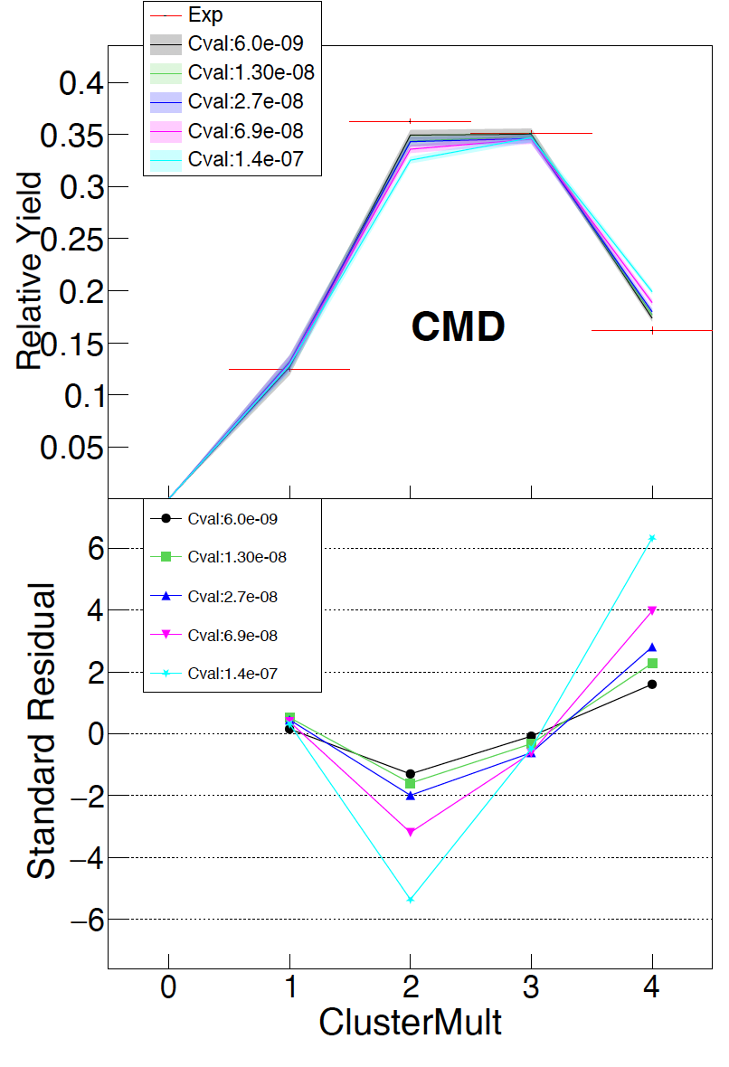
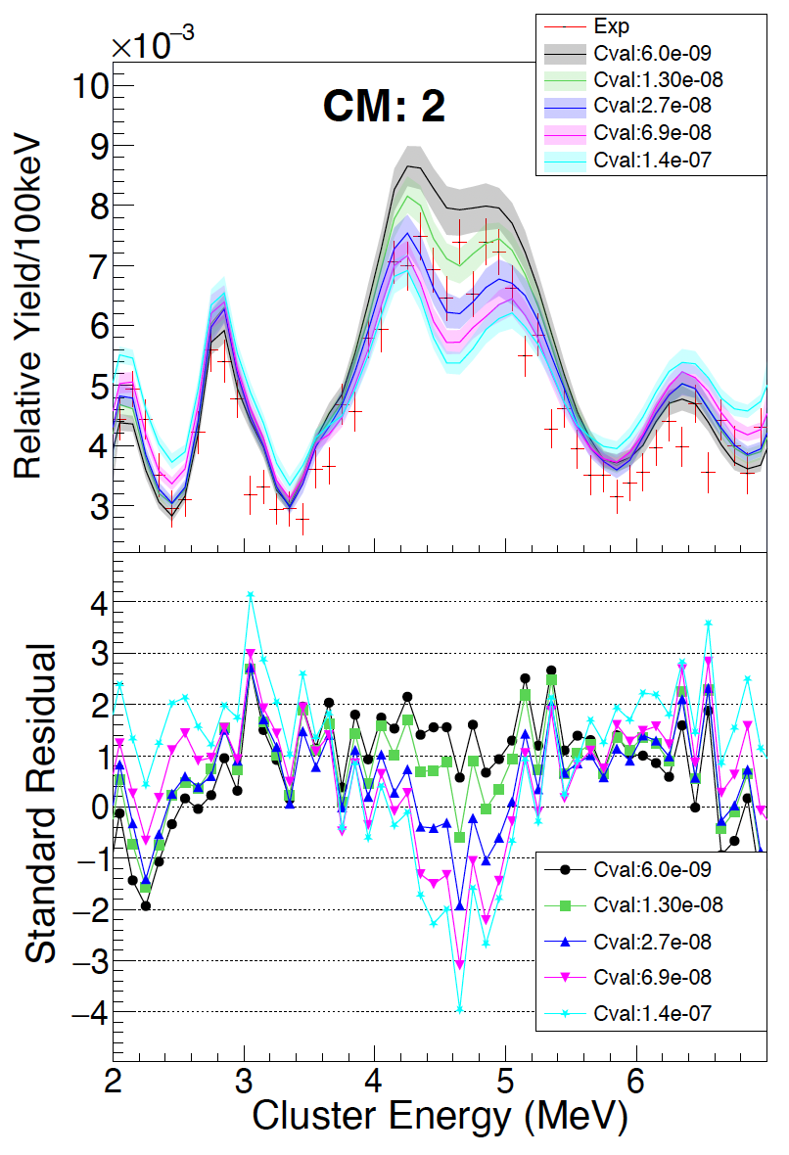
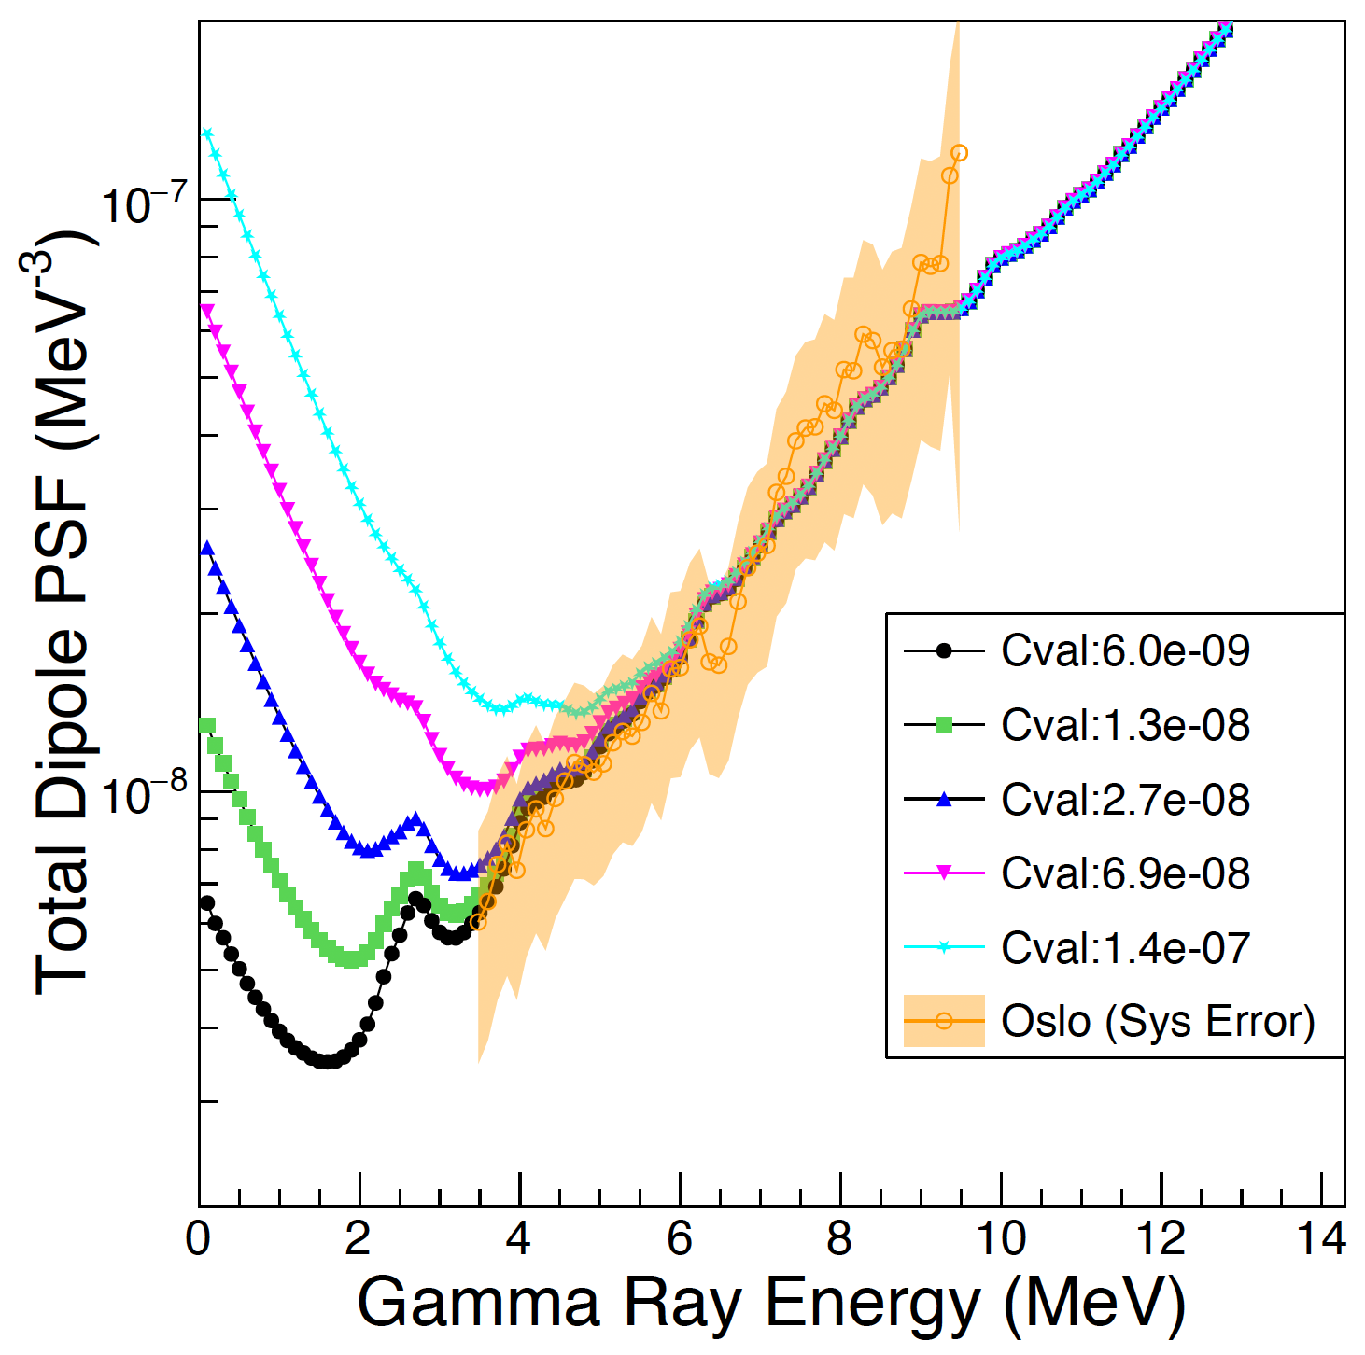
1) vary the low energy enhancement in the PSF
2) simulate many 58Fe deexcitation cascades
3) filter for detector response
4) compare simulation and experiment
Rule out large (but not small) low-energy enhancements
M. Sorensen

Slide 27
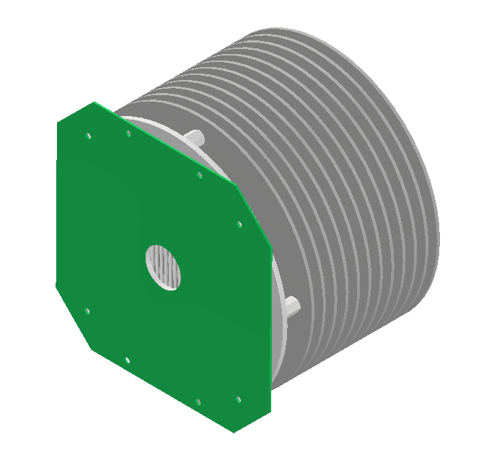
Successes, to date
Measurement of 57Fe(d.pg)58Fe
One Ph.D. completed (A. Abbott)
One Ph.D. dissertation in progress (M. Sorensen)
Two PRC and one NIM in preparation
Photon strength function of 58Fe measured
Zero-degree residue detector demonstrated
Measurement of 54Fe(d,pg)55Fe (A. Alvarez)
Field simulations for DAPPER TPC made (S. Regener)

Slide 28
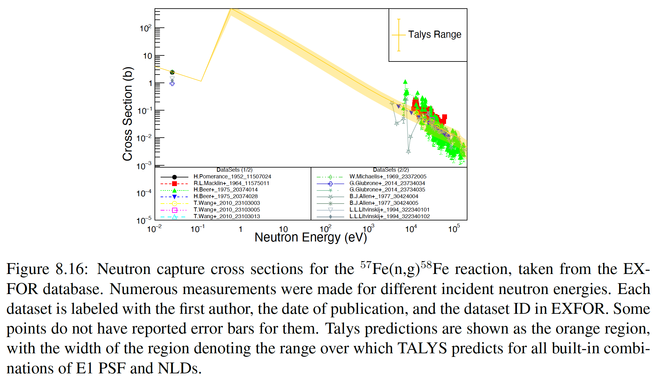
TALYS predictions incorporate 9PSF x 6NLD = 54 combinations

