Slide 1
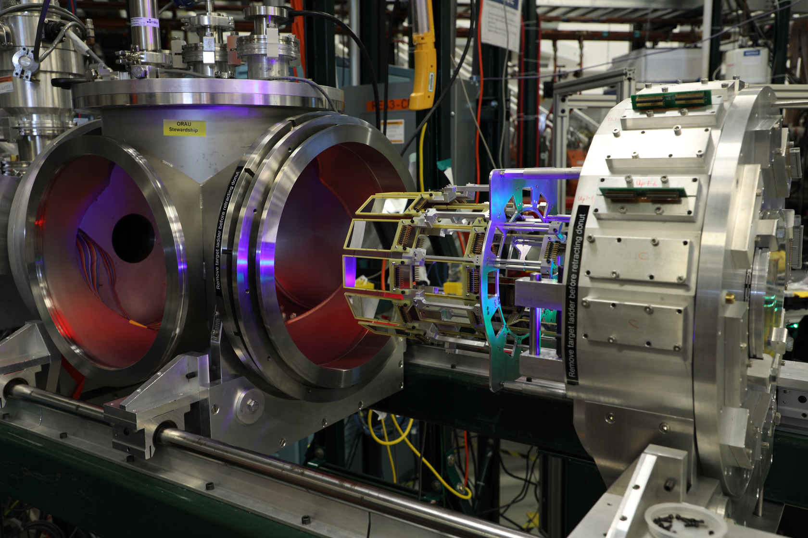

Opportunities for isomer studies for astrophysics at FRIB
Astrophysical interest in reactions on isomers
(some) Instruments at FRIB for astrophysics
Beam production/manipulation techniques
  Mixed GS:IS beams (adjustable ratio)
  Pure GS/IS beams
Experiments (works in progress/future)
  (d,p) for (p,γ) mirror symmetry (^{26g}Al, ^{26m}Al, ^{34g}Cl, ^{34m}Cl, ^{38g}K, ^{38m}K)
  (α,p) direct measurements (^{26g}Al, ^{26m}Al, ²⁶S)
  direct measurements of (p,γ) with SECAR
GODDESS silicon detector array coupled to GRETINA
S.D. Pain
Oak Ridge National Laboratory
Nucleus-Nucleus 2024, Whistler BC
Si detector array
Notes:
Asked to give overview talk, as so many contributed talks that warranted two sessions
Try, in my limited capacity, to highlight some of the areas of current focus
Observations/modelling – underqualified to talk about

Slide 2
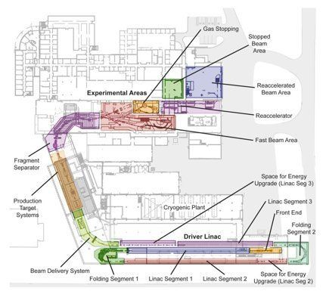
FRIB/ReA – tools and techniques
Production of radioactive beams via projectile fragmentation
  In-flight separation
  Delivery to fast-beam areas
Stopped/re-accelerated program (ReA3/6)
  Astrophysical energies (direct measurements)
  Coulomb-barrier energies (indirect techniques)

Slide 3
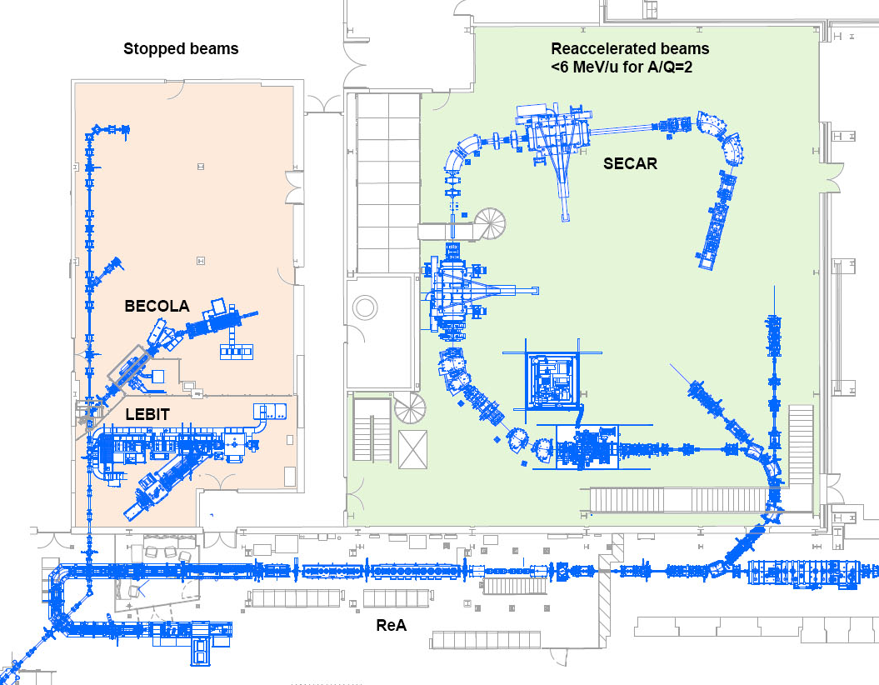
ReA3 instrumentation
Recoil separator for radiative capture reactions
D-VF-D-VF- D design
3.1% E
25 mrad
BGO array (49%)
e-13 rejection
Extended and jet targets
SECAR (Separator for Capture Reactions)
JENSA gas-jet target
(super)ORRUBA
Si array

Slide 4
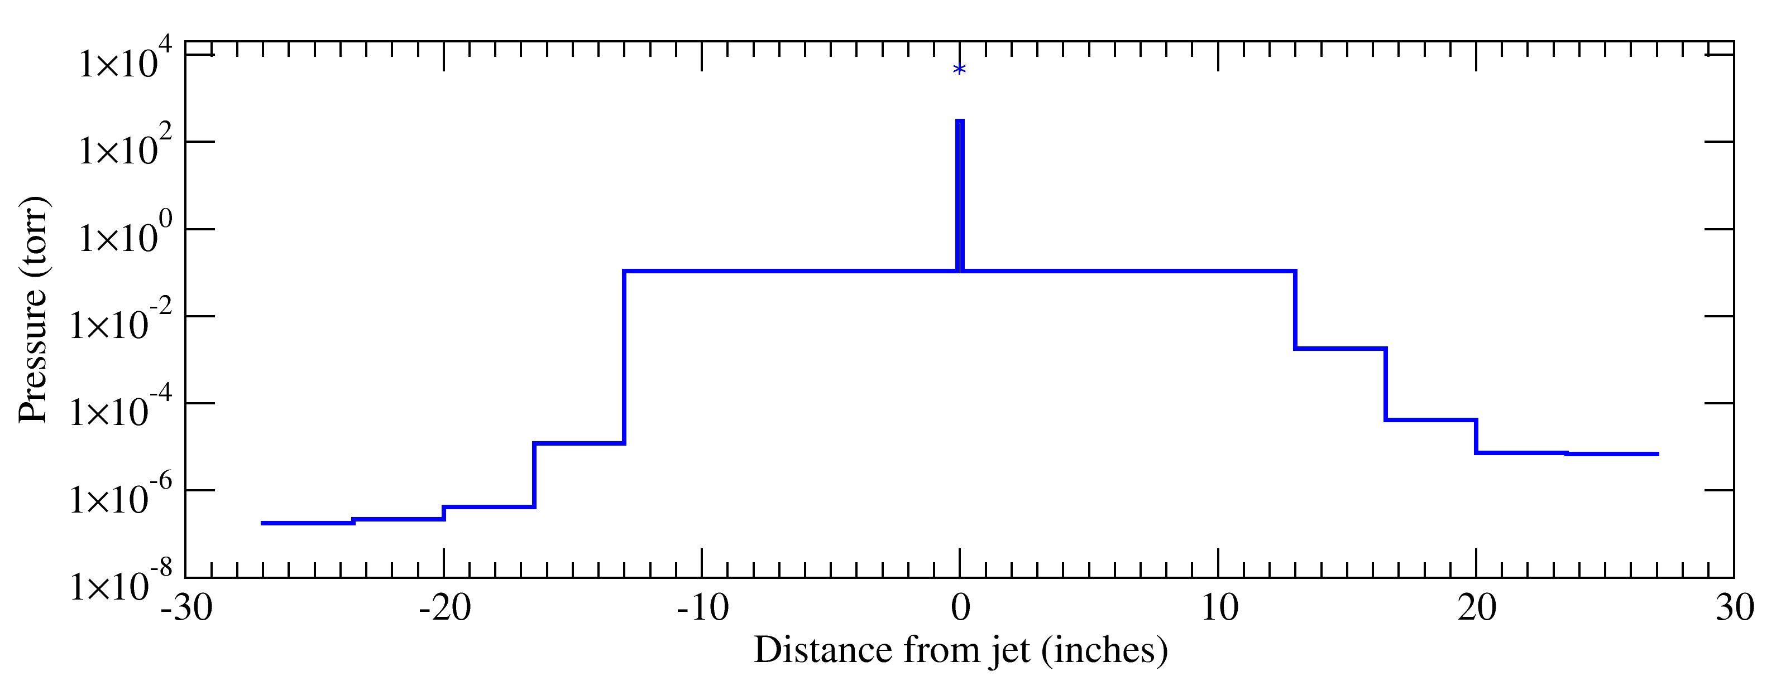
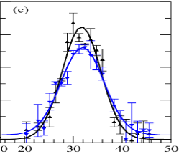
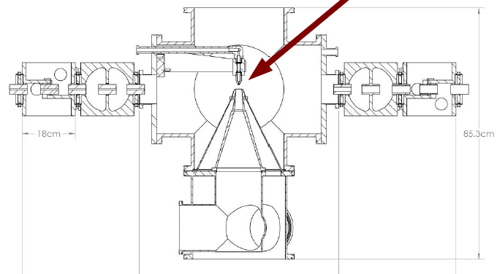
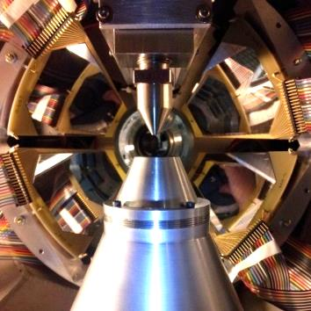
ReA3 instrumentation
Upstream differential pumping
(turbos)
Downstream differential pumping
(turbos)
3000 L/s turbo
~25-30 atm
~10-100
mTorr
90%
9%
SECAR (Separator for Capture Reactions)
JENSA gas-jet target
(super)ORRUBA
Si array
Localized dense recirculating gas jet
Target for
- SECAR eg (p,γ)
- stand-alone eg (α,p)

Slide 5
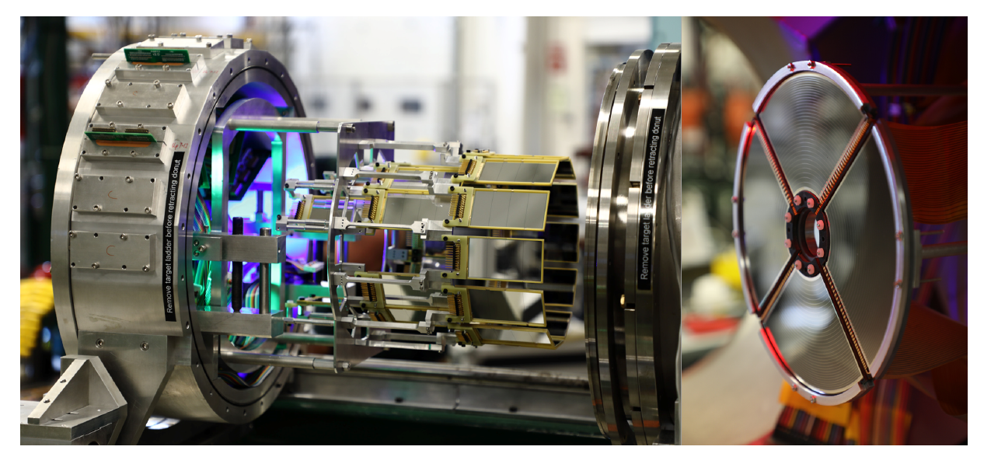
ReA3 instrumentation
Largest array of Si for RIB physics in US
Stand-alone, and couples to
  GRETINA
  Gammasphere
  JENSA
  S800
  FMA
  SECAR
  Fast ICs
Suite of about 140 Si detectors of various detector types (sX3s, BB10s, QQQ5,QQQ6, YY1, S2, …)
~1deg angular resolution
~25 keV energy resolution
PID
~4pi arrays (70-80% azimuthal coverage)
SECAR (Separator for Capture Reactions)
JENSA gas-jet target
(super)ORRUBA
Si array

Slide 6
Isomers in reaction networks (see Gavin’s talk)
Most astrophysical reaction networks have not fully treated reactions on excited states
due to paucity of information
accounted for such reactions via SEF, etc
sometimes treated as separate species (low temp) or as an effective species (higher temp)
Isomers impact reaction flows in almost all astrophysical environments (stellar, novae, XRB, r-process…)
β−decay lifetimes (often very different for GS and IS)
capture cross sections typically different, especially at low energy/mass, where resonance spacing is sparse
Isomers can be populated in a reaction network by multiple mechanisms
thermal population (γ induced – often not via direct transition, but higher-lying ones)
  Isomers may/may not be in thermal equilibrium
β decay (directly, or end-product)
reactions (eg capture)

Slide 7
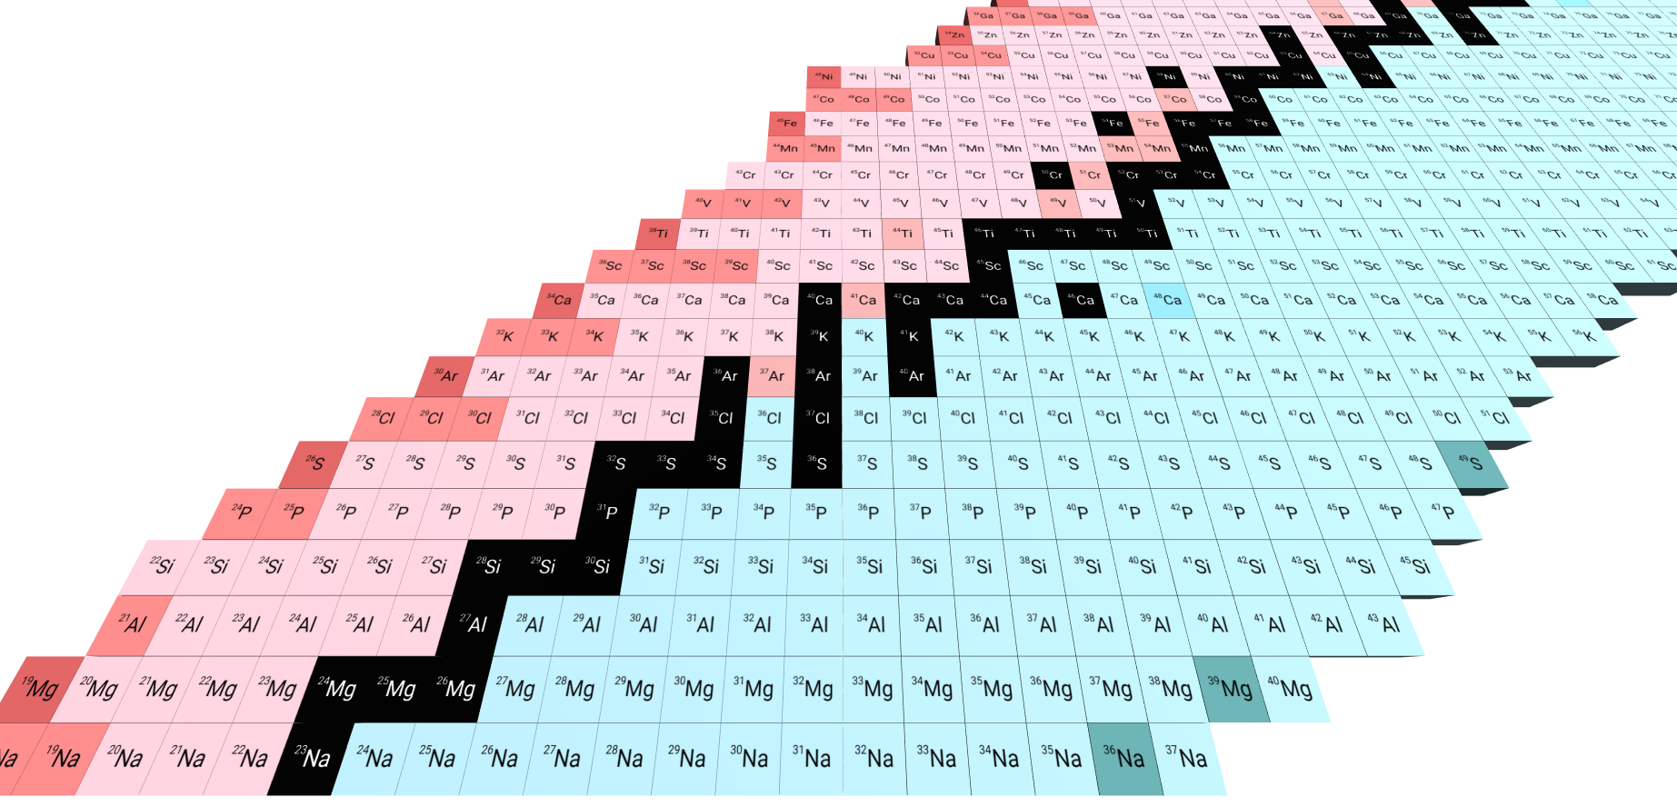
Astrophysically-interesting N=Z nuclides
Long-lived low-lying isomers in many odd-odd nuclides
Massive star, nova and XRB nucleosynthesis
  Species t(GS) t(IS) J^{π}(GS) J^{π}(IS)
  ²²Na 2.6 y 240 ns 3⁺ 1⁺
  ²⁴Al 2 s 130 ms 4⁺ 1⁺
  ²⁶Al 0.7 My 6.3 s 5⁺ 0⁺
  ³⁰P 2.5 m 96 fs 1⁺ 0⁺
  ³⁴Cl 1.5 s 32 m 0⁺ 3⁺
  ³⁸K 6.7 m 0.9 s 3⁺ 0⁺
  ⁴²Sc 0.7 s 1 m 0⁺ 7⁺
Many cases with a lifetime comparable to hold-up times

Slide 8
ORRUBA program
(d,p) reactions on N=Z nuclides for (p,γ)
(α,p) reactions
Measurement at HRIBF
^{26g}Al(d,p)
Measurements at ATLAS (GODDESS)
³⁰P(d,pγ)
²²Na(d,pγ)
Measurements run at ReA
^{38g,m}K(d,p)
^{26g}Al(α,p)
³⁴Ar(α,p)
⁵⁶Ni(α,p)
Measurement approved at ReA
^{34g,m}Cl(d,p)
^{26m}Al(a,p)

Slide 9
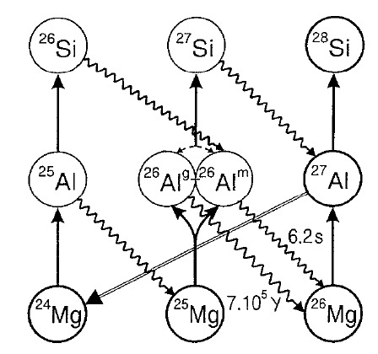
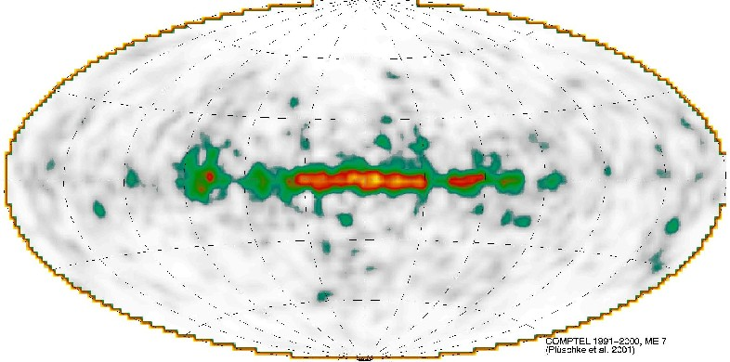
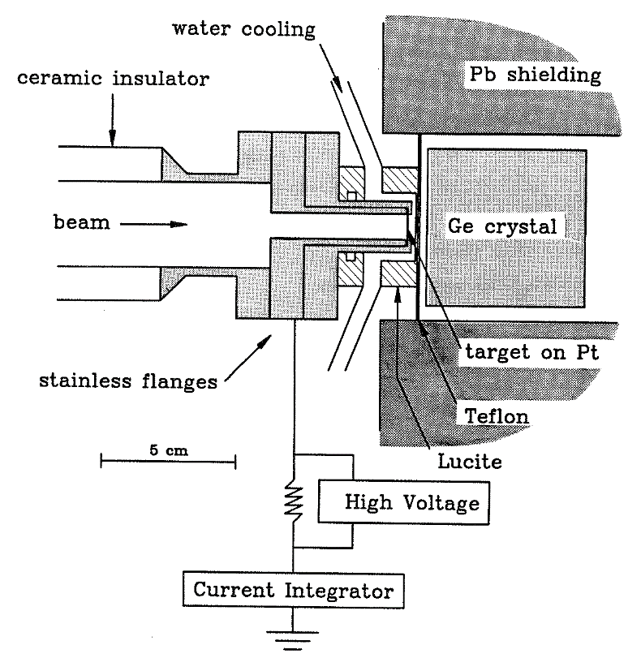
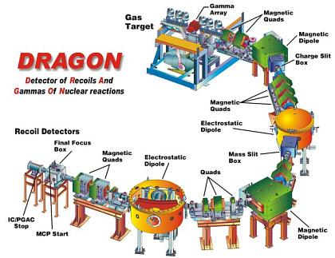
Direct measurements of ^{26g}Al(p,γ)
Normal kinematics
Subject to branching ratios, backgrounds (target contaminants, room, etc), target degradation, etc
5⁺ GS ~1 MY
Nucleosynthesis tracer (1.8 MeV γ)
Orion
Cygnus
0⁺ 228 keV IS ~6s
(see Annika’s talk)
Well-studied directly down to limits of sensitivity
508
429
Inverse kinematics
2.5e9 pps
8 days
Subject to branching ratios, charge state fractions, separator acceptance
35 ± 7 μeV
368
332
276
241,231
189
127
*
Lowest direct measurement
69
*
6
50-100 years!
Ruiz et al, PRL 96 252501 (2006)

Slide 10
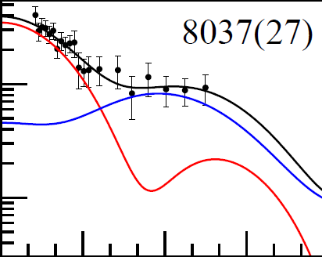
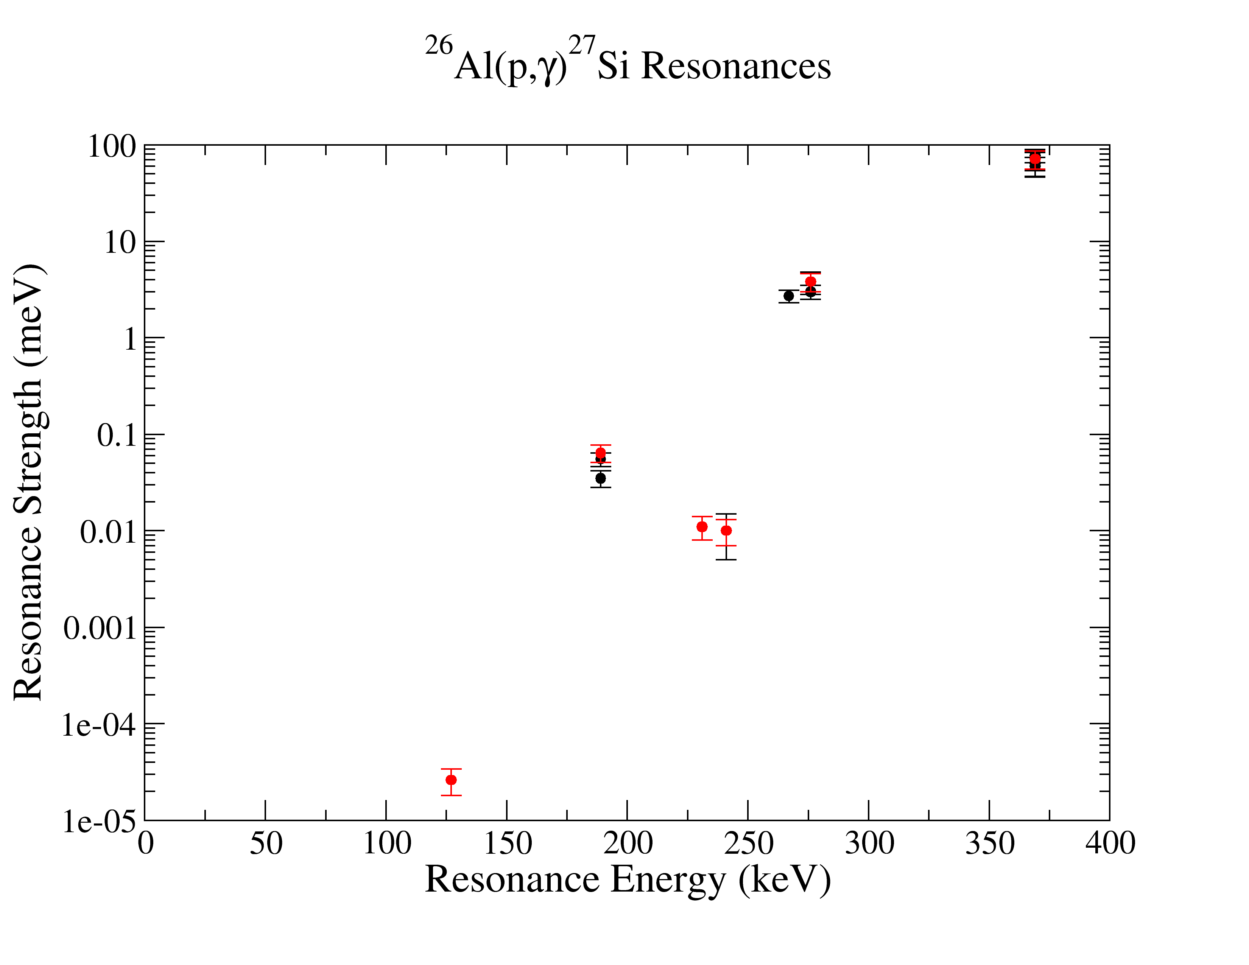
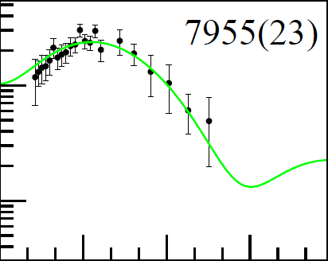
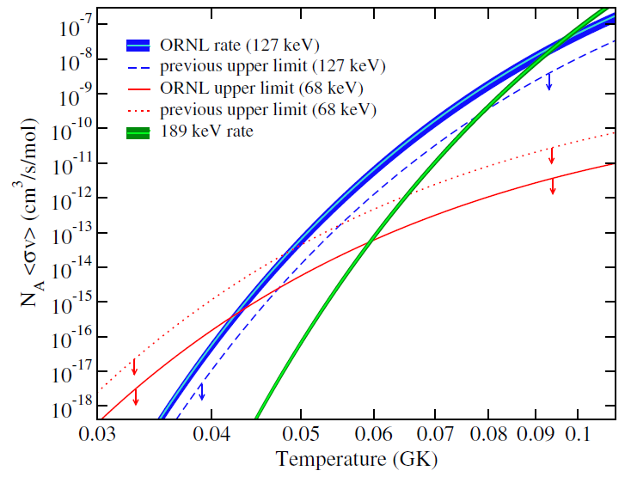
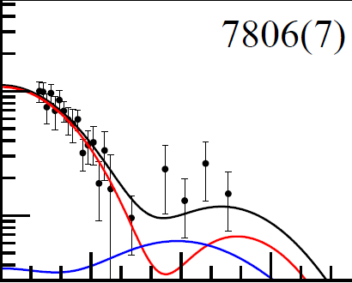
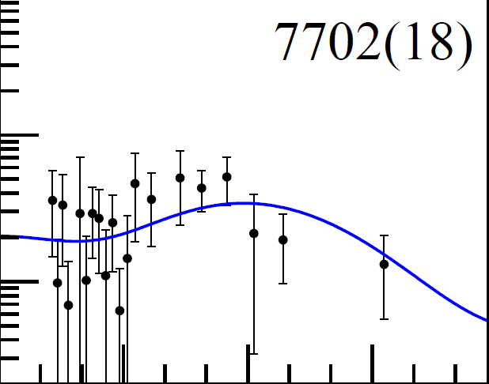
Resonance strengths from (d,p)
10⁹ pps
S.D. Pain et al., PRL 114 (2015)
SMEC gives ~10-20% reduction in C²S for ²⁷Si unbound states
V. Margerin et al., PRL 115 (2015)

Slide 11
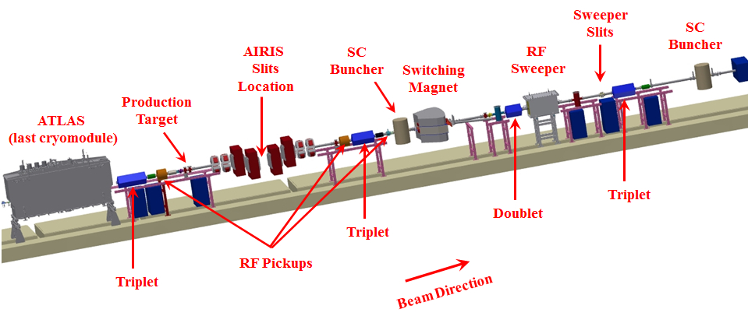
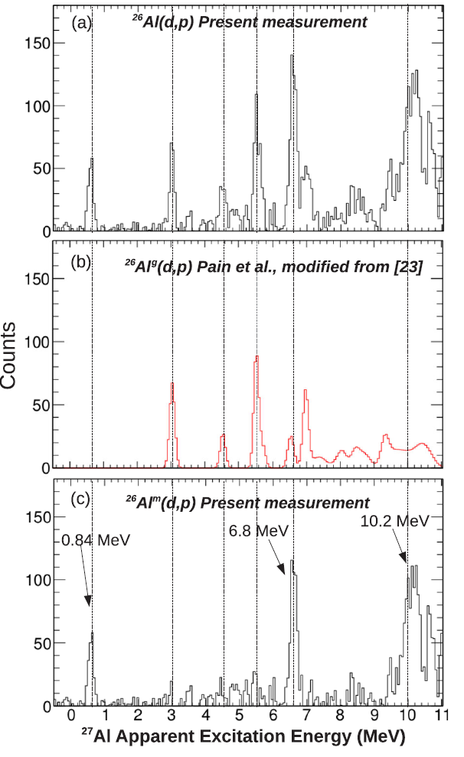

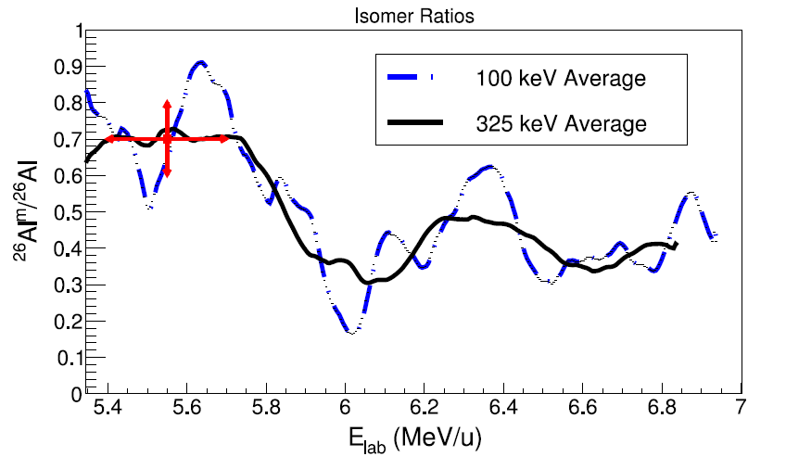
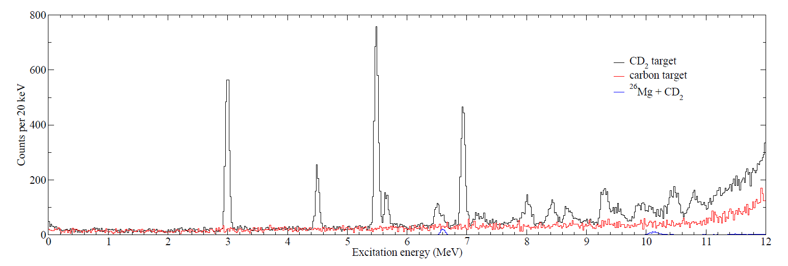
And the isomer?
²⁶Mg(p,n)^{26g,m}Al (ATLAS)
Measured ^{26g,m}Al(d,p)
Subtracted off HRIBF ^{26g}Al(d,p) published spectrum to get ^{26m}Al(d,p) and hence (p,γ)
(different energy, angles and resolution…)
ASTRO

Slide 12
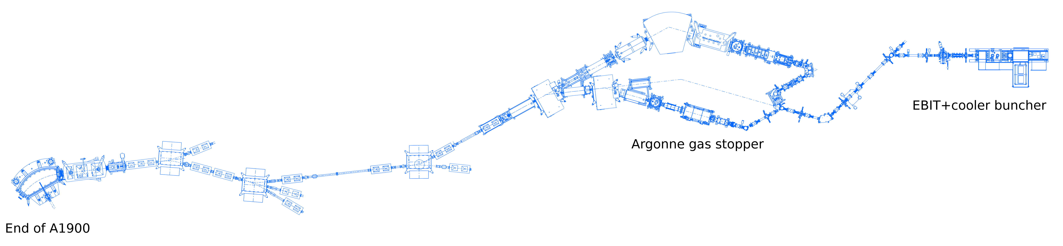
Production of mixed GS:IS beams at ReA…
Fragmentation produces species in excited states – decay both to GS and IS
Tune fast beam for fragment of interest, stopped/reaccelerated to energies for:
  Direct-reaction studies (transfer, charge-exchange, Coulex, …) for structure/indirect astrophysics (ORRUBA, SOLARIS, GODDESS, GRETA, LENDA, SeGA, Clarion2, ….)
  Direct measurements of astrophysical reactions [eg (p,γ) with SECAR, or (α,p) (α,n) with JENSA, MUSIC, HabaNERO, …]
  Reaccelerated beam good emittance, GS:IS composition adjustable, not impacting beam properties
1st selection: spin (though not specifically that of final state
  production yields, via tuning of the fragment separator
2nd selection: lifetimes
  Adjustment of hold-up times inherent to ReA
to LINAC
Cooler-buncher + EBIT
Gas stopper
fragments in
ARIS

Slide 13
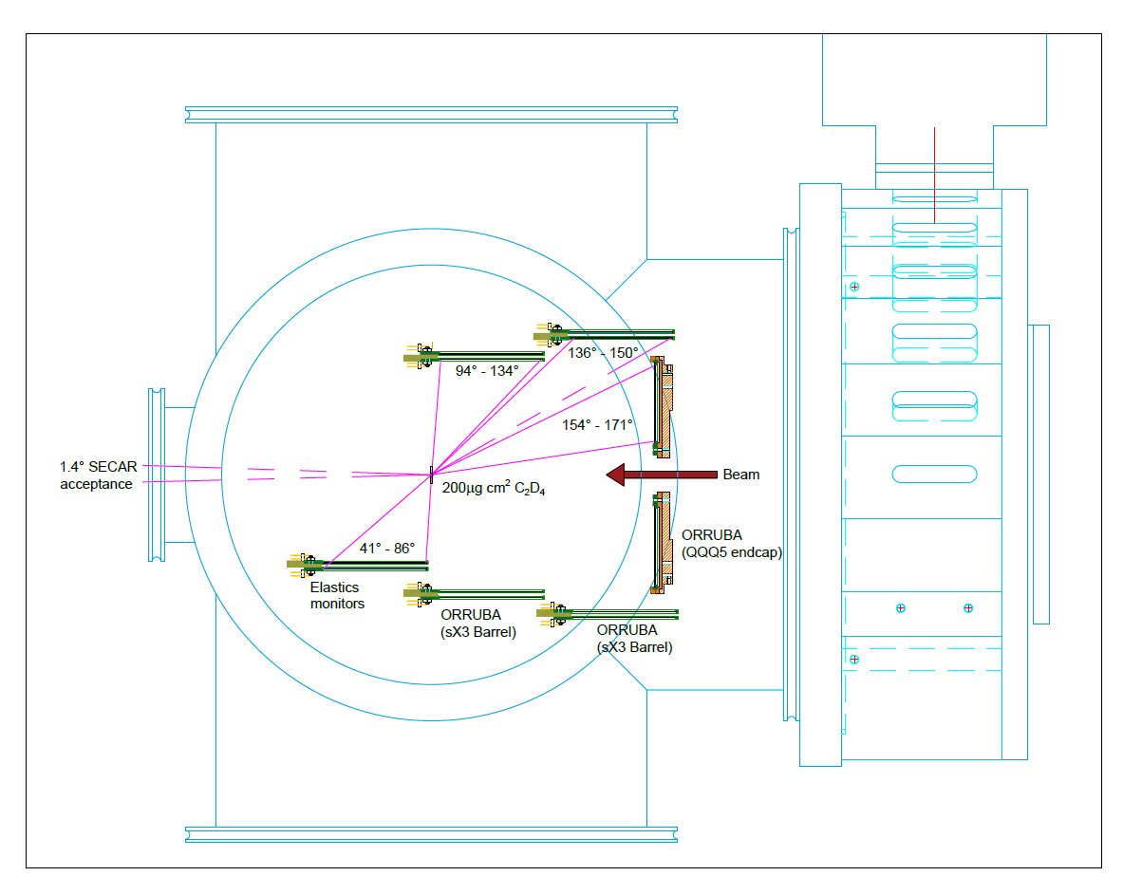
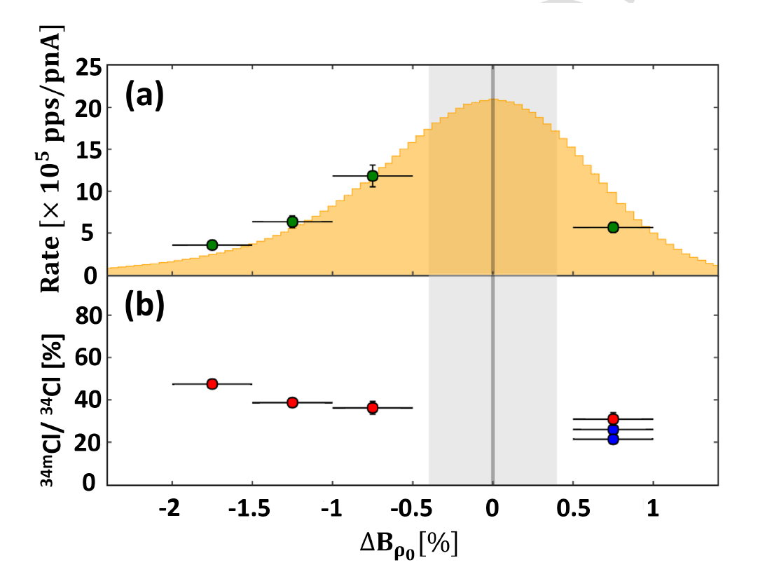
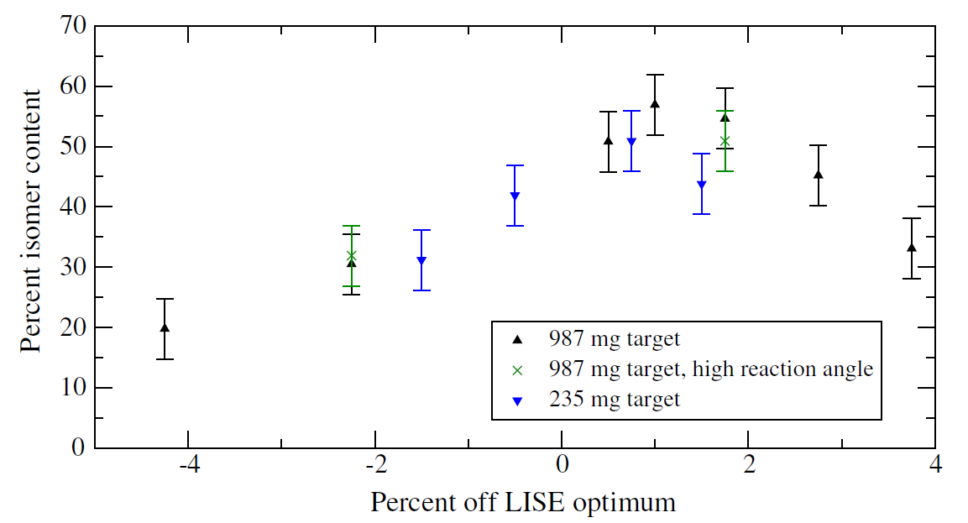
Adjusting GS:IS via separator tuning
³⁸K (⁴⁰Ca 140 MeV/u primary)
K.A. Chipps et al., Phys. Rev. Acc. and Beams 21, 121301 (2018)
GS 3⁺ t_{1/2} ~ 7.6 min
Isomer 0⁺ (130 keV) t_{1/2} ~ 1 sec
³⁴Cl (³⁶Ar 150 MeV/u primary)
O.A. Shehu et al., NIMA 21 (2022) (pre-proof)
GS 0⁺ t_{1/2} ~ 1.5s
Isomer 3⁺ (146 keV) t_{1/2} ~ 32 mins
Low-momentum tail favors higher-spin (ground state)
Low-momentum tail favors higher-spin (isomeric state)

Slide 14
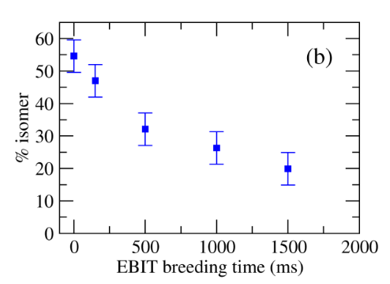
Adjusting GS:IS via holdup times
³⁸K
K.A. Chipps et al., Phys. Rev. Acc. and Beams 21, 121301 (2018)
GS 3⁺ t_{1/2} ~ 7.6 min
Isomer 0⁺ (130 keV) t_{1/2} ~ 1 sec
Let isomer decay away by adjusting hold-up times (EBIT/CB)

Slide 15
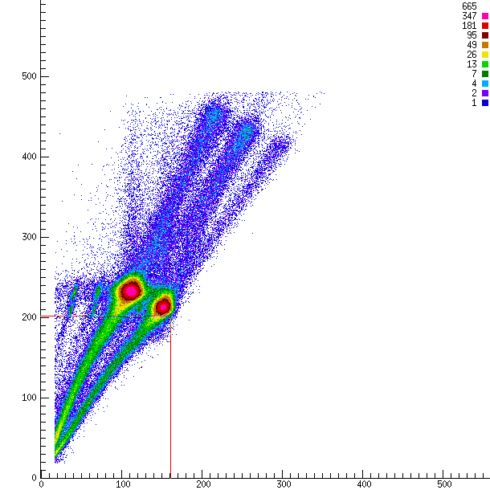
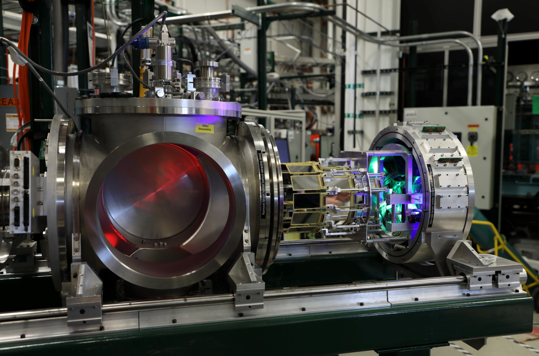

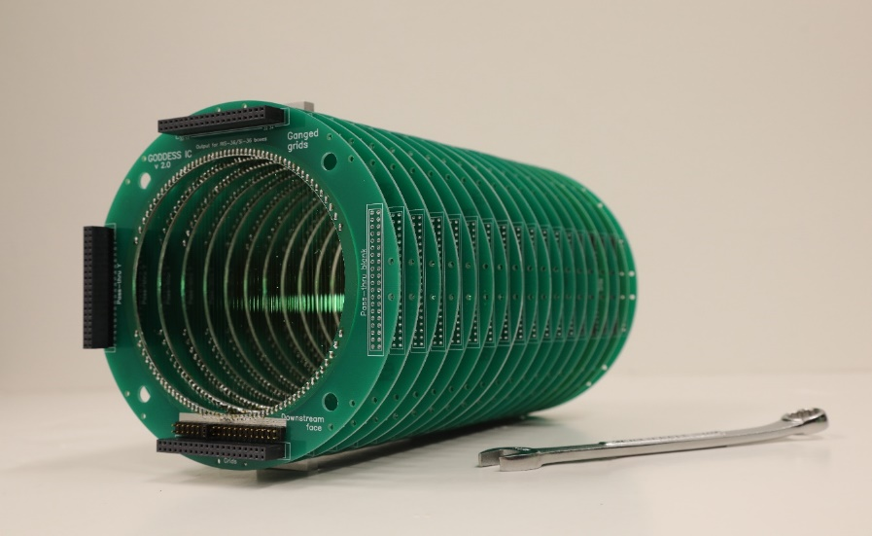
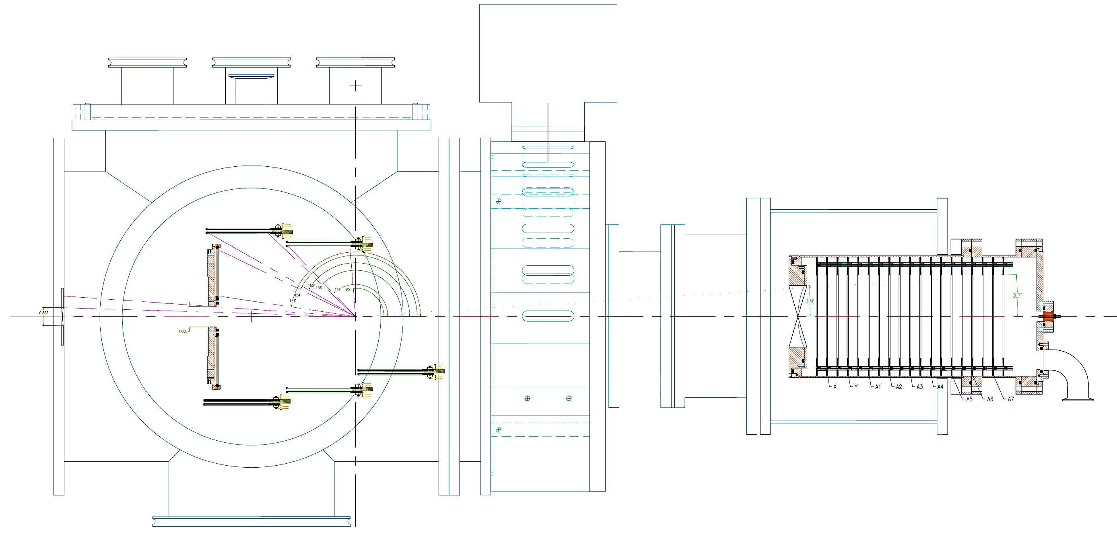
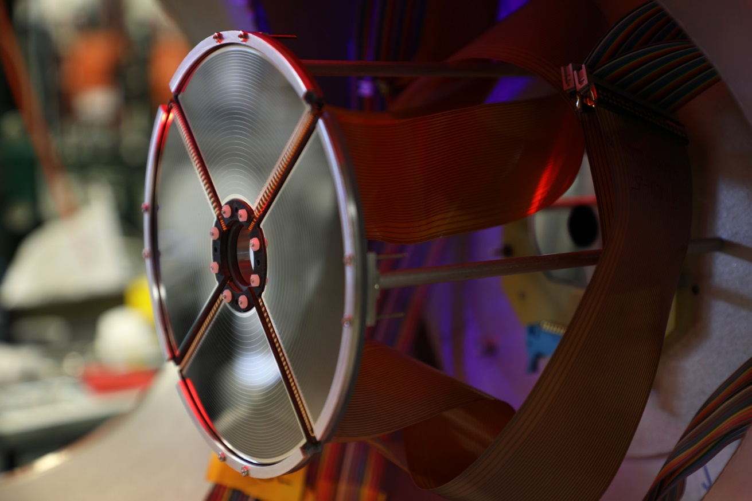
^{38g,m}K(d,p) setup
³⁸K + ³⁸Ar (60:40)
50 kHz total rate
4.57 MeV/A
~420 μg/cm² C₂D₄ target
~2 mm beam spot
Protons 95 -178 deg
(650 ch setup)
60% ³⁸K
40% ³⁸Ar
sX3 barrel
sX3 barrels (95-150 deg)
QQQ5 array (154-171 deg)
GODDESS PS IC (0-4 deg)
QQQ5 array
Y
ΔE
E
X
S2
S2
(174-178 deg)
sX3 elastics monitors

Slide 16
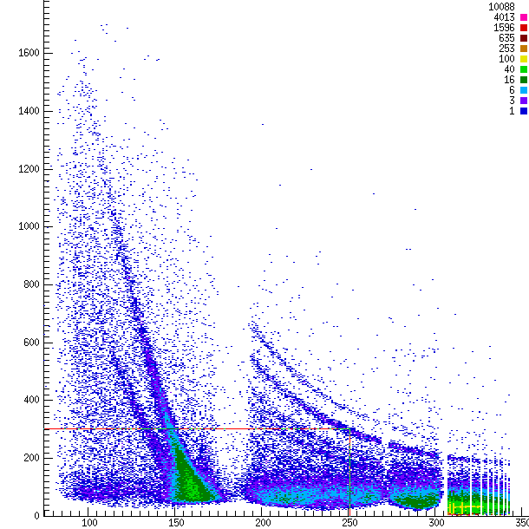
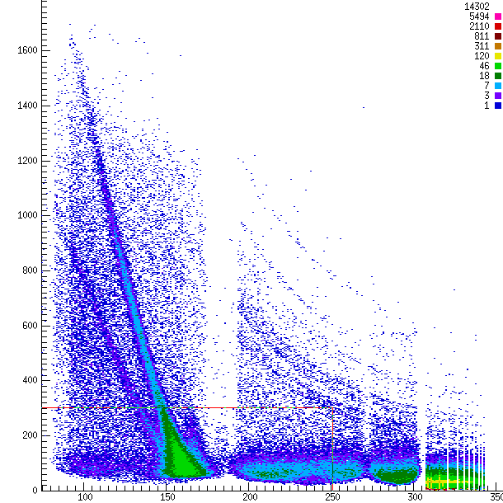

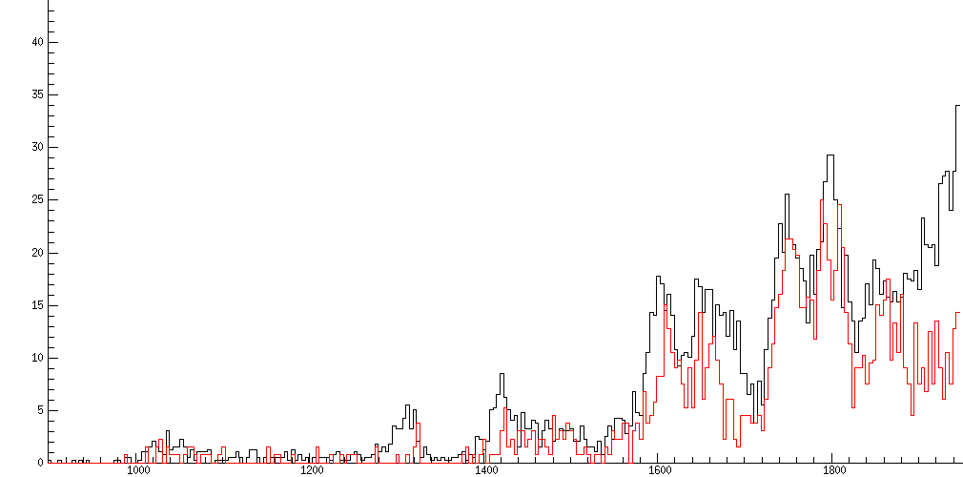
^{38g,m}K(d,p)³⁹K
ReA3/NSCL (18037)
S.D. Pain et al.
16
³⁸Ar(d,p)
16
^{38g,m}K(d,p)
14
14
12
12
10
10
Energy (MeV)
Energy (MeV)
8
8
6
6
150 ms breeding time
4
4
2
2
50 75 100 125 150 175
Lab angle (deg)
50 75 100 125 150 175
Lab angle (deg)
[GS + isomer]
[GS ‘only’]
scaled by # incident ³⁸K GS ions
ASTRO
Implant-decay curve
^{38g}K
^{38m}K
Difference = isomer contribution
1.5 s breeding time
0
2
4
6
8
Excitation energy (MeV)

Slide 17

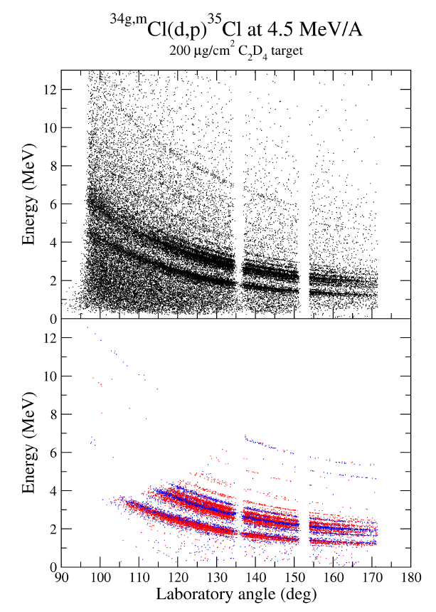
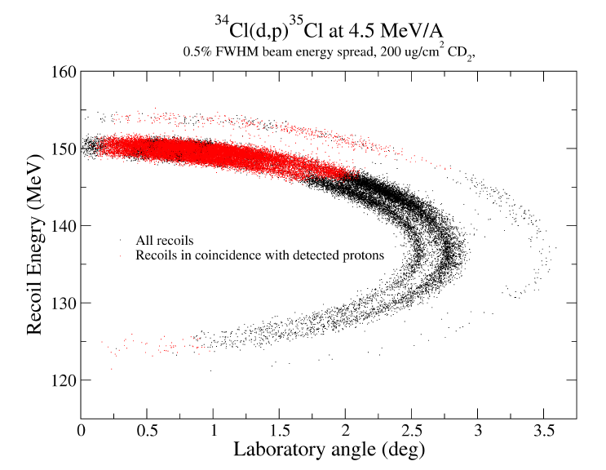
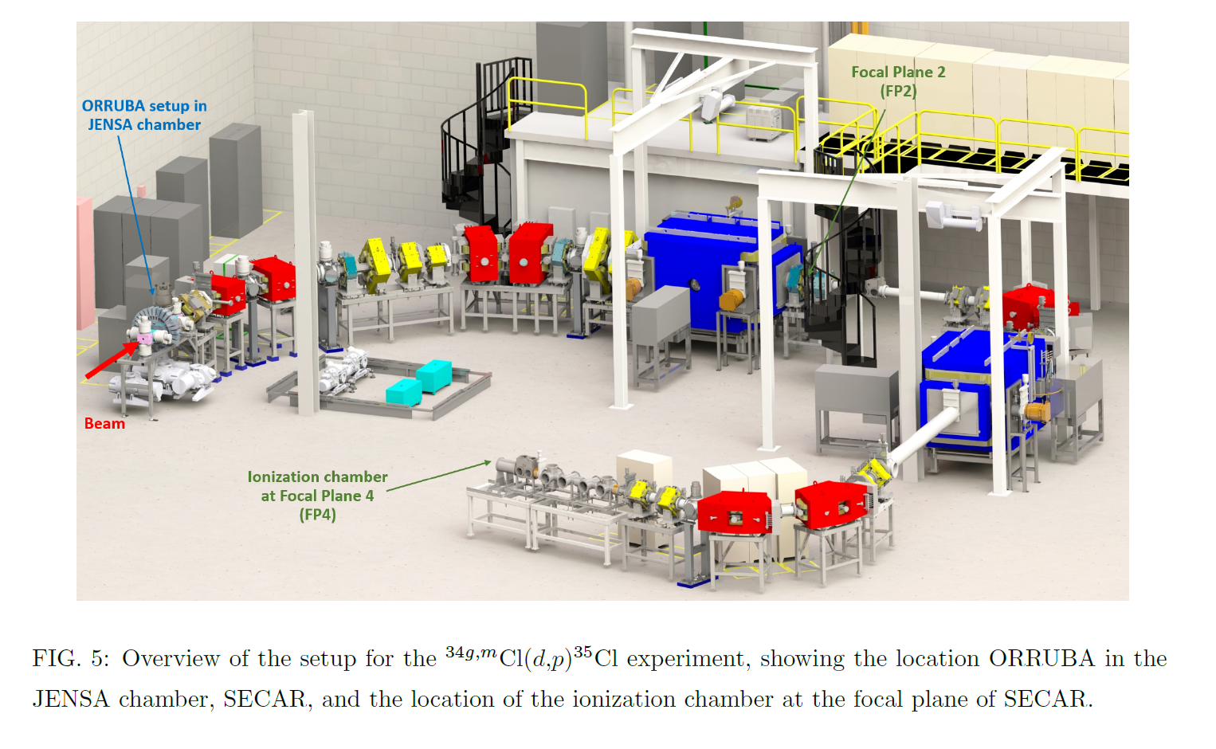
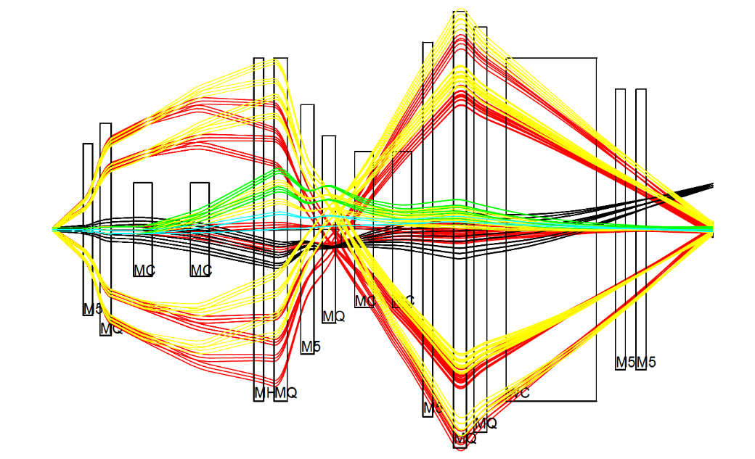
^{34g,m}Cl(d,p) at FRIB…
Measure ^{34g,m}Cl(d,p)
  10⁵ ions/s
Develop use of SECAR as recoil separator for transfer
S.D. Pain et al.,
Approved FRIB PAC1 (e21067)
Ashwin Nagarajan
(UTK/ORNL)
ORRUBA singles
ORRUBA+SECAR
³⁴Cl
³⁵Cl

Slide 18
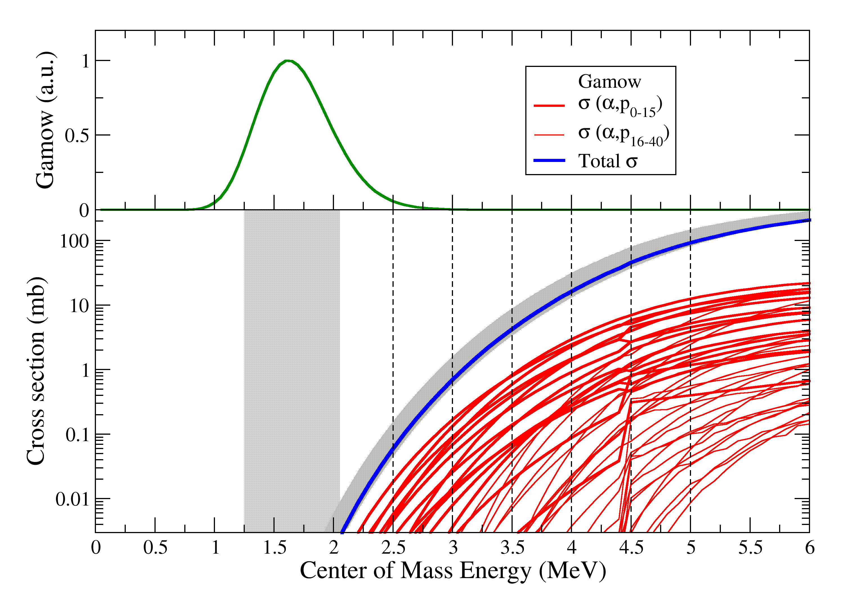

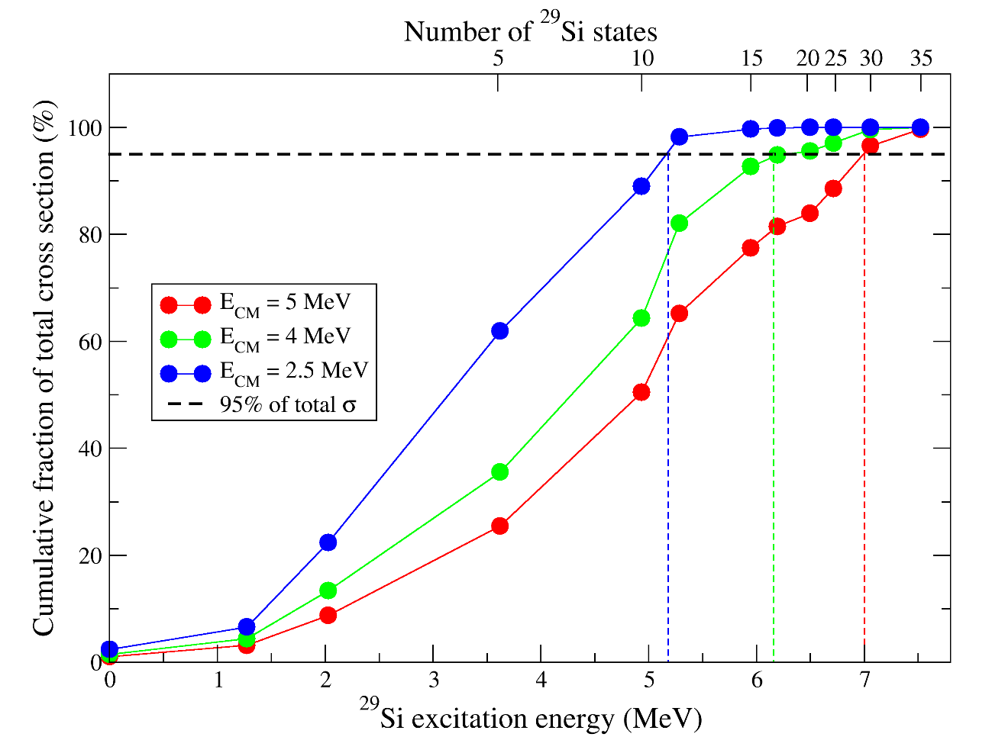
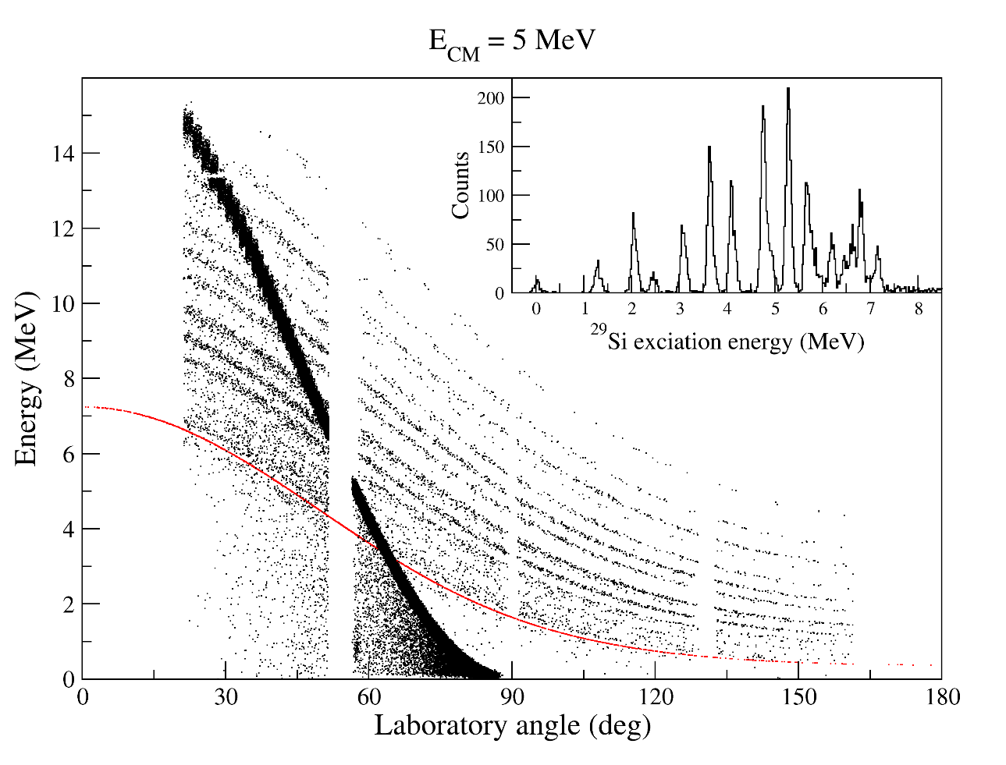
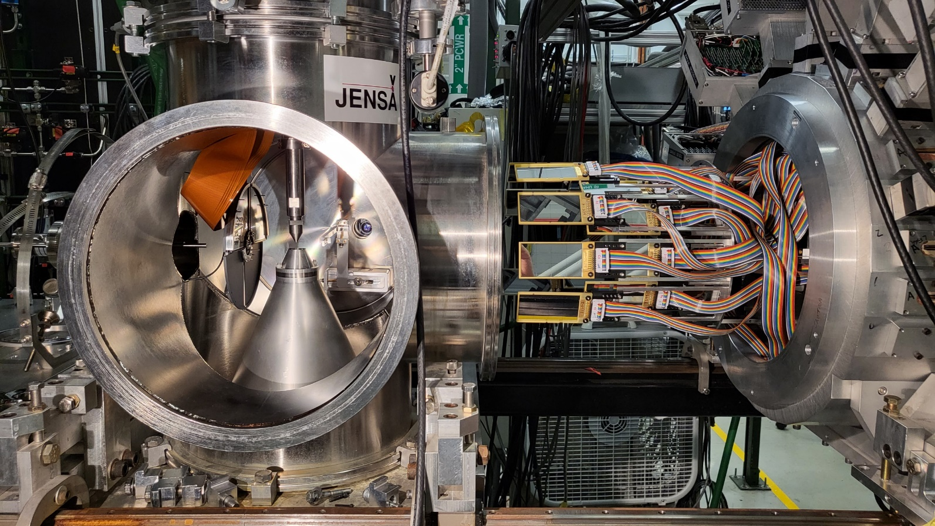
^{26g}Al(α,p) at ReA
Measurement completed April 30 2022
²⁶Al(a,p) impact in multi-zone XRB models
10⁶ pps batch-mode beam (cf 10³⁻⁴ for ³⁴Ar and ⁵⁶Ni)
Direct measurement of the reaction cross section just above the Gamow window
Test of whether/how well HF works and constrain into GW
Constrain partial cross sections at high energies, and total cross section at lower energies

Slide 19
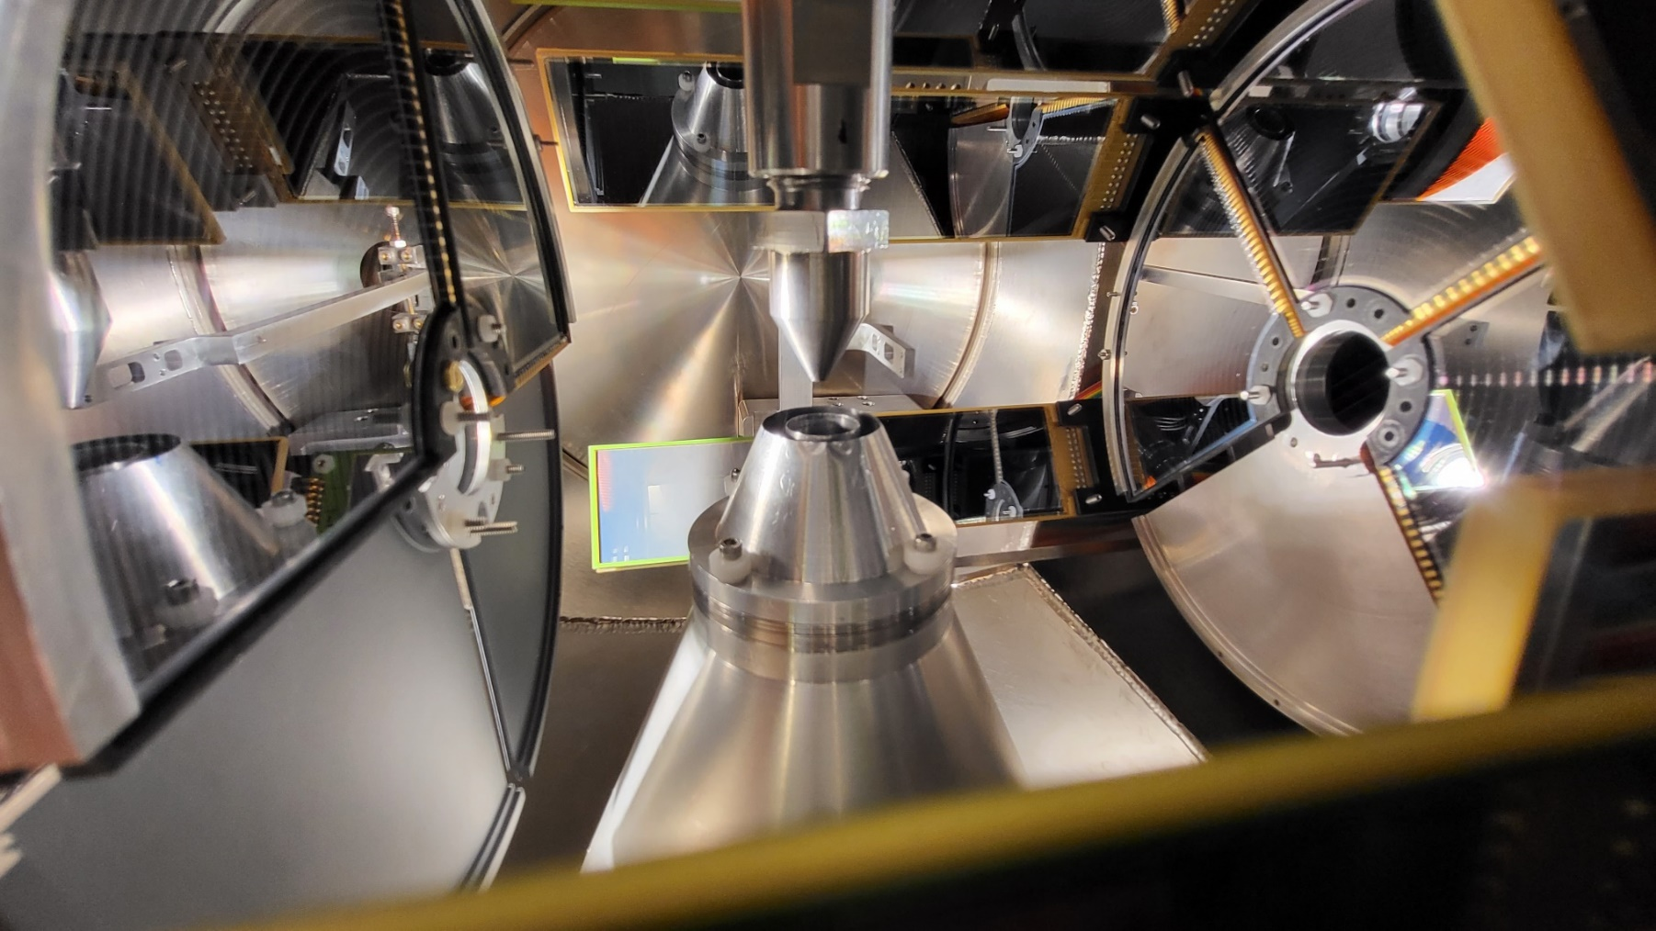
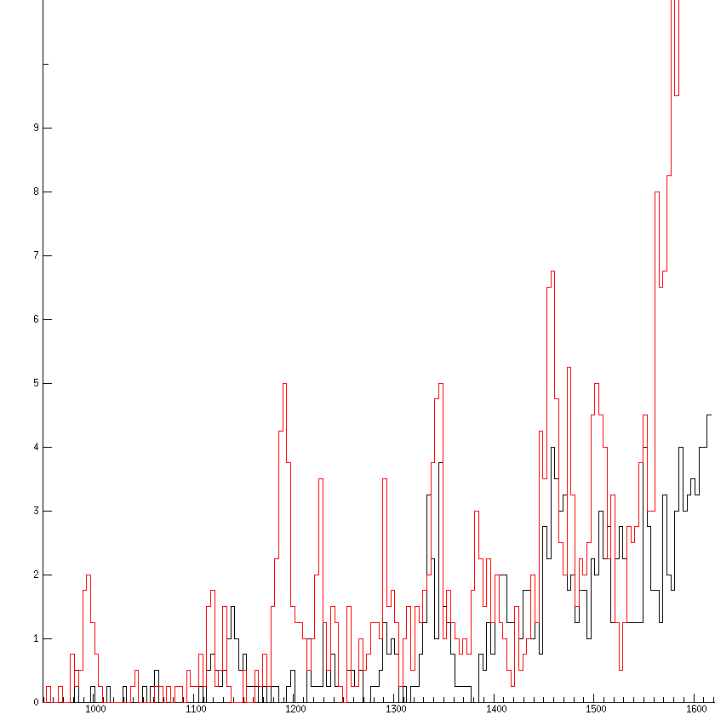
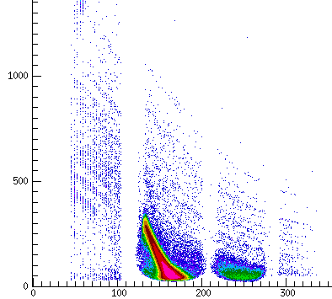
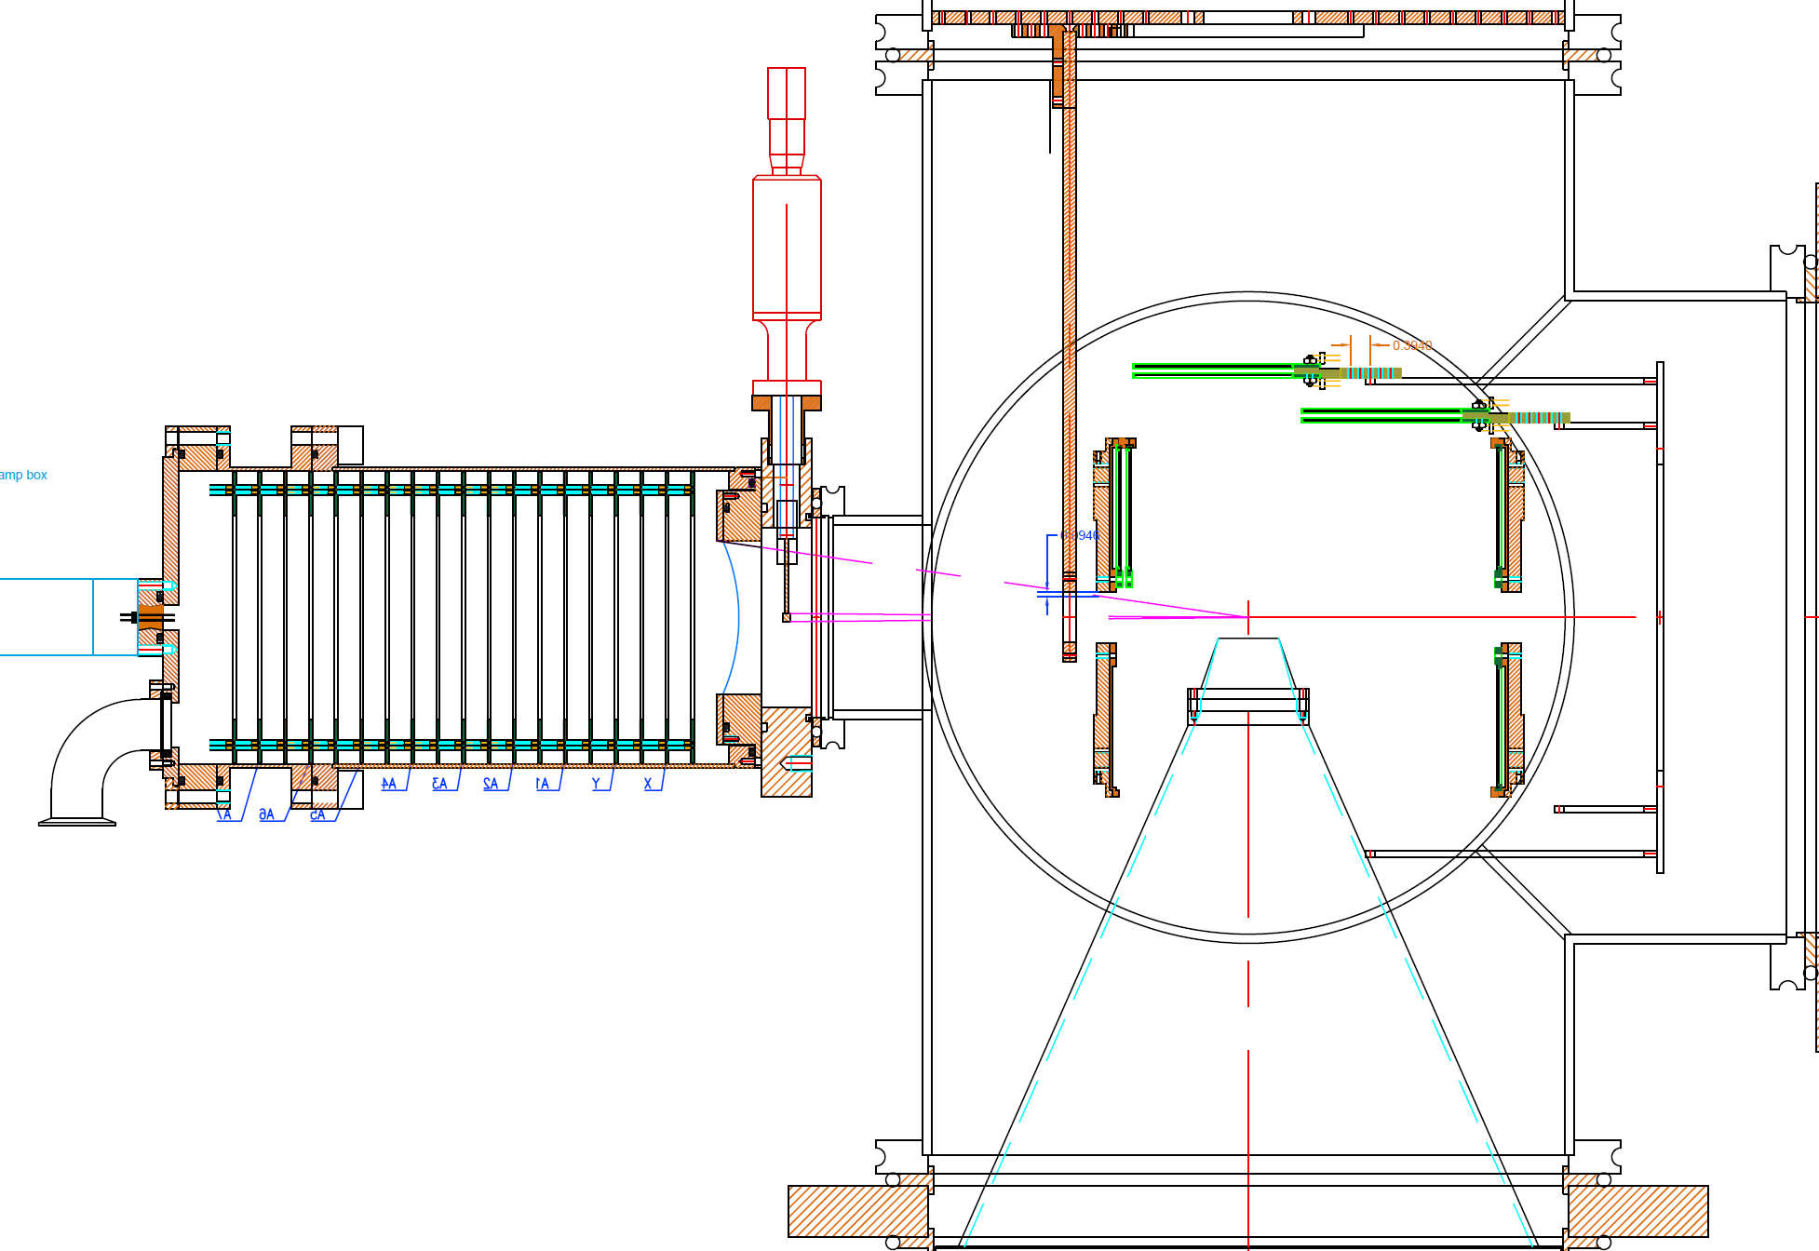
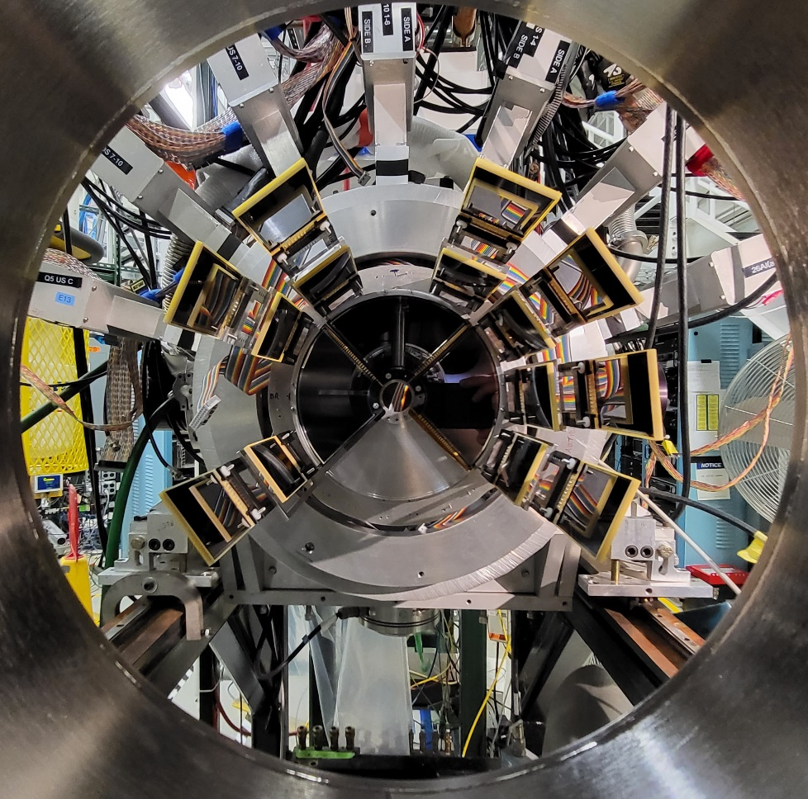
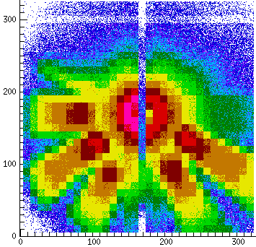
^{26g}Al(α,p) at ReA
6 mm blocker
0 1 2 3 4 5 6
E_{x} (MeV)
IC Y
IC
IC X

Slide 20

New approach: obtaining a pure ^{26m}Al beams at ReA
Tune ARIS for ²⁶Si
²⁶Si decays exclusively (>99.9%) to the 0⁺ ^{26m}Al
²⁶Si β decay t_{1/2} ~2 sec
^{26m}Al β decay t_{1/2} ~6 sec
2-3 s holdup time (a la ³⁸K) is enough to convert most of the ²⁶Si to ^{26m}Al
Beam of pure IS – proceed directly to measure ^{26m}Al(α,p) (do not pass GS)
S.D. Pain et al.,
Approved FRIB PAC2 (e23079)
^{26m}Al
²⁶Si
Cooler-buncher + EBIT
Gas stopper
ARIS

Slide 21








Summary
Thanks
ReA@FRIB provides some unique opportunities for astro-motivated isomer studies
Two approaches to delivering reaccelerated isomer beams at FRIB
  Tune for fragment of interest, get mixed GS/IS beams, and adjust GS:IS composition without impact on other experimental parameters
  Pure IS (mostly) beams by tuning fragment separator for parent
  Reaccelerated beam quality
Applied to ^{38g,m}K(p,γ) via ^{38g,m}K(d,p) using mirror symmetry
^{34g,m}Cl(d,p) run upcoming (ORRUBA+SECAR)
^{26g}Al(α,p) recently completed (ORRUBA+JENSA)
^{26m}Al(α,p) and ²⁶Si(α,p) approved(ORRUBA+JENSA)
Future opportunities with other devices beams and other devices (eg SECAR, GODDESS, SOLARIS, …)
ORRUBA, JENSA and SECAR Collaborations
ReA: A. Henriques, A. Lapierre, K. Lund, Y. Liu S. Nash, C. Sumithrarachchi, A. Villari
Si detector array

