Slide 1


Improving the theoretical description of nuclear β-decay half-lives
Ante Ravlić (ravlic@frib.msu.edu)
Facility for Rare Isotope Beams, Michigan State University
In collaboration with: W. Nazarewicz, K. Godbey, P. Giuliani, L. Jin, S. Lalit, N. Paar
14th International Conference on Nucleus-Nucleus Collisions (NN2024), Aug 18—23 2024, Whistler, Canada

Slide 2
D3C* relativistic EDF
FT-HBCS+FT-QRPA
Spherical symmetry
Impact of stellar environment on decay rates ?
[A. Ravlić, E. Yüksel, Y. F. Niu, and N. Paar, PRC 104, 054318 (2021).]
[A. Ravlić, E. Yüksel, Y. F. Niu, G. Colò, E. Khan, and N. Paar, PRC 102, 065804 (2020).]

Slide 3
What’s on the market ?
T. Marketin, L. Huther, and G. Martínez-Pinedo, PRC 93, 025805 (2016)
Relativistic D3C* interaction, includes allowed (1+) and first-forbidden (0-,1-,2-), restricted to spherical symmetry, false vacuum for even-even nuclei
E. M. Ney, J. Engel, T. Li, and N. Schunk, PRC 102, 034326 (2020)
Non-relativistic SkO’, includes allowed (1+) and first-forbidden (0-,1-,2-), axially-deformed nuclei, EFA blocking for odd nuclei, simple uncertainty estimate
A. Ravlic, W. Nazarewicz, N. Paar (in preparation, 2024)
Relativistic DD-PC interactions, includes allowed (1+) and first-forbidden (0-,1-,2-), axially-deformed nuclei, EFA blocking for odd nuclei, statistical uncertainty propagation

Slide 4

β-decay rate within first-order perturbation theory:
Phase-space factor
Shape-factor
$β^{−}$-decay scheme:
[H. Behrens, W. Buhring, Nucl. Phys. A, 162(1), 114-144 (1971).]

Slide 5

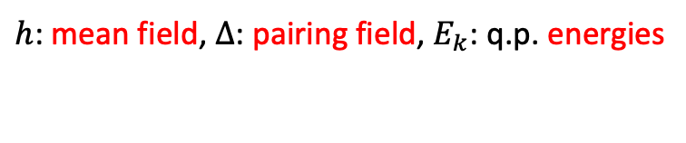
Ground state
Excited states
[T. Nikšić, D. Vretenar, and P. Ring, Phys. Rev. C 78, 034318 (2008).]
[A. Ravlić et al., PRC 104, 064302 (2021).]
[A. Ravlić et al., PRC 109, 014318 (2024).]
[A. Ravlić, et al., arXiv:2404.13266, accepted in PRC (2024).]
Solve relativistic Hartree-Bogoliubov equation:
Solve linear response QRPA* equation:
$h$: mean field, $Δ$: pairing field, $E_{k}$: q.p. energies
$F^{20},F^{02}$: q.p. comps of ext. field, $A,B:$ 2-body mat.els.
Quadrupole constraint ($β_{2}$) potential energy curve (PEC):
Strength function decomposed to $K$ projections:

Slide 6
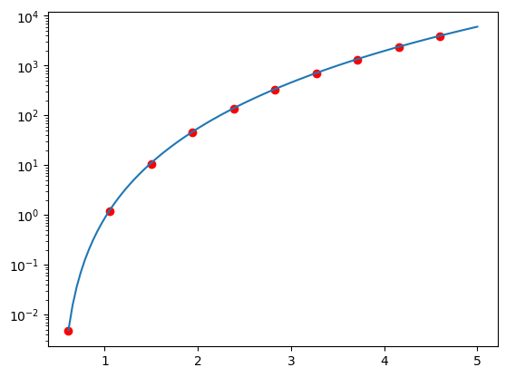
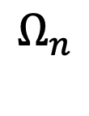



$$Ω_{1}$$
$$Ω_{2}$$
$$Ω_{n}$$
Turn decay rate expression into contour integration:
Phase-space factor is not an analytic function in cmplx plane:
Phase-space factor [arb. Unit.]
Original
PolyFit
[A. Ravlić, W. Nazarewicz, in preparation (2024).]
End-point energy $W_{0}$

Slide 7
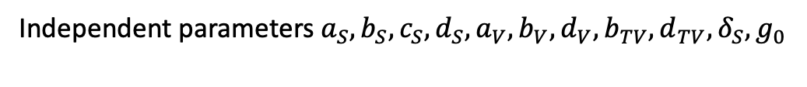
[T. Nikšić, D. Vretenar, and P. Ring, Phys. Rev. C 78, 034318 (2008).]
Particle-hole channel:
Independent parameters $a_{S}, b_{S}, c_{S}, d_{S}, a_{V}, b_{V}, d_{V}, b_{TV}, d_{TV}, δ_{S}, g_{0}$
Particle-particle channel:
Isovector pairing
Isoscalar pairing

Slide 8
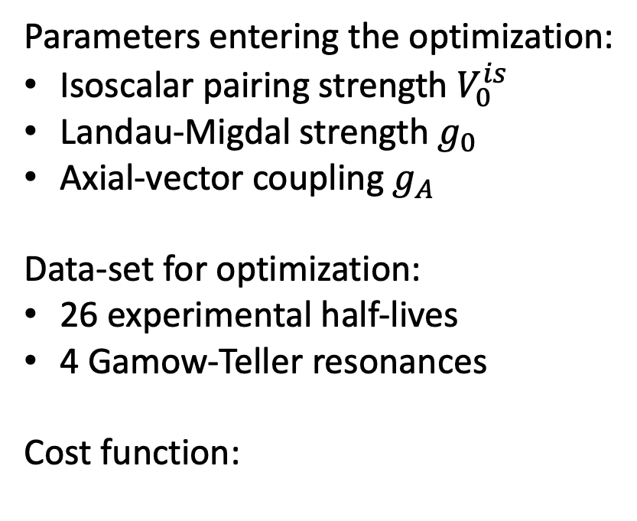
Optimization ?
[A. Ravlić, W. Nazarewicz, in preparation (2024).]
Optimal parameters:
Parameters entering the optimization:
Isoscalar pairing strength $V_{0}^{is}$
Landau-Migdal strength $g_{0}$
Axial-vector coupling $g_{A}$
Data-set for optimization:
26 experimental half-lives
4 Gamow-Teller resonances
Cost function:
Sensitivity matrix:
: model predictions
: exp .data
: weights

Slide 9
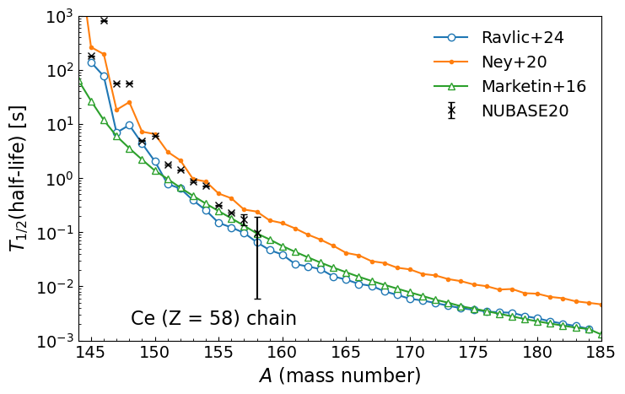
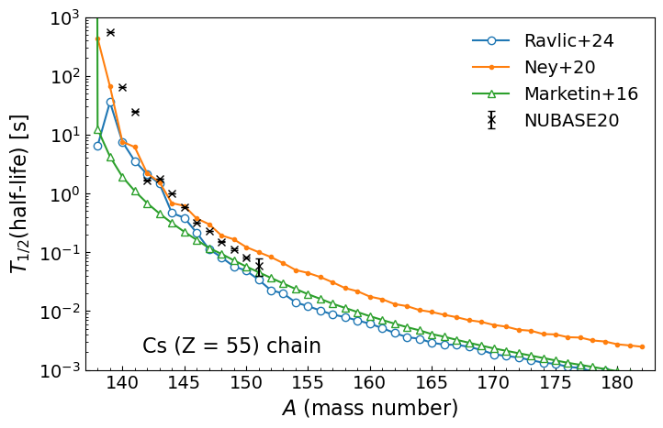
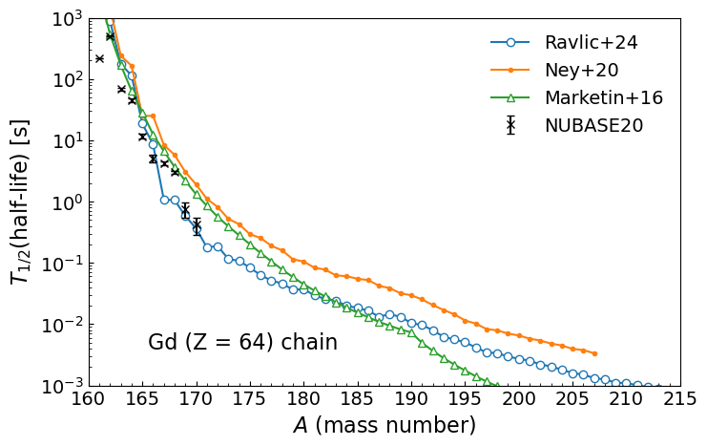
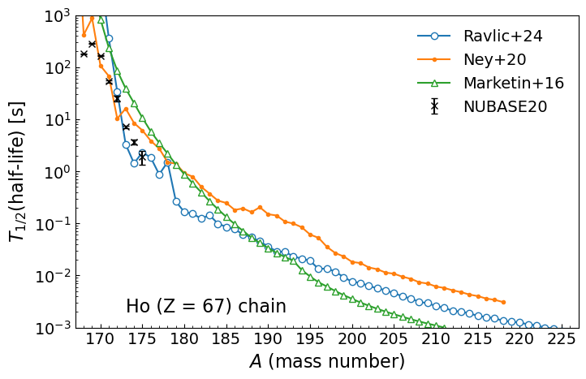
odd-Z chains
even-Z chains

Slide 10
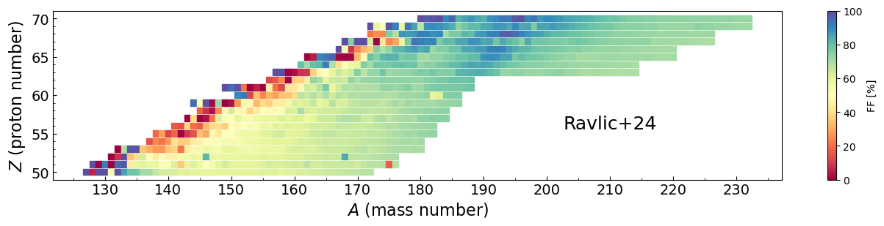
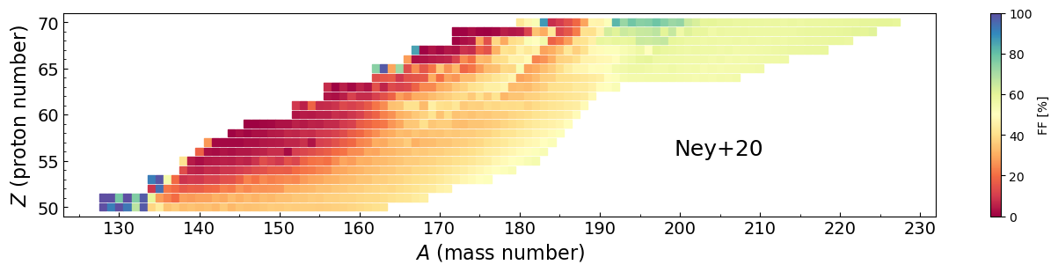
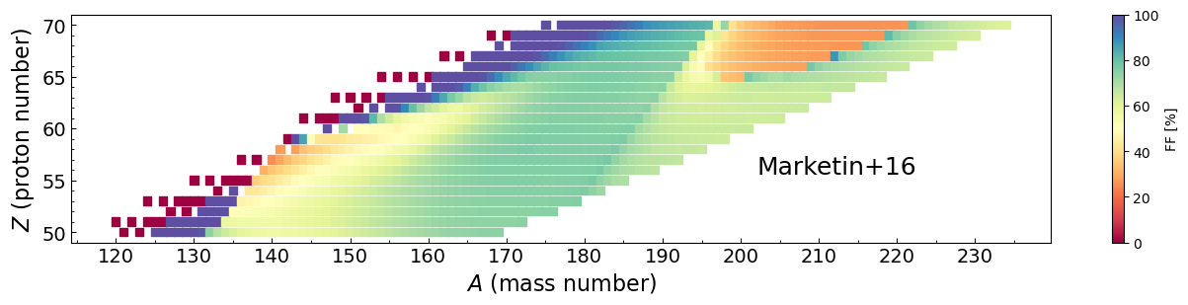
Contribution of first-forbidden transitions

Slide 11
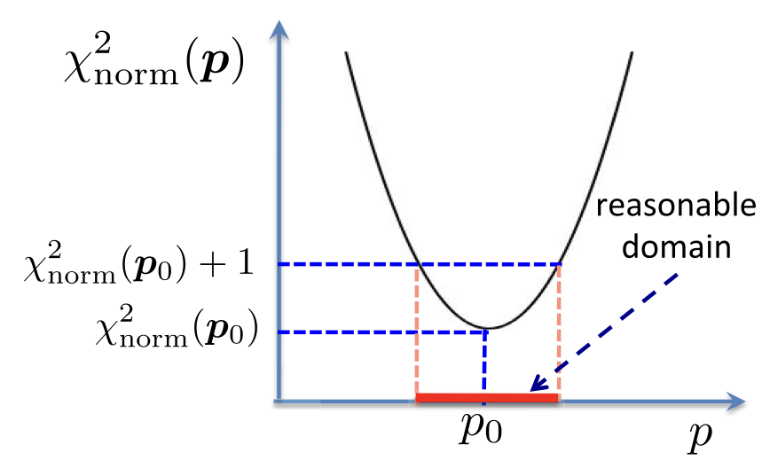
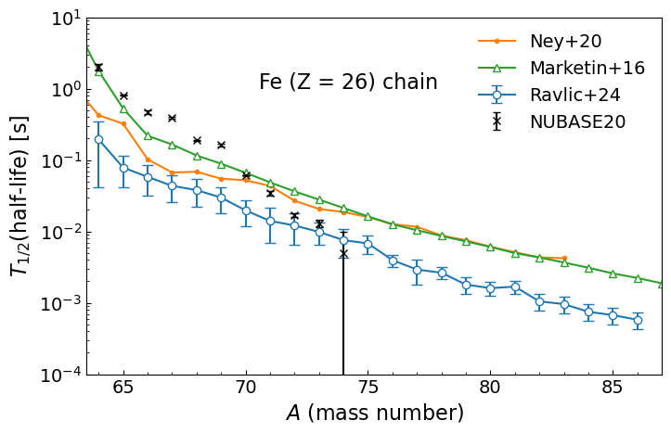
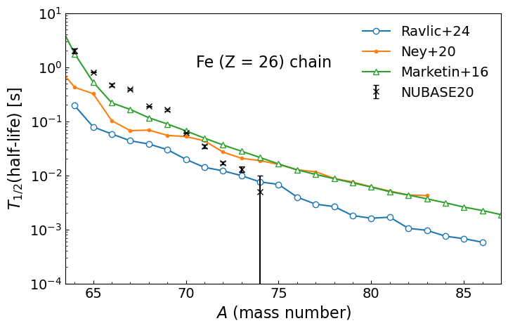
[J. Dobaczewski, W. Nazarewicz, P-G. Reinhard, J. Phys. G: Nucl. Part. Phys., 41, 074001 (2014)].

Slide 12
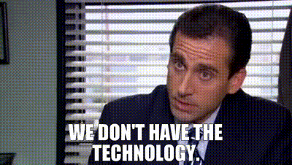
[L. Jin, A. Ravlic, K. Godbey, P. Giuliani, W. Nazarewicz, in preparation (2024).]
QRPA matrix has the form:
What if we want to study how the
Strength changes with parameters ?
Sampling lots of parameters numerically very challenging, especially for deformed nuclei
Chi2 optimization is hard enough, Bayesian UQ nearly impossible

Slide 13
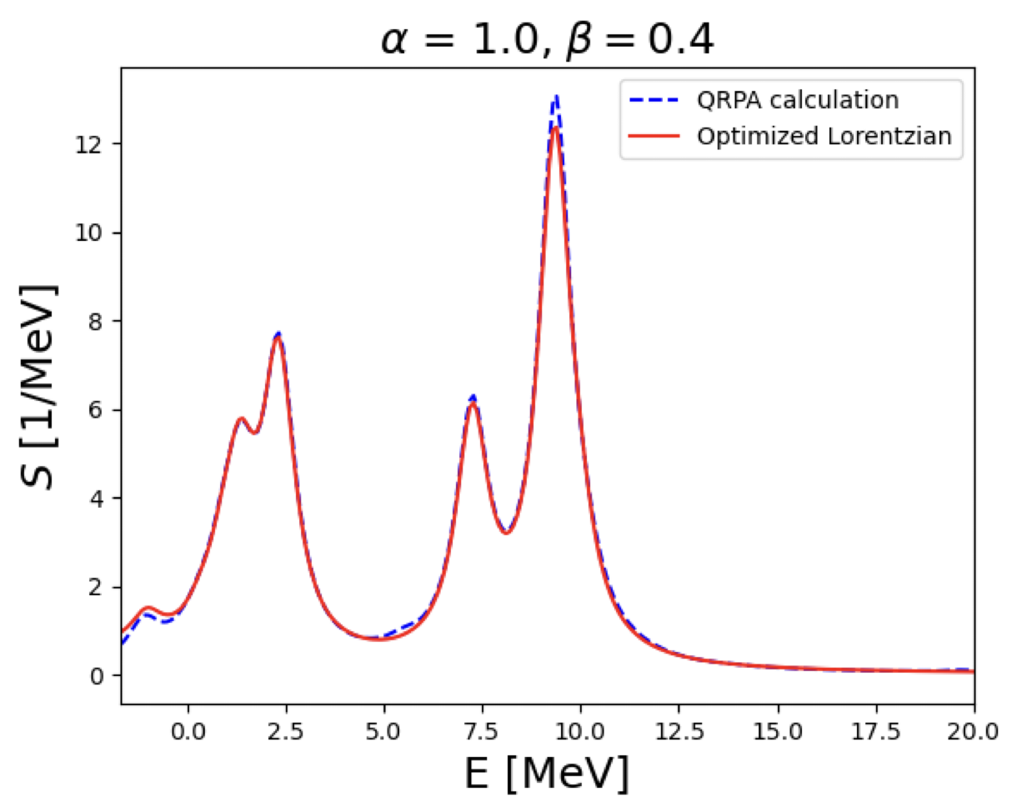
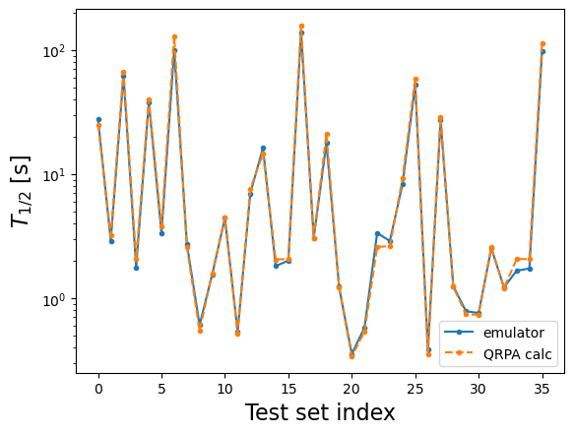
[P Cook, D Jammooa, M Hjorth-Jensen, DD Lee, D Lee, arXiv preprint arXiv:2401.11694]
Parametric matrix model (PMM):
Test
Train

Slide 14
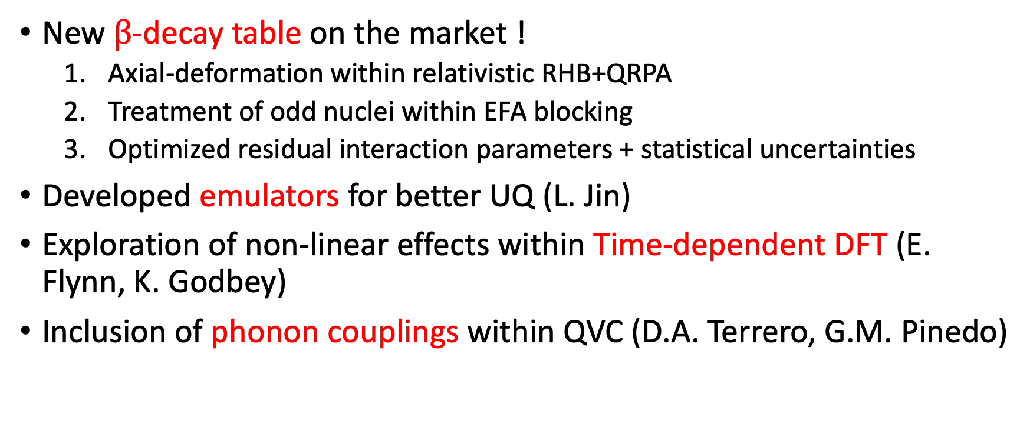
Outlook
New $β$-decay table on the market !
  Axial-deformation within relativistic RHB+QRPA
  Treatment of odd nuclei within EFA blocking
  Optimized residual interaction parameters + statistical uncertainties
Developed emulators for better UQ (L. Jin)
Exploration of non-linear effects within Time-dependent DFT (E. Flynn, K. Godbey)
Inclusion of phonon couplings within QVC (D.A. Terrero, G.M. Pinedo)

Slide 15

Thank you !
MSU/FRIB: Witek Nazarewicz, Kyle Godbey, Pablo Giuliani, Sudhanva Lalit
MSU/The University of Toledo: Lauren Jin
University of Zagreb: Nils Paar, Tamara Niksic
GSI/TU Darmstadt: Diana Alvear-Terrero, Gabriel Martinez-Pinedo, Caroline Robin
This work was supported by the U.S. Department of Energy under Award Number DE-NA0004074 (NNSA, the Stewardship Science Academic Alliances program) and the US National Science Foundation under Grant PHY-1927130 (AccelNet-WOU: International Research Network for Nuclear Astrophysics [IReNA])

