Slide 1
The Upgrade of the Facility EXOTIC
Marco Mazzocco
Dipartimento di Fisica e Astronomia, Università di Padova and INFN-Sezione di Padova
14th International Conference on Nucleus-Nucleus Collisions
Whistler, BC Canada
August 18-23, 2024

Slide 2
RIB In-Flight Production with EXOTIC
EXOTIC is an in-flight facility for the production of light weakly-bound RIBs, employing two-body inverse kinematics reactions with heavy-ion beams from the LNL-XTU tandem accelerator impinging on gas targets (p,d,³He).
The facility EXOTIC was commissioned in 2004 and then upgraded in 2012. F. Farinon et al., NIM B 266, 4097 (2008), M. Mazzocco et al., NIM B 317, 223 (2013).
8 Radioactive Ion Beams have been delivered so far:
  ¹⁷F (S_{p} = 600 keV) p(¹⁷O,¹⁷F)n Q_{value} = – 3.54 MeV;
  ⁸B (S_{p} = 137.5 keV) ³He(⁶Li,⁸B)n Q_{value} = – 1.97 MeV;
  ⁷Be (S_{α} = 1.586 MeV) p(⁷Li,⁷Be)n Q_{value} = – 1.64 MeV;
  ¹⁵O (S_{p} = 7.297 MeV) p(¹⁵N,¹⁵O)n Q_{value} = – 3.54 MeV;
  ⁸Li (S_{n} = 2.033 MeV) d(⁷Li,⁸Li)p Q_{value} = – 0.19 MeV;
  ¹⁰C (S_{p} = 4.007 MeV) p(¹⁰B,¹⁰C)n Q_{value} = – 4.43 MeV;
  ¹¹C (S_{p} = 8.689 MeV) p(¹¹B,¹¹C)n Q_{value} = – 2.76 MeV;
  ¹⁸Ne (S_{p} = 3.923 MeV) ³He(¹⁶O,¹⁸Ne)n Q_{value} = – 3.19 MeV.
Notes:
Preferire un carattere sans serif come Arial, Helvetica o Verdana. Font consigliabile da 30 a 40 pt.
Allineare i testi a sinistra, non giustificarli.
Utilizzare non più di tre blocchi di informazione per diapositiva.
Per evidenziare titoli o parole chiave, prediligere l’uso del grassetto a corsivo o colori.
Evitare ombre, sfumature e gradazioni di grigio.
Prestare attenzione al contrasto tra sfondo e testo. Prediligere testo nero su sfondo bianco.

Slide 3
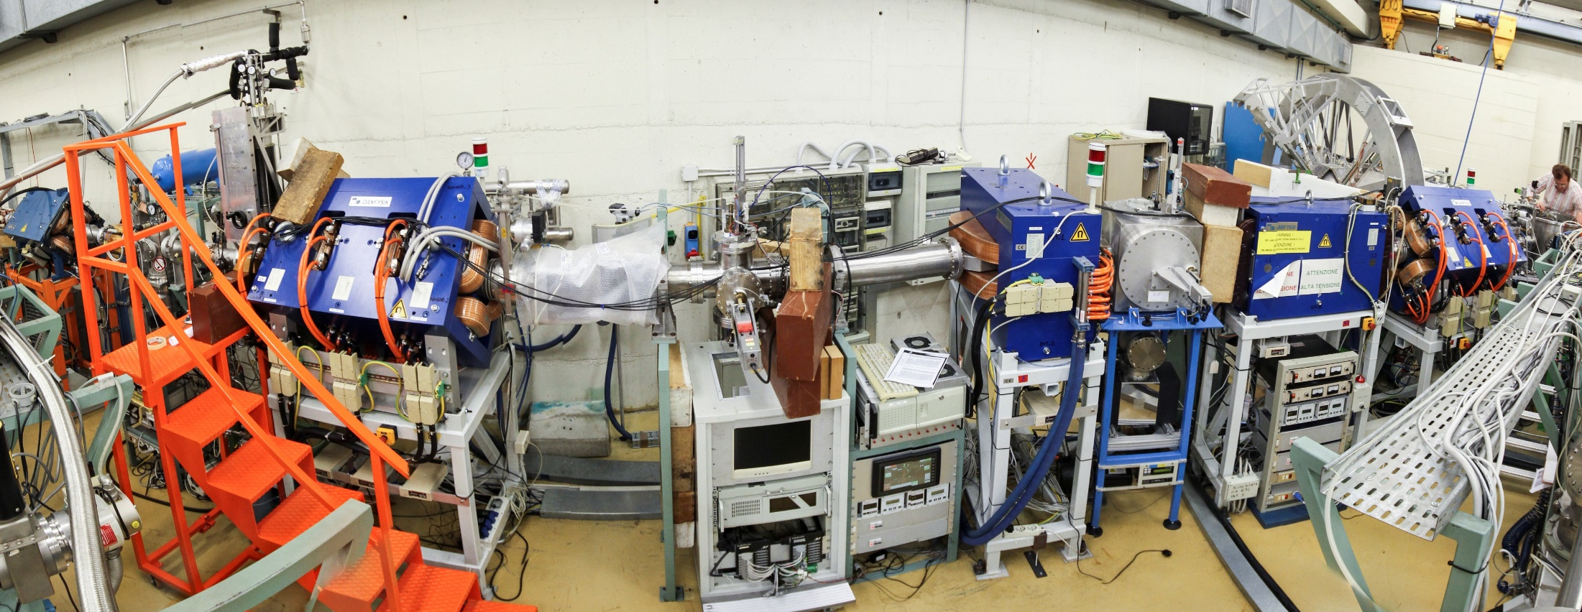
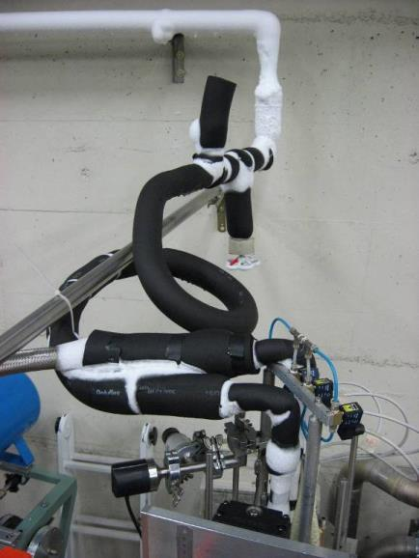
Facility EXOTIC at INFN-LNL
1st Quadrupole Triplet
30°-Dipole Magnet
2nd Quadrupole Triplet
Gas Target
Wien Filter
PRIMARY BEAM
SECONDARY BEAM
S3
Cryogenic Gas Target

Slide 4
Light RIBs at EXOTIC
¹⁷F E = 3–5 MeV/u Purity: 93-96 % Intensity: 10⁵ pps
⁸B E = 3–5 MeV/u Purity: 30-43 % Intensity: ~ 10³ pps
⁷Be E = 2.5–6 MeV/u Purity: 99 % Intensity: 10⁶ pps
¹⁵O E = 1.3 MeV/u Purity: 97-98 % Intensity: 4*10⁴ pps
⁸Li E = 2–2.5 MeV/u Purity: 99 % Intensity: 10⁵ pps
¹⁰C E = 4 MeV/u Purity: 99 % Intensity: 5*10³ pps
¹¹C E = 4 MeV/u Purity: 99 % Intensity: 2*10⁵ pps
¹⁸Ne E = 1.3 MeV/u Purity: 95 % Intensity: 6*10³ pps (under dev.)

Slide 5
Main Investigated Topics with EXOTIC
Reaction Dynamics at Coulomb Barrier Energies
¹⁷F + ²⁰⁸Pb C. Signorini et al., Eur. Phys. J. A 44, 63 (2010)
¹⁷F + ⁵⁸Ni M. Mazzocco et al., Phys. Rev. C 82, 054604 (2010)
¹⁷F + ¹H N. Patronis et al., Phys. Rev. C 85, 024609 (2012)
⁸B + ²⁸Si A. Pakou et al., Phys. Rev. C 87, 014619 (2013)
⁷Be + ⁵⁸Ni M. Mazzocco et al., Phys. Rev. C 92, 024615 (2015)
⁷Be + ²⁰⁸Pb M. Mazzocco et al., Phys. Rev. C 100, 024602 (2019)
⁷Be + ²⁸Si O. Sgouros et al., Phys. Rev. C 94, 044623 (2016), Phys. Rev. C 95, 054609 (2017)
⁸Li + ⁹⁰Zr A. Pakou at al., Eur. Phys. J. A 51, 55 (2015), Eur. Phys. J. A 51, 90 (2015)
⁸B + ²⁸Si C. Parascandolo, D. Pierroutsakou et al., (in preparation)
Resonant Scattering – α clustering
¹⁵O + ⁴He D. Torresi et al., Phys. Rev. C 96, 044317 (2017)
¹¹C + ⁴He D. Torresi, C. Wheldon, C. Parascandolo et al., (in preparation)
Reactions of Astrophysical Interest via Trojan Horse Method
⁷Be + ²H L. Lamia et al., Ap. J. 879, 23 (2019)

Slide 6
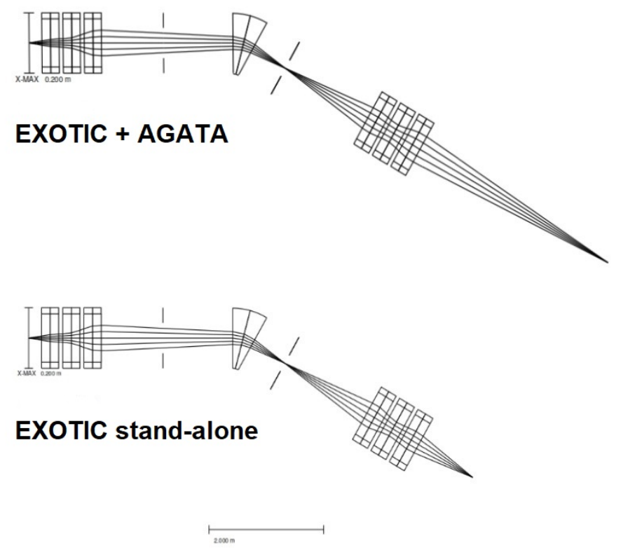
EXOTIC and AGATA (March 2021)
With the installation of AGATA, the two reaction chambers located in the proximity of the final focal plane of EXOTIC had to be removed.
Nevertheless, the AGATA focal plane, in the PRISMA-AGATA configuration, is located 2.68 m downstream the original final focal plane and ion-optical calculations proved the possibility of coupling EXOTIC and AGATA.

Slide 7
RIB Intensities for EXOTIC + AGATA
According to the ion-optical simulations, a ~50%-reduction in secondary beam intensity (with respect to the EXOTIC stand-alone configuration) is estimated for a target diameter of 15 mm.

Slide 8
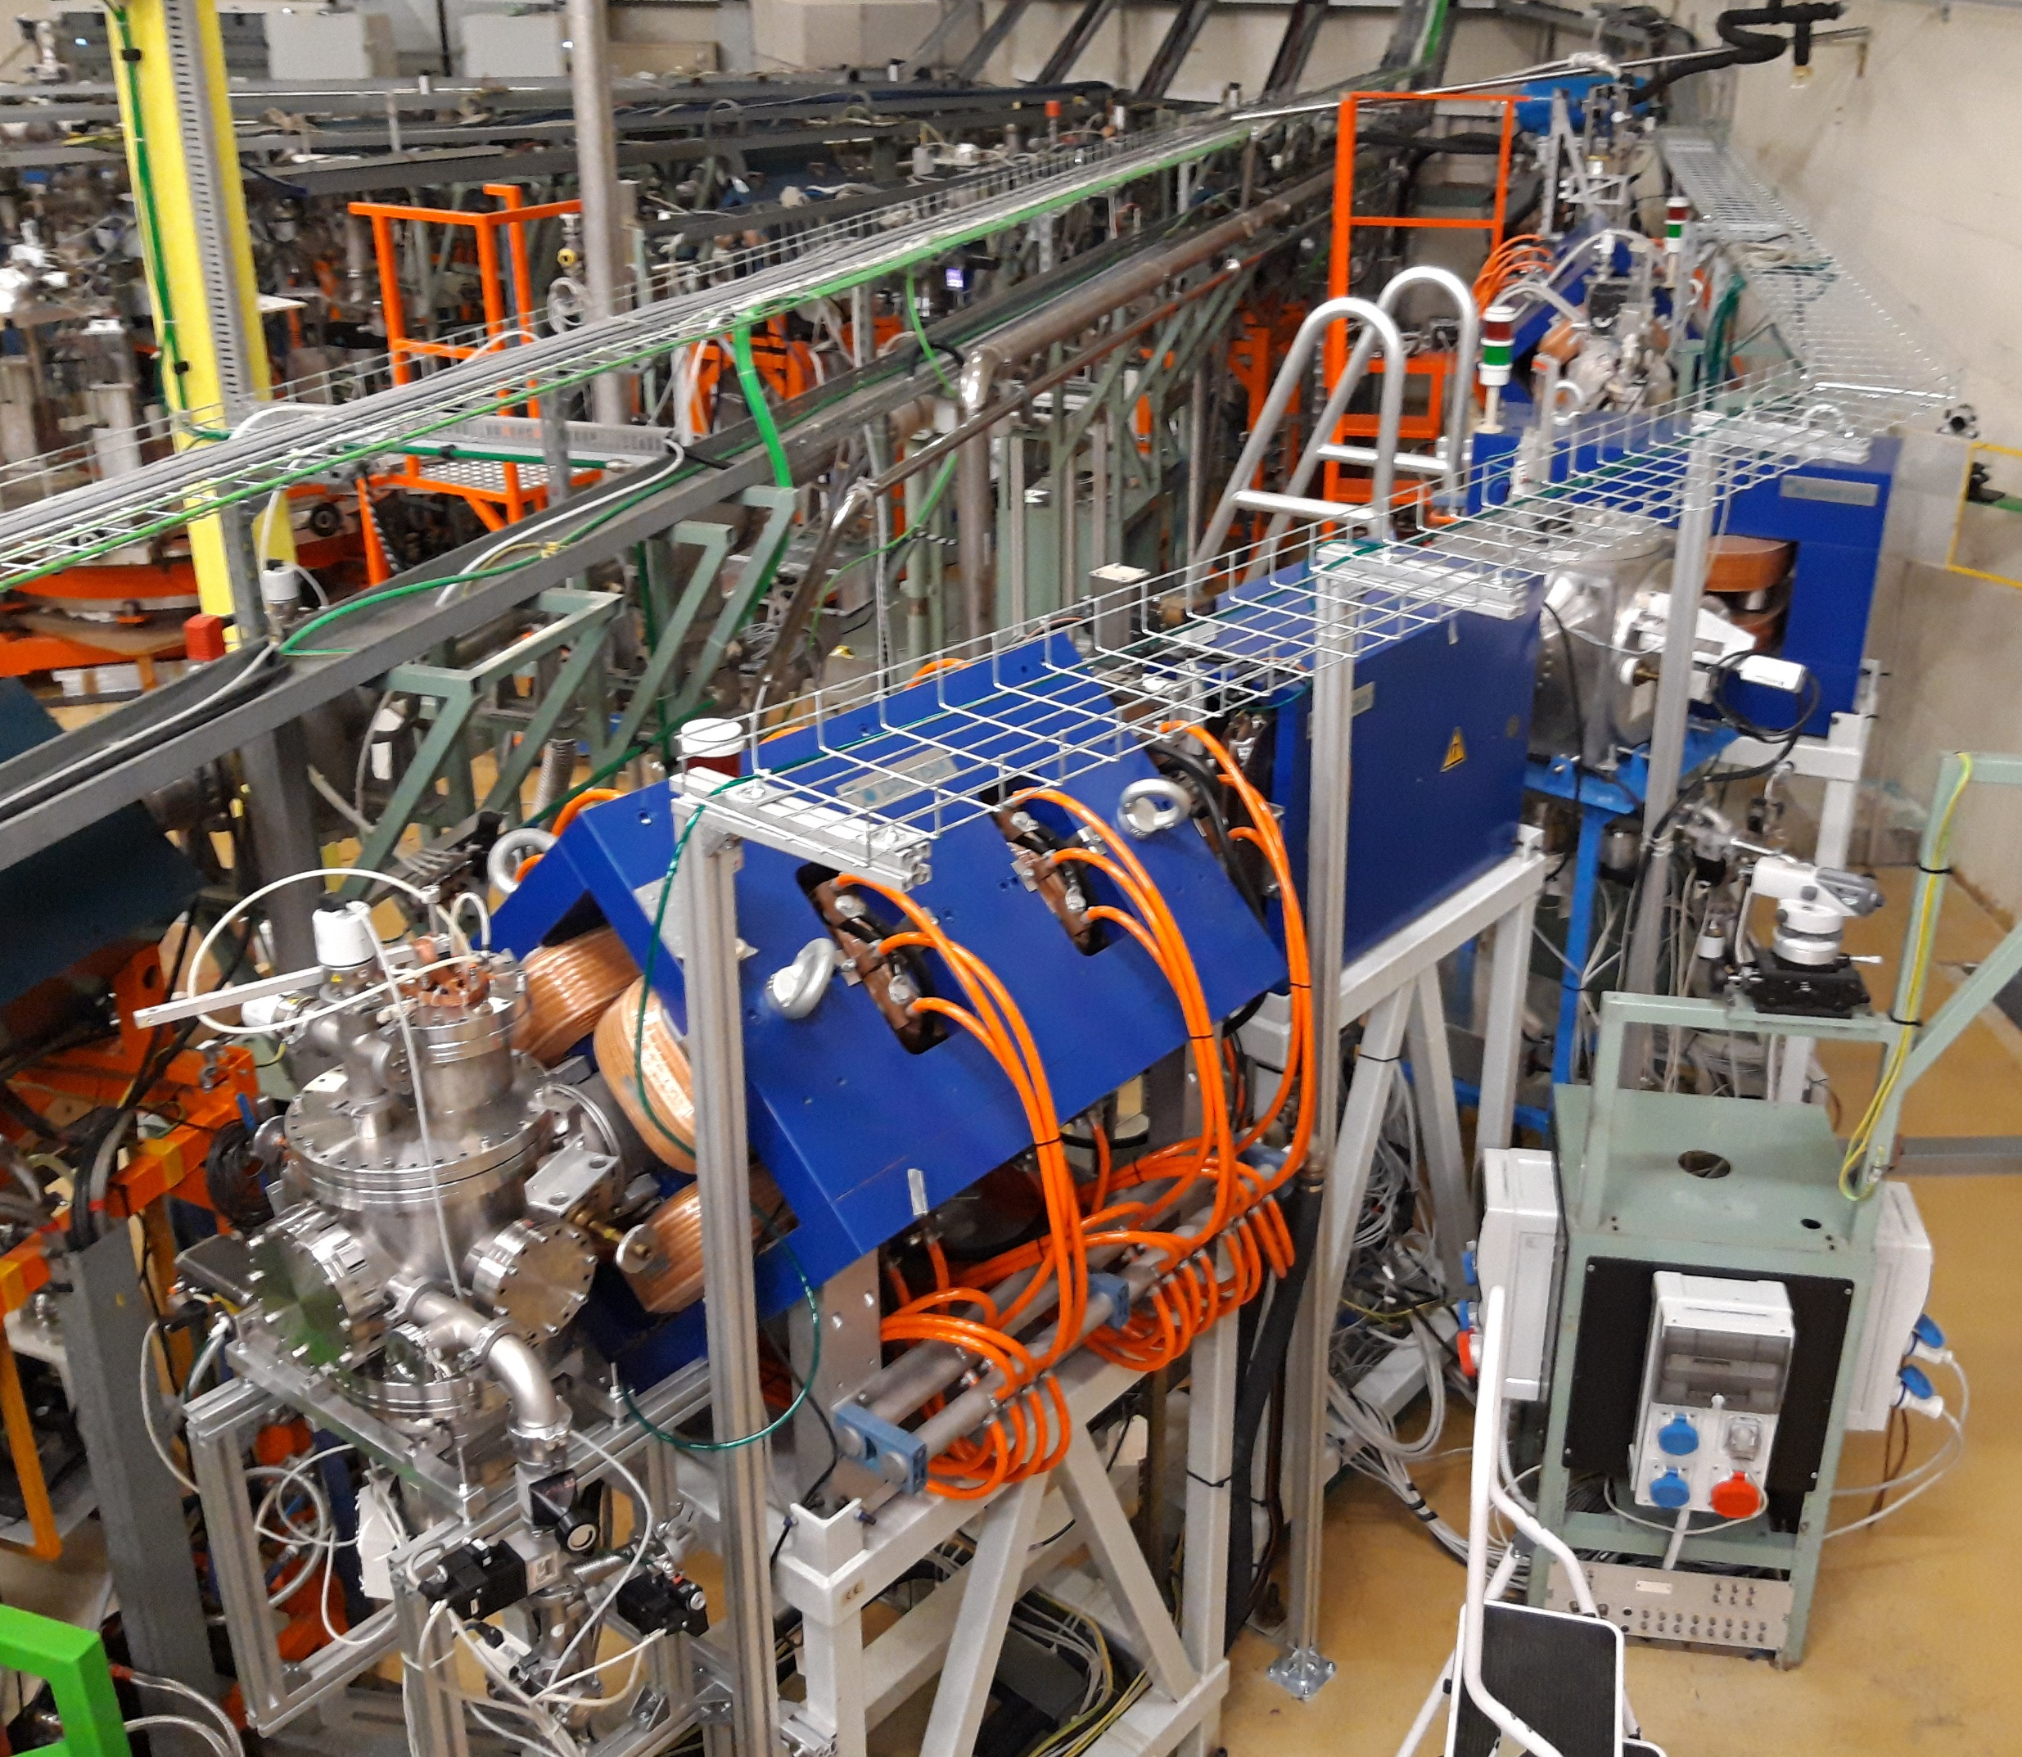
Upgrade of EXOTIC (2023)
Power lines
Signal cables
Beam diagnostics
Vacuum control
Gas target control
LN₂ pile-line insulation
Water collector and pipelines for cooling the magnets
Magnets and Wien Filter remote control
Slit remote control
Teslameters
Compressed air
Tracking detectors

Slide 9
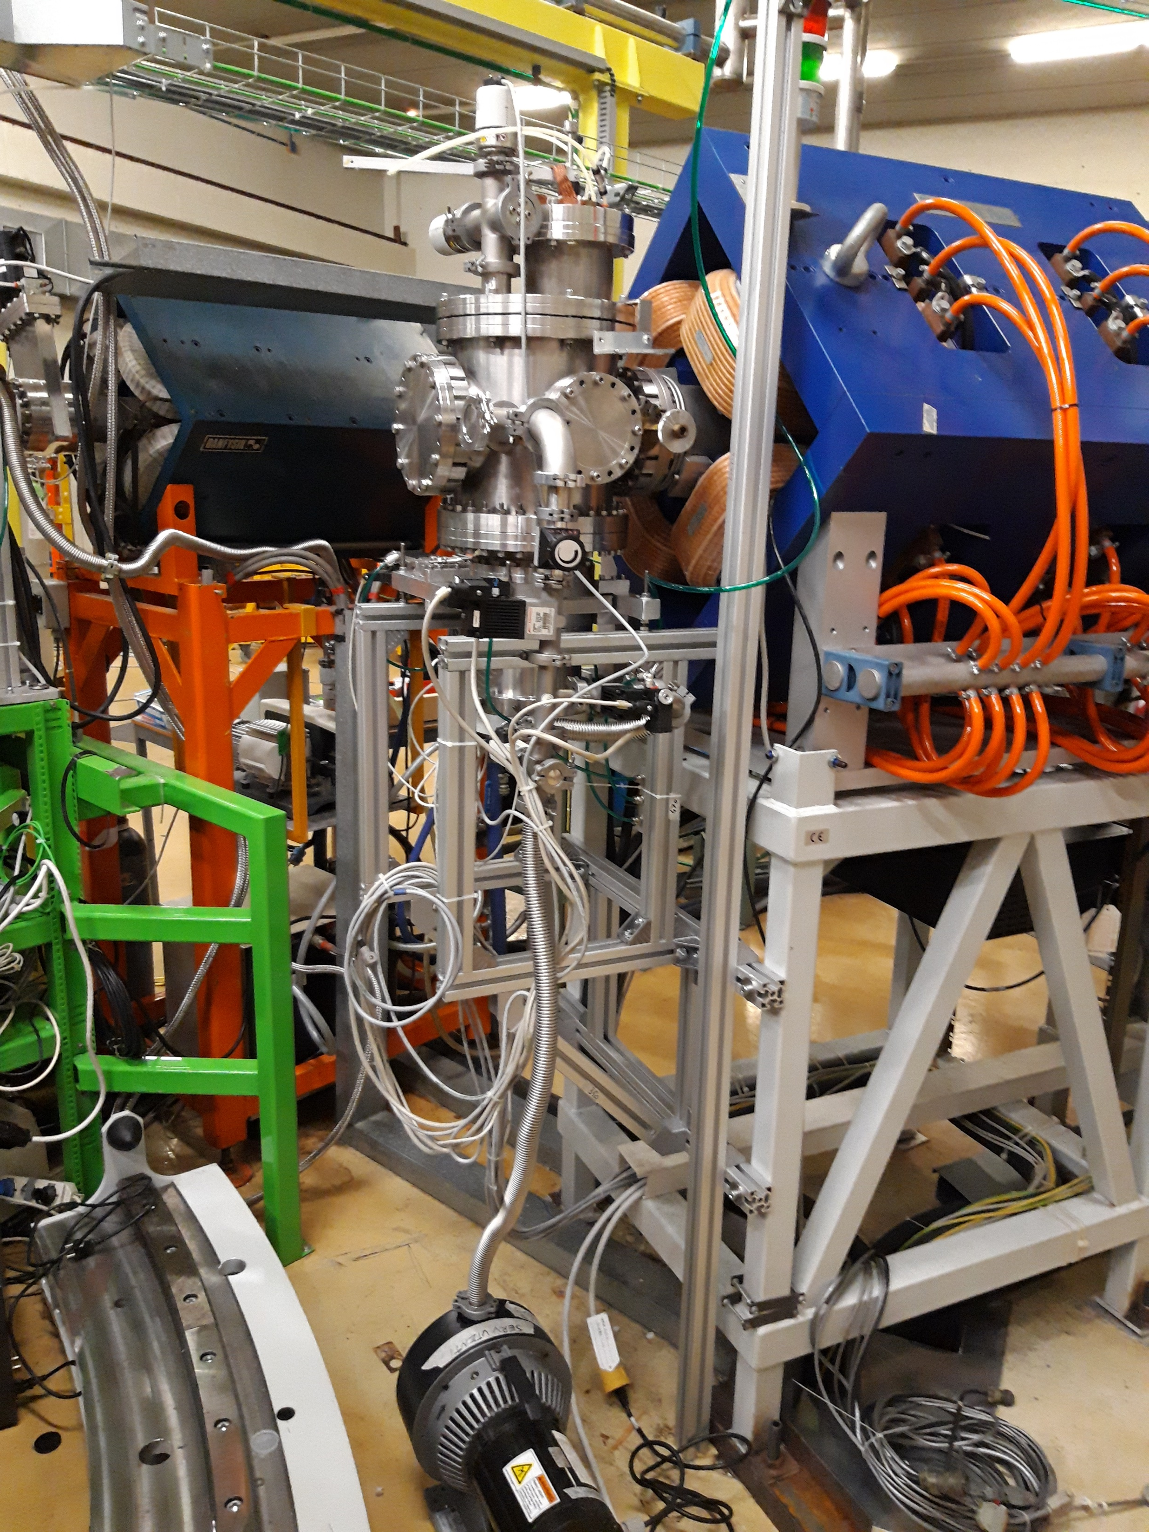
1st Commissioning Run (Oct. 28-29, 2023)
First experimental run with EXOTIC after nearly 4 years of inactivity.
Beam: ⁷Li³⁺, 48 MeV, 1-35 pnA
Target: ¹H₂, 1 bar, -184° C
RIB: ⁷Be⁴⁺, ~42 MeV
Reoptimization of the primary beam focussing procedure.
Quickly reproduced the secondary beam production conditions of November 2013.
Tuning of the ion optical elements of the beamline.
Test of the AGATA performance and neutron flux on the detectors.

Slide 10
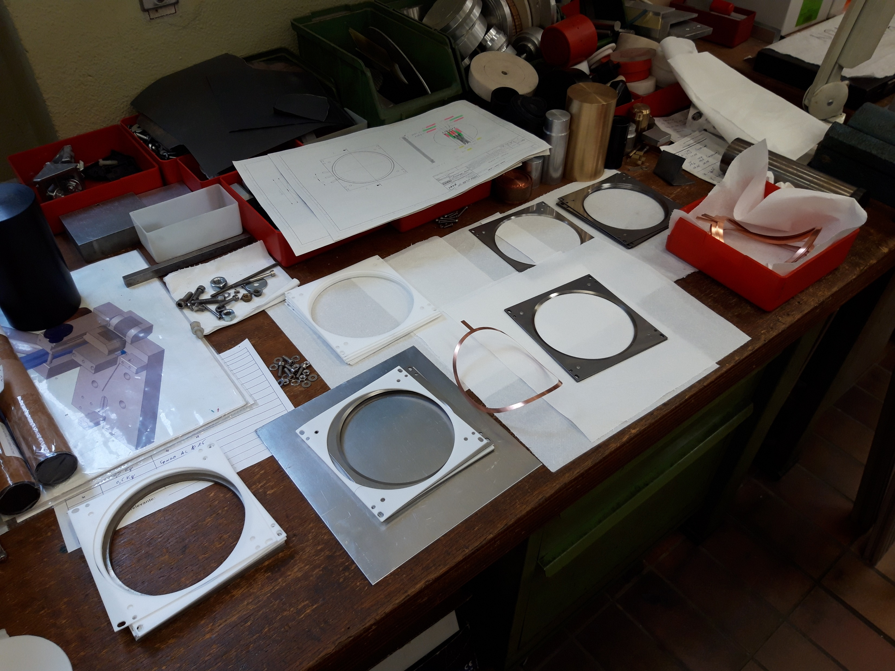
Building the MCP (Sep.-Nov. 2023)
MCPs from RoentDek (Hamamatsu) delivered at the end of July 2023.
Circular shape with a diameter of 104 mm (active area).
Lay-out of the mechanical support and electronics based on the MCP of PRISMA (rectangular shape of 100 mm x 80 mm).

Slide 11
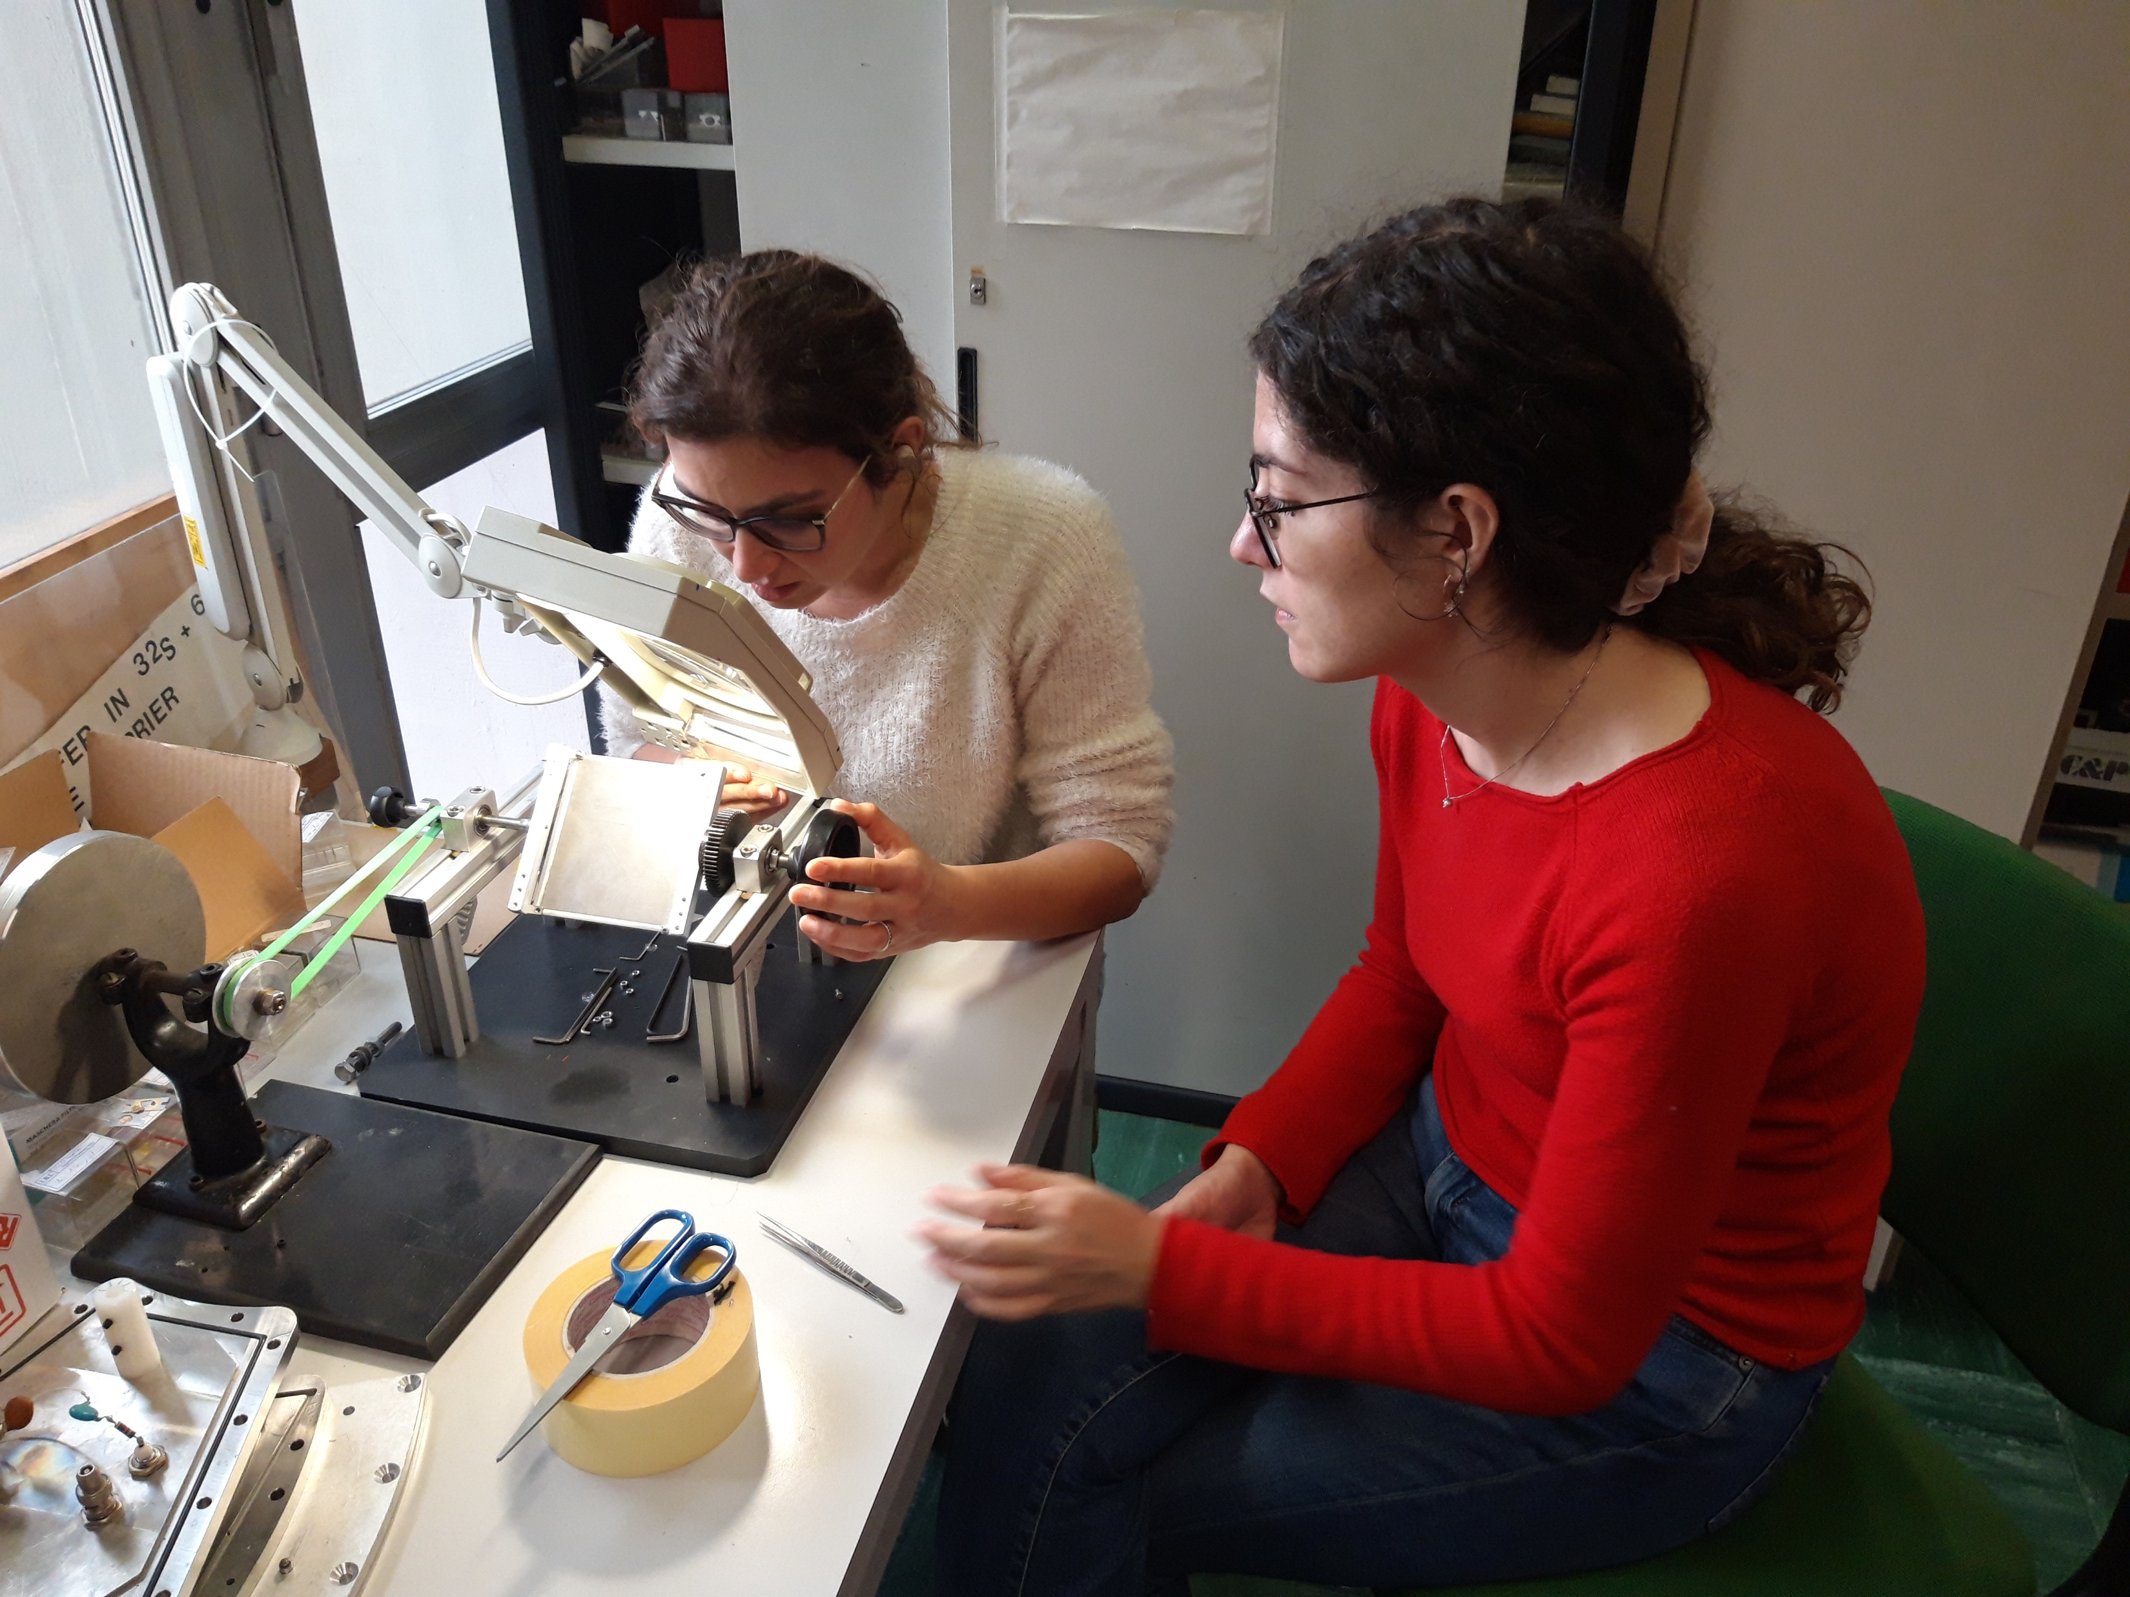
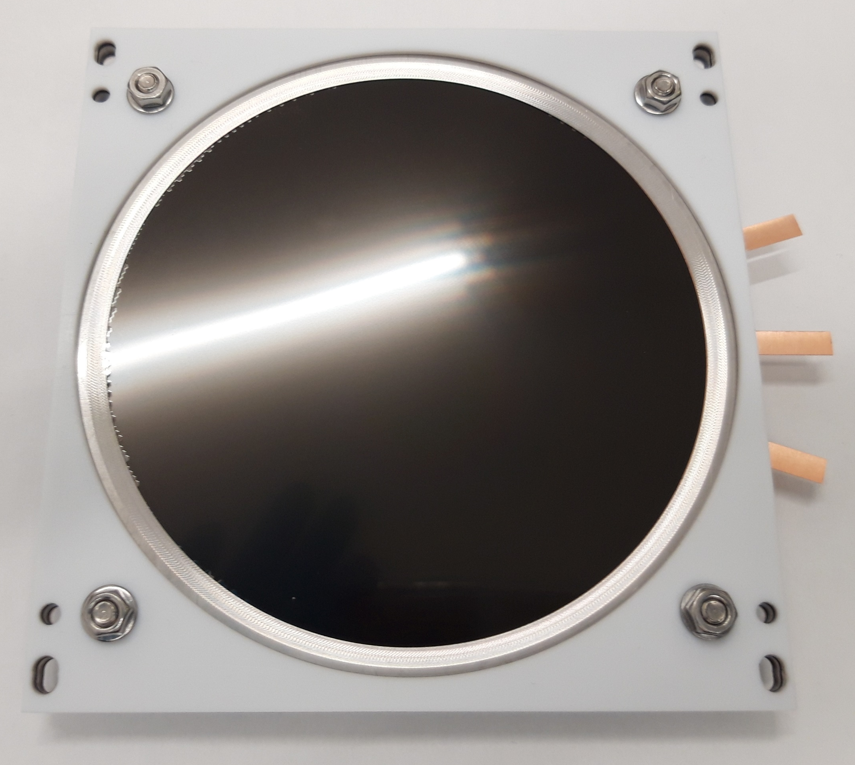
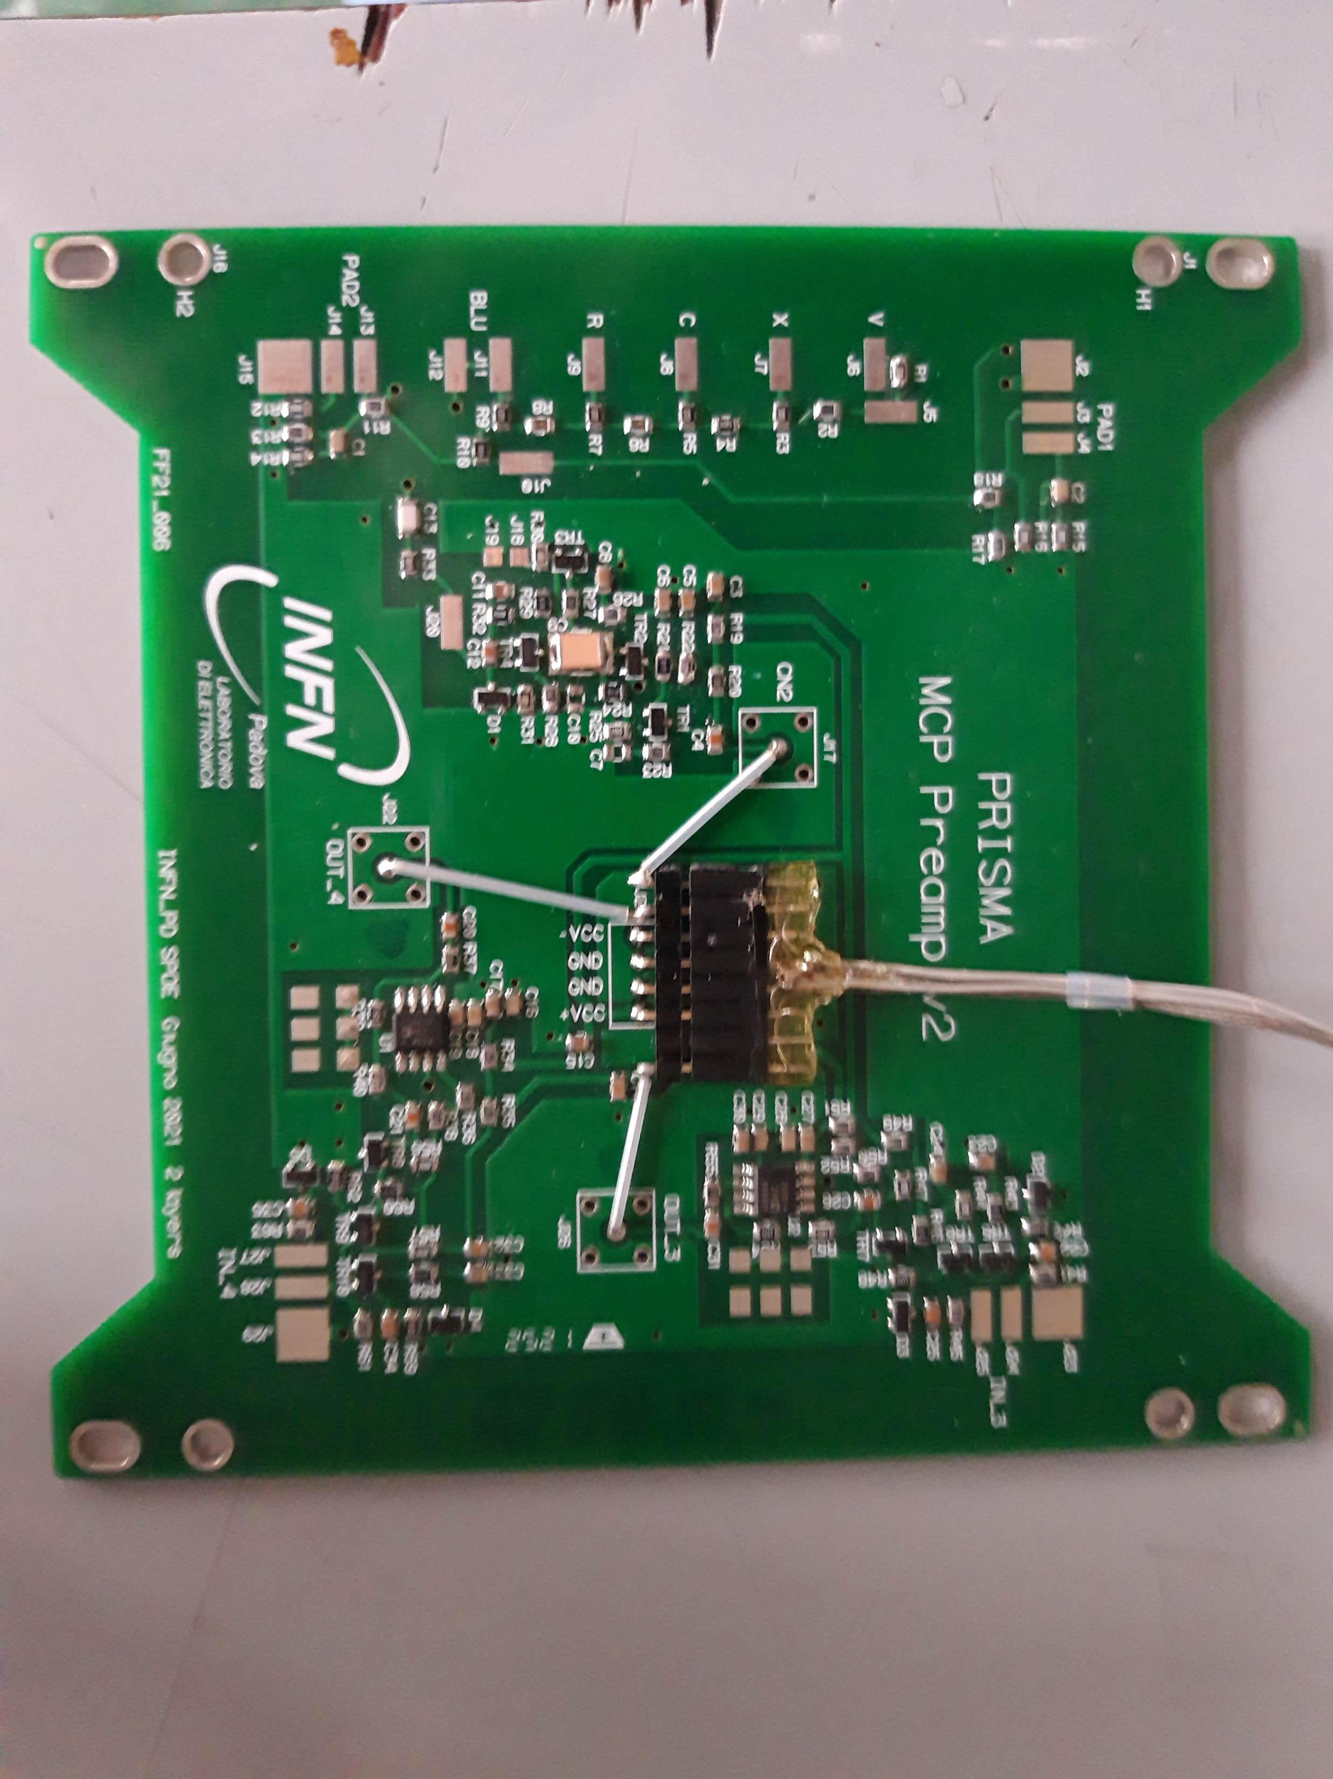
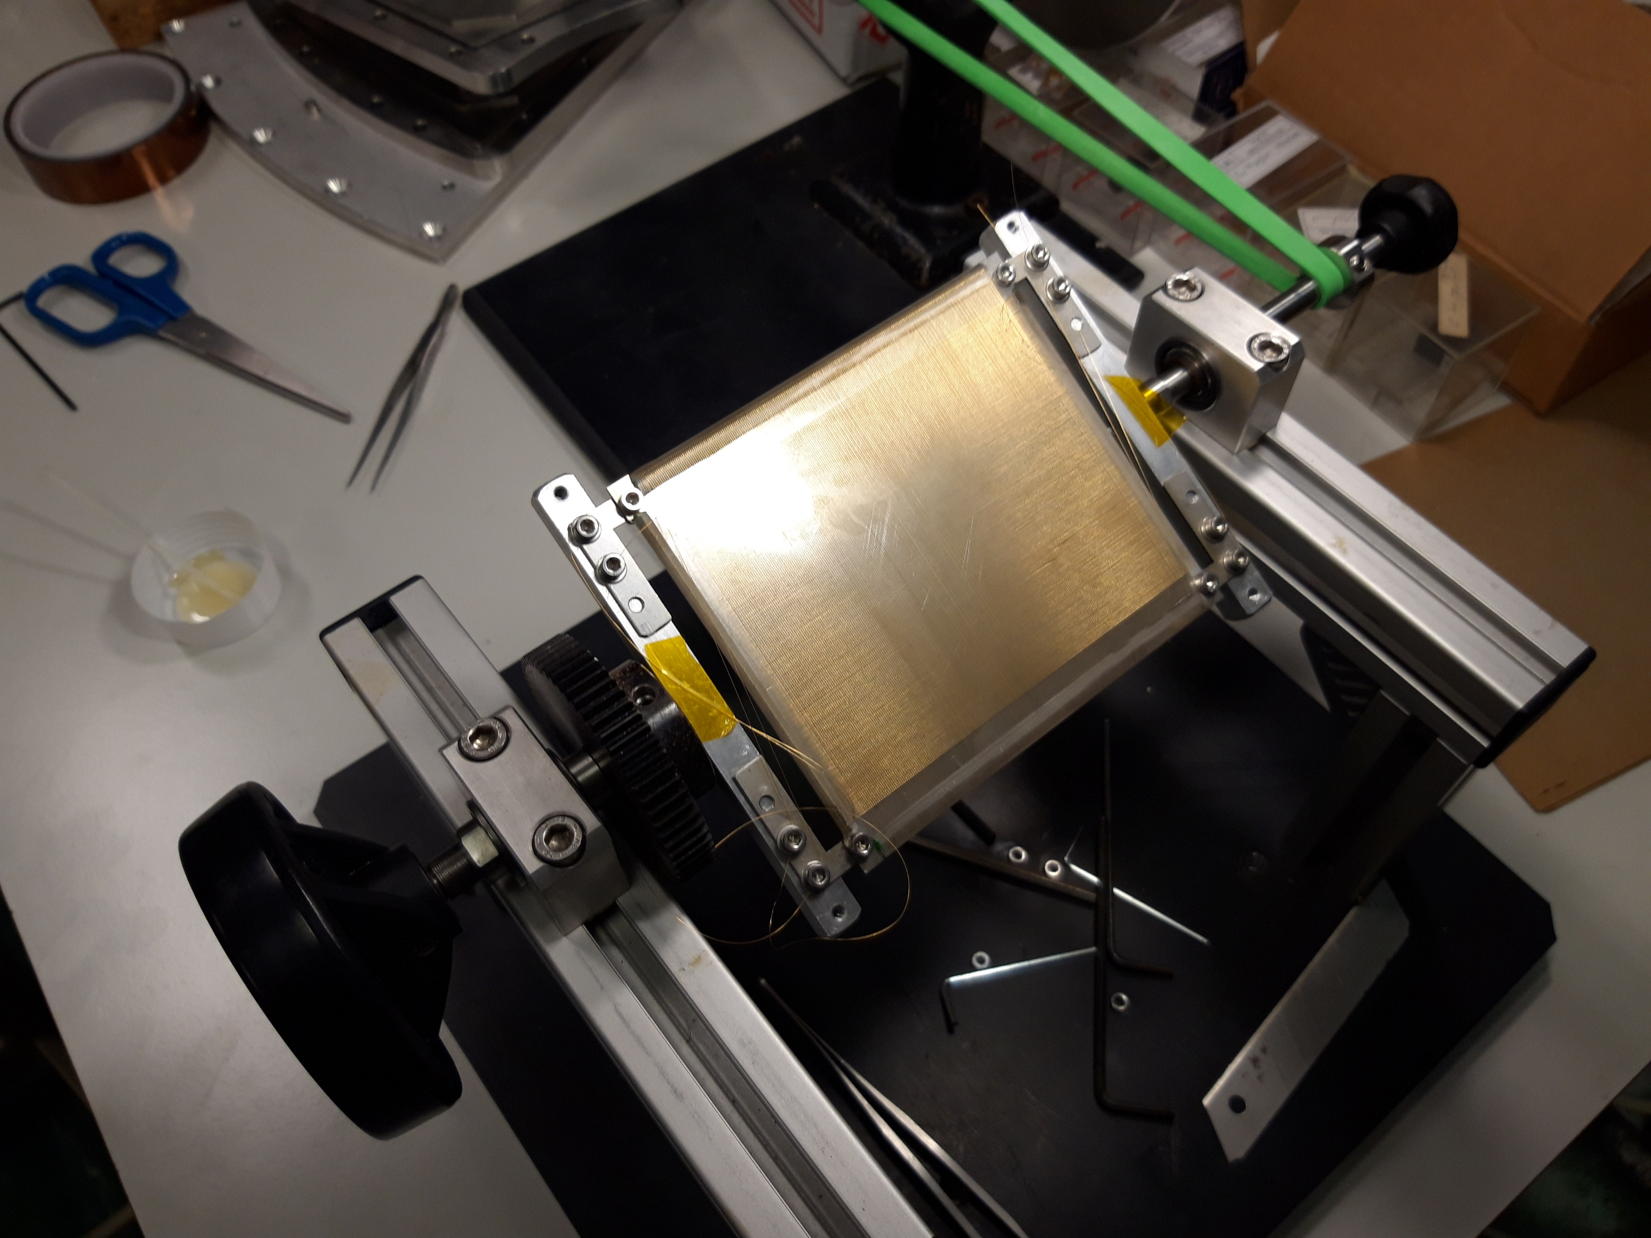
MCP, Delay Lines and Readout Electronics

Slide 12
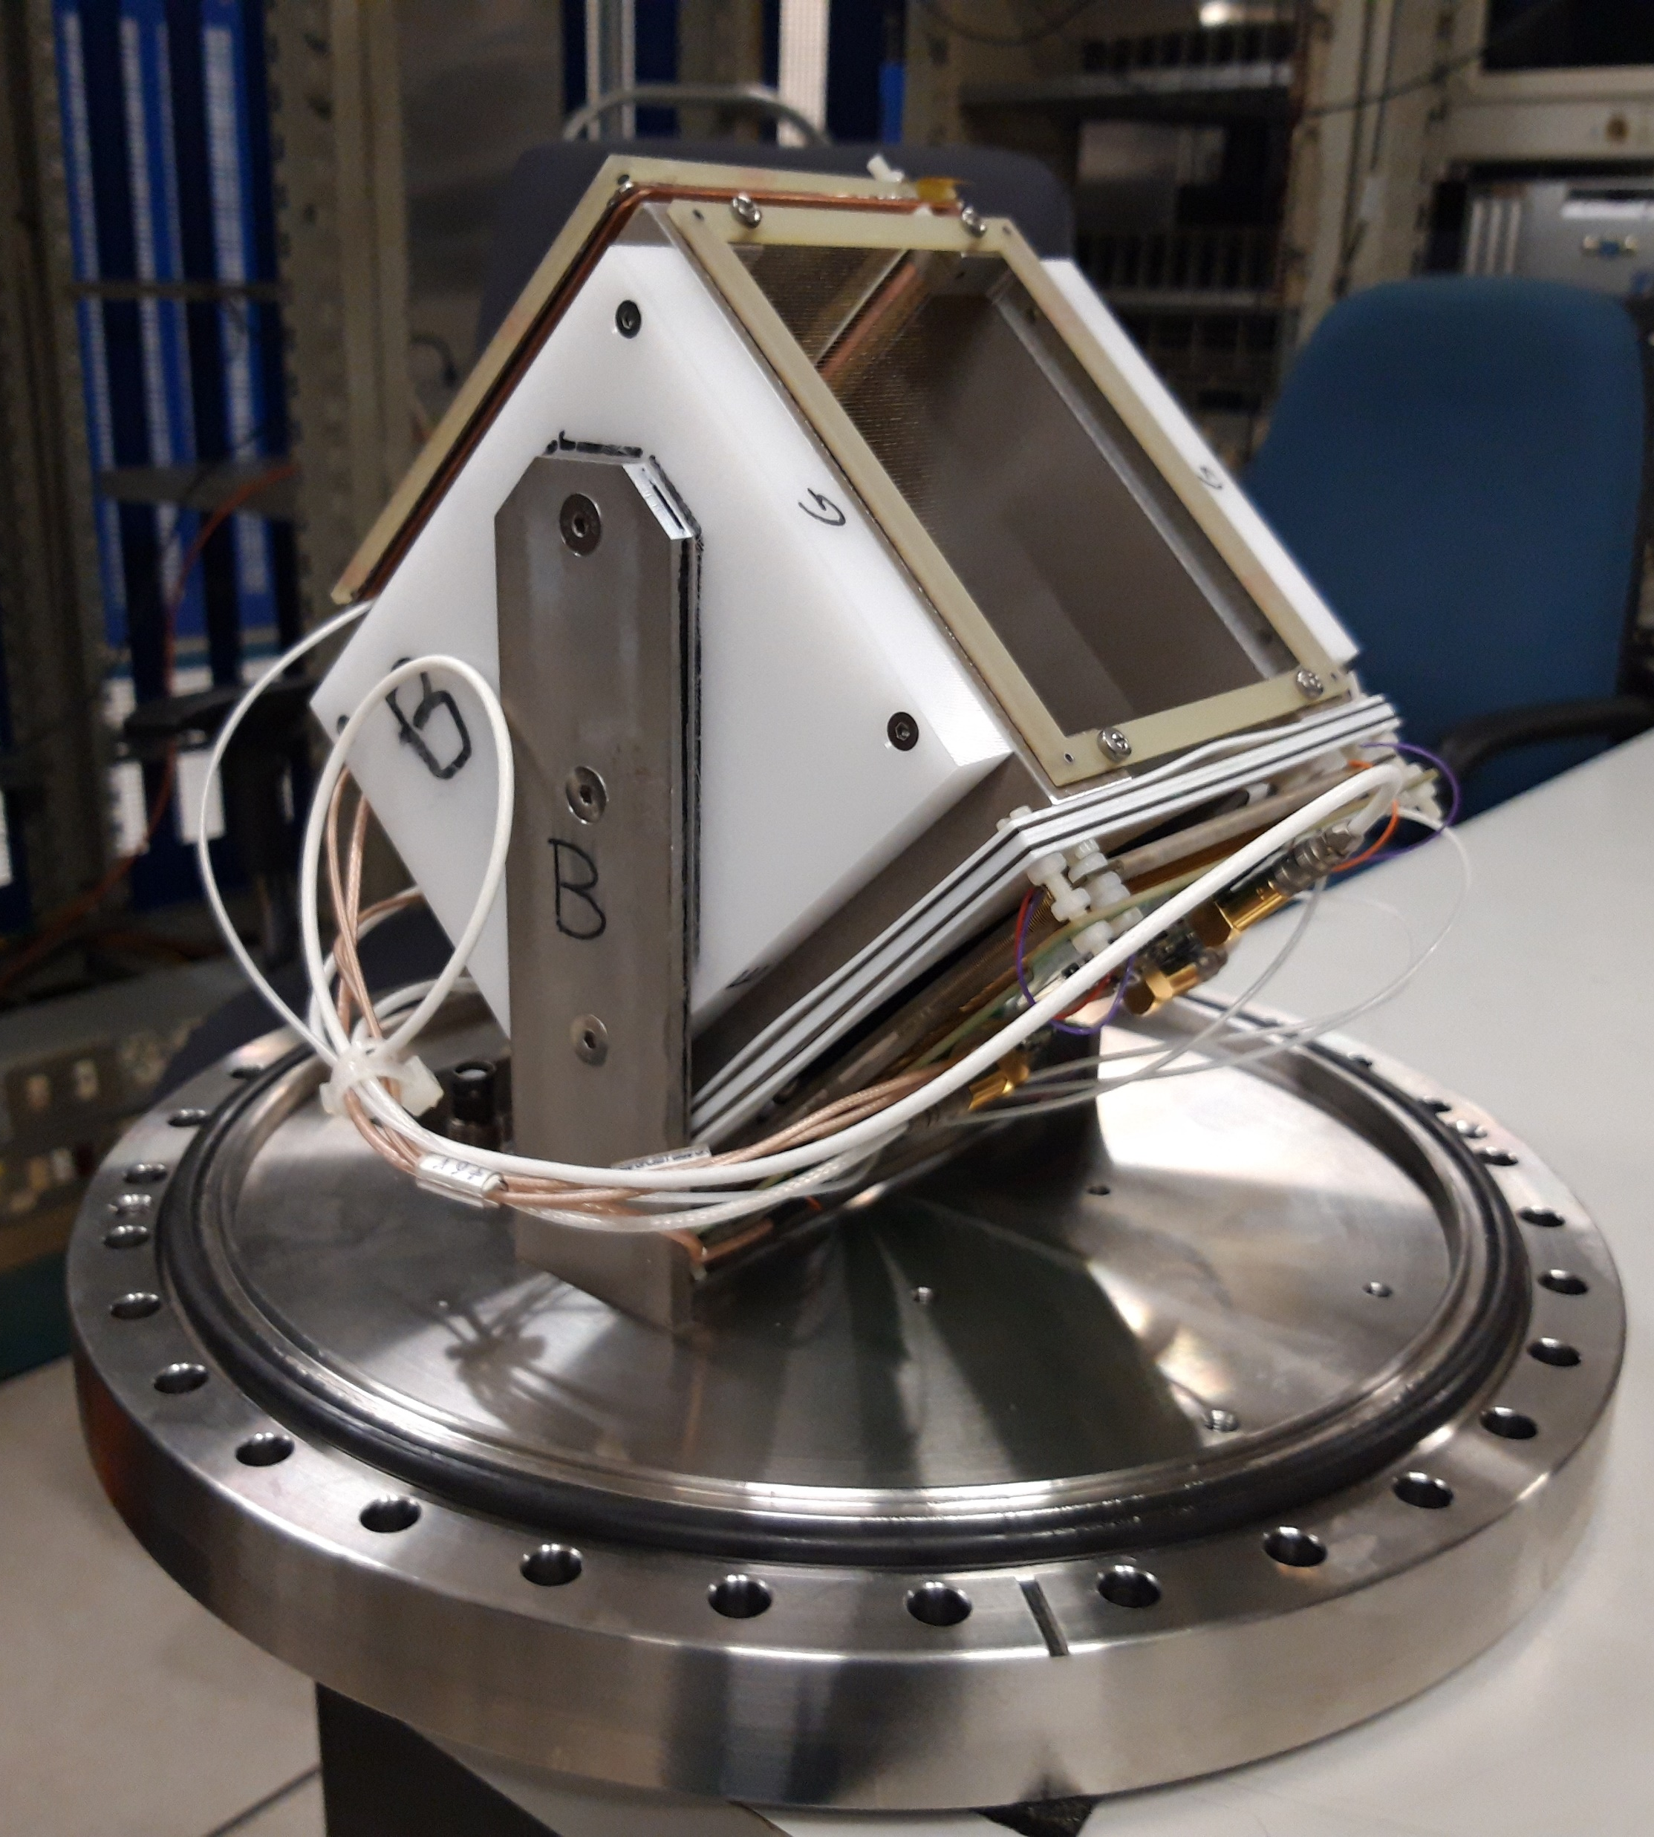
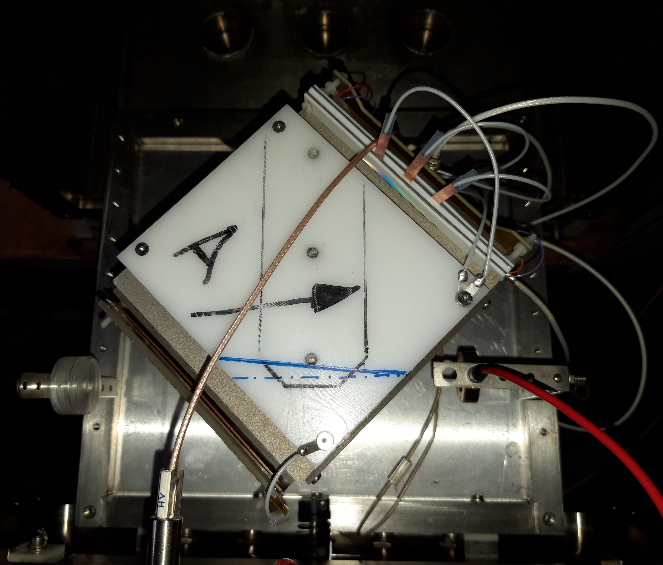
MCP First Tests (Dec. 3-4, 2023)

Slide 13
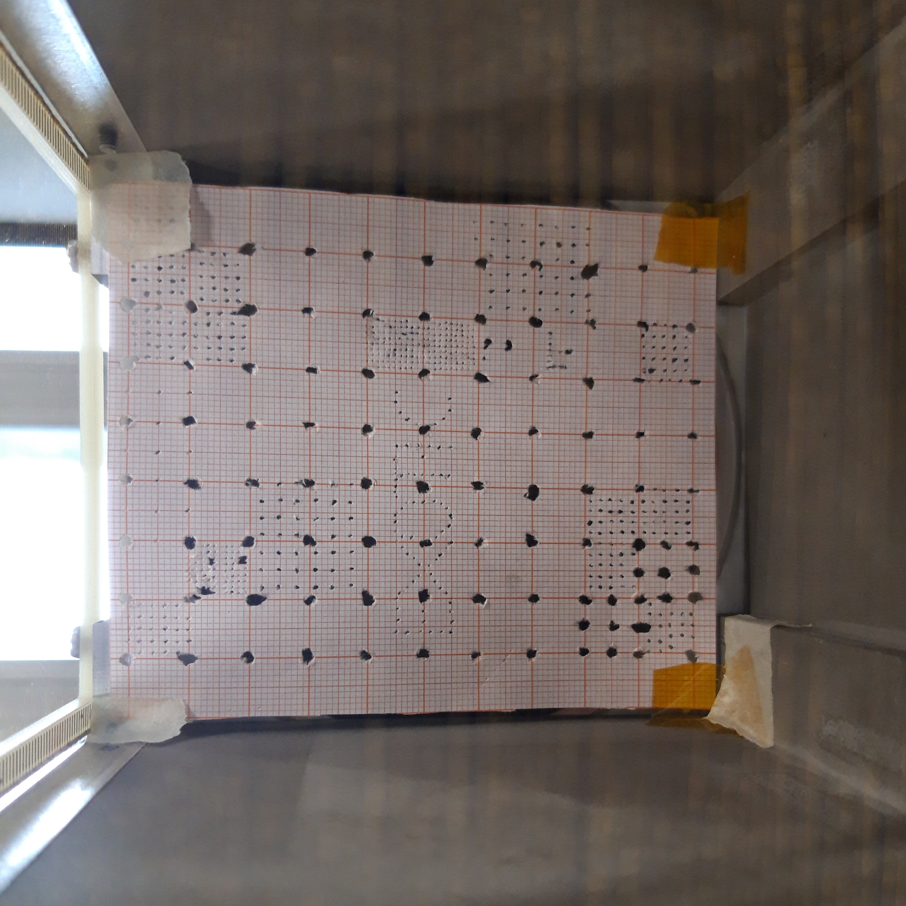
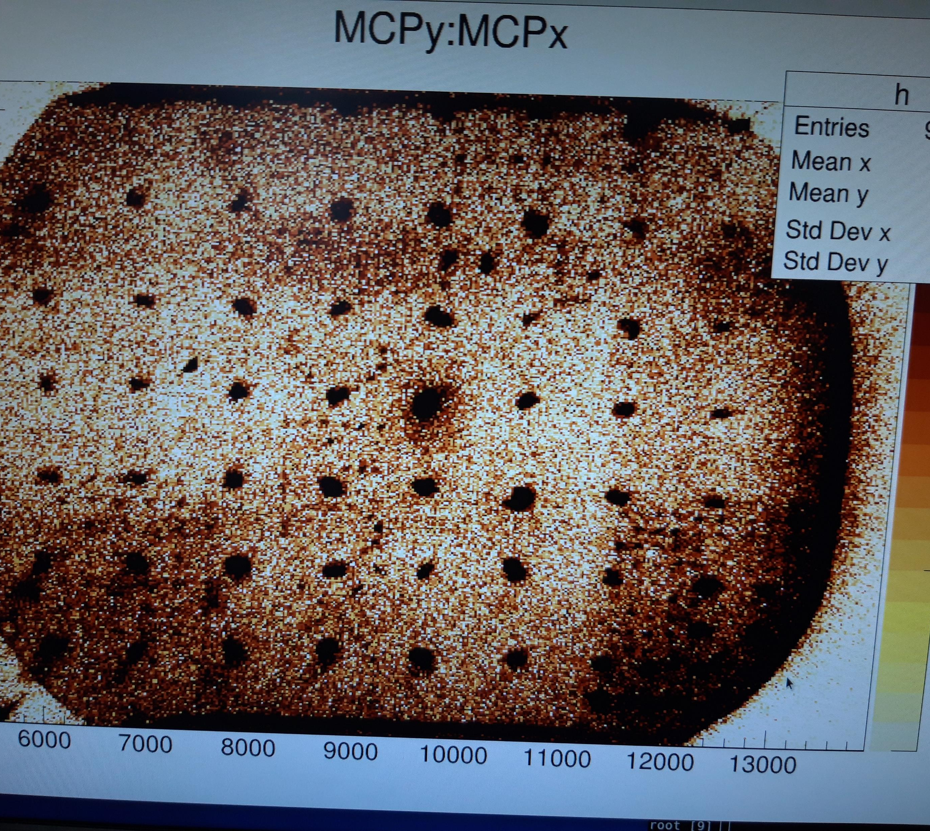
1st Test with α-particles (Dec. 18, 2023)

Slide 14
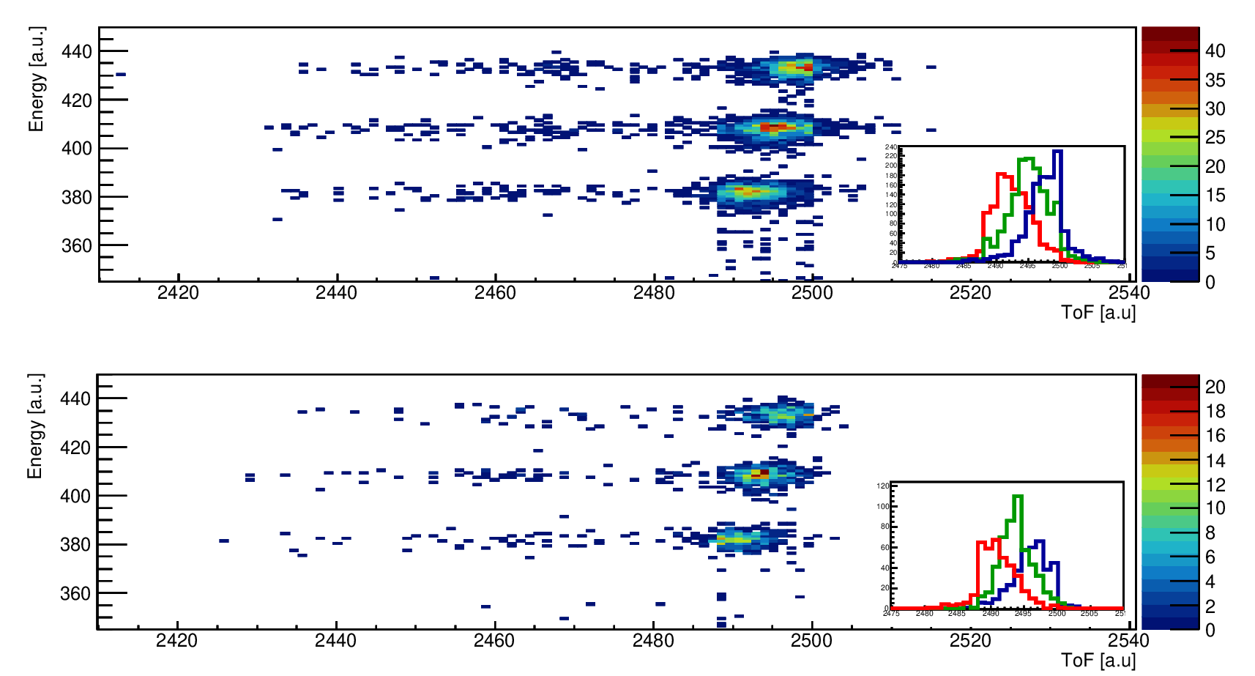
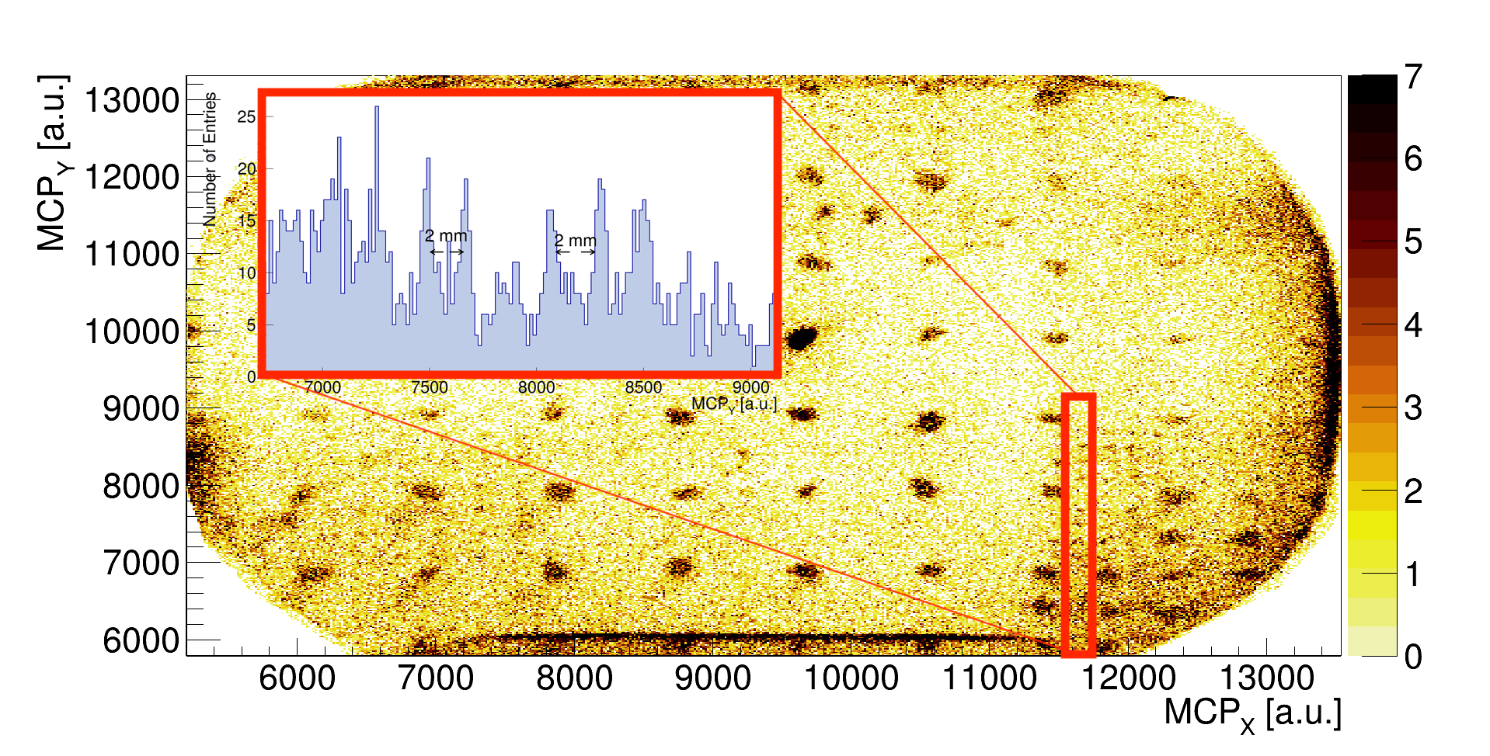
Time and Position Resolution
w/o magnets
w magnets
TOF resolution better than 600 ps
Position resolution: ~ 2 mm

Slide 15
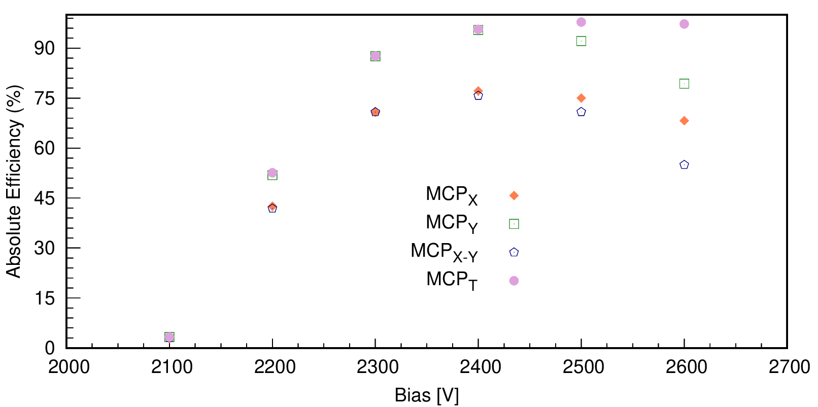
Efficiency with Alpha Particles

Slide 16
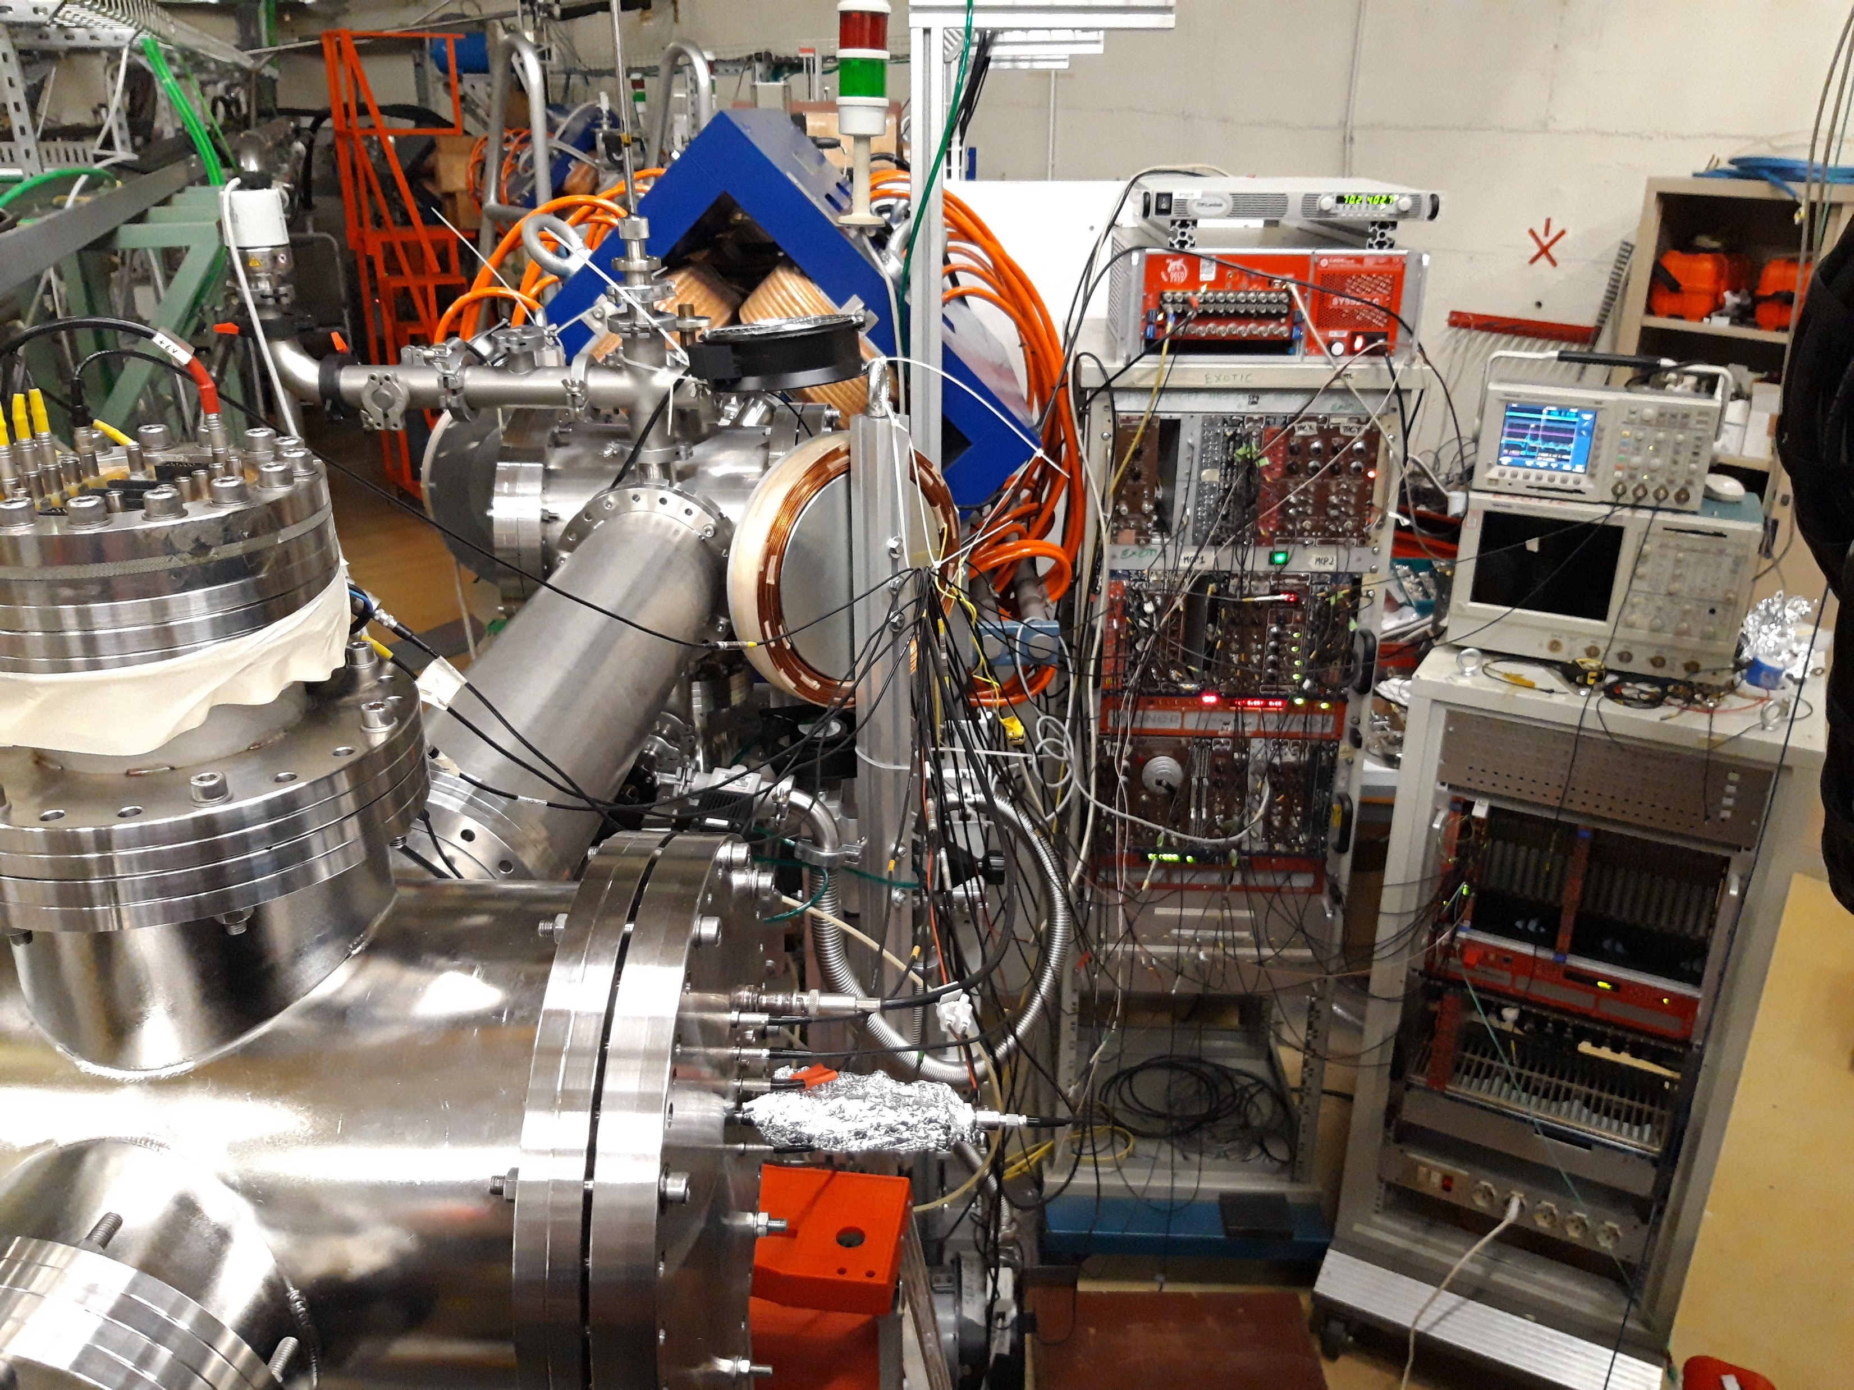
3rd Commissioning Run (July 5-6, 2024)
Beam: ¹¹B⁵⁺, 58 MeV, 10 pnA
Target: ¹H₂, 1 bar, -184° C
RIB: ¹¹C⁶⁺, ~43 MeV
Beam transport and focussing up to the second MCP.
Test of the newly developed Tracking Algorithm.
Beamtime suspended due to an accident to the LN₂ exhausting line.

Slide 17
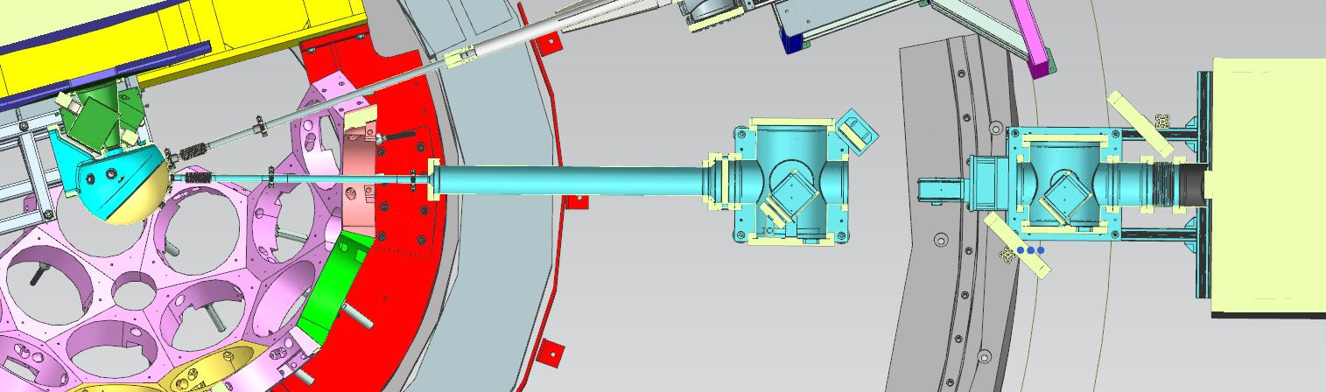
Next Commissioning Runs
Third Run (Second Attempt): November 2024: in-beam test of the two MCPs and of the event-by-event tracking algorithm for the beam particles.
Forth Run: December 2024: first test up to the AGATA reaction chamber.
In case of successful commissioning, we should be able to accept proposals for EXOTIC+AGATA experiments in the LNL-PAC meeting of December 2024.

Slide 18
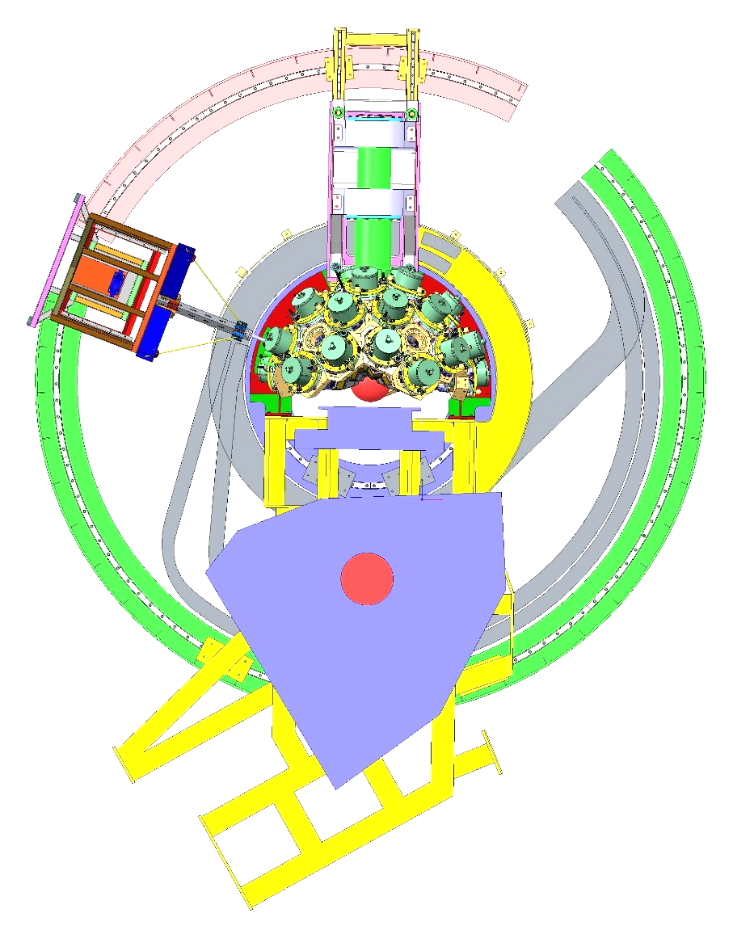
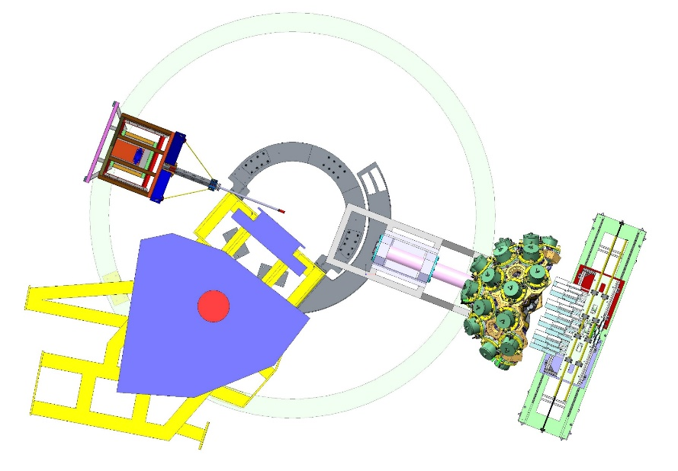
AGATA: Possible Configurations
AGATA coupled with PRISMA
AGATA zero degrees
PRISMA
NEDA
Current configuration
J. J. Valiente-Dobòn et al., Nucl. Instr. Meth. A 1049 (2023) 168040

Slide 19
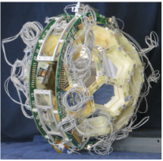
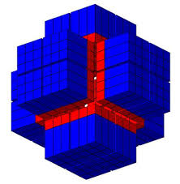
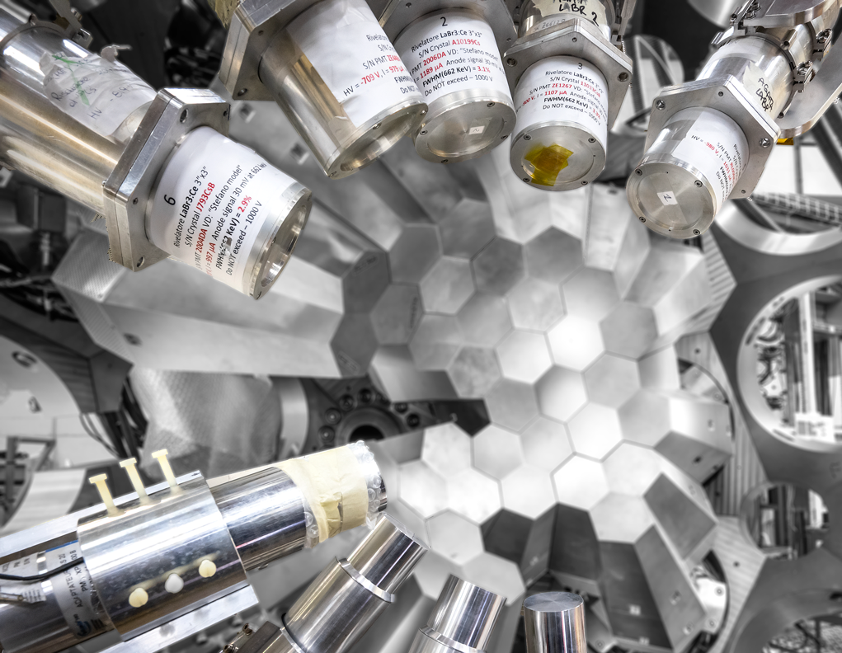
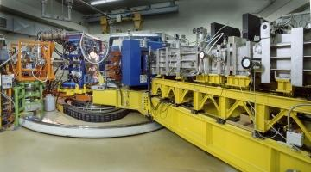
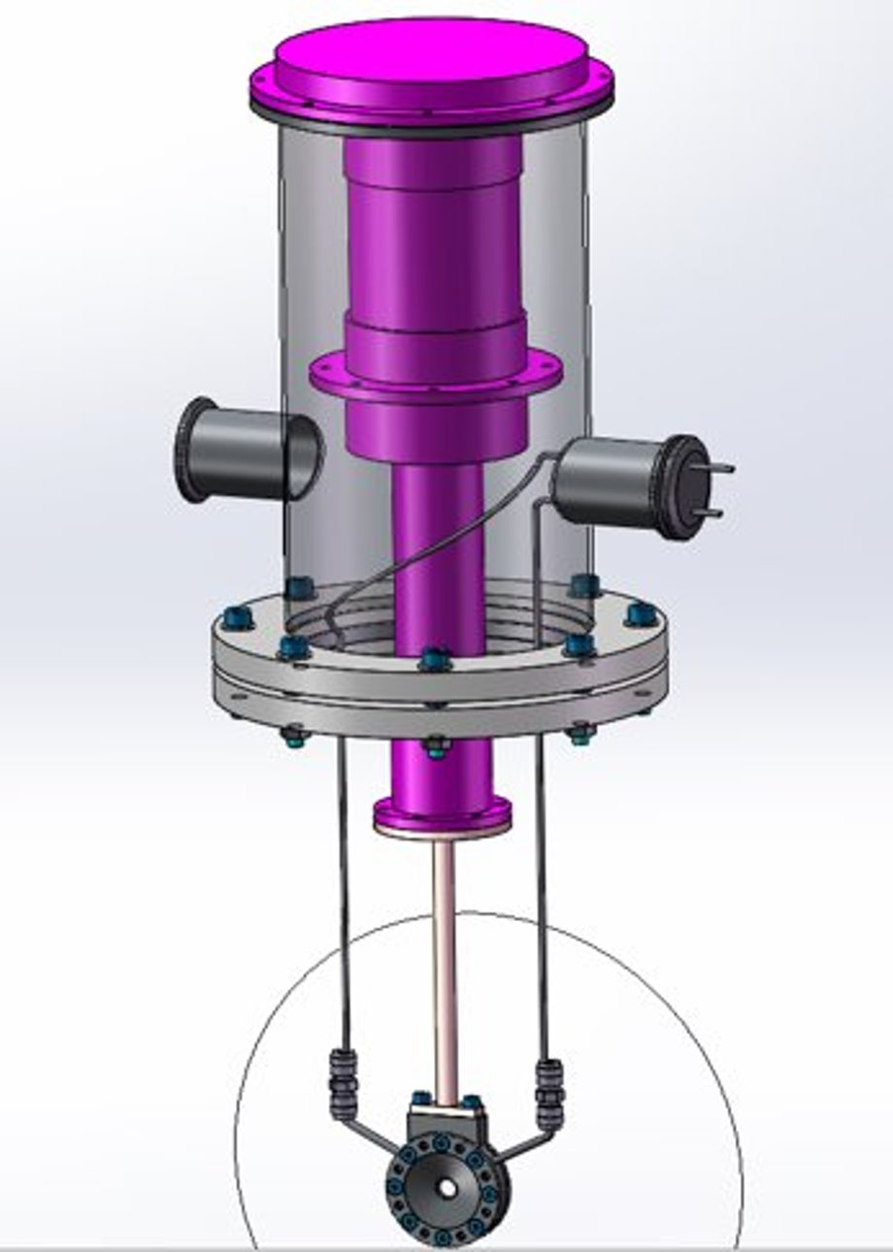
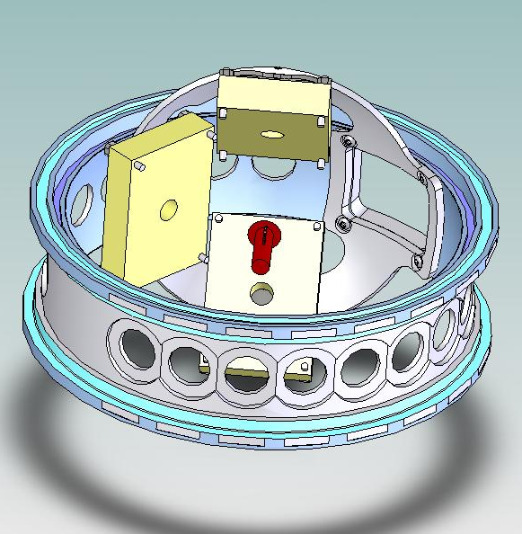
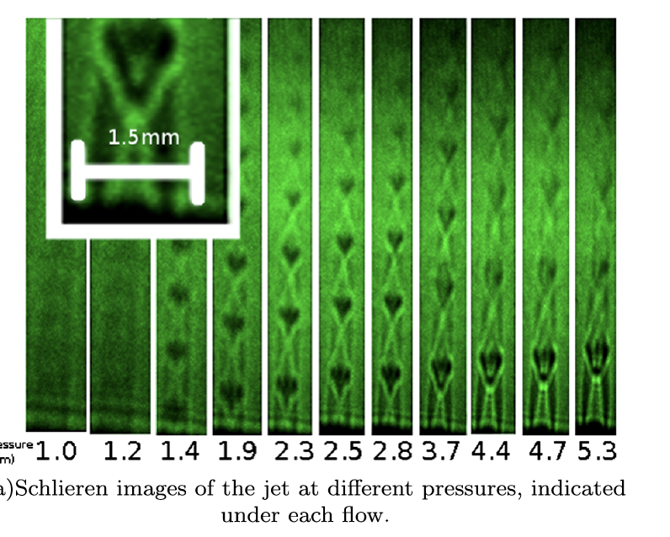
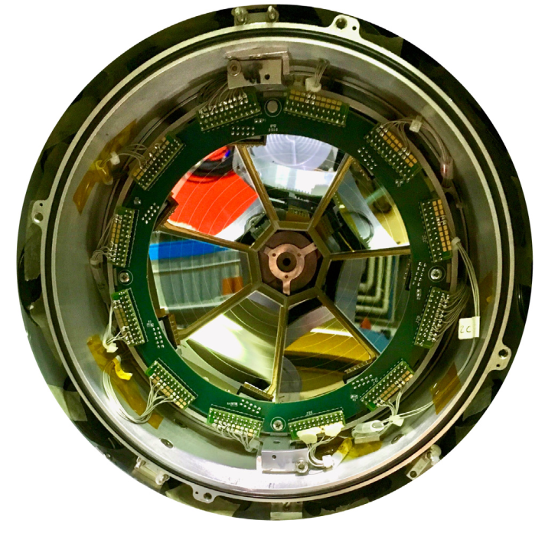
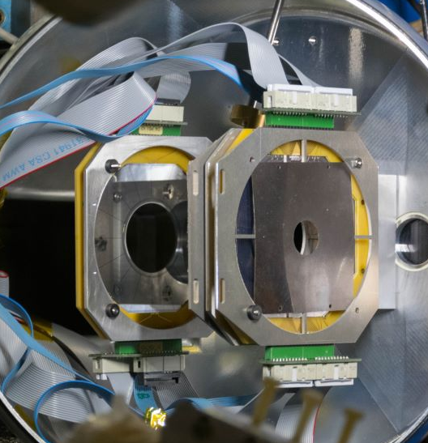
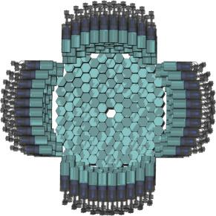
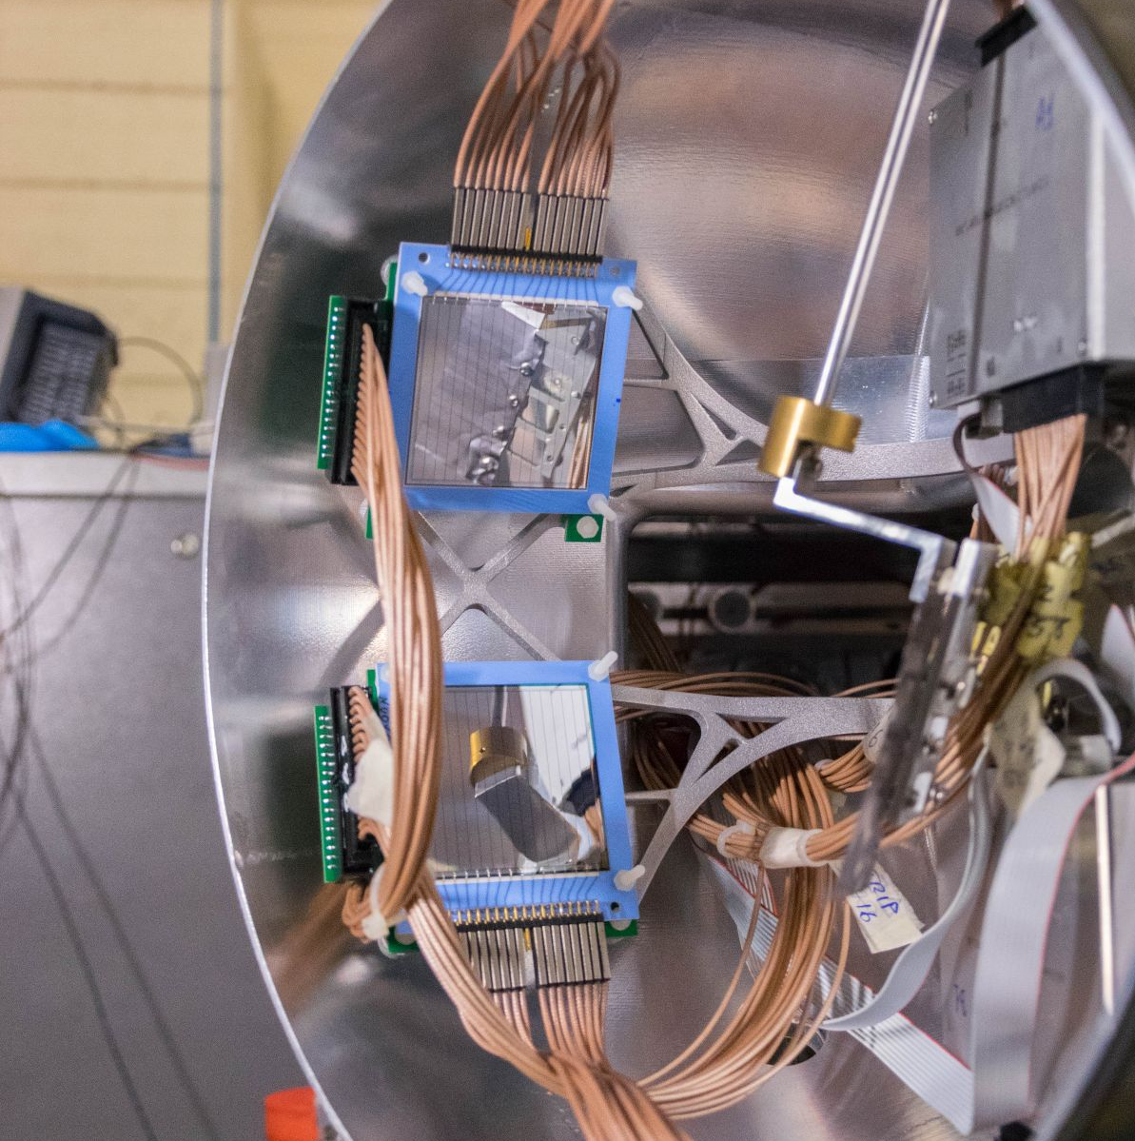
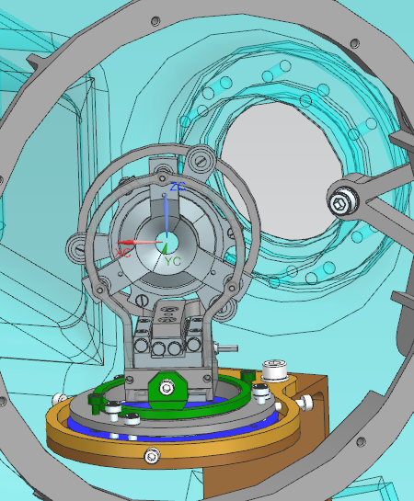
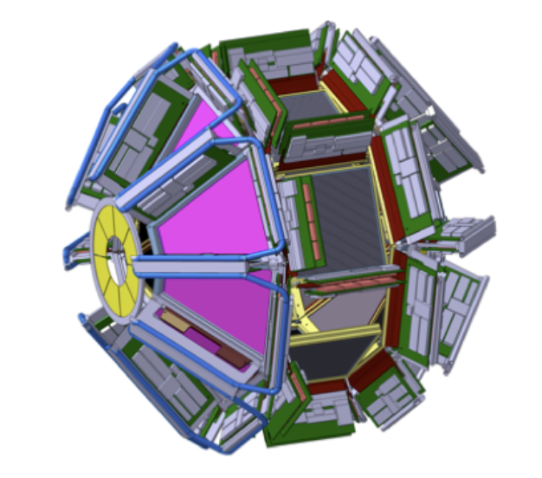
Ancillary Detectors and Targets
PRISMA
heavy ions
EUCLIDES
light charged particles
CTADIR
cryogenic target
PARIS
γ-rays
SUGAR
gas-jet target
DANTE
heavy ions
LaBr
γ-rays, fast timing
OSCAR
light charged particles
PLUNGER
Lifetime measurements
GRIT
light charged particles
SPIDER
light and heavy ions
SAURON
light charged particles
NEDA
neutrons

Slide 20
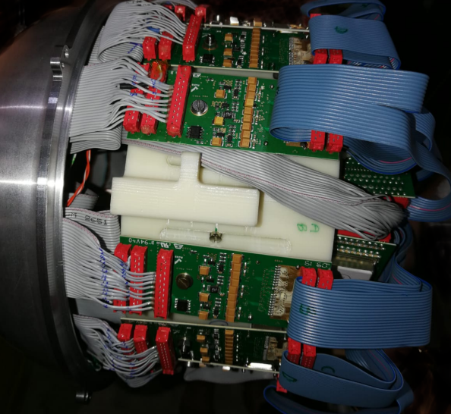
Charged Particle Arrays
SPIDER: Single layer 300-um thick segmented Si detector. Polar angle coverage θ = 124°-161°. Solid angle coverage: 17% of 4π. The configuration consists of 7 detectors arranged in a cone-like configuration at 10 cm from the target. Further details: M. Rocchini, et al., NIM A 971 (2020) 164030.
GAL-TRACE highly-segmented Si telescopes (up to 5 units): Telescope unit: ΔE (100 μm)-E(1.5 mm) . PSA available for light charged particles up to Oxygen. Polar angle coverage: 22°. Angular resolution: 1.5°. Solid angle coverage 6%, coupling with SPIDER possible. Time resolution: few ns. Further details: A. Goasduff et al., in press.
EUCLIDES ΔE-E Si telescopes (with beam absorbers): absolute proton efficiency ~ 60%; absolute alpha efficiency 25%. Average energy resolution: ~120 keV. Lower detection threshold under experimental conditions: few MeVs. EUCLIDES plunger configuration (with beam absorbers) absolute proton efficiency ~ 25%, absolute alpha efficiency ~ = 15%. Further details: D. Testov et al., EPJA 55, (2019) 47.
SAURON annular DSSDs: 3 thicknesses available: 300, 500 and 1500 μm. Geometrical position ±5 cm from target, Polar angle coverage θ = 25°-45° (forward) and/or θ = 135°-155° (backward). The position can be slightly adjusted. Further details: https://www.micronsemiconductor.co.uk/product/s1.

Slide 21
Summary
The facility EXOTIC has been upgraded (after nearly 4 years of inactivity) and restarted to be operative for the in-flight production of light weakly-bound Radioactive Ion Beams at INFN-LNL.
A new event-by-event tracking system based on two MicroChannelPlate detectors has been developed and is currently under final commissioning.
Two final commissioning runs for the coupling beetween EXOTIC and AGATA are planned for November and December 2024.
We should be able to accept proposals for expriments exploiting the unique features of EXOTIC+AGATA in the LNL PAC meeting of December 2024.

Slide 22
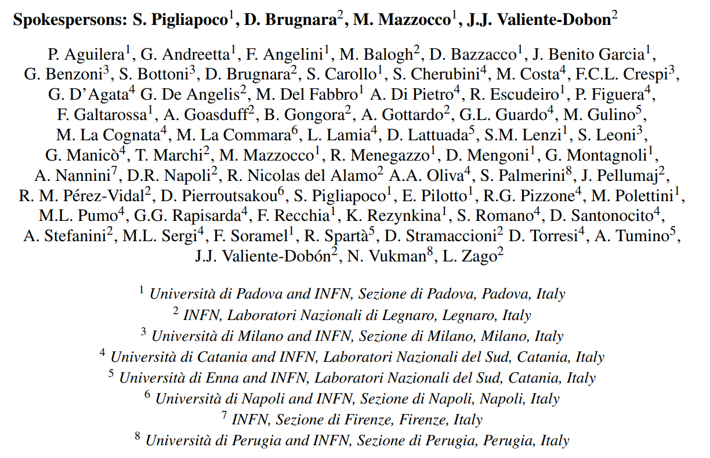
Collaboration

Slide 23
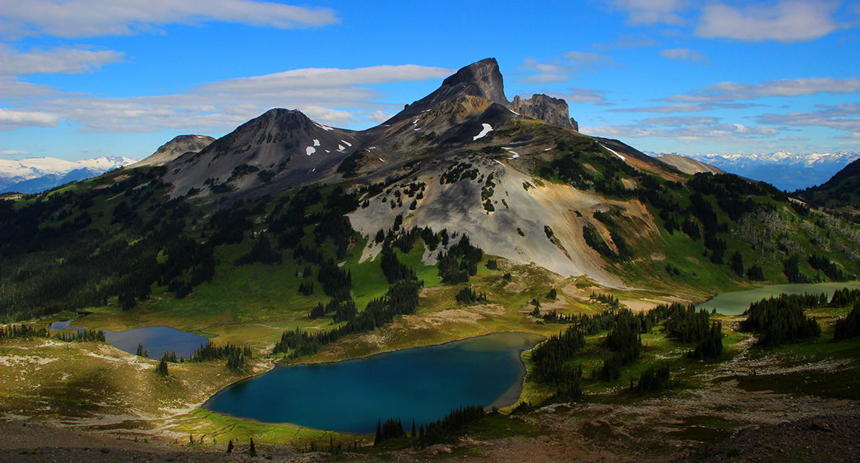
Università degli Studi di Padova
Thank you very much for your attention!

Slide 24
Backup

Slide 25
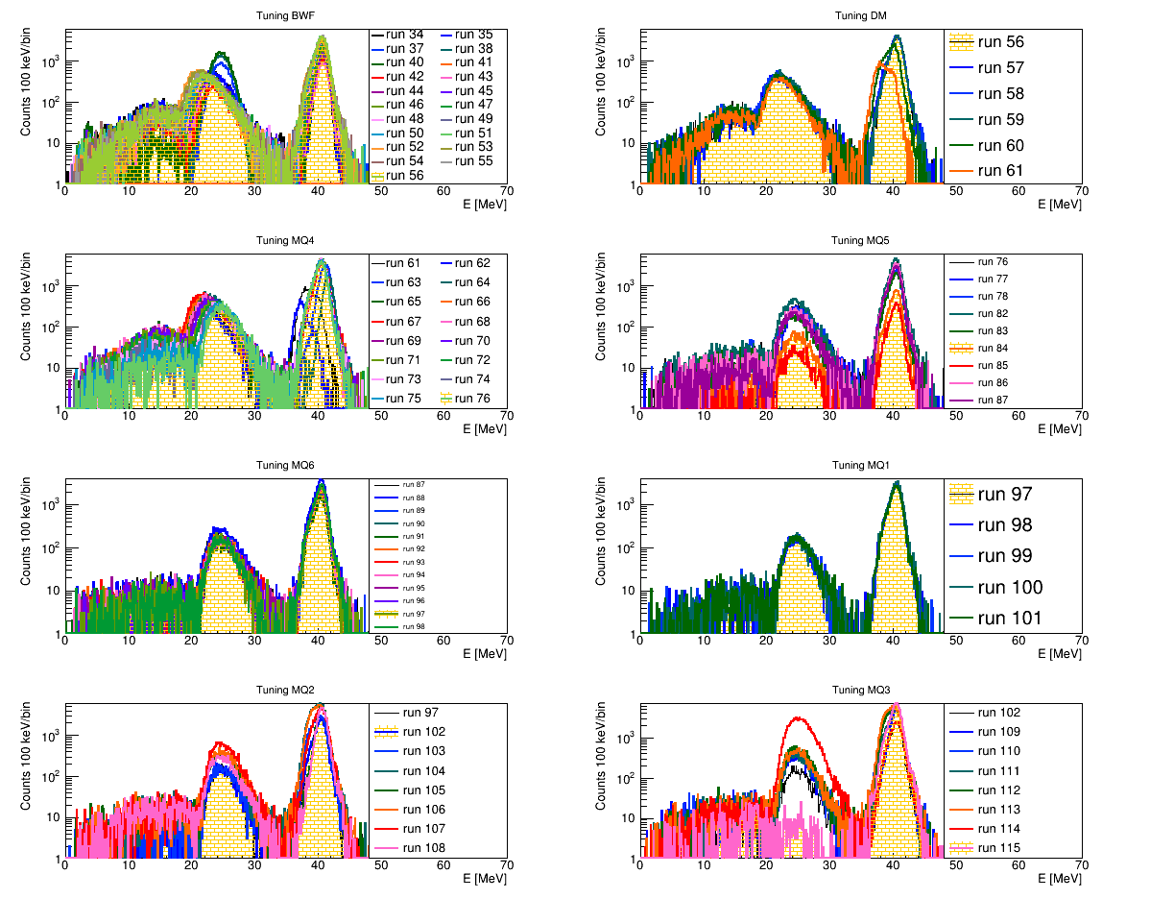
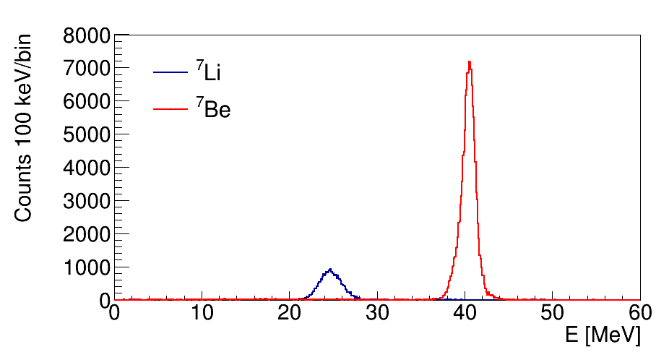
Ion-Optical Tuning of EXOTIC

Slide 26

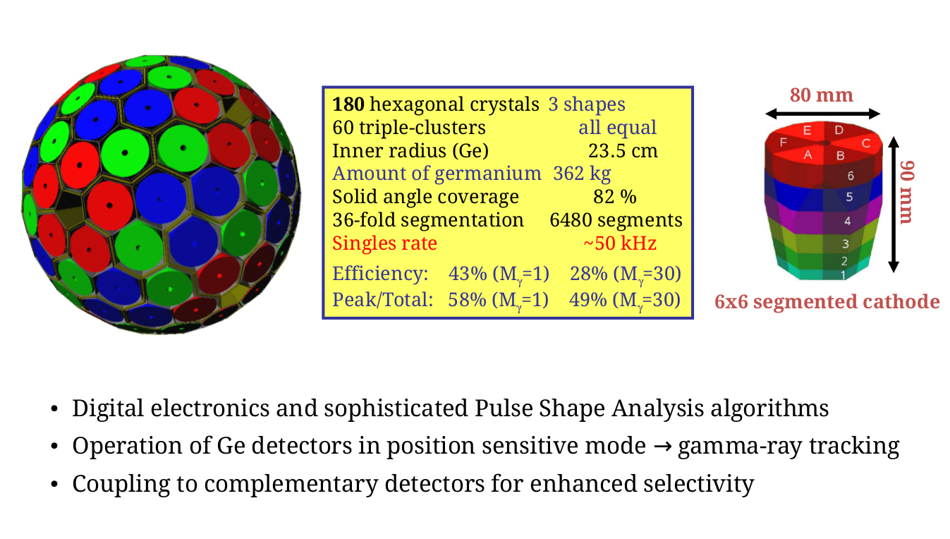
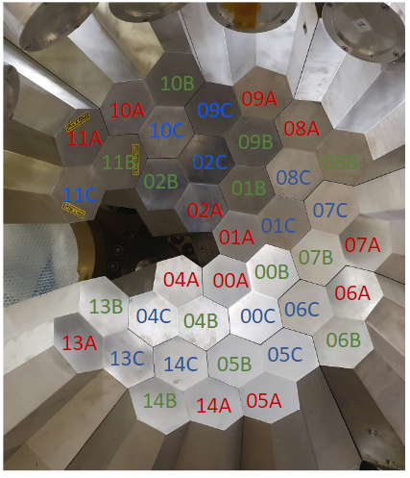
AGATA
Advanced GAmma Tracking Array
AGATA at LNL:
36 Crystals operative (12 ATCs)
Maximum counting rate per detector: 50 kHz
MWD-risetime 6µs - 2.5 µs
Position: 23.5cm - 18cm

Slide 27
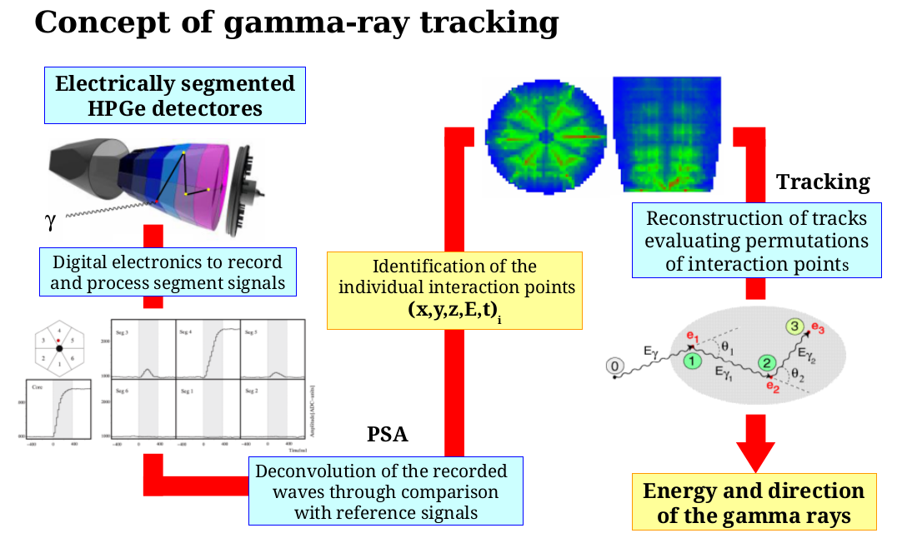
AGATA: Concept of γ-ray Tracking

Slide 28
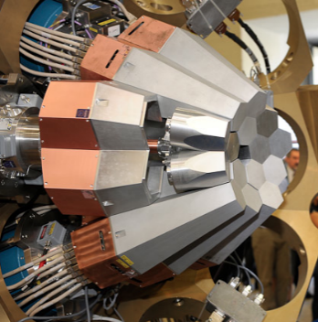
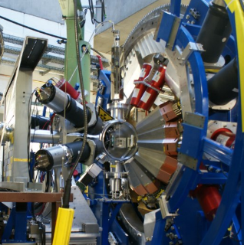
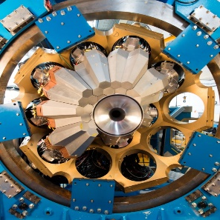
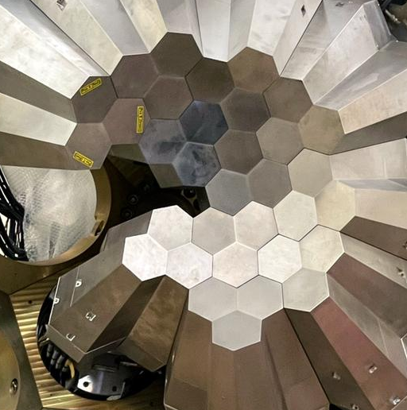
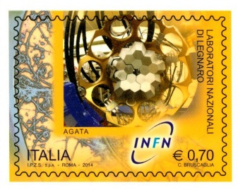
AGATA Time-Line
LNL
GSI
GANIL
LNL
2010
2011
2014
2021-2026
Demonstrator
Phase 1
Phase 2: up to 2𝝅
M. Zielinska: physics coordinator
J. J. Valiente Dobon: local coordinator

Slide 29
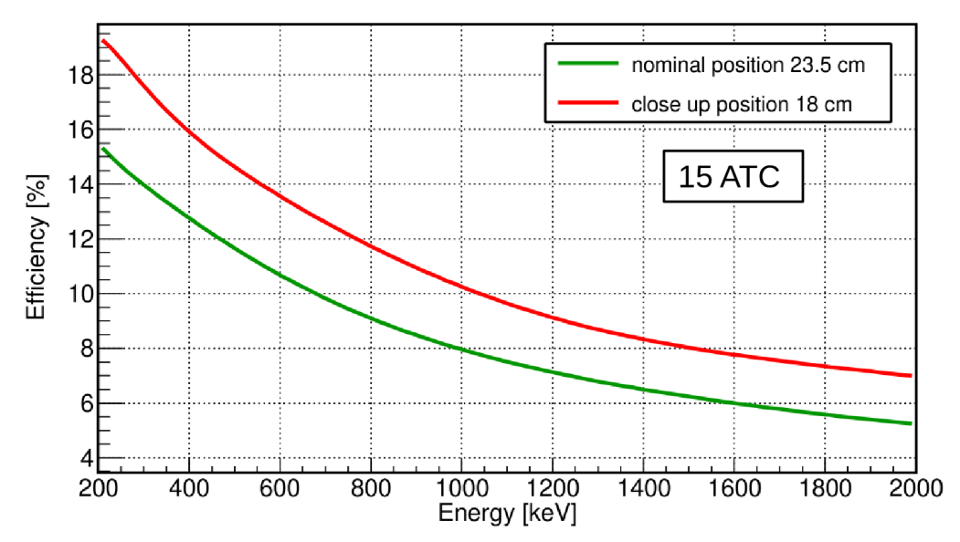
AGATA: Efficiency
Angular ranges of the crystals:
θ_{lab} = 88°-165.9° for the nominal position,
θ_{lab} =75°-143.2° for the close-up position.

Slide 30
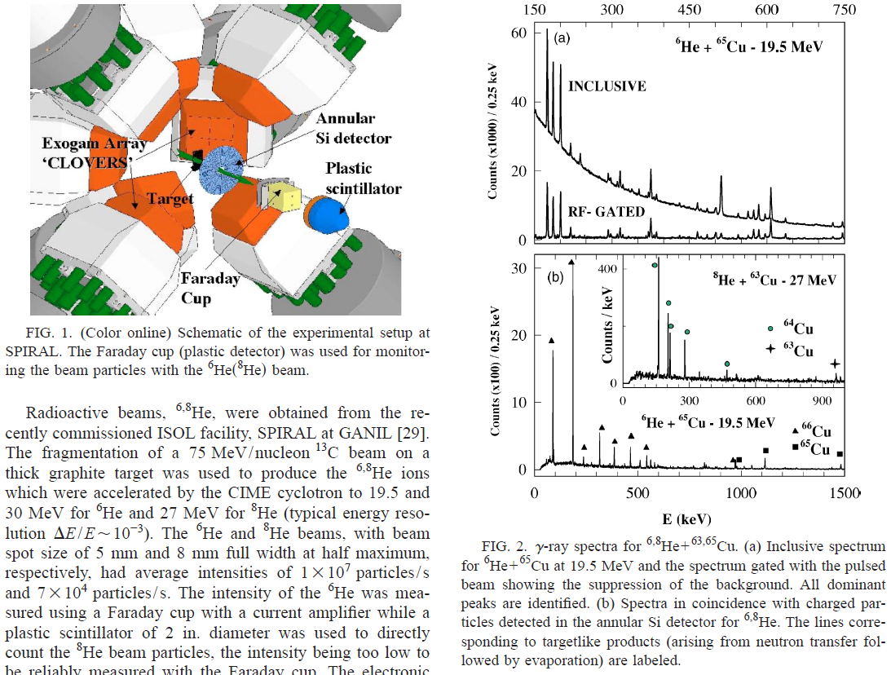
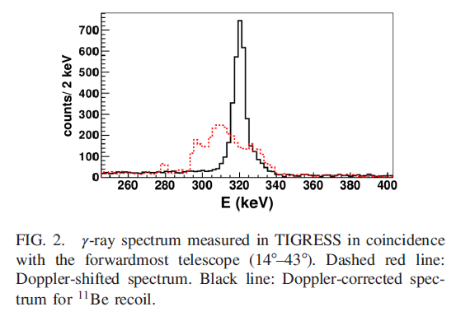
⁷Be + ²⁰⁸Pb
⁷Be + ²⁰⁸Pb: quasi-elastic scattering and projectile fragments (^{3,4}He) production measured at LNL.
⁷Be + γ (0.429 MeV) coincidences will permit to single out the inelastic scattering contribution to the quasi-elastic process.
^{3,4}He + γ coindicendes will help to establish the production mechansims from information on the target-like nuclei produced.
¹¹Be+¹⁹⁷Au @ TRIUMF
⁶He+⁶⁵Cu @ GANIL

Slide 31


¹¹C-¹¹B Isospin Asymmetry (A. Gottardo)
¹¹C(d,p)¹²C ¹¹B(d,n)¹²C
Same final wave function (excited states ¹²C)
Same reaction in Isospin Symmetry
Same initial wave function in Isospin Symmetry
Example: ⁵⁷Ni-⁵⁷Cu Mirror Symmetry
Isospin Symmetry is obviously violated by Coulomb interaction, are there nuclear sources?
Ab-initio calculations possible for A=11!
Looking at 2⁺ population, other states possible via particle spectroscopy
$${10}^{5} pps beam, σ=1 mbarn ⇒2500\frac{reactions}{day} ⇒100 high−energy \frac{γ rays}{day}$$

Slide 32


Off-beam Test of the Tracking Algorithm
ExSSiDe
MCP
α
source position

Slide 33


Off-beam Test of the Tracking System
EXotic Silicon Strip Detector (EXSSiDe)
Area: 64 mm x 64 mm
Thickness: 1 mm
Strip: 32 vertical x 32 horizontal
Position Resolution: 2 mm x 2 mm
MCP
EXSSiDe
α-Source

Slide 34


Off-beam Test of the Tracking System
Gate on EXSSiDe

