Slide 1


Isospin properties and pair correlations in ⁸⁸Ru
Bo Cederwall
KTH Royal Institute of Technology
14th Nucleus-Nucleus Collisions Conference NN2024
August 18 - 23, 2024, Whistler, BC Canada

Slide 2

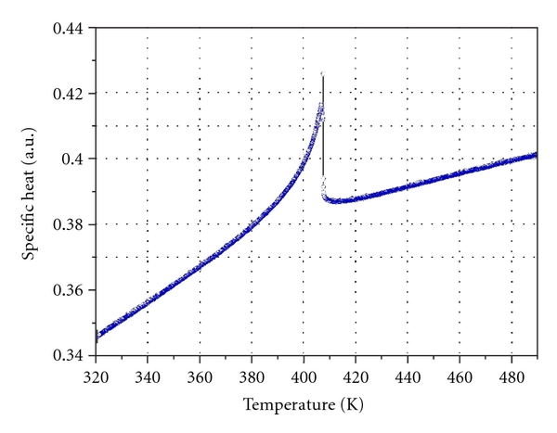
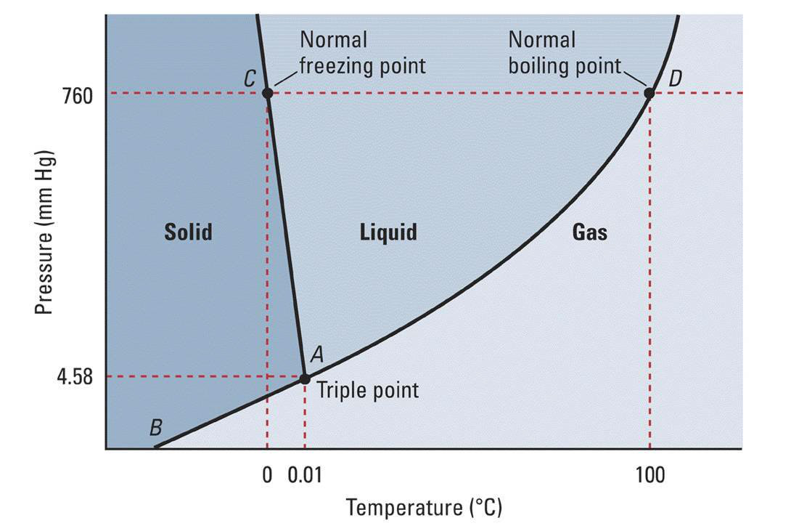
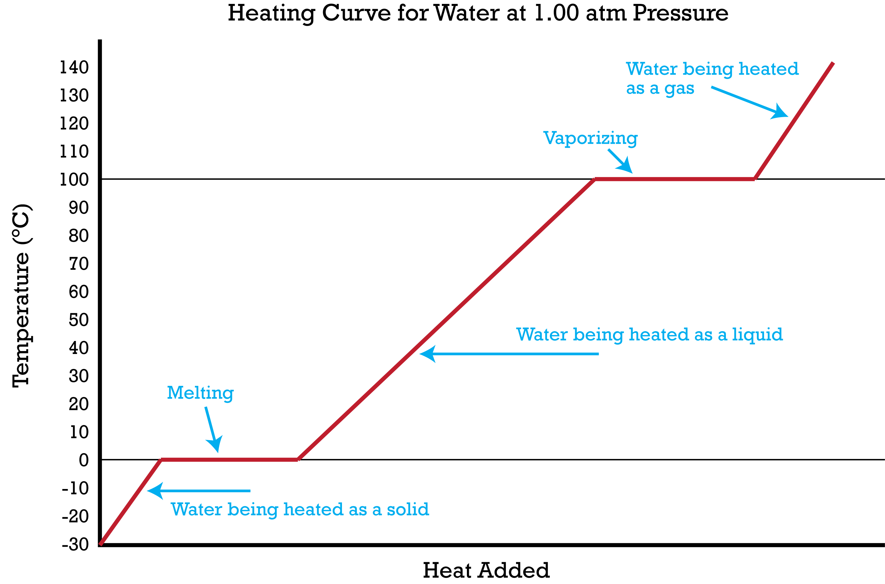
Phases of (macroscopic) matter - phase transitions
Temperature dependence of specific heat of BaTiO₃ single crystal around the paraelectric-ferroelectric phase transition point Tc
S. Grabovsky, M. Takesada, A. Onodera et al., Annual Meeting of Physical Society of Japan, March 2012
1st order phase transition:
https://socratic.org
Can we observe something similar in the nucleus?
NN2024 Whistler, BC CA / BC

Slide 3
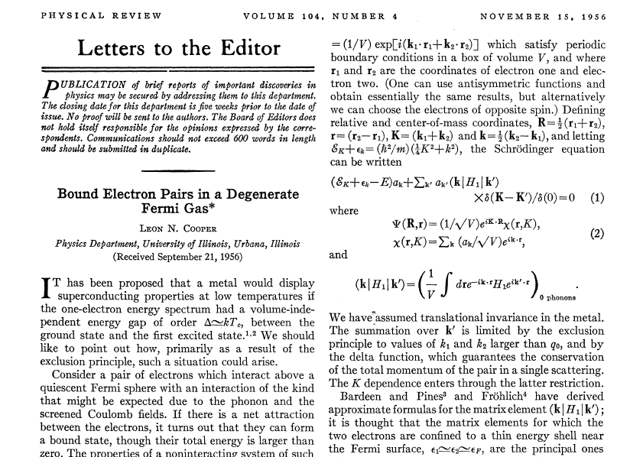
NN2024 Whistler, BC CA / BC

Slide 4
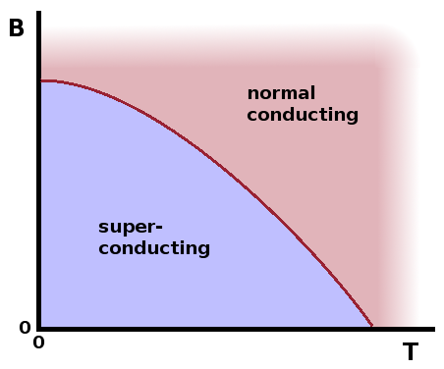
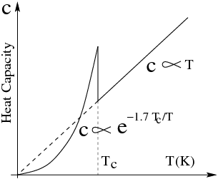
http://users.aber.ac.uk
Can we observe something similar in atomic nuclei?
NN2024 Whistler, BC CA / BC

Slide 5
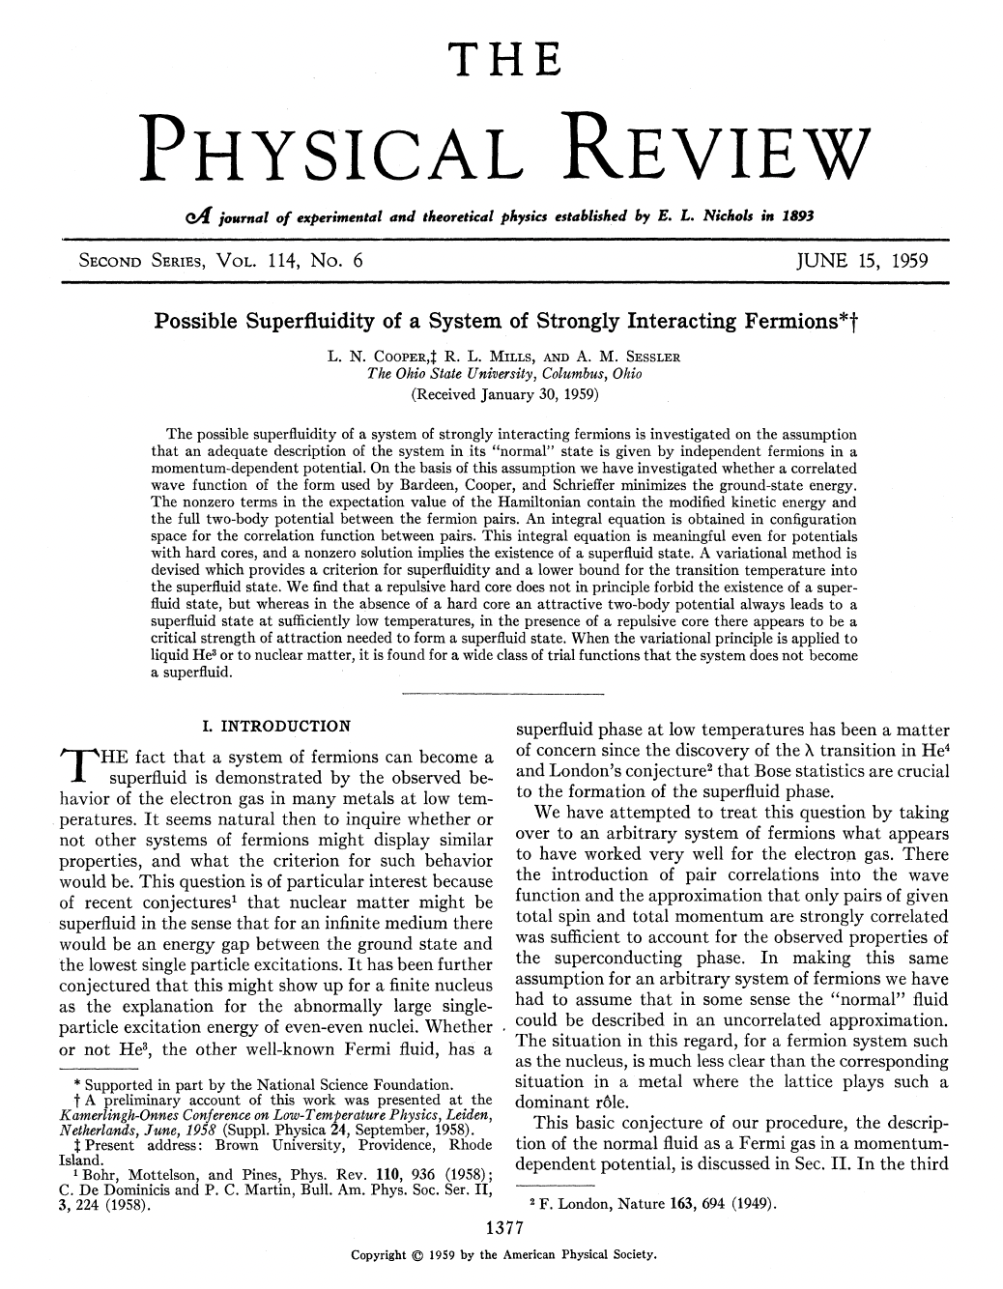
NN2024 Whistler, BC CA / BC

Slide 6
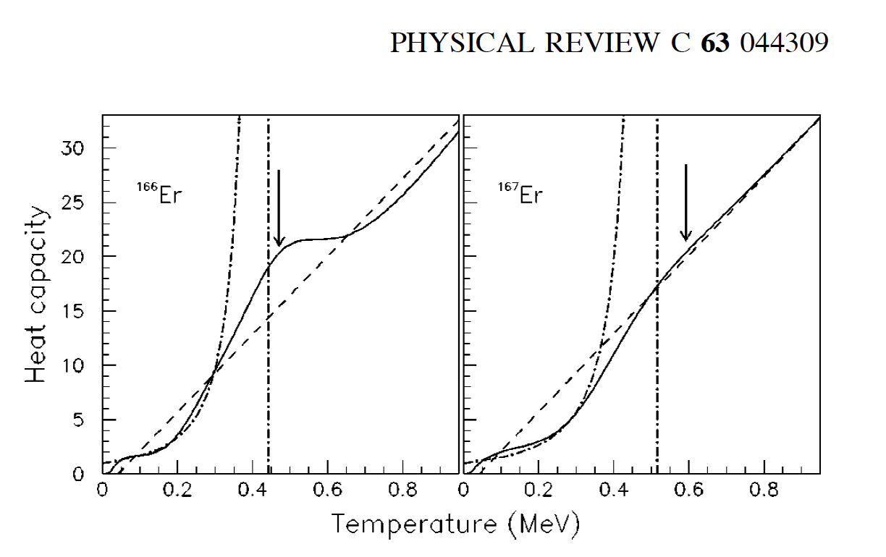
Nuclear pairing quantum phase transition
NN2024 Whistler, BC CA / BC
Notes:
The Oslo group is well known for its studies of nuclear level densities and has searched for the superfluid-normal phase transition and its critical temperature. Through their relentless studies of nuclear level densities at finite temperature they have managed demonstrate the effect. It is involves careful measurements of gamma-ray strength functions which are interpreted with a thermodynamic analysis adapted to the atomic nucleus

Slide 7

https://doi.org/10.1142/8526 (2013)
NN2024 Whistler, BC CA / BC

Slide 8
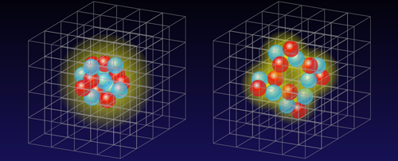
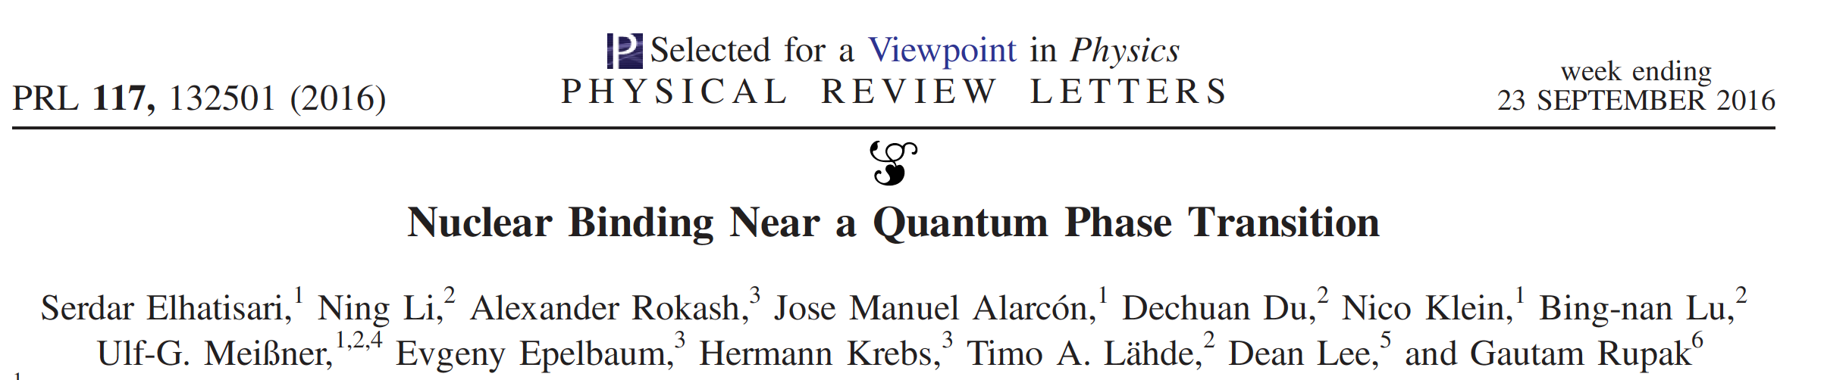
Quantum phase transitions in atomic nuclei
alpha clustering
Exotic phases of nuclear matter
Quartetting and 𝛼-particle condensation
Fermi liquid
α cluster phase
NN2024 Whistler, BC CA / BC

Slide 9
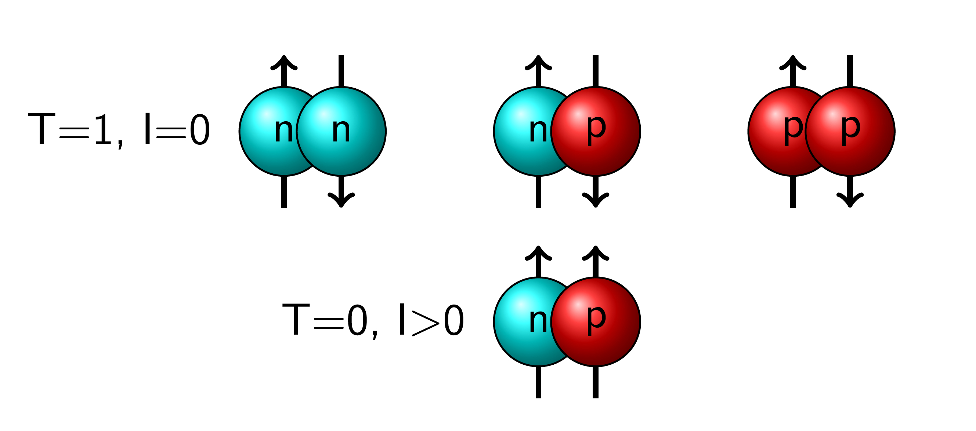
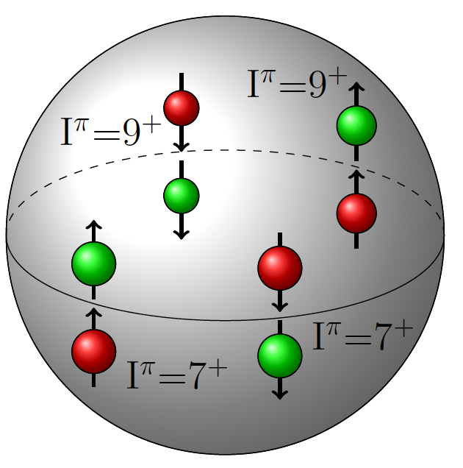
Isospin NN pairing modes
(a unique possibility for nuclei due to the coupling of two Fermi liquids)
J=9
J=9
100Sn
I
J=9
J=9
Isoscalar paired phase in ⁹²Pd?
B. Cederwall et al., Nature (London) 469, 68 (2011)
NN2024 Whistler, BC CA / BC

Slide 10
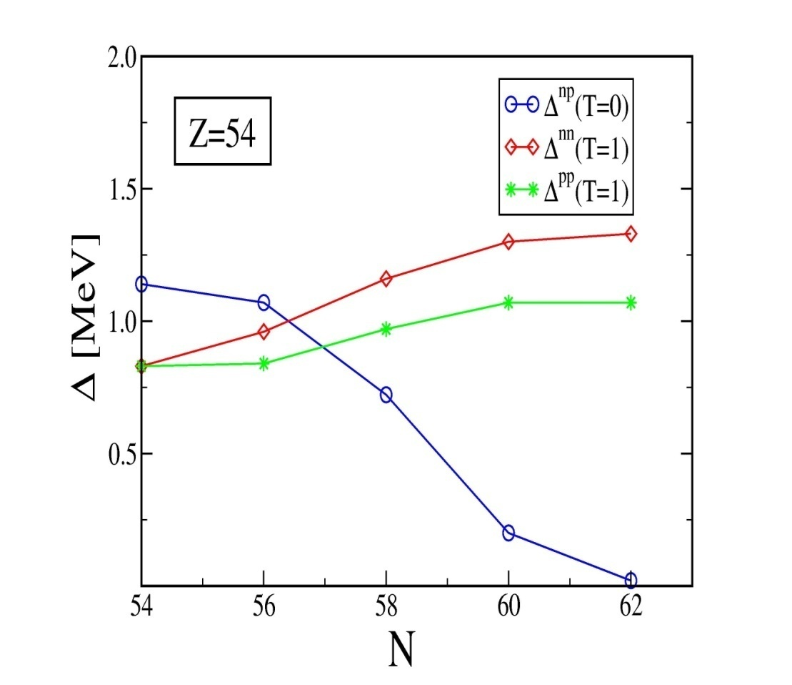
Theory predictions for neutron-proton pairing
in the heaviest N ~ Z nuclei
L. Goodman , PRC 60, 014311 (1999) –
HFB studies of ground states of e-e A = 76-96, N = Z nuclei
T=1 T=1 T=0
T=0
mass
76 80 90 96
W. Satula,R.Wyss,
Phys. Rev. Lett. Vol. 86, 4488 (2001)
”Isocranking”: The isoscalar (np) pair gap is predicted to increase sharply as N → Z
NN2024 Whistler, BC CA / BC
Notes:
Goodman: For 76Sr and 80Zr, T = 1 pairing provides significantly more binding energy than T=0 pairing. For 96Cd the situation is reversed, and T=0
pairing gives substantially more binding energy than T=1 pairing. For 92Pd the lowest energy state has /an,apT=0> Cooper pairs, while there is a higher energy state with the mixed phase containing /an,a p,T=0> Cooper pairs and T=1 Cooper pairs.
Goodman calcs based on HFB theory + isospin generalised BCS theory

Slide 11
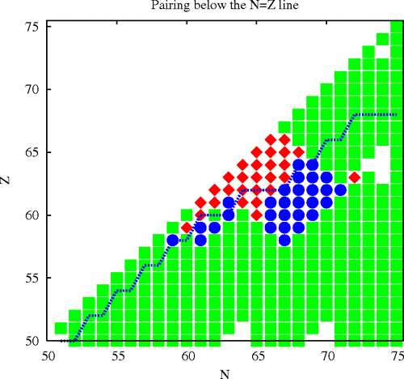
Isoscalar Pairing Condensate
Mixed Pairing Condensate
Isovector Pairing Condensate
Proton dripline
“Mixed-Spin Pairing Condensates in Heavy Nuclei“
A. Gezerlis, G. F. Bertsch, and Y. L. Luo
Phys. Rev. Lett. 106, 252502 (2011)

Slide 12
Similarly to a magnetic field on a superconductor, the rotational motion of a deformed nucleus counteracts the isovector-coupled (J=0) superfluid phase by breaking time-reversed nn or pp pairs.
(Coriolis anti-pairing effect)
NN2024 Whistler, BC CA / BC
Notes:
After the observation of the backbending effect, a discontinuity in the rotational patterns of deformed nuclei which is since long in the textbooks, it was thought to signal the phase transition between a paired superfluid phase and the normal phase. It was then explained as the partial destruction of the pairing phase by the breaking of one pair, followed by subsequent breaking of other pairs at higher rotational frequencies.

Slide 13
Isospin-generalized HFB theory
“T = 0 and T = 1 pairing in rotational states of the N = Z nucleus ⁸⁰Zr”
A. L. Goodman, PRC 63, 044325 (2001)
T=1 pairing is suppressed by the Coriolis effect in high-spin states
The T=0 coupling is less affected by the Coriolis anti-pairing effect and will still be active and could become dominant as I increases
NN2024 Whistler, BC CA / BC

Slide 14
Neutron-proton pairing in N ≈ Z nuclei - experimental probes
ISOVECTOR
ISOSCALAR
Masses - binding energies in e-e and o-o nuclei indicate that T=1 np pairing is dominant, no evidence for a T=0 (deuteron-like) pair condensate up to around A≈60. Need for accurate mass measurements in heavier N=Z systems
np (deuteron) pair transfer reactions
GT Beta decay strengths
Other radioactive decay modes: (alpha) proton???
Spectral properties of spherical N=Z nuclei near closed shells –deviations from classical s.p. behavior (e.g. ⁹²Pd – isoscalar spin-aligned coupling scheme*)
Rotational properties of deformed nuclei
?
Probe ground-state or low-spin correlations
We know the isoscalar effective NN interaction is strongly attractive but can it produce a correlated np pairing condensate?
B. Cederwall et al., Nature (London) 469, 68 (2011)
S. Frauendorf and A. Macchiavelli, Prog. Part. Nucl. Phys. 78, 24 (2014)
NN2024 Whistler, BC CA / BC

Slide 15
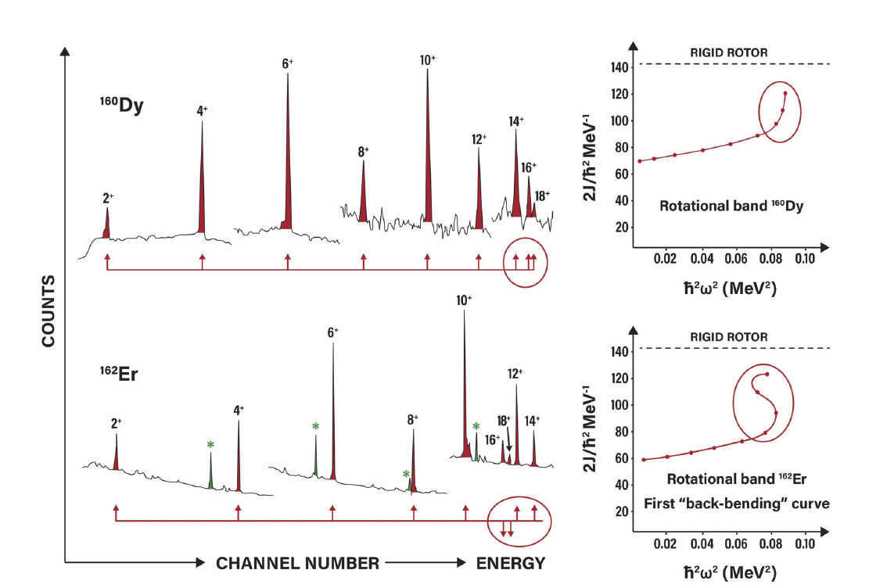
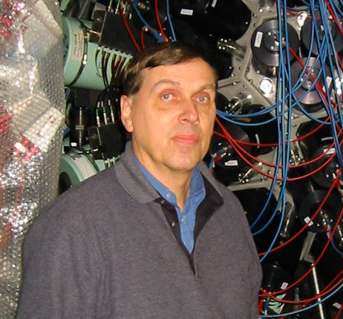
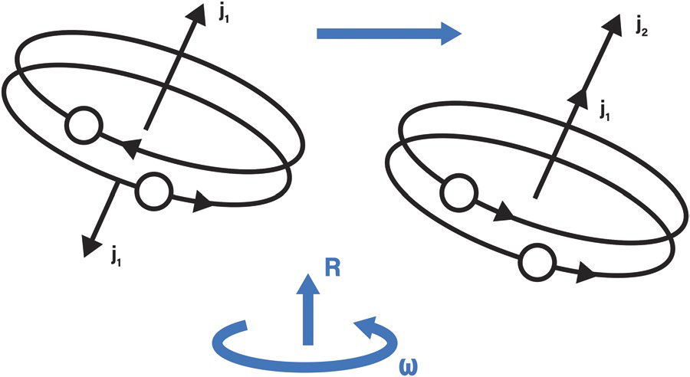
Rotational alignments (”backbending”) in deformed nuclei: a sensitive probe of pairing strength
Arne Johnson 1944-2023
Note: The “Backbending” effect (A. Johnson et al., 1971) is not a complete phase transition.
In the finite nuclear system the paired and unpaired phases are mixed after the first alignment (“Stockholm, S-band”) (F.S. Stephens and R.S. Simon, 1972).
A. Johnson, H. Ryde, and J. Sztarkier, Phys. Lett. B34, 605 (1971)
A. Johnson, H. Ryde, S. A. Hjorth, Nuc. Phys. A179, 753 (1972)
F. S. Stephens and R. S. Simon. Nuc. Phys. A183, 257 (1972)
R. Wyss & M. A. Riley, Fifty Years of Backbending, Nuclear Physics News, 32:2, 16-20 (2022)
NN2024 Whistler, BC CA / BC

Slide 16
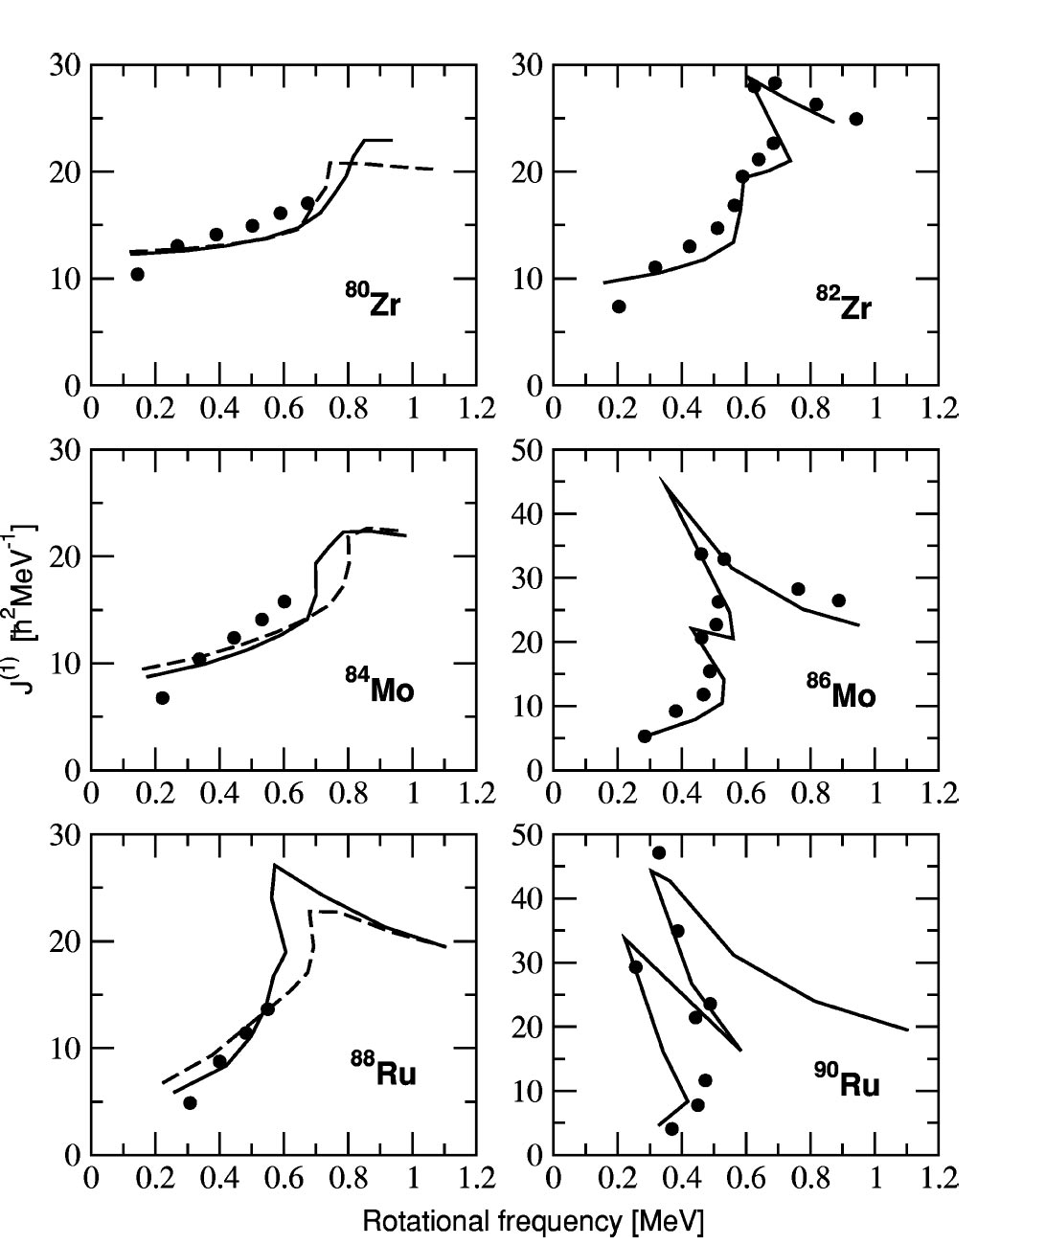
Delayed (or absent) paired (T=1) bandcrossings in deformed N=Z nuclei?
____ PSM
._ _ _ PSM with enhanced
np res. int
Situation prior to this work
N. Marginenan et al., Phys. Rev. C 65, 051303R (2002)
NN2024 Whistler, BC CA / BC

Slide 17


Experiment
GANIL, May of 2018, 10 days of beam time
Beam: ³⁶Ar (115 MeV, 5 ~ 10 pnA)
Target: ⁵⁴Fe (99.58%, 6 mg/cm²)
Main contaminations: ¹⁶O from oxidation, ⁵⁶Fe (0.40%)
Fusion-evaporation reactions of interest:
³⁶Ar(⁵⁴Fe, 2n)⁸⁸Ru
³⁶Ar(⁵⁴Fe, 2n1p)⁸⁷Tc
𝟖𝟖_{𝐑𝐮𝟒𝟒}
N=50
𝟒𝟒
p-drip line
N=48
¹⁰⁰Sn
Unknown
𝟖𝟕_{𝐓𝐜𝟒𝟒}
Unknown proton emitter
𝟒𝟑
Nucleus with only T_{1/2} known
Nucleus with ⩾ 1 excited state known
5
N=Z
NN2024 Whistler, BC CA / BC
6

Slide 18
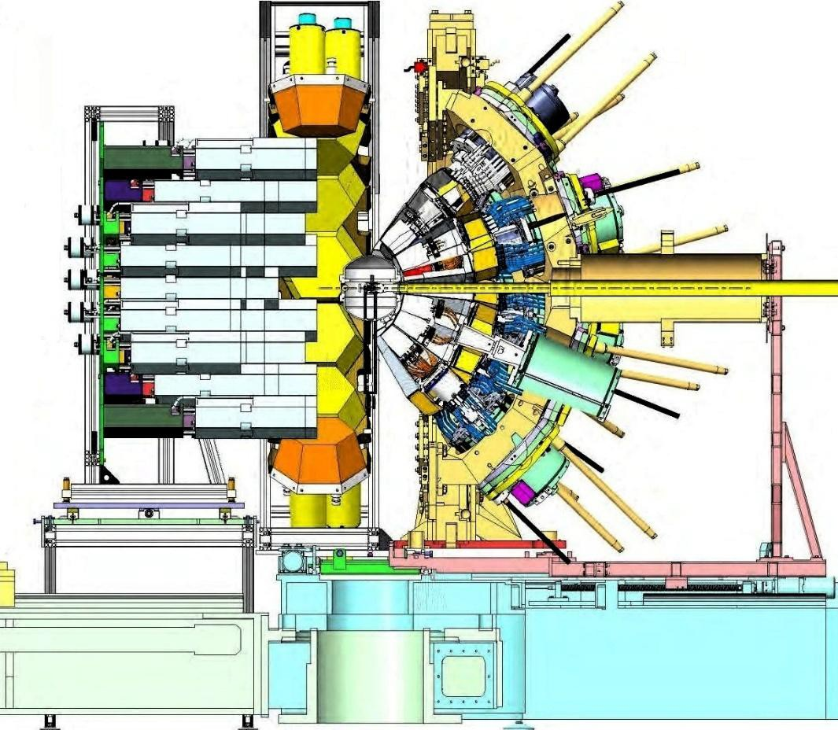
Experimental Setup
Target ⁵⁴Fe DIAMANT
NEDA
Beam ³⁶Ar
NWall
AGATA
G. de France, NUMEX02 Workshop at Debrecen, 2016
7
NN2024 Whistler, BC CA / BC

Slide 19
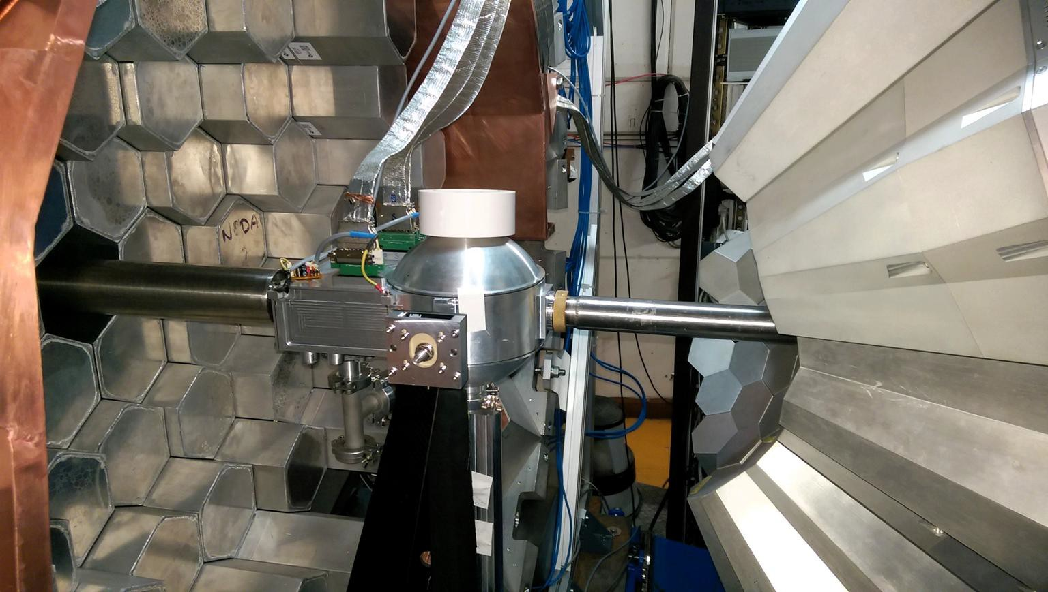
7
Courtesy of J Nyberg
NN2024 Whistler, BC CA / BC

Slide 20
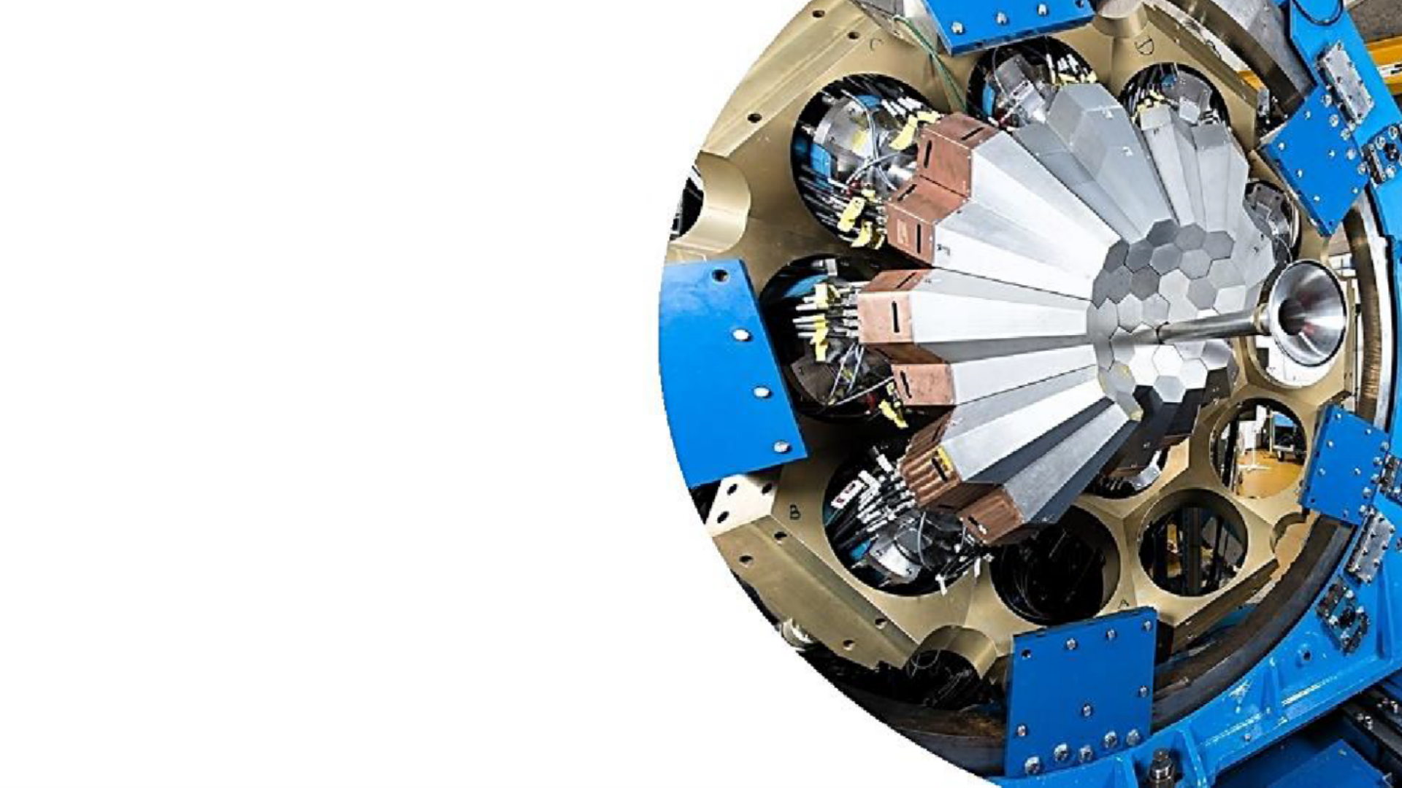
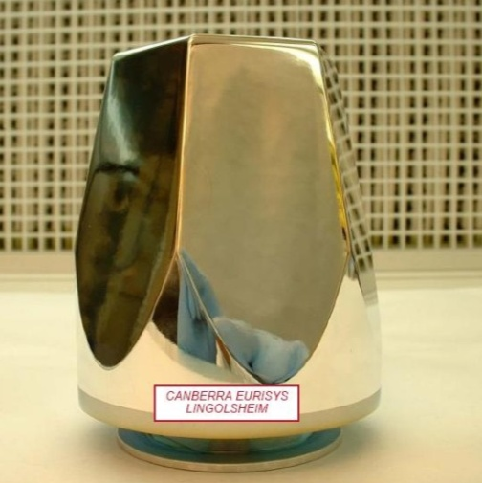
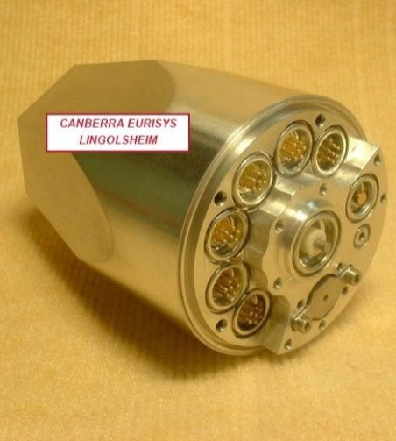
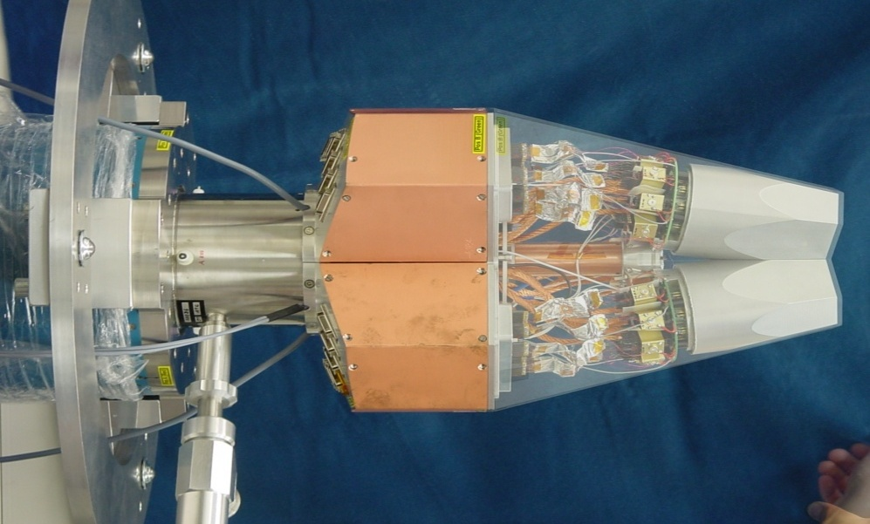
AGATA
34 AGATA crystals (out of 180)
~ 0.8𝝅 Coverage
E, T, Position (x, y, z)
Trigger: 𝜸𝜸-𝒏
From AGATA Home Page
NN2024 Whistler, BC CA / BC

Slide 21

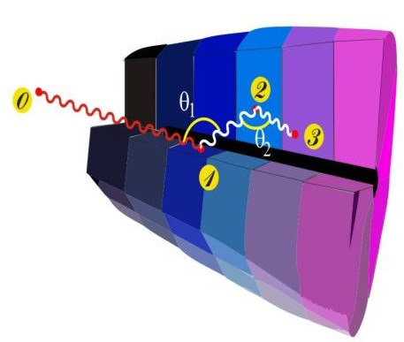
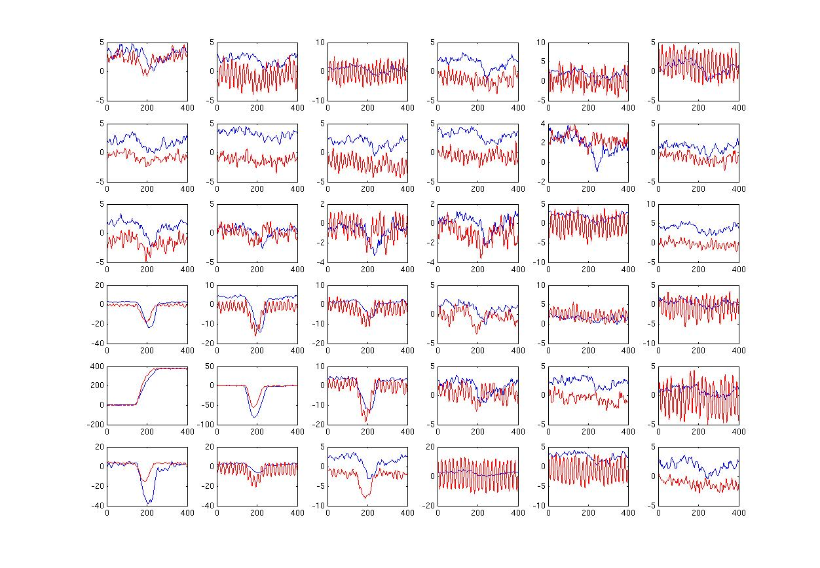
Basic ingredients of γ-ray tracking
4
1
Identified
interaction points
Reconstruction of tracks
e.g. by evaluation of permutations
of interaction points
Highly segmented
HPGe detectors
(x,y,z,E,t)_{i}
γ
·
·
·
Pulse Shape Analysis
to decompose
recorded waves
·
2
3
Digital electronics
to record and
process segment signals
reconstructed γ rays
NN2024 Whistler, BC CA / BC
Notes:
What has to be done to perform tracking
What are the ingredients
Detectors highly segmented, encapsulated, cryostats
Electronics Digital
PSA to extract Energy Time and Position
Algorithm development particularly for position
Area where effort is required Thorsten Kroell. See him.
Tracking algorithms, reconstruction of the events for full array
Obtain full energy
Many technical development in all areas.

Slide 22
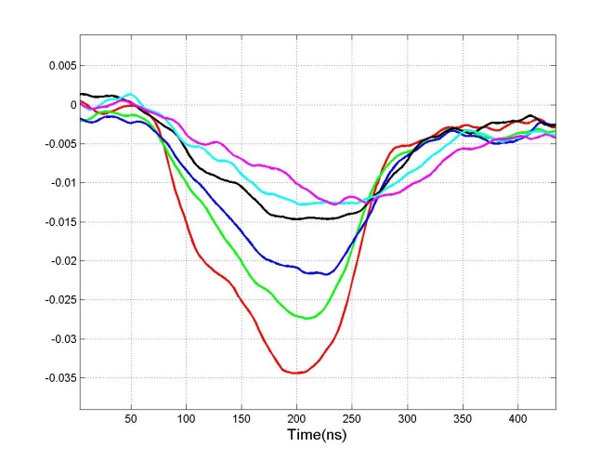
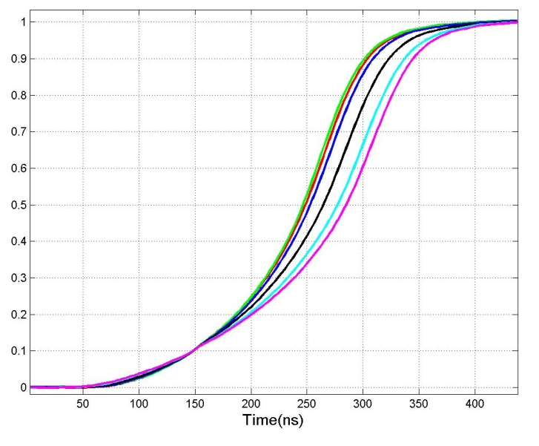
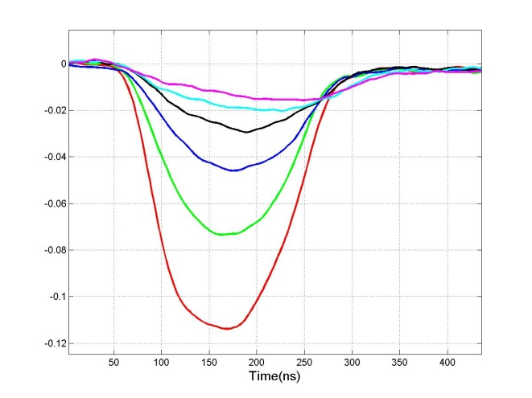

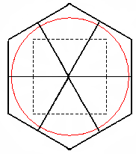
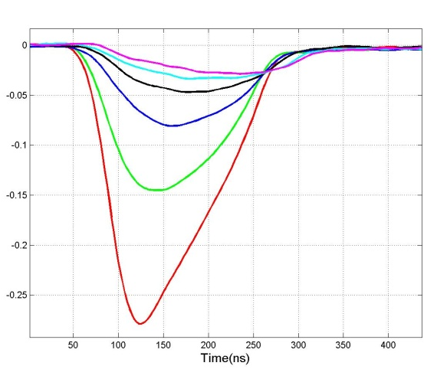
Pulse shape analysis – spatial resolution of 2-5 mm
Core
F3
F6
F2
F5
E1
D1
F4
0º
F1
C1
F3
F2
F1
A1
B1
F1
NN2024 Whistler, BC CA / BC
Notes:
What has to be done to perform tracking
What are the ingredients
Detectors highly segmented, encapsulated, cryostats
Electronics Digital
PSA to extract Energy Time and Position
Algorithm development particularly for position
Area where effort is required Thorsten Kroell. See him.
Tracking algorithms, reconstruction of the events for full array
Obtain full energy
Many technical development in all areas.

Slide 23

i
i
Position sensitive large-volume HPGe detector
→ ”Ge TPC” → γ-ray tracking
t
t
Pulse shape analysis
3D-position sensitivity from
2D-segmented HPGe detectors
- Achieving a “Ge TPC”
Contact segment size ~ cm²
Voxel size ~ mm³
Tracking
Correctly time order all
interactions
NN2024 Whistler, BC CA / BC

Slide 24
Forward Tracking of Compton Scattering Events
Find χ² for the N! permutations
of the interaction points
0123 0132
0231 0213
0312 0321
Accept permutation with smallest χ² if this is below a predefined value
χ²
How it works for
two 5-point events
W_{n} contains physics of Compton
scattering vertex and empiric factors
PROBLEMS : Position resolution, Short range scattering, Compton profile
Permutation number
NN2024 Whistler, BC CA / BC

Slide 25
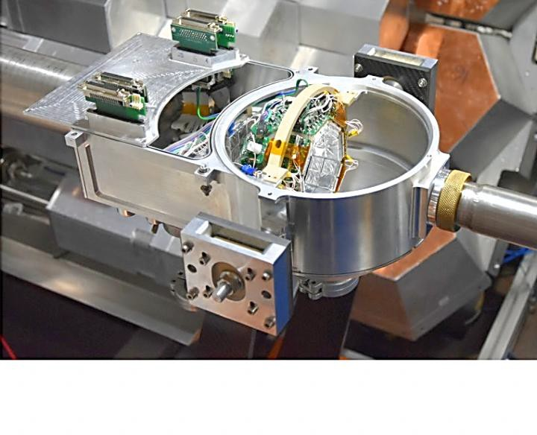
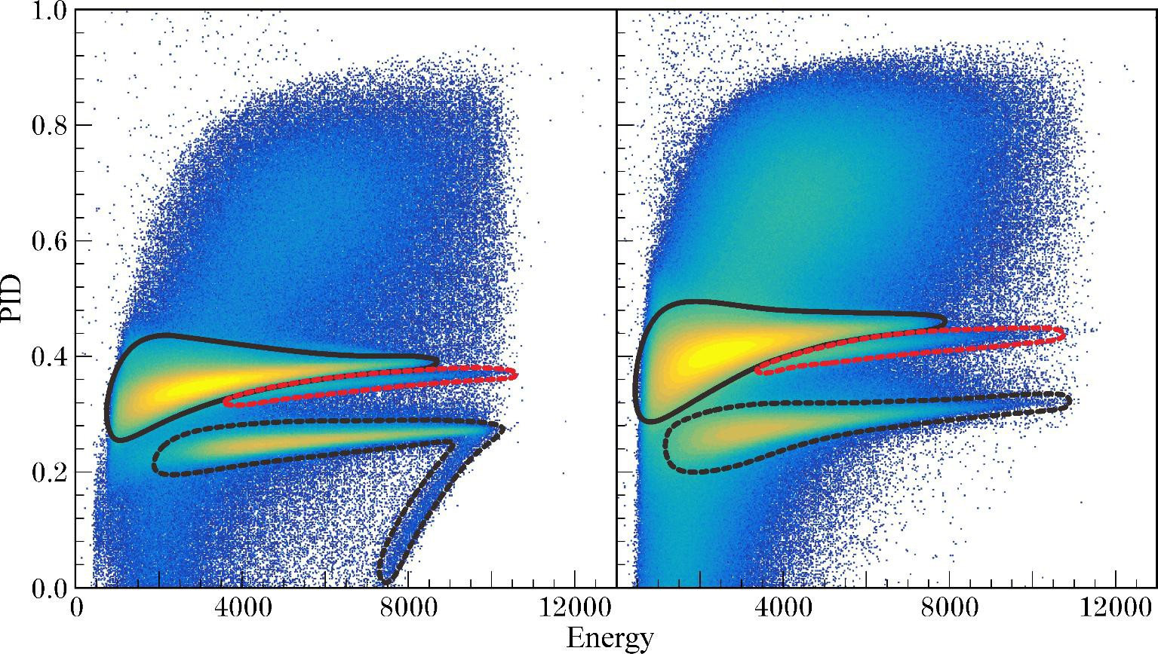
DIAMANT charged particle array
60 CsI(Tl) Detectors
~ 2𝝅 Coverage
E, T, PID
Slave Mode
𝜺_{p} ~ 40%, 𝜺_{𝜶} ~ 25%
Veto gate: reject all
pulse shape identififation of charged particles
proton
2 protons
A. Goasduff, AGATA Analysis Workshop at CSNSM, 2019
alpha
NN2024 Whistler, BC CA / BC

Slide 26
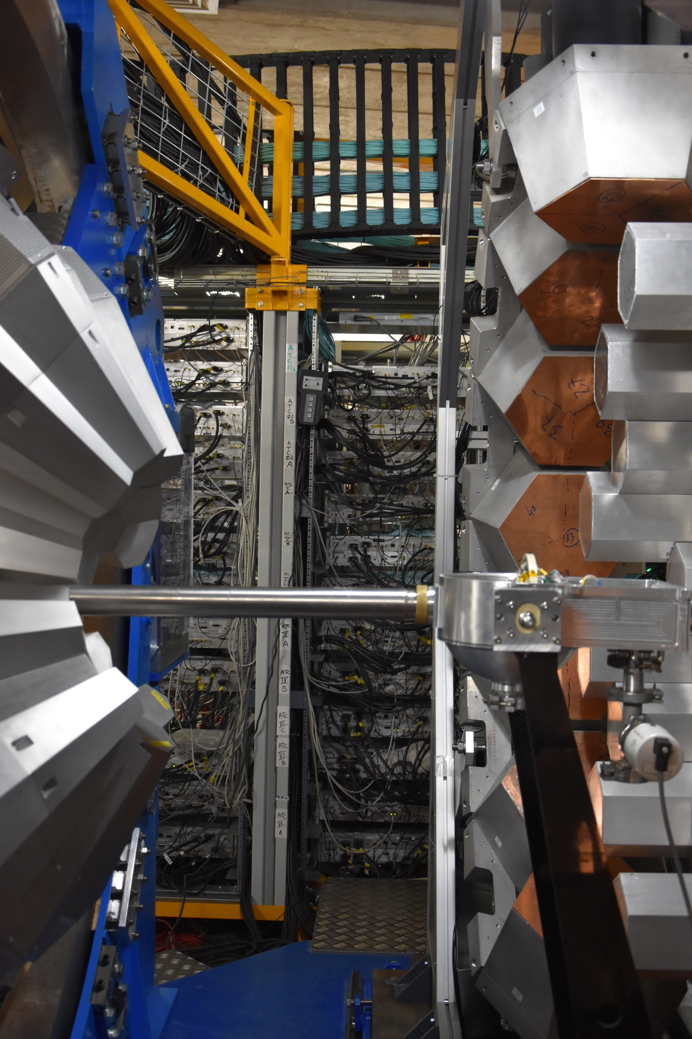
NEDA & NWall
Organic liquid scintillator cells
54 NEDA & 14 NWall
~ 1.6𝜋 Coverage
Pulse Shape
Trigger: 𝛾𝛾-n (neutron-like)
NN2024 Whistler, BC CA / BC

Slide 27
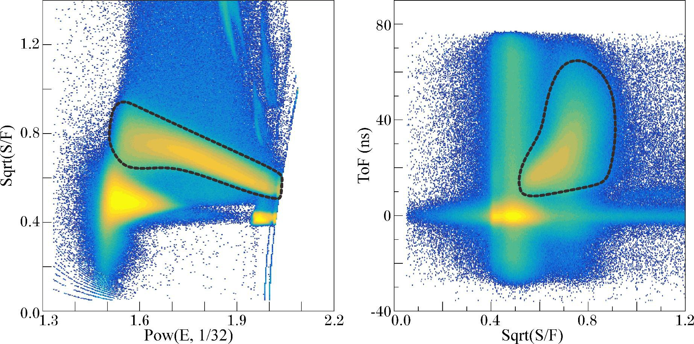
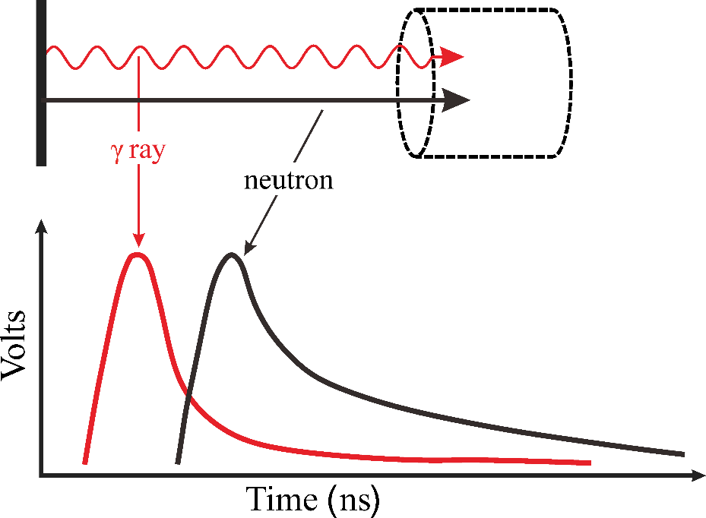
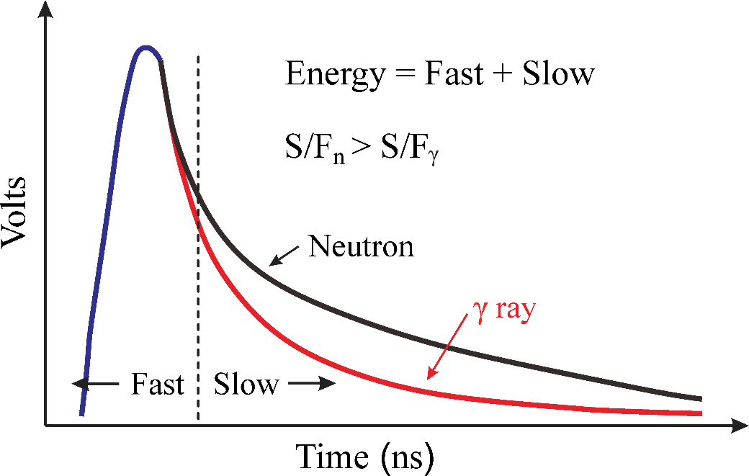
Neutron-γ Discrimination
Neutron
Gamma
PSD: Charge Comparison Method
ToF = CFDtime - RFtime
NN2024 Whistler, BC CA / BC

Slide 28
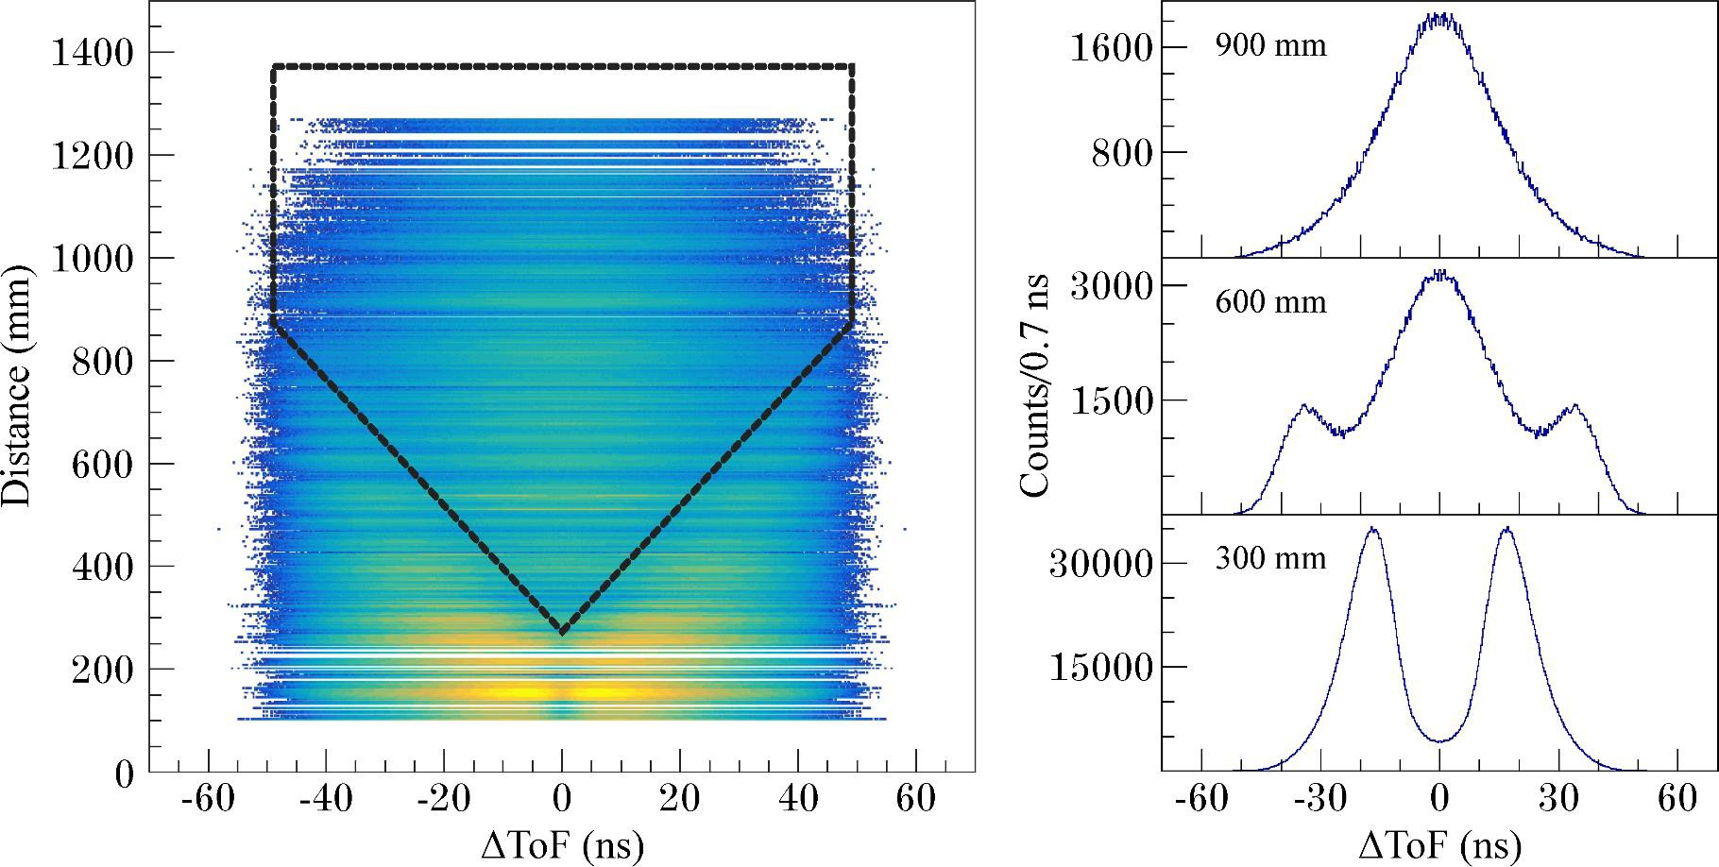
Neutron scatter rejection critical for identifying weak 2n- and 3n-emission reaction channels
Detector 2
Distance
𝚫ToF
Target
Detector 1
23
NN2024 Whistler, BC CA / BC

Slide 29
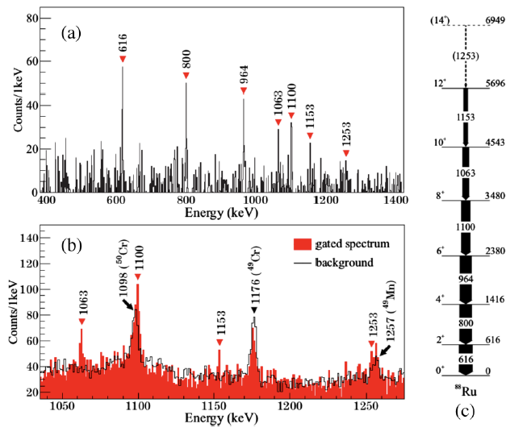
Results: yrast band in ⁸⁸Ru
new
Marginean et al.,
Phys. Rev. C, 63, 031303(R), 2001.
Taken from B. Cederwall et al, PRL 124 062501 (2020)
NN2024 Whistler, BC CA / BC

Slide 30

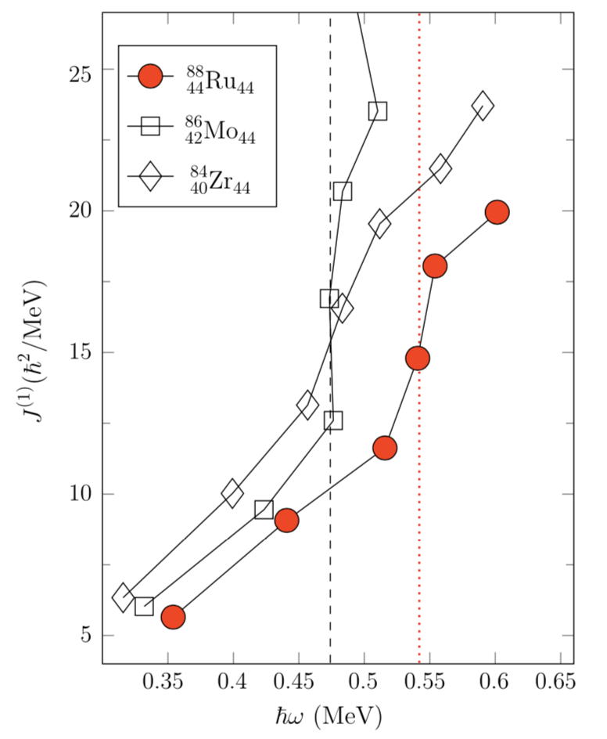
N=44 isotones
?
B. Cederwall et al, PRL 124 062501 (2020)
NN2024 Whistler, BC CA / BC

Slide 31
Strutinsky-type PES calculations * with standard isovector pairing
(total Routhian surface (TRS) approach)
Note: do not produce deformed ground-state shape
(but pronounced superdeformed minimum appears already at zero rot. frequency!)
ℏ𝝎 = 0.00 MeV
ℏ𝝎 = 0.24 MeV
* W. Nazarewicz, R. Wyss, A. Johnson, Nuclear Physics A 503(2), 285 (1989)
NN2024 Whistler, BC CA / BC

Slide 32
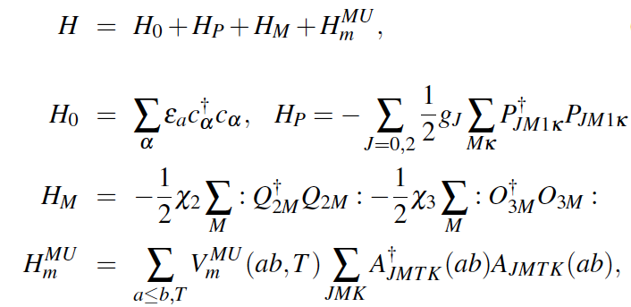
LSSM predictions for ⁸⁸Ru with interaction including an explicit pairing term (PMMU)
PMMU: H = H_{o} + H_{P} + H_{M} + H_{m} :
H_{o} = s.p, H_{P} = pairing
H_{M} = multipole, contains QQ + OO components
H_{m} = monopole term
K. Kaneko, T. Mizusaki, Y. Sun, and S. Tazaki, Phys. Rev. C89, 011302(R) (2014)
Kaneko, Sun and de Angelis, Nuclear Physics A957, 144-153 (2017)
Note: Without the T = 0 np pairing, the smooth pattern in ⁸⁸Ru disappears and it lacks rotational behaviour as for ^{90,92}Ru. QQ np T=0 is most important in ⁸⁸Ru.
NN2024 Whistler, BC CA / BC

Slide 33
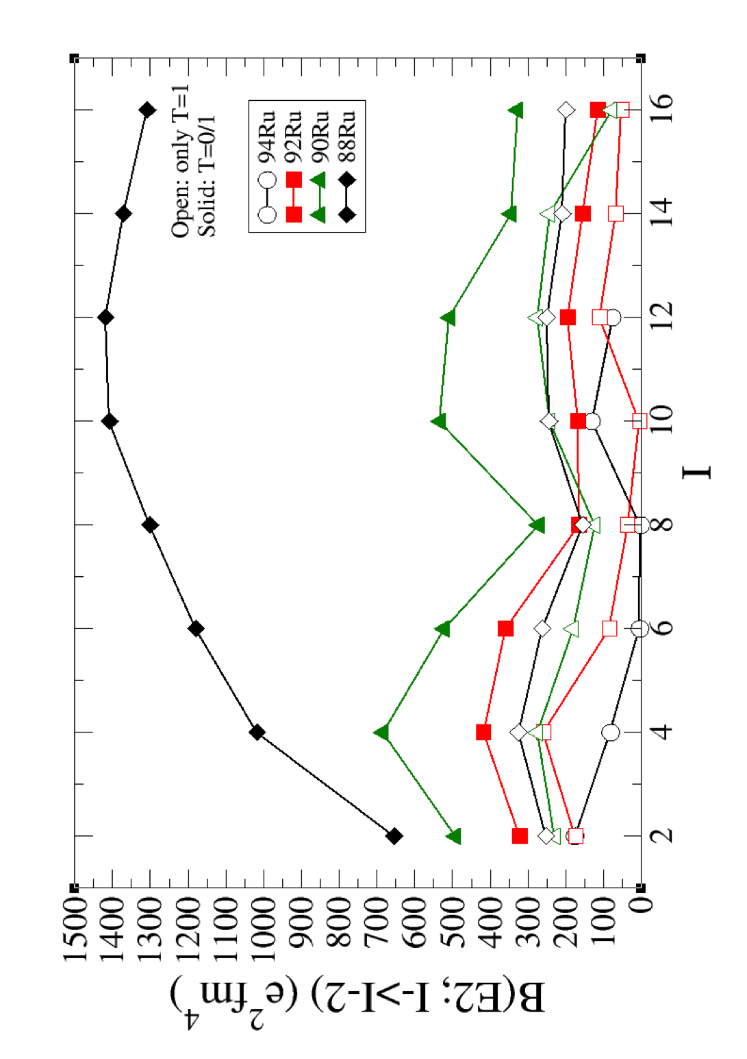
LSSM calculations: T=0 correlations drive collectivity
B(E2) measurements are critical
New results from GRETINA@FRIB (M. Bentley et al) , stay tuned!
Calculated B(E2;I→I-2) values as a function of angular momentum in ⁸⁸⁻⁹⁴Ru. The calculations have been performed in the fpg space with the JUN45 interaction using standard effective charges. The theoretical calculations for the spectra of ^{88,90,92}Ru include, in addition to full neutron-proton interactions (solid symbols), also results for pure T=1 neutron-proton (open symbols) interactions.
C. Qi et al.
expt
⁸⁸Ru
SM
NN2024 Whistler, BC CA / BC

Slide 34
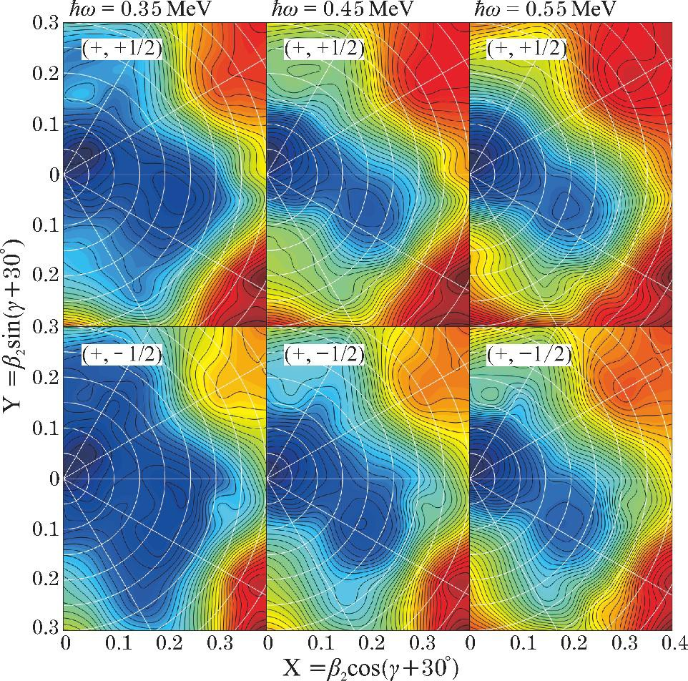
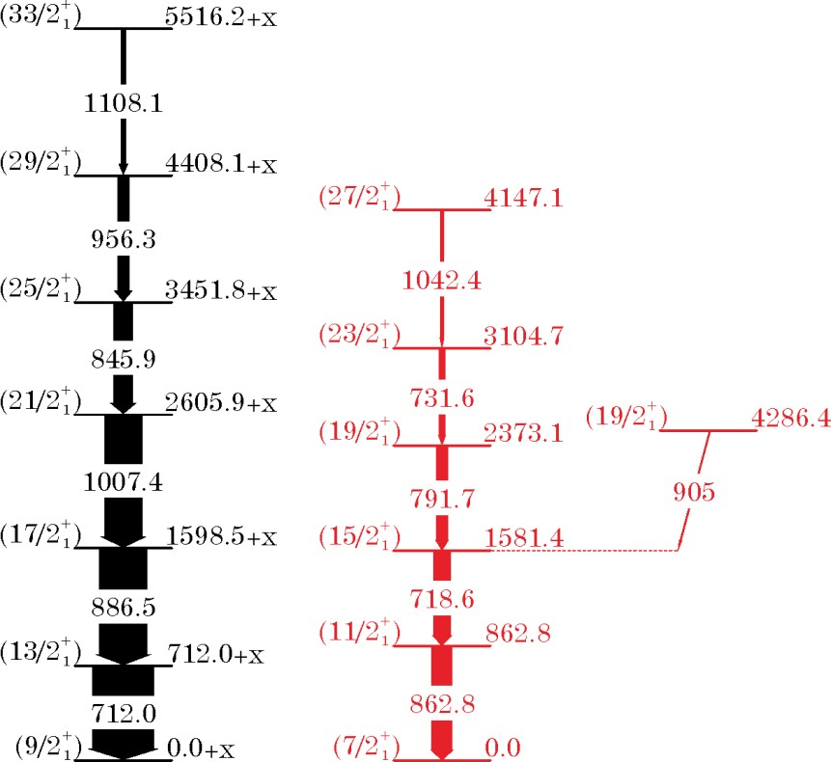
Extension of the ground state (𝜋g_{9/2}) band and new oblate band in the T_{Z}=1/2 nucleus ⁸⁷Tc
new
J. Phys. G, 17, 133, 1991.
NN2024 Whistler, BC CA / BC

Slide 35
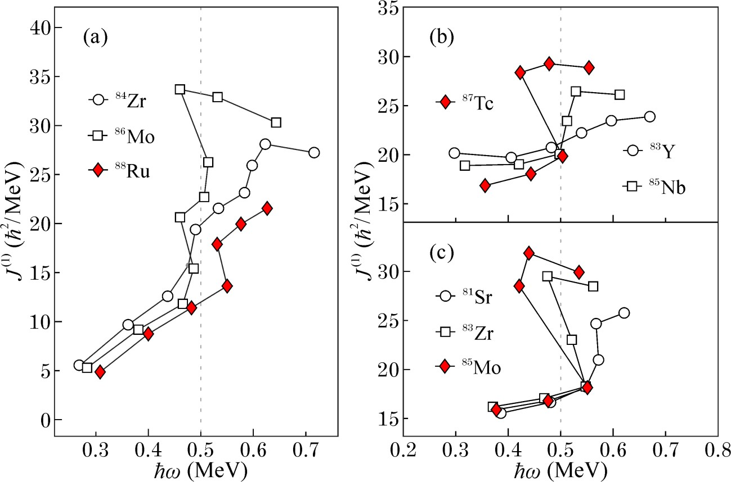
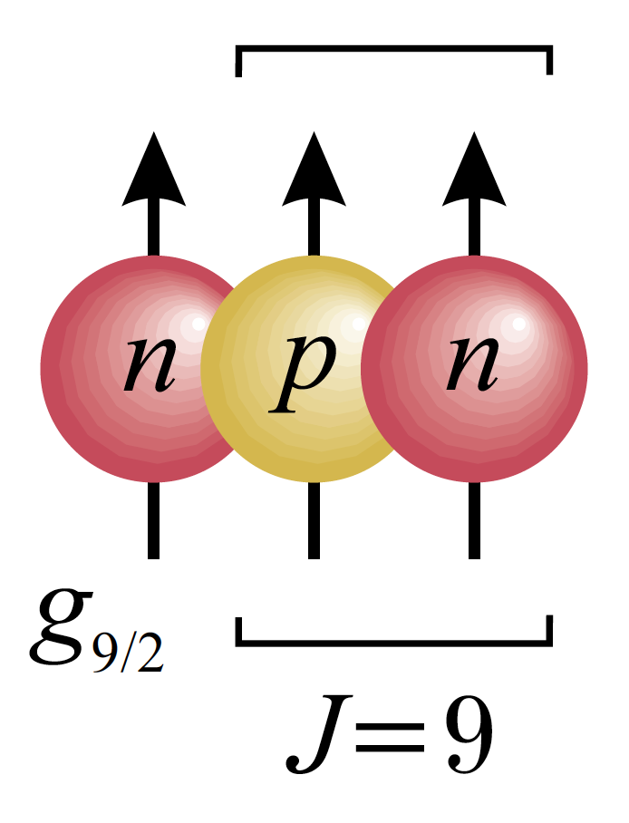
Pairing isospin modes in deformed N~Z nuclei at intermediate angular momentum
– odd-even vs even-even
N=44, ee
N=44, odd
Even-Even
N=44 Odd-Mass N=44
N=43
N=43, odd
B. Cederwall et al, PRL 124 062501 (2020)
X. Liu et al, PRC 104 L021302 (2021)
NN2024 Whistler, BC CA / BC

Slide 36
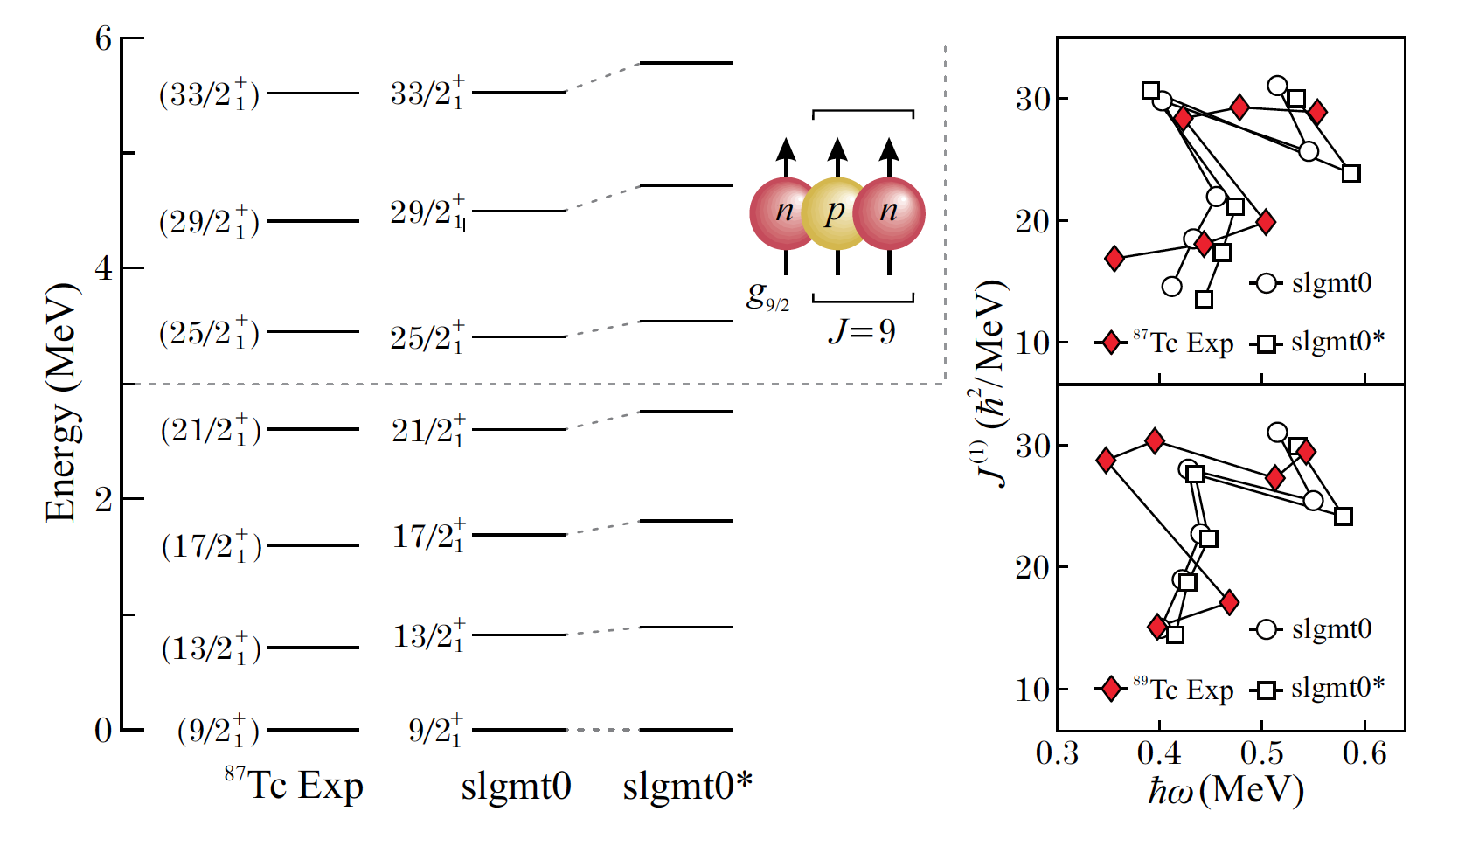
Shell model calculation for ⁸⁷Tc (T_{Z}=1/2) – effect of spin-aligned np pairs (V_{np})
Even-Even
N=44 Odd-Mass N=44
Odd-Mass
N=43
V_{np} - 200 keV
X. Liu et al, PRC 104 L021302 (2021)
F. J. D. Serduke, R. D. Lawson, and D. H. Gloeckner, Nucl. Phys. A 256, 45 (1976)
Odd-mass N~Z (T_{Z}=1/2) nuclei:
Odd valence particle contributes constructively to isoscalr np pairing correlations ”spin-dependent effective 3-N” interaction
as opposed to ”blocking” effect in pure isovector case?
Increase of structural difference between 1qp and 3qp configuration reduces interaction strength in the band crossing?
NN2024 Whistler, BC CA / BC

Slide 37
Influence of pairing isospin modes in deformed N~Z
– odd-A vs even-even cases (naïve picture)
h´= h₀ + h_{pair} -𝝎j_{x}
e´ (MeV)
N=44, ee
N=44, odd
Even-Even
N=44 Odd-Mass N=44
2
N=43
N=43, odd
ℏ𝜔_{c}
iv pairing gap ”2𝜟”
1
0
g-band (0/1qp)
-1
S-band (2/3qp)
iv + is pairing, ee
-2
iv pairing
iv + is pairing, odd
0.0
0.2
0.4
ℏ𝝎 (MeV)
NN2024 Whistler, BC CA / BC

Slide 38
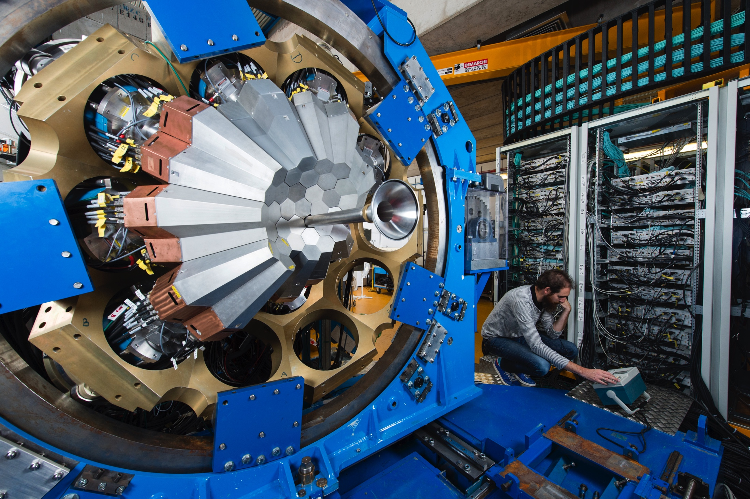
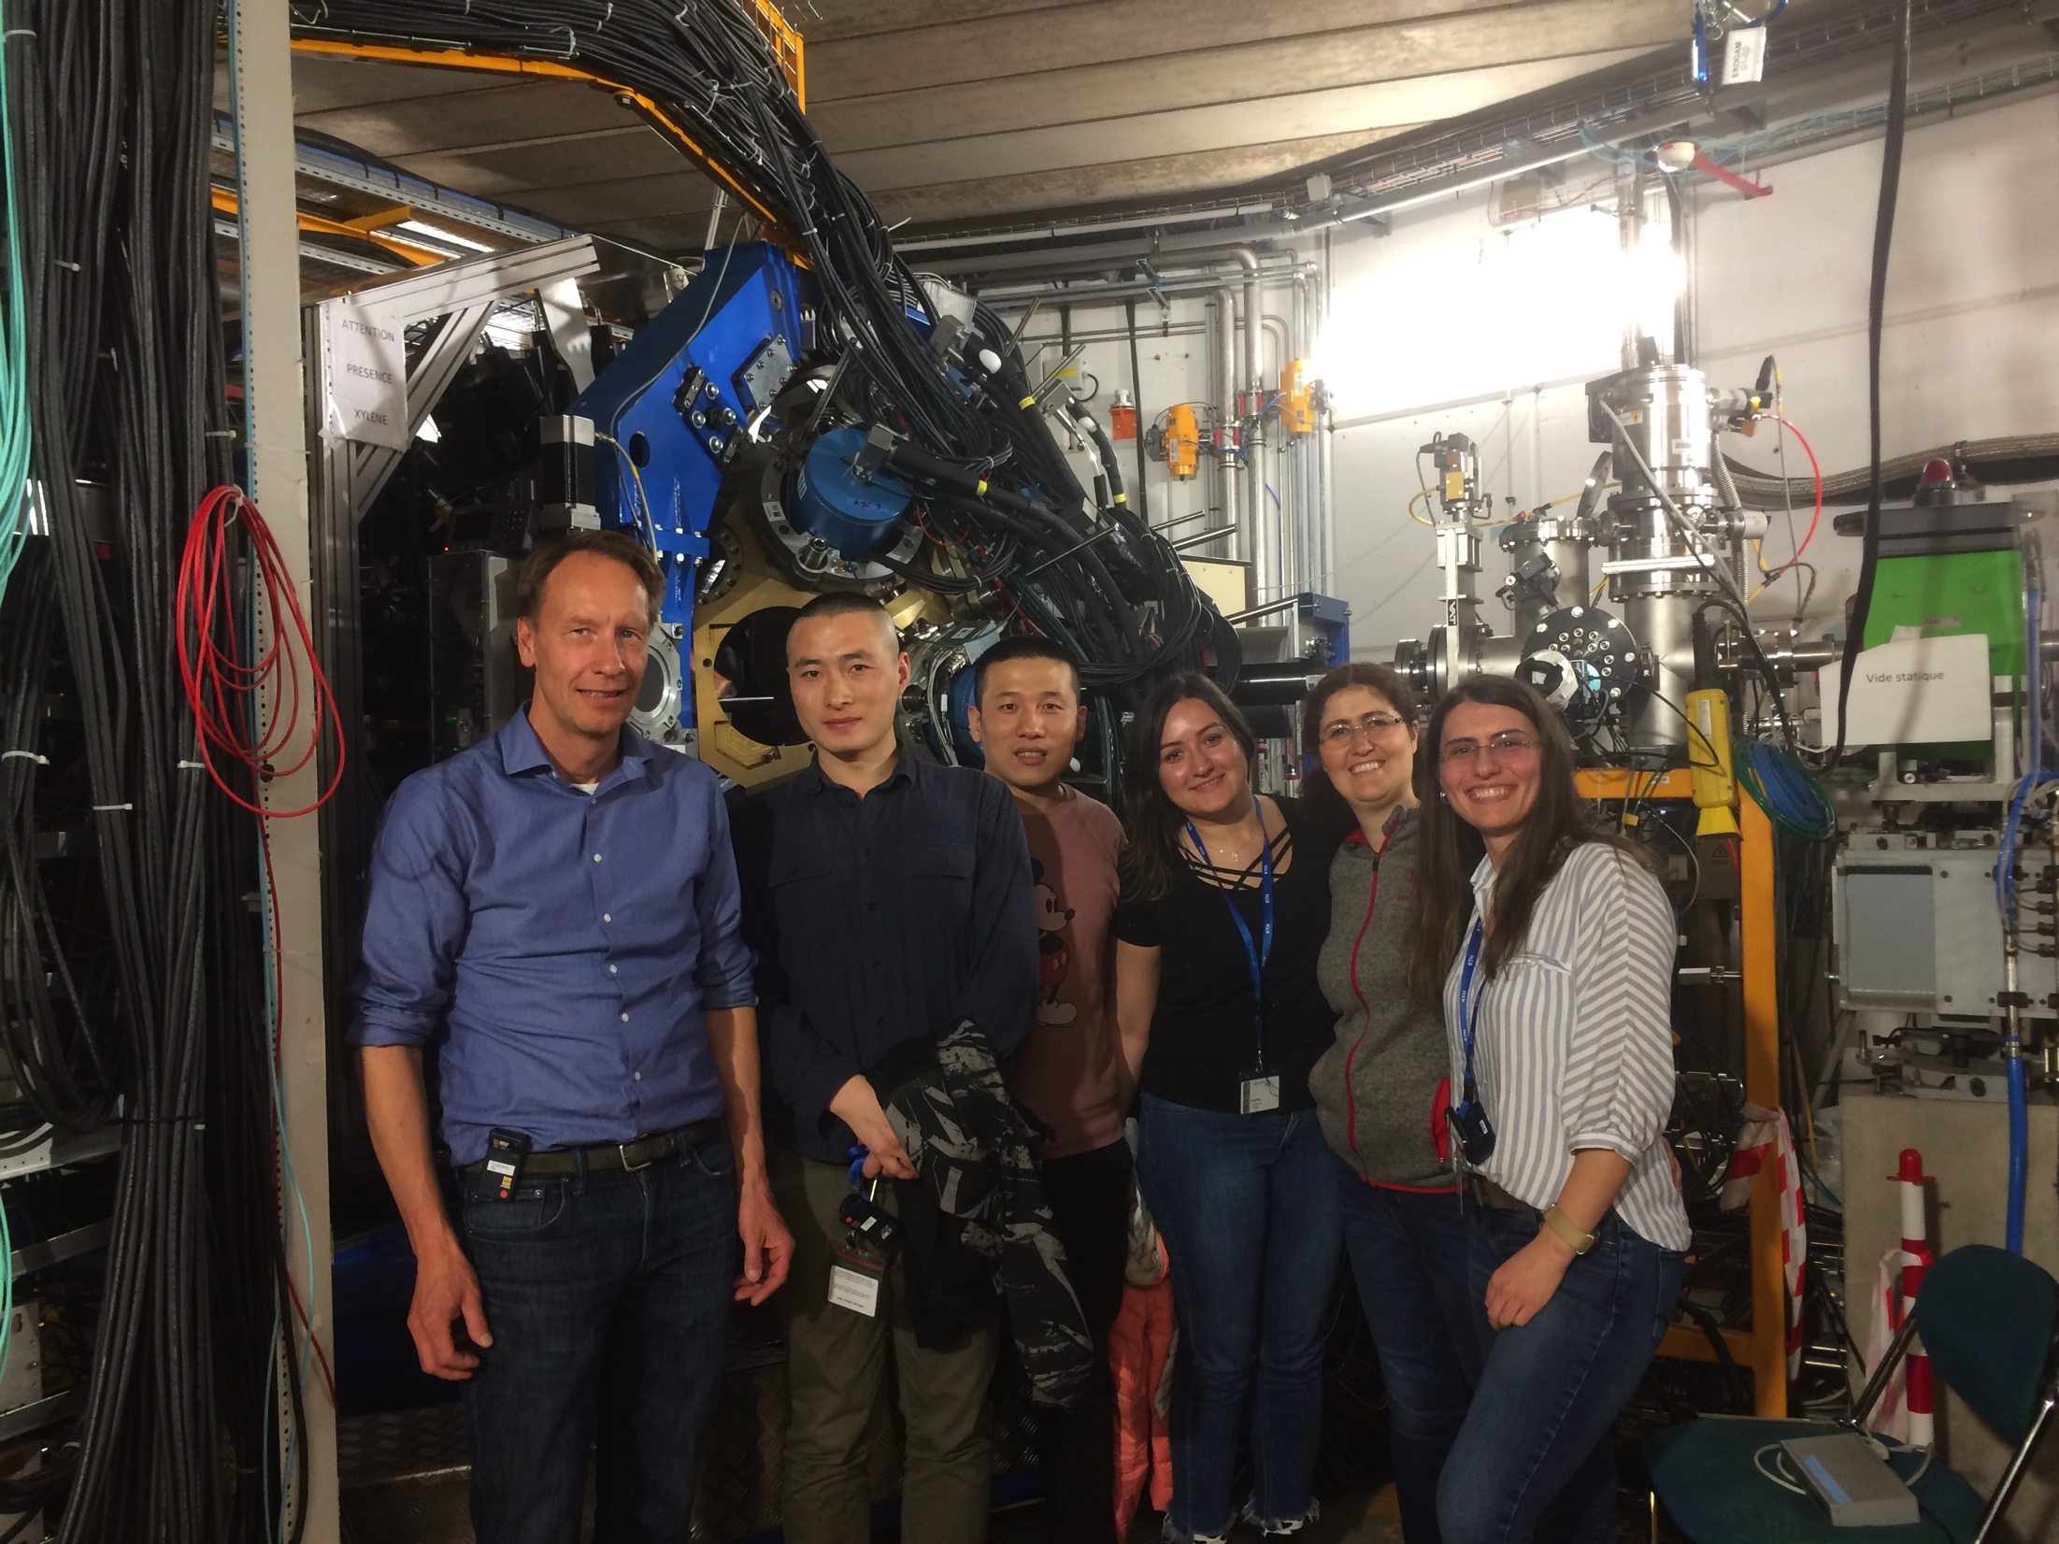
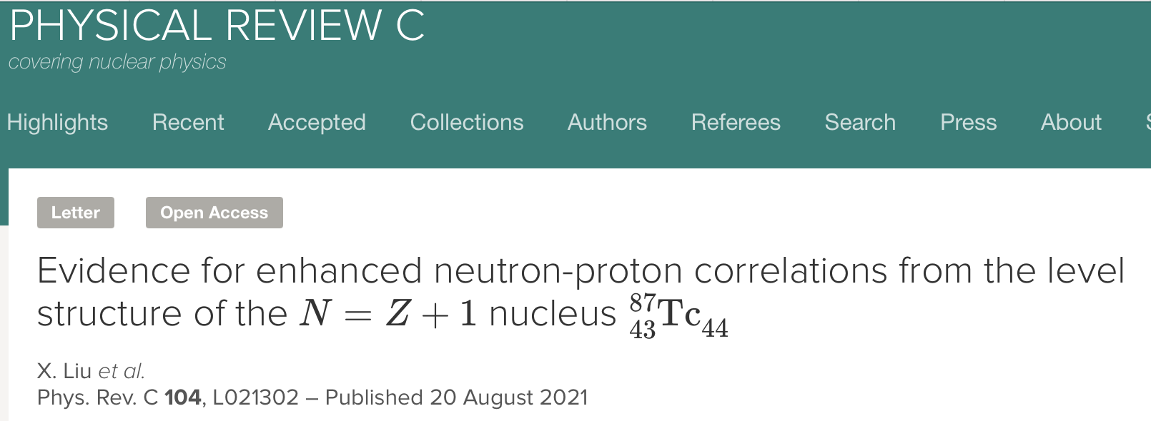


Experiment
𝟓𝟎
RAE2021 Nuclear Physics Division
NN2024 Whistler, BC CA / BC

Slide 39

Summary
Intermediate-angular momentum states in the heaviest deformed N~Z nuclei ⁸⁸Ru and ⁸⁷Tc have been observed with AGATA + ancillary detectors (NEDA/NWALL, DIAMANT)
In ⁸⁸Ru, the rotational frequency for the configuration change between the ground-state and qp-aligned structures indicates a ”delay” wrt standard calculations and expt data in neighboring Tz=1 isotones, in agreement with theoretical predictions for enhanced isoscalar np correlations.
For, the T_{Z}=1/2 isotone, ⁸⁷Tc, we observe an earlier band crossing frequency compared with the neighboring N=44 and N=43 odd-mass nuclei for the yrast band built on the 𝜋g_{9/2} ground state
∴ IV band crossing frequencies show opposite behavior as T_{Z} ➛ 0 for ee and oe systems
- a new signature for enhanced IS pair correlations in these N~Z systems?
Thanks to AGATA collaboration, GANIL, NEDA, DIAMANT teams!
NN2024 Whistler, BC CA / BC

Slide 40
Thank You

Slide 41
Backup

Slide 42



Slide 43

NEDA energy vs TOF
𝒗 ~ 𝟏𝟎/𝐓𝐨𝐅
𝒗 ~ 𝑬
22
NN2024 Whistler, BC CA / BC

Slide 44


Ginzburg-Landau theory
“Order parameter”
1st order phase transition
T_{C}
“Order parameter”
2nd order phase transition
T_{C}
“Control parameter” (B,T,p, …)
Note:
Atomic nuclei are finite systems!
Control parameter is discrete (particle number, excitation energy etc)
Two different coexisting fgermionic systems (neutrons and protons)

Slide 45

Precison mass data is crucially lacking for N=Z!
Precision of known masses in the ¹⁰⁰Sn region.
T. Faestermann, M. Górska, and H. Grawe, Prog. Part. Nucl.Phys. 69, 85 (2013)

Slide 46

Evidence for isovector np pairing from nuclear charge radius
“Proton-Neutron Pairing Correlations in the Self-Conjugate Nucleus ³⁸K Probed via a Direct Measurement of the Isomer Shift”
M.L. Bissell et al., PRL 113, 052502 (2014)

Slide 47
GT (beta decay) strengths
“Hindered Gamow-Teller Decay to the Odd-Odd N = Z ⁶²Ga: Absence of Proton-Neutron T=0 Condensate in A = 62”,
E. Grodner et al., PRL 113, 092501 (2014)
“Search for a new kind of superfluidity built on collective proton-neutron pairs with aligned spin is performed studying the Gamow-Teller decay of the T =1, J^{π} = 0⁺ ground state of ⁶²Ge into excited states of the odd-odd N = Z nucleus 62 Ga. Individual Gamow-Teller transition strengths agree well with theoretical predictions of the interacting shell model and the quasiparticle random phase approximation. The absence of any sizable low-lying Gamow-Teller strength in the reported beta-decay experiment supports the hypothesis of a negligible role of coherent T = 0 proton-neutron correlations in ⁶²Ga. “

Slide 48
N=Z deuteron transfer
T=0, J=1
± np (l=0)
T=0, I=0
T=1, J=0
even-even g.s.
ISSUES:
Need for (reaction) theory to develop clear predictions
Will be many years before intense beams of ⁸⁰Zr, ⁸⁴Mo, ⁸⁸Ru, ⁹²Pd etc are available for such studies
Only probes ground-state or low-spin correlations
odd-odd g.s.

Slide 49

Experimental systematics I vs ω
NN2024 Whistler, BC CA / BC

Slide 50

“Std” LSSM: B(E2)s “smoking gun” for spin-aligned T=0 paired phase
Upper: Shell model spectra of ⁹²Pd
calculated within the 1p_{3/2}0f_{5/2}1p_{1/2}0g_{9/2} space [10] (fpg) and the 1p_{1/2}0g_{9/2} space (pg).
Lower: B(E2; I → I − 2) values in ⁹²Pd calculated within the fpg and pg spaces. The two dashed lines show the predictions of the geometric collective model normalized to the 2⁺₁ state
C.Qi, J.Blomqvist, T.Bäck, B. Cederwall, A. Johnson, R. J. Liotta, and R. Wyss,
PRC 84, 021301(R) (2011)
BC / AGATA-LNL prePAC Nov 2021

Slide 51
Predictions for ⁸⁸Ru
”Standard” SM calculations* for ⁸⁸Ru predict similar ”alignment” of angular momentum

Slide 52










SM calculations for ⁸⁷Tc

Slide 53

As yet there is no data that definitively supports the presence of T=0 np BCS type pairing condensate, but clear evidence for influence of T=0 np interaction in spherical nuclei.
N = Z
^{96m}Cd (16⁺)
B S Nara Singh et al., PRL 107, 172501 (2011)
P.J. Davies et al
IoP talk + to be
Published (2016)
^{94m}Ag (21⁺)
C. Plettner et al.
Nucl. Phys. A733, 20 (2004)
⁹²Pd:
B Cederwall et al., Nature 469, 68 (2011)
⁸⁸Ru: 1st deformed e-e nucleus below ¹⁰⁰Sn:
N. Marginenan et al, PRC 63, 031303 (2001) – states to 8⁺

