Slide 1
Coulomb Excitation with Stable and Radioactive Beams
Jack Henderson
Nucleus-Nucleus Collisions 2024

Slide 2
Introduction

Slide 3
Introduction
Why Coulomb excitation?
Electromagnetic (“model independent”) probe of the nucleus
Sensitive to magnitudes and (relative) signs of electric multipole matrix elements including spectroscopic quadrupole moments
Large cross sections – well-suited to RIB
Exceptional probe of nuclear deformation through sum rules
Kumar PRL 28 249 (1972)
3

Slide 4
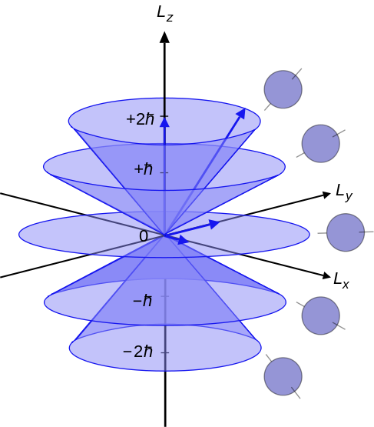
Introduction
How do we access quadrupole moments?
Qualitative picture: Nuclei reorient in electric field gradient to minimize their energy
Typical CoulEx reaction: dV/dr ≈ 10³⁰ V/cm²
Nucleus aligns relative to symmetry axis
Breaks m-state degeneracy
4

Slide 5
Introduction
Splitting ∝ dV/dr ~ 10³⁰ V/cm
$$E\left(t\right)∝eQ_{s}Z/r^{3}(t)$$
M
J^{𝜋}
M
±2
0
2⁺
±1
~100 keV
~100 keV
±1
0
±2
0⁺
0
0
Oblate splitting
Spherical
Prolate splitting
5

Slide 6
Introduction
Splitting ∝ dV/dr ~ 10³⁰ V/cm
$$E\left(t\right)∝eQ_{s}Z/r^{3}(t)$$
M
J^{𝜋}
M
0
±2
0
2⁺
±1
~100 keV
~100 keV
±1
$ΔM=0$ excitations are preferred
Excitation probability depends on energy
Introduces a $Q_{s}$ dependence to the cross-section
0
±2
0⁺
0
0
Oblate splitting
Spherical
Prolate splitting
6

Slide 7
Introduction
M. Zielinska et al. Eur. J. Phys. A 52 99 (2016)
Since angle and impact parameter are related, this introduces an additional angular dependence to the cross section
Also influences the angle-integrated cross-section
Measure the distribution and/or the integrated cross-section and access the quadrupole moment
7

Slide 8
Introduction
$$\frac{da_{k}}{dω}=−i\sum_{λμn}{Q_{λμ}\left(ε,ω\right)ζ_{kn}^{λμ}}\left\langle I_{k} | M\left(λ\right) | I_{n}\right\rangle e^{(iξ_{kn}(ε\sinh{ω+ω))}}a_{n}(ω)$$
a = (sub)state amplitude
$μ$ = magnetic substate
k = (sub)state being populated
n = (sub)state connected to k
$λ$ = multipole
$\left\langle I_{k} | M(λ) | I_{n}\right\rangle$ = electromagnetic matrix element connecting k and n
$Q_{λμ}\left(ε,ω\right)$ = collision function
$ζ_{kn}^{λμ}$ = coupling parameter
$ξ_{kn}$ = adiabaticity parameter
$$θ$$

Slide 9
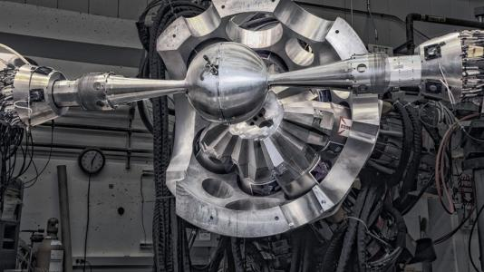
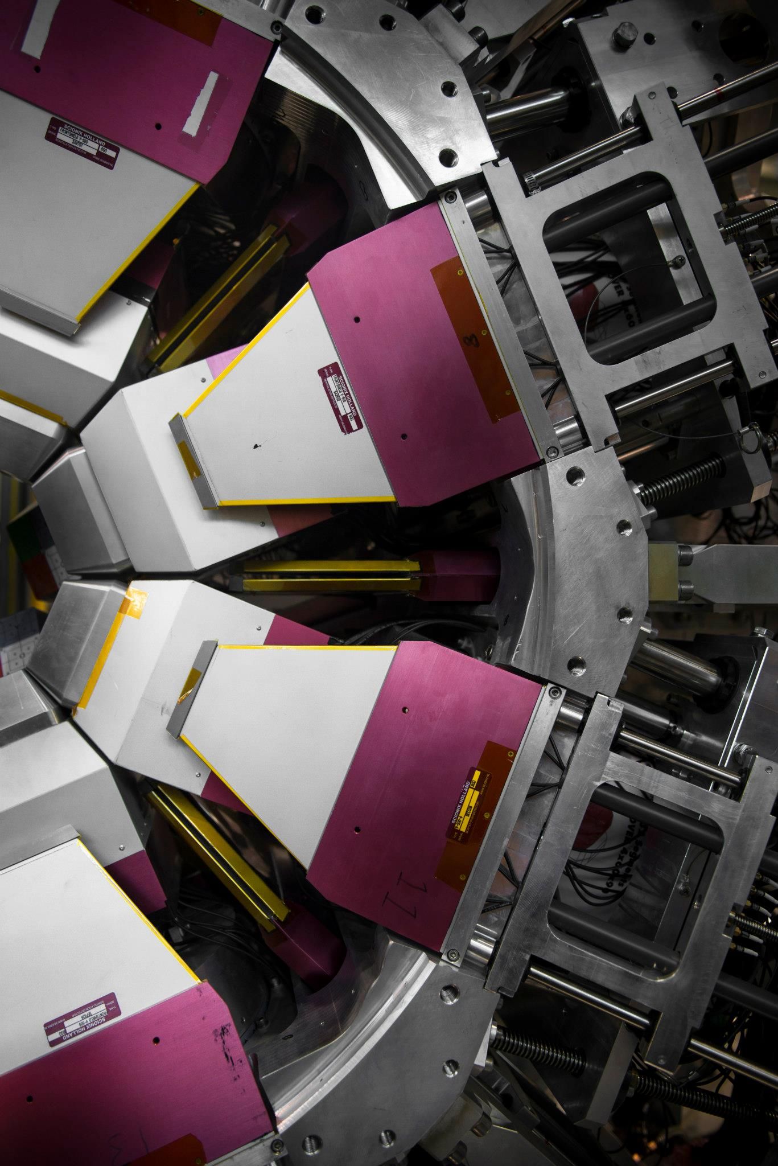
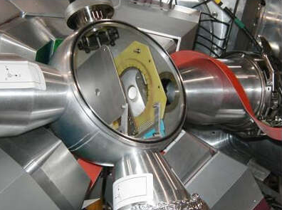
Results
²⁰⁸Pb & ⁹²Mo: GRETINA + CHICO2
⁸⁰Sr: TIGRESS + BAMBINO
9

Slide 10
Coulomb excitation of ²⁰⁸Pb
A quintessential doubly-magic system
Spherical* ground state
Poves et al. PRC 101 054307 (2020)
First excited 3- state, an octupole vibration
D. Goutte et al. PRL 45 1618 (1980)
A key benchmark for models and our understanding of EoS through neutron-skin
B. Hu et al. Nature Physics 18 1196 (2022)
D. Adhikari et al. PRL 126 172502 (2021)

Slide 11
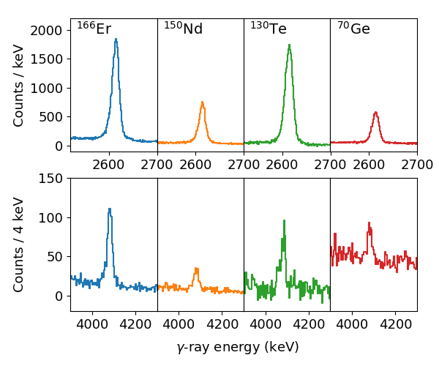
Coulomb excitation of ²⁰⁸Pb
Lead-208 targets often used in Coulomb excitation – clean spectra!
Combine data from four separate Coulomb-excitation measurements: ¹⁶⁶Er, ¹⁵⁰Nd, ¹³⁰Te and ⁷⁰Ge
See $3_{1}^{−}→0_{1}^{+}$ and $2_{1}^{+}→0_{1}^{+}$ transitions
All data taken with CHICO2 and GRETINA in 2022
Data analysed and matrix elements simultaneously minimised using GOSIA
https://github.com/jhenderson88/GOSIAFitter
JH et al. submitted for publication

Slide 12
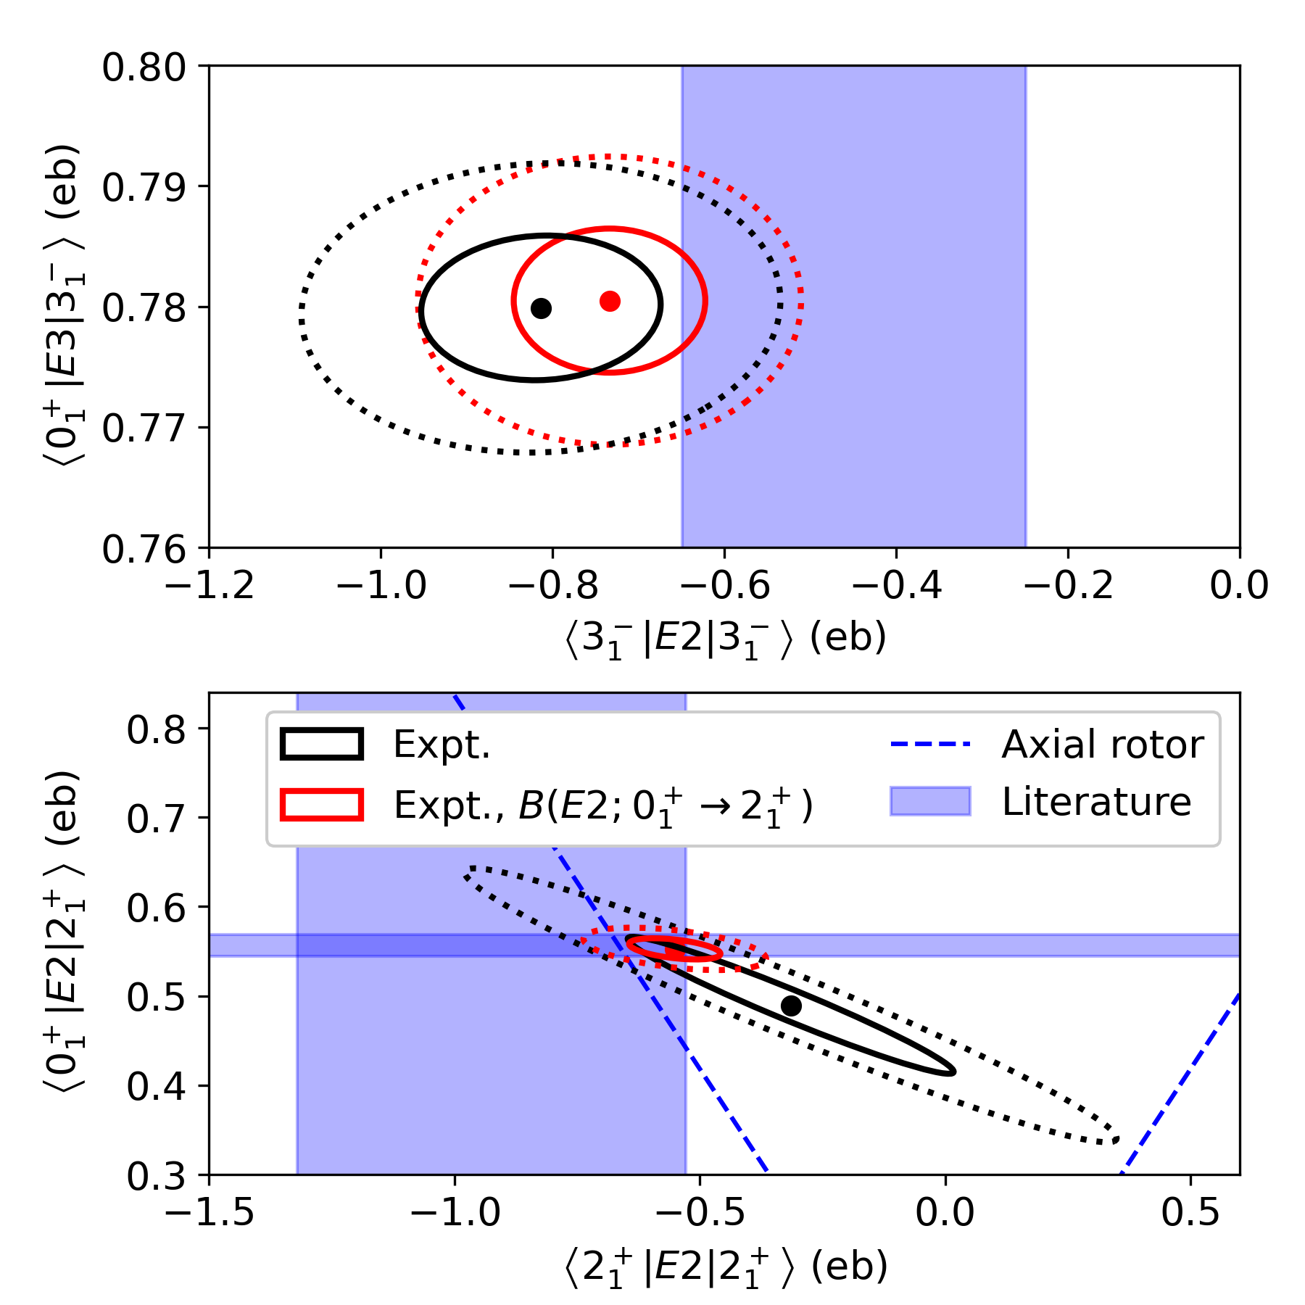
Coulomb excitation of ²⁰⁸Pb
Extract $\left\langle 0_{1}^{+} | E2 | 2_{1}^{+}\right\rangle$, $\left\langle 0_{1}^{+} | E3 | 3_{1}^{−}\right\rangle$, $\left\langle 2_{1}^{+} | E2 | 2_{1}^{+}\right\rangle$ and $\left\langle 3_{1}^{−} | E2 | 3_{1}^{−}\right\rangle$ matrix elements and their correlations
Constrain the data by including literature $\left\langle 0_{1}^{+} | E2 | 2_{1}^{+}\right\rangle$ [$B(E2;0_{1}^{+}→2_{1}^{+})$] and $\left\langle 0_{1}^{+} | E3 | 3_{1}^{−}\right\rangle$ [$B(E3;0_{1}^{+}→3_{1}^{−})$]
Able to tightly constrain both $\left\langle 2_{1}^{+} | E2 | 2_{1}^{+}\right\rangle$ [$Q_{s}(2_{1}^{+})$] and $\left\langle 3_{1}^{−} | E2 | 3_{1}^{−}\right\rangle$ [$Q_{s}(3_{1}^{−})$]
Consistent with Vermeer et al. Australian Journal of Physics 37 123 (1984) but improved uncertainty
JH et al. submitted for publication

Slide 13
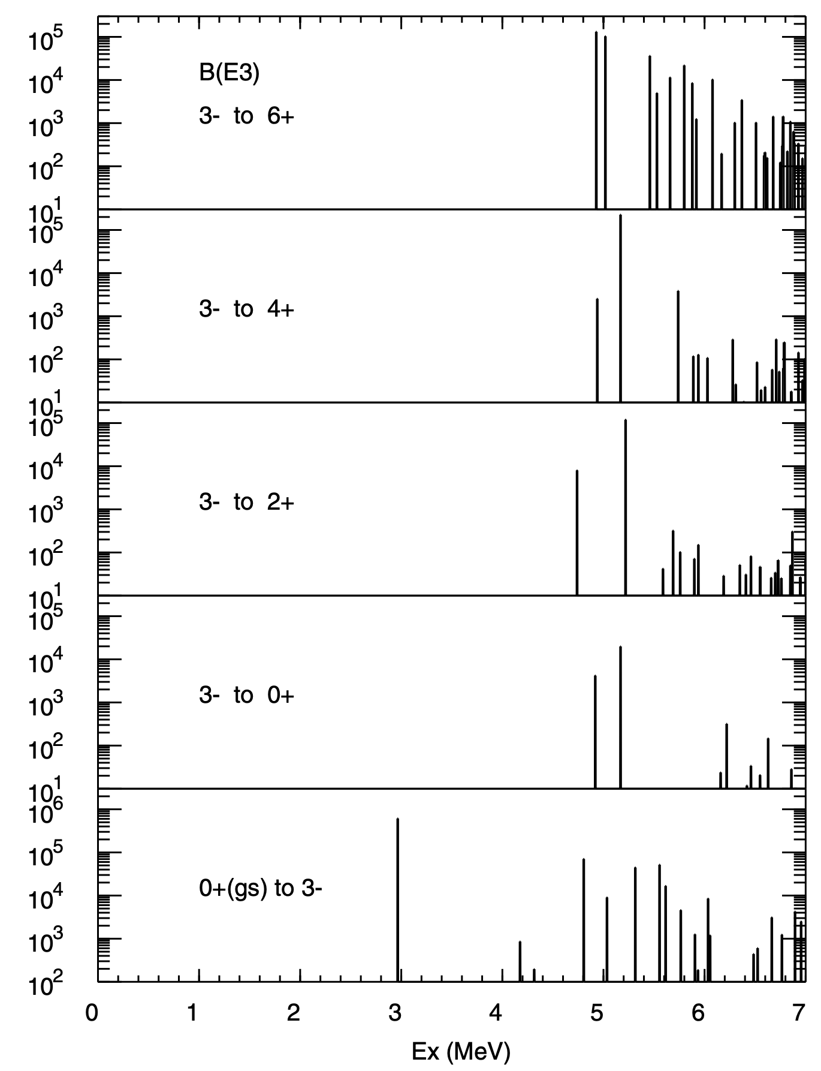
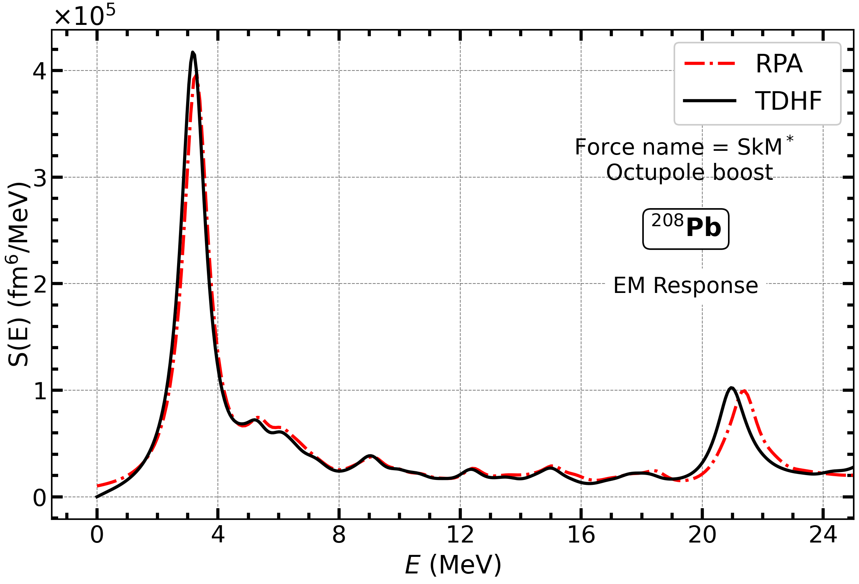
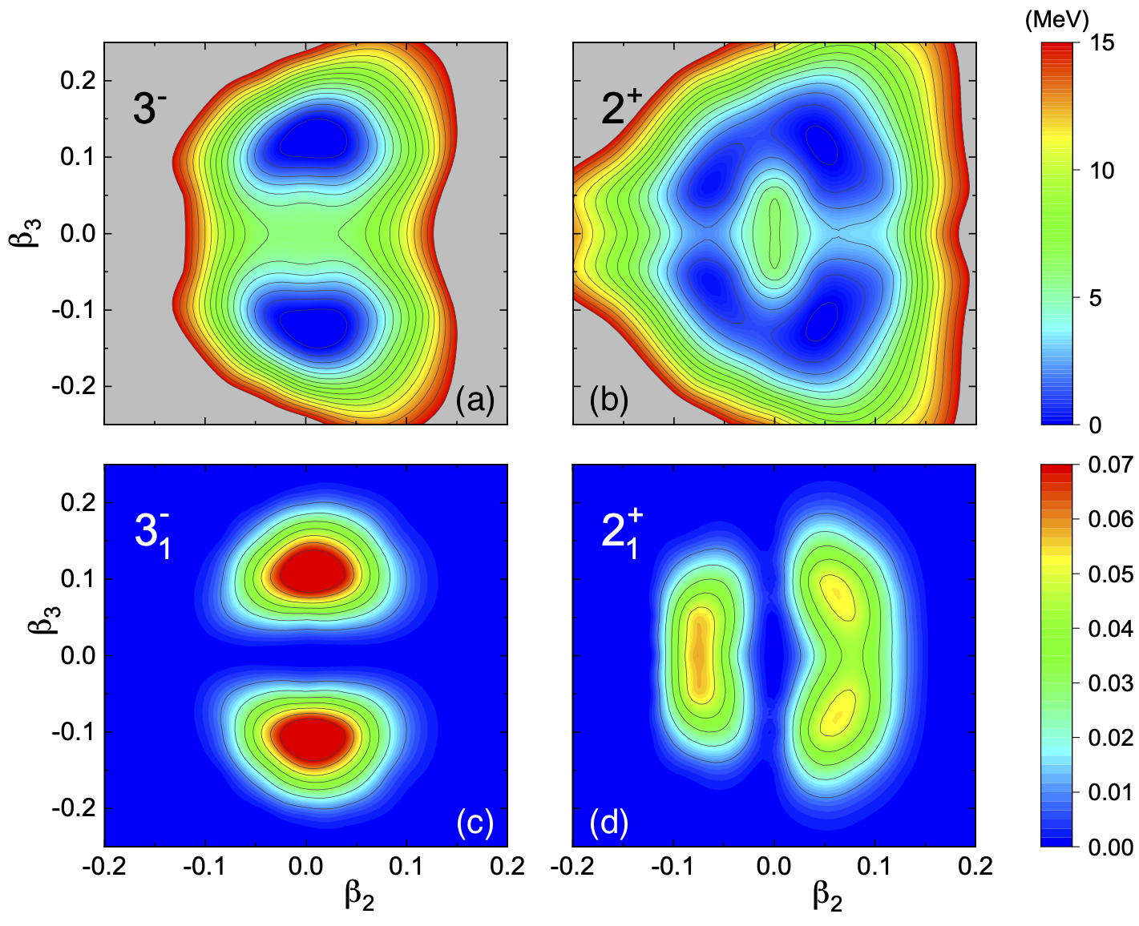
Coulomb excitation of ²⁰⁸Pb
P. D. Stevenson, Abhishek, E. Yuksel:
Skyrme + QRPA and Skyrme + TDHF
Energies and B(E2)/B(E3) only
Model comparison
Shell model, B. A. Brown:
PRL 85 5300 (2020)
T. R. Rodriguez and L. Robledo:
SCCM
JH et al. submitted for publication

Slide 14
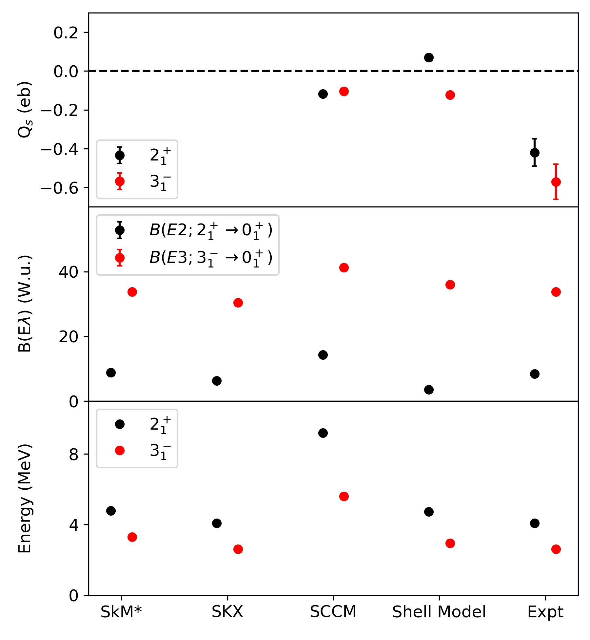
Coulomb excitation of ²⁰⁸Pb
Skyrme models best reproduce B(EL) and energies but no Q_{s} values and no indication of preference for prolate deformation
SCCM calculations overpredict excitation energies and B(EL) values but do reproduce signs and similarity of Q_{s}(2⁺) and Q_{s}(3⁻)
SM fails to reproduce the signs and magnitudes of the Q_{s} values but does reproduce energies and B(E3)
No model able to reproduce the electromagnetic observables
JH et al. submitted for publication

Slide 15
Coulomb excitation of ²⁰⁸Pb
Skyrme models best reproduce B(EL) and energies but no Q_{s} values and no indication of preference for prolate deformation
SCCM calculations overpredict excitation energies and B(EL) values but do reproduce signs and similarity of Q_{s}(2⁺) and Q_{s}(3⁻)
SM fails to reproduce the signs and magnitudes of the Q_{s} values but does reproduce energies and B(E3)
No model able to reproduce the electromagnetic observables
Implications for splitting of octupole two-phonon states due to coupling of octupole and quadrupole modes
A. Bohr and B. R. Mottelson, Nuclear Structure, vol.2
(Benjamin, New York, 1975) p. 569.
JH et al. submitted for publication

Slide 16
Coulomb excitation of ²⁰⁸Pb
With thanks to:

Slide 17
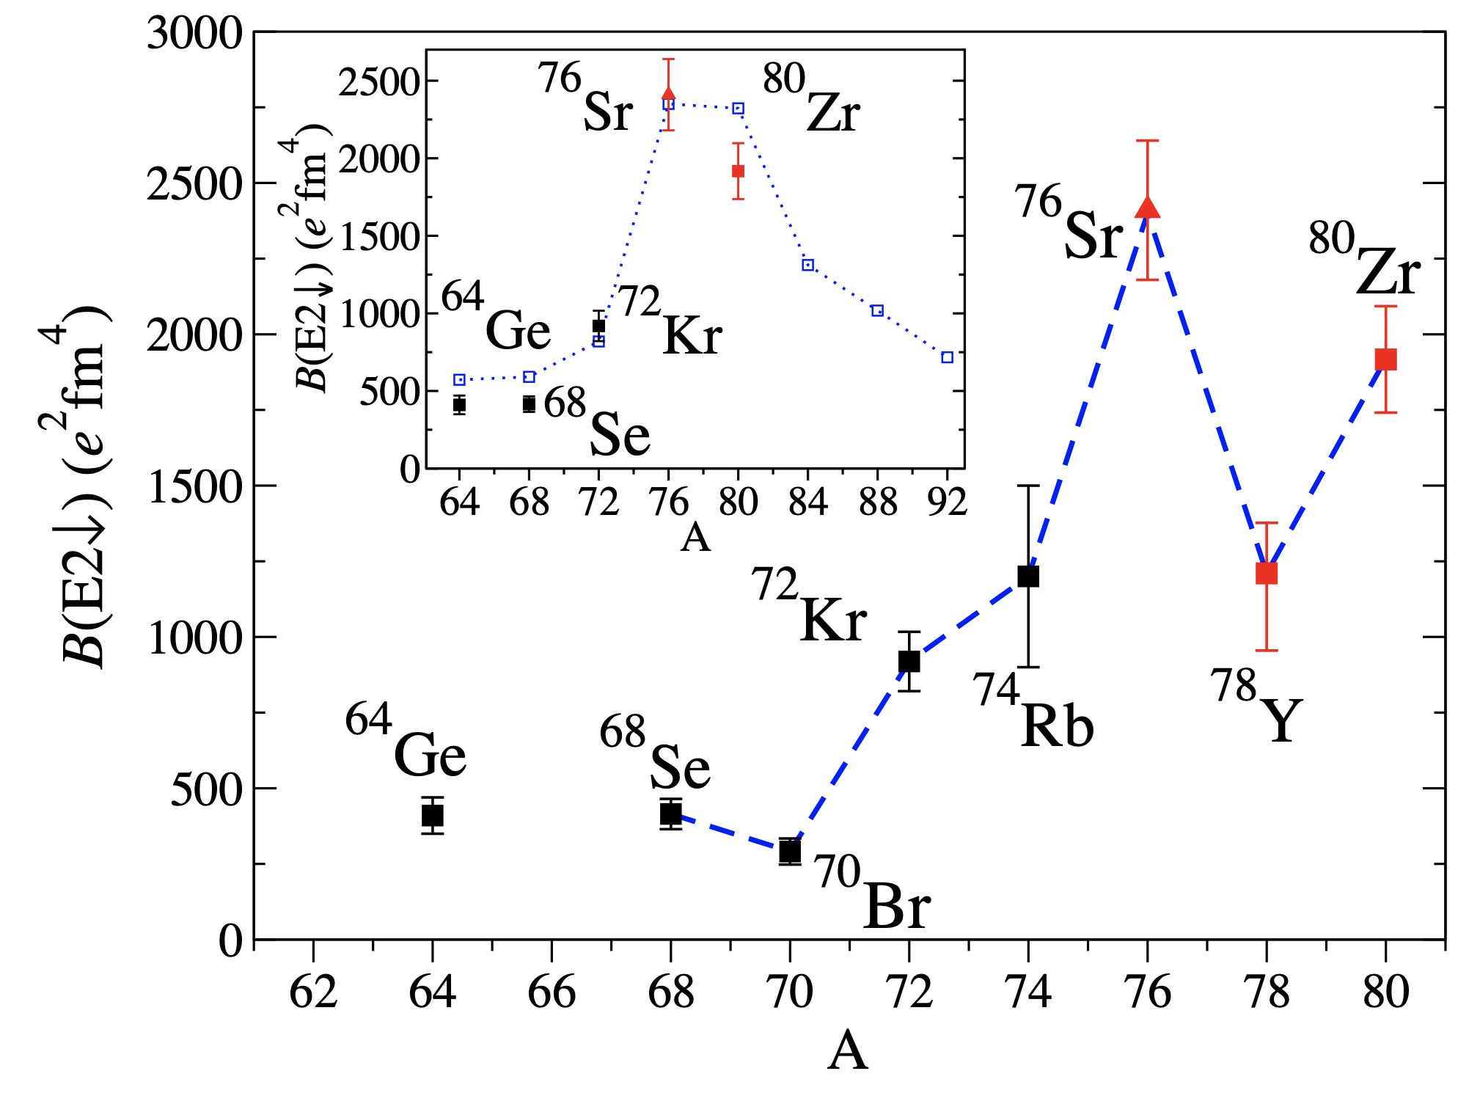
Strontium-80 Coulomb excitation
Region around N=Z=40 (⁸⁰Zr) associated with strong deformation
Driven by quasi-SU3 symmetry - strong $\left\langle Q∙Q\right\rangle$ interaction between $g_{9/2}$ and $d_{5/2}$ orbitals
Completely erases the influence of the HO shell closure (i.e. ⁹⁰Zr)
Predictions from PMMU interaction of a region of prolate deformation
R. Llewellyn et al.
PRL 124 152501 (2020)
K. Kaneko et al.
PLB 817 136286 (2021)

Slide 18
Strontium-80 Coulomb excitation
Region around N=Z=40 (⁸⁰Zr) associated with strong deformation
Driven by quasi-SU3 symmetry - strong $\left\langle Q∙Q\right\rangle$ interaction between $g_{9/2}$ and $d_{5/2}$ orbitals
Completely erases the influence of the HO shell closure (i.e. ⁹⁰Zr)
Predictions from PMMU interaction of a region of prolate deformation
R. Llewellyn et al.
PRL 124 152501 (2020)
Motivated Coulomb excitation measurements at TRIUMF
Goals were ^{78,80}Sr - beam difficulties prevented any attempt at ⁷⁸Sr (JANUS @ ReA6, FRIB PAC3 🤞🏻)
K. Kaneko et al.
PLB 817 136286 (2021)

Slide 19
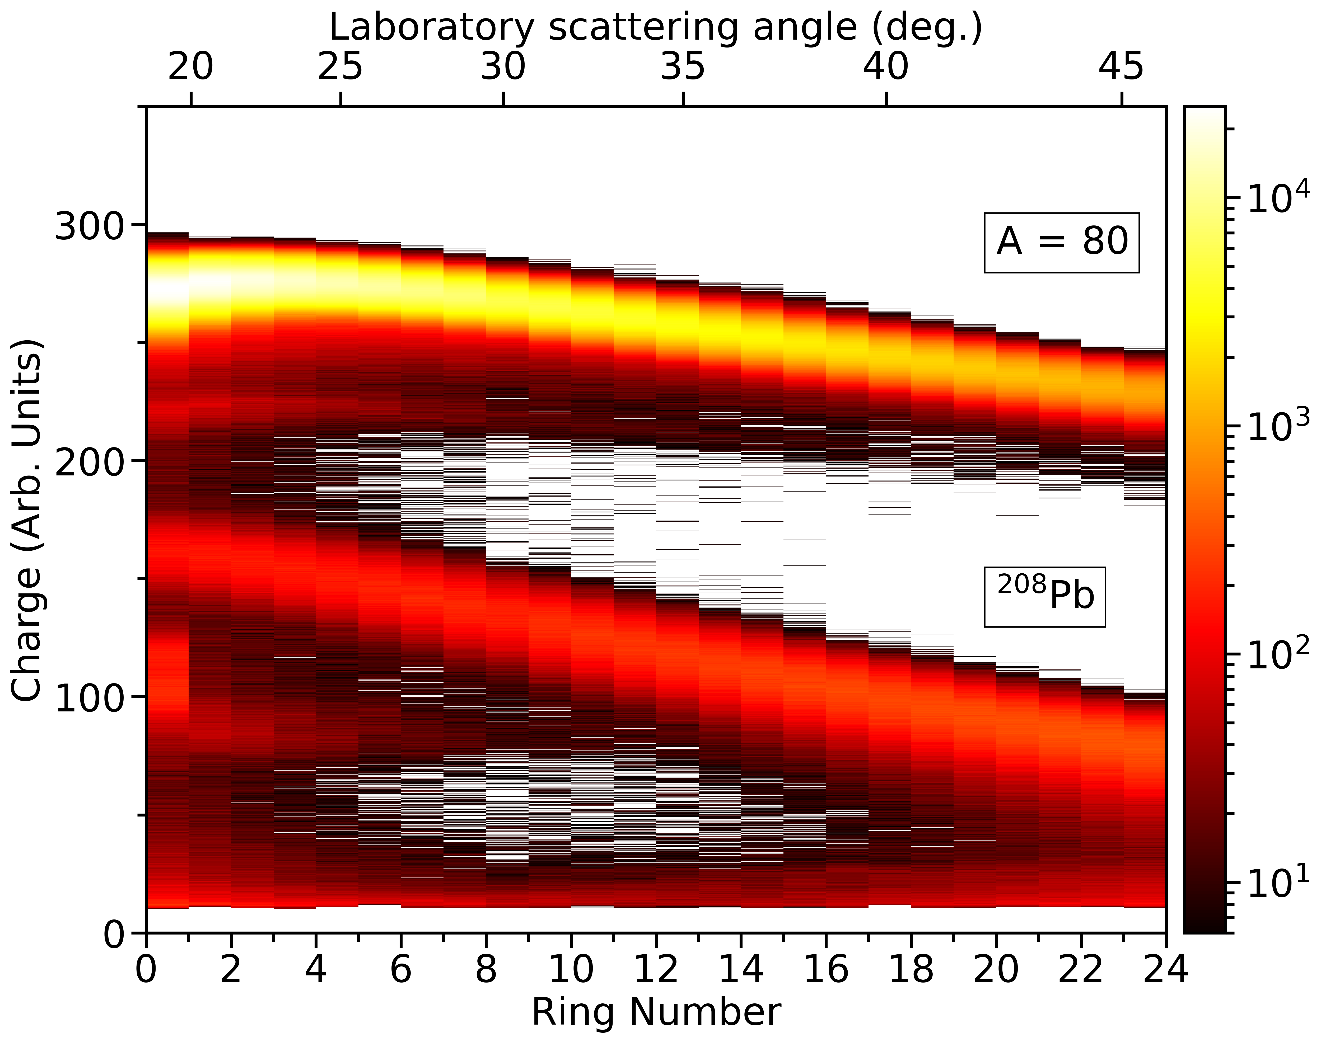
Strontium-80 Coulomb excitation
A=80 (Sr, Se, Kr) impinged upon ²⁰⁸Pb target
²⁰⁸Pb
⁸⁰Sr,Se,(Kr)
R. Russell et al. submitted for publication

Slide 20
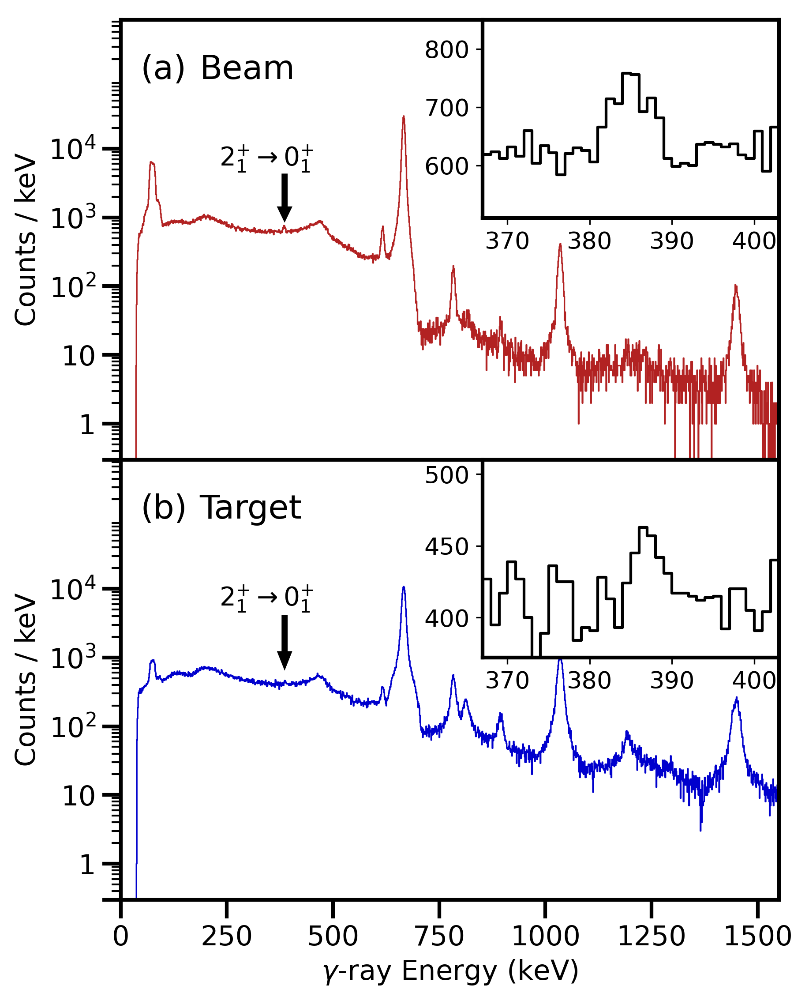
Strontium-80 Coulomb excitation
A=80 (Sr, Se, Kr) impinged upon ²⁰⁸Pb target
Spectra dominated by ⁸⁰Se Coulomb excitation
²⁰⁸Pb
⁸⁰Sr,Se,(Kr)
R. Russell et al. submitted for publication

Slide 21
Strontium-80 Coulomb excitation
A=80 (Sr, Se, Kr) impinged upon ²⁰⁸Pb target
Spectra dominated by ⁸⁰Se Coulomb excitation
⁸⁰Sr $2_{1}^{+}→0_{1}^{+}$ visible on ⁸⁰Se Compton background
²⁰⁸Pb
⁸⁰Sr,Se,(Kr)
R. Russell et al. submitted for publication

Slide 22
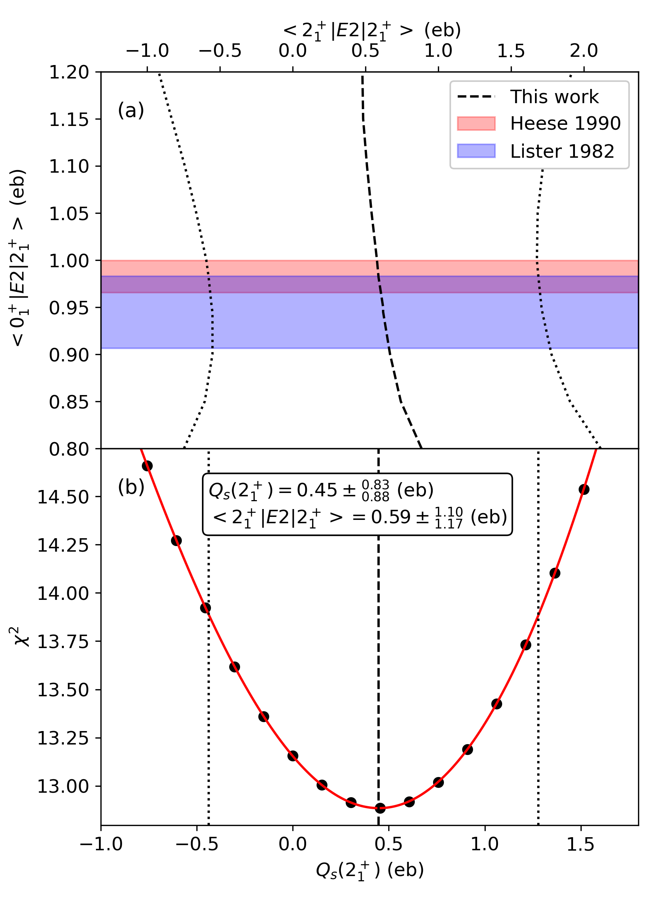
Strontium-80 Coulomb excitation
Strontium-80 quadrupole moment extracted from angular distribution
Verified consistency with both literature $2_{1}^{+}$ state lifetime
Limited correlation between $\left\langle 0_{1}^{+} | E2 | 2_{1}^{+}\right\rangle$ and $\left\langle 2_{1}^{+} | E2 | 2_{1}^{+}\right\rangle$
Large uncertainty dominated by background from ⁸⁰Se Coulomb excitation
R. Russell et al. submitted for publication

Slide 23
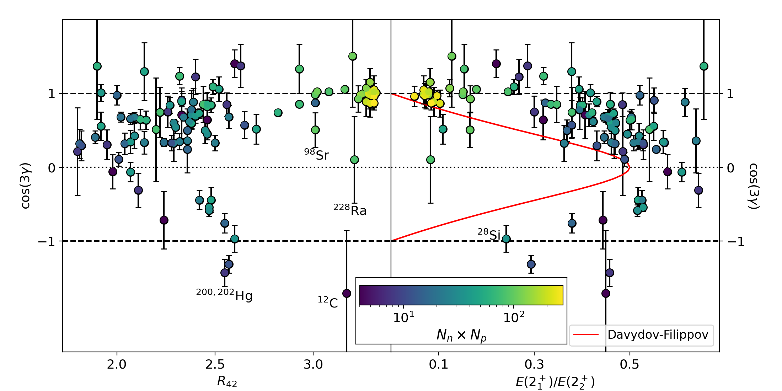
Strontium-80 Coulomb excitation
Use a simple metric for the form of the nuclear deformation
$$Q_{rot}(2_{1}^{+})−\frac{2}{7}\sqrt{\frac{16π}{5}B(E2;0_{1}^{+}→2_{1}^{+})}$$
$$\cos\left(3γ\right)≈−\frac{Q_{s}\left(2_{1}^{+}\right)}{Q_{rot}\left(2_{1}^{+}\right)}=q_{s}$$
$$\frac{Q_{s}(2_{1}^{+})}{Q_{rot}(2_{1}^{+})}$$
$$\frac{Q_{s}(2_{1}^{+})}{Q_{rot}(2_{1}^{+})}$$
JH, PRC 102 054306 (2020)
Rhodes et al. PRC 103 L051301 (2021)

Slide 24
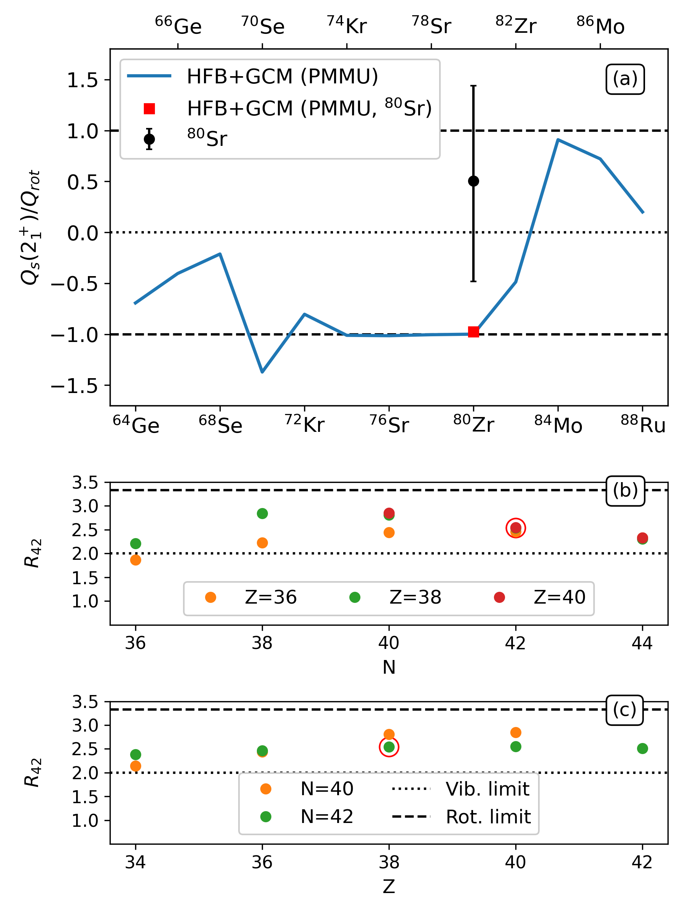
Strontium-80 Coulomb excitation
Comparison with PMMU calculations
Predict near-axial, prolate systems around N=Z=40
$$\frac{Q_{s}(2_{1}^{+})}{Q_{s,rot}(2_{1}^{+})}≈−1$$
Even with large uncertainty, experimental $Q_{s}(2_{1}^{+})$ is inconsistent with this prediction
More consistent with triaxial or oblate deformations
Kaneko et al. PLB 817 136286 (2021)
R. Russell et al. submitted for publication

Slide 25
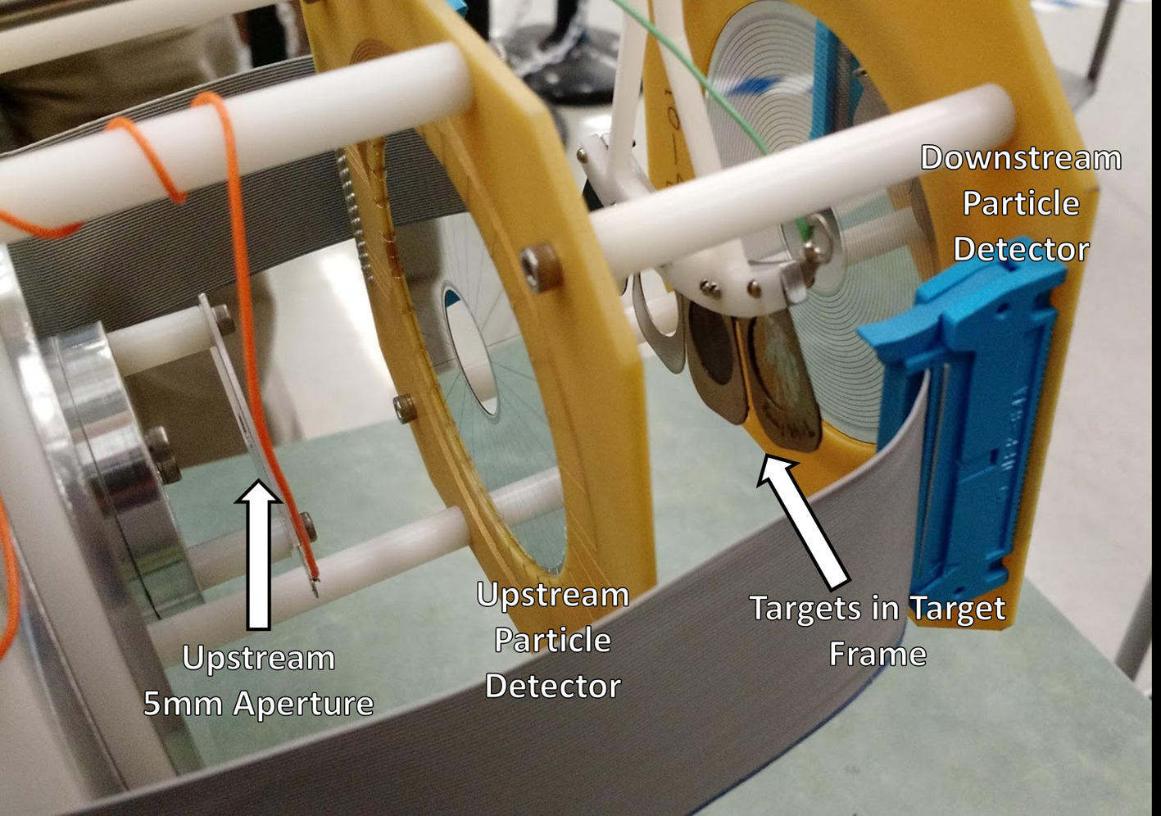
Strontium-80 Coulomb excitation
Contrary to PMMU calculation predictions, ⁸⁰Sr appears to be triaxial or oblate
Any island of strong, prolate, axial deformation around N=Z=40 is confined to ^{76,78}Sr and ^{78,80}Zr
Recently presented SM results (S. Lenzi, Monday and J. Ha, Tuesday) imply a different mechanism – more varied shapes
Neutron-deficient Sr (should be) accessible at FRIB-ReA6: a priority to perform safe Coulomb excitation

Slide 26
Strontium-80 Coulomb excitation
With thanks to:

Slide 27
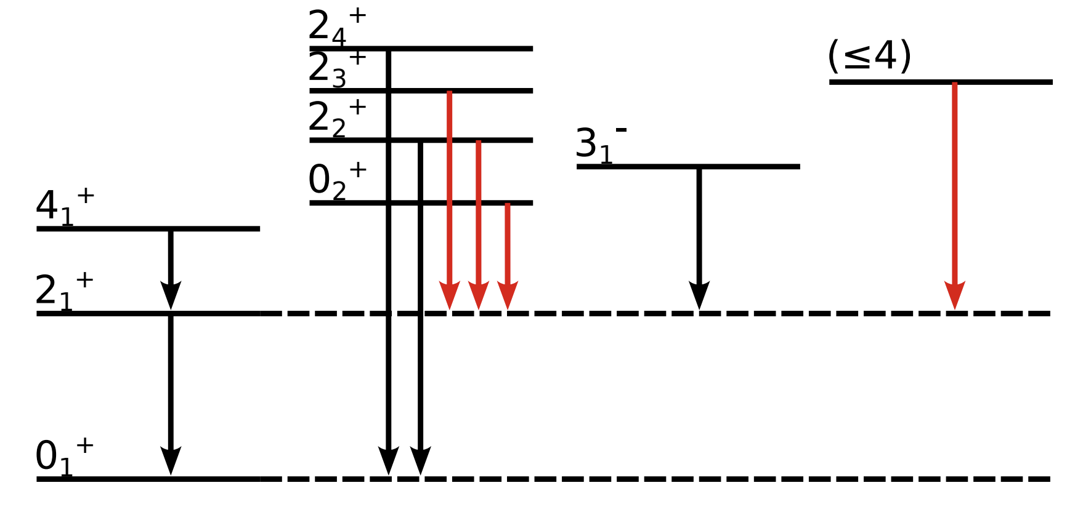
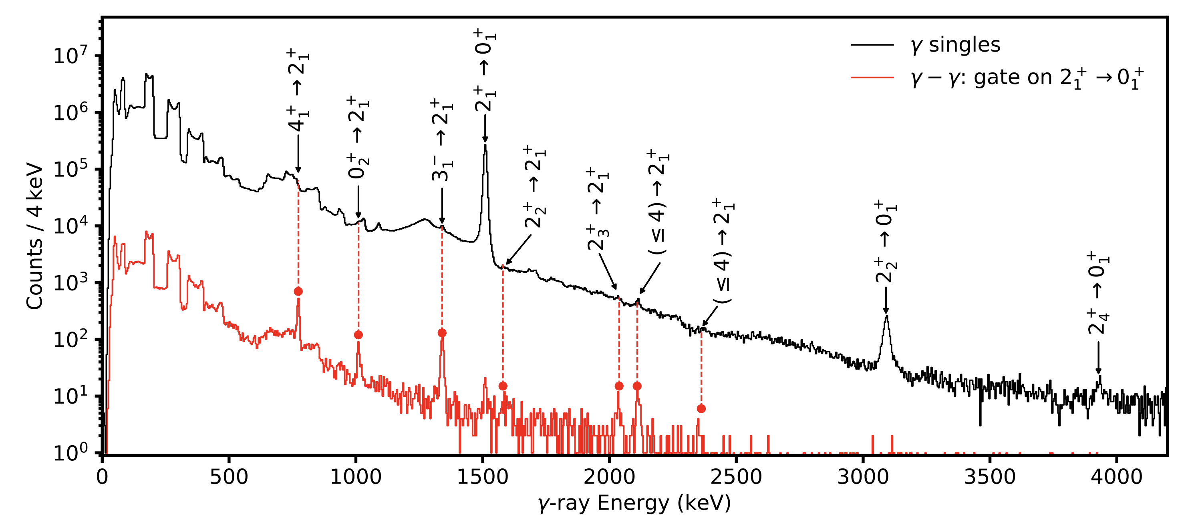
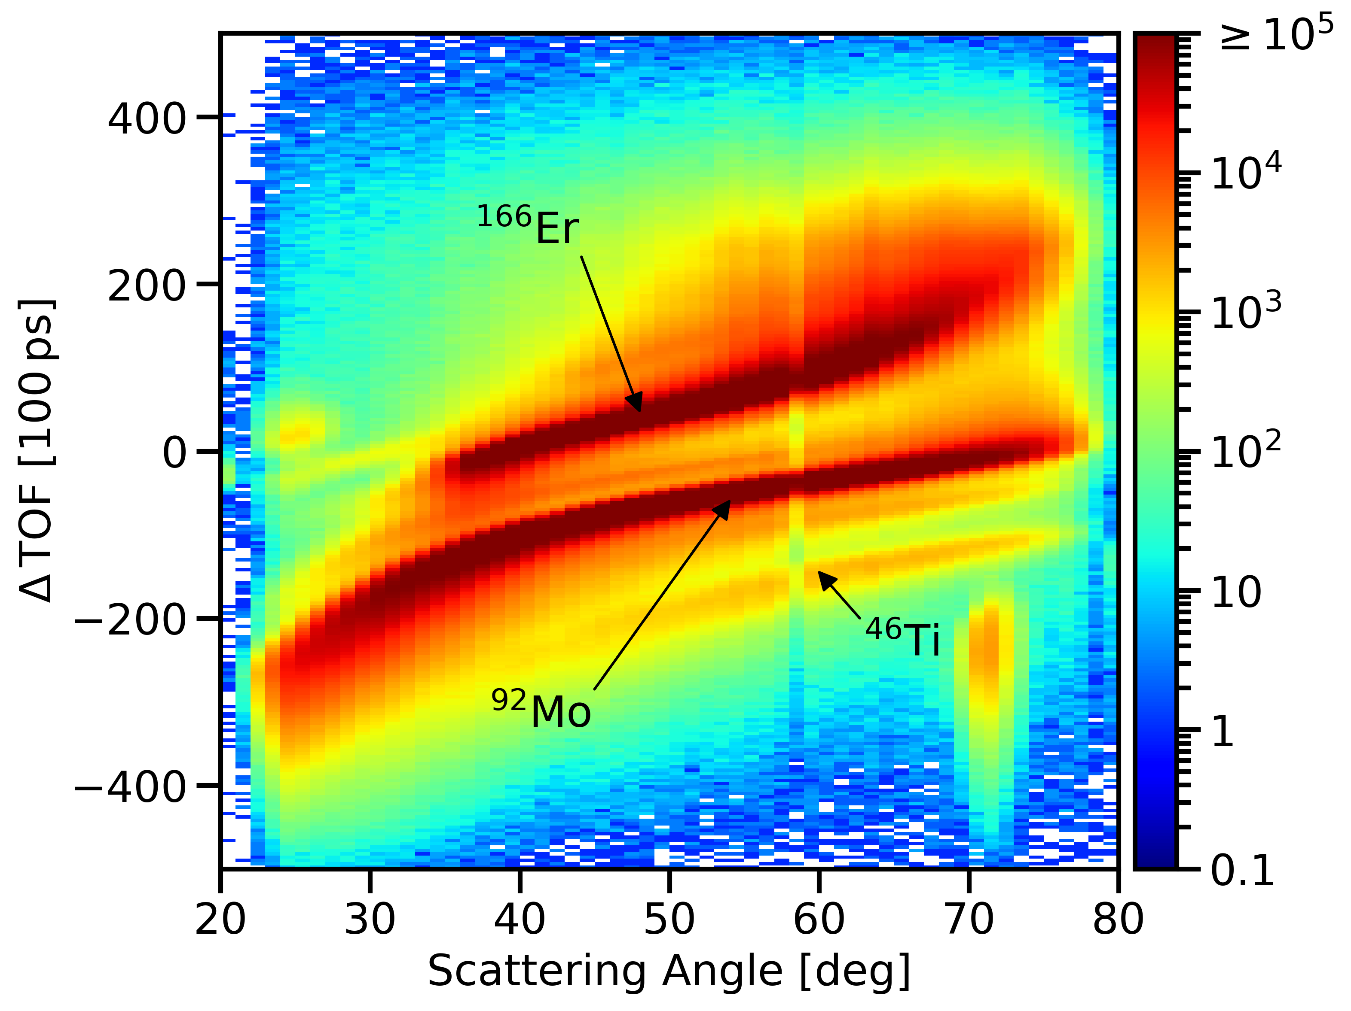
Molybdenum-92 Coulomb excitation
Molybdenum-92 Coulomb excited on a ¹⁶⁶Er target - same campaign as ²⁰⁸Pb
Multiple low-spin states observed – some previously unassigned
4 MeV
J. Heery et al., in preparation

Slide 28
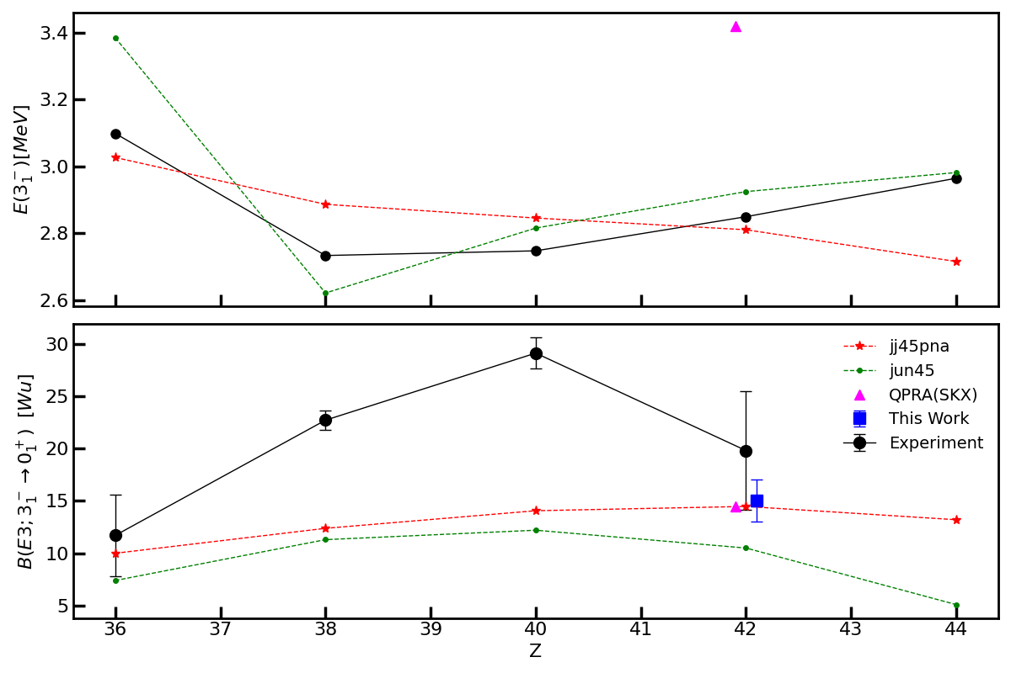
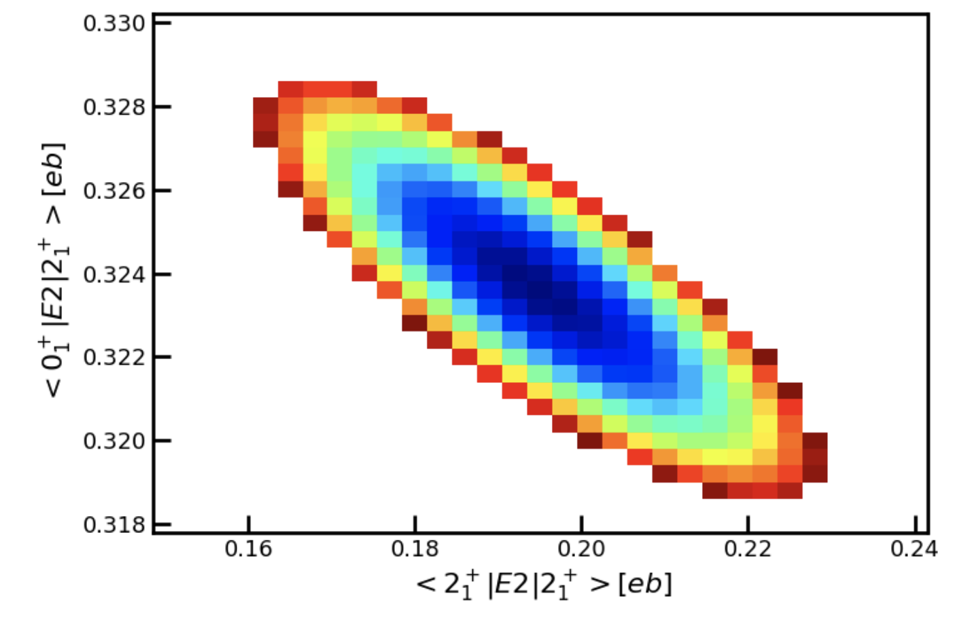
Molybdenum-92 Coulomb excitation
Oblate deformation [+ve Q_{s}(2⁺)] with indications of triaxiality, consistent with SM predictions
Smaller B(E3) than observed in Sr and Zr isotones – well reproduced by Skyrme (SKX) + QRPA
J. Heery et al., in preparation

Slide 29
Molybdenum-92 Coulomb excitation
With thanks to:

Slide 30
Coulomb excitation as a tool for nuclear medicine

Slide 31
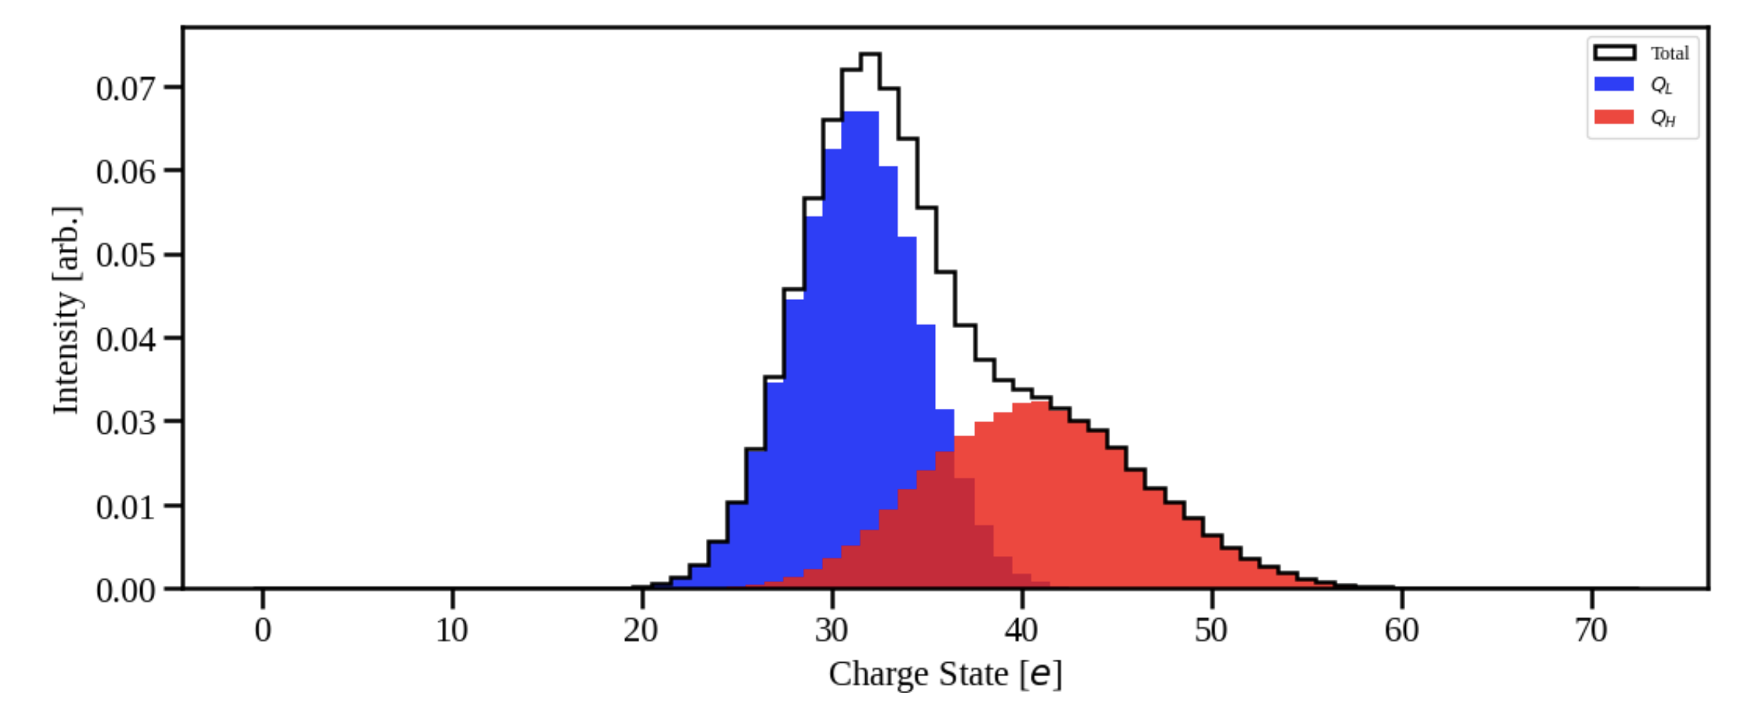
Coulomb excitation as a tool for nuclear medicine
ANL ATLAS proposal 2123
PI: Jacob Heery (Surrey)

