Slide 1
NN2024
14th International Conference on Nucleus-Nucleus Collisions
August 18 – 23, 2024
Whistler, BC Canada
August 20, 2024
Spectroscopy of neutron-rich nuclei produced in
multinucleon transfer reactions at KISS
WNSC, IPNS, KEK
Yutaka Watanabe
Contents
Physics motivation
Nuclear production by MNT reactions
KISS facility
Experimental results around N = 126 and actinoids
Beyond KISS
Summary

Slide 2
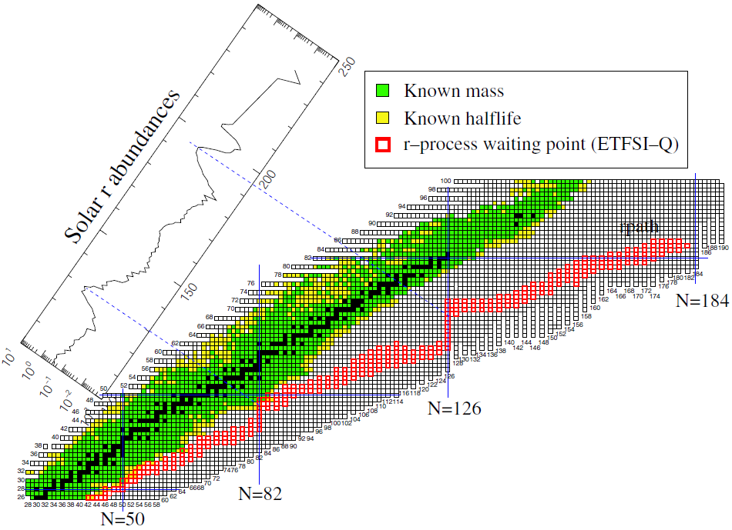
Spectroscopy of neutron-rich nuclei around N =126 and beyond
r-process nucleosynthesis
83
²⁰⁹Bi
5×10⁸ y ≦ T_{1/2}
82
²⁰⁸Pb
30 d ≦ T_{1/2} ＜ 5×10⁸ y
81
²⁰⁷Tl
Observed solar
r-abundance distribution
10 m ≦ T_{1/2} ＜ 30 d
3rd peak (A ~ 195)
²⁰⁶Hg
80
T_{1/2} ＜ 10 m
79
²⁰⁵Au
Unknown
Blank spot
²⁰⁴Pt
Actinoid
78
N~126
Atomic number
²⁰³Ir
77
Atomic number
76
²⁰²Os
r-process
75
²⁰¹Re
74
²⁰⁰W
Neutron number
73
¹⁹⁹Ta
H. Grawe et al., Rept. Prog. Phys. 70, 1525 – 1582 (2007).
72
¹⁹⁸Hf
116
117
118
119
120
121
122
123
124
125
126
Decay spectroscopy
Half life
Decay scheme
Neutron number
Laser spectroscopy
Charge radius
Magnetic dipole moment
Electric quadrupole moment
Mass spectroscopy
Frontier of known lifetime
Frontier of known mass

Slide 3
How to produce neutron-rich nuclei
Fragmentation ($∼$100 MeV/A)
Z
Subtractive
Target
N
Projectile
Fragment
Fragmentation
Target
RIBF, FRIB, FAIR, …
Access to the lower left direction.
Fusion ($∼$5 MeV/A)
Additive
Z
Fusion
Access to the upper right direction.
Projectile
Target
Compound
GARIS, SPIRAL2 S³, …
Target
N
Multinucleon transfer (5 – 10 MeV/A)
Z
Additive &
Subtractive
Transfer of protons and neutrons
Projectile
Multinucleon transfer
Target
Target
N
Access to all direction.
Access to the lower right direction
by adding neutrons and subtracting protons.

Slide 4
Spectroscopy of neutron-rich nuclei around N =126 and beyond
r-process nucleosynthesis
83
²⁰⁹Bi
5×10⁸ y ≦ T_{1/2}
82
²⁰⁸Pb
30 d ≦ T_{1/2} ＜ 5×10⁸ y
81
²⁰⁷Tl
Observed solar
r-abundance distribution
10 m ≦ T_{1/2} ＜ 30 d
3rd peak (A ~ 195)
²⁰⁶Hg
80
T_{1/2} ＜ 10 m
79
²⁰⁵Au
Unknown
Blank spot
¹⁹⁸Pt
²⁰⁴Pt
Actinoid
78
Atomic number
MNT
²⁰³Ir
N~126
77
Atomic number
76
²⁰²Os
r-process
75
²⁰¹Re
74
²⁰⁰W
Neutron number
73
¹⁹⁹Ta
H. Grawe et al., Rept. Prog. Phys. 70, 1525 – 1582 (2007).
72
¹⁹⁸Hf
116
117
118
119
120
121
122
123
124
125
126
Decay spectroscopy
Half life
Decay scheme
Neutron number
Laser spectroscopy
Charge radius
Magnetic dipole moment
Electric quadrupole moment
Mass spectroscopy
Frontier of known lifetime
Frontier of known mass

Slide 5
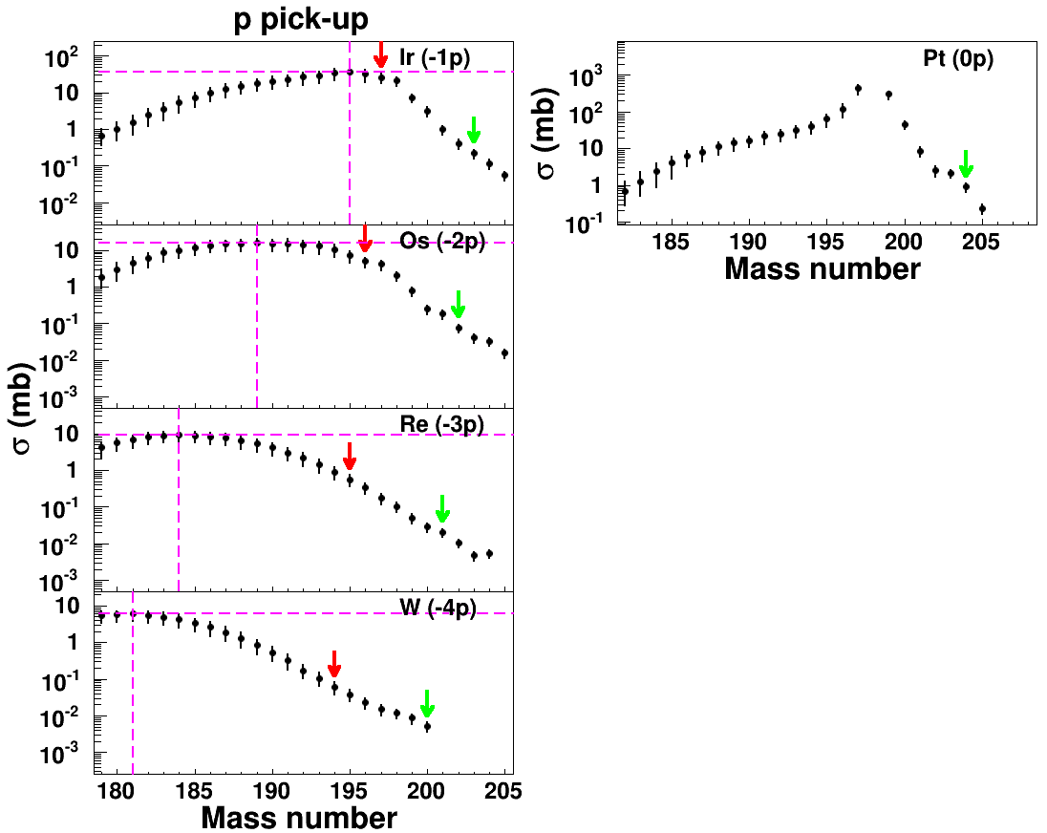
MNT reactions for neutron-rich nuclei around N = 126
The feasibility of the MNT reactions to produce neutron-rich nuclei was studied
in the reaction system of ¹³⁶Xe (8 MeV/A) + ¹⁹⁸Pt (1.3 mg/cm²).
Projectile-like fragments (PLFs) were detected by VAMOS++,
and target-like fragment (TLF) distributions were deduced.
Y.X. Watanabe et al., Phys. Rev. Lett. 115, 172503 (2015).
Isotopic distributions of target-like fragments (TLFs)
0n
N = 126
Measurements
N = 126
GRAZING calculations
A. Winther et al., Nucl. Phys. A 572, 191 (1994); 594, 203 (1995).
0n
N = 126
Neutron-deficient side
Large discrepancy between the measurements and the GRAZING calculations.
It is because of strongly damped component with N/Z equilibration, which is not included in the GRAZING calculations.
Neutron-rich side ($N∼126$)
Contributed by the weakly damped component with less particle evaporation.
The GRAZING calculations, which include particle evaporation, show relatively good agreement with the measurements.
0n
N = 126
Maximum
0n
N = 126

Slide 6
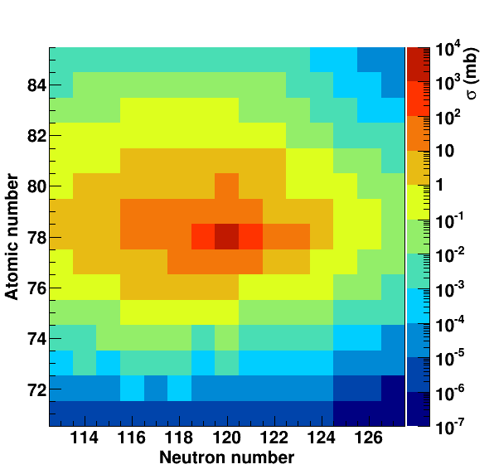
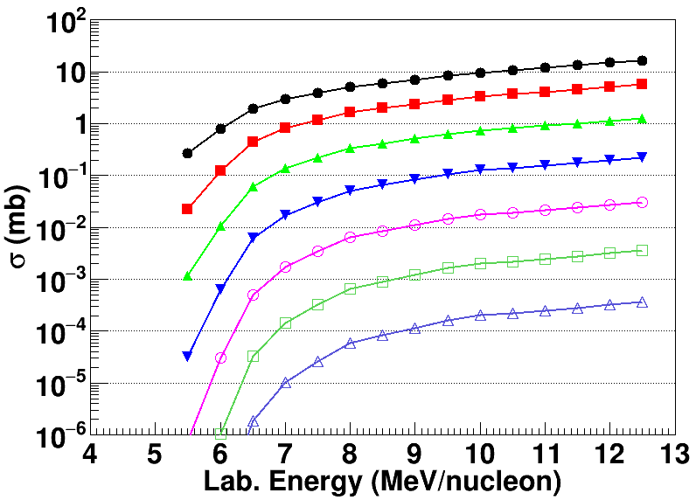
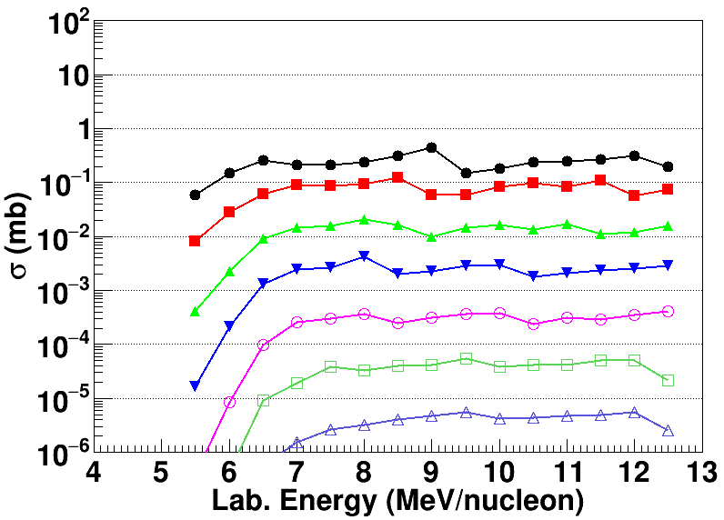
Properties of MNT reactions
¹³⁶Xe + ¹⁹⁸Pt (E_{cm} = 645 MeV)
¹³⁶Xe + ¹⁹⁸Pt
N = 126
²⁰⁴Pt
85
²⁰³Ir
²⁰²Os
²⁰¹Re
80
²⁰⁰W
Atomic number
¹⁹⁸Pt
¹⁹⁹Ta
p-pickup
¹⁹⁸Hf
75
n-stripping
115
120
126
Neutron number
GRAZING calculations
evaporation
Experimental difficulty
Simultaneous production of numerous nuclides → background
Optimal reaction energy
²⁰⁴Pt
²⁰³Ir
²⁰²Os
²⁰¹Re
²⁰⁰W
¹⁹⁹Ta
¹⁹⁸Hf

Slide 7
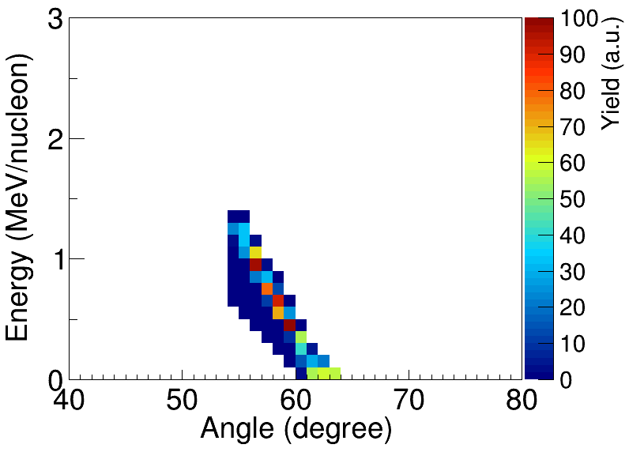
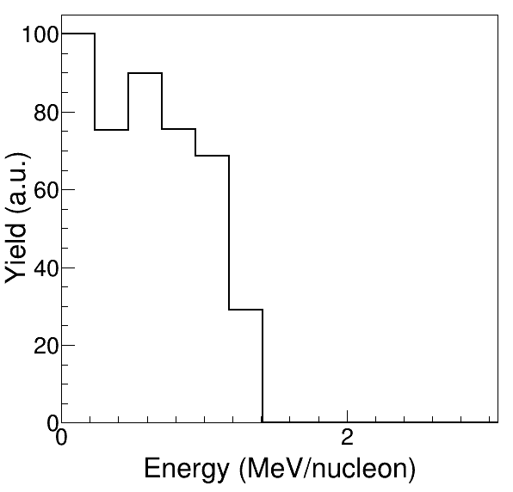
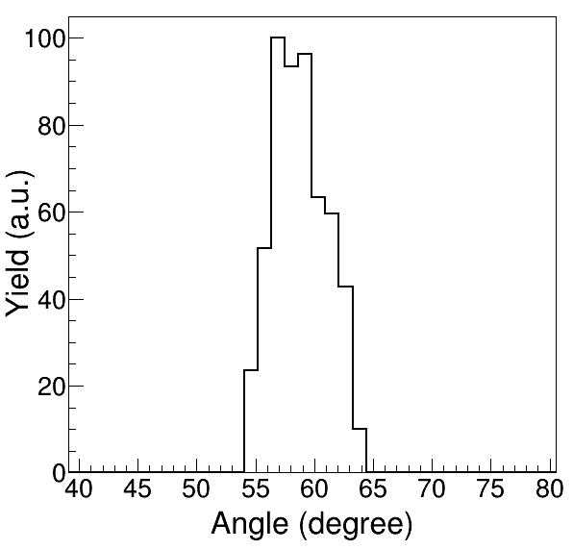
Properties of MNT reactions
¹³⁶Xe + ¹⁹⁸Pt (E_{cm} = 645 MeV)
MNT reaction of
¹³⁶Xe (9.4 MeV/nucleon) + ¹⁹⁸Pt (12.5 mg/cm²)
85
Energy-angle distribution
²⁰²Os
80
Atomic number
¹⁹⁸Pt
Low
p-pickup
Energy (MeV/A)
75
n-stripping
0
1
2
3
Reaction energy
²⁰²Os
115
120
126
High
Neutron number
GRAZING calculations
40
50
60
70
80
Angle (degree)
Experimental difficulty
Simultaneous production of numerous nuclides → background
Low and wide energy distribution
Wide angular distribution around the grazing angle
Energy distribution
Angular distribution
100
²⁰²Os
100
²⁰²Os
80
80
60
Yield (a.u.)
60
1.4 MeV/A
Yield (a.u.)
40
40
~9°
Development of experimental techniques to collect, separate, and identify reaction products.
20
20
0
0
1
2
3
0
40
50
60
70
80
Energy (MeV/A)
Angle (degree)

Slide 8
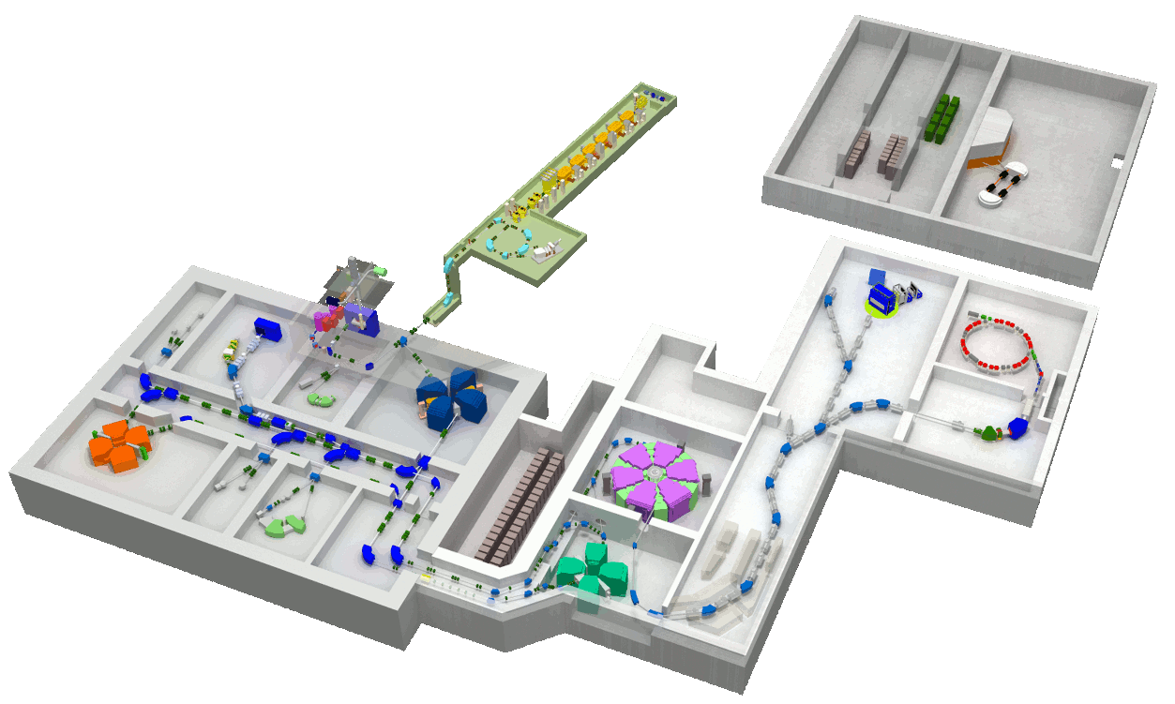
RIKEN RIBF (RI Beam Factory)
RILAC2
Nishina LINAC
Laboratory
RRC
E3
E2
RIBF bldg.
(new facility)
Nishina bldg.
(old facility)
KEK Isotope Separation System
Heavy ion beams (¹³⁶Xe, ²³⁸U, …), 10.75 MeV/nucleon, $≲$100 pnA

Slide 9
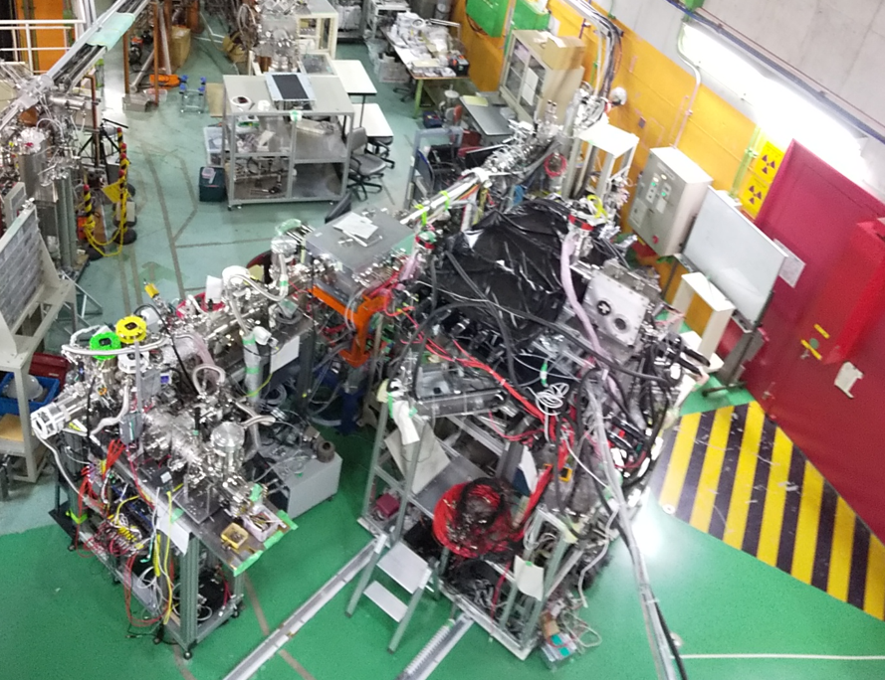
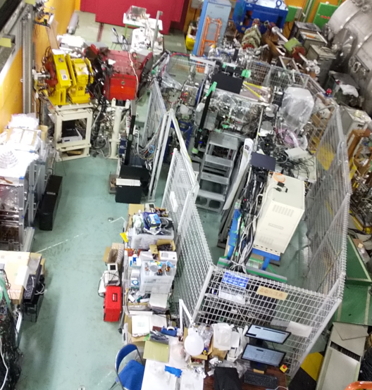
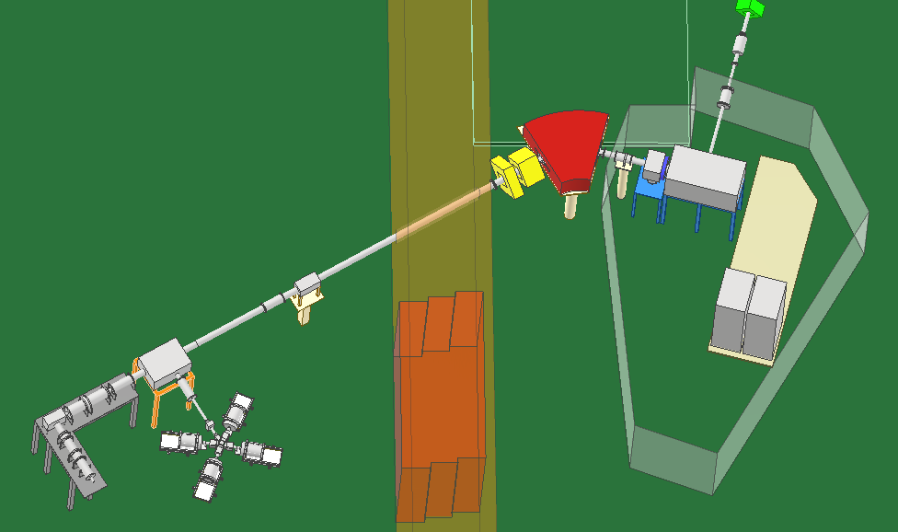
KEK Isotope Separation System (KISS)
2009: KISS project started
2011: KISS installed
2013: Online testing started
2015: WNSC established
2016: KISS has been open for users
E3 Lab.
E2 Lab.
Dipole magnet
Heavy ion beam
$m/{δm}=900$
Mass number selection
Argon gas
Lasers
Mass spectrometer
Gas cell cooler buncher
MRTOF Mass Spectrograph
Beam switch
Reaction products
Extraction chamber
$ΔV=20 kV$
Gas cell chamber
Decay spectrometer
Target (enriched ¹⁹⁸Pt, 92%)
Argon gas cell (neutralization)
Laser resonance ionization (Element selection)
Tape transport system
Gas counter
HpGe detectors
Y. Hirayama et al., Nucl. Instrum. and Meth. B 353, 4 – 15 (2015),
Y. Hirayama et al., Nucl. Instrum. and Meth. B 412, 11 – 18 (2017).
9

Slide 10
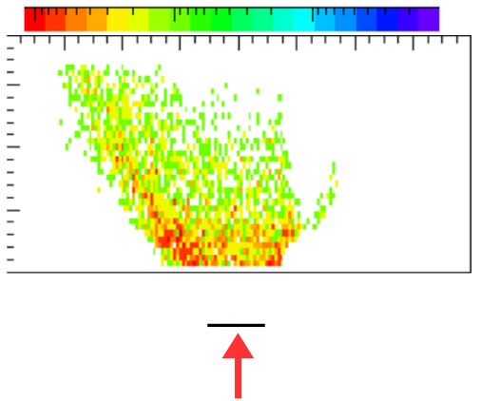
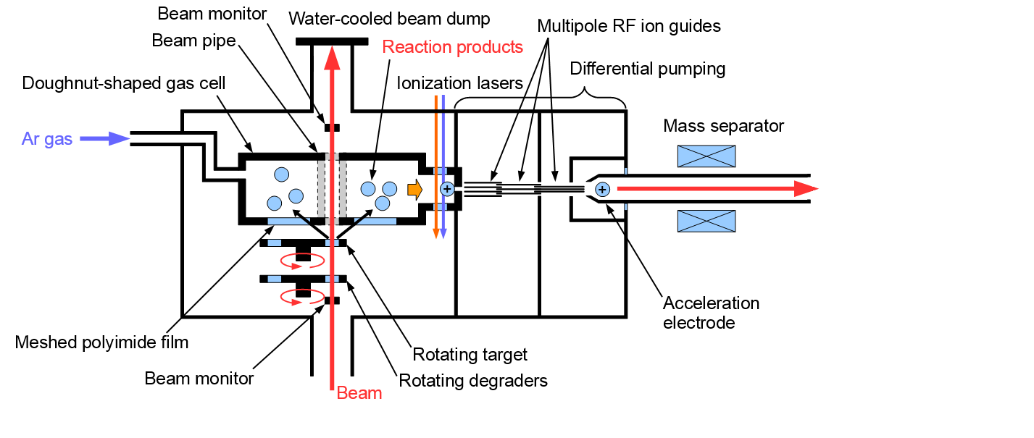
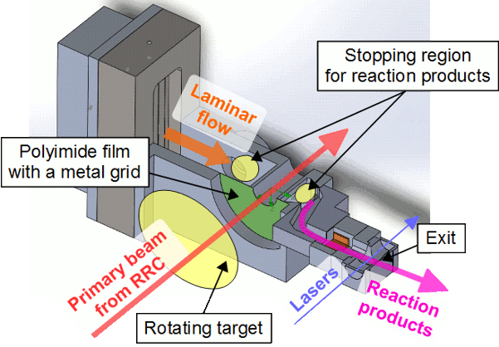
Production, collection, and separation
10
1
0.1
30
30
20
10
0
10
20
30
x (mm)
y (mm)
20
Ar gas
100 kPa
10
¹⁹⁷Ir
0
9 mm
¹⁹⁸Pt (12.5 mg/cm²)
¹³⁶Xe (9.4 MeV/nucleon)
Doughnut-shaped argon gas cell
¹⁹⁸Pt (12.5 mg/cm²)
Ti (3 μm × 3)
¹³⁶Xe (10.75 MeV/nucleon)
Nuclear production by multinucleon transfer (MNT) reactions
Efficient collection of reaction products by gas cell
Neutralization in argon gas
Element selection by laser resonance ionization
Mass selection by dipole magnet
Y. Hirayama et al., Nucl. Instrum. and Meth. B 412, 11 – 18 (2017).

Slide 11
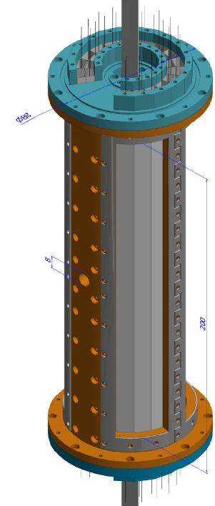
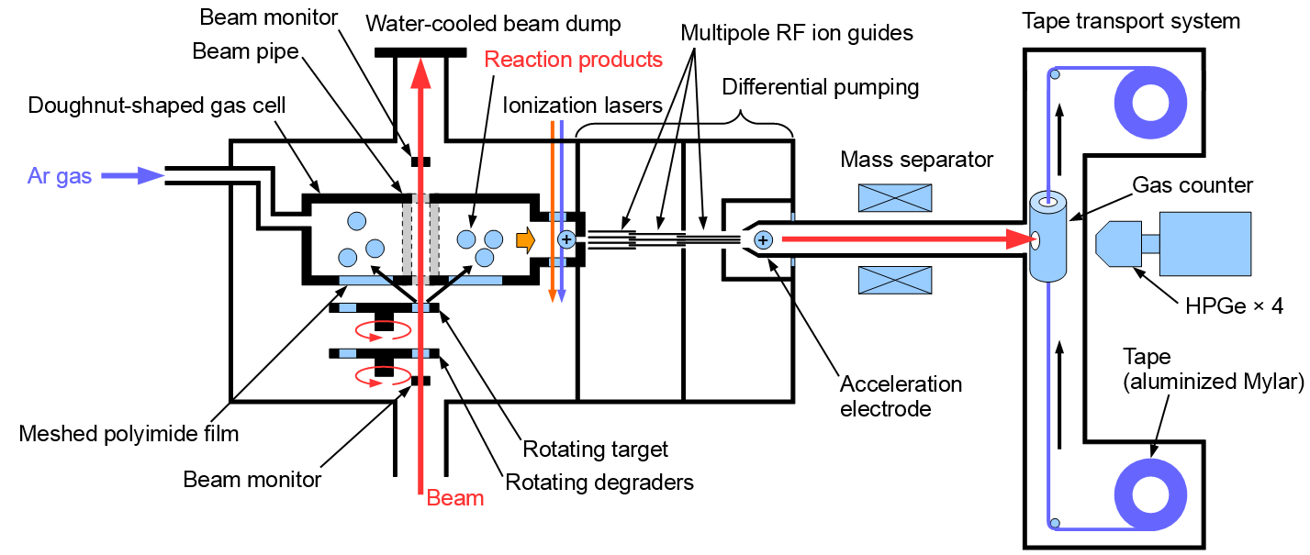
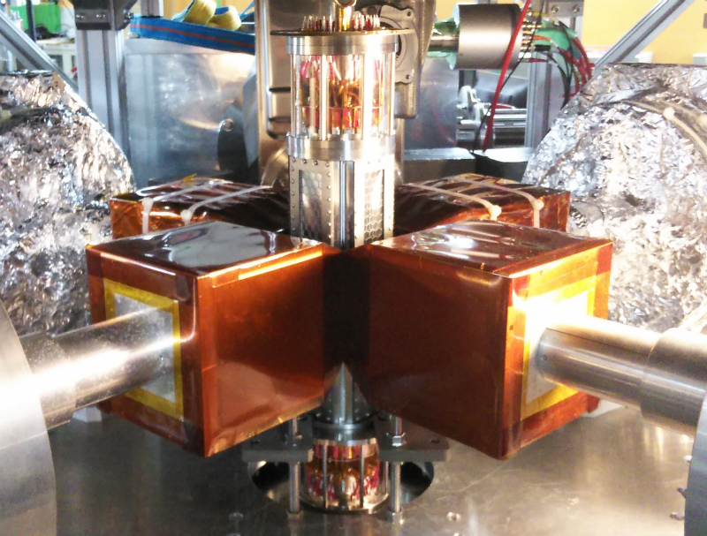
Decay spectroscopy
Tape
MSPGC
(Multi-Segmented Proportional Gas Counter)
2-layered 16-segmented proportional gas counter
SUS
β
BG
200 mm
KISS beam
KISS beam
ε_{β} = 40% for Q_{β} = 1 MeV
B.G. rate = 0.1 cps
M. Mukai et al., Nucl. Instrum. and Methods A 884, 1–10 (2018).
Mylar film
with mesh
¹⁹⁸Pt (12.5 mg/cm²)
Ti (3 μm × 3)
¹³⁶Xe (10.75 MeV/nucleon)
Four HPGe (High-Purity Germanium) clover detectors
ε_{γ} = 10% for E_{γ} = 1 MeV
Collaboration with IBS (Korea), IMP (China)

Slide 12
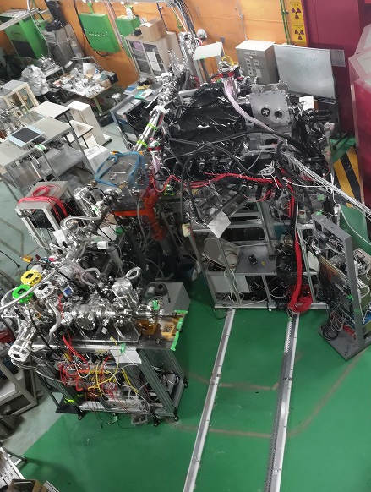
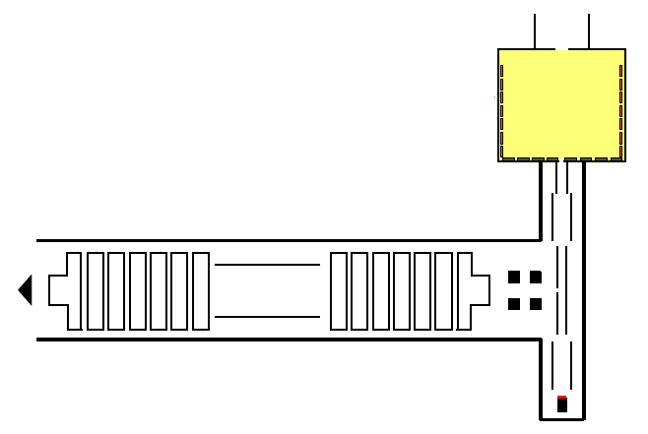
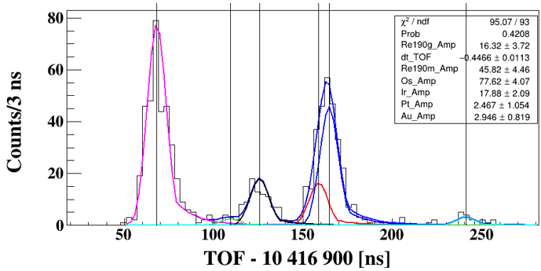
Mass spectroscopy
KISS beam
MRTOF-MS (Multi-Reflection Time-Of-Flight Mass Spectrograph)
Entrance hole $φ2 mm$
He gas cell
KISS beam
Decay spectrometer
DC electric field
RF carpet
QPIG
Beam switch
Linear Paul trap
MRTOF-MS
Ion detector
Steerer
Flat trap
TOF spectrum for A = 190
¹⁹⁰Os
Mass spectroscopy
+ Decay spectroscopy
Linear Paul trap
^{190g,m}Re
Thermal ion source
MRTOF-MS
Measurement time: a few 10 ms
Mass resolving power: $>$ 400 000
Efficiency: ~3%
¹⁹⁰Ir
¹⁹⁰Au
¹⁹⁰Pt
Peter SHURY at AFI 6 on Aug. 23

Slide 13
Experimental results (N ~ 126)
¹³⁶Xe + ¹⁹⁸Pt, ^{nat}Pt, ^{nat}Ir, ^{nat}W
$β\text{−}γ$ spectroscopy
μ
Q
μ Magnetic dipole moment
Q Electric quadrupole moment
Laser spectroscopy
Stable
Known
Mass measurement
Au
Pt
¹⁹²Pt
¹⁹⁴Pt
¹⁹⁵Pt
¹⁹⁶Pt
¹⁹⁸Pt
¹⁹⁹Pt
²⁰⁰Pt
²⁰¹Pt
Ir
¹⁹⁶Ir
¹⁹⁷Ir
¹⁹⁸Ir
¹⁹⁹Ir
²⁰⁰Ir
Os
Charge radius is known
¹⁹²Os
¹⁹³Os
¹⁹⁴Os
¹⁹⁵Os
¹⁹⁶Os
¹⁹⁷Os
¹⁹⁸Os
Re
¹⁹²Re
Element
W
¹⁸²W
¹⁸³W
¹⁸⁴W
¹⁸⁶W
Lifetime is known
Ta
¹⁸⁵Ta
¹⁸⁶Ta
¹⁸⁷Ta
Hf
Lu
Mass is known
Yb
108
109
110
111
112
113
114
115
116
117
118
119
120
121
122
123
124
125
126
127
$β\text{−}γ$ spectroscopy / Laser spectroscopy
Neutron number
²⁰⁰⁻²⁰¹Pt: Y. Hirayama et al., Phys. Rev. C 106, 034326 (2022).
^{187g}Ta: M. Mukai et al., Phys. Rev. C 105, 034331 (2022).
^{186m}Ta: Y.X. Watanabe et al., Phys. Rev. C 104, 024330 (2021).
^{195g}Os: M. Ahmed et al., Phys. Rev. C 103, 054312 (2021).
^{195m}Os: Y.X. Watanabe et al., Phys. Rev C 101, 041305(R) (2020),
103, 019902(E) (2021).
^{192g}Re: H. Watanabe et al., Phys. Lett. B 814, 136088 (2021).
^{187m}Ta: P. Walker et al., Phys. Rev. Lett. 125, 192505 (2020).
^{196–198}Ir: M. Mukai et al., Phys. Rev. C 102, 054307 (2020).
^{194,196}Os: H. Choi et al., Phys. Rev. C 102, 034309 (2020).
^{197,198}Os: Y. Hirayama et al., Phys. Rev. C 98, 014321 (2018), 069902(E) (2022).
^{199g,m}Pt: Y. Hirayama et al., Phys. Rev. C 96, 014307 (2017).
Notes:
13

Slide 14
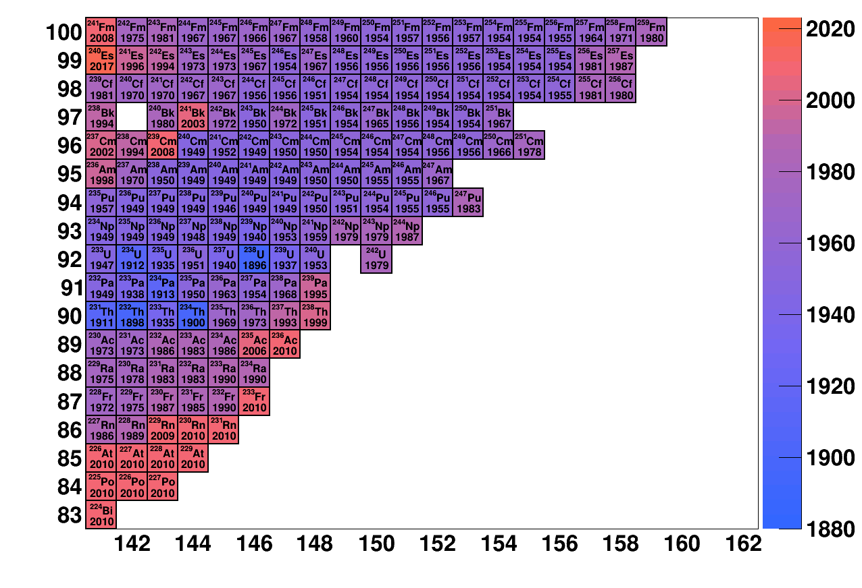
Spectroscopy of neutron-rich actinide nuclei
$β$ stable
r-process nucleosynthesis
Known-mass limit
(AME2020)
$α$ decay
Observed solar
r-abundance distribution
3rd peak (A ~ 195)
$β$ decay
spontaneous
fission
Blank spot
Actinoid
N~126
Discovery year
Atomic number
r-process
$$A=252$$
Neutron number
H. Grawe et al., Rept. Prog. Phys. 70, 1525 – 1582 (2007).
²³²Th
Atomic number
²³⁸U
MNT
$β$ decay
from r-process
path
Decay spectroscopy
Half life
Decay scheme
Laser spectroscopy
Charge radius
Magnetic dipole moment
Electric quadrupole moment
Mass spectroscopy
$$A=232$$
Neutron number

Slide 15
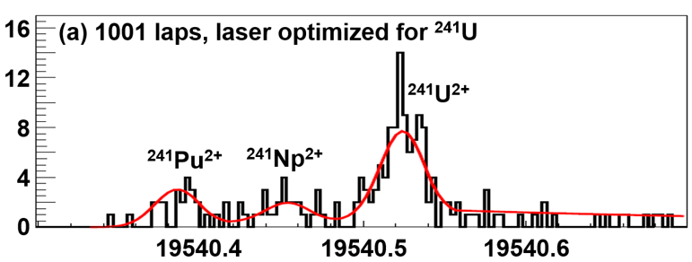
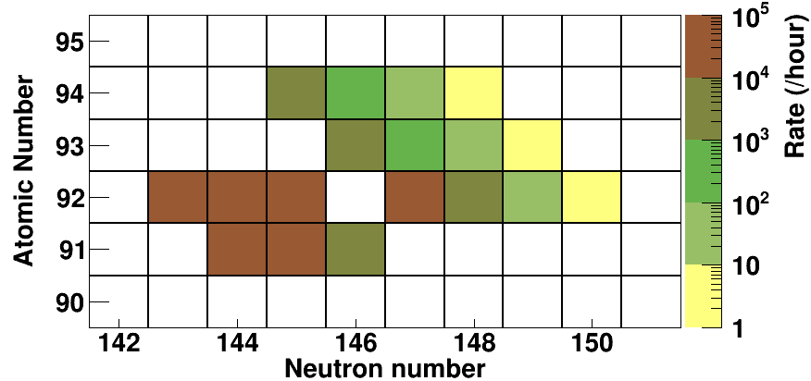
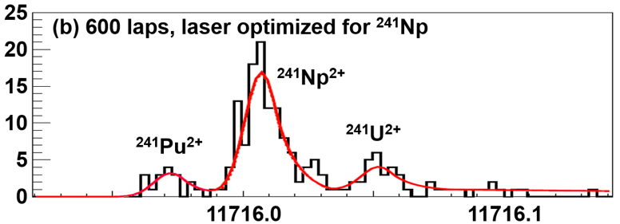
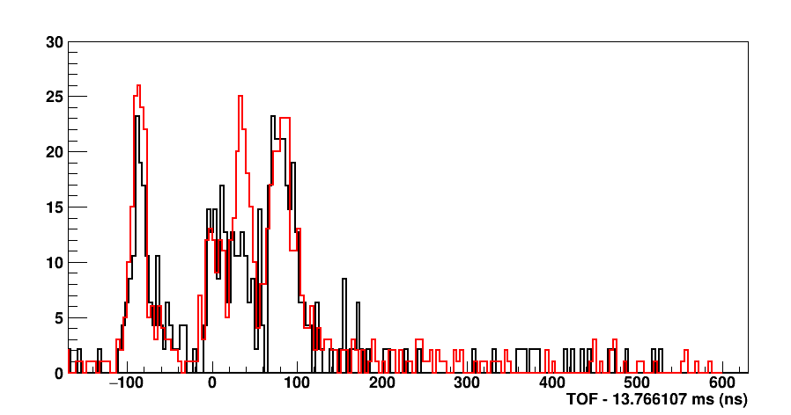
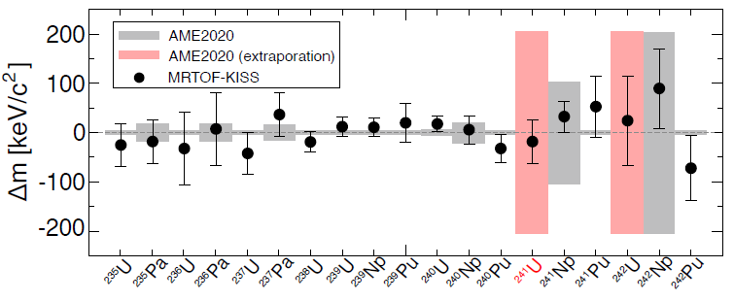
Mass spectroscopy of neutron-rich actinoids
²³⁸U (10.75 MeV/nucleon) + ¹⁹⁸Pt (12.5 mg/cm²)
TOF spectrum of MRTOF-MS
A = 241
MRTOF counts
A = 241
Am
Pu
Np
U
Pa
Th
Counts / 3 ns
New isotope
²³⁸U
TOF (μs)
Counts / 3 ns
Resonant
Non-resonant
Mass frontier
Lifetime frontier
Mass difference from AME2020
A = 242
TOF (μs)
30
²⁴²Pu²⁺
²⁴²U²⁺
New mass
25
20
²⁴¹PuH¹⁺
Counts
²⁴²Np²⁺
15
Laser on
10
Laser off
5
0
-100
0
100
200
300
400
500
600
T. Niwase et al., Phys. Rev. Lett. 130, 132502 (2023).
TOF – 13766.107 $μs$ (ns)

Slide 16
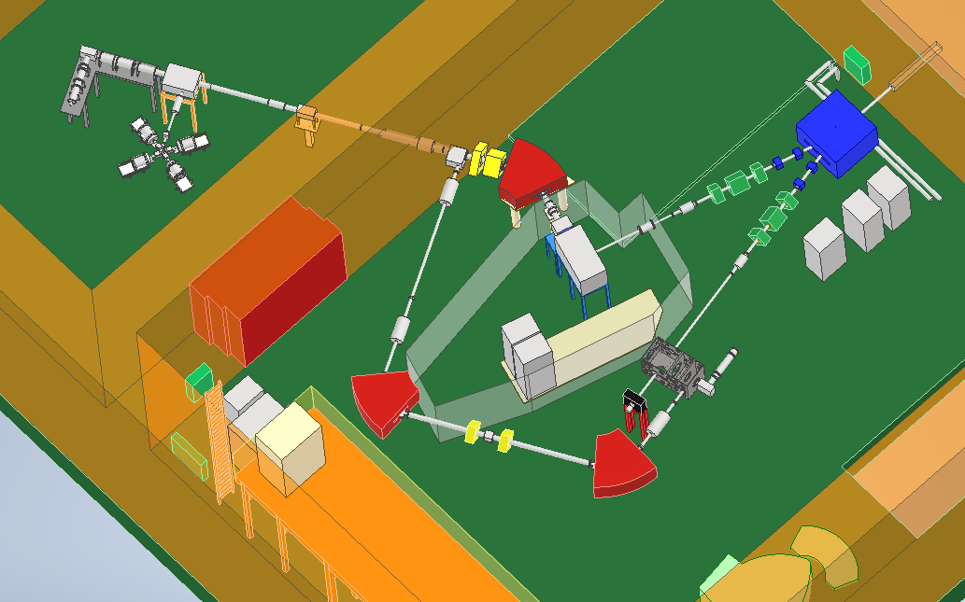
Beyond KISS: KISS-1.5
“Don’t separate, but measure multiple species at once”
MRTOF-MS
Gas cell chamber
Target system
Large rotating ^{nat}U target
RF helium gas cell
High beam intensity
Collection of reaction products as ions
Fast extraction
Decay spectrometer
KISS
MRTOF-MS
Direct mass measurements of extracted ions
Variable mass-range separator
Simultaneous transport of ions with different mass numbers
 | Primary beam | Total efficiency | Simultaneous measured nuclides | Efficacy
KISS | $$∼10 pnA$$ | <0.1% | 1 | 1
KISS-1.5 | $$100 pnA$$ | >1% | > 10 | $$100∼1000$$
 | Target system RF helium gas cell | RF helium gas cell | RF helium gas cell MRTOF-MS Variable mass-range separator

Slide 17
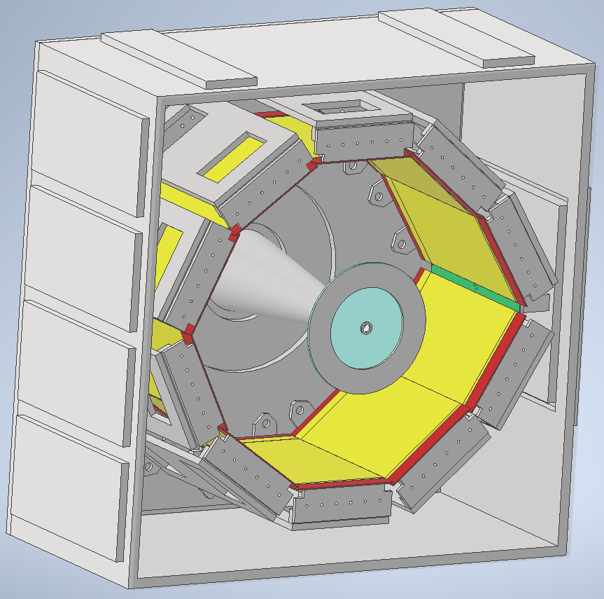
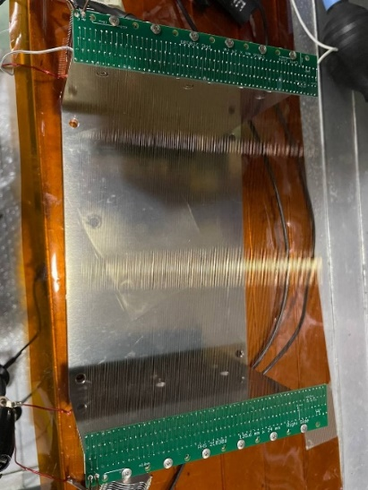
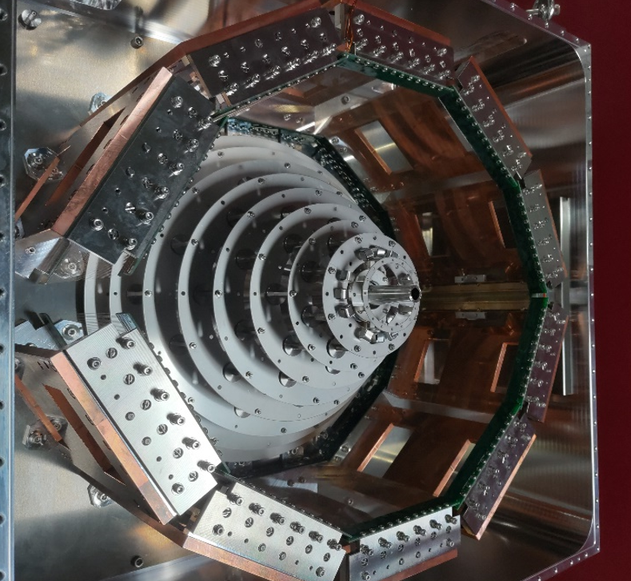
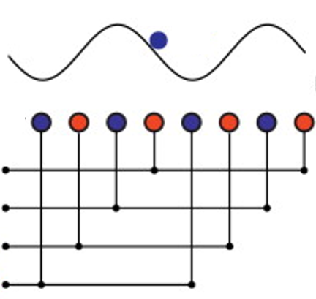
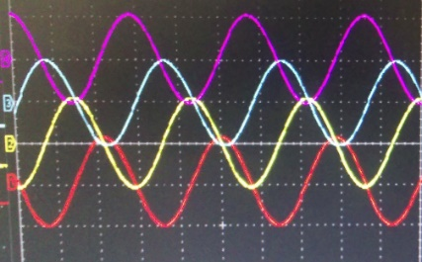
Doughnut-shaped RF helium gas cell
RFWC (RF Wire Carpet)
Extraction by RFC
Beam pipe
+
+
+
Polyimide window
+
Ion transport by static electric field
+
Ion transport by RFWC
224 BeCu wires
$φ$100 mm , 0.6 mm pitch
RF traveling wave (RFTW)
+
RF :0$°$
RF :90$°$
RF :180$°$
RF :270$°$
Developed by NSCL : $ε=10\%$
K.R. Lund et al., Nucl. Instrum. and Methods B 463, 378.(2020).

Slide 18
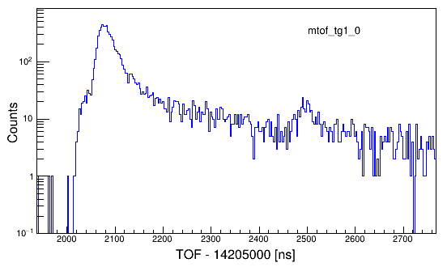
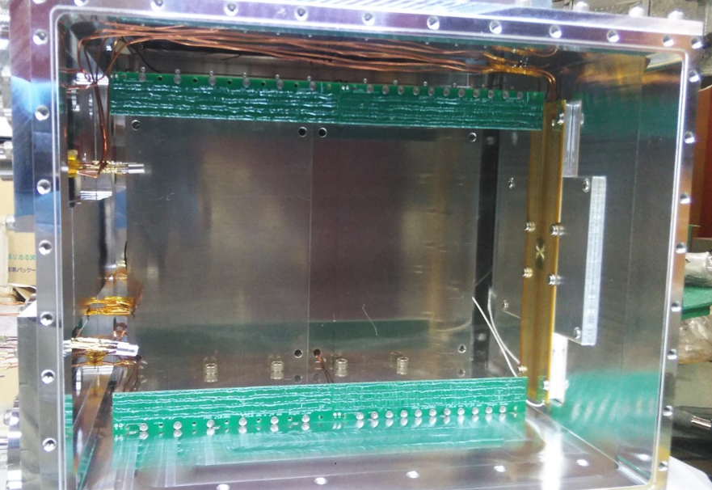
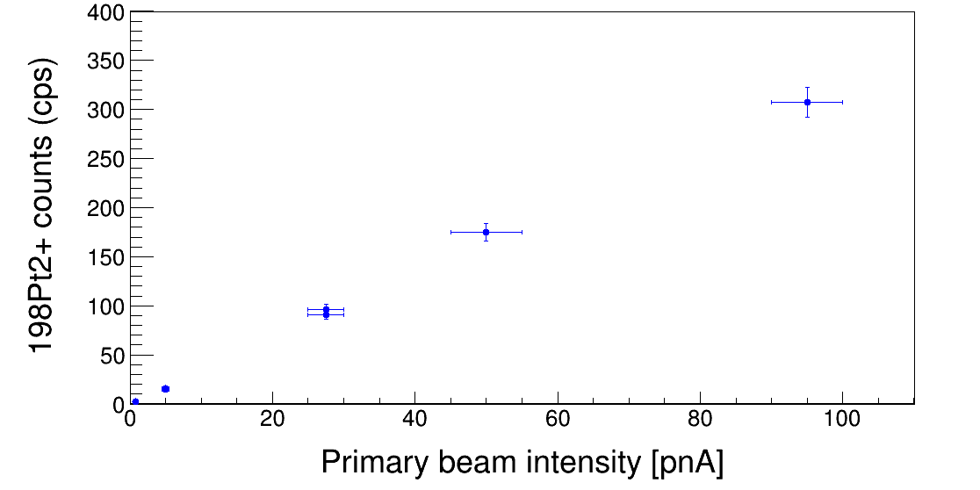
R&D of RF wire carpets
¹³⁶Xe + ¹⁹⁸Pt
Prototype RF helium gas cell
¹⁹⁸Pt
¹⁹⁸Hg
RFWC
(DC $−19 V)$
RFWC
(DC $−22 V)$
+
PI by using MRTOF-MS with 803 laps
+
+
+
+
+
+
RFC
(DC $−22 V$)
Y. Hirayama et al., Nucl. Instrument. and Methods A 1058, 168838 (2024).
Beam intensity linearity of the extracted ion counts: up to $100 pnA$
2 times higher than the argon gas cell
Extraction efficiency: 1%
10 times higher than the argon gas cell

Slide 19
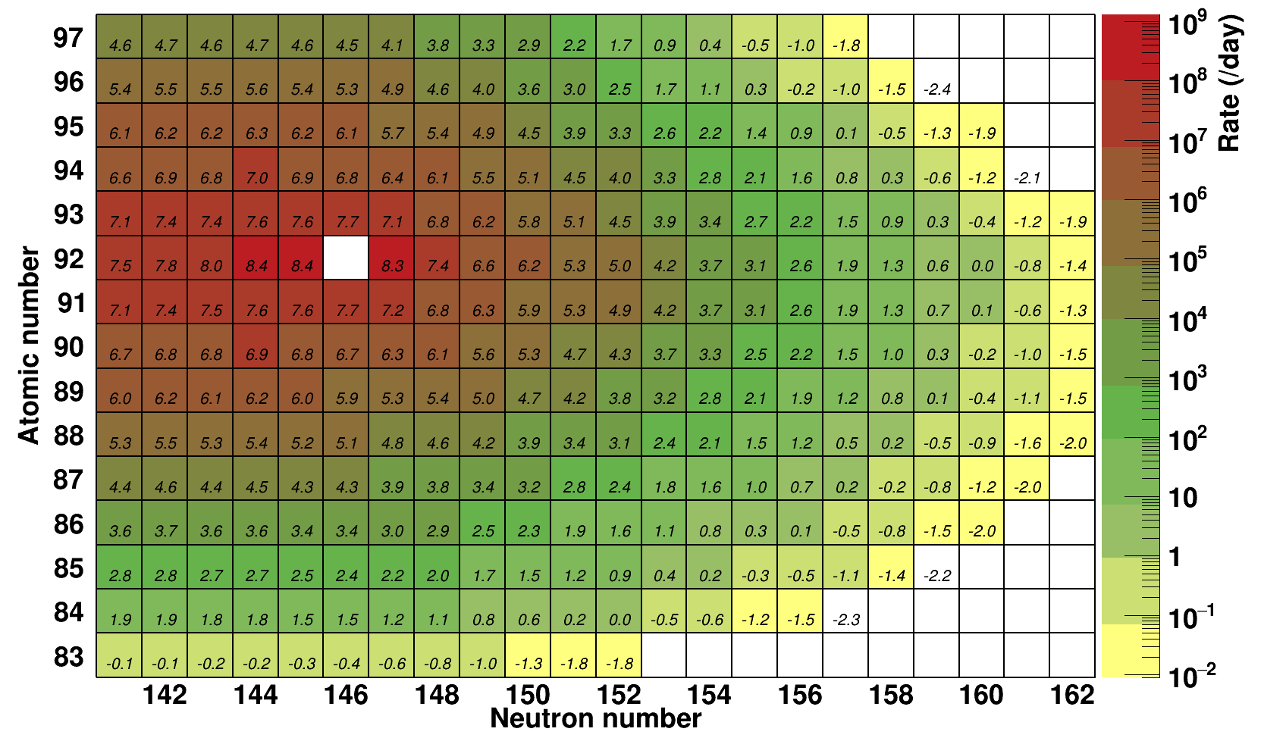
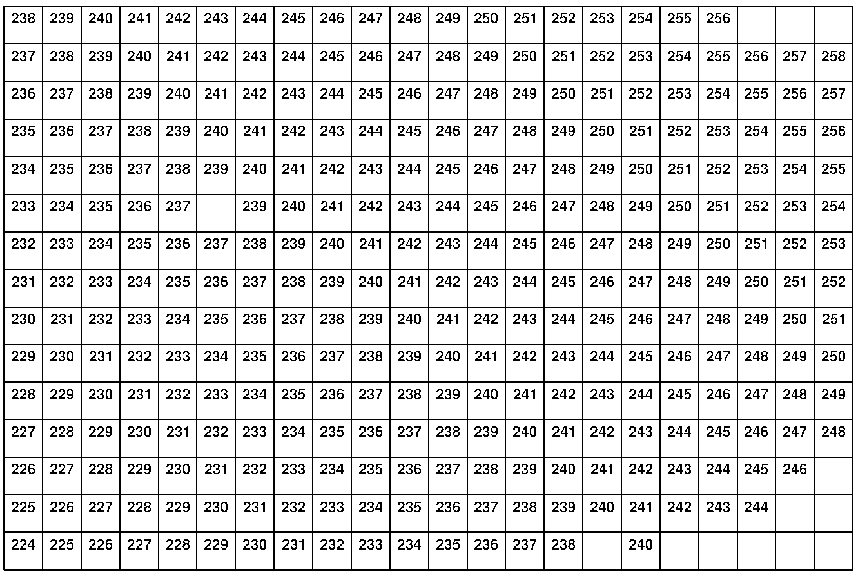
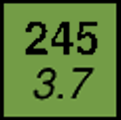
Expected yields at KISS-1.5
²³⁸U (9.4 MeV/nucleon, 100 pnA) + ^{nat}U (13 mg/cm²)
(Bk)
Yield per day
(Cm)
Mass number
$$\log_{10}\left(Yield per day\right)$$
(Am)
(Pu)
Known nuclide
(Np)
Mass-known nuclide
Atomic number
(U)
原子番号
²³⁸U
(Pa)
(Th)
Mass measurement
(>80 nuclides, >10 ppd)
(Ac)
(Ra)
Lifetime measurement
(>60 nuclides, >100 ppd)
(Fr)
Decay spectroscopy
(Rn)
(At)
(Po)
(Bi)
Neutron number
Fission probability of 90% was assumed.
Extraction efficiency of 1% was assumed.

Slide 20
Beyond KISS-1.5: KISS-II
 | FY2024 |  |  | FY2028 |  |  | 2032 |  |  | 2036
KISS-1.5
KISS-II
Primary beam separator
Mass measurement
GCCB + Ion trap
MRTOF-1
Rough mass selection
Beam
Mass measurement
Variable mass range
separator
(new-type ISOL)
MRTOF-2
Target
Beam
stopper
Single mass or multiple masses
Decay spectroscopy
Multi-segmented RF He gas cell
Gas filled solenoid filter
Separate TLF of MNT from primary beam
Extraction of All elements with high efficiency
$αβγ$ specstroscopy
Spectroscopy with high pure nuclide or multiple nuclides with TAG by MRTOF
 | Primary beam | Total efficiency | Simultaneous measured nuclides | Efficacy
KISS | $$∼10 pnA$$ | <0.1% | 1 | 1
KISS-1.5 | $$100 pnA$$ | >1% | > 10 | $$100∼1 000$$
KISS-II | 1 p$μ$A | >1% | > 10 | $$1 000∼10 000$$

Slide 21
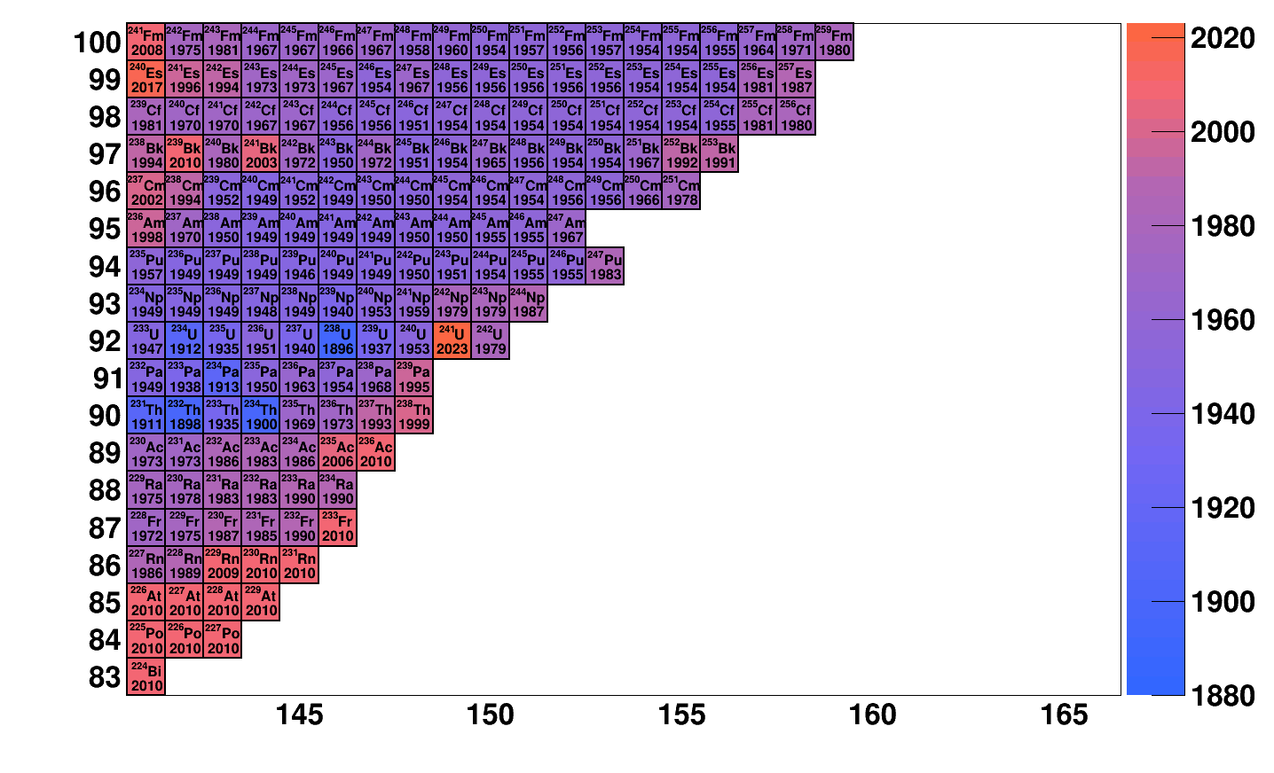
Research area around actinoids by KISS-II
Discovery year
²³⁸U+²⁴⁸Cm
Atomic number ($Z$)
KISS-1.5
KISS-II
Mass is known
Neutron number ($N$)

Slide 22
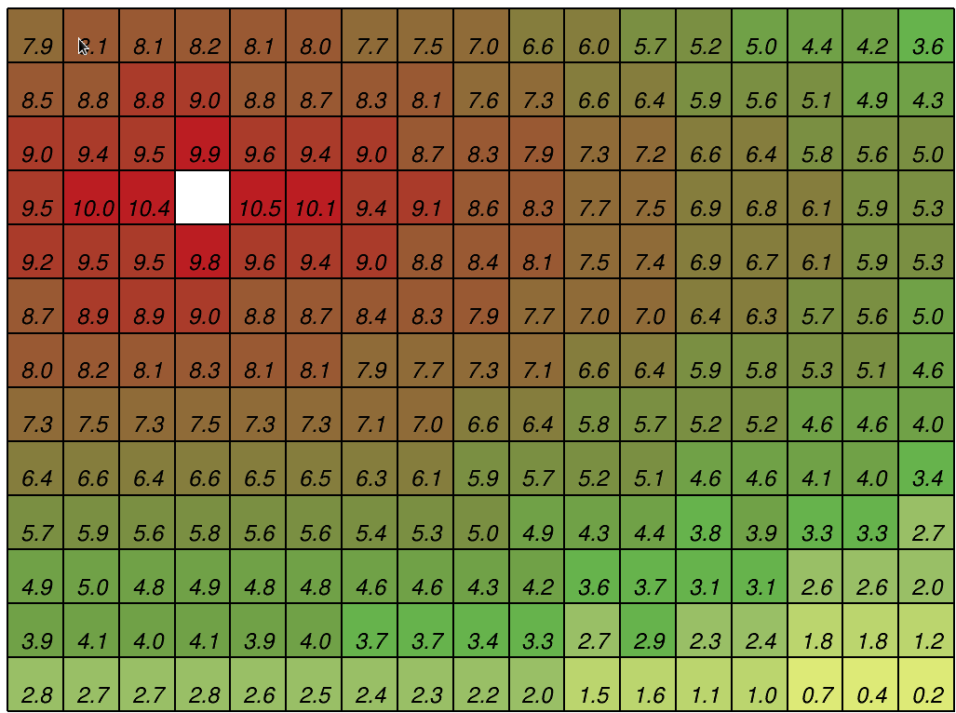
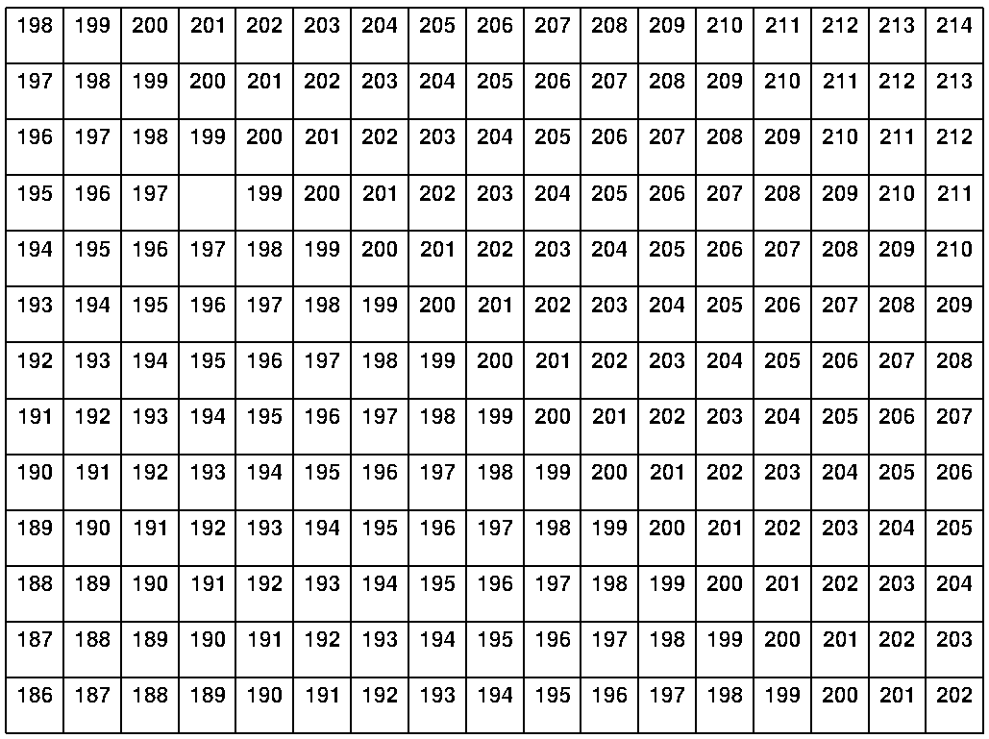
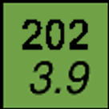
Expected yields around N = 126 at KISS-II
²³⁸U (9.0 MeV/nucleon, 1 p$μ$A) + ¹⁹⁸Pt (13 mg/cm²)
(Tl)
(Hg)
(Au)
(Pt)
¹⁹⁸Pt
(Ir)
(Os)
$$Mass frontier$$
(Re)
$$Experimentally$$
$$known frontier$$
(W)
(Ta)
$$Yield limit$$
$$(Rate>10/day)$$
(Hf)
(Lu)
(Yb)
$$Mass number$$
(Tm)
$$\log_{10}\left(Rate \left[/day\right]\right)$$
118
120
122
124
126
128
130
132
Neutron number
Extraction efficiency of 1% was assumed.

Slide 23
Summary
Spectroscopy of nuclei around N = 126 and neutron-rich actinoid from astrophysical interest
KISS
Nuclear production by MNT reactions
Collection by argon gas cell
Element selection by laser resonance ionization
Mass selection by ISOL
Equipments
MSPGC + HPGe detectors: Lifetime measurement, $β$-$γ$ spectroscopy
Excitation laser: Laser spectroscopy
MRTOF-MS: Mass spectroscopy
Beyond KISS: KISS-1.5
Large rotating uranium target
RF helium gas cell
Variable Mass-Range Separator
100 ~ 1000 times higher efficacy than KISS
More than 80 new isotopes with their precise mass measurements
Beyond KISS-1.5: KISS-II
Gas-filled solenoid filter
Multi-segmented RF helium gas cell
1 000 ~ 10 000 times higher efficacy than KISS

