Slide 1

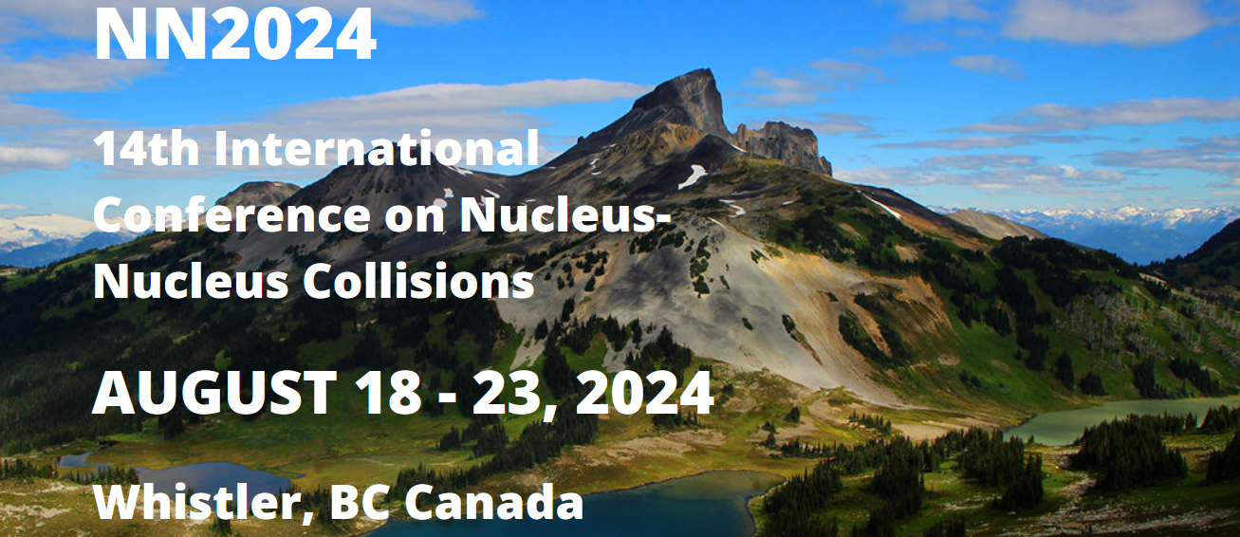
Research on Superheavy Elements: Experimental Prospects
D. Rudolph, Lund University, Sweden

Slide 2

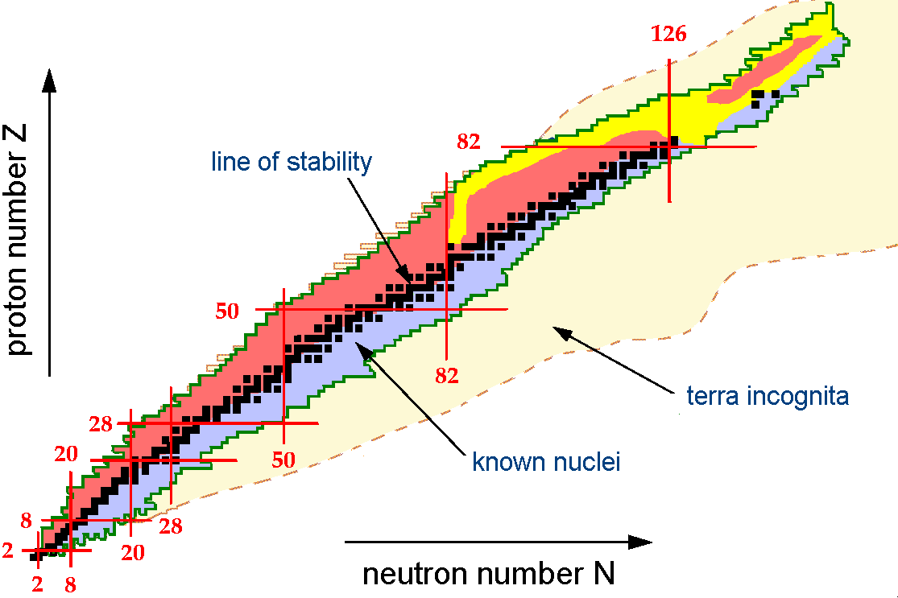





Outline
Introduction
Experimental Methods & Tools
Spectroscopy (Fl, Z=114)
Summary
Wenner-Gren stiftelserna
D. Rudolph, Lund University Nucleus-Nucleus Collisions, Whistler, Canada, August 2024

Slide 3
Are Superheavy Nuclei Special?
Challenge the limits of nuclear binding at the uppermost end of the chart of nuclei!
Plenary Talks NN2024:
Tu, 9:30, J.M. Gates (LBNL activities)
Th, 11:30, J. Khuyagbaatar (Fusion & Fission)
Th, 14:00, A. Lopez-Martens (Structure)
Dedicated SHE Sessions NN2024:
Monday & Thursday, late afternoon
D. Rudolph, Lund University Nucleus-Nucleus Collisions, Whistler, Canada, August 2024

Slide 4


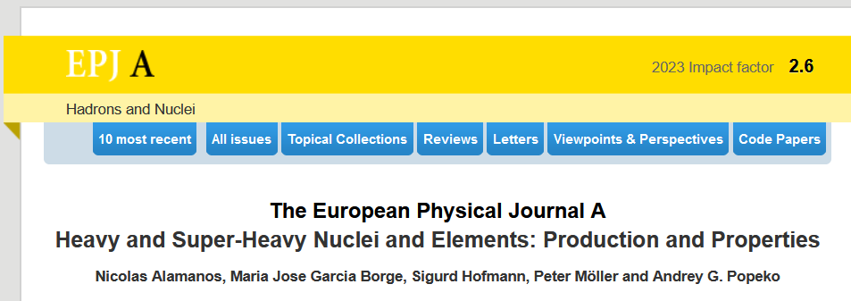
Background Material
Special Issue on Superheavy Elements
Edited by
Christoph E. Düllmann
Rolf-Dietmar Herzberg
Witold Nazarewicz
Yuri Oganessian
Nobel Symposium NS160
Chemistry and Physics of Heavy and Superheavy Elements
June 2016, Bäckaskog Castle, Sweden
Volume 944, Pages 1-690 (December 2015)
EPJ Web of Conferences 131 (2016)
Topical Issue 58 (2022-2023)
D. Rudolph, Lund University Nucleus-Nucleus Collisions, Whistler, Canada, August 2024

Slide 5
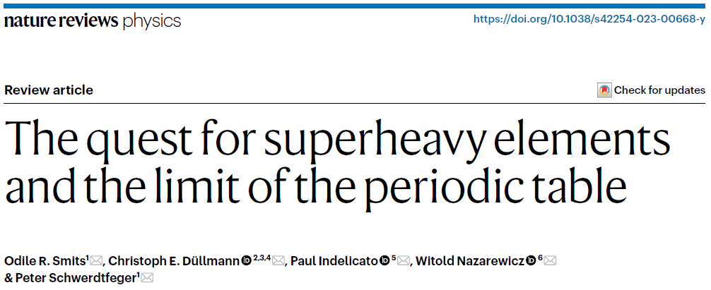

Background Material
February 2024
Books authored by science journalists
Press releases on new findings and associated comments in, e.g., Nature and Science
D. Rudolph, Lund University Nucleus-Nucleus Collisions, Whistler, Canada, August 2024

Slide 6
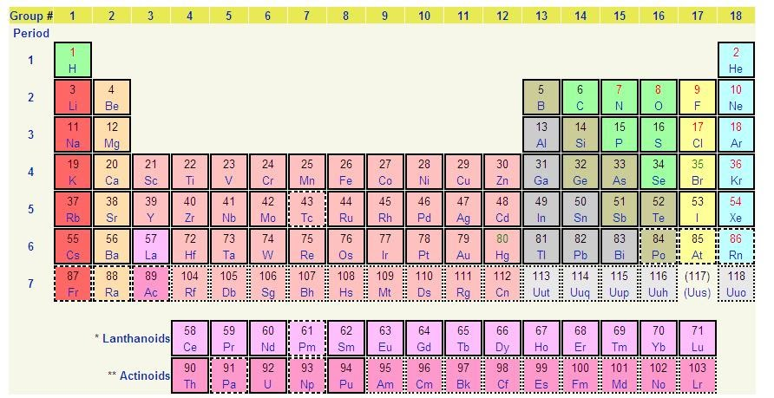
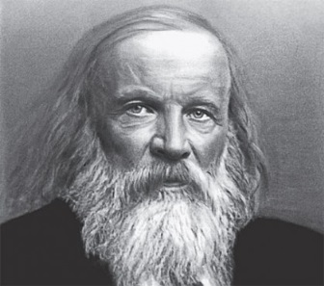
The Chemistry Perspective
31/12/2015: JWP IUPAC/IUPAP
approves elements 113, 115, 117, 118
113
115
117
118
Fl
Lv
119
?
120
?
92
U
The superheavy elements are the Transactinides, Z ≥ 104!
D. Rudolph, Lund University Nucleus-Nucleus Collisions, Whistler, Canada, August 2024

Slide 7
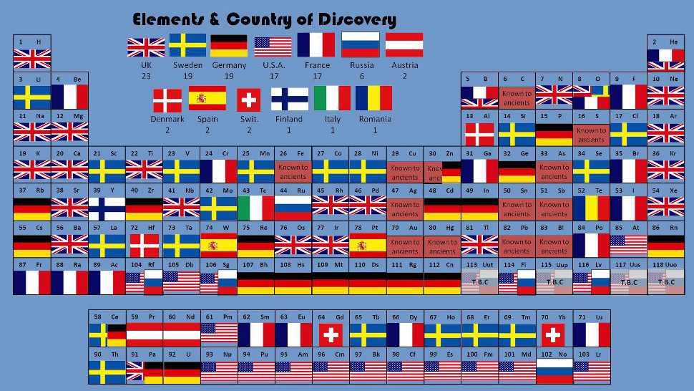

The Discovery Perspective
U.S.A. Sweden Germany France Russia
20 19 19 17 9
Japan
1
The superheavy elements are the Transactinides, Z ≥ 104!
D. Rudolph, Lund University Nucleus-Nucleus Collisions, Whistler, Canada, August 2024

Slide 8

Where is the Island of Stability?
Does it Exist in the First Place?
Problem: Production Rate!
1/year
1/month
1/week
1/day
120
Z=120
120
Z=119
Z
Og
?
Ts
Lv
Mc
114
114
Fl
Nh
Cn
Rg
Ds
Mt
108
108
Hs
Bh
liquid drop ”line of stability”
SF
184
184
α
100
β⁺ EC
100
β⁻
N
152
162
152
162
Underlying chart: courtesy C.E. Düllmann
D. Rudolph, Lund University Nucleus-Nucleus Collisions, Whistler, Canada, August 2024

Slide 9
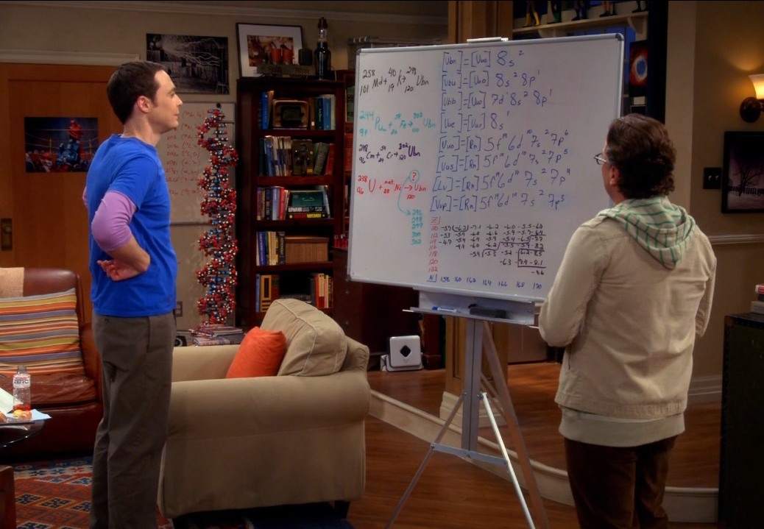

Making of SHE: In theory it’s easy …
http://www.youtube.com/watch?v=44slJj34qWo
http://www.youtube.com/watch?v=hktk-xyCCyY
D. Rudolph, Lund University Nucleus-Nucleus Collisions, Whistler, Canada, August 2024

Slide 10


Four Ingredients
1
Berkeley: 88” cyclotron, being upgraded (see talk by Jacklyn Gates tomorrow and afternoon session)
GSI Darmstadt: from UNILAC to HELIAC, dedicated new cw-LINAC for SHE (and material science) (see – possibly – talks by J. Khuyagbaatar / F. Giacoppo)
JINR Dubna: SHE Factory (dedicated SHE facility recently commissioned with first results published and increasing beam intensities/luminositites)
RIKEN: dedicated linear accelerator for SHE program (see – possibly – talk by S. Sakaguchi Thursday afternoon)
IMP/CAS Lanzhou (talk by Z. Gan seemingly cancelled) (?)
GANIL/SPIRAL2: involvement via new S³ facility
… others … (see talk by C.M. Folden Thursday afternoon)
heavy-ion beam separator
6·10¹²/s 100/s
detector
”1 particle μA”
⁴⁸Ca, ⁵⁰Ti, ⁵⁴Cr, …
ECR ion source
6 – 7 MeV/u
D. Rudolph, Lund University Nucleus-Nucleus Collisions, Whistler, Canada, August 2024

Slide 11
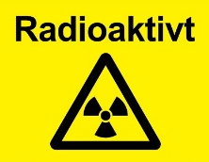
Four Ingredients
1
2
Needs for one target wheel: ≈ 20-30 mg of isotopically enriched material.
Note 1: You can’t just buy it!
”Access” to isotope facility in Oak Ridge via US DOE, and certainly for the more ”exotic” species like ²⁴⁴Pu and Bk and Cf isotopes.
Note 2: They are radioactive! GBq to TBq of α, β, γ, (n)
heavy-ion beam separator
6·10¹²/s 100/s
det
”1 particle μA”
⁴⁸Ca, ⁵⁰Ti, ⁵⁴Cr, …
actinide targets
D. Rudolph, Lund University Nucleus-Nucleus Collisions, Whistler, Canada, August 2024

Slide 12
Four Ingredients
1
2
3
Most often ”gas-filled” with Bρ ~ 1/<q>.
Suppression ≈ 10¹⁰ - 10¹¹
heavy-ion beam separator
6·10¹²/s SHE 100/s
det
”1 particle μA”
⁴⁸Ca, ⁵⁰Ti, ⁵⁴Cr, … beam background
actinide targets
What is the average charge state, <q>, of element 120 in dilute helium gas
???
D. Rudolph, Lund University Nucleus-Nucleus Collisions, Whistler, Canada, August 2024

Slide 13
Four Ingredients
1
2
3
4
heavy-ion beam separator detector (experiment station)
6·10¹²/s SHE rates:
100 - 1000/s
”1 particle μA”
⁴⁸Ca, ⁵⁰Ti, ⁵⁴Cr, … beam background
actinide targets
suppression ≈ 10¹⁰ - 10¹¹
D. Rudolph, Lund University Nucleus-Nucleus Collisions, Whistler, Canada, August 2024

Slide 14
Four Ingredients
1
2
3
4
heavy-ion beam separator detector (experiment station)
6·10¹²/s SHE rates:
”1/s”
”1 particle μA”
⁴⁸Ca, ⁵⁰Ti, ⁵⁴Cr, … beam background
actinide targets
Mass number, A
Mass, M - MR-ToF - Penning Trap
Single-atom chemistry (gas-chromatography)
Laser / atomic spectroscopy
…
See talks by …
Jennifer Pore (later today), Peter Schury (Friday), and Francesca Giacoppo (Thursday)
D. Rudolph, Lund University Nucleus-Nucleus Collisions, Whistler, Canada, August 2024

Slide 15
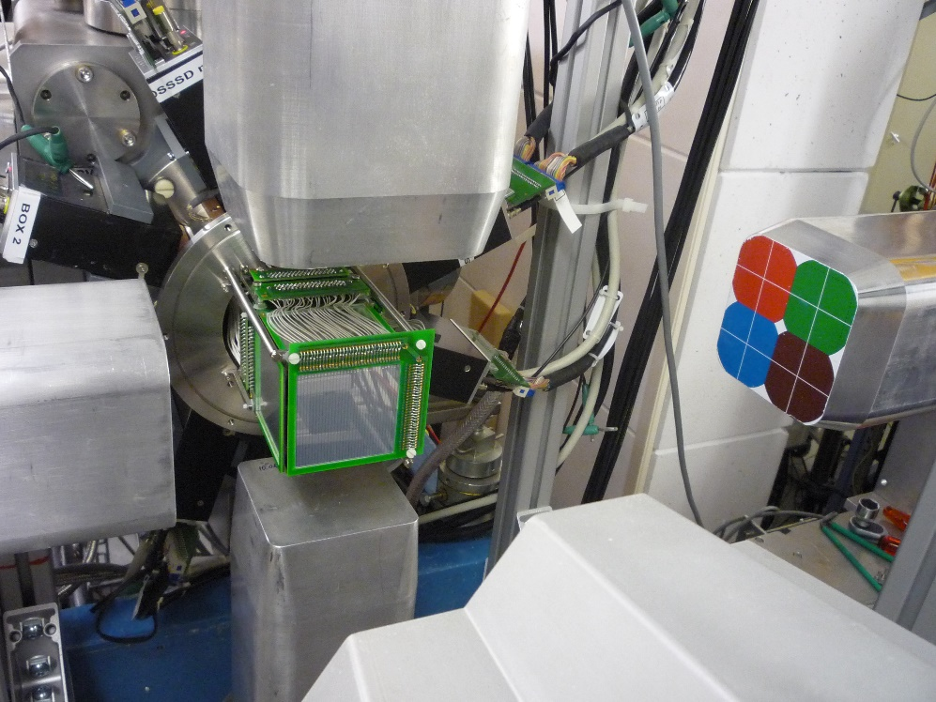

ID & Spectroscopy Principle (TASISpec)
Inner silicon cube: Germanium cube:
Implantation γ rays & X rays
α decay (”photons”)
Fission (Z identification)
Conversion electrons
Implantation, a few α decays, and fission occur in the same silicon detector pixel and within certain energy- and (decay) time intervals:
”Correlated α-decay chains”
L.-L. Andersson et al., NIM A 622, 164 (2010)
behind
TASCA
gas-filled separator at
Modern spectroscopy toolbox:
employ “digital” sampling electronics
Geant4-based virtual experiment to ensure self-consistency of physics observations
D. Rudolph, Lund University Nucleus-Nucleus Collisions, Whistler, Canada, August 2024

Slide 16
Nuclear Decay Spectroscopy
120
120
Shell gap at Z=114?
?
Z
Mc
Q_{α}
Z=115
114
1-2/day
114
Fl
Z=114
Structure constraint!
E1
α-decay fine structure!
108
Shape coexistence!?
108
0⁺
D. Rudolph et al., PRL 111, 112502 (2013)
Top Ten APS Physics Newsmakers 2013
J.M. Gates et al., PRC 92, 021301(R) (2015)
Spectroscopy limit α-γ
(100 or more per day)
2
SF
184
184
α
β⁺ EC
100
A. Såmark-Roth et al., PRL 126, 032503 (2021)
PRC 107, 024301 (2023)
D.M. Cox et al., PRC 107, L021301 (2023)
100
β⁻
N
152
162
152
162
Underlying chart: courtesy C.E. Düllmann
D. Rudolph, Lund University Nucleus-Nucleus Collisions, Whistler, Canada, August 2024

Slide 17
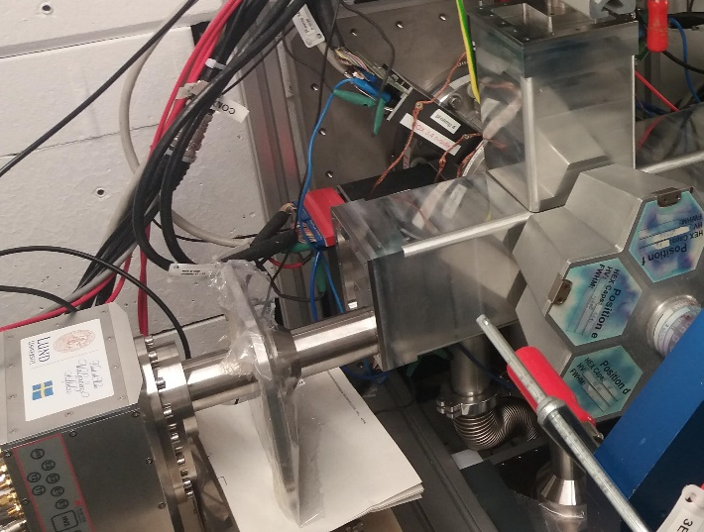









Flerovium Spectroscopy – ⁴⁸Ca+²⁴⁴Pu
21 days approved 2017
Scheduled summer 2018 (fire incident)
14 days re-scheduled 4/2019 (ion source issues)
12 days re-scheduled 3/2020
32 candidate flerovium chains
18 days “effective” with ≈0.8 particle μA (≈6·10¹⁸ total)
29 assigned flerovium chains
(2x ²⁸⁶Fl, 12x ²⁸⁸Fl, 15x ²⁸⁹Fl)
TASISpec+
4x COMPEX Ge modules
TASCA
2019/20
D. Rudolph, Lund University Nucleus-Nucleus Collisions, Whistler, Canada, August 2024

Slide 18
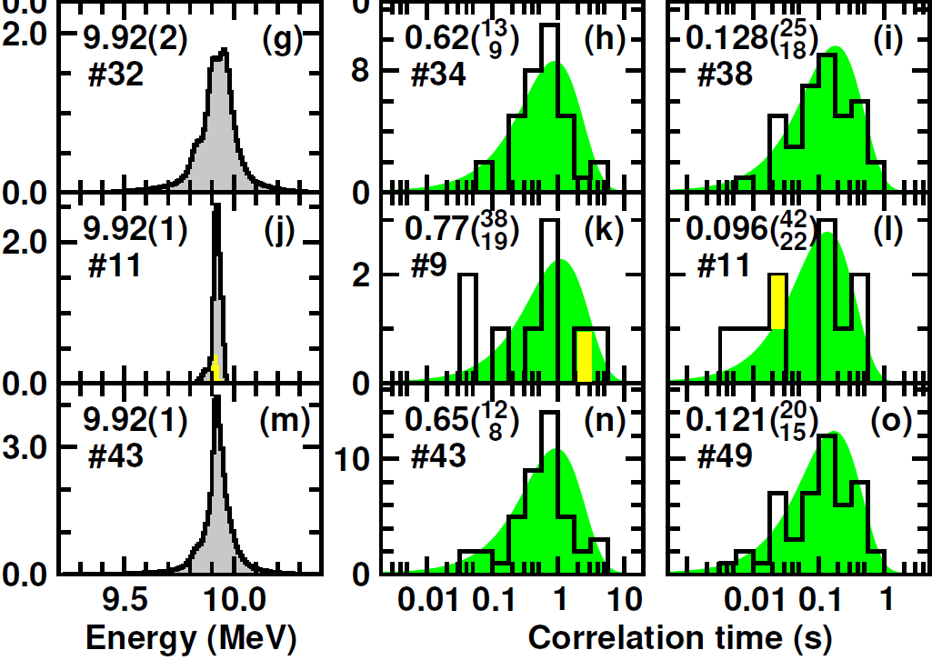

I. Spectroscopy of ²⁸⁸Fl Decay Chain
0⁺
²⁸⁸Fl
α
Q_{α,exp} = Q_{α,theo}
0⁺
²⁸⁴Cn b_{α} huge
HF small
previous
9.5 10.0 0.01 0.1 1 10 0.01 0.1 1
Energy (MeV) Correlation time (s)
Counts per channel
new
Fl 288
0.65( ) s
α 9.92(1)
Fl 288
0.62( ) s
α 9.92(2)
9.5 10.0 0.01 0.1 1 10 0.01 0.1 1
Energy (MeV) Correlation time (s)
Fl 288
0.77( ) s
α 9.92(1)
12
13
114
38
8
9
19
combined
Cn 284
0.12(2) s
sf 100%
Cn 284
0.13( ) s
sf 100%
Cn 284
0.10( ) s
sf 100%
4
112
3
2
2
A. Såmark-Roth et al., PRL 126, 032503 (2021)
D. Rudolph, Lund University Nucleus-Nucleus Collisions, Whistler, Canada, August 2024

Slide 19
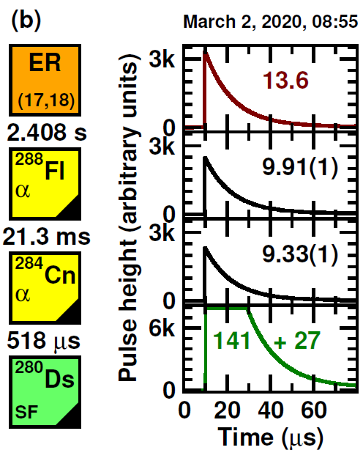
I. Spectroscopy of ²⁸⁸Fl Decay Chain
First ever
(1/51~2%)
recoil-α-α-SF
chain from ²⁸⁸Fl
Fl 288
0.65( ) s
α 9.92(1)
114
12
8
Cn 284
0.12(2) s
α 9.33(1)
sf 98%
112
Ds 280
0.36 ms
sf 100%
110
A. Såmark-Roth et al., PRL 126, 032503 (2021)
New isotope!
D. Rudolph, Lund University Nucleus-Nucleus Collisions, Whistler, Canada, August 2024

Slide 20
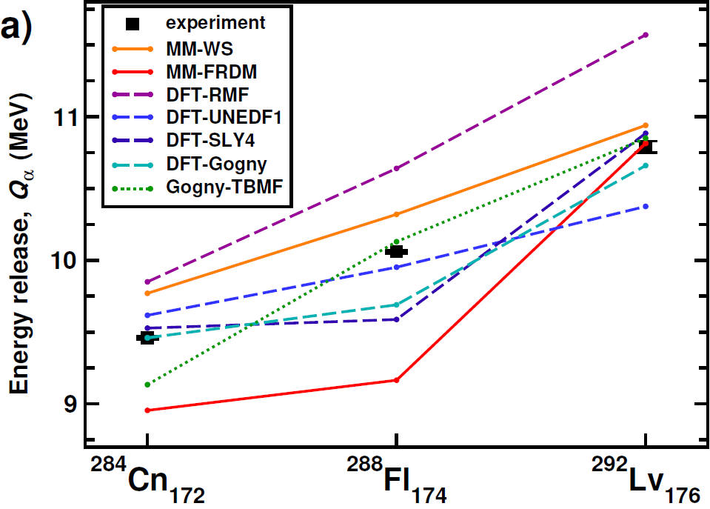
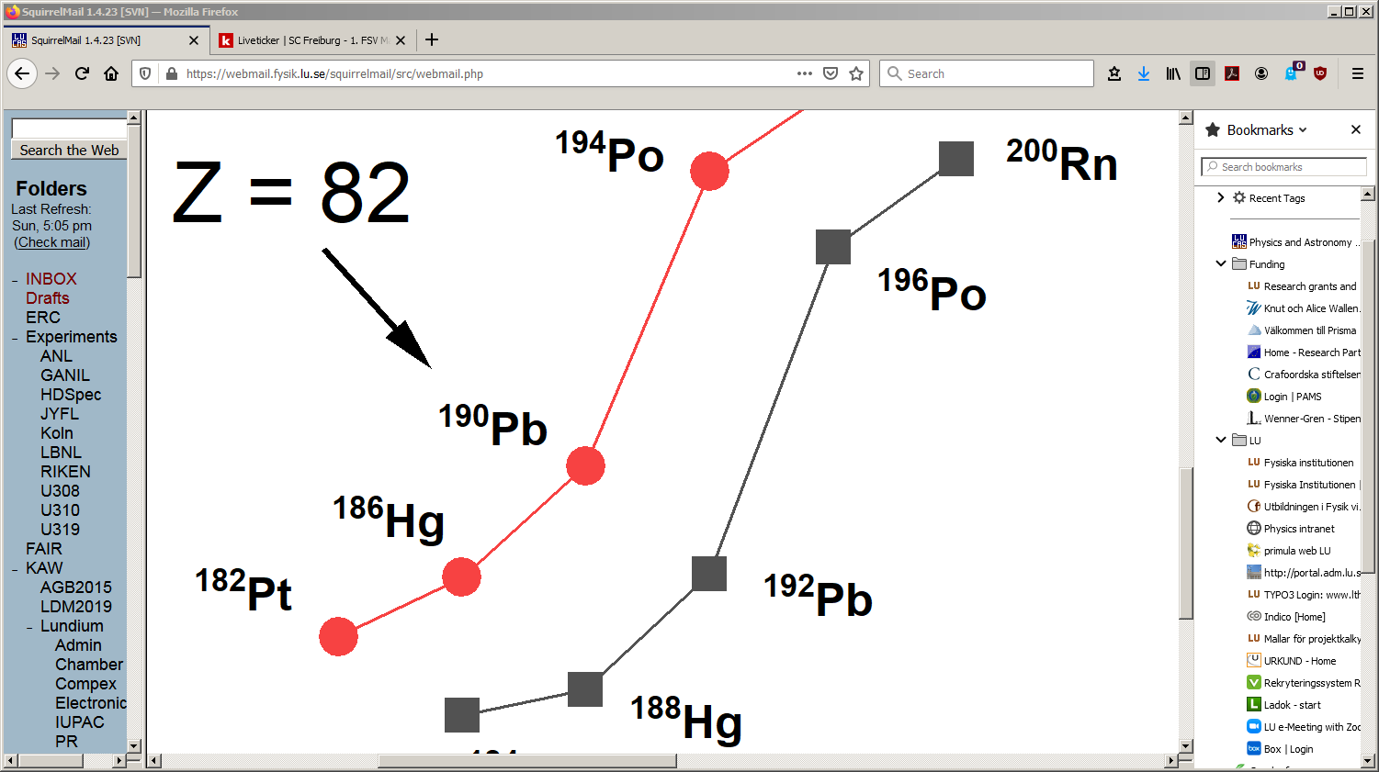
Impact on Z = 114 (Fl) Shell Gap
First ever α-decay chain ACROSS Z = 114 (gap?)
Z = 82, Pb
Q_{α}
N = 108,110
(MeV)
6
5
Lv 292
13( ) ms
α 10.64(4)
116
6
3
Fl 288
0.65( ) s
α 9.92(1)
114
12
8
NOT N = 126 !!
Cn 284
0.12(2) s
α 9.33(1)
sf 98%
112
Ds 280
0.36 ms
sf 100%
110
A. Såmark-Roth et al., PRL 126, 032503 (2021)
(Triaxial) Beyond Mean-Field Theory (Results):
J.L. Egido & A. Jungclaus, PRL 125, 192504 (2020).
D. Rudolph, Lund University Nucleus-Nucleus Collisions, Whistler, Canada, August 2024

Slide 21
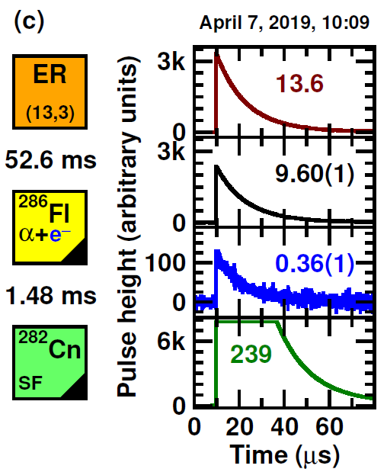
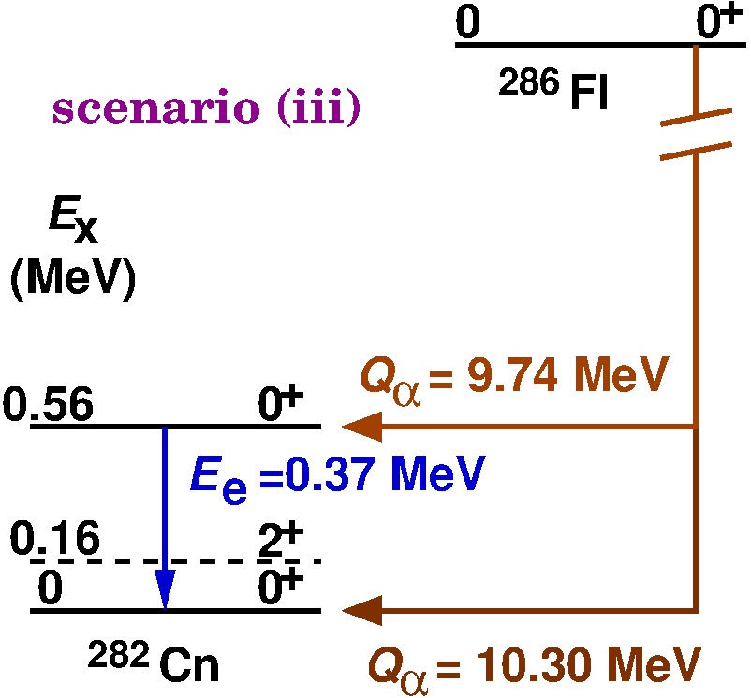
II. Spectroscopy of ²⁸⁶Fl Decay Chain
first ever (1/55~2%) decay
into excited 0⁺ ²⁸²Cn
₂
imp DSSD
1 out of 55
box DSSD
A. Såmark-Roth et al., PRL 126, 032503 (2021)
PRC 107, 024301 (2023)
D. Rudolph, Lund University Nucleus-Nucleus Collisions, Whistler, Canada, August 2024

Slide 22
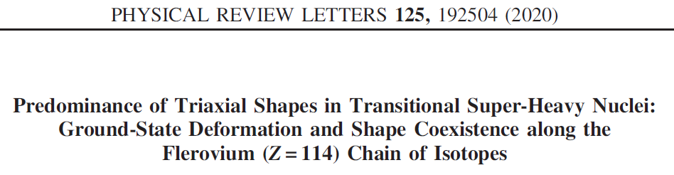
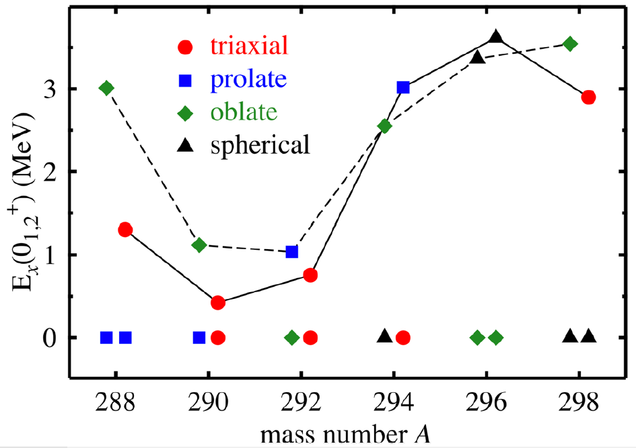
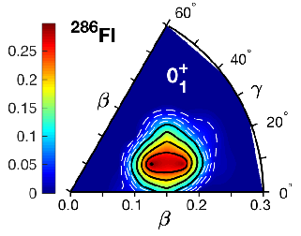
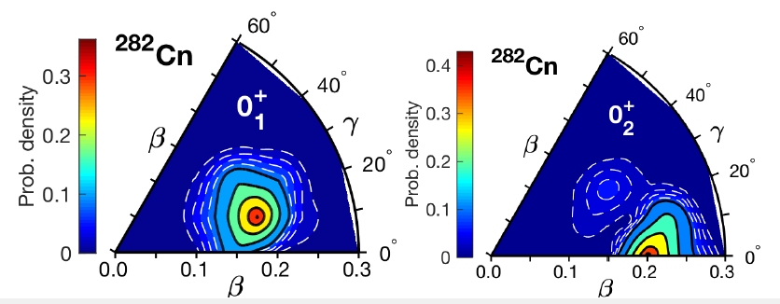
Triaxial Beyond Mean Field Calculations
shape coexistence
shape mixing
J. Luis Egido & Andrea Jungclaus
Z=114
Triaxial symmetry conserving configuration mixing approach (SCCM)
Gogny D1S
… importance of the γ degree of freedom is highlighted …
D. Rudolph, Lund University Nucleus-Nucleus Collisions, Whistler, Canada, August 2024

Slide 23
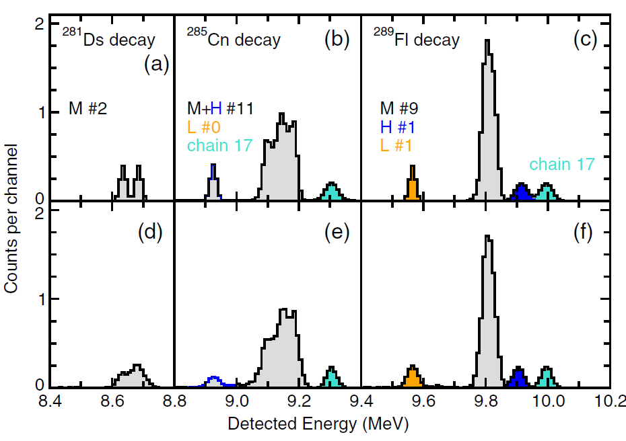

III. Spectroscopy of ²⁸⁹Fl Decay Chains
²⁸⁹Fl (15 chains):
^{exp}
almost doubling number of known chains (18)
observation of α-decay fine structure (certainly in the decay step ²⁸⁵Cn → ²⁸¹Ds)
confirmation of decay branch into ²⁷⁷Hs Ch.E. Düllmann et al., PRL 104, 252701 (2010).
consistency checks with Geant4 simulations
^{sim}
Fl 289
2.5( ) s
α 9.80,…
8
5
Cn 285
42( ) s
α 9.14,…
10
7
Ds 281
19( ) s
α 8.67(2)
sf 90%
D.M. Cox et al., PRC 107, L021301 (2023)
4
3
Hs 277
18( ) ms
sf 100%
25
7
D. Rudolph, Lund University Nucleus-Nucleus Collisions, Whistler, Canada, August 2024

Slide 24
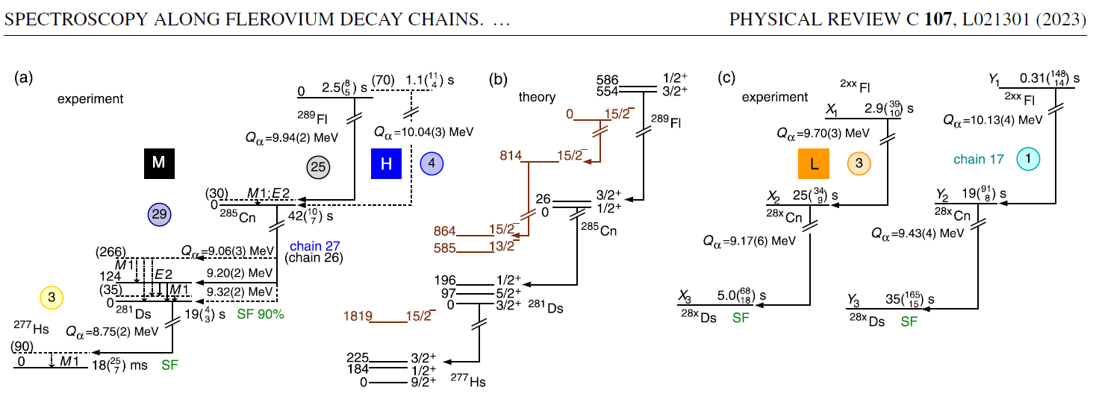
III. Spectroscopy of ²⁸⁹Fl Decay Chains
D.M. Cox et al., PRC 107, L021301 (2023)
(Triaxial) Beyond Mean-Field Theory (odd A!): J.L. Egido
(~4 weeks per decay step and parity on Madrid HPC)
D. Rudolph, Lund University Nucleus-Nucleus Collisions, Whistler, Canada, August 2024

Slide 25
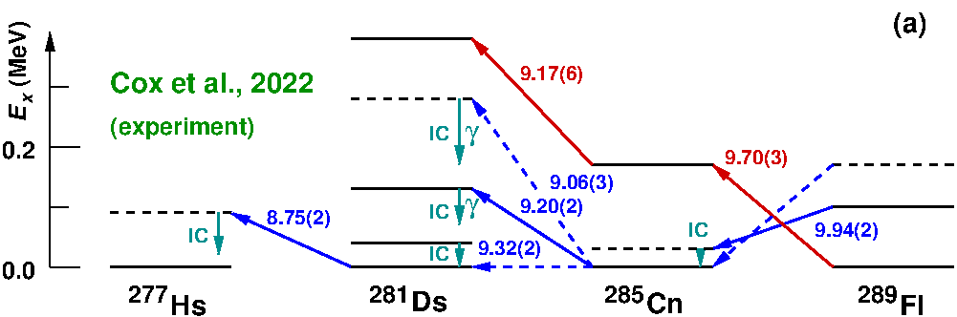
III. Spectroscopy of ²⁸⁹Fl Decay Chains
Nuclear structure comparison along decay chains
D. Rudolph, EPJ A 58, 242 (2022)
D.M. Cox et al., PRC 107, L021301 (2023)
D. Rudolph, Lund University Nucleus-Nucleus Collisions, Whistler, Canada, August 2024

Slide 26
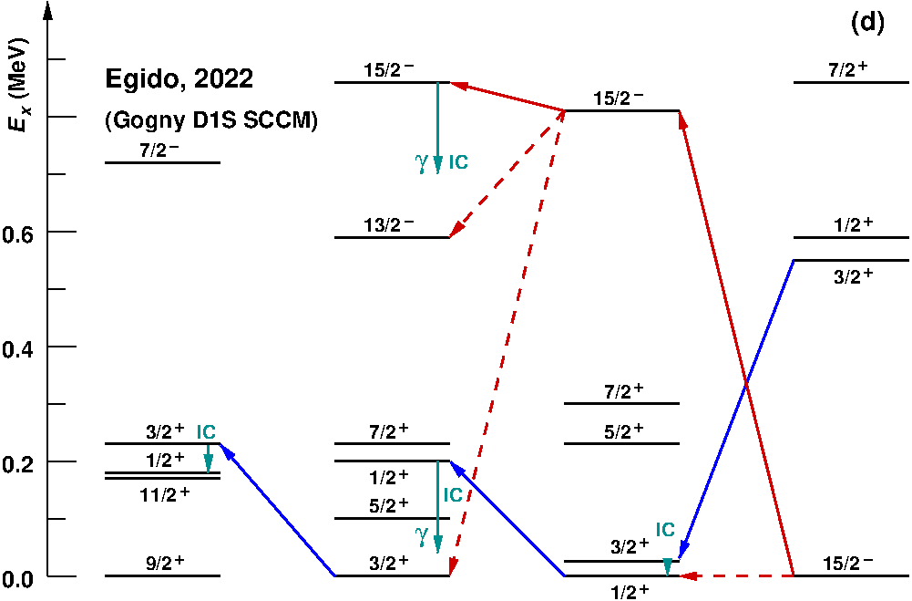
III. Spectroscopy of ²⁸⁹Fl Decay Chains
Nuclear structure comparison along decay chains
D. Rudolph, EPJ A 58, 242 (2022)
D.M. Cox et al., PRC 107, L021301 (2023)
J.L. Egido, private communication
J.L. Egido & A. Jungclaus,
Phys. Rev. Lett. 125, 192504 (2020)
D. Rudolph, Lund University Nucleus-Nucleus Collisions, Whistler, Canada, August 2024

Slide 27
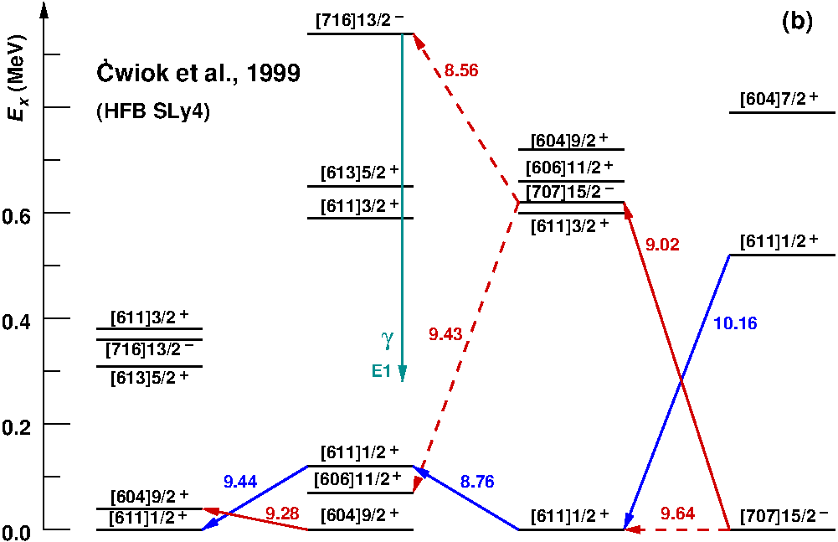
III. Spectroscopy of ²⁸⁹Fl Decay Chains
Nuclear structure comparison along decay chains
D. Rudolph, EPJ A 58, 242 (2022)
D.M. Cox et al., PRC 107, L021301 (2023)
S. Ćwiok, W. Nazarewicz, P.H. Heenen,
Phys. Rev. Lett. 83, 1108 (1999)
D. Rudolph, Lund University Nucleus-Nucleus Collisions, Whistler, Canada, August 2024

Slide 28
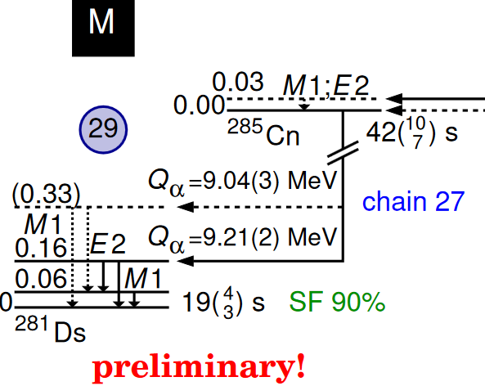
Summary – SHE Nuclear Structure
unfolding “yellow squares” into decay schemes
anchor points for nuclear structure theory in the SHE regime itself
(precise Q_{α} chains, fine structure, hindrance factors, γ-ray multipolarities, …)
Z=114 (at N ≈174) reveals γ-softness and/or shape coexistence rather than magicity (consistency between Triaxial Beyond Mean Field theory and experimental nuclear spectroscopy)
Cn 285
42( ) s
α 9.14(3)
10
7
X
Z = 2, 8, 20, 28, 50, 82, 114
Let’s look for the next magic candidate: Z=120!
Plenary talk by Jacklyn Gates tomorrow;
Technicalities: Rodney Orford later today
D. Rudolph, Lund University Nucleus-Nucleus Collisions, Whistler, Canada, August 2024

Slide 29
D. Rudolph, Lund University Nucleus-Nucleus Collisions, Whistler, Canada, August 2024

Slide 30
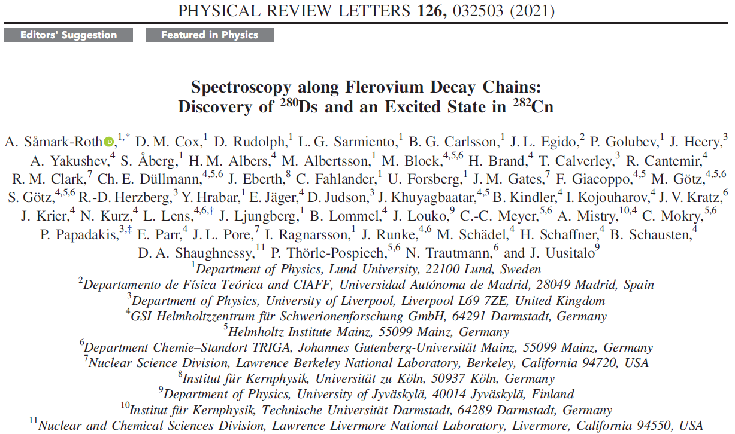




Collaboration Fl Spectroscopy

Slide 31
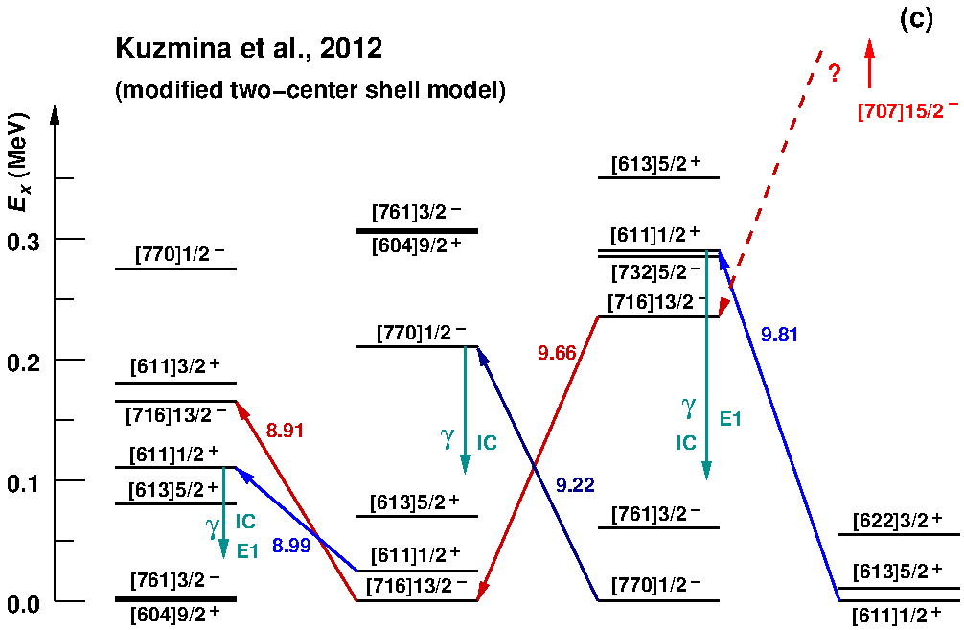
III. Spectroscopy of ²⁸⁹Fl Decay Chains
Nuclear structure comparison along decay chains
D. Rudolph, EPJ A 58, 242 (2022)
D.M. Cox et al., PRC 107, L021301 (2023)
A.N. Kuzmina, G.G. Adamian, N.V. Antonenko,
Phys. Rev. C 85, 027308 (2012)
D. Rudolph, Lund University Nucleus-Nucleus Collisions, Whistler, Canada, August 2024

Slide 32
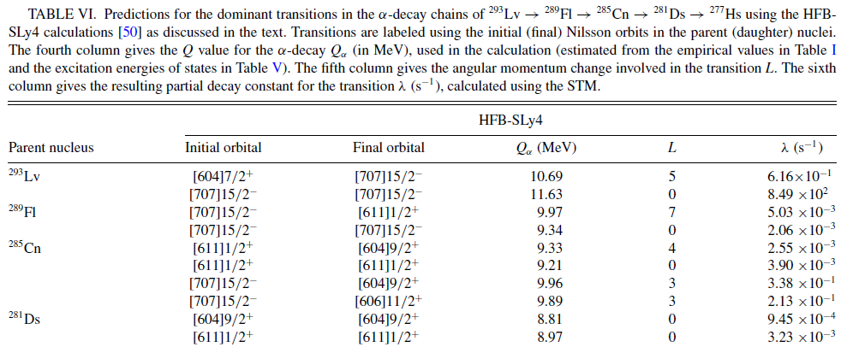
III. Spectroscopy of ²⁸⁹Fl Decay Chains
Nuclear structure comparison along decay chains …
D. Rudolph, EPJ A 58, 242 (2022)
D.M. Cox et al., PRC 107, L021301 (2023)
… plus proper
α-decay probabilities
R.M. Clark & D. Rudolph,
PRC 107, 034321 (2023)
D. Rudolph, Lund University Nucleus-Nucleus Collisions, Whistler, Canada, August 2024

Slide 33
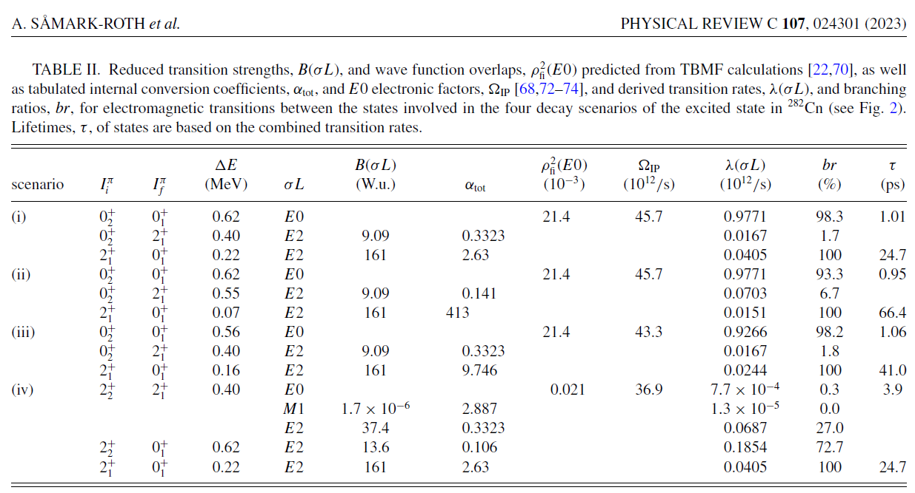
II. Spectroscopy of ²⁸⁶Fl Decay Chain
₂
(input from and discussions with T. Kibédi gratefully acknowledged)
br(0⁺→0⁺) ≈ 100%!
A. Såmark-Roth et al., PRL 126, 032503 (2021)
PRC 107, 024301 (2023)
D. Rudolph, Lund University Nucleus-Nucleus Collisions, Whistler, Canada, August 2024

Slide 34
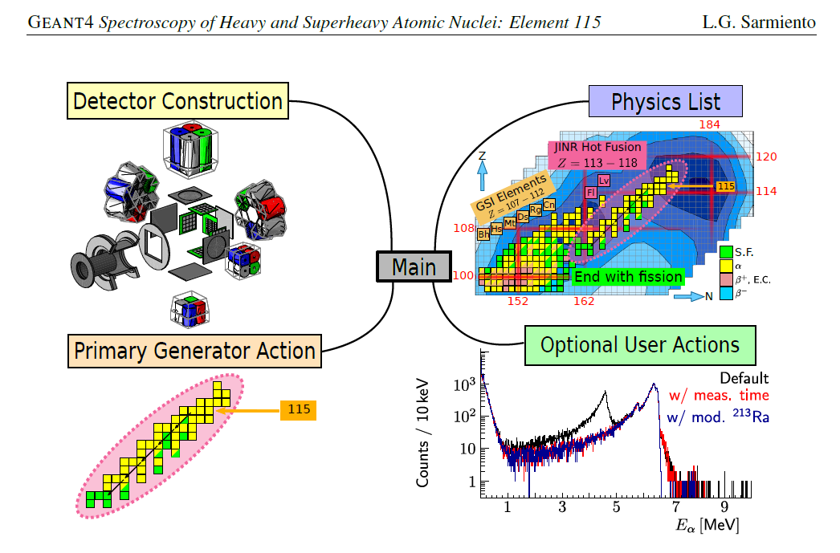

Geant4 Simulations – Virtual Experiments
L.G. Sarmiento et al., Proc. Science PoS(X LASNPA)057 (2014). Z ≥ 100!
Default:
Z < 100 !
LGS
e.g., decay schemes
e.g., time dependencies
Geant4 developer
Similar attempts: GABRIELA: A. Lopez-Martens et al., Nucl. Phys. A852, 15 (2011)
SHIP: F.P. Heßberger et al., Eur. Phys. J. A48, 75 (2012) … and certainly more
D. Rudolph, Lund University Nucleus-Nucleus Collisions, Whistler, Canada, August 2024

Slide 35
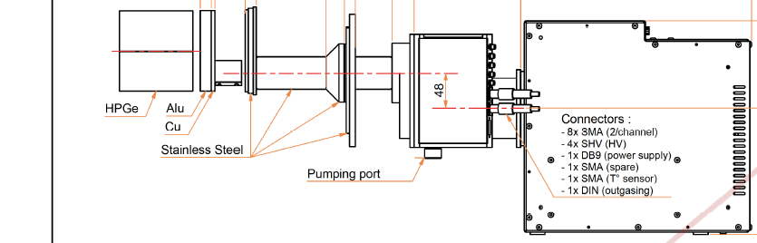
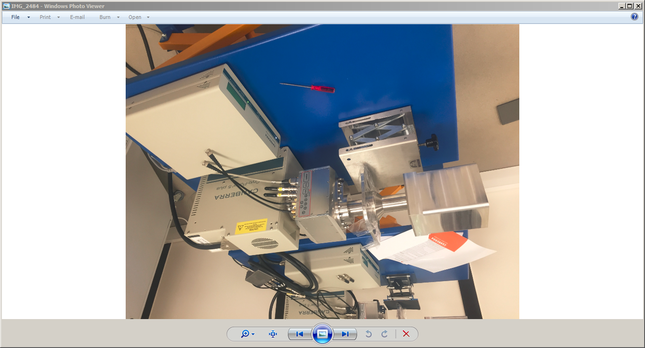
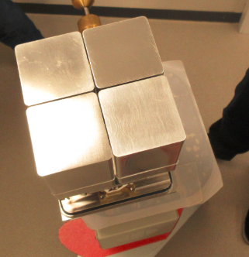
COMPEX Germanium Detector Modules
“cubic” shape
encapsulated
cryocooler
0.8 keV / 1.9 keV
A. Såmark-Roth, D.M. Cox, J. Eberth et al., Eur. Phys. J. A 56, 141 (2020)
D. Rudolph, Lund University Nucleus-Nucleus Collisions, Whistler, Canada, August 2024

Slide 36
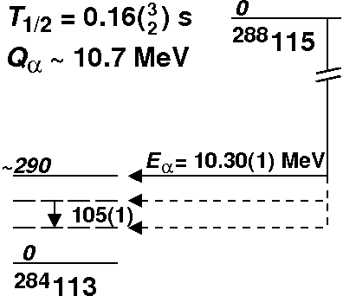
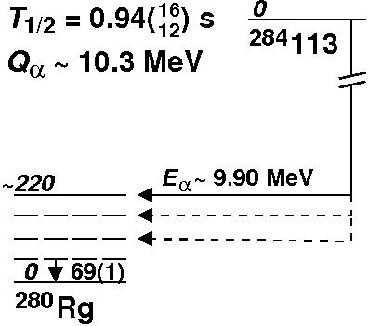
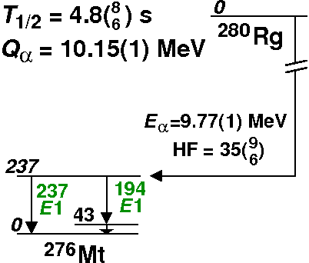
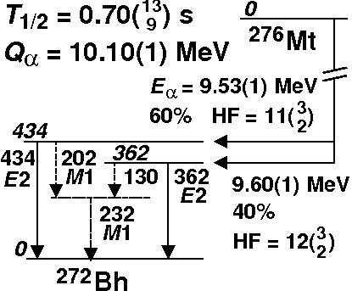
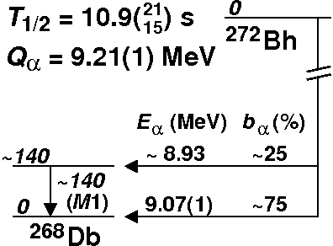
E115 – “Summary & Conclusions”
Open the modern spectroscopy toolbox …
fully pixelized Si detector system
complement with Ge array for photons
employ “digital” sampling electronics
cross-check with Geant4 simulations:
virtual experiment to ensure
self-consistency of
physics observations
~100 chains
Dubna, GSI, LBNL
²⁸⁸Mc
10.7(1) MeV
0.16(2) s
²⁸⁴Nh
0.92
10.2(1) MeV
0.93( ) s
²⁸⁰Rg
11
9
10.15(1) MeV
4.4( ) s
γ 237, …
E1 theory discussion:
Yue Shi et al., PRC 90, 014308 (2014)
D. Rudolph, JPS Conf. Proc 6, 010026 (2015)
²⁷⁶Mt
5
4
10.10(1) MeV
0.68( ) s
γ 362, …
²⁷²Bh
9
7
[Yu.Ts. Oganessian et al., PRC 87, 014302 (2013)]
D. Rudolph et al., PRL 111, 112502 (2013)
J.M. Gates et al., PRC 92, 021301(R) (2015)
[Yu.Ts. Oganessian et al., PRC 106, L031301 (2022)]
[Yu.Ts. Oganessian et al., PRC 106, 064306 (2022)]
9.21(1) MeV
10.5( ) s
²⁶⁸Db
15
11
27(3) h
+55 chains:
+55 chains:
D. Rudolph, Lund University Nucleus-Nucleus Collisions, Whistler, Canada, August 2024

Slide 37
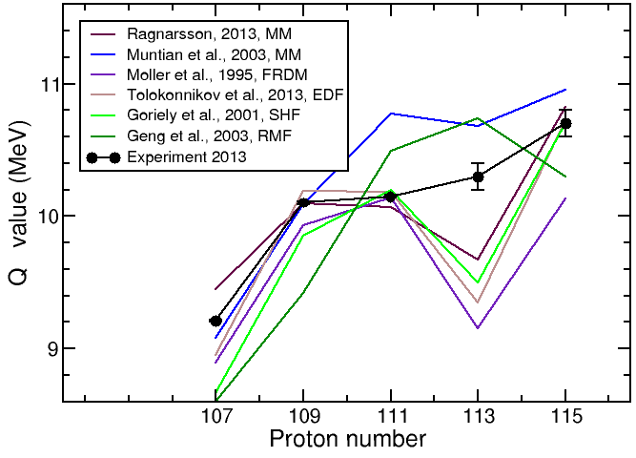
Q_{α} – values ²⁸⁸Mc Chain
Z=114 gap!?
?
β₂ ~ 0.2
α
D. Rudolph, Lund University Nucleus-Nucleus Collisions, Whistler, Canada, August 2024

Slide 38
Nuclear Structure Theory ²⁸⁹Mc-²⁸⁵Nh-²⁸¹Rg
macroscopic microscopic #1
macroscopic microscopic #2
Generalized, i.e. model independent
PATTERN predicted/expected:
ALL hitherto observed decay chains starting
from odd-A ISOTOPES of Fl, Mc, Lv, and Ts
(Z = 114 - 117) should reveal at least
TWO INDEPENDENT DECAY CHAINS!
(like in most other regions on the chart of nuclides)
Where are they ?
Energy (MeV)
[606]13/2
[615]11/2
I. Ragnarsson et al.
Energy (MeV)
A. Sobiczewski et al.
[503]7/2
It is not about which model fits best:
Pattern recognition!
Two separate α–decay sequences,
high-Ω π = + and low-Ω π = –
[606]13/2
α₊
[521]1/2
[505]9/2
α₊
[615]11/2
[510]1/2
0.4
0.2
0.0
[510]1/2
[624]9/2
[521]1/2
0.4
0.2
0.0
[510]1/2
α₊
[503]7/2
[512]5/2
[512]5/2
α₋
[615]11/2
[550]1/2
[512]3/2
[512]3/2
[615]11/2
[606]13/2
[503]7/2
[505]9/2
[503]7/2
α₋
[512]3/2
α₋
[510]1/2
α₋
[521]1/2
[521]1/2
[606]13/2
[503]7/2
[541]1/2
[512]3/2
[615]11/2
α₊
[606]13/2
ß₂ 0.067 0.132 0.147
ε₂ 0.057 0.045 0.082
energy density functional UNEDF1
energy density functional UNEDF1^{SO}
Energy (MeV)
Yue Shi et al.
Energy (MeV)
[615]11/2
[521]1/2
α₊
α₊
[550]1/2
Insufficient data?
(Over)simplified interpretation?
[521]1/2
0.4
0.2
0.0
[550]1/2
0.4
0.2
0.0
[505]9/2
[510]1/2
[615]11/2
[505]9/2
[615]11/2
α₊
[510]1/2
[503]7/2
[510]1/2
[505]9/2
α₋
[606]13/2
[510]1/2
[510]1/2
[615]11/2
[505]9/2
α₋
[550]1/2
α₋
[512]3/2
α₋
[512]3/2
[512]3/2
[512]3/2
[503]7/2
[512]3/2
[503]7/2
[510]1/2
α₊
[615]11/2
[550]1/2
[512]3/2
ß₂ 0.12 0.15 0.19
ß₂ 0.08 0.13-0.15 0.20
D. Rudolph, Lund University Nucleus-Nucleus Collisions, Whistler, Canada, August 2024

Slide 39
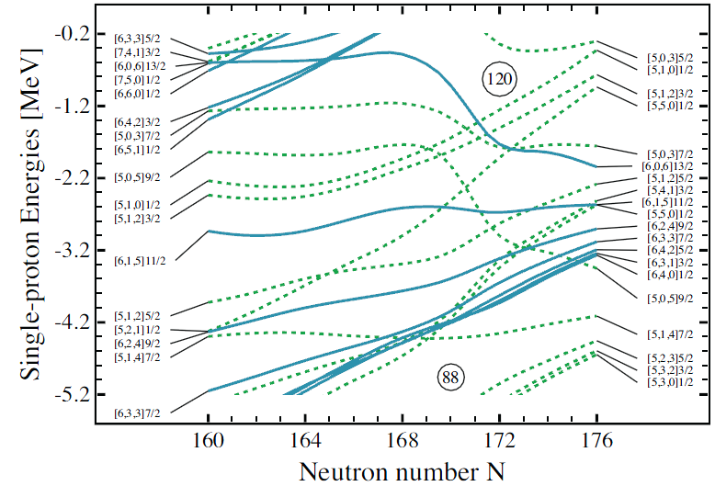
EDF Single-particle Diagrams
UNEDF1^{SO}
The [615]11/2⁺ orbital is bathing in a
sea of NEGAtive-parity orbitals!
L
116
114
110
108
105 115
Fermi surface
Yue Shi et al., PRC 90, 014308 (2014)
D. Rudolph, Lund University Nucleus-Nucleus Collisions, Whistler, Canada, August 2024

Slide 40
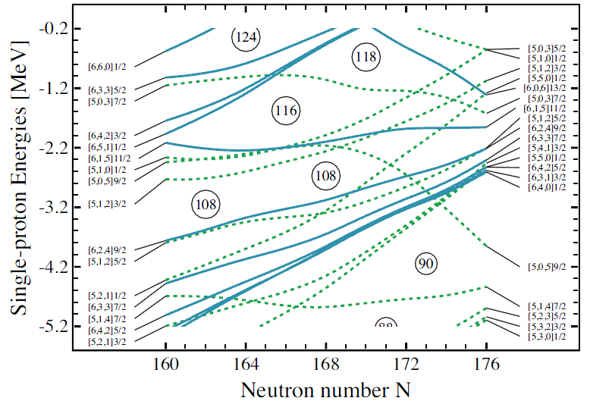
EDF Single-particle Diagrams
UNEDF1
The [615]11/2⁺ orbital is bathing in a
sea of NEGAtive-parity orbitals!
L
105 115
Fermi surface
Yue Shi et al., PRC 90, 014308 (2014)
D. Rudolph, Lund University Nucleus-Nucleus Collisions, Whistler, Canada, August 2024

Slide 41

Fusion-evaporation Reminder
increase beam energy
odd-mass
residue
Excitation energy
Change in observed yield of α₁ (= chain 1)
and α₂ (= chain 2) as function of beam energy
does not necessarily imply a
change of isotope (i.e. mass number, A) !
particle (neutron) evaporation
statistical γ-rays
particle (neutron) evaporation
statistical γ-rays
yrast line
low-j ; low-Ω
high-j ; high-Ω
α₂
Angular momentum
α₁
Note: some aspects simplified.
D. Rudolph, Lund University Nucleus-Nucleus Collisions, Whistler, Canada, August 2024

Slide 42
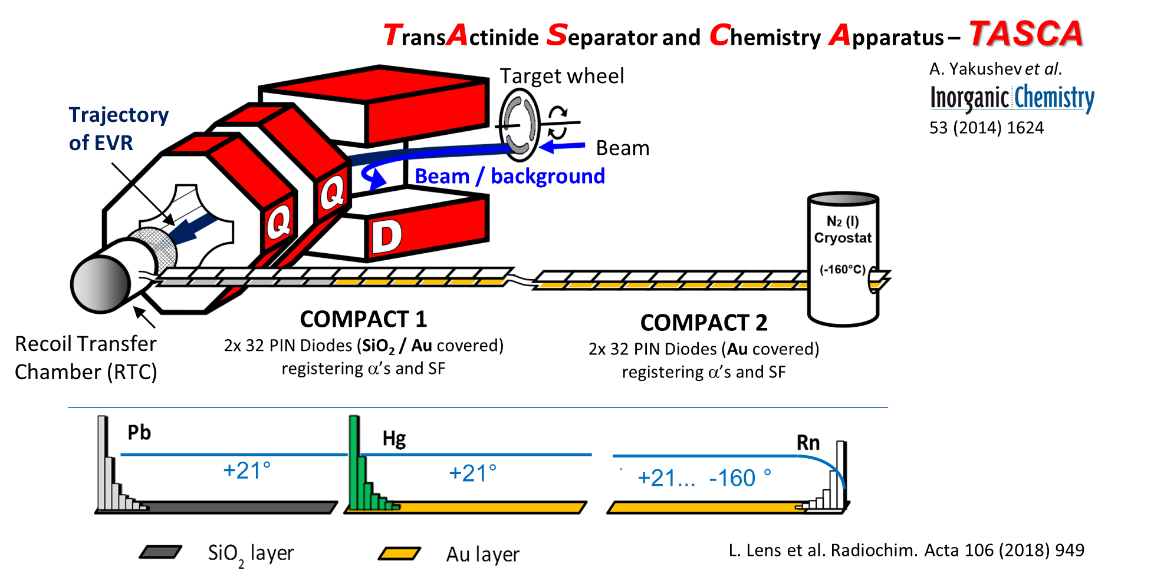
Flerovium (Element 114) Chemistry at TASCA
Nihonium and Moscovium chemistry is ”in the making”
Interaction of Fl with an inhomogeneous Au surface, A. Yakushev et al., Front. Chem. 10, 976635 (2022)
D. Rudolph, Lund University Nucleus-Nucleus Collisions, Whistler, Canada, August 2024

