Slide 1
Decay Properties of the
New Isotope ²⁵⁵Db
Jennifer L. Pore
Nuclear Science Division – Heavy Elements
Lawrence Berkeley National Laboratory
NN 2024

Slide 2

Discovery of New SHE Isotopes
What are the decay properties?
What is the half-life?
What is the decay mode?
How do these compare to neighboring isotopes?
Critical Benchmarks for Theory

Slide 3
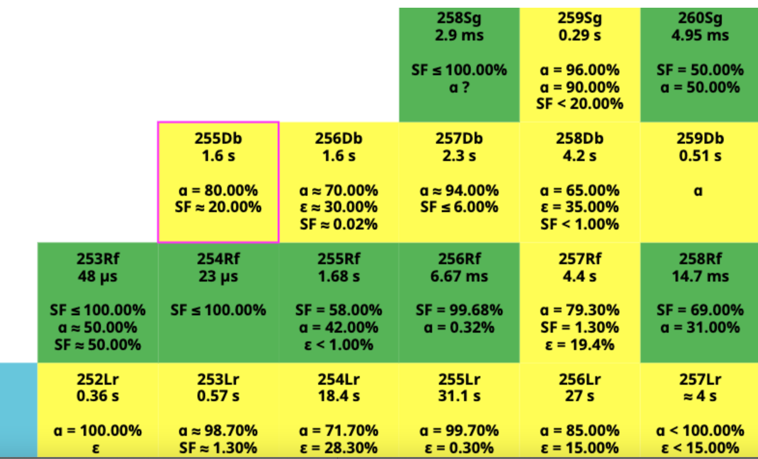
Neutron-Deficient Db Isotopes
Neutron-Deficient Db Isotopes

Slide 4
Previous Reports of ²⁵⁵Db
Previous Reports of ²⁵⁵Db
Two Previous Reports of ²⁵⁵Db
1976 JINR measurement
  1.6 s alpha decay
2005 University of Jyvaskyla Thesis
  37 ms 9.5 MeV alpha decay
  27 ms fission
  1.G.N. Flerov, JINR-E7-10128, (1976).
  2. A.-P. Lepp ̈anen, PhD Thesis, University of Jyv ̈askyl ̈a (Finland) Research Report No. 5/2005 (2005).

Slide 5
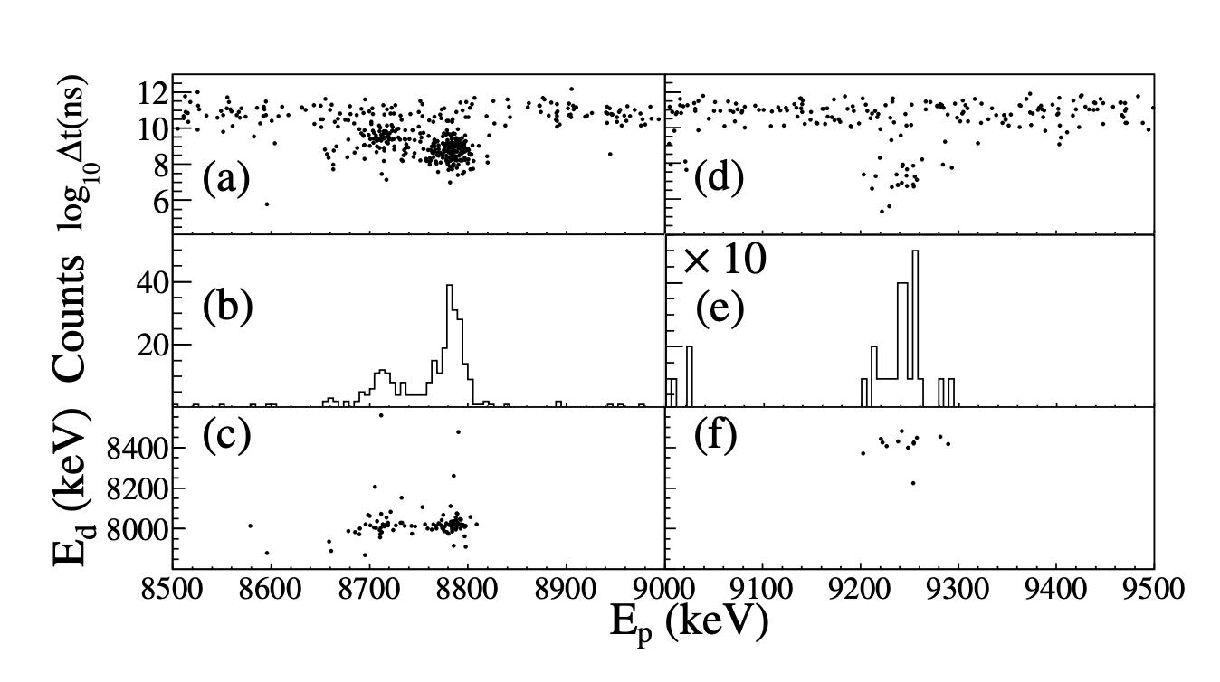
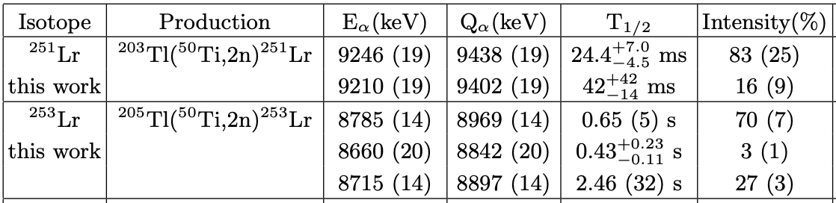
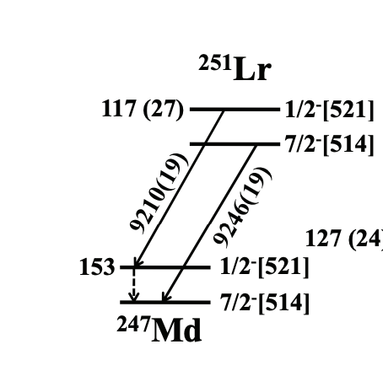
Daughter Isotope ²⁵¹Lr Discovered!
²⁵³Lr
²⁵¹Lr
²⁰³Tl(⁵⁰Ti, 2n)²⁵¹Lr
²⁵⁵Db
⍺
²⁵¹Lr
T. Huang et al., Phys. Rev. C 106, L061301 (2022).

Slide 6
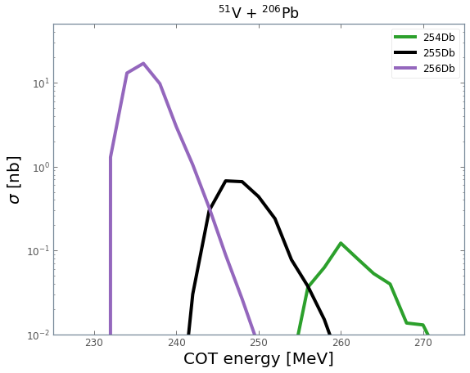
Production of Dubnium Isotopes
Compound Nucleus
Evaporation Residues
-1n
Observed Previously
⁵¹₂₃V₂₈
²⁰⁶₈₂Pb₁₂₄
²⁵⁷₁₀₅Db₁₅₂
²⁵⁶Db
²⁵⁶Db
HIVAP
Calculation
-2n
Not Confirmed
²⁵⁵Db
²⁵⁵Db
²⁵⁴Db
Scanned in Energy: 239 MeV – 251 MeV

Slide 7
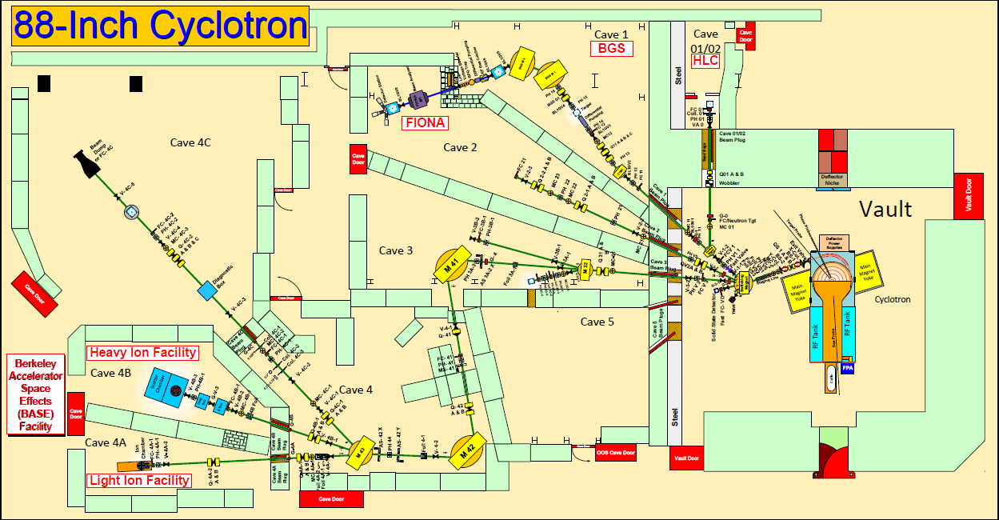

Slide 8
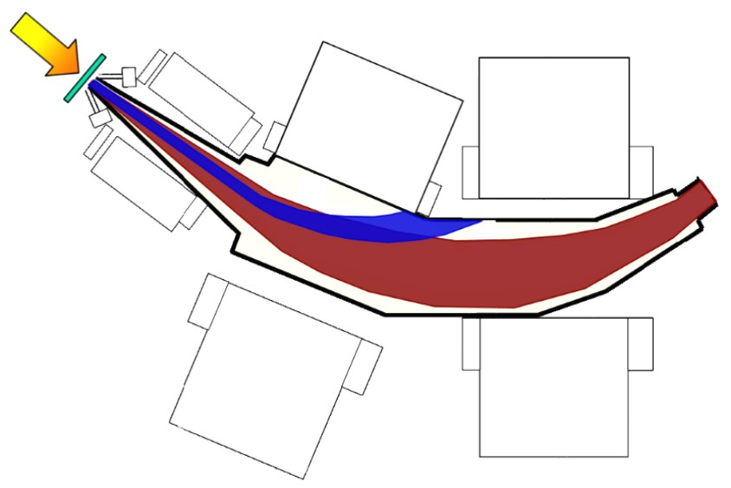
Berkeley Gas-filled Separator (BGS)
Beam
Target
DSSD
detector
Q1
Beam + Everything Else
Advantages of the BGS:
  High-transmission efficiency
  Large suppression of beam and unwanted reaction products
M1
Gradient-field
Dipole
M2
Flat-field
Dipole
8

Slide 9
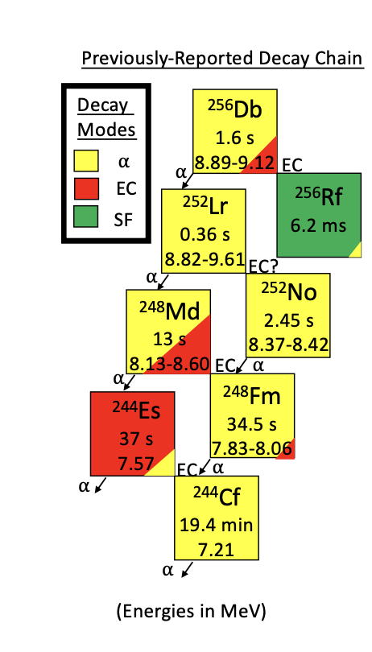
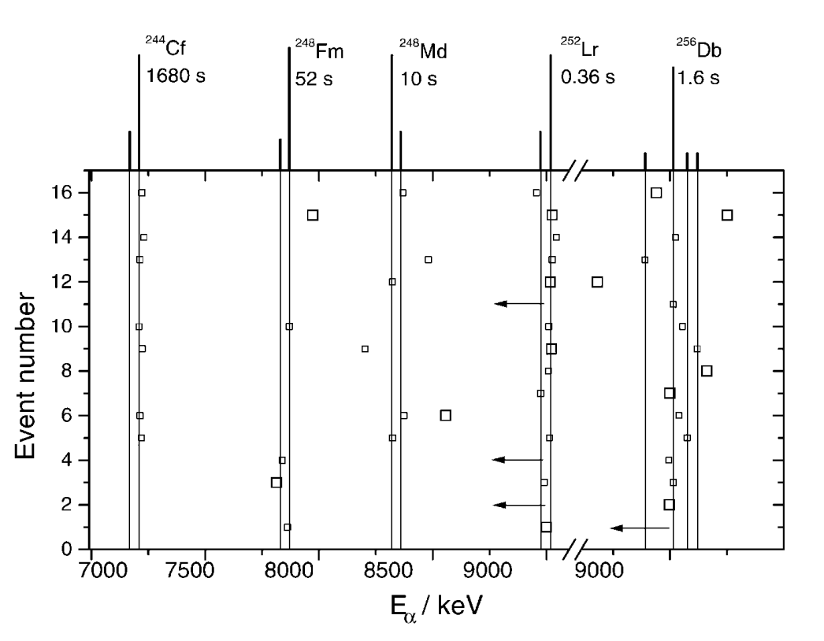
Previous Measurements of ²⁵⁶Db
²⁰⁹Bi(⁵⁰Ti, 2n)²⁵⁶Db
Observed 16 ⍺ correlations
Observed 9 SF events
F. P. Heßberger et al., Eur. Phys. J. A 12, 57–67 (2001).

Slide 10
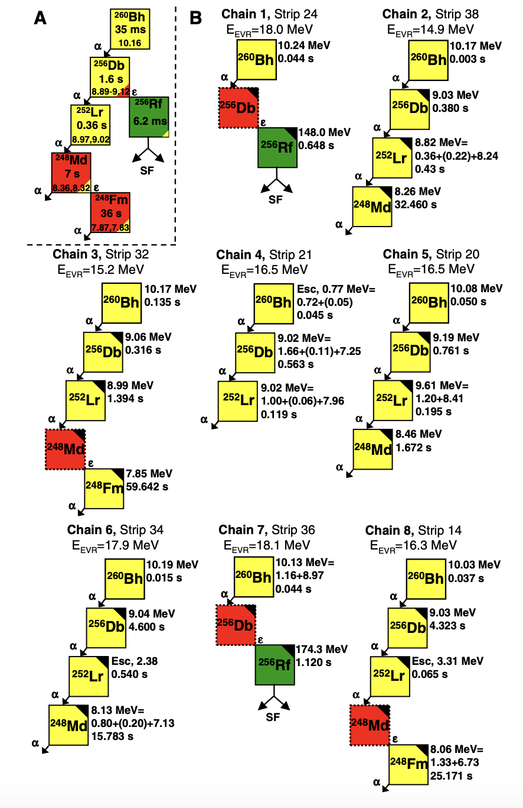
Previous Measurements of ²⁵⁶Db
²⁰⁹Bi(⁵²Cr, 1n)²⁶⁰Bh
Observed 7 ⍺ correlations
Observed 2 SF events
S.L, Nelson et al., PRL 100, 022501 (2008).

Slide 11
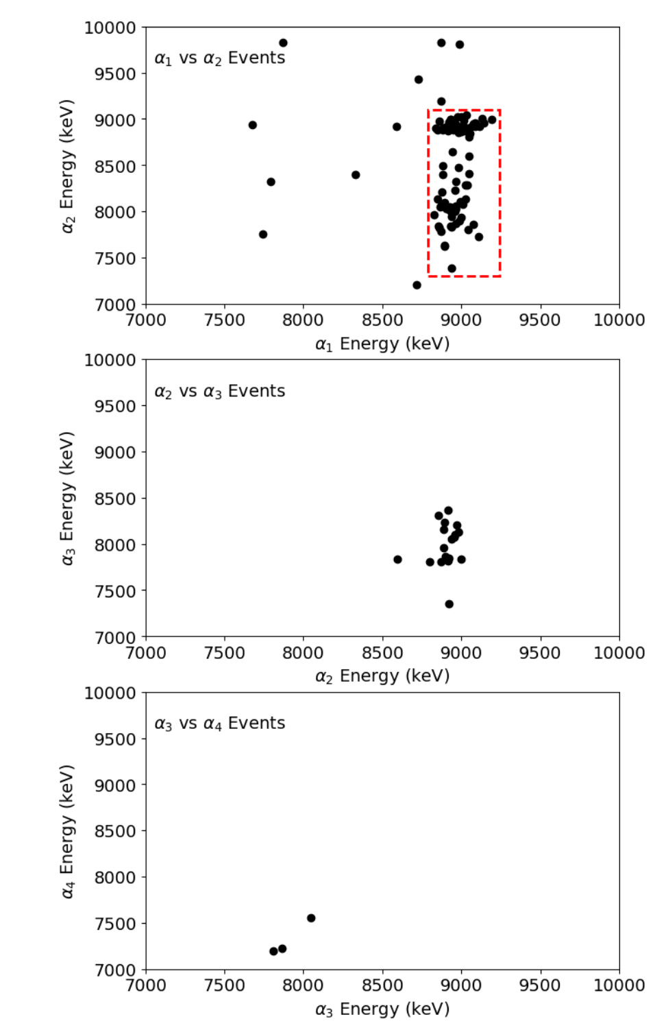
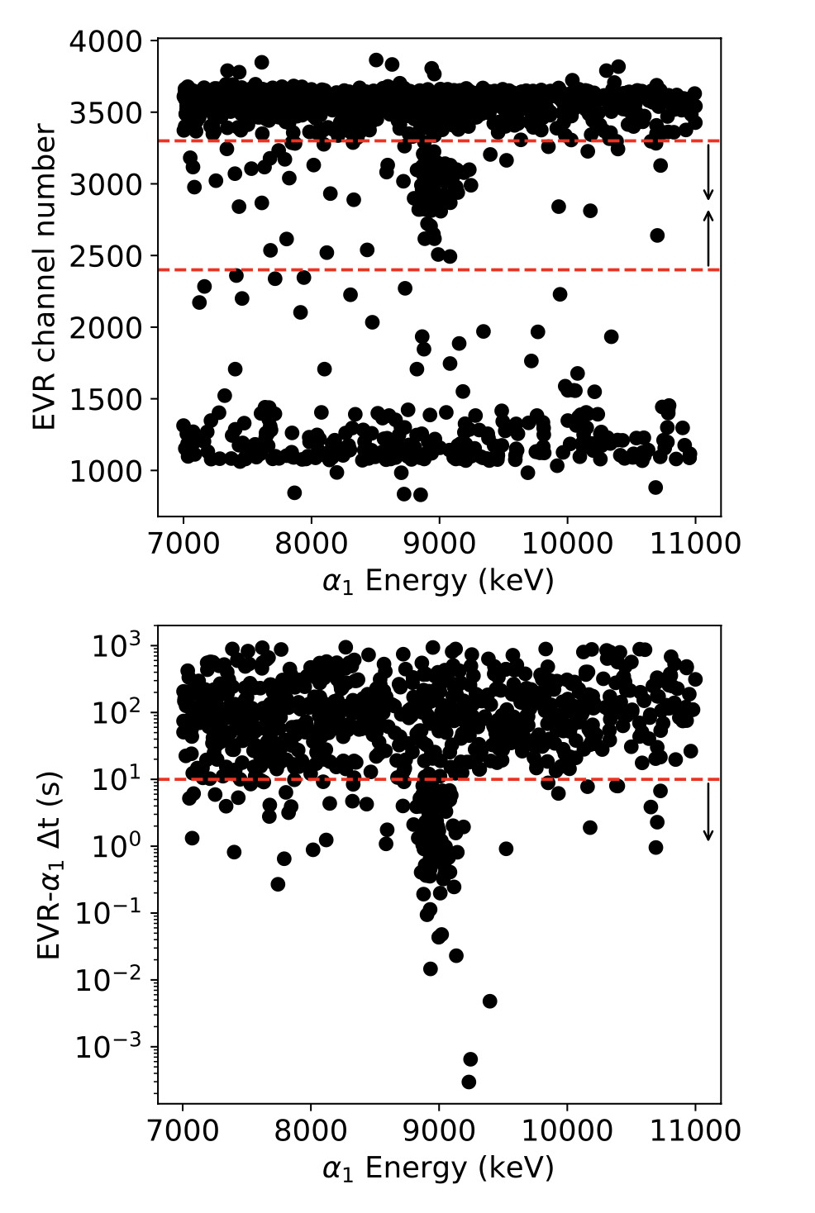
Measurement of ²⁵⁶Db with BGS
²⁰⁶Pb(⁵¹V, 1n)²⁵⁶Db
~12 days of data
85 Correlations
EVR Gates
EVR-alpha
Gate

Slide 12
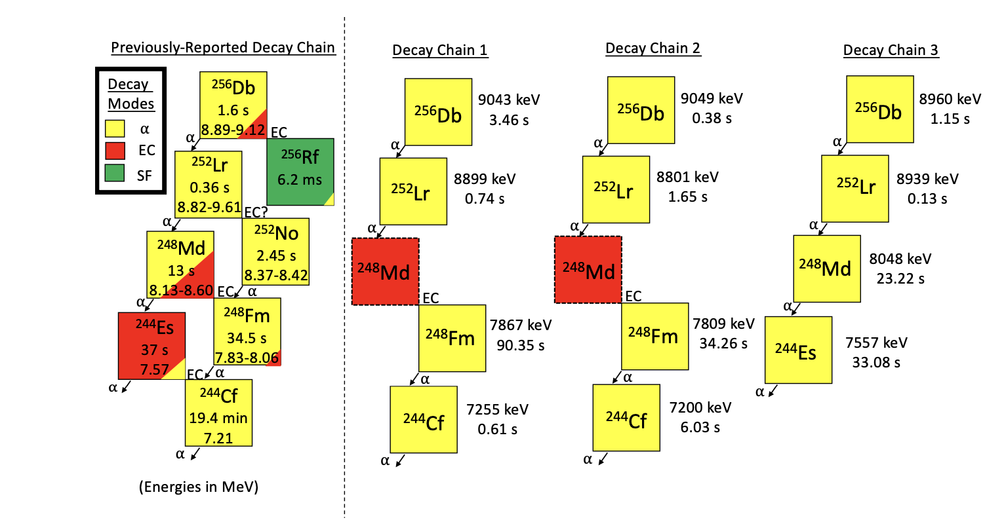
²⁵⁶Db: Four alpha Correlations

Slide 13
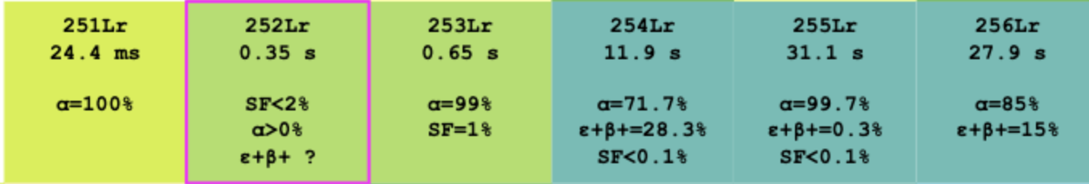
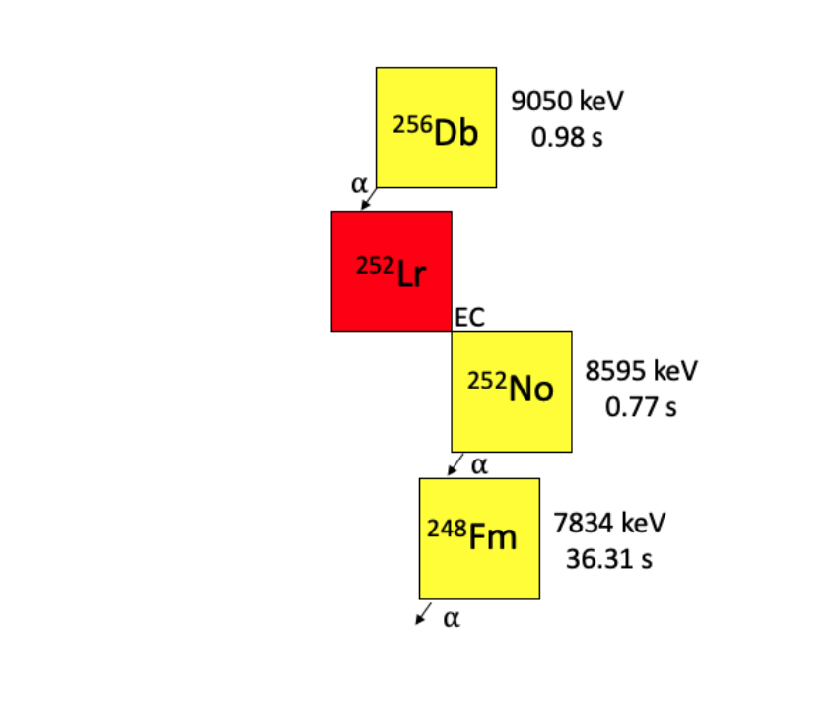
EC of ²⁵²Lr?
Observation of ²⁵²Lr EC Decay
Decay branch on the order of 10 – 30%

Slide 14
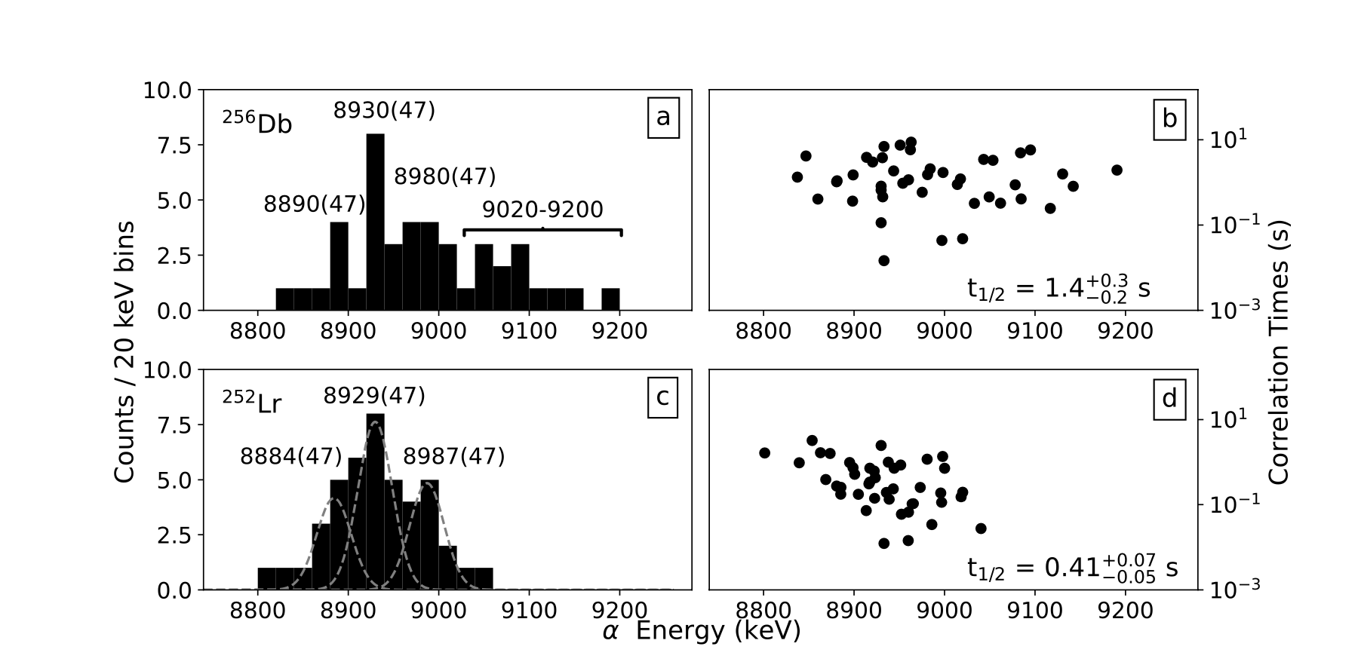
²⁵⁶Db and ²⁵²Lr Events

Slide 15
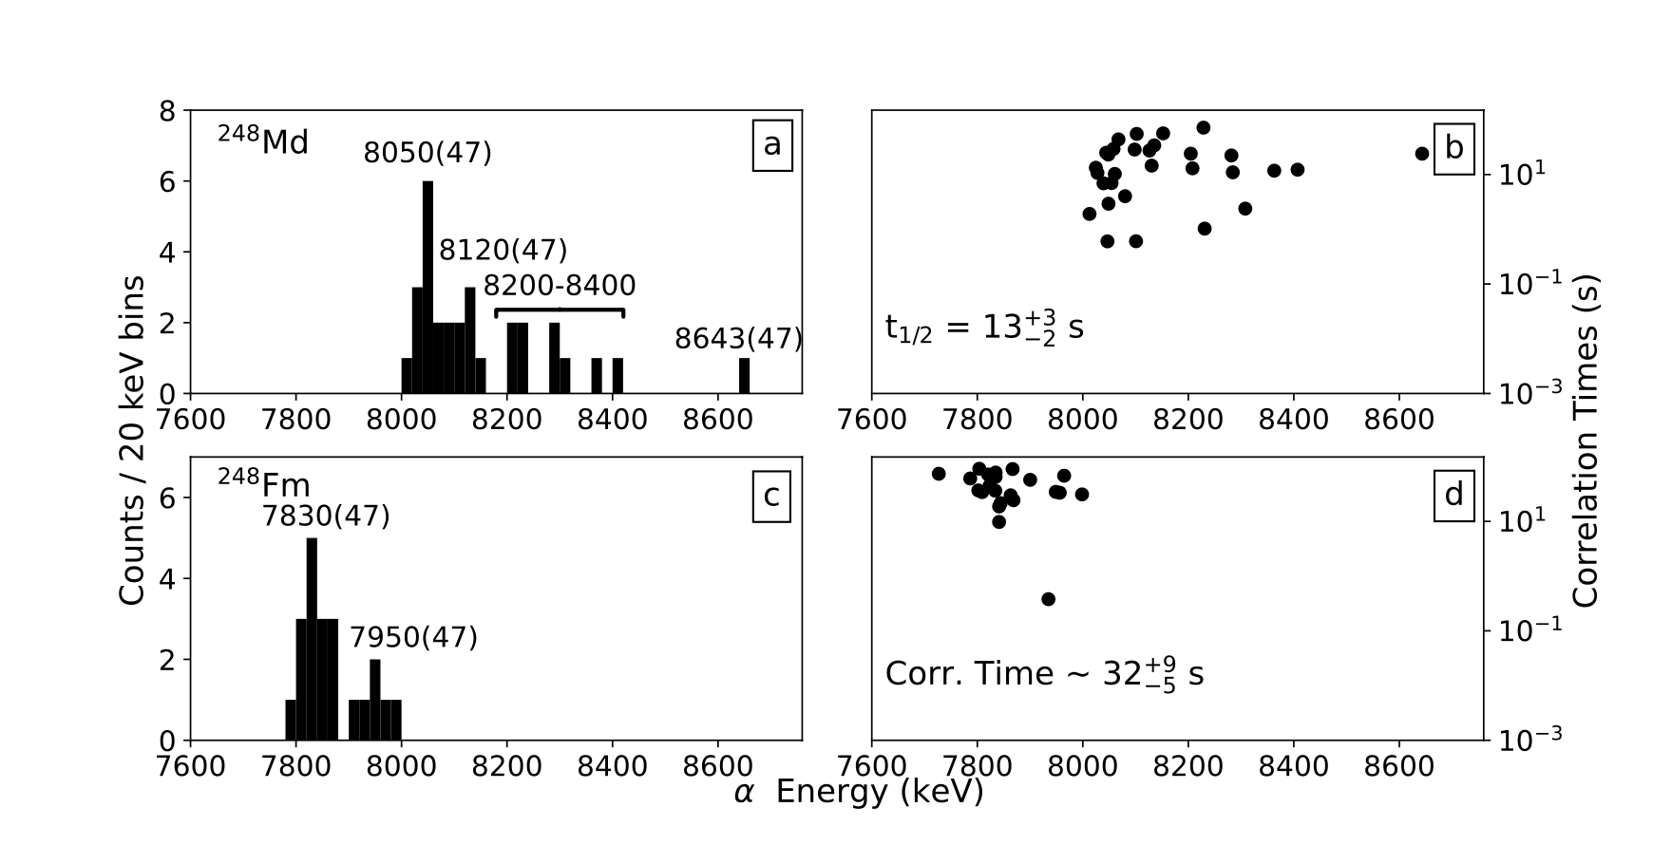
²⁴⁸Md and ²⁴⁸Fm Events

Slide 16
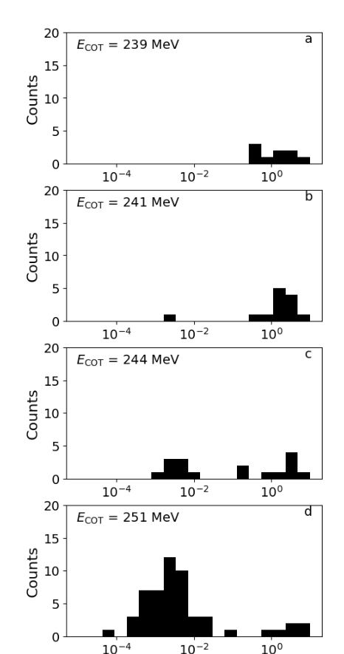
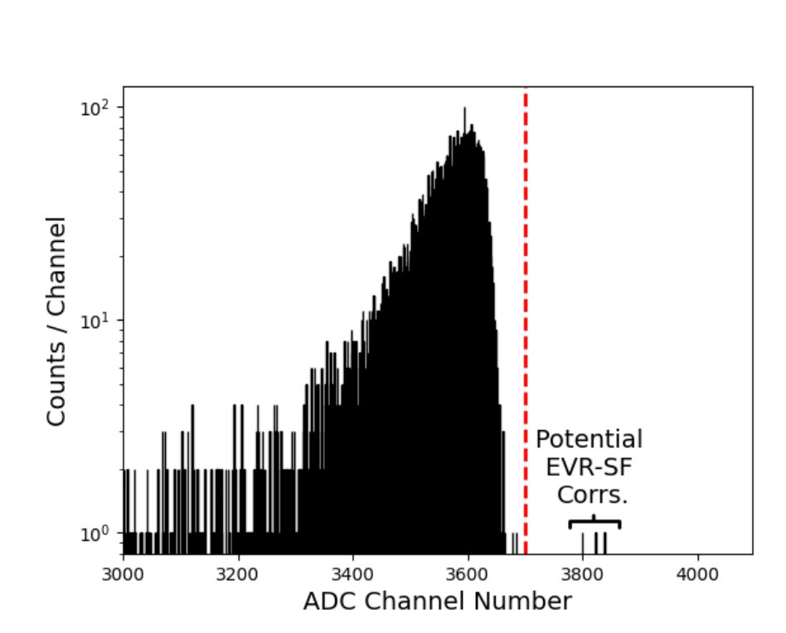
Identifying SF events

Slide 17
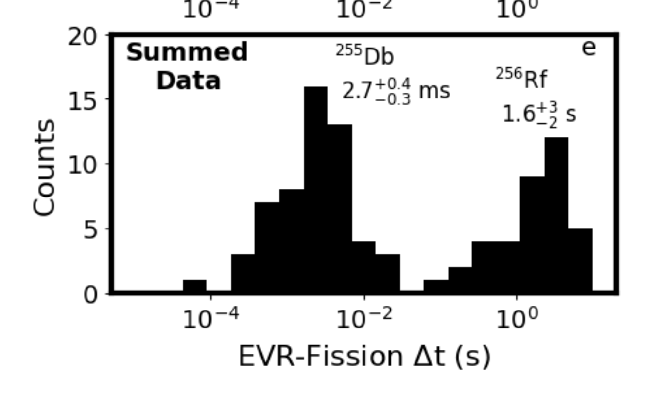
Identifying SF events
Primarily at High Beam energies (2n, ²⁵⁵Db)?
Primarily at Low Beam energies (1n, ²⁵⁶Db)

Slide 18
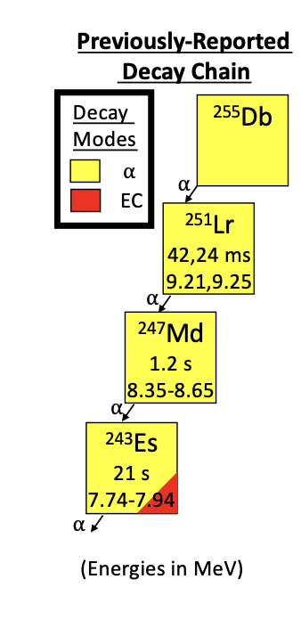
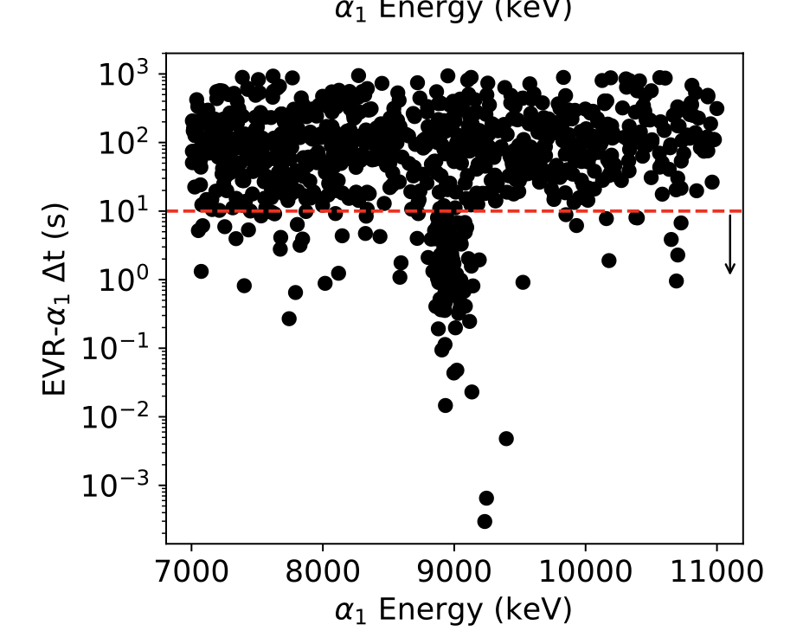
Identifying ²⁵⁵Db alpha events
²⁵⁶Db
²⁵⁵Db
EVR-alpha correlations
²⁵⁶Db
²⁵⁵Db

Slide 19
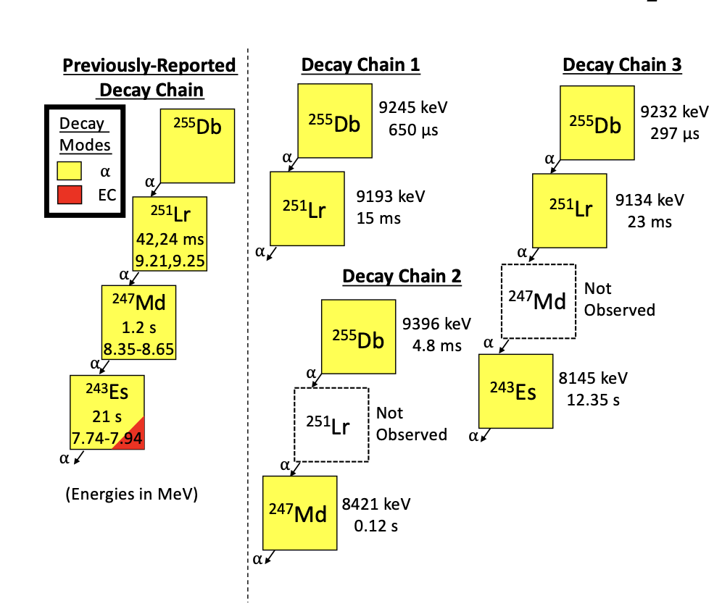
Identifying ²⁵⁵Db events
(tentative)

Slide 20
²⁵⁵Db Decay Properties
²⁵⁵Db
2.6 ms
SF ~ 92%
⍺ ~ 8%
(tentative)

Slide 21
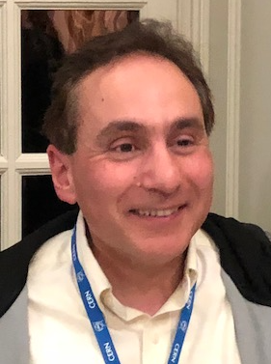
Comparing Decay Properties
²⁵⁵Db
2.6 ms
SF ~ 92%
⍺ ~ 8%
²⁵⁶Db
1.6 s
SF ~ 0.02%
⍺ ~ 70%
²⁵⁷Db
2.3 s
SF ~ 6%
⍺ ~ 94%
²⁵⁸Db
4.2 s
SF <1%
⍺ ~ 65 %
²⁵⁹Db
0.51 s
Previous Calculations:
SF t_{1/2} = 9.1x10⁻⁸ s to 23 s
⍺ t_{1/2} = 76 ms to 1.014 s
Both ⍺ and SF have been predicted as the primary decay mode
Reproduction of these decay properties will serve as an important theoretical benchmark
Calculation: Wentzel-Kramers-Brillouin (WKB) approximation was adopted within a self-consistent microscopic framework
In this approach, the produced SF half-life relies on calculations of the potential energy and collective mass consistently from nucleons and an effective interaction between them.
Theoretical t_{1/2} = 2.6 ms
This result is “very promising”, but calculation is very sensitive
Planning on continuing these calculations along the Db isotopic chain
Walid Younes
(LLNL/LBNL)
21

Slide 22
⁵¹V + ²⁰⁶Pb Cross-Section
Measured Cross-Sections
Compare to:
²⁰⁹Bi(⁵⁰Ti, 3n)²⁵⁶Db
σ = 0.19 nb
²⁰⁸Pb(⁵¹V, 1-2n) ²⁵⁸⁻²⁵⁷Db
σ ~ 2 nb
²⁵⁶Db (1n),
σ = 0.31 nb
²⁵⁵Db (2n),
σ = 0.099 nb

Slide 23

Summary
We have observed the new isotope ²⁵⁵Db at LBNL with the BGS.
This isotope primarily undergoes SF.
Reproduction of these decay properties will be an important theoretical benchmark in the SHE region.

Slide 24





Collaboration
Co-authors: J.M. Gates¹, W. Younes¹, L.M. Robledo^{2, 3}, R. Orford¹, F.H. Garcia¹, H.L. Crawford¹, P. Fallon¹, J.A. Gooding^{5,1} M. Kireeff Covo¹, M. McCarthy^{4,5}, and M.A. Stoyer^{1,6}
¹Nuclear Science Division, Lawrence Berkeley National Laboratory, Berkeley, CA 94720, USA
²Departamento de F ́ısica Teo ́rica and CIAFF, Universidad Auto ́noma de Madrid, E-28049 Madrid, Spain
³Center for Computational Simulation, Universidad Polit ́ecnica de Madrid, Campus de Montegancedo, Bohadilla del Monte, E-28660-Madrid, Spain
⁴Department of Nuclear Engineering, University of California Berkeley, Berkeley, CA 94720, USA
⁵Chemical Sciences Division, Lawrence Berkeley National Laboratory, Berkeley, CA 94720, USA
⁶Lawrence Livermore National Laboratory, Livermore CA 94550, USA
We gratefully acknowledge the operations staff of the 88-Inch Cyclotron. This work was supported in part by the U.S. Department of Energy, Office of Science, Offices of Nuclear Physics and Basic Energy Sciences under the contract No. DE-AC02- 05CH11231 The work at Lawrence Livermore National Laboratory is performed under the auspices of the U.S. Department of Energy under Contract DE-AC52- 07NA27344. The work of LMR is supported by Spanish Agencia Estatal de Investigacion (AEI) of the Ministry of Science and Innovation under Grant No. PID2021- 127890NB-I00.

