Slide 1


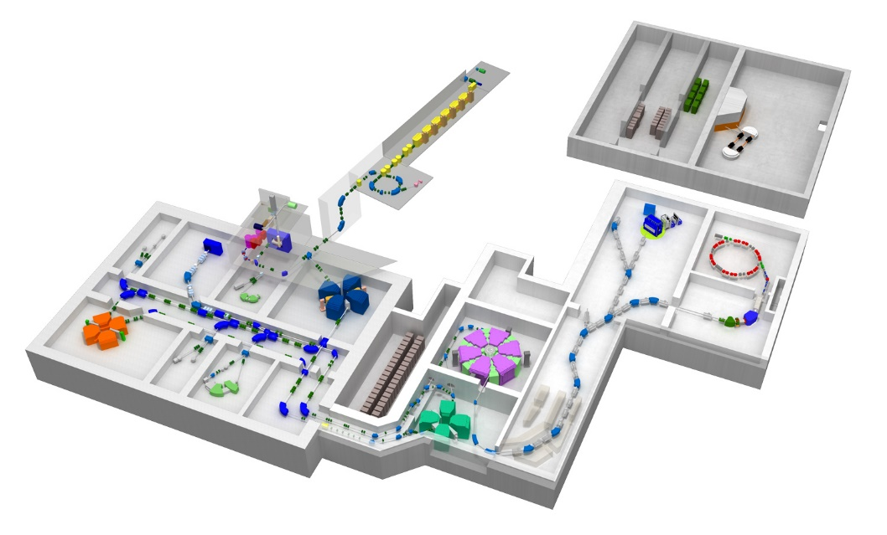
Neutron dripline search for fluorine, neon and sodium and the discovery of ³⁹Na
NN2024
Conducted at RIKEN RIBF using the BigRIPS separator
Toshiyuki Kubo, RIKEN Nishina Center
for the RIKEN RIBF new isotope collaboration
Layout of RIBF
BigRIPS separator:
characterized by
large acceptances & two-stage scheme
Invited talk presented on Aug. 20 at the NN2024 conference held Aug. 18th – 23rd, 2024,Whistler, BC, Canada
Notes:
Thank you very much chairman for the introduction.
First of all, I would like to thank the organizer for inviting me to this conference.
Today I would like to tell about neutron dripline search for fluorine, neon and sodium and the discovery of ³⁹Na, which were conducted separator at RIKEN RIBF using the BigRIPS separator.
This is the layout of RIBF and you see the BigRIPS separator here, which is characterized by large acceptances and two-stage scheme.
.

Slide 2
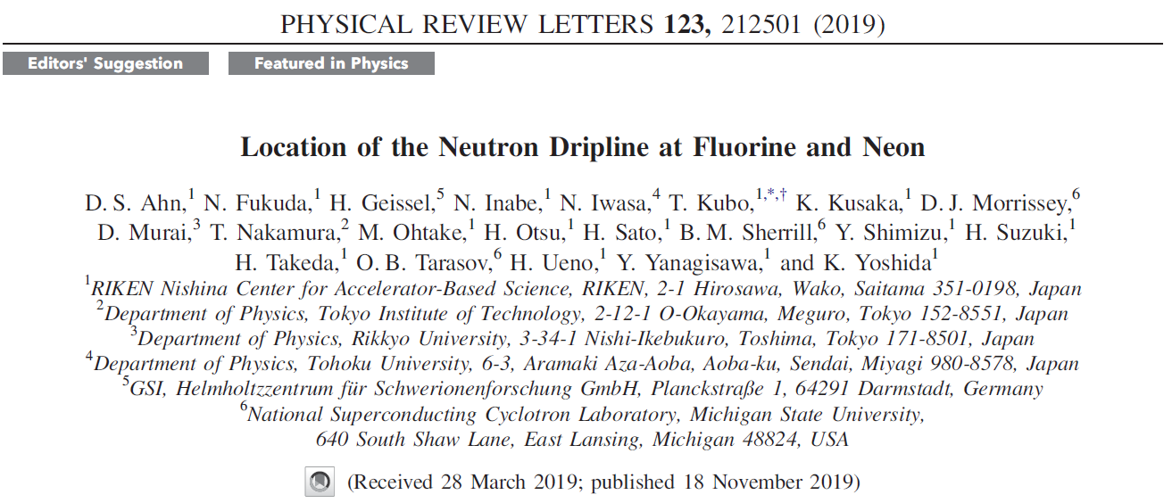
The present work was published in these two papers.
(Viewpoint)
Authors are given in alphabetic order.
(Viewpoint)
2
Notes:
This slide is to remind you that the present work was published in these two PRL papers.

Slide 3
Outline of the present work
We conducted search for extremely neutron-rich new isotopes ^{32,33}F, ^{35,36}Ne and ^{38,39}Na that are located beyond the A = 3Z + 4 line as shown below.
We performed the experiment two times.
In the first experiment, we determined the neutron dripline for F and Ne to be ³¹F and ³⁴Ne, respectively.
In the second experiment, we discovered an extremely neutron-rich isotope ³⁹Na with N = 28 and established its particle stability.
We discussed underlying nuclear structure, such as magicity loss at N = 28 and associated nuclear deformation. Nuclear binding near the limit of existence is determined reflecting details of underlying nuclear structure.
A = 3Z + 6
A = 3Z + 4
Notes:
This slide shows the outline of present work.
We conducted search for extremely neutron-rich new isotopes ^{32,33}F, ^{35,36}Ne and ^{38,39}Na that are located beyond the A = 3Z + 4 line as shown in this chart.
We performed the experiment two times.
In the first experiment, we determined the neutron dripline for F and Ne to be ³¹F and ³⁴Ne, respectively.
In the second experiment, we discovered an extremely neutron-rich isotope ³⁹Na with N = 28 and established its particle stability.
We discussed underlying nuclear structure, such as magicity loss at N = 28 and associated nuclear deformation. Nuclear binding near the limit of existence is determined reflecting details of underlying nuclear structure.

Slide 4
Outline of my talk
Introduction
Neutron dripline before present work
Known nuclear structure in this region
Experimental method
PID and background removal
Determination of the neutron dripline for F and Ne *
First experiment
Discovery of ³⁹Na **
Second experiment
Discussion on underlying nuclear structure
Magicilty loss and nuclear deformation
Summary
* Phys. Rev. Lett. 123, 212501 (2019)
** Phys. Rev. Lett. 129, 212502 (2022)
Notes:
This shows the outline of my talk.
In the introduction I will overview neutron dripline before present work and known nuclear structure in this region.
Then I will talk about the experimental method, focusing on PID and background removal.
And then the determination of the neutron dripline for F and Ne, the discovery of ³⁹Na, and the discussion on the underlying nuclear structure.
And finally I will summarize my talk.

Slide 5
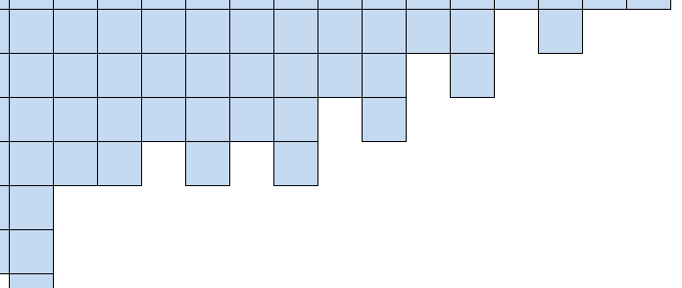
Situations of the neutron dripline before this work
Known isotopes were up to ³¹F, ³⁴Ne, ³⁷Na, and ⁴⁰Mg, all having A = 3Z + 4.
Neutron dripline was determined only up to oxygen (Z = 8), which is ²⁴O established in 1999.
New isotopes beyond the A = 3Z + 4 line were not searched last 20 years for F to Na and their dripline was not known.
A=3Z+4
Z =
12
³⁸Mg
⁴⁰Mg
11
³⁵Na
³⁷Na
N=28
2007
NSCL-A1900
10
³²Ne
³⁴Ne
2002
RIKEN-RIPS
9
²⁷F
²⁹F
³¹F
2002
RIKEN-RIPS
8
²⁴O
²⁶O
²⁸O
Observed in 1999
Known bound isotopes
7
²³N
N=20
RIKEN-RIPS
Mass model predictions
FRDM
KTUY05
HFB-24
Observed in 1970
Dripline established in 1999
Dubna
N=16
GANIL-LISE, RIKEN-RIPS
Notes:
This slide reminds you of the situations of the neutron dripline before this work.
Known isotopes were up to ³¹F, ³⁴Ne, ³⁷Na, and ⁴⁰Mg, all having A = 3Z + 4.
Neutron dripline was determined only up to oxygen (Z = 8), which is ²⁴O established in 1999.
New isotopes beyond the A = 3Z + 4 line were not searched last 20 years for F to Na and their dripline was not known.

Slide 6
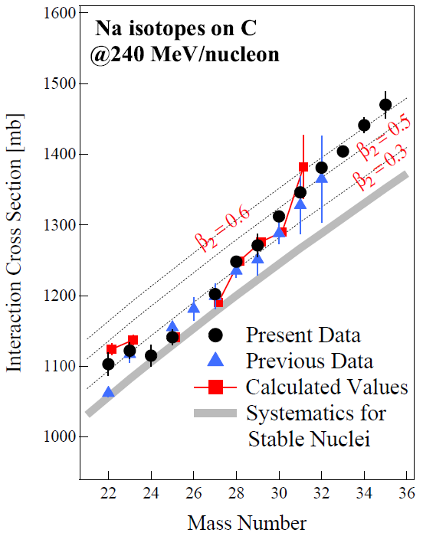
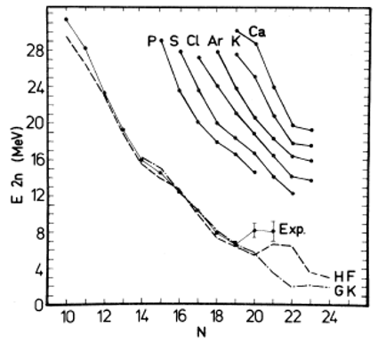
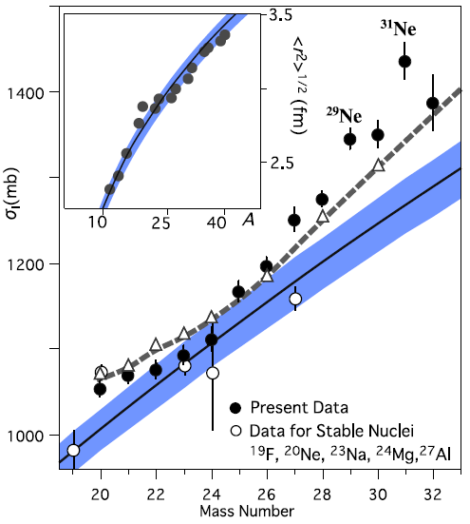
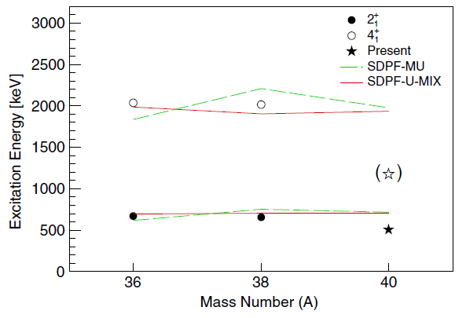
Experimental studies of nuclear structure for this region
The nuclear structure has been extensively studies by various measurements:
Mass (S_{2n}): specific behaviors for magic or deformed.
Interaction cross sections (σ_{I}): enhanced if deformation or halo exists.
In-beam γ ray spectroscopy using secondary reactions: being deformed or spherical is reflected by excitation energies of 2+, 4+ states for even-even nuclei (similarly for odd nuclei).
Cross section and momentum distribution in nucleon removal reactions: reflects existence of a deformed halo structure
Invariant mass spectroscopy
Examples
σ_{I}
S_{2n}
σ_{I}
Na
Ex of 2⁺, 4⁺
EPJ Conf.66 (2014)
Mg
Na
Ne
PRC 12, 644(1975)
PRL 122, 052501 (2019)
PLB 707, 357 (2012)
Notes:
This slides summarizes the experimental studies of nuclear structure in this region.
The nuclear structure has been extensively studies by various measurements listed here.

Slide 7
Known nuclear structure before this work
Island of Inversion (Z = 10 – 12 and N = 20 – 22) is shown below.
Deformation was experimentally confirmed for most of the isotopes (red circles).
For Mg, the deformation was confirmed for all the isotopes from ³²Mg till ⁴⁰Mg.
Magicity is lost at N = 20 and 28, causing the deformation.
The nuclear structure of ³¹F, ³⁴Ne, and ³⁷Na was not yet studied.
New magic number N = 16
Oxygen anomaly: dripline jump
Island of Inversion
⁴²Si
²⁶Mg
³²Mg
³⁸Mg
²³Na
³¹Na
³⁵Na
²²Ne
³⁰Ne
³²Ne
N = 28
¹⁹F
²⁷F
²⁹F
(lost)
¹⁸O
Dripline jump (> 6n)
N = 20
(lost)
Ground-state deformation confirmed experimentally
N = 16
(new magic)
Notes:
This slide summarizes known nuclear structure before this work.
Island of Inversion (Z = 10 – 12 and N = 20 – 22) is here.
Deformation was experimentally confirmed for most of the isotopes as indicated by red circles.
For Mg, the deformation was confirmed for all the isotopes from ³²Mg till ⁴⁰Mg.
Magicity is lost at N = 20 and 28, causing the deformation.
The nuclear structure of ³¹F, ³⁴Ne, and ³⁷Na is not yet studied.

Slide 8
Outline of my talk
Introduction
Neutron dripline before present work
Known nuclear structure in this region
Experimental method
PID and background removal
Determination of the neutron dripline for F and Ne
First experiment
Discovery of ³⁹Na
Second experiment
Discussion on underlying nuclear structure
Magicilty loss and nuclear deformation
Summary
Notes:
These are the situations before present work.
OK. Now I move on to the experimental method.

Slide 9
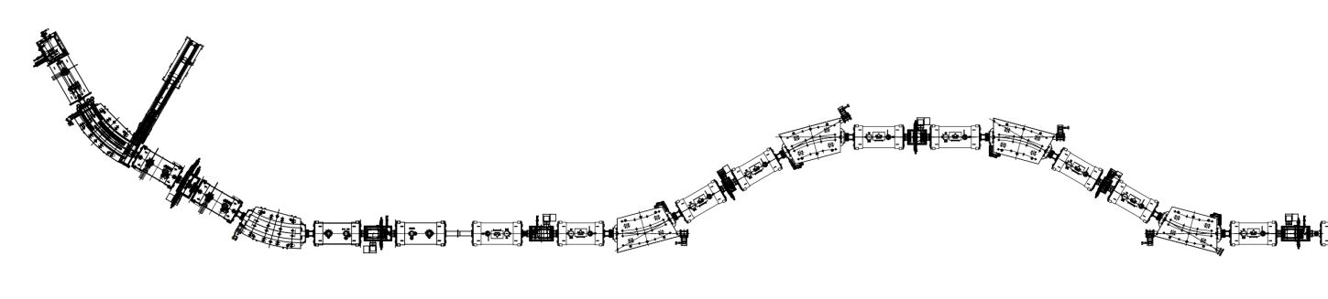
Experimental method
Isotopes were produced by projectile fragmentation of an intense ⁴⁸Ca beam at 345 MeV/u, and separated and identified in flight using the BigRIPS separator.
PID relied on TOF, Bρ and ΔE measurements through which Z and A/Z of fragments are deduced.
A background free PID was achieved by a thick collimator and detailed data analysis. It is crucial for the determination of neutron dripline.
⁴⁸Ca beam 345MeV/u, ~500 pnA
Degrader
Al 7mm
Be target 20mm
BigRIPS
TOF(β) : plastic
F0
F5
1st stage
D4
D5
D1
PPAC x2
Plastic 3mm
F2
PPAC x2
F7
Slit
F1
Slit
D2
D3
2nd stage
D6
PPAC x2
Degrader
Al 15mm
Slit
F3
Thick Fe collimator at F2
Bρ : plastic scintillator
(position measurement)
ΔE : Si (450 μm) x4
Plastic (position measurement)
Notes:
This slide shows the experimental method.
Isotopes were produced by projectile fragmentation of an intense ⁴⁸Ca beam at 345 MeV/u with about 500 pnA, and separated and identified in flight using the BigRIPS separator.
PID relied on TOF, Bρ and ΔE measurements through which Z and A/Z of fragments are deduced.
A background free PID was achieved by a thick collimator and detailed data analysis. It is crucial for the determination of neutron dripline.

Slide 10
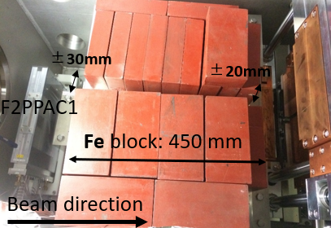
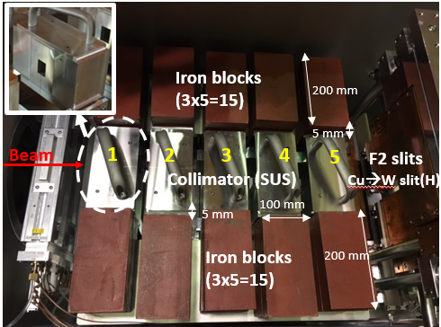
Background reduction and removal we made to achieve background free PID
We reduced light charged particle backgrounds, such as tritons, using a thick Fe collimator placed at the end of 1st stage (F2).
45 cm thick Fe collimator at F2
2nd exp. (more sophisticated)
1st exp.
We thoroughly removed inconsistent events by checking various correlation plots between detector signals in data analysis.
Examples
Examples
F5 plastic Δ(logQ) vs. ΔT
F7 Si ΔE vs. ΔΕ
Notes:
This slide shows the background reduction and removal that we made in the present experiments to achieve a background free PID.
We reduced light charged particle backgrounds, such as tritons, using a thick Fe collimator placed at the end of 1st stage.
We thoroughly removed inconsistent events by checking various correlation plots between detector signals in data analysis

Slide 11
Outline of my talk
Introduction
Neutron dripline before present work
Known nuclear structure in this region
Experimental method
PID and background removal
Determination of the neutron dripline for F and Ne
First experiment
Discovery of ³⁹Na
Second experiment
Discussion on underlying nuclear structure
Magicilty loss and nuclear deformation
Summary
Notes:
OK. Now I move on to the first experiment.

Slide 12
BigRIPS settings in the first experiment
We ran two settings.
Settings | ³³F | ³⁶Ne+³⁹Na
Tuned for | ³³F | Middle of ³⁶Ne & ³⁹Na
Beam | ⁴⁸Ca 345 MeV/u | ⁴⁸Ca 345 MeV/u
Target | Be 20 mm | Be 20 mm
Beam dump | ±125 mm | ±125 mm
Bρ before F1 | 9.385 Tm | 9.385 Tm
Bρ after F1 | 8.804 Tm | 8.721 Tm
F1 degrader | Al 15 mm 18.66 mr | Al 15 mm 18.66 mr
F5 degrader | Al 7 mm 5.969 mr | Al 7 mm 5.969 m
Δp/p | ±3% | ±3%
F2 slit | ±15mm(H) ±10mm(V) | ±15mm(H) ±10mm(V)
F7 slit | ±20 mm | ±20 mm
One is tuned for ³³F and another is tuned for the middle of ³⁶Ne and ³⁹Na.
These two settings have the same Bρ before the first dispersive focus F1.
Notes:
This slide shows the BigRIPS settings in the first experiment.
We ran two settings.
One is tuned for 33F and another is tuned for the middle of 36Ne and 39Na.
These two settings have the same Bρ before the first dispersive focus F1.

Slide 13
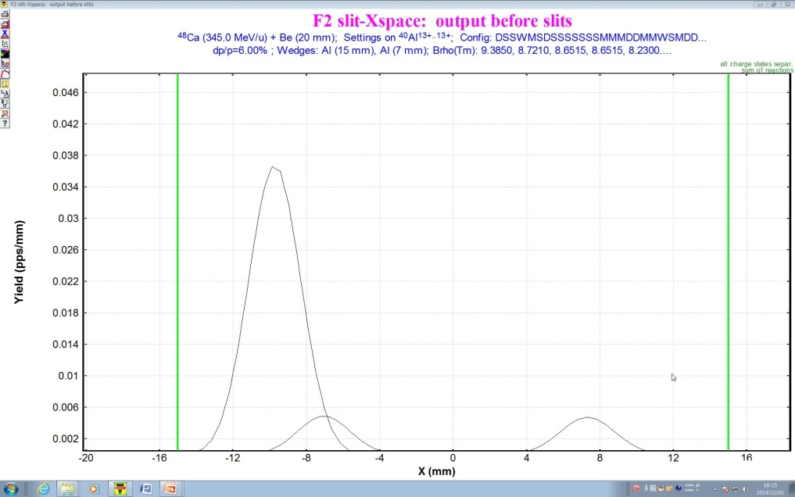
Bρ setting at F1 and isotope separation at F2
Simulated by LISE⁺⁺ code
Momentum (Bρ) distribution of ³³F, ³⁶Ne and ³⁹Na and Bρ setting at F1
Bρ₀ at D1 = 9.385 Tm
³⁹Na
Horizontal position spectrum at F2 in the ³⁶Ne+³⁹Na setting
³⁶Ne
³³F
³⁷Na -9.8mm
Beam axis
Width
Slit
Slit
± 3%
³⁶Ne -6.9mm
³⁹Na 7.0mm
Bρ₀₁ (Tm)
-15mm
X at F2 (mm)
+15mm
Good transmission is achieved for the targeted isotopes: ^{32,33}F, ^{35,36}Ne and ^{38,39}Na
From N. Inabe
Notes:
This slide shows the Brho setting at the first dispersive focus F1 and isotope separation at the achromatic focus F2 which were simulated by LISE code.
The left figure shows the Brho distribution for 33F, 36Ne and 39Na and the Brho setting at F1.
Good transmission is achieved for the targeted isotopes.
The right figure shows the horizontal position spectrum at F2 in the ³⁶Ne+³⁹Ne setting.
You see the beam axis here, and 36Ne here, 39Na here.

Slide 14
Results of the first experiment: Z vs A/Z PID plot
Very clean background free PID was achieved !
⁴⁸Ca beam intensity was as high as ~450 pnA.
³³F setting
³³F setting: 1.4×10¹⁷ ions in 14 h
No events for ³²F and ³³F!
No events for ³⁵Ne and ³⁶Ne!
c.f. ³¹F: 3938 events
³⁴Ne: 115 events
³⁶Ne + ³⁹Na setting
³⁶Ne+³⁹Na setting: 7.8×10¹⁶ ions in 7.8h
No events for ³⁵Ne and ³⁶Ne!
No events for ³⁸Na!
Amazingly 1 events for ³⁹Na!
c.f. ³⁴Ne: 4 events
³⁷Na: 363 events
Notes:
OK. This is the results of the first experiment, Z vs A/Z PID plots.
You can see very clean background free PID was achieved !
In the 33F setting we observed no events for 32F and 33F and no events for 35Ne and 36Ne.
In the ³⁶Ne+³⁹Na setting, we observed no events for 35Ne and 36Ne and no vents for 38Na.
But amazingly we observed 1 events for 39Na.

Slide 15





How we determined the neutron dripline from the non-observation of ^{32,33}F and ^{35,36}Ne
For this purpose, we evaluated the confidence level (CL) for non-existence.
The CL was calculated from the zero-event probability which was obtained using their expected yields and Poisson probability distribution as follows:
$$P(k|λ)=λ^{k}e^{−λ}/k!$$
$$P(0|λ)=e^{−λ}$$
$$CL=1−P(0|λ)$$
k = 0
Zero-event probability
Confidence level for non-existence
Poisson distribution
$λ$: expected yield
Event zero
$k$ : number of events
Systematic cross section measurements along with predictions
The expected yields of non-observed isotopes were estimated by extrapolation of cross sections.
Extrapolated!
For this purpose, we performed systematic cross section measurements and extrapolated the cross sections using the EPAX formula and the Qg systematics fit as shown in the figure.
Notes:
This slides shows how we determined the neutron dripline from the non-observation of ^{32,33}F and ^{35,36}Ne.
For this purpose, we evaluated he confidence level (CL) for non-existence.
The CL was calculated from the zero-event probability which was obtained using their expected yields and Poisson probability distribution as follows:
The expected yields of non-observed isotopes were estimated by extrapolation of cross sections.
For this purpose, we performed systematic cross section measurements and extrapolated the cross sections using the EPAX 2.15 formula and the Qg systematics fit as shown in the figure.

Slide 16

Summary of the confidence level (CL) evaluation and conclusion of the first experiment
The obtained CL values are quite high as shown below.
We concluded that the unobserved isotopes ^{32,33}F, ^{35,36}Ne and ³⁸Na are unbound with high confidences.
This allowed us to determine the neutron dripline of F and Ne to be ³¹F and ³⁴Ne, respectively.
CL (=1-P)
2.15
≈1
≈1
1 - 3x10⁻¹⁰
≈1
≈1
≈1
1 - 2x10⁻⁷
$${99.3 \% }_{−1.0\%}^{+0.4\%}$$
Improved by 2nd experiment
≈1
a ³³F setting. b Total of the ³³F and ³⁶Ne+³⁹Na settings. c ³⁶Ne+³⁹Na setting.
Notes:
This slide shows the summary of the confidence level (CL) evaluation and conclusion of the first experiment.
The obtained CL values are quite high as shown in this table.
We concluded that the unobserved isotopes ^{32,33}F, ^{35,36}Ne and ³⁸Na are unbound with high confidences.
This allowed us to determine the neutron dripline of F and Ne to be ³¹F and ³⁴Ne, respectively.

Slide 17
Outline of my talk
Introduction
Neutron dripline before present work
Known nuclear structure in this region
Experimental method
PID and background removal
Determination of the neutron dripline for F and Ne
First experiment
Discovery of ³⁹Na
Second experiment
Discussion on underlying nuclear structure
Magicilty loss and nuclear deformation
Summary
Notes:
OK. Now I move on to the second experiment.

Slide 18
1 event observed for ³⁹Na in the first experiment!
We were very much excited about this one event, because the sodium dripline may extend to the further neutron-rich side.
We decided to revisit the search for ³⁹Na in the second experiment!
³⁹Na
Notes:
This slide again shows the 1 event observed for ³⁹Na in the first experiment.
We were very much excited about this one event, because the sodium dripline may extend to the further neutron-rich side.
We decided to revisit the search for ³⁹Na in the second experiment!

Slide 19
BigRIPS settings in the second experiment
We ran two settings, in which we revisited the search for ³⁹Na and the production of ³⁶Ne, respectively.
Settings | ³⁹Na | ³⁶Ne
Tuned for | ³⁹Na | ³⁶Ne
Beam | ⁴⁸Ca 345 MeV/u | ⁴⁸Ca 345 MeV/u
Target | Be 20 mm | Be 20 mm
Beam dump | ±125 mm | ±125 mm
Bρ before F1 | 9.155 Tm | 9.408 Tm
Bρ after F1 | 8.439 Tm | 8.770 Tm
F1 degrader | Al 15 mm 18.66 mr | Al 15 mm 18.66 mr
F5 degrader | Al 7 mm 5.969 mr | Al 7 mm 5.969 mr
Δp/p | ±3% | ±3%
F2 slit | ±8.3mm(H) ±20mm(V) | ±8.3mm(H) ±20mm(V)
F7 slit | ±20 mm | ±20 mm
Bρ settings were fully optimized for the transmission of ³⁹Na and ³⁶Ne as a central particle.
Otherwise the second experiment was essentially the same as the first experiment.
Notes:
This slide shows the BigRIPS settings in the second experiment.
We ran two settings, in which we revisited the search for ³⁹Na and the production of ³⁶Ne, respectively.
Brho settings were fully optimized for the transmission of ³⁹Na and ³⁶Ne as a central particle in each setting.
Otherwise the second experiment was essentially the same as the first experiment.

Slide 20
Results of the search for ³⁹Na in the 2nd experiment
We revisited the search with fully optimized Bρ setting, longer running time and increased beam intensity.
Very clean background free PID again!
Z vs A/Z PID plot
⁴⁸Ca beam intensity was as high as ~540 pnA.
³⁹Na setting
³⁹Na setting: 5.25×10¹⁷ ions in 46.1 h
We clearly observed 9 events for ³⁹Na and established its particle stability!
³⁹Na
Production σ as small as 0.5 fb !
9 events
It is amazing that the Na dripline extends further to the neutron-rich side!
3.0
3.2
3.4
3.6
3.8
A/Z
Notes:
OK. This is the results of the search for ³⁹Na in the second experiment.
We revisited the search with fully optimized Bρ setting, longer running time and increased beam intensity.
You can see very clean background free PID again!
As you see here, we clearly observed 9 events for 39Na and established its particle stability!
The production cross section was as small as 0.5 fb.
It is amazing that the dripline of Na extends further to the neutron-rich side!

Slide 21



Results of the production of ³⁶Ne in the 2nd experiment
We observed no events again. CL for the non-existence of ³⁶Ne was significantly improved. We obtained more confidence for the location of Ne neutron dripline: ³⁴Ne.
³⁶Ne setting
Extrapolated!
Ne
σ (mb)
3.09x10¹⁷ ions in 25.3 h
No events!
Isotopes | Method | σ(fb) | Expected yields | CL (= 1–P)
³⁶Ne | EPAX 2.15 | 2.58 | 25.8 | ≈1
 | Qg (2nd exp.) | 0.74±0.24 | 7.39±2.40
 | Qg (1st exp.) | 0.84±0.22 | 5.03±0.96
 | Qg total
$${99.938 \% }_{−0.619\%}^{+0.056\%}$$
$${99.3 \% }_{−1.0\%}^{+0.4\%}$$
$${99.9996 \% }_{−0.005\%}^{+0.0004\%}$$
Notes:
This slide shows the results of the production of ³⁶Ne in the 2nd experiment.
We observed no events again.
CL for the non-existence of ³⁶Ne was significantly improved.
We obtained more confidence for the location of Ne neutron dripline: ³⁴Ne.

Slide 22
Summary of the experimental results
²⁶Mg
³⁸Mg
A = 3Z + 6
²³Na
³⁵Na
³⁸Na
³⁹Na
N = 28
²²Ne
³²Ne
³⁵Ne
³⁶Ne
N = 28
¹⁹F
²⁷F
²⁹F
³²F
³³F
¹⁸O
N = 20
neutron dripline known previously
A = 3Z + 4
A = 3Z + 4
unbound confirmed in this work
¹⁷B
N = 16
N =16
neutron dripline determined in this work
new isotope discovered in this work
³⁹Na
Notes:
This slide summarizes the present experimental results.
Unbound confirmed, neutron drilpine determined and new isotope doscvered.

Slide 23
Outline of my talk
Introduction
Neutron dripline before present work
Known nuclear structure in this region
Experimental method
PID and background removal
Determination of the neutron dripline for F and Ne
First experiment
Discovery of ³⁹Na
Second experiment
Discussion on underlying nuclear structure
Magicilty loss and nuclear deformation
Summary
Notes:
Now I move on to the discussion on underlying nuclear structure.

Slide 24
Nuclear structure and nuclear binding far from stability
Shell evolution
Location of neutron dripline or nuclear binding near the limit of existence is determined reflecting details of underlying nuclear structure.
So they could provide a key to understanding the structure at extremely neutron-rich conditions.
In the region far from stability, nuclear force such as tensor force causes evolution of nuclear shell property, which results in loss of magic numbers (or emergence of new magic numbers), as shown in the right figure.
With and without tensor force
From T. Otsuka, Phys. Scr. T152 (2013) 014007
Magicity loss causes nuclear deformation. (Jahn-Teller effect)
Nuclear deformation generates more binding energies, because valence nucleons are closely configured with strong correlations, as illustrated in this picture.
From Otsuka group’s Nature paper
N. Tsunoda, et al., Nature (London) 587, 66 (2020)
Deformation induces more stability!
Notes:
This slide is to remind you of the nuclear structure and nuclear binding far from stability.
Location of neutron dripline or nuclear binding near the limit of existence is determined reflecting details of underlying nuclear structure.
So they could provide a key to understanding structure at extremely neutron-rich conditions.
In the region far from stability, nuclear force, such as tensor force, causes evolution of nuclear shell property, which results in loss of magic numbers or the emergence of new magic numbers.
Magicity loss causes nuclear deformation. (Jahn-Teller effect)
Nuclear deformation generates more binding energies, because valence nucleons are closely configured with strong correlations, as illustrated in this picture.
This picture is borrowed from Otsuka group’s Nature paper.
Deformation induces more stability!

Slide 25
Implications of the present results on underlying nuclear structure
First, nuclear deformation, which induces more binding, plays a key role in determining the location of neutron dripline in this region.
Illustrates how deformation determines the dripline.
Spherical
This role of deformation was predicted by the recent large-scale shell model calculation by Otsuka group.
Deformed
From Otsuka group’s Nature paper
N. Tsunoda, et al., Nature (London) 587, 66 (2020)
Binding energy vs. N or deformation
Second, the newly established particle stability of ³⁹Na suggests the occurrence of nuclear deformation. ³⁹Na could be bound because its ground state is deformed. This implies that the N = 28 magicity is lost for Na, like the case of ⁴⁰Mg.
Notes:
This slide shows the implications of present results on underlying nuclear structure.
First, nuclear deformation, which induces more binding, plays a key role in determining the location of neutron dripline in this region.
This role of deformation was predicted by the recent large-scale shell model calculation by Otsuka group.
This picture taken from Otsuka group’s Nature paper illustrates how the deformation determines the dripline.
-----
Second, the newly established particle stability of ³⁹Na suggests the occurrence of nuclear deformation.
³⁹Na could be bound because its ground state is deformed.
This implies that the N = 28 magicity is lost for Na, like the case of ⁴⁰Mg.

Slide 26
Nuclear structure in the present region
Magicity loss at N = 20 and 28 causes the deformation in this region.
The deformation plays a key role in determining the neutron dripline.
³⁹Na could be bound because its ground state is deformed.
Possibly N = 28 magicity is also lost for Na and ³⁹Na is likely deformed.
This region could be all deformed!
Island of Inversion
⁴²Si
²⁶Mg
³²Mg
³⁸Mg
²³Na
³¹Na
³⁵Na
³⁹Na
²²Ne
³⁰Ne
³²Ne
¹⁹F
²⁷F
²⁹F
N = 28
(lost)
¹⁸O
Dripline jump by 6n
N = 20
(lost)
Ground-state deformation confirmed experimentally
Possibly N = 28 magicity lost and likely deformed
N = 16
³⁹Na
(new magic)
Notes:
This slide summarizes the nuclear structure in the present region.
This region could be all deformed!
Experimental studies on nuclear structure are awaited for 31F, 34Ne, 37Na and 39Na.

Slide 27
Summary of my talk
We reported the determination of neutron dripline for F and Ne and the discovery of ³⁹Na.
The location of the neutron dripline was extended up to Z = 10 for the first time in nearly 20 years. So was the existence limit of neutron-rich Na isotopes.
We discussed the implications on underlying nuclear structure: Nuclear deformation, which induces more stability, plays a key role in nuclear binding near the limit of existence and the location of the dripline.
N = 28
²⁶Mg
³⁸Mg
²³Na
³⁵Na
³⁹Na
N = 28
²²Ne
³²Ne
¹⁹F
²⁷F
²⁹F
New isotope discovered
¹⁸O
Dripline nuclei determined
N = 20
A = 3Z + 4
Possibly N = 28 magicity lost and likely deformed
A = 3Z + 4
³⁹Na
¹⁷B
N = 16
N =16
Notes:
OK. This is the summary of my talk.
We reported the determination of the neutron dripline for F and Ne and the discovery of ³⁹Na as shown below.
The location of the neutron dripline was extended up to Z = 10 for the first time in nearly 20 years. So was the existence limit of neutron-rich Na isotopes.
We discussed the implications on underlying nuclear structure: Nuclear deformation, which induces more stability, plays a key role in nuclear binding near the limit of existence and the location of the dripline.

Slide 28









List of collaborators
Authors are listed in alphabetic order
Thank you for your attention !
Notes:
This is the list of collaborators.
Thank you for your attention !

Slide 30
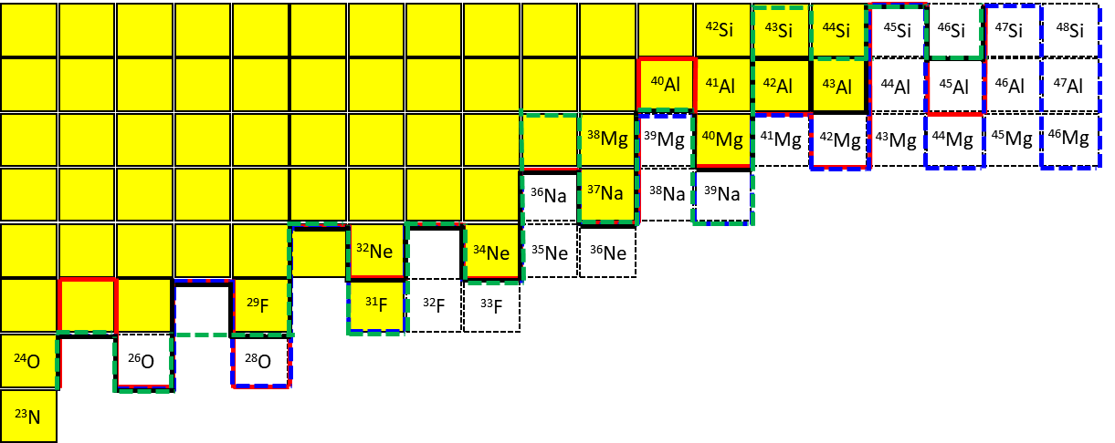
Future perspective
What to do next may include:
Experimental studies on the nuclear structure of ³¹F, ³⁴Ne, ³⁷Na and ³⁹Na.
Search for new isotopes for the next elements above Na (such as ⁴²Mg, ⁴⁵Al, and ⁴⁶Si).
Determination of the neutron dripline at Na (search for ⁴¹Na).
These will be important challenges for new-generation facilities!
³⁹Na
Bound (known)
Unbound or not observed
FRDM2012
KTUY05
Predictions
HFB-24
HFB-22
from D.S. Ahn
Notes:
This slide shows the future perspective.
What to do next may includes:
Experimental studies on the nuclear structure of ³¹F, ³⁴Ne, ³⁷Na and ³⁹Na.
Search for new isotopes for the next three elements above Na.
Determination of the neutron dripline at Na.
These will be important challenges for new-generation facilities including GSI FAIR!

Slide 31
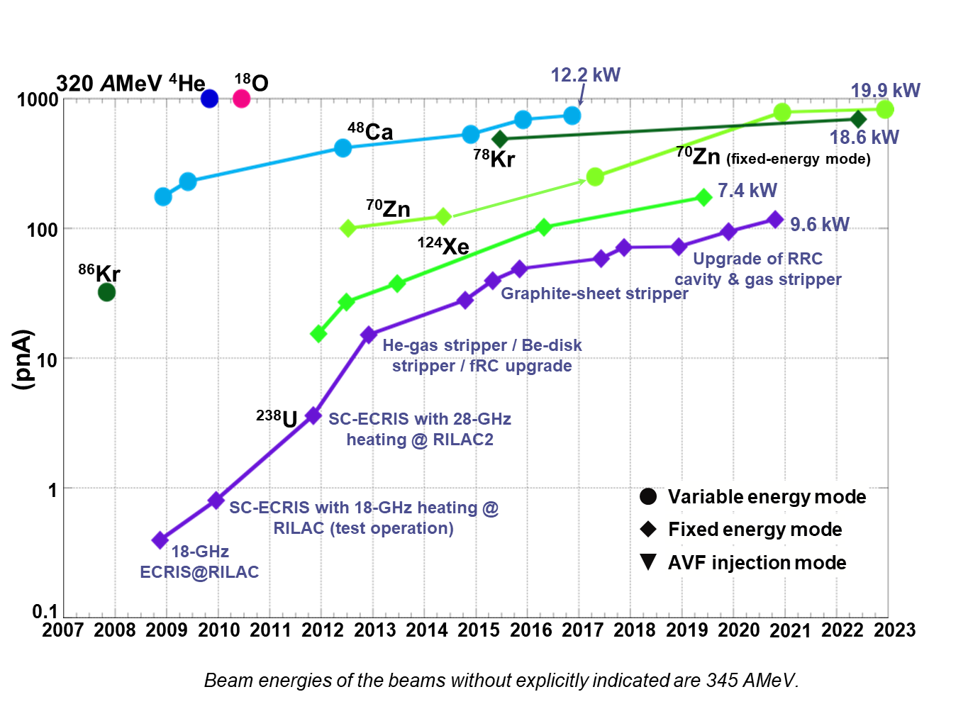
Primary beam intensities at RIKEN RIBF
Maximum beam intensities achieved so far
⁴⁸Ca: 737 pnA (12.2 kW)
⁷⁰Zn: 824 pnA (19.9 kW) → highest!
⁷⁸Kr: 691 pnA (18.6 kW)
¹²⁴Xe: 173 pnA (7.4 kW)
²³⁸U: 117 pnA (9.6 kW)
Reaching the goal intensity of
1000 pnA
E = 345 MeV/u
As of 2023
1 pnA (particle nA) = 6.24 x 10⁹ particles/s
Goal intensity
1000 pnA
History of beam intensities at RIBF
From RIBF Accelerator Group (Courtesy of N. Fukunishi)
Notes:
This slide shows the primary beam intensity at RIBF.
Maximum beam intensities are listed here.
The highest beam intensity was achieved for 70Zn beam, which is over 800 pnA.
The intensities are reaching the goal intensity of 1000 pnA.
For U, it is a little over 100 pnA.
This is the history of beam intensity.

Slide 32
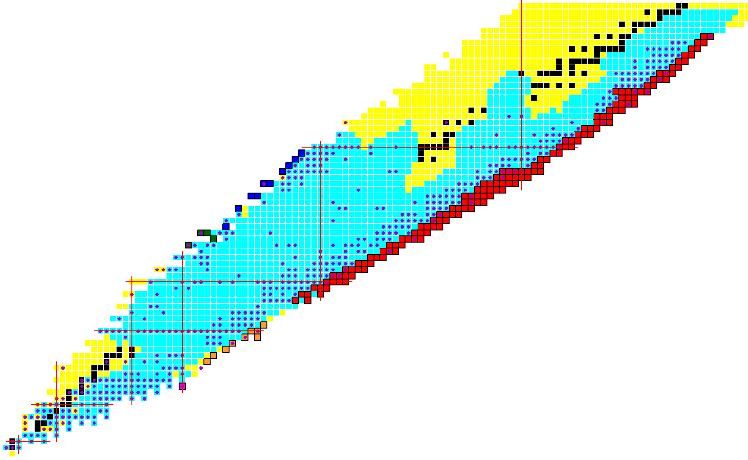
RI beams produced at BigRIPS (May 2007 – Aug. 2024)
We have produced a total of 696 RI beams and delivered to 268 experiments.
by using:
- In-flight fission of ²³⁸U
- Projectile fragmentation of
¹⁴N, ¹⁸O, ⁴⁸Ca, ⁷⁰Zn, ⁷⁸Kr & ¹²⁴Xe
Production yields for over
a thousand of RI beams
A number of new isotopes
and new isomers
Reached ~ 0.5 fb
As of Aug. 2024
90
100
70
60
¹²⁴Xe
¹²⁴Xe
50
²³⁸U In-flight fission
40
82
⁷⁸Kr
● RI beam produced (696)
for 268 experiments
■ Production yields
measured (> 1500)
New isotopes (171)
■ ²³⁸U in-flight fission (147)
■ ¹²⁴Xe P.F. (10)
■ ⁷⁸Kr P.F. (4)
■ ⁷⁰Zn P.F. (9)
■ ⁴⁸Ca P.F. (1)
28
⁷⁰Zn
Z
50
20
⁴⁸Ca
¹⁸O
8
28
20
8
N

Slide 33
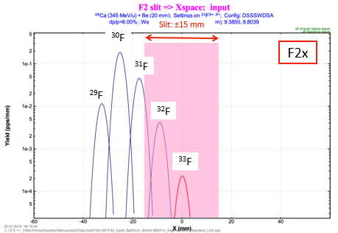
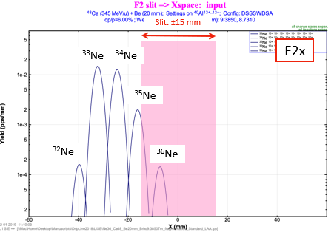
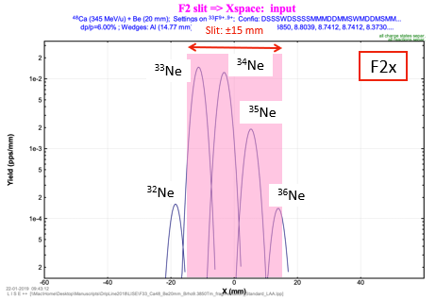
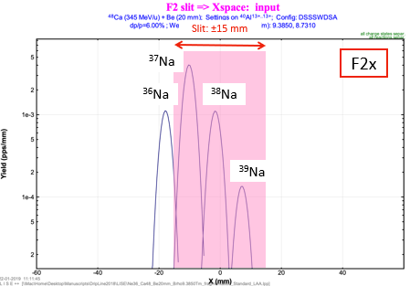
Some details of horizontal position spectrum at F2
All the targeted isotopes (^{32,33}F, ^{35,36}Ne and ^{38,39}Na) are inside the slit opening.
³³F setting
³⁶Ne+³⁹Na setting
Ne
F
F2 slit opening
F2 slit opening
LISE⁺⁺ simulation
F2 slit: ±15mm
Ne
Na
F2 slit opening
F2 slit opening
From D.S. Ahn
Notes:
This shows some details of horizontal position spectrum at F2.
You can see all the targeted isotopes are located inside the slit opening.

Slide 34
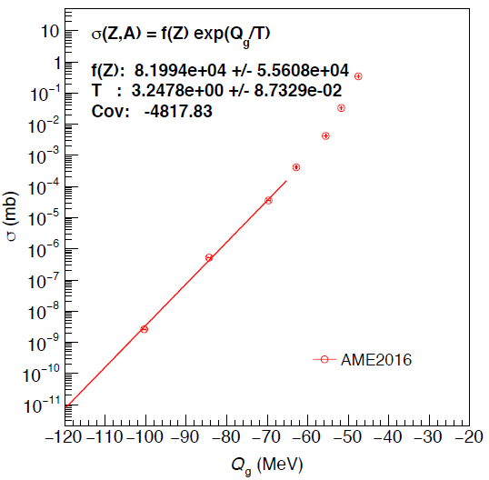
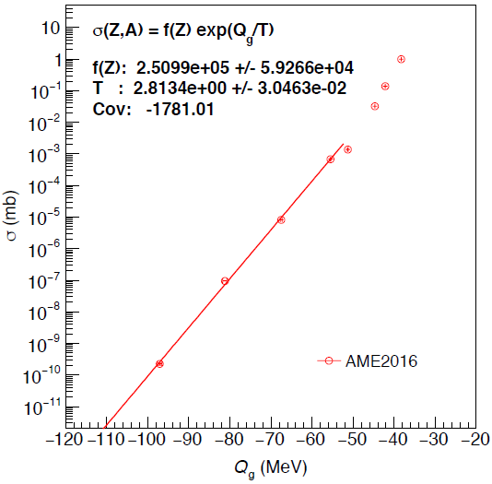
Q_{g} systematics fit and extrapolation of cross sections
σ(Z,A) = f(Z) exp(Q_{g}/T ), Q_{g} = ΔMp – ΔMf, T : temperature parameter
Good for the region far from stability.
See O. Tarasov et al., PRL102, 2009.
F isotopes
Ne isotopes
²⁸Ne
²⁷F
³⁰Ne
²⁹F
³²F
³²Ne
³³F
³⁵Ne
³¹F
(Qg)
³⁴Ne
(Qg)
³⁶Ne
Assume S_{1n}=0, S_{2n}=0 for ³²F and ³³F.
Assume S_{1n}=0, S_{2n}=0 for ³⁵Ne and ³⁶Ne.
Notes:
This slide shows the Q_{g} systematics fit and extrapolation of cross sections for F and Ne isotopes.

Slide 35
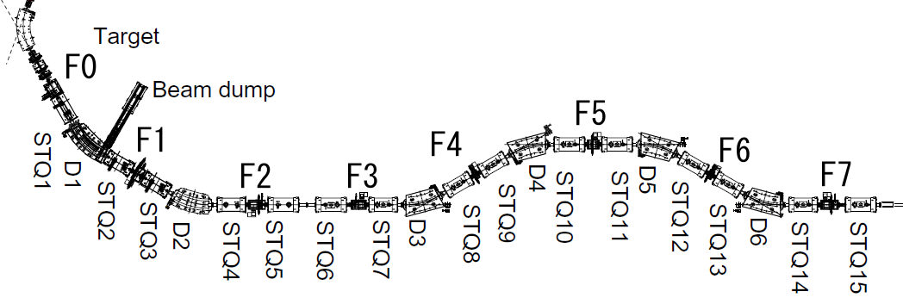
BigRIPS separator (since March 2007)
Two-stage separator characterized by:
Large acceptances
→ efficient RI beam production
High momentum resolution at 2nd stage
→ excellent particle identification (PID)
Δθ = 80 mr
Δφ = 100 mr
Δp/p = 6 %
Bρ = 9 Tm
L = 78.2 m
E = 345 MeV/u
2nd stage
(F3 – F7)
Rp = 3420
Target
Wedge
Wedge
Beam dump
1st stage
(F0 – F2)
Rp = 1270
STQ1-14: large-aperture superconducting quadrupole triplets D1-D6: dipoles F1-F7: focuses
Notes:
This is just to mind you of the BigRIPS separator. BigRIPS is a two-stage separator characterized by large acceptances which allows efficient RI beam production, and high Brho resolution at the second stage, which allows excellent particle identification.

