Slide 1
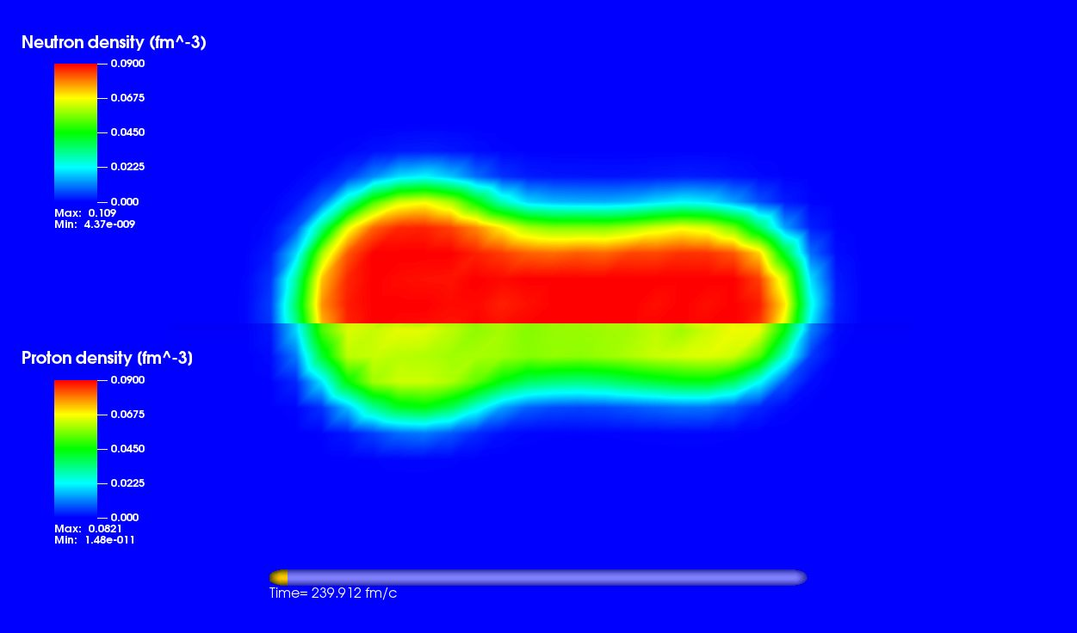
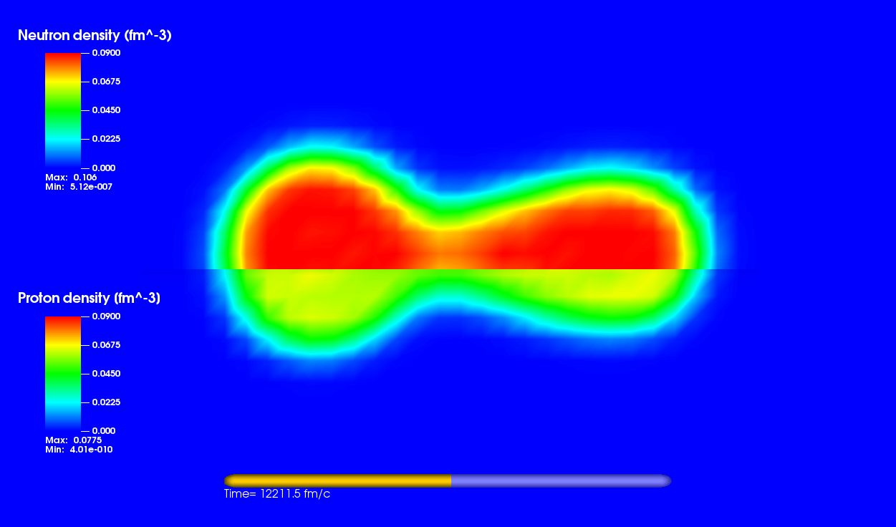
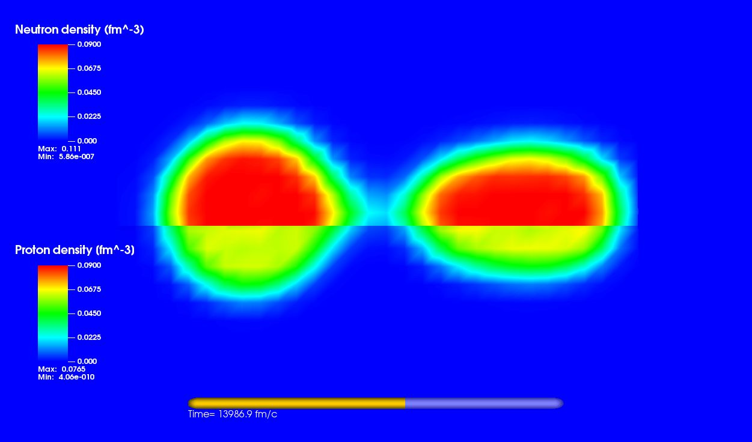
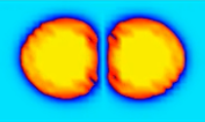
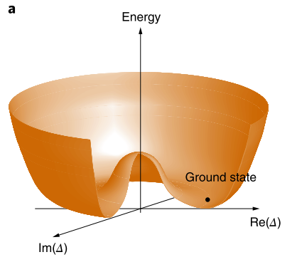
Nuclear dynamics in the framework of time-dependent density functional theory with pairing correlations.
Piotr Magierski
(Warsaw University of Technology)

Slide 2
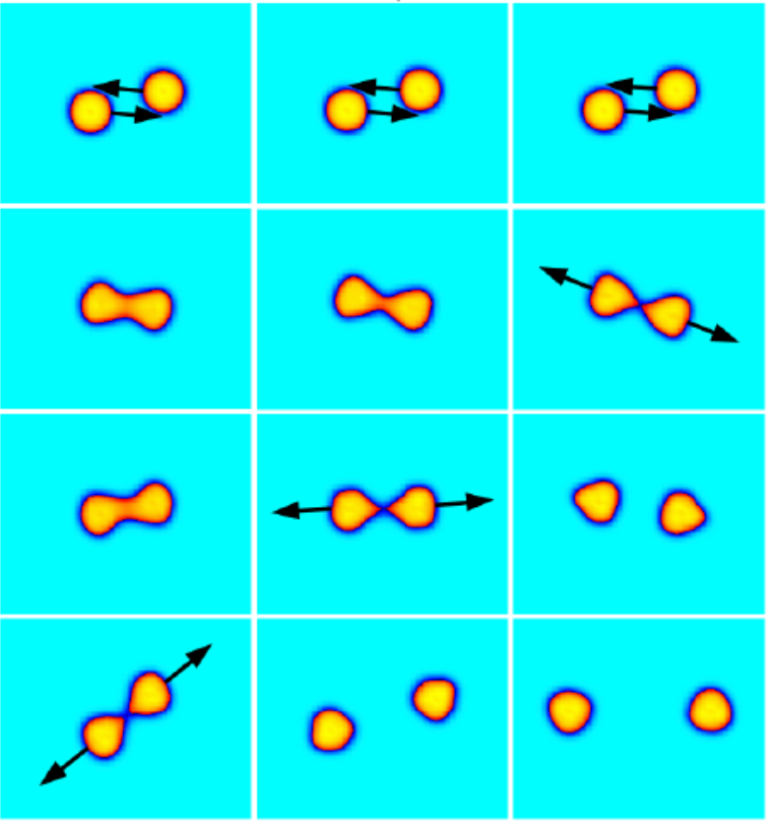
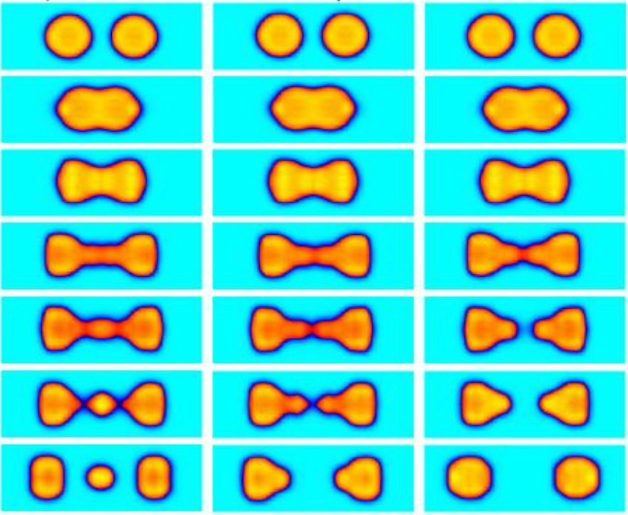
Introduction
Theoretical framework (Superfluid local density approximation)
Induced fission
Nucleus-nucleus collisions
Nucleus in a superfluid environment (neutron star crust)

Slide 3
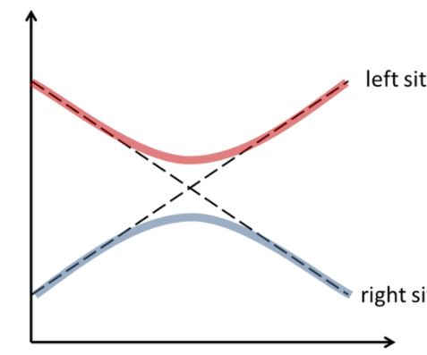
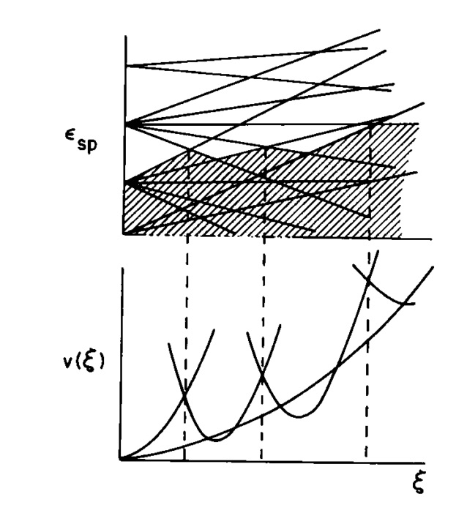
Pairing as an energy gap
Qua
Quasiparticle energy:
Potential energy surface
Single-particle levels
Deformation
Deformation
As a consequence of pairing correlations
large amplitude nuclear motion becomes
more adiabatic.
While a nucleus elongates its Fermi surface
becomes oblate and its sphericity must be restored
Hill and Wheeler, PRC, 89, 1102 (1953)
Bertsch, PLB, 95, 157 (1980)
From Barranco, Bertsch, Broglia, and Vigezzi
Nucl. Phys. A512, 253 (1990)

Slide 4
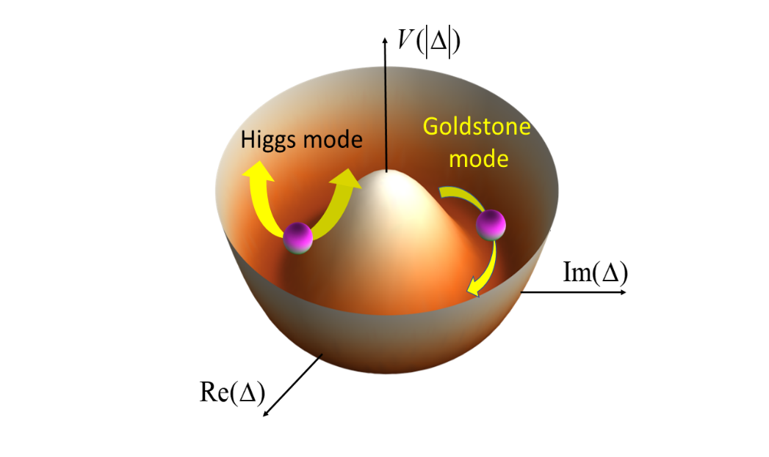
Appearance of pairing field in Fermi systems is associated with U(1) symmetry breaking.
There are two characteristic modes associated with the field
Nambu-Goldstone mode explores the degree of freedom associated with the phase:
Higgs mode explores the degree of freedom associated with the magnitude:
What’s the difference between pairing correlations and existence of superfluid phase?
- Superfluid phase exists if the off-diagonal long range order is present:
- This limit is unreachable in atomic nuclei due to their finite size. Therefore it is
more convenient to look, instead, for the manifestations of the phase::
C.N. Yang, Rev. Mod. Phys. 34, 694 (1962)

Slide 5
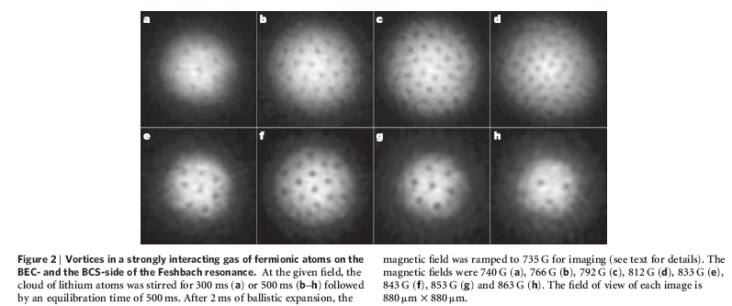
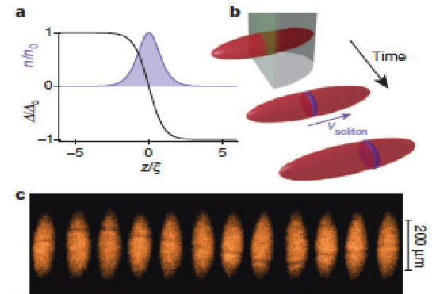
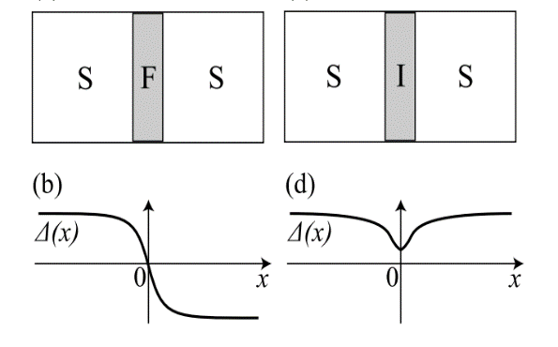
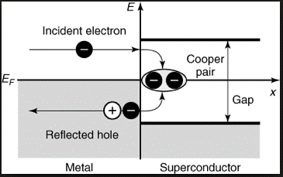
The well known effects in superconductors where the simplified BCS approach fails
1) Quantum vortices,
solitonic excitations
related to pairing field
(e.g. domain walls)
2) Bogoliubov – Anderson phonons
3) Proximity effects: variations of
the pairing field on the length
scale of the coherence length.
4) Physics of Josephson junction
(superfluid - normal metal),
pi-Josephson junction
(superfluid - ferromagnet)
5) Andreev reflection
(particle-into-hole and hole-into-particle scattering)
Andreev states cannot be obtained within BCS

Slide 6
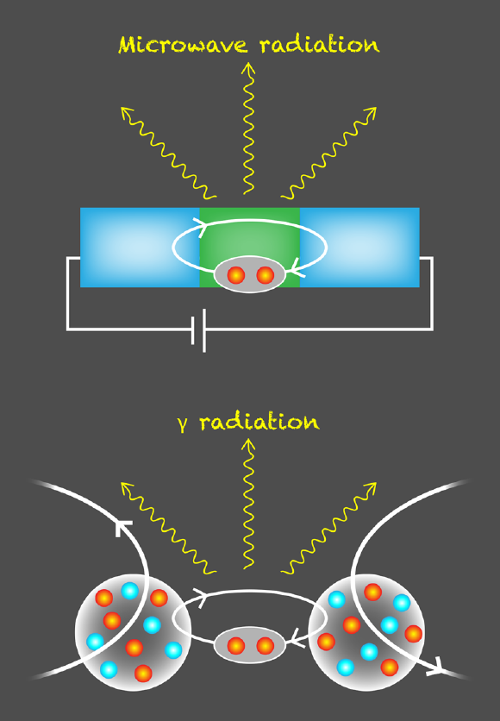
Nuclear systems
Some evidence for a nuclear DC Josephson effect has been gathered over
the years, following ideas presented in papers:
V.I. Gol’danskii, A.I. Larkin, JETP 26, 617 (1968), K. Dietrich, Phys. Lett. 32B 428 (1970)
Experimental evidence of enhanced nucleon pair transfer reported eg. in:
M.C. Mermaz, Phys. Rev. C36 1192, (1987), M.C. Mermaz, M. Girod, Phys. Rev. C53 1819 (1996)
Surprisingly evidence for AC Josephson effect has also been found
G.Potel, F.Barranco, E.Vigezzi, R.A. Broglia, “Quantum entanglement in nuclear Cooper-pair tunneling with gamma rays,” Phys.Rev. C103, L021601 (2021)
R. Broglia, F. Barranco, G. Potel, E. Vigezzi
„Transient Weak Links between Superconducting Nuclei: Coherence Length”
Nuclear Physics News 31, 25 (2021)
(see talk by Gregory Potel on Wednesday)
From P. Magierski, Physics 14 (2021) 27.

Slide 7
GOAL:
Unified description of nuclear dynamics involving medium and heavy nuclei based on microscopic theoretical framework including pairing correlations.
Microscopic framework = explicit treatment of fermionic
degrees of freedom.
In most cases we are interested in extracting one-body observables.
This leads to considering Energy Density Functional (EDF) expressed in terms of local densities.

Slide 8
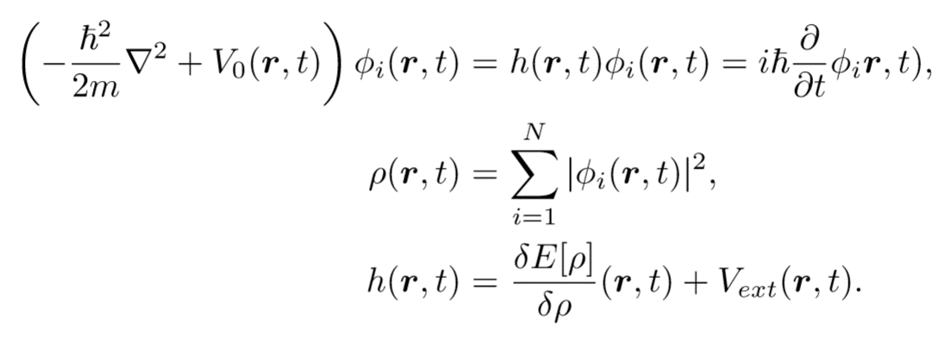
Kohn-Sham prescription in Time Dependent Density Functional Theory (TDDFT): replacing the interacting many-body system with the selfconsistent eqs. representing the equivalent noninteracting system.
Equivalence: one-body densities representing both systems are the same.
For normal (nonsuperfluid) systems:
TDHF eqs.
See eg. talks of C. Simenel and R. Gumbel

Slide 9
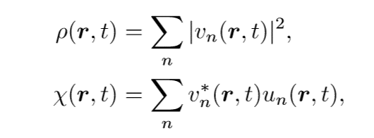
For superfluid systems:
TDHFB eqs. (TDSLDA)
Note that now:

Slide 10
Solving time-dependent problem for superfluids within TDSLDA
The real-time dynamics is given by equations, which are formally equivalent to the Time-Dependent HFB (TDHFB) or Time-Dependent Bogolubov-de Gennes (TDBdG) equations
where h and Δ depends on “densities”:
A. Bulgac, Y. Yu, Phys. Rev. Lett. 88 (2002) 042504
A. Bulgac, Phys. Rev. C65 (2002) 051305
huge number of nonlinear coupled 3D Partial Differential Equations (in practice n=1,2,…, 10⁵ - 10⁶)
Present computing capabilities:
full 3D (unconstrained) superfluid dynamics
spatial mesh up to 100³
max. number of particles of the order of 10⁴
up to 10⁶ time steps (for cold atomic systems – time scale: a few ms
for nuclei – time scale: 100 zs)
P. Magierski, Nuclear Reactions and Superfluid Time Dependent Density Functional Theory, Frontiers in Nuclear and Particle Physics, vol. 2, 57 (2019)
A. Bulgac, Time-Dependent Density Functional Theory and Real-Time
Dynamics of Fermi Superfluids, Ann. Rev. Nucl. Part. Sci. 63, 97 (2013)
A. Bulgac, M.M. Forbes, P. Magierski,
Lecture Notes in Physics, Vol. 836, Chap. 9, p.305-373 (2012)

Slide 11
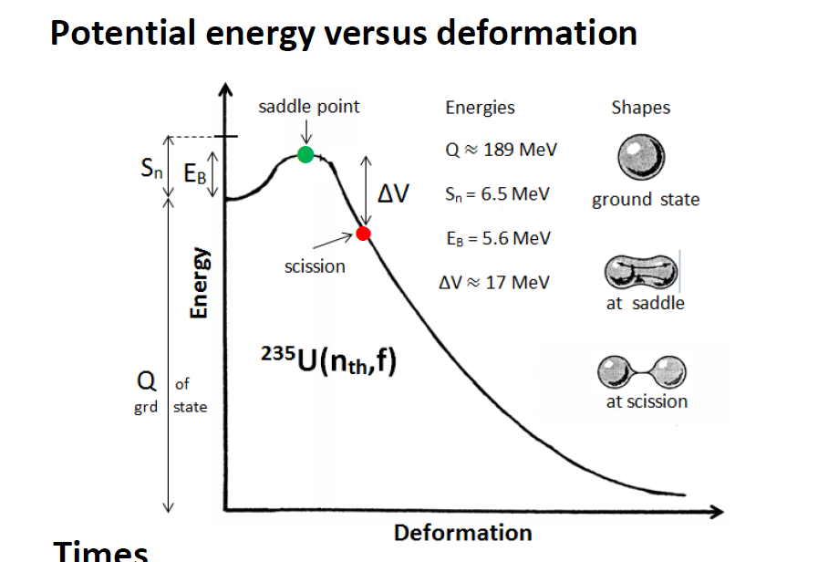
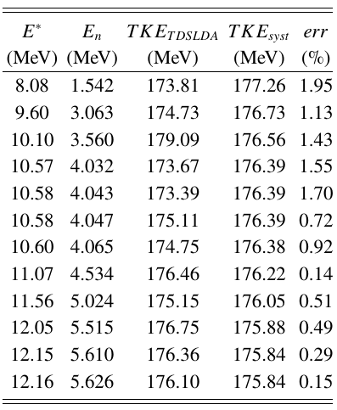
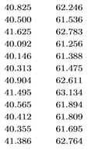
Nuclear fission dynamics
Estimation of characteristic time scales
for low energy fission ( <10MeV ):
Ground state to saddle - 1 000 000 zs
Saddle to scission - 10-100 zs
Acceleration of fission fragments
to 90% of their final velocity - 10 zs
Neutron evaporation - 1 000 zs
1 zs = 10⁻²¹ s
Total kinetic energy of the fragments
From F. Gonnenwein FIESTA2014
240
Fission dynamics of Pu within TDSLDA
Calculated TKEs
reproduce
experimental data
with accuracy < 2%
A. Bulgac, P.Magierski, K.J. Roche, and I. Stetcu, Phys. Rev. Lett. 116, 122504 (2016)

Slide 13
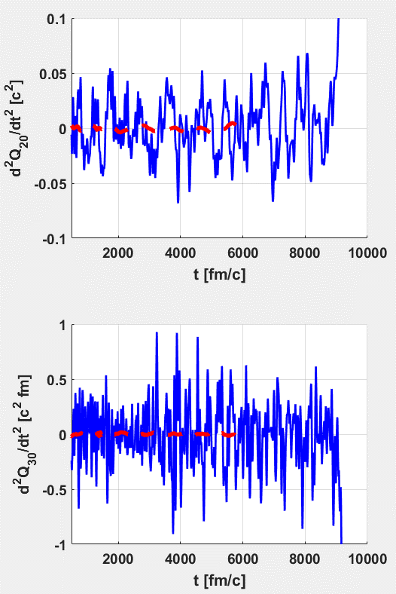
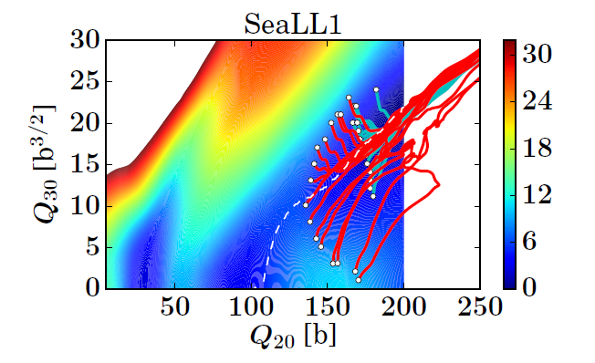
Fission dynamics of Pu
240
Accelerations in quadrupole and octupole
moments along the fission path
240
Trajectories of fissioning $Pu$ in the collective
space at excitation excitation energy of E=8-9 MeV:
A. Bulgac, et al. Phys. Rev. C 100, 034615 (2019)
Note that despite the fact that nucleus is already beyond the saddle point the collective motion on the time scale of 1000 fm/c and larger is characterized by the constant velocity (see red dashed line for an average acceleration) till the very last moment before splitting.
On times scales, of the order of 300 fm/c and shorter, the collective motion is a subject to random-like kicks indicating strong coupling to internal d.o.f

Slide 14
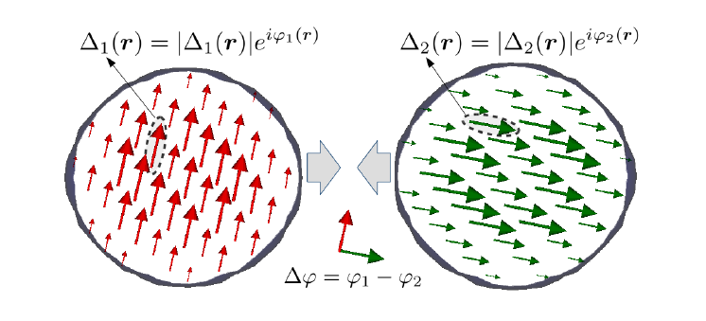
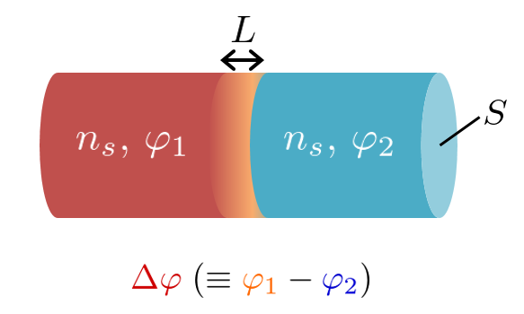
„Heavy soliton” creation in nuclear collision
Collisions of superfluid nuclei having different phases of the pairing fields
The main questions are:
-how a possible solitonic structure can be manifested in nuclear system?
-what observable effect it may have on heavy ion reaction:
kinetic energy distribution of fragments, capture cross section, etc.?
Clearly, we cannot control phases of the pairing field in nuclear experiments and
the possible signal need to be extracted after averaging over the phase difference.
From Ginzburg-Landau (G-L) approach:
For typical values characteristic for two medium nuclei:

Slide 15
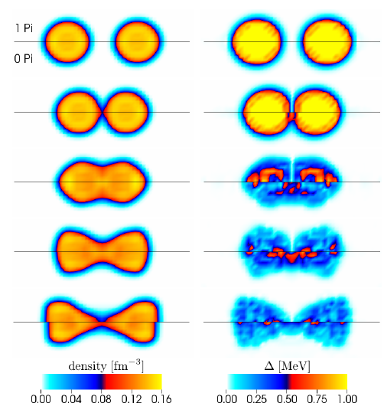
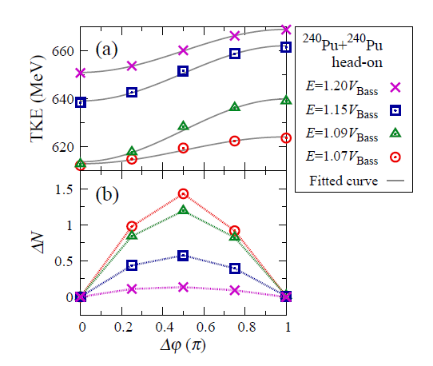
²⁴⁰Pu+²⁴⁰Pu
Total kinetic energy of the fragments (TKE)
!
Average particle transfer between fragments.
Creation of the solitonic structure between colliding nuclei prevents energy
transfer to internal degrees of freedom and consequently enhances the kinetic
energy of outgoing fragments.
Surprisingly, the gauge angle dependence from the G-L approach is perfectly
well reproduced in the kinetic energies of outgoing fragments!
P. Magierski, K. Sekizawa, G. Wlazłowski, Phys. Rev. Lett. 119 042501 (2017)

Slide 16
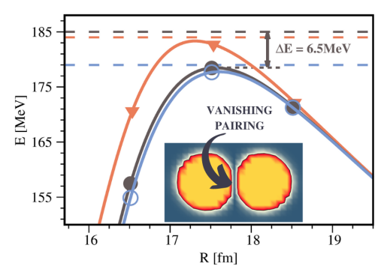
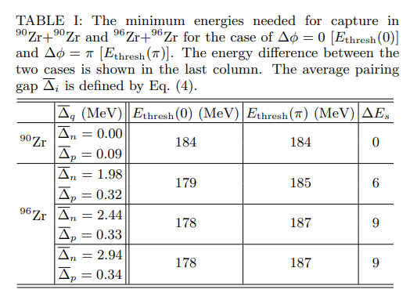
Dynamic nature of the effect:
Solid lines: static barrier between two nuclei (with
pairing included):
90Zr+90Zr - brown
96Zr+96Zr - black (0-phase diff.) and
blue (Pi-phase diff.)
Static barriers are practically insensitive to the phase difference of pairing fields.
Dashed lines: Actual threshold for capture
obtained in dynamic calculations.
Hence measures the additional energy which
has to be added to the system to merge nuclei.
Dependence of the additional energy
on pairing gap in colliding nuclei
P. Magierski, A. Makowski, M. Barton, K. Sekizawa, G. Wlazłowski, Phys. Rev. C 105, 064602, (2022)
G. Scamps, Phys. Rev. C 97, 044611 (2018): barrier fluctuations extracted from experimental data provide evidence that the effect exists.

Slide 17
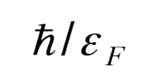
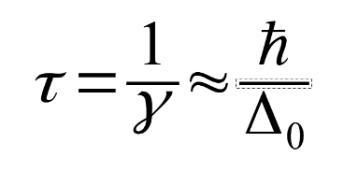
Pairing Higgs mode
Let’s consider Fermi gas with schematic pairing interaction and
coupling constant depending on time:
- coupling constant is switched on withing time scale
much shorter than
As a result pairing becomes unstable and increases exponentially
Time scale of growth and the period of subsequent oscillation is related to static value of
pairing :

Slide 18
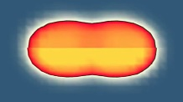
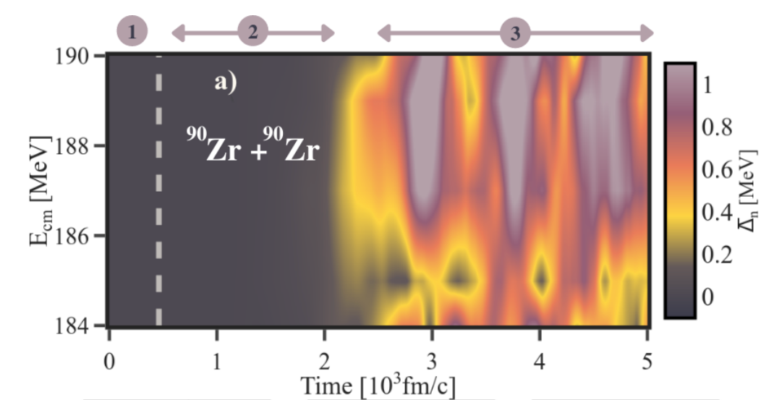
Pairing instability in nuclear reaction
BCS formula – weak coupling limit
Fermi energy
Pairing coupling constant
Density of states at the Fermi level
Although one cannot change coupling constant in atomic nuclei one may affect
density of states at the Fermi surface and consequently trigger pairing instability.
Collision of two neutron magic
systems creates an elongated
di-nuclear system.
Within 1500 fm/c pairing is
enhanced in the system
and reveals oscillations with
frequency:
Collision time
P.Magierski, A. Makowski, M. Barton, K. Sekizawa, G. Wlazłowski, Phys. Rev. C 105, 064602, (2022)

Slide 19
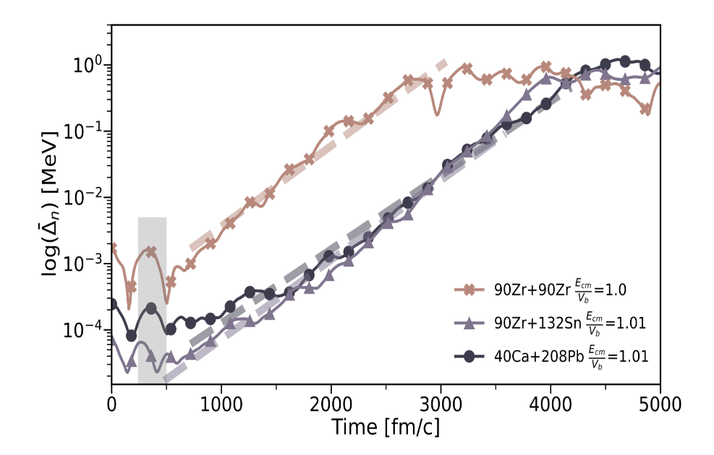
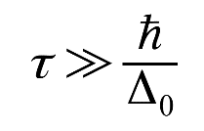
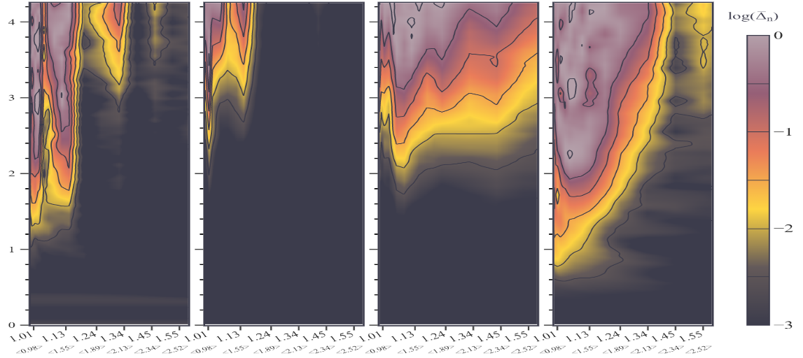
Interestingly, the effect is generic and occurs for various collisions of magic nuclei.
Collision time
Exponential increase of pairing gap
after collision indicating pairing
instability in di-nuclear system.
Time scale of pairing enhancement:
It occurs up to relatively high collision energies
Log(Δ )
4.0
n
3.0
Time [10³ fm/c]
2.0
1.0
Collision time
0.0
⁹⁰Zr+⁹⁰Zr
⁹⁰Zr+¹³²Sn
⁴⁰Ca+²⁰⁸Pb
⁴⁸Ca+²⁰⁸Pb
1.0 1.55
1.0 1.55
1.0 1.55
1.0 1.55
E_{CM}/V_{B}
The excitation energy of a compound system after merging exceeds 20-30 MeV.
It corresponds to temperatures close to or even higher than the critical temperature for superfluid-to-normal transition. Therefore it is unlikely that the system develops superfluid phase and it is rather nonequilibrium enhancement of pairing correlations.

Slide 20
Dynamic pairing enhancement
T≈1MeV
Temperatures, associated with excitation energies relative to the nuclear configuration
after merging, are about 1 MeV .
They exceed the critical temperature for the superfluid-to-normal transition.
TDHF (collisionless part)
Pairing („collision” term)
Pairing correlations appearing at relatively high excitation energy provide a nonnegligible
modification of the density evolution.

Slide 21
Superconducting
systems of interest
Ultracold atomic (fermionic) gases. Unitary regime.
Dynamics of quantum vortices, solitonic excitations, quantum turbulence
Nuclear physics.
Induced nuclear fission, fusion, collisions.
Astrophysical applications.
Modelling of neutron star interior (glitches): vortex dynamics, dynamics of inhomogeneous nuclear matter.
Collisions of ultracold atomic clouds offer an insight into pairing-related effects relevant to nuclear collisions.
- Pairing gap to Fermi energy ratio

Slide 22
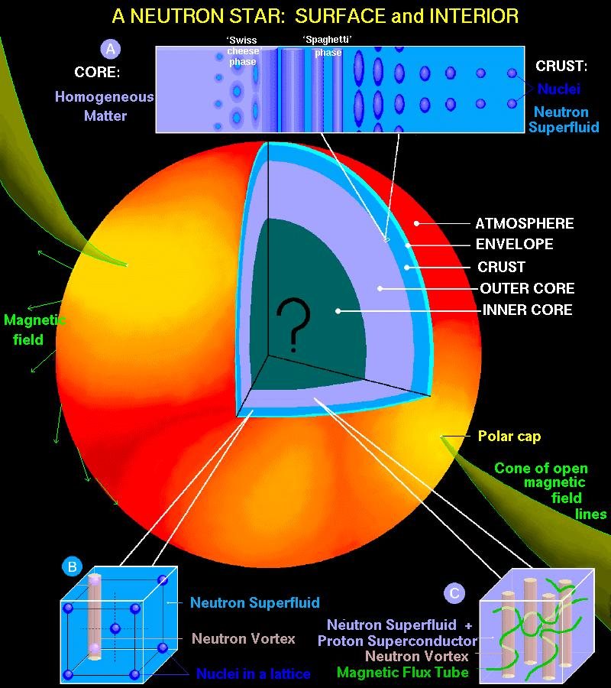
Determination of the neutron star crust properties:
dynamics of nuclear Coulomb crystal
Effective mass of a nucleus in superfluid neutron environment
Suppose we would like to evaluate an effective mass of a heavy particle immersed
in a Fermi bath.
Can one come up with the effective (classical) equation of motion of the type:
?
In general it is a complicated task as the first and the second term may not be unambiguously separated.
However for the superfluid system it can be done as for sufficiently slow motion (below the critical velocity) the second term may be neglected due to the presence of the pairing gap.

Slide 23
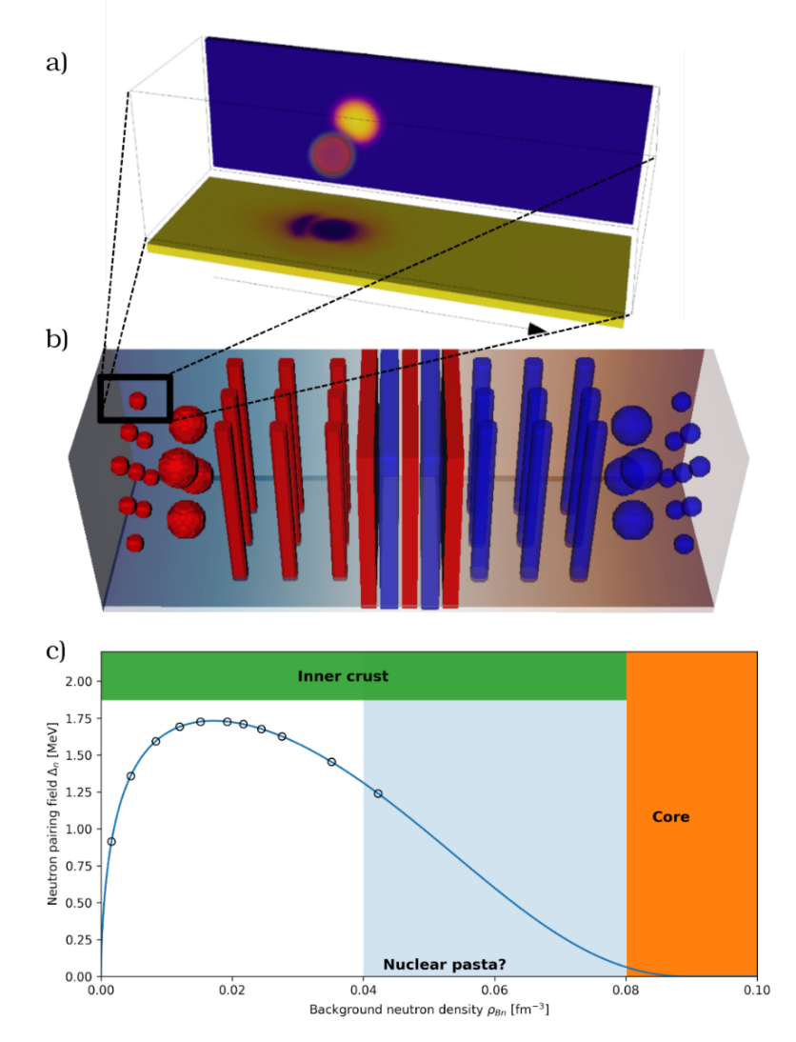
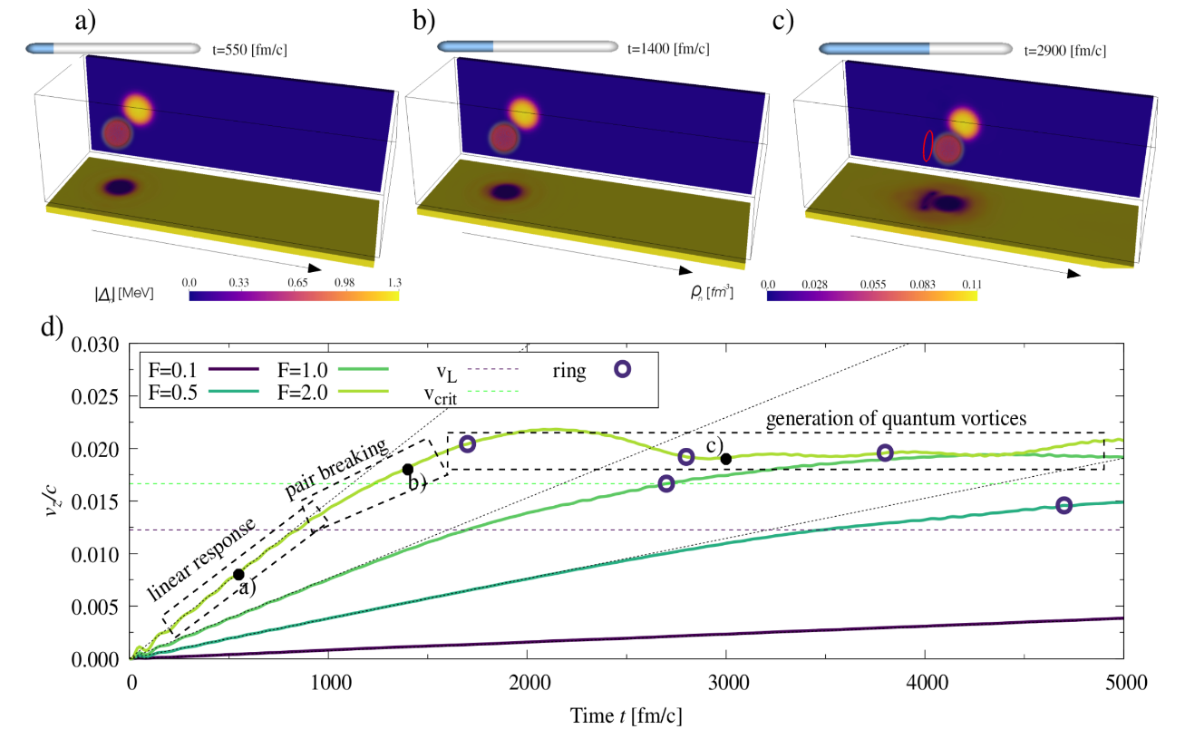
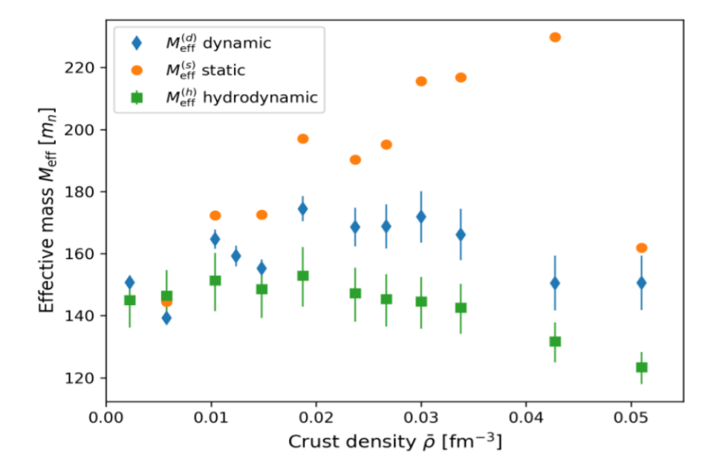
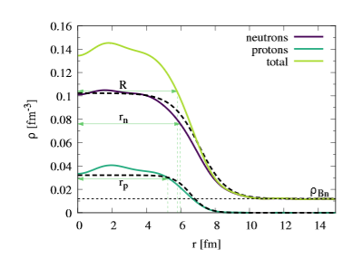
Dynamics of nuclear impurity in the neutron star crust: effective mass and energy dissipation
D. Pęcak, A.Zdanowicz, N. Chamel, P. Magierski, G. Wlazłowski, arXiv:2403.17499

Slide 24
Summary and open questions
Induced fission: the nuclear motion from sadle to scission is not adiabatic, although it is slow.
Excitation energy sharing: depending on dynamics and density of states at scission - very severe
test for TDDFT.
TDHFB provides evidence for nontrivial behavior of pairing correlations in highly nonequilibrium conditions which includes solitonic excitations (dynamic barrier modification for capture) and pairing enhancement as a result of collision.
There is certain experimental evidence for solitonic excitations, although not easy to
extract (G. Scamps, Phys. Rev. C C 97, 044611 (2018) ).
Pairing enhancement in collision of magic nuclei is a generic feature of TDHFB appearing in collisions
of magic nuclei at energies close to the Coulomb barrier.
Impact of pairing enhancement on dynamics is unknown and requires more theoretical
effort: impact on quasifission process, interplay between pairing and shell effects in
nuclear collisions, …

