Slide 1
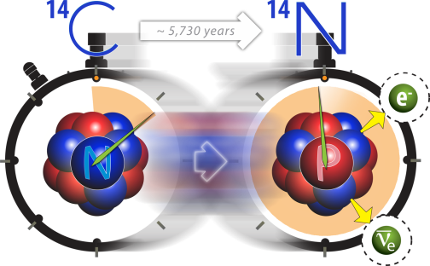
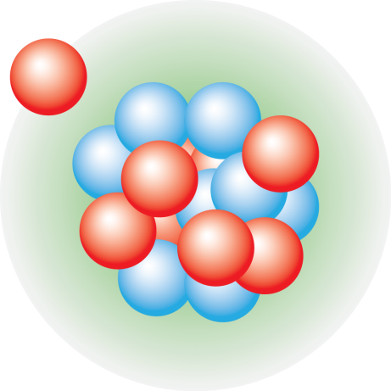



Frontiers in Ab-Initio Computations of Atomic Nuclei
Gaute Hagen
Oak Ridge National Laboratory
14th International Conference on Nucleus-Nucleus Collisions (NN2024)
Whistler, August 22nd, 2024

Slide 2
Collaborators
@ ORNL / UTK: B. Acharya, Baishan Hu, G. R. Jansen, T. Papenbrock
@ LSU: Z. H. Sun
@ Chalmers: A. Ekström, C. Forssén
@ Mainz: S. Bacca
@ LANL/WUSTL: S. Novario
@ TRIUMF: P. Navratil

Slide 3

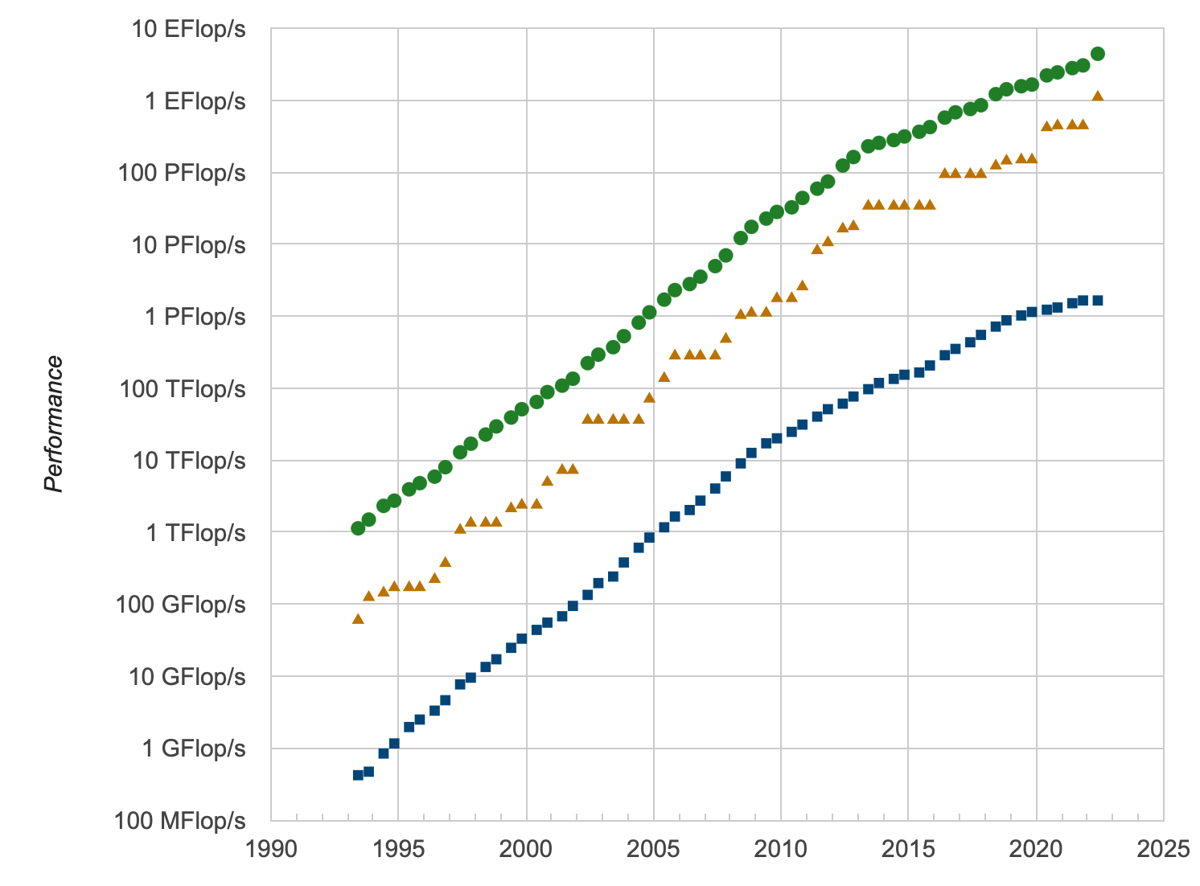
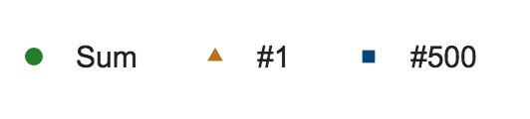
Trend in realistic ab-initio calculations
Tremendous progress in recent years because of ideas from EFT and the renormalization group
Computational methods with polynomial cost (coupled clusters 🙂quantum computing 🤔)
Ever-increasing computer power?
Development with time (top500.org)
No. 1 in 2024
Hu et al. Nat Phys (2022)
SUMMIT @OLCF
Notes:
he bars highlight the years of the first realistic computations of doubly magic nuclei. The height of each bar corresponds to the mass number A divided by the logarithm of the total compute power RTOP500 (in flops s−1) of the pertinent TOP500 list45. This ratio would be approximately constant if progress were solely due to exponentially increasing computing power. However, algorithms which instead scale polynomially in A have greatly increased the reach.

Slide 4
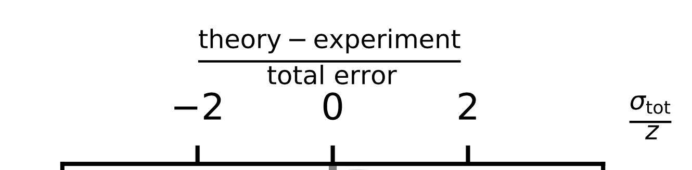
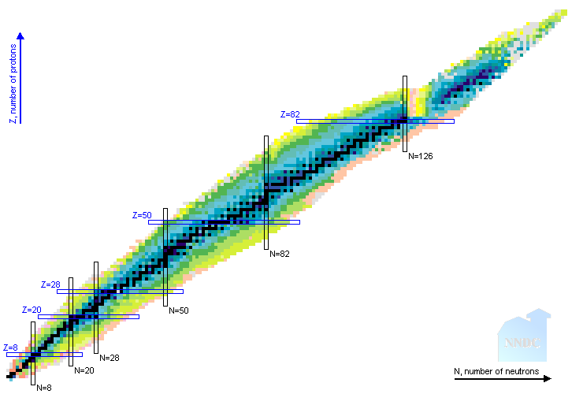
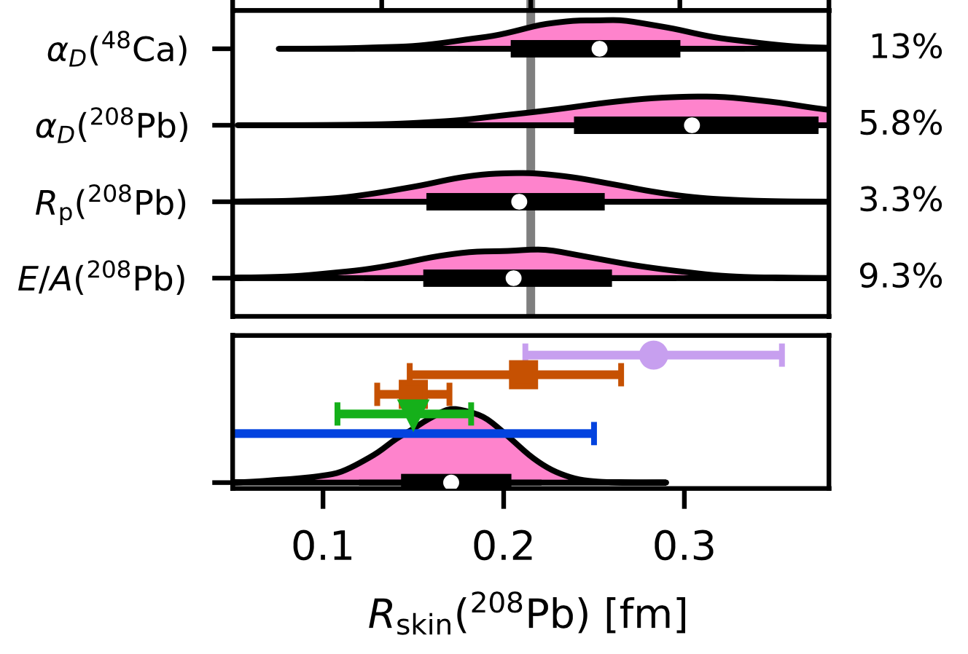
The Hamiltonian knows best
Gysbers et al, Nat Phys (2019)
Gysbers et al, Nat Phys (2019)
Ab-initio approaches are changing the way we compute nuclei
Hu et al. Nat Phys (2022)
Hagen, Jansen, Papenbrock,
Phys Rev Lett (2016)
Stroberg et al, Phys Rev Lett (2021)

Slide 5
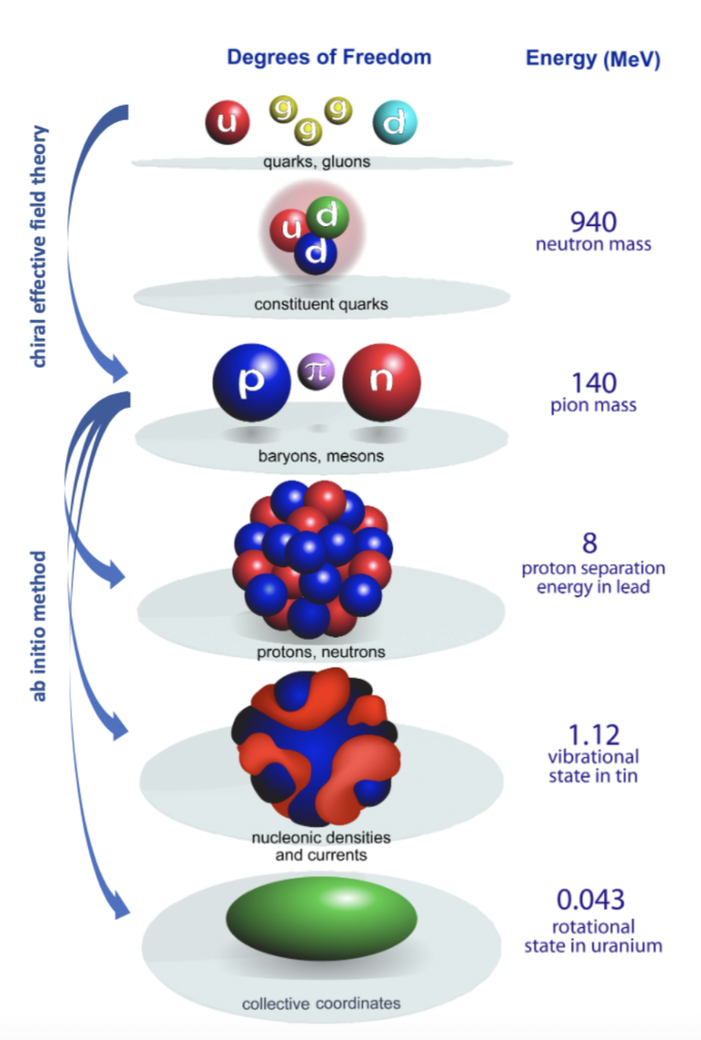
Multiscale physics of nuclei from ab-initio methods
What is ab initio in nuclear theory?
A. Ekström et al, Frontiers (2023)
“we interpret the ab initio method to be a systematically improvable approach for quantitatively describing nuclei using the finest resolution scale possible while maximizing its predictive capabilities”
Nuclei exhibit multiple energy scales ranging from hundreds of MeV in binding energies to fractions of an MeV for low-lying collective excitations.
Describing these different energy scales within a unified ab-initio framework from chiral interactions is a long-standing challenge
Figure adapted from Bertsch, Dean, Nazarewicz, SciDAC review (2007)
Notes:
Ab initio is interpreted differently to different people. Generic expression that benefits a vibrant competitive market place (reflect the creativity and innovation of scientist)
ab initio is unlike Tennessee Whiskey or French Champagne, which are internationally protected labels, but rather like Gruyère cheese, i.e., a generic expression that benefits a “vibrant, competitive marketplace”

Slide 6
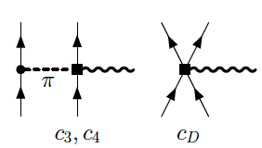
Interactions from chiral effective field theory
Parameters of the model
(16 at NNLO)
Constrained by data & carry uncertainties
Chiral EFT offers consistency between forces and currents
Figure adapted from Bertsch, Dean, Nazarewicz, SciDAC review (2007)

Slide 7
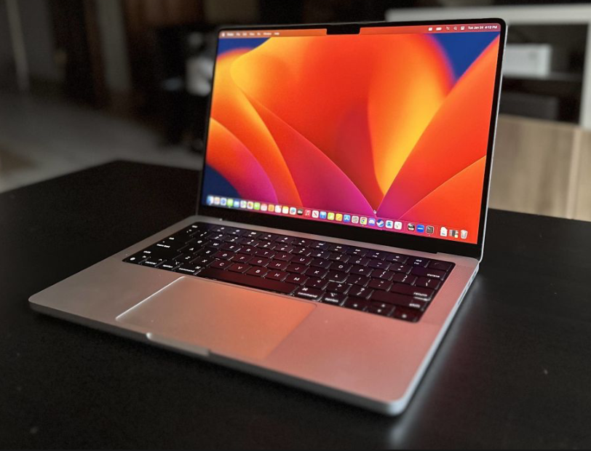
Solving the quantum many-nucleon problem
An exponentially hard problem to solve!
1.1 exaflops
IBM Q Experience
Polynomial scaling
Systematically improvable approaches with controlled approximations:
Coupled-cluster, IMSRG, Gorkov, SCGF,…
Emulators?
Fault tolerant quantum computing??

Slide 8
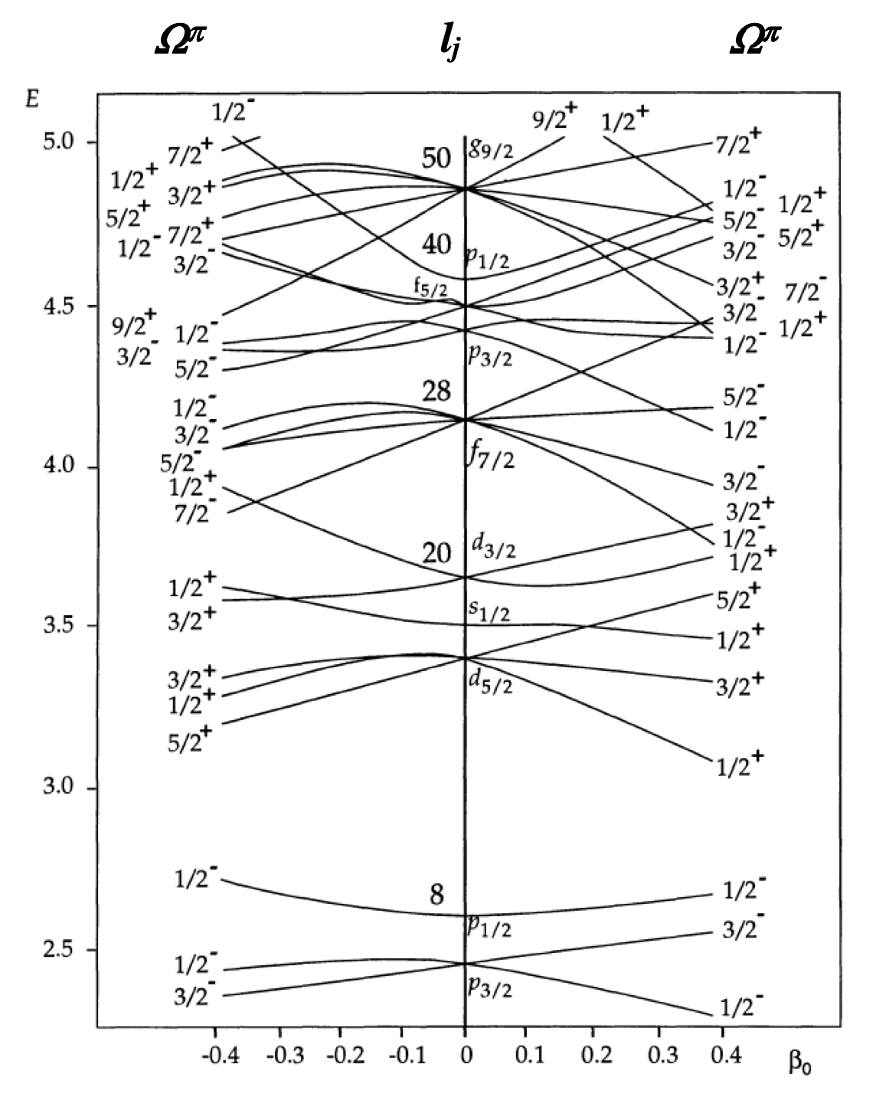
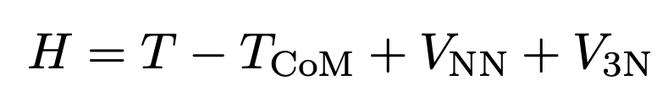
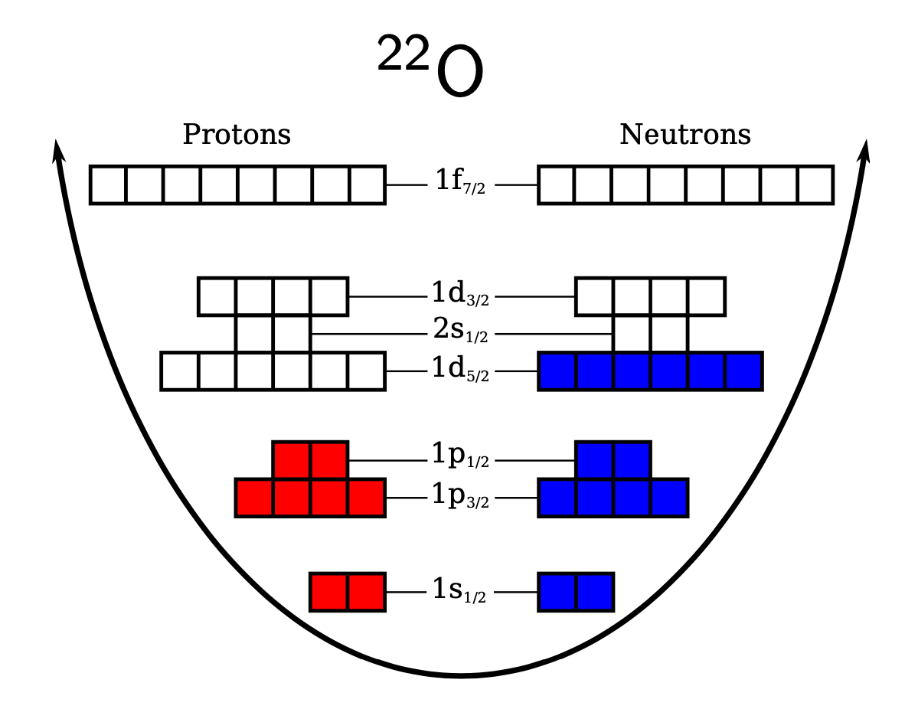
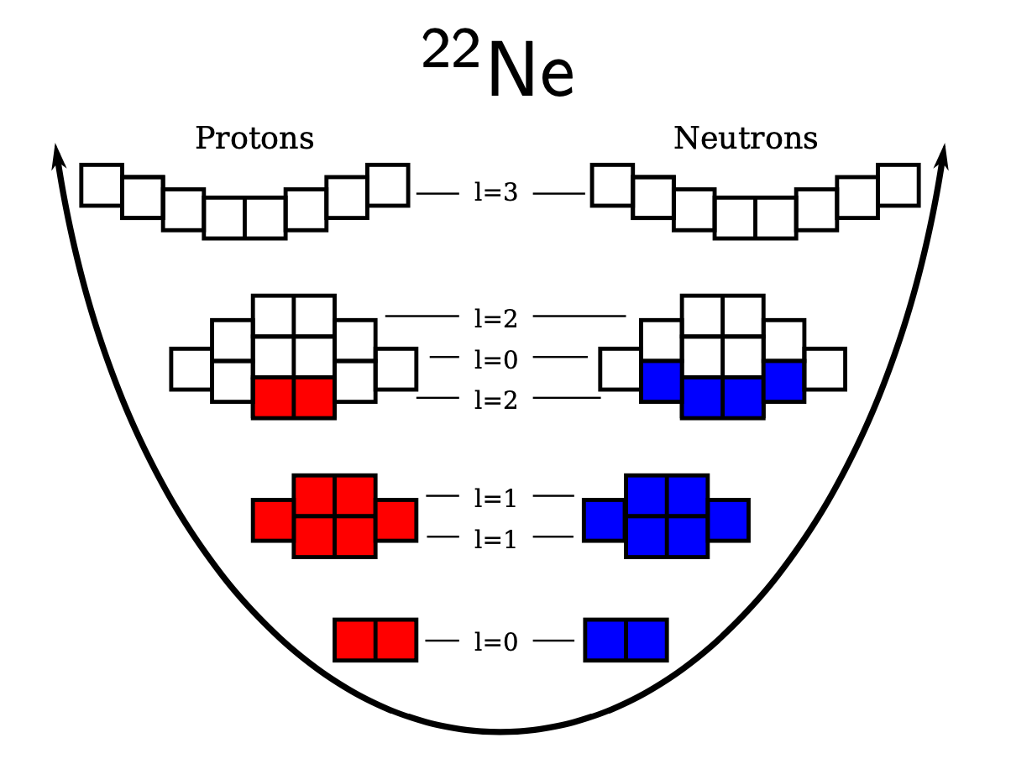
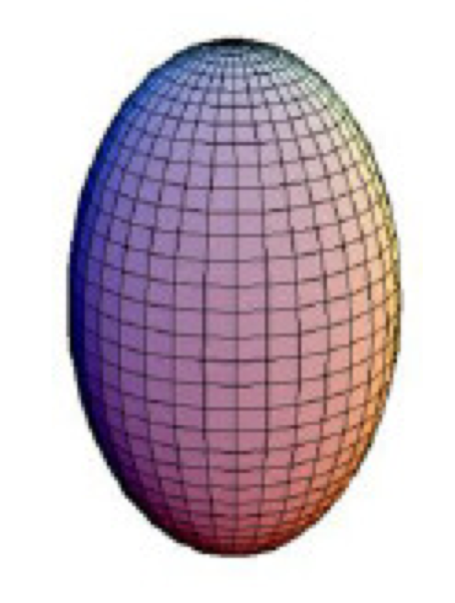
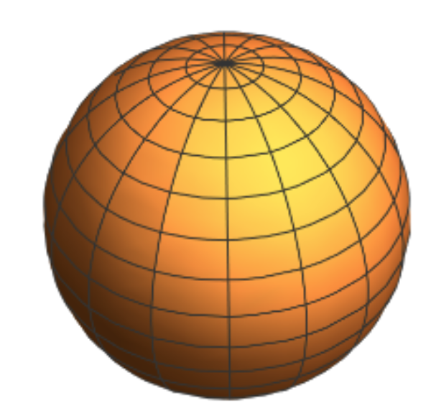
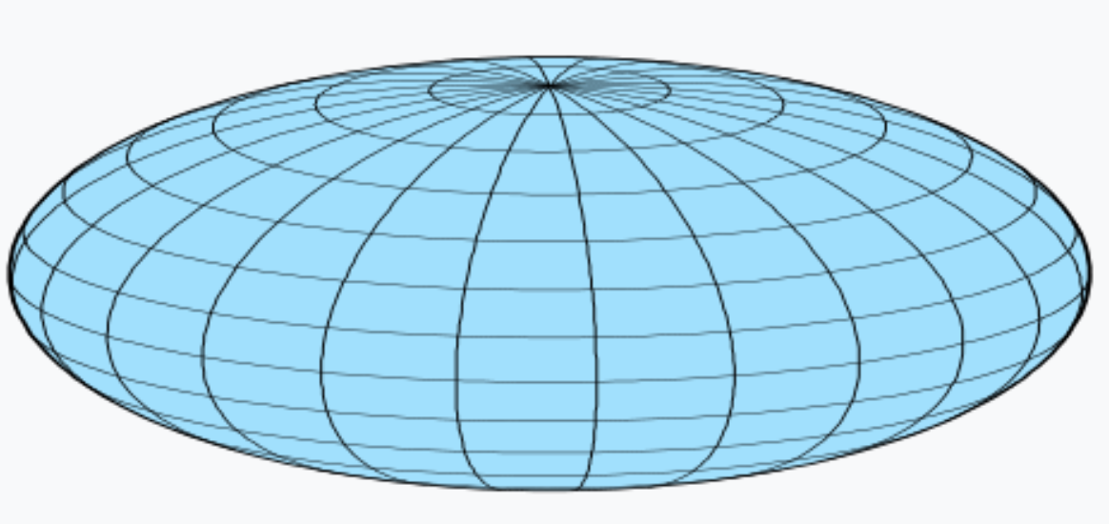
Coupled-cluster computations of deformed nuclei
The key lies in choosing the correct starting point
Compute Hartree-Fock reference state:
Informs us about emergent breaking of symmetries
Spherical
Deformed
Wave-operator (includes many-body correlations)

Slide 9
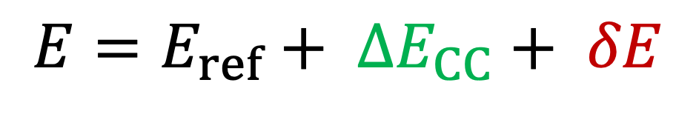
Coupled-cluster computations of deformed nuclei
Include short-range correlations via coupled-cluster theory
  Large contribution to total energy
  Cost increases polynomial with mass
Include long-range correlations via symmetry projections
  Small contribution to total energy
  Relevant for rotational bands and transition matrix elements
S. J. Novario, et al PRC 102, 051303 (2020)
Total energy:
$$E=E_{ref}+ ∆E_{CC}+ δE$$
Notes:
Norm kernel: overlap of rotated and initial states
Hamiltonian kernel: Hamiltonian matrix element between rotated and initial states

Slide 10
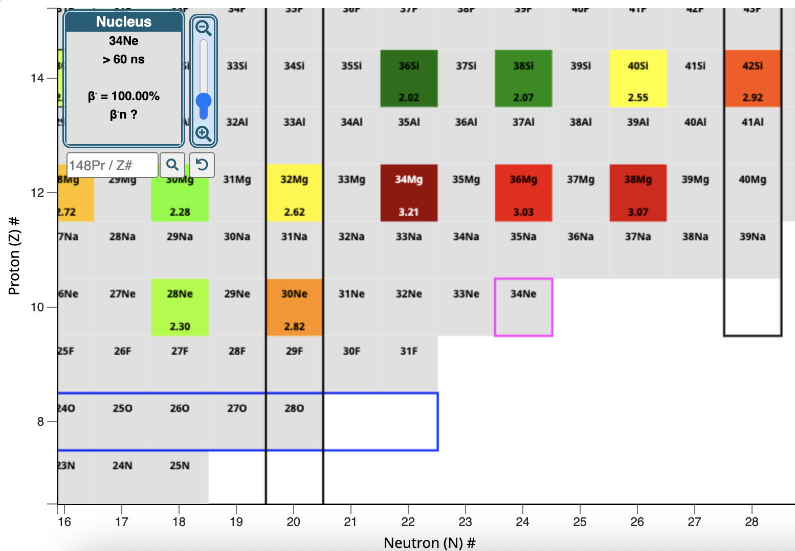
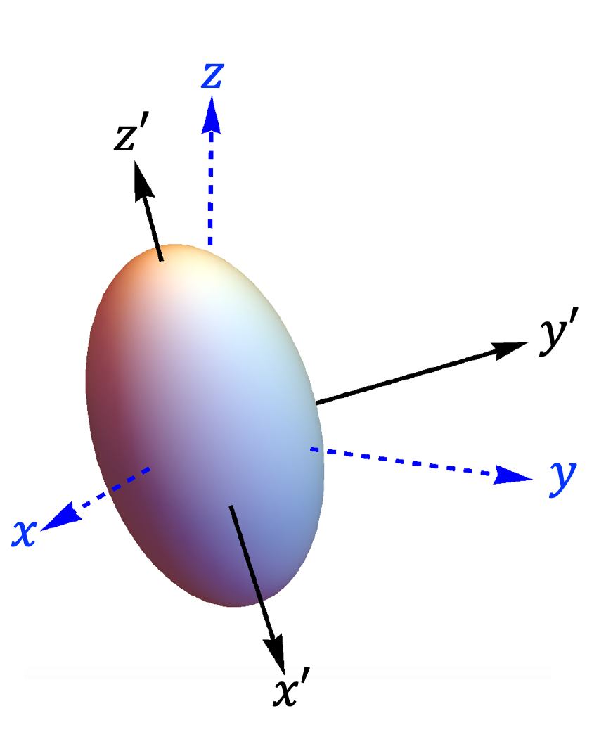
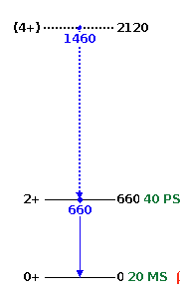
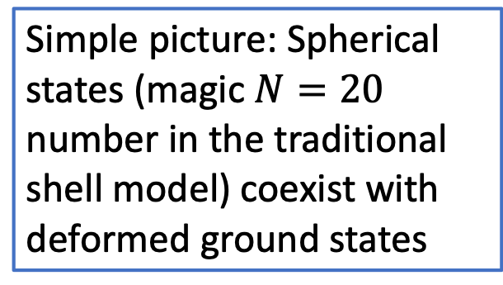
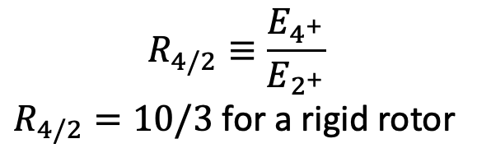
Neutron-rich nuclei beyond N = 20 are deformed
$$R_{4/2}≡\frac{E_{4^{+}}}{E_{2^{+}}}$$
$R_{4/2}=10/3$ for a rigid rotor
?
?
Simple picture: Spherical states (magic $N=20$ number in the traditional shell model) coexist with deformed ground states
³⁴Mg
(BE: 257MeV)
Poves & Retamosa (1987); Warburton, Becker, and Brown (1990); …
Notes:
In 34Mg the lowest rotational excitation is only 0.26% of the total binding energy

Slide 11
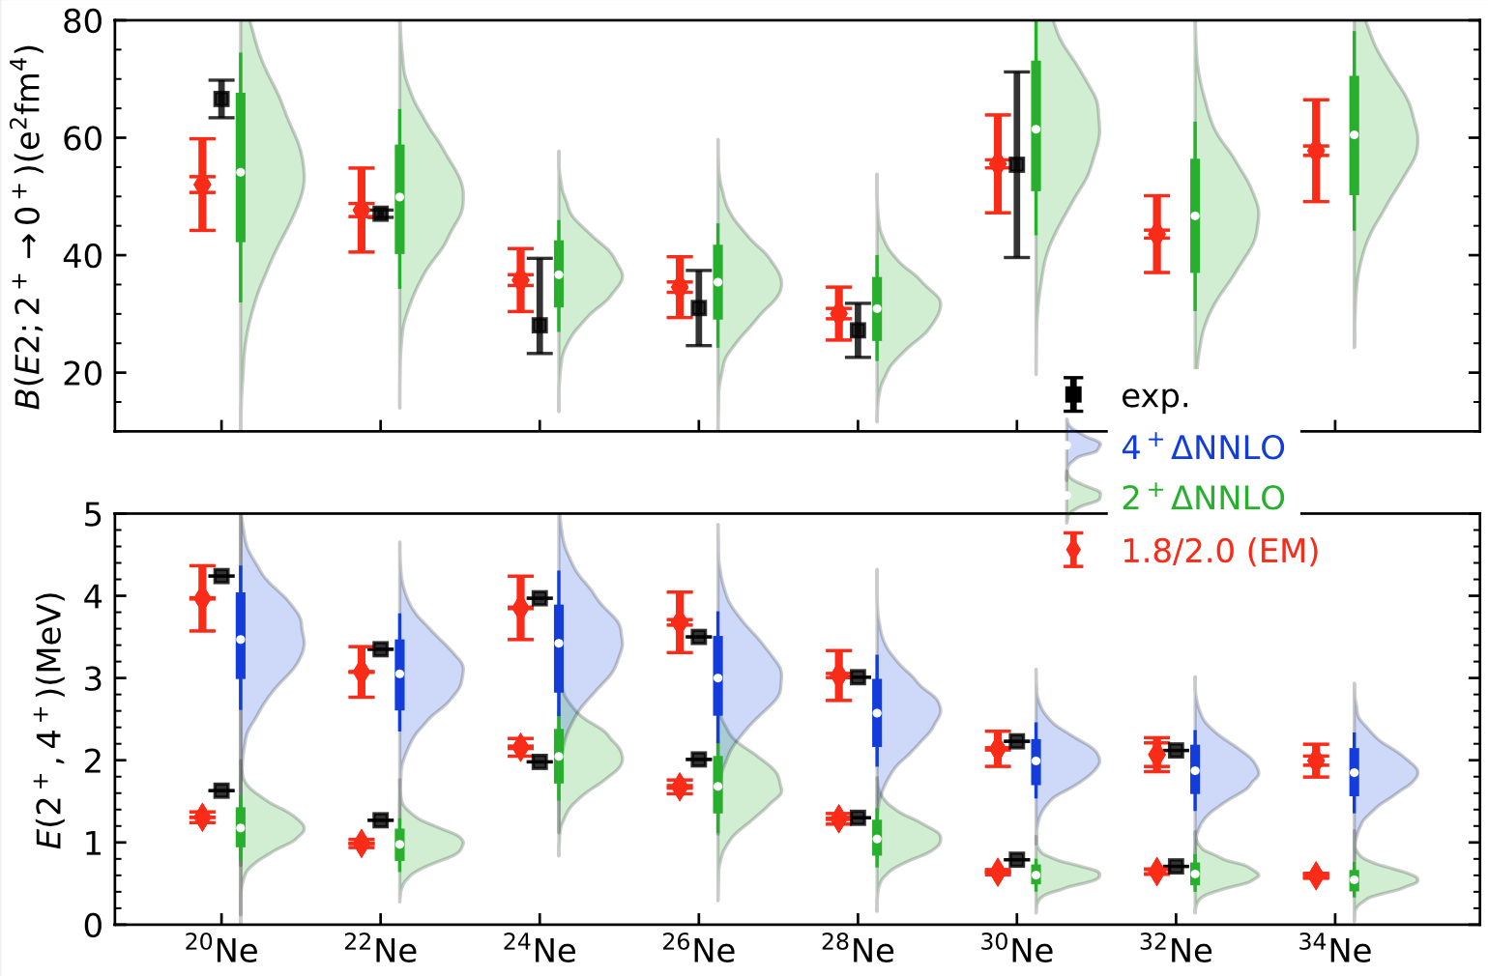
Collectivity in neon isotopes
Calculations follow data
No effective charges
Spectra of ³⁰⁻³⁴Ne follow that of a rigid rotor
Small energies reflect a large moment of inertia and a strong deformation
Ensemble of delta-full interactions from recent study of ²⁸O
Y. Kondo et al.,
Nature 620, 965–970 (2023)
Zhonghao Sun, A. Ekstrom, C. Forssen, G. Hagen. G. R. Jansen, T. Papenbrock arXiv:2404.00058 (2024)

Slide 12
Shape co-existence in ³⁰Ne
Zhonghao Sun, A. Ekstrom, C. Forssen, G. Hagen. G. R. Jansen, T. Papenbrock arXiv:2404.00058 (2024)
Notes:
signatures of the N = 20 magic number can be seen in our calculations and lead to shape coexistence

Slide 13
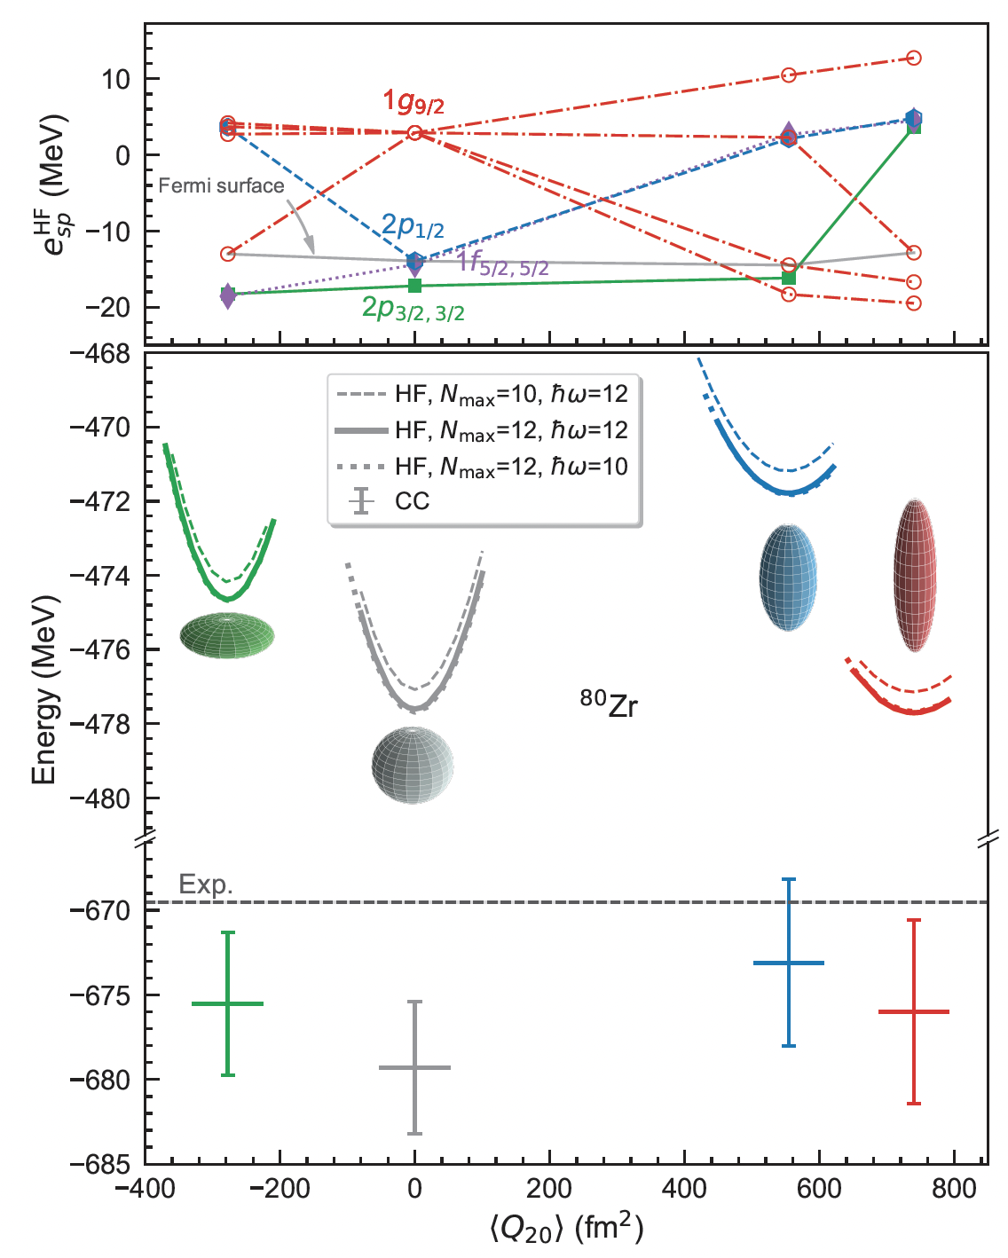
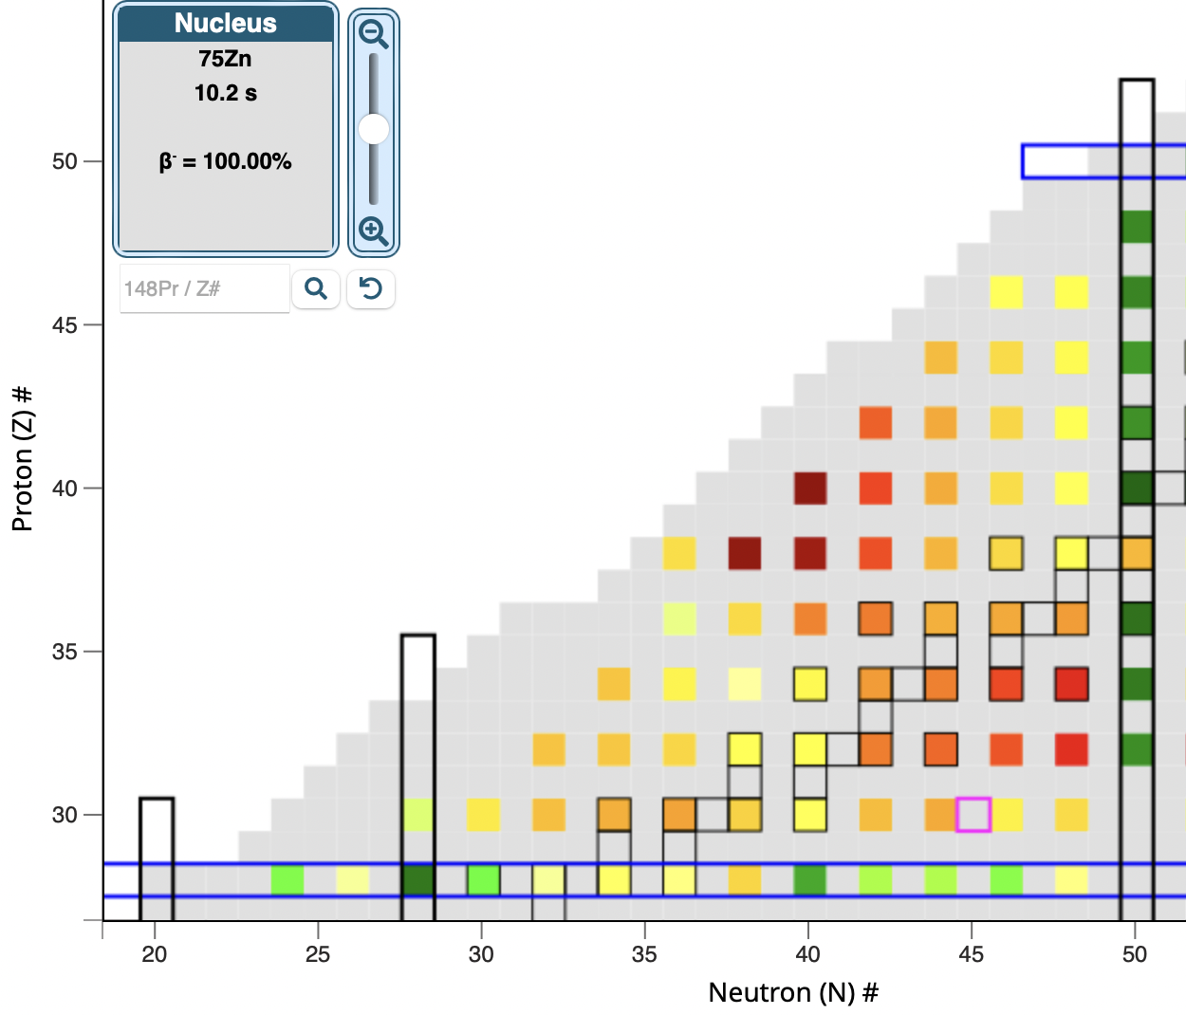
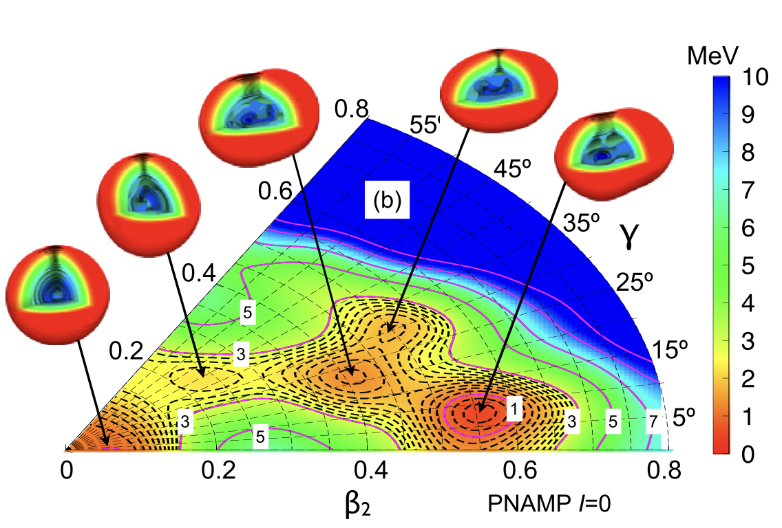
Strongly deformed nuclei around ⁸⁰Zr
Tomás R. Rodríguez, J. Luis Egido,
Phys. Lett. B 705 255 (2011)
N = Z
Baishan Hu, Zhonghao Sun, G. Hagen, T. Papenbrock. Phys. Rev. C 110, L011302 (2024)

Slide 14
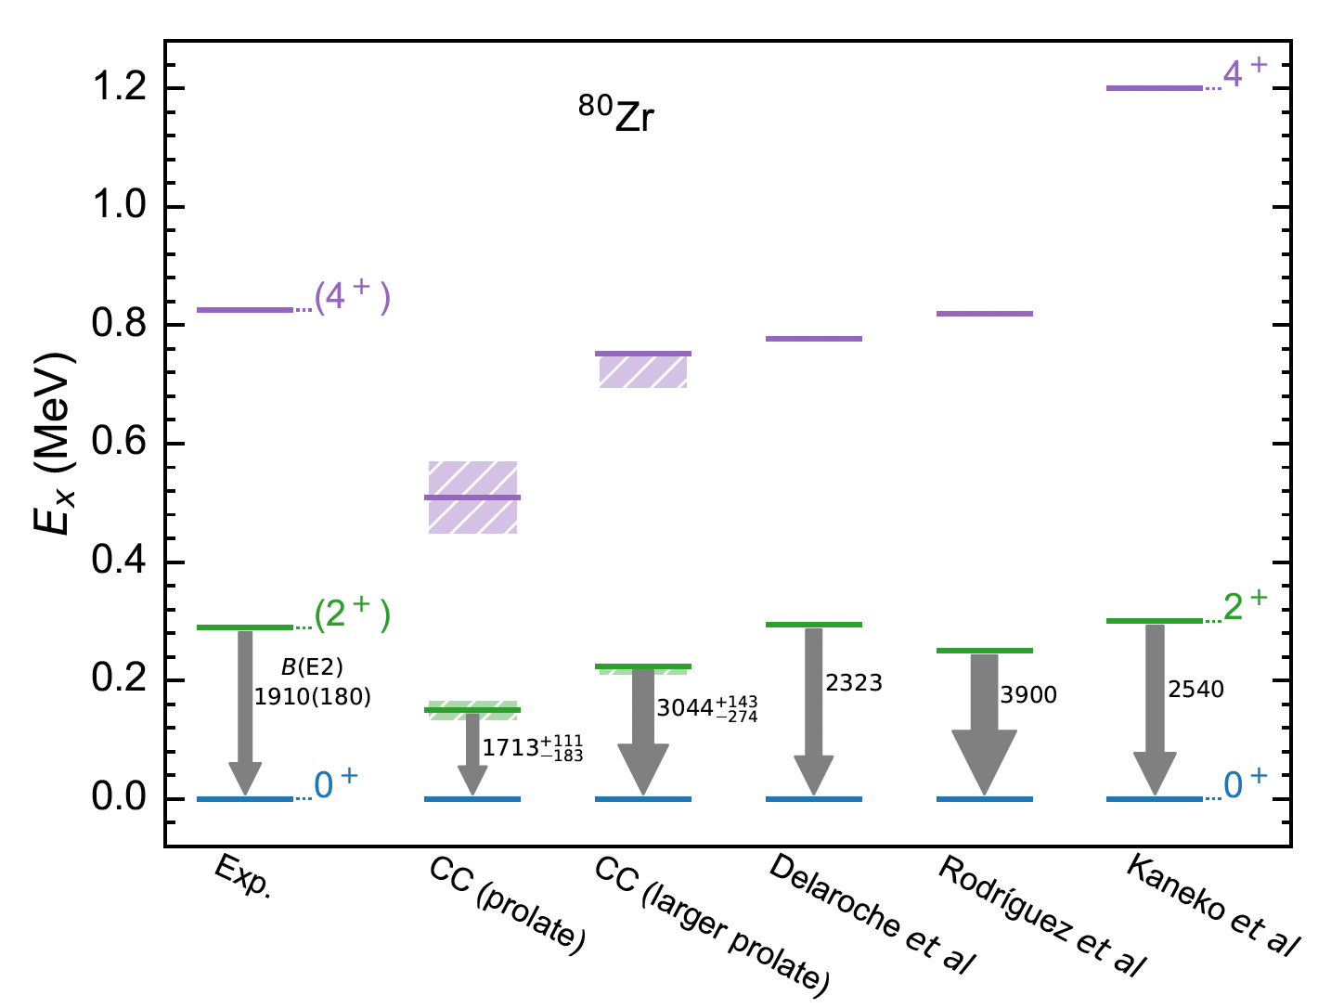
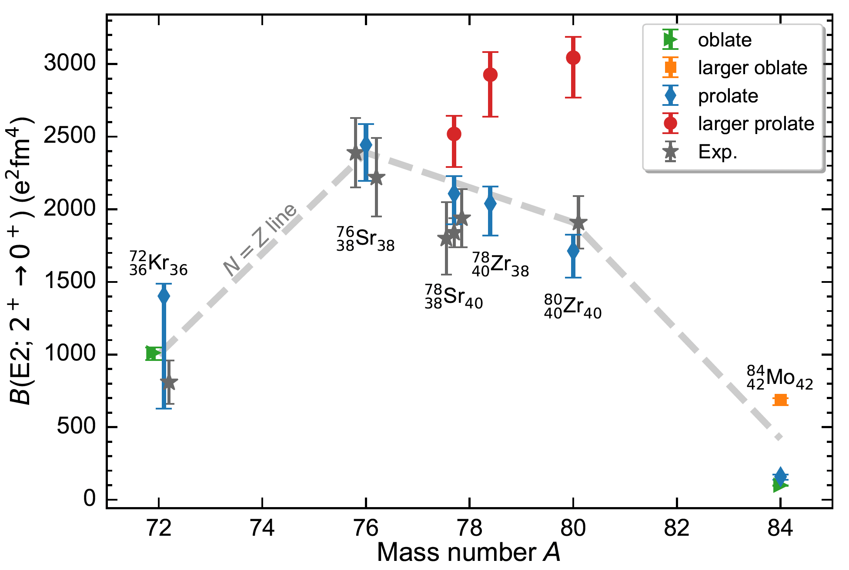

Strongly deformed nuclei around ⁸⁰Zr
Spectrum prefers larger prolate shape
$B(E2)$ prefers prolate band
See Jeongsu Ha’s
talk on Tuesday
1.8/2.0(EM)
Baishan Hu, Zhonghao Sun, G. Hagen, T. Papenbrock. Phys. Rev. C 110, L011302 (2024)

Slide 15
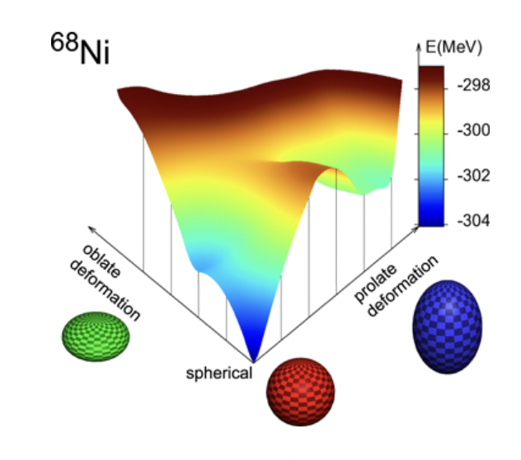
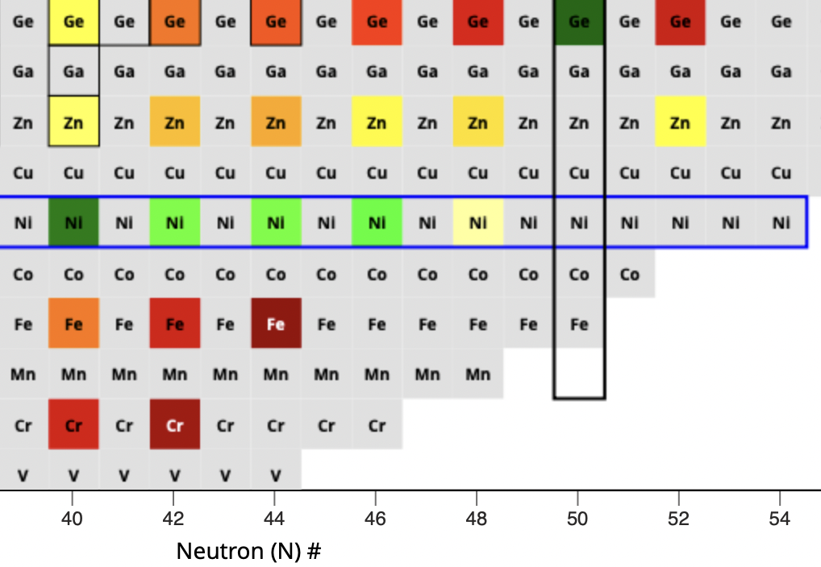
Deformation “south” of ⁷⁸Ni
R. Taniuchi, et al, Nature 569, 53 (2019)
T Otsuka and Y Tsunoda J. Phys. G 43 024009 (2016)
Deformed band?
Where is the band head?

Slide 16
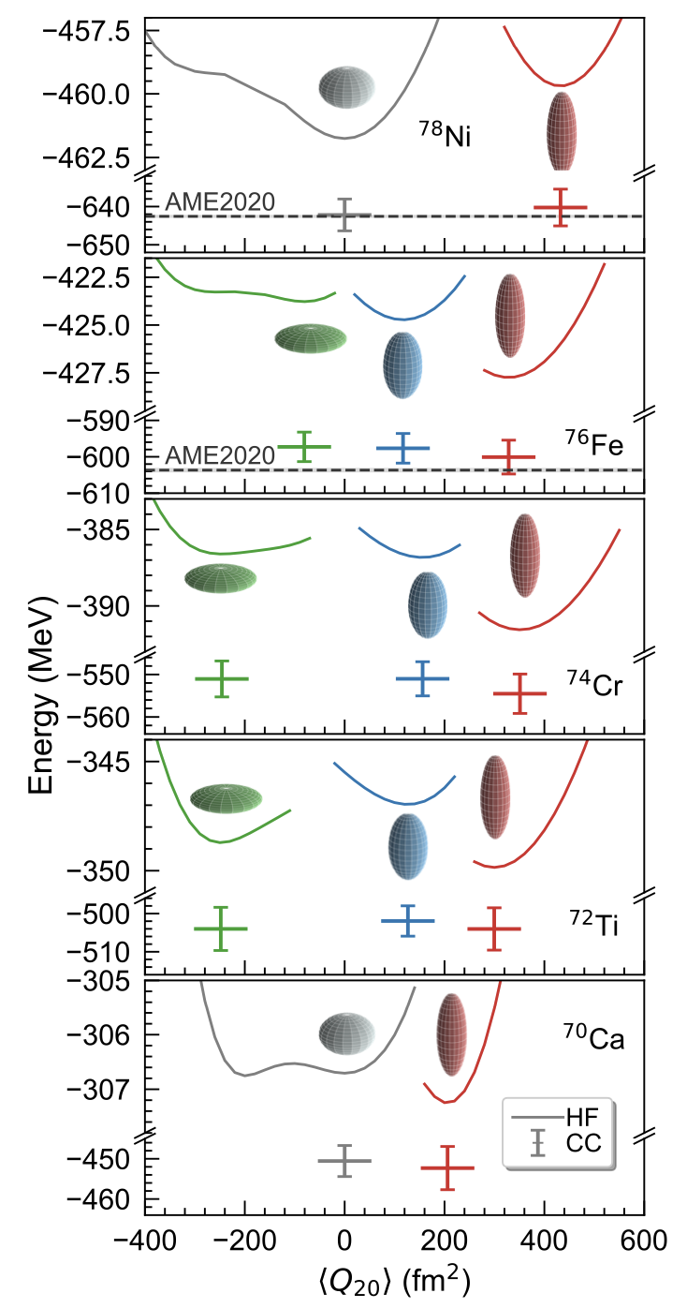
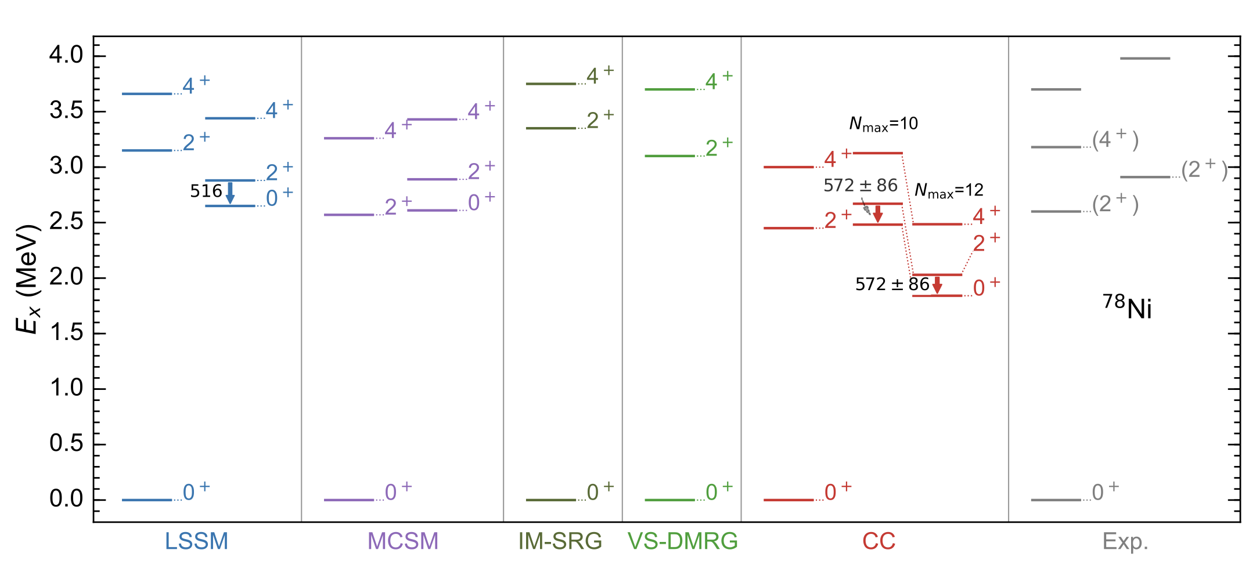
Deformation “south” of ⁷⁸Ni
Erosion of the magic number N = 50 toward ⁷⁰Ca manifested by onset of deformation in the ground-states
For ⁷⁸Ni we predict a low-lying rotational band consistent with recent data and other
F. Nowacki et al, PRL 117, 272501 (2016)
R. Taniuchi, et al, Nature 569, 53 (2019)
A. Tichai et al, Phys. Lett. B 855, 138841 (2024)
Baishan Hu, Zhonghao Sun, G. Hagen, G. R. Jansen, T. Papenbrock arXiv:2408.07856 (2024)

Slide 17
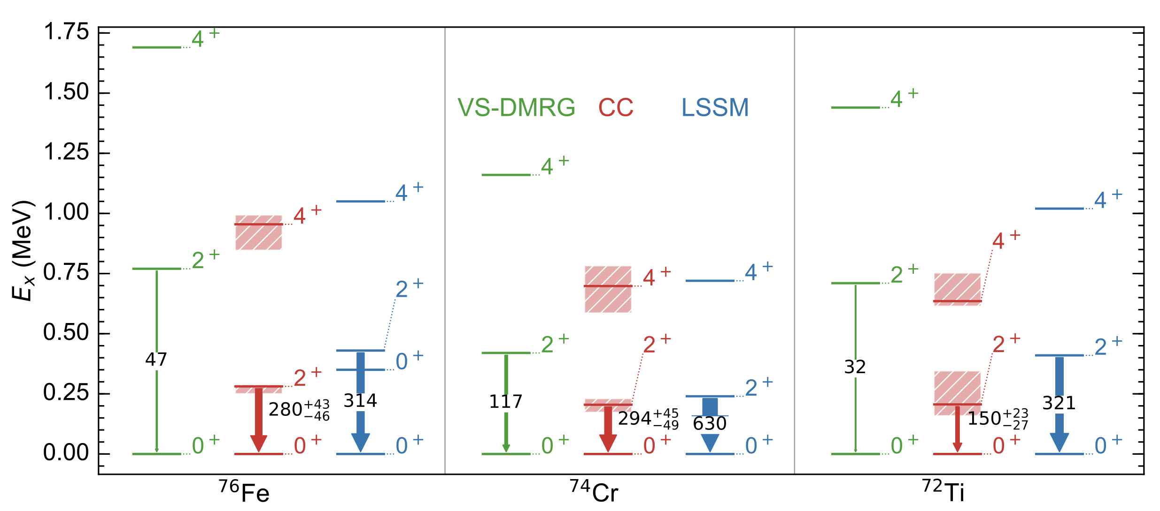
Deformation “south” of ⁷⁸Ni
Baishan Hu, Zhonghao Sun, G. Hagen, G. R. Jansen, T. Papenbrock arXiv:2408.07856 (2024)

Slide 18
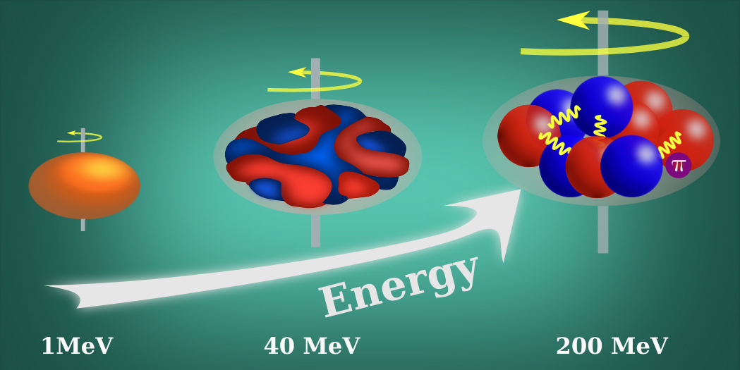
What drives deformation in nuclei?
50’s: surface vibrations of a liquid drop (Bohr/Mottelson)
60’s: competition between pairing and quadrupole interactions from HFB calculations in two shells (Baranger/Kumar)
70’s: isoscalar neutron-proton interactions dominate over isovector pairing from shell model (Federman/Pittel, Dufour/Zuker)
Parameters of the model
(17 at NNLO)
Constrained by data & carry uncertainties
Nuclear deformation viewed at different resolution scales

Slide 19
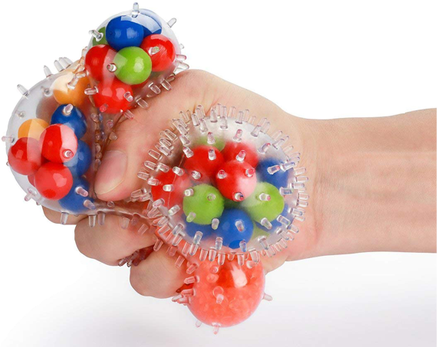
Global sensitivity analysis
Sensitivity analysis addresses the question ‘How much does each model parameter contribute to the uncertainty in the prediction?’
Global methods deal with the uncertainties of the outputs due to input variations over the whole domain.
Computational bottleneck
A global sensitivity analyses of properties of atomic nuclei typically would require more than one million model evaluations
Sensitivity analysis of the radius and binding energy of ¹⁶O
Andreas Ekström, Gaute Hagen PRL 123, 252501 (2019)

Slide 20
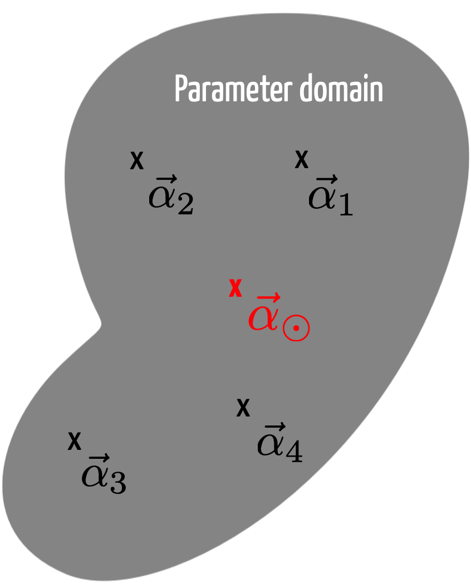
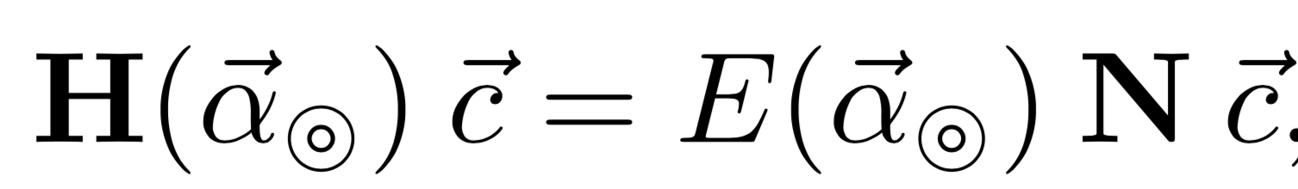
Reduced order model for deformed states
Zhonghao Sun, A. Ekstrom, C. Forssen, G. Hagen. G. R. Jansen, T. Papenbrock arXiv:2404.00058 (2024)
Eigenvector continuation method [Frame D. et al., Phys. Rev. Lett. 121, 032501 (2018), A. Ekström, G. Hagen PRL 123, 252501 (2019), S. König et al Phys. Lett. B 810 (2020) 135814]
Write the Hamiltonian in a linearized form
Select “training points” (snap-shots) where we solve the exact problem
Project a target Hamiltonian onto sub-space of training vectors and diagonalize the generalized eigenvalue problem
Latin Hypercube Sampling

Slide 21
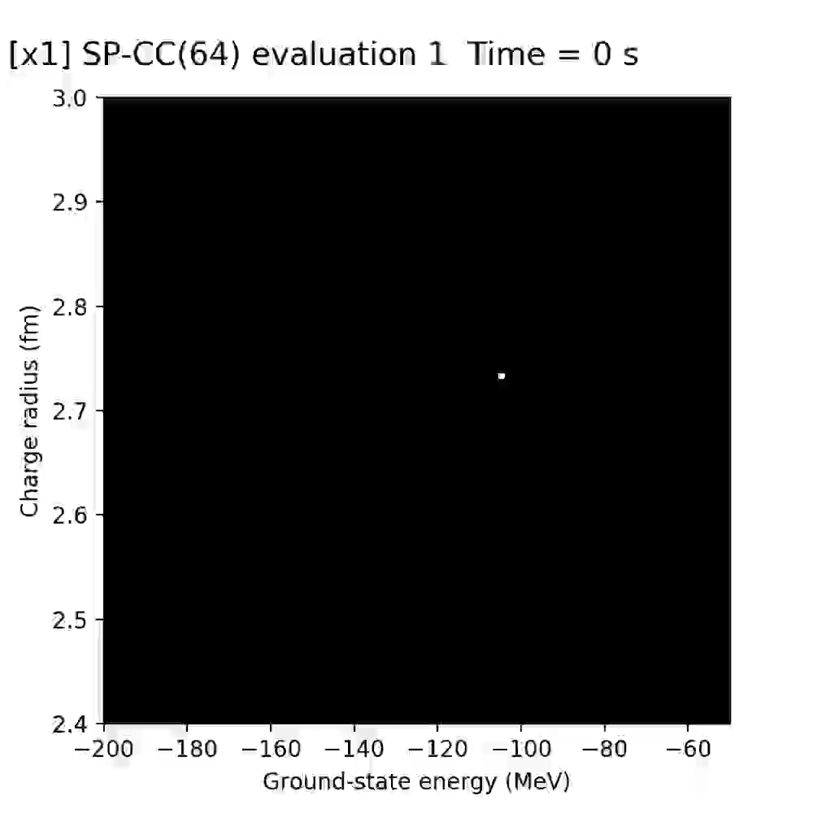
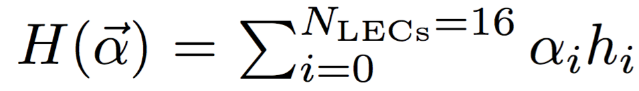
Computing nuclei at lightning speed
(~5 mins: ~10⁵ energy/radius calculations of ¹⁶O)
Realtime speed and accuracy of emulated ground-state energy and charge radius of ¹⁶O for different values of interaction parameters
Accuracy: roughly the pixel size
Speedup: 20 years of single node computations can be replaced by a 1 hour run on a laptop
Andreas Ekström, Gaute Hagen PRL 123, 252501 (2019)
Notes:
space-filling latin hypercube design
Select 64 and 128 sub-space vectors in the 16 dimensional space of LECs using a space-filling latin hypercube design

Slide 22
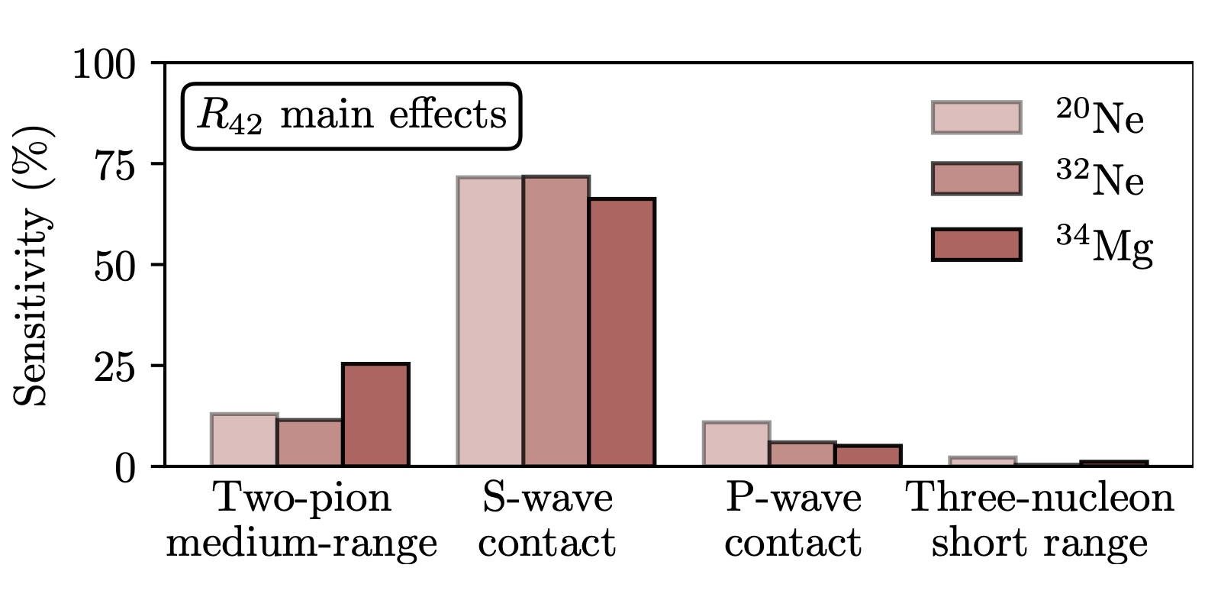
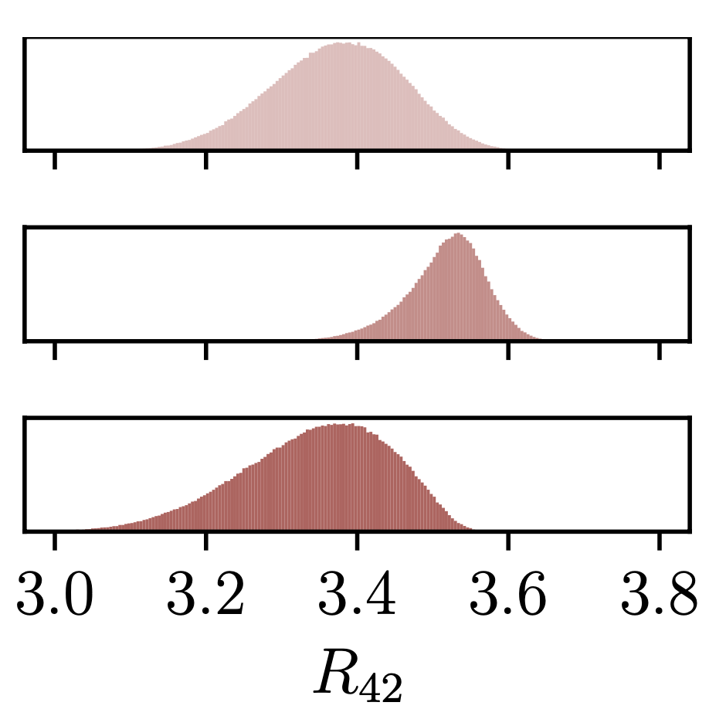
Linking deformation to nuclear forces
~10⁶ samples
More than 50% of the deformation is driven by the S-wave contact part of the interaction
Adding short-range repulsion increase deformation presumably by reducing pairing
Medium-range two-pion exchange is also important. Increasing its strength increases deformation, presumably by adding attraction in higher partial waves
Notes:
The first order sensitivity apportions the total variance in the model output to an individual model parameter αi. The higher-order indices, e.g. Sij, apportion the variance in the model output to the combination of parameters αi and αj

Slide 23
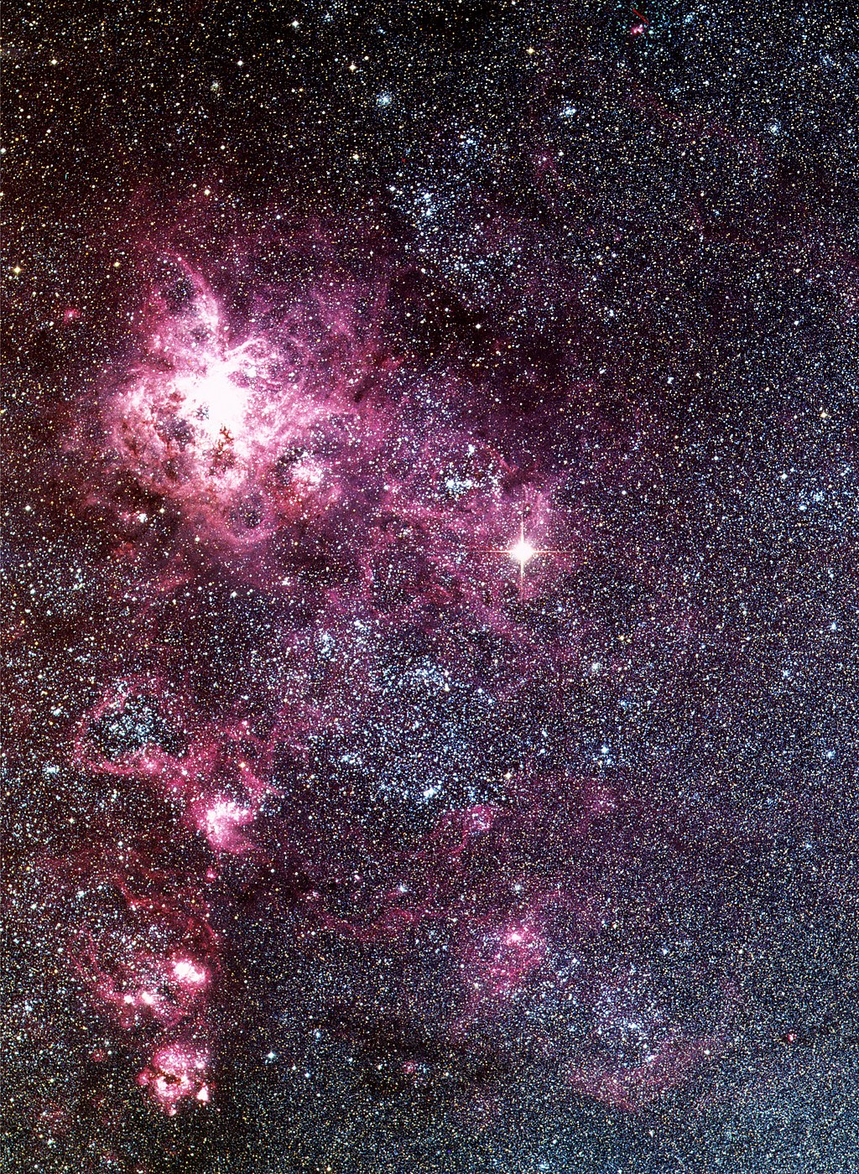
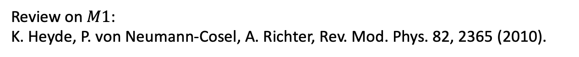
Why do people care about M1 transitions?
Supernova 1987A
M1 spin excitations are dominated by isovector contributions.
The isovector-0 component of the Gamow-Teller operator translates to inelastic neutral-current neutrino-nucleus reactions at energies relevant for supernovae.
Our understanding of M1 impacts supernovae signals and dynamics.
Lüttge, von Neumann-Cosel, Neumeyer, Richter, Nucl Phys A (1996);
Langanke, Martinez-Pinedo, von Neumann-Cosel, Richter, Phys Rev Lett (2004);
Loens, Langanke, Martinez-Pinedo, Sieja, EPJA (2012);
Tornow et al, Phys Letts B (2022).
Review on $M1$:
K. Heyde, P. von Neumann-Cosel, A. Richter, Rev. Mod. Phys. 82, 2365 (2010).
February 24, 1987
Las Campanas Observatory

Slide 24
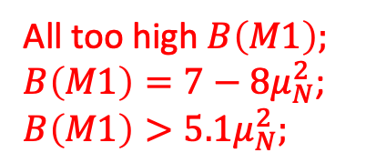
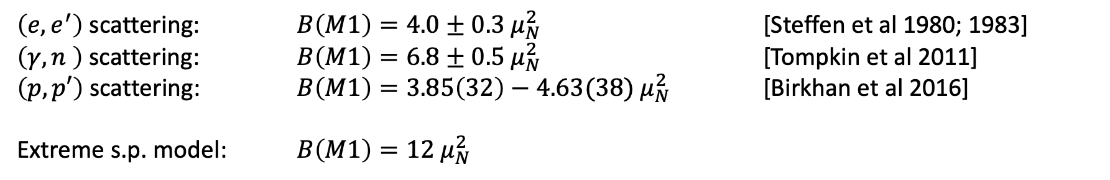
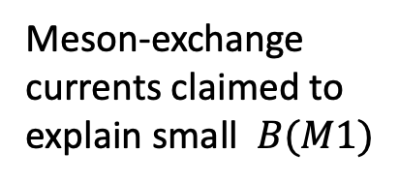
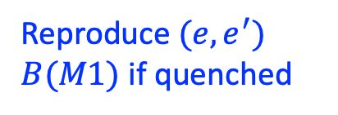
The status
$\left(e,e^{′}\right)$ scattering: $B\left(M1\right)=4{.0±0.3 μ}_{N}^{2}$ [Steffen et al 1980; 1983]
$\left(γ,n \right)$ scattering: $B\left(M1\right)=6{.8±0.5 μ}_{N}^{2}$ [Tompkin et al 2011]
$\left(p,p′\right)$ scattering: $B\left(M1\right)=3{.85\left(32\right)−4.63(38) μ}_{N}^{2}$ [Birkhan et al 2016]
Extreme s.p. model: $B\left(M1\right)=12 μ_{N}^{2}$
Theory has a hard time to reproduce a large amount of quenching
Meson-exchange currents claimed to explain small $B(M1)$
Harting, W. Weise, H. Toki, and A. Richter, Physics Letters B 104, 261 (1981).
J. B. McGrory and B. H. Wildenthal, Phys. Lett. B 103, 173 (1981).
Toru Suzuki, S. Krewald, and J. Speth, Phys. Lett. B 107, 9 (1981).
G. F. Bertsch, Nucl. Phys. A 354, 157 (1981).
M. Kohno and D. W. L. Sprung, Phys. Rev. C 26, 297 (1982).
K. Takayanagi, K. Shimizu, and A. Arima, Nucl. Phys. A 481, 313 (1988).
M. G. E. Brand, K. Allaart, and W. H. Dickhoff, Nucl. Phys. A 509, 1 (1990).
B. A. Brown and W. A. Richter, Phys. Rev. C 58, 2099 (1998).
J. D. Holt, J. Menendez, J. Simonis, and A. Schwenk, Phys. Rev. C 90, 024312 (2014).
J. Wilhelmy, et al., Phys. Rev. C 98, 034315 (2018).
All too high $B\left(M1\right);$
$B\left(M1\right)=7−8μ_{N}^{2}$; $B\left(M1\right)>5.1μ_{N}^{2};$
Reproduce $(e,e^{′})$ $B(M1)$ if quenched

Slide 25
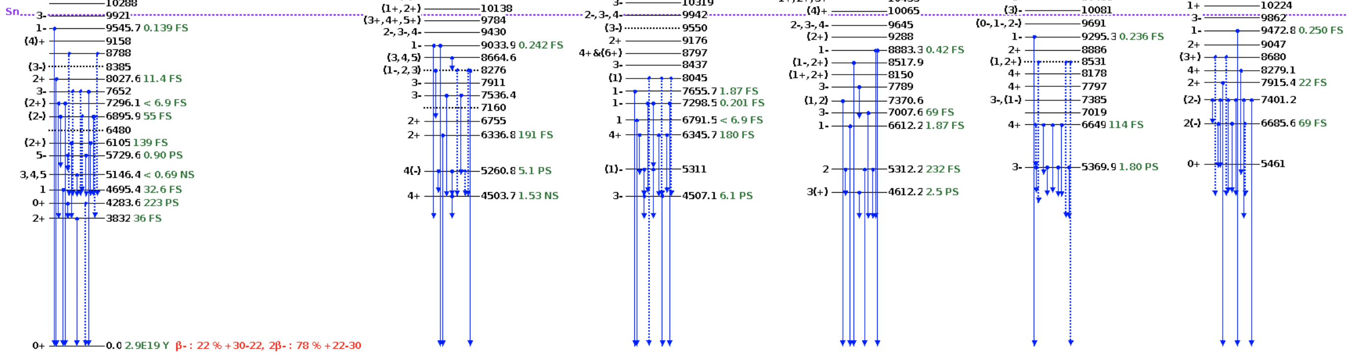
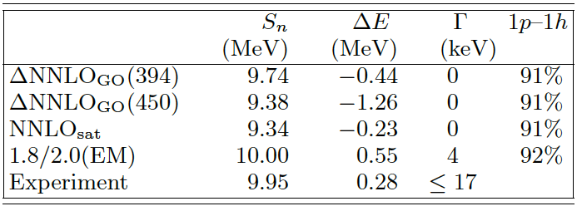


The resonant 1⁺ state in ⁴⁸Ca at 10.224 MeV
Scattering / reactions that probe the $1^{+}$ state: $(e,e^{′})$, $(p,p′)$, $(p,n)$, or $(γ,n)$
Simple picture of the $1^{+}$ state: neutron 1p-1h excitation; extreme single-particle model: $B\left(M1\right)=12 μ_{N}^{2}$
Bijaya Acharya et al., Phys. Rev. Lett. 132, 232504 (2024)

Slide 26

Contributions to B(M1)
continuum
2p-2h correlations
2B currents
3p-3h correlations
Bijaya Acharya et al., Phys. Rev. Lett. 132, 232504 (2024)

Slide 27

Magnetic dipole transition in ⁴⁸Ca
Bijaya Acharya et al., Phys. Rev. Lett. 132, 232504 (2024)

Slide 28
Summary
Breaking and restoring symmetries
  Exploits separation of scale between collective and specific UV physics
  Conceptually simple & computationally affordable
  Shape coexistence in ³⁰Ne and ³²Mg
  Connected deformation to microscopic forces
  Much improved B(E2) values with no effective charges in ^{3x}Ne, ^{3x}Mg, ⁸⁰Zr
  B(M1) in ⁴⁸Ca larger than (e,e’) but in agreement with (n,𝛾)
  Two-body currents do not quench B(M1)
Thank you for your attention!

Slide 29


M1 moments in calcium
$$μ_{NLO}(k)=−\frac{i}{2}∇_{q}×J_{1π}(q,k)|_{q=0}+\frac{i}{2}e(τ_{1}×τ_{2})_{z}R×∇_{k}V_{1π}(k)$$
“Intrinsic”
“Sachs”
Sachs term give dominant contribution
Bijaya Acharya et al., Phys. Rev. Lett. 132, 232504 (2024)

Slide 30
Shape co-existence in ³²Mg
Zhonghao Sun, A. Ekstrom, C. Forssen, G. Hagen. G. R. Jansen, T. Papenbrock arXiv:2404.00058 (2024)
Notes:
signatures of the N = 20 magic number can be seen in our calculations and lead to shape coexistence

Slide 31


Deformation in neutron-rich magnesium
⁴⁰Mg
Crawford et al. PRL 122, 052501 (2019)
Tsunuda et al, Nature 587, 66 (2020)
³⁹Mg
Rotational structure in good agreement with experiment
Indications of shape co-existence in ⁴⁰Mg
Find oblate band in ⁴⁰Mg 2-3MeV above the prolate band
Ikuko Hamamoto, Phys. Rev. C 93, 054328 (2016)

Slide 32


Benchmarking projected coupled-cluster in ²⁰Ne
Benchmarks from SA-NCSM
[Dytrych, Launey et al. (2020)]
NNLO_{opt}
Notes:
Dynamic correlations re- fer to excitations between a dominant configuration and a relatively small number of other configurations that are energetically important. Static correlations are between many dominant configurations. In the case of a symmetry-breaking deformed reference state, for ex- ample, any rotation of the reference state yields another dominant configuration.
32

Slide 33

Cross-validation of projected HF emulator
400 cross-validation points 10% around Delta-GO(394)
³²Ne
Accuracy of R42 emulators as measured by the difference with respect to 400 exact Hartree-Fock calculations
The standard deviation of the differences indicates a relative precision of 1%
The emulated energies are accurate on the 10 keV level
Total energy
R42 ratio
Notes:
The first order sensitivity apportions the total variance in the model output to an individual model parameter αi. The higher-order indices, e.g. Sij, apportion the variance in the model output to the combination of parameters αi and αj

Slide 34

Inclusion of three-body forces
The normal ordered 2-body approximation breaks rotational symmetry when normal-ordered with respect to a broken symmetry reference state
Perform spherical HF with fractional filling to normal-order three-nucleon force
Use normal-ordered Hamiltonian in the 2-body approximation in a second HF calculation of deformed nuclei
What is the correct spherical filling in very deformed nuclei?
Mikael Frosini et al, Eur. Phys. J. A 57 (2021)

Slide 35


Deformation “south” of ⁷⁸Ni

Slide 36

Coupled-cluster computations of strongly deformed nuclei around ⁸⁰Zr

Slide 37
Model-space convergence of energies

Slide 38
Model-space convergence of B(E2)s

