Slide 1

Winter Nuclear & Particle Physics Conference - 2024
Bromont, QuEbec
McGill University, SNOLAB, TRIUMF
https://indico.triumf.ca/e/WNPPC2024

Slide 2
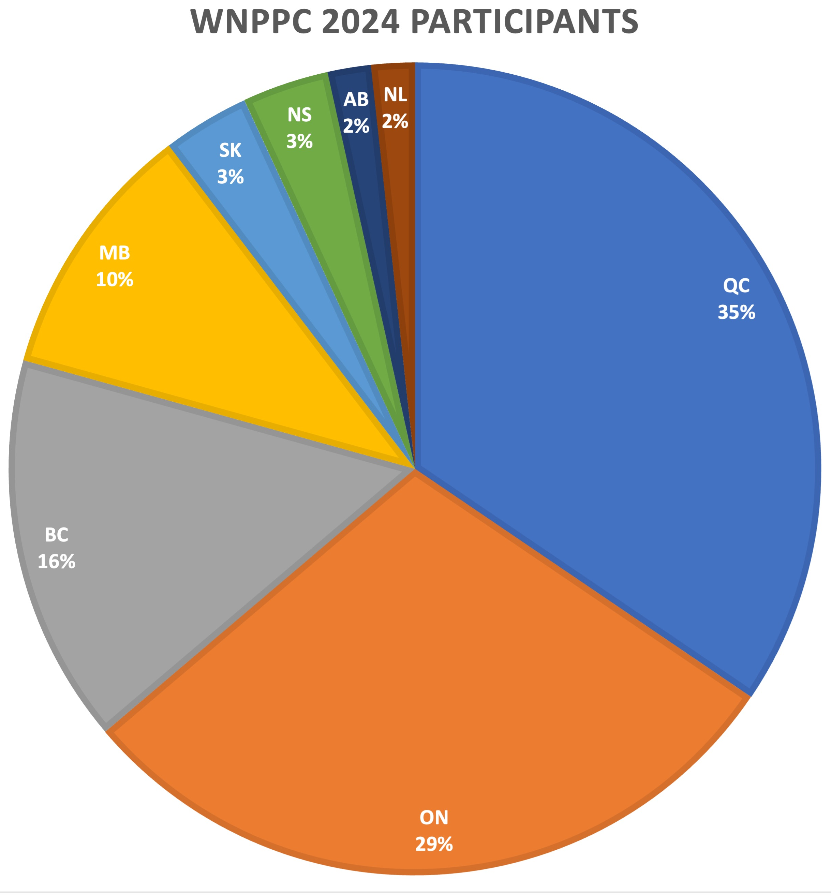
Welcome to Bromont!
43 student participants
18 regular participants
8 companions
A warm welcome to all participants!

Slide 3
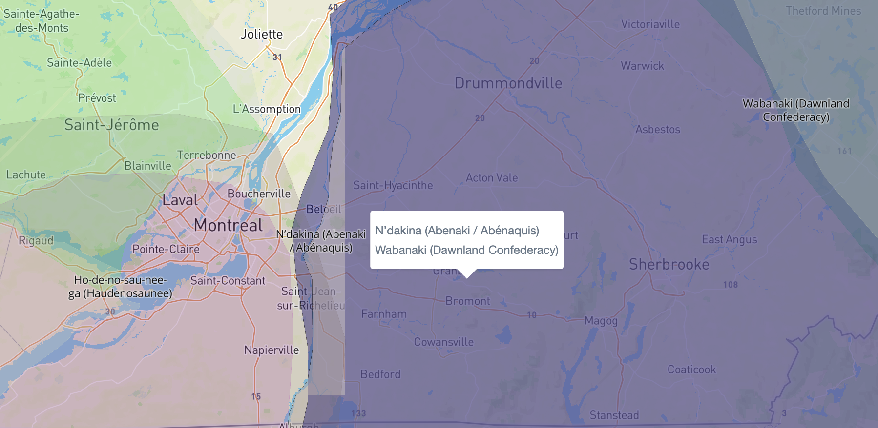
Native-Land.ca

Slide 4







SPONSORS
Physics Department – Département de Physique
Particle Physics Division (PPD)
Division of Nuclear Physics (DNP)

Slide 5
Code of Conduct
Behaviour that violates our code of conduct will not be tolerated and under given circumstances can have the consequence of revoking the privilege to participate in WNPPC2024.
In line with our core values of Equity and Inclusion, we are committed to providing a safe and inclusive environment that fosters the exchange of scientific ideas, encourages open and respectful dialogue, and is free of harassment and discrimination.
We respect each other, take care of each other, and support the success of all. We do not tolerate discrimination, harassment, or bullying. Conference participants have a right to belong and a responsibility to treat one another with respect.
Acts of discrimination, harassment, or bullying will result in immediate action, and notification of appropriate authorities, if necessary. This includes, but is not limited to: sexual harassment, intimidation, threatening behaviour, sustained disruption, use of offensive or demeaning language including unwelcome or offensive jokes, unwanted photography, screenshots or recording without consent, engaging in biased, demeaning, or hostile commentary based on individual characteristics such as age, race, ethnicity, sex, sexual orientation, gender identity or expression, marital status, nationality, political affiliation, ability status, educational background, or any other characteristic protected by law.

Slide 6
Code of Conduct
We respect each other, take care of each other, and support the success of all.

Slide 7
Code of Conduct
If you have any concerns, have experienced or observed any behaviour that violates this code of conduct, please feel encouraged to contact the conference ombudspersons via email or private message.
The Ombudspersons for WNPPC2024 are:
Thomas Brunner – thomas.brunner@mcgill.ca
Erica Caden – erica.caden@snolab.ca
WNPPC2024 Conference Organizer is:
Jana Thomson - WNPPC@triumf.ca
All complaints will be treated with the utmost seriousness and discretion.

Slide 8
Food
Meals and Coffee Breaks
Coffee and snacks are included in your conference registration fee. For those attendees staying at the Hotel Chateau Bromont, breakfast is included in the room fee. For those who have purchased lunches and dinners, meal tickets can be found in the registration package and will be collected at the Restaurant.
4 Canards Restaurant
Breakfast: 6:30 – 10:00
Lunch:
Dinner: 17:30 – 21:30
Beagle Club
11:30 – midnight

Slide 9
Map

Slide 10
Student Talk Judging
Thanks to CINP and IPP for their support of best student presentation prizes!
Talks will be judged on:
  Oral - How well did the presenter present their ideas?
  Motivation/Significance - What was the significance of the presenter’s research?
  Discussion/Conclusions - Does the presenter draw logical conclusions from the results obtained?
  Visual - Were their slides designed in a clear and attractive manner?
  Response to Questions -Are they able to frame their talk within the bigger picture?

Slide 11
Adventure Afternoons
Afternoons are free for you to explore Bromont and the outdoors (and the indoors)
Bromont ski area is a quick walk/shuttle drive away. Shuttles are available at the hotel. Call their number to schedule pick up or drop off
Besides skiing there are other activities:
  Spa
  Hiking
  Snowshoeing

Slide 12

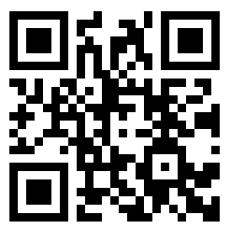

Slide 13


Slide 14
Enjoy the Conference!
https://indico.triumf.ca/e/WNPPC2024

