Slide 1
Data Analysis for the NEWS-G Dark Matter Experiment
Jon Clarke (he/him), jon.clarke@queensu.ca PhD student, supervisor Guillaume Giroux
Globie
WNPPC, 16 February 2024

Slide 2
Introduction
What is the NEWS-G experiment?
What is its current status?
How have I analyzed some of its data?

Slide 3
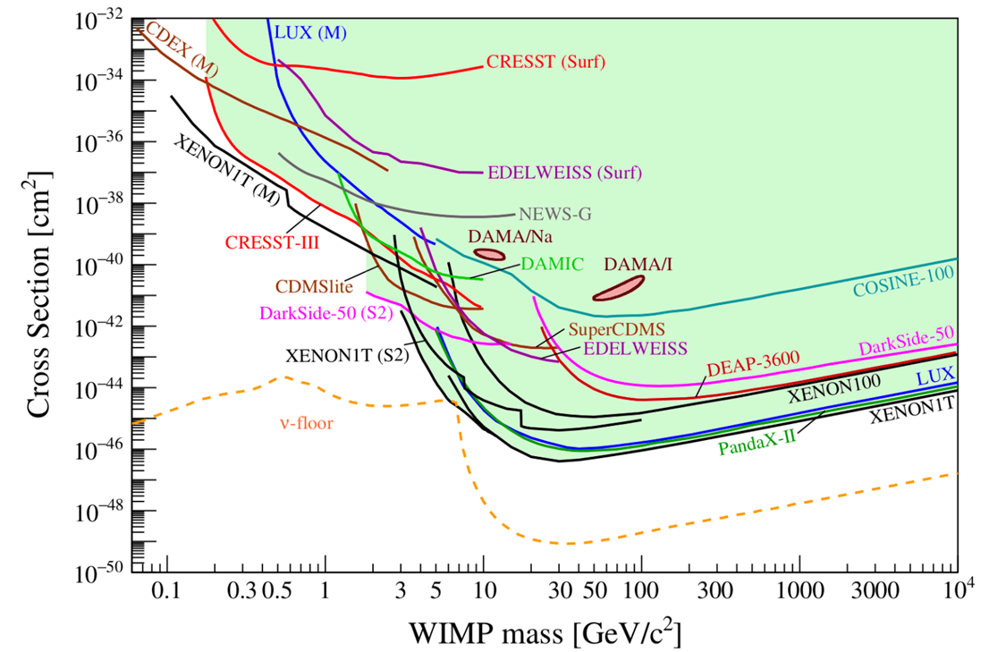
Low-mass WIMP search motivation
arXiv:2104.07634 [hep-ex]
Absence of canonical weakly interacting massive particles (WIMPs)
Motivation to look at remaining parameter space at lower masses (~0.1−1 GeV) for WIMP-like dark matter candidates

Slide 4
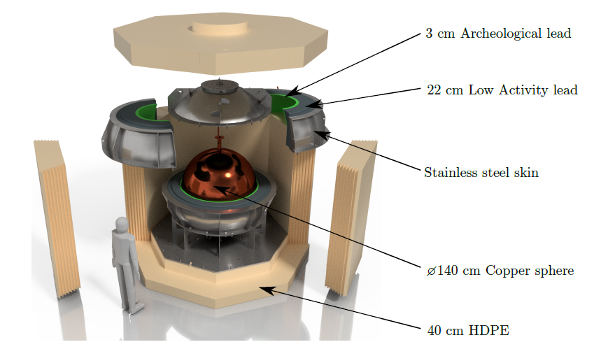
NEWS-G and SPCs
Spherical proportional counters (SPCs)
Grounded metal spheres
Filled with gas, e.g., neon + 2% methane
Central anode - radial electric field
New Experiments with Spheres–Gas (NEWS-G) experiment - copper SPCs to search for low-mass dark matter
Previous dark matter limits
SEDINE detector (60 cm diameter) at Laboratoire Souterrain de Modane (LSM), France, in 2017
Latest detector
S140 (140 cm diameter) currently at SNOLAB, Sudbury, Canada, after short commissioning at LSM in 2019
SNOLAB detector paper doi:10.1088/1748-0221/18/02/T02005

Slide 5
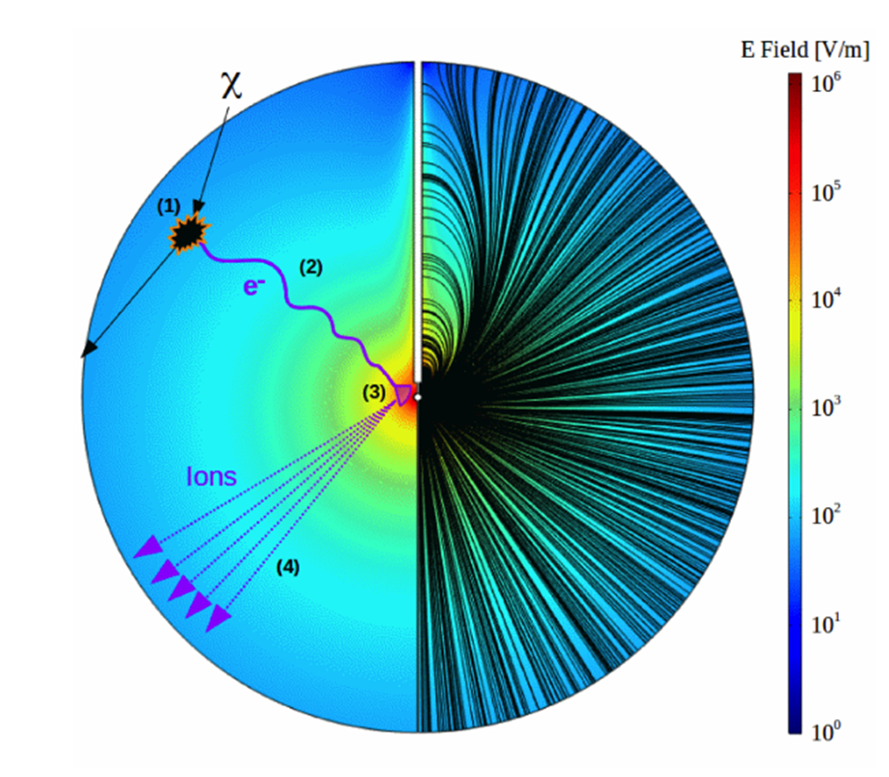
Principle of operation
Gas molecules ionised by incoming particles
Freed primary electrons drift towards central anode
Townsend avalanche close to the anode produces secondary electron-ion pairs, amplifying signal
Current induced in the anode by drifting secondary ions

Slide 6
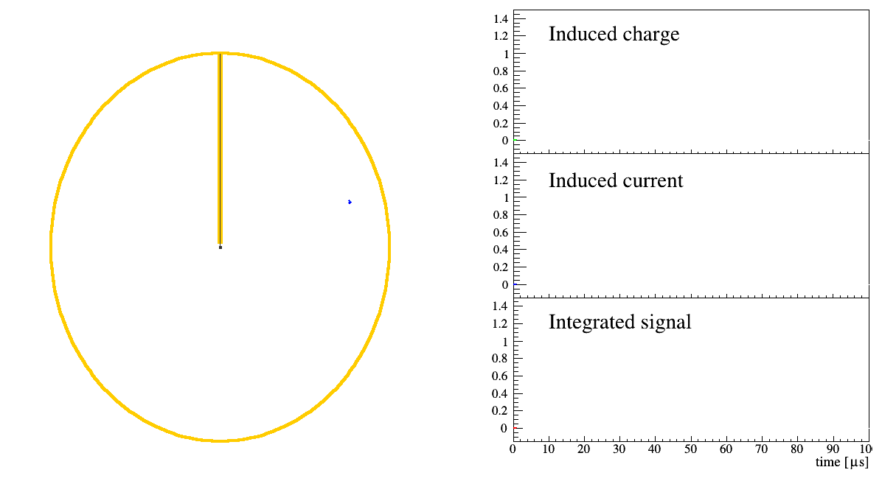
P Gros

Slide 7
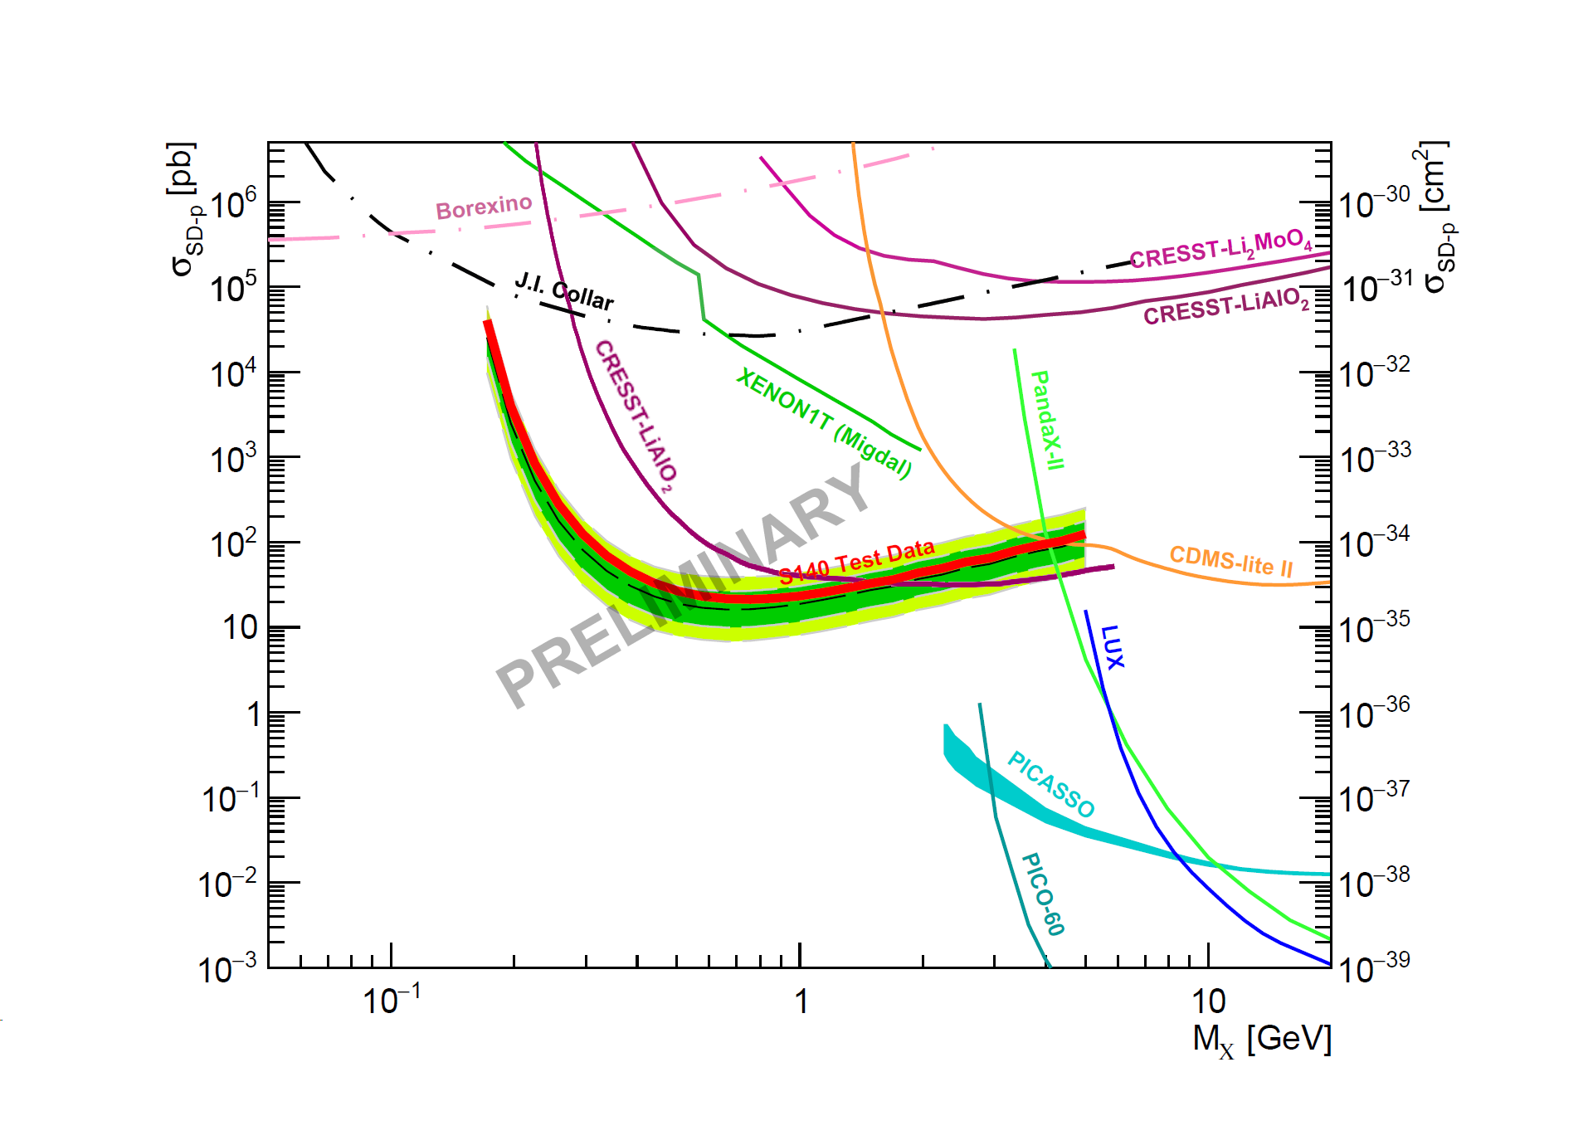
Current status
Unblinded S140 LSM data last month, “watch this space”
In green are the limits predicted before unblinding
Strongest constraints for proton spin-dependent interaction at 0.2-1.5 GeV
Have also been gathering S140 data at SNOLAB since July 2022
scipost_202210_00005v1

Slide 8
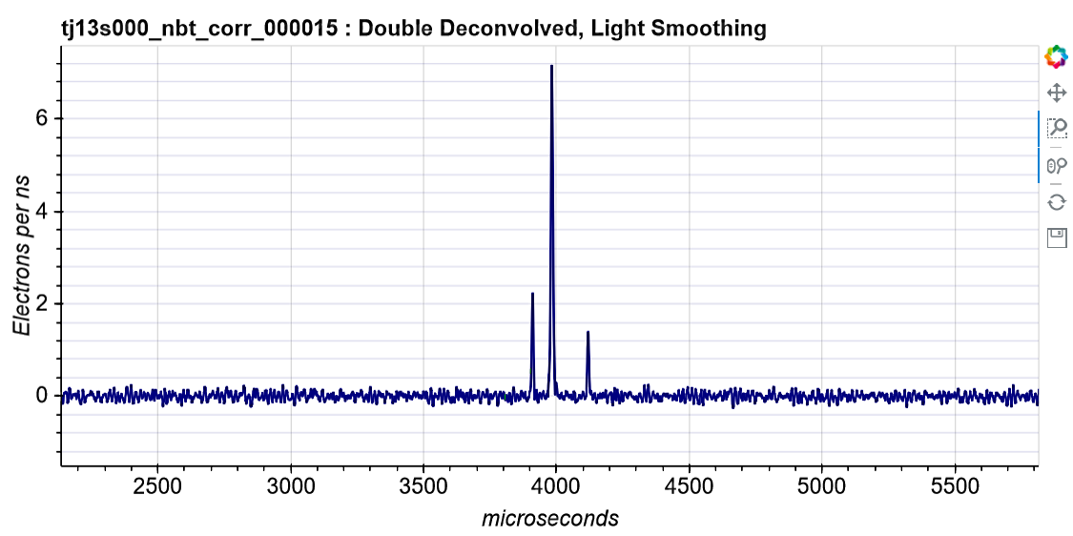
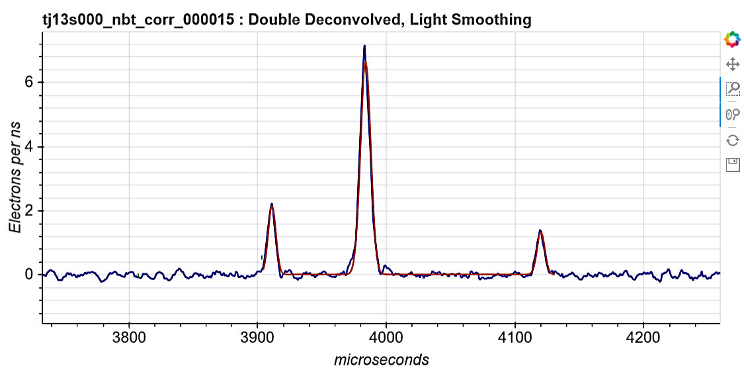
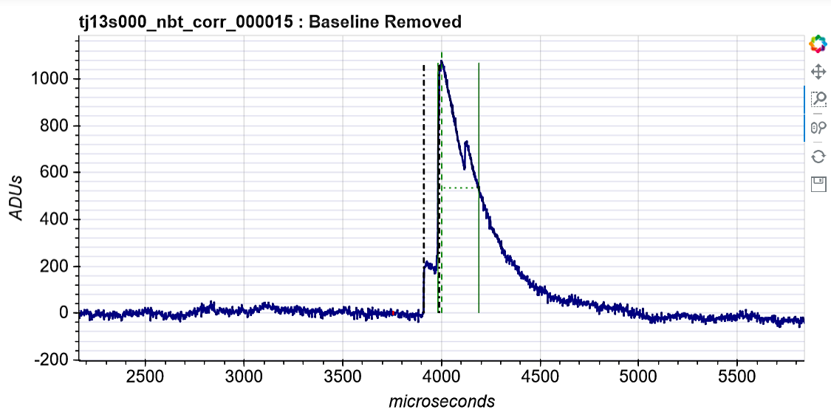
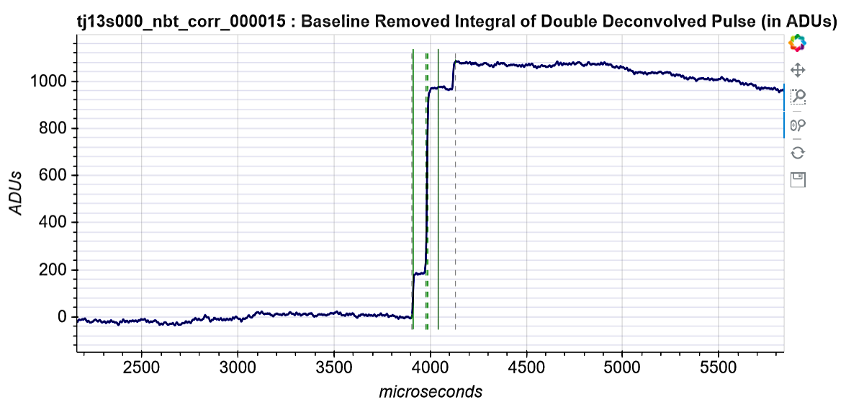
Double deconvolution
Double deconvolution
Voltage (ADUs)
Integration
Time (μs)
Signal amplitude underestimated due to the exponential decay of the preamplifier
Full amplitude (energy) is retrieved by doing a double deconvolution of the raw signal, and then integrating the pulses
8

Slide 9
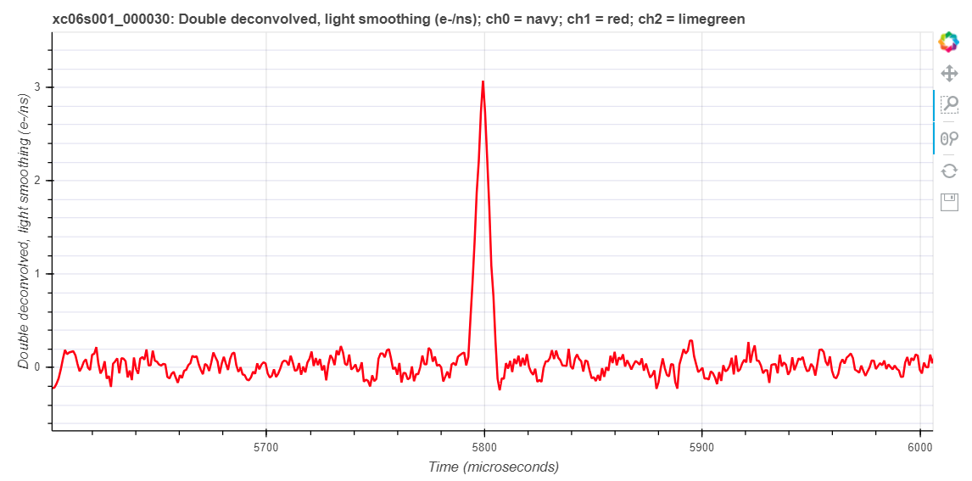
Single-electron background
Limiting factor for our WIMP exclusion limits
Mechanism of this background not known
Hypothesis: it is similar to that for “alpha tails”, but generated by lower-energy events
Typical double-deconvolved signal from a single primary electron

Slide 10
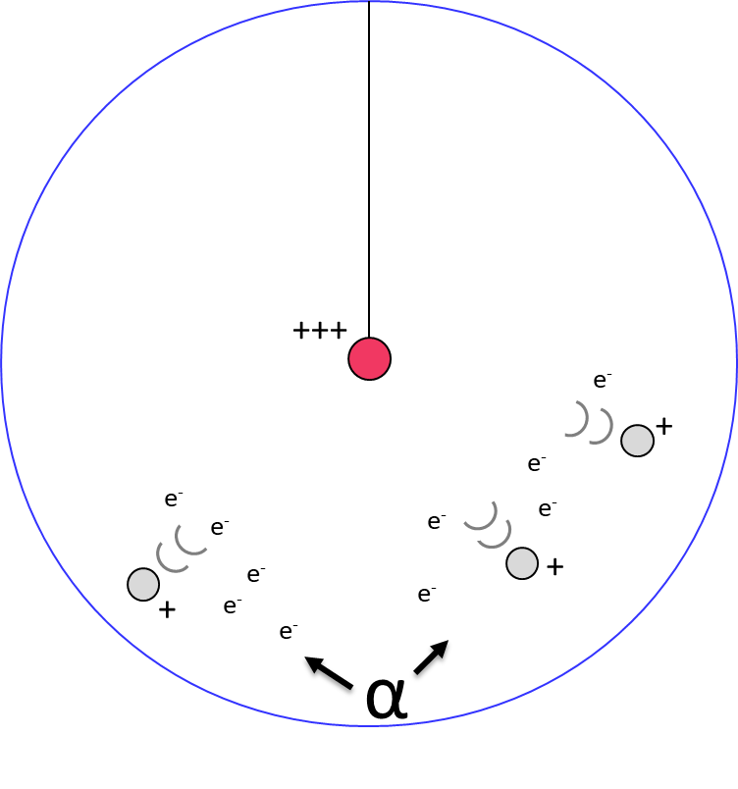
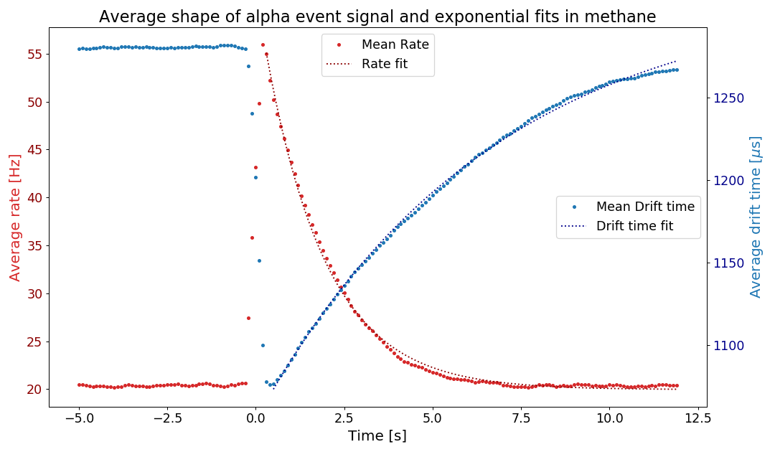
Alpha contamination
Inner surface of the sphere is contaminated with Pb-210, which decays to the alpha-emitter Po-210, ~25 mHz of alphas
Alphas ionize a lot of gas and create a space charge that disturbs the electric field; changes the electron drift time
For some still unknown reason, a high rate of low-energy events occur for around 5s after each alpha; so-called “alpha tail”
5 s cut after each alpha reduces background by ~70% but exposure by only ~12%
Rate increases
Average drift time (μs)
Average rate (Hz)
Methane 135 mbar 1630 V
Drift time decreases
Time (s)

Slide 11
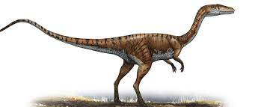
Alpha tails
α
Hypothesis: due to negative ions (rather than e) caused by attachment, especially to O₂ molecules
If we learn something about the alpha tails, perhaps we learn something about the single-e background?
I analyzed and compared 14 runs across 25 days, when we know that detector had a leak and the gas was not refilled, so gas quality was continually worsening, and run conditions were otherwise identical
(The leak has since been fixed… by tightening one screw… oops)

Slide 12
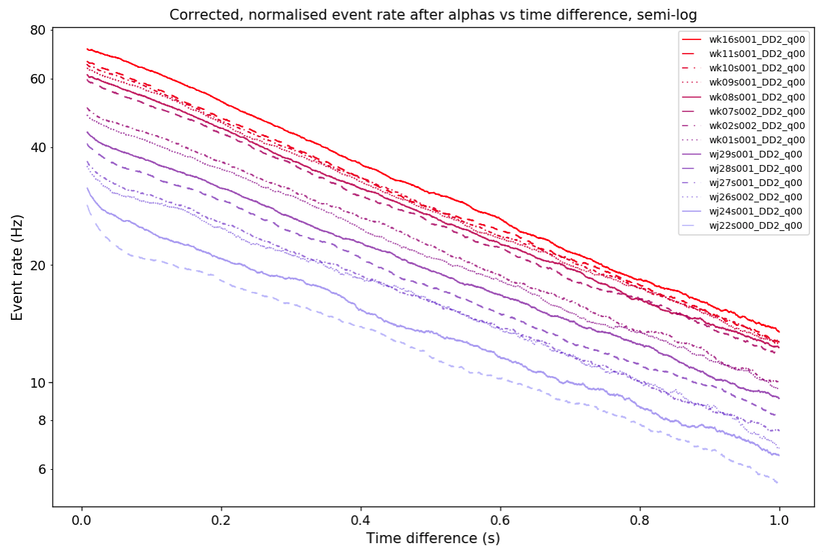
22 Oct (j22) to 16 Nov (k16), 2022
Evidence that the alpha tail worsens as gas quality worsens
1st indication that single-e background might relate to gas quality
Event rate (Hz)
Fast, early decay disappears
Event rate increases
(Also, decay constant of exponential fit increases, 1.32 to 1.49 s⁻¹)
Time since alpha event (s)
J Clarke

Slide 13
What’s next?
NEWS-G
SNOLAB test data available (began July 2022)
Other projects: G3 - study coherent elastic neutrino-nucleus scattering; ECuME - electroform a 1.4 m SPC underground, then DarkSPHERE – electroform 3 m SPC underground at Boulby, UK
My work
Shift consideration from this double-deconvolved data to our peak-finding data
Directly study phenomenon with biggest impact on exclusion limit: single-electron background

Slide 14
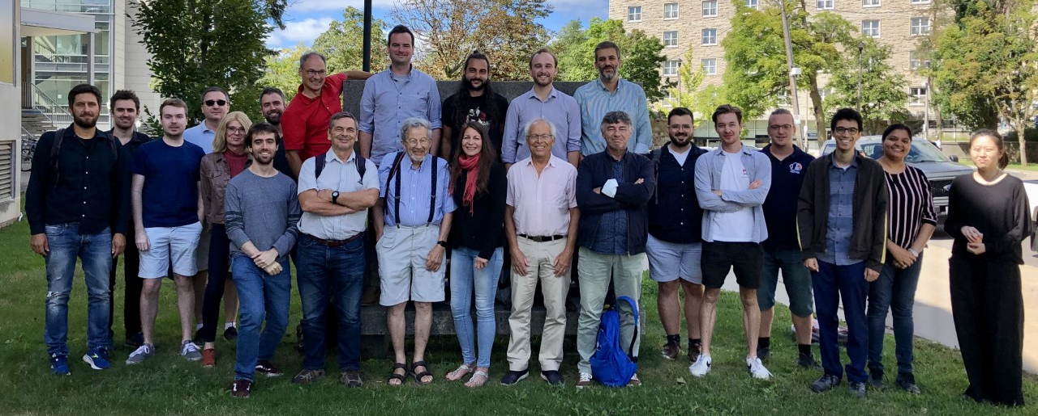
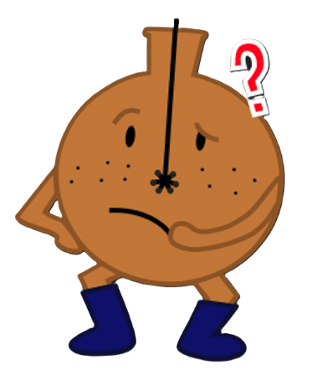
https://www.queensu.ca/physics/news-g/teams/collaboration
Thank you
Any questions?

Slide 15
Extra slides

Slide 16
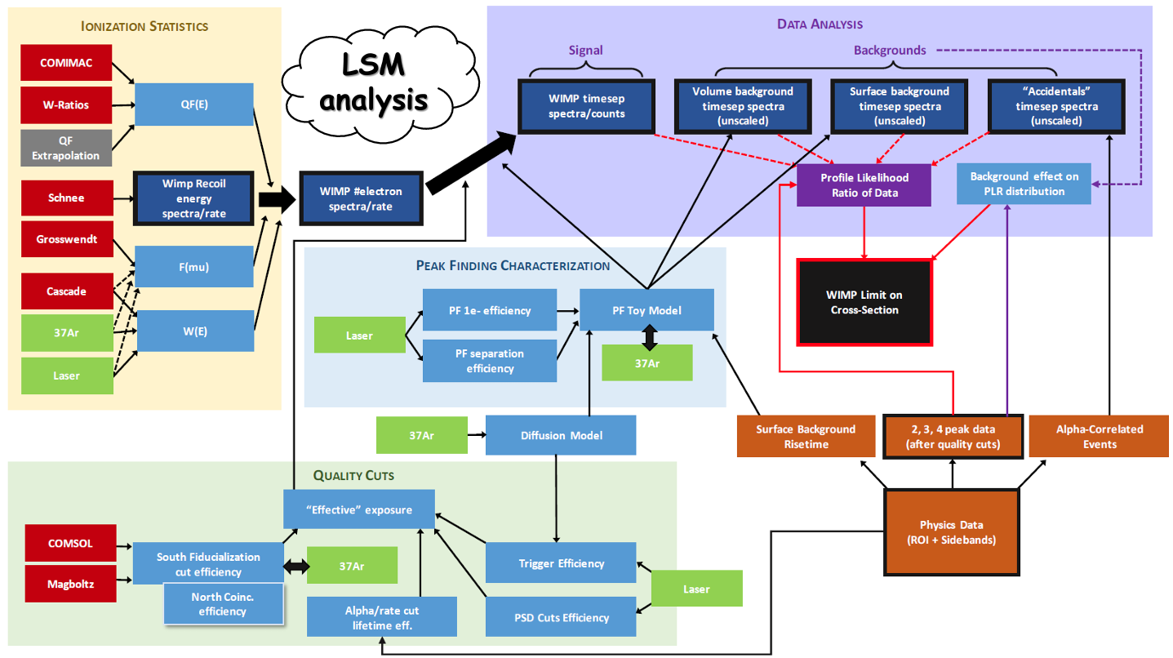
F Vazquez de Sola

Slide 17
Submitted abstract
The NEWS-G experiment searches for low-mass dark matter candidates at SNOLAB in Sudbury, Ontario. This direct dark matter search is performed using a spherical proportional counter filled with low atomic mass gases, such as 98% neon + 2% methane. The detector consists of a grounded copper sphere with a high-voltage anode in the centre, which detects ionization within the gas. The inner surface of the sphere is contaminated with Pb-210, which decays to the alpha-emitter Po-210. After each background alpha decay, space charge effects cause the event rate in the detector to increase, creating an "alpha tail". One set of runs covered a period when the gas quality in the detector was worsening. Analysis of the event rate uncovered a relationship, with worsening gas quality increasing the alpha tail. I will describe the experiment, and present its existing results and current status, and my analysis of the alpha tails. Greater understanding of the alpha tails may elucidate the cause of the detector's most common background events, single-electron ones, suggesting a valuable focus for future work.
https://indico.triumf.ca/login/?next=/event/441/abstracts/1169/
6 min - 6 slides on NEWS-G; 6 mins - 6 slides on my alpha-tails analysis; 3 min for questions

