Slide 1

#133
Photon-to-Digital Converter for Large Scale Noble Liquid Detectors and Neutron Imaging
Olivier Lepage^{1,2} , Tommy Rossignol^{1,2}, Nicolas Roy^{1,2}, Frédéric Vachon^{1,2}, Keven Deslandes^{1,2}, Arnaud Samson^{1,2}, Lorenzo Fabris³, Jean‑François Pratte^{1,2} and Serge A. Charlebois^{1,2}
¹ Université de Sherbrooke, Department of Electrical and Computer Engineering, Sherbrooke, Québec, Canada
² Interdisciplinary Institute for Technological Innovation, Sherbrooke, Québec, Canada
³ Oak Ridge National Laboratory, Oak Ridge, United States
February 15th to 18th 2024
61st Winter Nuclear & Particle Physics Conference

Slide 2
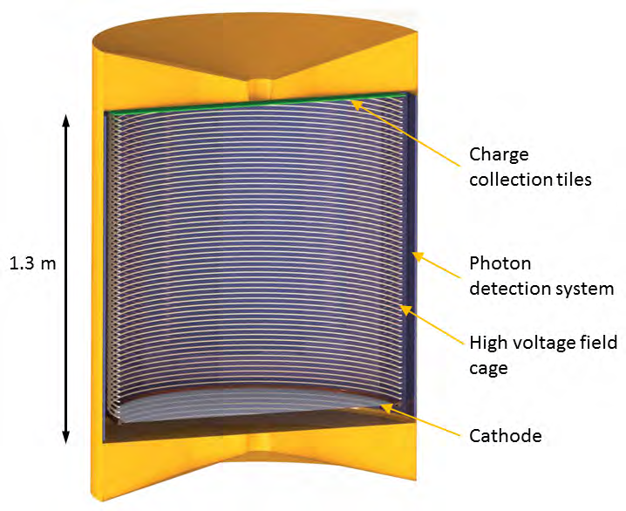
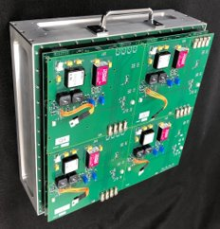
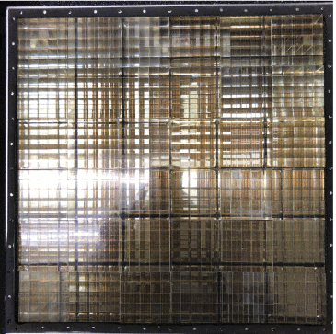
Large Scale Noble Liquid Experiments and Neutron Imaging
Large Scale Noble Liquid Experiments
Neutrinoless double beta decay and dark matter search
4.6 m² of detectors
200 W max.
Neutron imaging
Large pixelated sensitive area
Portability (compact and low-power)
30 cm
30 cm
ORNL Portable Pixelated Fast-Neutron Imaging Panel [2]
[1] nEXO Collaboration et al, 2018

Slide 3
Large Scale Noble Liquid Experiments and Neutron Imaging
Large Scale Noble Liquid Experiments
Neutrinoless double beta decay and dark matter search
4.6 m² of detectors
200 W max.
Neutron imaging
Large pixelated sensitive area
Portability (compact and low-power)
30 cm
30 cm
ORNL Portable Pixelated Fast-Neutron Imaging Panel [2]
[1] nEXO Collaboration et al, 2018
Need : Large area, low-power and good timing precision photon counting system.

Slide 4
Digital Solution: 3DPDC + Tile controller
PCB
Notes:
Our solution
3D integration (detector top and electronic bot)
Maximize photosensitive (why?)
Tile controller: interfacing and communication
Transition: Lets talk about how the detector work

Slide 5
Digital Solution: 3DPDC + Tile controller
PCB
Notes:
Our solution
3D integration (detector top and electronic bot)
Maximize photosensitive (why?)
Tile controller: interfacing and communication
Transition: Lets talk about how the detector work

Slide 6
Digital Solution: 3DPDC + Tile controller
PCB
Notes:
Our solution
3D integration (detector top and electronic bot)
Maximize photosensitive (why?)
Tile controller: interfacing and communication
Transition: Lets talk about how the detector work

Slide 7
Digital Solution: 3DPDC + Tile controller
Notes:
Our solution
3D integration (detector top and electronic bot)
Maximize photosensitive (why?)
Tile controller: interfacing and communication
Transition: Lets talk about how the detector work

Slide 8
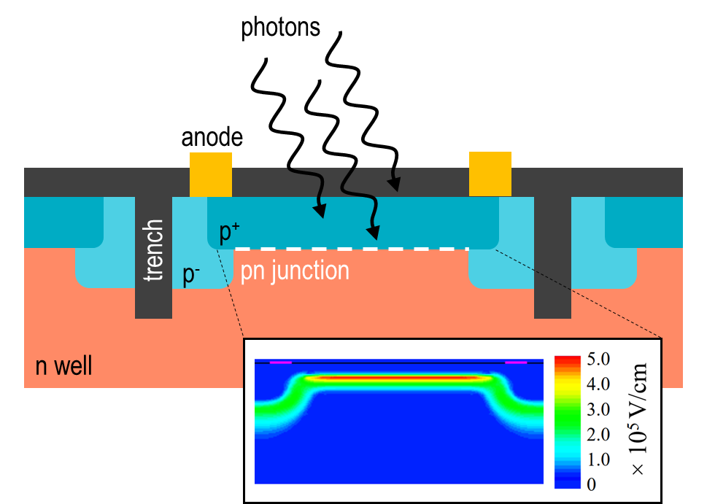
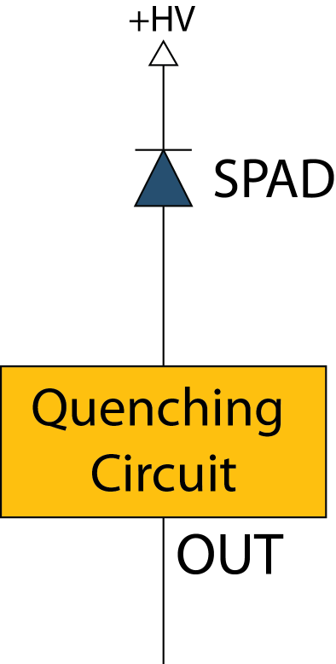
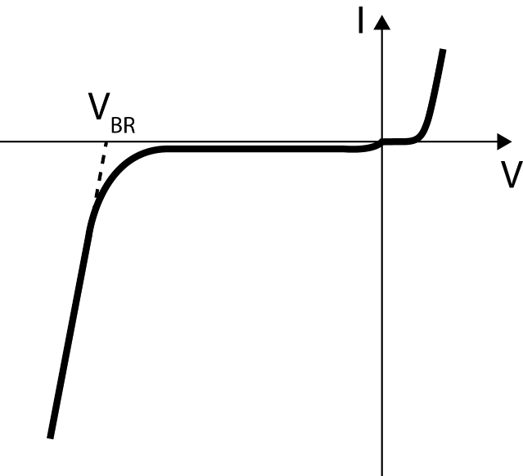
Single photon avalanche diode (SPAD)
SPAD cross-section
Schematic circuit
SPAD I-V curve
(20-60 V)
Recharge
3
Hold-off
1
Quench
2
Notes:
PN junction with trenches
Schema: We bias the diode
CS: high electric field
Photon hit -> avalanche -> high current
To not burn the diode -> Quench the circuit, put the voltage under breakdown voltage
Hold off to let the carriers finish the avalanche
Recharge the spad and ready to detect photon
All this process means that the response of the spad is binary

Slide 9


Single photon avalanche diode (SPAD)
SPAD cross-section
Schematic circuit
SPAD I-V curve
(20-60 V)
Recharge
3
Hold-off
1
1
Quench
2
Notes:
PN junction with trenches
Schema: We bias the diode
CS: high electric field
Photon hit -> avalanche -> high current
To not burn the diode -> Quench the circuit, put the voltage under breakdown voltage
Hold off to let the carriers finish the avalanche
Recharge the spad and ready to detect photon
All this process means that the response of the spad is binary

Slide 10


Single photon avalanche diode (SPAD)
SPAD cross-section
Schematic circuit
SPAD I-V curve
(20-60 V)
Recharge
3
Hold-off
2
1
1
Quench
2
Notes:
PN junction with trenches
Schema: We bias the diode
CS: high electric field
Photon hit -> avalanche -> high current
To not burn the diode -> Quench the circuit, put the voltage under breakdown voltage
Hold off to let the carriers finish the avalanche
Recharge the spad and ready to detect photon
All this process means that the response of the spad is binary

Slide 11

Single photon avalanche diode (SPAD)
SPAD cross-section
Schematic circuit
SPAD I-V curve
(20-60 V)
Recharge
3
Hold-off
2
1
1
3
Quench
2
Notes:
PN junction with trenches
Schema: We bias the diode
CS: high electric field
Photon hit -> avalanche -> high current
To not burn the diode -> Quench the circuit, put the voltage under breakdown voltage
Hold off to let the carriers finish the avalanche
Recharge the spad and ready to detect photon
All this process means that the response of the spad is binary

Slide 12
Single photon avalanche diode (SPAD)
SPAD cross-section
Schematic circuit
SPAD I-V curve
(20-60 V)
Recharge
3
Hold-off
2
1
1
3
Quench
2
Response of the SPAD is binary
Notes:
PN junction with trenches
Schema: We bias the diode
CS: high electric field
Photon hit -> avalanche -> high current
To not burn the diode -> Quench the circuit, put the voltage under breakdown voltage
Hold off to let the carriers finish the avalanche
Recharge the spad and ready to detect photon
All this process means that the response of the spad is binary

Slide 13
Analog SiPM VS Digital SiPM
SiPM : Silicon Photo Multiplier
Analog SiPM
Photon to Digital Converter (aka Digital SiPM)
HV
HV
SPAD
Response of the SPAD is binary
SPAD
Quench
Quench
Digital Signal Processing
Amplifier, Shaper,…
ADC
Analog current sum
SiPM capacitance → electronic noise
The amplifier transforms charge into voltage and then BACK to digital.
Individual SPAD readout,
no D/A+A/D conversion.
Everything stays digital.
Notes:
Usually, we use SiPM as detector
They are array of spad in parallel
Compare to analog system SiPM -> we stay digital
Our system use quench on each individual spad
Since Spad response is binary, send a binary value directly to the processor
EVERYTHING STAYS DIGITAL
Next -> architecture of our system: the PDC

Slide 14
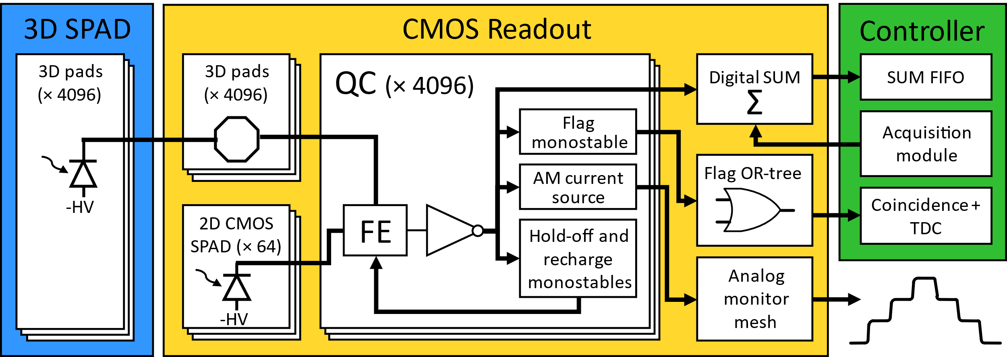
Photon-to-Digital Converter: Architecture
×64 PDCs/Controller
Notes:
Architecture:
All spads have their own QC
If not integrated -> 2D SPAD for testing without 3d integration
Next -> PDC output

Slide 15
Photon-to-Digital Converter: Architecture
3D SPAD
  4096 SPAD
  3D pads
  HV at the anode
CMOS readout pads
  3D pads (X 4096)
  Individual quenching circuit for each SPAD
2D CMOS SPAD
  64 SPAD on CMOS readout
  Individually quenched
×64 PDCs/Controller
Quenching circuit
Read the SPAD from the cathode
Send the flag
Hold-off et recharge the SPAD
Notes:
Describe each output:
Flag: Fastest - if one or more trigger, the flag is sent
DS: Do a sum of the spad triggered at a moment in time. Memory of 128 acquisitions
AM: Like SiPM -> Current proportionnal to spad triggered (for test)
Controller: Start acquisition based on flag received
TDC for timing measurements
Receive data + do post-processing
Communication with computer

Slide 16
Photon-to-Digital Converter: Architecture
3D SPAD
  4096 SPAD
  3D pads
  HV at the anode
CMOS readout pads
  3D pads (X 4096)
  Individual quenching circuit for each SPAD
2D CMOS SPAD
  64 SPAD on CMOS readout
  Individually quenched
×64 PDCs/Controller
Quenching circuit
Read the SPAD from the cathode
Send the flag
Hold-off et recharge the SPAD
Notes:
Describe each output:
Flag: Fastest - if one or more trigger, the flag is sent
DS: Do a sum of the spad triggered at a moment in time. Memory of 128 acquisitions
AM: Like SiPM -> Current proportionnal to spad triggered (for test)
Controller: Start acquisition based on flag received
TDC for timing measurements
Receive data + do post-processing
Communication with computer

Slide 17
Photon-to-Digital Converter: Architecture
3D SPAD
  4096 SPAD
  3D pads
  HV at the anode
CMOS readout pads
  3D pads (X 4096)
  Individual quenching circuit for each SPAD
2D CMOS SPAD
  64 SPAD on CMOS readout
  Individually quenched
×64 PDCs/Controller
Quenching circuit
Read the SPAD from the cathode
Send the flag
Hold-off et recharge the SPAD
Notes:
Describe each output:
Flag: Fastest - if one or more trigger, the flag is sent
DS: Do a sum of the spad triggered at a moment in time. Memory of 128 acquisitions
AM: Like SiPM -> Current proportionnal to spad triggered (for test)
Controller: Start acquisition based on flag received
TDC for timing measurements
Receive data + do post-processing
Communication with computer

Slide 18
Photon-to-Digital Converter: Architecture
3D SPAD
  4096 SPAD
  3D pads
  HV at the anode
CMOS readout pads
  3D pads (X 4096)
  Individual quenching circuit for each SPAD
2D CMOS SPAD
  64 SPAD on CMOS readout
  Individually quenched
×64 PDCs/Controller
Quenching circuit
Read the SPAD from the cathode
Send the flag
Hold-off et recharge the SPAD
Notes:
Describe each output:
Flag: Fastest - if one or more trigger, the flag is sent
DS: Do a sum of the spad triggered at a moment in time. Memory of 128 acquisitions
AM: Like SiPM -> Current proportionnal to spad triggered (for test)
Controller: Start acquisition based on flag received
TDC for timing measurements
Receive data + do post-processing
Communication with computer

Slide 19
Photon-to-Digital Converter: Architecture
Flag output
  Pulsed output (adjustable from few ns to tens of ns).
  From an OR-tree.
  Timing jitter better than 100 ps RMS.
Digital Sum
  Digital count of triggered SPADs inside a bin (dynamic range of 4096 photons).
  Adjustable bin width from 10 ns up to µs.
  Internal FIFO of 128 bins.
Analog Monitor
  Current proportional to triggered SPADs.
×64 PDCs/Controller
Controller (1 for 64 PDCs)
Start PDC acquisition, based on the number of flag received to discriminate dark count.
Bank of TDCs for timing measurements on flags.
Receives data from PDCs and includes post-processing.
Communicate with an external computer.
Notes:
Describe each output:
Flag: Fastest - if one or more trigger, the flag is sent
DS: Do a sum of the spad triggered at a moment in time. Memory of 128 acquisitions
AM: Like SiPM -> Current proportionnal to spad triggered (for test)
Controller: Start acquisition based on flag received
TDC for timing measurements
Receive data + do post-processing
Communication with computer

Slide 20
Photon-to-Digital Converter: Architecture
Flag output
  Pulsed output (adjustable from few ns to tens of ns).
  From an OR-tree.
  Timing jitter better than 100 ps RMS.
Digital Sum
  Digital count of triggered SPADs inside a bin (dynamic range of 4096 photons).
  Adjustable bin width from 10 ns up to µs.
  Internal FIFO of 128 bins.
Analog Monitor
  Current proportional to triggered SPADs.
×64 PDCs/Controller
Controller (1 for 64 PDCs)
Start PDC acquisition, based on the number of flag received to discriminate dark count.
Bank of TDCs for timing measurements on flags.
Receives data from PDCs and includes post-processing.
Communicate with an external computer.
Notes:
Describe each output:
Flag: Fastest - if one or more trigger, the flag is sent
DS: Do a sum of the spad triggered at a moment in time. Memory of 128 acquisitions
AM: Like SiPM -> Current proportionnal to spad triggered (for test)
Controller: Start acquisition based on flag received
TDC for timing measurements
Receive data + do post-processing
Communication with computer

Slide 21
Photon-to-Digital Converter: Architecture
Flag output
  Pulsed output (adjustable from few ns to tens of ns).
  From an OR-tree.
  Timing jitter better than 100 ps RMS.
Digital Sum
  Digital count of triggered SPADs inside a bin (dynamic range of 4096 photons).
  Adjustable bin width from 10 ns up to µs.
  Internal FIFO of 128 bins.
Analog Monitor
  Current proportional to triggered SPADs.
×64 PDCs/Controller
Controller (1 for 64 PDCs)
Start PDC acquisition, based on the number of flag received to discriminate dark count.
Bank of TDCs for timing measurements on flags.
Receives data from PDCs and includes post-processing.
Communicate with an external computer.
Notes:
Describe each output:
Flag: Fastest - if one or more trigger, the flag is sent
DS: Do a sum of the spad triggered at a moment in time. Memory of 128 acquisitions
AM: Like SiPM -> Current proportionnal to spad triggered (for test)
Controller: Start acquisition based on flag received
TDC for timing measurements
Receive data + do post-processing
Communication with computer

Slide 22
Photon-to-Digital Converter: Architecture
Flag output
  Pulsed output (adjustable from few ns to tens of ns).
  From an OR-tree.
  Timing jitter better than 100 ps RMS.
Digital Sum
  Digital count of triggered SPADs inside a bin (dynamic range of 4096 photons).
  Adjustable bin width from 10 ns up to µs.
  Internal FIFO of 128 bins.
Analog Monitor
  Current proportional to triggered SPADs.
×64 PDCs/Controller
Controller (1 for 64 PDCs)
Start PDC acquisition, based on the number of flag received to discriminate dark count.
Bank of TDCs for timing measurements on flags.
Receives data from PDCs and includes post-processing.
Communicate with an external computer.
Notes:
Describe each output:
Flag: Fastest - if one or more trigger, the flag is sent
DS: Do a sum of the spad triggered at a moment in time. Memory of 128 acquisitions
AM: Like SiPM -> Current proportionnal to spad triggered (for test)
Controller: Start acquisition based on flag received
TDC for timing measurements
Receive data + do post-processing
Communication with computer

Slide 23
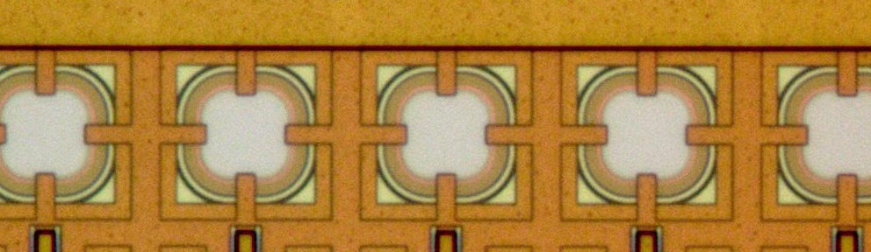
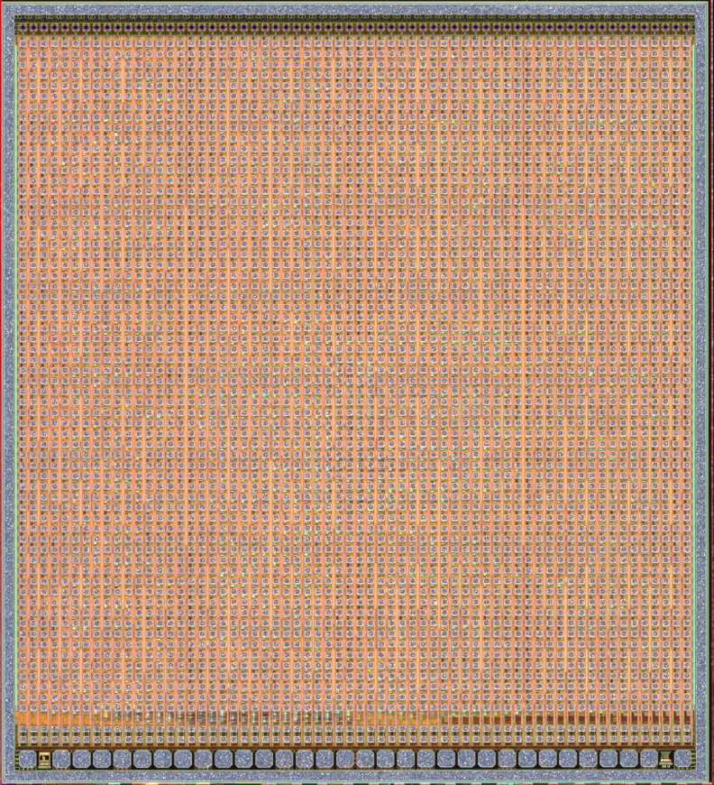
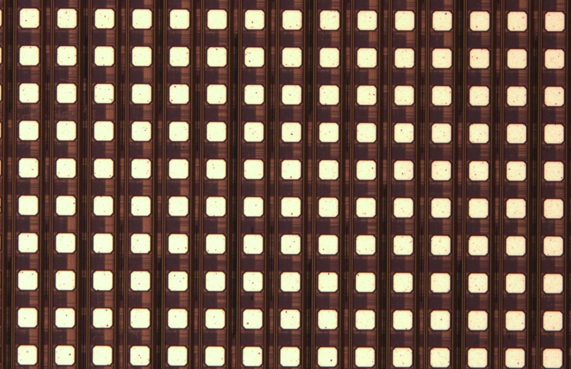
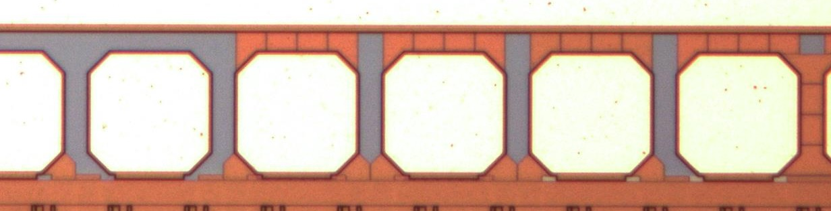
Pdc: Fabricated CMOS READOUT
Key Specifications
TSMC 180 nm BCD CMOS process.
78 µm SPAD-to-SPAD pitch for a 5X5 mm active area
Every SPAD is controlled individually.
  Noisy/defective SPADs can be disabled.
Dynamic range of 0 to 4096 photons.
5.3 mm
64x 2D CMOS SPADs
64×64 quench circuits
ready for 3D integration
5.85 mm
IO pads ESD protected
PDC CMOS READOUT
Notes:
3 main sections
Compare to SiPM, we can disabled noisy SPAD
We remove « screamers »

Slide 24
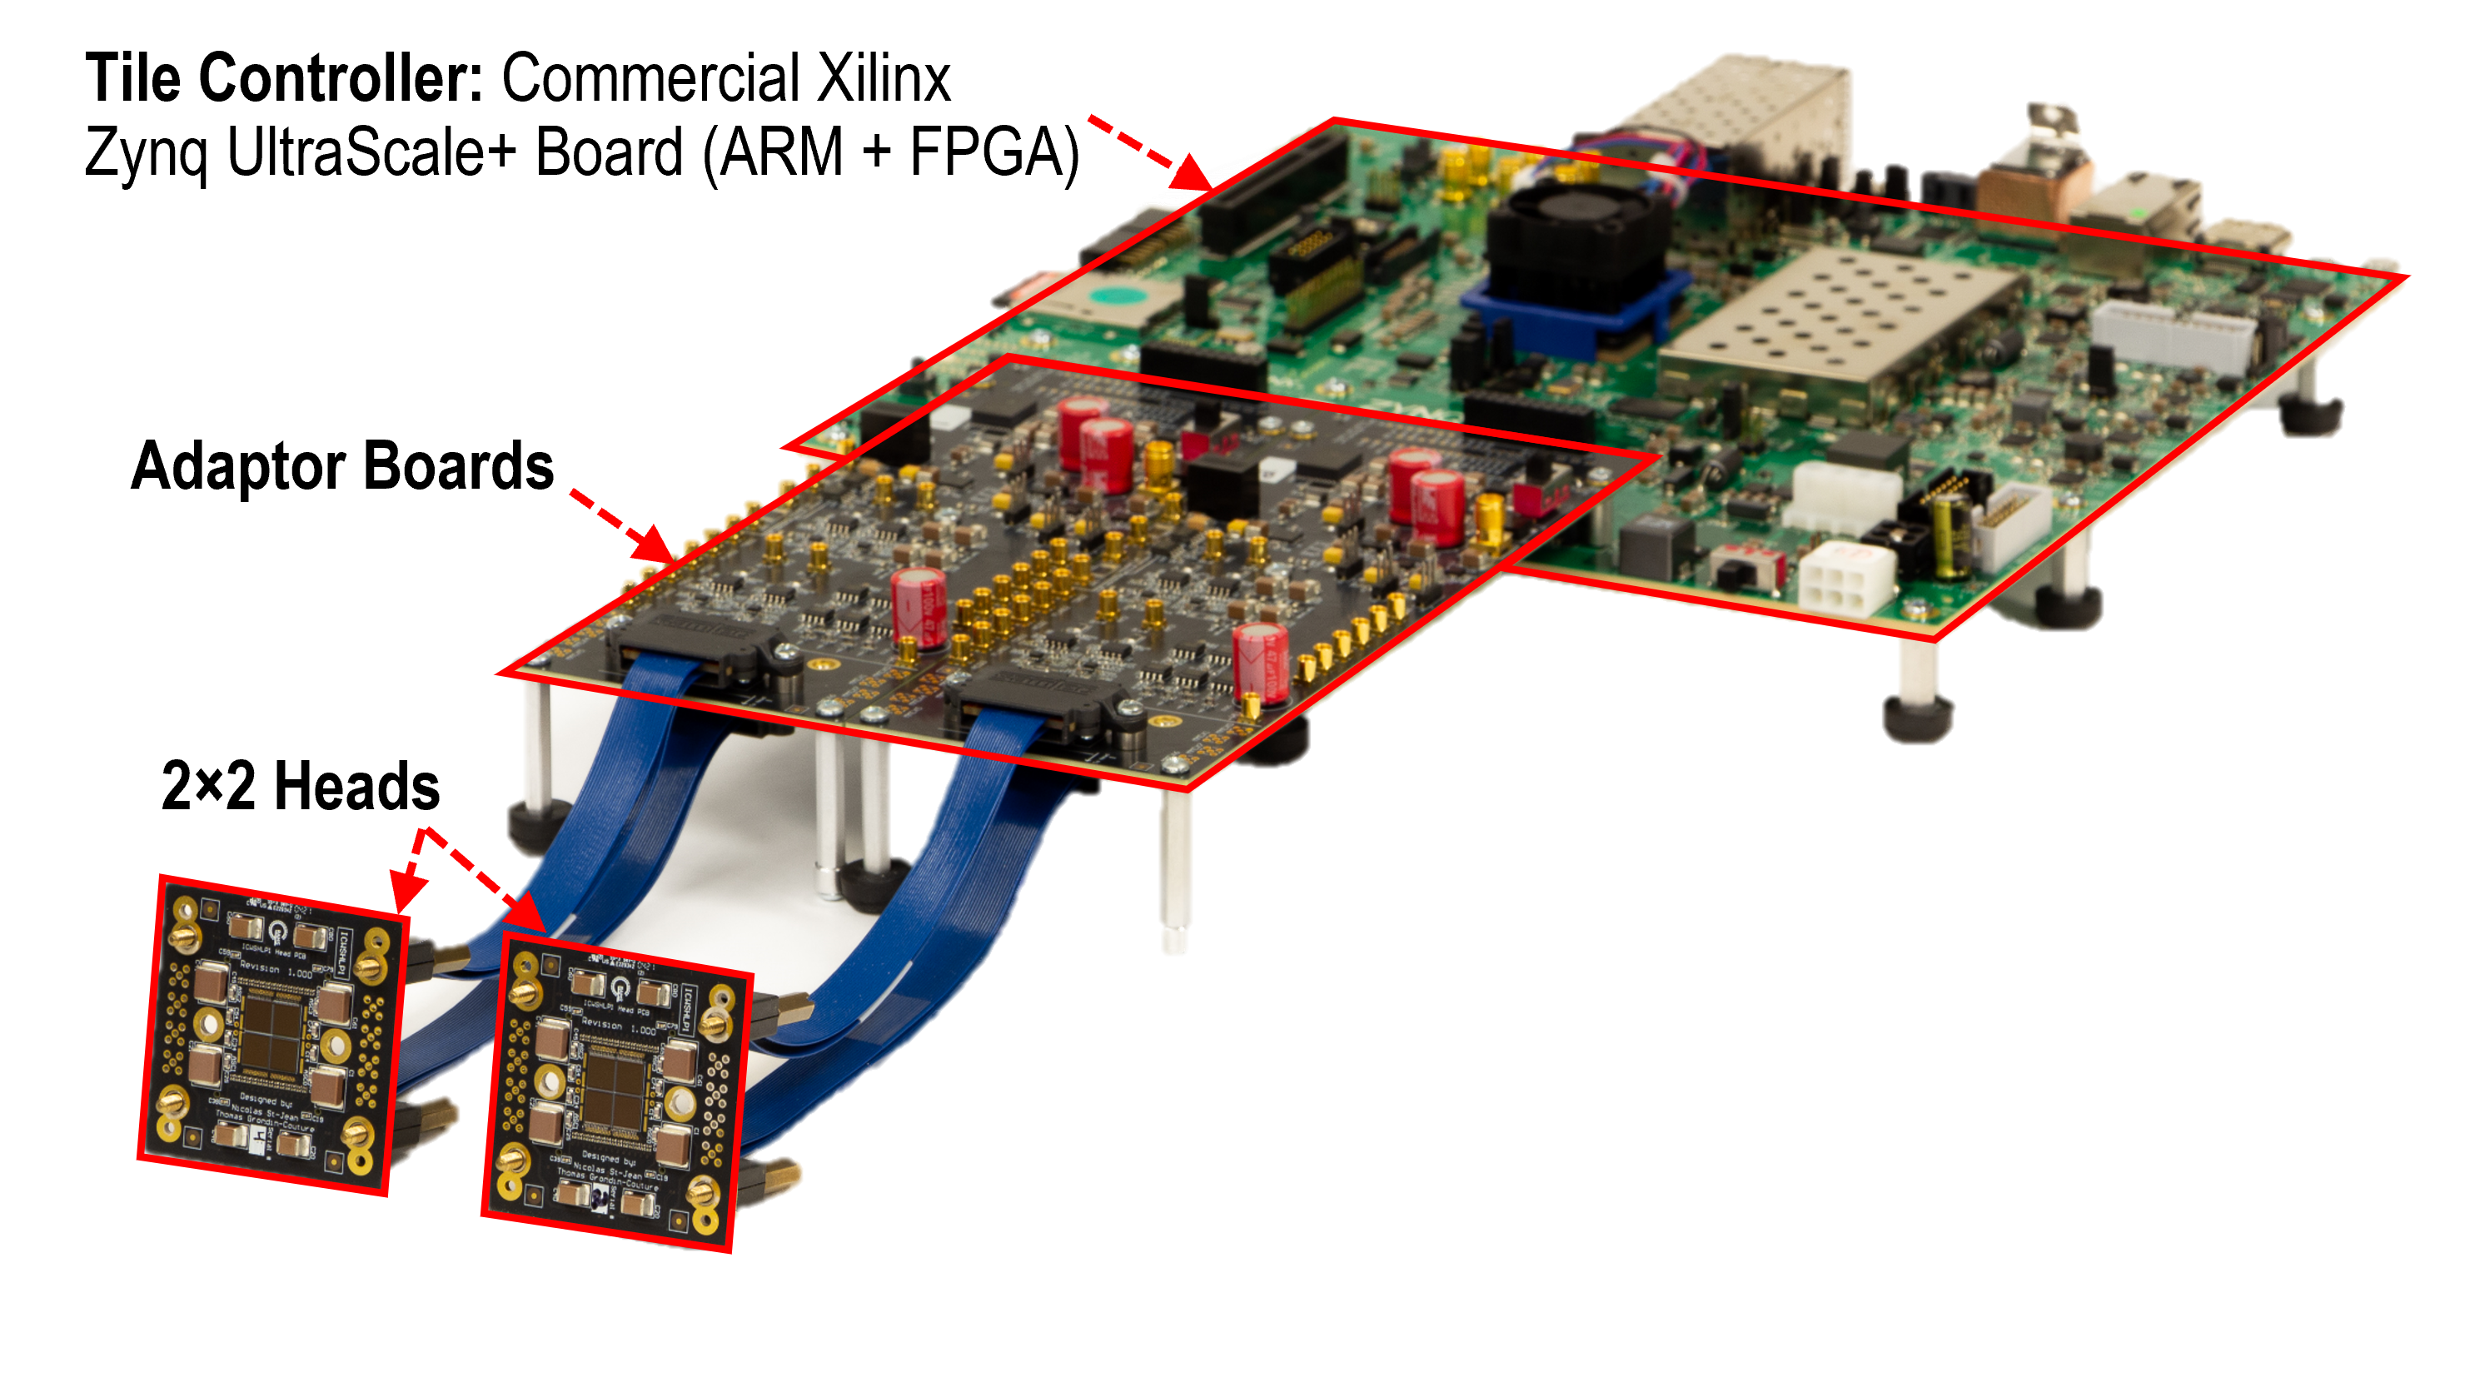
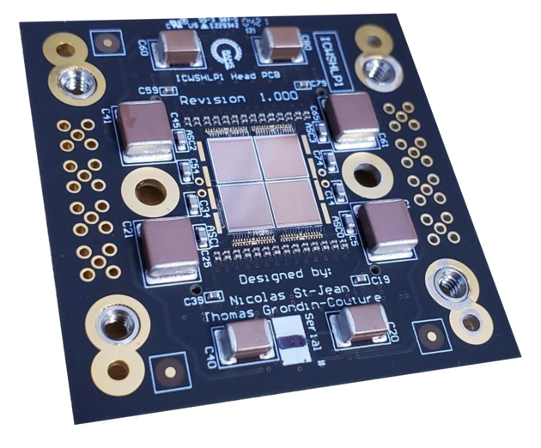
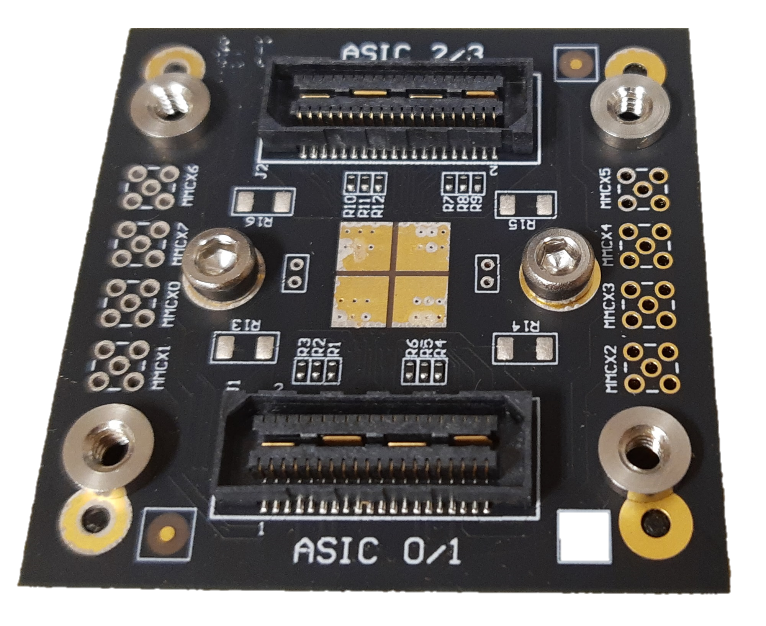
2×2 Photodetection Module
2×2 PDCs
Top
50 mm
50 mm
Bottom

Slide 25
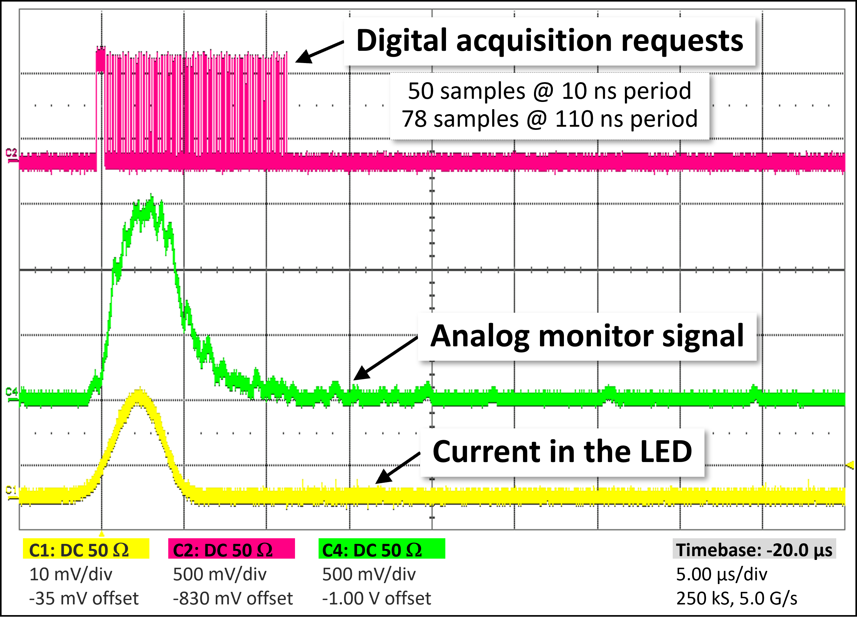
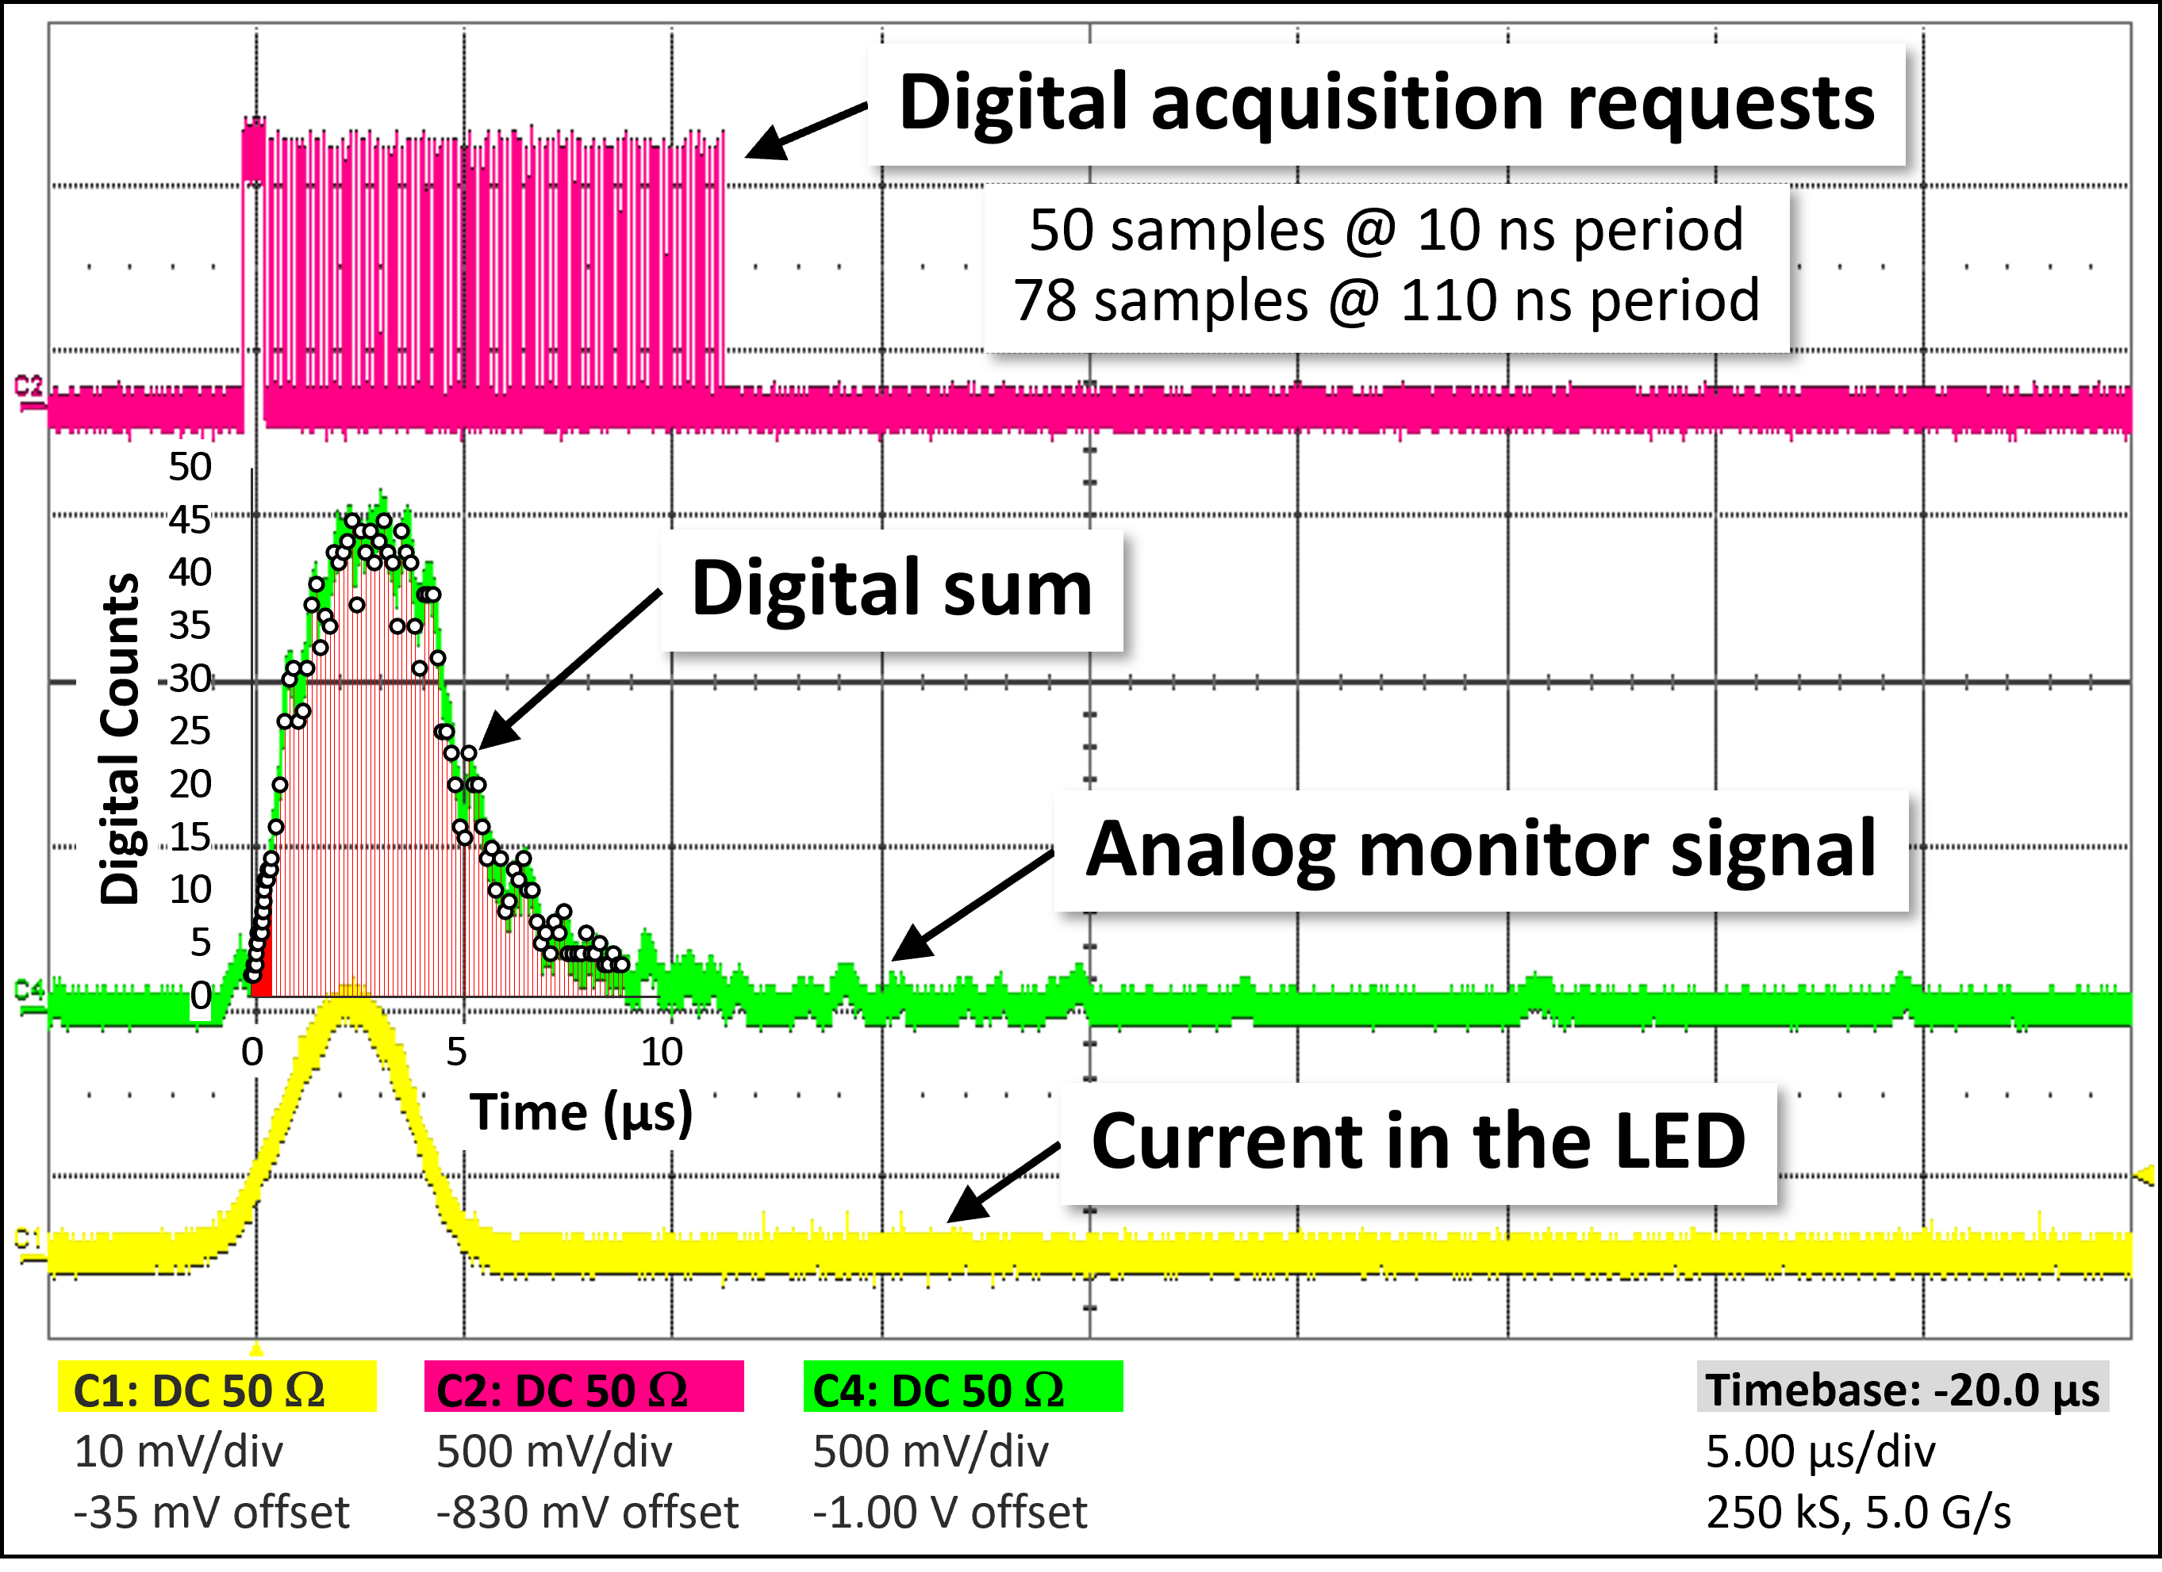
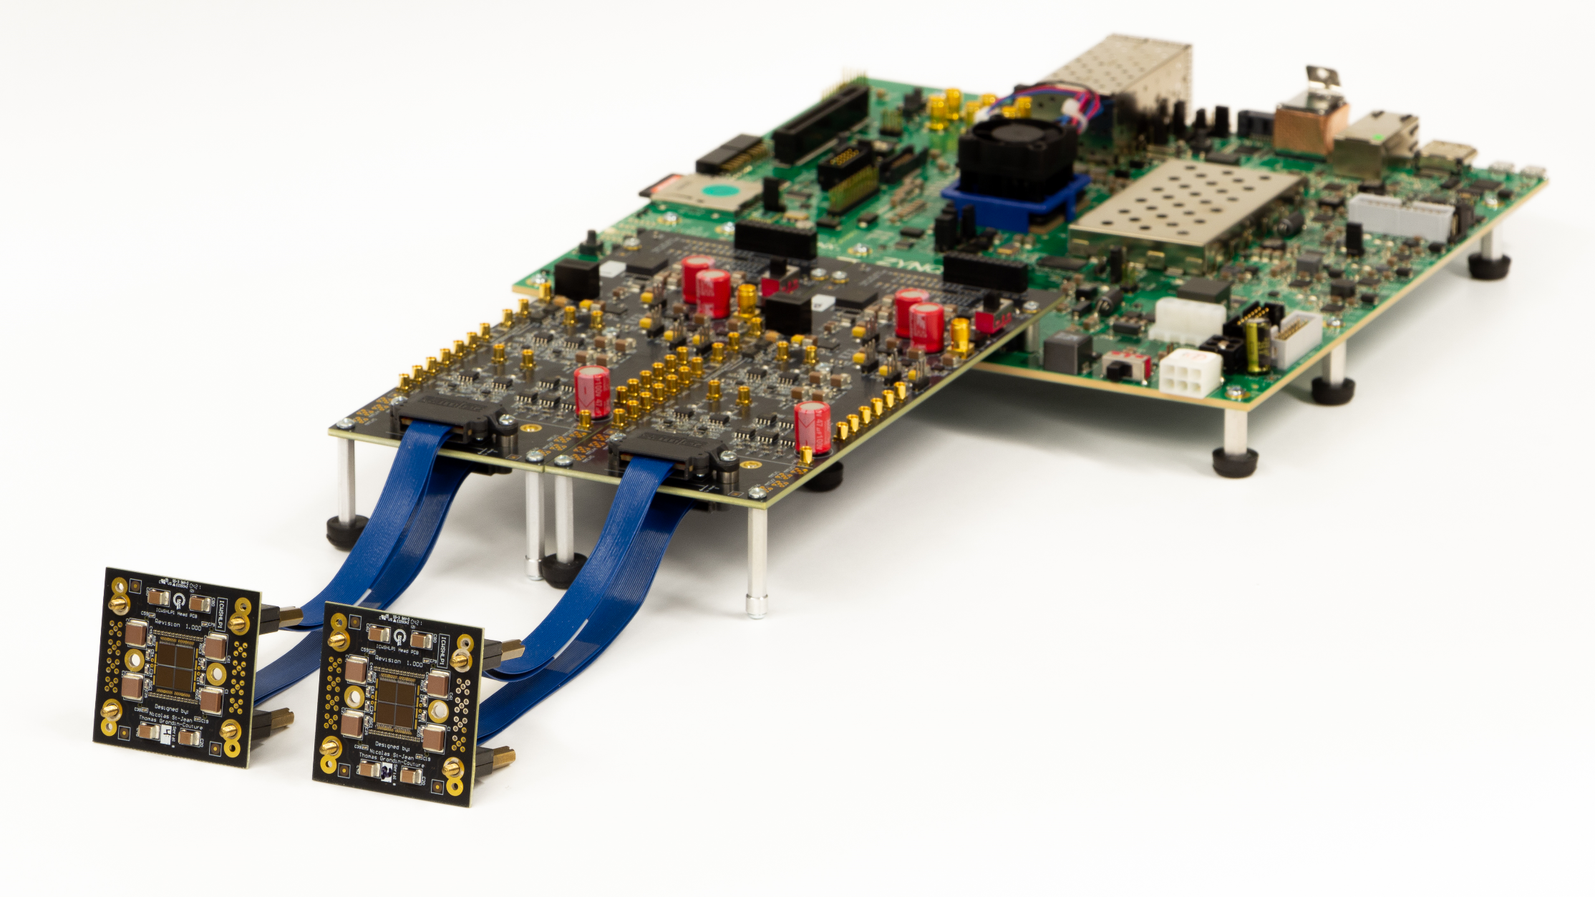

2×2 Photodetection Module with LED Testing
Current in the LED to trigger the SPADs
  Driven by a waveform generator
Analog Monitor
  Amplitude proportional to the number of SPADs triggered
Digital Sum Acquisition
  Based on a 100 MHz readout clock
  Generated by the FPGA (Tile Controller)
1010101010
Using embedded CMOS test SPADs of the PDC
Notes:
LED that emits small amount of photons
AM: similar to SiPM
DS: adjust bin width

Slide 26
2×2 Photodetection Module with LED Testing
Current in the LED to trigger the SPADs
  Driven by a waveform generator
Analog Monitor
  Amplitude proportional to the number of SPADs triggered
Digital Sum Acquisition
  Based on a 100 MHz readout clock
  Generated by the FPGA (Tile Controller)
1010101010
Using embedded CMOS test SPADs of the PDC
Notes:
LED that emits small amount of photons
AM: similar to SiPM
DS: adjust bin width

Slide 27
2×2 Photodetection Module with LED Testing
Current in the LED to trigger the SPADs
  Driven by a waveform generator
Analog Monitor
  Amplitude proportional to the number of SPADs triggered
Digital Sum Acquisition
  Based on a 100 MHz readout clock
  Generated by the FPGA (Tile Controller)
1010101010
Using embedded CMOS test SPADs of the PDC
Notes:
LED that emits small amount of photons
AM: similar to SiPM
DS: adjust bin width

Slide 28
2×2 Photodetection Module with LED Testing
Current in the LED to trigger the SPADs
  Driven by a waveform generator
Analog Monitor
  Amplitude proportional to the number of SPADs triggered
Digital Sum Acquisition
  Based on a 100 MHz readout clock
  Generated by the FPGA (Tile Controller)
1010101010
Using embedded CMOS test SPADs of the PDC
Notes:
LED that emits small amount of photons
AM: similar to SiPM
DS: adjust bin width

Slide 29
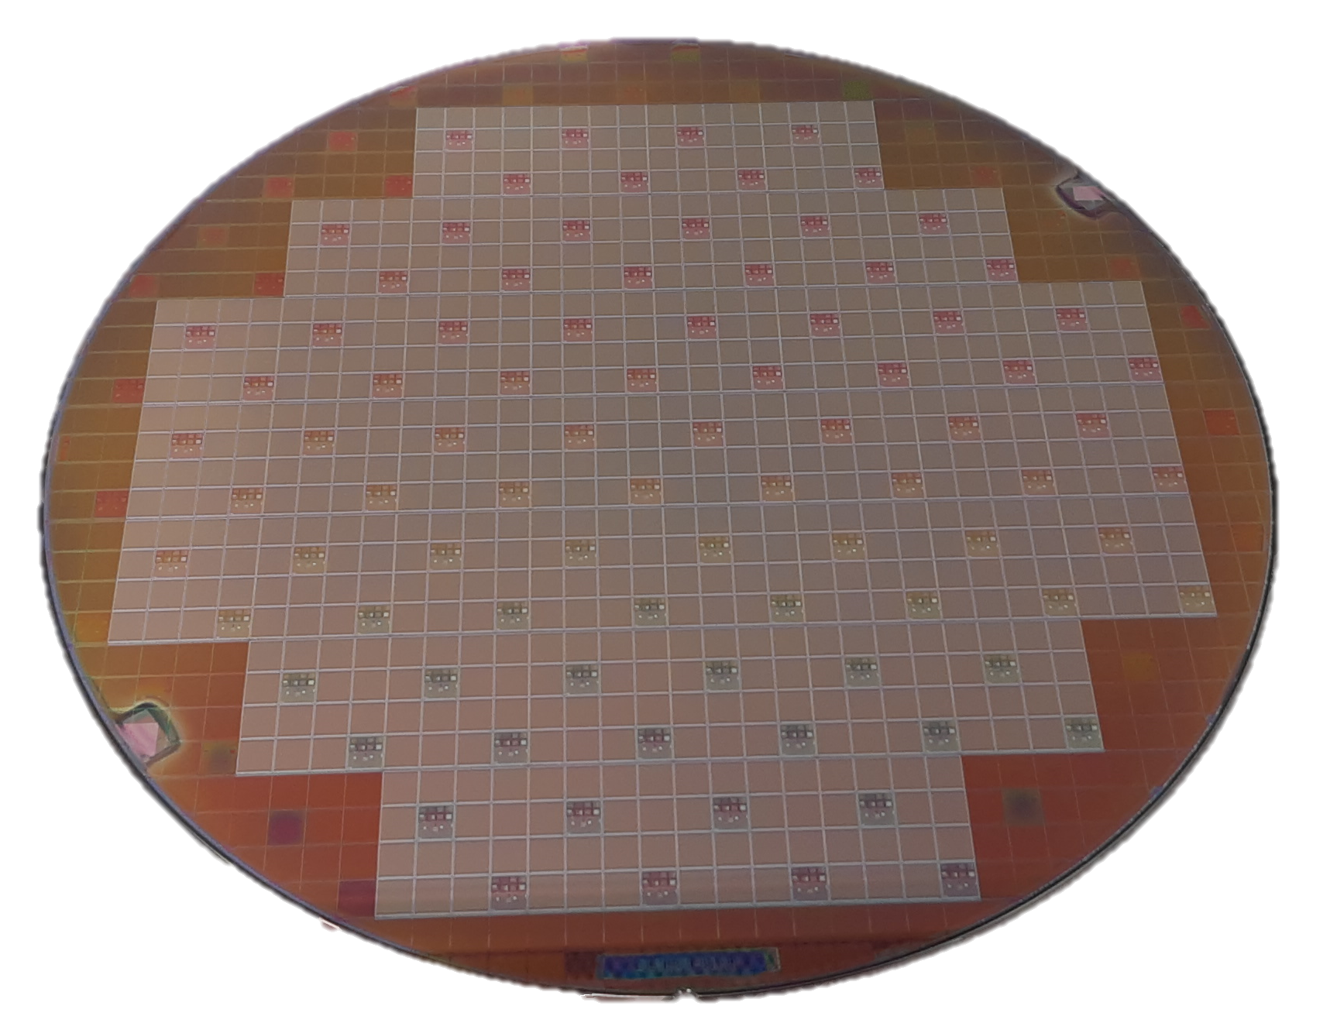
Wafer run of the PDC
200 mm wafer of PDCs
Notes:
2X2 and 8X8 require a lot of work: PCB, dicing, wirebonding, etc.
For 3D integration wafer to wafer
Wafer contain a lot of device (600 device)
So we need a testing platform

Slide 30
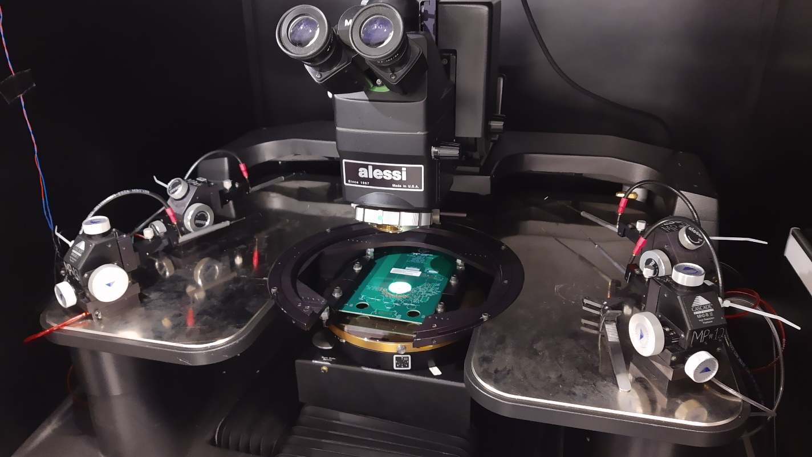
Test Bench for wafer-level measurement
Probe station with probe card attach to it
Notes:
Use a probe station

Slide 31
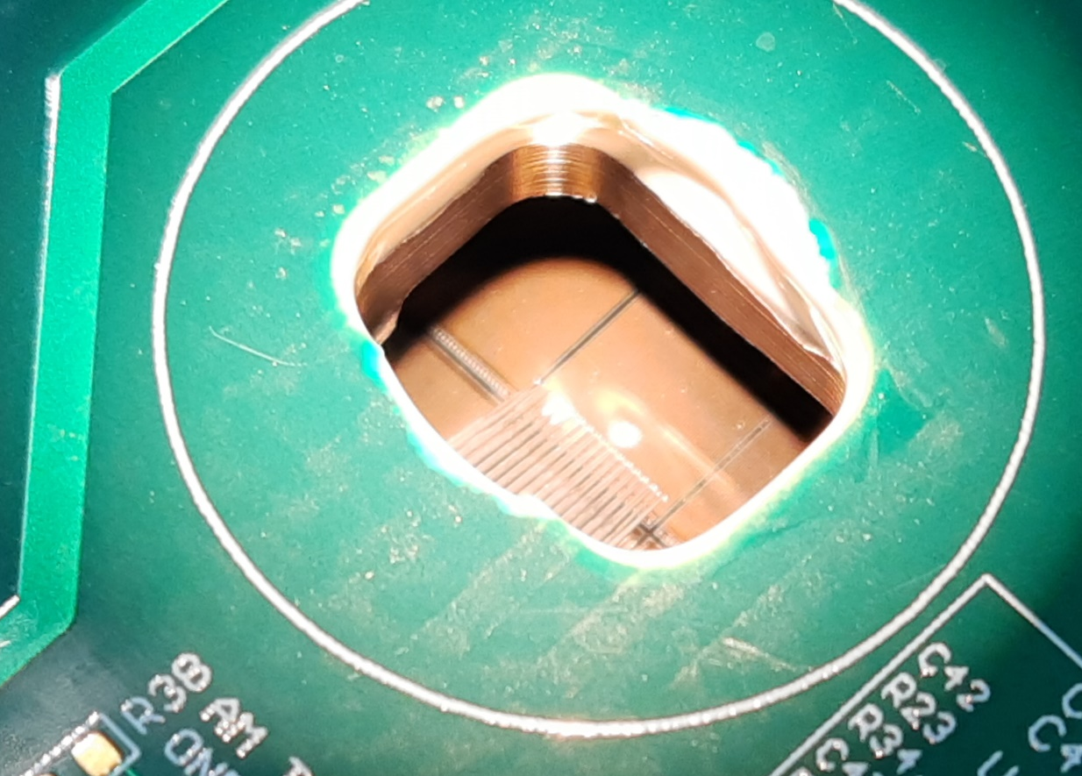
Test Bench for wafer-level measurement
Dedicated probe card
Active probe card with FPGA
Passive probe card
Needles of the probe card
Probe station with probe card attach to it
Notes:
Use a probe station

Slide 32
Test Bench for wafer-level measurement
Automated movement for wafer-level measurement (over 600 PDC)
Movement of the chuck in relation to the wafer
Notes:
Utilisez les images

Slide 33
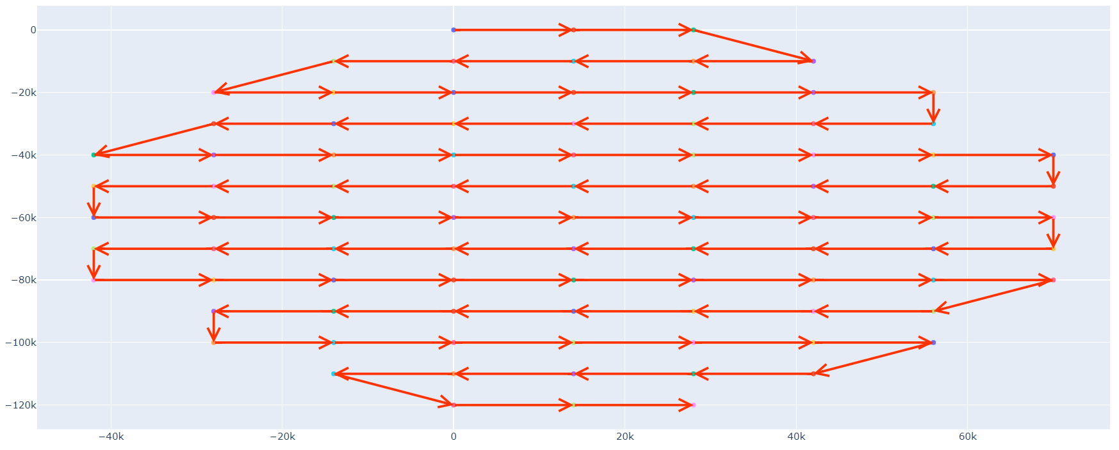
Test Bench for wafer-level measurement
Automated movement for wafer-level measurement (over 600 PDC)
Movement of the chuck in relation to the wafer
Notes:
Utilisez les images

Slide 34
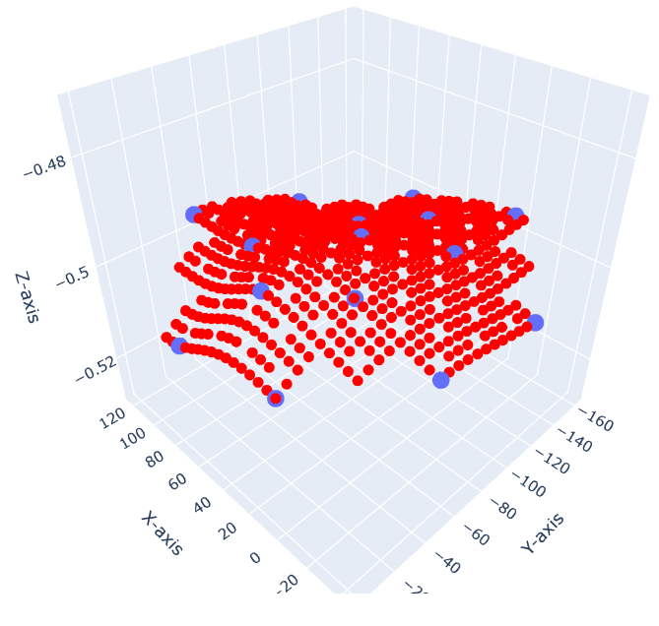
Test Bench for wafer-level measurement
Automated movement for wafer-level measurement (over 600 PDC)
Adjusting the height of contact according to wafer topology
Movement of the chuck in relation to the wafer
Wafer topology
Notes:
Utilisez les images

Slide 35
Conclusion
Photon-to-Digital Converters keep the information digital all along the acquisition chain.
FPGA-based tile controller gives a lot of flexibility to implement multiple features.
  Flag-based acquisition, dark count mitigation, pulse shape discrimination, and so on.
Tile Controller ASIC in development to replace the FPGA boards.
Wafer level measurement will accelerate the testing of multiple PDC for larger system integration.
Notes:
Wafer to be use on larger panel

Slide 36
Conclusion
Photon-to-Digital Converters keep the information digital all along the acquisition chain.
FPGA-based tile controller gives a lot of flexibility to implement multiple features.
  Flag-based acquisition, dark count mitigation, pulse shape discrimination, and so on.
Tile Controller ASIC in development to replace the FPGA boards.
Wafer level measurement will accelerate the testing of multiple PDC for larger system integration.
Notes:
Wafer to be use on larger panel

Slide 37
Conclusion
Photon-to-Digital Converters keep the information digital all along the acquisition chain.
FPGA-based tile controller gives a lot of flexibility to implement multiple features.
  Flag-based acquisition, dark count mitigation, pulse shape discrimination, and so on.
Tile Controller ASIC in development to replace the FPGA boards.
Wafer level measurement will accelerate the testing of multiple PDC for larger system integration.
Notes:
Wafer to be use on larger panel

Slide 38
Conclusion
Photon-to-Digital Converters keep the information digital all along the acquisition chain.
FPGA-based tile controller gives a lot of flexibility to implement multiple features.
  Flag-based acquisition, dark count mitigation, pulse shape discrimination, and so on.
Tile Controller ASIC in development to replace the FPGA boards.
Wafer level measurement will accelerate the testing of multiple PDC for larger system integration.
Notes:
Wafer to be use on larger panel

Slide 39
Conclusion
Photon-to-Digital Converters keep the information digital all along the acquisition chain.
FPGA-based tile controller gives a lot of flexibility to implement multiple features.
  Flag-based acquisition, dark count mitigation, pulse shape discrimination, and so on.
Tile Controller ASIC in development to replace the FPGA boards.
Wafer level measurement will accelerate the testing of multiple PDC for larger system integration.
Notes:
Wafer to be use on larger panel

Slide 40












A team’s work
Université de Sherbrooke
ORNL
Teledyne Dasla
Jean-François Pratte
Serge Charlebois
Artur Turala
Catherine Pepin
Frédéric Nolet
Frédéric Vachon
Gabriel Lessard
Guillaume Théberge-Dupuis
Jeanne Morehead
Jérémy Chenard
Jérôme Deshaies
Keven Deslandes
Nicolas Roy
Philippe Arsenault
Philippe Martel-Dion
Raffaele Aaron Giampaolo
Robin Scarpellini
Samuel Parent
Sean Prentice
Simon Carrier
Tommy Rossignol
Olivier Lepage
Yves-Alexandre Beebe
Lorenzo Fabris
Paul A. Hausladen
Samuel Parent
Claude Jean (CEO)
Stephane Martel
René Martel
Robert Groulx
Maxime Côté
This material is based upon work supported by the U.S. Department of Energy, National Nuclear Security Administration, Defense Nuclear Non-Proliferation Research and Development Office, and by the U.S. Department of Energy, Office of Science, High Energy Physics, under contract number DE-AC05-00OR22725.

Slide 41
References
[1] nEXO Collaboration et al, “Nexo Pre-Conceptual Design Report,” arXiv.org, 13-Aug-2018. [Online]. Available: https://arxiv.org/abs/1805.11142.
[1] M. R. Heath et al., “Development of a Portable Pixelated Fast-Neutron Imaging Panel”, DOI:10.1109/TNS.2021.3136344.
Notes:
Wafer to be use on larger panel

Slide 42
BACKUP

Slide 43
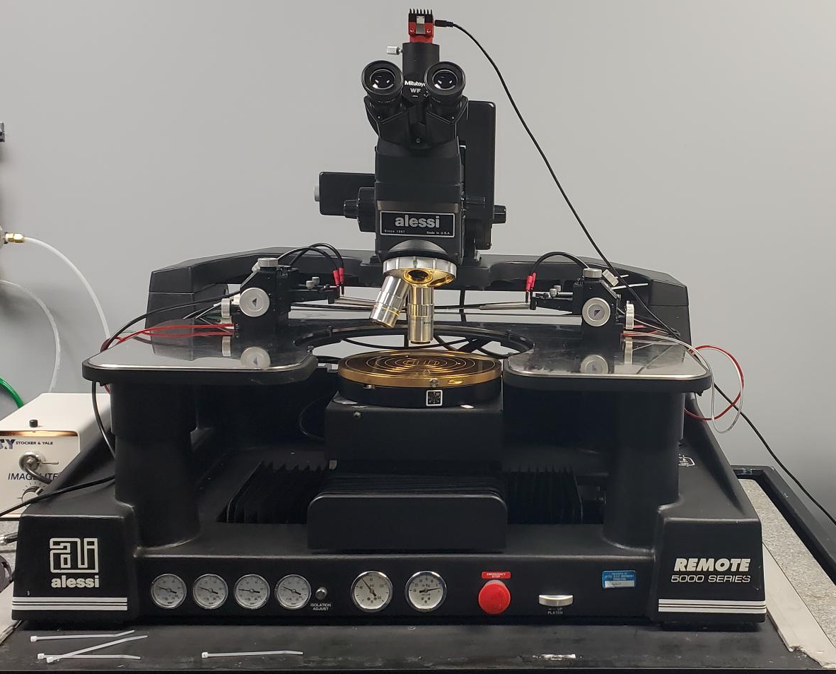
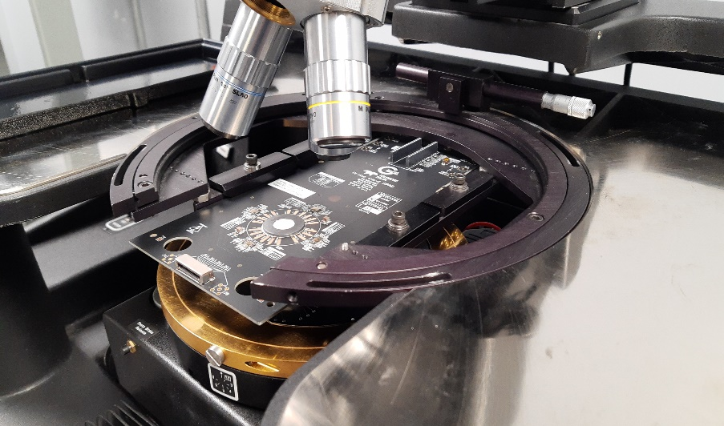
Test Bench for wafer-level measurement
Probe station
Fully automatic chuck enabling scripts for multiple measurement on a wafer
Program to adapt for the wafer topology
Probe card
Can act as the interface between the PDC and the controller (FPGA)
Probe station
Wafer topology
Probe card on the station

Slide 44
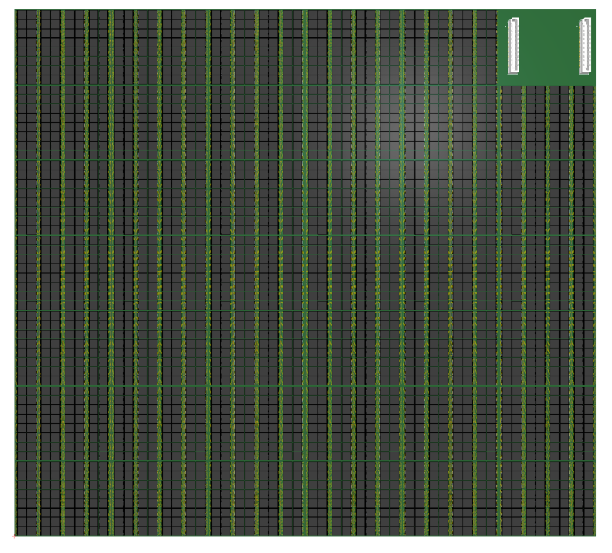
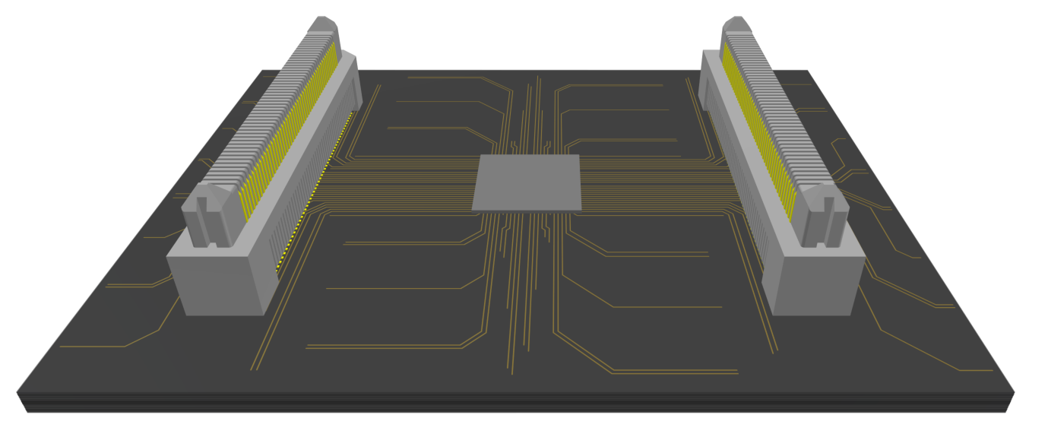
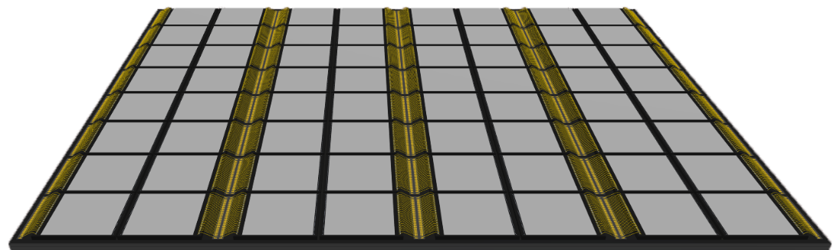
Portable API-Based neutron Radiography
PDC panel array of 42 modules of 8 x 8 PDC
400-500 nm peak pixelated plastic scintillators
11E+6 SPADs over 30 x 30 cm²
40W PDC power consumption
  10 ns binning for 3k events/s/PDC,
  128 bins/event (1280 ns range/event)
Simulated timing distribution PDC of 25 ps RMS
~30 cm
~30 cm
Bottom side
Top side

Slide 45
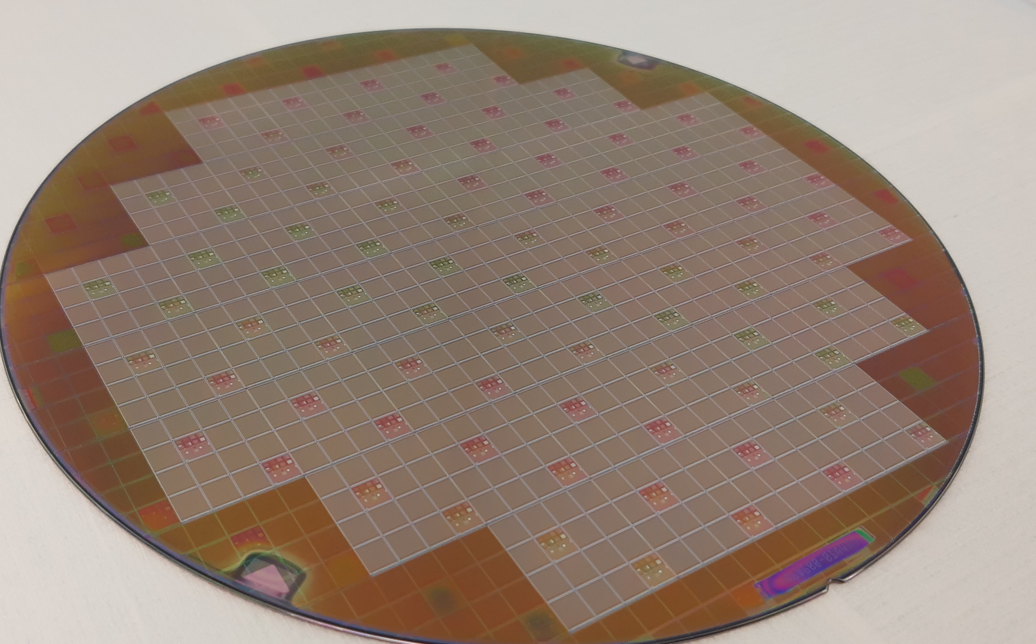
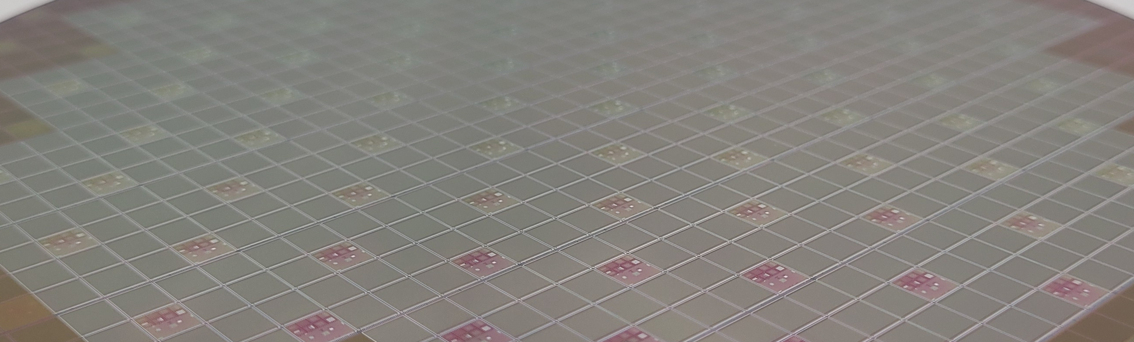

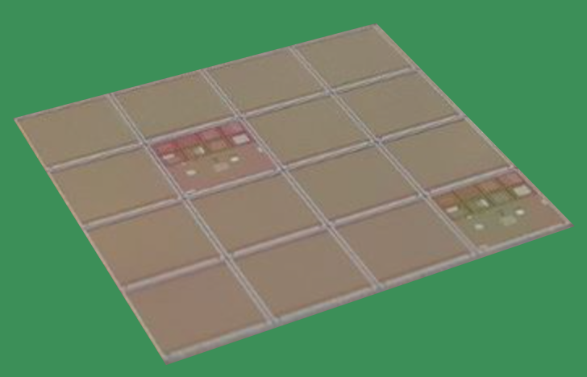
Digital Solution: Towards a 3D Integration
8 inch CMOS wafer
8 inch to 6 inch coring down
3D Bonding @ Teledyne DALSA (TDSI)
6 inch
SPAD wafer
6 inch
CMOS wafer
Alignment die for 3D bonding
PDC CMOS readout
*SPAD process & 3D bonding process completed @ TDSI
Reticle of 4×4 dies

Slide 46
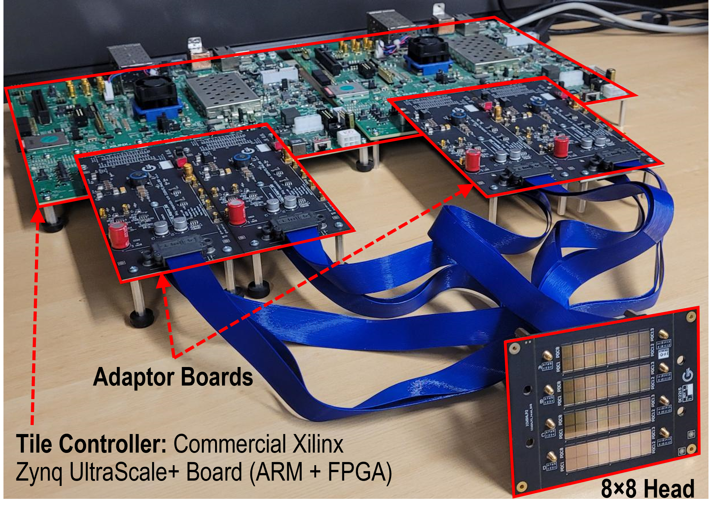
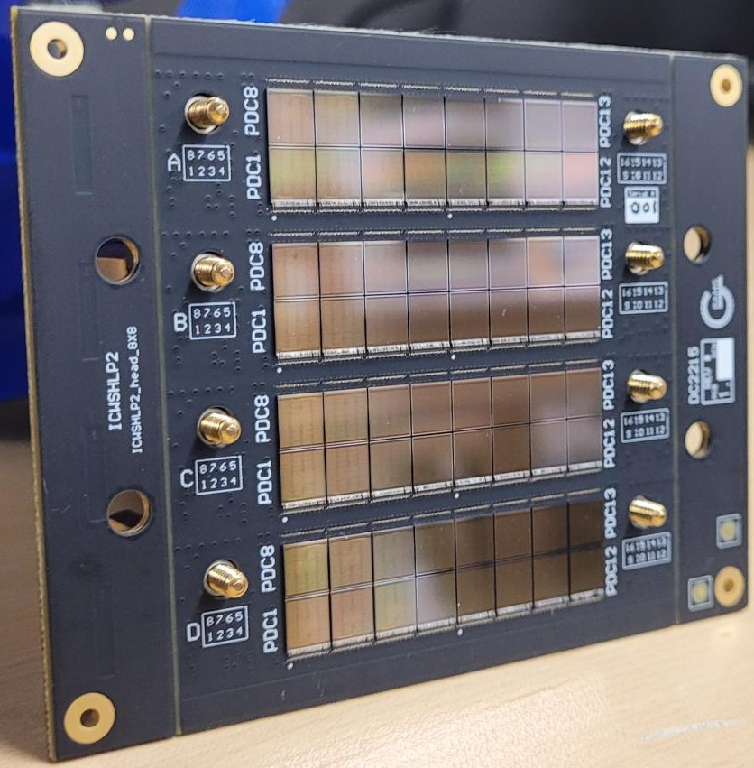
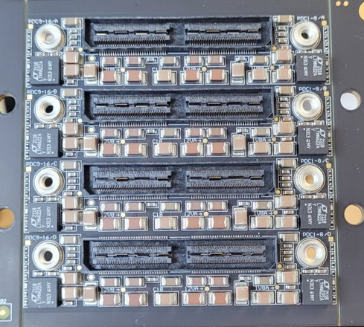
8×8 Photodetection Module
8×8 PDCs
Top
74 mm
94 mm
Bottom
8×8 PCB tile prototype​

Slide 47
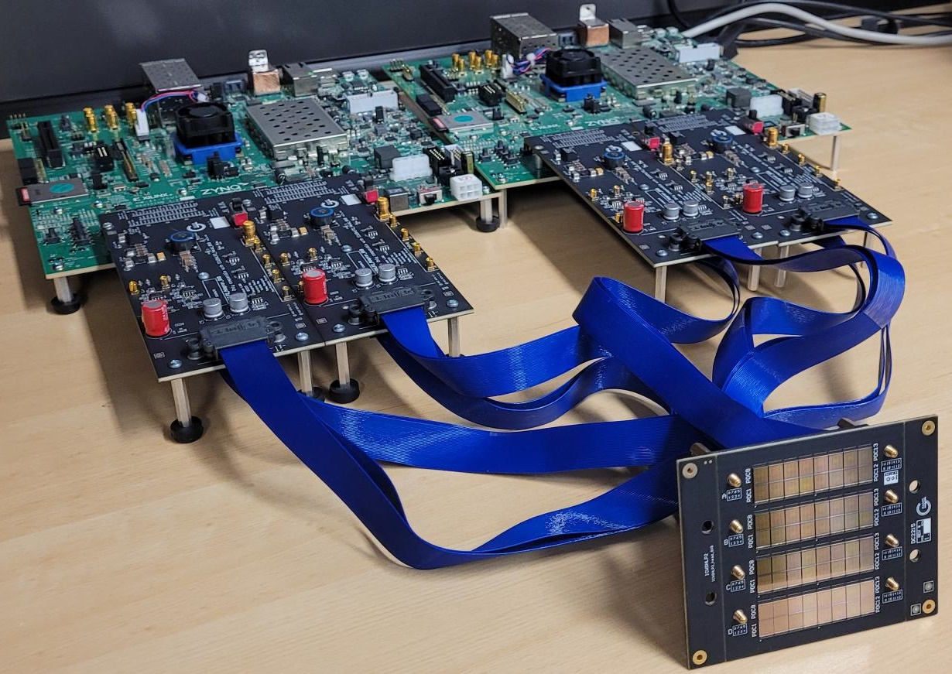
Next Step: FPGA board to a Tile controller
FPGA-based Controller
ASIC-based Controller
Top side
45 mm
57 mm
Bottom side

Slide 48
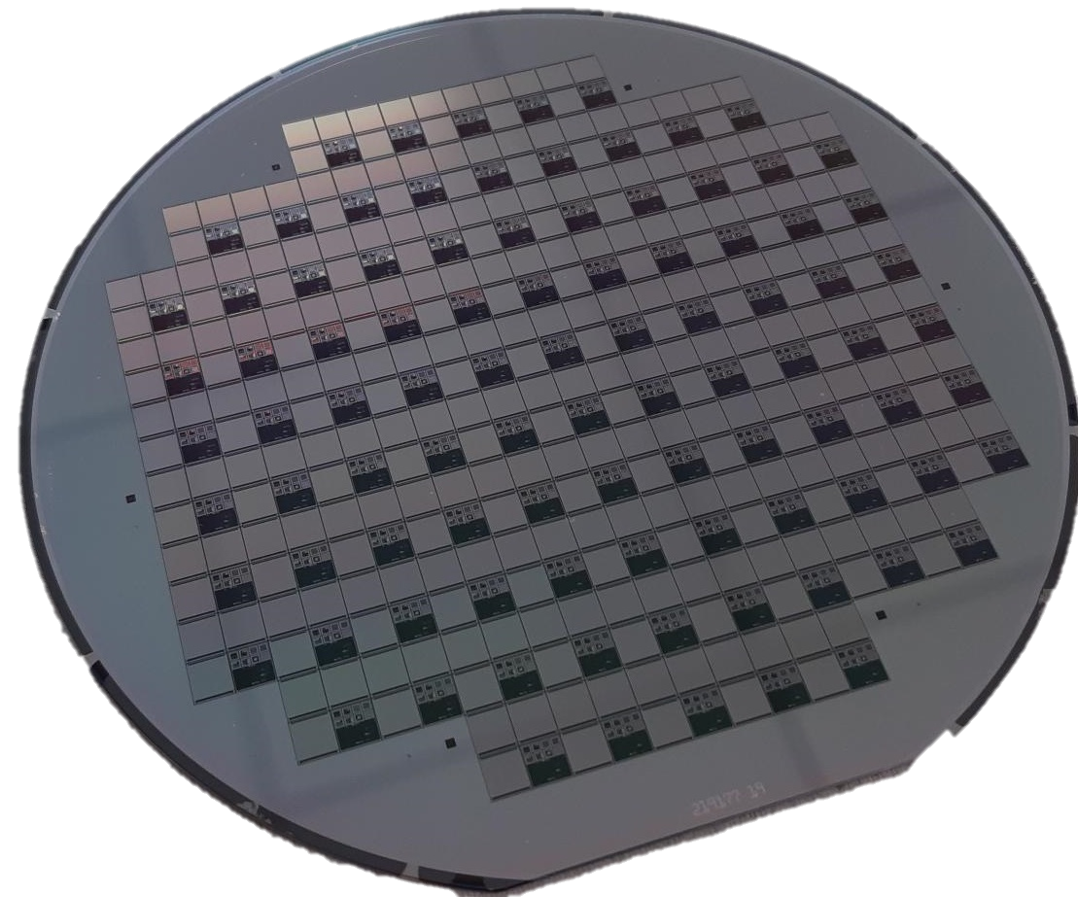
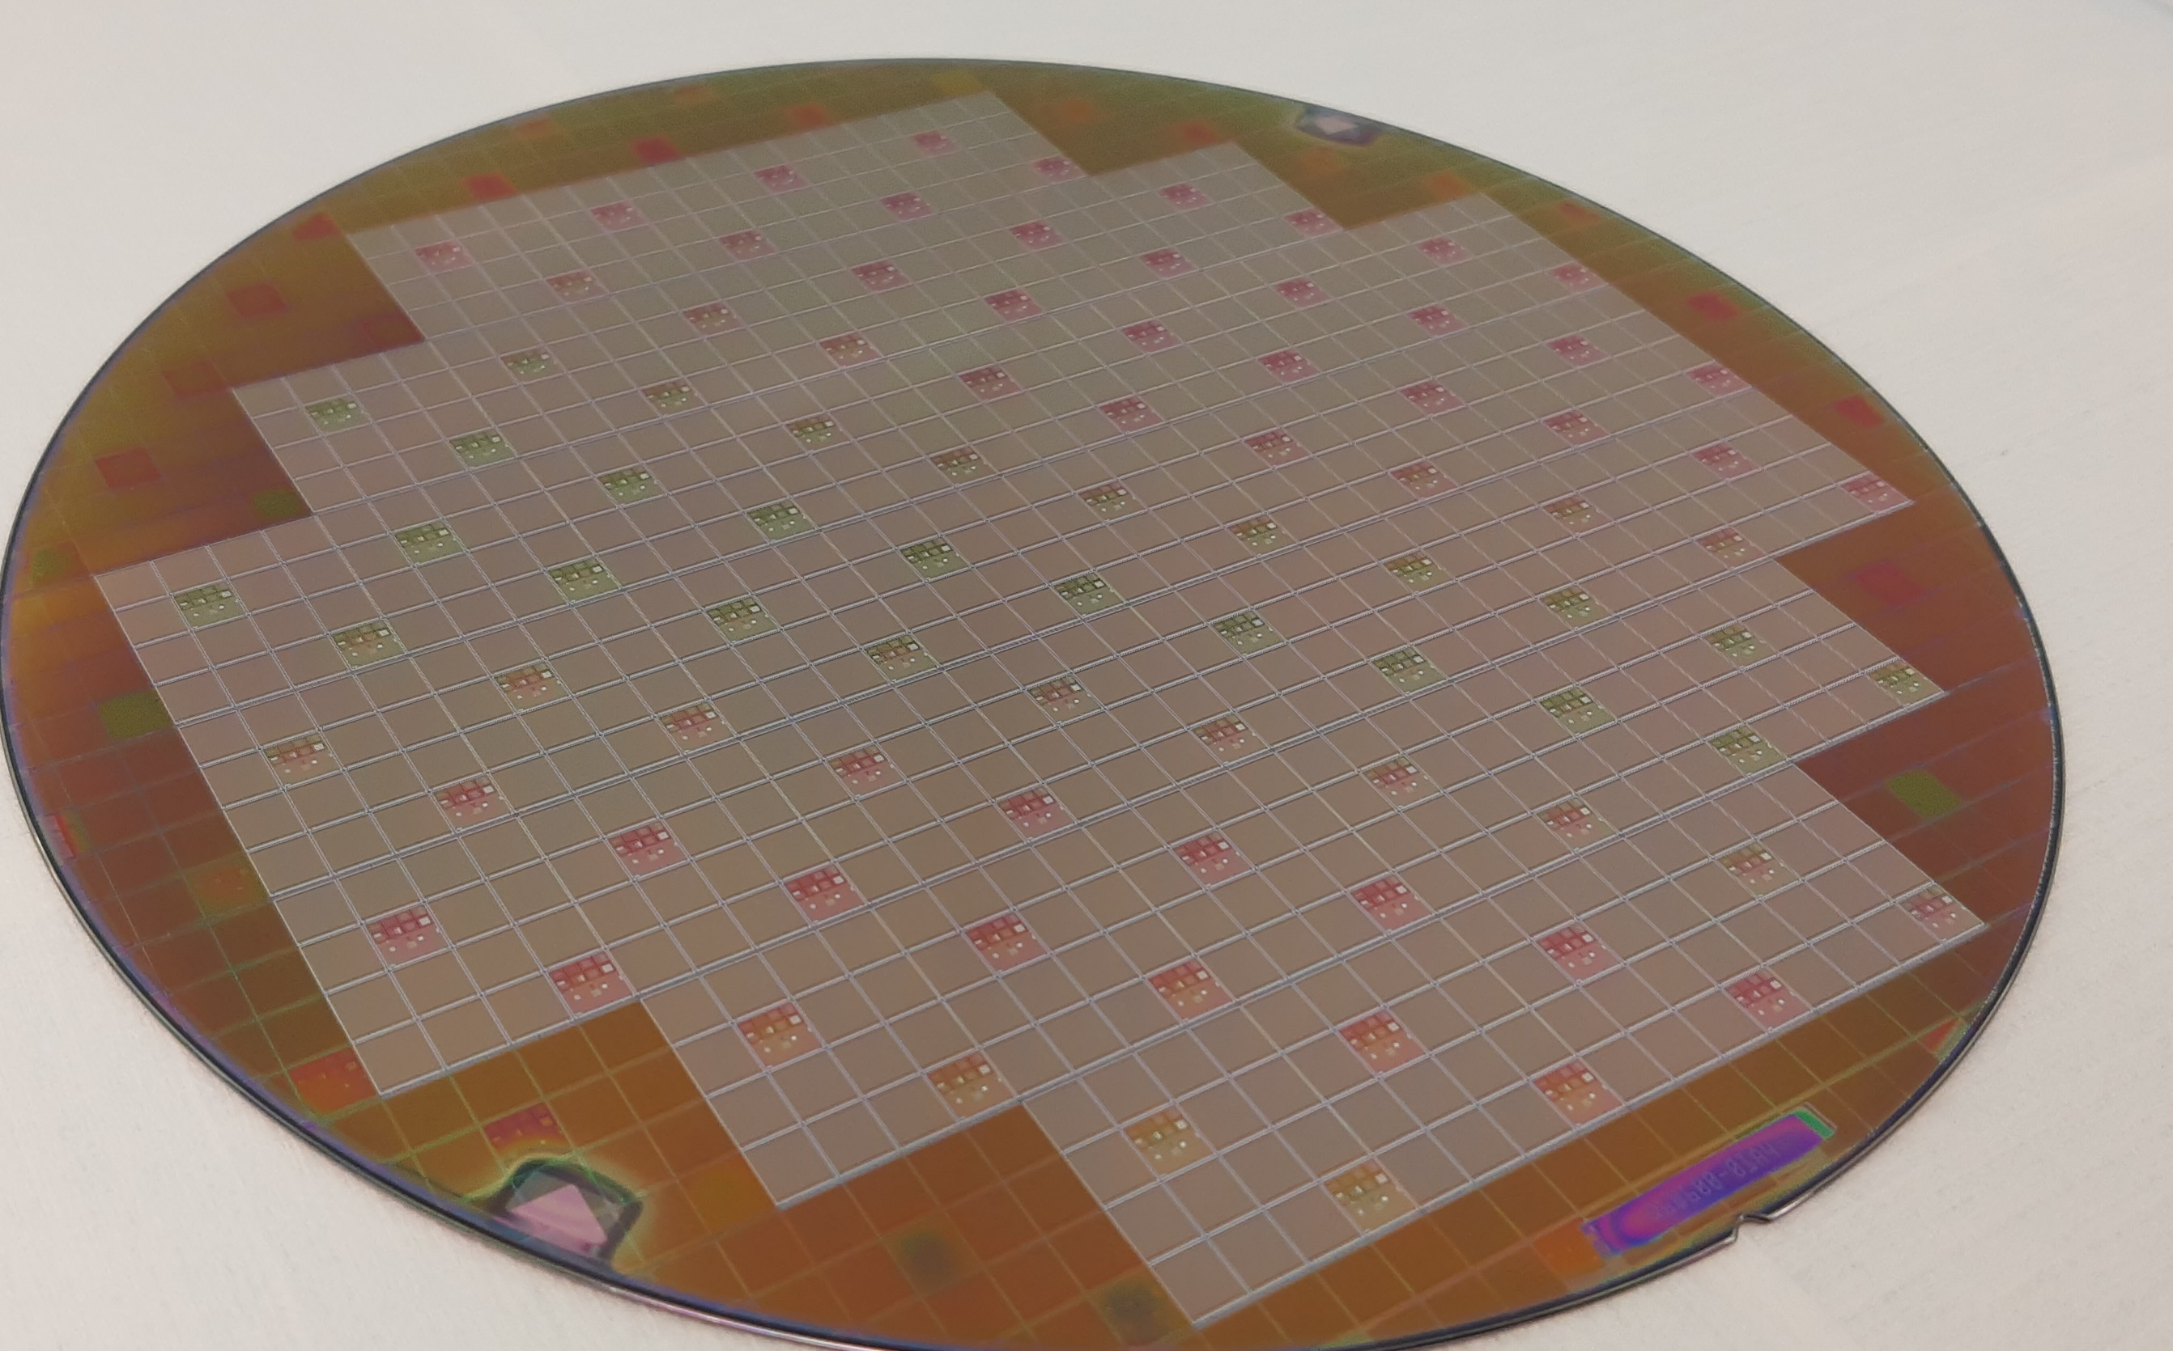
Toward 3d-PDC
150 mm SPAD wafer
200 mm PDC wafer

Slide 49
Test Bench for wafer-level measurement
Probe station
Semi-automatic movement for wafer-level measurement (over 600 PDC)
Wafer topology interpolation
Movement of the chuck in relation to the wafer
Wafer topology
Notes:
Utilisez les images

Slide 50


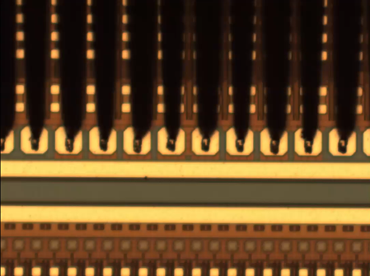

Test Bench for wafer-level measurement
Dedicated probe card
Active probe card with FPGA
Passive probe card
Laptop with Python scripts
Probe card on a probe station
Needles of the probe card (Microscope view)
Notes:
Use a probe station

