Slide 1
Search for the X-17 Particle in Montreal
Arvind Gupta and The Montreal Tandem Accelerator Lab

Slide 2
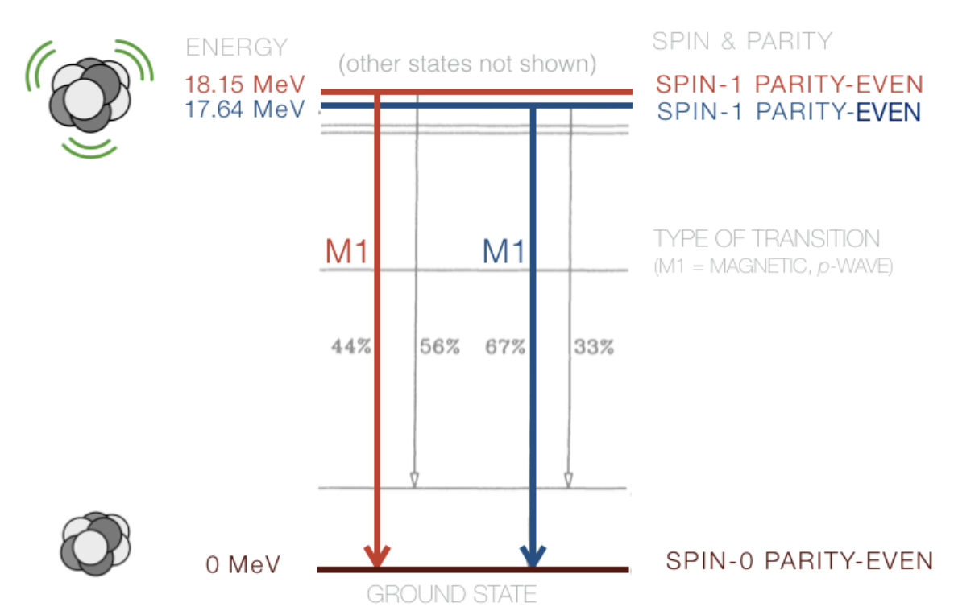
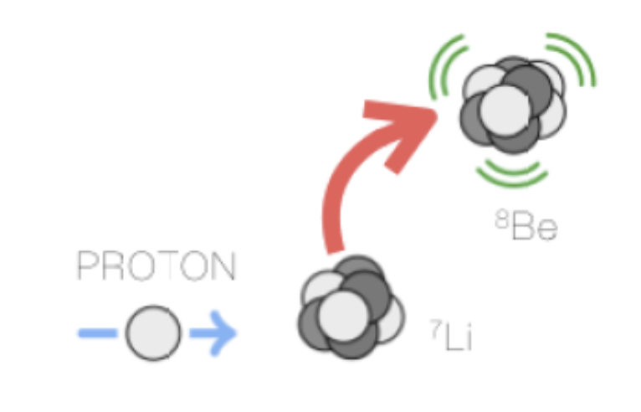
The Atomki Experiment
Original experiment by A.J. Krasznahorkay 's team at the Institute for Nuclear Research, Hungarian Academy of Sciences (MTA Atomki).
Observed an anomaly in the Internal Pair Creation (IPC) signal of excited ${}_{}^{8}{Be}$ atoms.
The experiment investigated, anomalies observed in the internal pair creation of 17.6 MeV and 18.15 MeV M1 transitions in ${}_{}^{8}{Be}$.
The excited states were produced by a proton beam impinging on thin ${}_{}^{7}{Li}$ targets.

Slide 3
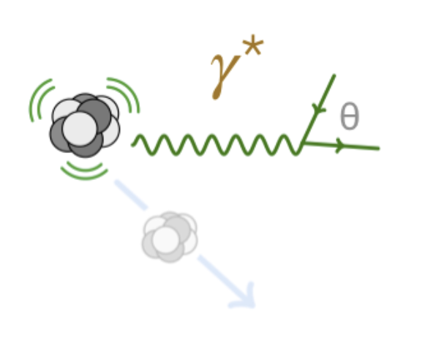
The Atomki Experiment
Original experiment by A.J. Krasznahorkay 's team at the Institute for Nuclear Research, Hungarian Academy of Sciences (MTA Atomki).
Most excited states decay promptly back to 𝑝${}_{}^{7}{Li}$ but can through certain electromagnetic processes rarely decay into photons with branching ratio $B({}_{}^{8}{{Be}^{∗}}→{}_{}^{8}{Be} γ)$ ≈ 1.4 × ${10}^{−5}$.
Even more rarely they can decay via Internal Pair Creation where the photons decays into electron and positron pairs with branching ratio: $B({}_{}^{8}{{Be}^{∗}}→{}_{}^{8}{Be} e^{+}e^{−})$ ≈ 3.9 × ${10}^{−3}B({}_{}^{8}{{Be}^{∗}}→{}_{}^{8}{Be} γ)$ ≈ 5.5 × ${10}^{−8}$.

Slide 4
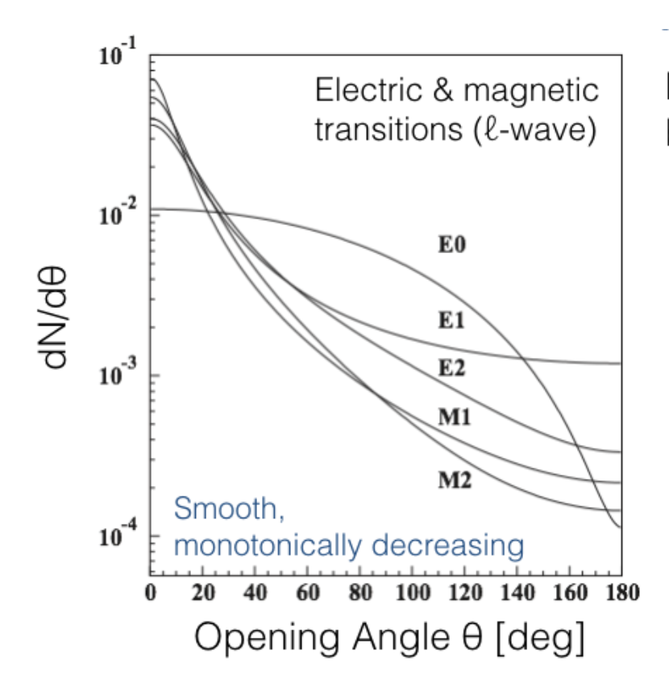
The Atomki Experiment
Original experiment by A.J. Krasznahorkay 's team at the Institute for Nuclear Research, Hungarian Academy of Sciences (MTA Atomki).
For IPC decays, the angular correlation between the electron-positron pairs can be measured as well as the invariant mass $m_{e+e−}$.
We expect the angular correlation distribution to be peak at low values of $θ$ and fall off smoothly for increasing angles as predicted by QED.

Slide 5
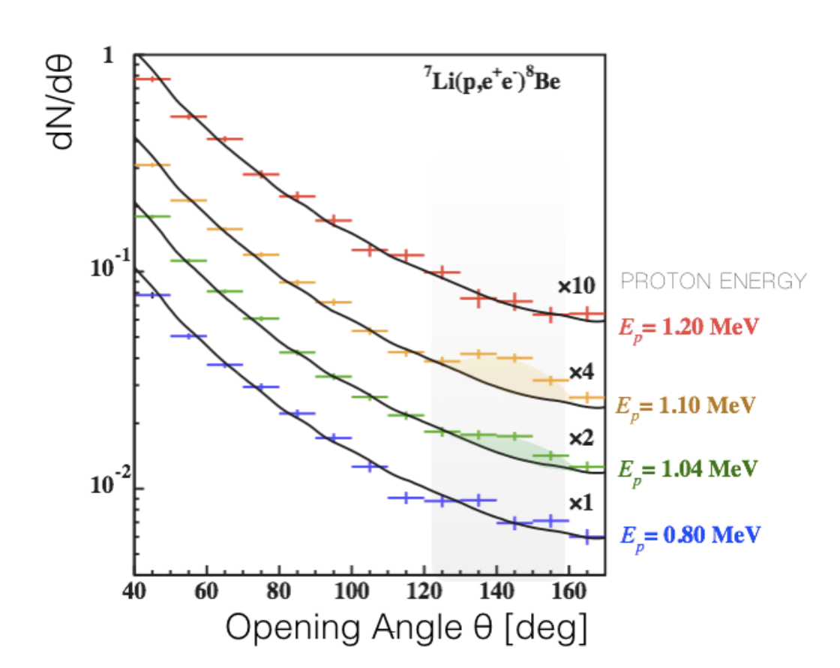
The Atomki Experiment
Original experiment by A.J. Krasznahorkay 's team at the Institute for Nuclear Research, Hungarian Academy of Sciences (MTA Atomki).
Instead the Atomki team observed an excess of large IPC opening angles, especially pronounced for the 18.15 MeV M1 transition.
The anomaly is especially pronounced around 140 degrees and has a significance of 6.8σ.
Opening angle, asymmetry and invariant mass is consistent with decay of a new particle, a boson with mass 17.6 MeV was found to be the best fit.

Slide 6
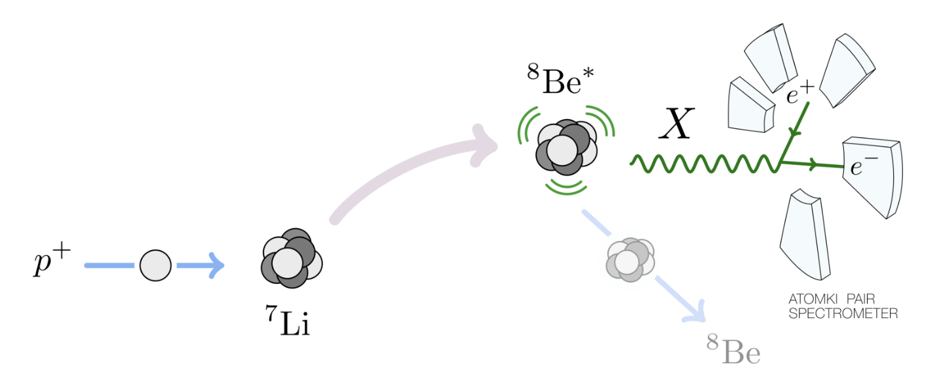
The Atomki Experiment

Slide 7
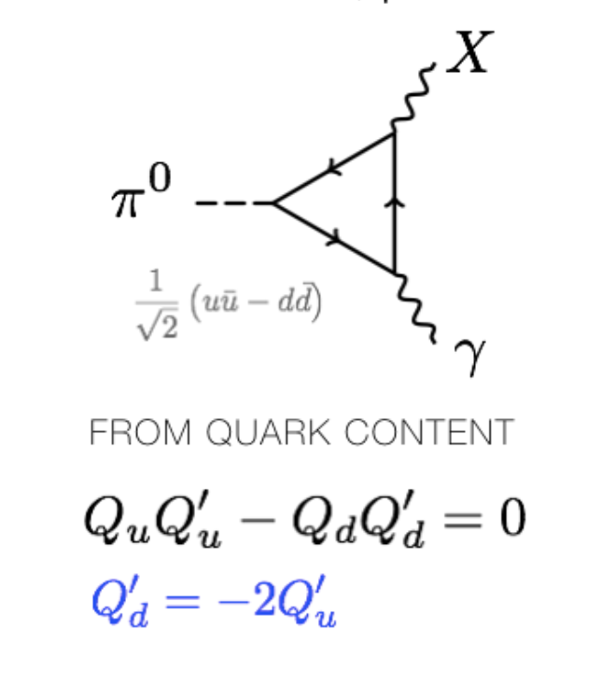
Some Theory
Theory Groups from UC Irvine, University of Kentucky, and UC Riverside investigated the anomaly.
Atomki suggested that the new particle appears to be a dark photon.
However such a dark photon would have been observed by the NA48/2 experiment which looked for dark photons in the decay of neutral pions ($π^{0}$).
For the photon-like particle theory to work, X-17 has to have a vanishing coupling to protons (and neutrinos) relative to neutrons i.e it is protophobic.
NA48/2 neutral pion decay

Slide 8
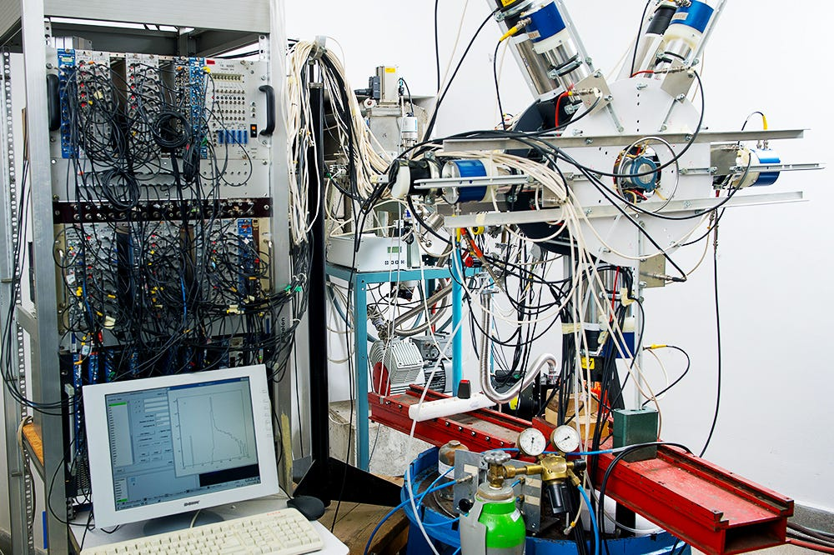
Atomki Experimental setup
IPC pairs were detected by five plastic ∆E–E detector telescopes
∆E detectors of 38×45×1 ${mm}^{3}$ and E detectors of 78×60×70 ${mm}^{3}$ placed perpendicularly to the beam direction at azimuthal angles of 0◦, 60◦, 120◦, 180◦ and 270◦.

Slide 9
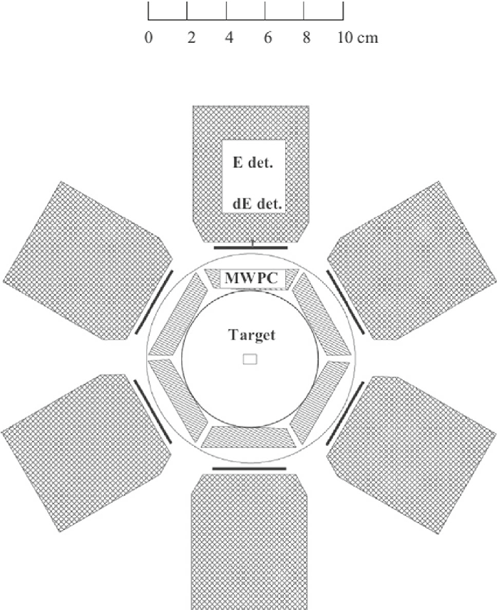
Atomki Experimental setup
Angles chosen to obtain a homogeneous acceptance of the $e^{−}e^{+}$ pairs as a function of the correlation angle.
The positions of the hits were registered by multiwire proportional counters (MWPC) placed in front of the ∆E-E detectors.

Slide 10
Montreal Experimental Setup
The experimental setup at the Tandem Accelerator in the University of Montreal consists of two main elements.
Cylindrical multiwire proportional chamber (MWPC): inner radius 6 cm and length 36 cm, filled with 74% Ar and 26% CO2.
16 scintillator bars 1.4 m in length, cylindrically arranged at an inner radius of 16 cm.
The MWPC and the scintillators were previously used by the Daphne experiment.

Slide 11
Montreal Experimental Setup

Slide 12
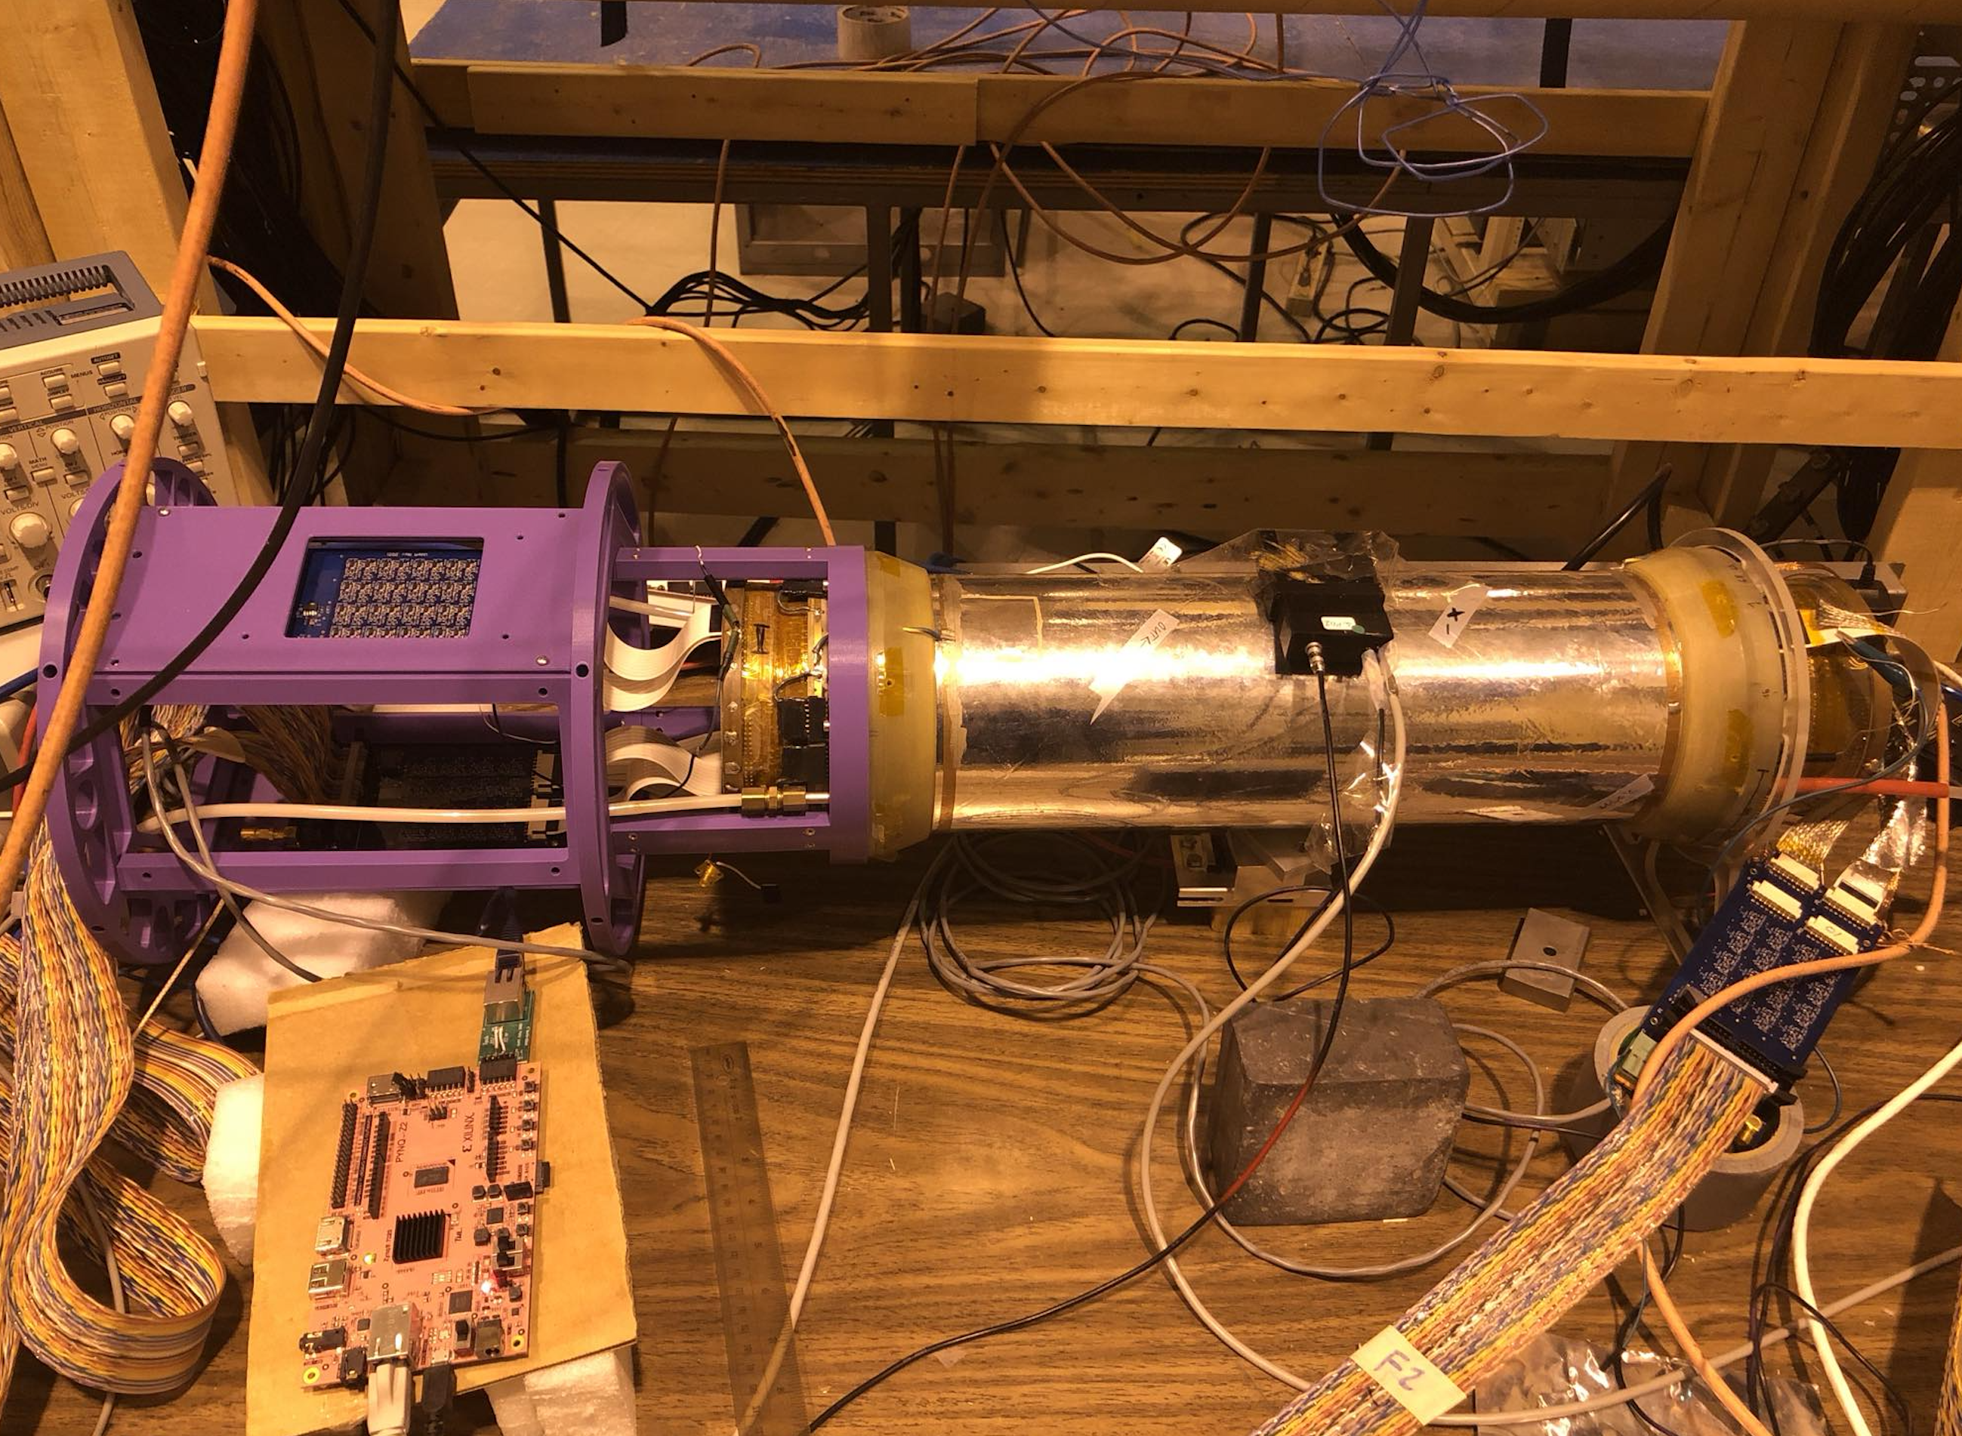
Multiwire Proportional Chamber
Cylindrical Chamber made up of light material (1 mm of Rohacell).
192 anode wires at 2 mm spacing and 60 inner and 68 outer cathode strips of width 4 mm arranged at 45 degrees to the anode wires.
Angular resolution of around 2 degrees.

Slide 13
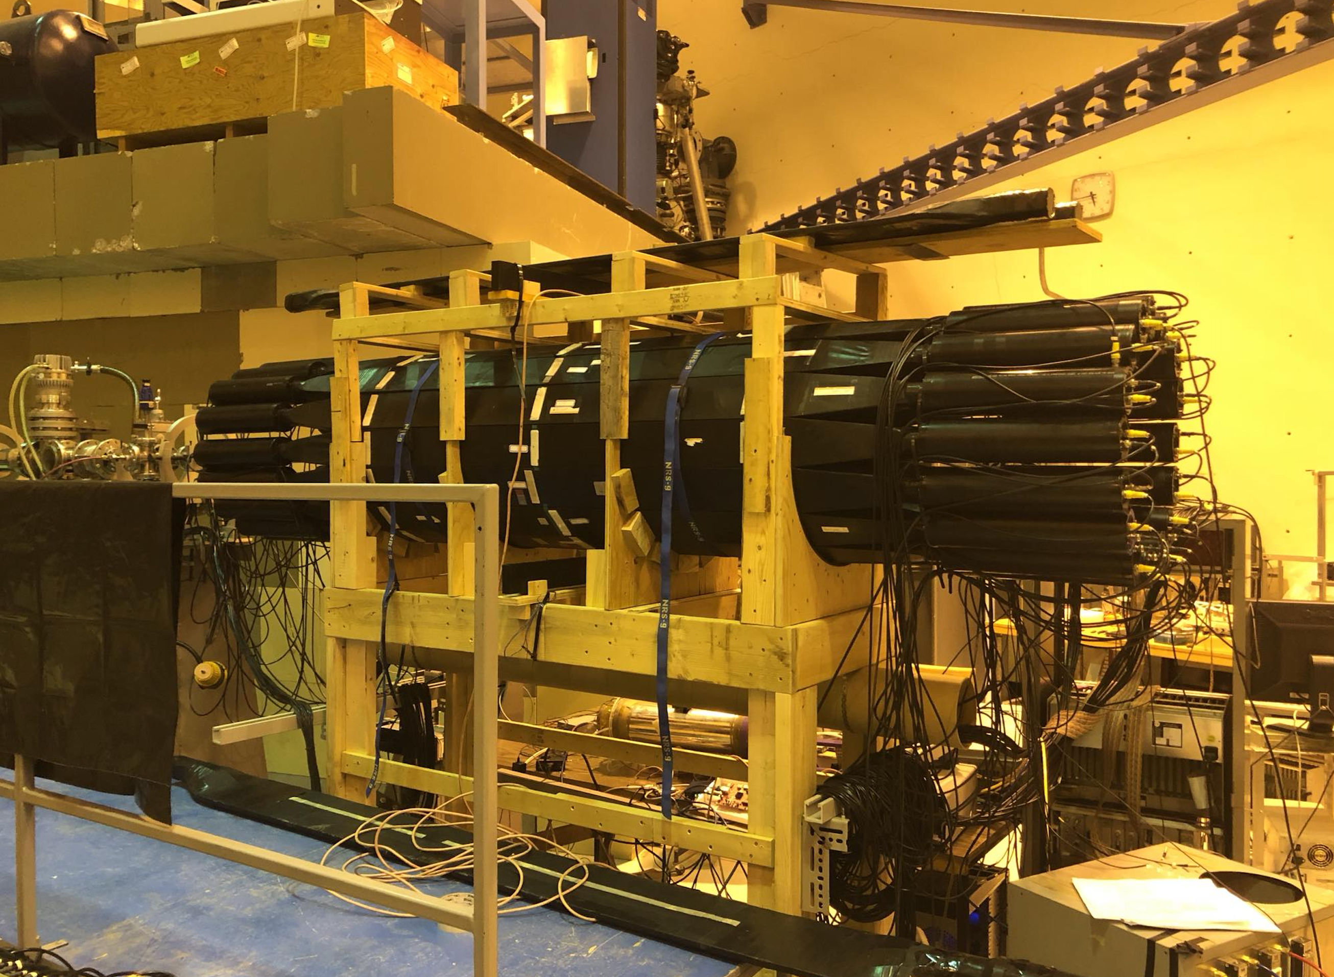
Scintillators and PMT's
16 scintillator bars and 32 photomultiplier tubes.
Signals from both ends of the scintillator bar allow a good measurement of the energy deposited by the electrons with an estimated resolution of $7\%/\sqrt{E(MeV)}$.

Slide 14
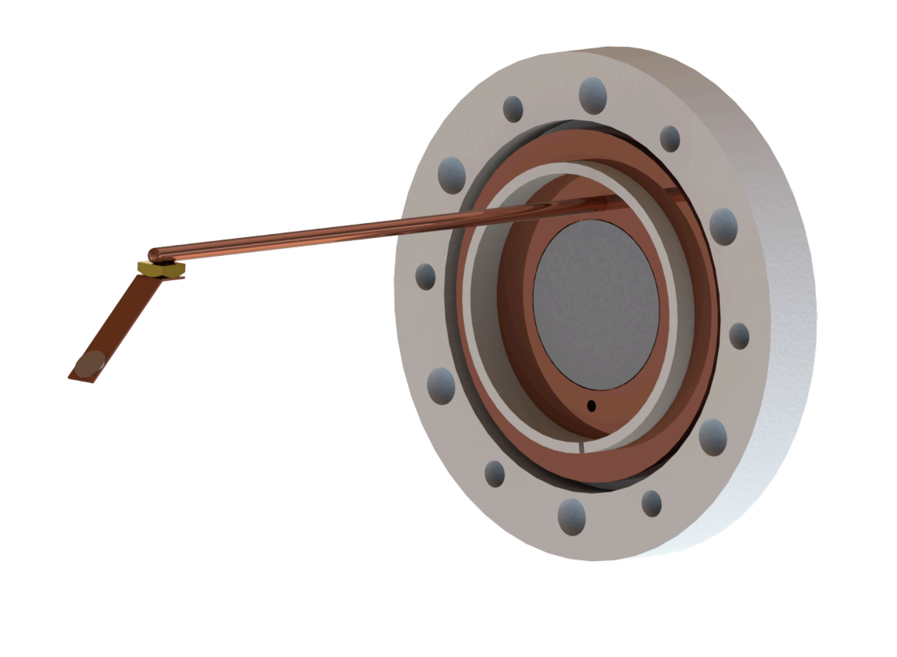
Target
A LiF target is evaporated on a thin Al or Cu foil which is inclined at 45 degrees relative to the beam line and is held by a cooling rod.
In the target region, the beamline is composed of a low density carbon fiber material with a wall thickness of 0.8 mm.

Slide 15
GEANT4 Monte Carlo Simulation
A Monte Carlo simulation of the experiment is also setup using GEANT4.
The simulation includes all the basic elements of the detector and takes into account the energy resolution measurement in the scintillators and the electron/positrons directions in the MWPC.

Slide 16
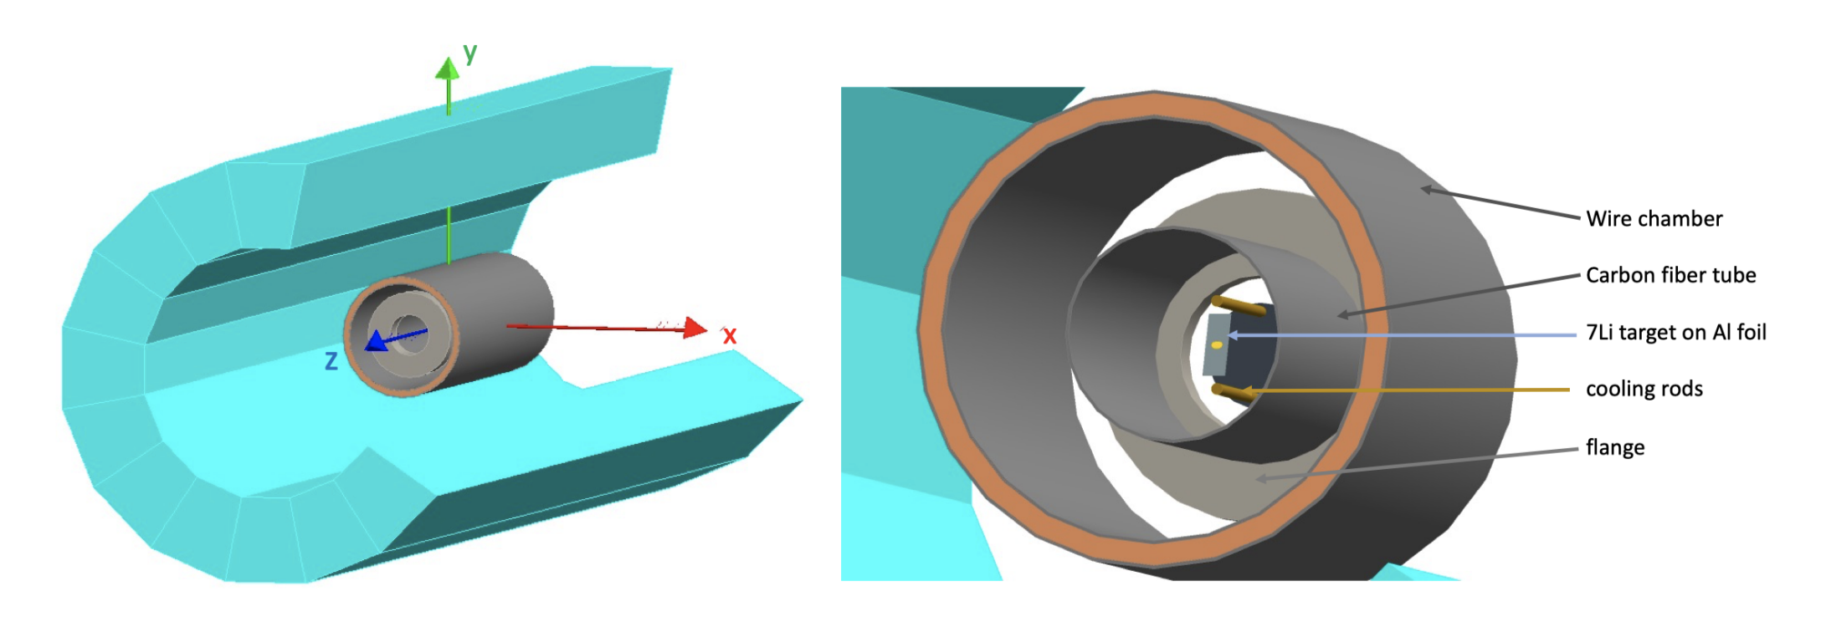
GEANT4 Monte Carlo Simulation

Slide 17
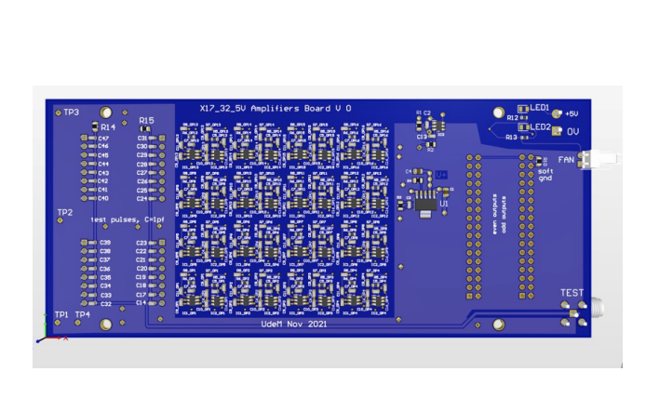
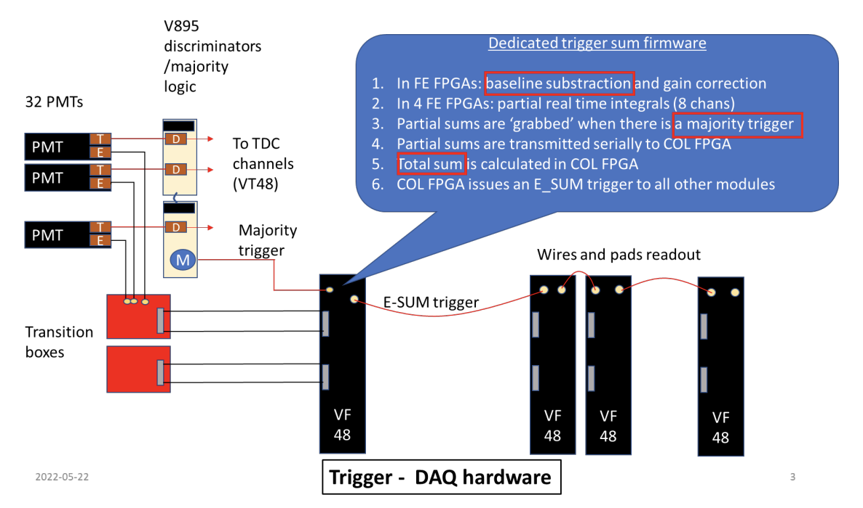
Current Status
Various elements (Scintillators, MWPC, Target) of the experiment are already in place.
The electronic data acquisition (DAQ) hardware has been tested and is being deployed.
We aim to perform beam runs and data acquisition in early summer 2024 and expect results towards the end of summer 2024.

Slide 18
For More Details

Slide 19
Thank you
Arvind Gupta​
arvind.gupta@umontreal.ca

Slide 20
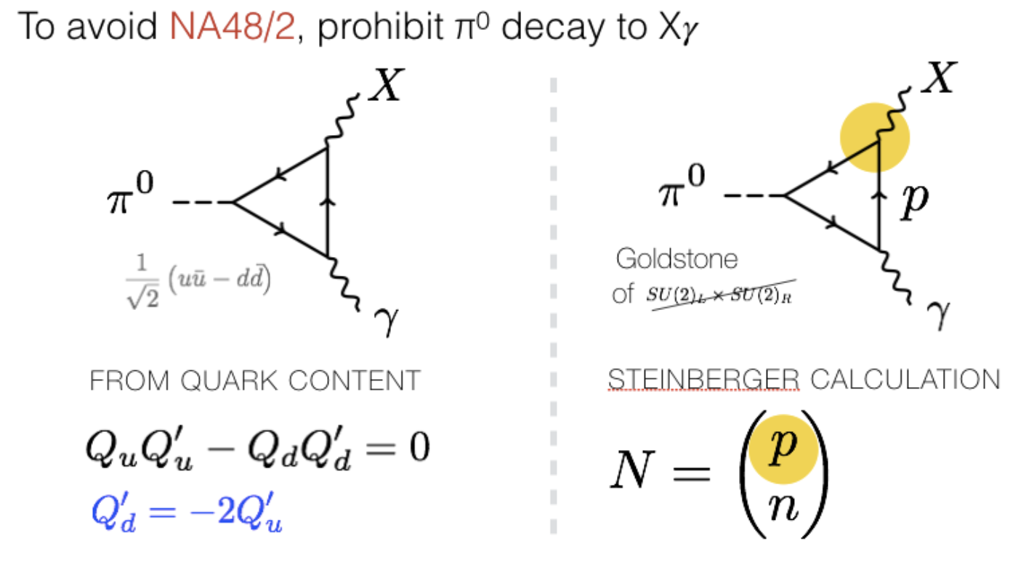
Appendix

