Slide 1
Through Thick and Tin: Investigating Tin Isotopes Approaching N=Z Nuclei
Annabelle Czihaly
MSc Student, University of Victoria

Slide 2
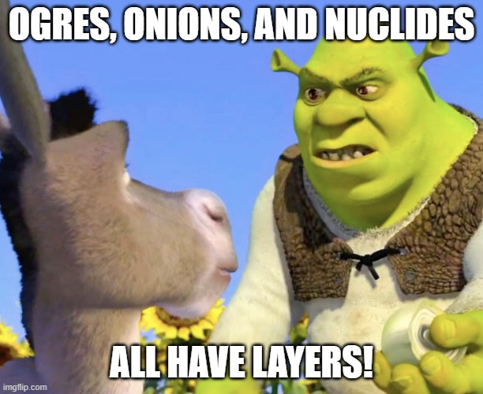
Notes:
Ogres, onions, and nuclides have one thing in common: they all have layers!

Slide 3
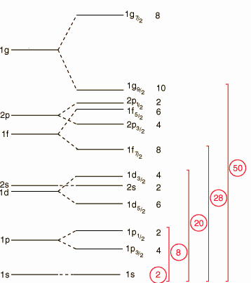
Nuclear shell model describes the configuration of protons and neutrons in a nucleus
Describes protons and neutrons as shells
Large energy gaps lead to closed shells
High stability that can be observed
More spherical
Longer half-lives
More binding energy
Energy levels
Splitting from adding spin-orbit terms
Notes:
The nuclear shell model discovered in 1949 describes protons and neutrons as shells in a nucleus. It was independendlty developed in 1949 by Mayer and Jensen who shared the Nobel prize for its discovery in 1963. What we're looking at here on the left are different energy levels. As we move towards the right, we add spin, angular momentum, and spin-orbit terms and due to hyperfine structure, we end up with this particular spacing where we can see different gaps between certain orbitals. Large energy gaps lead to something called shells and they occur at 2, 8, 20, 28, and 50 which we can see highlighted in red. We expect a closed shell to be an energetically favourable configuration and as a result, closed shells have high stability which can be observed in a number of different observables.
Can have 2 protons or neutrons in the s shell, a total of 6 for the p_3/2 and p_½ and so on. You can see we have very large gaps positioned throughout our energy levels that are available to our nucleons. These large gaps effectively create layers or shells within our nucleus. These occur at closed shells for 2 nucleons, 8 nucleons, 20, 28, 50 and in neutrons, we have evidence they go up to 126 neutrons.
First proposed in 1949 by maria goeppert mayer and hans jensen and is such a powerful idea that it won the nobel prize in 1963 and it’s a model that we use even today to understand nuclear structure. When we have this big energy gap, we see exceptionally stability. These nuclides tend to be spherical, have longer halflives, tend to have more binding energy because this is a more stable configuartion.

Slide 4
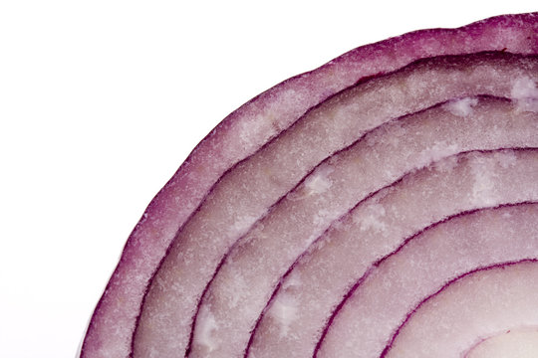
Nuclear shell model describes the configuration of protons and neutrons in a nucleus
Developed in 1949 by Maria Goeppert Mayer and Hans Jensen
Nobel prize in 1963
Nuclear shell model is analogous to atomic shell model
Full shell = magic number of protons or neutrons
Found at N, Z = 2, 8, 20, 28, 50
Notes:
The nuclear shell model is analogous to the atomic shell model you learned about in high school with different forces at play . A closed shell is a ground state configuration because it is energetically favourable. Shell closures occur at special numbers, called magic numbers, and nuclei with a magic number of nucleons are unusually stable.

Slide 5
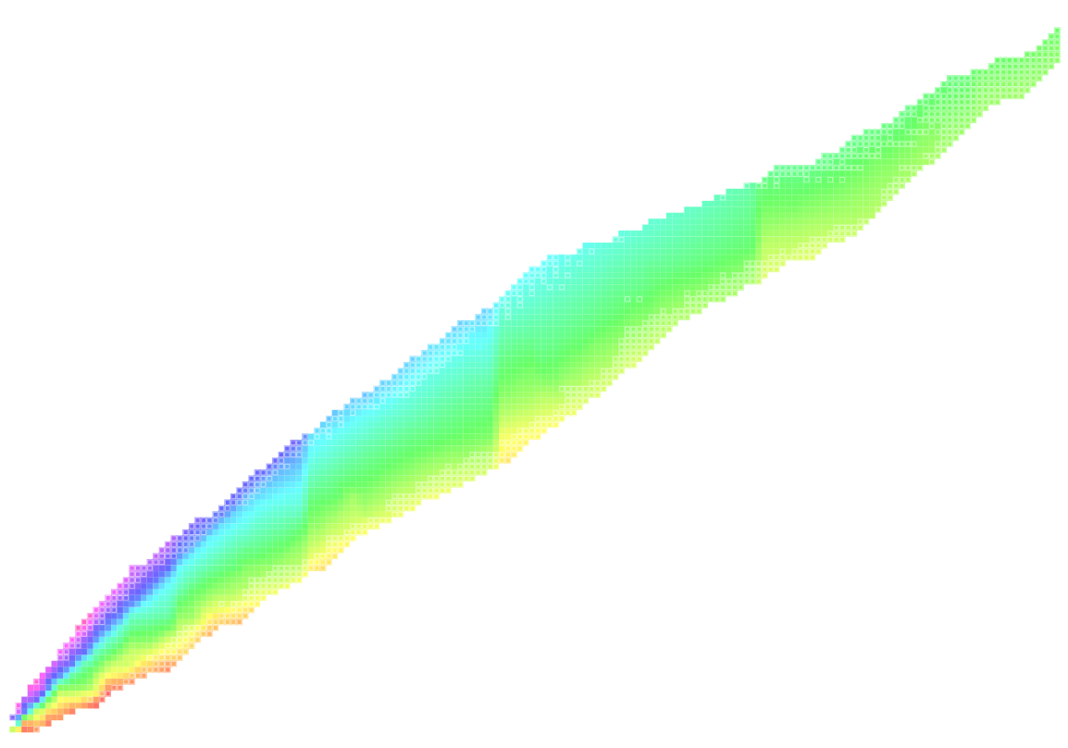
Evolution of nuclear structure manifests in mass differences
S_{2N}= M(N-2, Z) - M(N, Z) + 2M_{N}
Energy required to remove 2 neutrons from a nucleus
N = 126
Protons (Z)
Similar behaviour at magic number of neutrons
Same is true with two-proton separation energy plot
Doubly magic: magic number of protons and neutrons
N = 82
N = 50
Neutrons (N)
Notes:
Taking a mass difference, or two in the case of this plot, illistrates features in the evolution of nuclear structure. In this heatmap, the x axis corresponds to increasing neutron numbers and the y axis corresponds to increasing proton numbers and each tiny box represents a unique nuclide. What I want you to notice are regions with similar behaviour. What I see, and I hope you see, is that behaviour repeats itself at magic numbers of neutrons. In these regions, we have closed shells with unusual stability. I've now told you about nuclides with exceptional stability when the neutron number is magic however, the same shells exist for magic proton numbers, too. We can then have nuclides that are so-called doubly magic, like tin 100, with a magic number of both protons and neutrons.
We have our neutron number coming along the horizontal axis and our proton number on the vertical axis which means that every square is a particular nuclide with distinct nuclear behaviour.
What we see is the two neutron separation energy. The equation is here where we can see that we're taking a mass difference between 2 neighboring nuclides and 2 neutrons which tells me that cost of taking off two valence neutrons. What we can see on the western shore is that it is very costly to remove two neutrons whereas on the eastern shore, it is very cheap as these nuclides are neutron rich. The next trend I want to point your eyes to is a little hard to see but if you follow this light blue colour, we see it grows and then sharply decreases, grows back, and sharply decreases. We see these regions coming out and they line up perfectly with magic numbers for closed shells that I mentioned previously.

Slide 6
Extraordinary isotope, exceedingly difficult to measure: ¹⁰⁰Sn
Challenges
Low production cross section
Beam containing tin is heavily contaminated
Motivation
Doubly magic
High binding energy
Heaviest N=Z nuclide
Mass has never been directly measured
How can we tackle the challenge to measure ¹⁰⁰Sn?
Notes:
I told you about nuclei with exceptional stability and doubly magic nuclei which have a magic number of both protons and neutrons. This brings me to my isotope of interest, tin 100. Tin 100 is particular intersting because it sits on the edge of the proton dripline, is the heaviest N=Z nuclide, and theory had yet to catch up to it. Furthermore, its mass has never been directly measured due to its low production cross section and high level of contamination. So how can we tackle the challenge of understanding the structure of tin 100 and its neighbourhood?

Slide 7
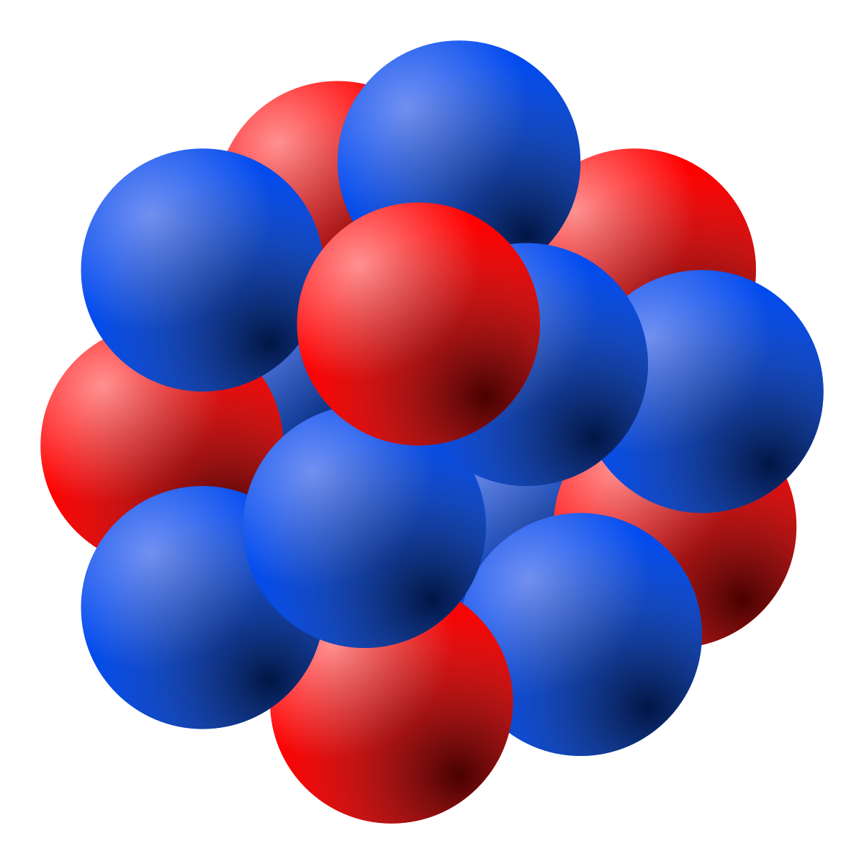
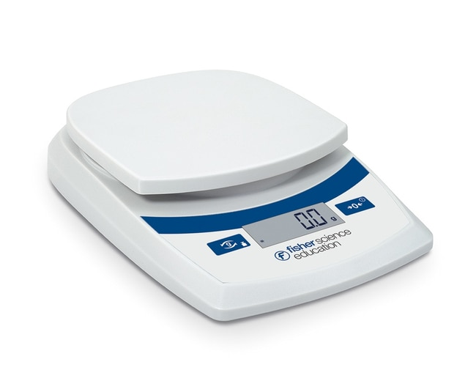
How do we measure the mass of an ion?
*image is not to scale...pun intended
Notes:
so how do we actually go about measuring the mass of an ion?

Slide 8
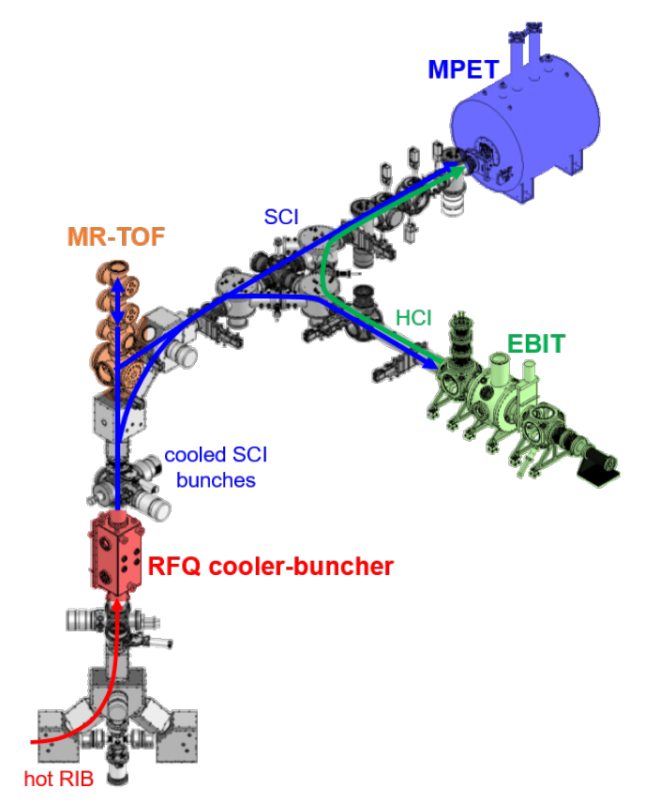
TRIUMF's Ion Trap for Atomic and Nuclear science (TITAN)
TITAN facility measures masses to high precision
For studies of nuclear structure, nuclear astrophysics, and fundamental symmetries
Notes:
This brings us to the preliminary results of my analysis. In this plot, the deviation of my analysis in pink with respect to the atomic mass evaluation in purple which is basically the bible of mass measurements. As we can see, our results are in excellent agreement with previous measurements done with penning trap mass spectrometry, the gold standard of mass measurements. Additionally, the achieved precisions are good enough to for us to make inferences about nuclear structure. This experiment was remarkable in more ways than one. As one of the first with TITAN's MR-TOF, it is gratifying to see such precision achieved in a fraction of the time compared to penning trap mass spectrometry, such as those performed with SHIPTRAP and JYFLTRAP. This demonstrates the power of TITAN's MR-TOF to further survey this region and push towards tin 100 which, due to a site-wide power failure, was not able to be reached in this 2018 experiment.
What I want to impress upon you is that this data was taken in less than 1 day and with no effort, error bars that are meaningful for nuclear structure comparisons in less than 1 day compared to a typical penning trap experiment that lasts a few days.
Pennings traps may be the gold standard but we're gonna win with the mrtof in terms of speed, efficiency, and still be able to achieve science results.

Slide 9
Journey of the ions
Cyclotron
Ta target
Cooler & Buncher
Detector
Electrostatic Mirrors
P
Radioactive beam containing tin
Notes:
At TRIUMF, our cyclotron creates a high-energy 480 MeV beam of protons. This proton beam is then impinged on a thick tantalum target. From the subsequent nuclear reactions in the target, a hot radioactive beam containing tin is sent through a cooler buncher. The beam interacts with helium buffer gas which cools it and due to the potential of the electrodes, guides the cooled beam and accumulates it prior to ejection. The now cooled and bunched beam is sent through two electrostatic mirrors and detected. You'll notice that the detector is a stopwatch as it measures the flight time of the ions, from injection into the mirrors to extraction.
Make arrows bigger

Slide 10
Principle of the Multiple-Reflection Time-of-Flight Mass Spectrometer (MR-TOF)
Notes:
Now I will discuss the mirrors from the previous slide in more detail. The mirrors represent the multiple reflection time of flight mass spectrometer, mrtof for short. From energy conservation, we know that for monoenergetic ions, heavier ions will move slower than lighter ions. Thus, heavier ions will take more time to travel the same flight path and therefore reach the detector after the lighter counterparts which results in mass separation. Since UBC won't let us tear down the campus to create a long flight path, we fold over our flight track using a pair of electrostatic mirrors, coloured blue in this figure. The mirrors allow us to bounce the ions and reflect multiple times. For this experiment, ions completed over 400 laps before we ejected them to our detector. The detector measures the time of flight of the ions which we can use to determine their mass.
Mention equation, remove numbers from ions, mirrors > electrostatic mirrors, make text bigger, show bouncing somehow,
All of you have done 1/2 mv^2 so all of you know that if we're running the same distance, things that are heavy will move slower than things that are lighter. But our path length needs to be on the order of kilometers. So how do we accomplish this?

Slide 11
Principle of the Multiple-Reflection Time-of-Flight Mass Spectrometer (MR-TOF)
Electrostatic mirror
Notes:
So we inject ions all with the same energy, bounce them back and fourth 350 times until we get to that longer path length, then we open up the second electrostatic mirror and let the ions impinge on the detector.

Slide 12
Principle of the Multiple-Reflection Time-of-Flight Mass Spectrometer (MR-TOF)
Notes:
So we inject ions all with the same energy, bounce them back and fourth 350 times until we get to that longer path length, then we open up the second electrostatic mirror and let the ions impinge on the detector.

Slide 13
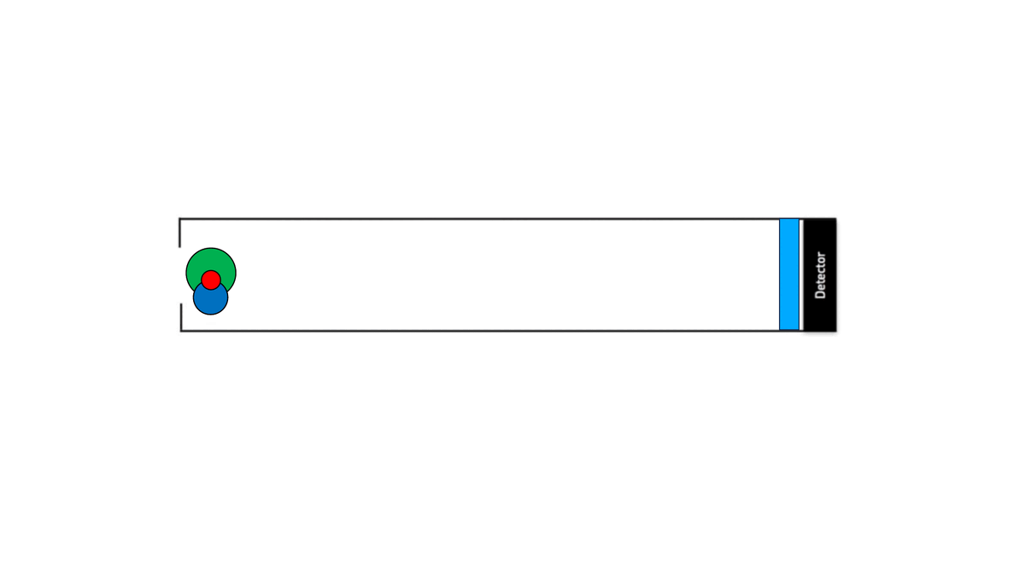
Principle of the Multiple-Reflection Time-of-Flight Mass Spectrometer (MR-TOF)
Electrostatic mirror
Notes:
So we inject ions all with the same energy, bounce them back and fourth 350 times until we get to that longer path length, then we open up the second electrostatic mirror and let the ions impinge on the detector.

Slide 14
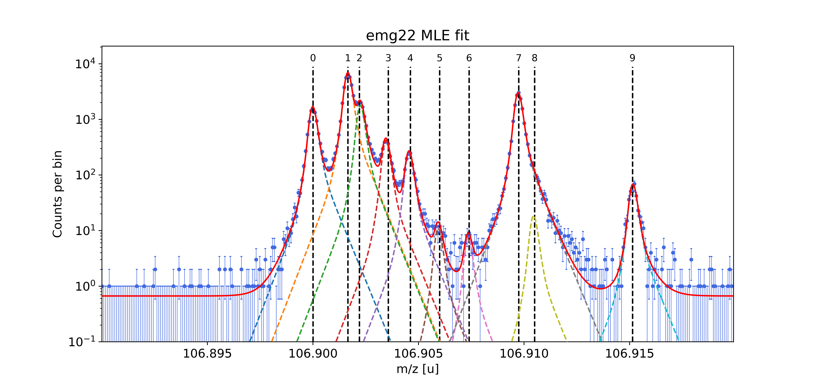
Spectrum shows high resolving power allowing fully-resolved tin peaks
c, t₀, b: calibration parameters
⁹¹Y¹⁶O⁺
^{107g}In
^{107m}In
⁹¹Zr¹⁶O⁺
¹⁰⁷Sn
N_{IT}: number of turns
Notes:
From the measured time of flight, we can determine mass. Here, c, t_0, and b are calibration parameters and N_IT is the number of turns the ions made in the mrtof. On the right we see an example of a spectrum. The x axis corresponds to mass which increases as we move along. What I want you to take away from this spectrum is that despite numerous peaks, we have fully resolved our isotope of interest, tin, from all background contamination. Additionally, we can identify all major contaminents and our knowledge of the system is so great that we can even identify a low-lying isomer, an exicted nuclear state, of indium. This spectrum is fitted using a modified gaussian function.
Know what the parameters are!!
In reality, our equation is a bit more complicated than the ½ mv^2 but as you can see, it is nothing more than a quadratic and some contstants plus the number of turns which I control. Here is a realistic spectrum with the horizontal axis being time which I have already converted to mass and on the y axis we have a logarithmic scale of counts. The most critical thing we were able to do was to resolve tin from contamination. We can see a lot of junk that we needed to separate from our tin, recall that this is a logarithmic scale so the contamination dwarfs the tin and we were still able to resolve our ion of interest. We know our system and line shapes so well that we can identify a slight asymmetry in our In peak and know that it is due to an isomer, an excited nuclear state. When we fit this with our exponentially modified guassian, we can very nicely flesh out that we actually have two species contributing to this peak here.

Slide 15
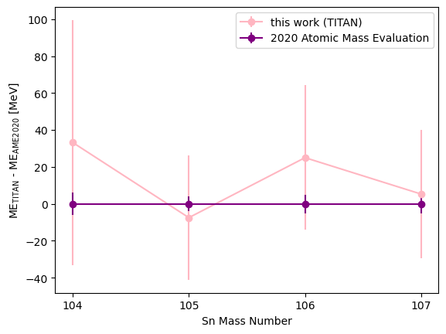
Preliminary results agree with gold standard of mass spectrometry
In excellent agreement with previous Penning trap measurements (gold standard for mass spectrometry) in fraction of the time
Achieved precisions are acceptable to make inferences about nuclear structure
Notes:
This brings us to the preliminary results of my analysis. In this plot, the deviation of my analysis in pink with respect to the atomic mass evaluation in purple which is basically the bible of mass measurements. As we can see, our results are in excellent agreement with previous measurements done with penning trap mass spectrometry, the gold standard of mass measurements. Additionally, the achieved precisions are good enough to for us to make inferences about nuclear structure. This experiment was remarkable in more ways than one. As one of the first with TITAN's MR-TOF, it is gratifying to see such precision achieved in a fraction of the time compared to penning trap mass spectrometry, such as those performed with SHIPTRAP and JYFLTRAP. This demonstrates the power of TITAN's MR-TOF to further survey this region and push towards tin 100 which, due to a site-wide power failure, was not able to be reached in this 2018 experiment.
What I want to impress upon you is that this data was taken in less than 1 day and with no effort, error bars that are meaningful for nuclear structure comparisons in less than 1 day compared to a typical penning trap experiment that lasts a few days.
Pennings traps may be the gold standard but we're gonna win with the mrtof in terms of speed, efficiency, and still be able to achieve science results.

Slide 16
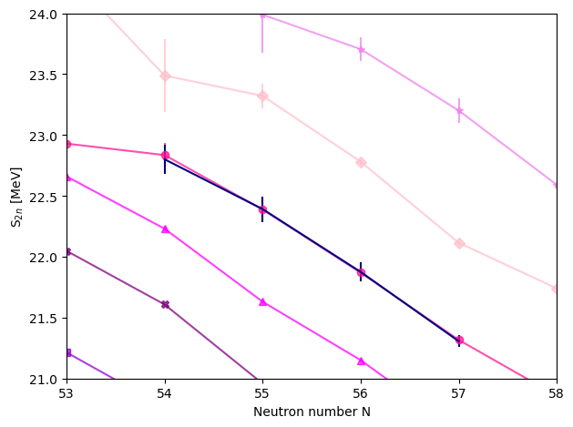
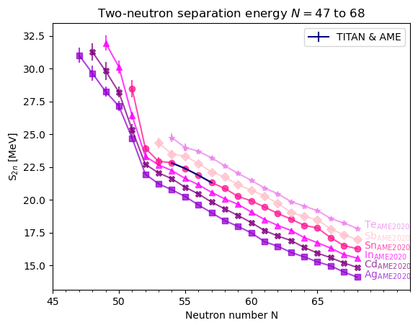
Mass surface measured is consistent with expected nuclear shell model
Notes:
Earlier I showed you a heatmap of the two neutron separation. here is the same plot in 2d with titan results highlighted in blue. The x axis is increasing neutron number and the y axis is the two neutron separation energy in mev. We can see that two neutron separation number decreases as the number of neutrons increases. We see a universal feature at n=50 of a steep drop off indicating a neutron shell closure. We approach this jump with our dataset but we unfortunatly didn't make it all the way to tin 100 as we suffered from a campus wide power shutdown which took nearly a week to recover from. Let's zoom into this plot a bit...
When we zoom into the TITAN results highlighted in this inset, we see behaviour that is consistent with the nuclear shell model, as the TITAN values hug the previous mass evaluation. in conclusion, our results are indicative of midshell behaviour and support the neutron-shell closure at tin 100.
Previously we had to squint to see the magic numbers in the heat map but
Universal, dramatic kink at N=50 which is indicative of a magic number here. All data is from the atomic mass evaluation of 2020 which is this fantastic evaluation where the authors survey all possibly mass measurements and do a weighted average of them and we get this evaluation we can see here. If we look at the inset, in dark blue we see our values weighted with the other measurements. We see a very small deviation which isn't really meaningful and what it tells us is that we have the same slope and we have no major deviations which would be indicative of deformation or unusual shell structure. We have this smooth slope that extends all the way until our next shell closure at N=82 which isn't shown here. So we have no reason to doubt our nuclear shell model and we do believe that tin 100 is consistent with a full shell closure at N=Z=50.

Slide 17
Summary
Successfully measured ¹⁰⁴⁻¹⁰⁷Sn via MR-TOF technique with TITAN with error bars of 34-66 keV
Preliminary results agree within 1 sigma to 2020 Atomic Mass Evaluation
Plot of the two-neutron separation energy supports the shell closure at N=50 in the Sn isotopes
Accepted letter of intent to measure ¹⁰⁰Sn with MR-TOF
Notes:
In summary, we successfully measured tin 104 to 107 via the MR-TOF technique in a fraction of the time compared to penning trap mass spectrometry. As I told you earlier, the challenge for penning traps is low production and high contamination which makes investigating tin more in the realm of the mrtof. Additionally, our preliminary results agree to the 2020 atomic mass evaluation within 1 sigma and we have demonstrated that we have every reason to believe the shell closure at n=50 continues to exist based on our s2n plot. Leaving you today with a hopeful outlook, we have an accepted letter of intent to measure more tin and are awaiting beam scheduling with high hopes that we will execute the experiment this year.
What we really need to do is get to tin 100. We have an accepted letter of intent and just need to be scheduled. If we're lucky, I will be ready to tell you all about tin 100 next year and if indeed there is a kink at N=50 that we can verify with a direct measurement with TITANs MRTOF. That would be really really exciting and the reason we are so good at dealing with lots of contamination and managing our limited beam time.
What I did show you today is that we made it out to tin 104 with meaningful error bars in less than 24 hours. Our results are in agreement with the gold standard penning trap measurements to less than 1 sigma. Everything is lining up for that two neutron separation energy so now its just a matter of time before we can directly demonstrate that.

Slide 19
Ions in MR-TOF

Slide 20
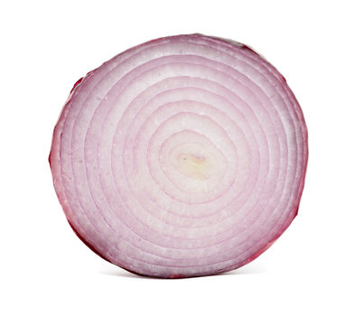
What do ogres, onions, and nuclides have in common? Layers!
Developed in 1949 independently by Mayer and Jensen
Describes protons and neutrons as shells
Large energy gaps lead to closed shells
High stability that can be observed
Large energy gaps lead to closed shells and magic numbers
Notes:
The nuclear shell model discovered in 1949 describes protons and neutrons as shells in a nucleus. It was independendlty developed in 1949 by Mayer and Jensen who shared the Nobel prize for its discovery in 1963. What we're looking at here on the left are different energy levels. As we move towards the right, we add spin, angular momentum, and spin-orbit terms and due to hyperfine structure, we end up with this particular spacing where we can see different gaps between certain orbitals. Large energy gaps lead to something called shells and they occur at 2, 8, 20, 28, and 50 which we can see highlighted in red. We expect a closed shell to be an energetically favourable configuration and as a result, closed shells have high stability which can be observed in a number of different observables.
Can have 2 protons or neutrons in the s shell, a total of 6 for the p_3/2 and p_½ and so on. You can see we have very large gaps positioned throughout our energy levels that are available to our nucleons. These large gaps effectively create layers or shells within our nucleus. These occur at closed shells for 2 nucleons, 8 nucleons, 20, 28, 50 and in neutrons, we have evidence they go up to 126 neutrons.
First proposed in 1949 by maria goeppert mayer and hans jensen and is such a powerful idea that it won the nobel prize in 1963 and it’s a model that we use even today to understand nuclear structure. When we have this big energy gap, we see exceptionally stability. These nuclides tend to be spherical, have longer halflives, tend to have more binding energy because this is a more stable configuartion.

Slide 21
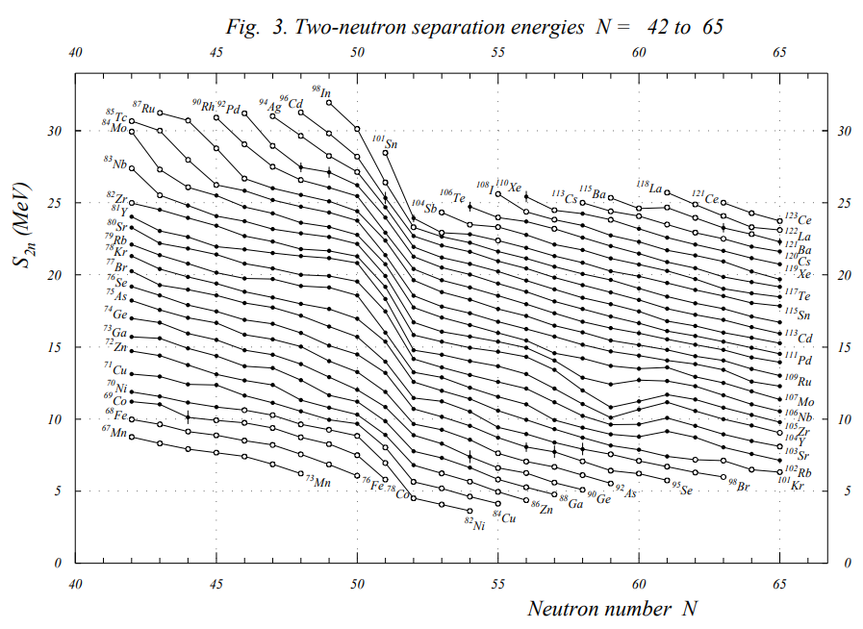
Notes:
Another way we can see the emergence of magic numbers is by looking at the two neutron separation energy plots like this one for different isotopes. There is a near-universal jump seen at N=50 indicating a closed shell.

Slide 22
Binding energy
Mass excess Δ(N, Z)=M(N, Z) - Au
Difference between mass and mass number

Slide 23
Why EMG?
Fits were performed using Gaussians modified with exponential tails on both sides. Although we expect the beam to take on a gaussian form, the shape is highly tune dependent . We have experimentally shown that using exponentially modified gaussians improves the quality of fit and therefore the precision compared to a pure Gaussian.

Slide 24
Fit example
Mass 107
Mass excess: -78506.941 keV
5.298 keV above 2020 Atomic Mas Evaluation (AME2020)
Notes:
Why EMG? Although the beam shape is expected to be Gaussian, the shape is tune dependent. We tune our peaks to be as symmetric as possible for the experimental conditions. We have experimentally shown that using EMGs improves the quality of fit and therefore the precision compared to a pure Gaussian.

Slide 25
Notes:
Well...much like Frodo's journey to Mordor, the path ions take is not so simple.

Slide 26
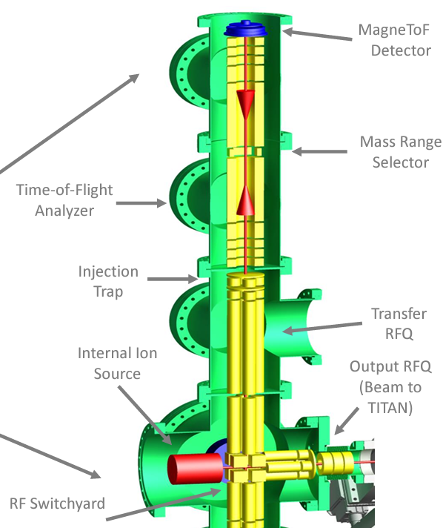
TRIUMF's Multiple-Reflection Time-of-Flight (MR-TOF) mass spectrometer
High resolving power
Non-scanning
Fast measurement cycles
Notes:
High resolving power: higher you go, better you can resolve one species from the next
Penning traps are resonant. Scan through freqs, 41 steps, only 1 at cyclotron freq. 39 points are not helpful.

Slide 27
Sources of error
Statistical error
From peak fitting
Error of calibrant masses
Systematic error
Dominated by opening time of 2nd mirror
Switching from trap potential to ejection potential is not perfect
Determined to be a 12.79 keV shift
Notes:
Speaking of errors, there are 2 sources of error: statistical errors which arise from the peak fitting procedure and systematic errors. The systematic error is dominated by the opening time of the second mirror. When ions are completing their last lap, the second mirror switches its potential from the trapping potential to ground. as this change isn't instant nor can the potential behave exactly as a step function, there is a sort of ringing in the second mirror. This ringing can effect the potential that the ions feel as they fly out and towards the detector, thus changing their energy and measured time of flight. This effect was investigated and results in a 13 keV shift.

Slide 28
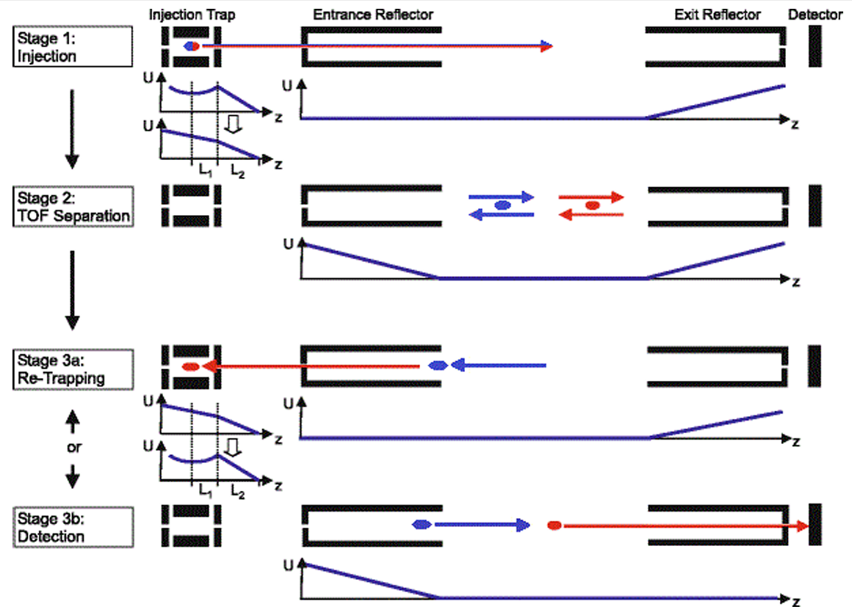
Notes:
This is a diagram that represents the journey of the ions, from injection to detection with the red and blue dots representing ions of different masses. First, a beam of ions is sent to an injection trap which cools and prepares the ions for the analyzer.
Then ions are sent to the time of flight analyzer. Once in the analyzer, the ions reflect off multiple times off of electrostatic mirrors. The next stage is called re-trapping, when the ions are then sent back to the injection trap and contaminants are removed. The ions are then sent back into the analyzer, fly through, and reach a detector which measures the ions time of flight.
Monoenergetic ions E = ½ mv^2

Slide 29
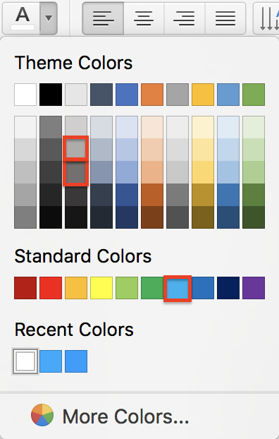
Instructions—Please read
The arrangement in this Instructions slide is not part of the style template and should be not replicated.
The typeface used in the template is Arial. Do not use any other font. The minimum type size for content is Arial Bold 20.
TRIUMF’s Theme colours for presentations are provided by default (top row of the image on the right). Do not change them. The highlighted blue in the image is TRIUMF’s Cyan Blue (the brand blue), used in this template for titles and highlights. All text in slides should be black or in one of the two highlighted grays. Do not use reds or purple.
Use one of the 5 provided options for cover/back-cover. Do not use these cover/back-cover formats anywhere else in your deck.
The images on the cover/back-cover formats are included in the collection of 30 TRIUMF stock images provided at the end. Feel free to use them or discard them at discretion.
Discard any unused slides. Those would make your presentation unnecessarily heavier.
Questions, comments and suggestions are welcome by TRIUMF’s Graphic Designer at diana@triumf.ca

Slide 30
Notes:
So we inject ions all with the same energy, bounce them back and fourth 350 times until we get to that longer path length, then we open up the second electrostatic mirror and let the ions impinge on the detector.

Slide 31
Notes:
So we inject ions all with the same energy, bounce them back and fourth 350 times until we get to that longer path length, then we open up the second electrostatic mirror and let the ions impinge on the detector.

Slide 32
Notes:
So we inject ions all with the same energy, bounce them back and fourth 350 times until we get to that longer path length, then we open up the second electrostatic mirror and let the ions impinge on the detector.

Slide 33
Notes:
So we inject ions all with the same energy, bounce them back and fourth 350 times until we get to that longer path length, then we open up the second electrostatic mirror and let the ions impinge on the detector.

Slide 34
Notes:
So we inject ions all with the same energy, bounce them back and fourth 350 times until we get to that longer path length, then we open up the second electrostatic mirror and let the ions impinge on the detector.

Slide 35
Notes:
So we inject ions all with the same energy, bounce them back and fourth 350 times until we get to that longer path length, then we open up the second electrostatic mirror and let the ions impinge on the detector.

Slide 36
Notes:
So we inject ions all with the same energy, bounce them back and fourth 350 times until we get to that longer path length, then we open up the second electrostatic mirror and let the ions impinge on the detector.

Slide 37
Notes:
So we inject ions all with the same energy, bounce them back and fourth 350 times until we get to that longer path length, then we open up the second electrostatic mirror and let the ions impinge on the detector.

Slide 38
Notes:
So we inject ions all with the same energy, bounce them back and fourth 350 times until we get to that longer path length, then we open up the second electrostatic mirror and let the ions impinge on the detector.

Slide 39
Notes:
So we inject ions all with the same energy, bounce them back and fourth 350 times until we get to that longer path length, then we open up the second electrostatic mirror and let the ions impinge on the detector.

Slide 40
Notes:
So we inject ions all with the same energy, bounce them back and fourth 350 times until we get to that longer path length, then we open up the second electrostatic mirror and let the ions impinge on the detector.

