Slide 1
Science Technology dept
Fabrice Retiere

Slide 2
Sci Tech 3.0
2014-2020 Sci Tech 1.0 – FR dept head, Nigel Hessey deputy
2020-2023 Sci Tech 2.0 – Nigel Hessey dept head, Beatrice Franke deputy
Since 1 Oct 2023 Sci Tech 3.0 – FR dept head, deputy TBA
  Revisiting organization within 3 tenets: safety, fairness, impact

Slide 3
Sci Tech 3.0 organization proposal
Head
F. Retiere
Deputy
TBA
DAQ
P-A. Amaudruz
Electronics dev.
D. Bishop
Physics Tech.
N. Hessey
Detectors
P. Lu
Head
Deputy
DAQ
Systems
Electronics
Concept
Strategy
2.0 - Current organization
Excluding minor update
3.0 - Proposed updated organization
Project initiation
and R&D
Project implementation
Possible Sci Tech BAE in this group

Slide 4
Safety culture and scope of work
Updating all training plan including management requirements
  At department level focus training on management
  Technical training at group level
Explicit definition of scope, role and responsibilities in dept/group manuals
  Role of department head
  Role of deputy
  Role of group head
  Project initiation process
  Project implementation process
    Integrate with the new Quarterly Project Prioritization

Slide 5
Fairness – Revisiting the project handling processes
Initiation (up to GATE-1) under department head.
  Assess project scope and relevance/match for Sci Tech in terms of technology and management
  Define the strategy for project implementation if pass GATE-1. Hoping that GATE-1 will become a go/no-go process as a project size is only “known” at that point.
  Aim to have only one entry point for Sci Tech work
    Probably shared with NSERC MRS
Implementation under deputy (probably)
  For now, appointed Pietro Giampa as Project Implementation Coordinator
  Augment QRPP process with Sci Tech project assessment

Slide 6
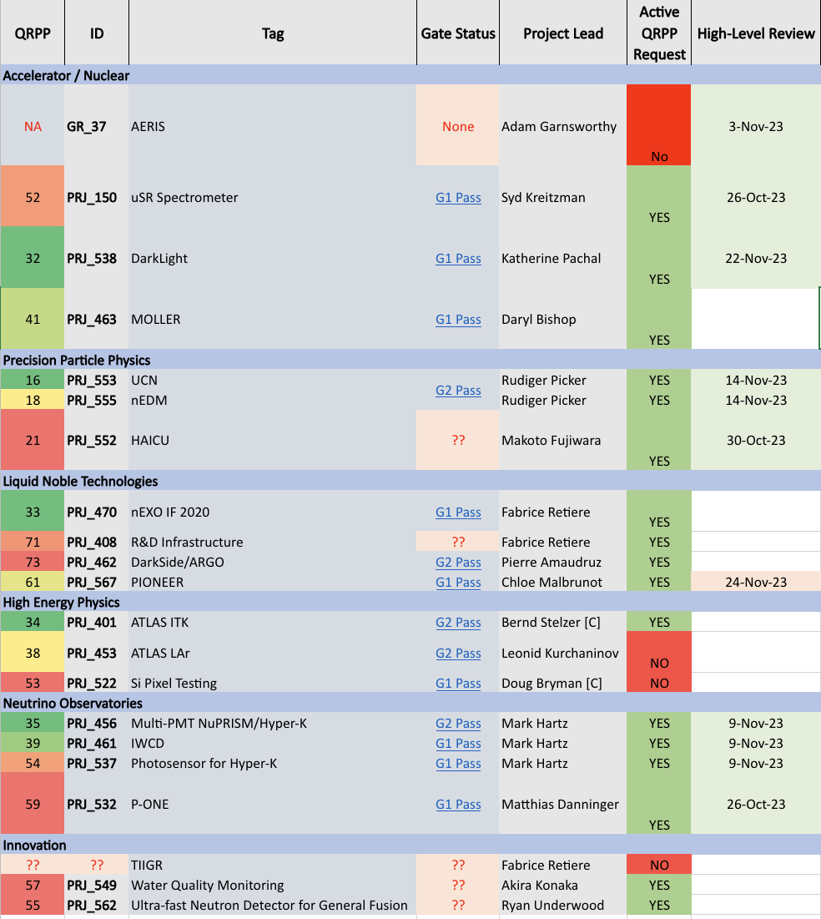
Fairness -
Project overview
Pietro leading the review effort
Continue to track down effort not capture as projects…
Aim to have a strategy to put forward by next QRPP (early January)
  Trade-off between projects

Slide 7
Impact – we need big visible projects
HAICU? Take system development responsibility?
UCN EDM? Take system development responsibility?
nEXO? Revisit contribution. Add DAQ on long run. Be engaged in facility development that will stay at TRIUMF?
P-ONE will most likely focus effort on DAQ
And looking at the next CFI round

Slide 8
Growth strategy within academia
Within TRIUMF – Integrate or collaborate with detector and quantum centers should they happen
  Detector center meant to safeguard R&D effort
Leverage and drive CFI
  Working on a CFI with SFU (new CERC, Darren Grant) and UBC (non physics) for infrastructure development focusing on integrated detectors from idea to innovation
    Deliverables are cutting edge infrastructure enabling emergence of new technology AND solutions for tackling climate change and health care
    Technologies include digital photon and particle detectors
  Ensure that CFI leave some infrastructure at TRIUMF

Slide 9
Growth strategy in technology transfer
Water monitoring system led by neutrino group
  Focus on first nation
Forest fire early detection with Sensenet (Vancouver, BC)
  TRIUMF focus on single photon air analysis (SPAA) sensor
  Associated to NRC grant and foreseeing NSERC ALLIANCE grant
GHz neutron spectrometer with General Fusion (Richmond, BC)
  MITACS grant for postdoc fellow. NSERC ALLIANCE grant submitted
Next generation SiPM development with Vessel-energy (Richmond, BC)
  Working on defining scope of work
Investigate medical imaging opportunity with life science division
  TIIGR (Therapeuthic Isotope Imager with Gamma Ray) – possible CFI
  Time of flight computed tomography with Sherbrooke
  Light based therapy
Emerging collaboration with DWAVE led by P. Giampa

Slide 10
Moving forward until next ACOT
Department organization finalized
Group/dept manuals and training plans completed
  Process for handing project in place
Project implementation process in place
Contribution to major projects established
Work on integration with pan-Canadian NSERC MRS started

