Slide 1
Particle Physics
Oliver Stelzer-Chilton
ACOT Meeting, November 2023

Slide 2
Particle Physics Department
Particle Physics – O. Stelzer-Chilton
Deputy – M. Hartz
I. Trigger M. Vetterli (SFU)
O. Stelzer-Chilton D. Gingrich (UofA)
M. Swiatlowski P. Savard (UofT)
B. Stelzer (SFU) G. Azuelos (UdeM, emeritus)
A. Konaka D. Karlen (UVic)
M. Hartz (with IPMU) X. Li
W. Rau (with MI). J-M. Poutissou (emeritus)
K. Clark (with Queens, MI) T. Brunner (McGill)
S. Yen (emeritus)
M. Fujiwara A. Capra
R. Picker D. Gill (emeritus)
C. Malbrunot R. Helmer (emeritus)
A. Olin (emeritus) T. Numao (emeritus)
Monthly meetings inclusive to
Particle Physics,
Theory,
Science Technology
and Scientific Computing
department members
Dark Matter Forum Meetings
Science and Technology Seminars
Quantum Forum Seminars
Affiliated Scientists
S. Bhadra (YorkU)
D. Bryman (UBC)
M. Hasinoff (UBC)
R. McPherson (UVic)
S. Oser (UBC)
T. Momose (UBC)
W. Van Oers (Manitoba)
R. Thompson (Calgary)
B. Pointon (BCIT)
M. Danninger (SFU)
P. De Perio (IPMU/Tokyo)
A. Khramov (BCIT)

Slide 3
Particle Physics Department
Particle Physics – O. Stelzer-Chilton
Deputy – M. Hartz
I. Trigger M. Vetterli (SFU)
O. Stelzer-Chilton D. Gingrich (UofA)
M. Swiatlowski P. Savard (UofT)
B. Stelzer (SFU) G. Azuelos (UdeM, emeritus)
A. Konaka D. Karlen (UVic)
M. Hartz (with IPMU) X. Li
W. Rau (with MI). J-M. Poutissou (emeritus)
K. Clark (with Queens, MI) T. Brunner (McGill)
S. Yen (emeritus)
M. Fujiwara A. Capra
R. Picker D. Gill (emeritus)
C. Malbrunot R. Helmer (emeritus)
A. Olin (emeritus) T. Numao (emeritus)
Monthly meetings inclusive to
Particle Physics,
Theory,
Science Technology
and Scientific Computing
department members
Dark Matter Forum Meetings
Science and Technology Seminars
Quantum Forum Seminars
Affiliated Scientists
S. Bhadra (YorkU)
D. Bryman (UBC)
M. Hasinoff (UBC)
R. McPherson (UVic)
S. Oser (UBC)
T. Momose (UBC)
W. Van Oers (Manitoba)
R. Thompson (Calgary)
B. Pointon (BCIT)
M. Danninger (SFU)
P. De Perio (IPMU/Tokyo)
A. Khramov (BCIT)

Slide 4
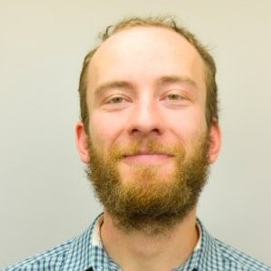
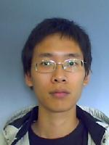
Particle Physics Personnel news
New BAE Andrea Capra started in September
Postdoc at TRIUMF working on ALPHA(-g) and Darkside-20k
PhD from York University in 2016
New Affiliate Scientist Alex Khramov
Assistant Professor at BCIT
Former ALPHA collaborator at CERN and Laser specialist
Strengthening AMO efforts
New “P&S” Scientist Chukman So
Expert on magnet design and simulation
Currently with the ALPHA project
Future in Science & Technology

Slide 5
Particle Physics within the Physical Sciences Division
The departments of Particle Physics, Science & Technology and Scientific Computing address the areas:
High Energy Frontier
Neutrinos and Dark Matter
Precision Tests of Fundamental Interactions
Lead in Scientific Discovery through focus projects
Projects where we are involved in all areas
detector design/construction, operations, data analysis
Ensure critical mass is established, maintain leadership in all areas
Current experiments
ATLAS, T2K/Hyper-K, ALPHA, TUCAN, SuperCDMS
New experiments expected to reach that point in the future
DarkLight, nEXO
HAICU (experimental space identified)
PIONEER

Slide 6
Enable Particle Physics in Canada and Abroad
TRIUMF is part of a network of laboratories and partner institutions
Leverage TRIUMF key expertise in accelerator, computing, detector and DAQ technologies
Unique expertise in e.g. cryomodules, SiPM, TPC, gaseous detectors, DAQ, etc…
Support for Accelerator and Engineering, Science Technology and Computing are crucial
New group PHORWARD: Technology focus on single photon detector and noble liquids applied to physics on weak decay (PIONEER and nEXO) and dark matter (DEAP, DarkSide, and ARGO)
SNOLAB: detector, facility and DAQ systems through Science and Technology involvement
-> SuperCDMS, nEXO, ARGO, DEAP, SNO+
CERN: In kind contributions to LHC and HL-LHC, share in detector upgrades -> ATLAS, ALPHA
KEK/J-PARC: beam monitoring accelerator contributions
share in detector upgrades -> T2K/Hyper-K
Gran Sasso: DAQ systems -> DarkSide
PSI: PIONEER
Future involvement
Ocean Networks Canada: -> P-One

Slide 7
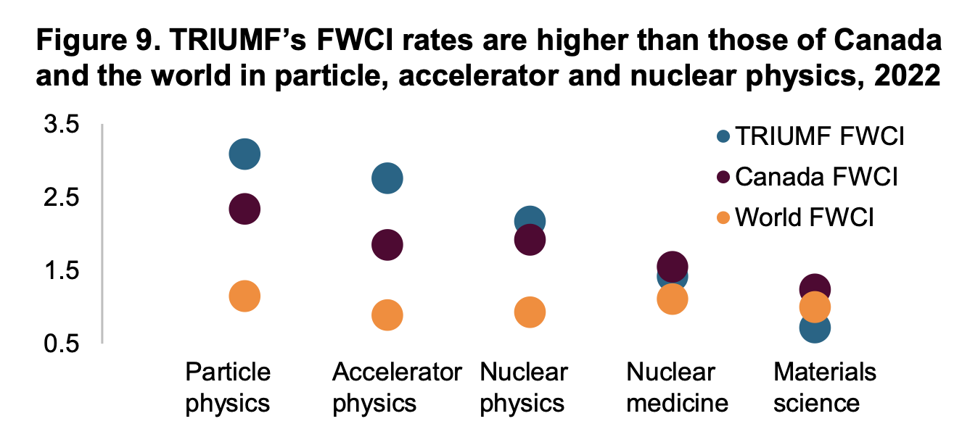
Peer Review Cttee
Excellent evaluation!
Report public

Slide 8
Five-Year Plan: PSD Planning
IPP AGM at CAP Congress, June 22nd

Slide 10
R&D focus for state-of-the-art detectors that leads to new capabilities and spin-offs
The first TPC in an experiment (TRIUMF E104)
The first SiPM in an experiment (T2K FGD)
Facilitate detector development used and available across the laboratory and Canada
Provide key expertise not available through e.g. CFI hires
Sustainability Spin-Offs - air and water quality monitoring
Detector Center

Slide 11
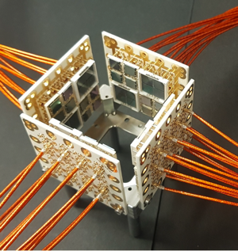
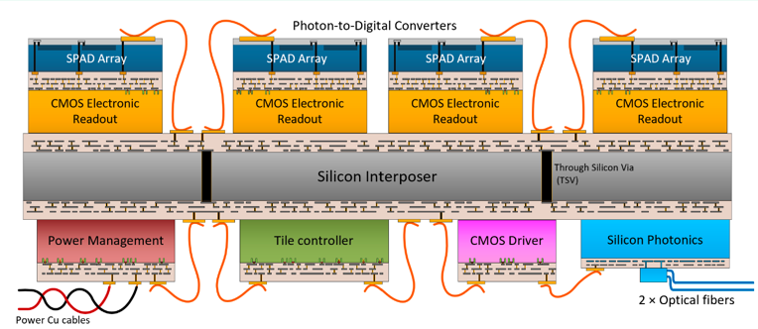
The Road Ahead
Leverage on existing infrastructure ATLAS ITK, nEXO
Radiation hard silicon detectors for future colliders (CMOS, LGAD)
Collaboration with ECFA Detector Development Roadmap DRD2, DRD3
Digital Single Photon detection (SiPM)
TRIUMF has an excellent track record on graduate student training and has a first class undergraduate & coop program
Building on GRIDS, opportunity for a CREATE program
On-the-job training in top research environment
Work integrated learning, in collaboration with e.g. BCIT
Other technologies being looked at
Liquid noble detectors
Optical fibres for dosimetry

Slide 12
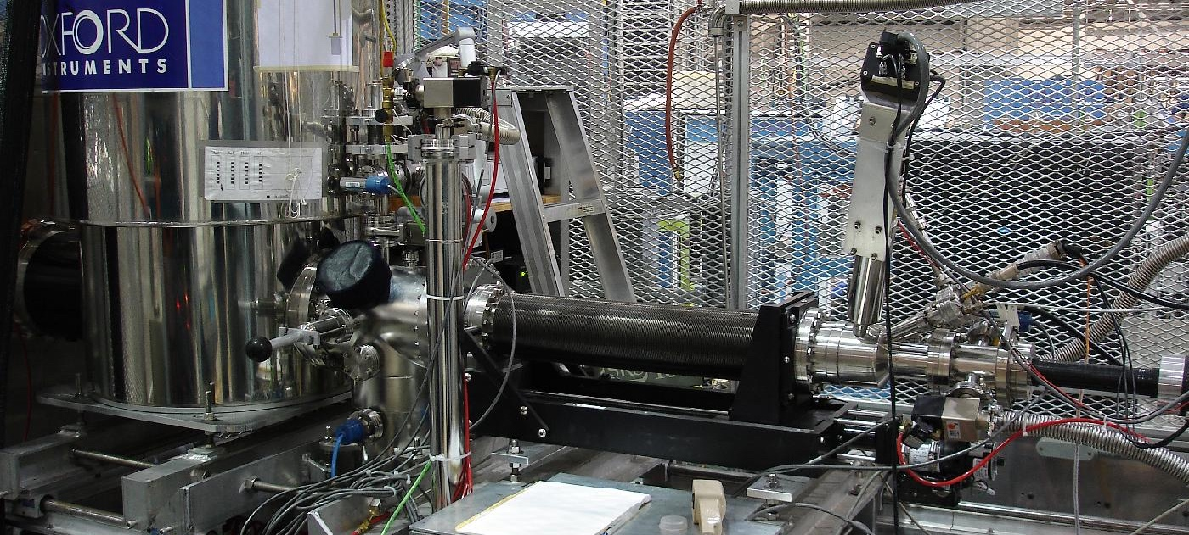
Enhance the leading edge in TRIUMF’s existing experimental programs which employs quantum techniques (spin polarized beams μSR and βNMR, TUCAN, ALPHA, Francium trapping, RILIS, etc)
Connect Canadian researchers in novel use of quantum experiments
Establish & support new flagship experiments at TRIUMF
RadMol, HAICU, etc
Characterization laboratory to enable material characterization for green technologies (batteries and hydrogen storage devices)
Quantum Center

Slide 13
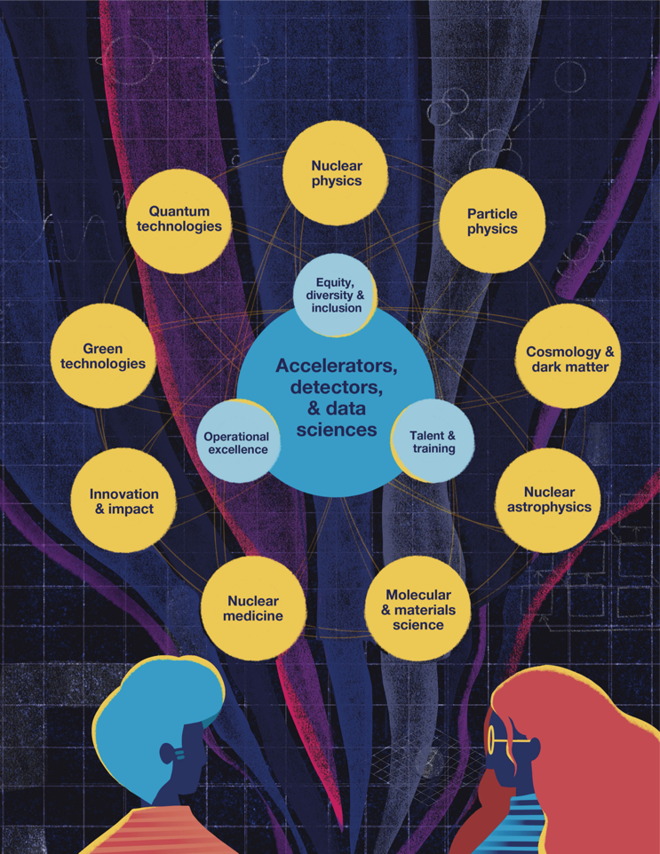
Quantum Center
Existing quantum experiments spans across the laboratory divisions and departments
They very often require common technical support & infrastructure
Cryogenics handling and design, laser metrology, coating expertise, magnet design
Pool the resources and sustain the expertise in the long term and allow better cross-fertilization across departments and divisions
Provides a structure that allows R&D stage critical to the development of new ideas prior to funding requests
Act as a wedge for longer-term growth in quantum technologies – in alignment with 20 Year Vision
First step, LT appointed Ian McKenzie as PSD representative to organize workshop in January

Slide 14
Collaboration across departments and divisions
Enhance Research Output
Drives collaboration national and international
Helmholtz, WatChMal Collaboration
Maintain and expand expertise in Quantum Computing and Quantum-assisted AI
Infrastructure support
AI Center

Slide 15
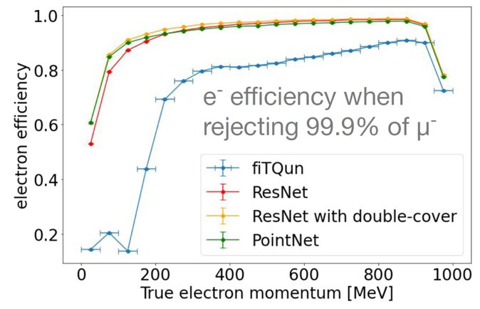
The Road Ahead
Machine Learning engagement fairly recent since 2018
Part of the current TRIUMF strategic plan
Particle physics applications → Science
Bleeding edge
Quantum Assisted ML
Trigger on FPGA
Accelerator: AI-based beam tuning → better operations
No active projects in: Nuclear physics, Molecular and Material and Life Sciences - Manpower limited!
Vehicle for taking advantage of National Quantum Strategy
Research (Alliance Quantum / International / Consortia)
Talent (CREATE / MITACS)
Commercialization Pillar (incl NRC AQC)

Slide 16
TRIUMF Five-Year Plan
Key Themes of the Proposal ($450M)
Completion and operation of major platforms to deliver new science
Complete ARIEL and IAMI, initial operation phases
Talent attraction and retention
Aligning compensation to market requirements, attracting international experts
Regulatory compliance and operational excellence
New requirements being placed on TRIUMF (CNSC, EGBC, NRC, …)
Deferred maintenance
Major components (electrical substation, BL1A, …)
Scientific programme alignment to 20-year Vision
Development of research centres for new initial thrusts in the vision

Slide 17
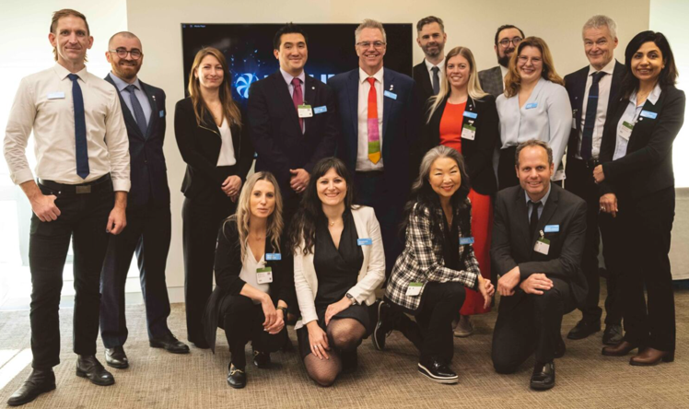
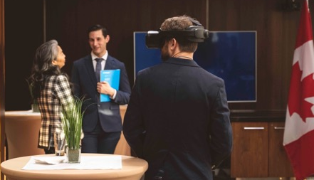
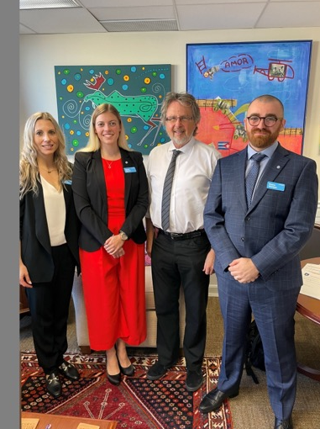
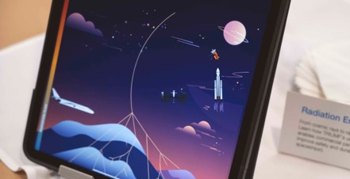
Lobby Day “TRIUMF on the Hill”
October 23 & 24 in Ottawa
17 stakeholder (MPs, Senators, staffers) meetings held with various teams, including PSD members
Positive reception in all meetings
Built momentum for the Five-Year Request for Support
Print copy was released in Ottawa, online release public
Reception reached over 100 individuals
VR headsets with CERN and TRIUMF tours
Tablets with AR, Discover our lab, Interactive PIF/NIF
Hands-on demos
Detectors: SiPM, PMTs, BeEST & ATLAS ITK petal
MVM ventilator
Target assembly for production of medical isotopes
TV with short TRIUMF movies & testimonials

Slide 18
CFI Proposals
In collaboration with the university PI’s and often TRIUMF co-PI’s
Successful in IF 2022/23:
Hyper-K $6.4M (add total)
200 mPMTs, photogrammetry calibration and
water quality monitoring equipment
P-One $5.9M (total project $14.8M)
Six instrumented mooring lines for neutrino telescope at Ocean Network Canada (OCN)
nEXO $12M
Liquid Xenon detectors (TRIUMF part SiPM characterization)
Preliminary Planning for IF 2025 (EOI ~December)
ATLAS-Tier-1
Integrated Detector Development
PIONEER
TUCAN
nEXO / DarkSide

Slide 19
Summer Schools
TRISEP (with Perimeter Institute and SNOLAB)
GRIDS (together with MacDonald Institute)
Connecting to the Community

Slide 20
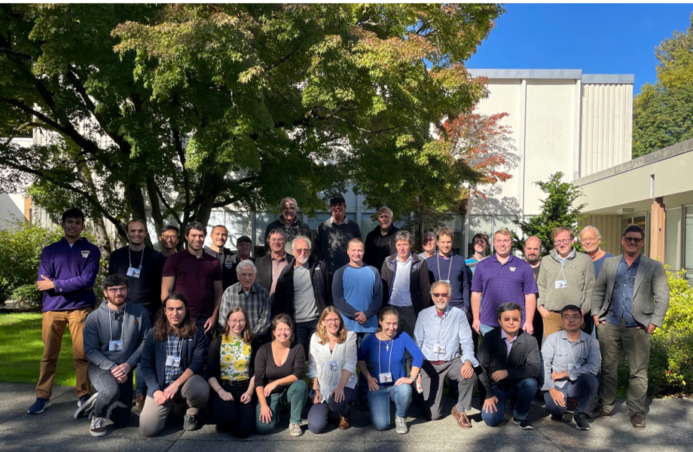
International Year of Basic Sciences for Sustainable Development
Co-organized a 24h webinar in conjunction with world environment day, TRIUMF focus on Americas
Hosted vice-chair Dr. Prajval Shastri with several events at TRIUMF and a panel discussion downtown Vancouver
First PIONEER collaboration meeting
CENPA October 2023
Connecting to the Community
Closing ceremony at CERN December 15th
International Decade of Sciences for Sustainable Development
2024–2033 has been proclaimed by the United Nations General
Assembly on August 25th

Slide 21
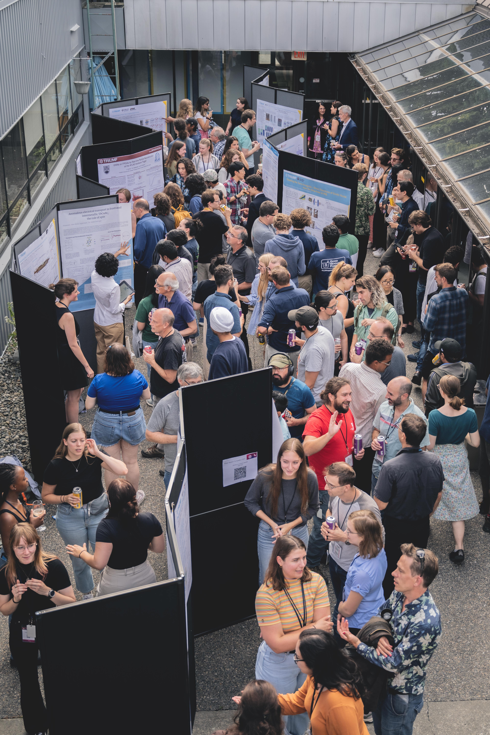
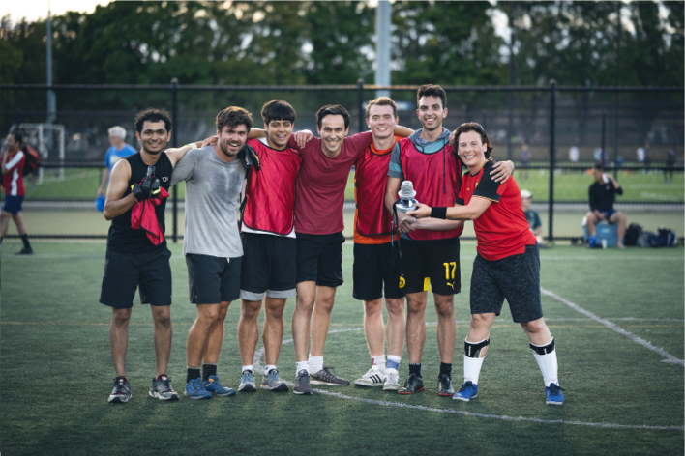
Connecting to the Community
New record 280 participants

Slide 22
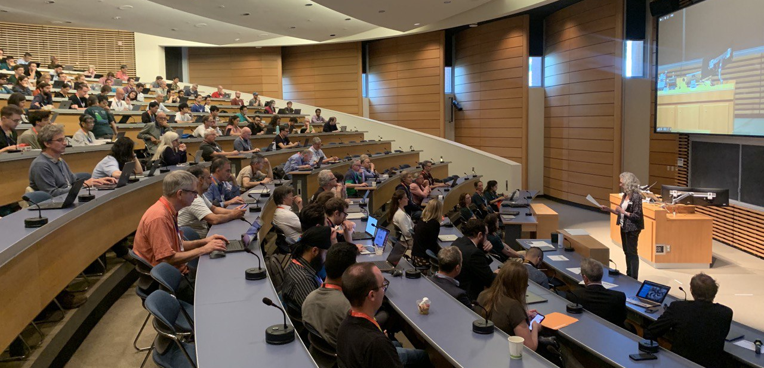
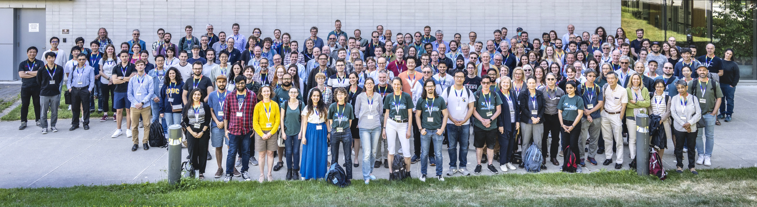
Connecting to the Community
ATLAS Week in Vancouver ~350 participants
Well received!
Tours of TRIUMF
Universal Science Outreach event on Tuesday
An ATLAS week special event with robotics
demos, virtual & augmented realities, exhibits,
talks and more!
Good collaboration with Comms office

Slide 23
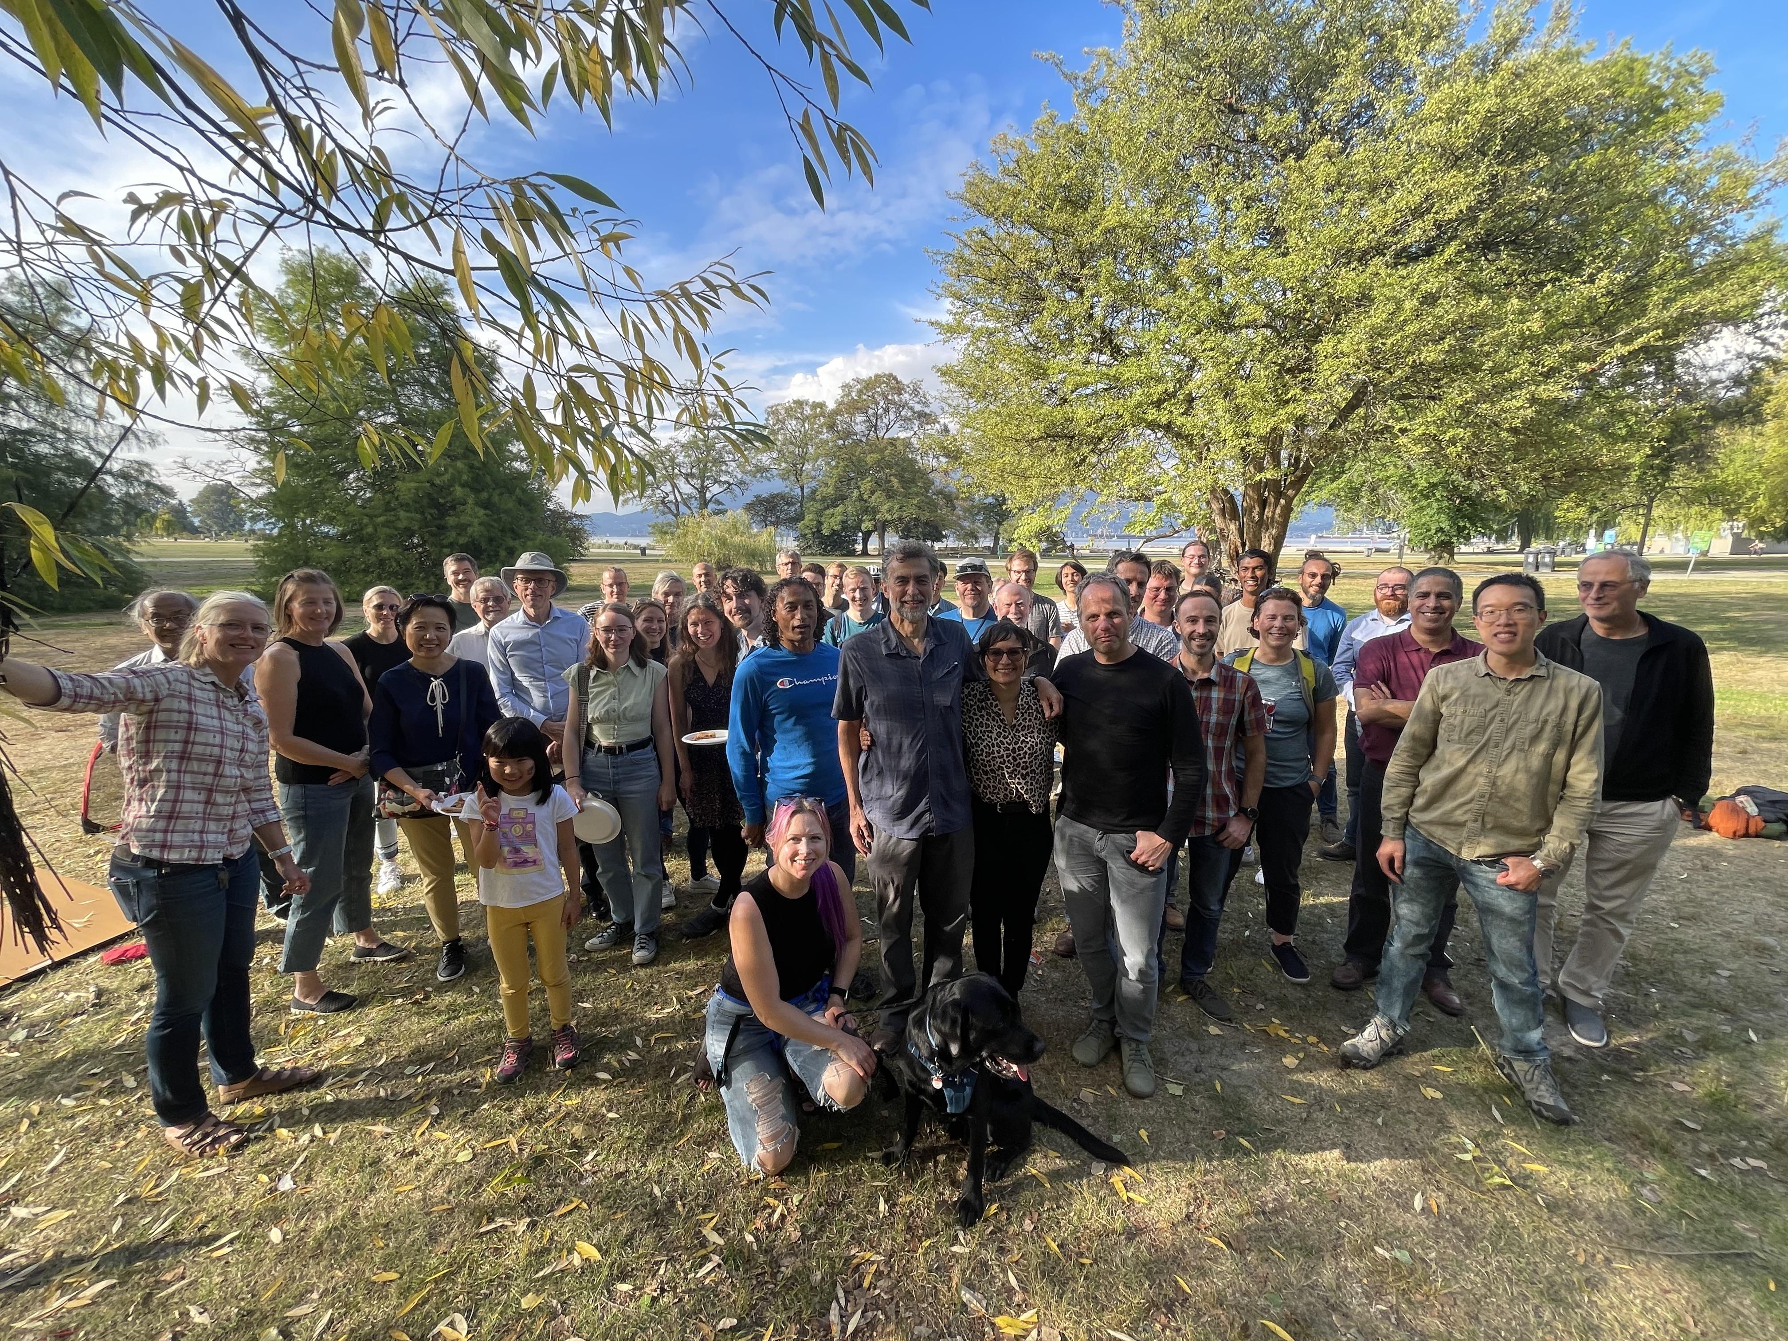
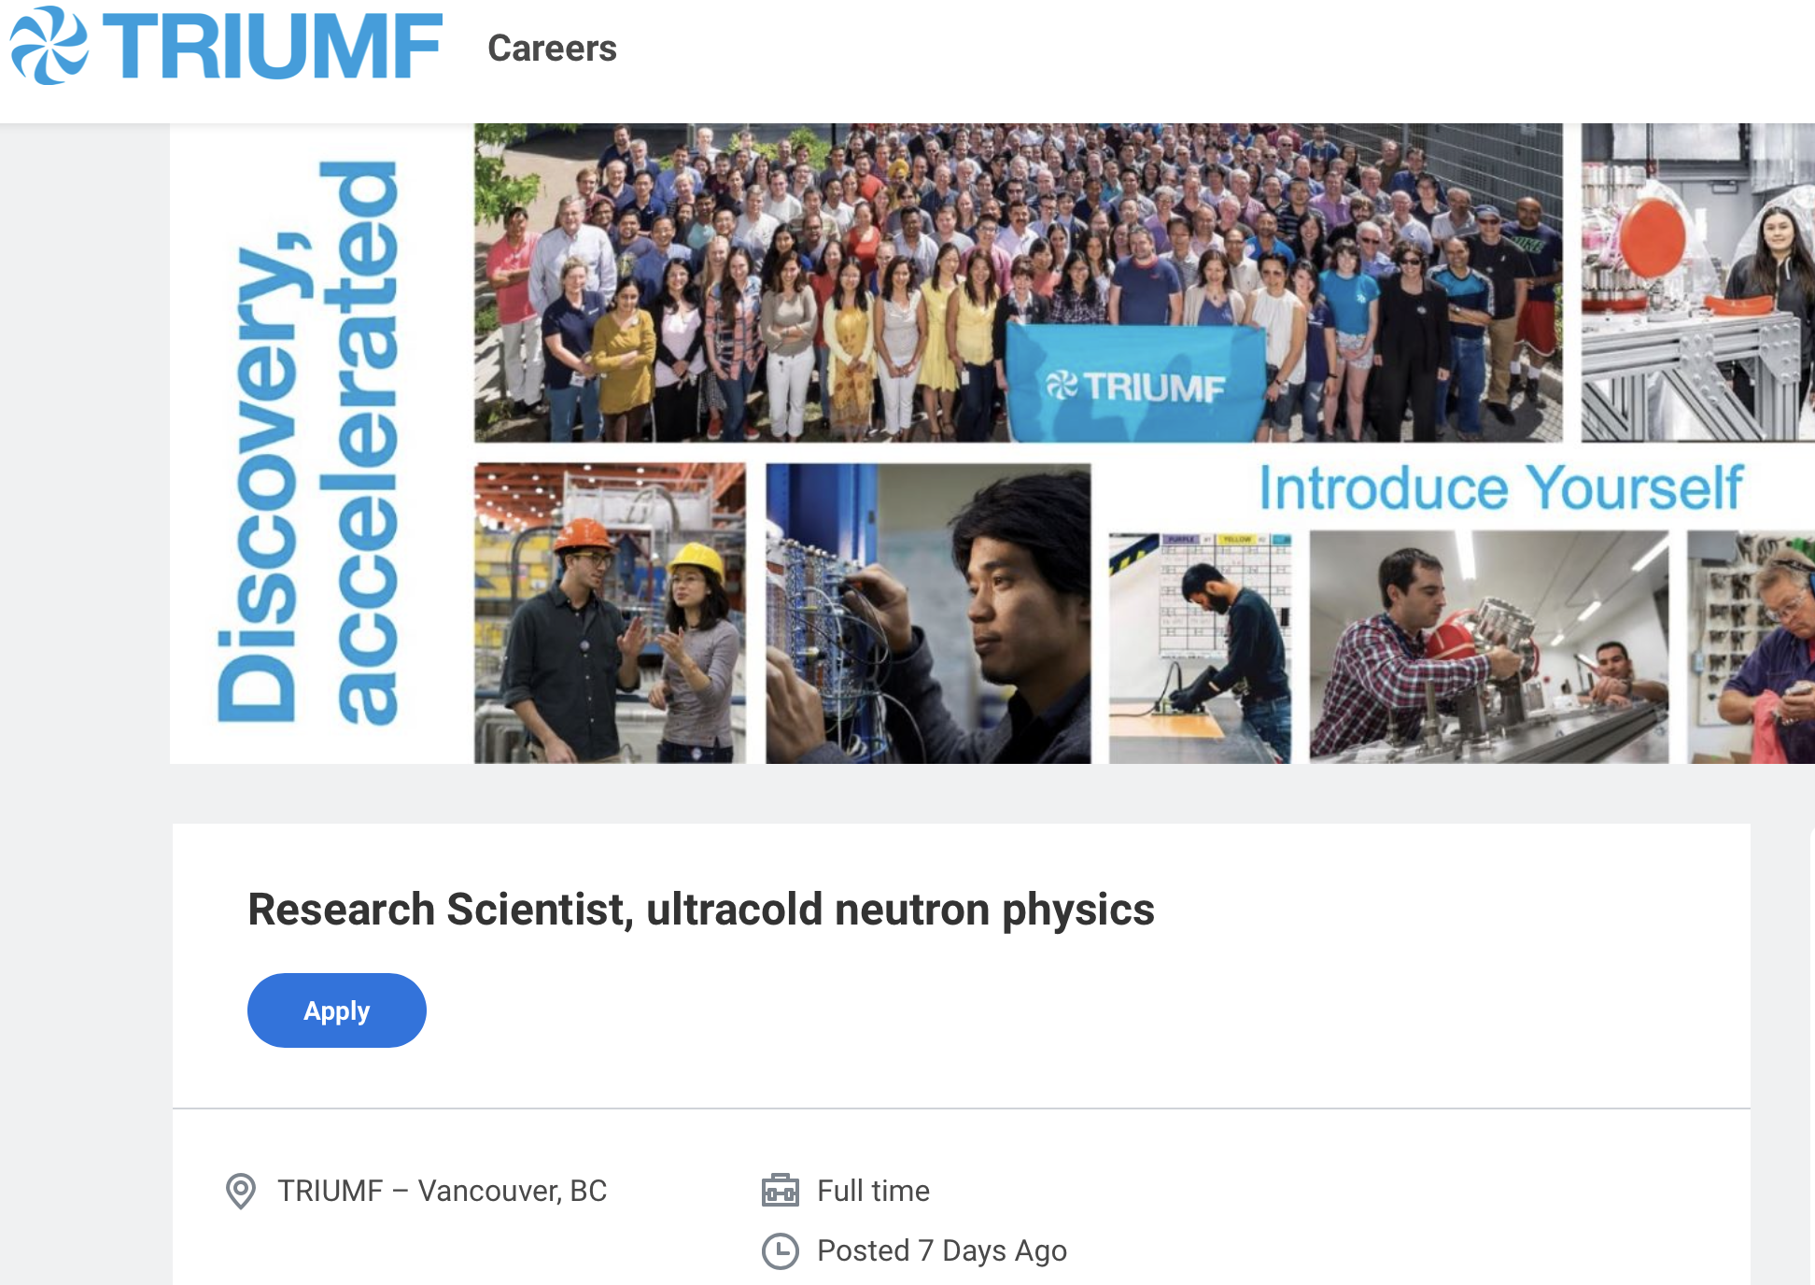
Beatrice Franke Departure
Big loss to the laboratory
Organized a farewell party between Particle Physics and Science & Technology
Replacement hire for UCN prepared and posted – with deadline of January 31st

Slide 24
Summary
Excellent track record on designing, enabling and extracting science from Particle Physics experiments (see Research Highlights)
Particle Physics together with Science and Technology and Scientific Computing were fully engaged in shaping the present and future of TRIUMF
Departmental / Divisional planning for next 5-year plan with guidance from the 20-year vision
New research centers are in the 5-year plan together with expected science achievements
Collaboration with ECFA Detector Development Roadmap DRD
Ongoing concern about space, including facilitating new research space
BAE hire for ALPHA completed
Replacement hire for UCN ad posted - Application deadline January 31st
Preparing CFI requests for 2025 competition

Slide 25
Thank you Merci
www.triumf.ca
Follow us @TRIUMFLab

Slide 26
Summary
Particle Physics addresses many of the most compelling questions
Embedded in international collaborations
Growing onsite effort with new opportunities
Excellent track record on designing, enabling and extracting science from Particle Physics
Need state of the art detector, computing and new facilities to enable breakthrough science
Strengthen detector development capabilities
Expect many exciting results from Particle Physics by 2030
ATLAS: Higgs boson potential, sensitivity to many new particles, precision measurements
Hyper-K: Probing CP violation in neutrino sector
UCN: World leading neutron EDM and neutron lifetime measurement
ALPHA: Precision anti-matter spectroscopy and effect of gravity on anti-matter
SuperCDMS & DarkSide 20k: Most sensitive Dark Matter results
DarkLight: Sensitivity to find X17 related boson
PIONEER: Worlds most precise e-µ universality test

Slide 27
From PSD retreat: Hiring Priorities in Particle Physics
Baseline highest priority for 2025-2030
TUCAN (1+)
Hyper-K (succession)
Strengthening Science & Technology capabilities (2+ A&P)
Growth area (depending on funding and green light for the projects - not ranked)
Astro-particle / nEXO / DarkSide-20k (SNOLAB connection)
PIONEER (secure critical mass)
P-One (potentially big local experiment)
Future Collider (joint-position with university)
UCN (joint-position with university)
Quantum/Precision (joint-position with university)
New hires (P&S scientist + technical expertise for newly proposed centers)
flat-flat
+10%
Blue sky

Slide 28
Next CFI competition

