Slide 1
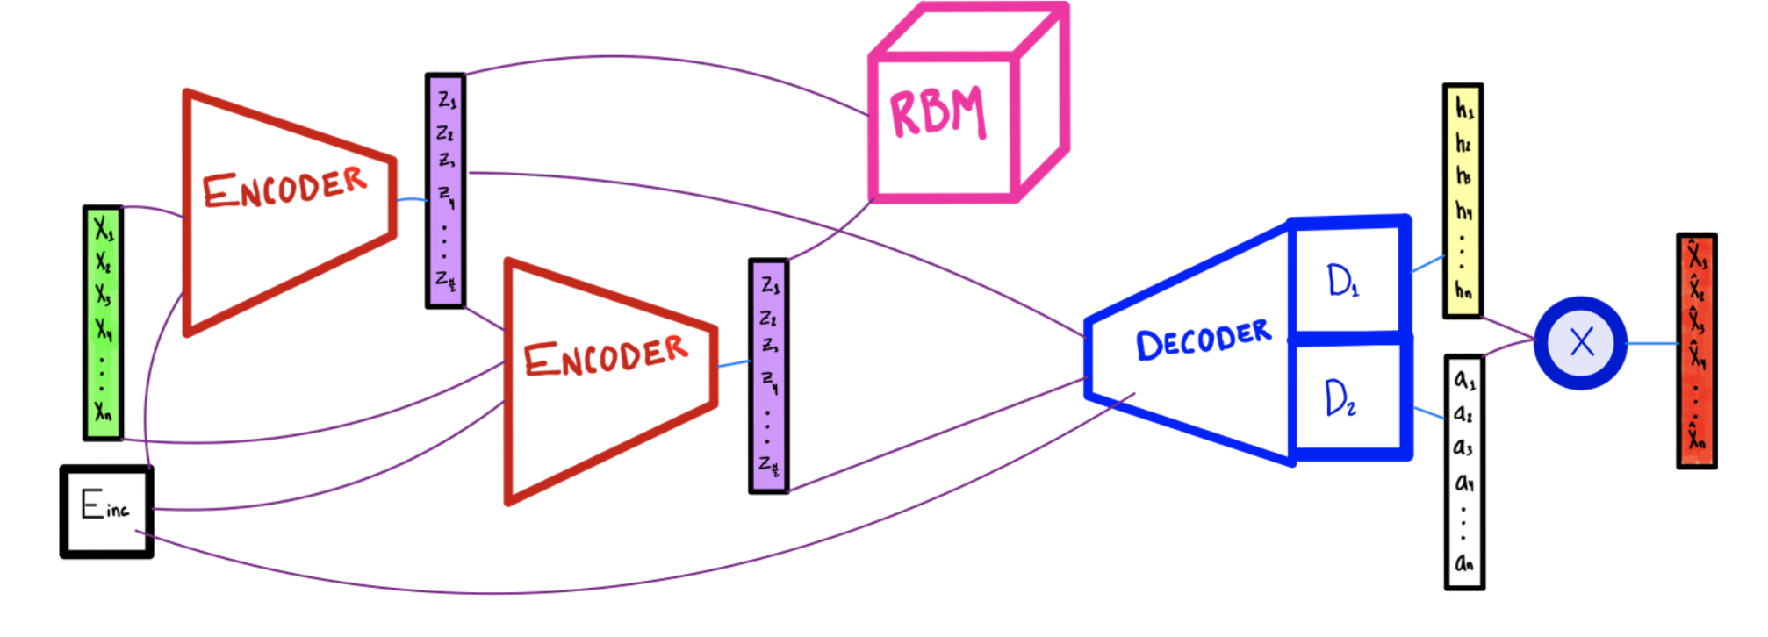
Model #1 – Energy-Conditioned Hierarchical CNN Encoder & Energy-Conditioned CNN Decoder
CNN
CNN
CNN
Chimera

Slide 2
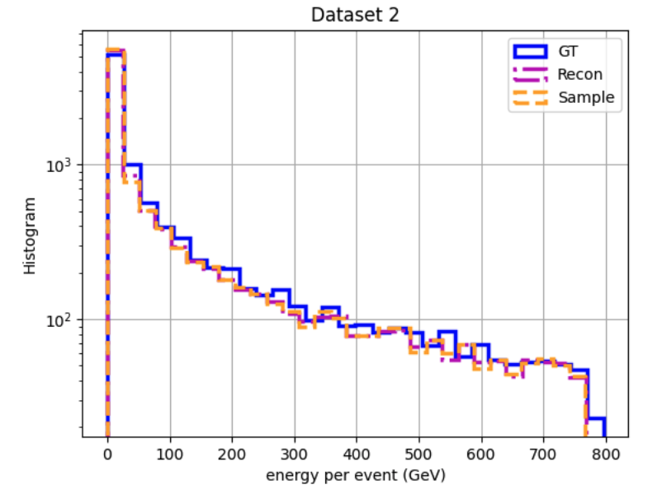
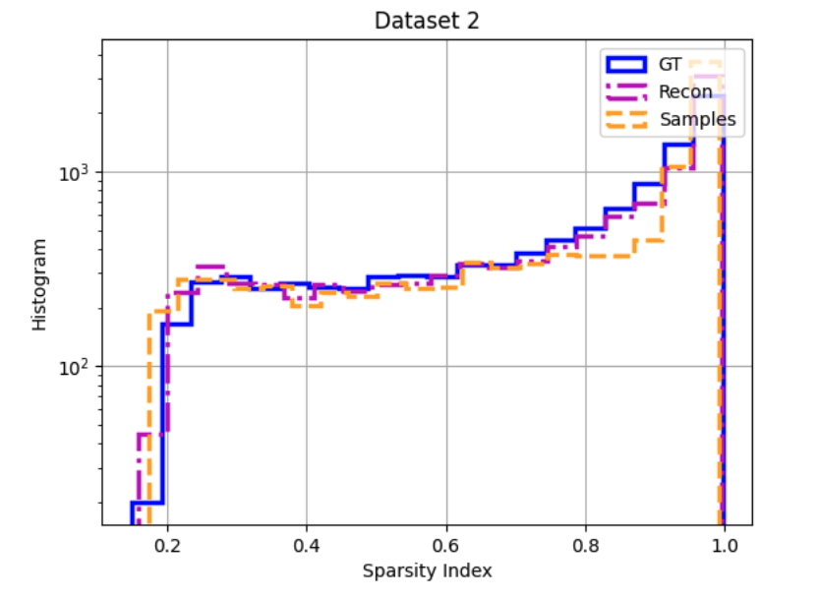
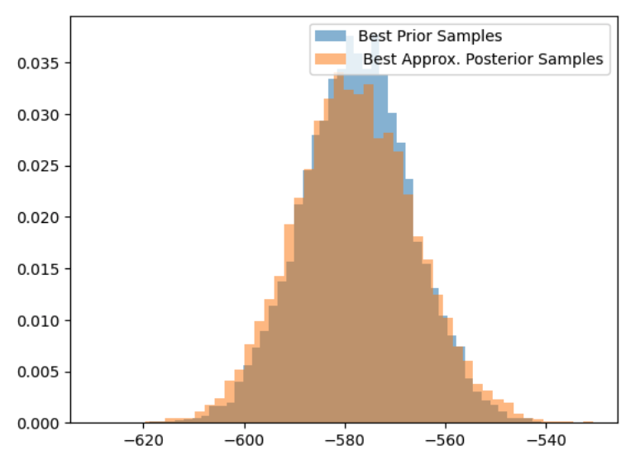
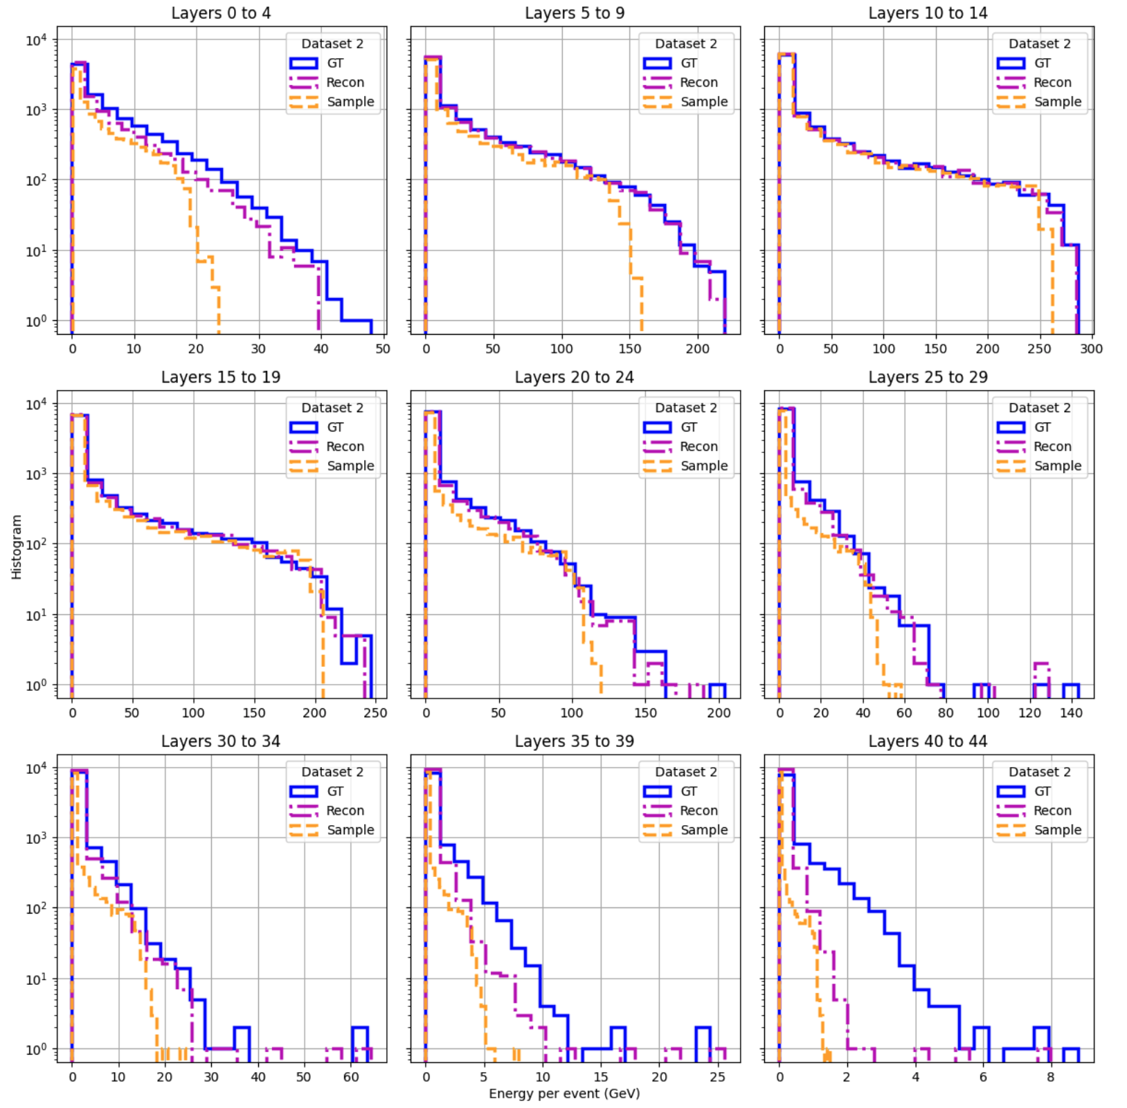
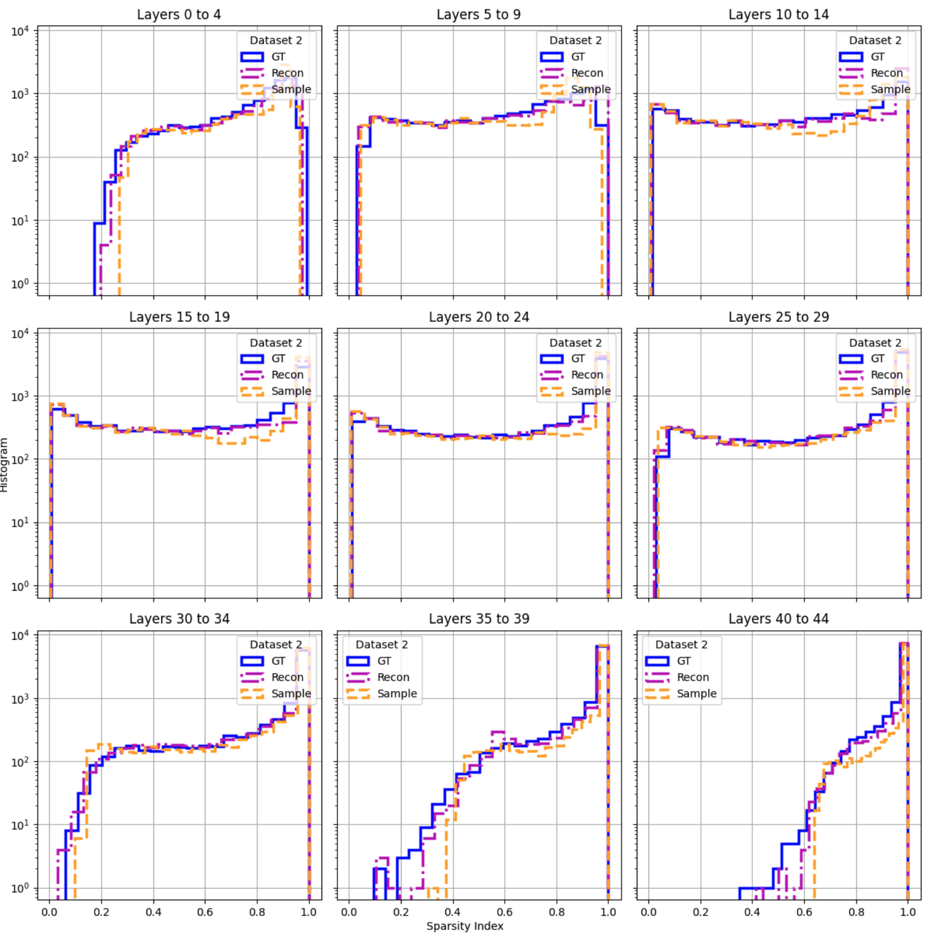
Note: Orange histogram corresponds to RBM energy evaluated over encoded data samples from approx. posterior. Blue histogram corresponds to RBM energy evaluated over samples generated via Gibbs sampling in latent space. We expect overlap between the two histograms for well-trained models
Frequency
RBM Energy

Slide 3
Model #2 – Unconditioned Hierarchical CNN Encoder & Unconditioned CNN Decoder
CNN
CNN
CNN
Chimera
Connection removed from model

Slide 4
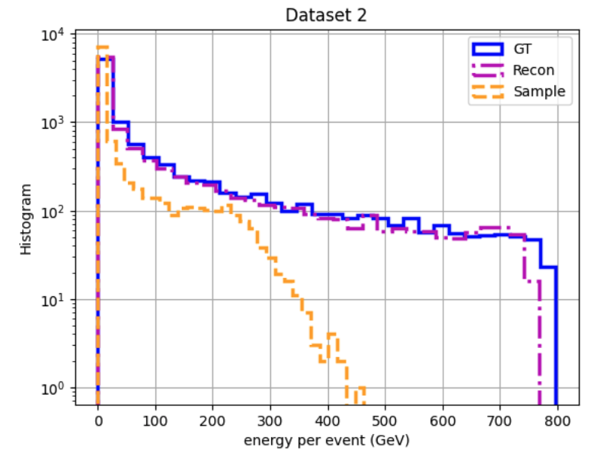
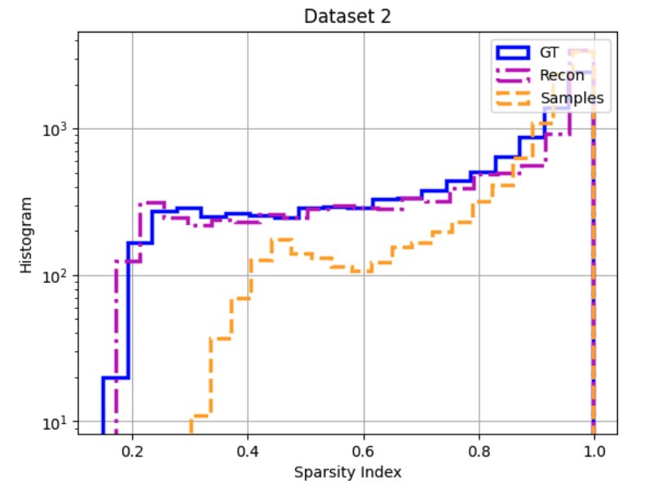
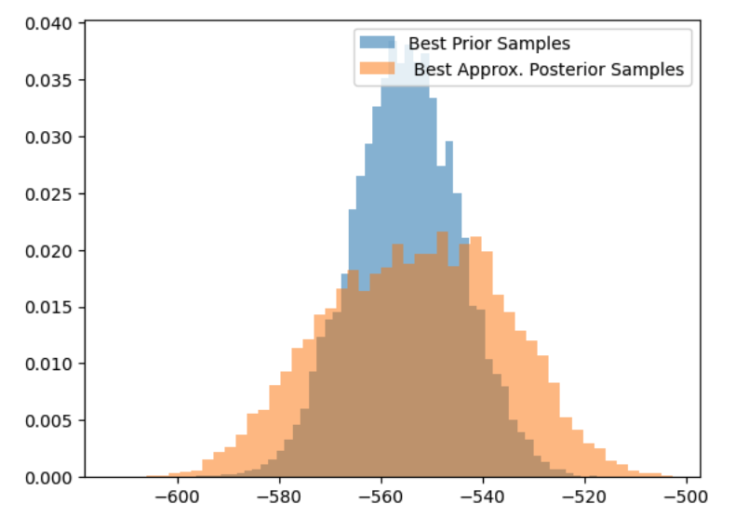
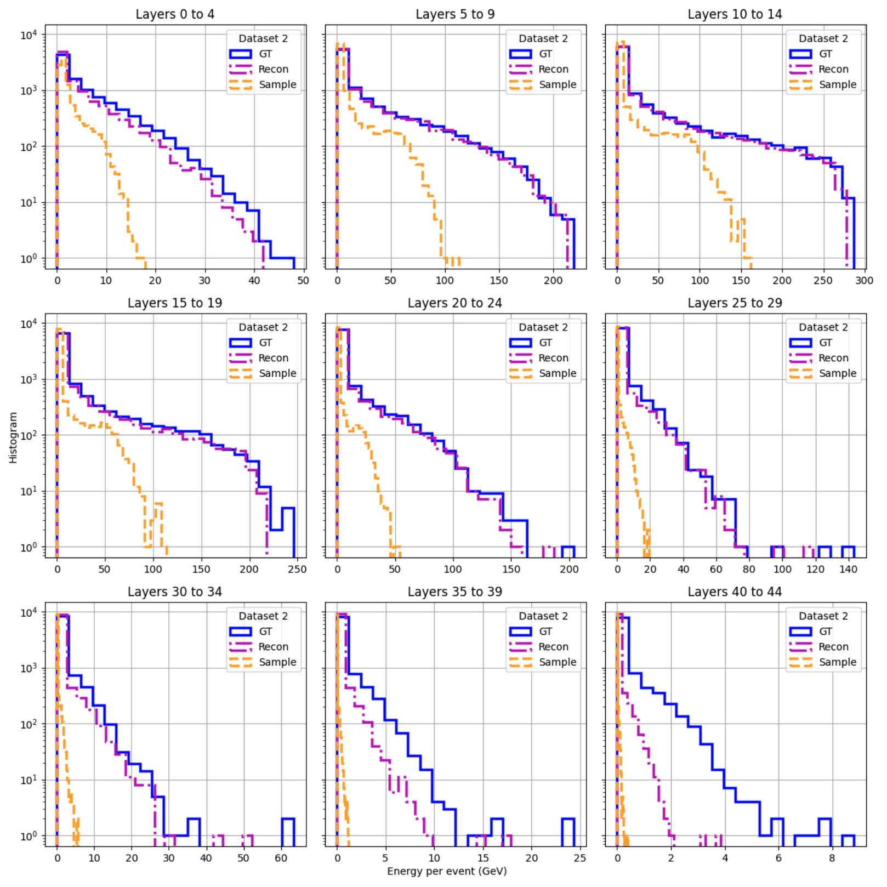
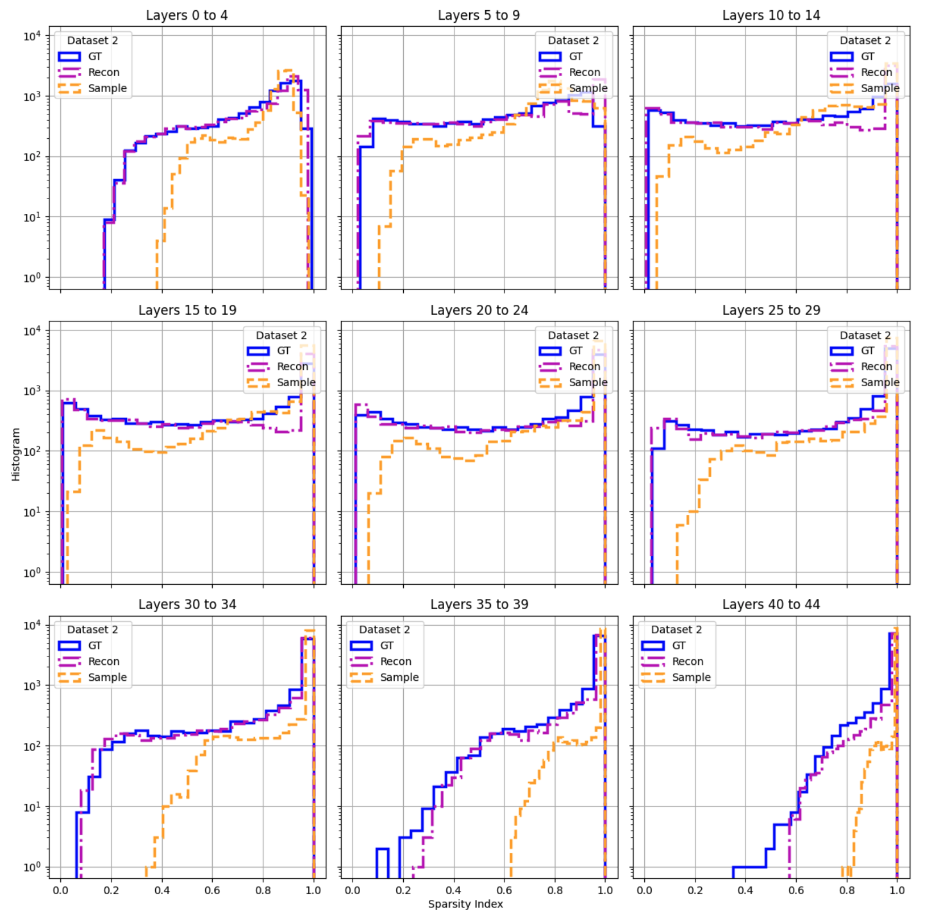
Frequency
RBM Energy

Slide 5
Model #3 – Energy-conditioned Hierarchical CNN Encoder & Unconditioned CNN Decoder
CNN
CNN
CNN
Chimera
Connection removed from model

Slide 6
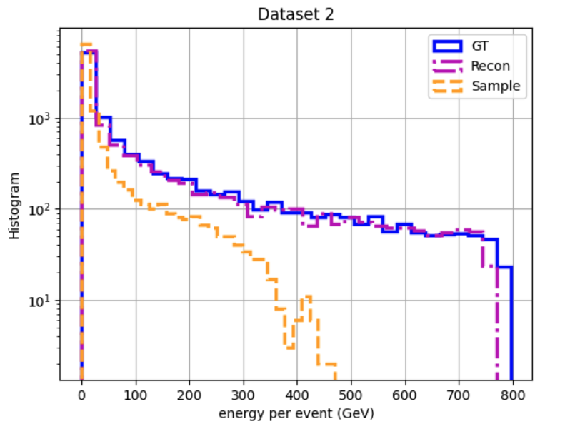
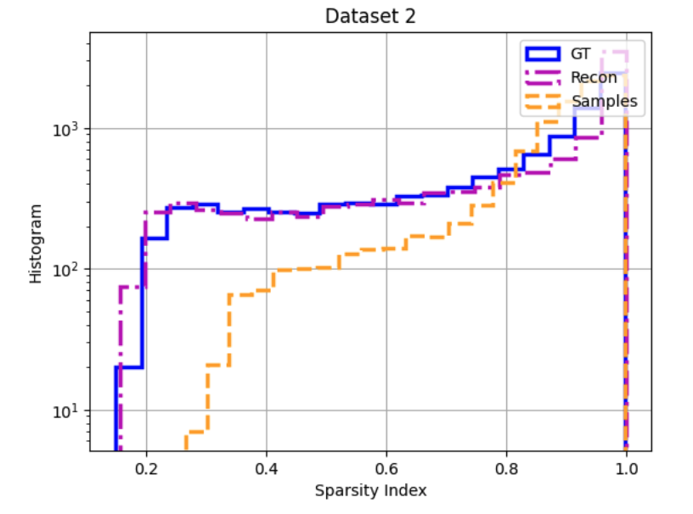
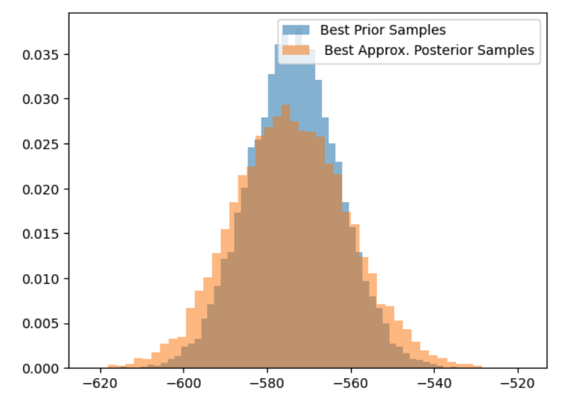
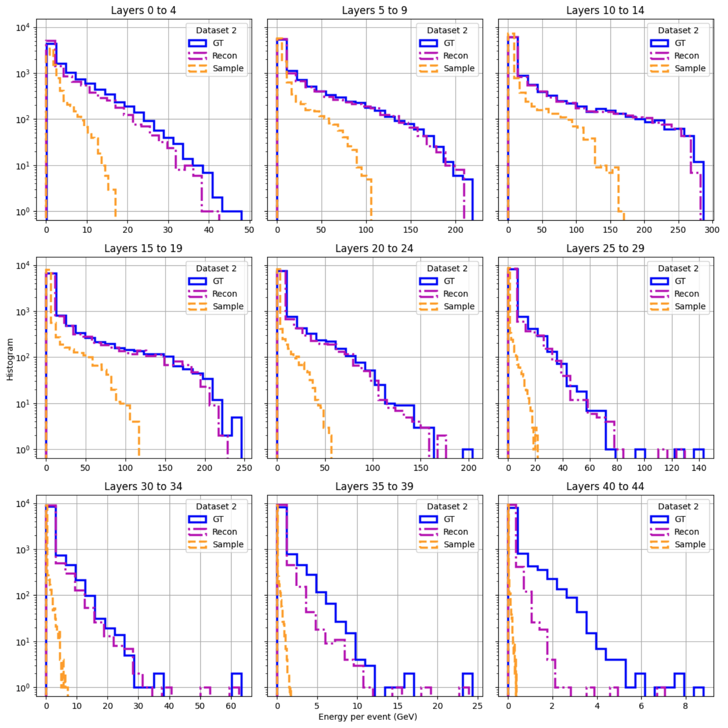
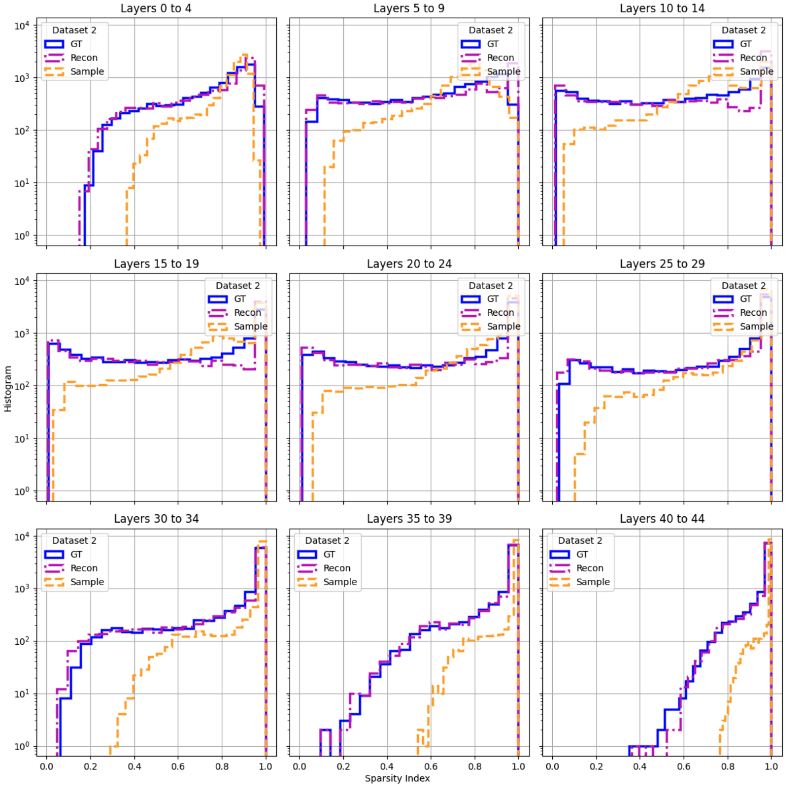
Frequency
RBM Energy

Slide 7
Model #4 – Energy-conditioned Hierarchical FCN Encoder & Energy-conditioned FCN Decoder
FCN
FCN
FCN
Chimera

Slide 8
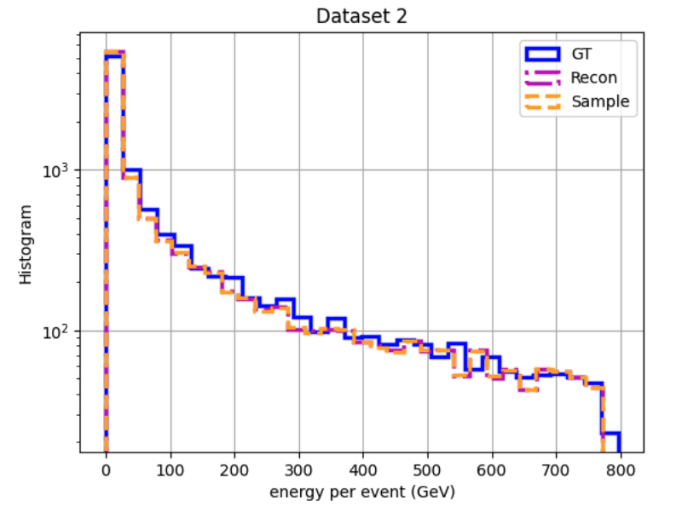
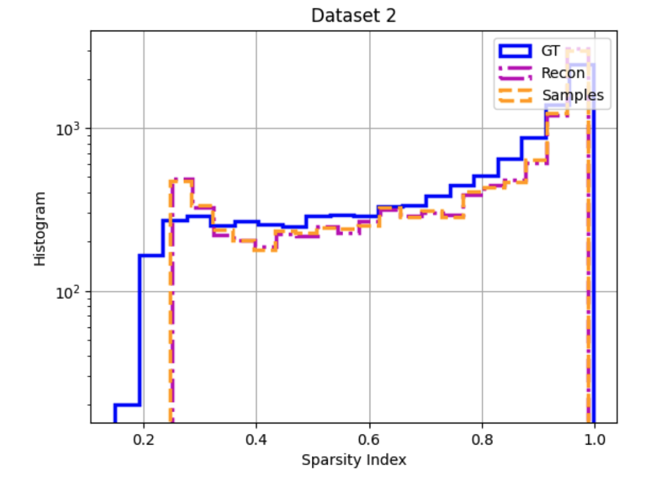
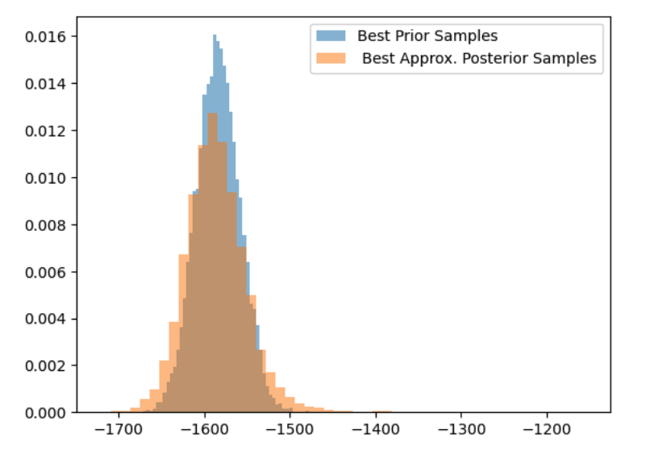
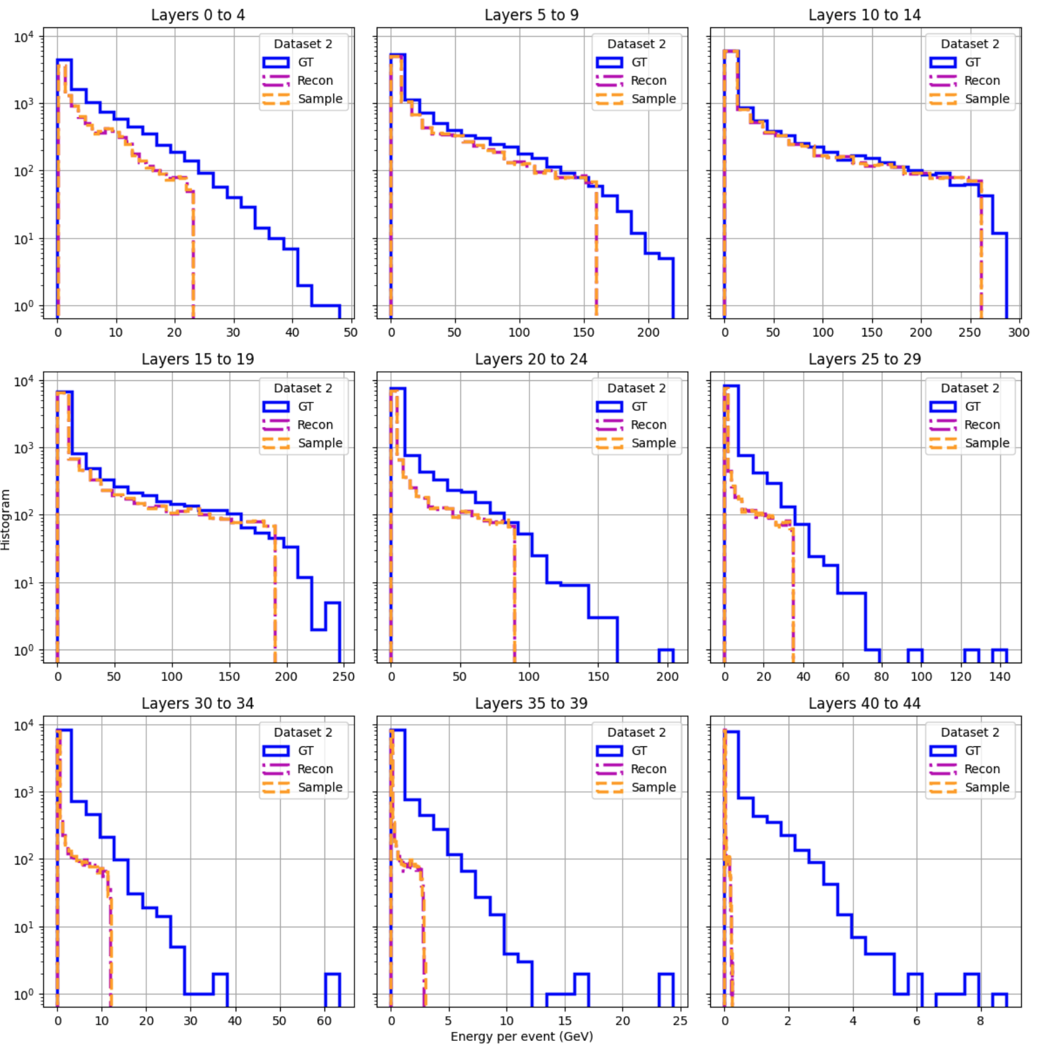
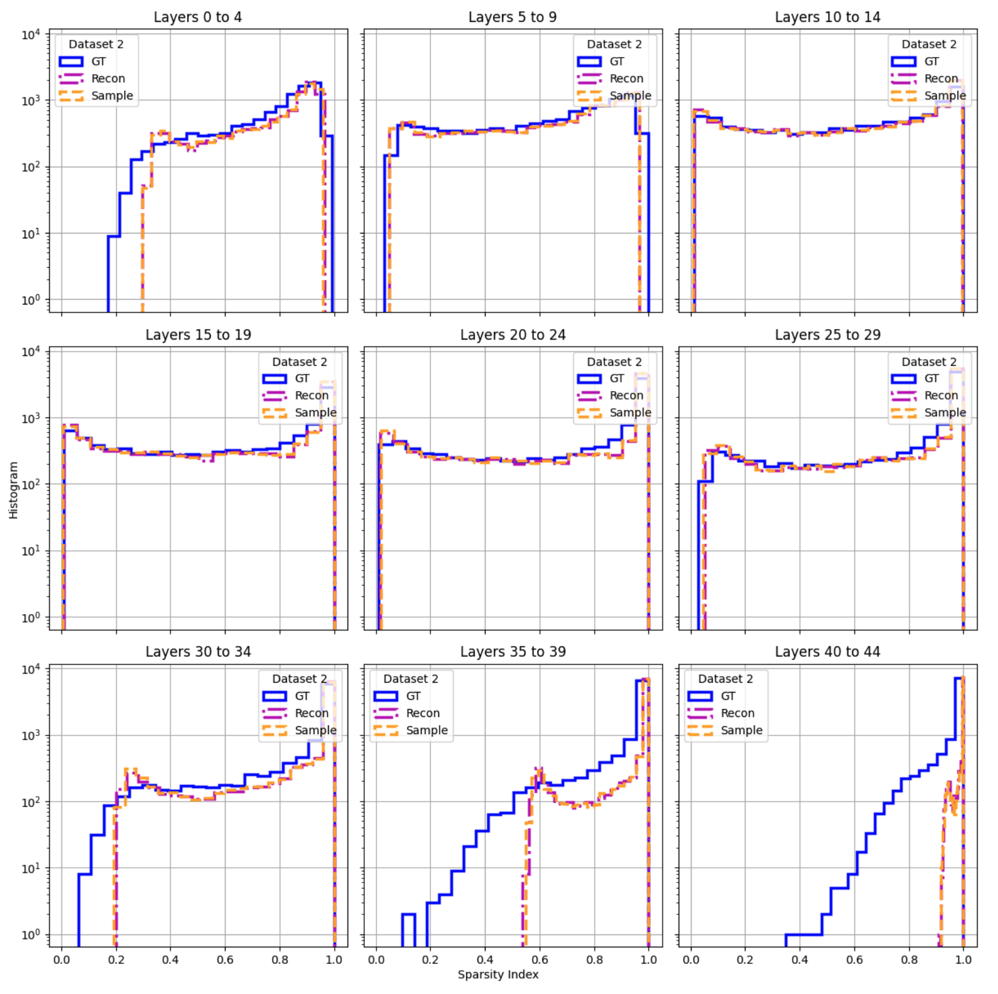
Frequency
RBM Energy

Slide 9
Model #5 – Unconditioned Hierarchical FCN Encoder & Unconditioned FCN Decoder
FCN
FCN
FCN
Chimera
Connection removed from model

Slide 10
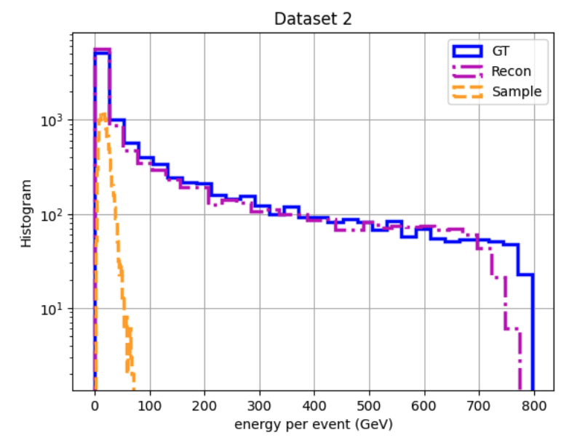
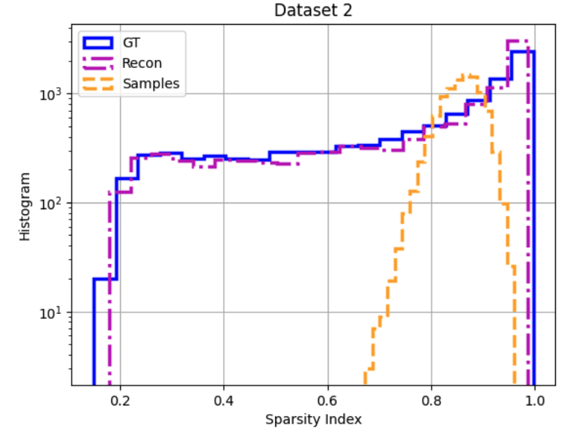
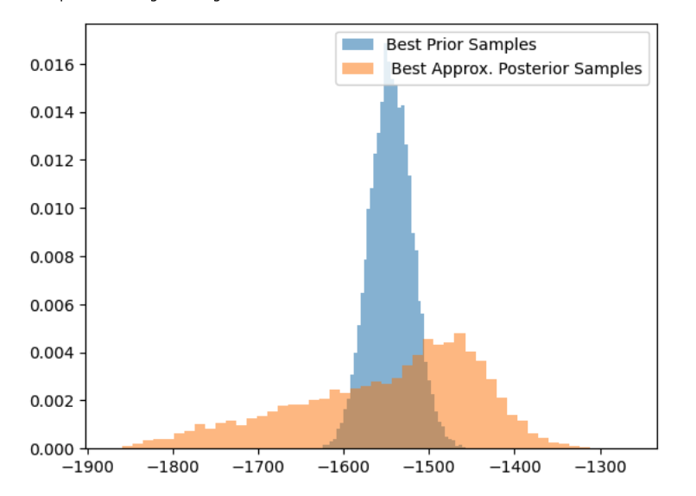
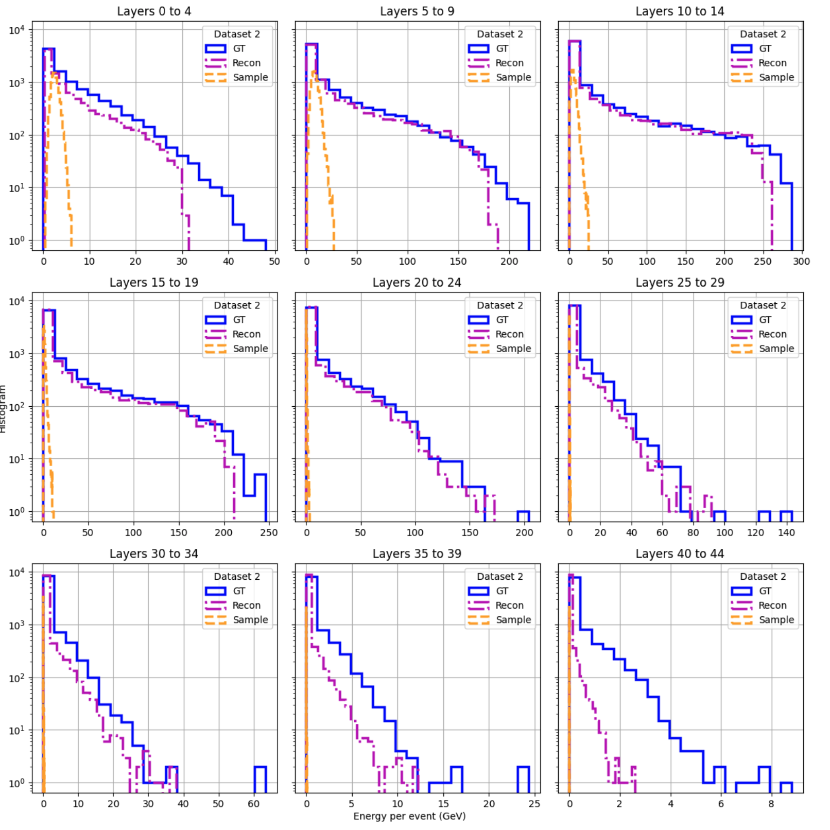
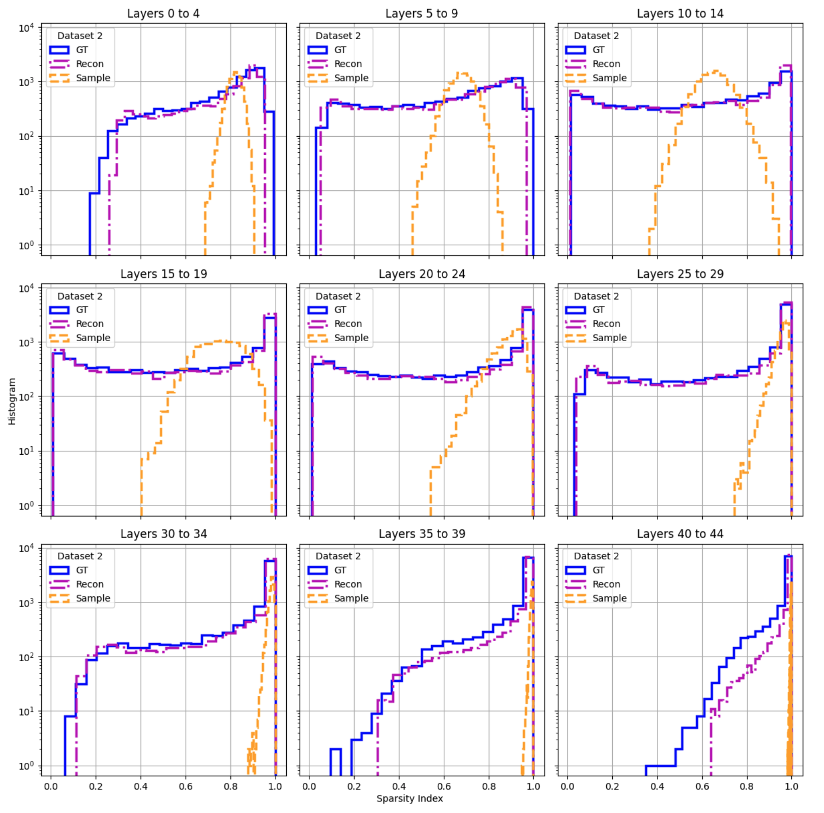
Frequency
RBM Energy

Slide 11
Model #6 – Unconditioned Hierarchical CNN Encoder w/ PReLU Act. Fn. & Unconditioned CNN Decoder
+ Dwave-sparse RBM
CNN + PReLU
FCN
CNN + PReLU
Sparse Chimera
Connection removed from model

Slide 12
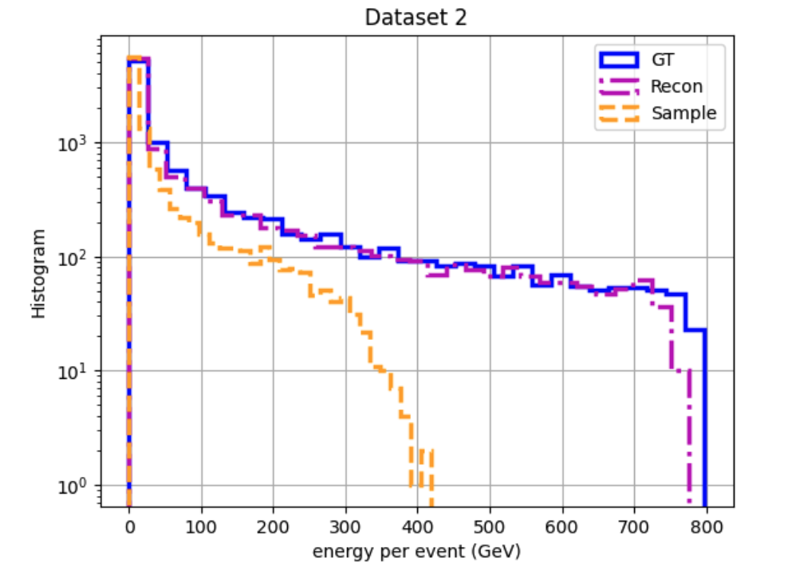
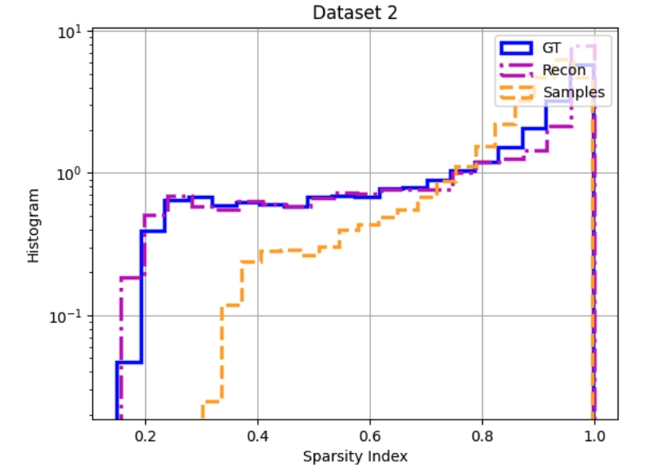
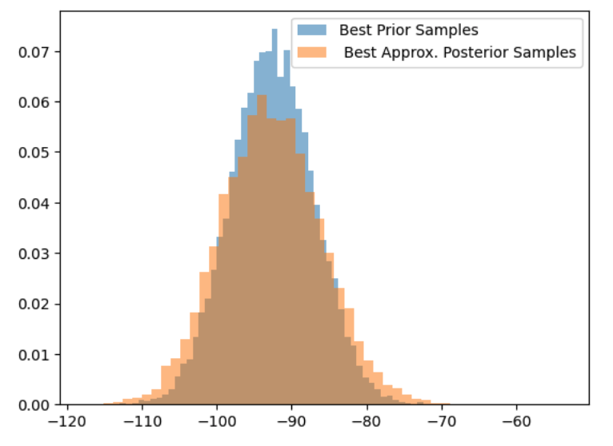
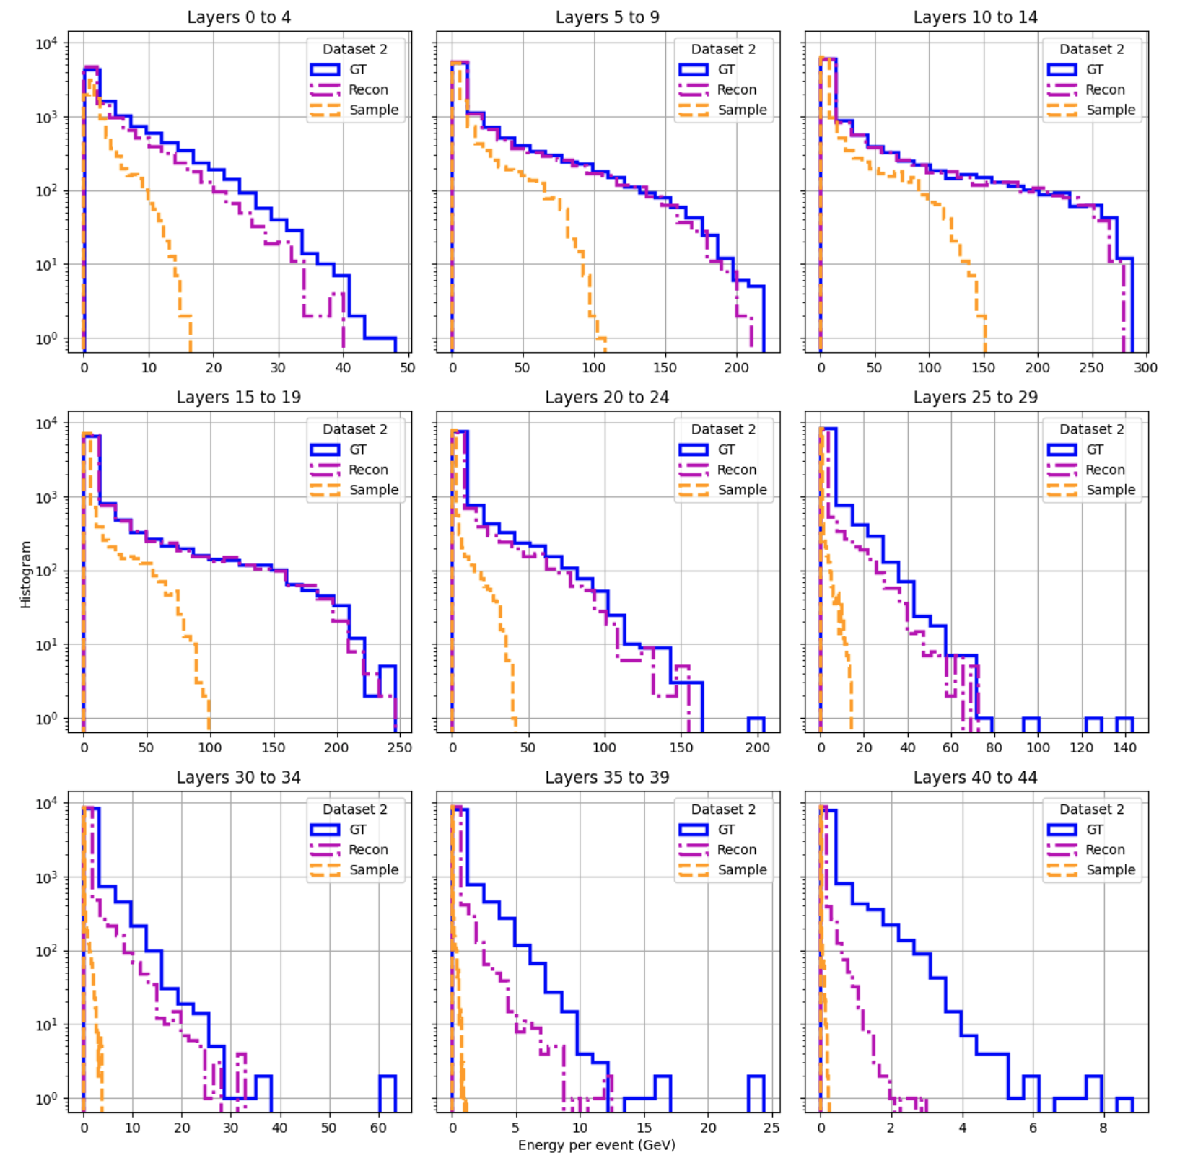
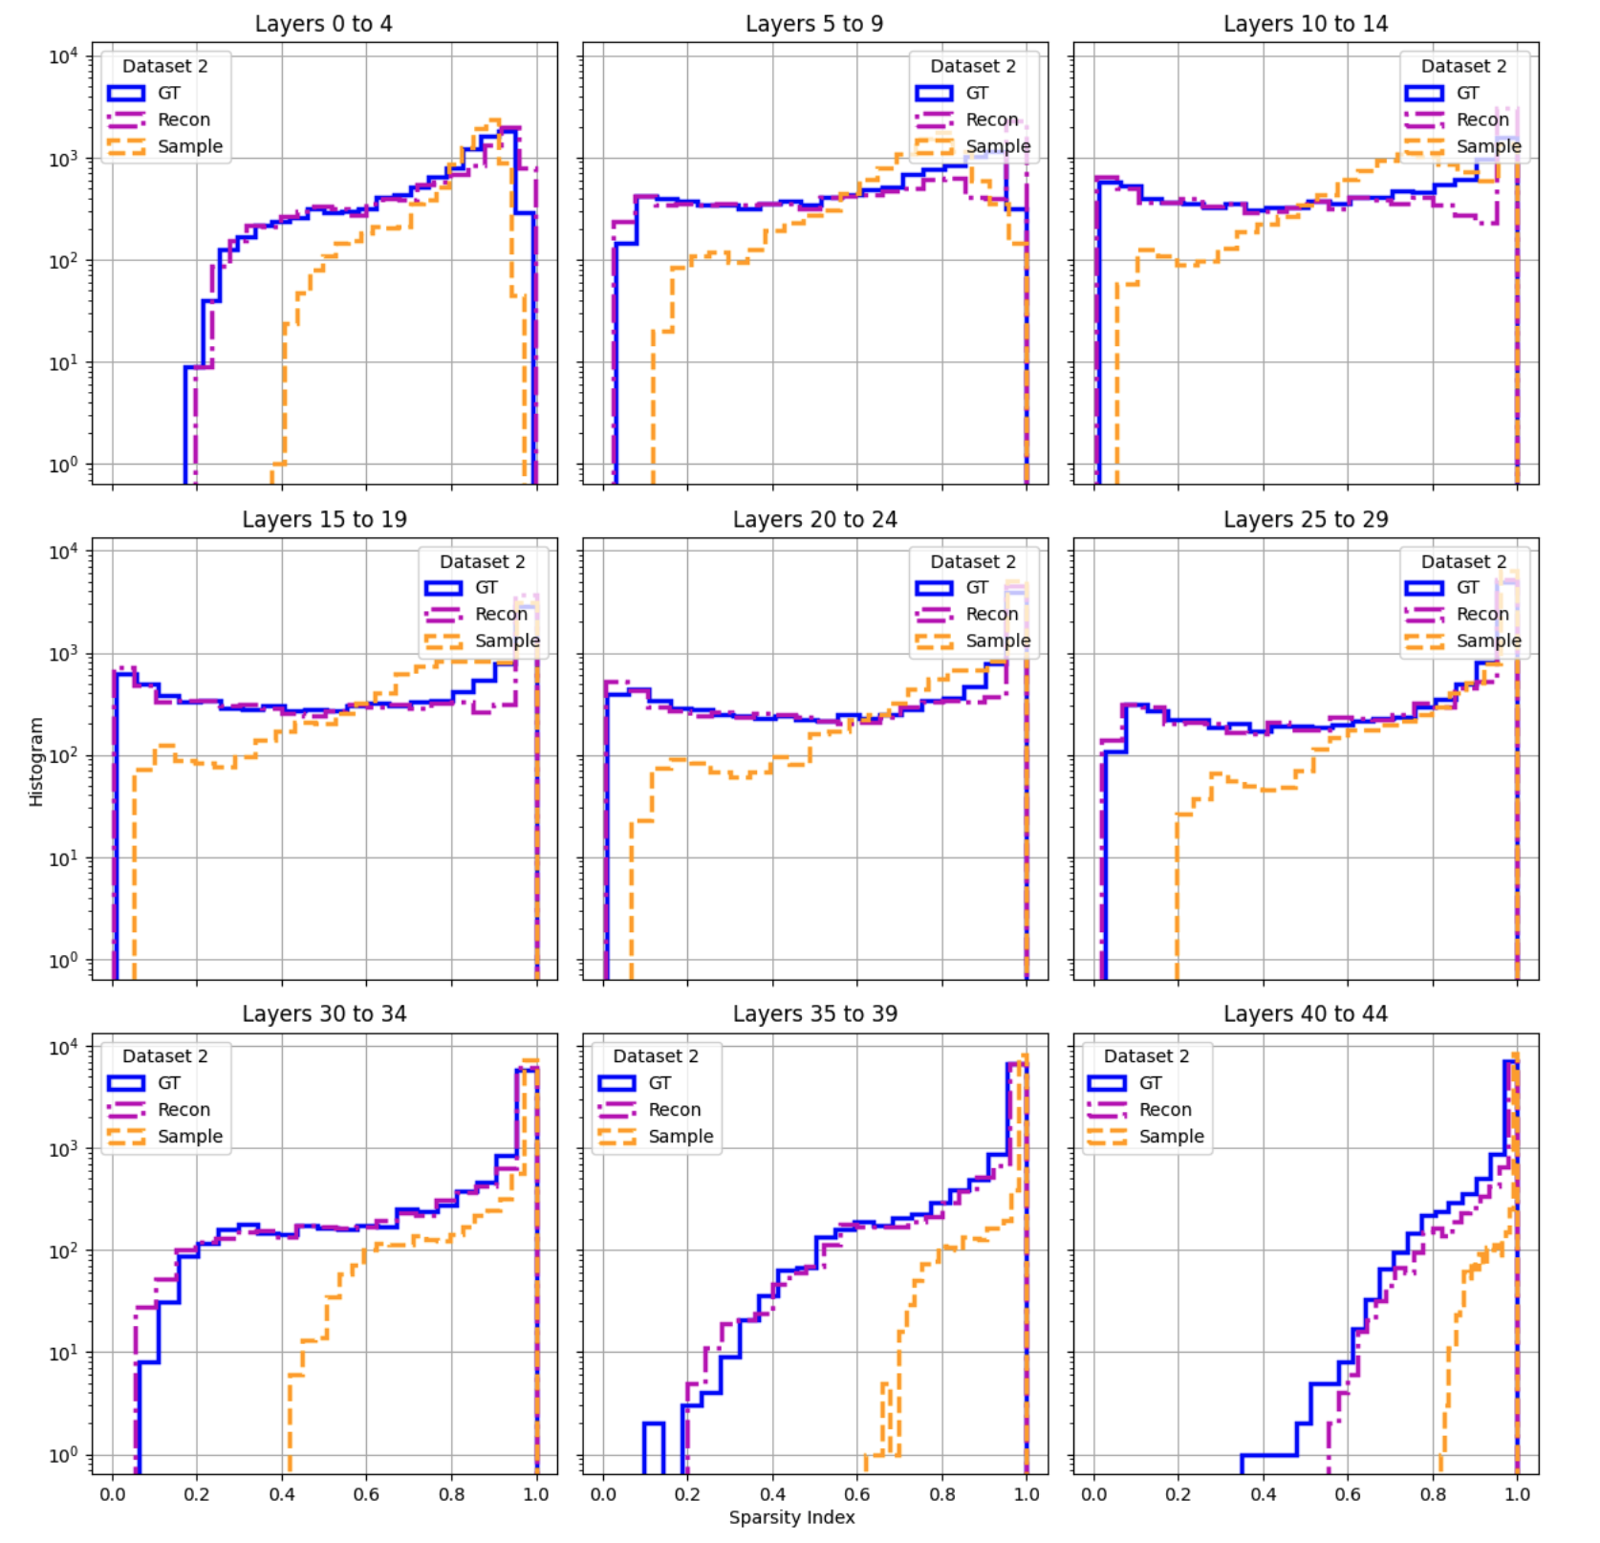

Slide 13
Model #7 – Unconditioned Hierarchical CNN Encoder w/ PReLU Act. Fn. & Unconditioned CNN Decoder
+ Fully Dense RBM
CNN + PReLU
FCN
CNN + PReLU
Dense Chimera
Connection removed from model

Slide 14
