Slide 1
Particle Physics Faculty Meeting
Agenda
News/Update
Committee Roundtable

Slide 2
TRIUMF is located on the traditional, ancestral, and unceded territory of thexʷməθkʷəy̓əm (Musqueam) people, who for millennia have passed on their culture, history, and traditions from one generation to the next on this site.
TRIUMF’s home has always been a seat of learning.

Slide 3
ACOT
Particle Physics / Science & Technology / Scientific Computing parallel session
Nov 27th from 8am-10am
Plenary and talk by director on Wednesday Dec 6th
Checked with Young-Kee on agenda (will be her last ACOT)
1) high level achievements since the last meeting, 2) 5-year plan, 3) challenges and concerns
Proposed agenda
Research highlights – 45min
Updates / 5-year plan / SciTech 3.0
Meet with students and postdocs – 30min at the end
Generally good feedback – Request to see plan for restructured SciTech Department at next ACOT

Slide 4
Preliminary Planning for IF 2025 (EOI ~December)
ATLAS-Tier-1
Integrated Silicon Detector Development
PIONEER
TUCAN
RadMol
nEXO / DarkSide?

Slide 5
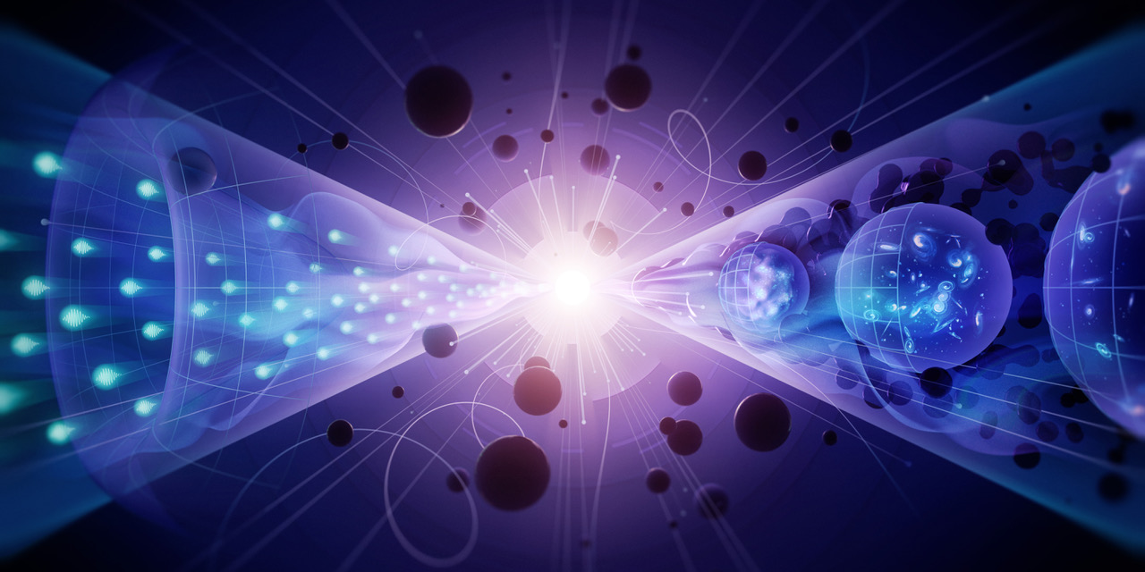
Various
UCN position posted, deadline January 31st
Search committee being formed
Feedback on last Town-Hall?
Budget request submitted
~1K for Quantum and Detector seminars was added to Particle Physics budget PRG_2358
A hybrid town hall meeting hosted jointly by DPF and Fermilab to discuss the P5 report was held on Dec. 11, 2023 from 1-6 Xiaoyue has organized a “watch party”

Slide 6
Physical Sciences
ACOT parallel sessions – Particle-SciTech-SciComp; Nuclear; CMMS – overall positive outcome
Nuclear Physics – discussions of the PEng support for PSD
Theory this morning
Board of Governors approved promotions of four PSD scientists:
David Morrissey – level C, Stephan Malbrunot – level B, Chloe Malbrunot – level B, Max Swiatlowski – level B
TRIUMF Internal Process and Timelines for Application of Canada Foundation for Innovation - Innovation Fund (IF) 2025 – announced in November
Expression of Interest submission deadline Dec 1st – aligned with member universities deadlines
Five EOIs received
Carl Svensson appointed in a joint TRIUMF - U Guelph position starting in January 2024
This is the third joint appointment with U Guelph. The position has been vacant for couple of years
PSD admin assistant Allayne McGowan is leaving TRIUMF for an executive admin assistant in another company starting in January
Thank you, Allayne, for all the hard work supporting PSD!
Updates from the Science Technology dept

Slide 7
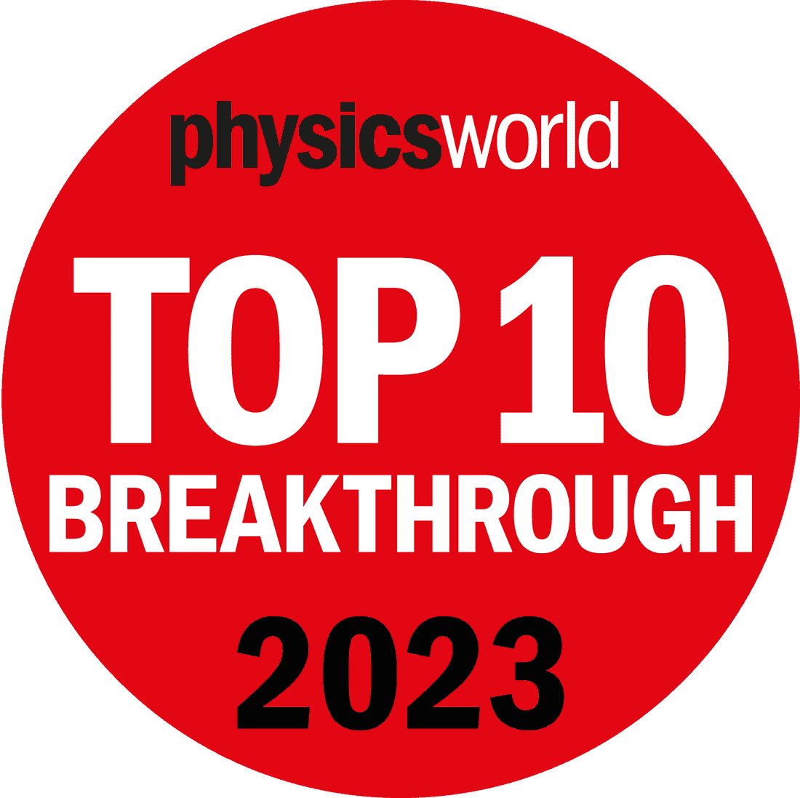
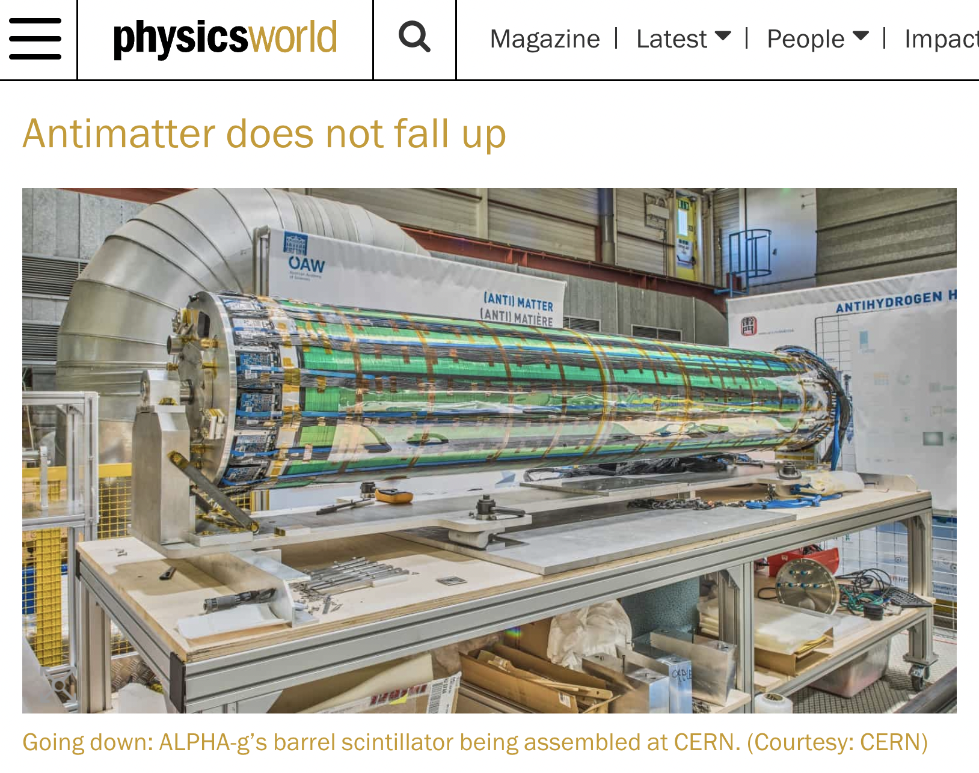
Physical Sciences
Updates from the Particle Physics dept
ALPHA — Breaking News!
ALPHA-g result just chosen as one of 2023 Top 10 Breakthroughs by Physics World Magazine
This follows a 2021Top 10 Breakthrough on ALPHA's antihydrogen laser cooling
TRIUMF-built ALPHA-g Barrel Scintillator detector

Slide 8
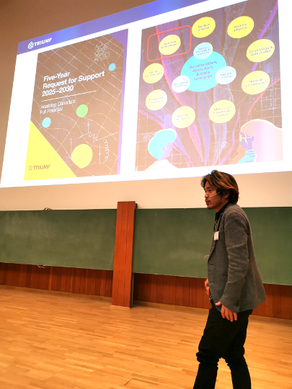
ALPHA Update
ALPHA is getting much international attention
Some recent talks by ALPHA-TRIUMF members
TRIUMF Colloquium on ALPHA-g result, Nov 2
Plenary talk on "Quantum Sensors" at ICFA Seminar "Future Prospectives in High Energy Physics" DESY, Germany, Nov 28
APS-JPS joint meeting in Hawaii "ALPHA&HAICU", Nov 29
Scheduled invited talks
Plenary talk at Quantum Symposium 2023, Japan, Dec 13
National Metrology Institute of Japan, Dec 14
KEK IPNS Seminar, Japan, Dec 18
J-PARC Seminar, Japan, March 22, 2024
Other invitations include: Oxford Univ, King's College London
Newly hired BAE needs a lab space; continued progress on renovation of the Old Compressor Building space is urgent
Advertising TRIUMF FYP at ICFA meeting, DESY

Slide 9
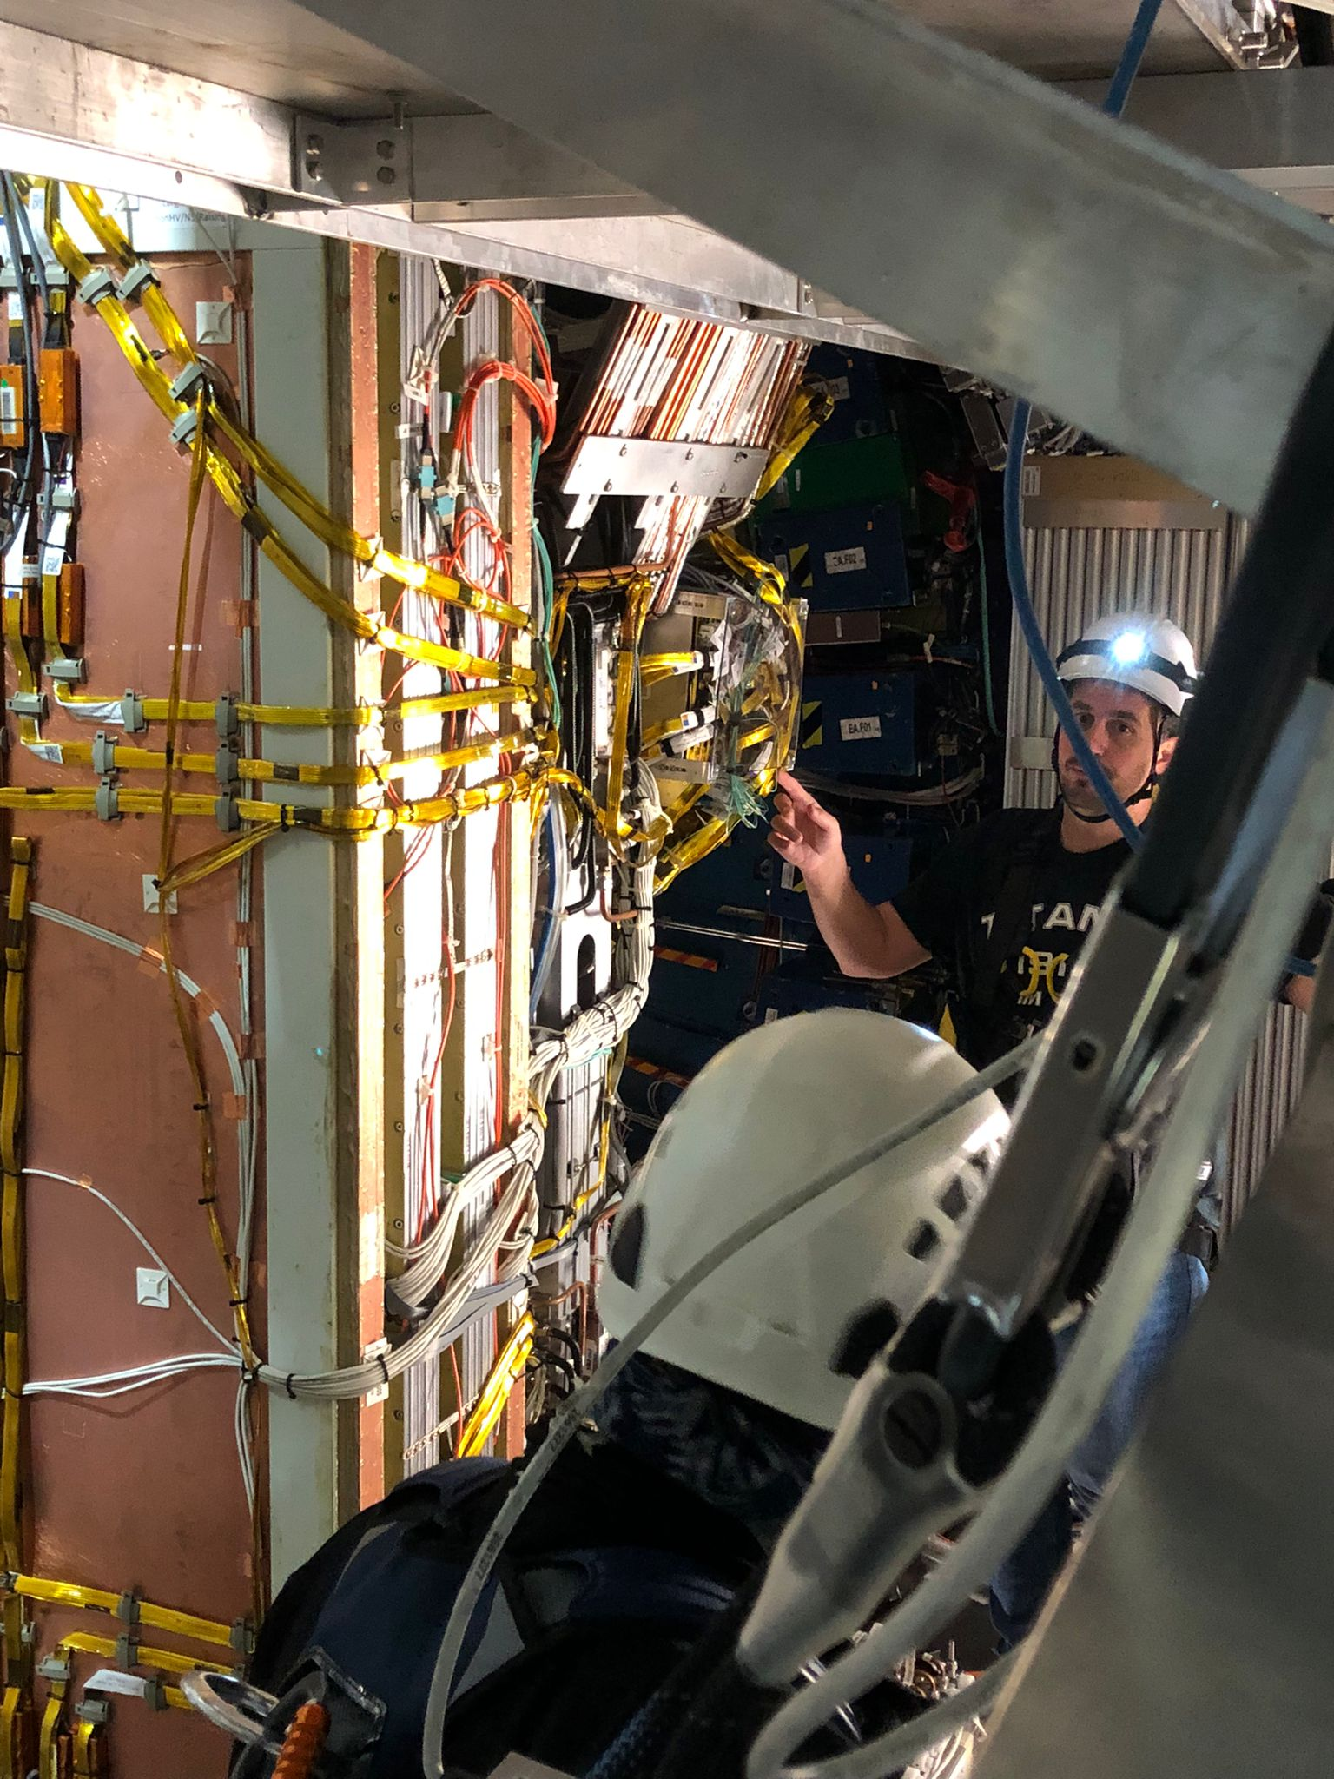
ATLAS Update
Personnel changes and movements
Kate Pachal rejoined ATLAS group in September, in particular to reinforce ITk local effort
Matt Basso (post-doc) convener of HWW since October
Geetika Jain (post-doc) left in October
Grad students Callum and Leesa both moved to CERN for a year in September
Co-op Jessica Bohm finished machine-learning project on particle flow implementation; continuing work as Senior Thesis at Waterloo
Co-op Joshua Lerner finished machine-learning project for ATLAS trigger, gave final talk in ATLAS trigger meeting
ITk Co-op student Richard Salami finished project on modules, gave a talk about it at ITk Week at CERN (Lightning talks)
LAr Co-op student Denaisha Kraft made ASICs measurements with HEC preamplifiers and cables over Summer
new co-op student Marko Jovanovic (SFU) for January – May 2024, with Max
Recent roles and appointments
Max appointed lead of “Advanced and Global Particle Flow Taskforce”, aiming to deploy machine-learning reconstruction techniques developed by TRIUMF and collaborators in core ATLAS software for HL-LHC upgrade
ITk:
Second PPB petal in Vancouver completed (third in the whole project) and being tested; modules for third PPB petal being assembled
More than 50% of end-cap sensor production tested
ITk module Production Readiness Review (part 2: module-loading and end-cap modules) in November
Organised by Luise Poley; 7/20 talks given by Vancouver ITk team, results presented largely based on Vancouver work
ITk team have been very busy with the Hiroshima conference this week
LAr Calorimeter Phase II:
Preproduction ASICs packaging in JCET delayed to mid Sept, shipped to TRIUMF Nov. 4.
Boards for QC tests produced and tested. Test setup complete
QC tests started. Preliminary yield 84% (75% was expected)
NSW sTGCs:
sTGC pad trigger operating since July in the ATLAS endcap muon trigger sector logic, giving the needed ~6-8 kHz rate reduction to keep running under continuous high pileup conditions
Currently profiting from winter shutdown to replace versatile link optical receivers on Level 1 data-driver cards (Stergios, Leesa)
sTGC work in the ATLAS cavern

Slide 10
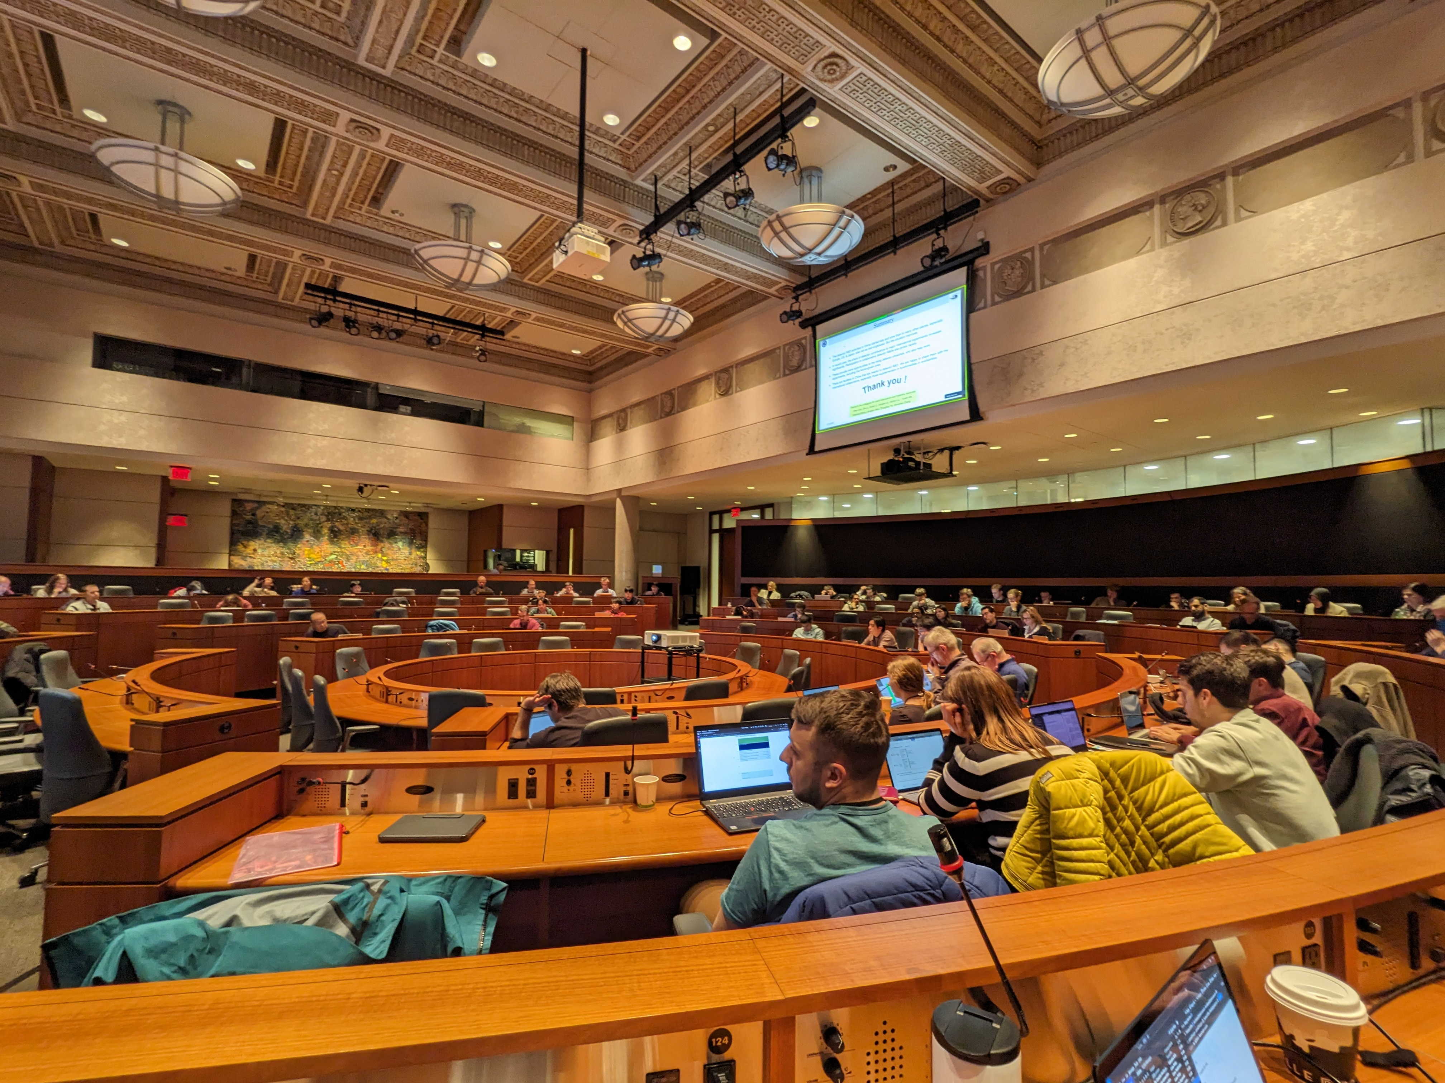
ATLAS Update (2)
Talks and conferences
Marco Valente: ATLAS & CMS Di-Higgs searches, status and prospects at Higgs2023 in November in Beijing
Max Swiatlowski: invited experimental summary talk at BOOST 2023 at LBNL in August
Evan Carlson: ATLAS & CMS searches for long-lived and exotic particles at Rencontres du Vietnam in August
Max: TRIUMF Colloquium October 5, “The LHC’s Next Frontier: Searching for Pairs of Higgs Bosons to Understand the Standard Model and Beyond”
Oliver Stelzer-Chilton: ATLAS Searches for New Phenomena at WIN2023 in July in China
Dilia Portillo, Russell, and Max participated in ATLAS Hadronic Calibration Workshop in Valencia in September
Estel Perez: ATLAS New Small Wheel performance studies at TIPP 2023 in Cape Town in September
Luise Poley: Curing early breakdown in silicon strip sensors with radiation, at Hiroshima conference in Vancouver, this week
Publications since July with major contributions from group members:
Search for top-philic heavy resonances in pp collisions at √s =13 TeV with the ATLAS detector (Kate) - accepted EPJC Dec 3. arXiv:2304.01678
Public results and publications submitted to journals since July:
Electroweak SUSY multi-b (HH->4b + Missing Energy) ATLAS-CONF-2023-048 (Max & Marco)
HH resonant combination submitted to PRL (Max & Marco)
Search for Dark Jets public briefing, submitted to JHEP (Dilia)
Search for massive, long-lived charged particles with large specific ionisation and low-β ATLAS-CONF-2023-044 (Kate)
In total ATLAS has submitted 106 papers for publication since the start of 2023 (5 on Run 3 data)

Slide 11
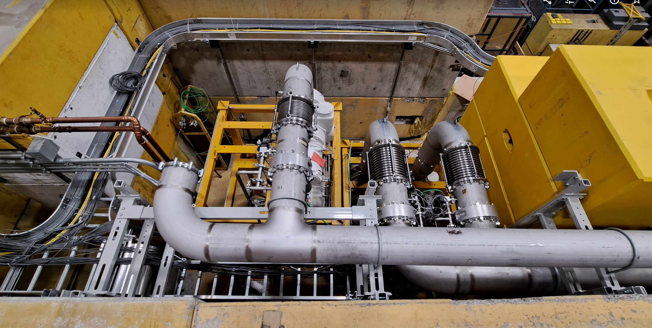
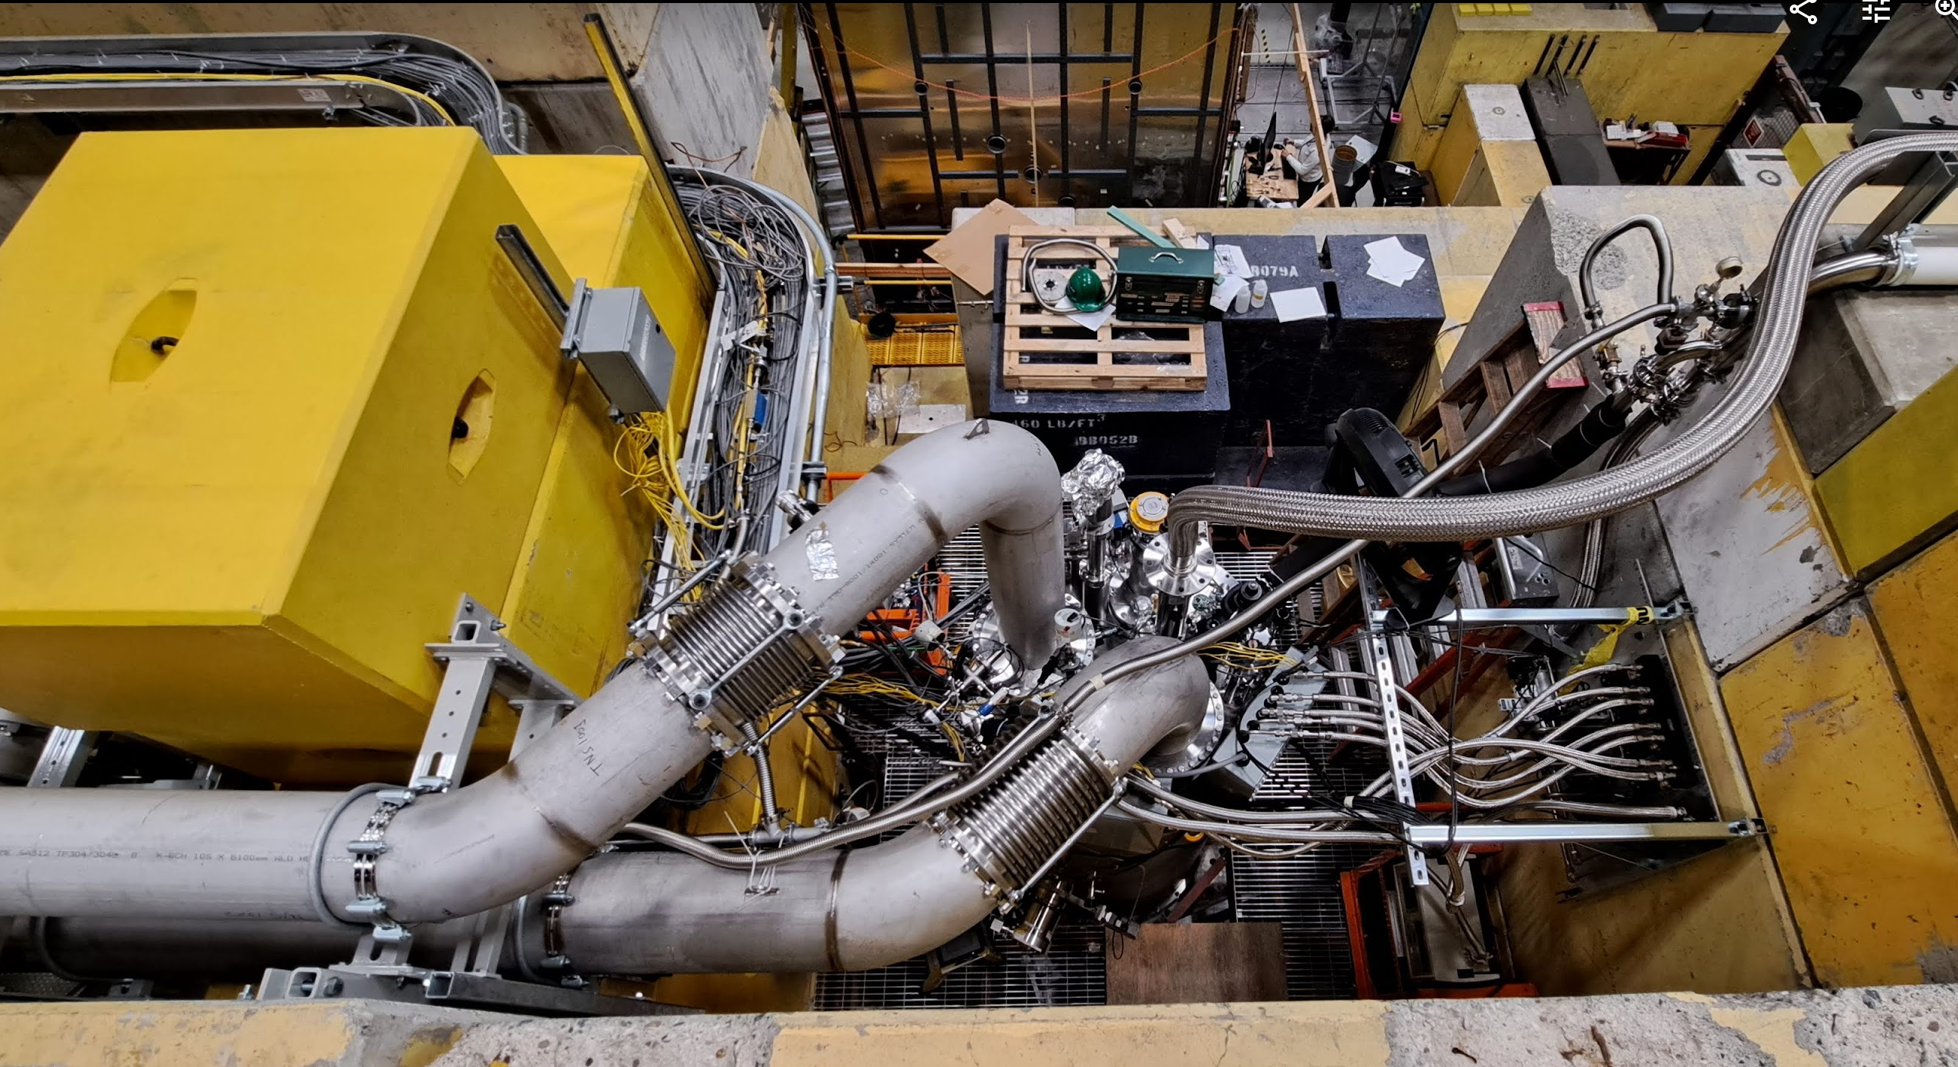
UCN/TUCAN Update
Pumps and large pumping ducts to cryostat
We just completed our next major milestone before the liquefier is shipped for repair: cooling the UCN source He cryostat down to superfluid temperatures using the large sub-atmospheric pumps (Phase 2B cooldown)
A lot of installations, cabling and controls work was completed beforehand.
Using helium-4 in both, the helium-3 and helium-4 system, we reached 1.1 K as expected
All hardware performed well: pumps, sensors, valves, heaters, slow control and the cryostat
No clogging in the needle valves.
Cooldown to 1.1 K took < 48 h.
Performed helium boiling curve measurement with short, UCN friendly, heat exchanger.
Kudos to the UCN group, especially our post-docs and students, who worked very hard to make this happen! Big thanks also to beamlines, controls and cryo group.
In other news: tail section manufacture is progressing well, wall 2/6 has been completed in the machine shop and is leak tight!

Slide 12
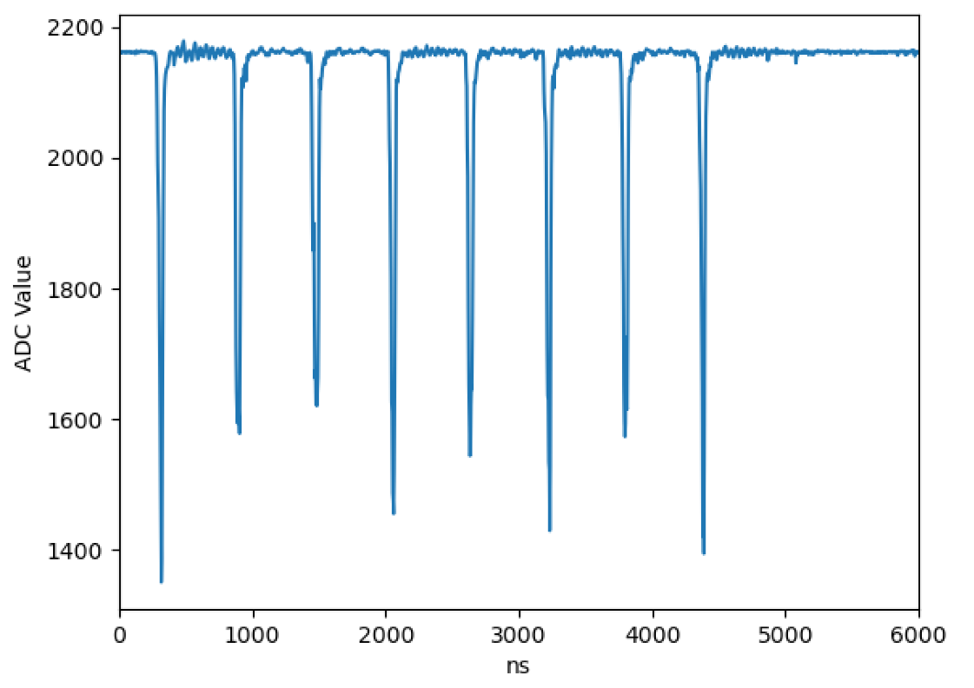
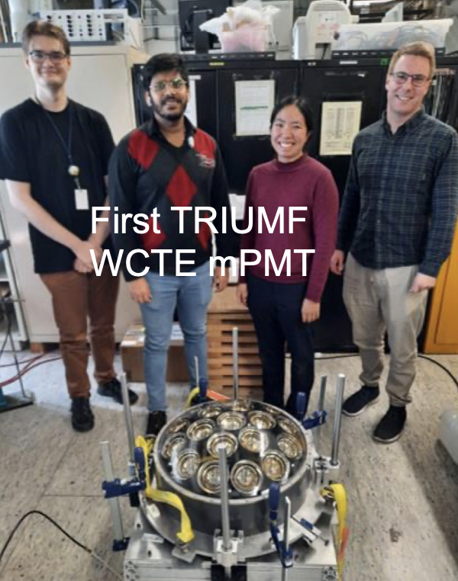
T2K/Hyper-K Update
T2K beam structure with OTR background light measurement apparatus
T2K beam has resumed from Nov. 24
New record beam power of 610 kW achieved
F. Cormier (TRIUMF postdoc) and J. Zhang (UBC grad. student) traveled to J-PARC for beam start and to make new OTR monitor measurements (upper right)
First multi-PMT for WCTE pilot production completed (lower right)
Super-K facing challenge of magnetic field compensation coil failures
Measurement of 20-inch PMT magnetic field dependence withTRIUMF PTF becomes critical

Slide 13
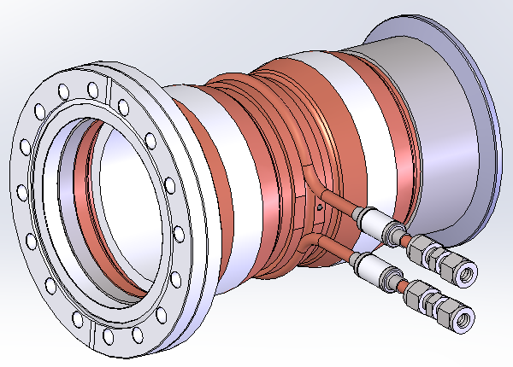
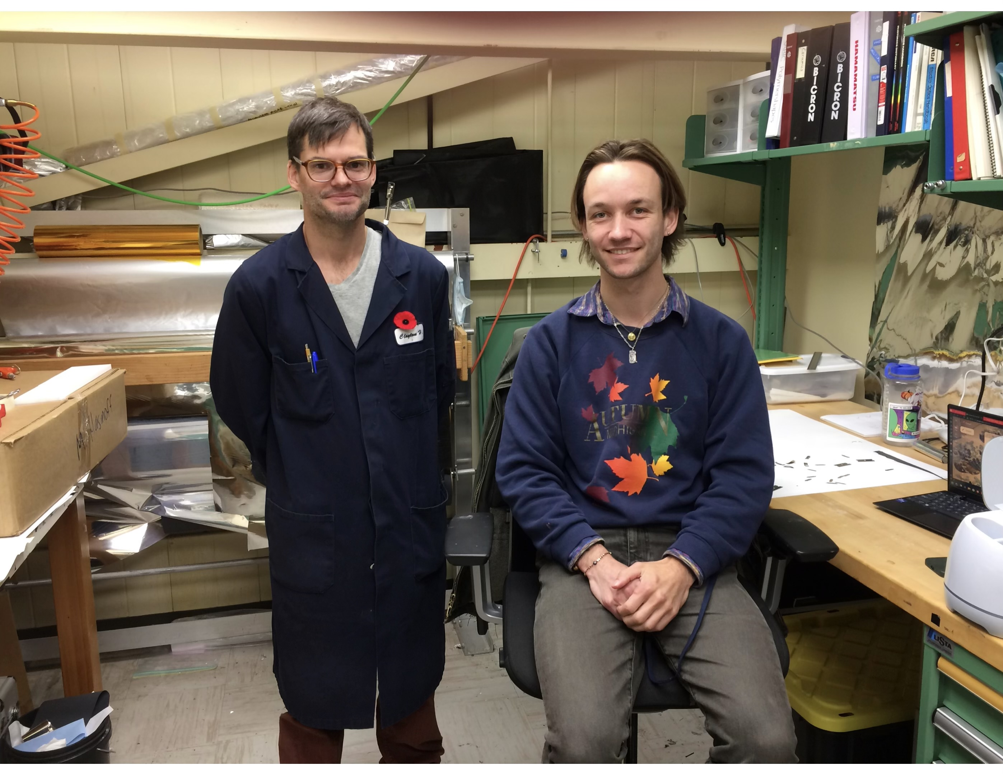
DarkLight Update
Development with GEM tracking detectors at TRIUMF ongoing (Laura). Now working on readout and triggering.
Trigger detector construction almost done (Mike + SciTech)
18 scintillators and 216 light guides finished polishing, gluing, and wrapping – thanks to Clayton and our co-op Ben
New readout boards tested, expect full shipment mid-December
Grateful to Philip Lu for prompt completion of collimator design!
Collaboration meeting held at MIT in November. Accelerator and collaboration agree to aim at June installation date
Personnel updates:
UBC/TRIUMF MSc student Gabby Gelinas received IAEA Marie Skłodowska-Curie Fellowship (20000 euros + tuition)
TRIUMF postdoc Laura Miller is now simulation coordinator
Kate elected co-spokesperson of DarkLight, along with Jan Bernauer (Stony Brook University)
Recent presentations: Kate gave invited plenary talk at IEEE NSS conference in Vancouver highlighting DarkLight and TRIUMF; gave DarkLight overview at APS/JPS DNP workshop. Laura will give DarkLight talk at Lake Louise Winter Institute.
Collimator design (P. Lu)
Clayton and Ben in the scintillator shop

Slide 14
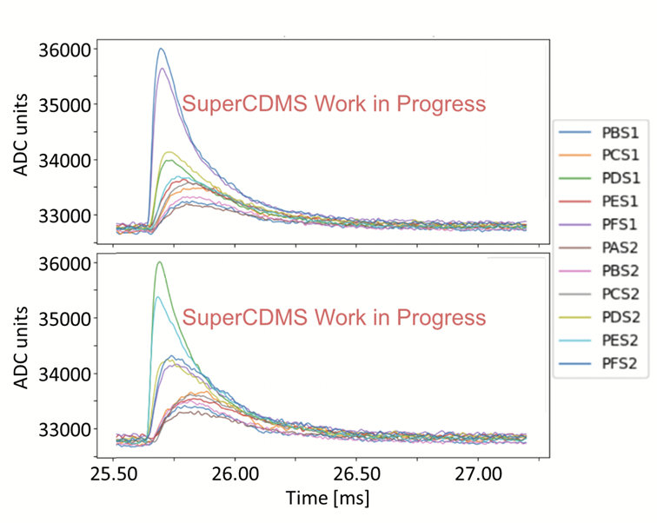
SuperCDMS Update
Examples of 1.3 keV events in Ge detector
Main focus in the past weeks on Detector Tower testing in CUTE
Sensor performance tests complete
HV and noise performance test ongoing
Calibration effort started
Ge: neutron activation → ⁷¹Ge EC decay: 10.3 keV, 1.3 keV, 160 eV
Si: high stat. gamma calibration to explore low-energy features in Compton spectrum (100 eV to 1.8 keV)
Improving event reconstruction (energy, position) and analysis tools
Different pulse shapes/amplitudes in each channel allow for position reconstruction

Slide 15
AOB

Slide 16
Committee Updates
IPP Council / CAP
Science Council
Space
Seminar/Colloquia
SciTech seminars/Quantum Forum/Dark Matter Forum
Mixer
Science Week
Safety
Academic
Summer schools
Health & Wellness
Diversity committee
IYBSSD

Slide 17
Next Meeting
Jan 11th

