Slide 1
HAICU introduction

Slide 2
Extended meeting
Exchanges of the information across various subgroups in HAICU.
Inform the people in the HAICU group who don't normally attend our weekly meetings on what's going on.
Reviews of key technical issues by the entire groups. We wish to take advantage of our diverse technical backgrounds to help solve challenging problems each sub-group is facing.
Status review of the project, including the timelines. This is in part for our TRIUMF quarterly review of the project priorities (QRPP). For sub-projects by TRIUMF groups, this will help determine the level of resource requests for the next quarter.
Finalize, if possible, the design of the key sub-systems so that we can move to the construction phase.
And most importantly, have some drinks after the meeting at a pub! --> Andrea

Slide 3
QRPP – Quarterly Review of Project Priority
TRIUMF decides on resources priority on all projects
Next meeting: Jan 10 -11, 2023
Science Technology department wants the info by Jan 5
We need to provide man-weeks for each resources (mechanical, electrical, DAQ (firmware etc), Detectors
We would like to get the estimate for the next meeting ASAP

Slide 4
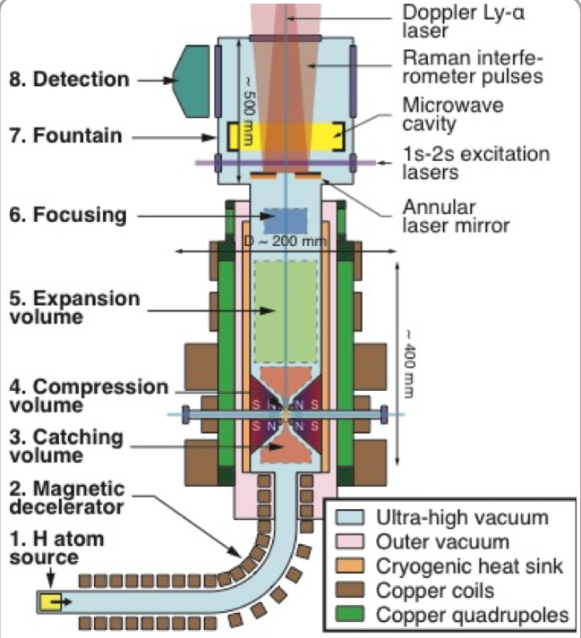
HAICU Overview
New quantum techniques
Atomic fountain
Quantum Interferometer
(Anti)molecule formation
Atom manipulation with MOF*: Magneto-Optical Fridge
(*tentative name)
Technical developments required
New types of magnets
VUV lasers
Microwaves
Hydrogen Detectors
Aiming for several orders of magnitude
Improvement in antiH - H symmetry tests
HAICU hydrogen fountain

Slide 5
PHASE 1

Slide 6
Phase 0
Significantly reduced complexity in design from Phase 1
Objectives:
Trap and detect hydrogen atoms
Laser cooling if lifetime allows
Learn what the limiting factors may be
Trap
Trap depth: by putting the quad coils outside mirrors
Magnets: Less aggressive cooling schemes
Vacuum: starting with room temperature vacuum
Removing near axial laser ports

Slide 7
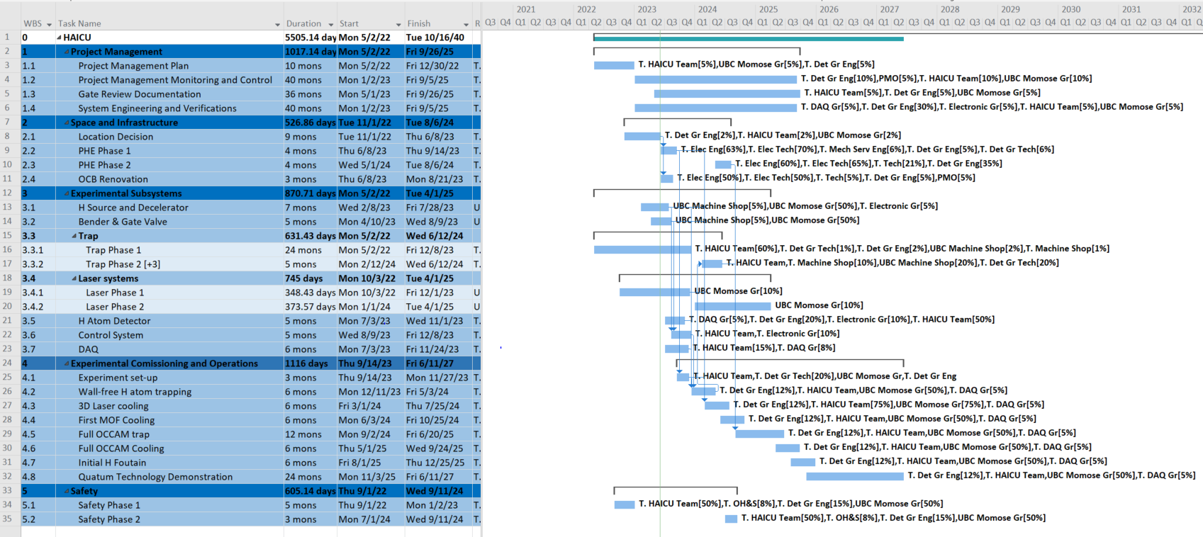
Timeline as of Gate 1 review (June 2023)
Significant delays!

Slide 8
Resources
Overall schedule
Timing of the decelerator moving to TRIUMF
Human power at UBC for decl. construction; late Feb
Labview control for decl. timing
H-mass spectrometer for ASACUSA?
Desk spaces?

