Slide 1
Hydrogen source for HAICU
Reza, Qianqian, Taka
HAICU presentation
December 2023

Slide 2
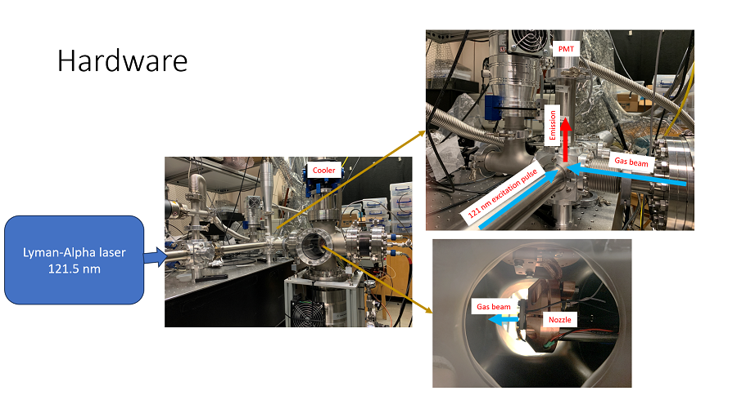

Slide 3
Previous results

Slide 4
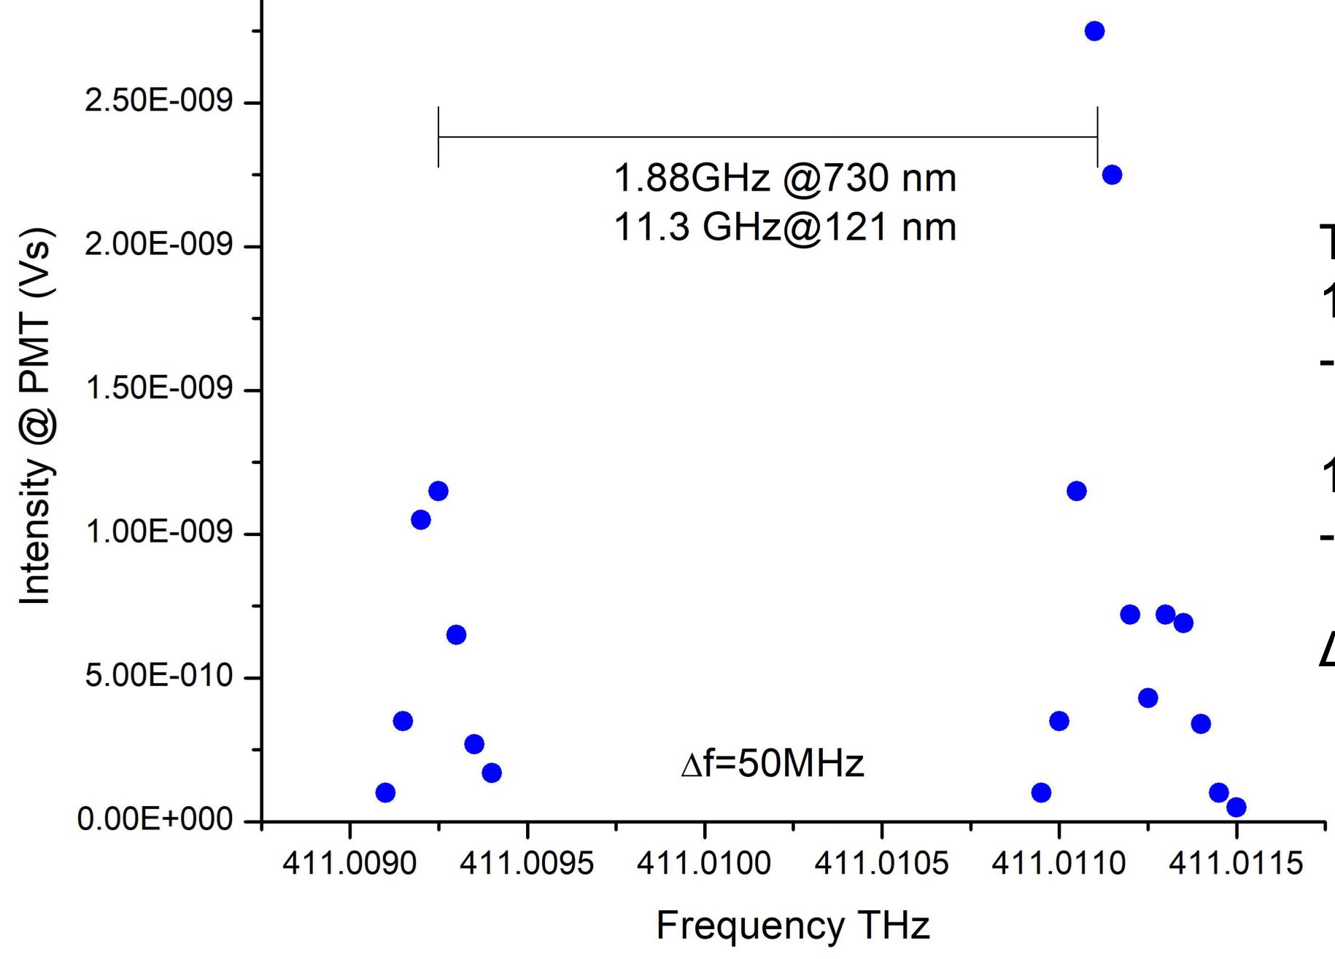
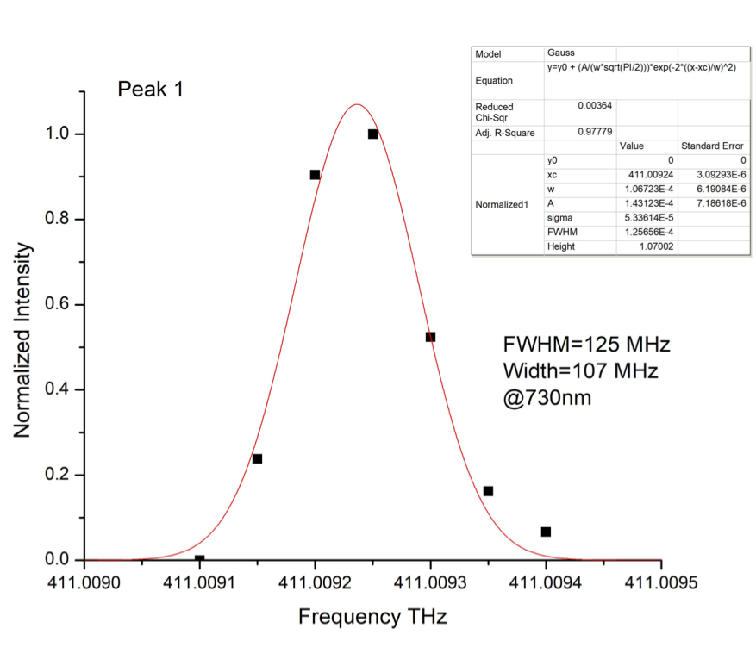
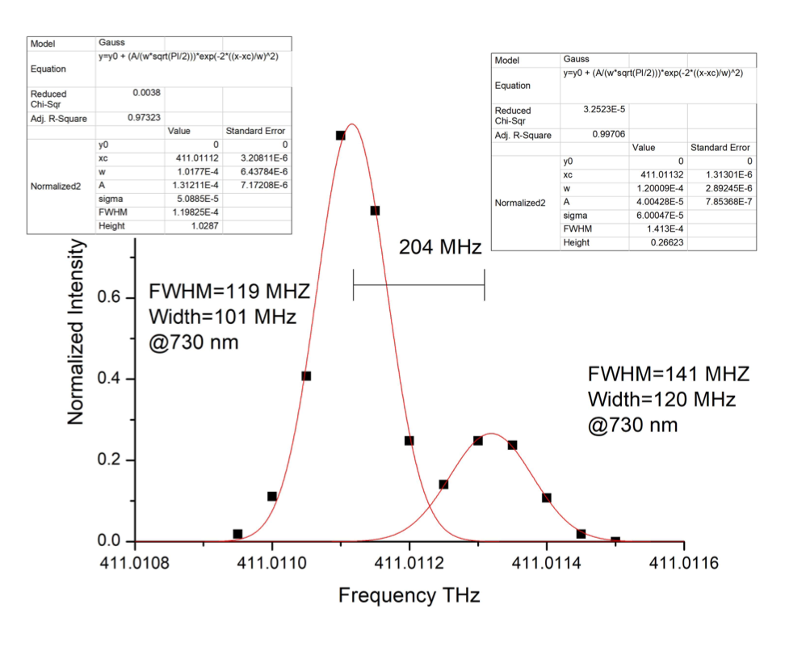
Frequency scan
Wavemeter accuracy : 50MHz at 730m = 300MHz at 121 nm
11.3 GHz
2P(F=2,1) →1S(F=1,0)
2P3/2
2P1/2→1S
2P3/2→1S
10969.04153 MHz
800 MHz width ~
2P(F=1,0) →1S(F=1,0)
2P1/2
at 730 nm
2P3/2(F=2,1)→1S(F=1)
⸗
⸗
⸗
⸗
1.2 GHz
1S F=1
2P3/2(F=1)→1S(F=0)
1420.4057 MHz
FWHM 720 MHz @121nm
1S F=0
FWHM 750 MHz @121nm
FWHM 850 MHz @121nm

Slide 5
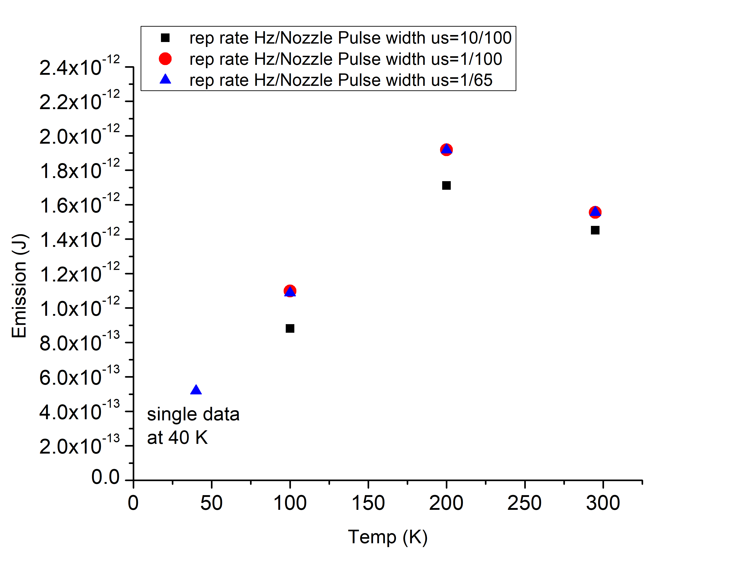
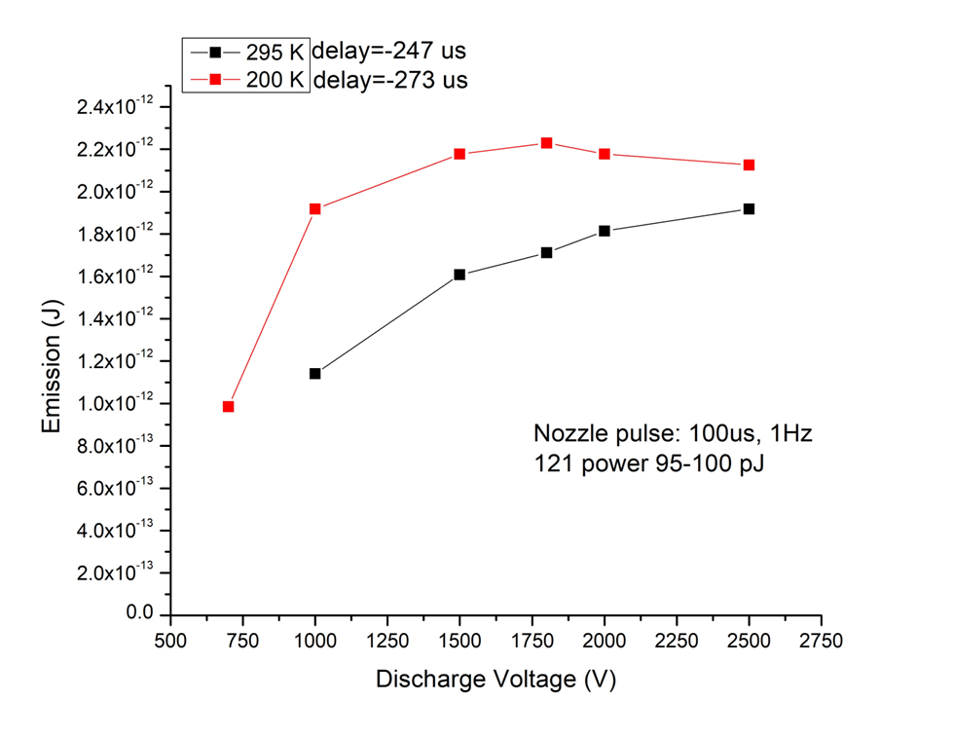
Cooled Pure H₂
Cooled gas beam results in relative lower velocity (by 30% at 50K)
Gas discharge condition

Slide 6
Current work: Gas mixing and cooling
Mixing H₂ with some noble gases (Ar, He, Ne)
Find optimum condition for:
“slower Velocity from the source <900m/s” and
“Large emission signal”

Slide 7
Current work: Gas mixing and cooling
 | Intensity ratio | Velocity reduction at RT
Pure H2 | 1
30% H2/Ar | Very small | 50%
30% H2/He | 50% | 20%
30% H2/Ne | 70% | 60%

Slide 8
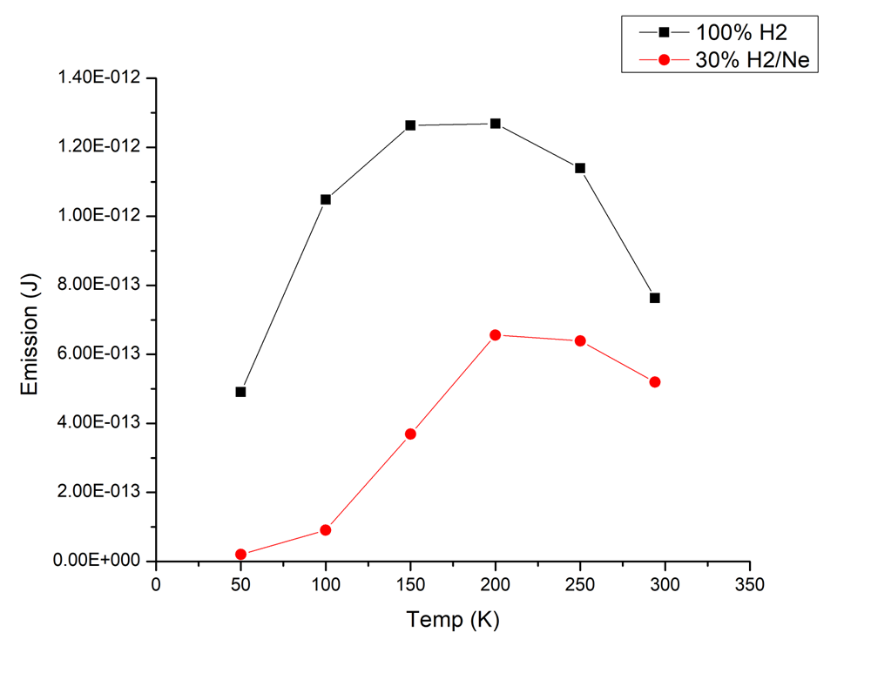
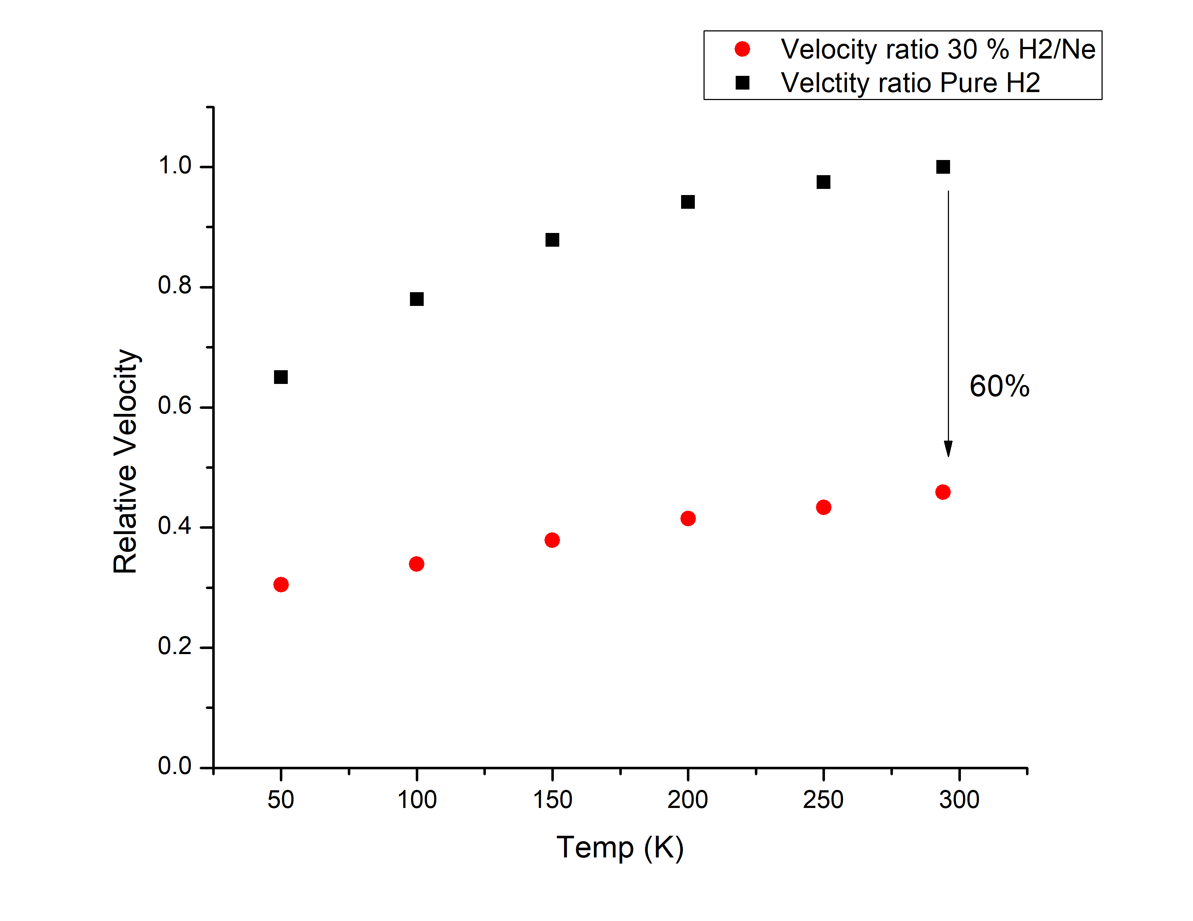
Current work: Gas mixing and cooling
30% Mix to pure ratios:
Intensity ratio at RT: 70%
Velocity reduction at RT: 60%
H₂/Ne is promising
Expecting increasing emission intensity at colder temp. → larger chamber and better vacuum

Slide 9
Thank you

Slide 10
Appendix

Slide 11
Labelled version for reference
Optical isolator
Collimating telescope
Seed Laser (729.4 nm)
12
9
To lock system
HR/PTZ
8
Intracavity telescope
1
2
3
Ti:Sa
Ti:Sa
BSa
13
BSa
729.4 nm
OC
R=25%
T=75%
11
10
50/50 BS
50/50 BS
50/50 BS
4
BBO
Frequency doubling
Pulsed Nd:YAG (532 nm, 10 Hz rep.)
f=2 m
364.7 nm
Beam dump
14
5
Pellin Broca
Prism
To scope
7
Vacuum line
THG cell
PD to FP
PD to lock system
PMT
121.6 nm
Kr/Ar
364.7 nm
6
Bsa = beam sampler
Gas beam
PD = fast photodetector
Frequency tripling
FP = Fabry-Perot

