Slide 1
HAICU Update UBC Momose Lab
HAICU Controls Status
-

Slide 2
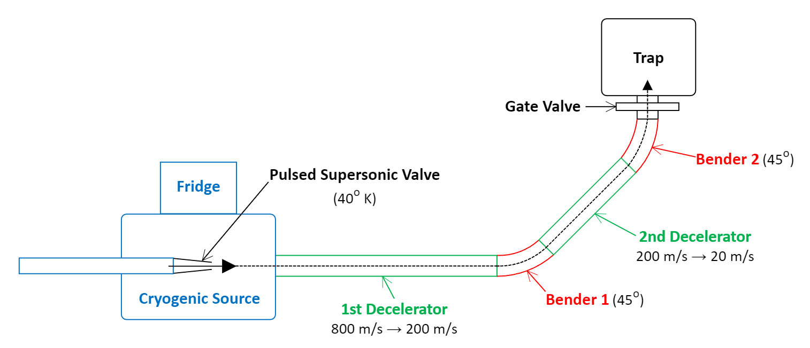
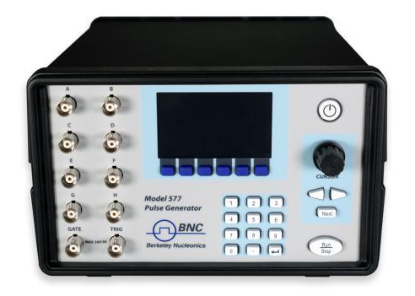
System Control
Deliverables
Precisely timed controls of apparatus to deliver a 20 m/s packet of ions at the entrance to the trap
The UBC delivered components each have drive electronics so a single TTL edge can be used to initiate operation.
Laser detection requires 10 Hz flashlamp and Q-Switch (system heartbeat)
6
1
5
4
2
3
System timing controller
Two BNC Digital Delay Generators will generate trigger signals for each component of the system
If required (for instance, during alignment) the laser Flash and Qswitch are also generated by the DDG

Slide 3
Decelerator Electronics MLD Development
The decelerator electronics will require more than 270 channels of digital control with 10 nS edge placement resolution. A UBC design Multi-Line Driver (MLD) can provide 96 lines, so 4 MLDs will be used for HAICU decelerator control.
TRIUMF Digital Development Team has rewritten firmware and Host software to improve performance and stability.
Progress
Stable USB control ready for use in January
Conversion to Ethernet ready for us in March (but conversion is transparent to other software).
Issues such as FPGA module end of life and useability enhancements will follow
Outlook
Ethernet capability added by March will improve noise immunity and stability and simplify setup.
Risks
Resources from Electronics Group are currently unofficially provided to our group. We should apply for approved resources to ensure that programming work can be done to some schedule.

Slide 4
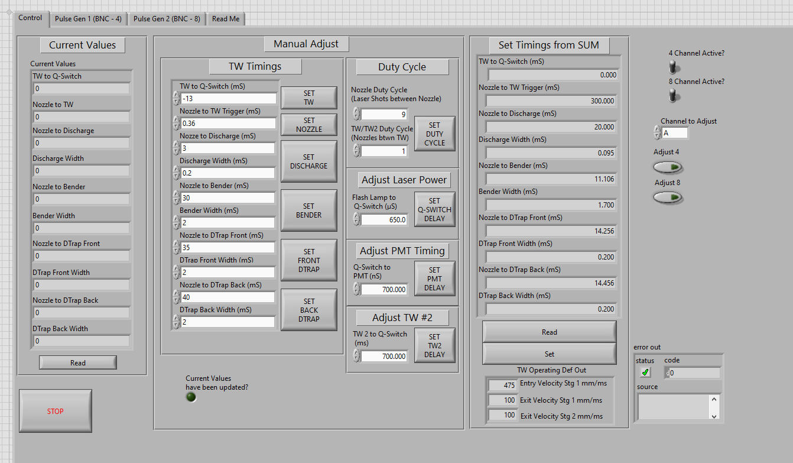
System Control
Scope
Coordination of the activation of each subsystem to achieve desired packet of H2 arriving at the trap.
Using 2x 8 channel BNC DDG to trigger nozzle, deceleration stages, bender, and detection laser.
Progress
Momose lab has existing platform for this
Outlook
Ready.
Risks
None anticipated.

Slide 5
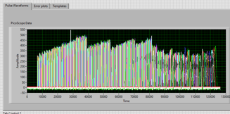
Performance Monitoring
Requirement
Shot to shot monitoring of current through each decelerator trap for tuning and failure detection
Progress
Momose lab has existing platform for this working on a 16 tunebox system
Outlook
32 tunebox system ready for March.
Risks
None anticipated.

