Slide 1
-HAICU-
TRIUMF Infrastructures update

Slide 2
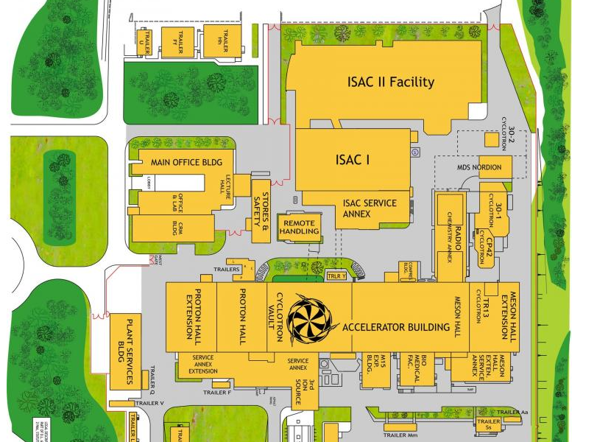
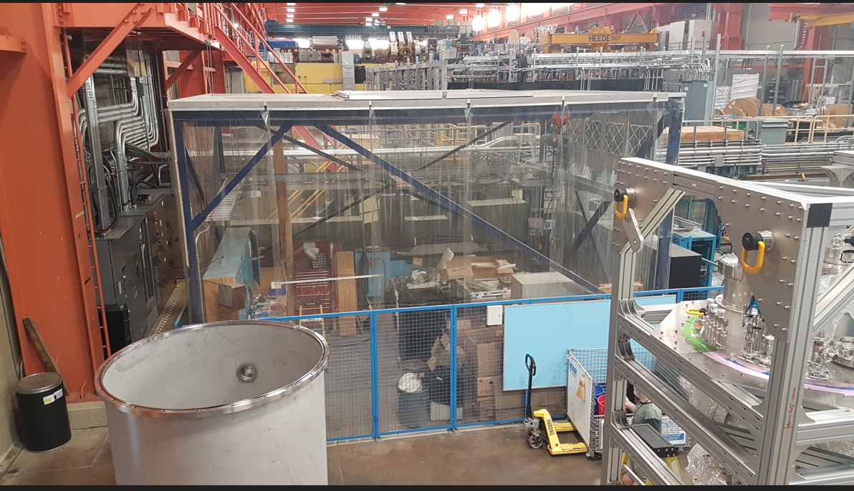
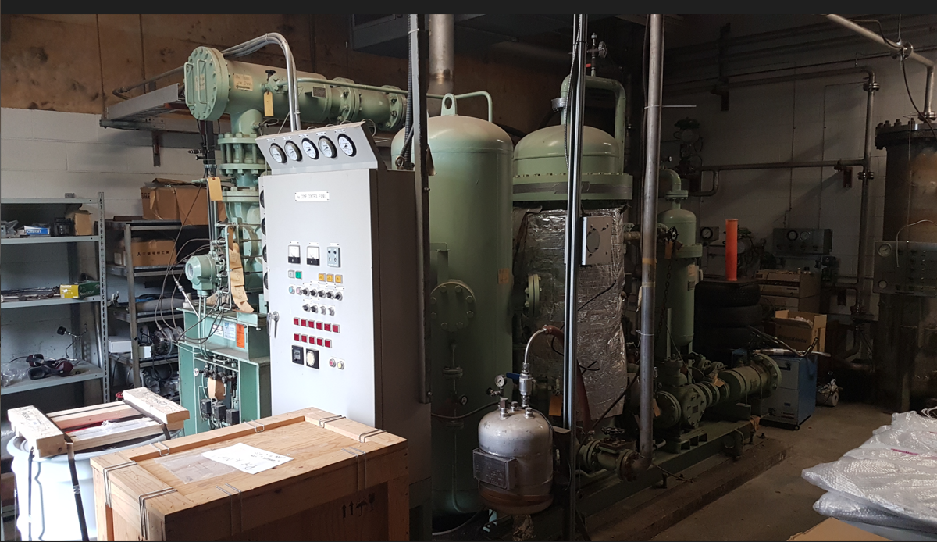
Locations of PHE and OCB
You are here!
Old Compressor Building
(OCB)
Being renovated
Proton Hall Extension
(PHE)
Future HAICU space
The area in the PHE meet HAICU’s requirement but is occupied by Mel Good.
Renovating the OCB will make space to:
- relocate Mel and free the PHE for HAICU
- make a small experiment space for multiple user (including HAICU).

Slide 3
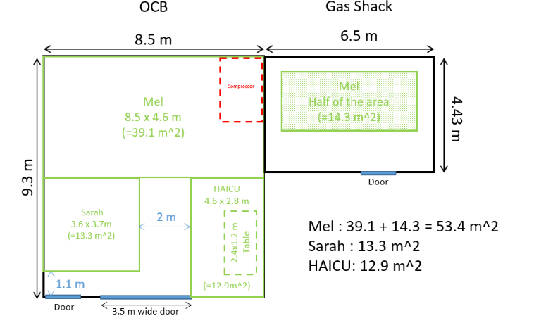
Renovation of the OCB
Done:
- Discussion with all parties involved and approbation by the space committee (back in April)
- First round of cleaning
- Electrical disconnection of the Compressor (End of July)
Currently:
- Mechanical disconnection of the compressor planned for
the 3rd of January (request submitted mid-July
-> Peter Bratt left, and Bill Richert overloaded).
To be done:
- Removal of the compressor (planned for Mid January, Protech waiting for us)
Then actual renovation start:
- resurfacing the concrete slab
- new light
- covering insulation
- move in-use compressor
- new floor.
Renovation plan
Estimated to be done by the end of March
(Risk: Rick might be overloaded)

Slide 4
PHE Electrical upgrade.
Done:
- Electrical requirements
- job requested to Electrical Services.
Currently:
Assisting the Electrical services (Tola) for the design.
Critical item:
Procuring electrical panels and transformers is the most critical -> could take more than 6 months if purchased new.
Tola is focusing on defining the list of the equipment needed.
Randy is securing equipment already on-site.
Timeline: Aiming to have the drawings and procurement done by the end of February - Mid march.
Installation could start before the end of OCB renovation.

Slide 5
TRIUMF resources requested
Rick Maharaj: 7 weeks (1.75 FTE) for the OCB renovation
Tola Babalola: 1 month (1 FTE) for the design, the drawings and the procurement.
Electrical services : 2 weeks (0.5 FTE) to support Tola.
Nicolas Massacret : 0.5 FTE for infrastructures. Internal discussion to increase-it.
QUESTIONS ?

