Slide 1
Kerr-nonlinear oscillator:
Quantum echo and squeezing
Dawn Mao, Ilya Averbukh & Roman Krems
University of British Columbia
Department of Chemistry and QMI

Slide 2
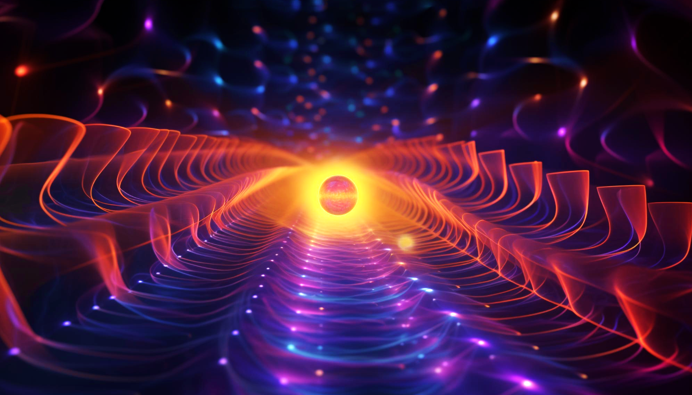
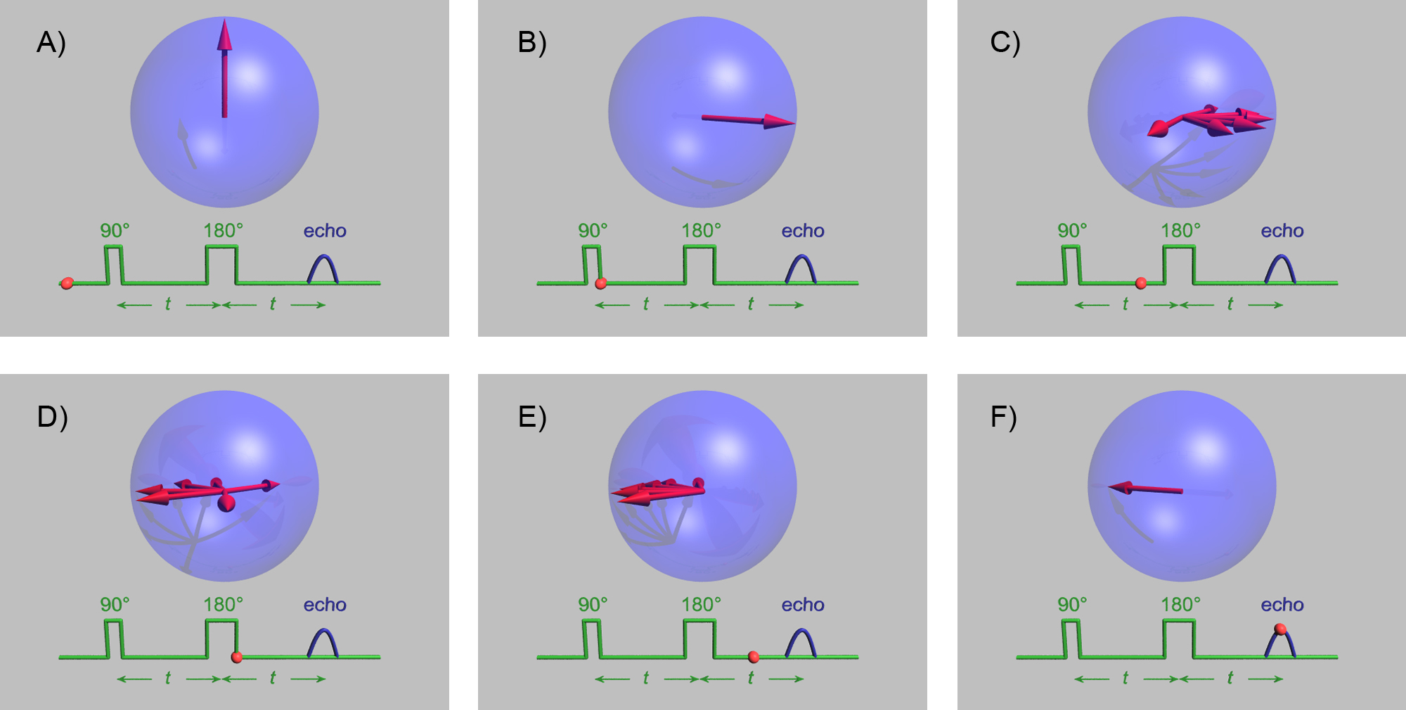
Introduction: what is an echo?
Spontaneous delayed responses following a series of pulsed excitations.
It is a universal phenomenon in both classical and quantum ensembles of nonlinear system
Most famous example: spin-echo effect discovered by Erwin Hahn in 1950
File:HahnEcho GWM.gif. (2020, September 5). Wikimedia Commons. Retrieved 00:38, December 22, 2023 from https://commons.wikimedia.org/w/index.php?title=File:HahnEcho_GWM.gif&oldid=448790781.
Notes:
In this animation, we start with a group of spins pointing up in the Bloch sphere within a vertical magnetic field.
At a certain time, a 90-degree pulse is applied to these spins, flipping them into the horizontal plane.
Due to inhomogeneity of the magnetic field, the spins begin to rotate at different speeds within the Bloch sphere. You can see the spins spread out. Consequently, the signal produced by the spins decays.
What we do next is to apply a 180-degree pulse to these spins. This pulse serves to refocus the spins, resulting in the resurgence of the signal from the spins. And that signal is our echo

Slide 3
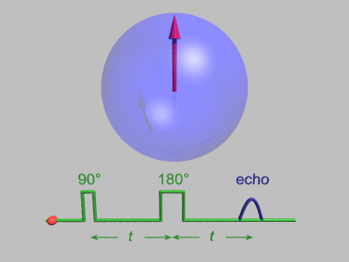
Introduction: what is an echo?
Spontaneous delayed responses following a series of pulsed excitations.
It is a universal phenomenon in both classical and quantum ensembles of nonlinear system
Most famous example: spin-echo effect discovered by Erwin Hahn in 1950
File:HahnEcho GWM.gif. (2020, September 5). Wikimedia Commons. Retrieved 00:38, December 22, 2023 from https://commons.wikimedia.org/w/index.php?title=File:HahnEcho_GWM.gif&oldid=448790781.
Notes:
In this animation, we start with a group of spins pointing up in the Bloch sphere within a vertical magnetic field.
At a certain time, a 90-degree pulse is applied to these spins, flipping them into the horizontal plane.
Due to inhomogeneity of the magnetic field, the spins begin to rotate at different speeds within the Bloch sphere. You can see the spins spread out. Consequently, the signal produced by the spins decays.
What we do next is to apply a 180-degree pulse to these spins. This pulse serves to refocus the spins, resulting in the resurgence of the signal from the spins. And that signal is our echo

Slide 4
Introduction: the past and the future
Past projects by our group members
Studied echoes in various systems: rotating and vibrating molecules, ultra-cold neutrons and atoms bouncing in gravitational traps
Our interest in prospective project with HAICU
Explore the possibility of observing echoes in trapped cold Hydrogen atoms

Slide 5
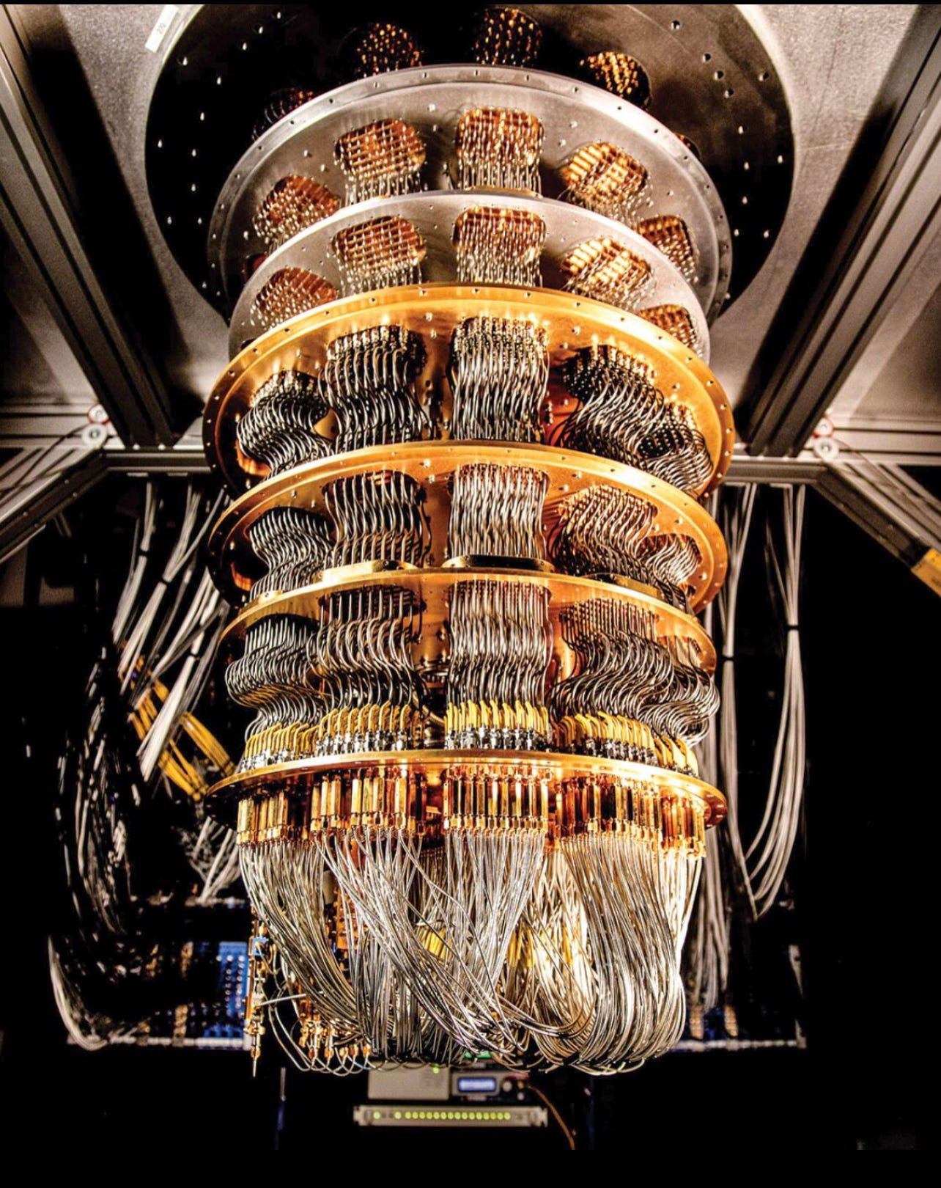
Introduction: the present
My current research project
The study of classical and quantum echoes in a driven Kerr oscillator
Kerr oscillator: quantum oscillator with fourth-power nonlinearity
Application in quantum computing
Challenge: the computational units of a quantum computer (qubits) are erroneous due to decoherence and environmental noise
Kerr-cat qubits: 1) efficient error correction with minimal hardware requirement; 2) logical qubit with exponentially reduced error

Slide 6
Introduction
System we are focusing on: Quantum echoes in Kerr-nonlinear quantum oscillators
Why do we care about this system
Big picture: application in quantum computing
The computational unit of a quantum computer, i.e. qubits, have quantum error due to decoherence and noise
Traditional way of quantum error correction (QEC) would lead to hardware overhead, because the error correction qubits also are erroneous
Solution: bosonic codes which store error-correctable quantum information in bosonic modes
Utilizes the infinite number of energy levels of a quantum harmonic oscillator
Examples: Kerr-cat qubits (papers citation)

Slide 7


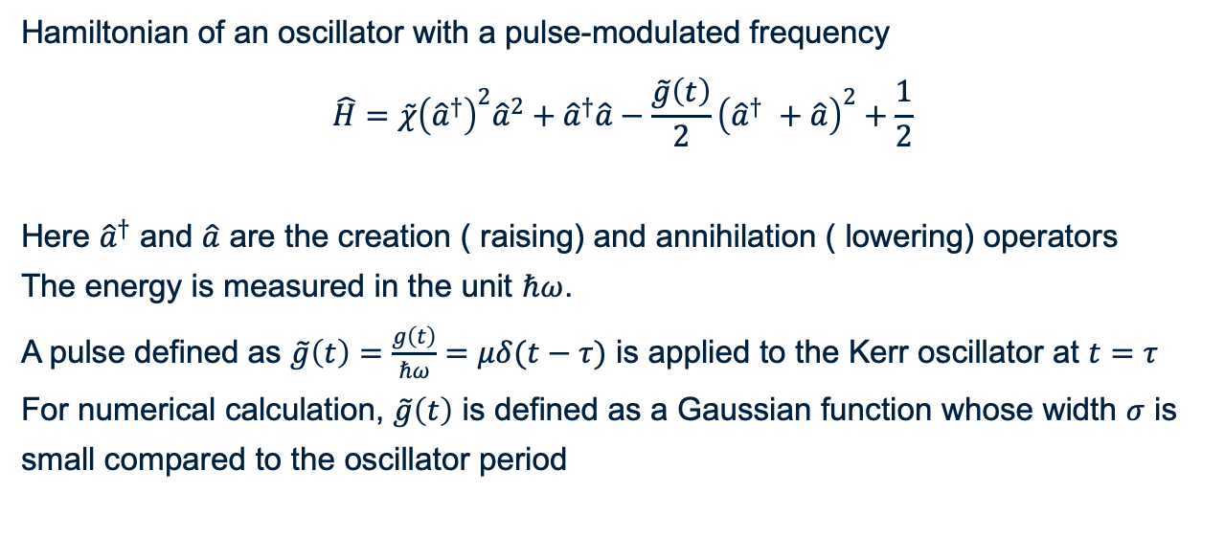
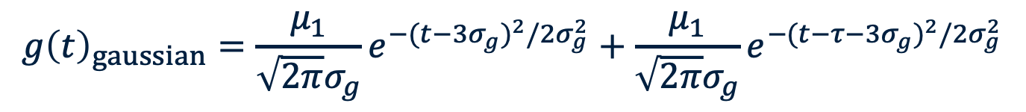
Kerr-nonlinear oscillator
Hamiltonian of an oscillator with a pulse-modulated frequency
$$\hat{H}=\tilde{χ}{\left({\hat{a}}^{†}\right)}^{2}{\hat{a}}^{2}+{\hat{a}}^{†}\hat{a}−\frac{\tilde{g}\left(t\right)}{2}{\left({\hat{a}}^{†} +\hat{a}\right)}^{2}+\frac{1}{2}$$
Here ${\hat{a}}^{†}$ and $\hat{a}$ are the creation ( raising) and annihilation ( lowering) operators
The energy is measured in the unit $ℏω$.
A pulse defined as $\tilde{g}\left(t\right)=\frac{g\left(t\right)}{ℏω}=μδ(t−τ)$ is applied to the Kerr oscillator at $t=τ$
For numerical calculation, $\tilde{g}\left(t\right)$ is defined as a Gaussian function whose width $σ$ is small compared to the oscillator period
Kerr-nonlinearity
Harmonic
$$g{\left(t\right)}_{gaussian}=\frac{μ_{1}}{\sqrt{2π}σ_{g}}e^{−{(t−3σ_{g})}^{2}/2σ_{g}^{2}}+\frac{μ_{1}}{\sqrt{2π}σ_{g}}e^{−{(t−τ−3σ_{g})}^{2}/2σ_{g}^{2}}$$

Slide 8
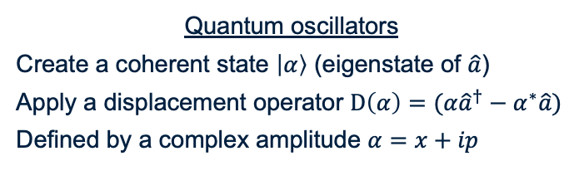



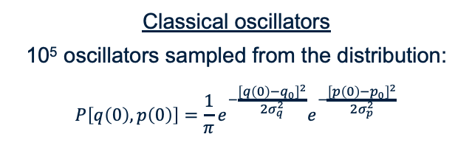

The system at $t=0$
Classical oscillators
10⁵ oscillators sampled from the distribution:
$$P\left[q\left(0\right), p\left(0\right)\right]=\frac{1}{π}e^{−\frac{{\left[q\left(0\right)−q_{0}\right]}^{2}}{2σ_{q}^{2}}}e^{−\frac{{\left[p\left(0\right)−p_{0}\right]}^{2}}{2σ_{p}^{2}}}$$
Quantum oscillators
Create a coherent state $\left|α\right\rangle$ (eigenstate of $\hat{a}$)
Apply a displacement operator $D\left(α\right)=(α{\hat{a}}^{†}−α^{∗}\hat{a})$
Defined by a complex amplitude $α=x+ip$
Phase diagram at $t=0$
Wigner function of $\left|α\right\rangle$
$$q\left(0\right)=6\sqrt{2}$$
$$p\left(0\right)=0$$
$$α=6\sqrt{2}$$
$$q\left(0\right)=6\sqrt{2}$$
$$p\left(0\right)=0$$
$$q\left(0\right)=6\sqrt{2}$$
$$p\left(0\right)=0$$

Slide 9
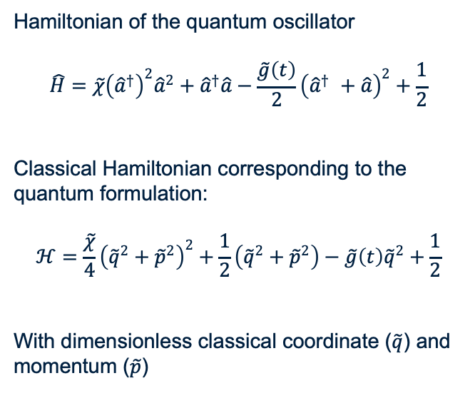
System at $t=0$
Classical oscillators
10⁵ oscillators sampled from the distribution:
$$P\left[q\left(0\right), p\left(0\right)\right]=\frac{1}{π}e^{−\frac{{\left[q\left(0\right)−q_{0}\right]}^{2}}{2σ_{q}^{2}}}e^{−\frac{{\left[p\left(0\right)−p_{0}\right]}^{2}}{2σ_{p}^{2}}}$$
Hamiltonian of the quantum oscillator
$$\hat{H}=\tilde{χ}{\left({\hat{a}}^{†}\right)}^{2}{\hat{a}}^{2}+{\hat{a}}^{†}\hat{a}−\frac{\tilde{g}\left(t\right)}{2}{\left({\hat{a}}^{†} +\hat{a}\right)}^{2}+\frac{1}{2}$$
Classical Hamiltonian corresponding to the quantum formulation:
$$ℋ=\frac{\tilde{χ}}{4}{\left({\tilde{q}}^{2}+{\tilde{p}}^{2}\right)}^{2}+\frac{1}{2}\left({\tilde{q}}^{2}+{\tilde{p}}^{2}\right)−\tilde{g}\left(t\right){\tilde{q}}^{2}+\frac{1}{2}$$
With dimensionless classical coordinate ($\tilde{q}$) and momentum ($\tilde{p}$)
Phase diagram at $t=0$
Kerr-nonlinearity
Harmonic
$$q\left(0\right)=6\sqrt{2}$$
$$p\left(0\right)=0$$

Slide 10
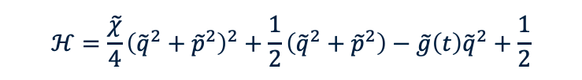
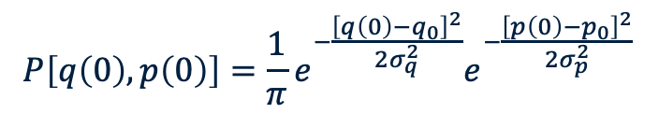
Classical Kerr-oscillator: free propagation
0
$$ℋ=\frac{\tilde{χ}}{4}{\left({\tilde{q}}^{2}+{\tilde{p}}^{2}\right)}^{2}+\frac{1}{2}\left({\tilde{q}}^{2}+{\tilde{p}}^{2}\right)−\tilde{g}\left(t\right){\tilde{q}}^{2}+\frac{1}{2}$$
$$P\left[q\left(0\right), p\left(0\right)\right]=\frac{1}{π}e^{−\frac{{\left[q\left(0\right)−q_{0}\right]}^{2}}{2σ_{q}^{2}}}e^{−\frac{{\left[p\left(0\right)−p_{0}\right]}^{2}}{2σ_{p}^{2}}}$$
Notes:
animation

Slide 11


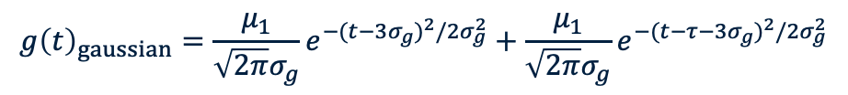

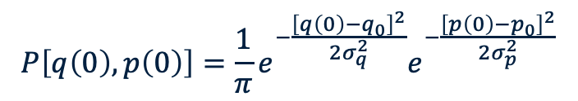


Classical Kerr-oscillator: Kicked
$$ℋ=\frac{\tilde{χ}}{4}{\left({\tilde{q}}^{2}+{\tilde{p}}^{2}\right)}^{2}+\frac{1}{2}\left({\tilde{q}}^{2}+{\tilde{p}}^{2}\right)−\tilde{g}\left(t\right){\tilde{q}}^{2}+\frac{1}{2}$$
$$\tilde{g}\left(t\right)=\frac{g\left(t\right)}{ℏω}=μδ(t−τ)$$
Echo $t=2τ$
Echo $t=4τ$
Echo $t=6τ$
Pulse applied at $t=τ=0.5$
$$P\left[q\left(0\right), p\left(0\right)\right]=\frac{1}{π}e^{−\frac{{\left[q\left(0\right)−q_{0}\right]}^{2}}{2σ_{q}^{2}}}e^{−\frac{{\left[p\left(0\right)−p_{0}\right]}^{2}}{2σ_{p}^{2}}}$$
$$g{\left(t\right)}_{gaussian}=\frac{μ_{1}}{\sqrt{2π}σ_{g}}e^{−{(t−3σ_{g})}^{2}/2σ_{g}^{2}}+\frac{μ_{1}}{\sqrt{2π}σ_{g}}e^{−{(t−τ−3σ_{g})}^{2}/2σ_{g}^{2}}$$
Notes:
animation

Slide 12
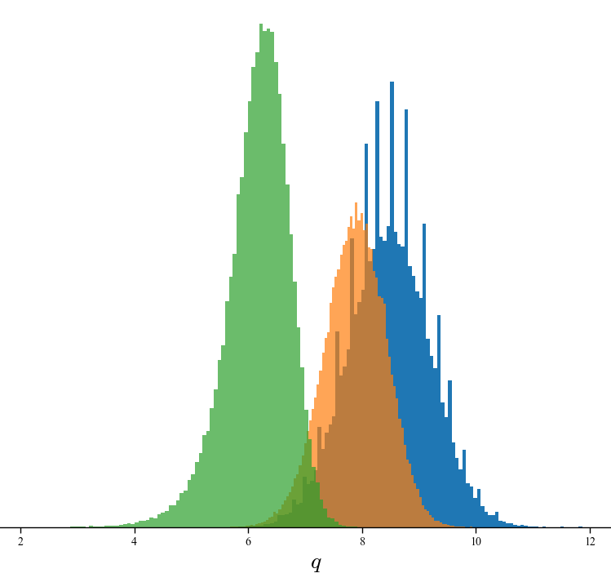



Classical oscillator: squeezing ( $0≤t≤t+Δ$ )
Squeezed coherent state
$$t=0$$
$$t=0.005$$
$$t=0.01$$

Slide 13

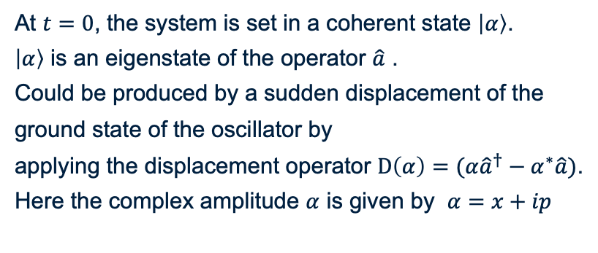


Quantum Kerr oscillator
$$\hat{H}=\tilde{χ}{\left({\hat{a}}^{†}\right)}^{2}{\hat{a}}^{2}+{\hat{a}}^{†}\hat{a}−\frac{\tilde{g}\left(t\right)}{2}{\left({\hat{a}}^{†} +\hat{a}\right)}^{2}+\frac{1}{2}$$
Wigner function of $\left|α\right\rangle$ at $t=0$
At $t=0$, the system is set in a coherent state $\left|α\right\rangle$.
$\left|α\right\rangle$ is an eigenstate of the operator $\hat{a}$ .
Could be produced by a sudden displacement of the ground state of the oscillator by
applying the displacement operator $D\left(α\right)=(α{\hat{a}}^{†}−α^{∗}\hat{a})$.
Here the complex amplitude $α$ is given by $α=x+ip$
$$α=6\sqrt{2}$$

Slide 14

Quantum Kerr oscillator: free propagation
$$\hat{H}=\tilde{χ}{\left({\hat{a}}^{†}\right)}^{2}{\hat{a}}^{2}+{\hat{a}}^{†}\hat{a}−\frac{\tilde{g}\left(t\right)}{2}{\left({\hat{a}}^{†} +\hat{a}\right)}^{2}+\frac{1}{2}$$
0
Notes:
If we allow the coherent state to freely propagate in this Kerr oscillator potential, the coherent state doesn’t preserve. The average position of the oscillator spreads and washes out, so that the average position is at zero, until when time equals to pi, where we have a resurgence of signal and half-revival time.

Slide 15


Quantum Kerr oscillator: kicked
$$\hat{H}=\tilde{χ}{\left({\hat{a}}^{†}\right)}^{2}{\hat{a}}^{2}+{\hat{a}}^{†}\hat{a}−\frac{\tilde{g}\left(t\right)}{2}{\left({\hat{a}}^{†} +\hat{a}\right)}^{2}+\frac{1}{2}$$
Echo
Half Revival
Half Revival
Echo
Echo
Echo
Squeezing
Pulse
$$τ=0.5$$
Pulse
$$τ=0.5$$

Slide 16






Quantum oscillator: squeezing
Squeezed coherent state
$t=0$: $|α⟩$ saturates the uncertainty relation $ΔxΔp≥\frac{ℏ}{2}$
Symmetric distribution of the operators uncertainties
$t=δ$: squeezed state $Δx^{′}<Δx_{g}$ and $Δp^{′}>Δp_{g}$
$$Δx_{g}=Δp_{g}=\sqrt{ℏ/2}$$
$Δx^{′}<Δx_{g}$
$$Δp^{′}>Δp_{g}$$
Var($x$)
$$⟨x⟩$$
$Δx^{′}<Δx_{g}$
$$Δp^{′}>Δp_{g}$$
Notes:
Symmetric distribution of the operator uncertainties:

Slide 17
Free propagation (no pulse)
Echo with squeeze (pulse @ $t=τ=0.5)$

Slide 18


$$t=0$$
$$t=0$$
Free propagation (no pulse)
Echo with squeezing (pulse @ $t=τ=0.5)$

Slide 19


$$t=0.53$$
$$t=0.53$$
Free propagation (no pulse)
Echo with squeeze (pulse @ $t=τ=0.5)$

Slide 20


$$t=\frac{π}{3}$$
$$t=\frac{π}{3}$$
Free propagation (no pulse)
Echo with squeeze (pulse @ $t=τ=0.5)$

Slide 21


$$t=\frac{π}{2}$$
$$t=\frac{π}{2}$$
Free propagation (no pulse)
Echo with squeeze (pulse @ $t=τ=0.5)$

Slide 22


$$t=\frac{5π}{6}$$
$$t=\frac{5π}{6}$$
Free propagation (no pulse)
Echo with squeeze (pulse @ $t=τ=0.5)$

Slide 23


$$t=π$$
$$t=π$$
Free propagation (no pulse)
Echo with squeeze (pulse @ $t=τ=0.5)$

Slide 24
Relating this work to the HAICU project
Objective: exploring the prospects of observing echoes in the HAICU trap
Parameters of the trap
    What is the non-linear potential for the HAICU system?
    How many quantum levels are supported by the potential of the trap?
    Is the system classical or quantum?
Perturbation
    How could the kicking perturbation be applied in the trap?
    What are the time scales? → the duration of the pulse has to be small compare to the period of oscillation
Echo detection
    What can be measured to detect echo?

