Slide 1
Overall schematic

Slide 3
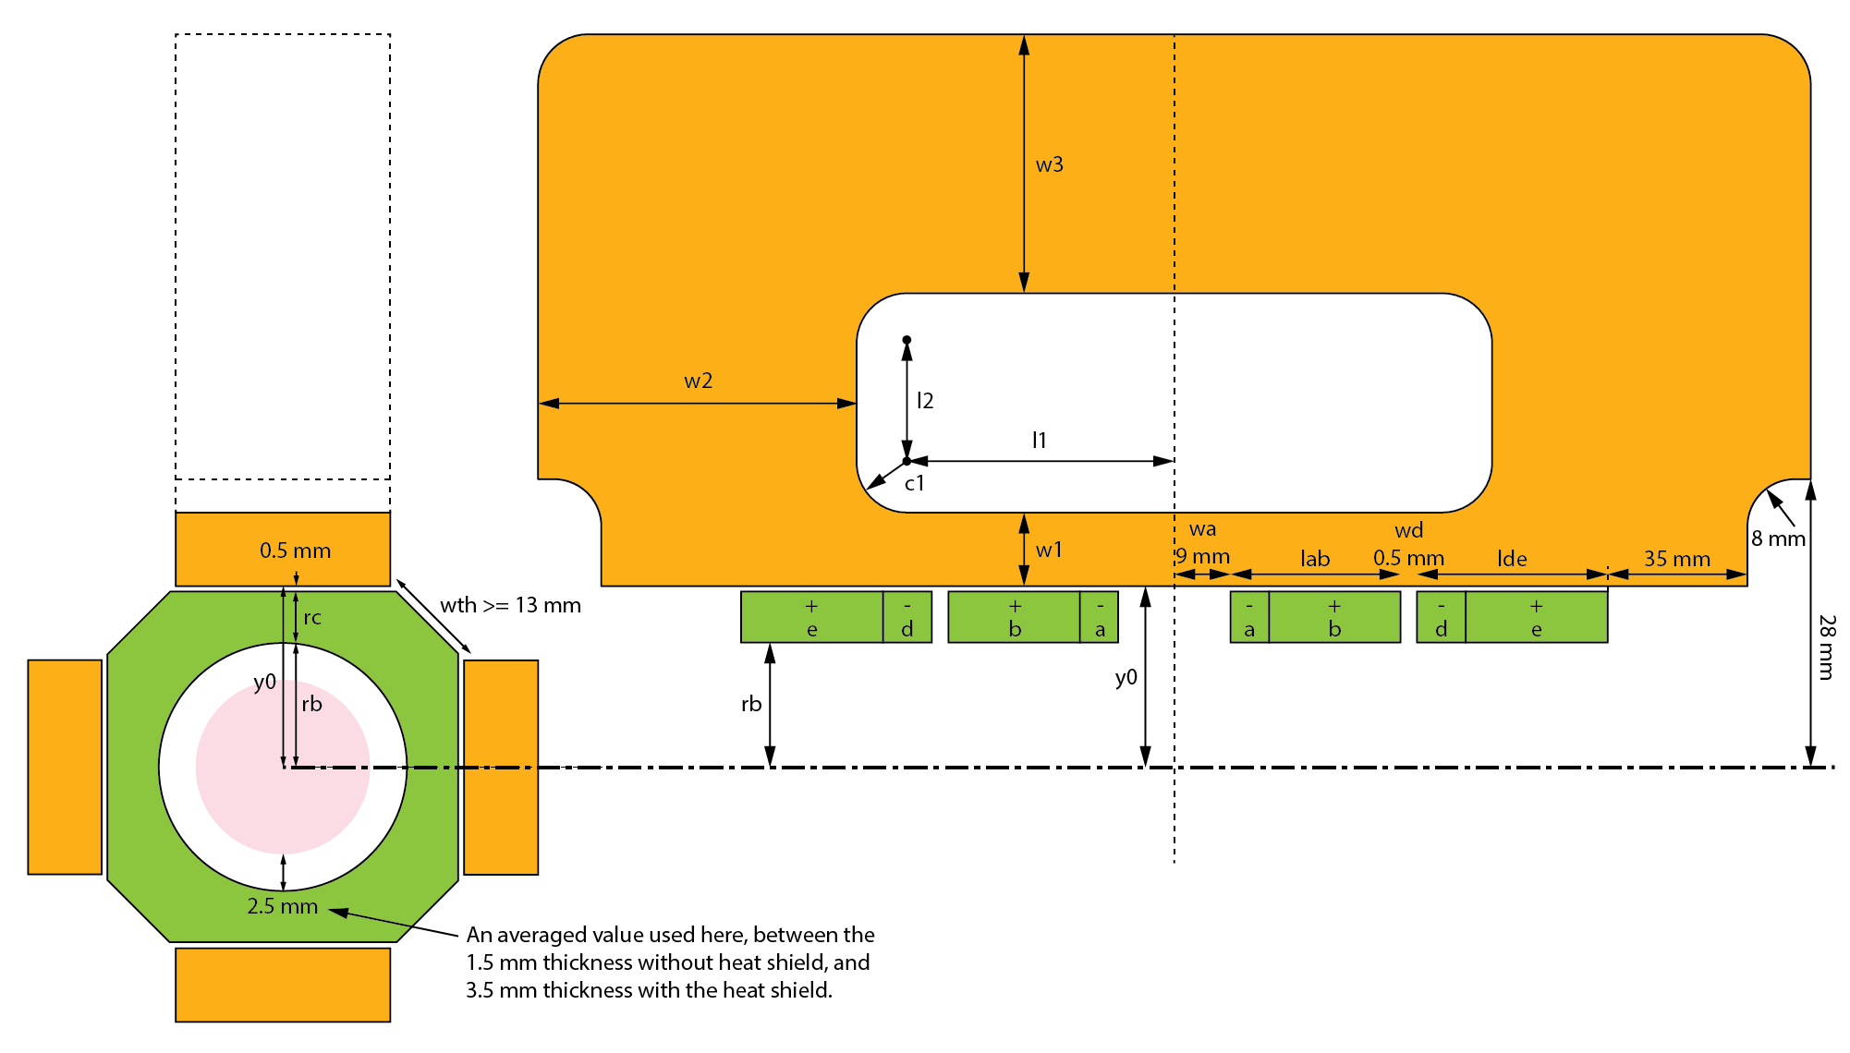
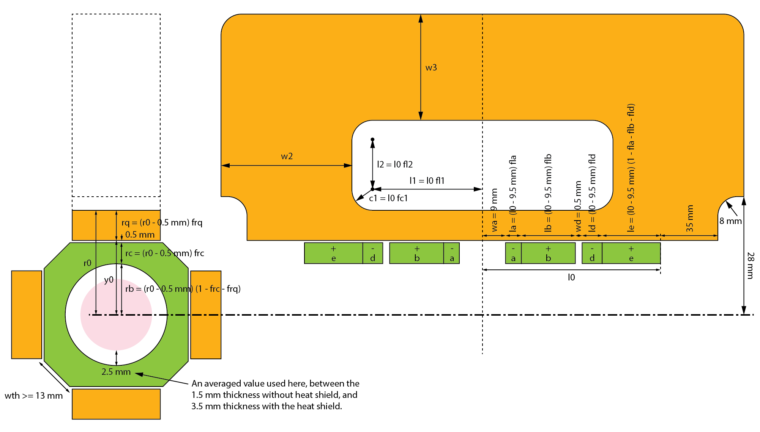
Magnetic trap, continuum model
Non-integer turns
No limit on copper sheet gauges
Non-integer number of coolant holes
v19 to v20: re-scaling some parameters

Slide 4
Optimisation using simplex search

Slide 5
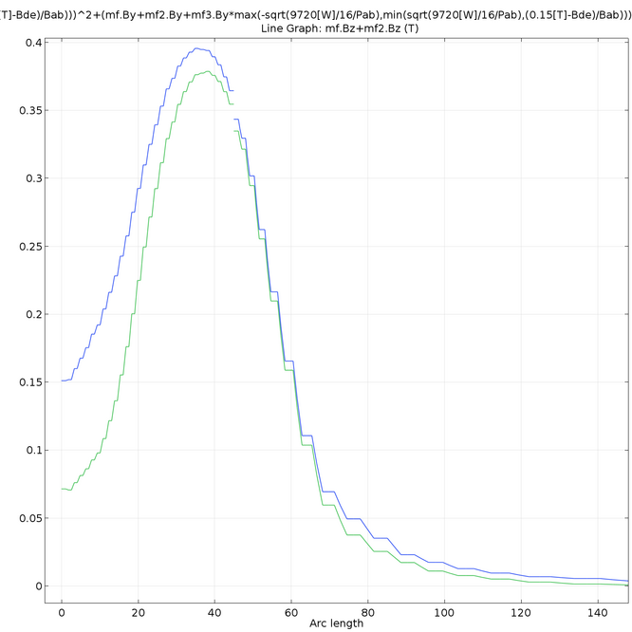

Slide 6
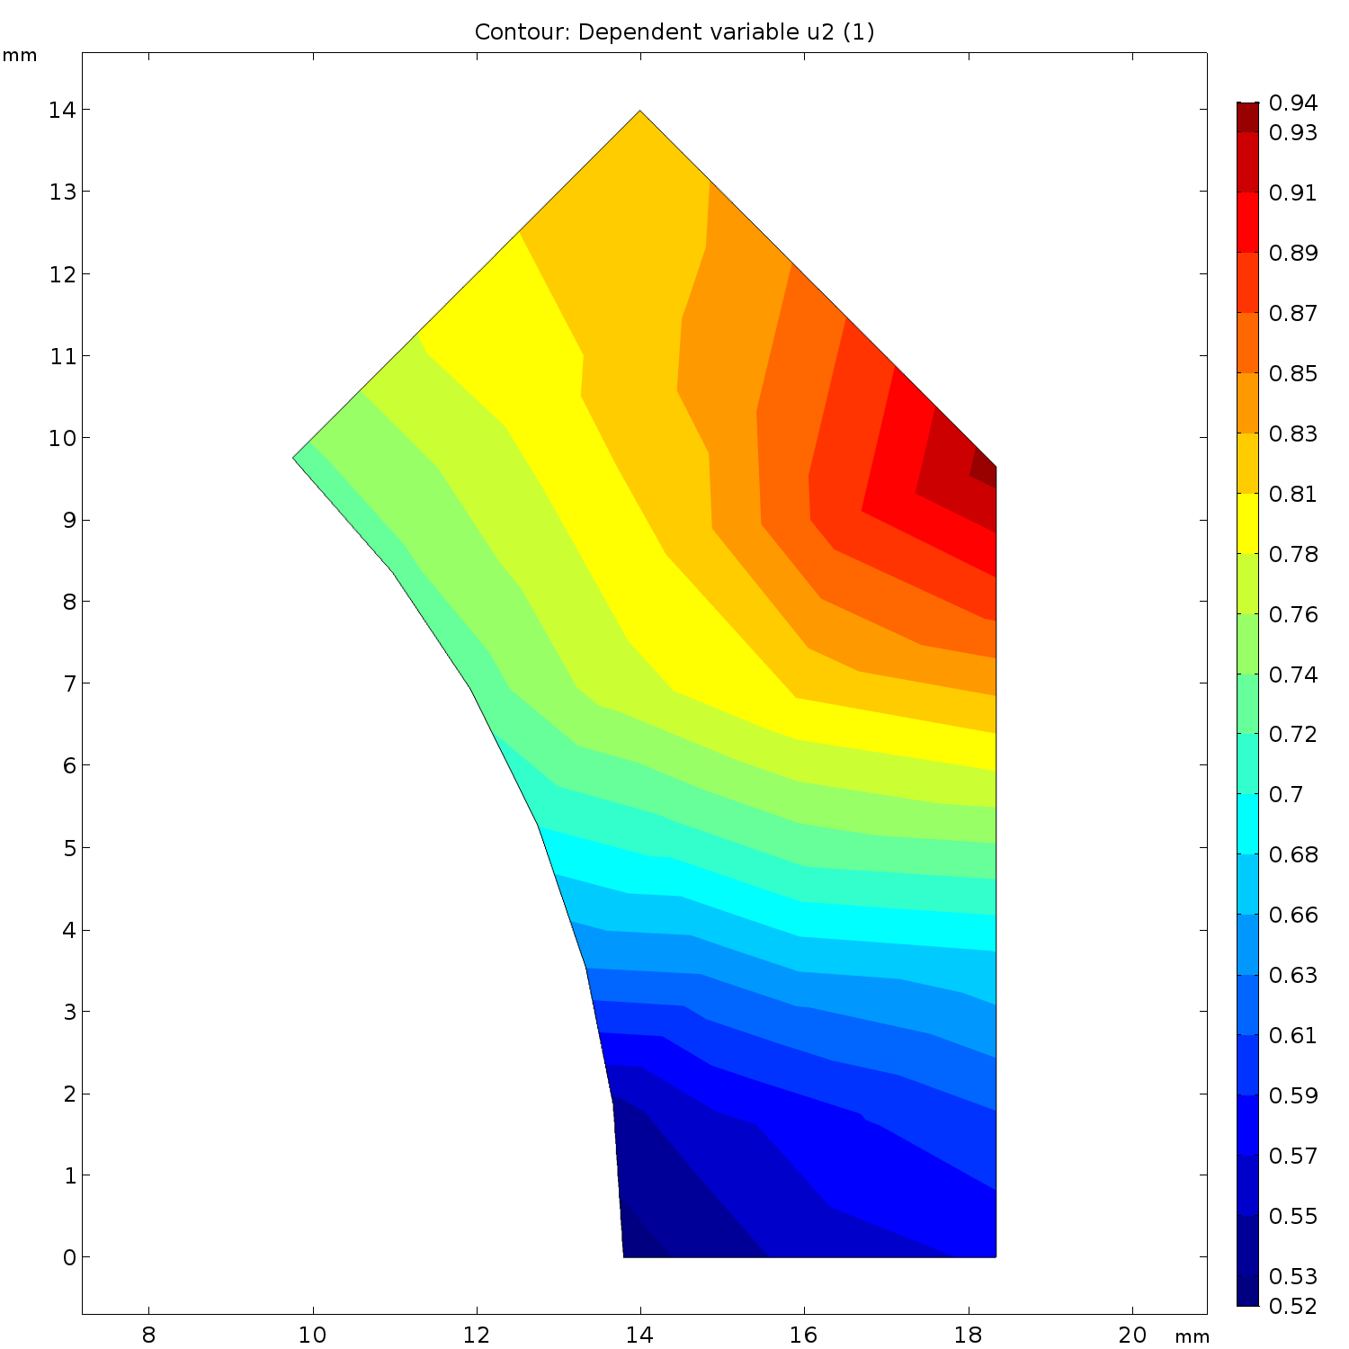

Slide 7
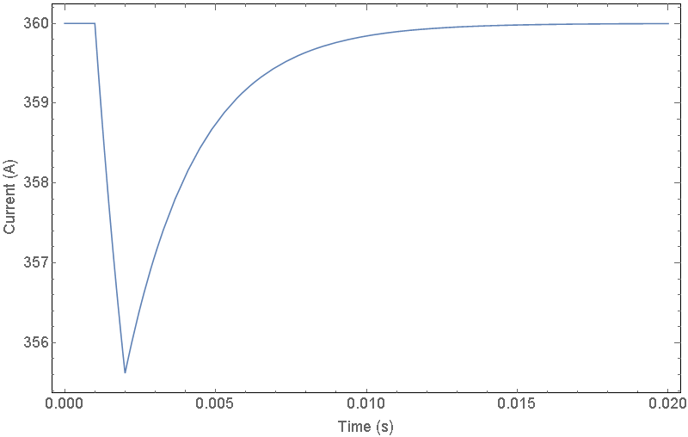
Limiting induced voltage
Depends on the Sorensen
Right: 0.3 V induced voltage, assumes constant voltage from the Sorensen, no attempt to correct current deviation

Slide 8
Discretising the continuum model
Imperfect match due to limited copper sheet gauges and integer number of turns
Quadrupole: 0.040” copper, 0.003” Kapton, 18 turns
Gate coil: 0.016” copper x 2, 0.003” Kapton, 4+40 turns
Booster coil: 0.012” copper x 2, 0.003” Kapton, 1+6 turns
Still able to retain most of the trap depth
Issue: Booster coil is more power-dense than the gate coil, but both share the same coolant hole pattern
In the process of fixing this, re-running optimisation

Slide 11
Coolant hole placing
Bernoulli equation with frictional loss:
Input: a 1/16" diameter, 166.8332 mm long coolant hole subject to 30 psi of pressure difference
Output: flow speed = 8.027 m/s
Turbulent flow simulation:
Input: a 1/16" diameter, 166.8332 mm long coolant hole, inlet temperature of 30 degC, wall temperature of 50 degC along a 106.8332 mm section
Output: power removed = 380.6025 W
Comsol 2D electrical + thermal sim
Input: 6 coolant holes per 45 degrees, each coolant hole removes 380.6025 W / 2.5 = 152.241 W (safety factor of 2.5), 9 V / 44 turns / 8 sectors voltage difference applied across the simulation domain
Output: 369.388 A current per 0.032" thickness, which is higher than the required 360 A.

Slide 12
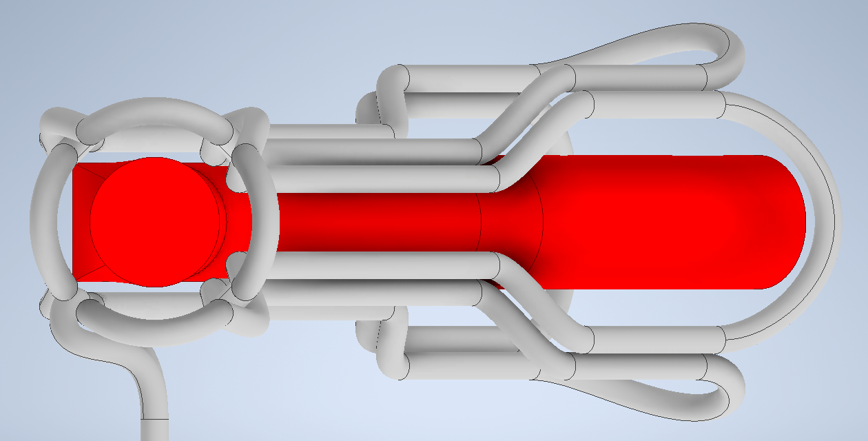
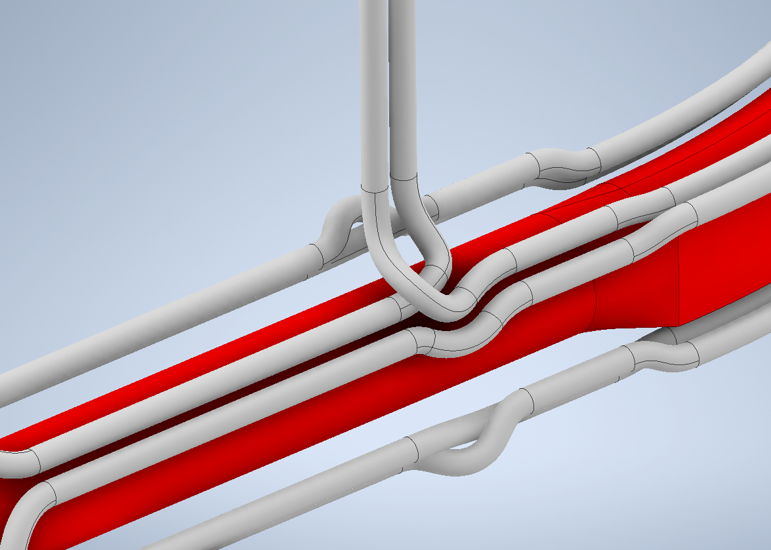

Slide 13
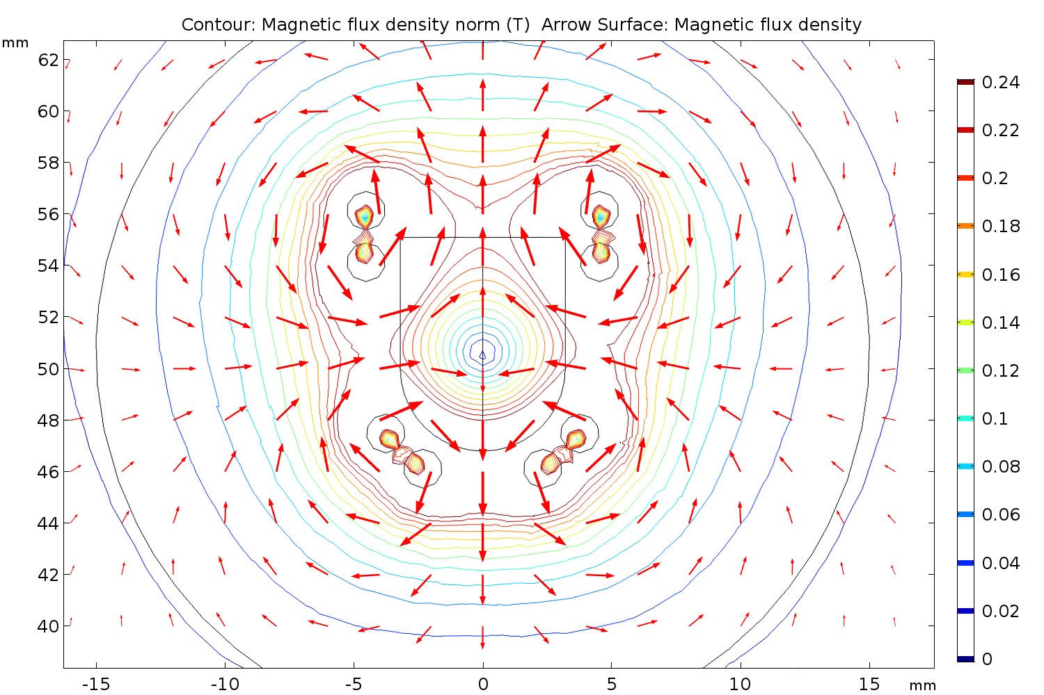

Slide 14
