Slide 1
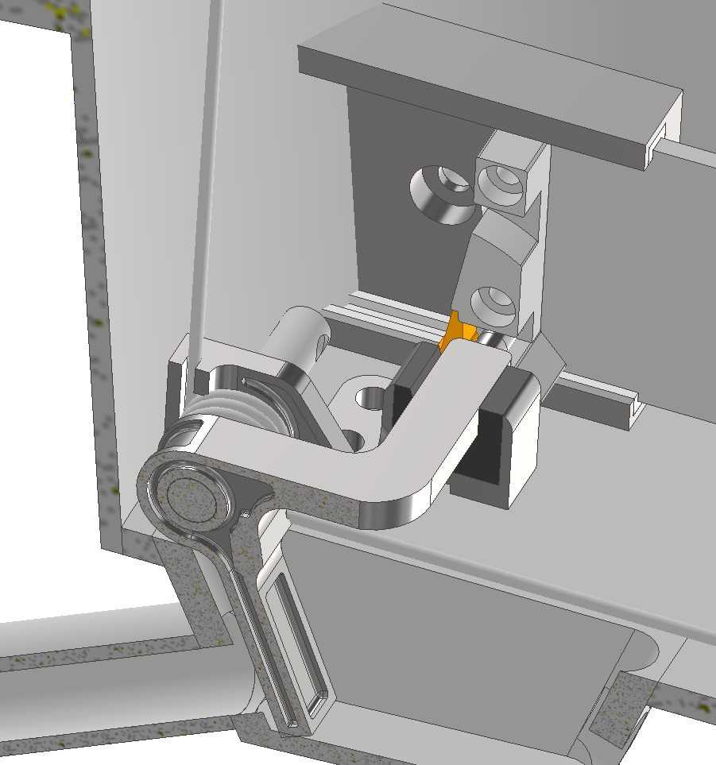
Fast-Closing Shutter for Particle Decelerator
Motivation: Improve the vacuum quality in the HAICU trap by preventing gas from off-gassing in the decelerator from entering
Design: A spring actuated fast-closing (<10 ms) shutter at the bender before the trap to be triggered after particles pass through the bender
Shutter design, installed at the last bender

Slide 2
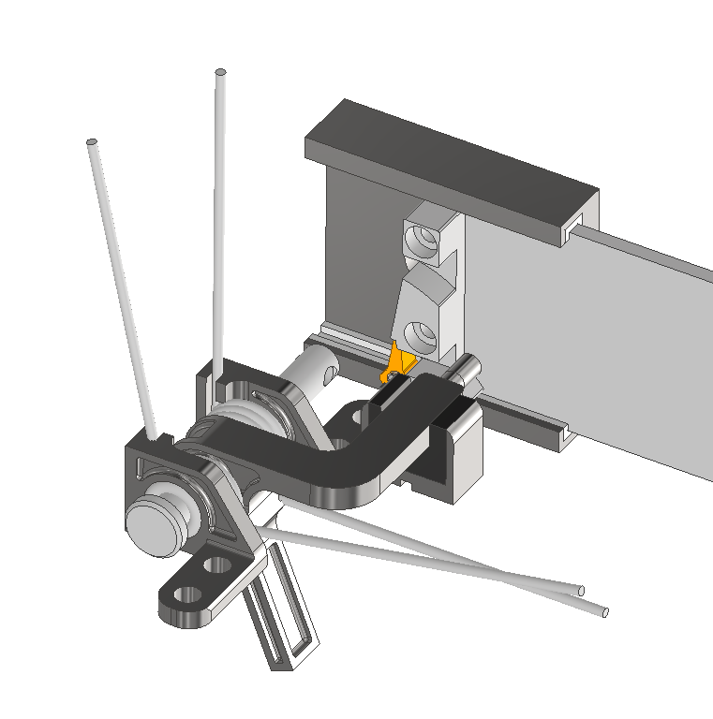
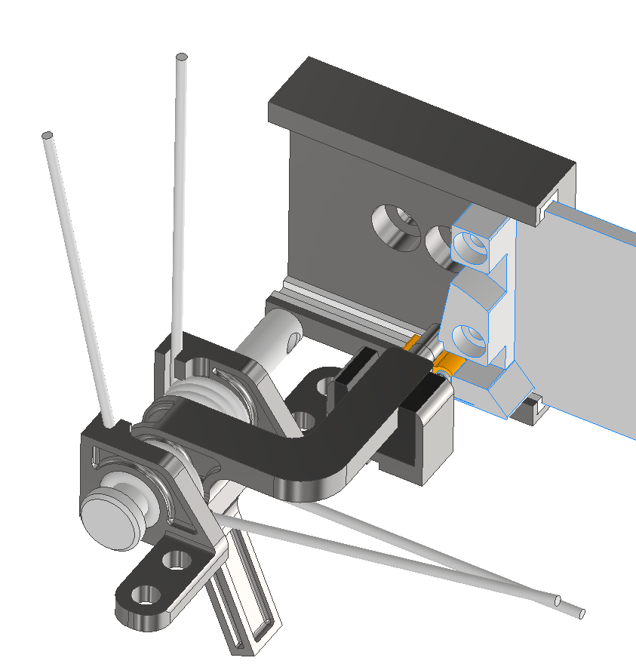
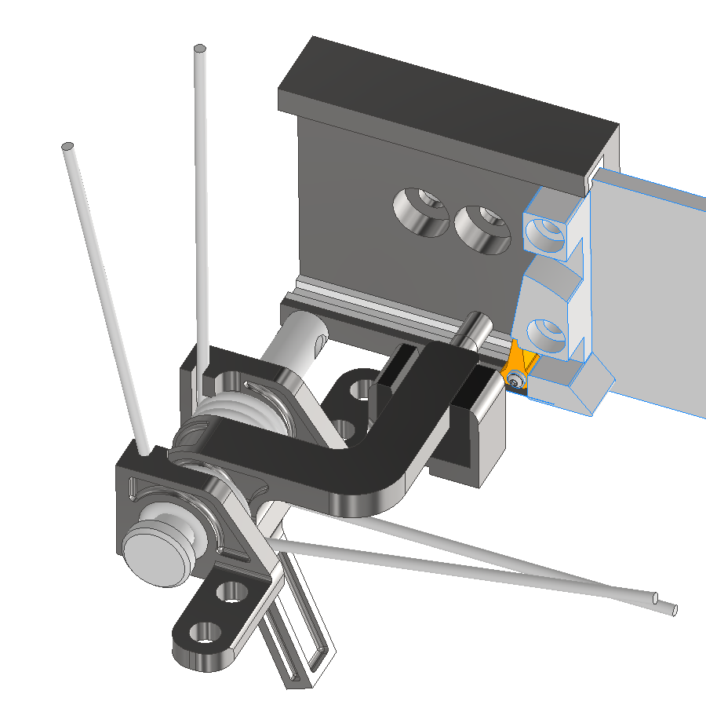
Fast-Closing Shutter for Particle Decelerator
Valve Motion: Resetting
1
Closed Valve
2
Valve Resetting, 1-way door opened
3
Valve Reset, ready to open

Slide 3
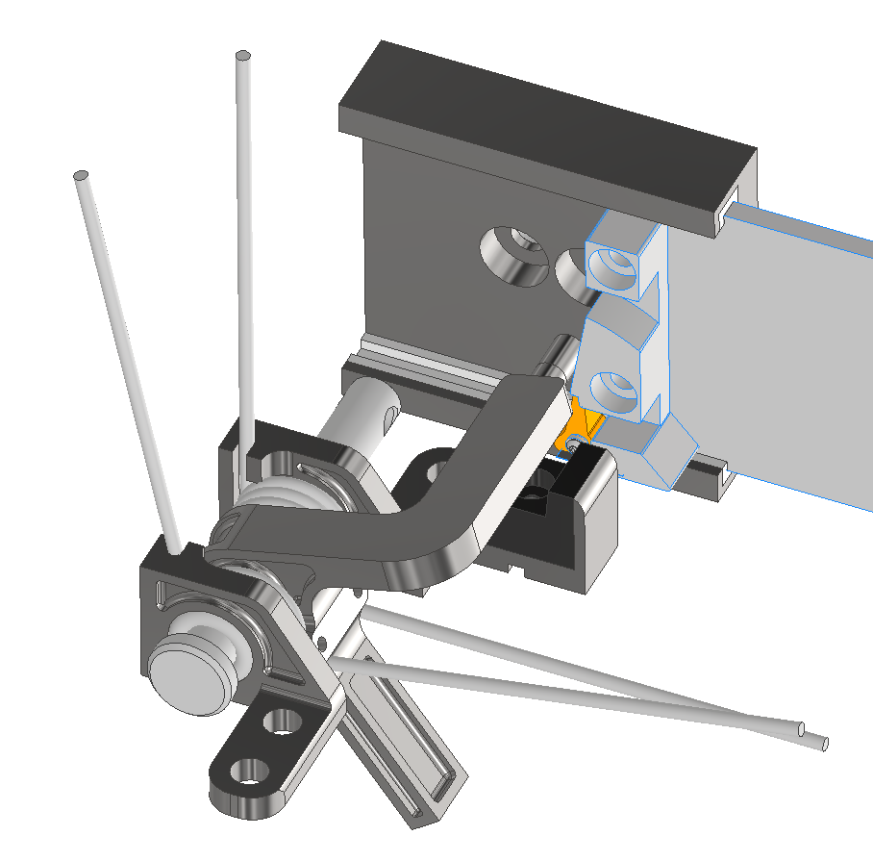
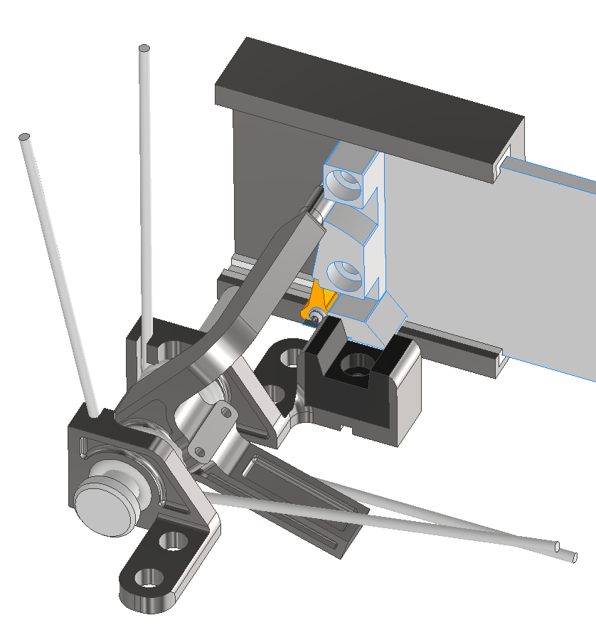
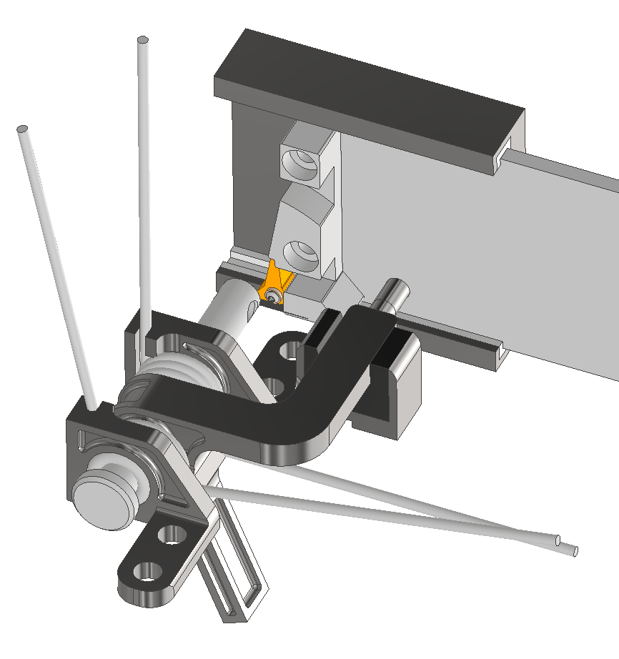
Fast-Closing Shutter for Particle Decelerator
Valve Motion: Opening & Closing
4
5
Valve Opened (70° max. rotation)
6
Valve Opening
Valve closed rapidly by spring tension

Slide 4
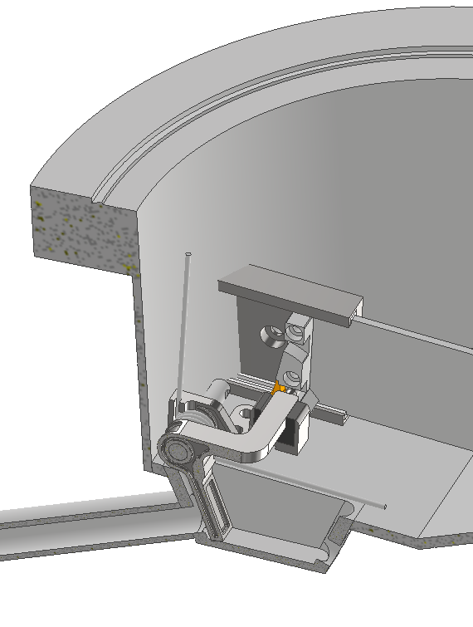
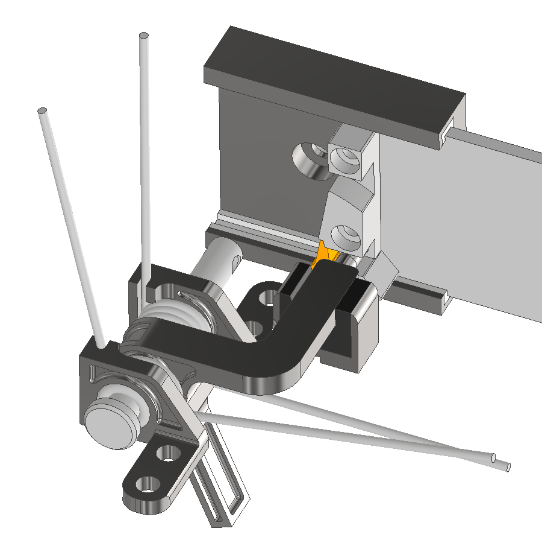
Fast-Closing Shutter for Particle Decelerator
Shutter Details:
PEEK Bushings at Rotating Parts
Viton Dampener
3D Printed SS316 Parts
Installed Shutter

Slide 5
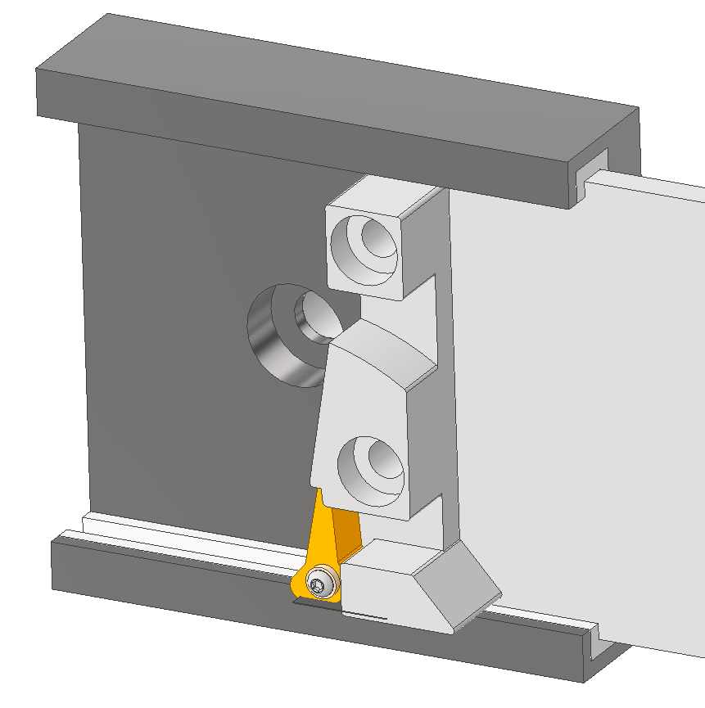
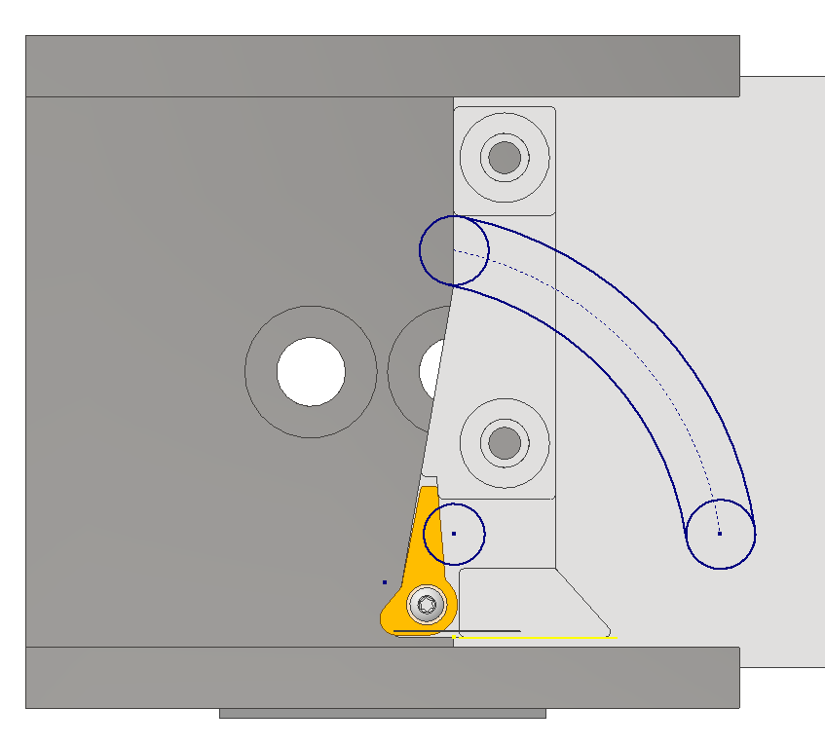
Fast-Closing Shutter for Particle Decelerator
Actuator Details:
PEEK Bushing
One-Way Door, Tensioned Closed
Shutter Pin-Path through the actuator

Slide 6
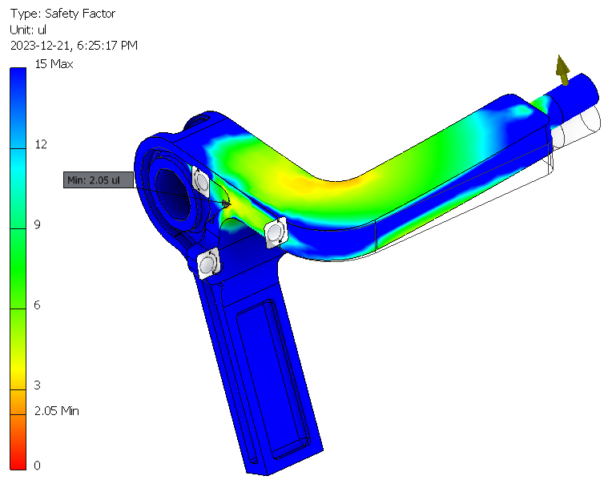
Fast-Closing Shutter for Particle Decelerator
Design Considerations
Many space constraints – off-the-shelf fast-closing valves are not suitable
FEA & hand calculations to validate shutter strength
Designed for UHV
UHV Compatible Materials (SS316, Viton, PEEK)
PEEK Bushings to prevent cold-welding of moving parts
No closed volumes
Next Steps:
Order 3D printed metal parts for benching testing
Shutter FEA Results, 50 N

