Slide 1
Neutrinoless Double Beta Decay Searches
Aksel Hallin
Victoria, BC
May, 2019

Slide 2
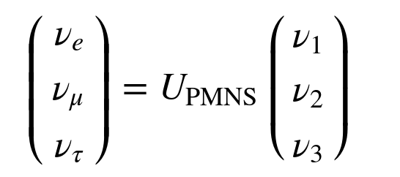
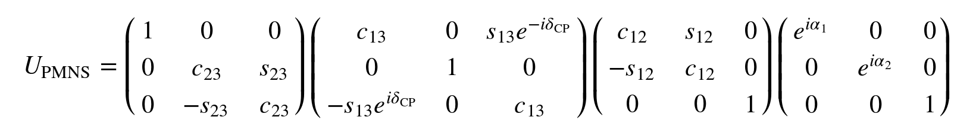
Neutrino Oscillations
Pontecorvo-Maki-Nakagawa-Sakata Matrix

Slide 3
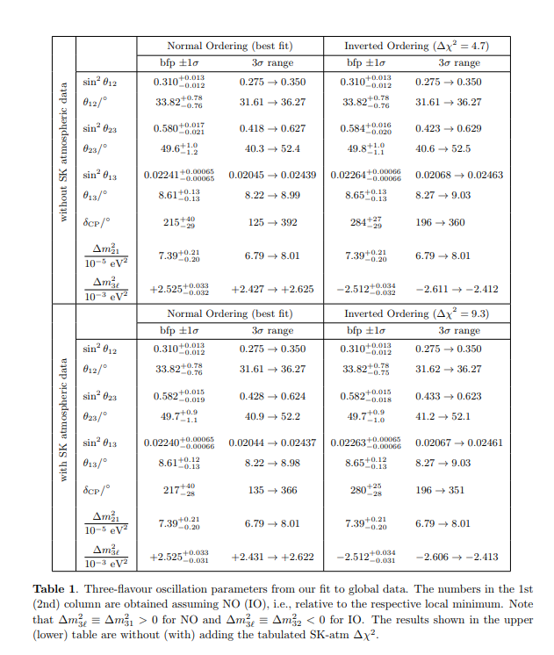
Esteban, Gonzalez-Garcia, Hernandez-Cabezudo, Maltoni and Schwetz JHEP 01(2019) 106

Slide 4
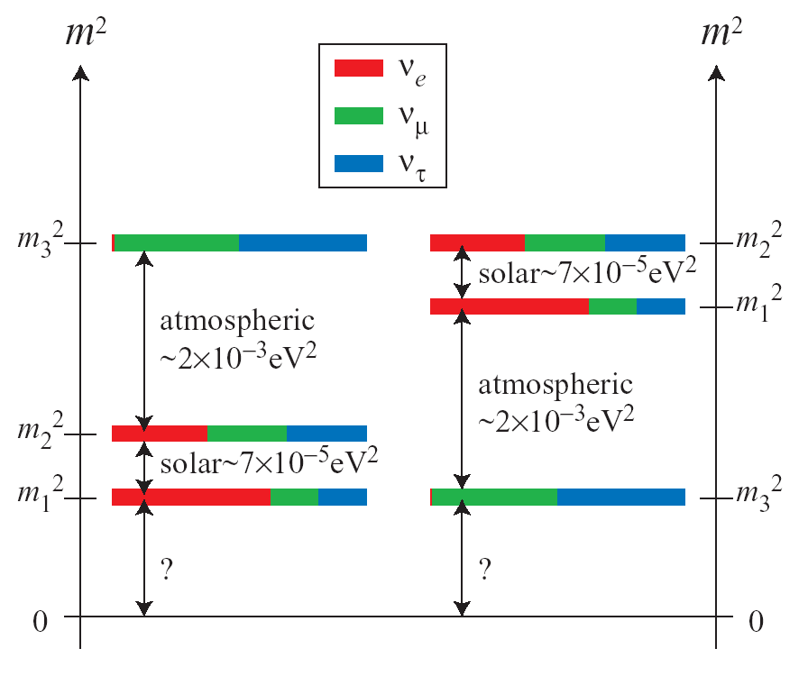
What we don’t know
Absolute masses
Value δ_{CP}?
CP Violation in Neutrino Sector?
Leptogenesis & Matter-Antimatter
Asymmetry in the Universe?
Are Neutrinos their own Antiparticles?
Neutrinoless double beta decay provides input to several of these questions...

Slide 5
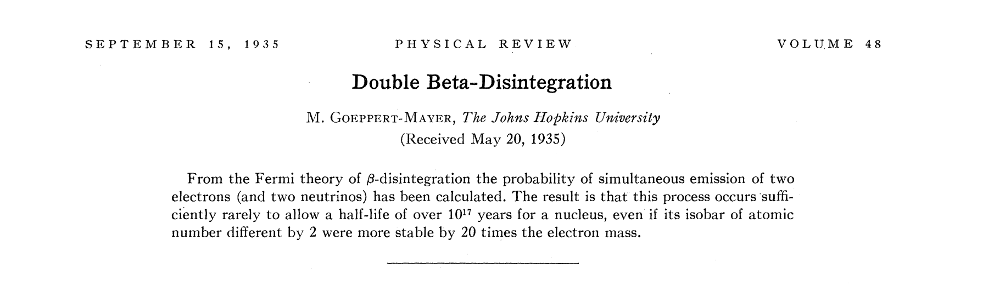
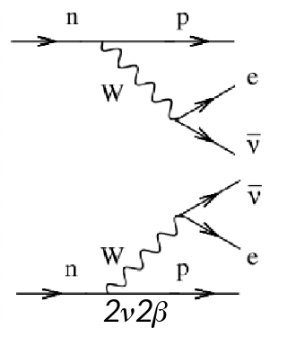

Double Beta Decay:

Slide 6
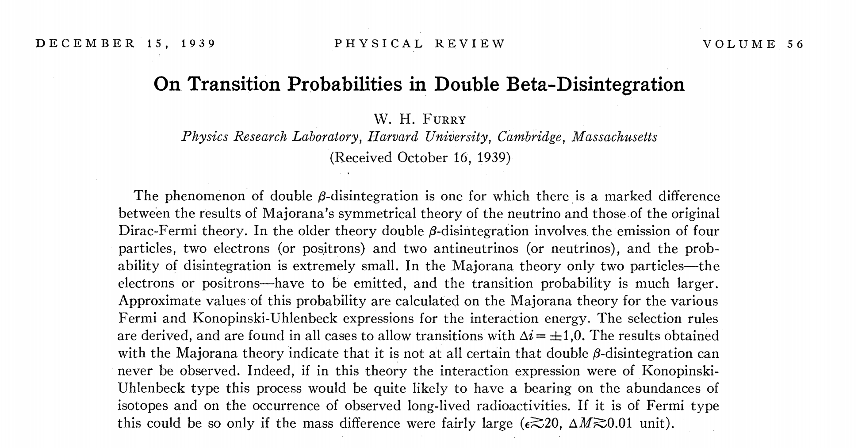
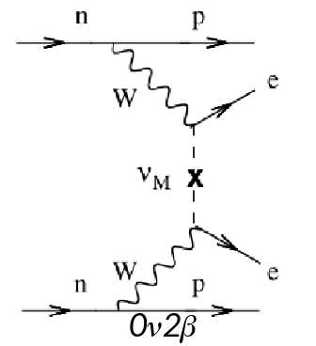

Neutrinoless Double Beta-Decay

Slide 7
Physicists are poor at communicating to the public!
“Search for neutrinoless double beta decay”
“Search for creation of matter”
“Search for reactions with matter/antimatter asymmetry”

Slide 8
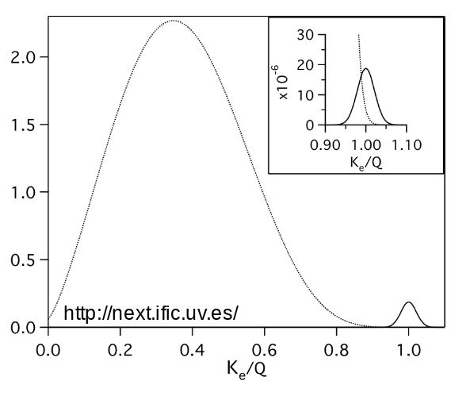
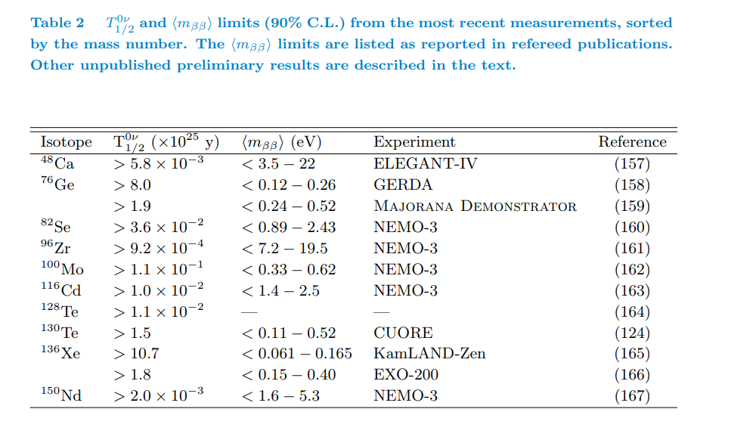
Experimental Signature and current limits
Dolinski, Poon, Rodejohann arXiv 1902.04097

Slide 9
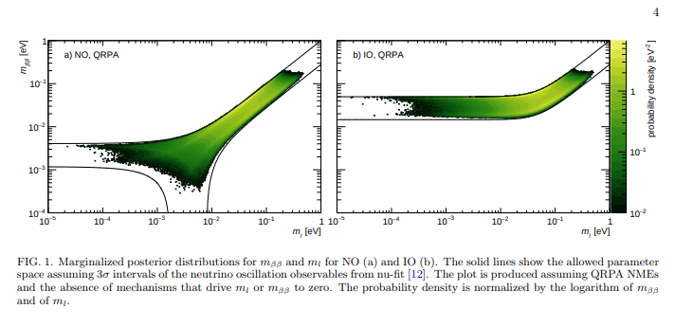
Where we are
Need two orders of magnitude in effective neutrino mass=4 orders of magnitude in detector FV!

Slide 10
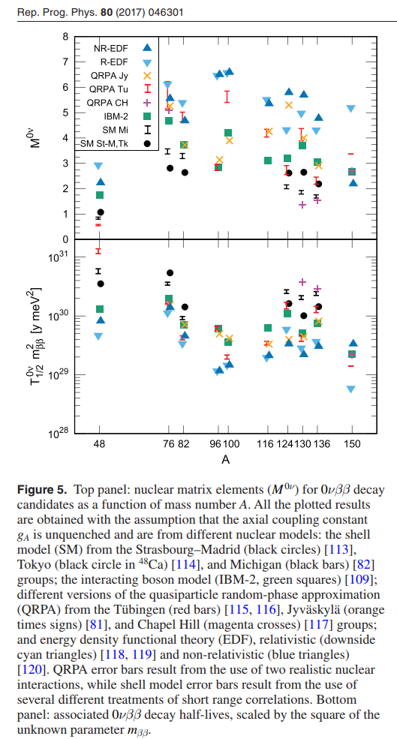
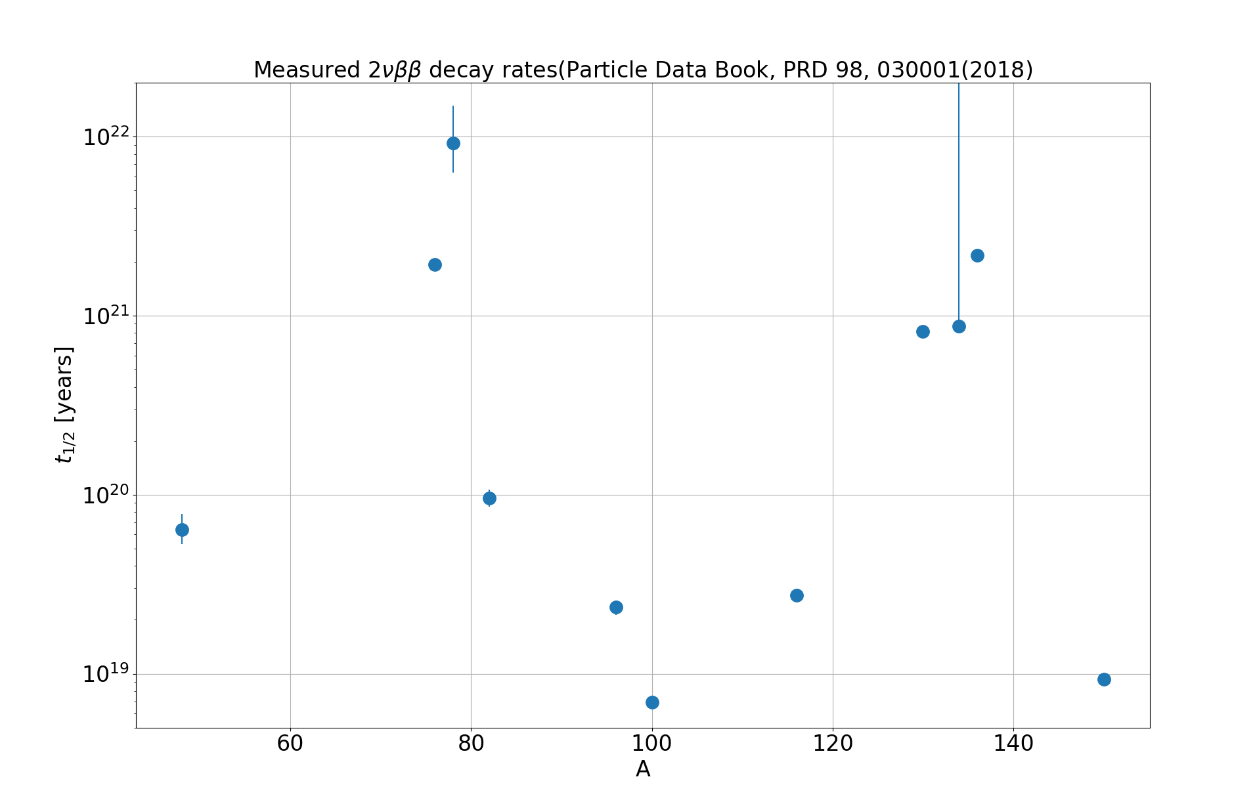
Nuclear matrix elements
Engel and Menendez
Largely nuclear theory required to improve things
Argues for multiple experiments with different isotopes

Slide 11
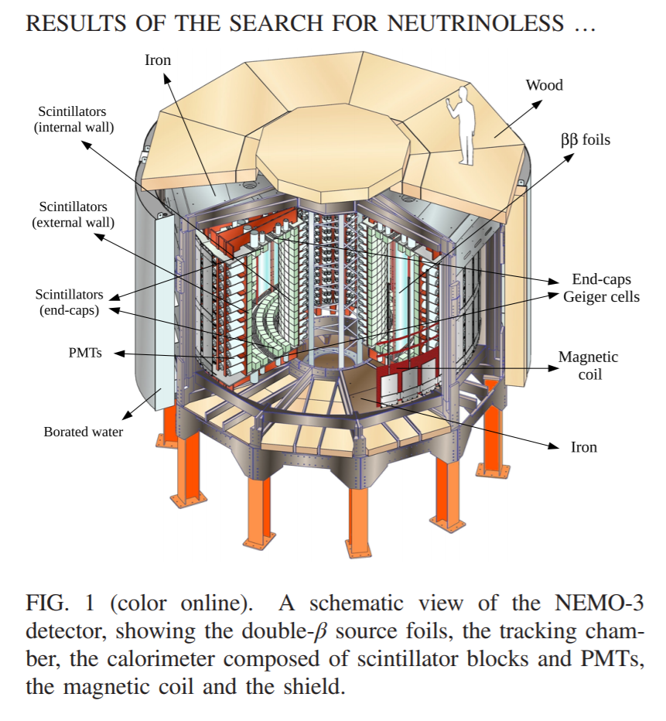
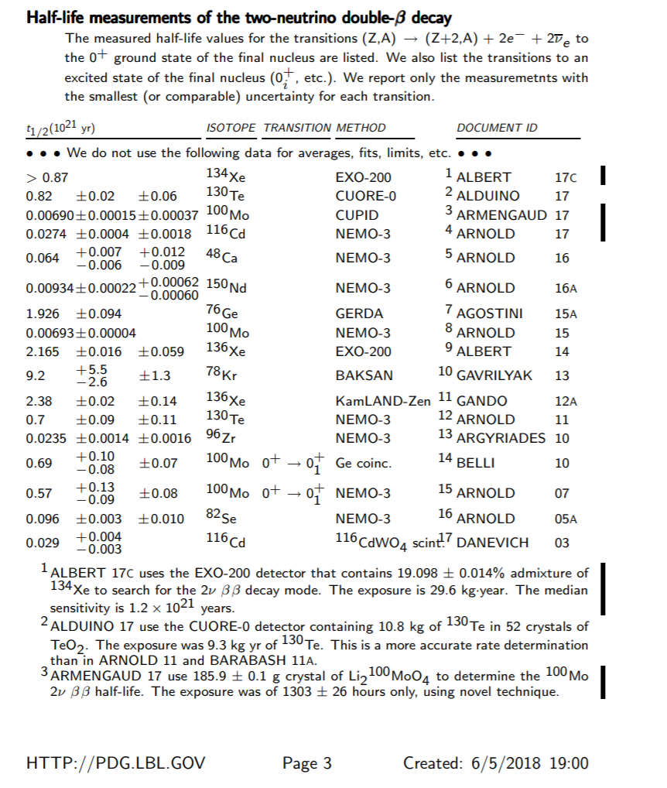
NEMO-3 Tracking detector

Slide 12
Background/kg also needs to be reduced by 10000
Personal opinion: A complete and demonstrable background model is the single most important measure of the believability of a result. You want to show you understand backgrounds at all energies and all positions.
Big steps in background rejection have come from a variety of techniques, including materials selection/chemistry, processing techniques, detector innovations, and data processing/analysis/particle identification.

Slide 13
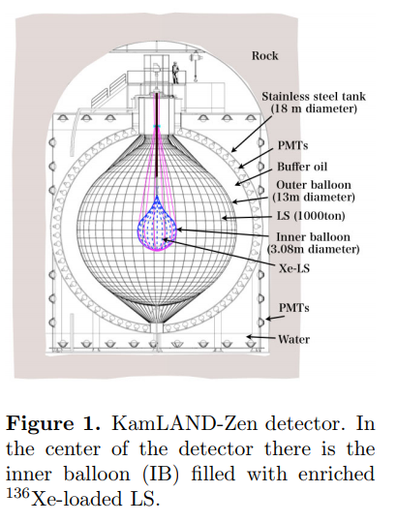
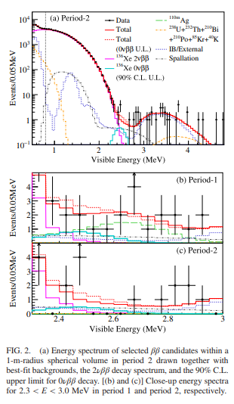
Large Liquid Scintillator Detectors: Kamland-Zen and SNO+
Kamland-Zen is the most
sensitive experiment with
half-life> 1.07 x 10²⁶ y.
But because of my personal
Connections I will concentrate
on SNO+...

Slide 14
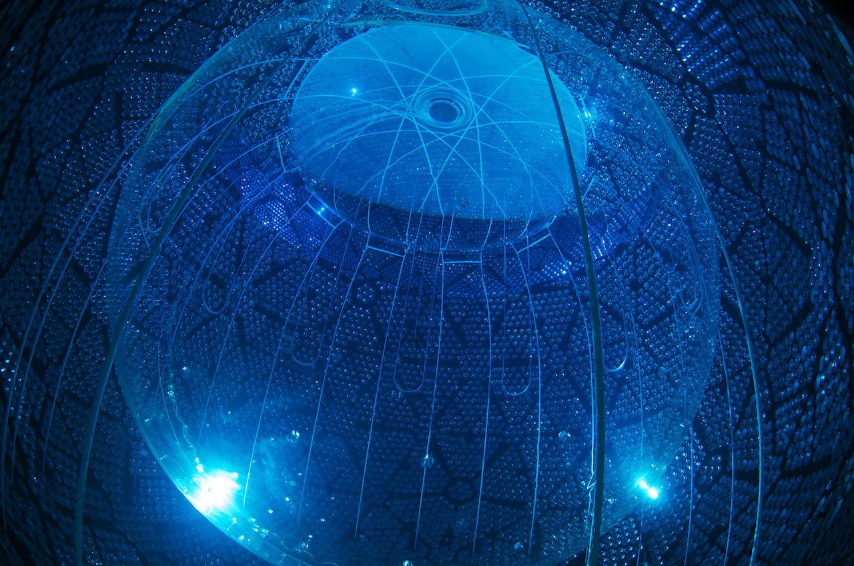
SNO+

Slide 15
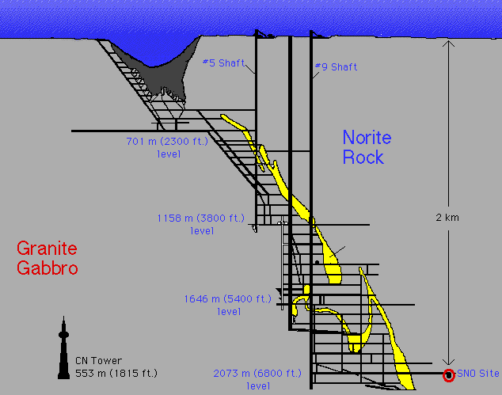
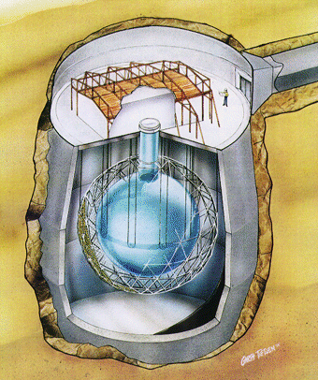
SNO
1000 tonnes D₂O
Support Structure for 9500 PMTs, 60% coverage
12 m Diameter Acrylic Vessel
1700 tonnes Inner Shielding H₂O
5300 tonnes Outer Shield H₂O
Urylon Liner and Radon Seal

Slide 16
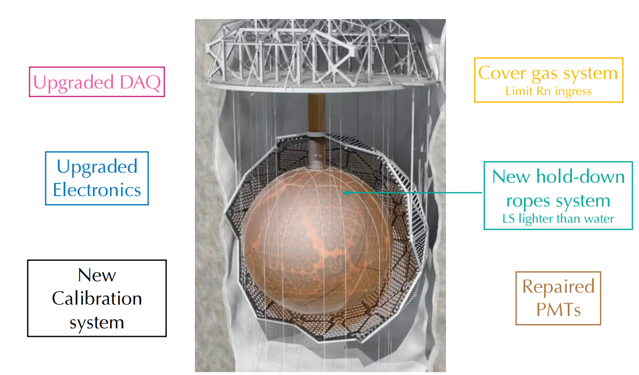
Repair Cavity Liner
^{Underwater Cameras}

Slide 17
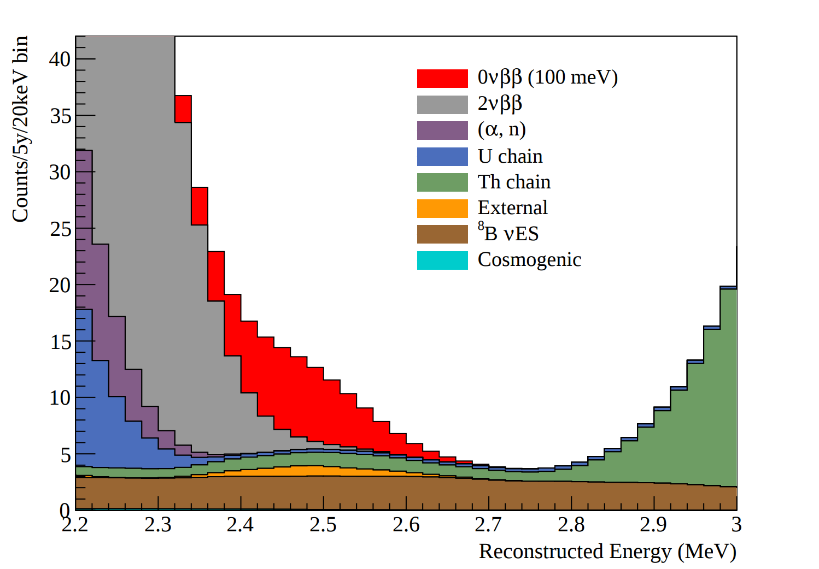
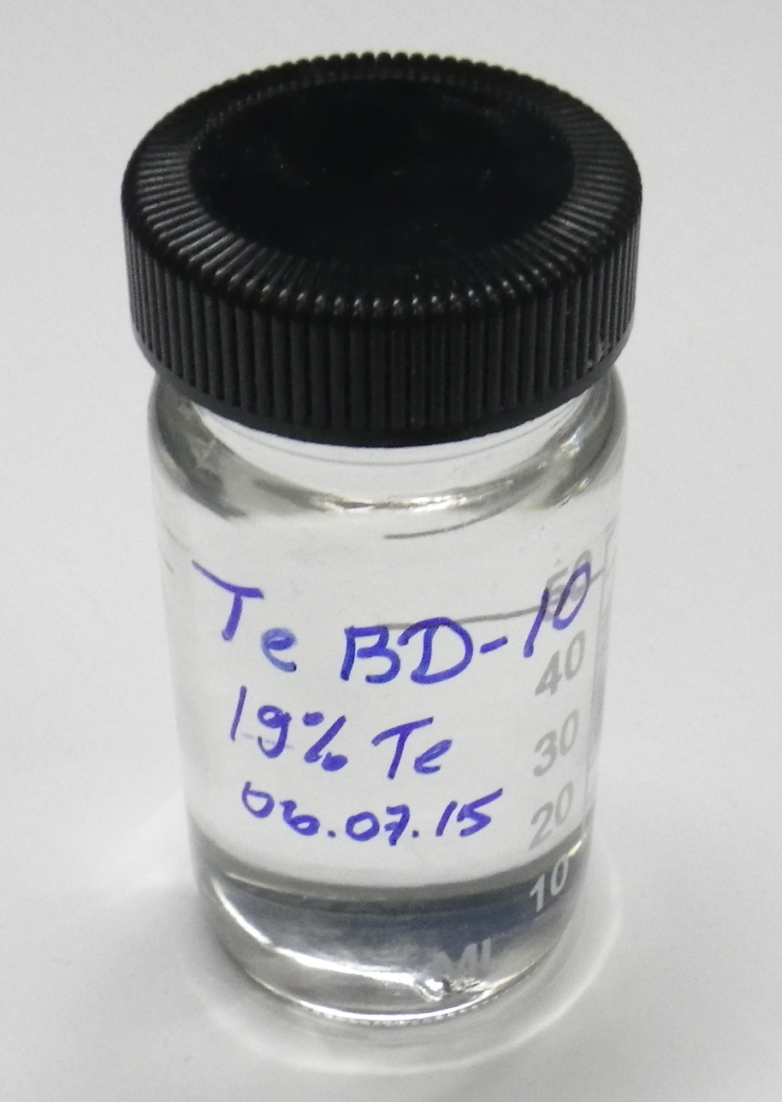
Better energy resolution would obviously help
Biggest background is ⁸B solar neutrinos! Work is ongoing to see if Cerenkov component of very prompt light can be used to suppress solar neutrinos.
Pulse shape discrimination might be useful to suppress gammas.
Taking advantage of large isotopic abundance (34%) of ¹³⁰Te, small 2νββ decay rate, large ²¹⁴Bi-²¹⁴Po rejection factor
Very scalable:
SNO+ Expected Signal and Backgrounds

Slide 18
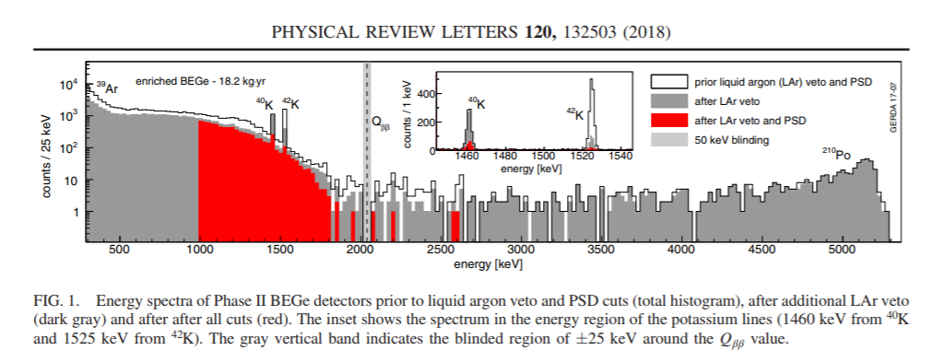
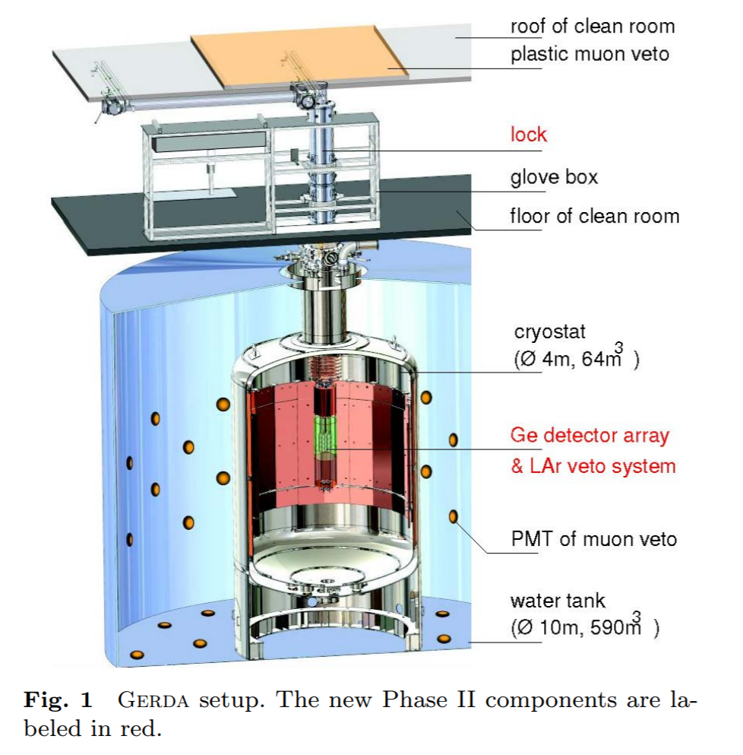
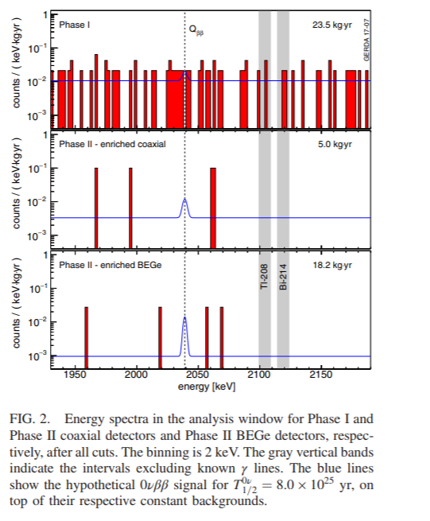
Enriched Germanium Detectors: GERDA. Halflife > 8x10²⁵ y.
Background free!
Extremely good energy resolution (3-4 keV FWHM at 2039 keV Q_{ββ})
Small electrode detectors; ability to distinguish very local energy deposits in bulk from multisite or surface events

Slide 19
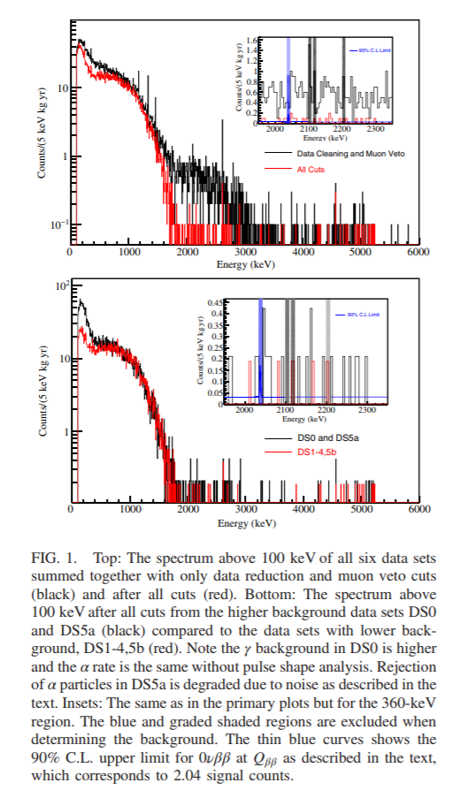
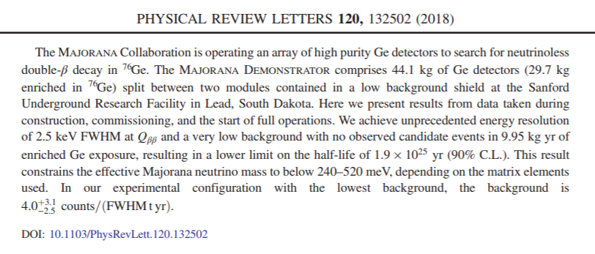
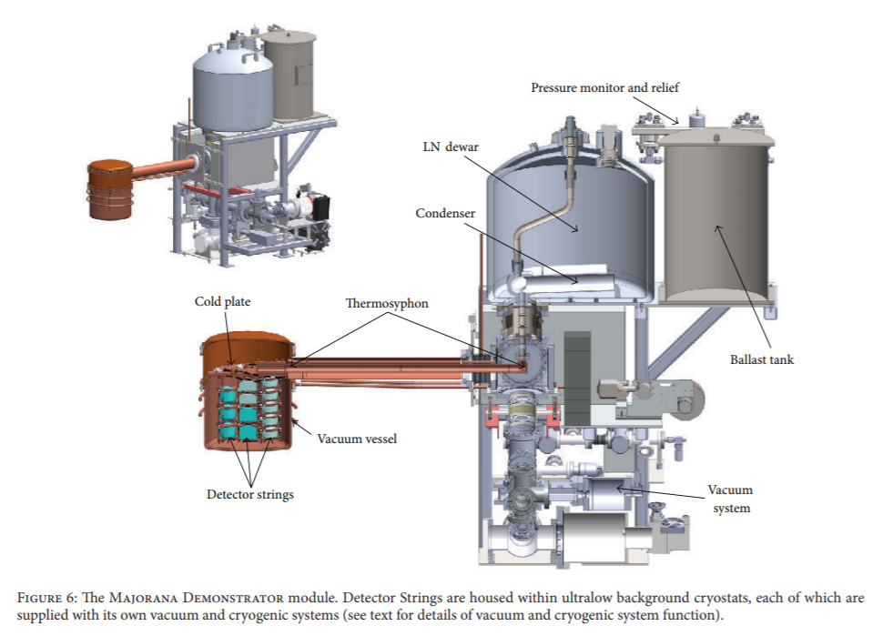
Majorana Demonstrator:
Background free
2.5 keV resolution
Point contact detectors
Has joined with Gerda->LEGEND

Slide 20
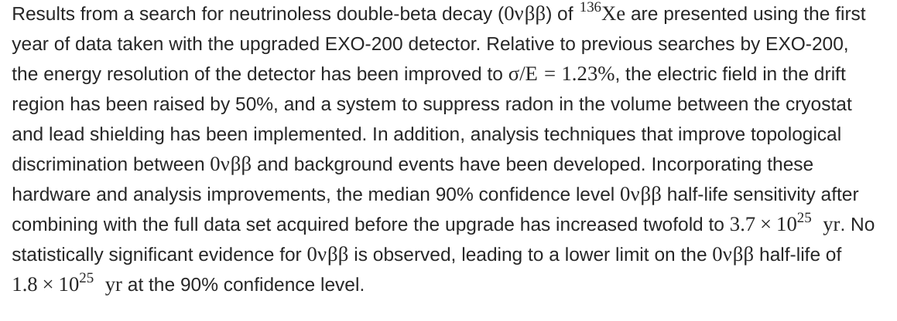
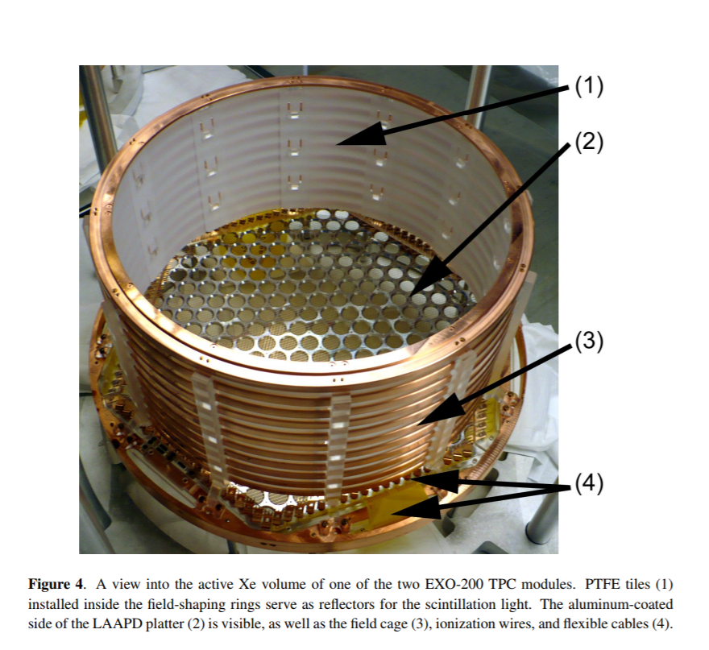
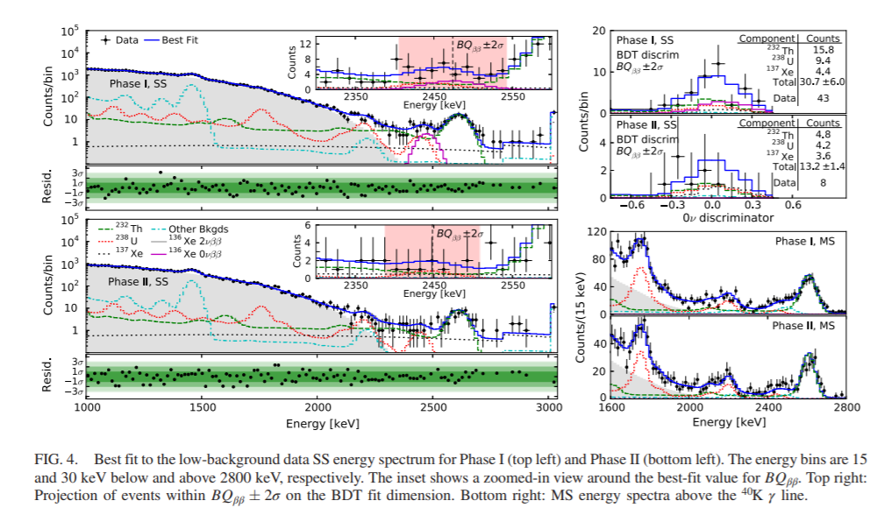
EXO-200 ¹³⁶Xe TPC
JINST 7 P05010 (2012)

Slide 21
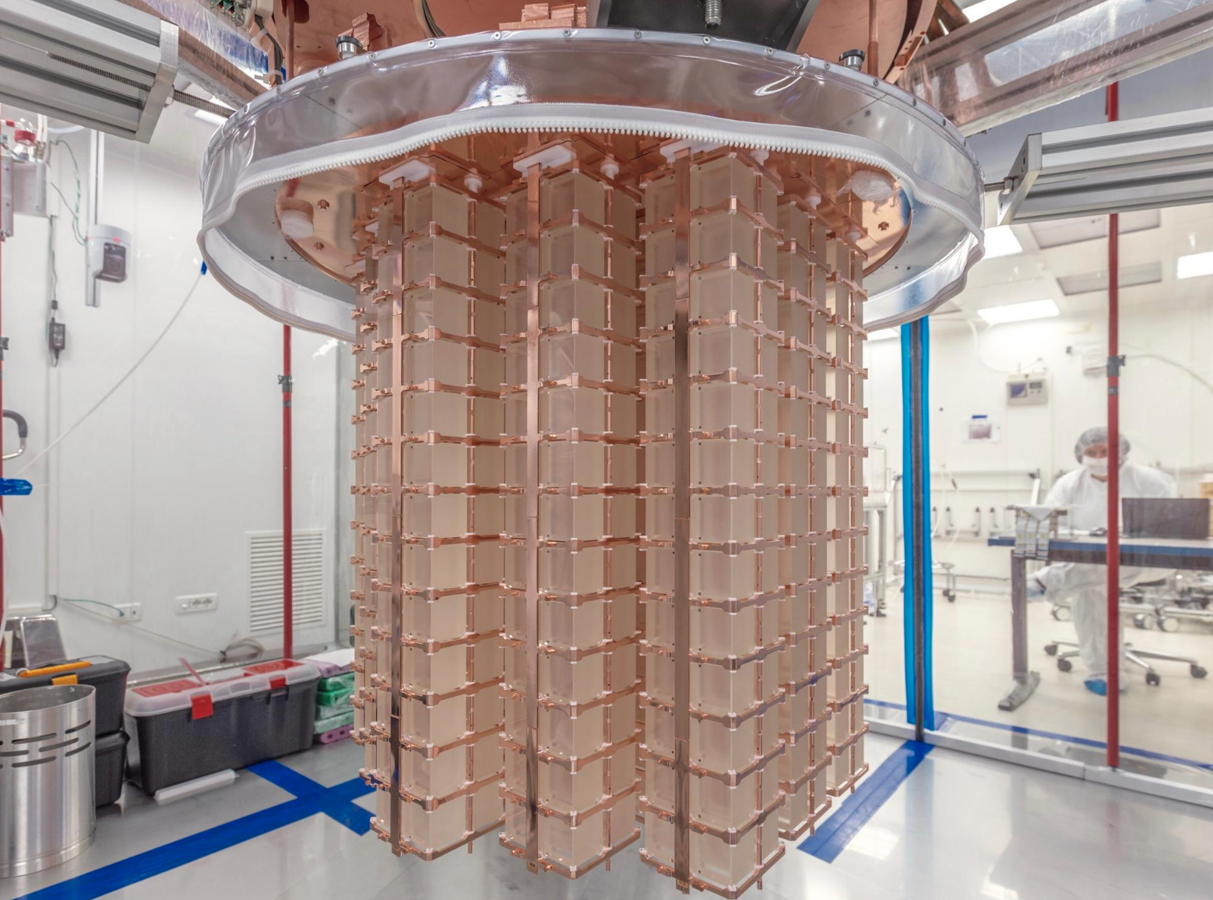
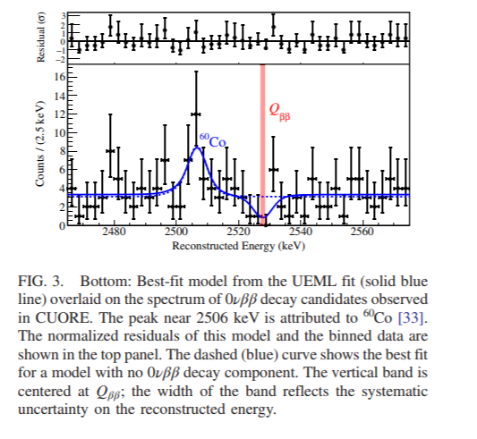
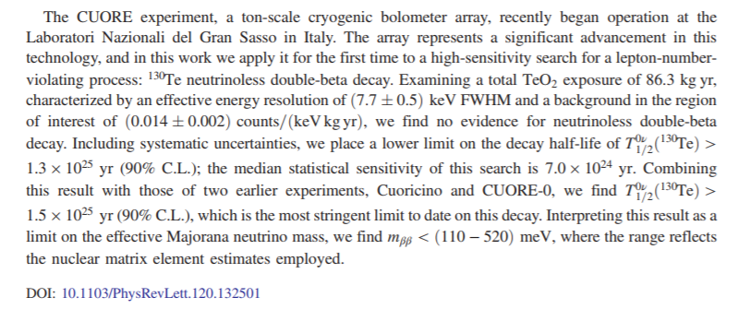
CUORE: Cryogenic Bolometer

Slide 22
Summary
Finding Neutrinoless Double Beta Decay is compelling physics and a high priority.
We need to expect that detectors might need to scale in size and purity by 3-4 orders of magnitude.
There is an active and ingenious international program developing a variety of technologies in a variety of isotopes. I have only shown a sample.

