Slide 1
ARIEL Target Development
ARIEL Town Hall Meeting
January 11, 2017
Alexander Gottberg
Department Head, Targets and Ion Sources

Slide 2
ARIEL + ISAC: A RIB Factory
2 additional target stations, independent e-driver, medical isotope production
Increased reliability, efficiency, flexibility, additional RIB species, 3000 RIB h/y
TRIUMF RIB Factory 2023
ARIEL
2022
CANREB
2020
ISAC Upgrade
2018
9000 RIB h/y,
3 simultaneous beams,
increased development capabilities,
pure n-rich beams, extended beamtimes
ISAC II
2005
HRS, EBIS charge state booster, Nier-spectrometer,
increased beam purity
Production facility, 0.153 – 1.8 MeV/u
ISAC I
1995
Post-Acceleration
≤16 MeV/u
2500 RIB h/y
TISOL
1988
Thick targets, 500 MeV separation online
→ Bob Laxdal: Operational model and ramp-up
→ Eric Guetre: ARIEL schedule

Slide 3
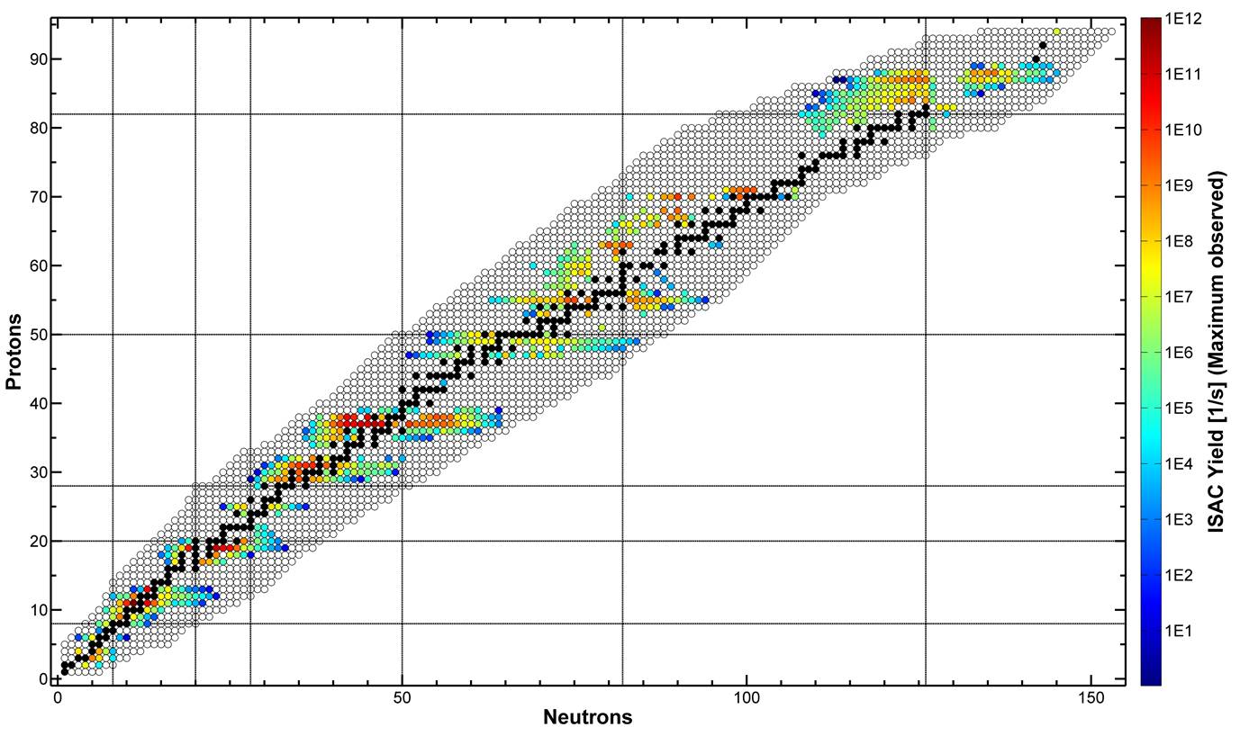
ISAC Radioisotope Beams Since 1998
target materials:
UC_{x}
UO₂
ThO
Nb
Ta
TaC
NiO
ZrC
TiC
SiC
ion sources:
surface
resonant lasers
FEBIAD
IG-LIS

Slide 4
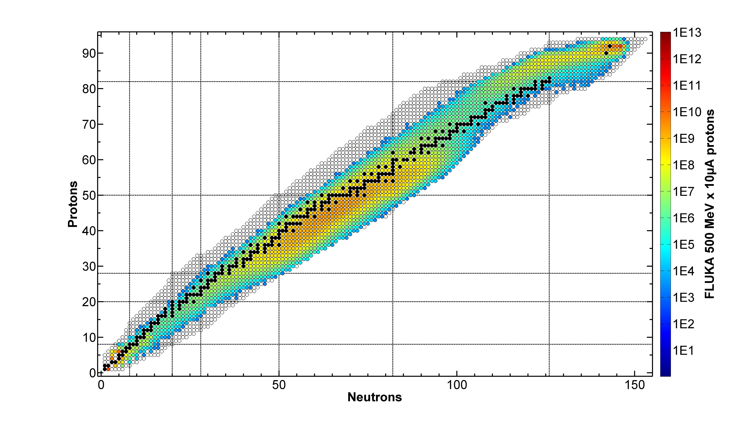
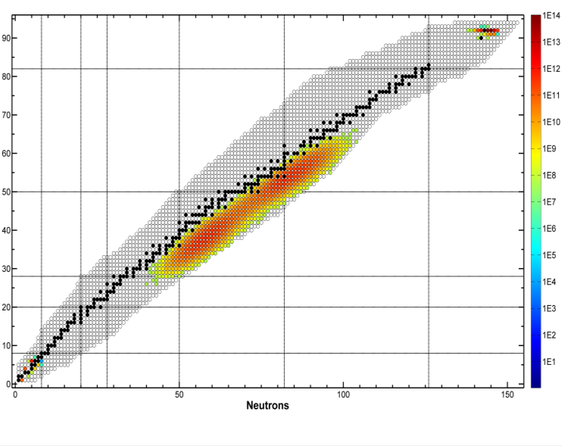
An Independent Driver for TRIUMF’s Rare Isotope Program
production intensity from ²³⁸UC_{x}
500 MeV x 10 µA protons [1/s]
50 MeV x 10 mA electrons [1/s]
Pure n-rich products from photofission

Slide 5
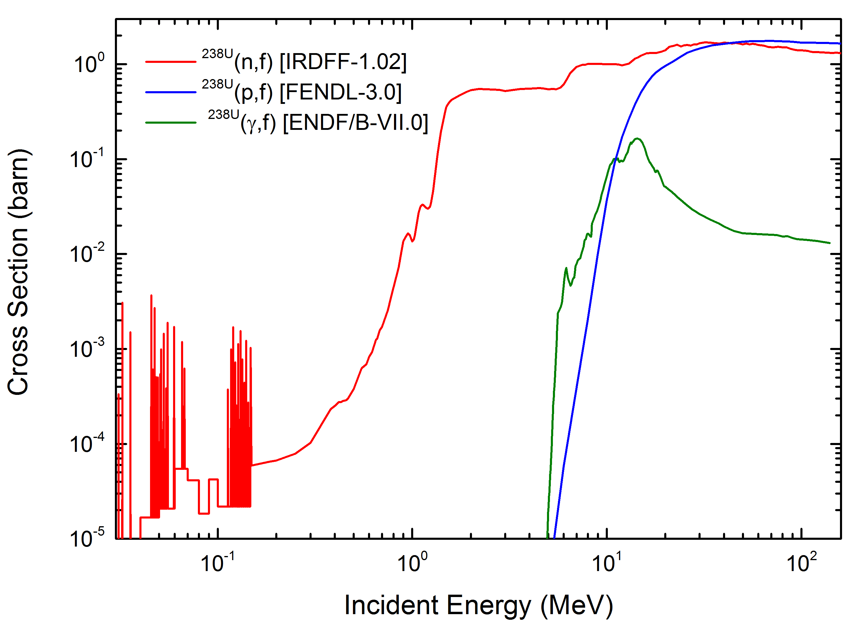
An Independent Driver for TRIUMF’s Rare Isotope Program
production intensity from ²³⁸UC_{x}
cross sections
50 MeV x 10 mA electrons [1/s]
Pure n-rich products from photofission
Production cross section greatly reduced in comparison to high-energy hadrons

Slide 6
An Independent Driver for TRIUMF’s Rare Isotope Program
production intensity from ²³⁸UC_{x}
500 MeV x 10 µA protons [1/s]
50 MeV x 10 mA electrons [1/s]
Pure n-rich products from photofission
Production cross section greatly reduced in comparison to high-energy hadrons

Slide 7
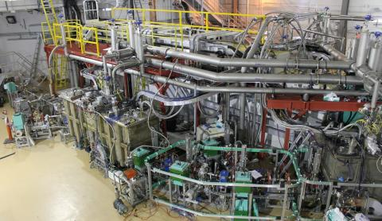
An Independent Driver for TRIUMF’s Rare Isotope Program
production intensity from ²³⁸UC_{x}
TRIUMF’s new superconducting e-linac
50 MeV x 10 mA electrons [1/s]
How much electron beam energy?
How much electron beam power?
  … for a competitive RIB program
Pure n-rich products from photofission
Production cross section greatly reduced in comparison to high-energy hadrons

Slide 8
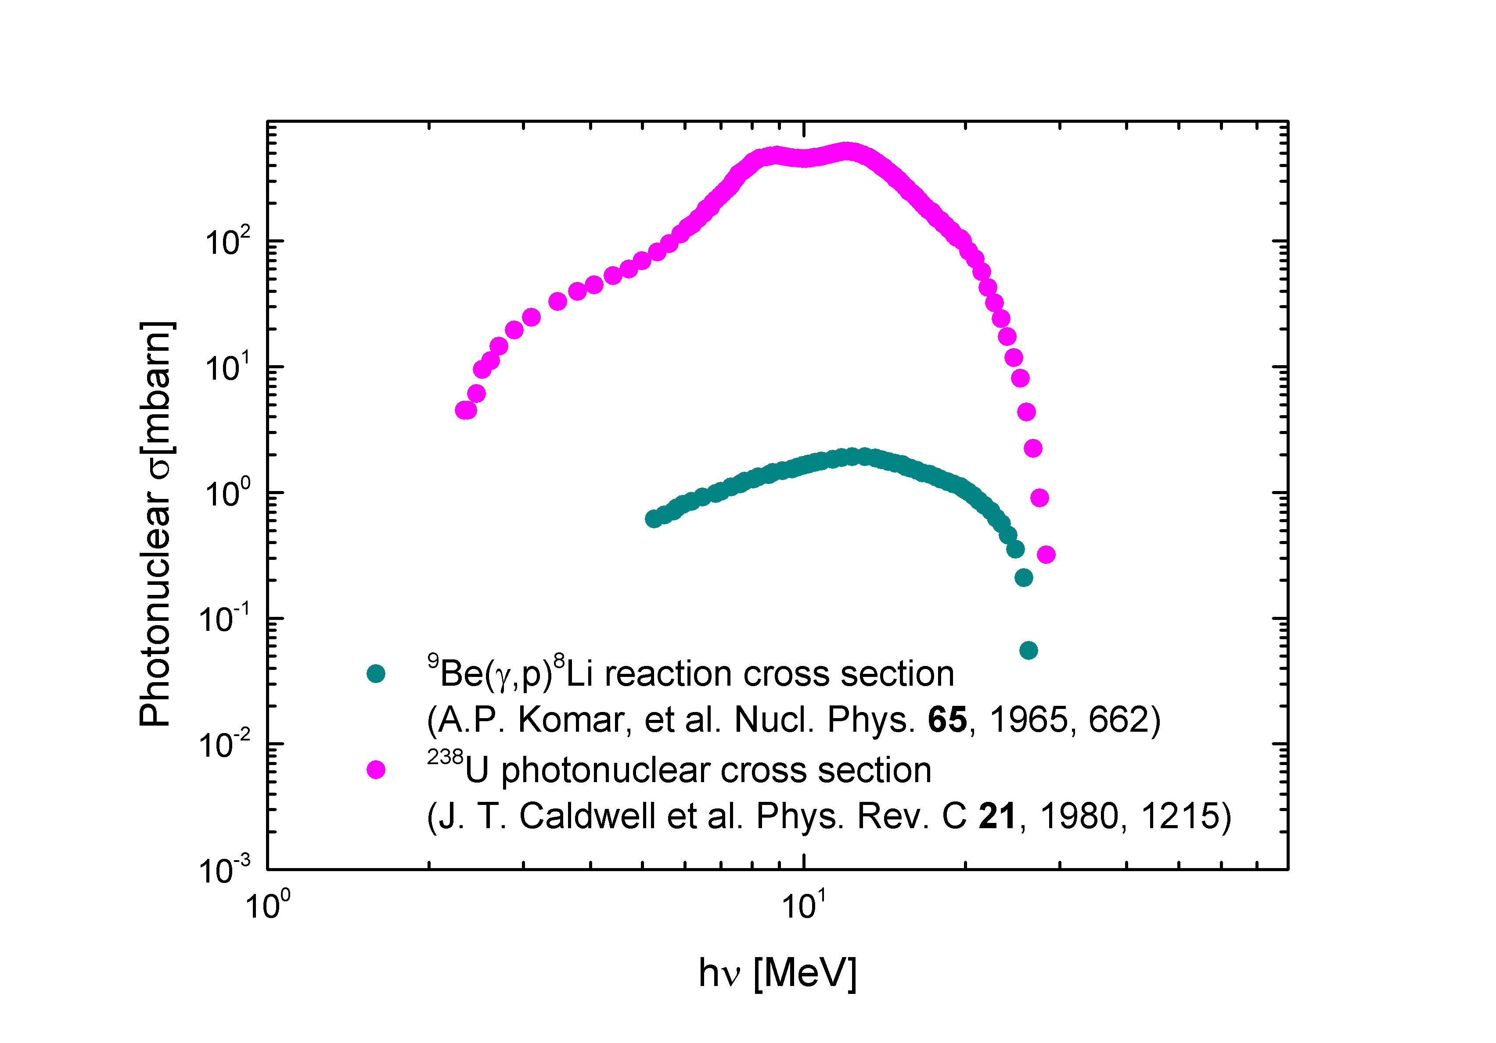
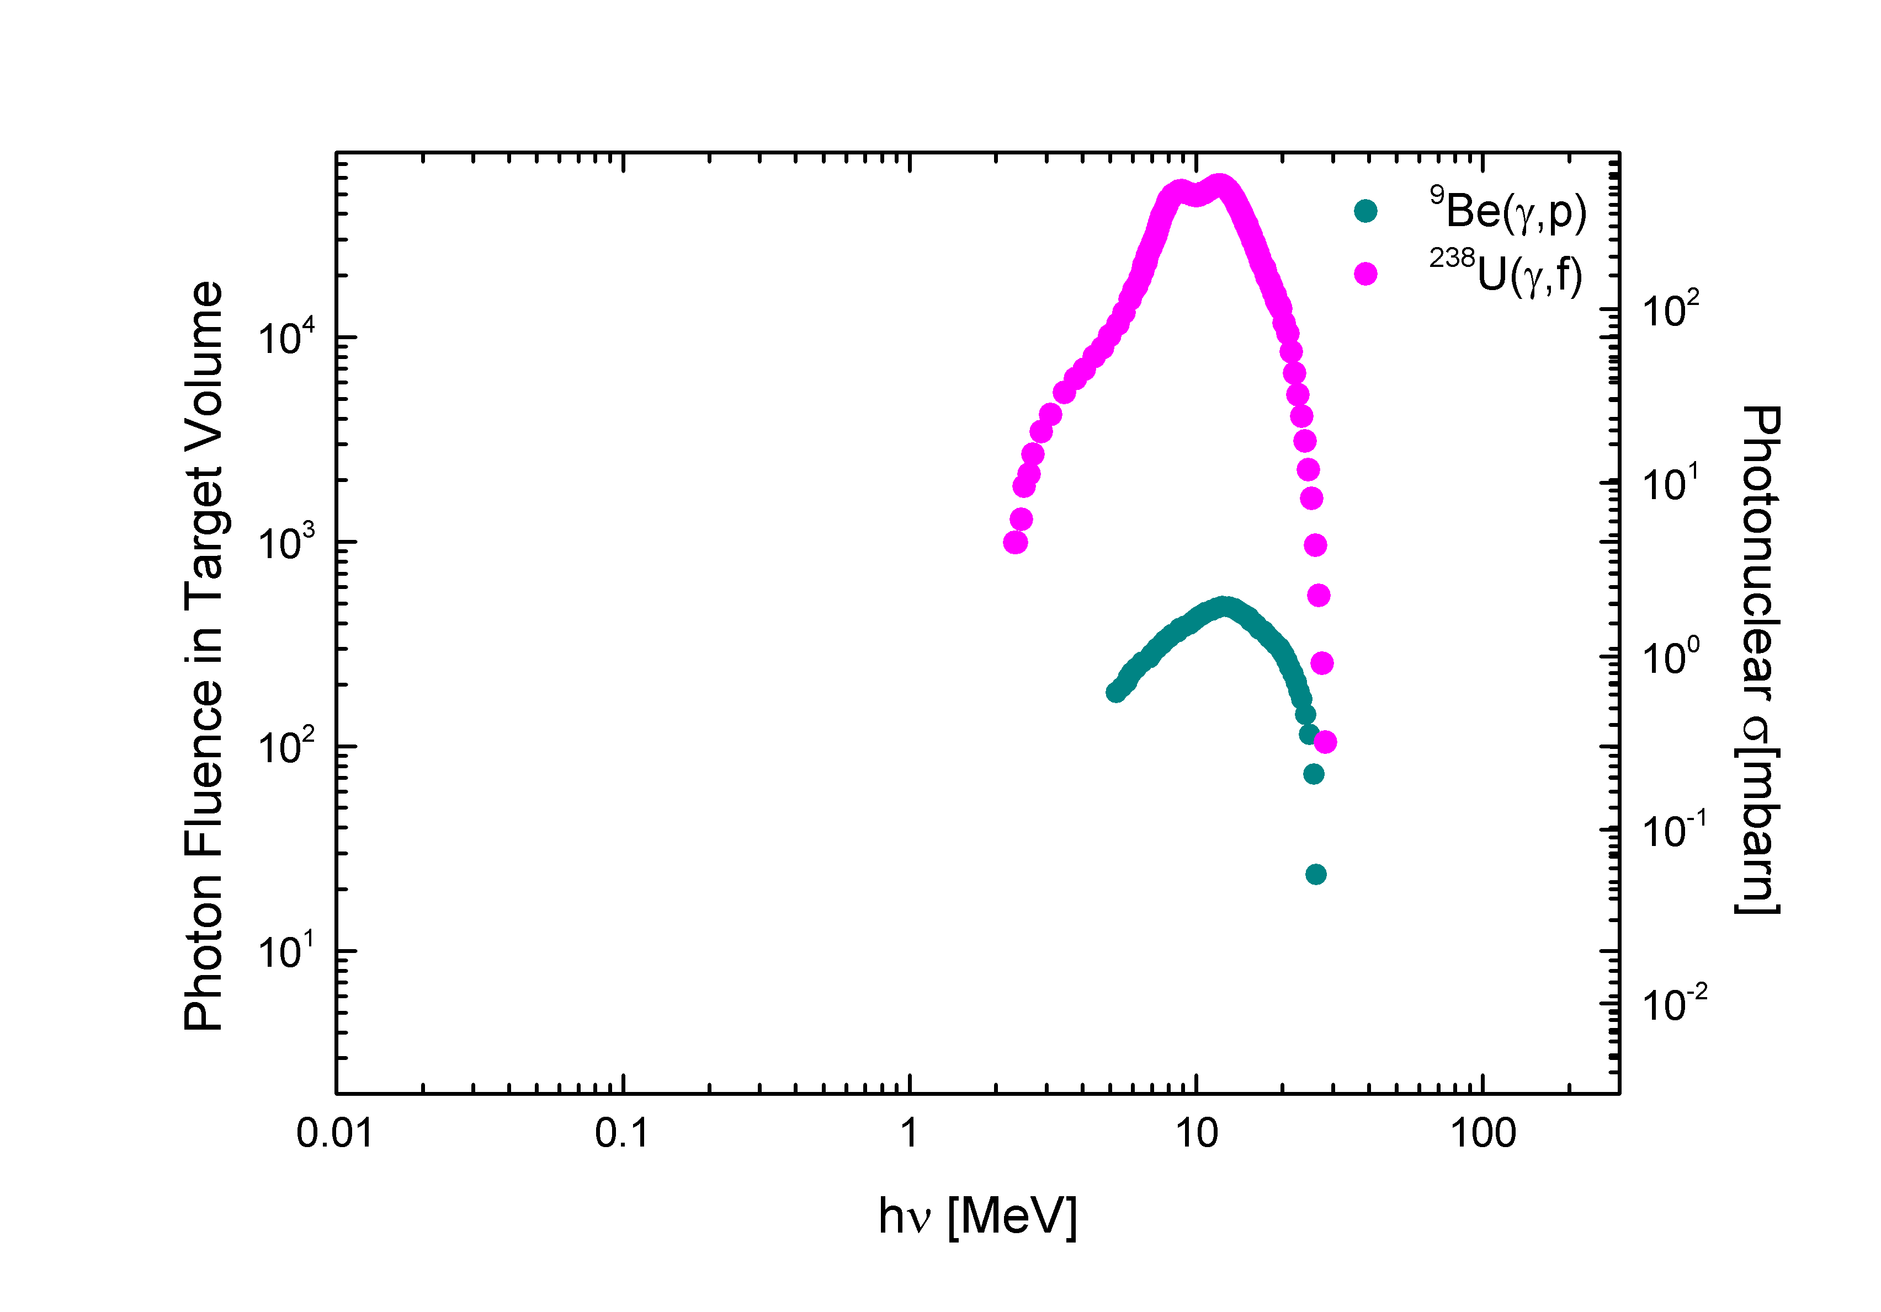
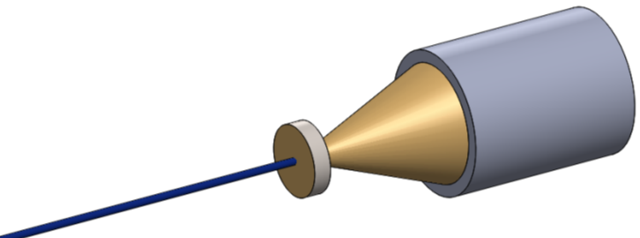
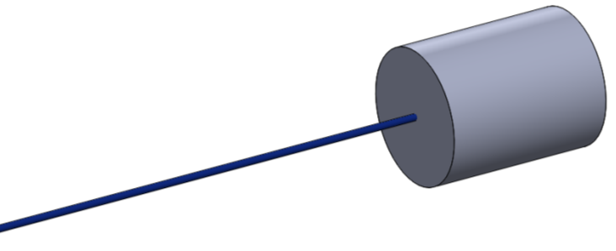
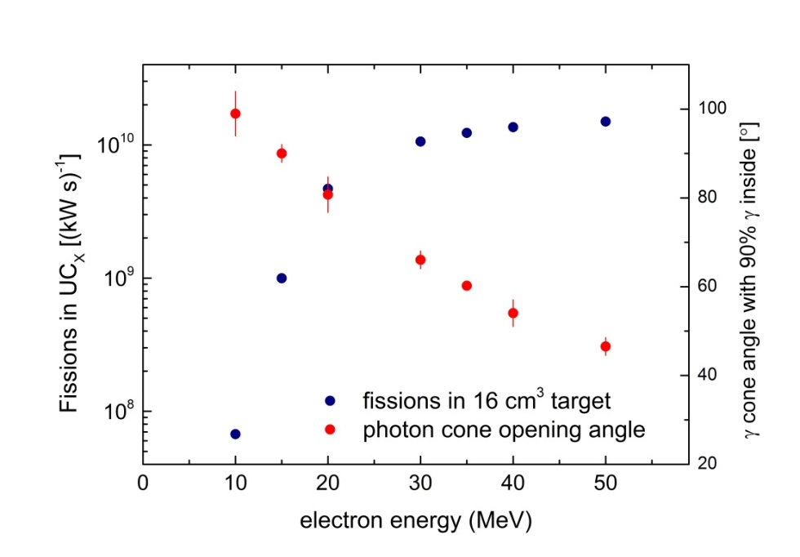
e-Induced Radioisotope Production Principles
50 MeV electron range ≈ 10 mm → direct target irradiation leads to:
inhomogeneous heat profile
overheating for P_{e} > 3 kW
→ use of high-Z e-to-γ converter
UC_{x} / BeO
electrons

Slide 9
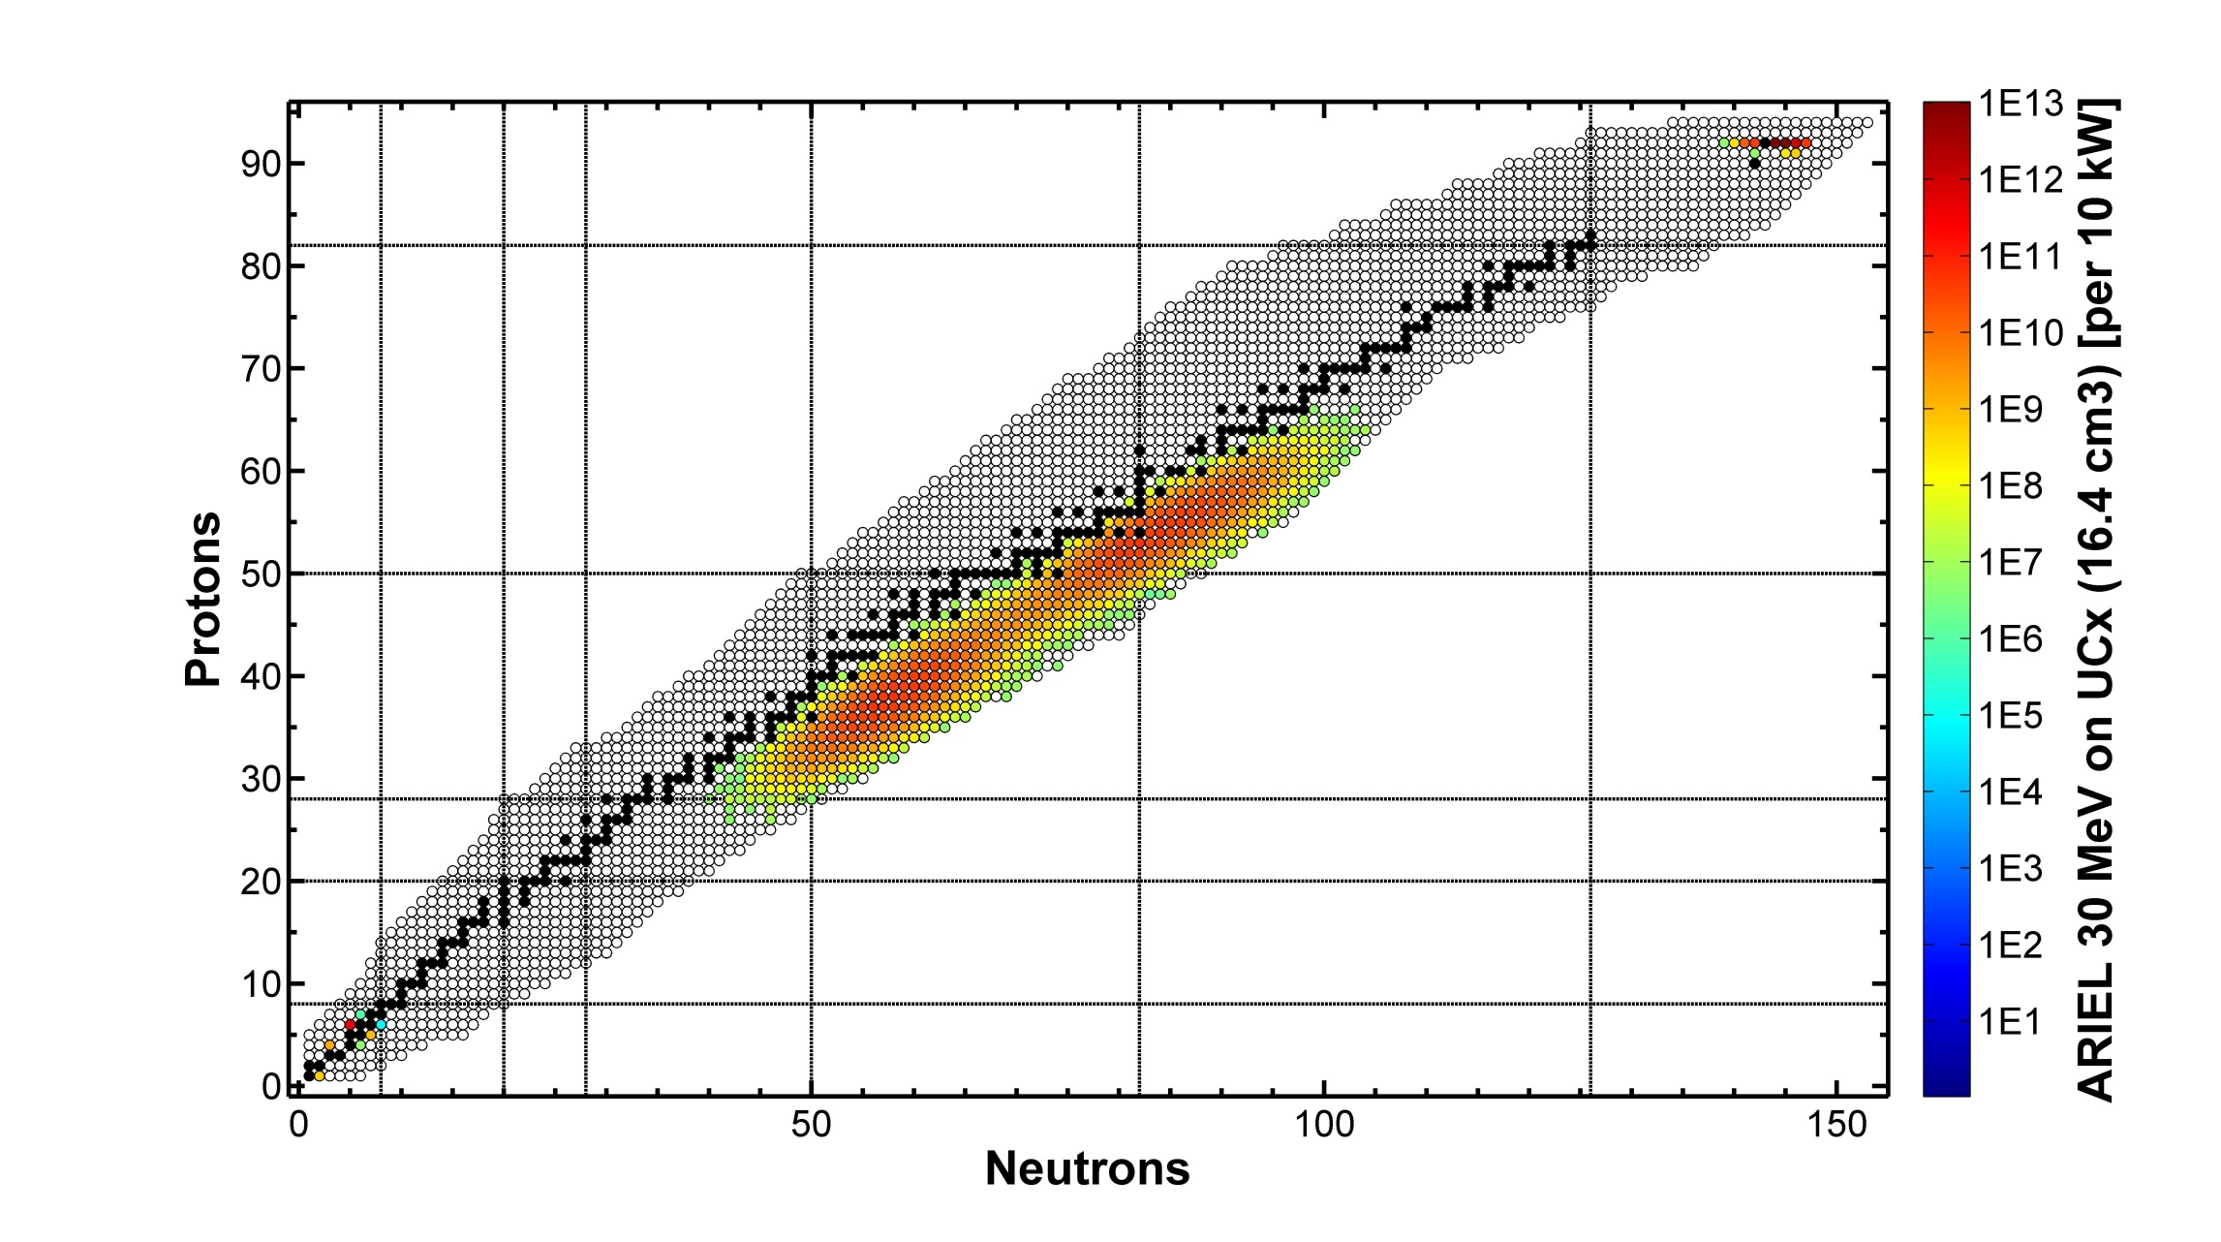
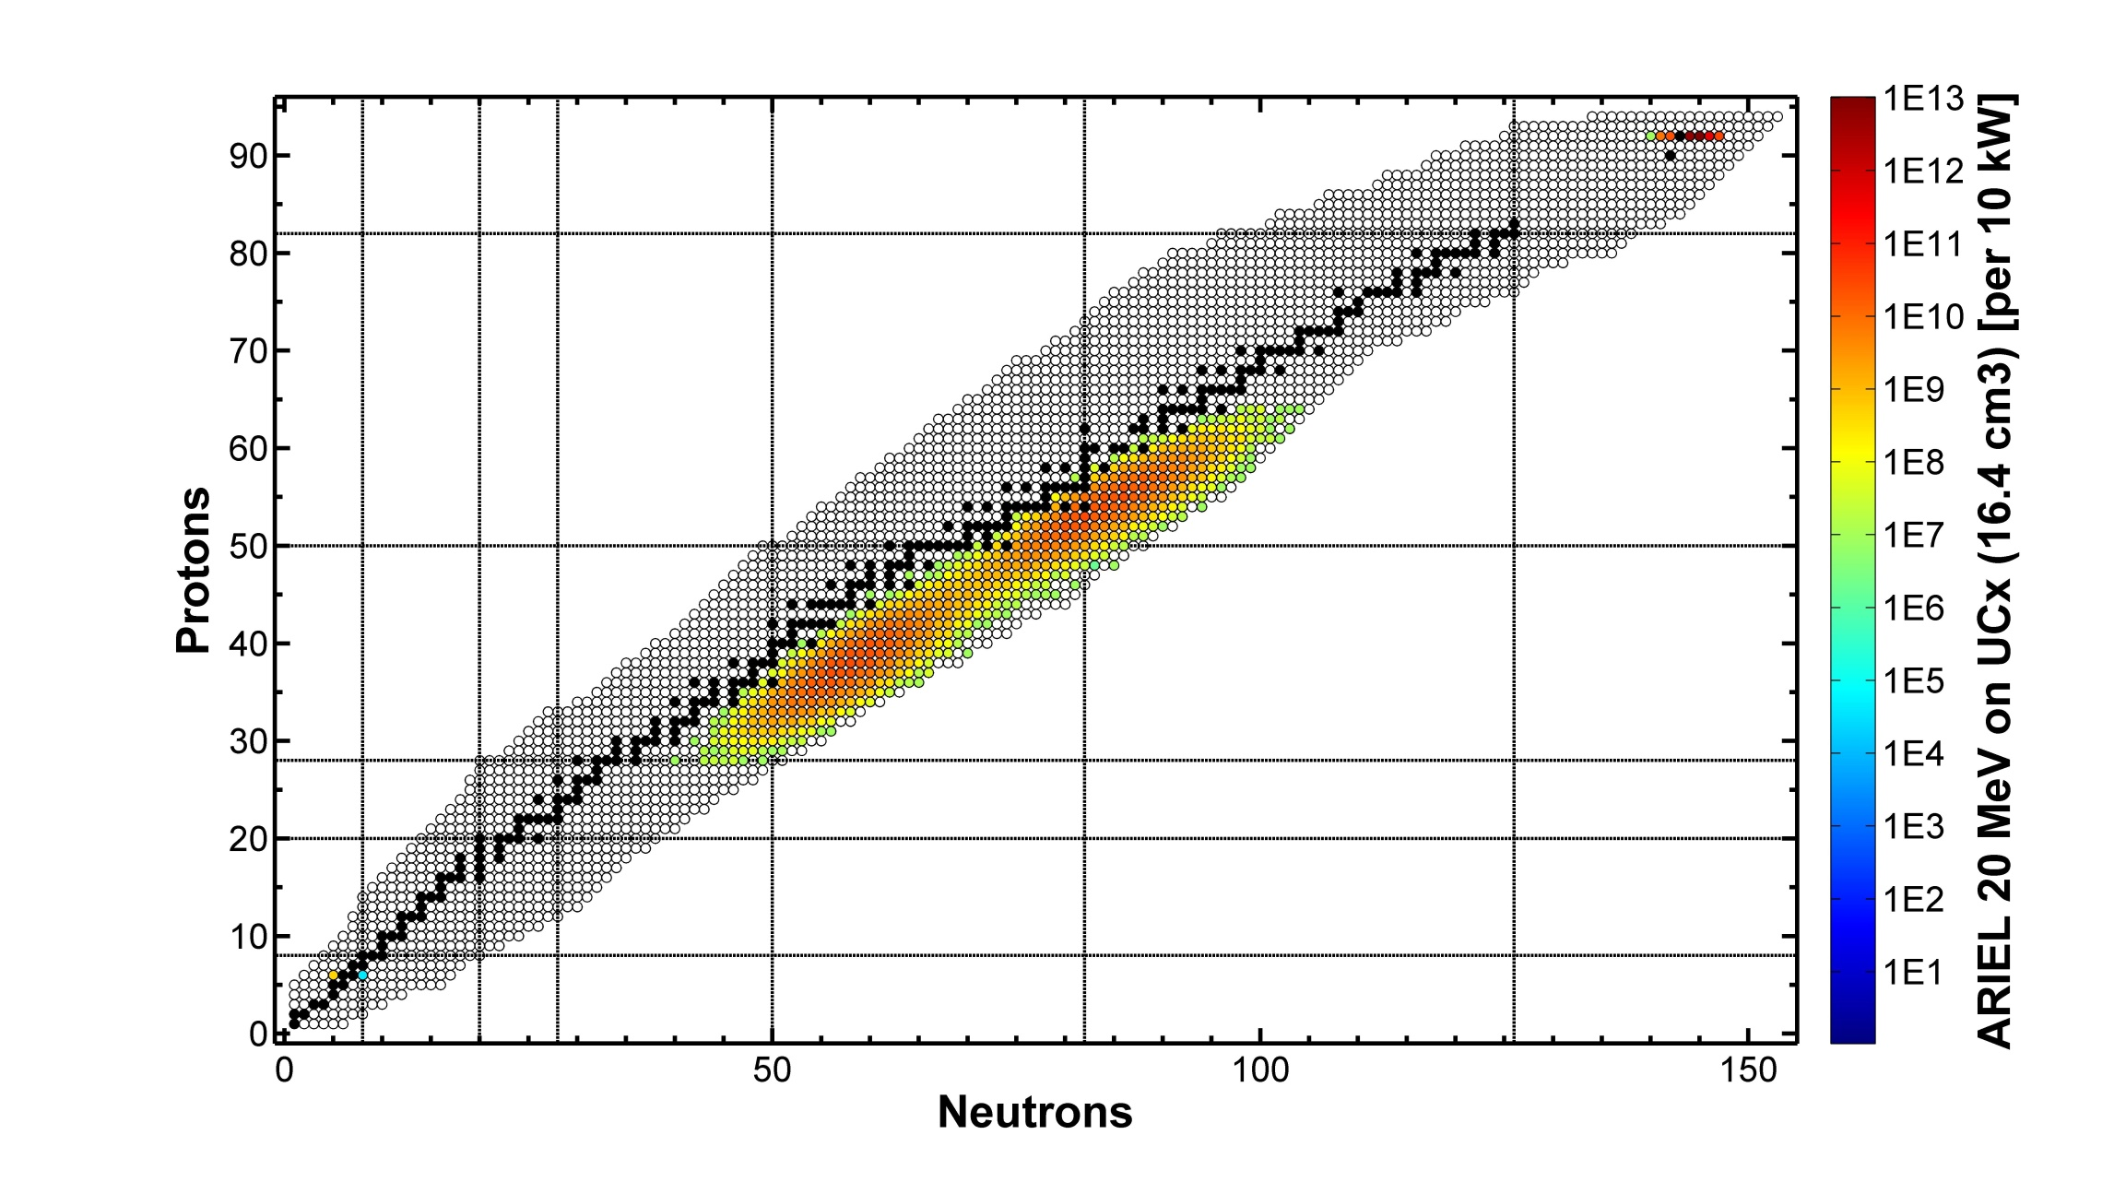
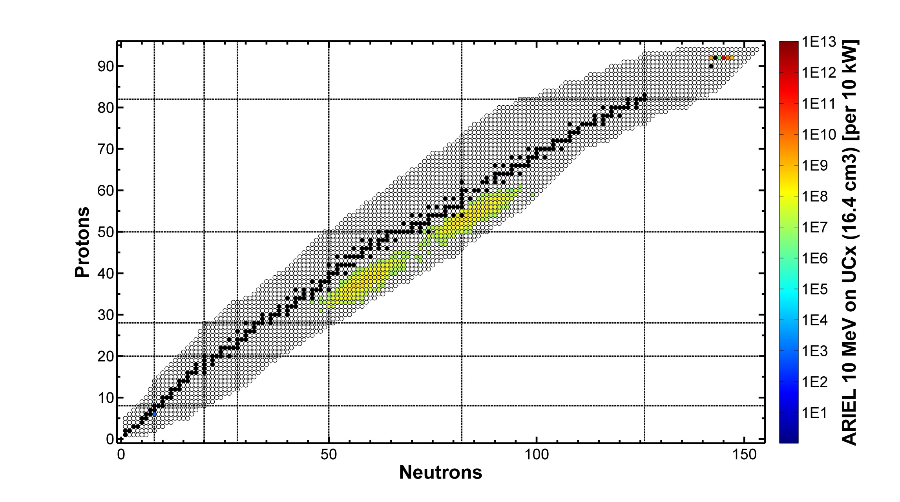
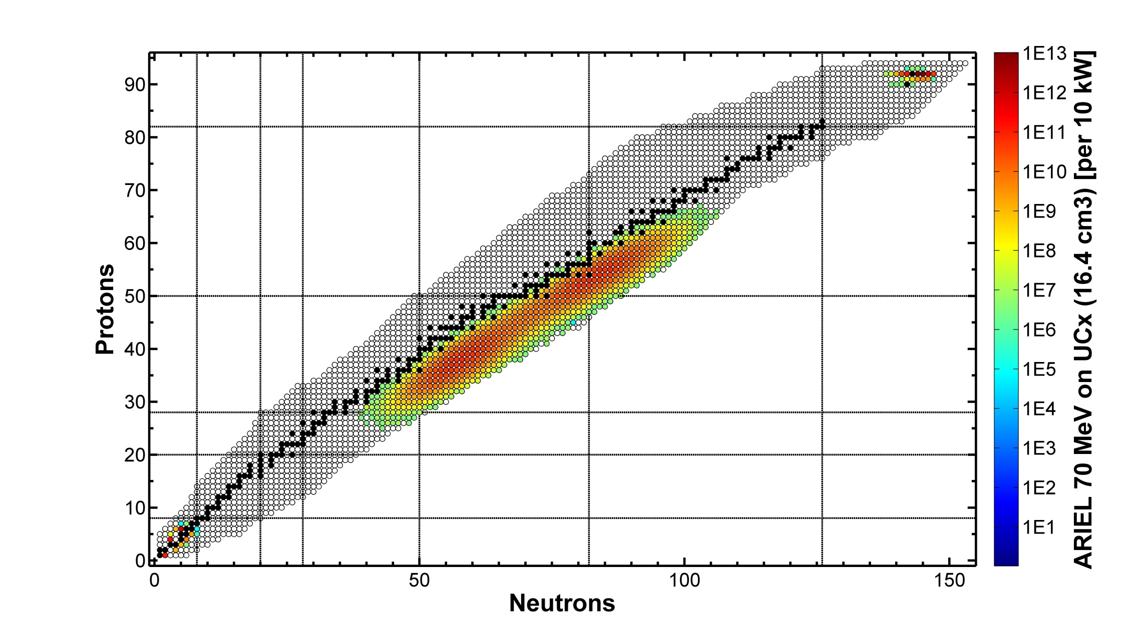



ARIEL Production at Various Electron Energies
→ E_{e} = 35 MeV
Postpone resource-intense implementation of 50 MeV electron beam capabilities.

Slide 10
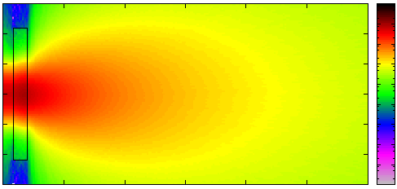
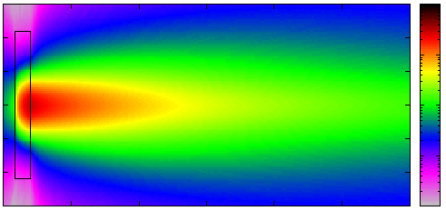
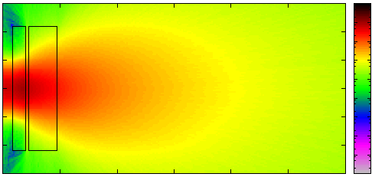
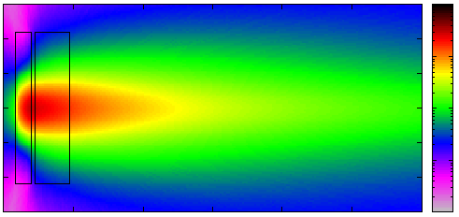
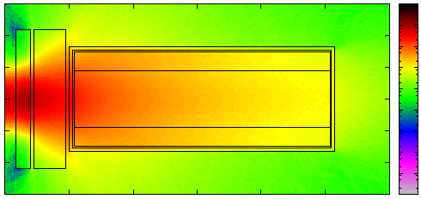
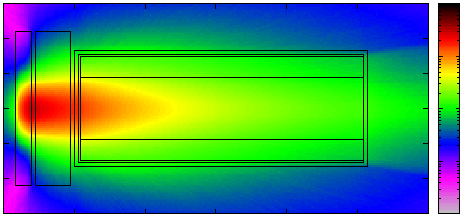
Electron Beam Power
ARIEL, 50 MeV, 10 mA, 500 kW
Electron Fluence [1/cm²]
Photon Fluence [1/cm²]
1· 10¹⁸
1· 10¹⁸
W converter
4.6 mm
1· 10¹⁶
1· 10¹⁷
1· 10¹⁴
1· 10¹⁶
6 cm
1· 10¹²
1· 10¹⁵
1· 10¹⁰
1· 10¹⁴
10 mm Al
attenuator
blocking
residual primaries
1· 10¹⁸
1· 10¹⁸
1· 10¹⁶
1· 10¹⁷
1· 10¹⁴
1· 10¹⁶
1· 10¹²
1· 10¹⁵
1· 10¹⁰
1· 10¹⁴
1· 10¹⁸
1· 10¹⁸
UC_{x} target
80 mm
1· 10¹⁶
1· 10¹⁷
1· 10¹⁴
1· 10¹⁶
1· 10¹²
1· 10¹⁵
1· 10¹⁰
1· 10¹⁴

Slide 11
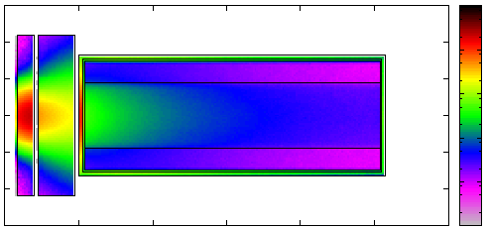
Electron Beam Power
ARIEL, 50 MeV, 10 mA, 500 kW
Electron Fluence [1/cm²]
Photon Fluence [1/cm²]
Power Deposition [kW/cm³]
1· 10¹⁸
1· 10¹⁸
W converter
4.6 mm
1· 10¹⁶
1· 10³
1· 10¹⁷
1· 10¹⁴
1· 10²
1· 10¹⁶
6 cm
1· 10¹²
1· 10¹⁵
1· 10¹⁰
1· 10¹
1· 10¹⁴
1· 10⁰
10 mm Al
attenuator
blocking
residual primaries
1· 10¹⁸
1· 10⁻¹
1· 10¹⁸
1· 10¹⁶
1· 10⁻²
1· 10¹⁷
1· 10¹⁴
1· 10¹⁶
power deposition:
200 kW in converter
80 kW in target container
1· 10¹²
1· 10¹⁵
1· 10¹⁰
1· 10¹⁴
1· 10¹⁸
1· 10¹⁸
UC_{x} target
80 mm
1· 10¹⁶
1· 10¹⁷
ISAC is currently the facility with the highest power in an ISOL target (≈ 8 kW) world-wide.
No cooing technology available beyond that without significant RIB intensity losses!
1· 10¹⁴
1· 10¹⁶
1· 10¹²
1· 10¹⁵
1· 10¹⁰
1· 10¹⁴

Slide 12
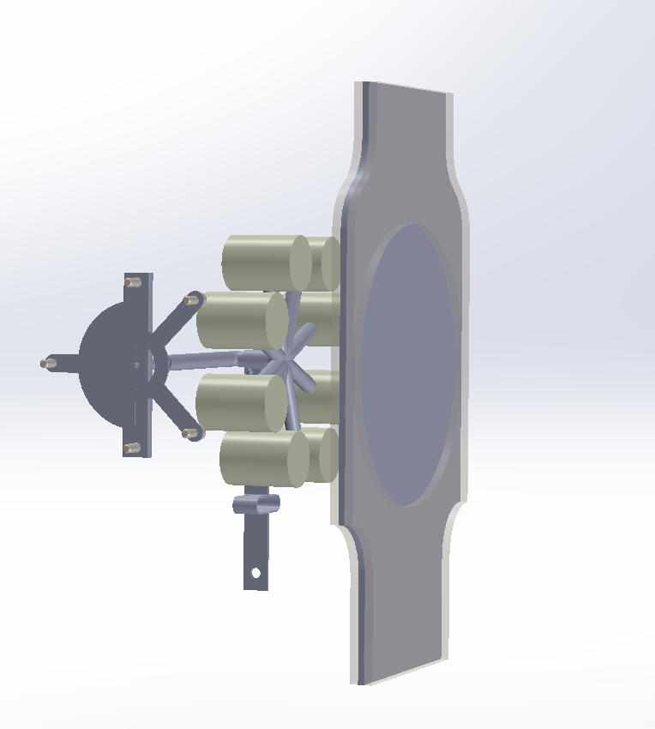
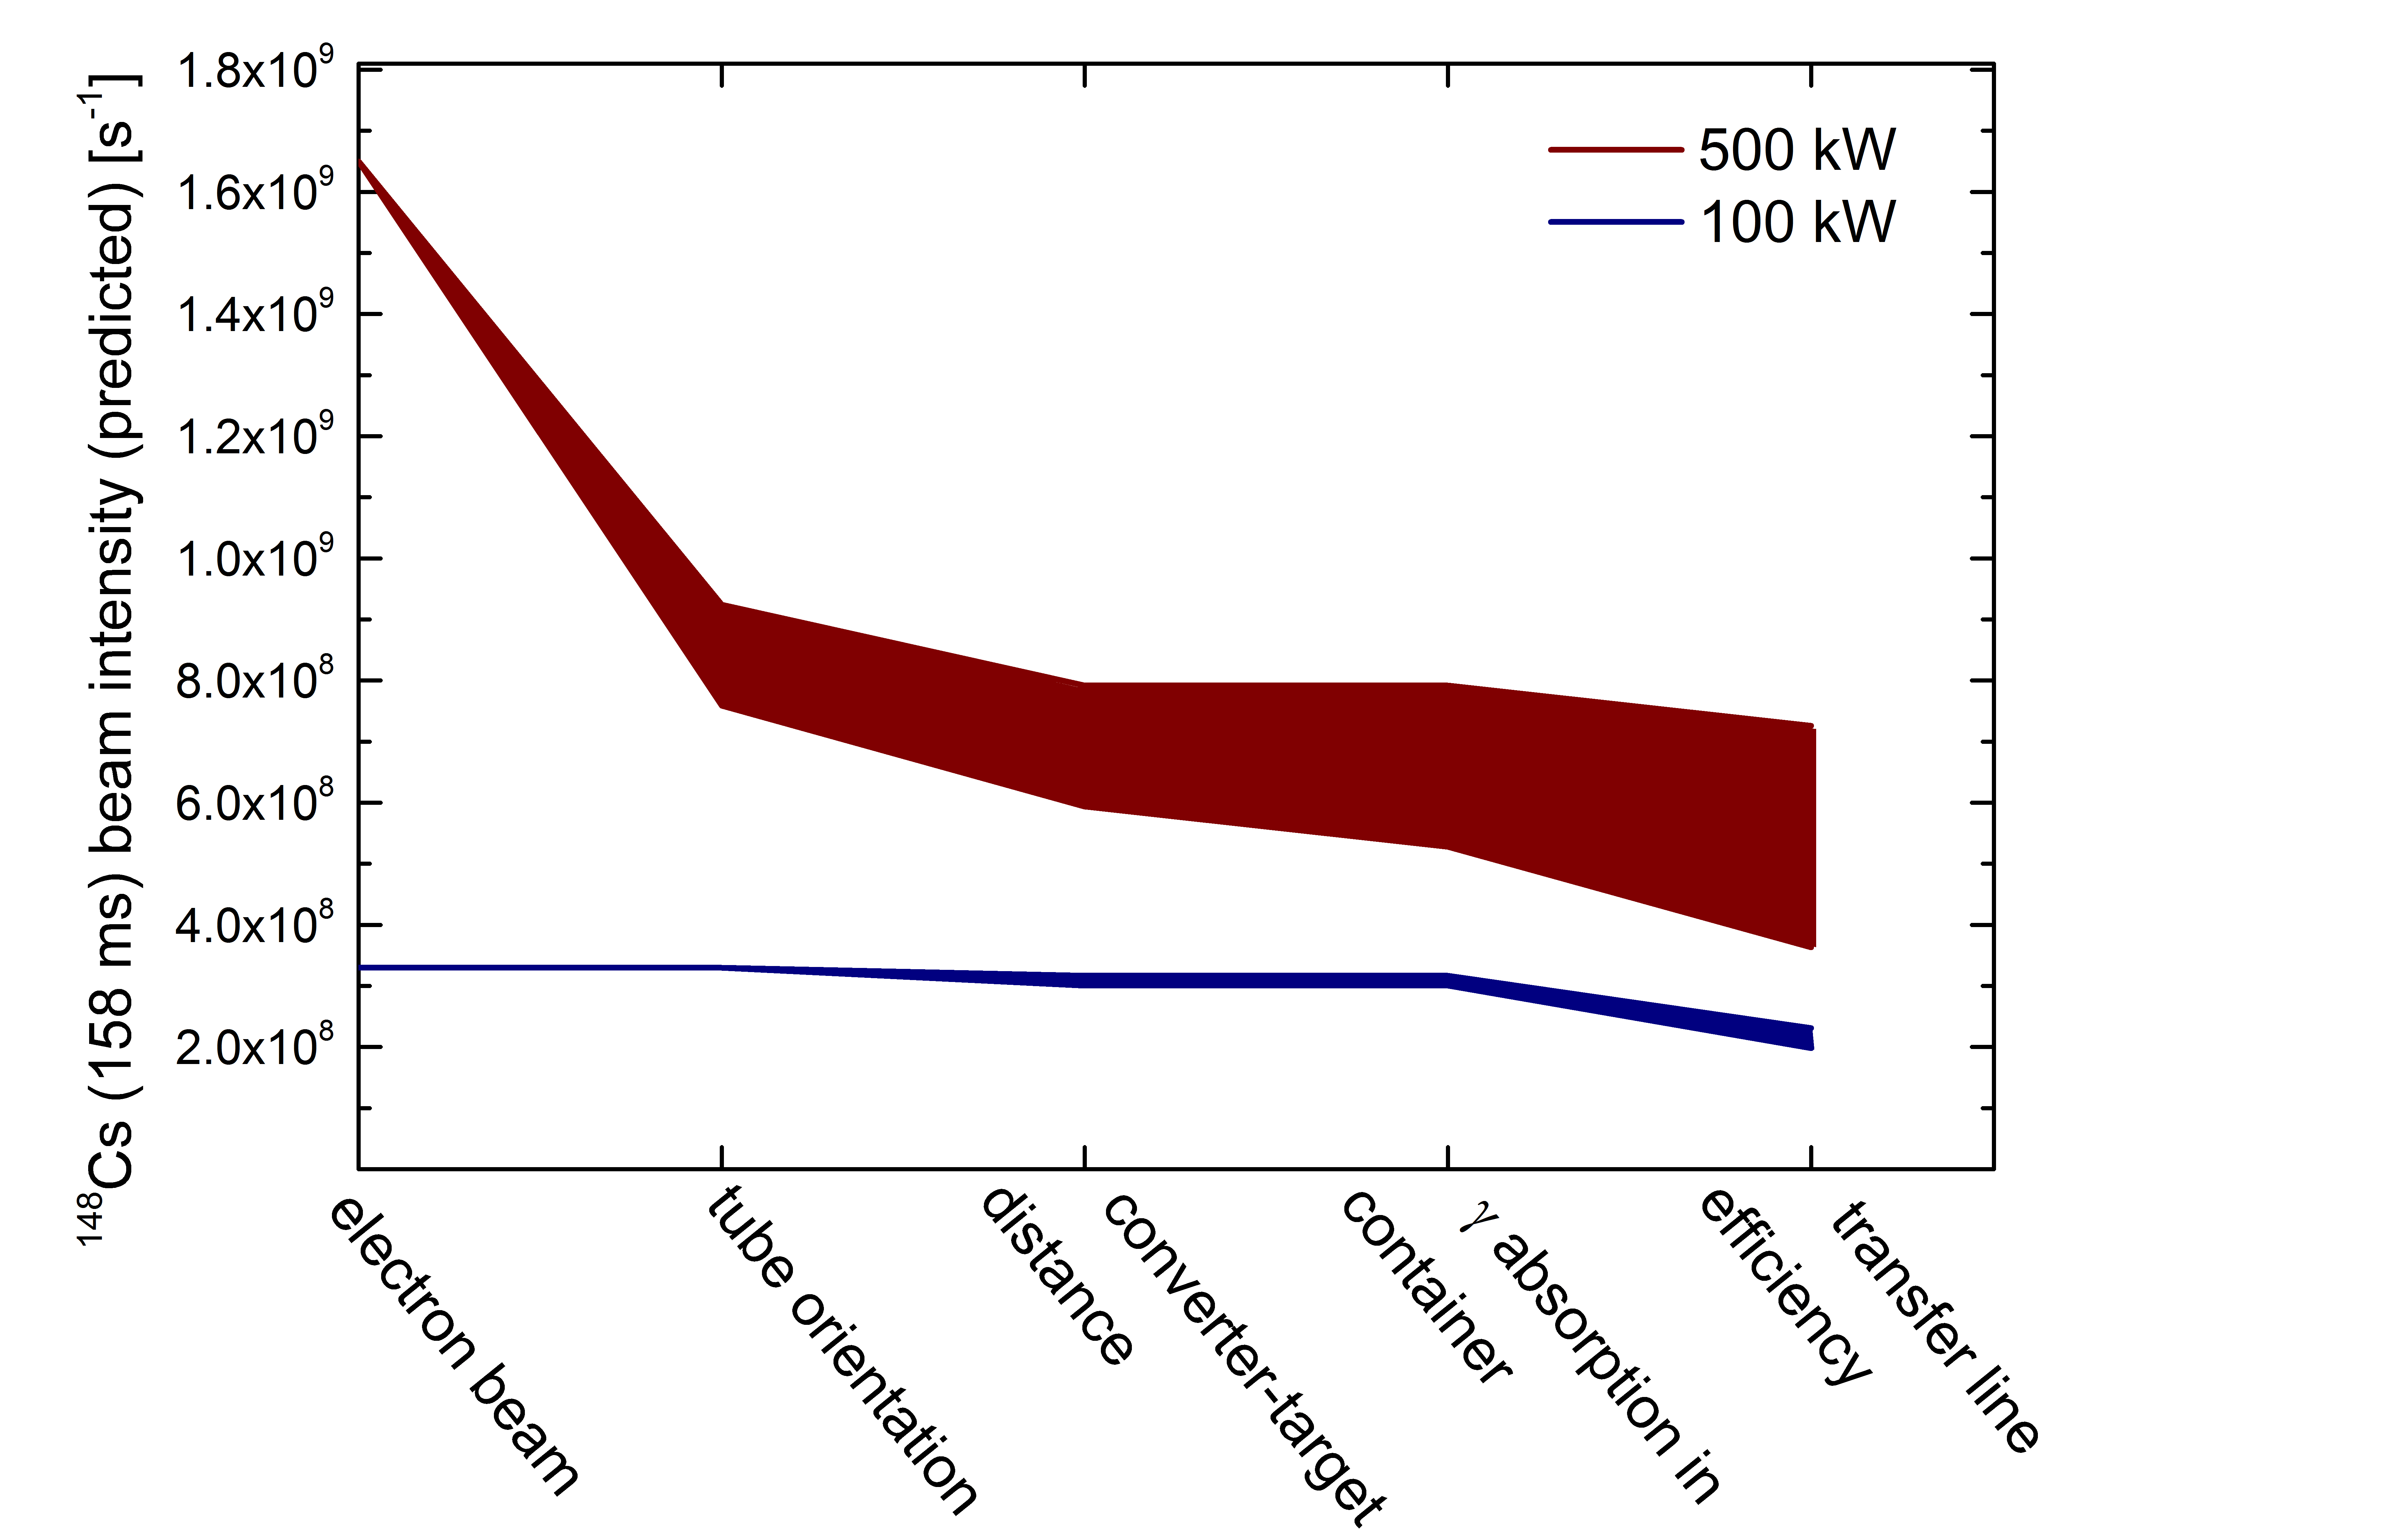
Design Study: Towards 500 kW
!
windowless liquid metal converter
20 kW per target container
≤
multiple horizontal target containers
multiple
transfer lines
ion source
electron beam multi-spot scanning
→ P_{e} ≤ 100 kW
Postpone resource-intense implementation of 500 kW converter and target capabilities.
Heat gradients
Increased assembly vulnerability
Longer effusion times for less volatile species
Additional interlock systems
common
transfer line
electron beam power from 100 kW to 500 kW
→ ≤2-fold increase in exotic radioisotope yields
For comparison:
x5 is a typical reach of any target / ion source development.
target +
transfer line heating
challenging

Slide 13
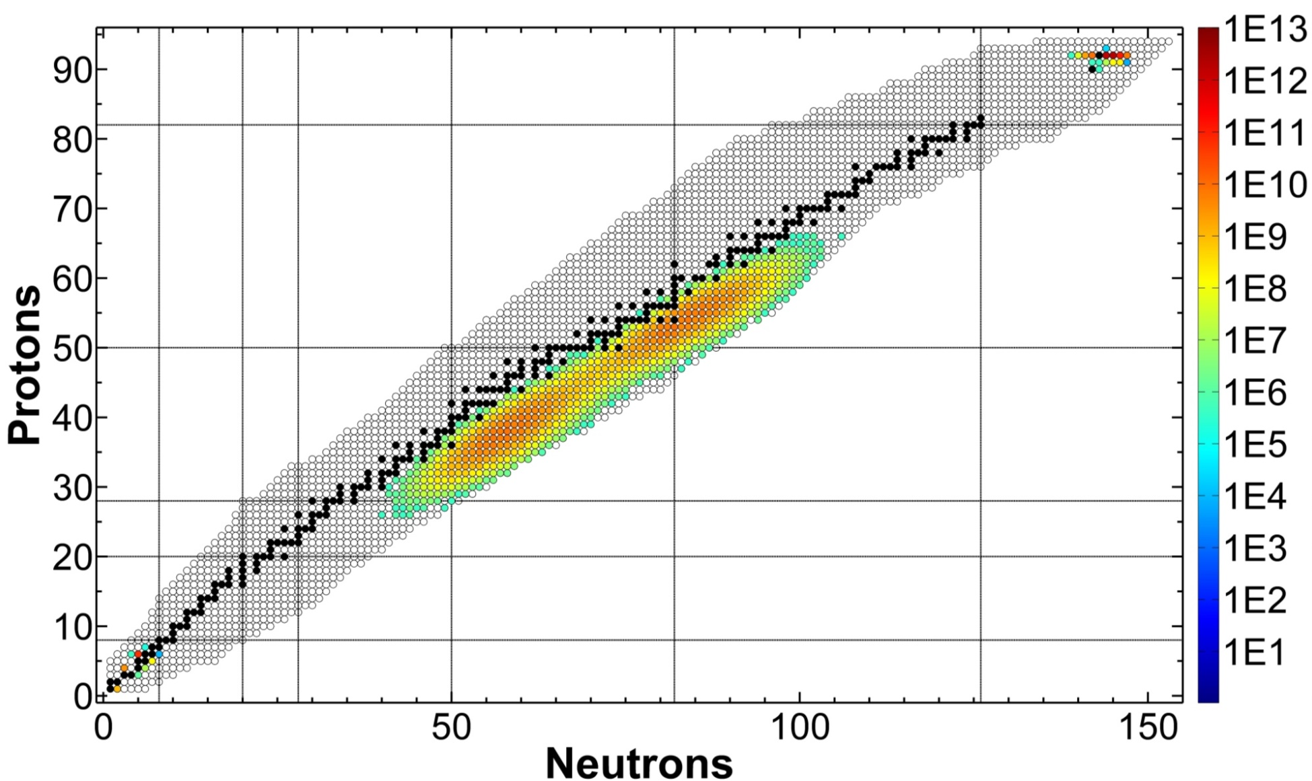
Development of Requirements and Concepts
Process and design development driven by:
Operational model
Schedule and budget
Maximum RIB intensity, diversity, purity, reliability
Development flexibility
Choosing state-of-the art technology and applying lessens learnt in ISAC and other facilities
E_{e} = 35 MeV (saturation of fission rate)
P_{e} ≤ 100 kW (no technology for efficient use of higher power available, shielding designed for 500 kW)
mechanical part of target exchange in ≤ 24 h → target exchange in station not in hot cell, maximum fraction of process load in main control room
pre-conditioned hermetic target vessel and target acceptance stand (TISA) to approach 95% target assembly reliability (from top level requirement)
…

Slide 14
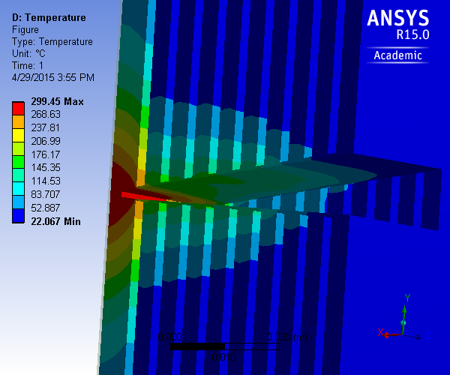
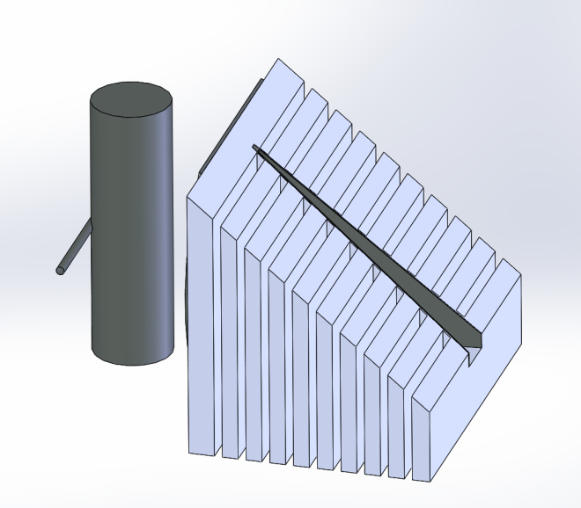
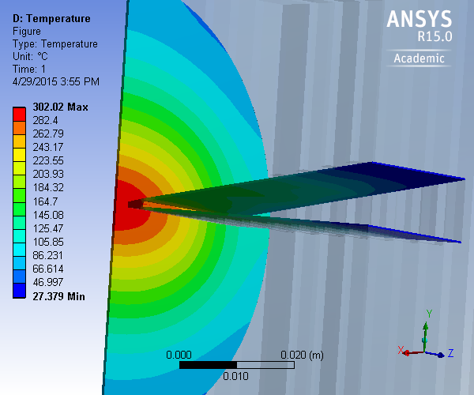
Towards a > 2 kW ARIEL Electron-to-Gamma Converter
Solid Trench-Type Converter
vertical 50 cm³
BaO / UC_{x} target
50 kW e-beam power, 35 MeV
generation of bremsstrahlung in high-Z layer
stopping all primaries in low-Z material
Al cooling body with water cooling
water cooling
5 cm
e⁻
8 x 45 mm
transfer
line
Full primary electron absorption:
→ beam power limit
for solid converter:
30 - 100 kW
(subject to tests)
→ 15% of beam power deposited in target → beam power limit for target ≈ 80 kW
Al cooling body
high-Z
primary converter
high-Z primary converter layer
effective thickness: 0.5 S₀
vertical UC_{x} container
vertically scanned electron beam
minimize distance converter-target
limit target thickness

Slide 15
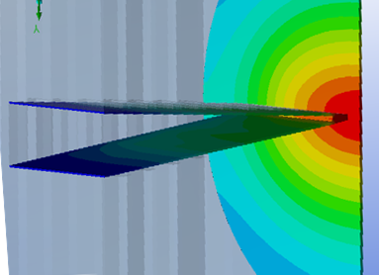
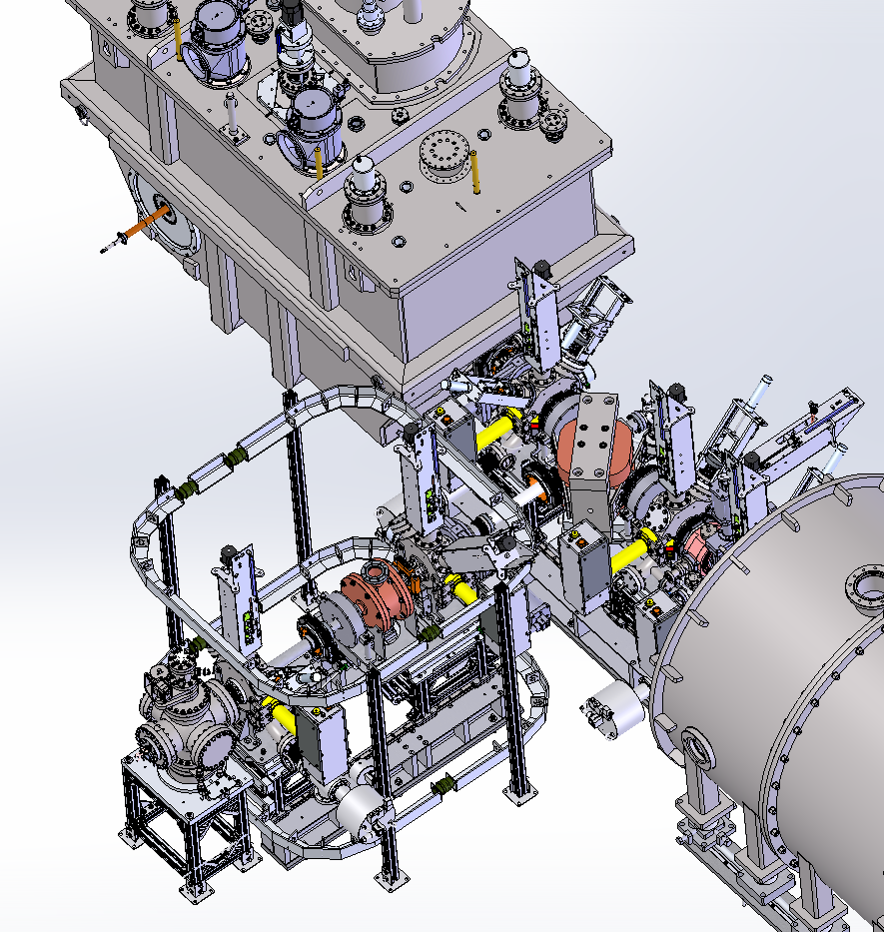
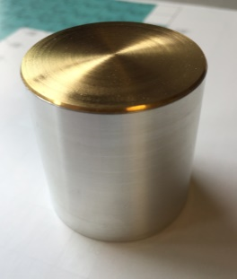
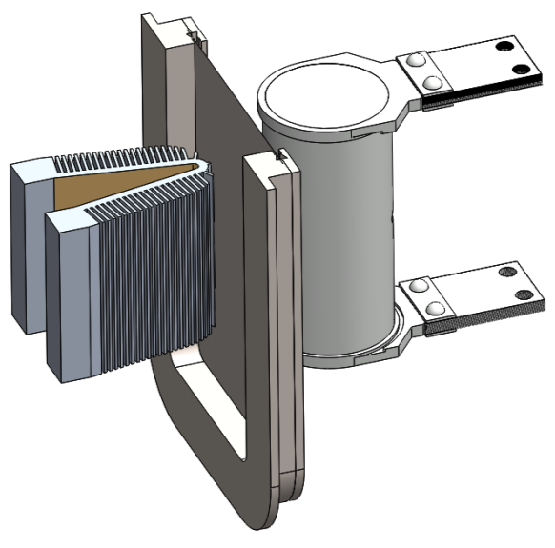
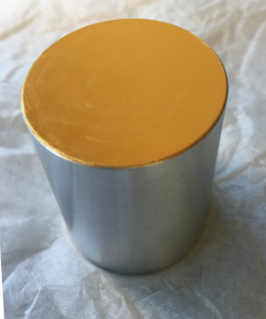
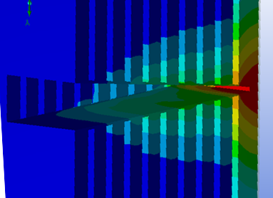
Towards a > 2 kW ARIEL Electron-to-Gamma Converter
ARIEL electron-to-γ converter, γ-ray window, target geometry
→ converter materials irradiation test stand at e-linac to simulate AETE power density (material bond qualifications ongoing)
γ-ray window
primary converter
layer (Au) ~300 °C
50 mm
e-beam
50 kW, 35 MeV
8 x 45 mm²
300 keV
diagnostics
water-cooled
converter backing
(Al) ~60 °C
converter
test stand
target container
2000 °C
300 keV e-gun

Slide 16
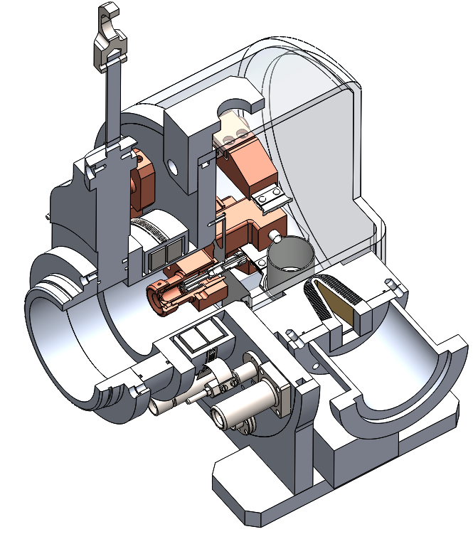
Target / Ion Source / Converter Concept
water-cooled high current feedthrough
flexible Ta sheet connectors
Making use of novel technology
(Al welding techniques, sealing materials, etc.)
≈50 kW electron-to-gamma converter
γ-window separating electron and RIB beamlines
Full offline conditionability
Life time approximately 5 weeks
Target design allowing for proton / electron module compatibility
Flexibility for ion source and transfer line design
Compatible target vessel waste strategy developed
Preparing for 30 target units per year
(target material synthesis, assembly production, waste management)
gate valve
primary vacuum
target material container
γ-ray window
trench-type
converter
ion source
target-to-RIB vacuum interface
converter-to-e beamline vacuum interface

Slide 17
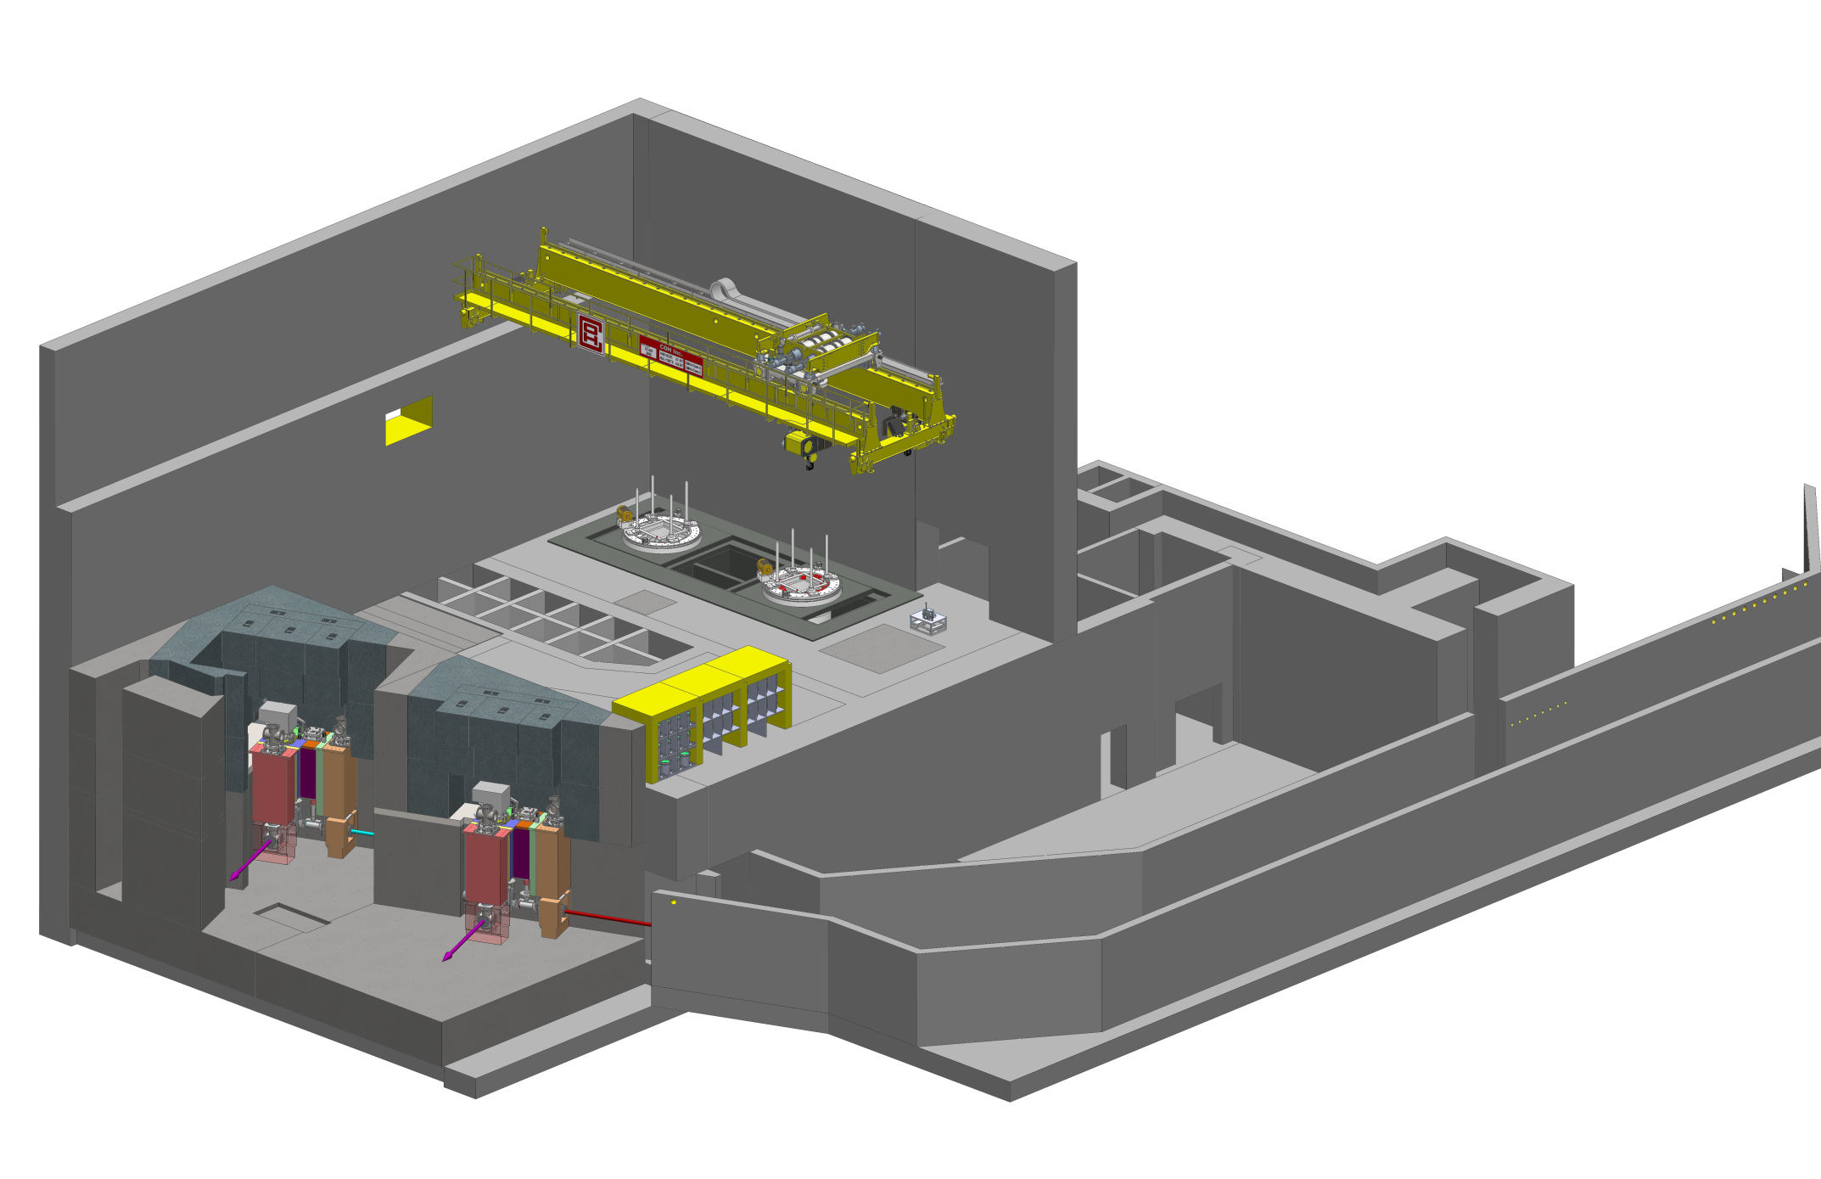
ARIEL Target Station / Target Hall
Direct target exchange process (target remote connections at target station without moving target module to hot cell)
Modular design of components in high-radiation fields
Target station (gas and vacuum management, module interfaces)
Target pit (shielding, support / alignment structure, main services voids)
Hot cell, RIB modules, electron delivery line
remote-controlled crane (existing)
Hall with two floor levels (existing)
hot cell facility
module storage
target exchange point
AETE
APTW
spent targets
drivers beam tunnel (existing)
ASTM
electrons
RIB
protons
RIB

Slide 18
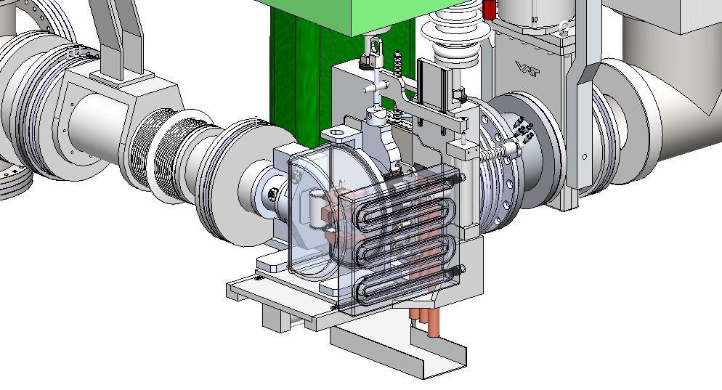
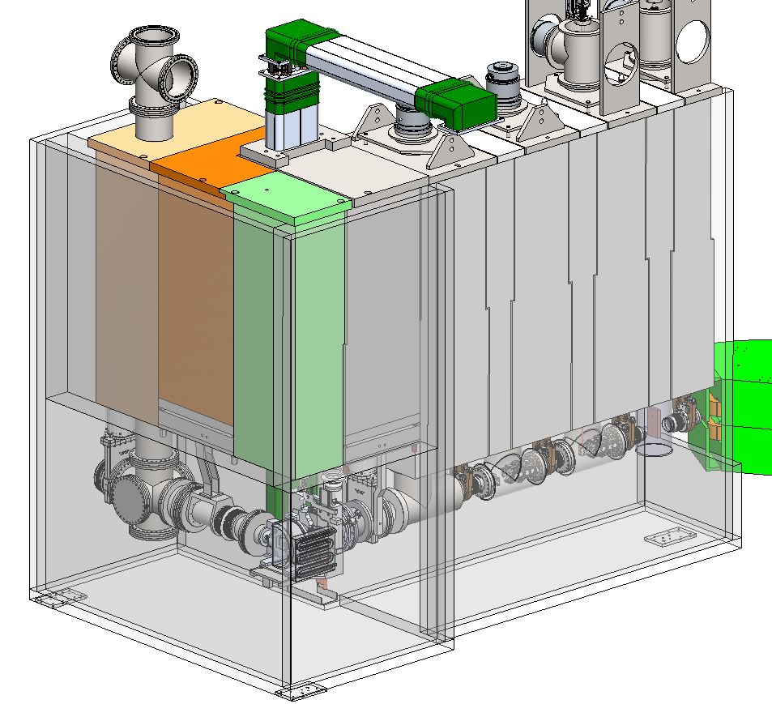
ARIEL Target Station / Target Hall
high-voltage feedthrough
HV feedthrough
4th RIB transport module
60 kV insulation
remote vacuum disconnect
Electron diagnostics module
3rd RIB transport module
remote vacuum disconnect
Converter module
2nd RIB transport module
Target module
isolation valve
Target access
shield plug
1st RIB transport module
3.2 m
hermetic target vessel
AETE / APTW compatible TIS front end
target remote coupling table
Modules that allow for hot-cell based maintenance and repair
Direct target exchange in target station in ≤ 24 h
Hermetic and disposable target vessel
Converter on target vessel (start-up), on converter module (later)
Secondary confinement volume in air
Symbiotic medical target behind target
hermetic target vessel
secondary confinement
gas enclosure (vacuum at ISAC)

Slide 19
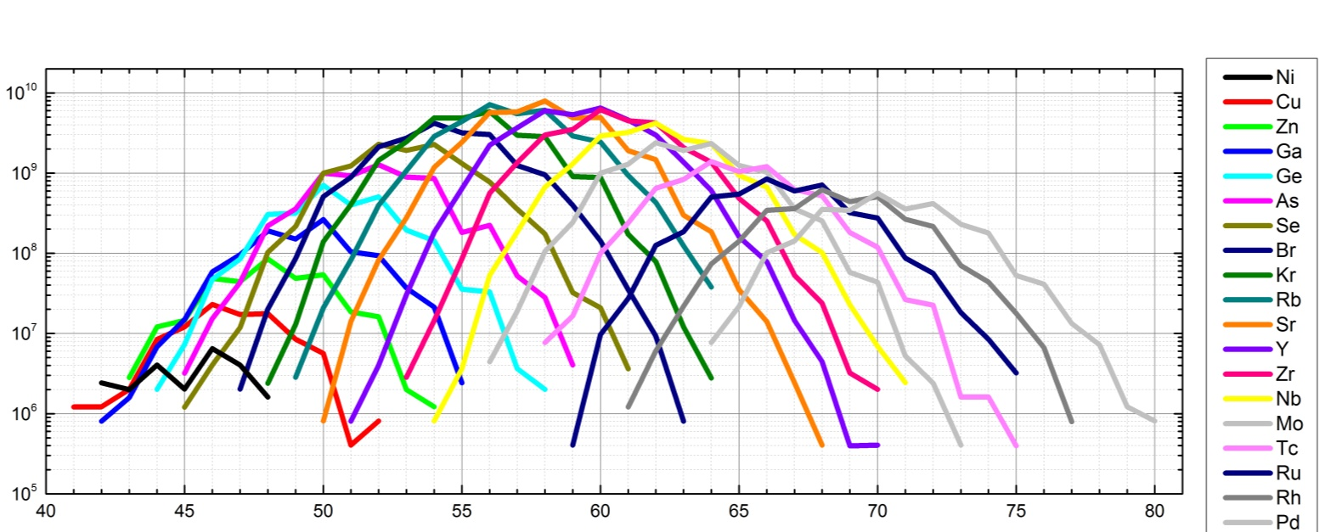
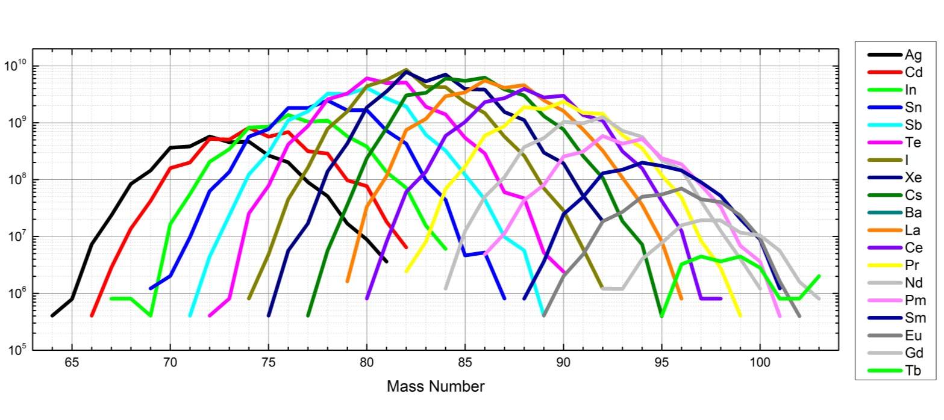
FLUKA Production Map from 35 MeV Electrons
ARIEL Current Concept Design In-Target Production Yields [10 kW⁻¹·s⁻¹]
In-target production rates
[10 kW⁻¹ ∙ s⁻¹]:
from BeO:
⁸Li: 5∙10¹⁰
from UC_{x}:
⁷⁸Ni: 1∙10⁵
⁹⁸Kr: 8∙10⁷
¹⁰⁰Rb: 1∙10⁸
⁹⁸Sr: 5∙10⁹
¹³²Sn: 5∙10⁸
¹⁴⁶Xe: 2∙10⁷
¹⁴⁴Ba: 5∙10⁹
¹⁵⁰Cs: 4∙10⁵
in agreement with initial project description
In-Target Production Rate in Current Concept [(10kW s)⁻¹]
Neutron Number

Slide 20
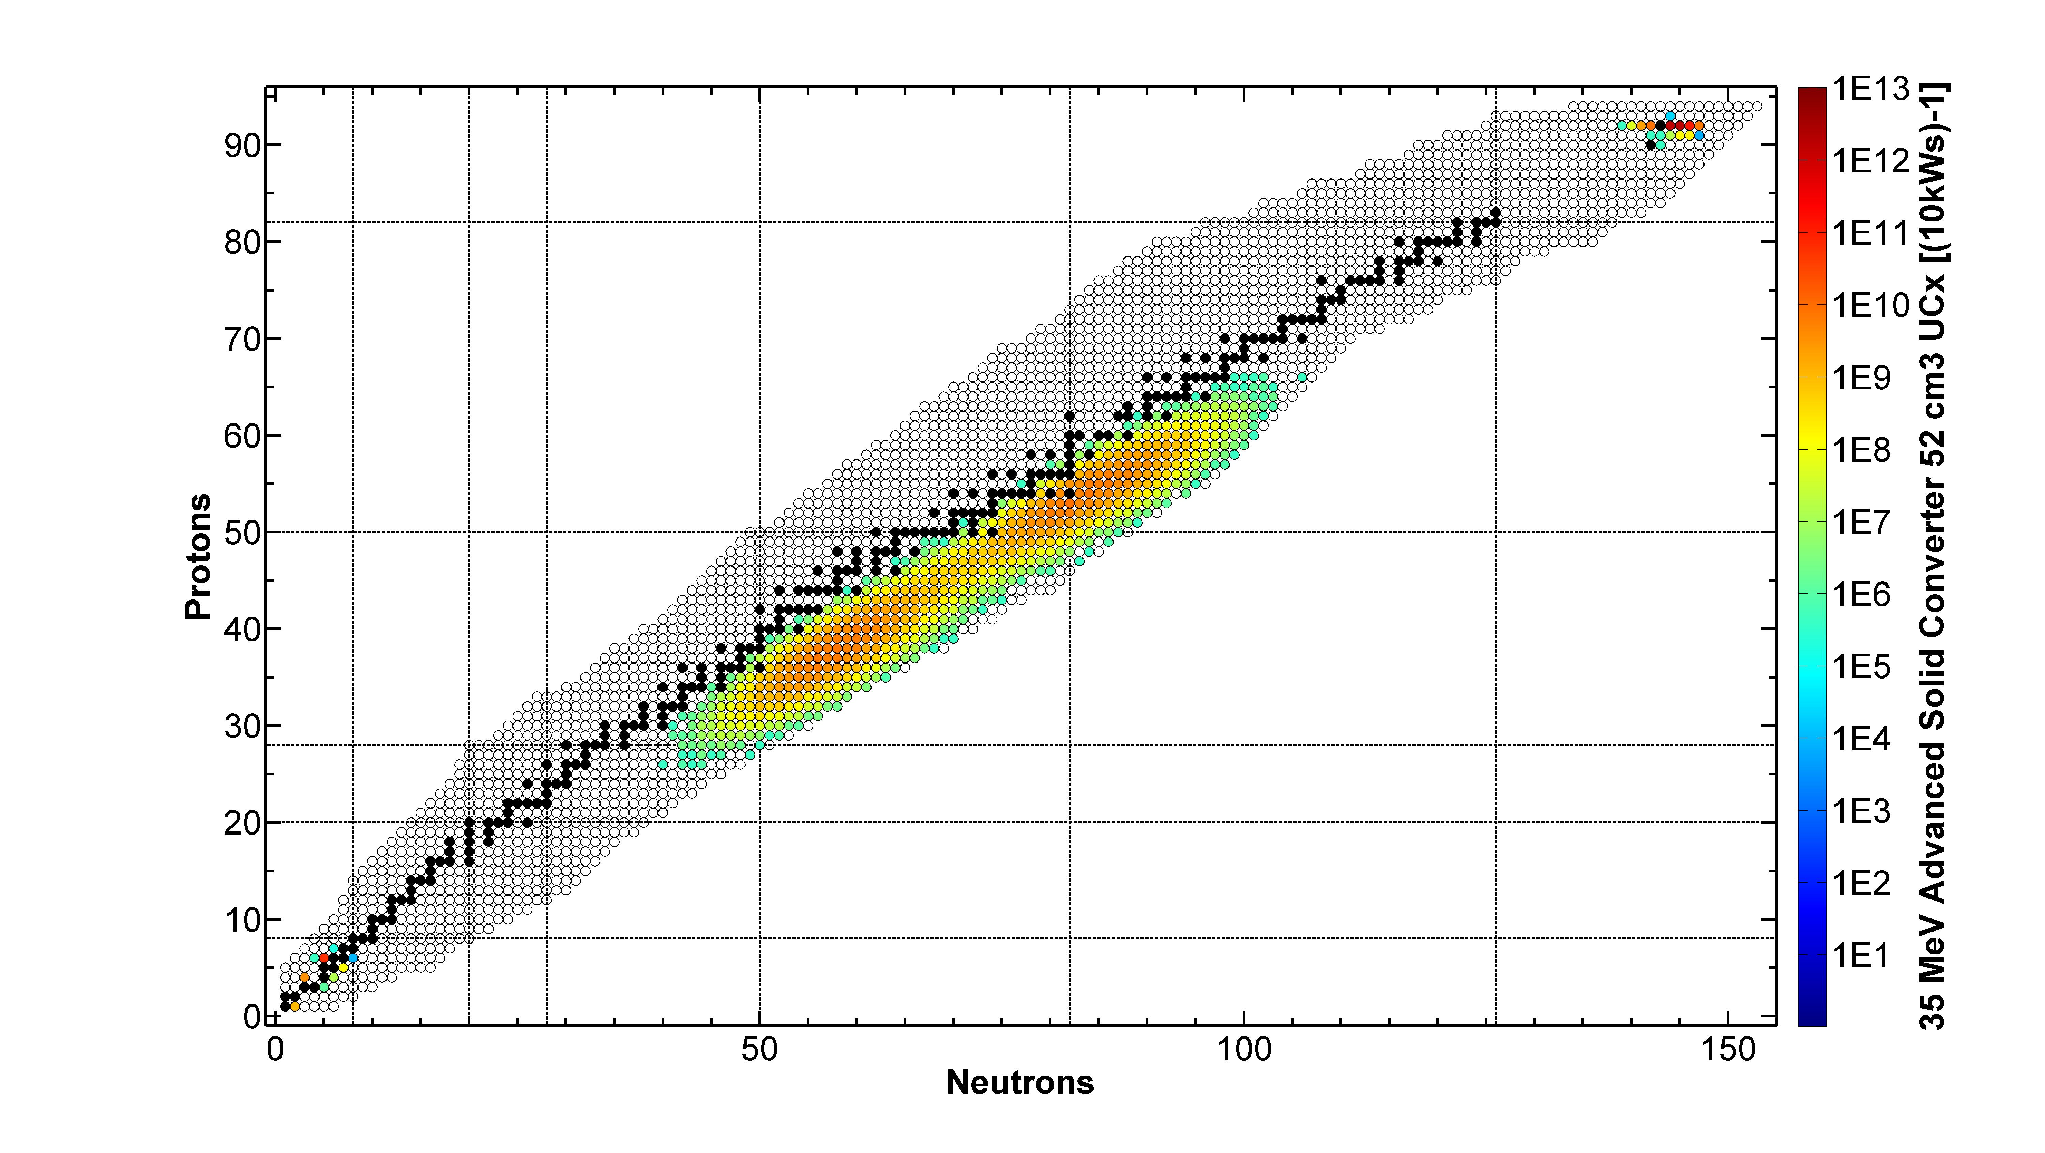
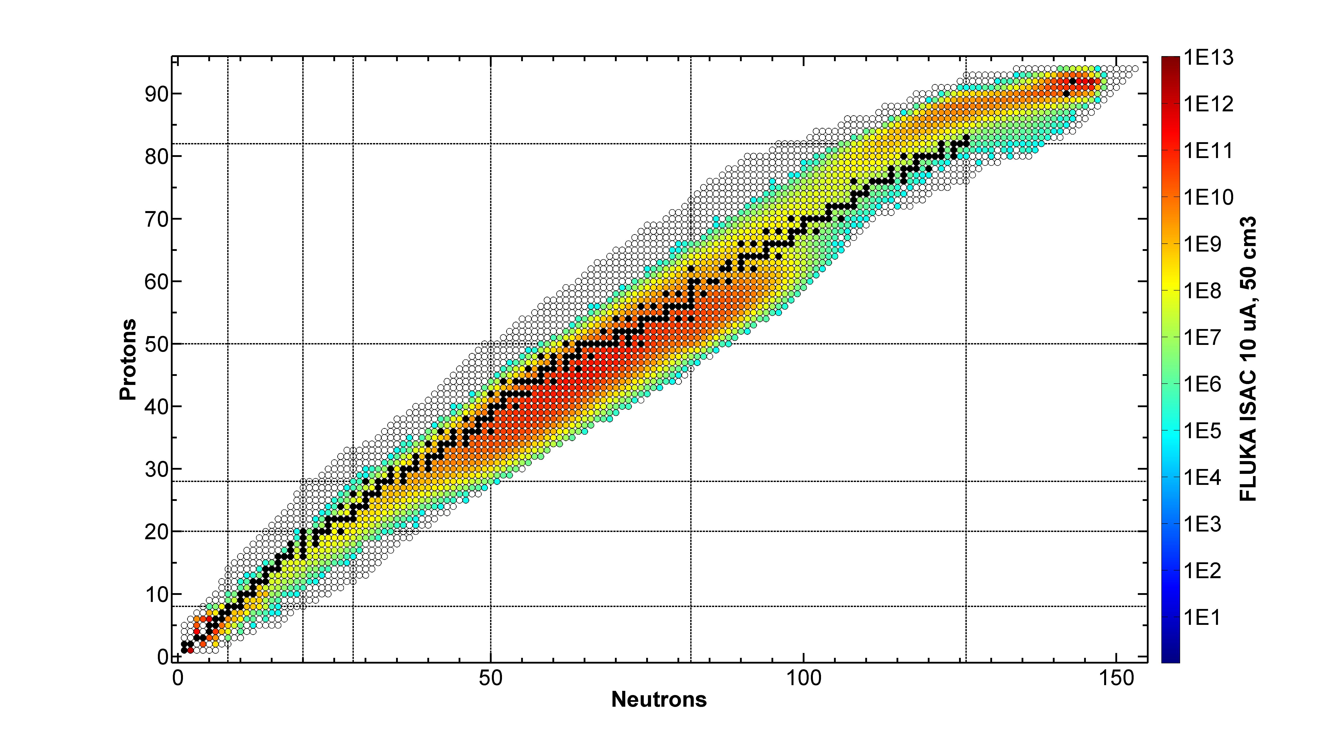
Preliminary: Expected Yields from AETE in Low Energy Stations
From BeO at 50 kW electron beam power:
⁸Li expected yield: 5∙10⁷ s⁻¹ (assuming 0.2% extraction, 10% ionization)
ARIEL 35 MeV, 10 kW, concept geometry [s⁻¹]
ISAC 500 MeV, 10 µA [s⁻¹]
From UC_{x} at 50 kW electron beam power:
Overall fission rate: ~1∙10¹² s⁻¹
ARIEL RIB yield predictions available for experiment planning

Slide 21
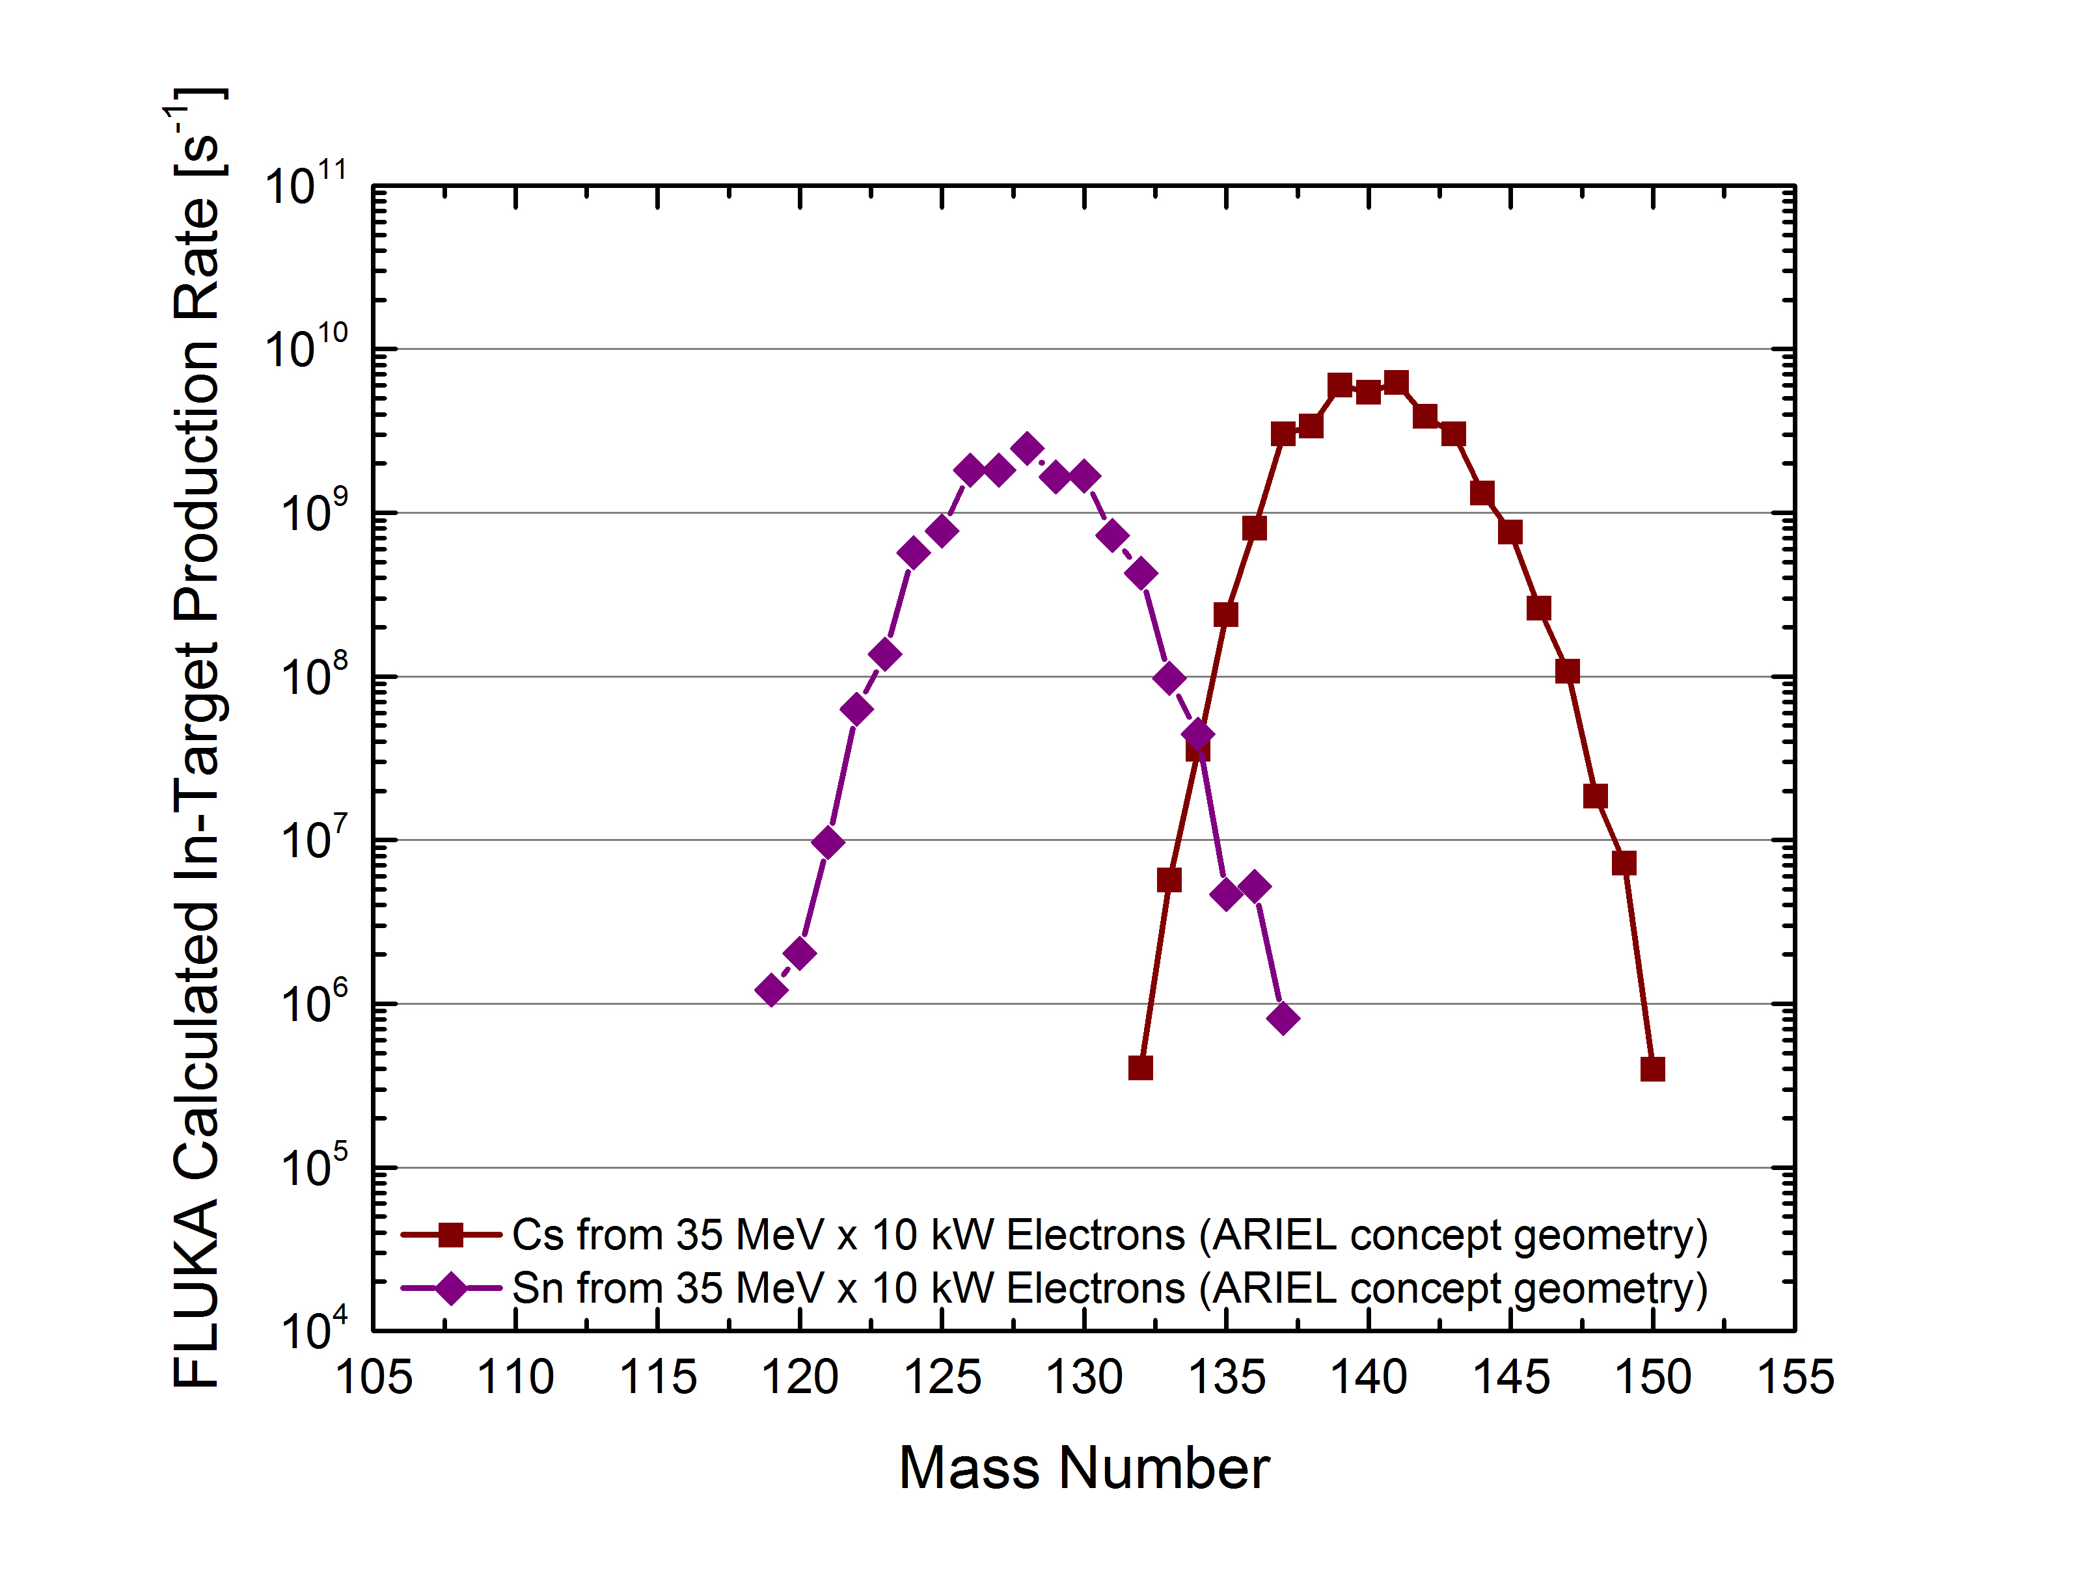
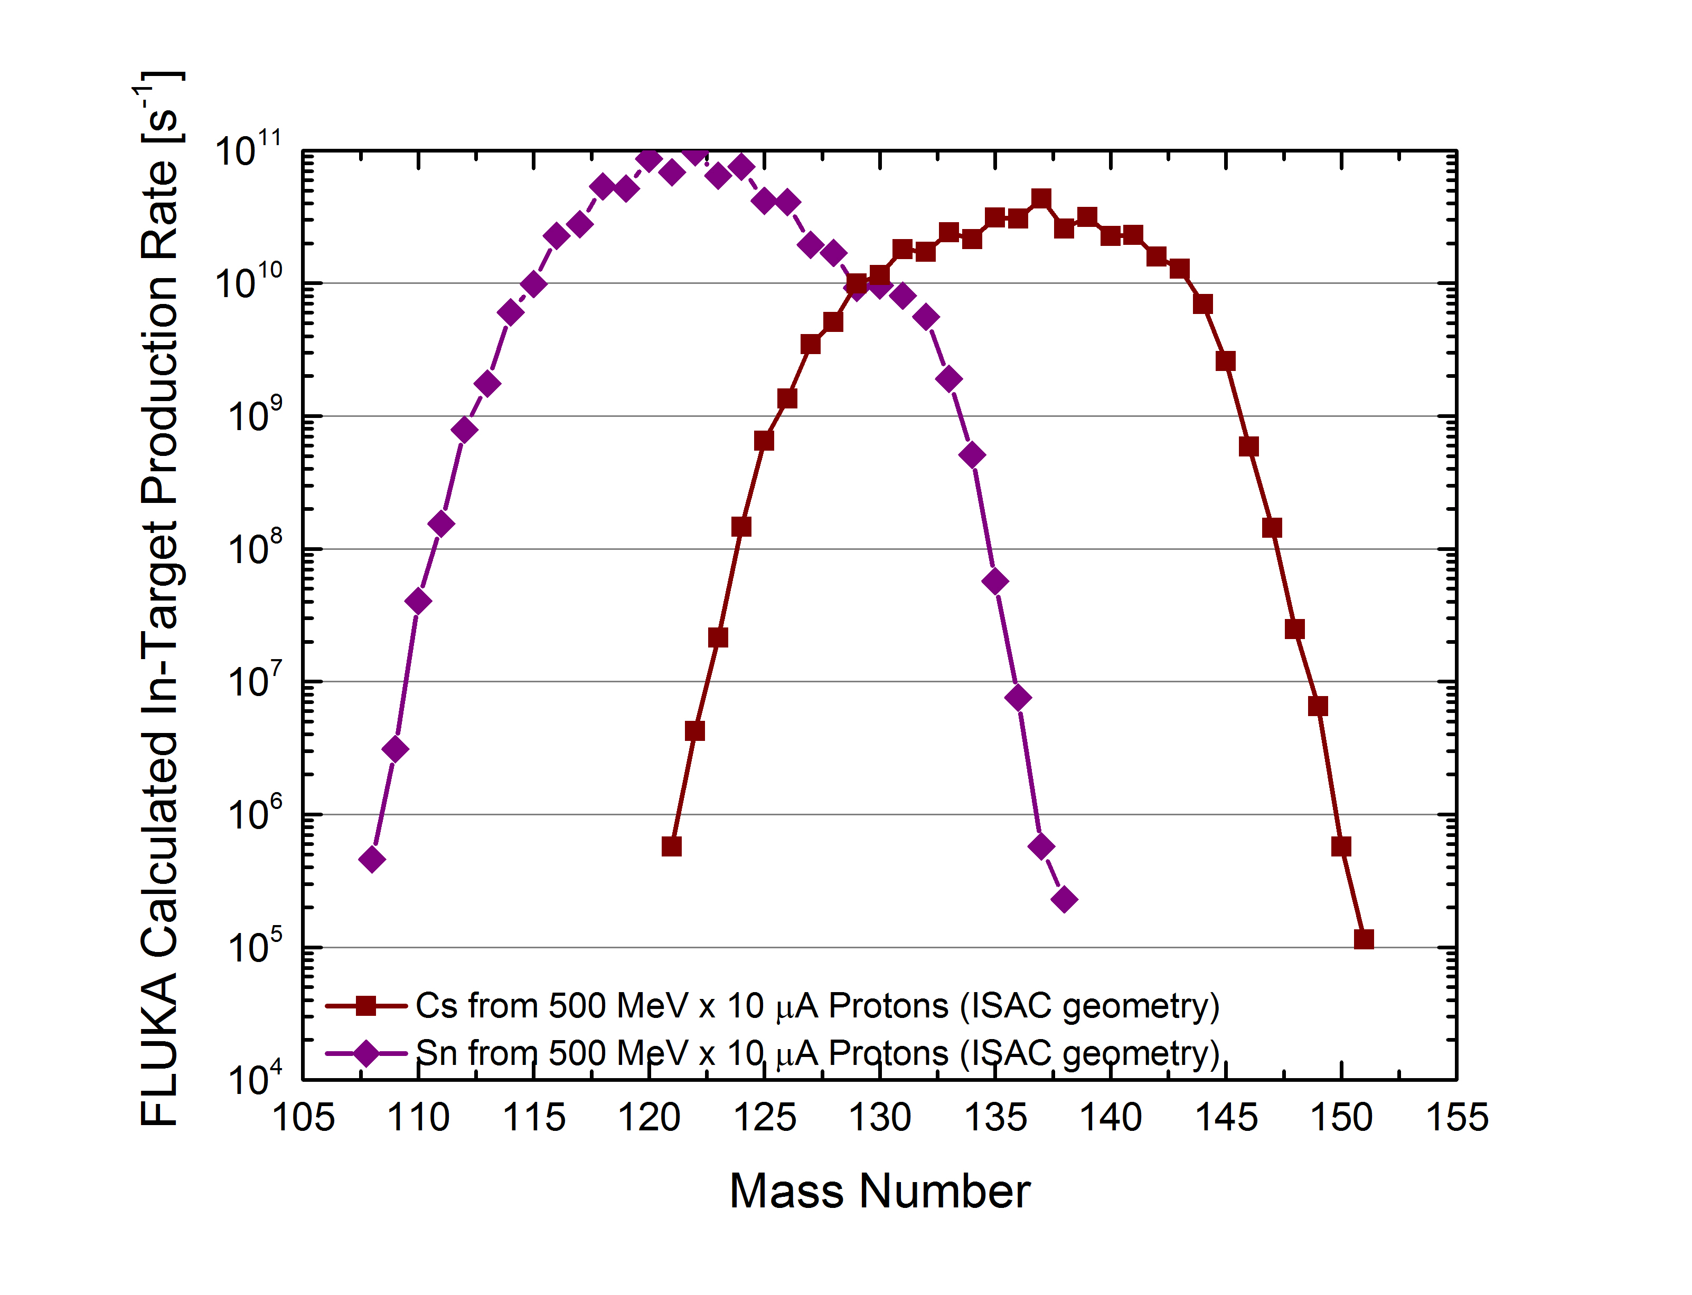
Preliminary: Expected Yields from AETE in Low Energy Stations
From BeO at 50 kW electron beam power:
⁸Li expected yield: 5∙10⁷ s⁻¹ (assuming 0.2% extraction, 10% ionization)
ARIEL 35 MeV, 10 kW, concept geometry [s⁻¹]
ISAC 500 MeV, 10 µA [s⁻¹]
¹³⁴Sn
¹³⁴Sn
From UC_{x} at 50 kW electron beam power:
Overall fission rate: ~1∙10¹² s⁻¹
ARIEL RIB yield predictions available for experiment planning
AETE will provide:
Pure n-rich fission fragments
Additional beamtime with modern, reliable driver
Chances for long-duration beam time
High integrated yields for specific isotopes
Development capability
APTW will provide:
Access to all ISAC spallation targets
Hermetic target vessel
→ new target materials
Additional development flexibility for new ion sources and transfer line technologies

Slide 22
RIB Development
ISAC is currently ≈1.8-fold overbooked
with ARIEL the output of RIB shall triple (from ~2800 h/a to over 9000 h/a)
→ ARIEL will offer new RIB perspectives in alignment with high international backload on RIB delivery
(targets with flexible technology for optimized and reliable isotope yields, quick turn-over, purity, isotope availability)
Areas of target, ion source, converter development:
New target nuclides (Be, Ca, La, W, Pb, Bi)
Nanostructured porous target materials (SiC, TiC, UC_{x}, LaC₂)
Molecular beams for extraction of non-volatile species
New ion sources (TRILIS + FEBIAD, various work function SIS)
New transfer lines (quartz, cold, variable temperature)
High-power electron-to-γ converter
Proton-to-neutron converter
ARIEL will allow for:
More online development time (4 target stations,
faster target turn-over, 2 yield stations, 2 independent drivers)
Additional development capabilities
(pulsed driver beam, hermetic target vessel, additional development space for ion sources and transfer lines)
Conditions: sufficient resources, experts that are not occupied with operation / repair / maintenance, sufficient online development time
ISAC yields since 1998

Slide 24
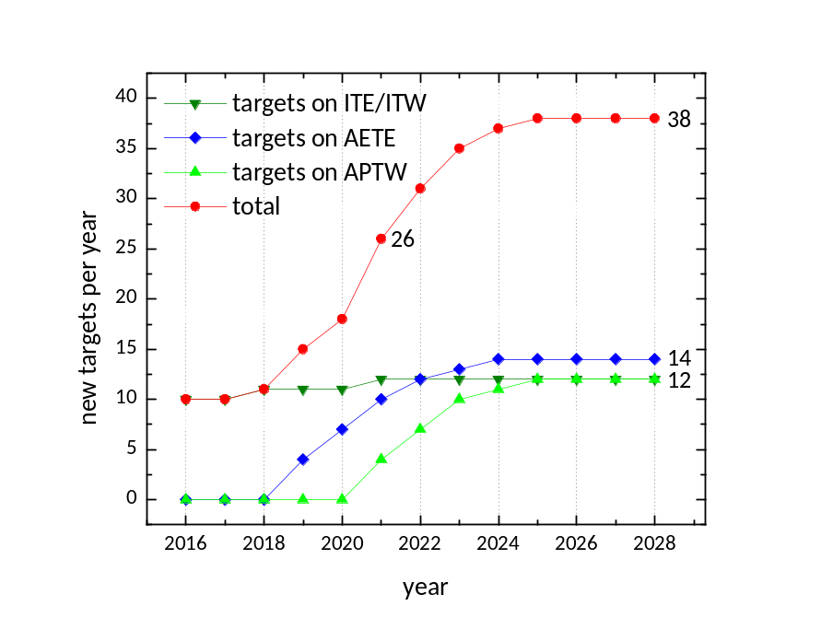
Upcoming Challenges
Target module refurbishment
Target laboratories restructuring
ARIEL development / construction
Target production ramp-up
→ Proactive approach :
Target material and target assembly production schedule with sufficient reserve
Sustainable target module refurbishment program
One additional target module in circulation
Upscaling production methodology (UC_{x} production currently ~ 6 weeks)
Systematic approach towards targets assembly reliability
Utilizing additional ARIEL infrastructure (laboratories, material ovens, manpower)
less “firefighting”

Slide 25
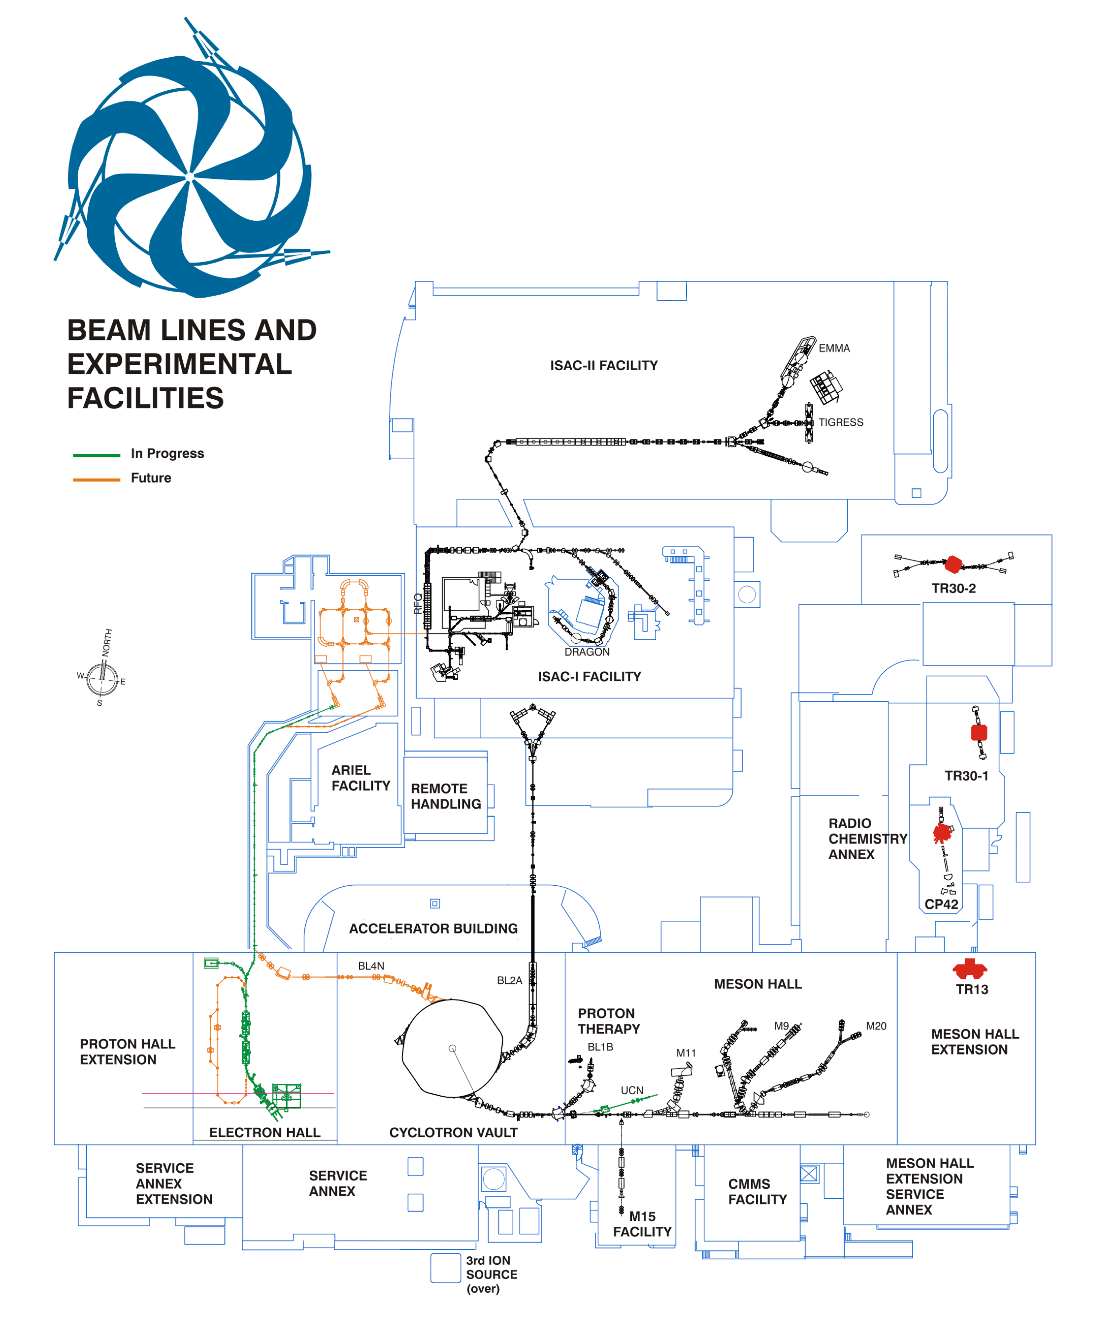
TRIUMF – A High-Power Target Laboratory
TRIUMF (since 1968)
550 MeV, 150 kW cyclotron
50 MeV, 500 kW e-linac
>6000 proton h annually to:
ISOL production (50 kW
protons,100 kW electrons)
µ and π production (60 kW)
medical isotopes (50 kW)
cold neutrons (20 kW)
proton therapy (50 W)
ISAC (since 1995)
2 target stations
500 MeV, 50 kW protons
Post-Acc. RIB:
1.8 MeV/u &
≤16 MeV/u
ARIEL (since 2010)
2 target stations under construction
35 MeV:
100 kW electrons
500 MeV:
50 kW protons
→ RIB power: 1 pW to 100 nW

Slide 26
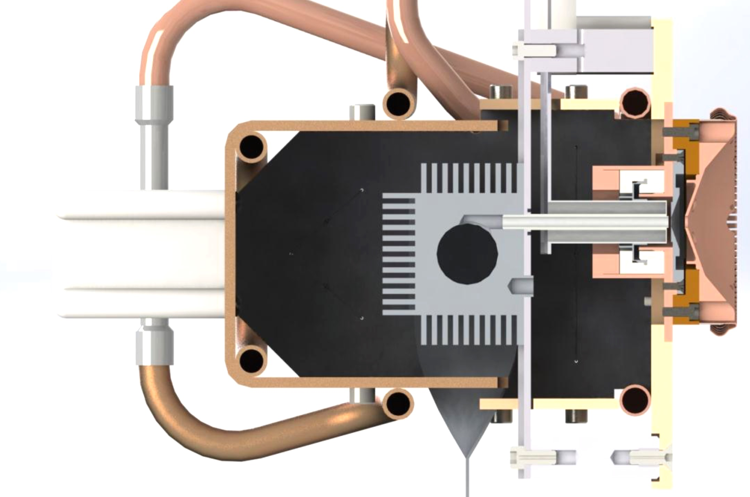
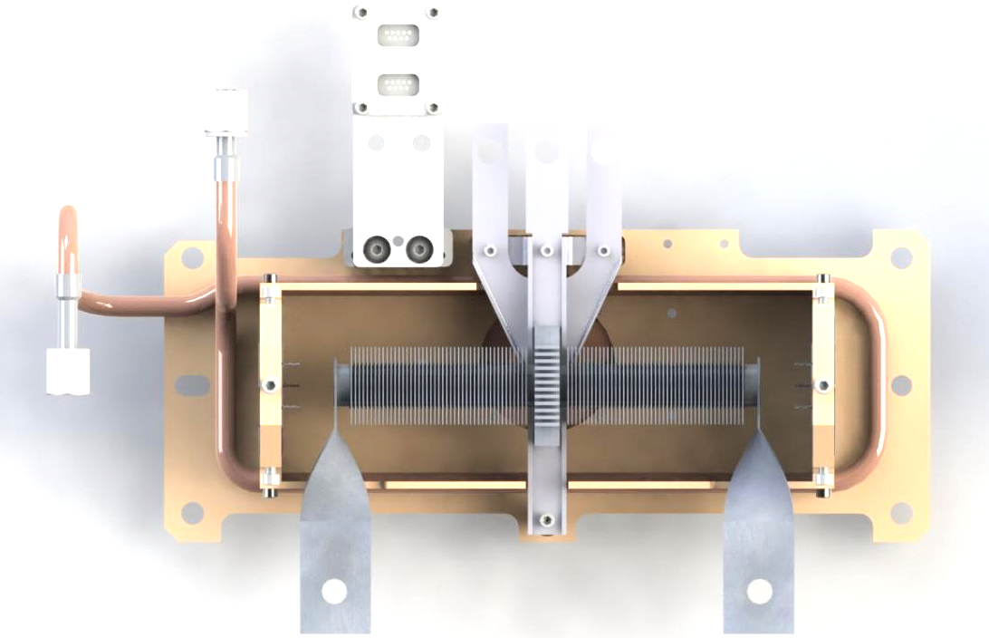
ISAC Target Assembly
ionizer tube
extraction electrode
multi-pin (diagnostics, ion source, etc.)
ionizer heating
terminals
heat shield (cover hidden)
target container ~2000 °C
(Ø 20 mm, 60 cm³)
hot cell telemanipulator
grips
cooling-water
supply
target oven
target oven heating terminals
heat shield
diffusion bonded Ta fins
→ radiative cooling of up to 13 kW
→ 50 kW proton irradiation

