Slide 1
Project Introduction and Current Status of ARIEL
Reiner Kruecken
Deputy Director
January 11, 2017

Slide 2
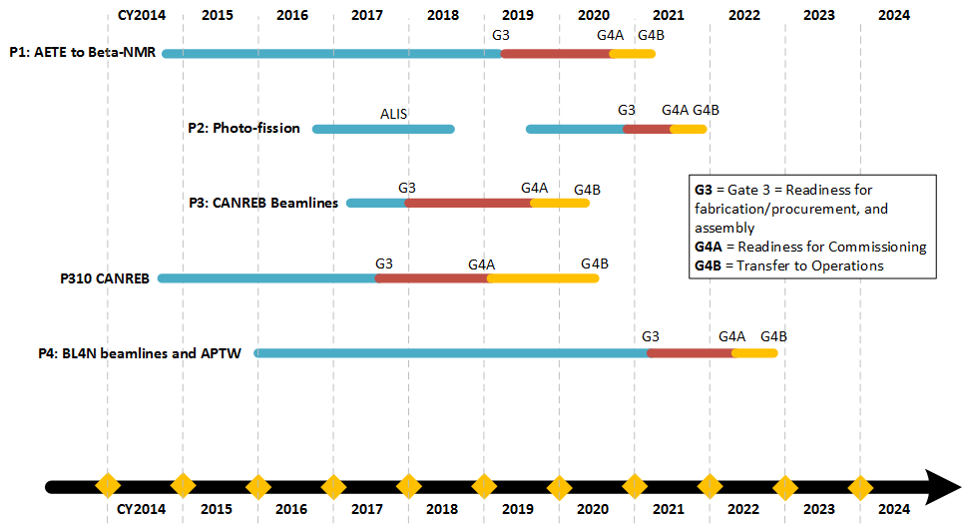
ARIEL-II baselined schedule
P5: (50 MeV eLinac, 500 kW converter R&D) postponed

Slide 3
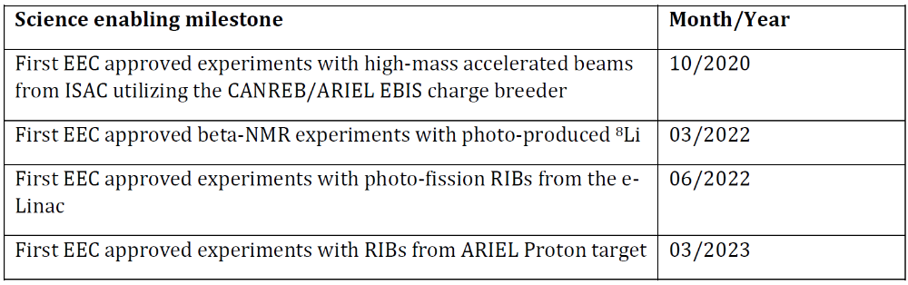
ARIEL: Science enabling milestones
Higher intensity, cleaner high-mass accelerated beams
More RIB hours, cleaner n-rich RIBs
3 parallel RIBs
Dates based on Monte Carlo analysis of schedule
Current best estimates but with high confidence
Efforts under way to accelerate schedule

Slide 4
ARIEL-II baselined schedule
P5: (50 MeV eLinac, 500 kW converter R&D) postponed

Slide 5
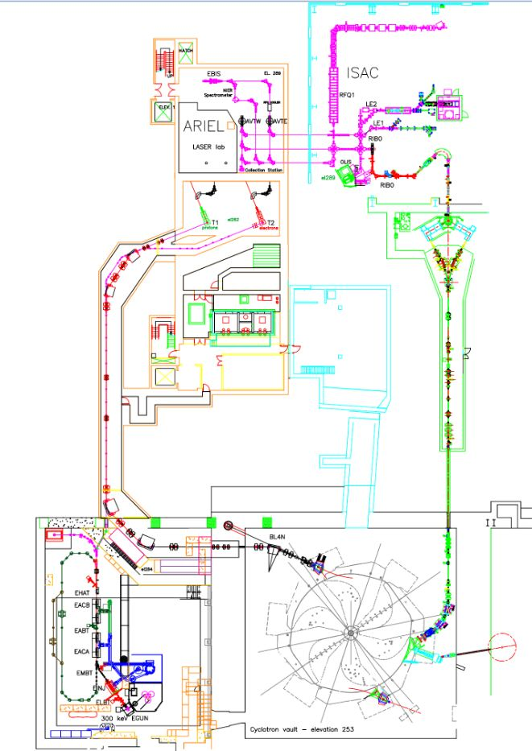
ARIEL is divided geographically
#1 RIB delivery
#2 ARIEL target stations & infrastructure
#3 Driver beam lines
#1
P355 – Laboratories ($1.3M)
P424 – Target Hall Infrastructure ($10.6M)
#2
P310 – CANREB ($3.4M)
#3
P353 – Target Stations ($9M)
P354 – Beamlines ($7M)
P363 – e-linac completion ($0.5M)
P179 – BL4N ($4.5M)
P358 – CFS ($3.3M)
Least risk: complete asap
AETE is new tech: higher risk
Depends on target stations

Slide 6
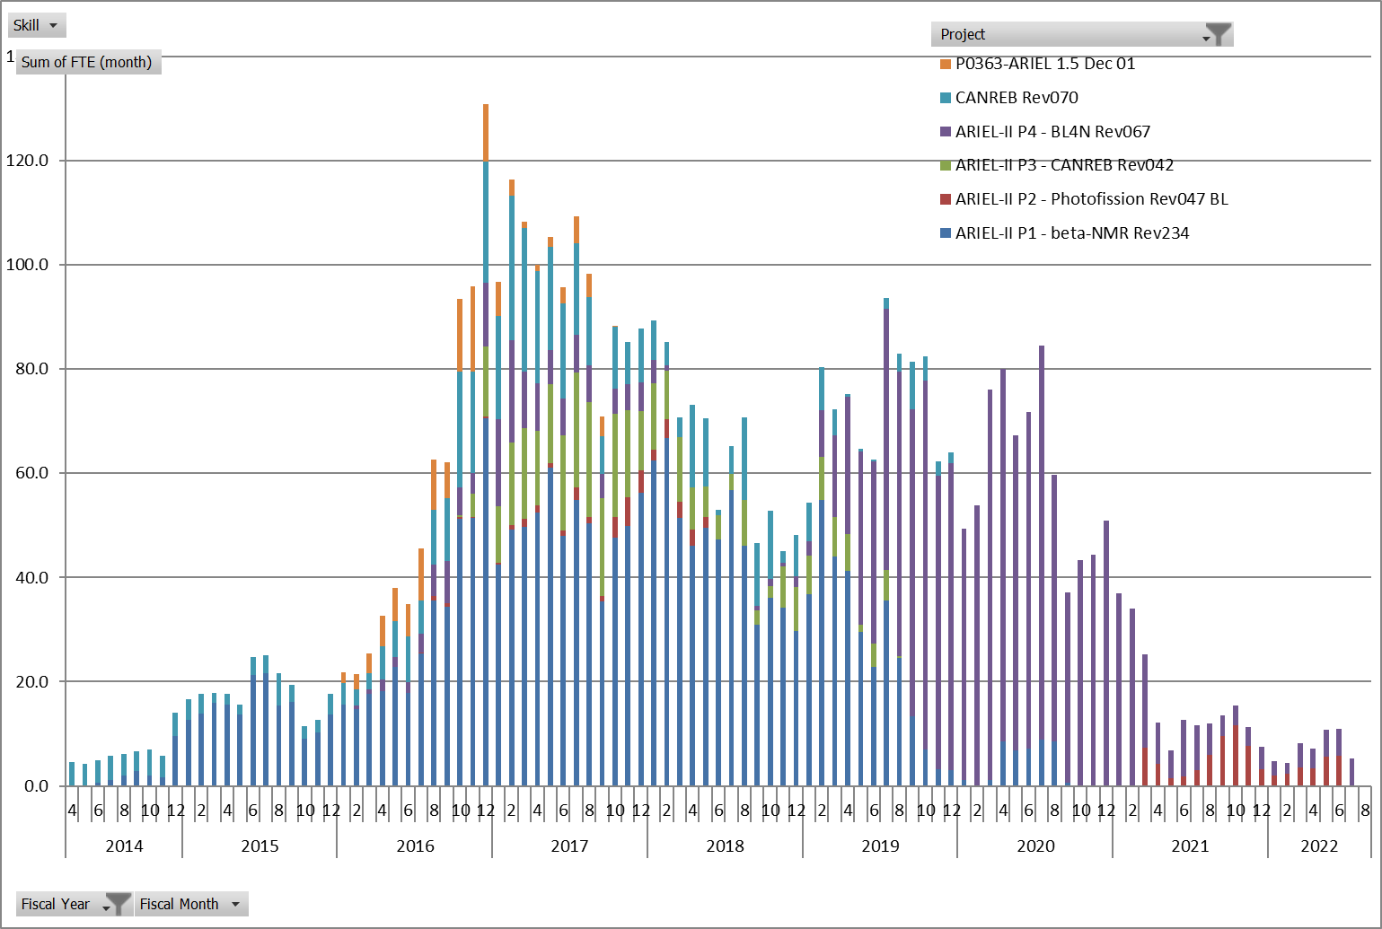
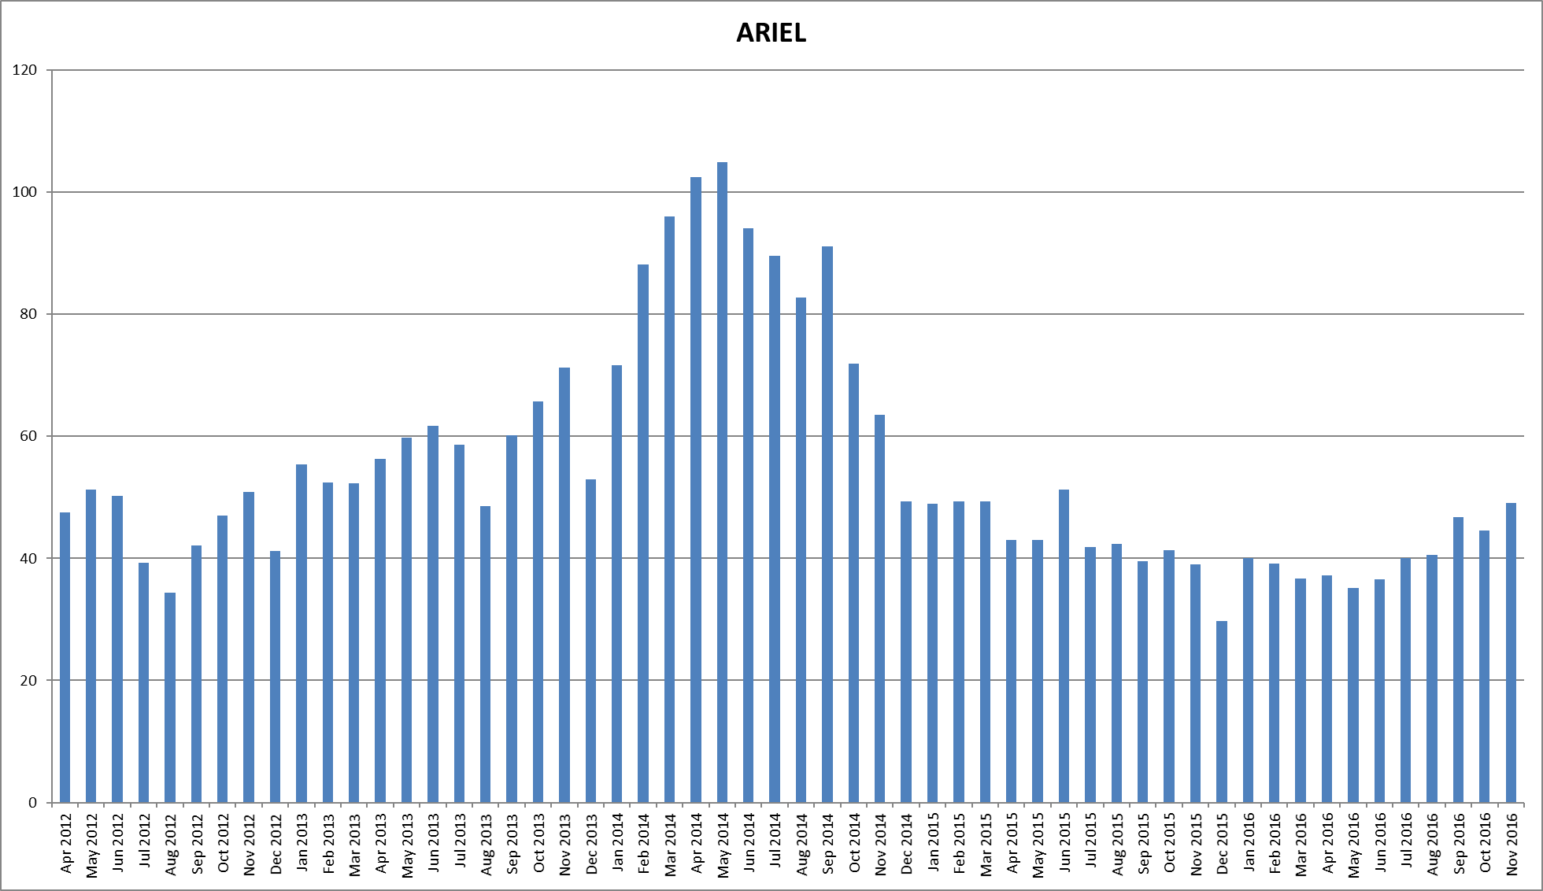
ARIEL Resource Load by Fiscal Year
ARIEL II + CANREB + ARIEL 1.5
ARIEL-II schedule is manpower limited
Action: schedule was levelled to limit times with > 80 FTE
80 FTE
all ARIEL related projects
80 FTE
FY2012 FY2013 FY2014 FY2015 FY2016

Slide 7
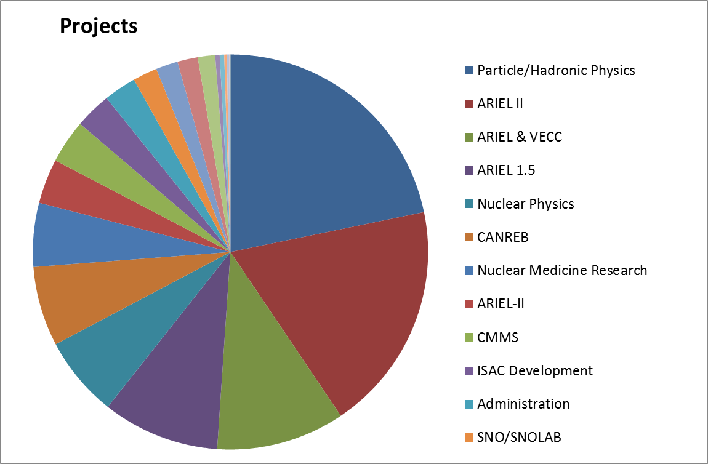
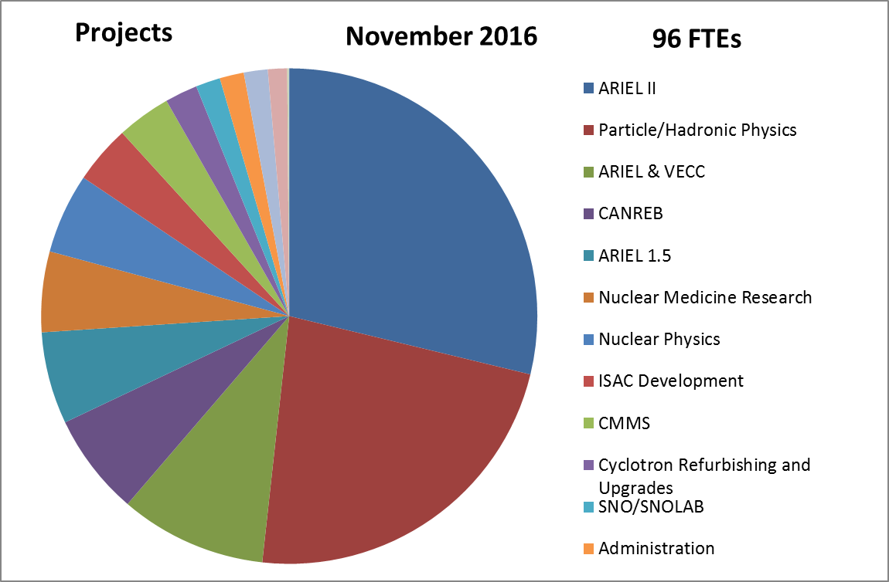
TRIUMF Project Manpower (NRC funds)
December 2015 – November 2016
ALPHA-g
UCN
ATLAS
…
CANREB
ARIEL II
ARIEL II
EMMA
GRIFFIN
ARIEL & VECC
ARIEL 1.5
ARIEL 1.5
81 FTE
CANREB
ALPHA-g
UCN
ATLAS
…
ARIEL & VECC

Slide 8
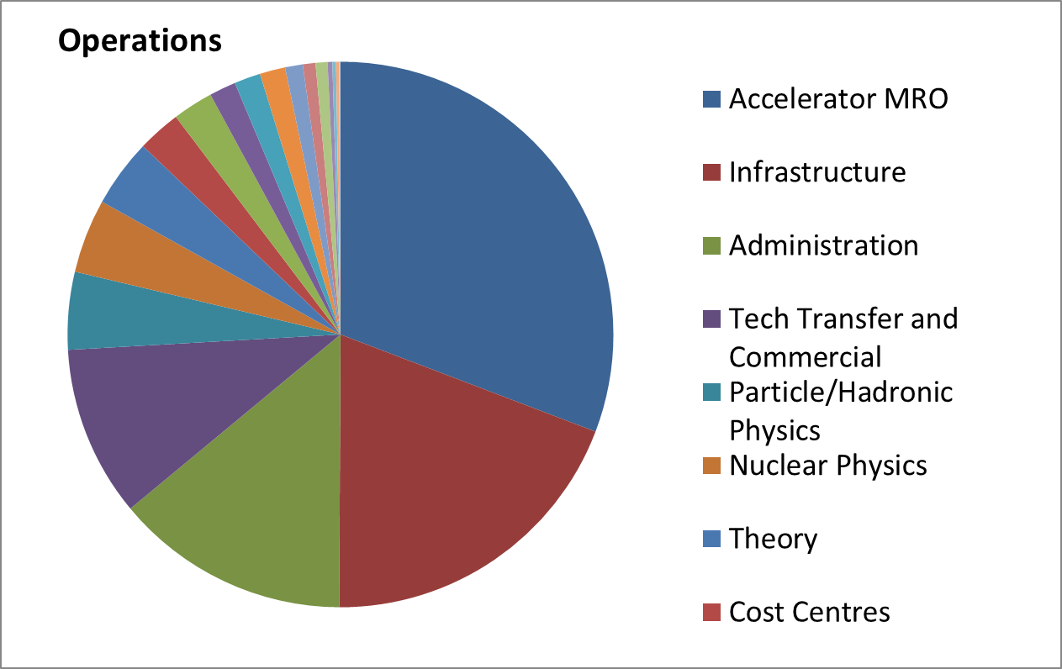
Operations manpower
December 2015 – November 2016
~80 FTE
(20-25 FTE for ISAC)
263 FTE

Slide 9
Existing Resource Action Plan
ARIEL-II schedule is manpower limited
Action: schedule was levelled to limit times with > 80 FTE
Measures already taken to allow planned project delivery
We have identified obstacles in the project organization
Action: restructured project to decouple project components
We have identified over-allocated resources
Action: hired 13 FTE (engineers, scientists, technicians) to alleviate immediate pressures (~$2M), more might be necessary.
To be addressed:
Ensure fully adequate resourcing based on up-to-date integrated schedules
Reduce multitasking and focus team members

Slide 10
How to accelerate ARIEL-II
  Identify one major goal for each year and focus effort on it
    2018: Focus on CANREB & RIB Transport installations
    2019: Focus on Target Hall installation
    2020: Focus on BL4N installation
  Take advantage of spatial separation of project parts and form dedicated ARIEL-II assembly & installation teams, starting 2H2017, to prevent multi-tasking
    1 team for Target Hall
    1 team for RIB and driver beams
  Make more manpower available for the project by
    Hire more contract labour … only possible within available budget, will be fully utilized
    delaying other projects [big ones: ALPHA-g, UCN, EMMA (completed), M9 reconnect]
    Involvement of university resources
    Reduced beam delivery
    … need to consider graded approach

Slide 11
Potential user involvement
Well defined engineering / manufacturing packages for university workshops
(utilization of NSERC SAP MRS funded support groups)
Assembly / test of electronics components, e.g. for diagnostics elements
Simulations, e.g. targets/ion-sources
Materials tests, e.g. photo converter and targets test stand
Support during commissioning of certain components
  E.g. CANREB charge breeder
  HRS
  Beam lines
  Diagnostics set-ups

Slide 12
Scenarios for reduced beam delivery
# | Measure to be considered | Advantages | Disadvantages
1 | full shutdown for one year (e.g. 2019) | Reduced power bill (~$2.5M) ➔ would allow for hiring contract labor Frees ~80FTE for 9 months No distraction by maintenance ➔ can focus teams on project work | Loss of commercial revenue (~$3M) Loss of customers and users Loss of science output and delayed HQP training Not all 80FTE can be utilized for project work
2 | 6 months operation for several years | Slightly reduced power bill ($~1.25M) ➔ would allow for hiring contract labor Frees ~80 FTE for 3 months No distraction by maintenance ➔ can focus teams on project work | Significantly reduced commercial revenue Potential loss of customers and users Reduced of science output and delayed HQP training Not all 80FTE can be utilized for project work

Slide 13
Scenarios for reduced beam delivery
# | Measure to be considered | Advantages | Disadvantages
3 | 12 months ISAC shutdown in one year (e.g. 2019) | Frees up to 20 FTE for 9 months frees key personnel from operational duties (Accel. Phys., Rem. Handling) | Loss of ISAC science output Loss of ISAC users Not all ISAC operations personnel can be utilized for project
4 | 6 months ISAC operation in 2018-2022 | Frees up to 20 FTE for 3 month per year Allows to advance ARIEL and ISAC Target Module Strategy frees key personnel from operational duties (Accel. Phys., Rem. Handling) | Reduced science output Not all ISAC operations personnel can be used for project
5 | Shorter running in 2017 (April-October) | Frees up to 20 FTE for 2 month frees key personnel to focus on important goals for ISAC refurbishments, T2M9 fix, Main Magnet Power Supply | Reduced science output

Slide 14
Scenarios for reduced beam delivery
# | Measure to be considered | Advantages | Disadvantages
6 | Reduced/ focussed ISAC operations | TRILIS only in 2nd half of 2017 Frees a few FTE in first half 2017 allows Laser Team to focus on ALIS clean room installation (before CANREB equipment is installed) | Frees only a few FTE Somewhat constraint science program, difficulty scheduling
7 | Reduced/ focussed ISAC operations | No accelerated beam in 2019 Frees < 10 FTE in 2019 frees some technical personnel for assembly, installation Allows ion source experts and operations teams to focus on commissioning of CANREB | Frees only a < 10 FTE Insufficient impact on accelerating the project? Constraint science program, difficulty scheduling

Slide 15
Conclusion
Delivery of ARIEL project is challenging and ultimately manpower limited
  We are taking every step possible to optimize schedule and resource usage
Acceleration of the schedule is only possible with substantial additional interventions with negative impact on science program
Next steps we are taking:
  Further improve project planning and supplement resources as required (within available budget)
  Reduced Beam Delivery
    Carry out more detailed analysis of the impact of reduced beam delivery on ARIEL schedule
    Propose detailed plan at Science Week 2017
  Identify concrete opportunities for involvement of users
  Communication with the user community is critical ….. stay engaged ….

Slide 16



Thank you!
Merci!
Follow us at TRIUMFLab

