Slide 1
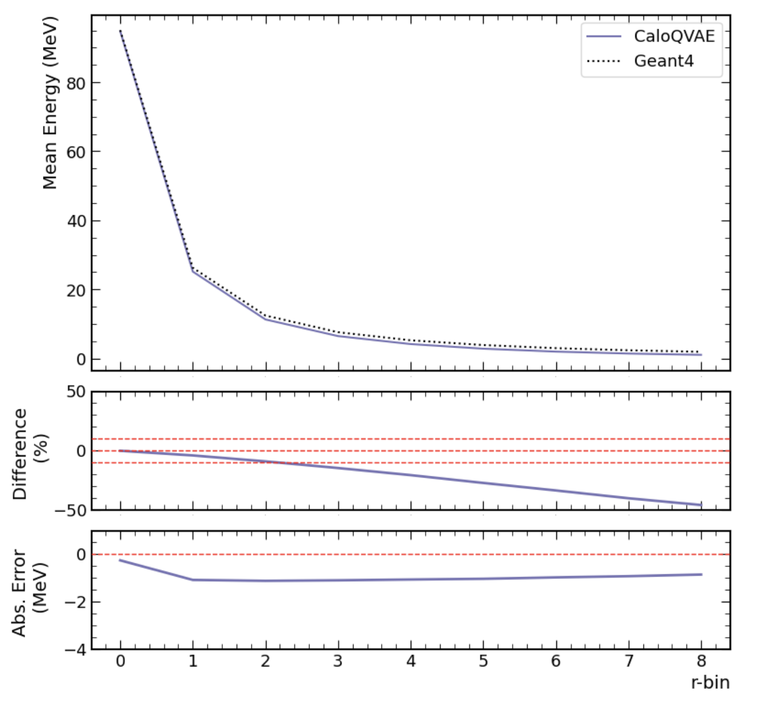
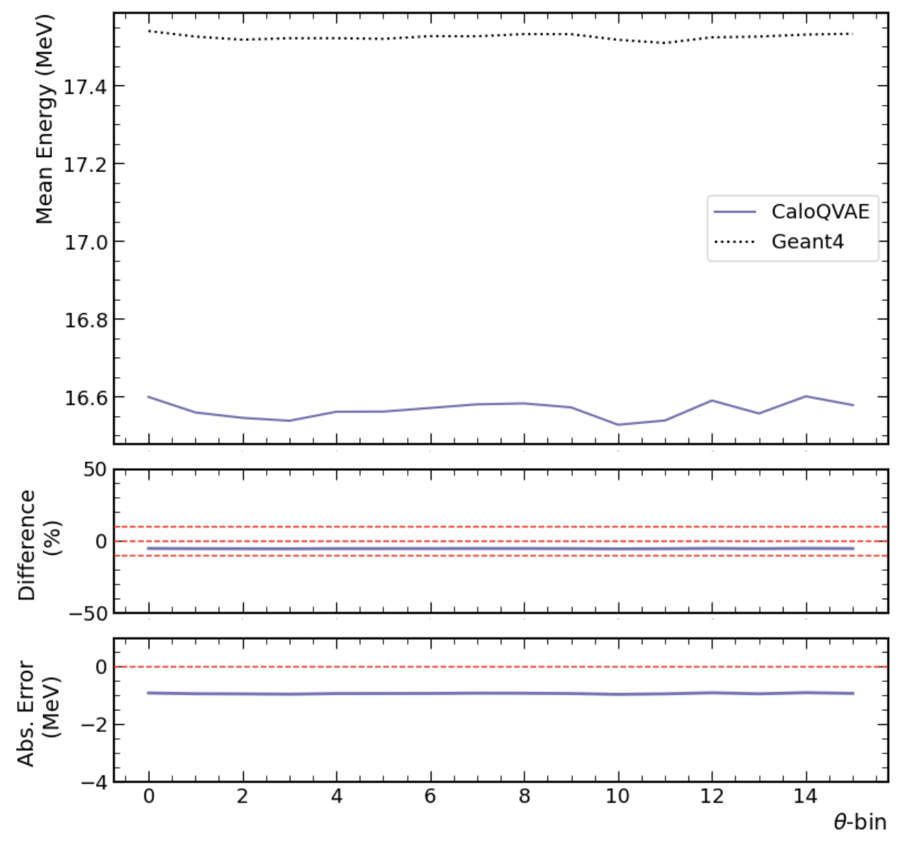
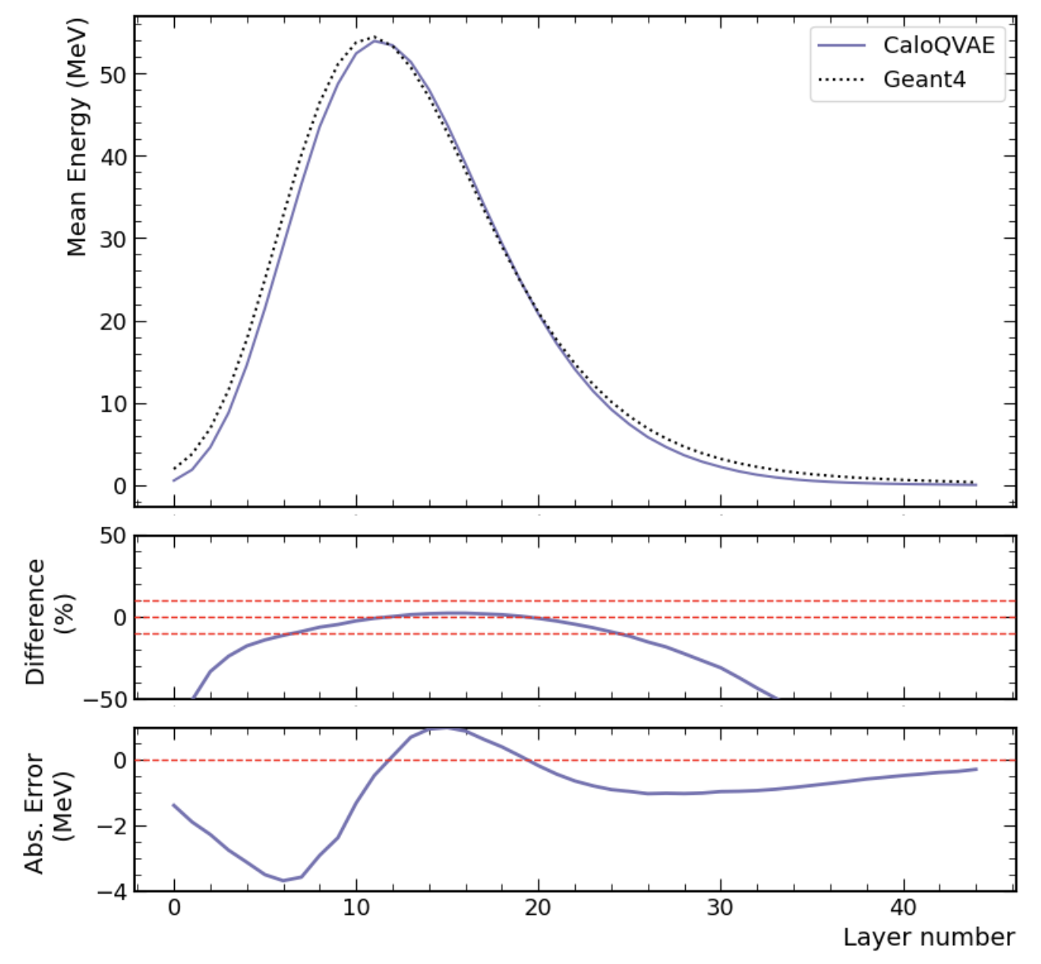
Total Energy Spectrum plots

Slide 2
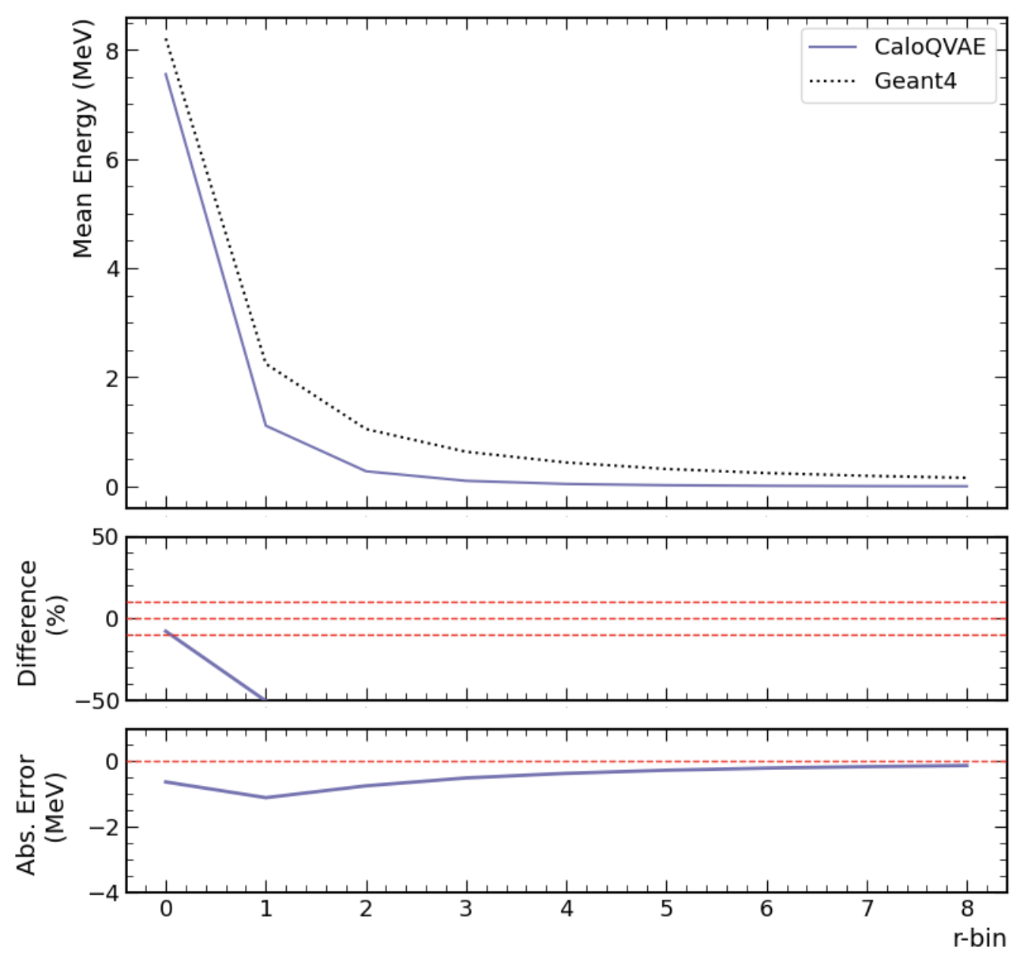
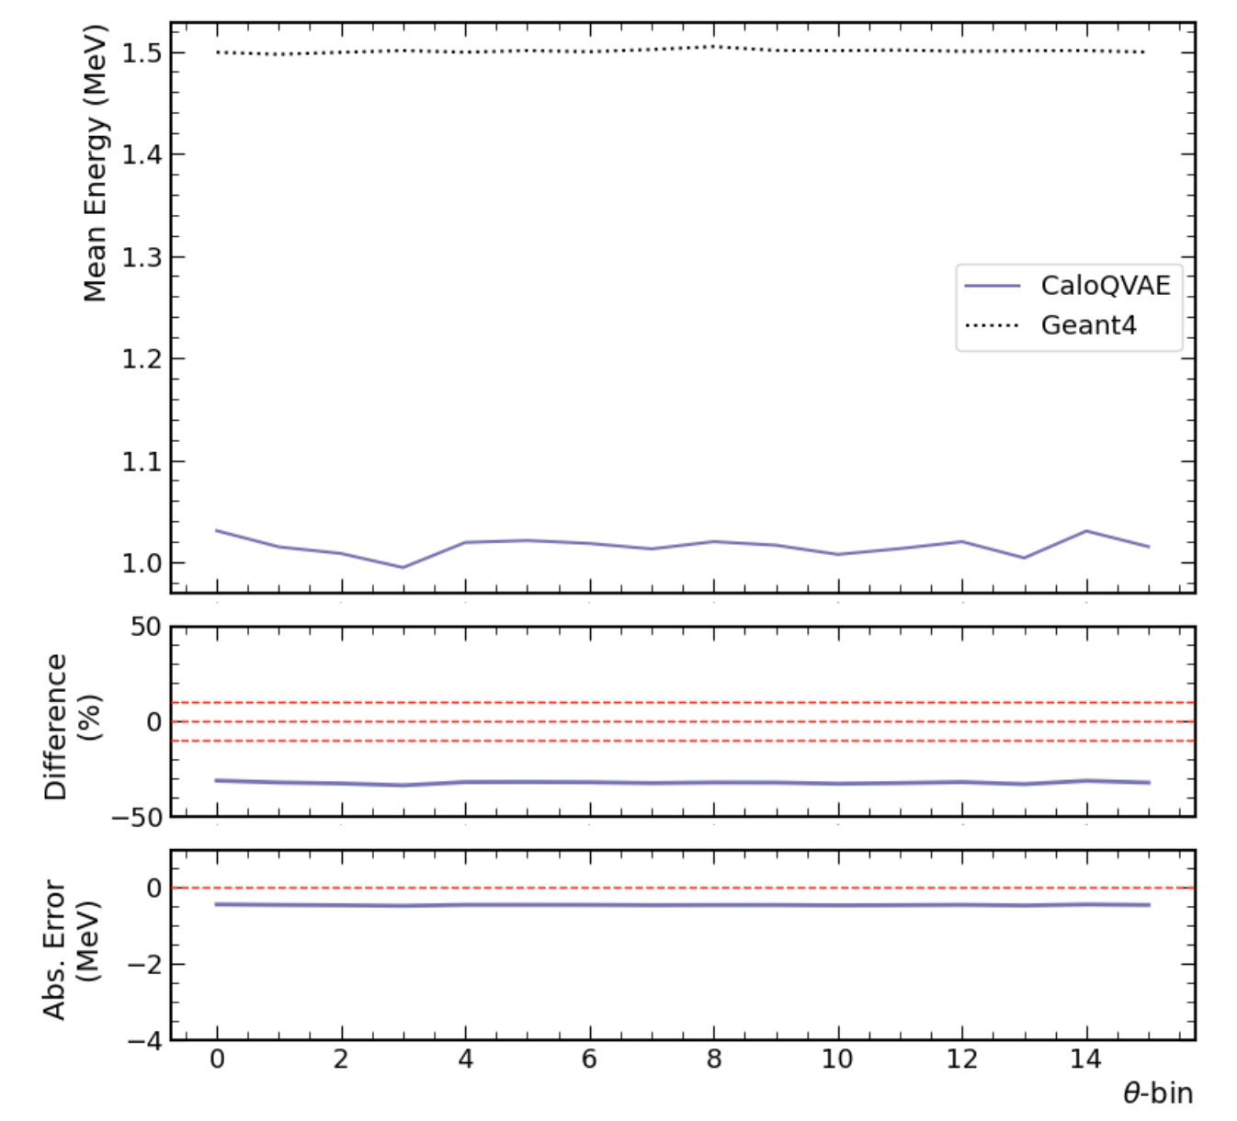
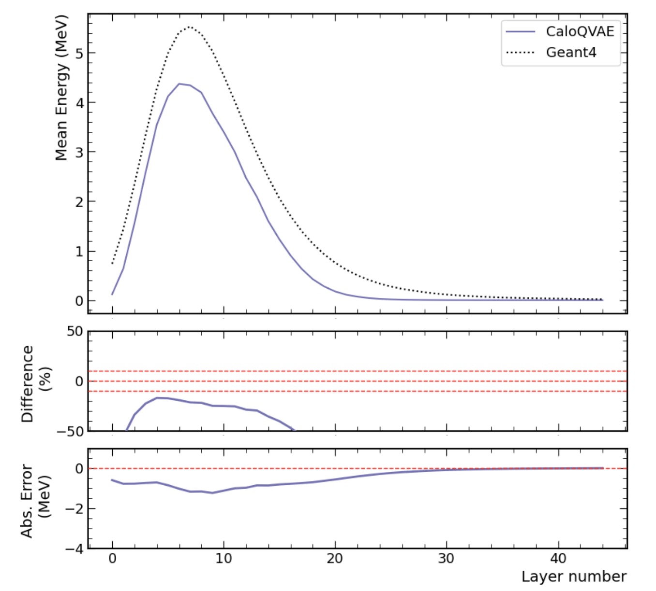
Low-Energy (0-50 GeV) plots

Slide 3
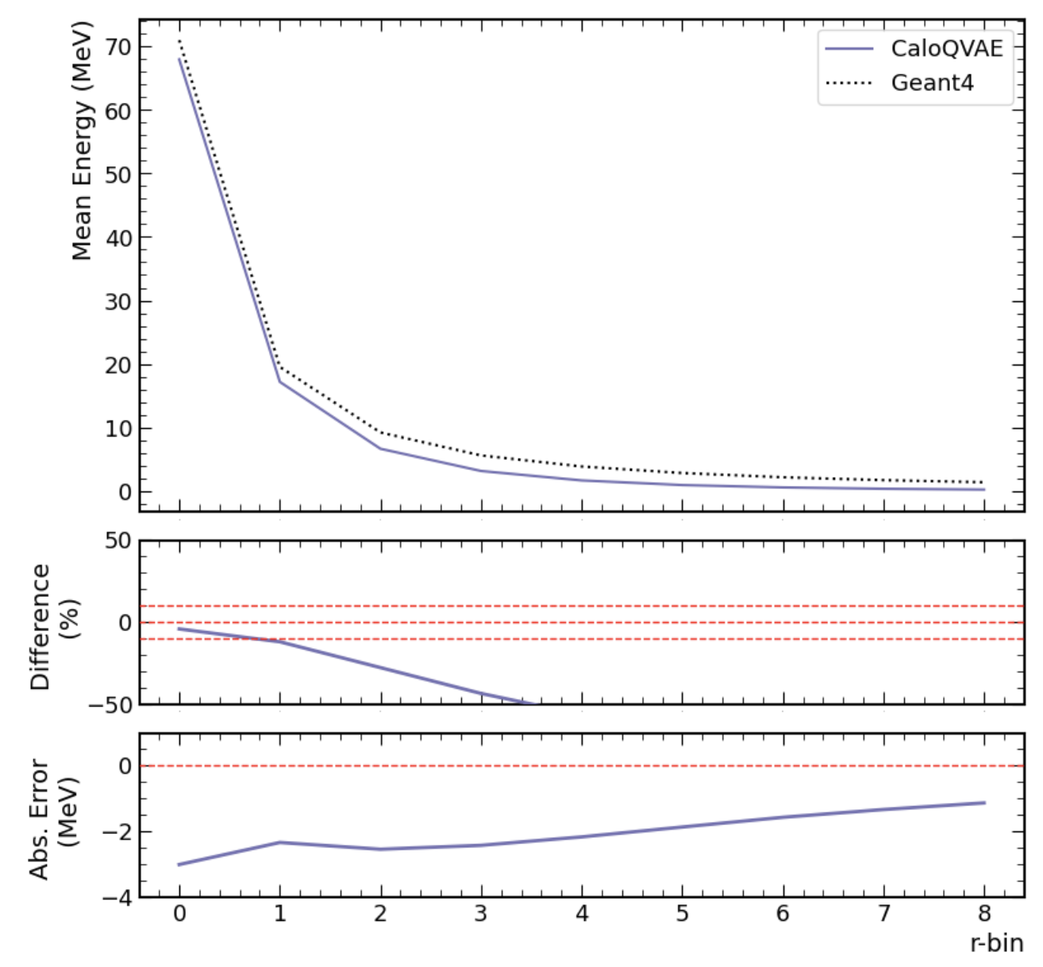
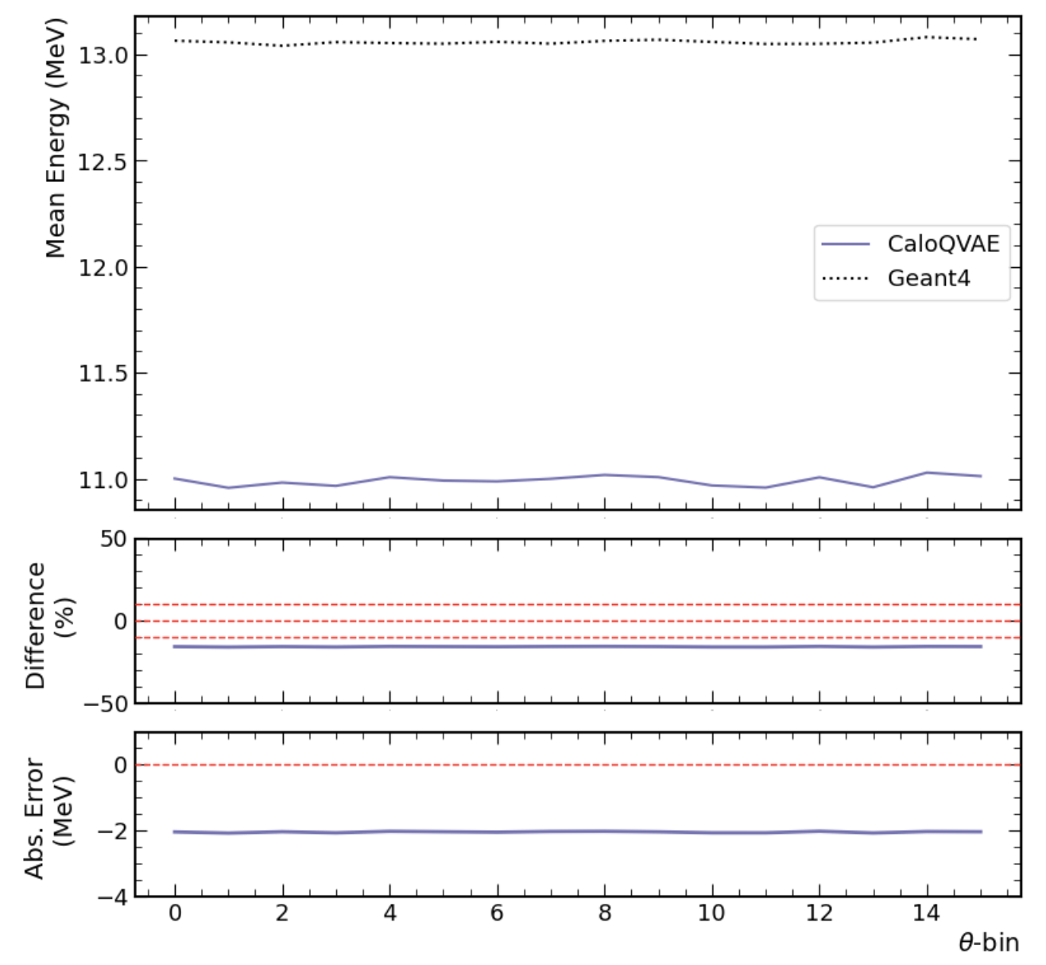
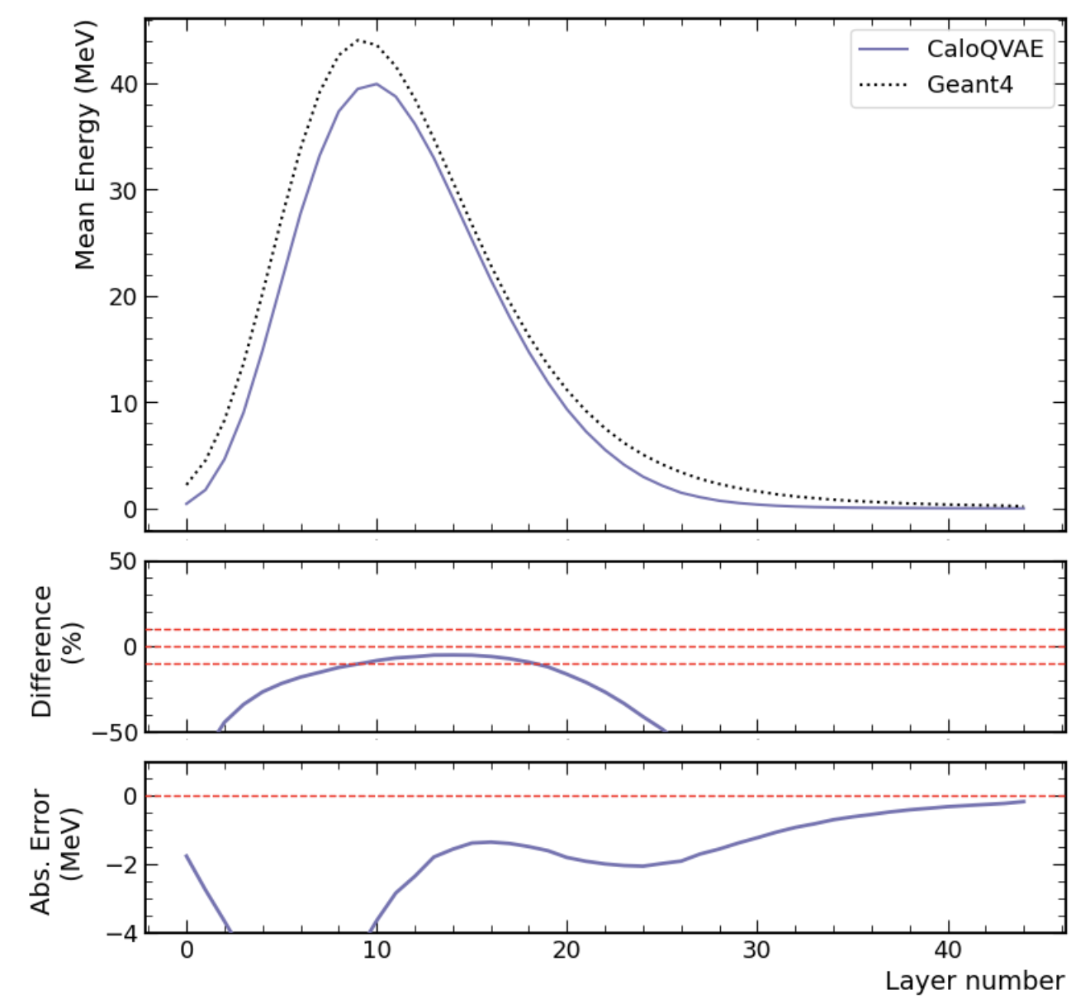
Mid-Energy (50-200 GeV) plots

Slide 4
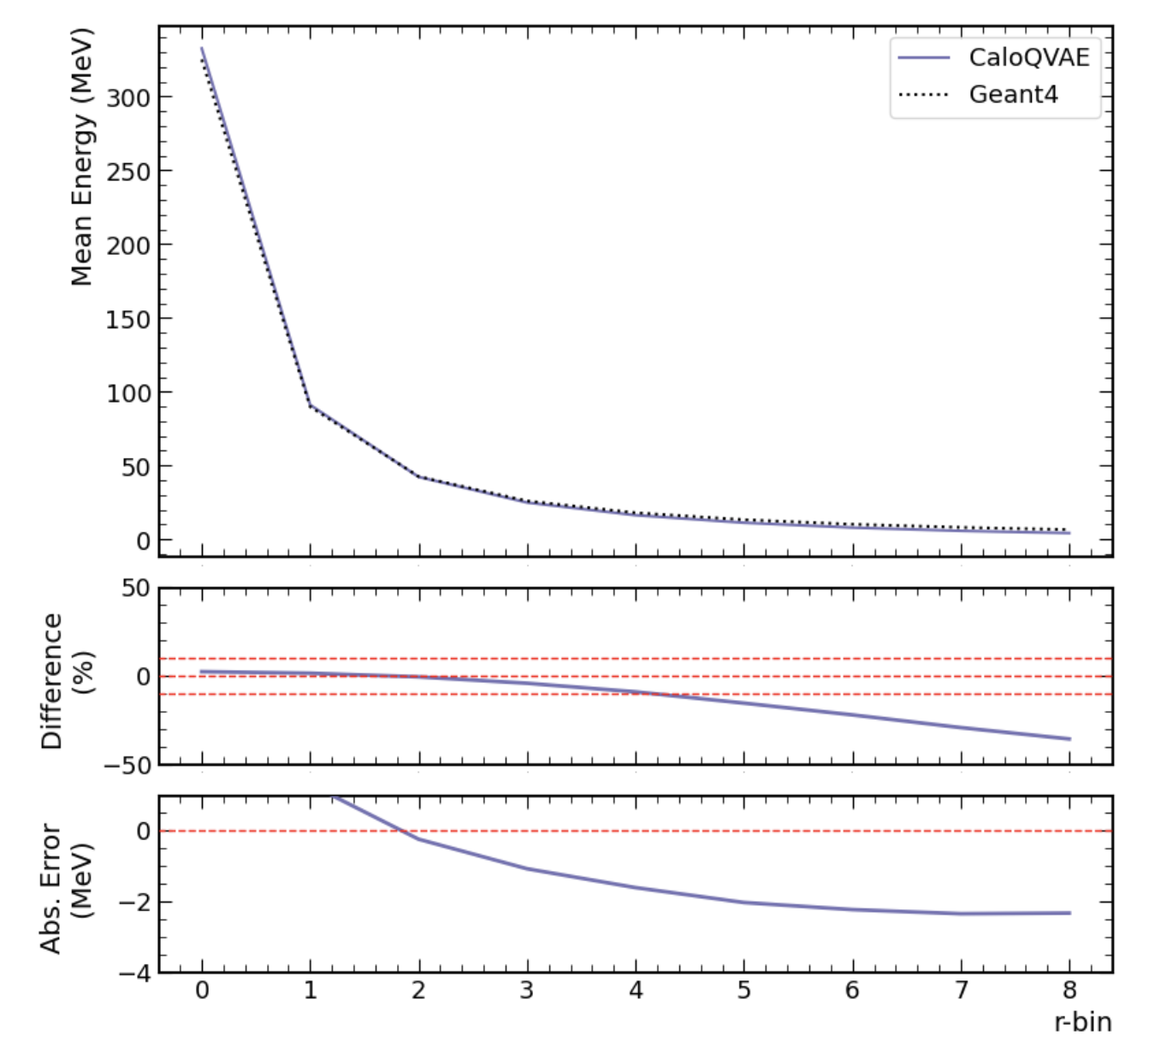
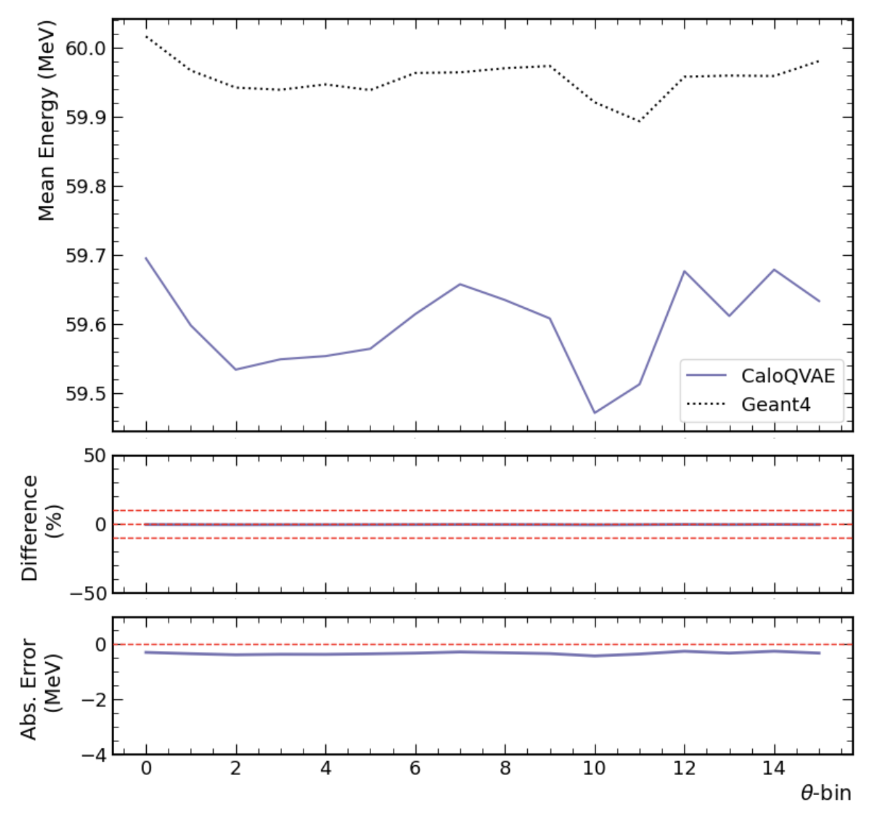
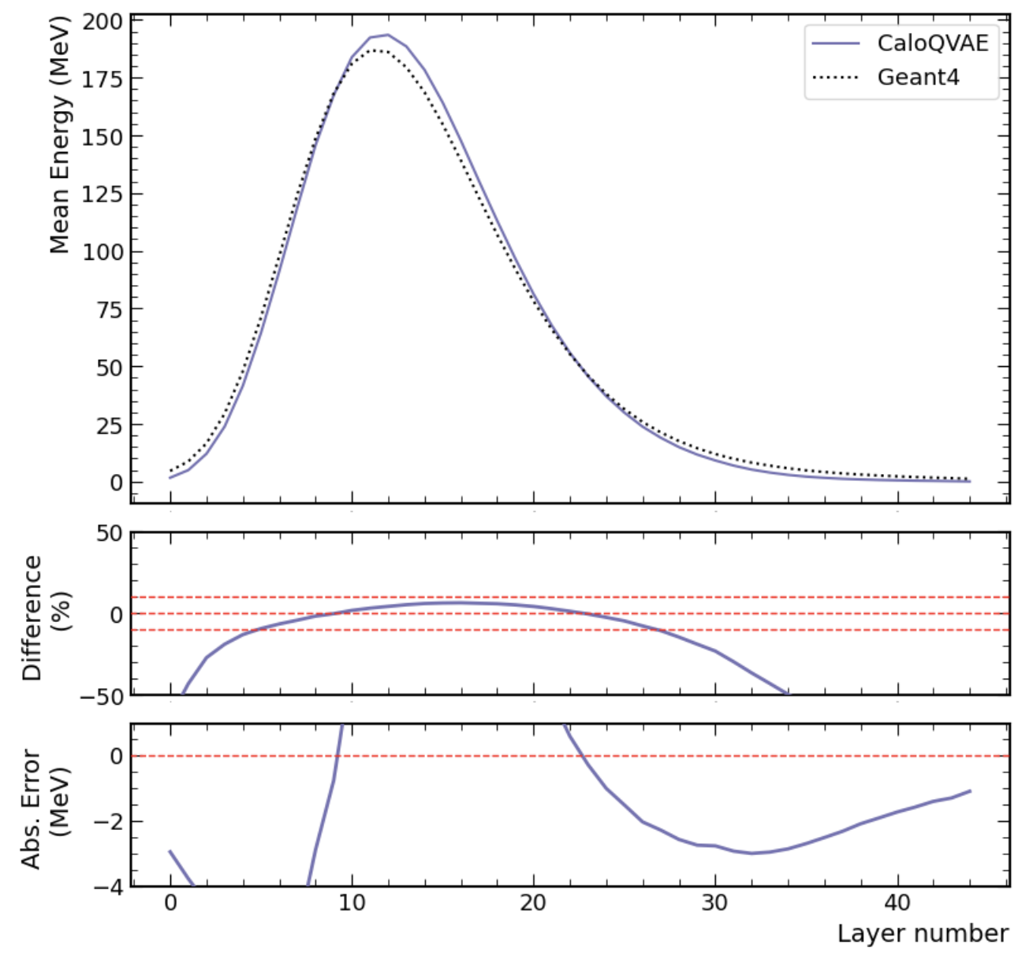
High-Energy (200-1000 GeV) plots

Slide 5
(0-50 GeV)
(50-200 GeV)
(200-1000 GeV)

Slide 6
(0-50 GeV)
(50-200 GeV)
(200-1000 GeV)

Slide 7
(0-50 GeV)
(50-200 GeV)
(200-1000 GeV)

Slide 8
Training Procedure

Slide 9
Generative Procedure

