Slide 1
Development of Ac-225 Chelator
The University of British Columbia/ TRIUMF/ BC Cancer Research Center
Dr. Lily Li
(Abdera Therapeutics)
July 22nd, 2024

Slide 2
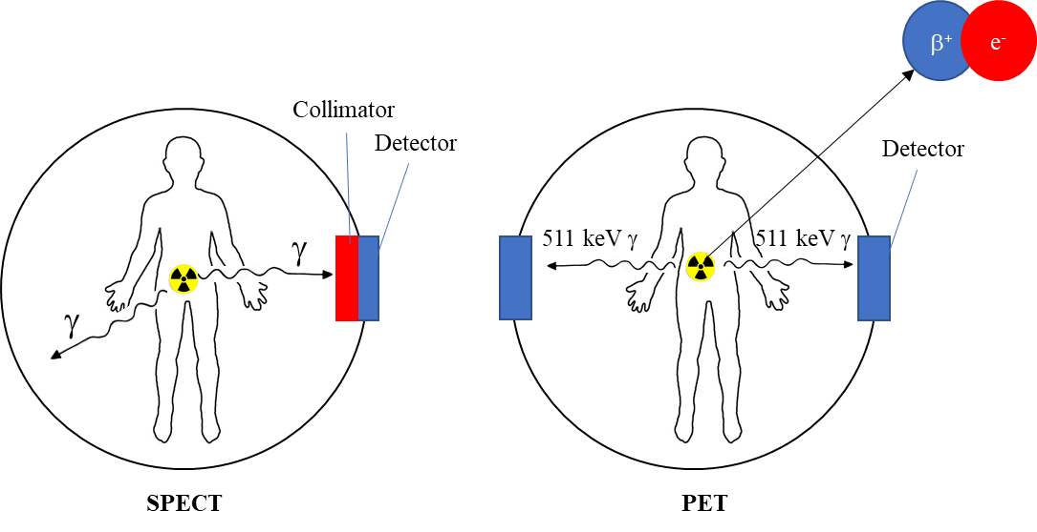
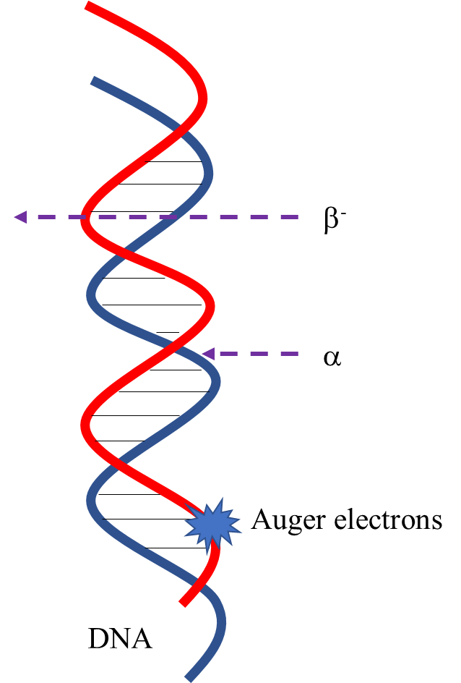
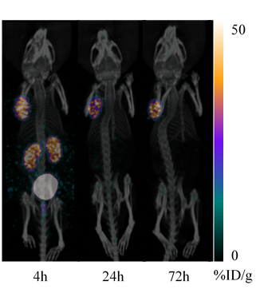
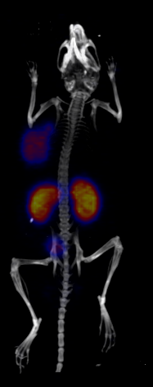
Imaging
Therapy
Low-energy γ-rays (100−250 keV)
β⁻ particles
γ-ray−emitters
β⁺−emitters
α particles
35
Tumor
Tumor
Auger electrons
0
%ID/g
[¹⁷⁷Lu][Lu(pypa-C7-PSMA617)] (44.1 MBq)
[⁴⁴Sc][Sc(pypa-C7-PSMA617)] (5.5-11.1 MBq)

Slide 3
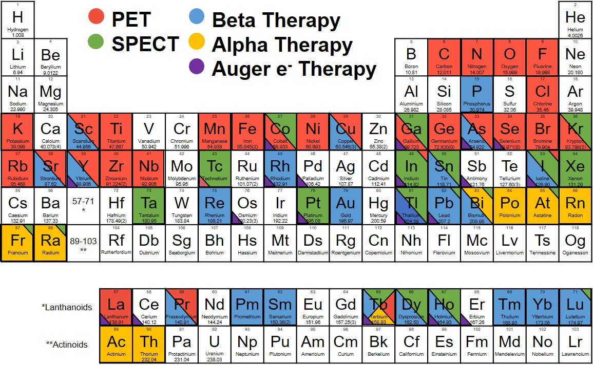
²²⁵Ac
→ α, t_{1/2} = 9.92 d
→ α-therapy
Kostelnik, T. I., et al., Chem. Rev., 2019, 119, 902-956.

Slide 4
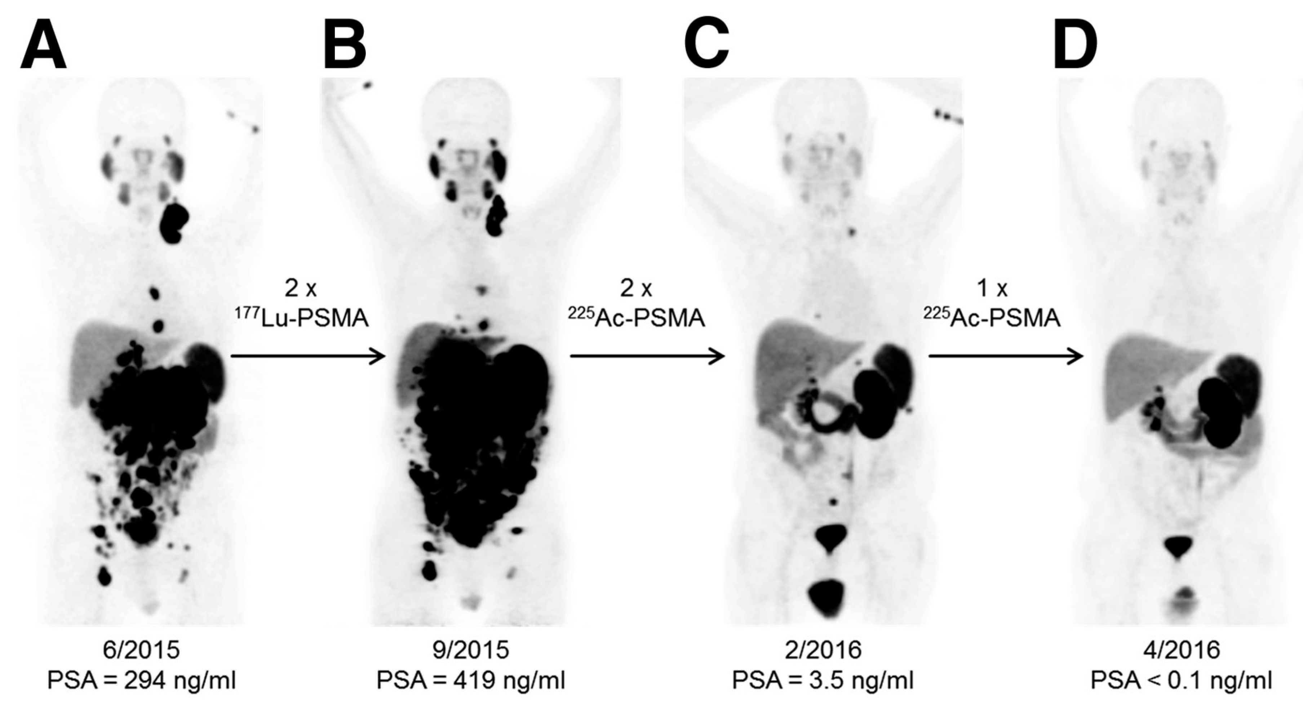
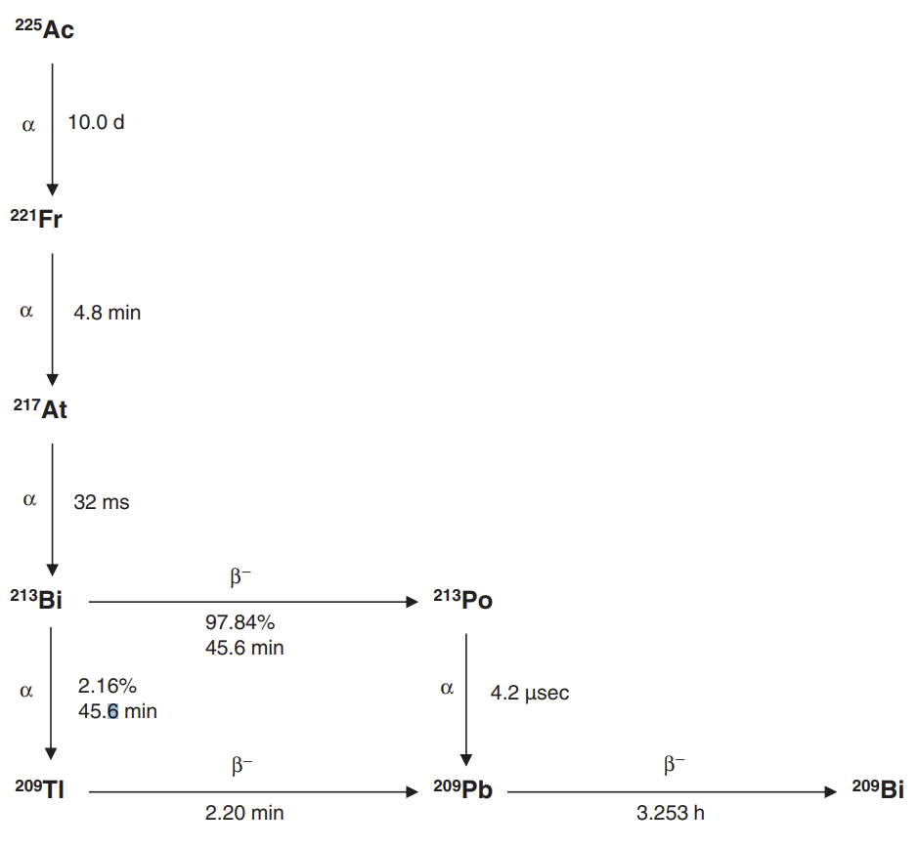
Actinium-225 for Targeted-Alpha-Therapy
⁶⁸Ga-PSMA-11 PET/CT scans of patient B. In comparison to initial tumor spread (A), restaging after 2 cycles of β-emitting ¹⁷⁷Lu-PSMA-617 presented progression (B). In contrast, restaging after second (C) and third (D) cycles of α-emitting ²²⁵Ac-PSMA-617 presented impressive response. (the patient received 3 cycles of 6.4 MBq (100 kBq per kilogram of body weight) at bimonthly intervals)
Kratochwil, C., et al., J Nucl Med. 2016, 57, 1941-1944.
Rosenblat, T. L., et al., Clin. Cancer Res. 2022, 28, 2030-2037.

Slide 5
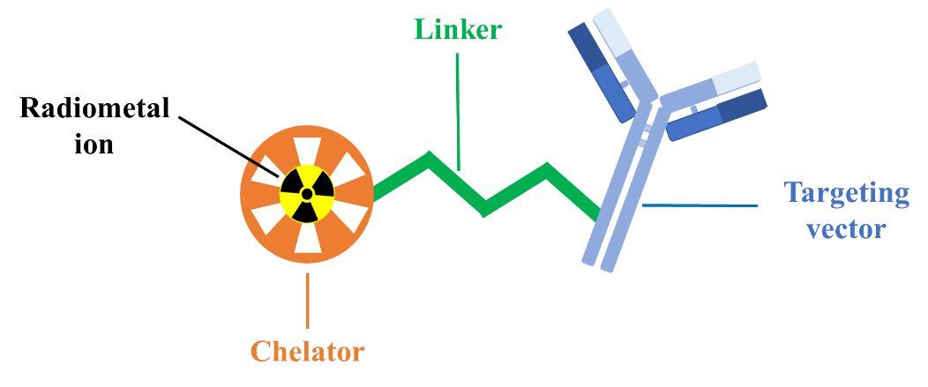
Bioconjugation
Influence on the pharmacokinetics and metal coordination sphere
Fast and quantitative radiolabeling at ~RT, under diluted conditions (<10⁻⁵ M)
High stability in vivo
Facile and versatile linker incorporation
Notes:
The bifunctionalization site on the chelator and the choice of the linker are important considerations in chelator design because both can significantly influence the pharmacokinetics and metal coordination sphere.

Slide 6
Larger Chelator for Larger Metal ions - H₄py4pa
Macrocyclic Chelator
Acyclic Chelator

Slide 7
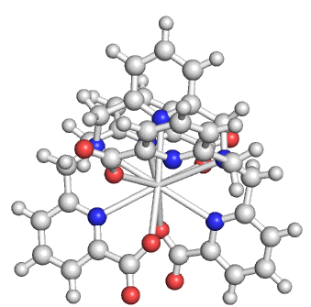

Structure of [La(py4pa)]⁻ Anion
Atom | Bond Length (Å)
Central N_{pyr} | 2.7175
Tertiary N (1) | 3.0519
Tertiary N (2) | 3.0926
Picolinate (1.1) N | 3.1412
Picolinate (2.1) N | 3.2408
Picolinate (1.1) O | 2.6605
Picolinate (2.1) O | 2.6626
Picolinate (1.2) N | 2.7735
Picolinate (2.2) N | 2.7592
Picolinate (1.2) O | 2.5718
Picolinate (2.2) O | 2.5479
DFT-calculated structure of [La(py4pa)]⁻
Li. L., et al., Bioconjugate Chem., 2021, 32, 1348-1363

Slide 8
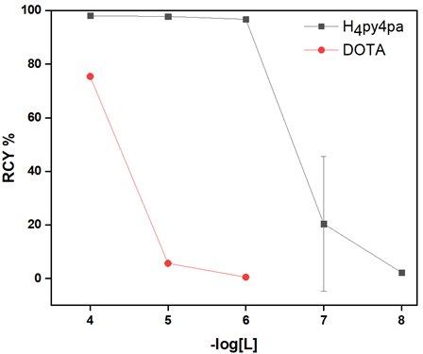
Radiolabeling and Serum Stability of [²²⁵Ac][Ac(py4pa)]⁻ and [²²⁵Ac][Ac(DOTA)]⁻
Concentration-dependent radiolabeling
Mouse Serum Stability (% intact)
Day | [²²⁵Ac][Ac(py4pa)]⁻ | [²²⁵Ac][Ac(DOTA)]⁻
1 | 99 (0) | 99 (0)
2 | 99 (0) | 99 (0)
5 | 99 (0) | 99 (0)
7 | 99 (0) | 99 (0)
9 | 99 (0) | 99 (0)
Conditions: 37°C, 9 d
Conditions: 30 min, RT, pH=7 (1 M NH₄OAc solution)
Li. L., et al., Bioconjugate Chem., 2021, 32, 1348-1363

Slide 9

Bifunctionalization of H4py4pa
R-NCS +
H₂N
H₄py4pa
Me₄py4pa-OH
H₄py4pa-phenyl-NCS
Functionally versatile H₄py4pa
(Bifunctional Precursor)

Slide 10
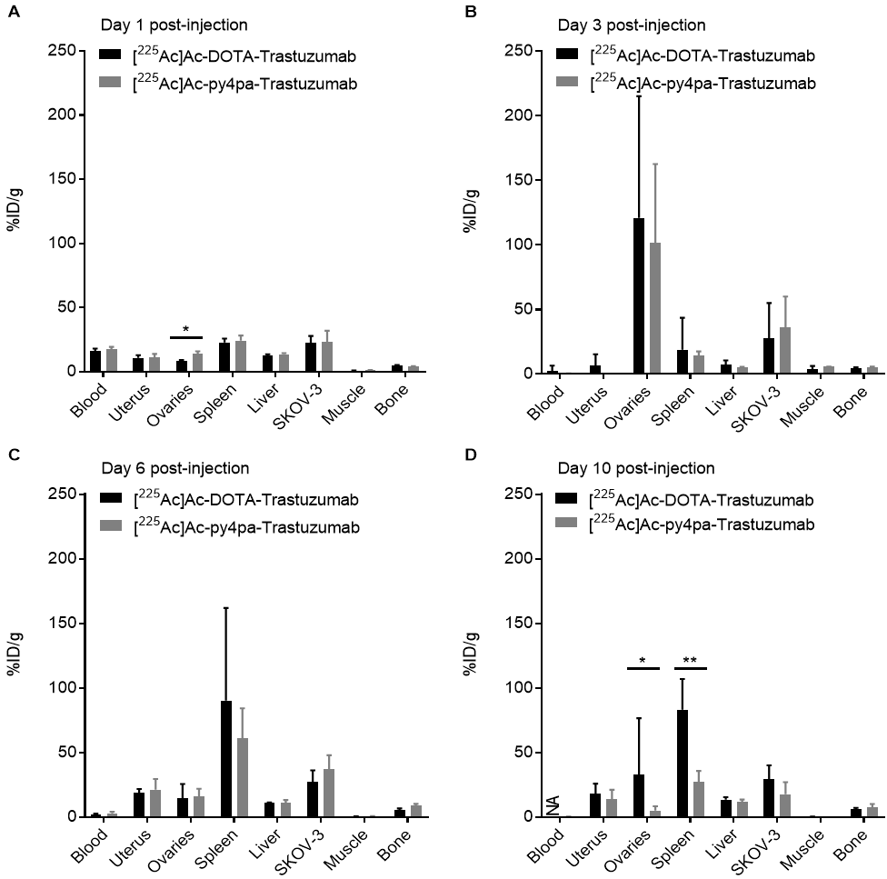
[²²⁵Ac][Ac(py4pa-phenyl-Trastuzumab)] Biodistribution
H₄py4pa-phenyl-
Trastuzumab
DOTA-benzyl-
Trastuzumab
Trastuzumab: an antibody targets HER2 receptor positive cancer
Li. L., et al., Bioconjugate Chem., 2021, 32, 1348-1363
Ovarian cancer xenografts mice model (SKOV-3)

Slide 11

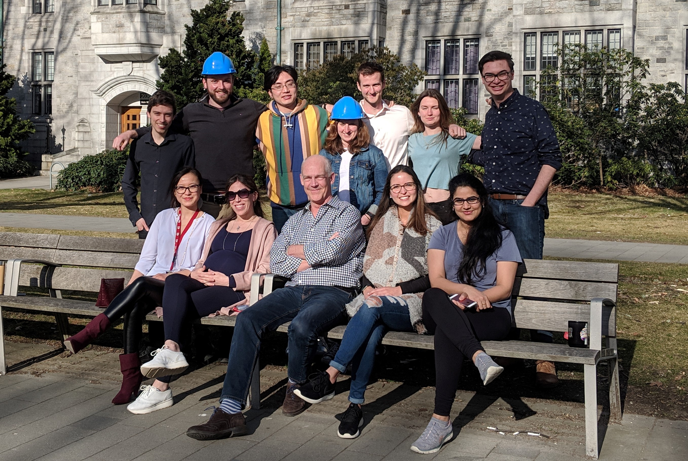







Acknowledgement
Medicinal Inorganic Chemistry Group

Slide 12
Supplementary

Slide 13
Biodistribution Studies
[¹⁷⁷Lu][Lu(pypa-C7-PSMA617)] (44.1 MBq)
[¹¹¹In][In(pypa-C7-PSMA617)] (24.9 MBq)

Slide 14
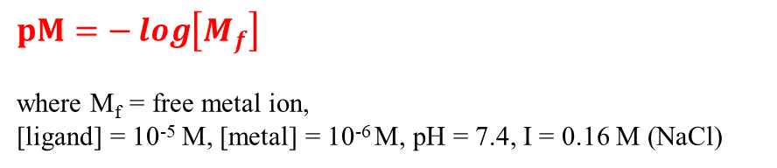
Solution Studies with La³⁺-pypa and py4pa Complexes
[La(pypa)]⁻
[La(py4pa)]⁻
Formation constants and pM values.
Equilibrium reaction | H₄pypa | H₄py4pa
M³⁺ + L ⇆ ML | 19.74(3); 19.54(2) | 20.37(2); 20.33(3)
pM | 19.9 | 21.0
$pM=−\log\left[M_{f}\right]$
where M_{f} = free metal ion,
[ligand] = 10⁻⁵ M, [metal] = 10⁻⁶ M, pH = 7.4, I = 0.16 M (NaCl)
Ferenc Krisztian Kalma ́ et al., Inorg. Chem. 2015, 54, 2345−2356
María de Guadalupe Jaraquemada-Peláez et al., Dalton Trans. 2017,46, 14647-14658
Li. L., et al., Bioconjugate Chem., 2019, 30, 1539-1553 (ACS Editors’ Choice)
Li. L., et al., Bioconjugate Chem., 2020, in press (03/2020)
Notes:
pM value reflects the concentration of the free metal ion at a defined ligand concentration, metal concentration and pH, and changes according to the factors that affect the formation constant (T, pH, ligand basicity)

Slide 15
Structure of [La(py4pa)]⁻ Anion
Atom | Bond Length (Å)
Central N_{pyr} | 2.7175
Tertiary N (1) | 3.0519
Tertiary N (2) | 3.0926
Picolinate (1.1) N | 3.1412
Picolinate (2.1) N | 3.2408
Picolinate (1.1) O | 2.6605
Picolinate (2.1) O | 2.6626
Picolinate (1.2) N | 2.7735
Picolinate (2.2) N | 2.7592
Picolinate (1.2) O | 2.5718
Picolinate (2.2) O | 2.5479
400 MHz,298 K, D₂O
[La(py4pa)]⁻
H₄py4pa
DFT-calculated structure of [La(py4pa)]⁻
Li. L., et al., Bioconjugate Chem., 2020, in press (03/2020)

