Slide 1
Actinium-226 as a potential theranostic isotope: imaging, dosimetry, and therapy
Helena Koniar
PhD, Medical Physics
Life Sciences Division, TRIUMF
Dept. of Physics and Astronomy, UBC

Slide 2
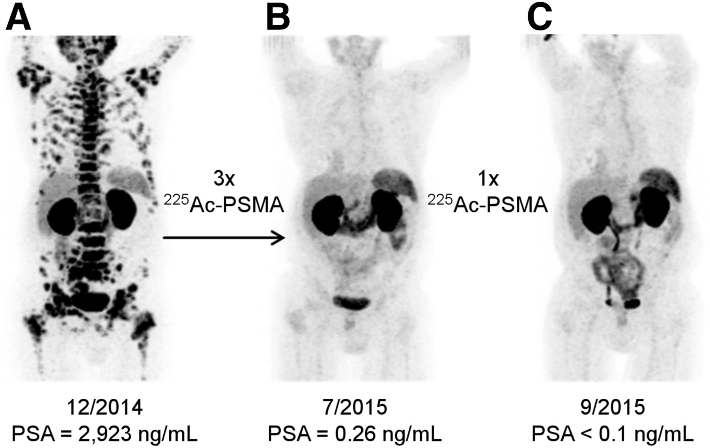
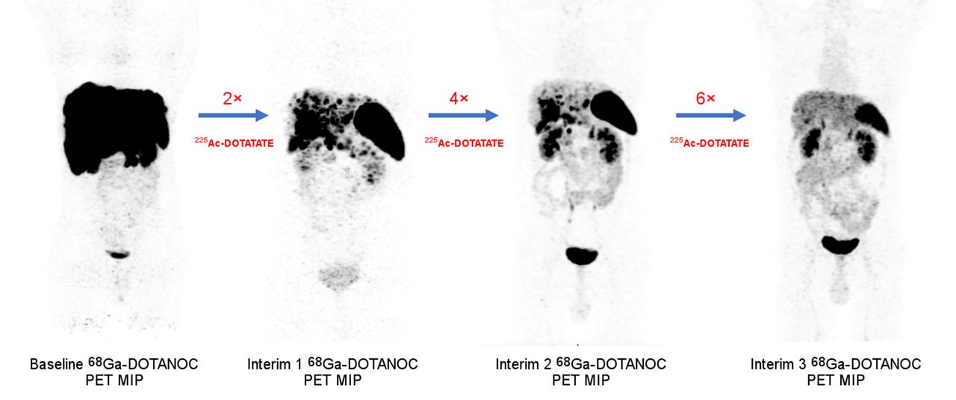
Background
Targeted Alpha Therapy with Actinium-225 (²²⁵Ac)
⁶⁸Ga-PSMA PET/CT scans of patient
⁶⁸Ga-DOTANOC PET/CT scans of patient
Kratochwil, et al. J Nucl Med. 2016; 57: 1941-1944.
Ballal, et al. J Nucl Med. 2023, 64: 211-218.
Therapeutic potential is strong, but dosimetry considerations remain limited and currently rely on surrogate imageable isotopes
Notes:
Ac-226 has been proposed as an element equivalent matched pair for Ac-225 radiopharmaceutical development. The Ac-225 decay chain can only been imaged or quantified through its daughter isotopes emissions, so localizing Ac directly is not possible. Ac-226 however directly emittes two gamma photons in its initial decay that are ideal energies for SPECT imaging applications. This could enable matched pair Ac 225 and 226 pairs with identical in vivo behaviour due to their element equivalence.
Additionally, Ac-226 has a favourable decay scheme for therapeutic applications with its daughter Th226 which decays with a 30 minute half life to emit 4 high energy alphas.

Slide 3
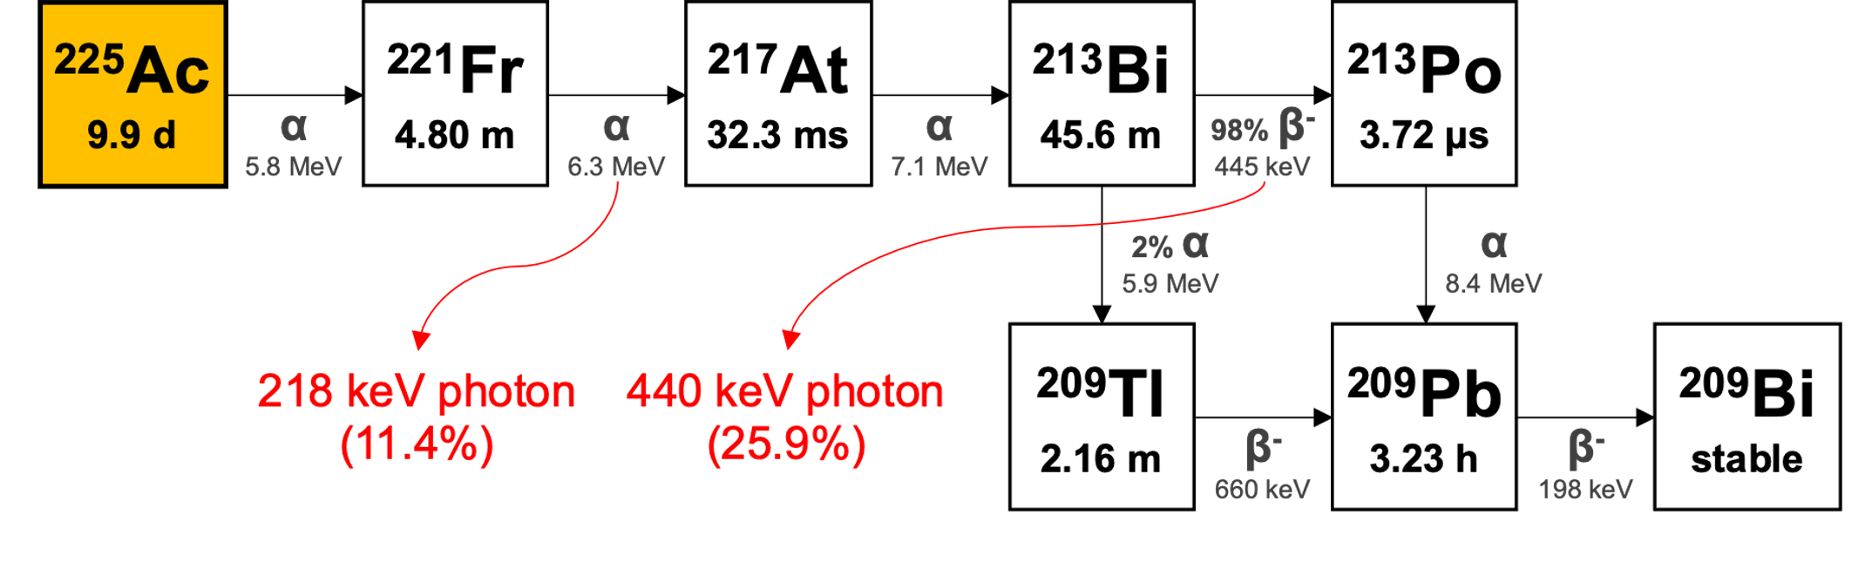
Physical Properties of ²²⁵Ac
Background
²²⁵Ac decay chain and its physical properties.

Slide 4
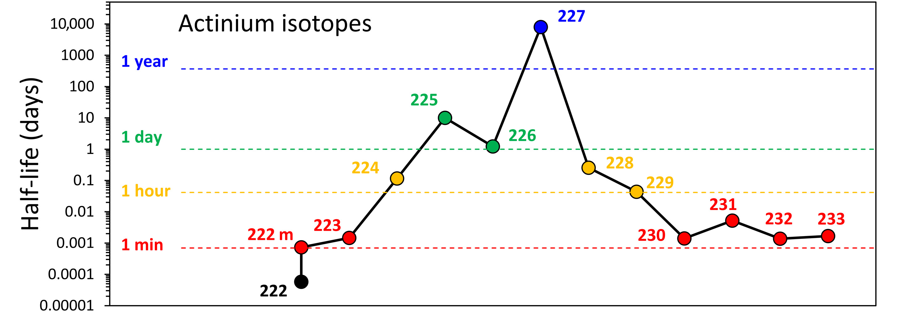
Actinium Isotopes
Background
Deblonde, et al. 2021 Science Advances 7 43

Slide 5
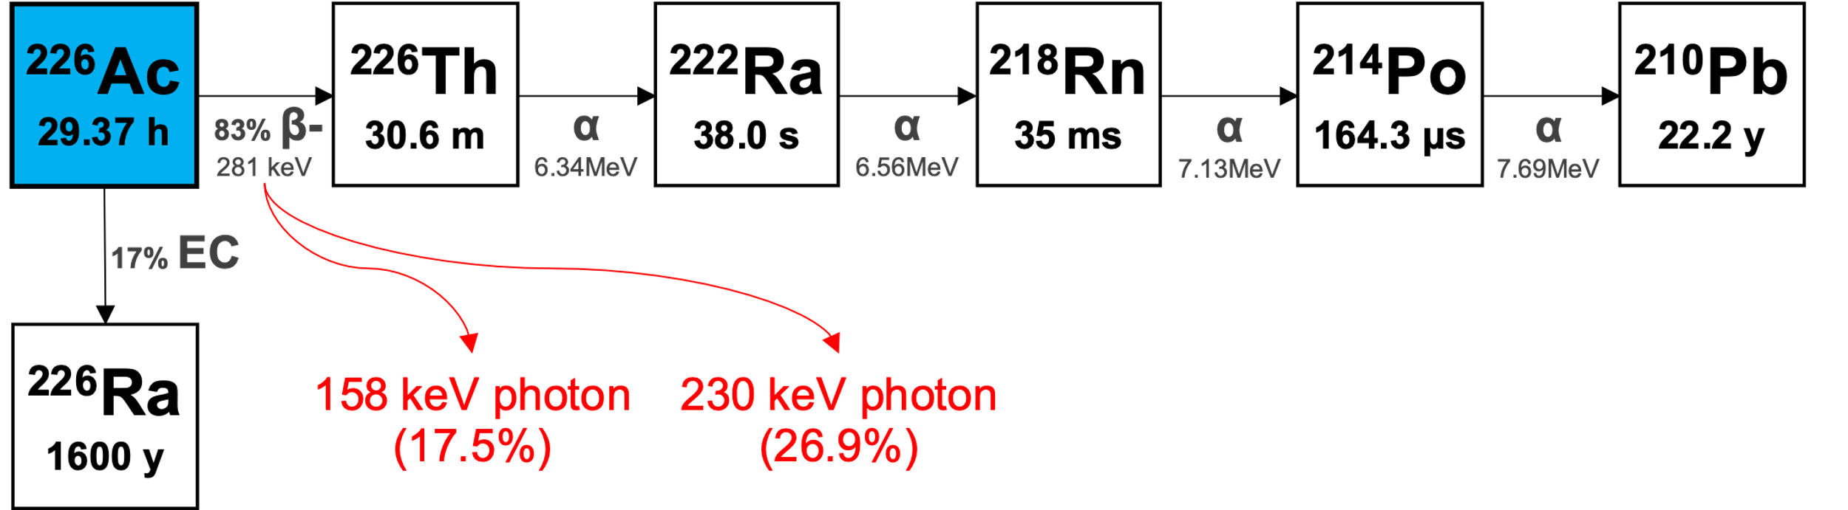
Physical Properties of ²²⁶Ac
Background
Direct gamma emission from ²²⁶Ac
Element equivalence to ²²⁵Ac ensures identical pharmacokinetics
Therapeutic potential from four alpha emissions via ²²⁶Th decay
²²⁶Ac decay chain and its physical properties.
Notes:
Ac-226 has been proposed as an element equivalent matched pair for Ac-225 radiopharmaceutical development. The Ac-225 decay chain can only been imaged or quantified through its daughter isotopes emissions, so localizing Ac directly is not possible. Ac-226 however directly emittes two gamma photons in its initial decay that are ideal energies for SPECT imaging applications. This could enable matched pair Ac 225 and 226 pairs with identical in vivo behaviour due to their element equivalence.
Additionally, Ac-226 has a favourable decay scheme for therapeutic applications with its daughter Th226 which decays with a 30 minute half life to emit 4 high energy alphas.

Slide 6
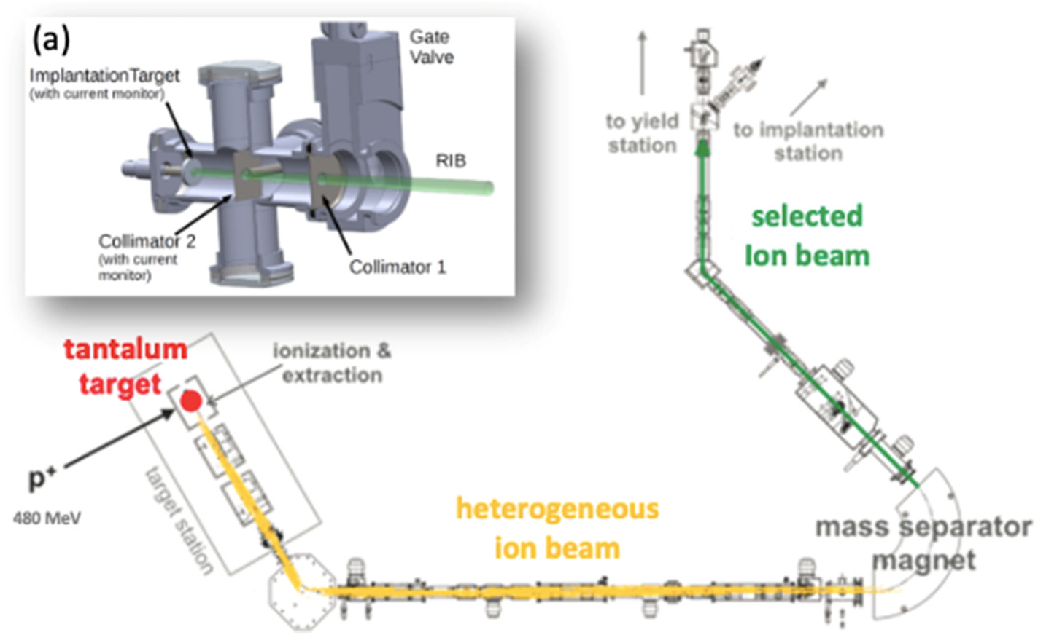
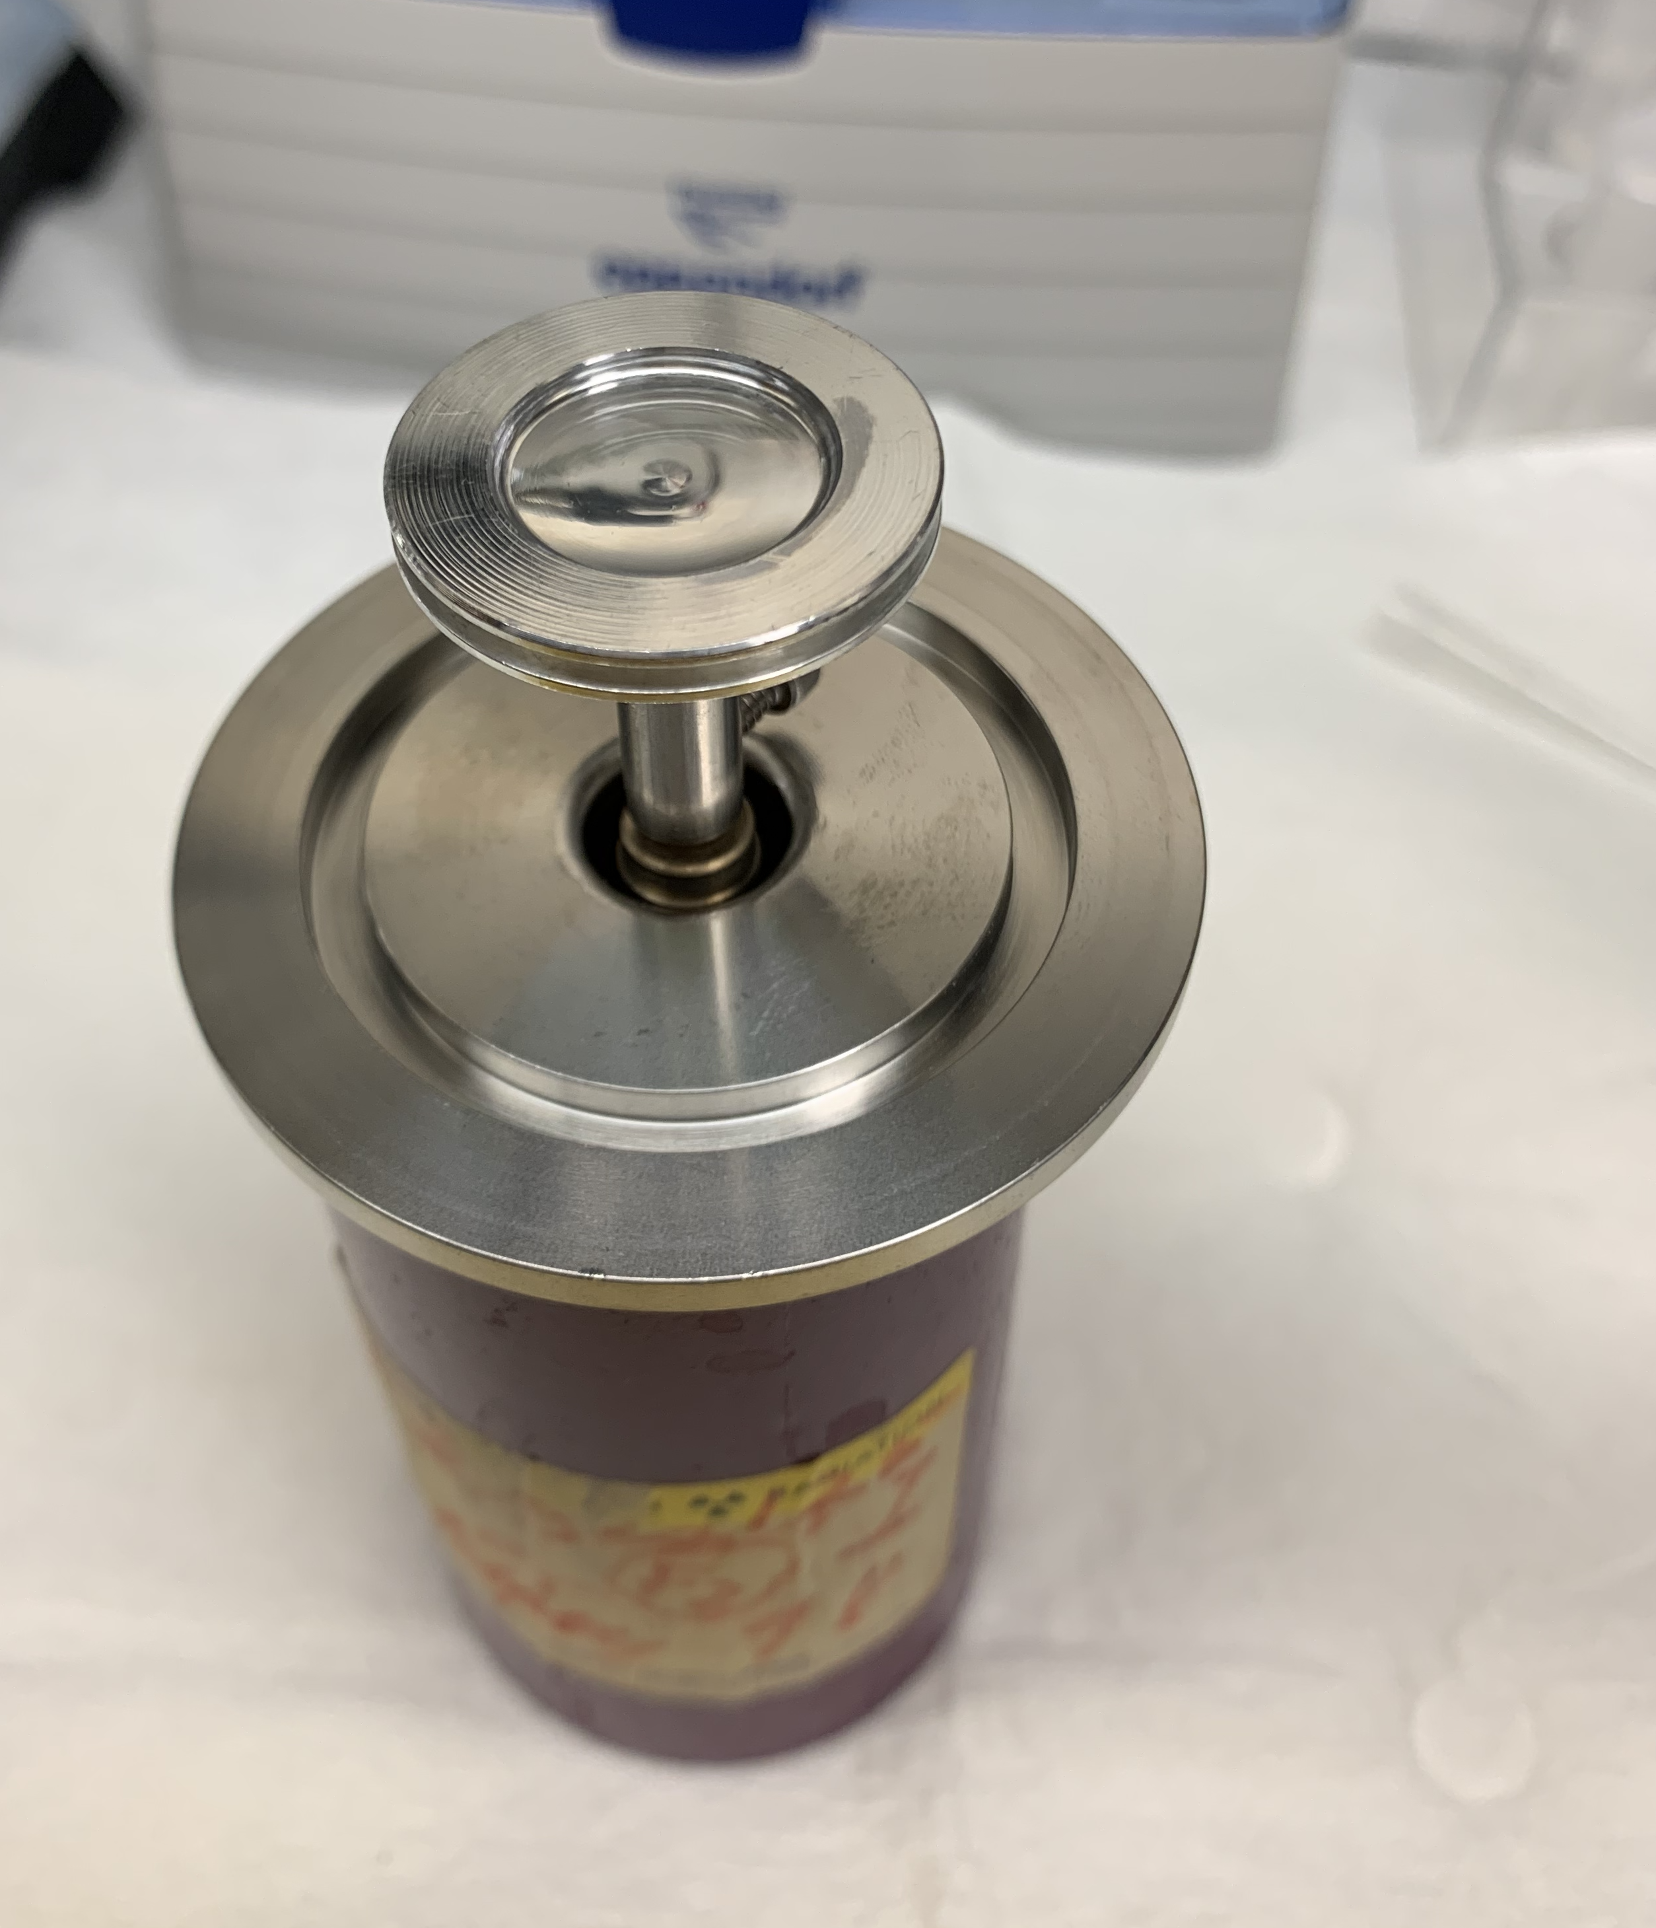

Background
²²⁶Ac Production with TRIUMF’s ISAC Facility
implantation target
²²⁶Ac ion beam
uranium
Fiaccabrino, et al. Nucl Med Biol. 2021; 94-95:81-91.

Slide 7
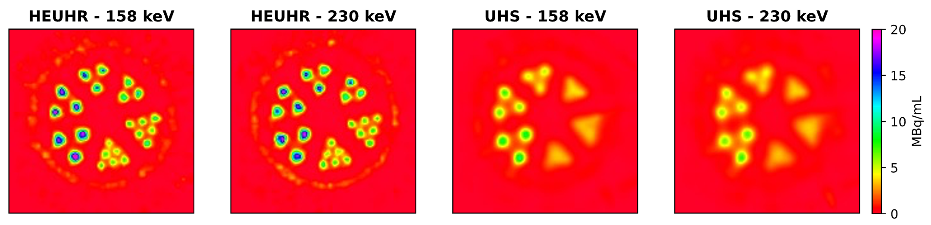
Objective
²²⁶Ac as a novel theranostic isotope
Koniar, et al. Phys Med Biol. 2022; 67 185009.
Previously validated SPECT imaging capabilities with phantom studies
Objective: Assess a preclinical matched ^{225/226}Ac-radiopharmaceutical for its diagnostic and therapeutic efficacy
Notes:
We have previously established SPECT imaging characteristics with Ac-226 in a pre clinical SPECT scanner with resolution, uniformity and contrast phantoms in order to determine the capabilities and limitations of this imaging system. We found high resolution and quantitative accuracy is possible.
So following this phantom study, our goal was to move onto in vivo assessment and investigate the accuracy of SPECT images relative to ex vivo biodistribution measurements.

Slide 8
Methods
In vivo assessment with a neuroendocrine tumour model
NRG mice with AR42J tumour xenografts were injected with [²²⁶Ac]Ac-crown-TATE
Evaluated in vivo SPECT imaging, ex vivo biodistribution with dosimetry estimates, and therapeutic efficacy
Yang, et al. Chem. Eur. J. 2020; 26, 11435.

Slide 9
Methods
In vivo assessment with a neuroendocrine tumour model
Study | Injected activity | Size | Methods
SPECT imaging | 2 MBq | n = 2 | SPECT images were acquired with the VECTor microSPECT/CT and reconstructed from the 158 keV and 230 keV photopeaks and corrected for decay, scatter, and attenuation
Biodistribution and dosimetry | 60 kBq | n = 20 | Mice were sacrificed at 1, 3, 5, 24, and 48 h p.i. for ex vivo activity measurements. Radiation dosimetry was derived for the tumour and organs of interest.
Therapy monitoring | 125 kBq 250 kBq 375 kBq | n = 11 n = 12 n = 10 | Mice were injected with different activity levels and monitored for body weight and tumour size until experimental endpoints were reached.

Slide 10
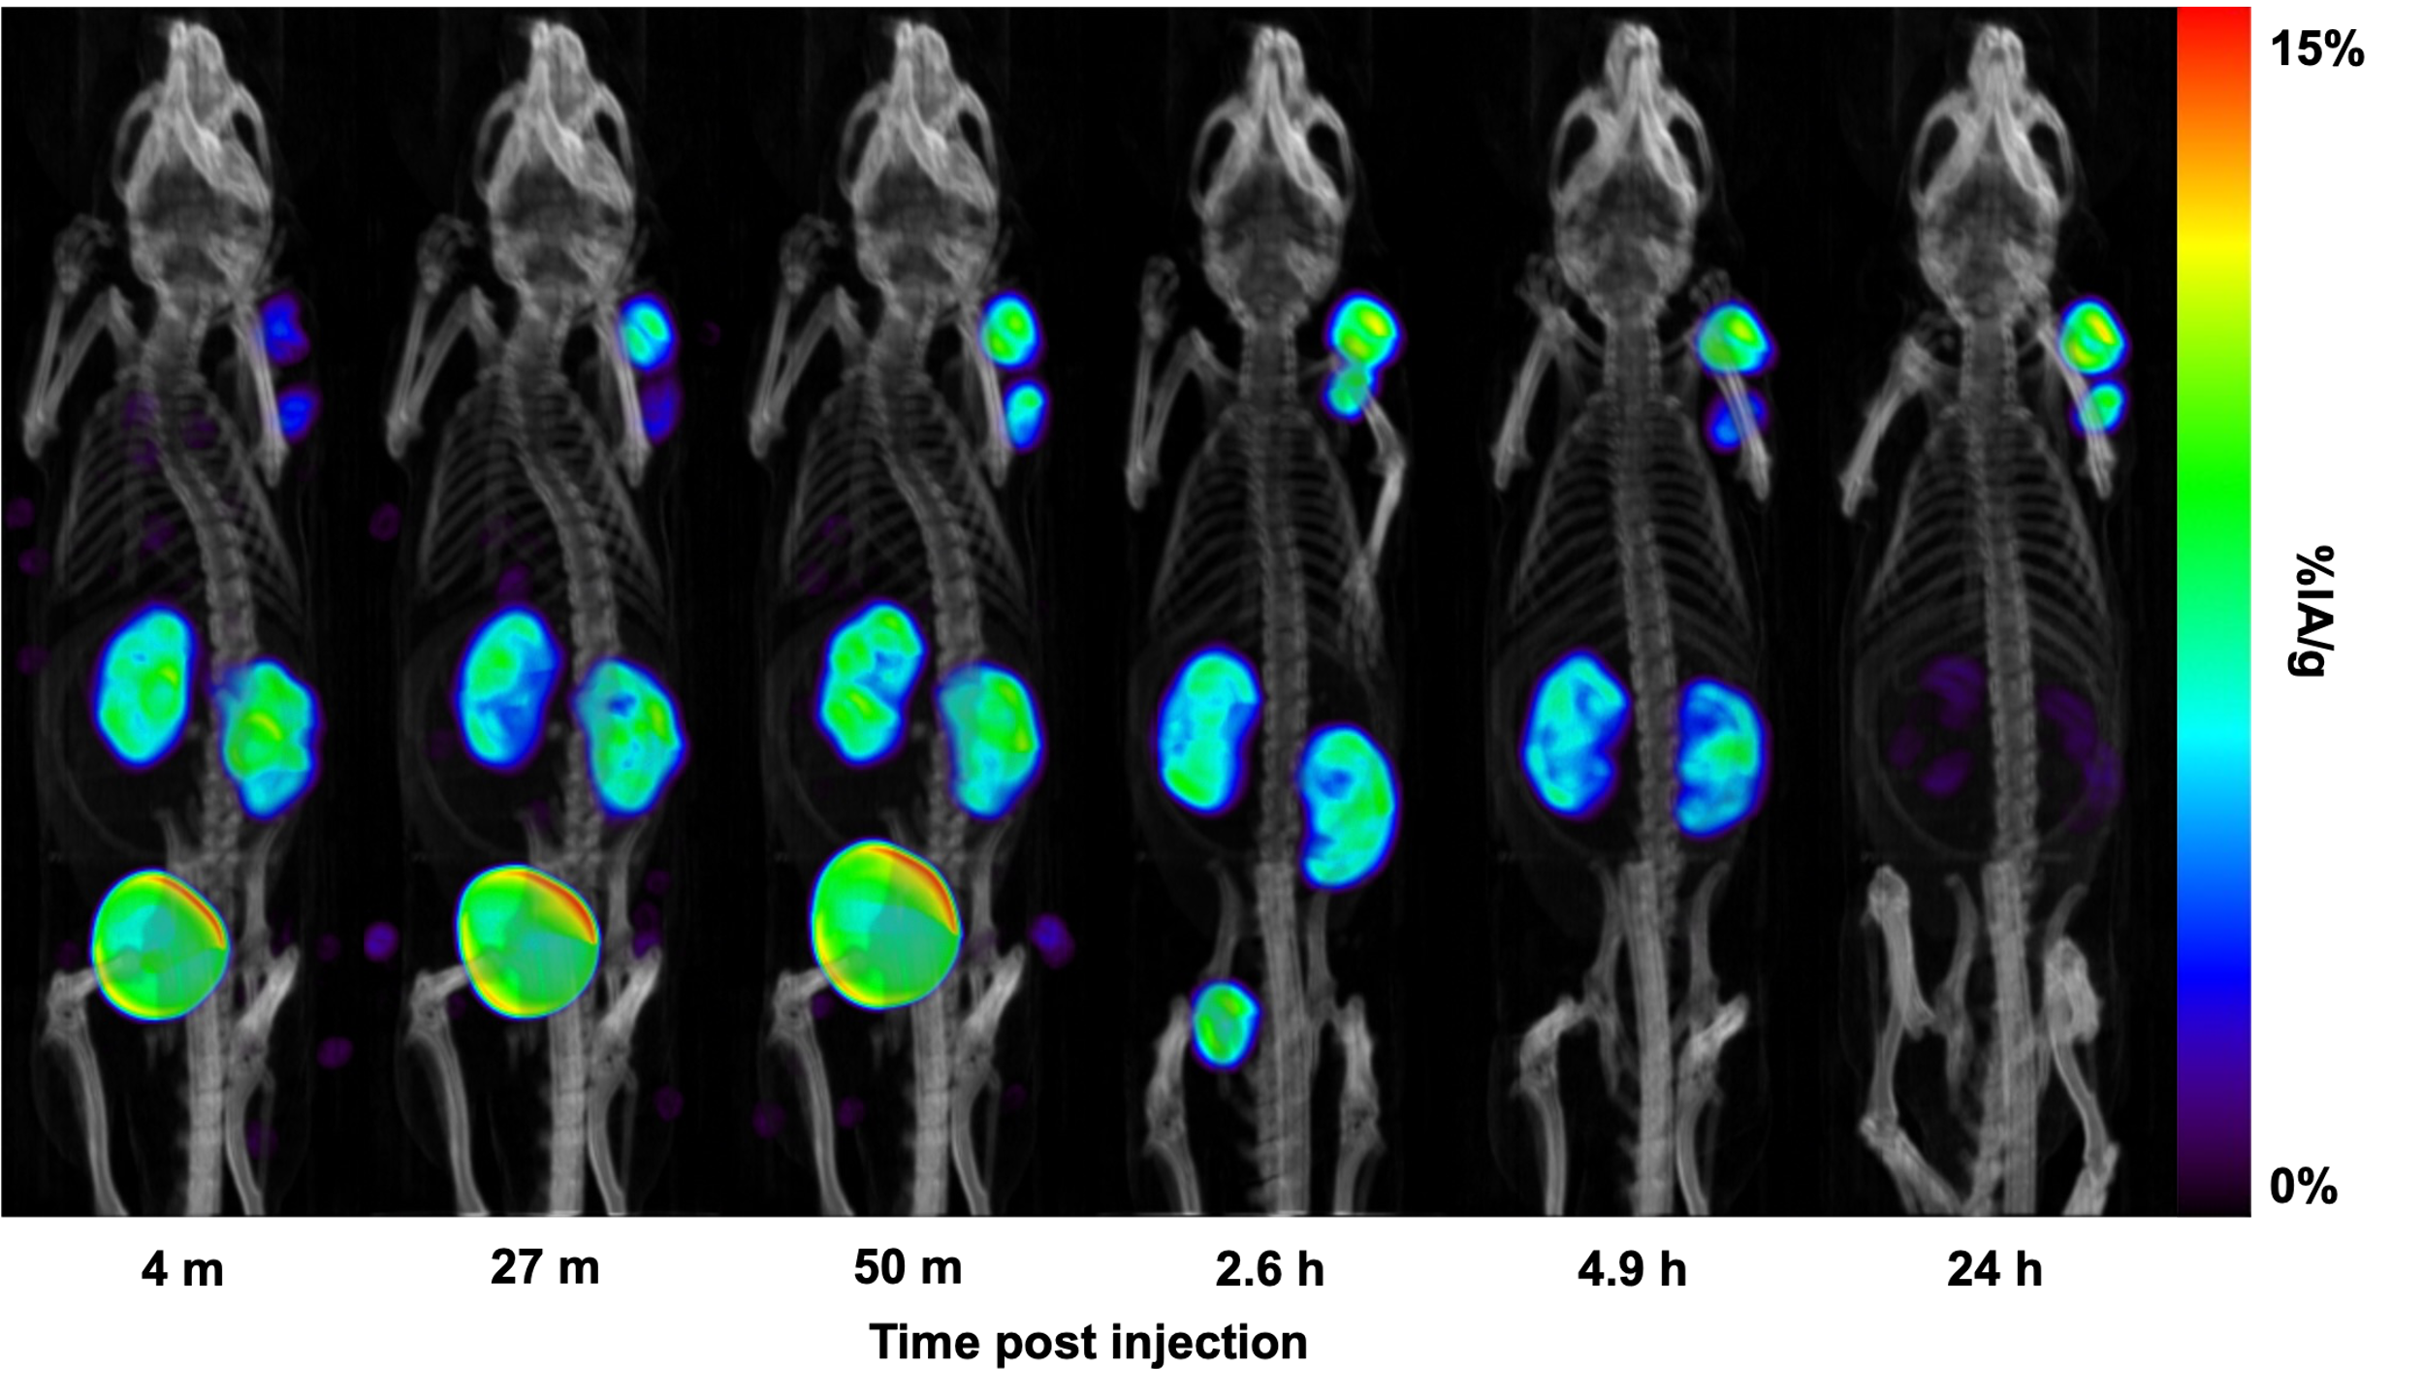
Results
In vivo quantitative SPECT imaging of [²²⁶Ac]Ac-crown-TATE
Tumour
Kidneys
Bladder

Slide 11
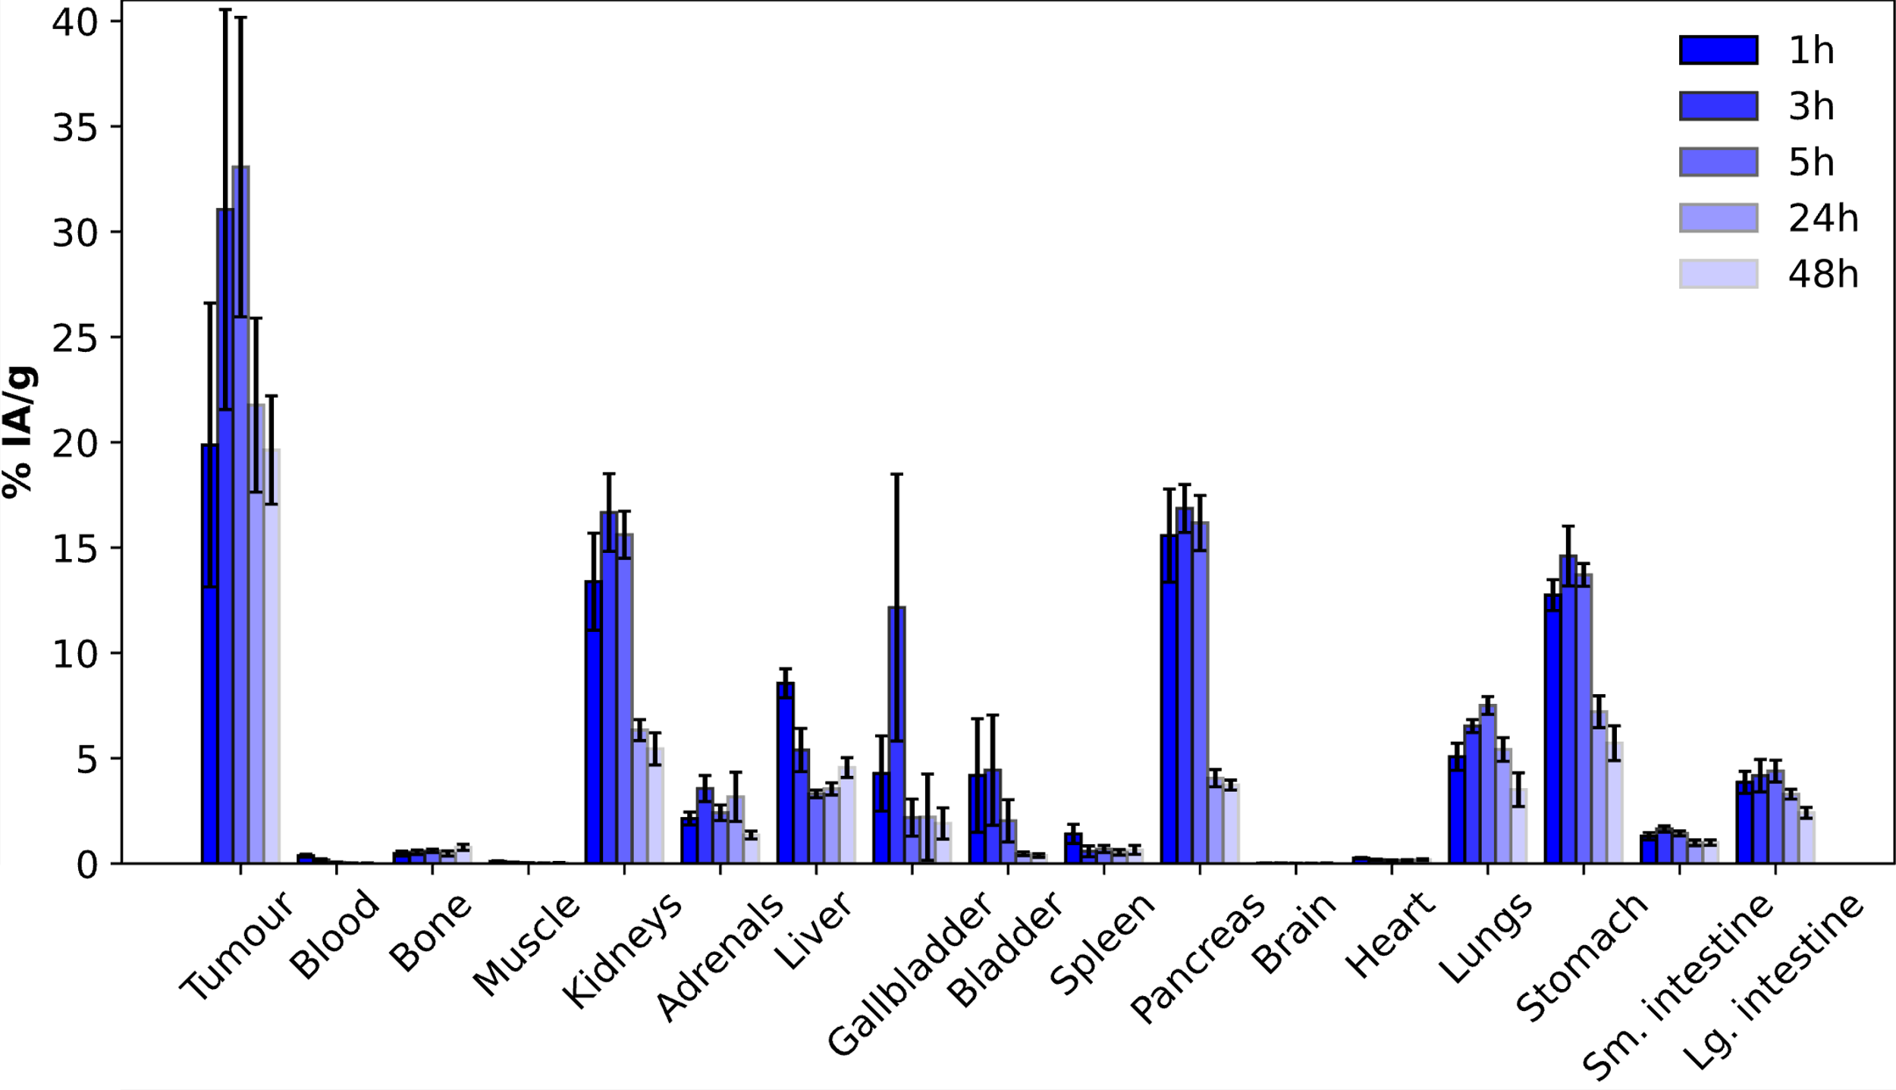
Results
[²²⁶Ac]Ac-crown-TATE ex vivo biodistribution

Slide 12
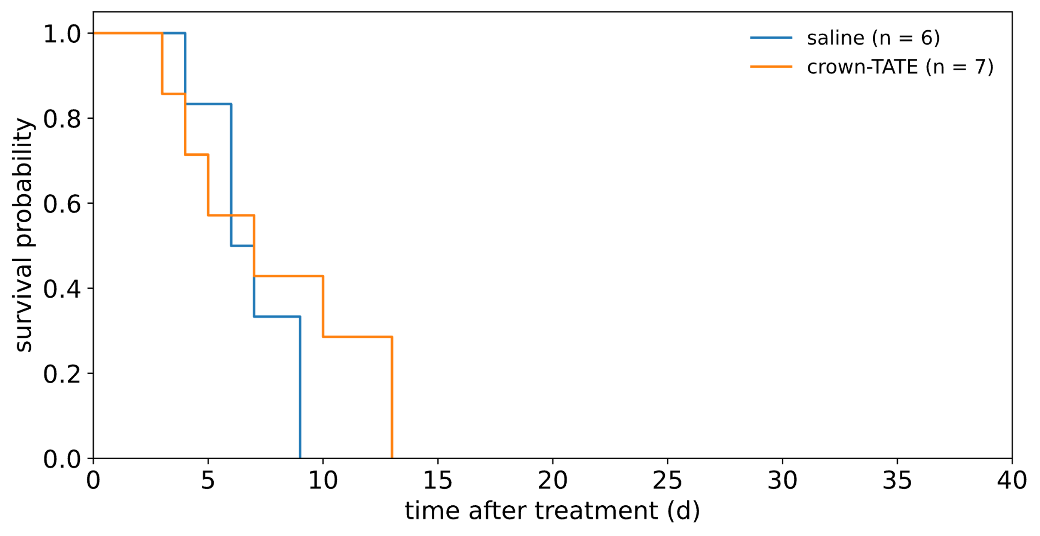
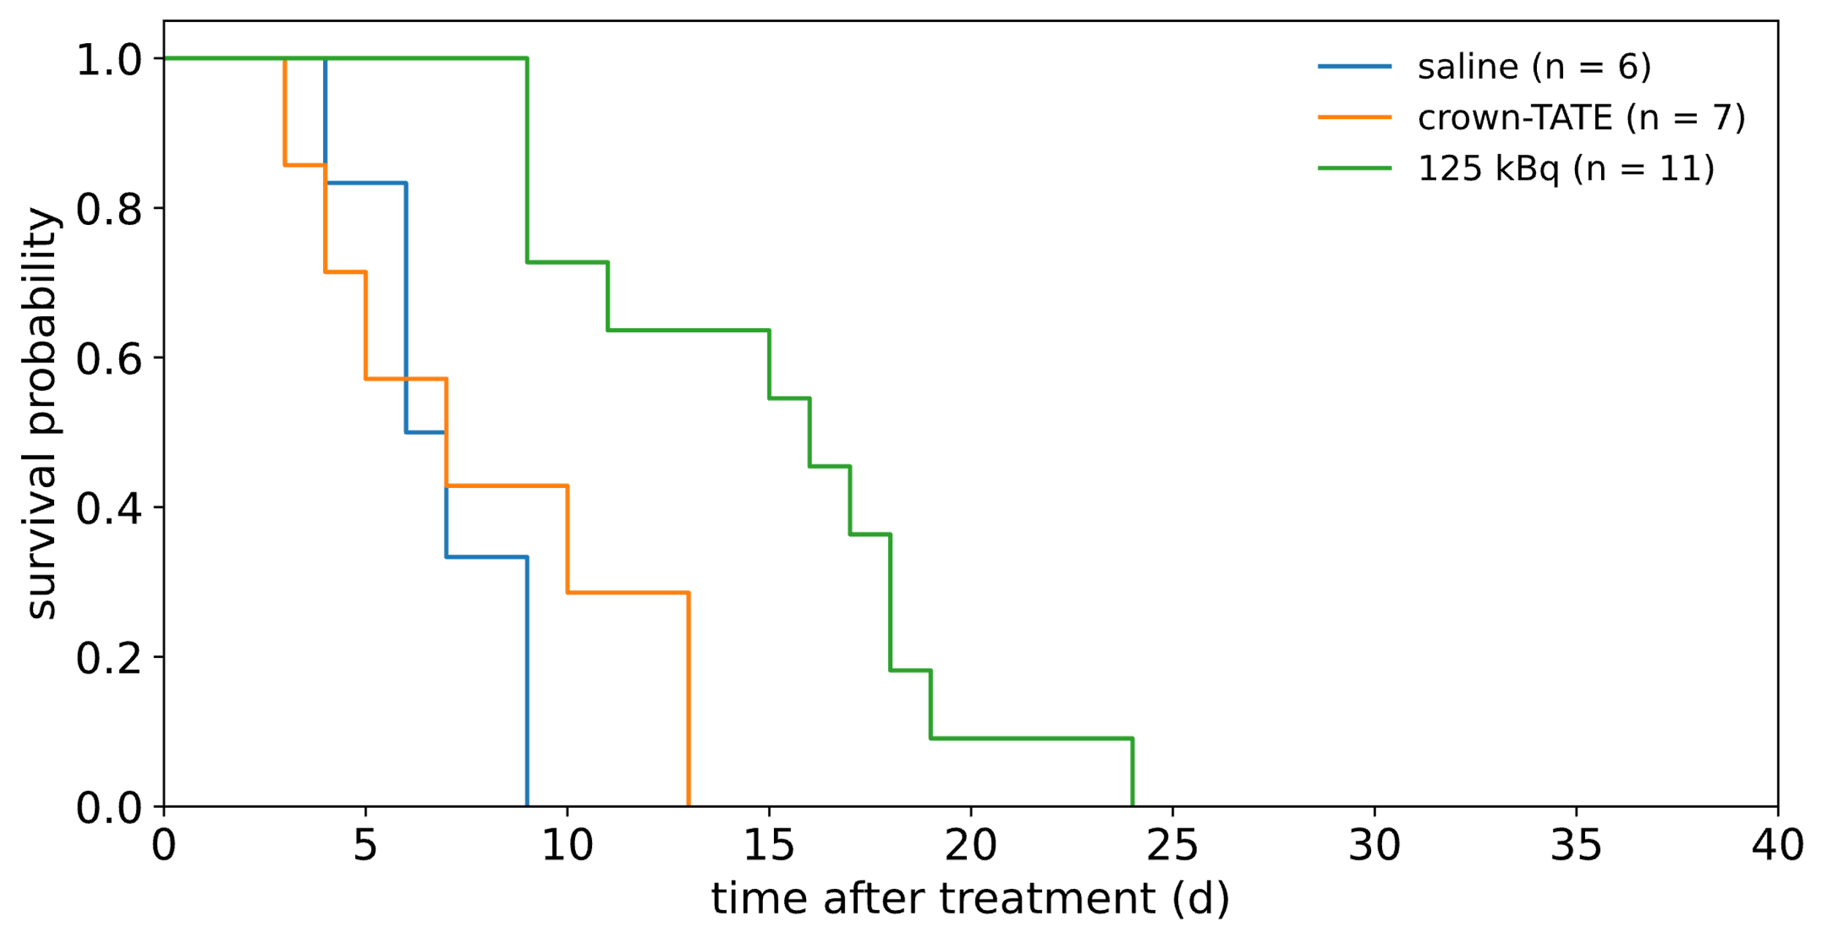
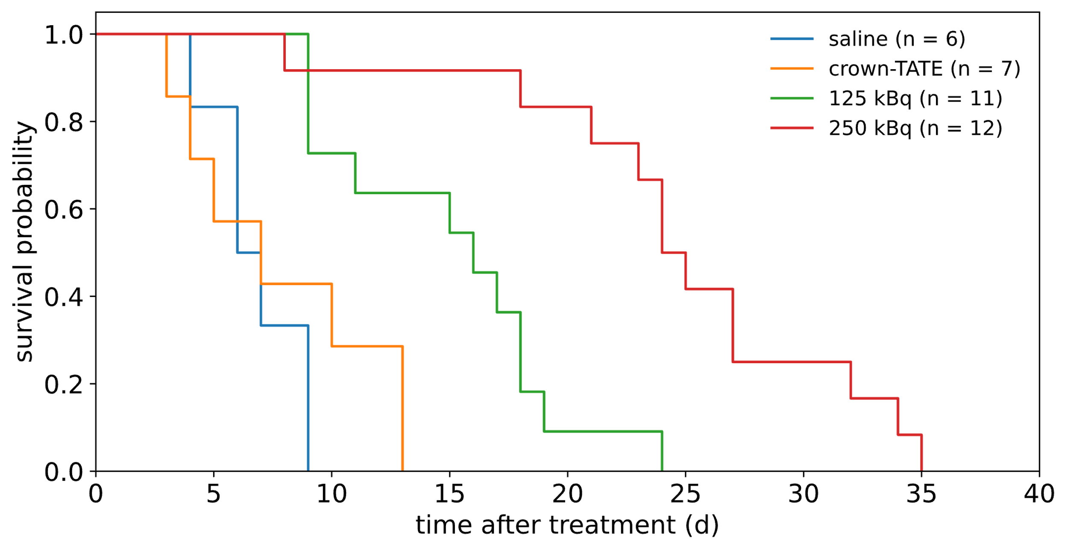
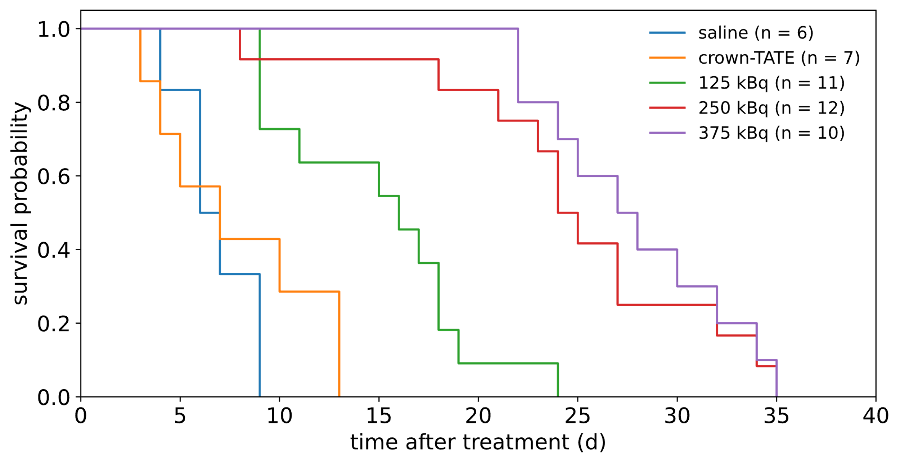
Results
Survival following treatment with [²²⁶Ac]Ac-crown-TATE
Notes:
Low 16 days,
Medium 24 days, and
High 27 days

Slide 13
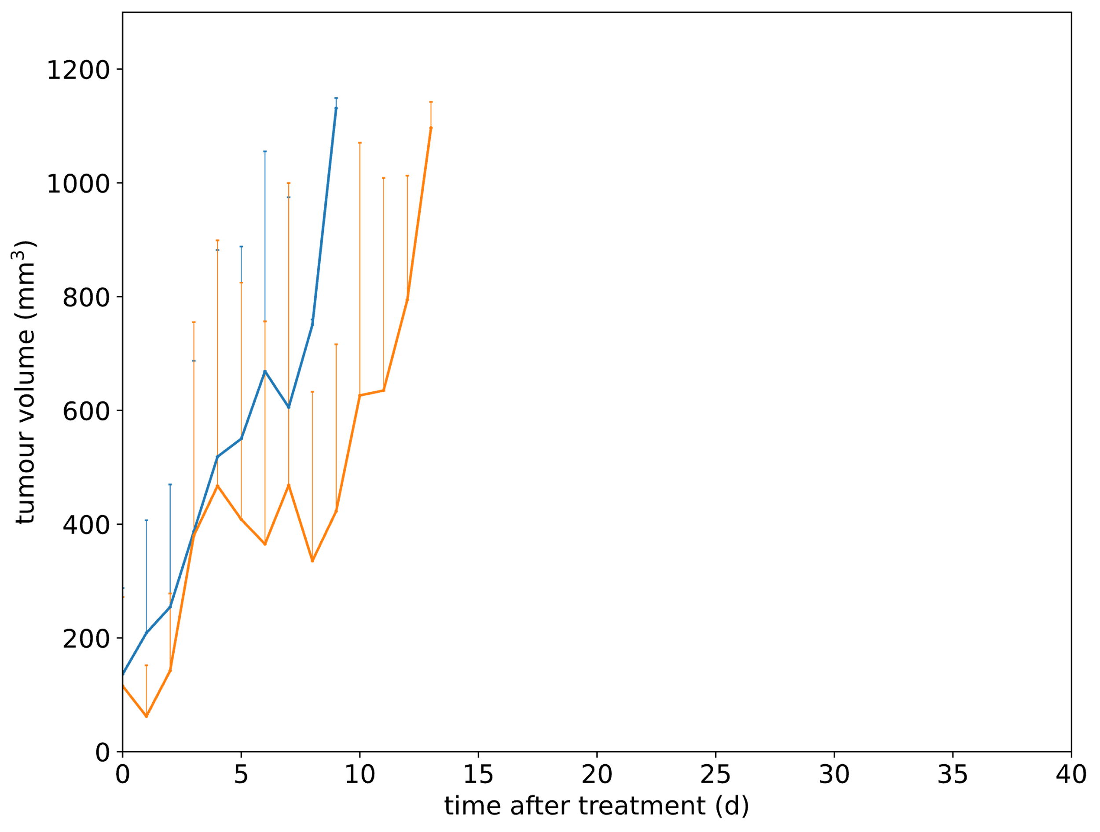
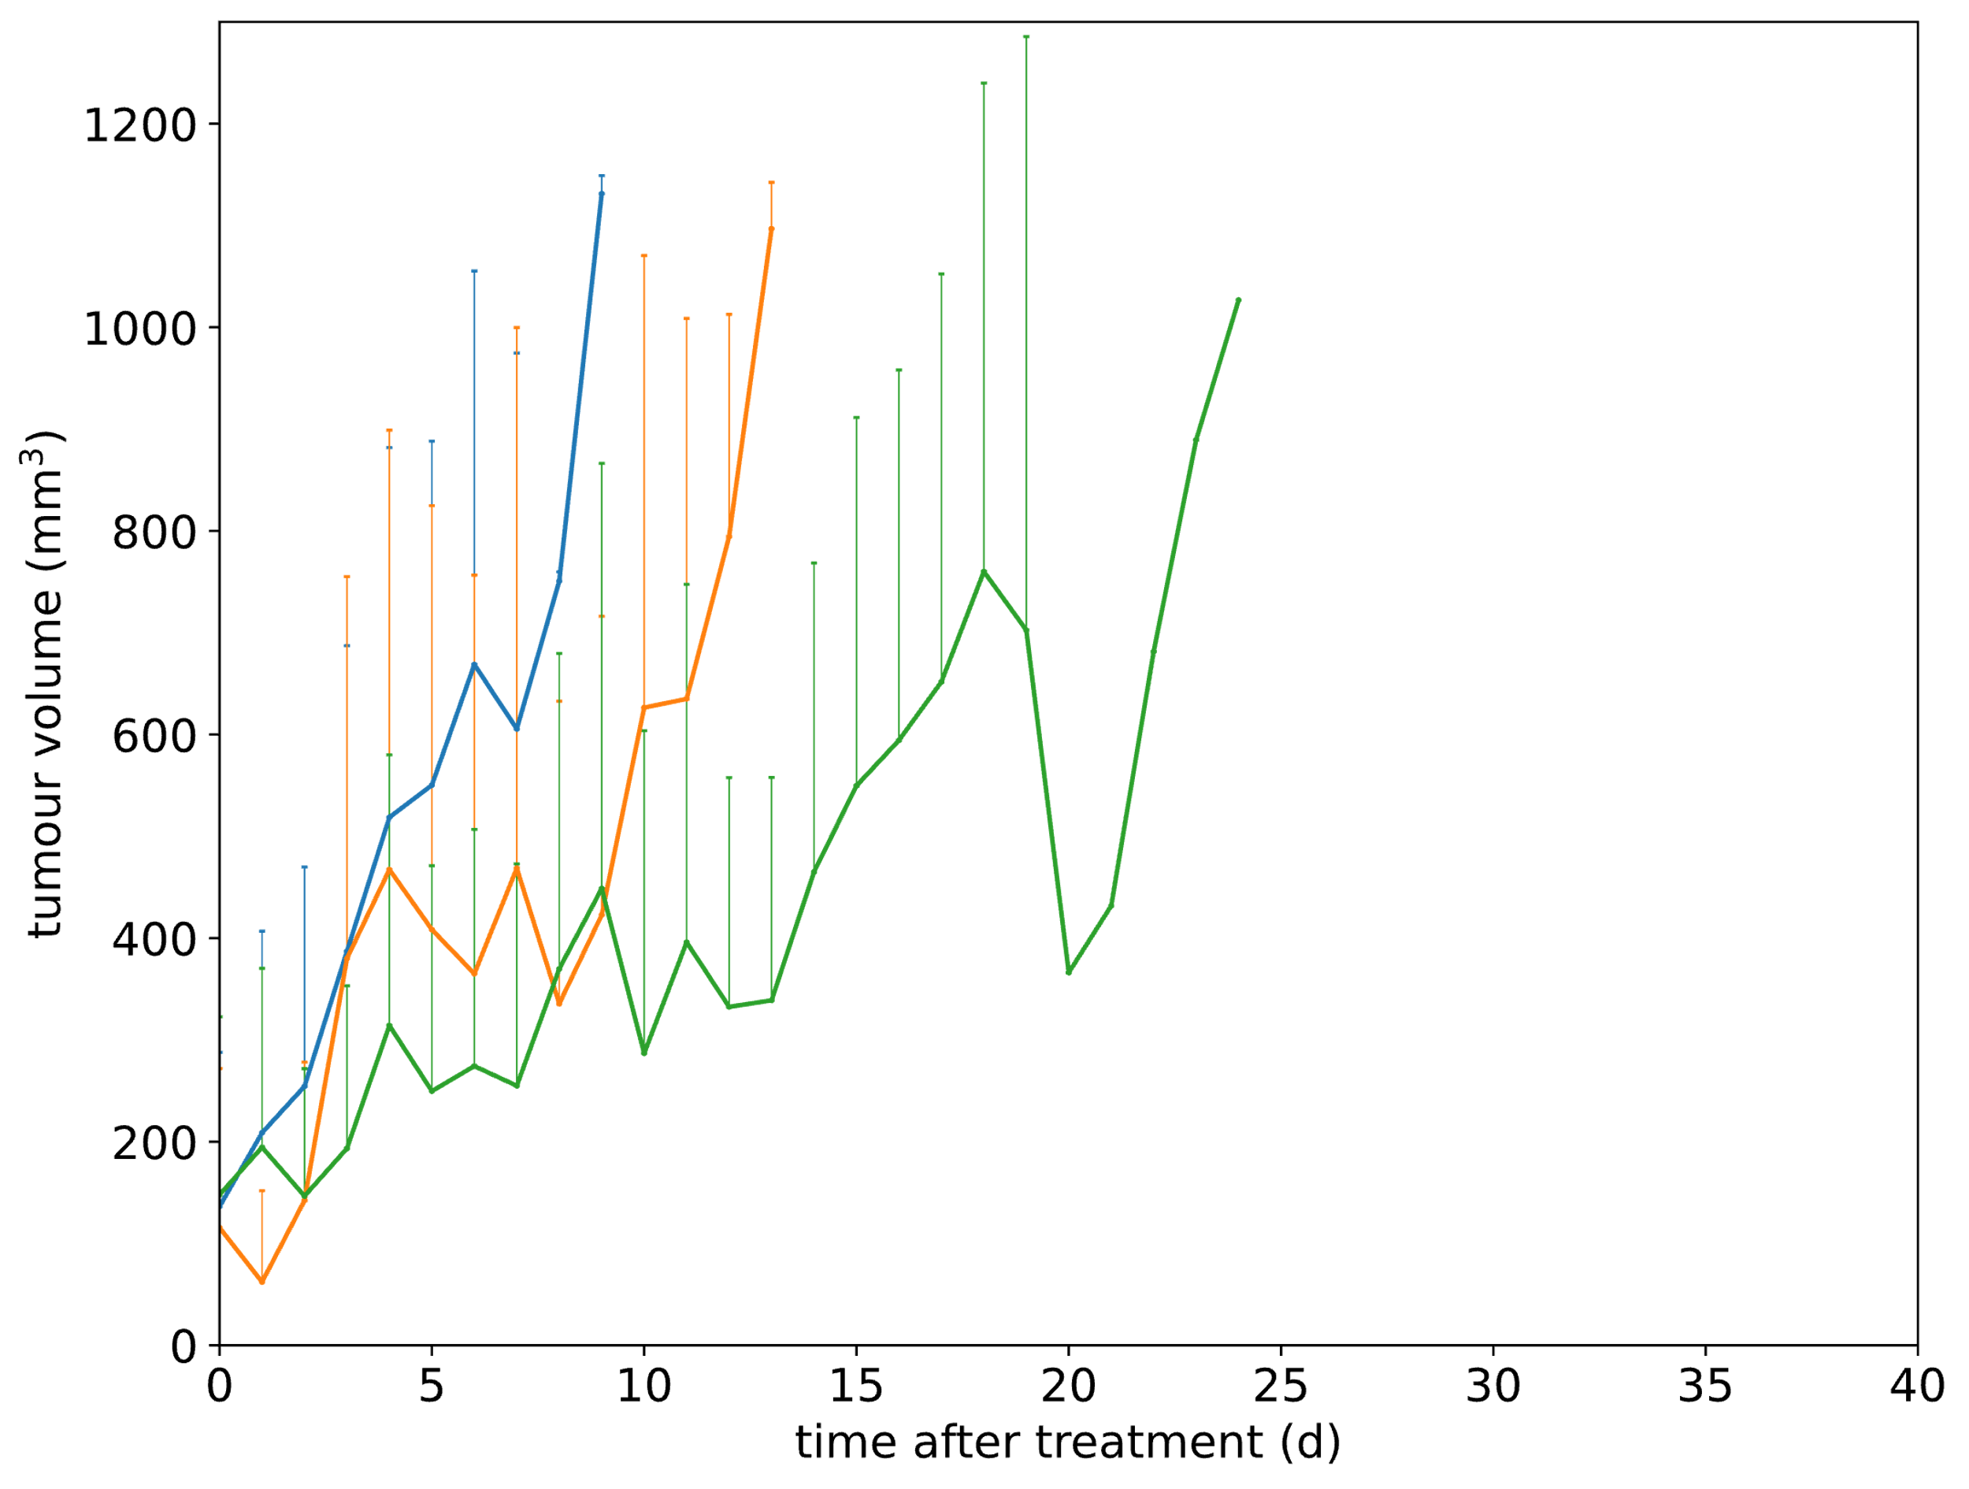
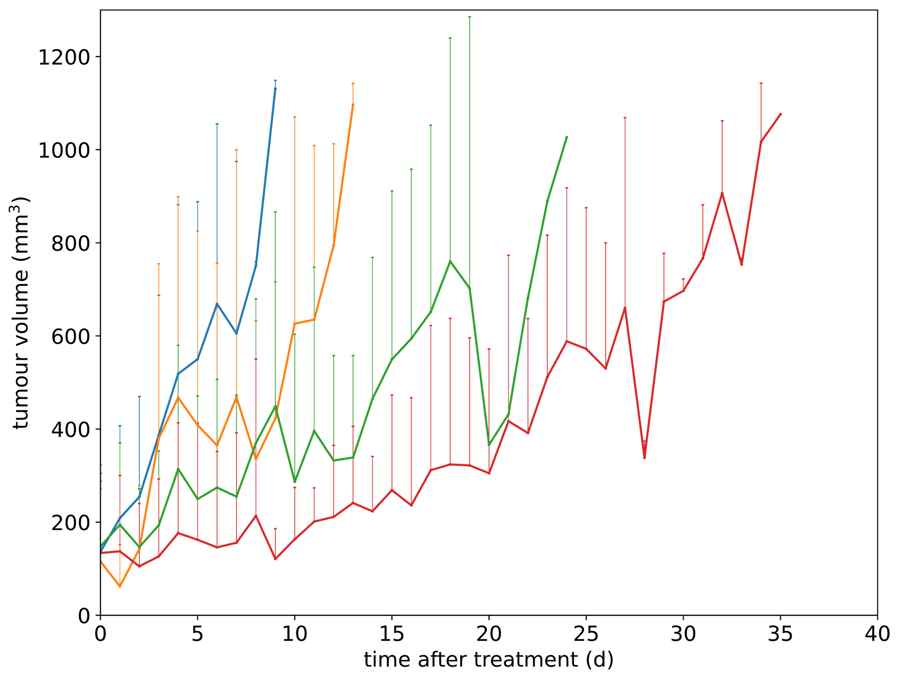
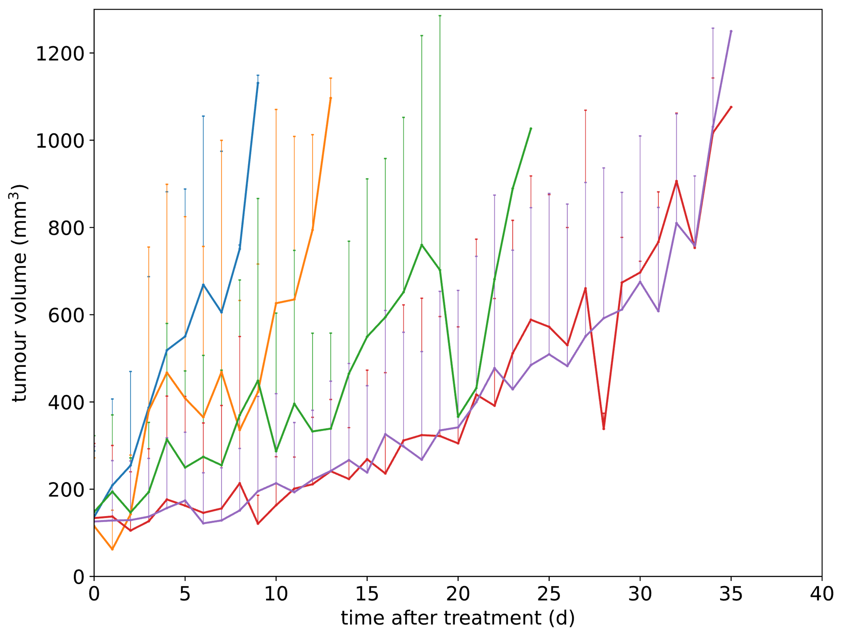
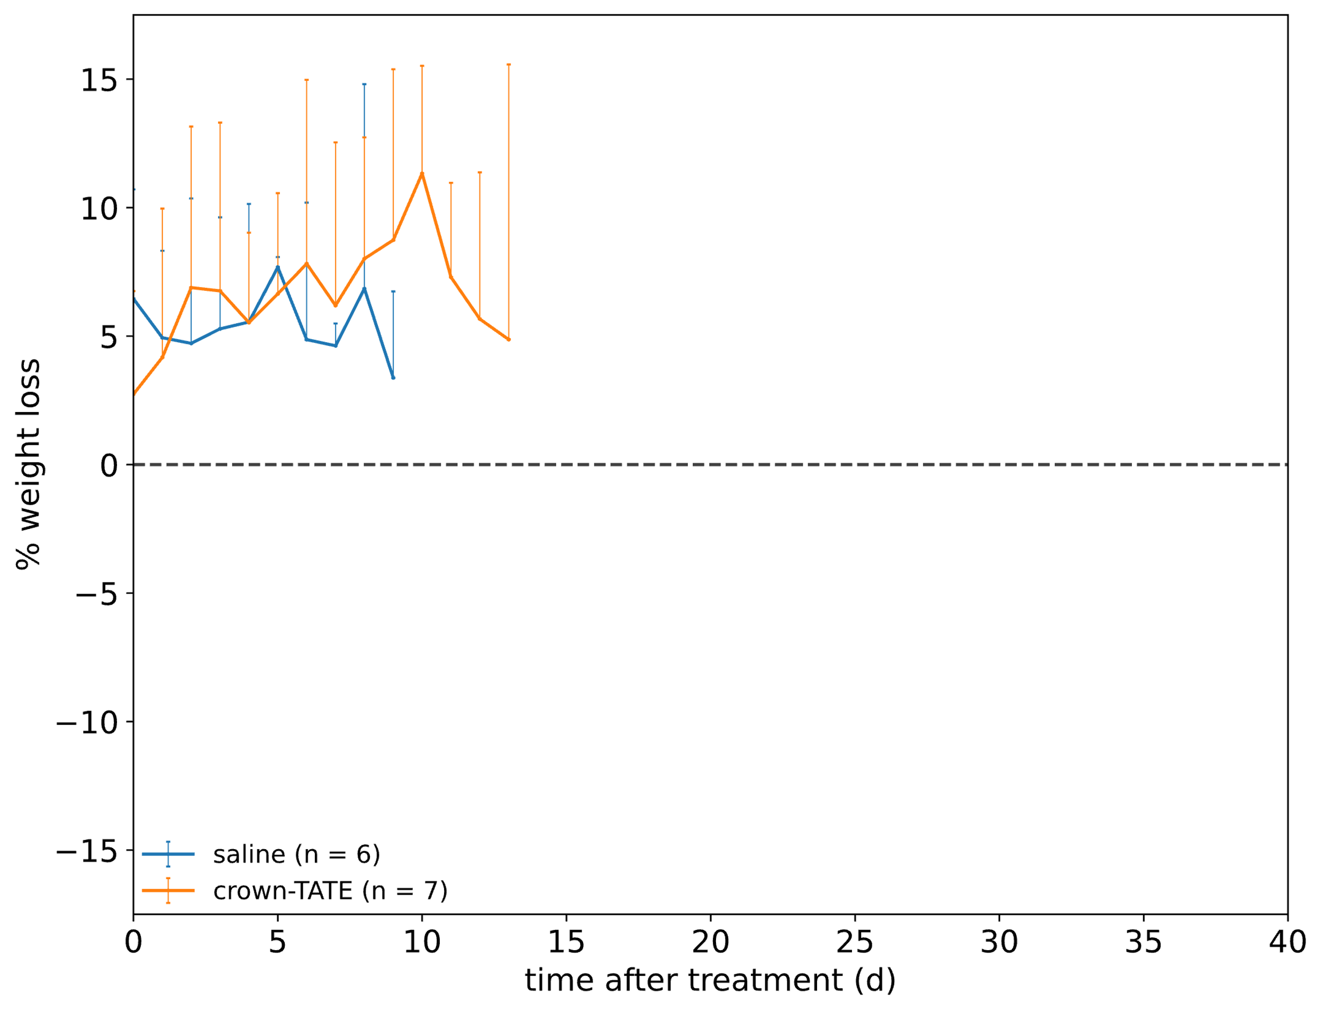
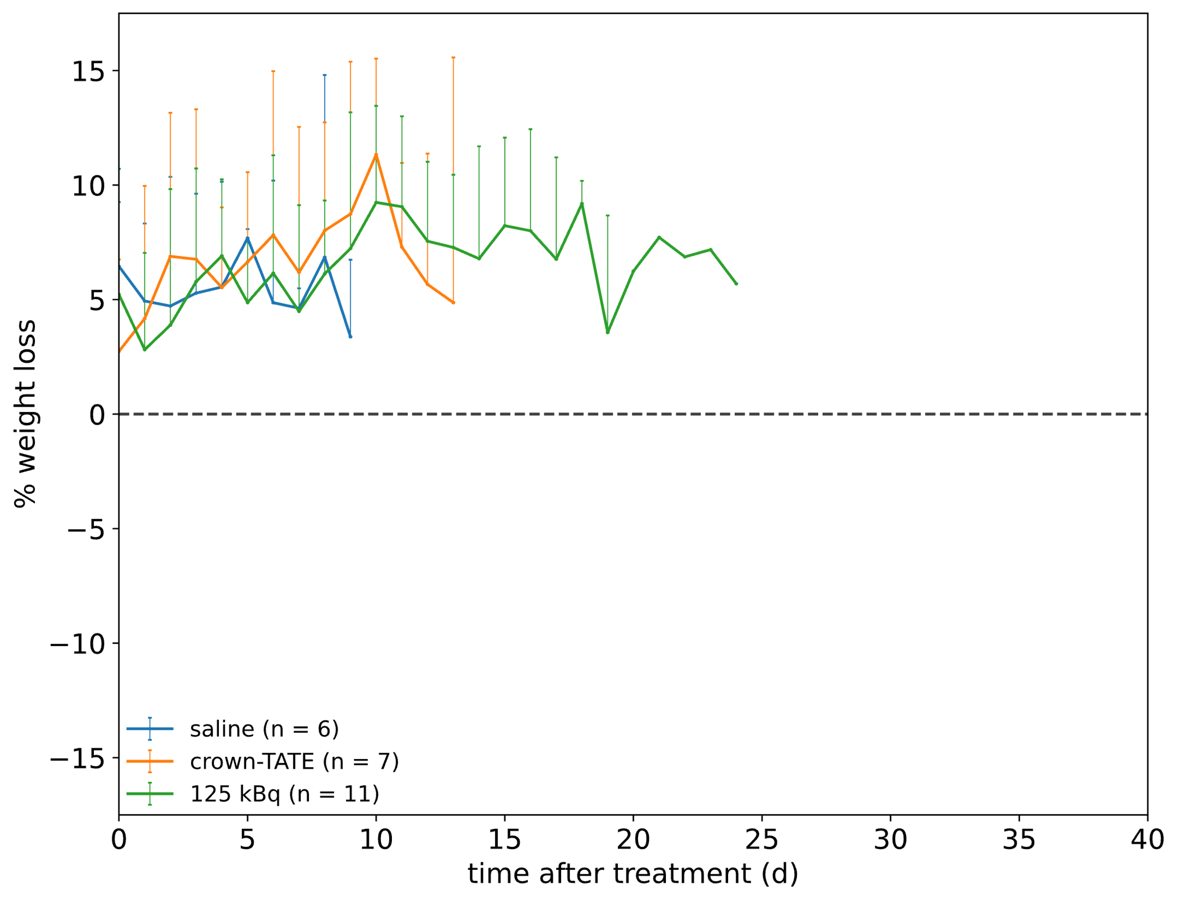
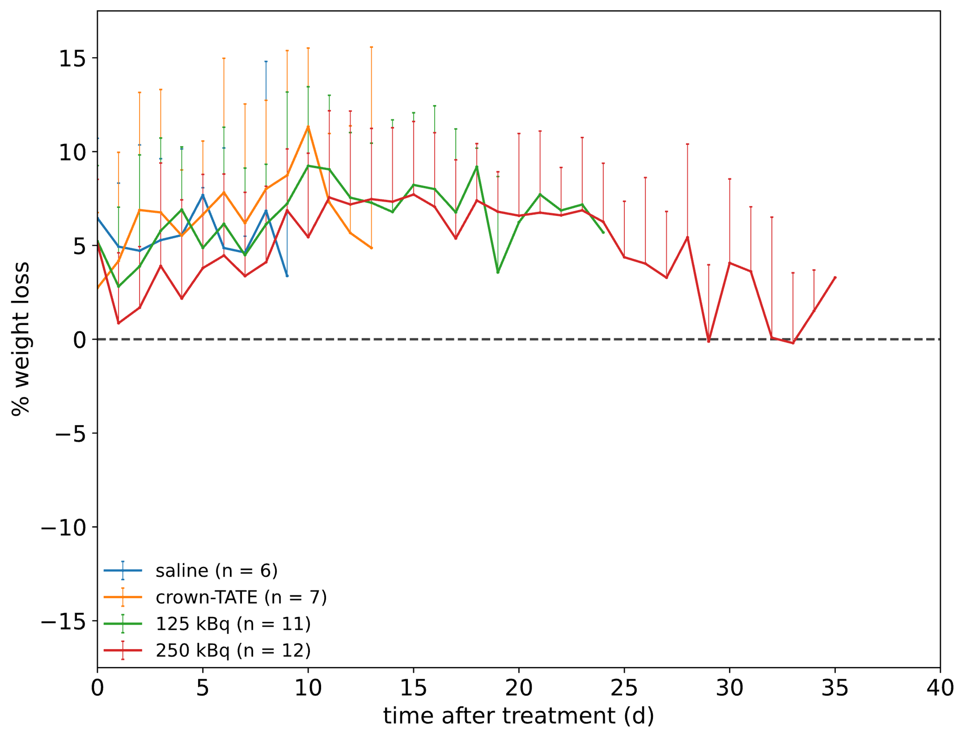
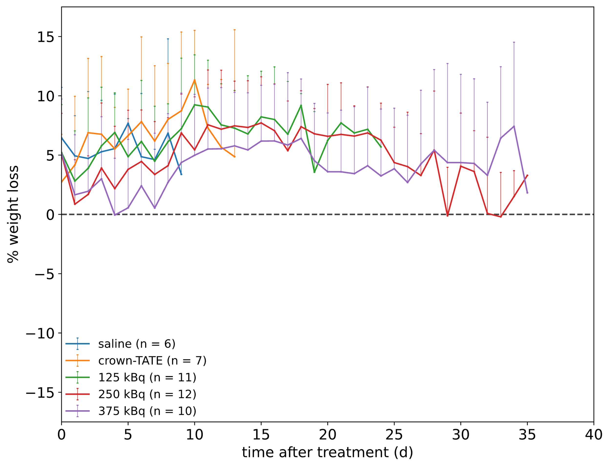
Results
Survival following treatment with [²²⁶Ac]Ac-crown-TATE
Notes:
Low 16 days,
Medium 24 days, and
High 27 days

Slide 14
Conclusions
Summary
Background:
²²⁶Ac has potential applications as a standalone theranostic isotope for targeted radionuclide therapy
Main findings:
Validates ²²⁶Ac capabilities for SPECT imaging and targeted alpha therapy
Significance / clinical relevance:
Demonstrates personalized dosimetry can start at preclinical stages

Slide 15



Acknowledgements
Luke Wharton
Aidan Ingham
Ana Paulina Morales Oliver
Peter Kunz
Valery Radchenko
Hua Yang
Paul Schaffer
Cristina Rodríguez-Rodríguez
Sathiya Sekar
Maryam Osooly
Arman Rahmim
Carlos Uribe
Helen Merkens

Slide 16


Thank you
Merci
Helena Koniar
PhD, Medical Physics
Life Sciences Division, TRIUMF
Dept. of Physics and Astronomy, UBC

