Slide 1

Studying nuclear structure with laser spectroscopy
TRIUMF Science Week 2024
22nd July 2024
Kara M. Lynch
Royal Society Dorothy Hodgkin Fellow
Nuclear Physics Group
The University of Manchester

Slide 2

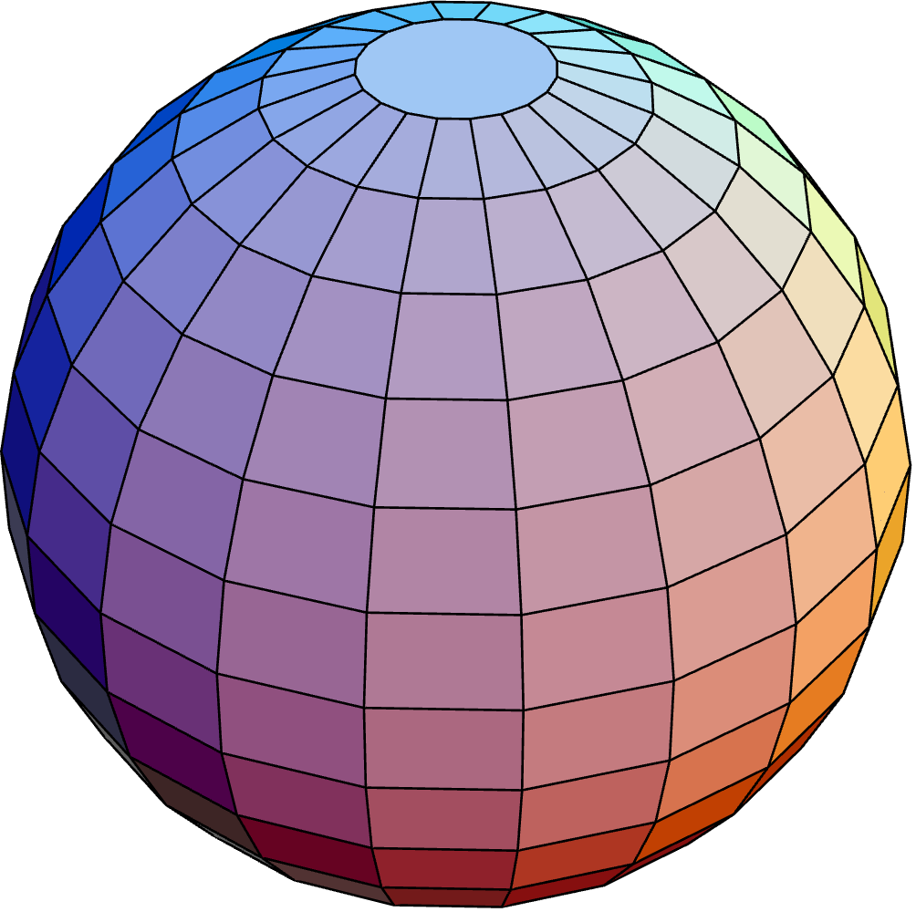
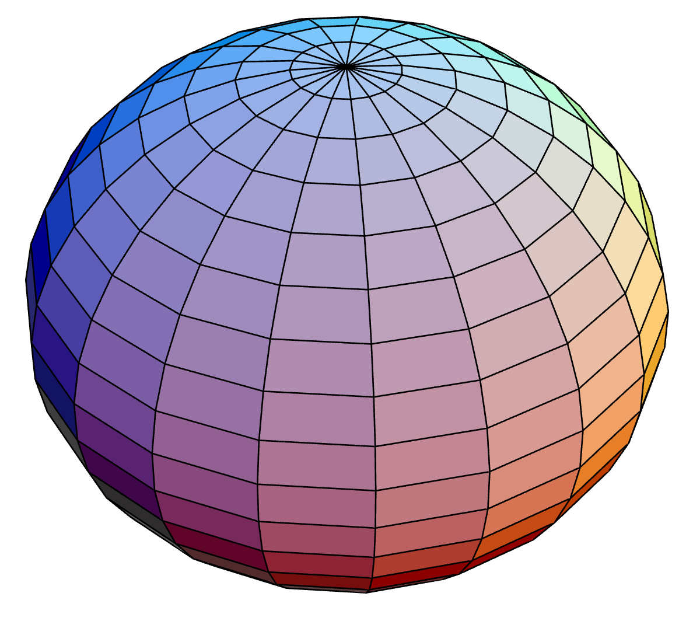





Overview
Royal Society Research Fellow at the University of Manchester, UK
Perform laser spectroscopy at ISOLDE to measure fundamental properties of the nucleus
Started a new research programme – ESPEN: Examining the Shape of Proton Emitting Nuclei
Contents of talk:
  Nuclear structure studies
  Laser spectroscopy at ISOLDE
    Collinear laser spectroscopy
    In-source laser spectroscopy
  Recent highlights
  Future plans
?
Lu
?
MPhys
PhD
Research Fellow
Research Fellow
2010
2013
2014
2015
2018
2020
2022
Marie Curie Fellow
Trainee Patent Attorney
Career break

Slide 3
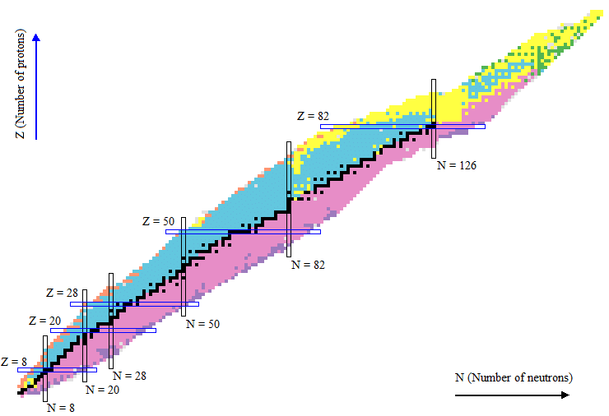
Nuclear landscape
Aim is to understand nuclear structure across the nuclear chart
Study of nuclear properties is vital
  Test our understanding
  Benchmark nuclear theories
Investigations are often focused around
  Emergence/disappearance of magic numbers
  Extremes of nuclear existence
Stable
Z (No. of protons)
β+ decay
β- decay
⍺ decay
Fission
p decay
N (No. of neutrons)
Nuclear Shell Model

Slide 4
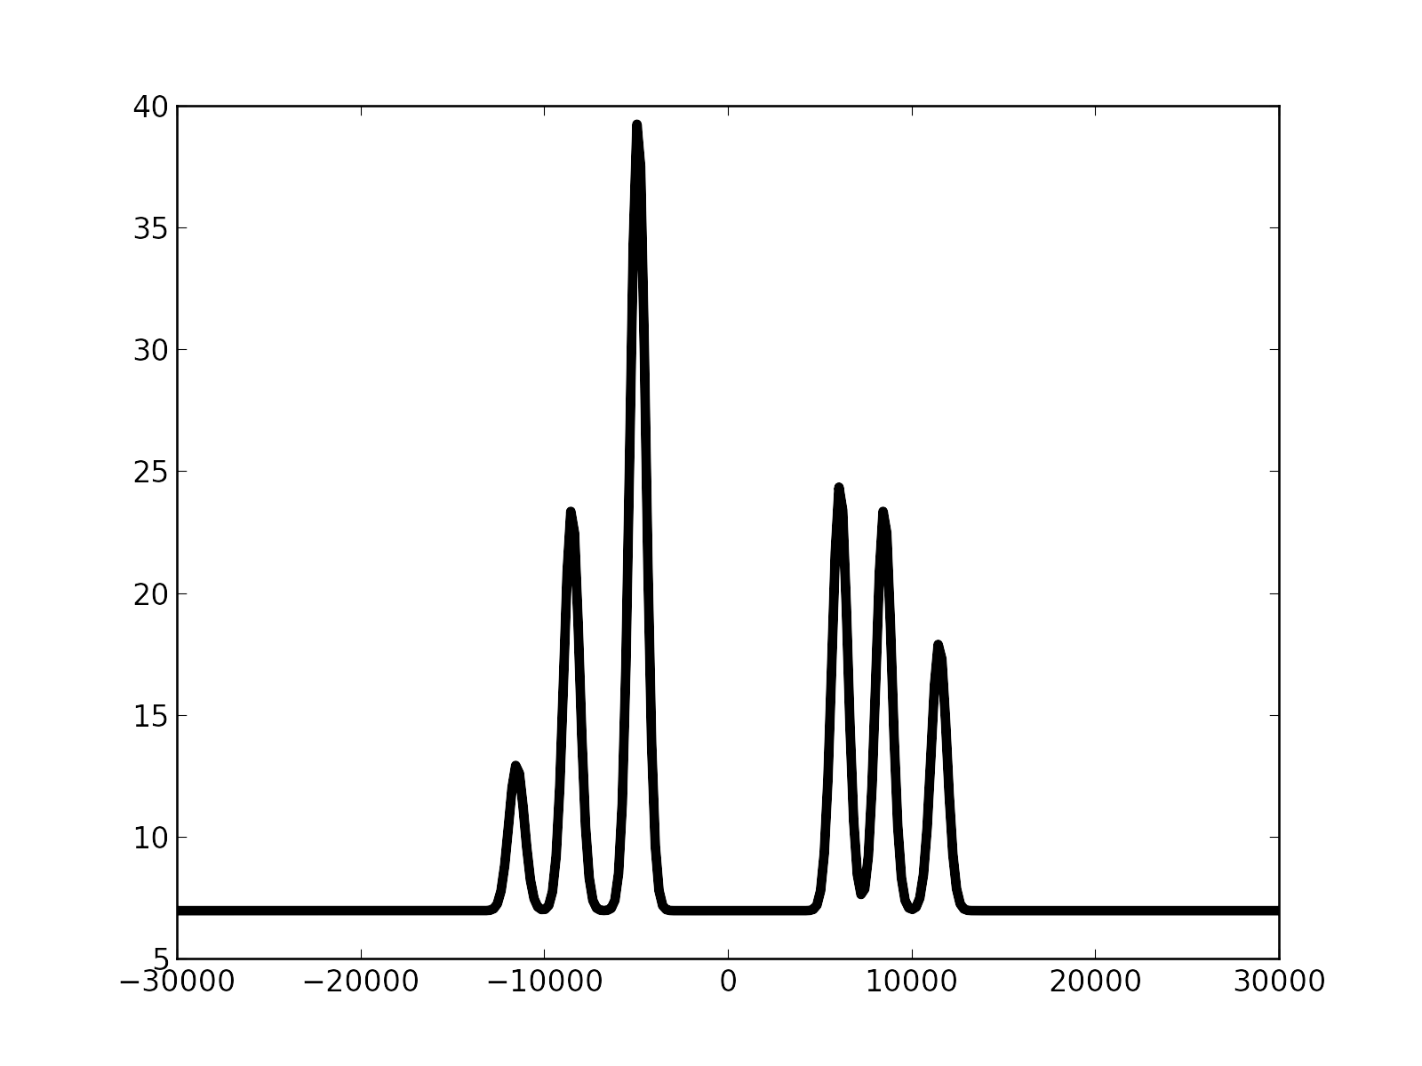
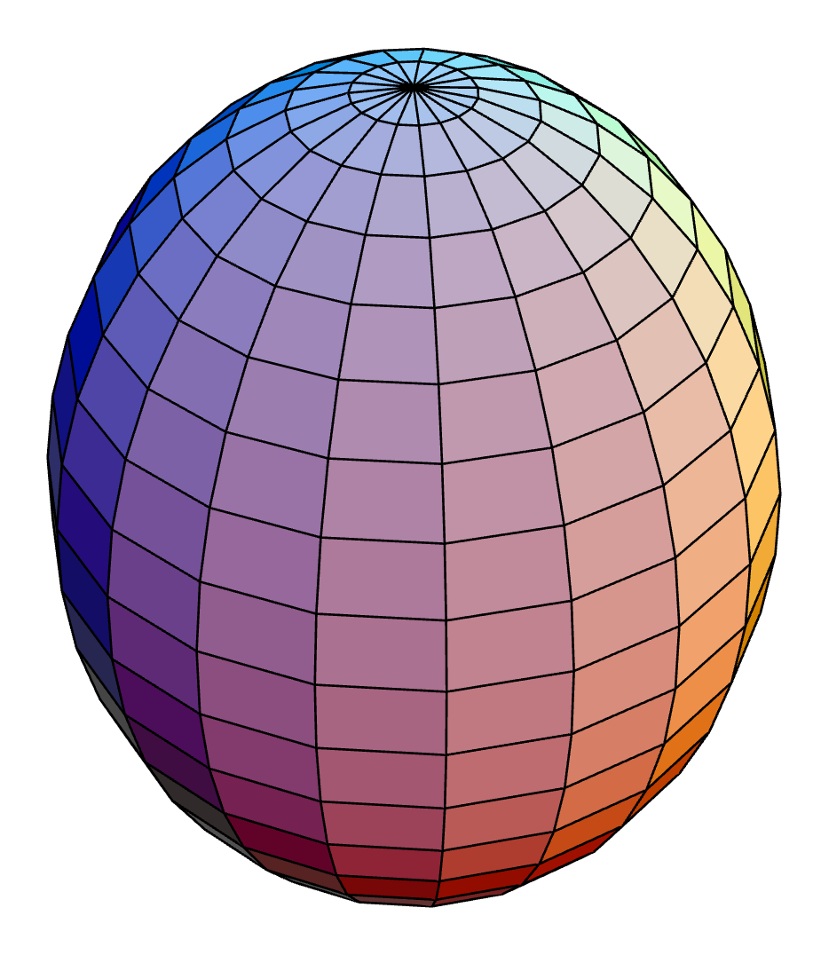
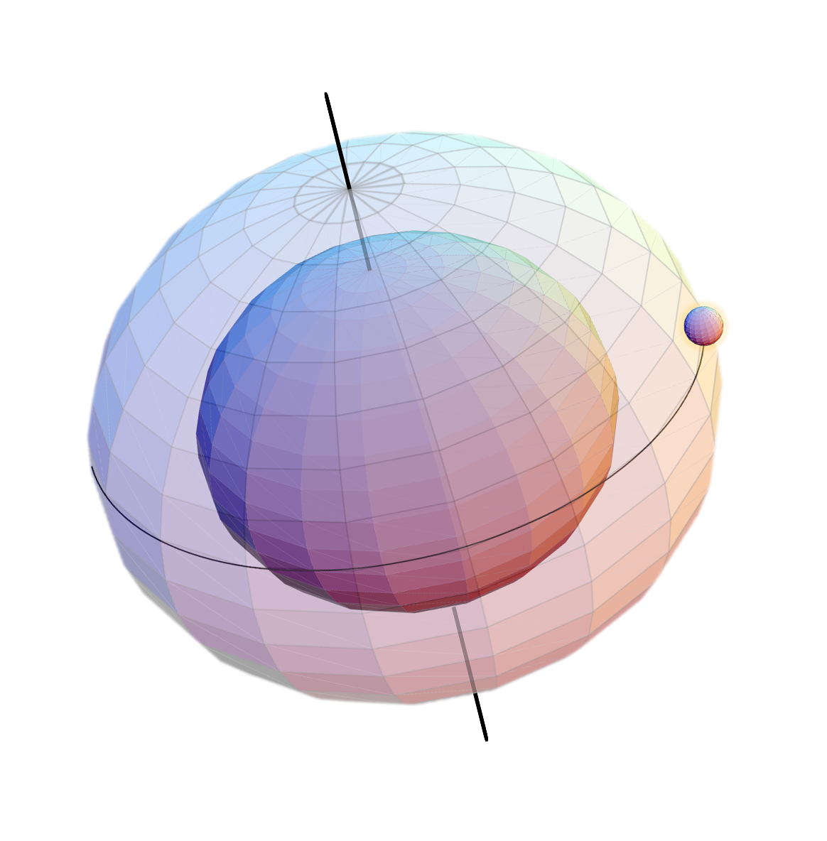

Laser spectroscopy
Fundamental nuclear observables measured with laser spectroscopy
Probe the hyperfine structure of the energy levels of the electron
Nuclear observables extracted with nuclear-model independence
Nuclear spin
Magnetic dipole moment
Electric quadrupole moment
Ex
Change in mean-square charge radii
GS
Spatial distribution of protons

Slide 5
Resonance ionization spectroscopy
Resonant excitation is followed by an ionization step into the continuum
  Resonantly ionize the nuclear state of interest
Laser spectroscopy:
  Fluorescence detection: Measure photons emitted from de-excitation of electrons
  Ion detection: Measure ion created from resonance ionization process
Laser spectroscopy
AI
Ground state
IP
Isomer 1
Ryd
Isomer 2
Counts
Count ions
Ex
Laser frequency (MHz)
Laser-assisted decay spectroscopy
GS
Counts
Measure radioactive decay
Alpha energy (keV)

Slide 6
The hyperfine spectra
The frequency of each hyperfine peak is given by:
where
The centroid and hyperfine factors can be determined from the hyperfine spectrum using a
minimization fitting routine
Notes:
From difference in energy of fine structure state with hyperfine state, nuclear parameters can be extracted.
Sub-state weighted centroid of the multiplet allows us to determine the isotope shift.

Slide 7
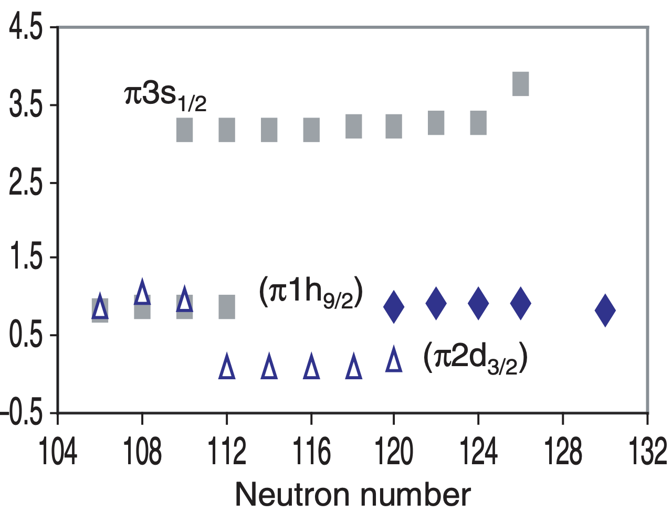
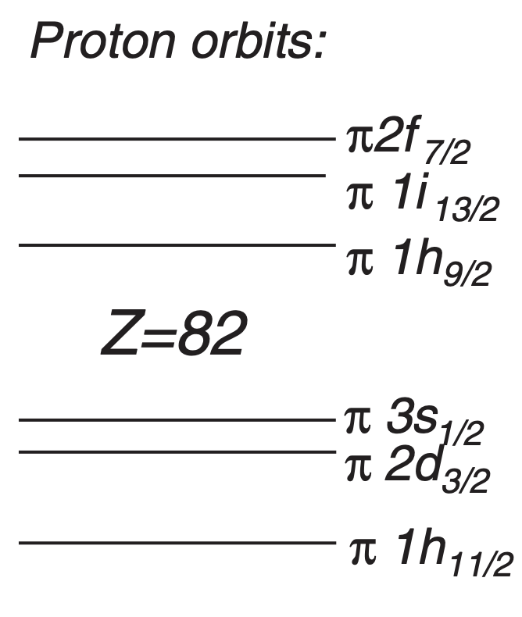
Magnetic moment μ_{I}
Extracted from hyperfine A factors
Measure of the single-particle nature of the nucleus
Sensitive to the nuclear orbitals occupied by the valence protons and/or neutrons
Insight into the ‘location’ of the neutrons and protons in the nucleus
μ/I
Au (Z=79)
Tl (Z=81)
Bi (Z=83)
G. Neyens Rep. Prog. Phys. 66 633 (2003)

Slide 8
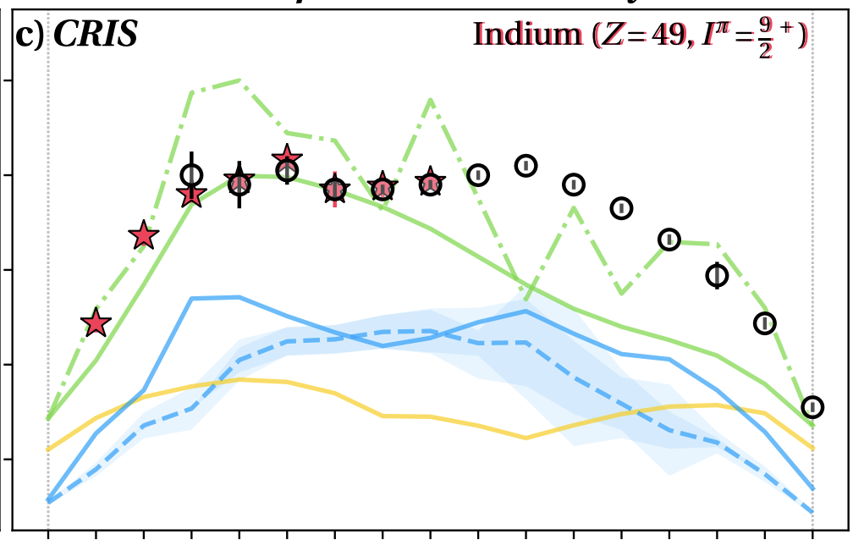
Quadrupole moment Q_{s}
Extracted from hyperfine B factors
Measures the static deformation of the nucleus
Nuclear-model independent measurement of the shape of the nucleus
Qs (fm²)
Oblate
β < 0
Spherical
β = 0
Prolate
β > 0
50
Neutron Number
82
J. Karthein et al. Nature Physics. Accepted (2024)

Slide 9
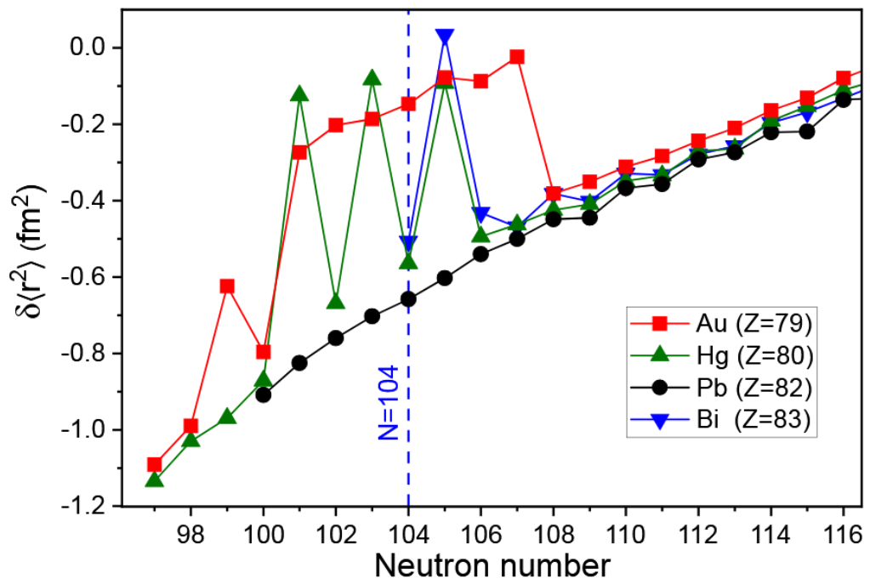



Change in charge radii $δ{\left\langle r^{2}\right\rangle }^{AA′}$
Study hyperfine structure of isotopes along an isotopic chain
Shift in centroid frequency of hyperfine structure for each isotope
Isotope shift ($δv^{AA′}$) allows extraction of change in mean-square charge radii ($δ{\left\langle r^{2}\right\rangle }^{AA′}$)
How the spatial distribution of protons changes when neutrons are removed from nucleus
Isotope A
R₁
Isotope A’
$$δv^{AA′}$$
R₂
J. Cubiss et al. PRL 131 202501 (2023)
$δv^{AA′}=F δ{\left\langle r^{2}\right\rangle }^{AA′}+M \frac{A^{′}−A}{AA′}$

Slide 10
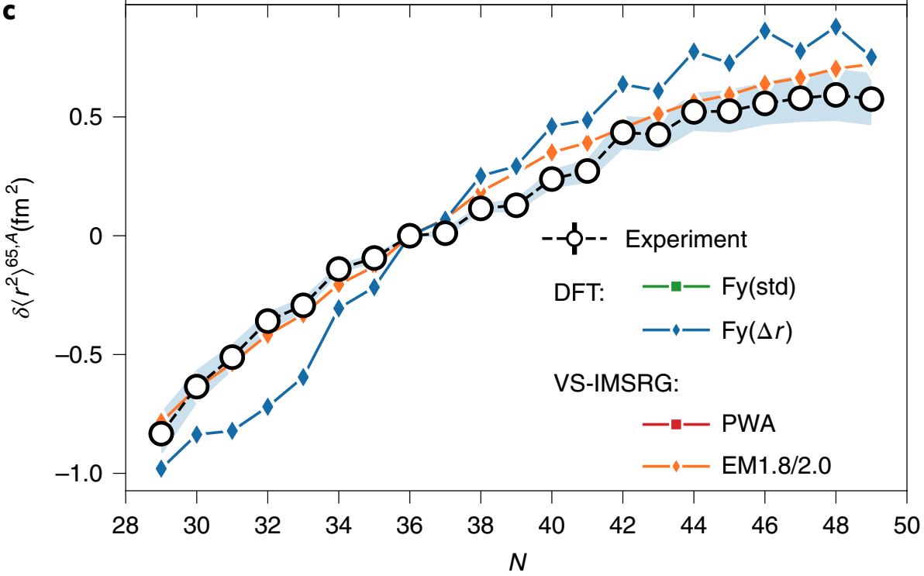
Charge radius: A sensitive probe
Charge radius is sensitive to complex dynamics of protons and neutrons moving
inside the nucleus
Test state-of-the-art nuclear theories:
  Ab-initio VS-IMSRG: uses 2- and 3-body forces, constrained by properties of ³H, ³He, ⁴He
  Density Functional Theory: uses experimental data to constrain the nuclear model
Precise experimental charge radii measurements
  Distinguish between nuclear models
  Experimental uncertainty <0.01 fm²
Insight into the changing proton distribution
~0.8 fm
Proton
7.7 fm
Gold
Experiment
Ab-initio (VS-IMSRG)
Global (DFT)
?
Lu
?
R.P. de Groote et al., Nature Physics 16 620–624 (2020)

Slide 11

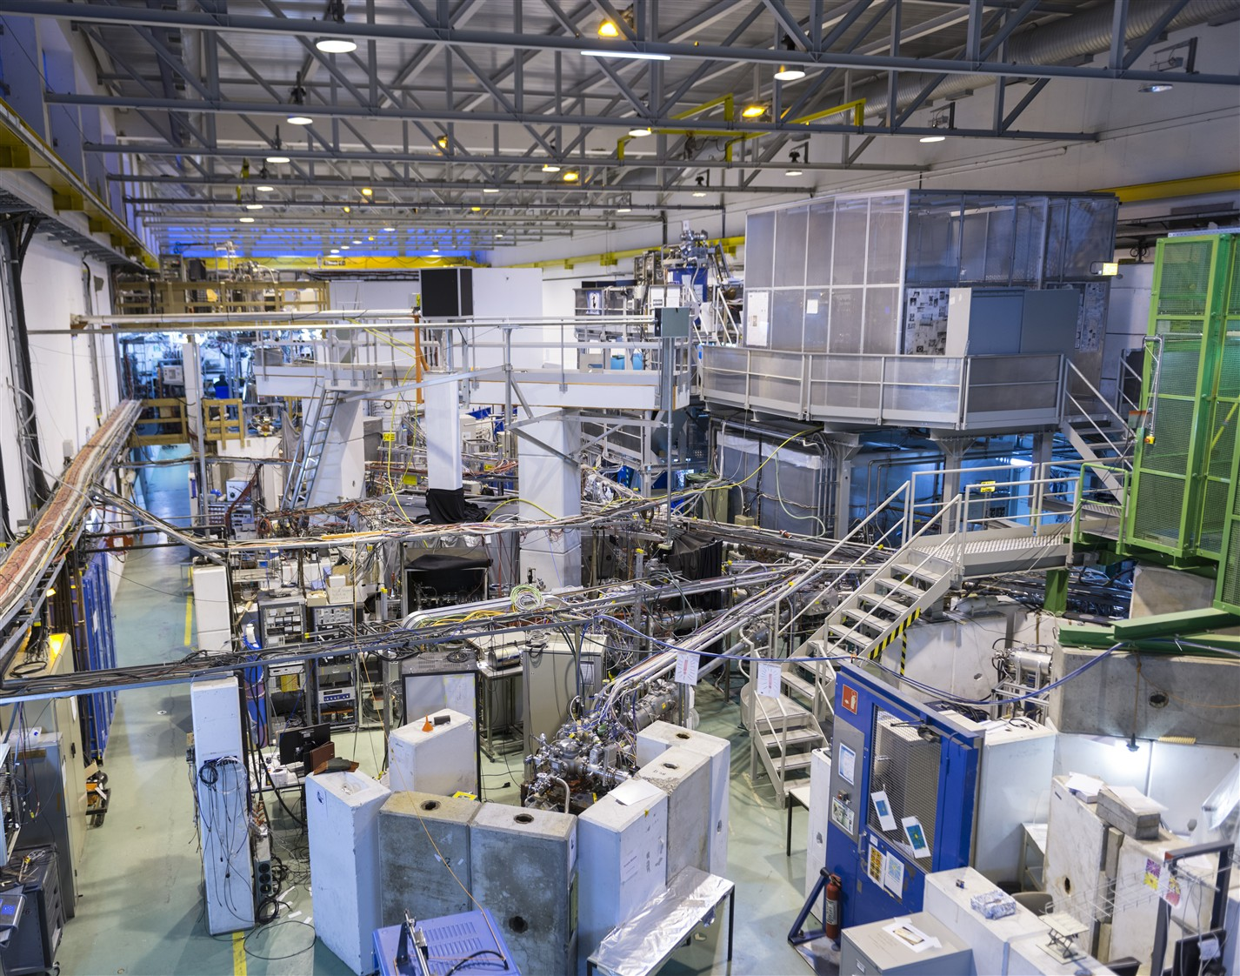
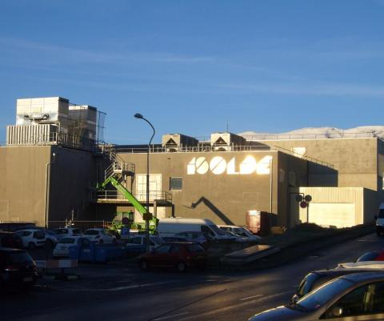
Production of exotic nuclei
Go to radioactive ion beam facilities to study exotic nuclei
Require sensitive and efficient laser spectroscopy techniques to measure them
Focus on laser spectroscopy studies at ISOLDE facility at CERN
Uses 1.4 GeV protons from the PS Booster
Produces radioactive isotopes for
  nuclear physics
  astrophysics
  solid-state physics
  bio-physics
  fundamental physics

Slide 12




Laser spectroscopy at ISOLDE
Neutralisation
Fluorescence detection
Collinear laser spectroscopy
Neutralisation
Ionization
ISCOOL buncher
1.4 GeV protons from PSB
Ion detection
Mass separation
Laser-assisted decay spectroscopy
RILIS lasers
ISOLDE
Current or ion detection
Target e.g UCx
Ion source
In-source laser spectroscopy
Laser-assisted decay spectroscopy
MR-ToF
Laser-assisted mass measurements

Slide 13
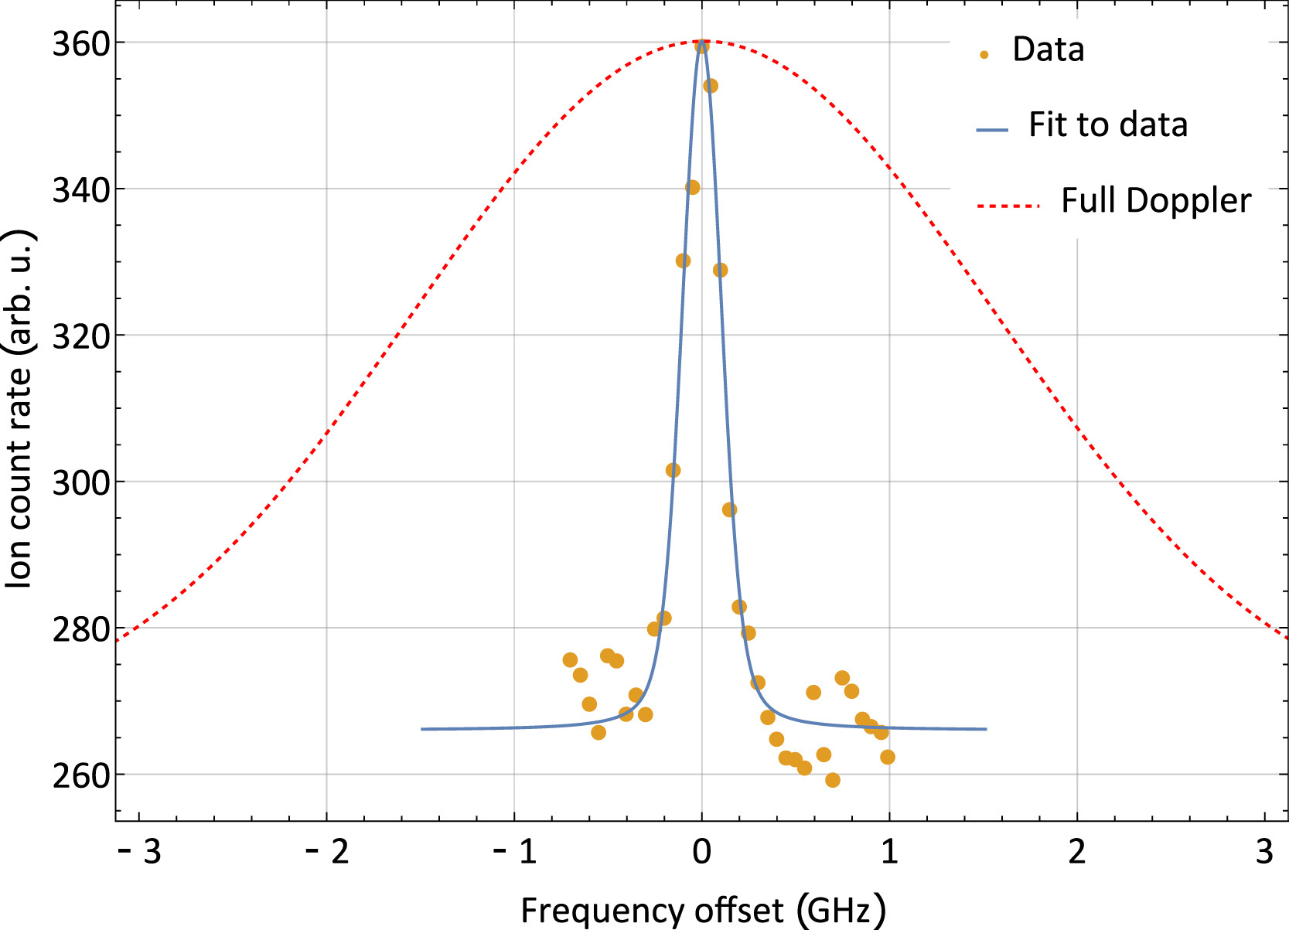
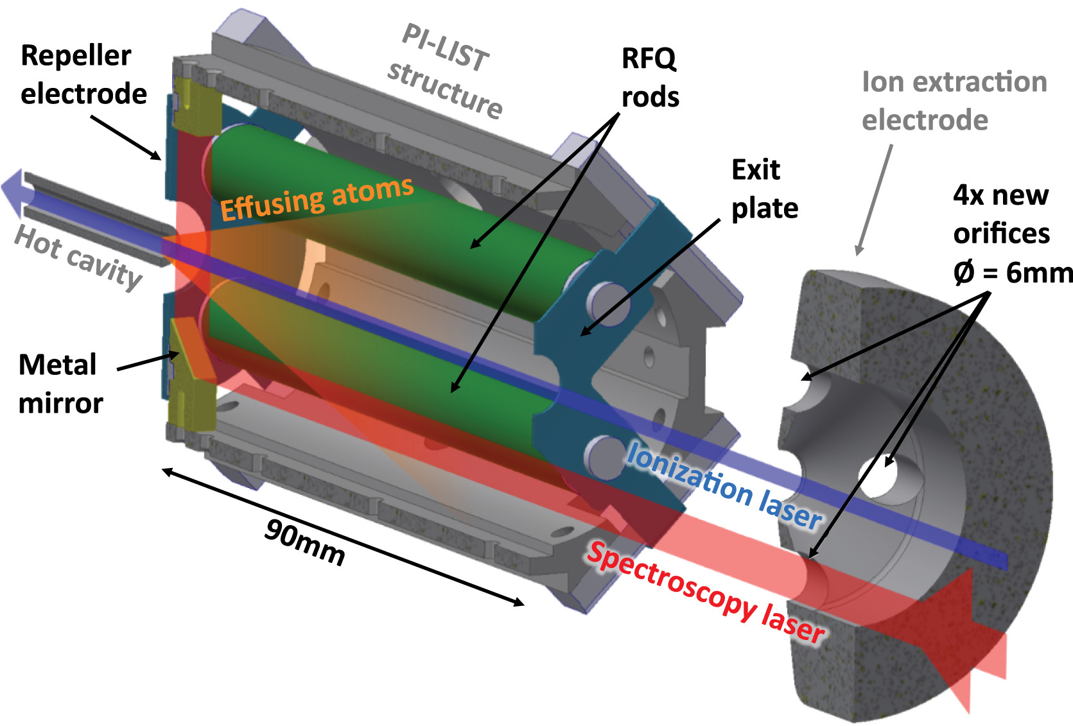
Recent studies at ISOLDE
J. Cubiss et al.
Phys Rev Lett 131 202501 (2023)
Actinium Z=89
R. Heinke et al. NIM B 541 8-12 (2023)
Gold Z=79
Nickel Z=28
S. Malbrunot-Ettenauer et al.
Phys. Rev. Lett. 128 022502 (2022)
Scandium Z=21
S. W. Bai et al. Phys. Lett. B 829 137064 (2022)
Aluminium Z=13
P. Plattner et al. Phys. Rev. Lett. 131 222502 (2023)

Slide 14
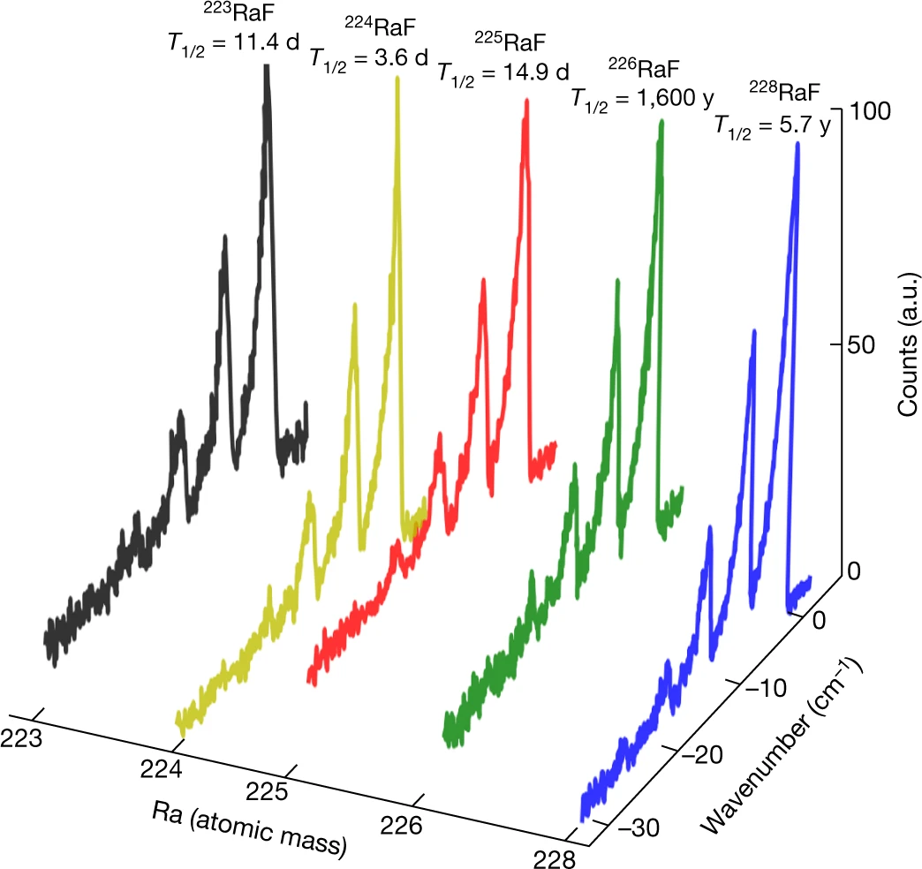
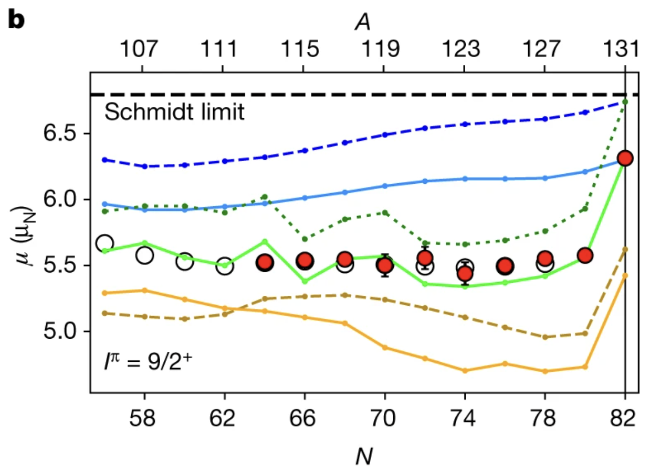
Recent studies at ISOLDE
RaF molecules
R. F. Garcia et al. Nature 581 396–400 (2020)
S. M. Udrescu et al. Nature Physics 20 202–207 (2024)
Indium Z=49
A. R. Vernon et al. Nature 607 260–265 (2022)
J. Karthein et al. Nature Physics Accepted (2024)
Scandium Z=21
S. W. Bai et al. Phys. Lett. B 829 137064 (2022)

Slide 15
Recent studies at ISOLDE
RaF molecules
R. F. Garcia et al. Nature 581 396–400 (2020)
S. M. Udrescu et al. Nature Physics 20 202–207 (2024)
AcF molecules
Francium Z=87
Gold Z=79
Indium Z=49
A. R. Vernon et al. Nature 607 260–265 (2022)
J. Karthein et al. Nature Physics Accepted (2024)
Chromium Z=24
Zinc Z=30
Scandium Z=21
S. W. Bai et al. Phys. Lett. B 829 137064 (2022)
Aluminium Z=13
Recent experiment

Slide 16

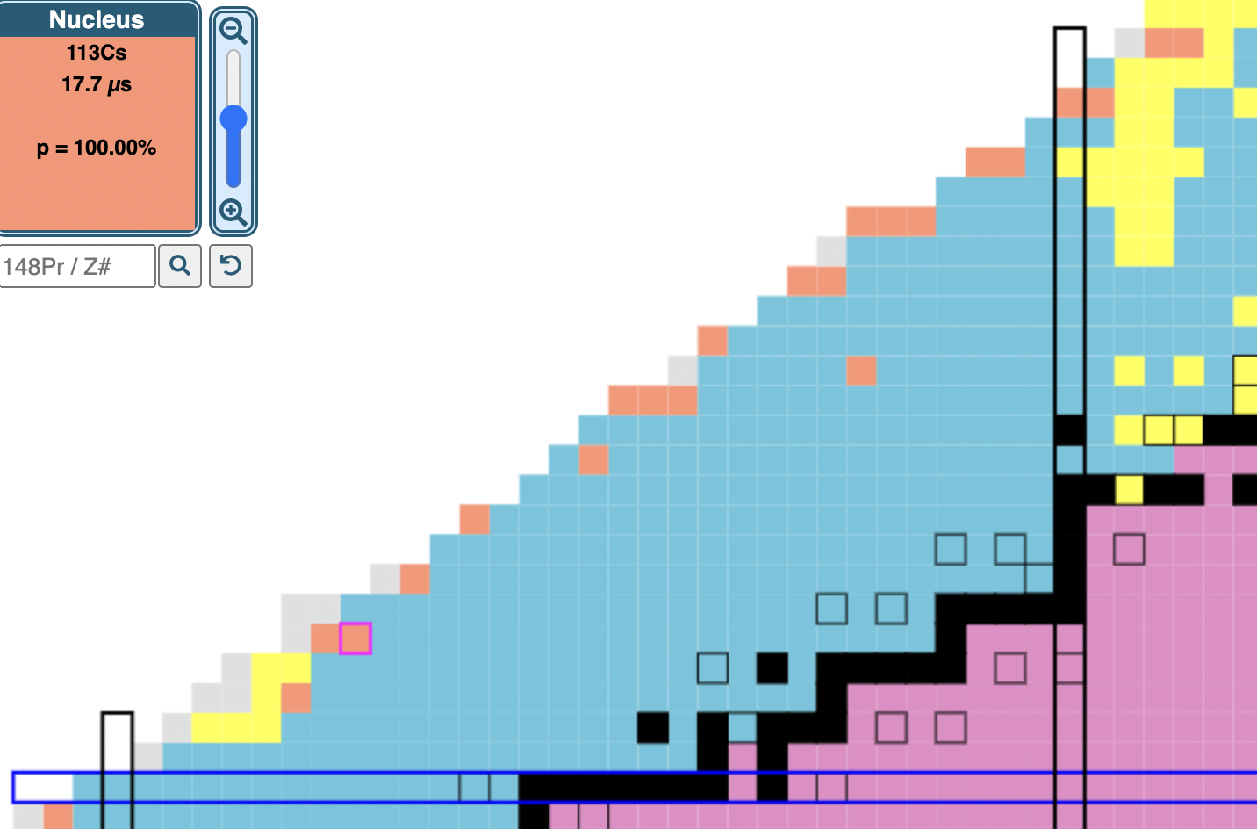
ESPEN: Examining the Shape of Proton-Emitting Nuclei
New research project – ESPEN: Examining the Shape of Proton-Emitting Nuclei
Proton-emitting nuclei located beyond the proton drip line
  Proton no longer bound in nucleus by nuclear force
Shape of proton-emitting nuclei has only been inferred by nuclear theory
  Not directly measured
What is the shape of the nucleus in the moments before it emits a proton?
How does the shape of the nucleus change when the proton becomes unbound?
Coulomb and centrifugal potential
Energy
Distance from centre of nucleus
Strong interaction potential

Slide 17
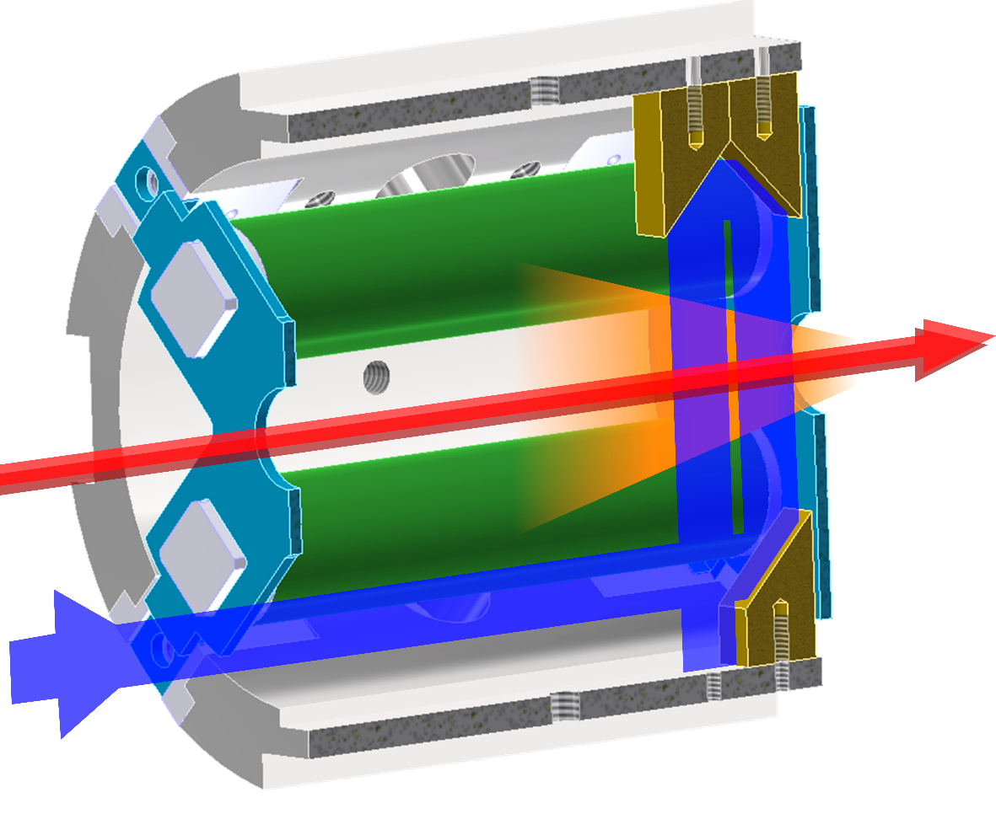
Towards studying proton-emitting nuclei
Plan to investigate how the shape of the proton-unbound nuclei change in two regions:
  Above Z=50, where nuclei change from spherical to slightly deformed
  Below Z=72, where nuclei change from slightly to highly deformed
Project will use two different resonance ionization spectroscopy (RIS) techniques
  Sensitive to nuclear observables e.g. high-resolution spectroscopy
  Efficient to measure as exotic isotopes as possible
1. Collinear Resonance Ionization Spectroscopy (CRIS)
  Experimental beamline at ISOLDE
  Perform collinear RIS
2. PI-LIST set-up
  Newly developed target-ion source at ISOLDE
  Perform in-source laser spectroscopy
PI-LIST
¹⁵¹Lu
¹⁴⁷Tm
¹⁴¹Ho
Collinear Resonance Ionization Spectroscopy (CRIS)
¹¹³Cs
¹⁰⁹I
¹⁰⁵Sb

Slide 18
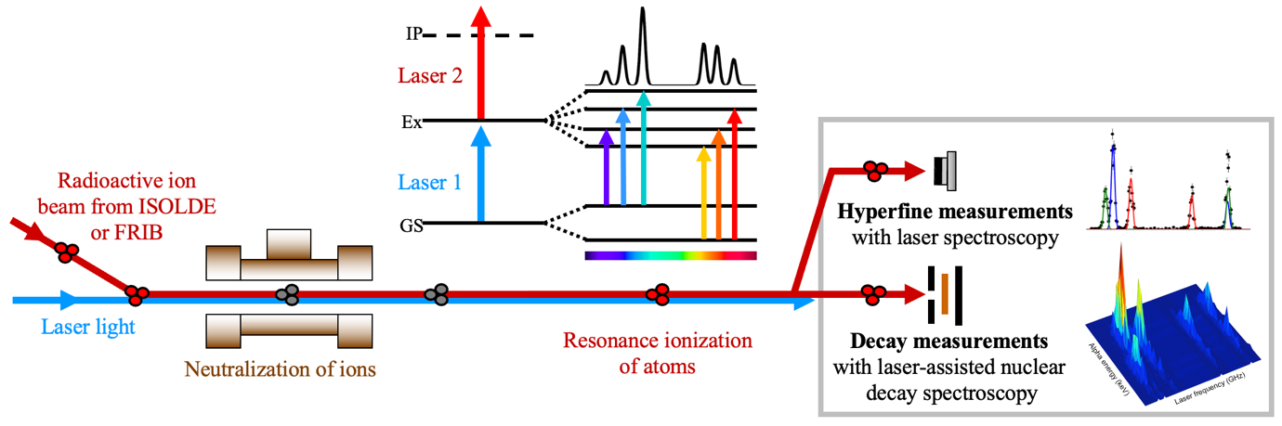
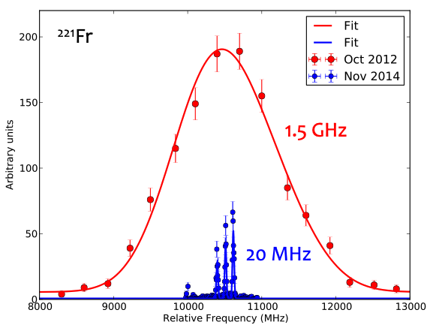
Collinear Resonance Ionization Spectroscopy (CRIS)
Sensitivity
Collinear geometry reduces thermal Doppler broadening
  Improves resolution from 1.5 GHz to 20 MHz
Efficiency
Detection of ions
Use a bunched beam to reduce duty-cycle losses associated with using pulsed lasers
UHV region to minimize collisional ionization to minimize background
¹¹³Cs
¹⁰⁹I
¹⁰⁵Sb

Slide 19
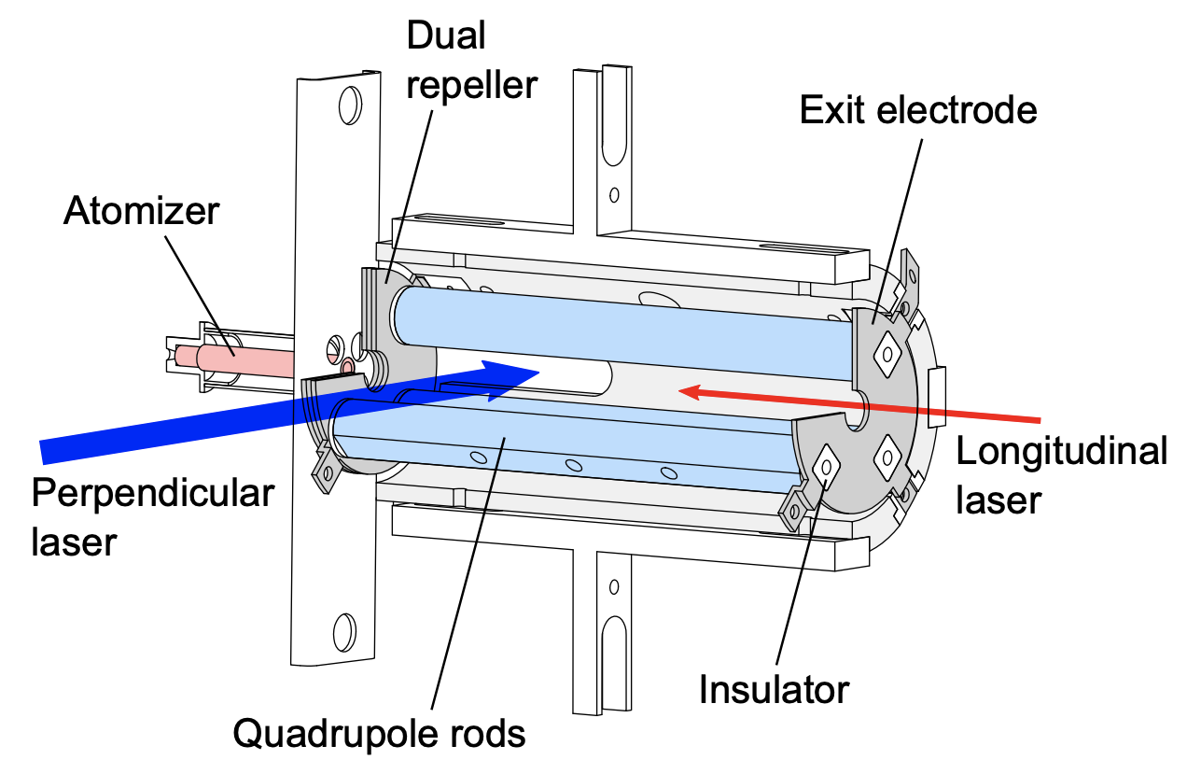
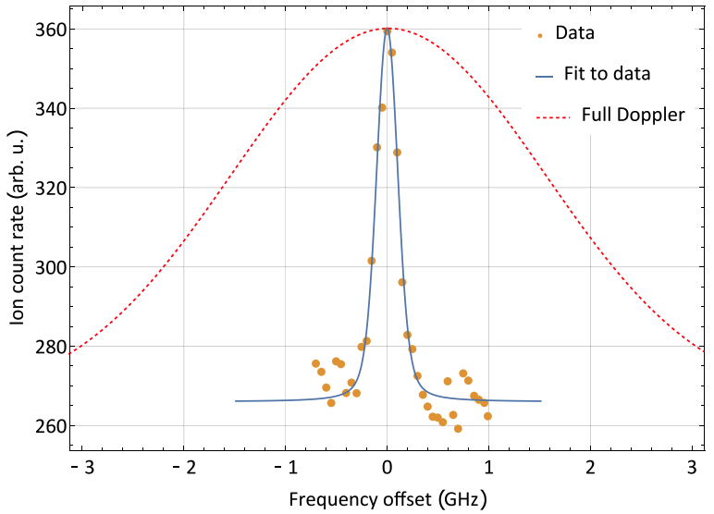
Perpendicularly-Illuminated Laser Ion Source and Trap (PI-LIST)
Significant isobaric contamination due to surface ionization for Lu, Tm, and Ho
  Challenging with CRIS technique
Develop and use the new Perpendicularly-Illuminated Laser Ion Source and Trap (PI-LIST)
Efficiency
High efficiency due to studying the isotopes at the point of creation (in the target-ion source)
Sensitivity
Resolution significantly increased due to ionising the atoms in a
perpendicular geometry – From 1.5 GHz to 200 MHz
1.5 GHz
200 MHz
T. Kron et al. PRC 102 (2020)
R. Heinke et al. NIM B 541 8-12 (2023)
¹⁵¹Lu
¹⁴⁷Tm
¹⁴¹Ho

Slide 20
Resolution in laser spectroscopy
1. In-source laser spectroscopy:
Shine laser light directly into the target-ion source
Probe max. number of atoms
High temperature of source causes broadening of linewidths
Low resolution: 1.5 – 3 GHz
Measure > 0.01 ions/s
‘Low’ resolution allows us to measure:
Hyperfine A factor → magnetic moments
Isotope shift → charge radii
Increasing resolution

Slide 21
Resolution in laser spectroscopy
2. Collinear laser spectroscopy
Laser light shone collinearly with atom beam
Reduces thermal broadening to below natural linewidth
High resolution: 20 – 100 MHz
Measure: > 20 ions/s
‘High’ resolution allows us to measure:
Hyperfine B factor → quadrupole moments
Increasing resolution
3. Perpendicular illumination (PI-LIST)
Shine laser light perpendicularly to the atoms in the target-ion source
Probe reduced ensemble of atoms
Resolution: 150 – 200 MHz

Slide 22
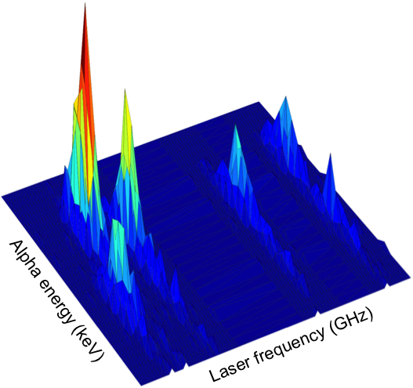
Laser-assisted decay spectroscopy
Different nuclear states have different hyperfine structures
  Selectively ionize the nuclear state of interest for decay spectroscopy on pure beams
Perform laser-assisted decay spectroscopy on neutron-deficient Lu isotopes
  ISOLDE Decay Station (IDS)
  Understand level structure and alpha decay
Possibility to perform laser-assisted proton decay spectroscopy
  Construct a new Proton Decay Spectroscopy Station (pDSS)
If yields are favourable, use to study:
  ¹⁰⁵Sb, ^{114,115}Cs and ¹¹⁰I at ISOLDE
  ¹⁵¹Lu and ^{146,147}Tm at ISOLDE and/or FRIB
Understanding of nuclear structure at proton drip line
  Laser spectroscopy provides electromagnetic moments and charge radii
  Decay spectroscopy provides lifetime, decay pathways and level ordering
p?
¹⁰⁵Sb
β⁺
~1%
¹⁰⁴Sn
~99%
E_{p}=478 keV
¹⁰⁵Sn
K.M. Lynch et al.,
PRX 4 011055 (2014)

Slide 23

Exciting plans in the coming months
Collaborations between laser spectroscopists interested in proton-emitting nuclei
ISOLDE
CRIS of neutron-deficient Sb isotopes
Planned for 10-18th August
Yield measurements of neutron-deficient Lu and Ho isotopes
K. M. Lynch, T. E. Cocolios et al.
Planned for 16-19th September
Laser spectroscopy of neutron-deficient Tm isotopes
B. Cheal, L. Vazquez Rodriguez et al.
Very nice results from yield measurements and experiment in 2023
Full COLLAPS experiment planned in September
IGISOL, Jyvaskyla, Finland
Production tests of stable Tm at IGISOL
A. de Roubin, M. Reponen, S. Geldhof et al.
Planned for 5-8th September
¹⁵¹Lu
¹⁴⁷Tm
¹⁴¹Ho
¹¹³Cs
¹⁰⁹I
¹⁰⁵Sb

Slide 24



Summary
Laser spectroscopy provides nuclear-model independent measurements of nuclear observables
  Magnetic moments, quadrupole moments, nuclear spin and change in charge radii
Dynamic and complementary programme of laser spectroscopy at ISOLDE, CERN
  In-source laser spectroscopy
  Collinear laser spectroscopy
Started a new research programme to study nuclei at the proton drip line
Planned experiments include:
  CRIS – Study Sb isotopes in August
  PI-LIST – Yield tests for Lu and Ho isotopes in September
?
Lu
Results will hopefully help us understand impact of the unbound proton on shape of nucleus
?
Selected by
Funded by

Slide 25
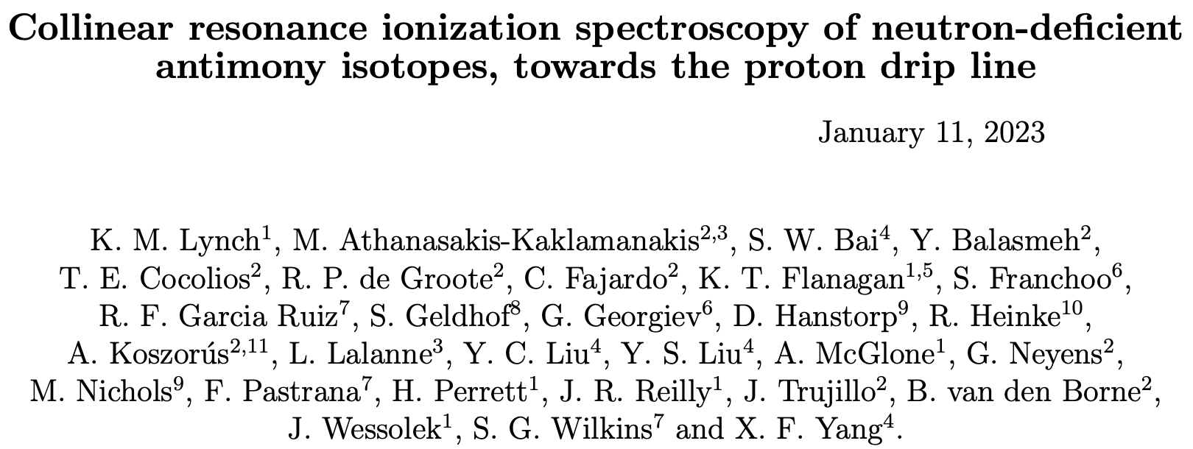
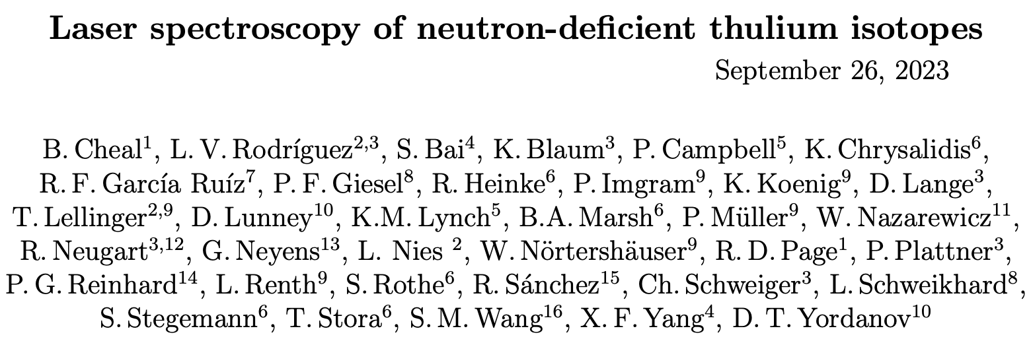
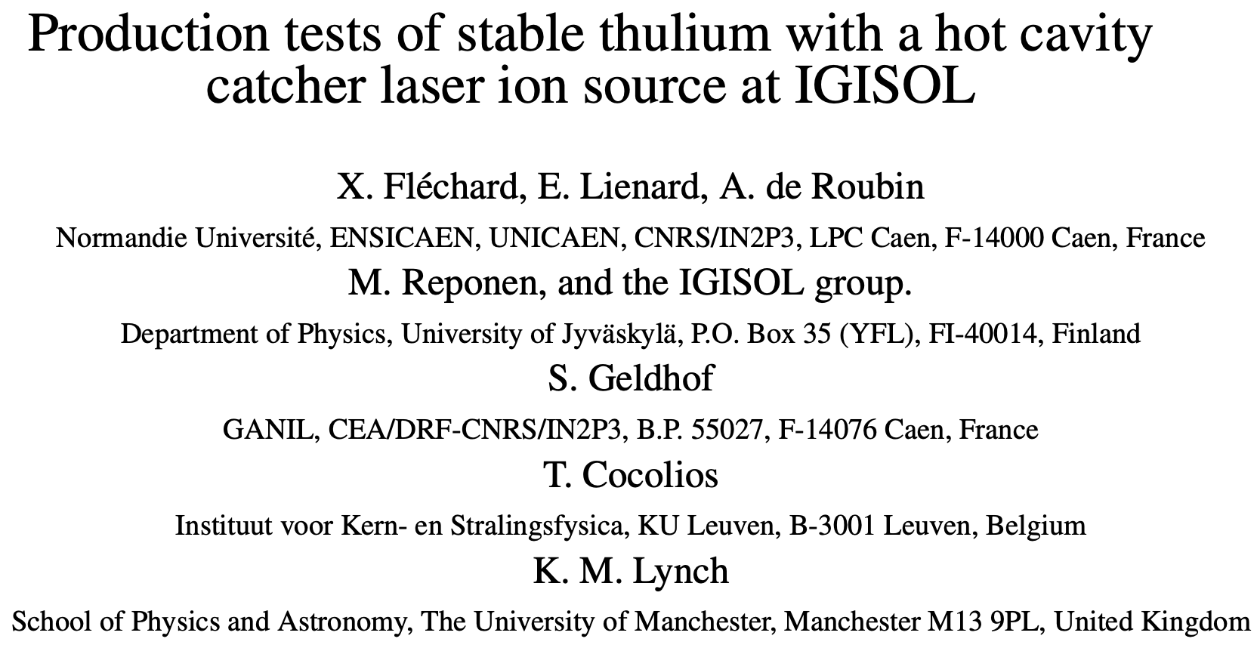
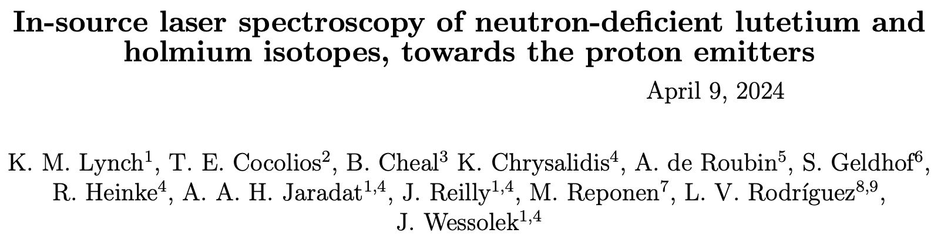
Thank you
Thank you to my collaborators at ISOLDE (CRIS, RILIS, COLLAPS) and JYFL
Thanks for your attention!
Selected by
Funded by

Slide 27
Properties of proton emitters
Proton emitter ¹¹³Cs is located in transition region between spherical and deformed nuclei
  Mild prolate deformation necessary to correctly predict proton-decay rate
Proton-decay rate for ¹⁵¹Lu only described by assignment of mild oblate deformation
  Predicted to have spherical shape
Deformed framework needed to describe proton emitter ¹⁴⁷Tm
  Located in transition region between spherical and highly-deformed nuclei
Highly-deformed prolate shape needed to describe proton
decay rate of ¹⁴¹Ho
¹⁵¹Lu
¹⁴⁷Tm
Correct nuclear shape essential to accurately predict properties of proton emitters
Direct measurement of nuclear properties crucial to test our understanding at nuclear extremes
¹⁴¹Ho
¹¹³Cs

Slide 28
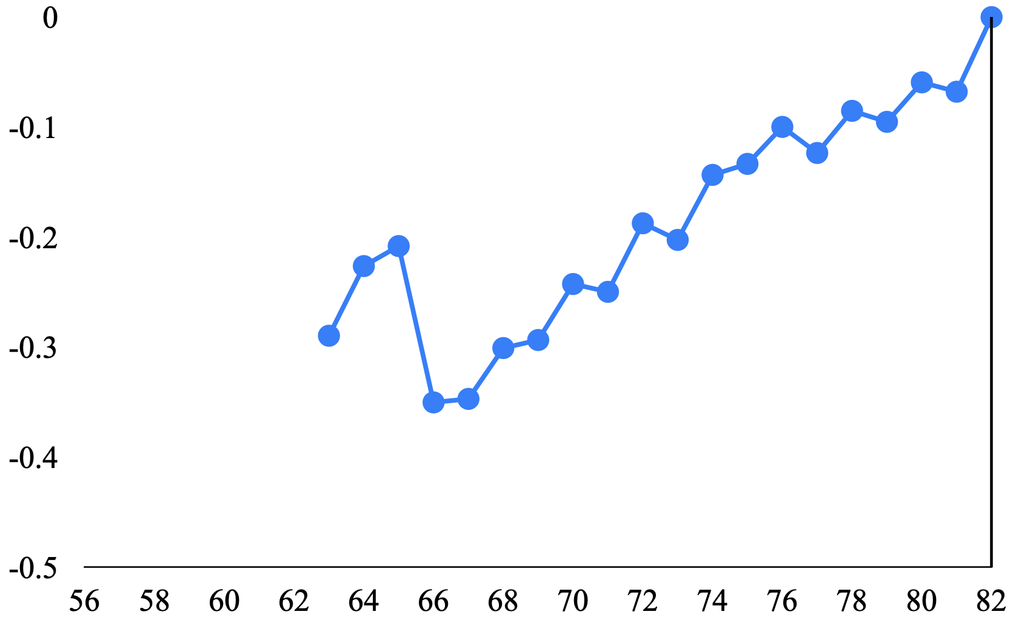

Part 1: Proton-unbound Sb, I and Cs
Proton emitters
Proton drip line
Cs (Z=55)
112
113
114
115
116
117
118
I (Z=53)
108
109
110
111
113
114
115
116
Sb (Z=51)
105
106
107
108
109
110
111
112
113
114
Measure
Previously measured
Part 1: Laser spectroscopy of Sb, I and Cs isotopes at ISOLDE
  Use Collinear Resonance Ionization Spectroscopy (CRIS) technique
Measure isotopes across proton drip line at ¹⁰⁵Sb, ¹⁰⁹I and ¹¹⁵Cs
  Measure electromagnetic moments and charge radii
Understand evolution of deformation across
proton drip line
Cs
δ<r²> (fm²)
How does the shape of the nucleus change when the proton becomes unbound?
?
N

Slide 29
Part 1: Proton-unbound Sb, I and Cs
Proton emitters
Proton drip line
Cs (Z=55)
112
113
114
115
116
117
118
I (Z=53)
108
109
110
111
113
114
115
116
Sb (Z=51)
105
106
107
108
109
110
111
112
113
114
Measure
Previously measured
Compare to ab-initio, DFT and GCC nuclear theory calculations
  Provide insights into microscopic effects in the proton distribution
Status:
Experiment to study neutron-deficient Sb isotopes scheduled for 10-18 August at ISOLDE
  Laser spectroscopy of ¹¹²Sb towards the proton drip line
  Yield measurements for possible proton-emitter ¹⁰⁵Sb
Previous Sb measurements down to ¹¹²Sb
S. Lechner et al. PRC 104 014302 (2021)
S. Lechner et al. PLB 847 138278 (2023)

Slide 30
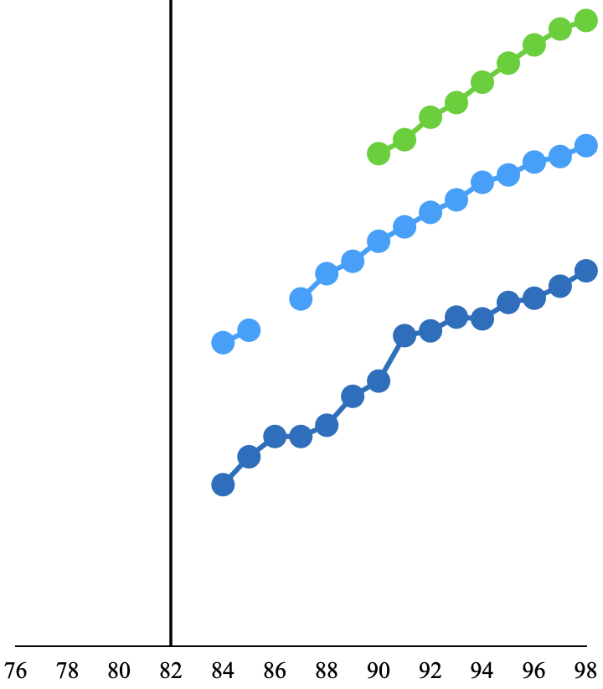
Part 2: Proton-unbound Lu and Ho
Proton emitters
Proton drip line
Lu (Z=71)
150
151
152
153
154
155
156
157
Tm (Z=69)
146
147
148
149
150
151
152
153
154
155
Ho (Z=67)
141
142
144
145
146
147
148
149
150
151
152
153
Measure
N=82
Previously measured
Part 2: Laser spectroscopy of Lu and Ho isotopes at ISOLDE
  Perform in-source laser spectroscopy with PI-LIST setup
  Measure isotopes across proton drip line at ¹⁵⁵Lu and ¹⁴⁵Ho
Compare to DFT and GCC nuclear theory calculations
  Understand role of deformation as proton drip line is crossed
Status:
Proposal to measure yields of Lu and Ho isotopes accepted
  Collaboration with Thomas Cocolios
  Hopefully scheduled in September
  In preparation for proposal the following year
Lu
Tm
Drip line
Ho
δ<r²> (fm²)
N

Slide 31

Part 3: Proton emitters ¹⁵¹Lu and ¹⁴⁷Tm
Proton emitters
Proton drip line
Lu (Z=71)
150
151
152
153
154
155
156
157
Tm (Z=69)
146
147
148
149
150
151
152
153
154
155
Ho (Z=67)
141
142
144
145
146
147
148
149
150
151
152
153
Measure
N=82
Previously measured
Part 3: Laser spectroscopy on proton emitters ¹⁵¹Lu and ¹⁴⁷Tm
  Perform resonance ionization spectroscopy at new RiSE experiment at FRIB
  Supported by measurements from ISOLDE
Benefit from higher yields at FRIB to measure proton emitters
New Resonance ionization Spectroscopy Experiment (RiSE)
  Integrated into BECOLA in FRIB facility
  Collaboration with R. Garcia Ruiz, K. Minamisono
?
Lu
?
What is the shape of the nucleus in the moments before it emits a proton?

Slide 32
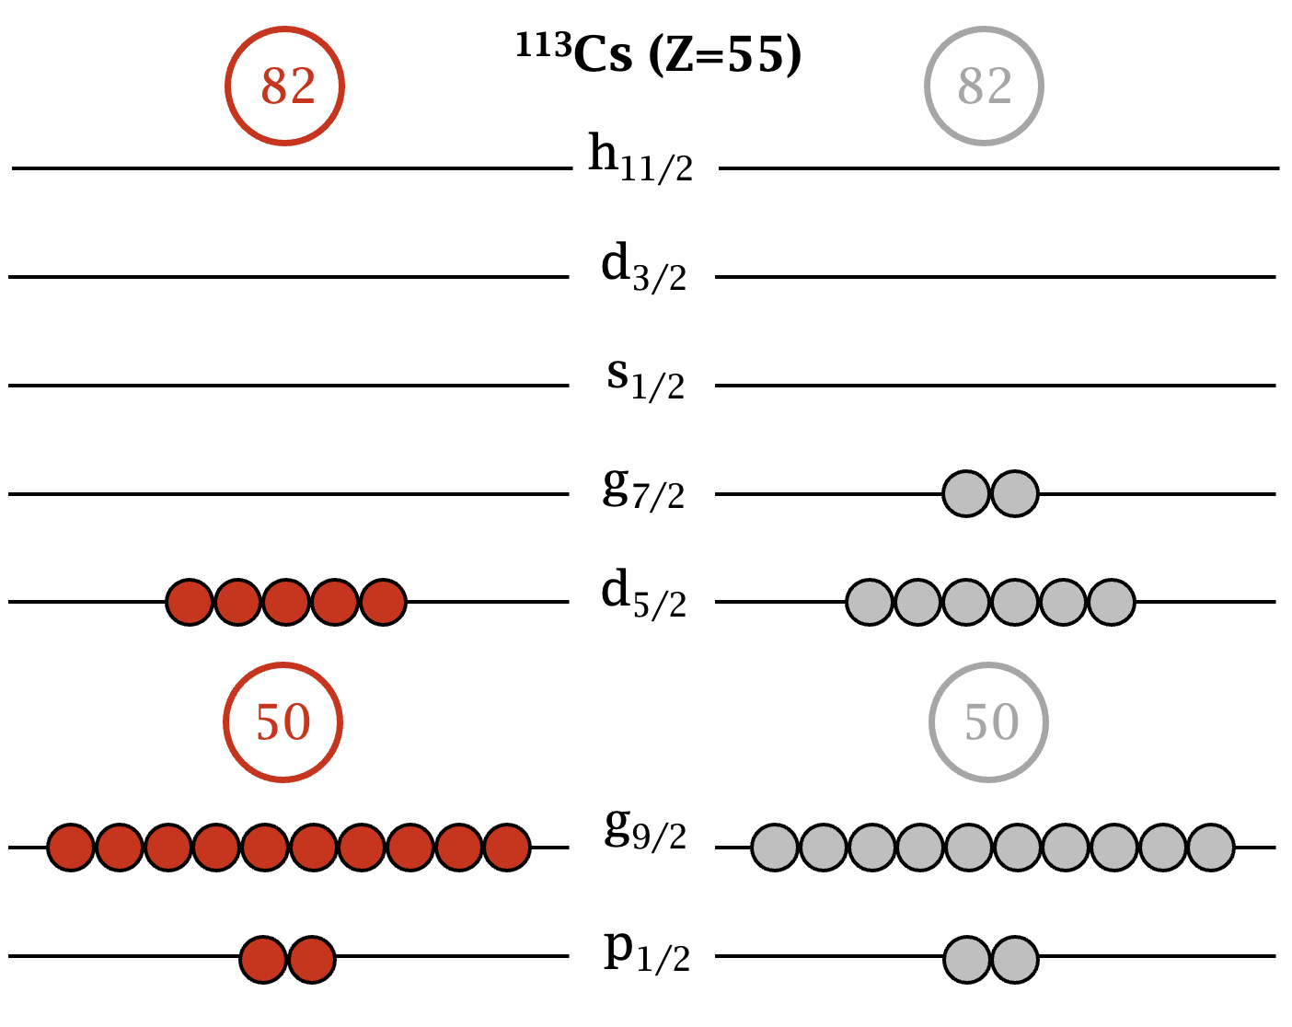
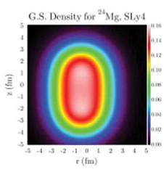
State-of-the-art nuclear theories
Ab-initio model (VS-IMSRG):
Uses 2- and 3-body forces, constrained by properties of ³H, ³He, ⁴He
Fundamental building blocks ‘scaled-up’ to heavier nuclei
Can currently calculate properties up to Sn (Z=50)
Model space
Global model (Density Functional Theory):
Uses experimental data to constrain the nuclear model
Uses nuclear density functionals to calculate nuclear properties
  e.g. energy levels, masses, charge radii
Use different density functionals to test influence on nuclear properties
Gamow Coupled Cluster approach:
Modelled with valence proton atop a vibrational core
Alter strength of proton-core interaction
Identify impact of proton continuum on charge radii

Slide 33
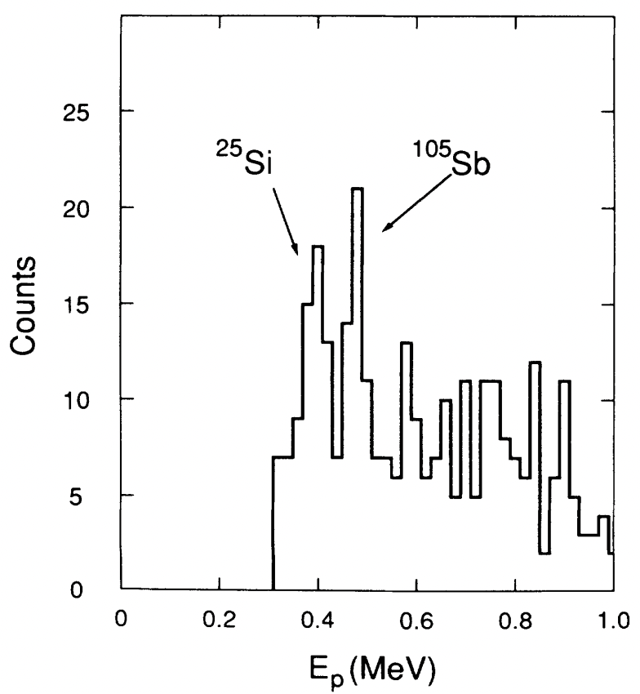
¹⁰⁵Sb – Proton emitter?
Status of ¹⁰⁵Sb as a proton emitter is contested in literature
1994: Berkeley experiment saw proton emission at 478 keV with 1% BR
  58Ni + 50Cr reaction
  Measurement after 25 ms
Later GSI experiments failed to see proton emission from ¹⁰⁵Sb
  58Ni + 50Cr reaction
  Measurement after 2.8 secs
Could there is a short-lived ground or isomeric state that decays via proton emission?
  Very small branching ratio of ¹⁰⁹I alpha decay puts limit on ground-state proton decay of ¹⁰⁵Sb
Decay of short-lived isomeric state of ¹⁰⁵Sb possible
Measuring with CRIS, we will immediately see if an isomeric state is present
  Extra peaks in HFS spectrum
  Perform laser-assisted proton decay spectroscopy on isomeric state
R.J. Tigne et al. Phys. Rev. C 49, R2871(R) (1994)
Z. Lui et al. Phys. Rev. C 72, 047301 (2005)
p?
¹⁰⁵Sb
β⁺
~1%
¹⁰⁴Sn
~99%
E_{p}=478 keV
¹⁰⁵Sn

Slide 34
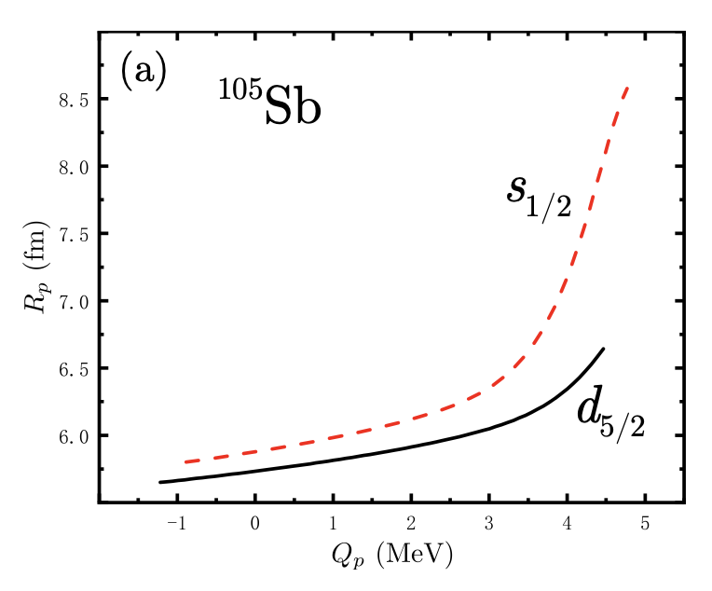
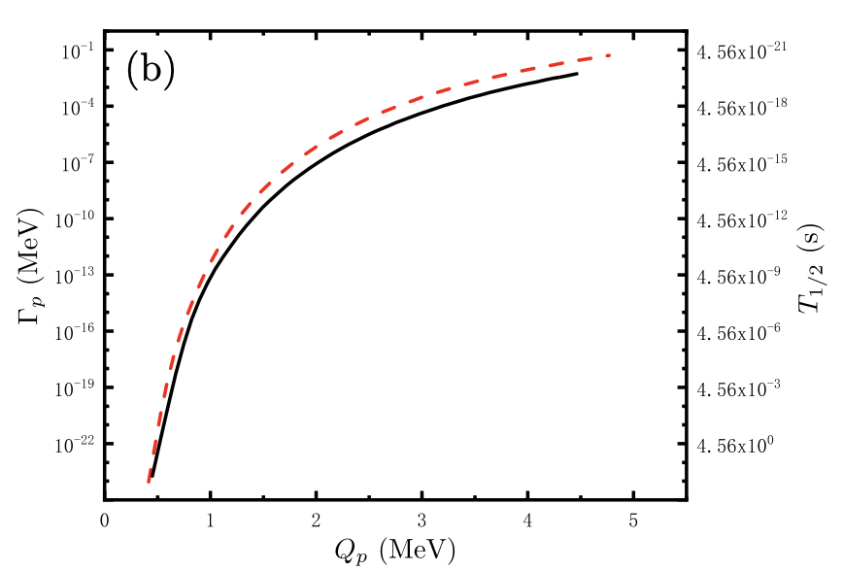
¹⁰⁵Sb – Charge radii
W. Nazarewicz, Private Communication
Nuclear theory colleagues have started calculations for Sb isotopes
Visible impact of proton-decay Q-value on charge radii

Slide 35
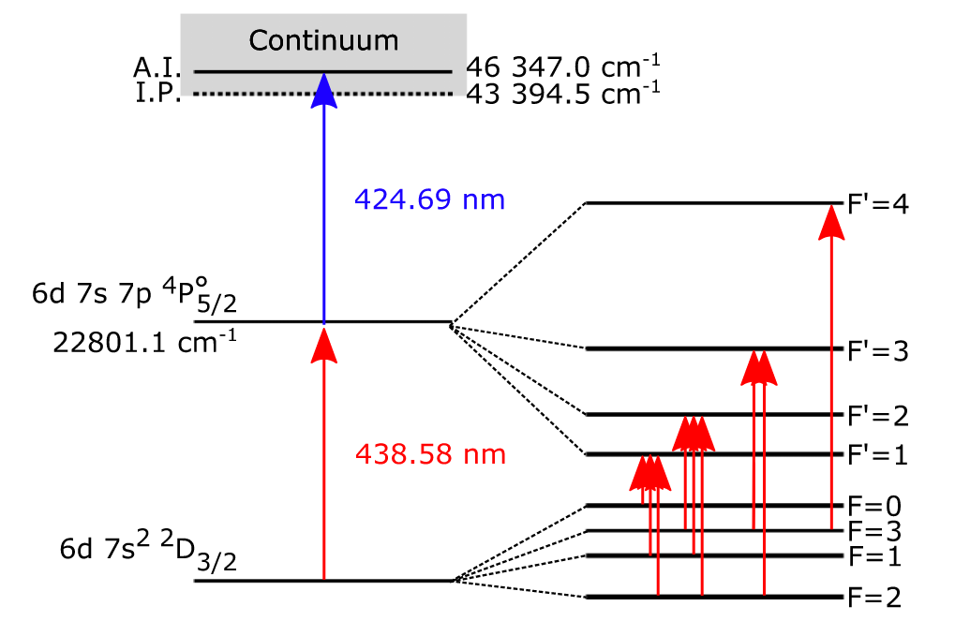
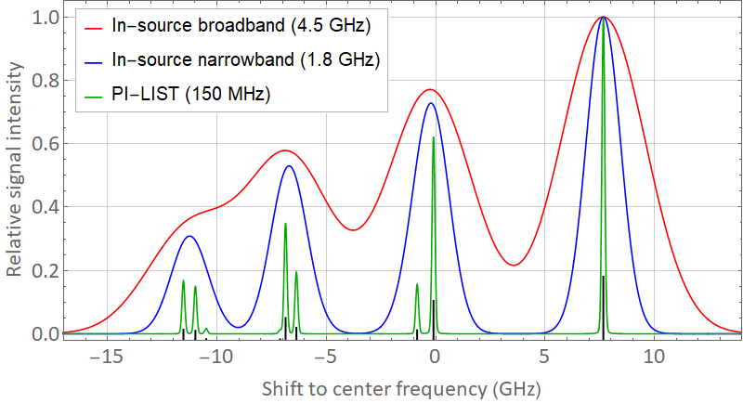
Resolution with PI-LIST
v_{thermal}
Atomic
beam cone
Narrow bandwidth
spectroscopy laser
Crossed atom beam / laser geometry
Selection of reduced Doppler ensemble
in laser intersection volume
Standard in-source spectroscopy resolution: 1 - 5 GHz
High resolution with new PI-LIST setup:
150 - 200 MHz
Slide kindly provided by R. Heinke

