Slide 1
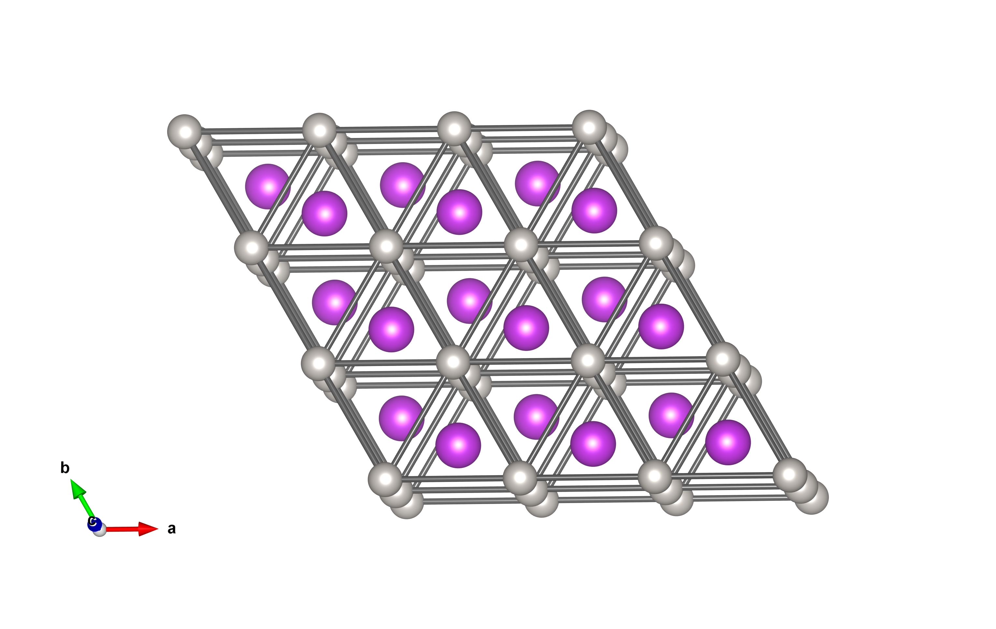
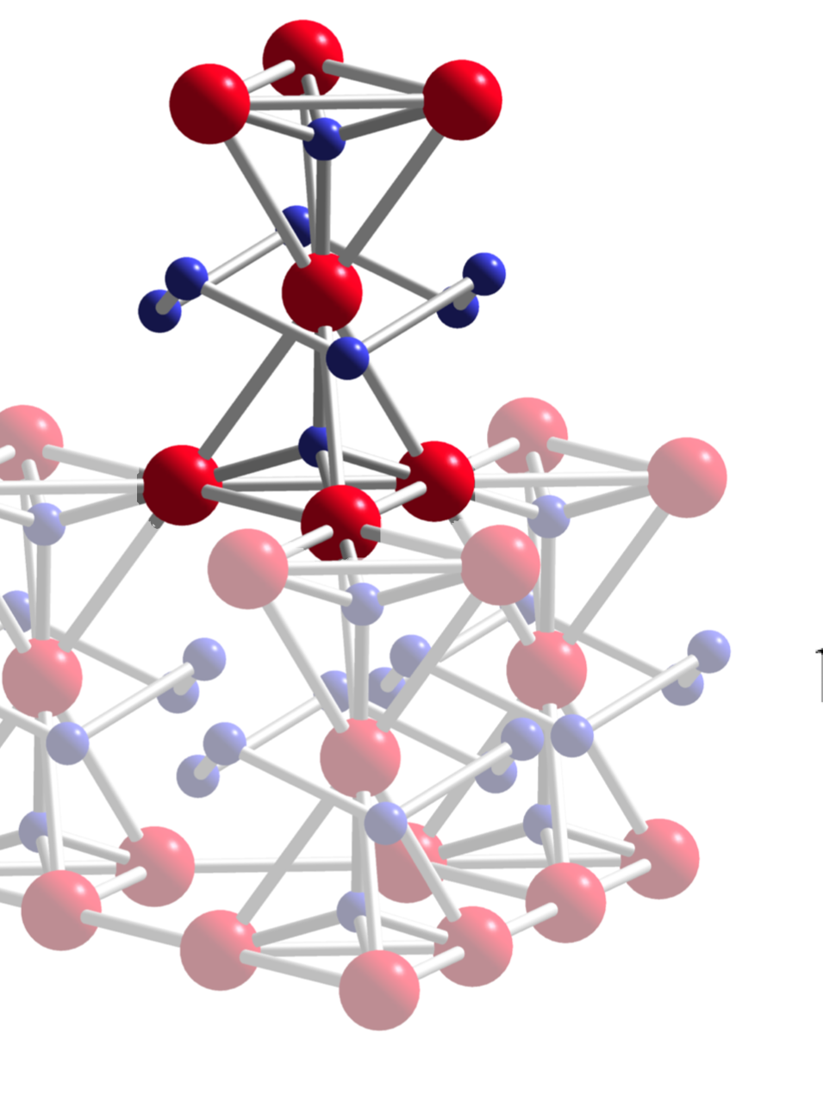
Searching for Quantum Spin Liquids and Ices with Muons
Graeme Luke
Dept. of Physics & Astronomy
McMaster University

Slide 2
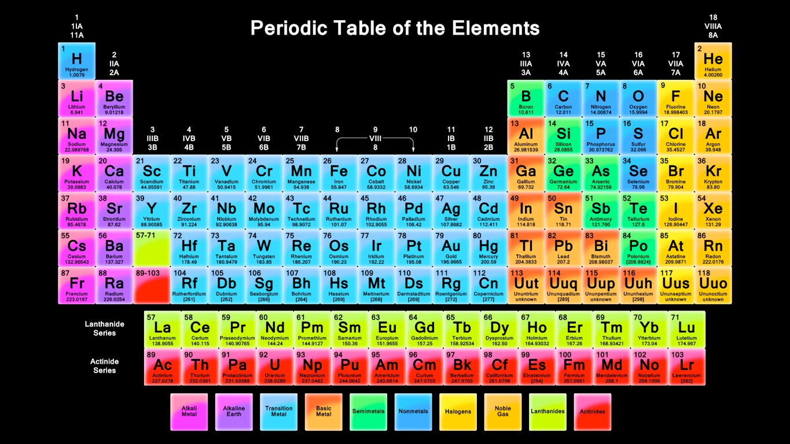
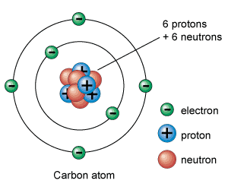
Reductionist Approach
Standard model of particle physics a very successful description of particles and interactions in a reductionist view.
Periodic table of elements.

Slide 3
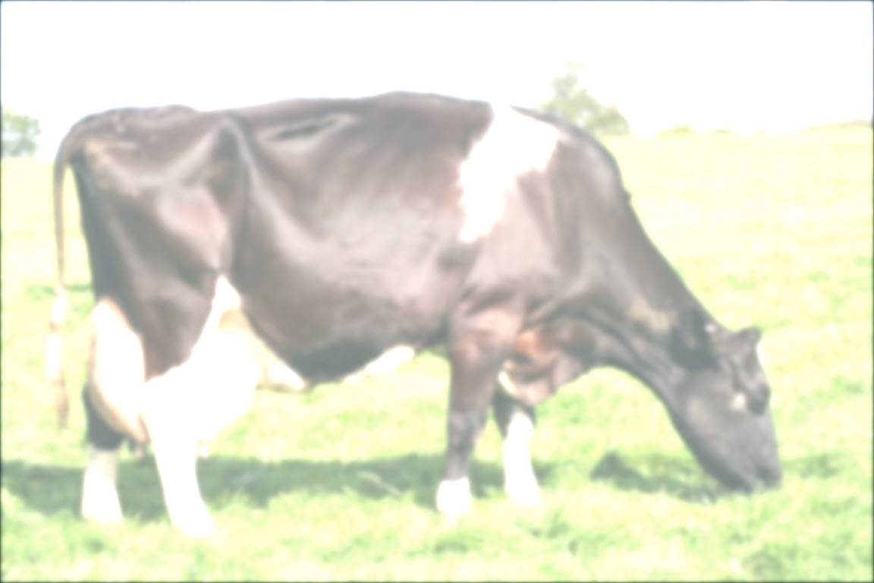
Emergence
Many (most) complex phenomena not amenable to a reductionist approach.
10²³ atoms/cm³, reductionist approach untenable.
most profound emergent problem: life
Collective phenomena in microscopic systems that are qualitatively different from that of their microscopic constituents.
Emergent approach
identify origins of emergent behaviour
use these organizing principles as building blocks for model of quantum matter.
Some properties protected: independent of the microscopic details.

Slide 4
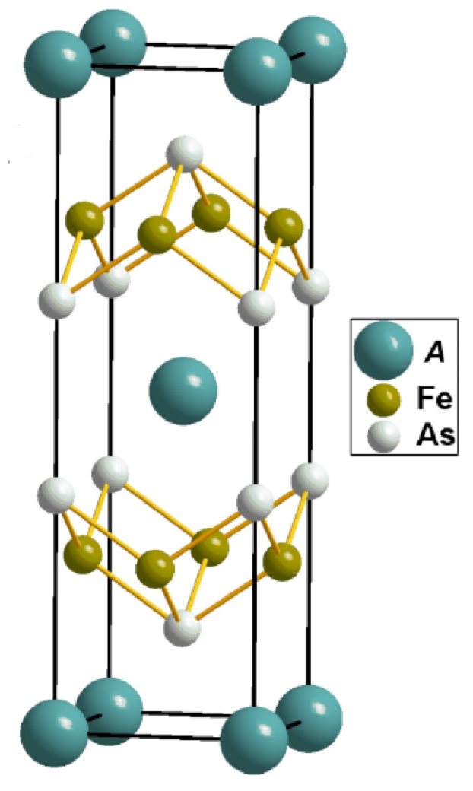
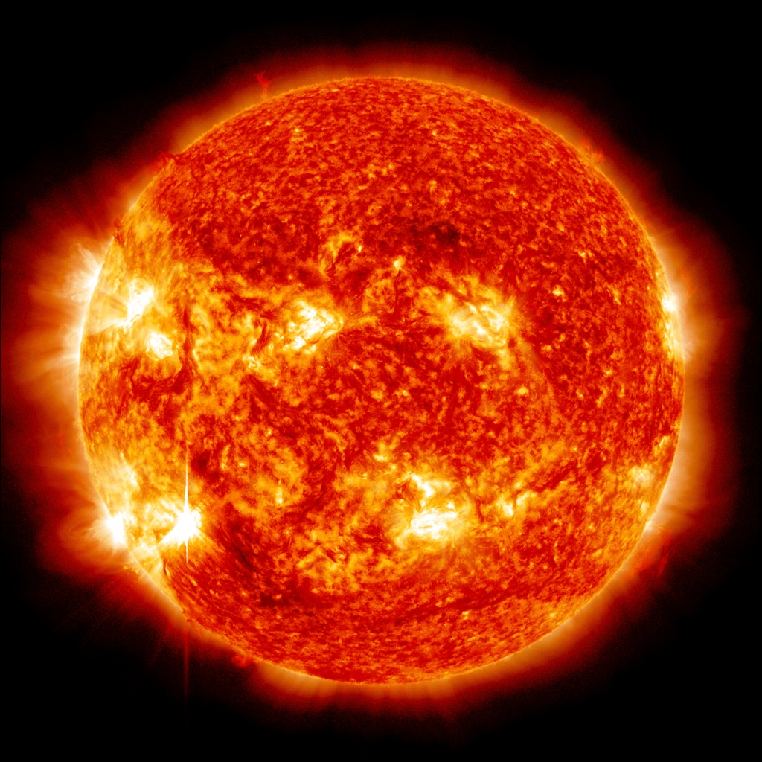
Crystalline Systems
Crystalline Solid
Liquid
Plasma
➞
➞
Decreasing Temperature➞
Symmetry Breaking➞

Slide 5
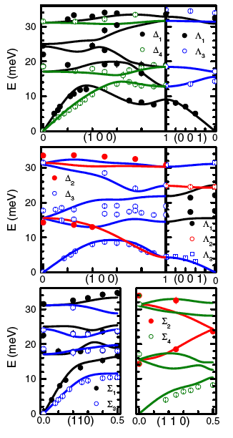
Crystalline Solids
CaFe2As2
Periodic arrangement of ions.
Vibrations of ions about equilibrium positions (classical normal modes)
quantized into elementary excitations: Phonons
Experimentally detected, eg. inelastic neutron scattering.
Mittal et al., PRL 102 (217001) 2009.

Slide 6
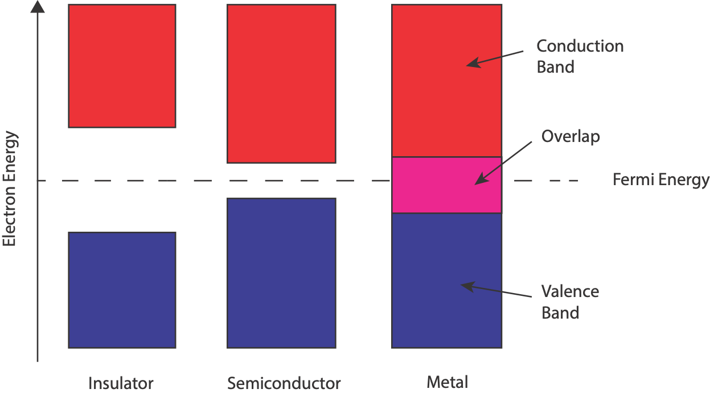
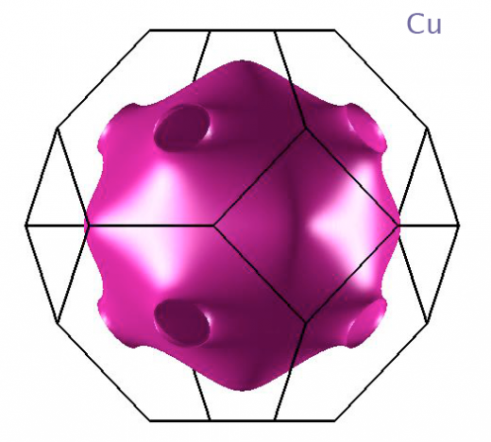
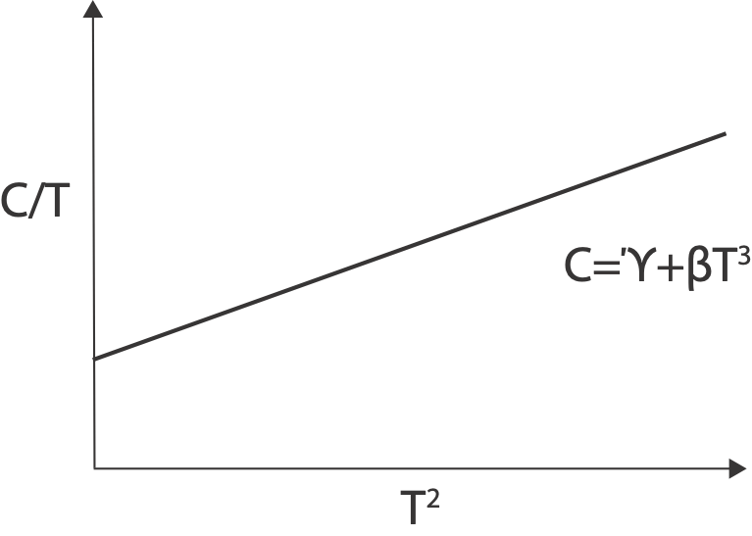
Electrons in Solids
Overlap between electron wavefunctions results in bandstructure.
Insulator, semi-conductor or metal: varying response to electric field.
Pauli exclusion and (nearly) free electrons gives good description of basic metals.
independent electrons
electron quantum numbers are momentum and spin.
www.physics.ox.ac.uk

Slide 7
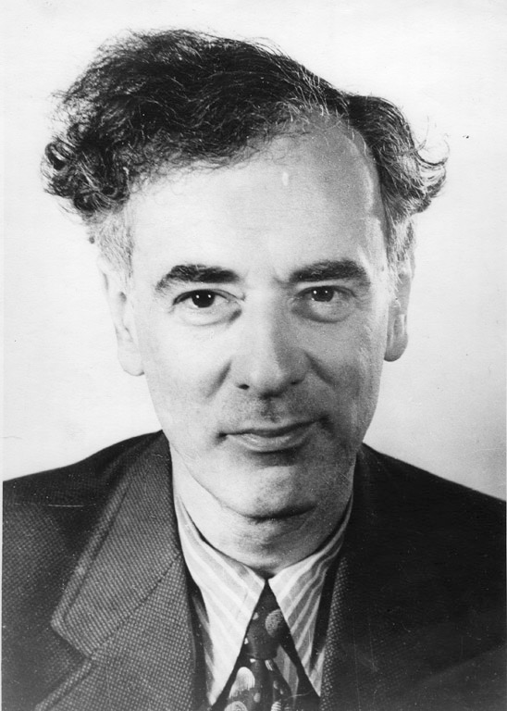
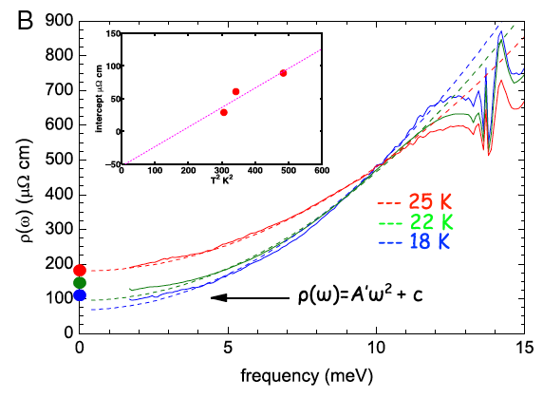
Electrons ➞ Quasiparticles
electrons not actually free, independent in metals.
Quasiparticle: combined properties of electron and its surroundings as a composite object that can be treated as a single particle with renormalized properties.
electron, hole
Landau Fermi Liquid
𝛒~AT²
Landau
Nagel et al., PNAS 109, 19161 (2012).

Slide 8
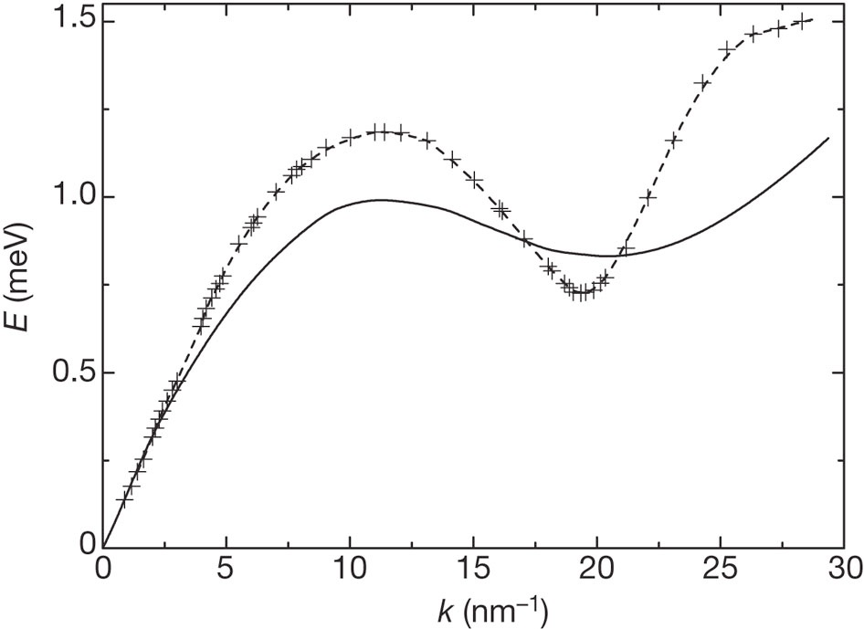
Quasiparticles - Quantized Excitations
Phonon
Magnon: magnetic excitation
Roton: circulating superfluid (He⁴)
Polaron: charged quasiparticle and accompanying lattice deformation
Soliton: (eg. polyacetylene)
Spinon/Holon: from spin/charge separation
Monopoles
Majorana fermion: quasiparticle that is its own anti-particle
Glyde, H. R. Excitations in Liquid and Solid Helium (Clarendon, 1994)
Balents, Nature 464, 199 (2010)

Slide 9
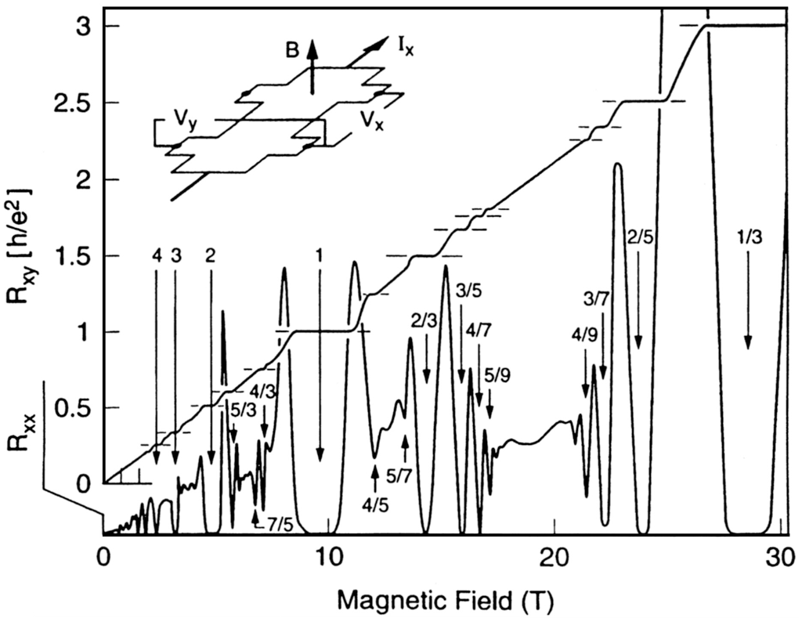
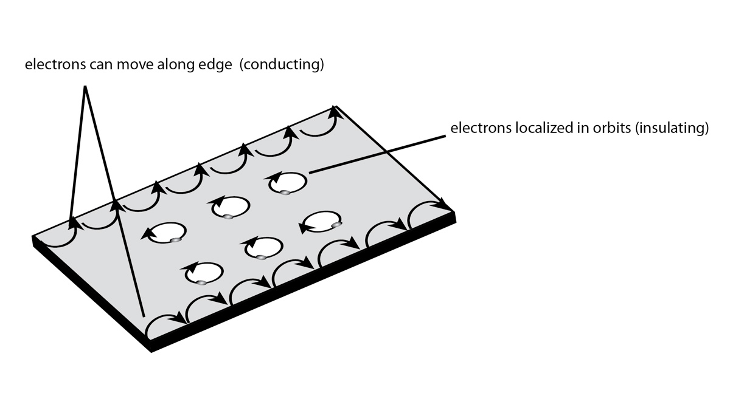
Quantum Hall Effect
Quasiparticles in 2-D electron gas move in edge states around sample.
Quantized Hall Resistance gives resistance standard, fine structure constant.

Slide 10
Quantum Materials
Materials whose essential properties go beyond semi-classical particles.
Collective properties governed by fully quantum behaviour
Strong electronic correlations, often resulting in some kind of order such as magnetic, superconducting, topological…
Fundamental degrees of freedom: charge, spin, orbit and lattice become intertwined.
Emergence of novel excitations/quasiparticles/behaviour.

Slide 11
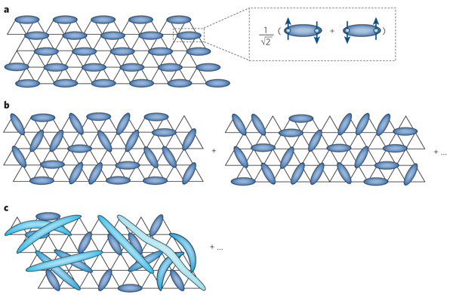
Quantum Spin Systems
Role of quantum fluctuations in Quantum spin systems (eg. spin 1/2).
Neel state not an eigenstate of Heisenberg Hamiltonian.
increasingly bad for low-d, low spin.
Quantum spin liquid: originally suggested by Anderson for 2-D spin 1/2 -RVB.
Spin liquid, Quantum spin liquid states
Emergent excitations include monopoles, spinons, holons.
Balents, Nature 464, 199 (2010).

Slide 12
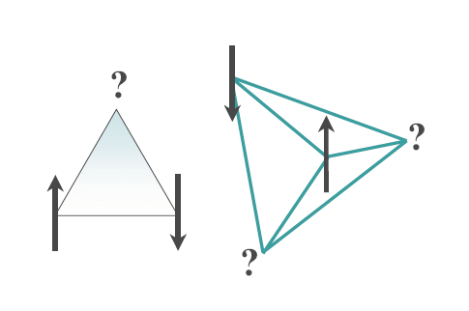
Geometrical Frustration
No periodic arrangements of moments which can simultaneously minimize energy.
Can have large number of classically degenerate ground states.
Leads to competing low temperature phases and enhanced quantum mechanical spin dynamics.
Possible emergent phenomena, quasiparticles.

Slide 13
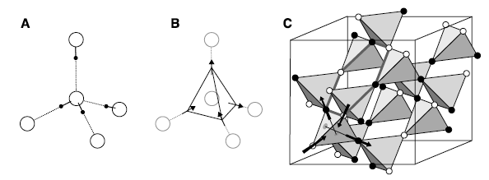
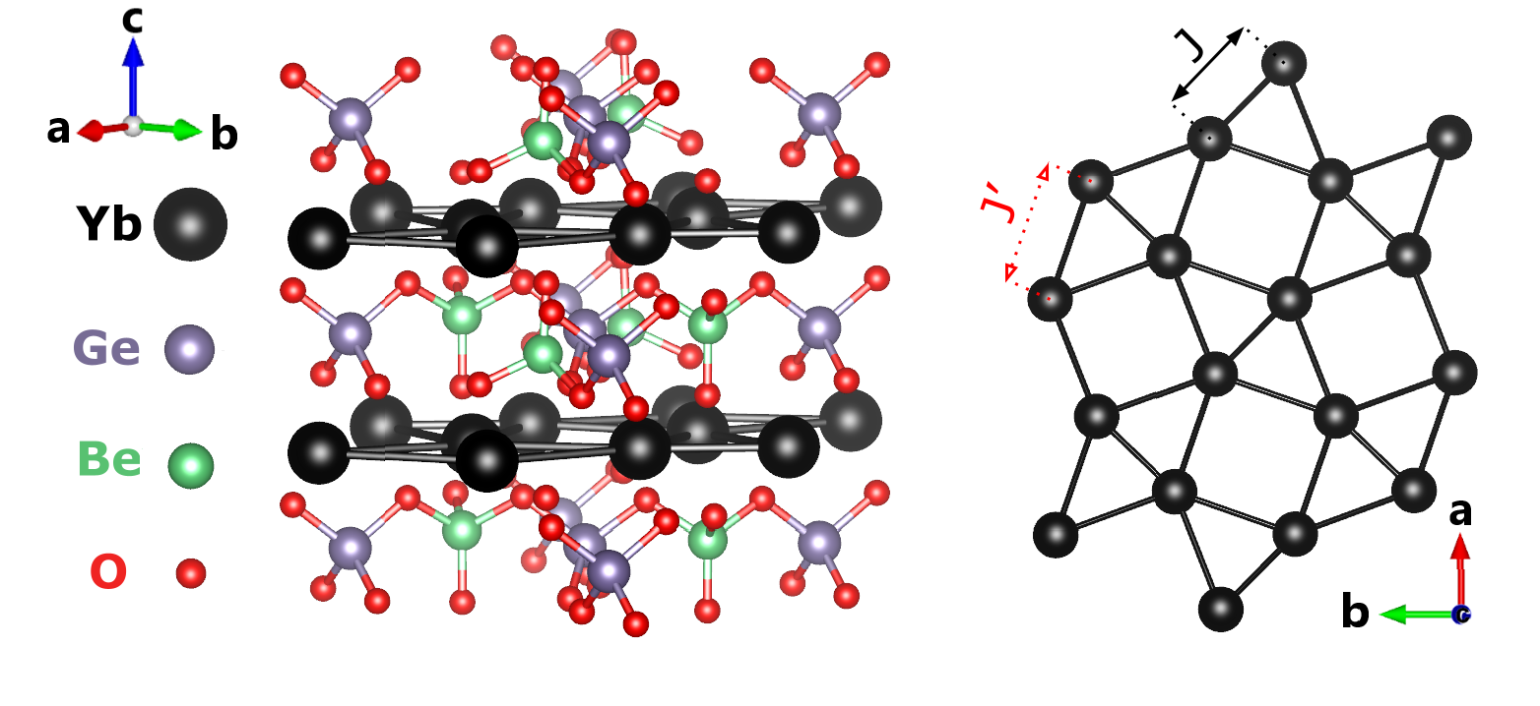
Lattices Promoting Geometrical Frustration
Stacked Triangular
Pyrochlore
Kagome
Shastry-Sutherland J1-J2

Slide 14
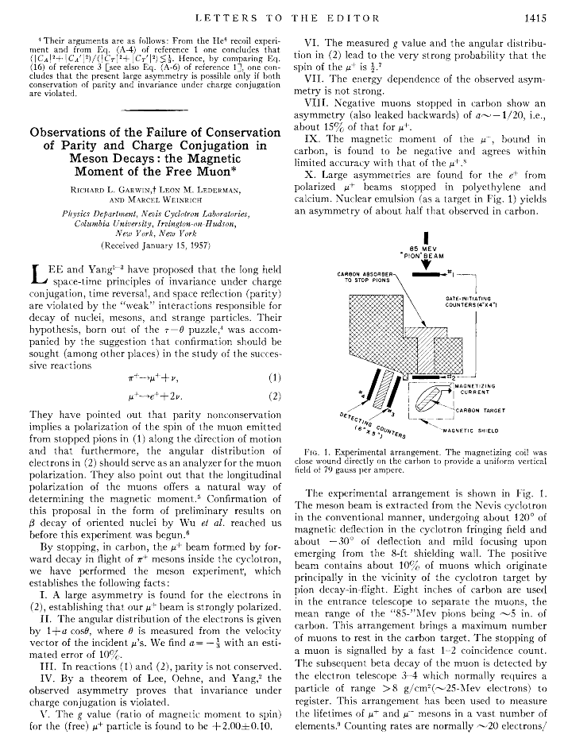

Slide 15
Pion → Muon → e⁺
μ⁺e⁺+ν_{e}+ν_{μ} (2.2μs)
<a> = 1/3
π⁺μ⁺+ν_{μ} (26ns)

Slide 16
μSR Technique

Slide 17
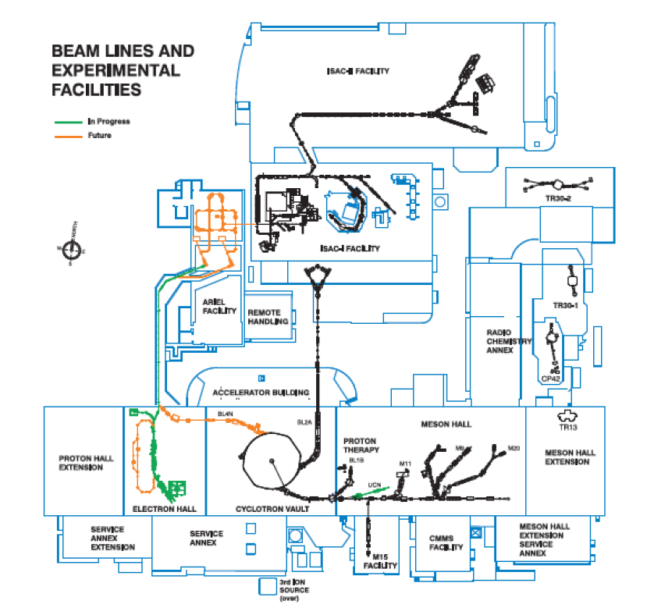
TRIUMF

Slide 18
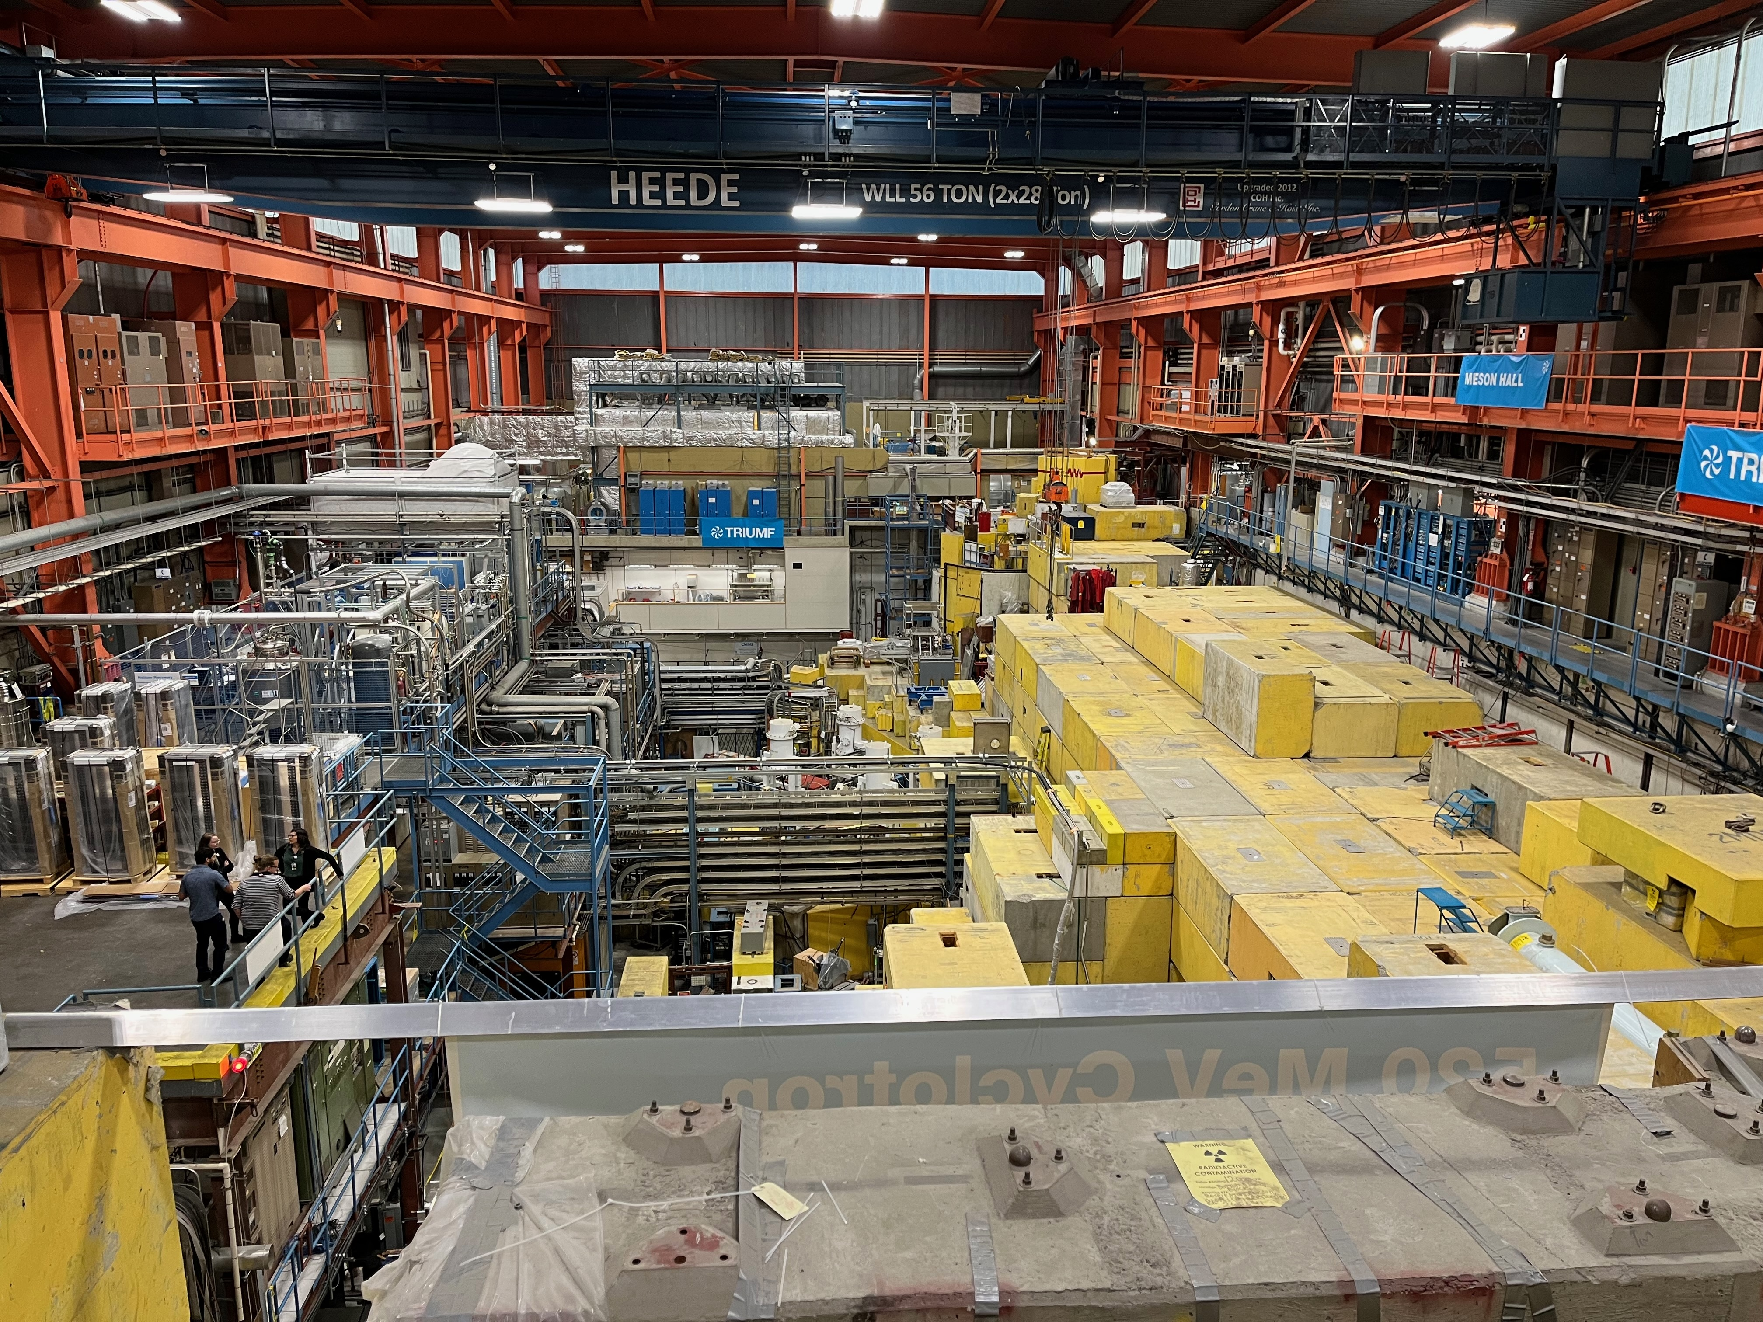

Slide 19
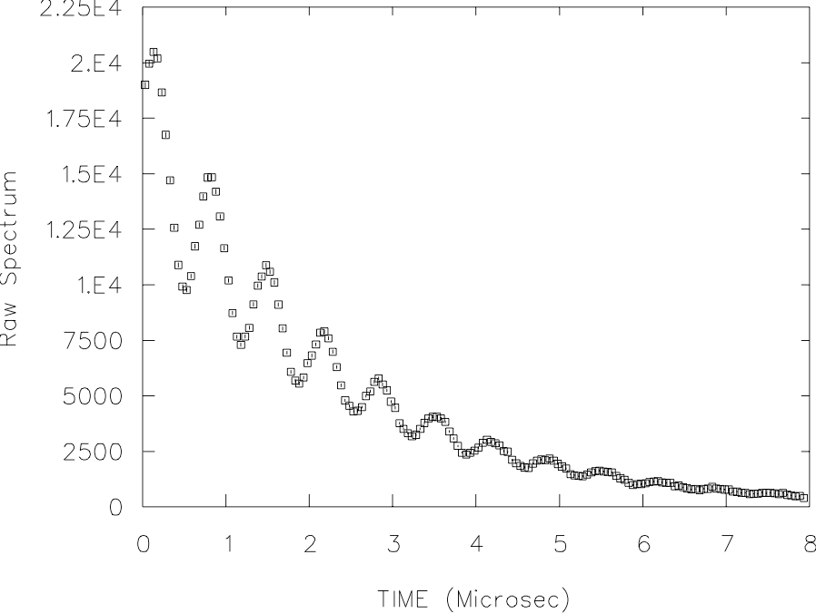
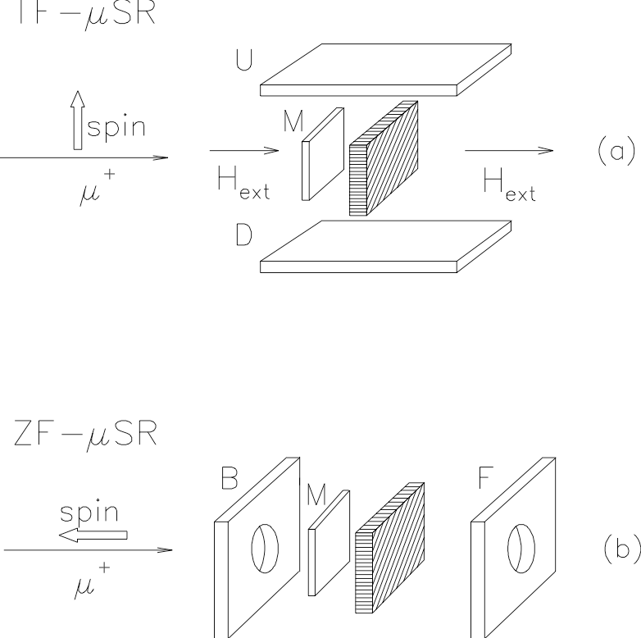
Experimental Geometry
τμ=2.2μs

Slide 20
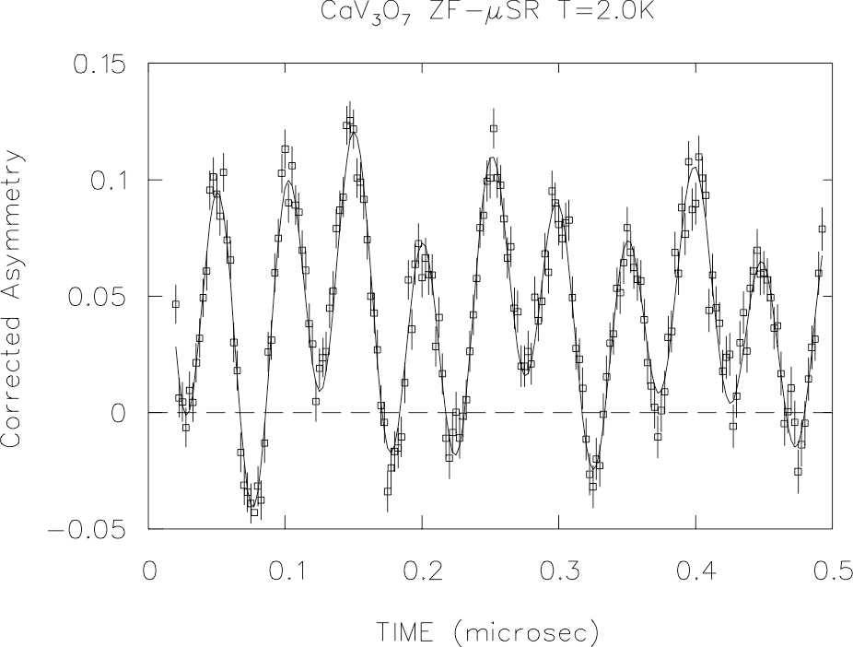
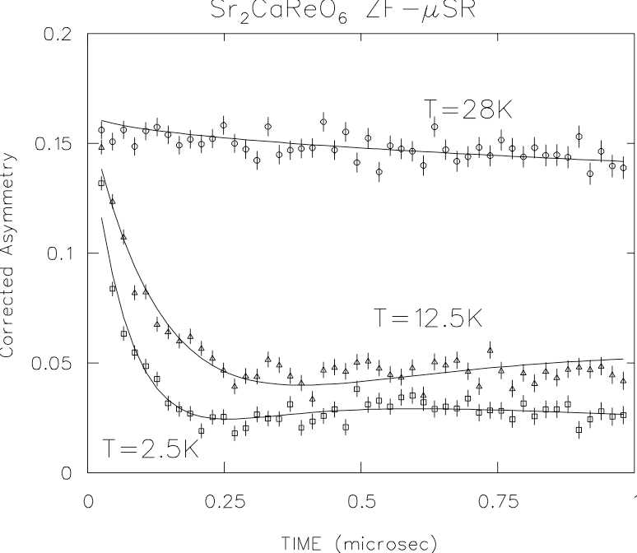
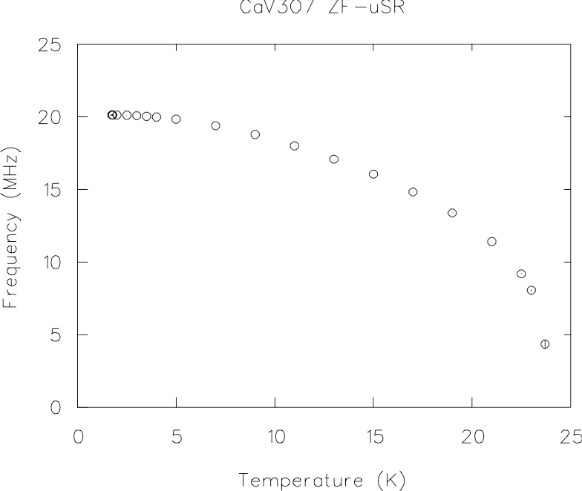
Zero Field ZF-μSR
Ordered state, ν∝ Moment ∝$\sqrt{I_{B}}$
Random frozen spins give characteristic relaxation.

Slide 21
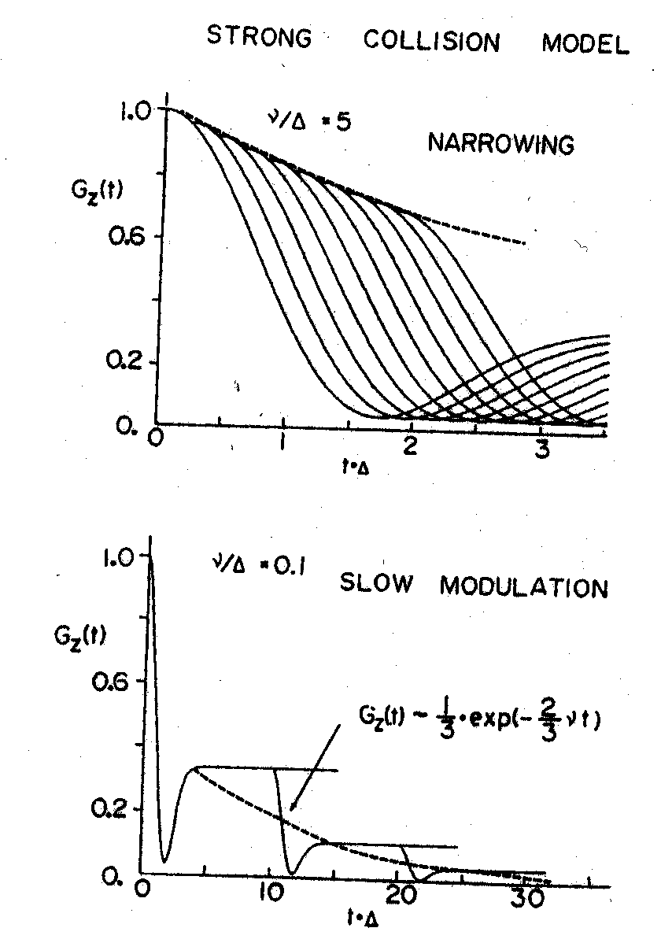
Spin Fluctuations - Dynamics
Longitudinal Field µSR

Slide 22
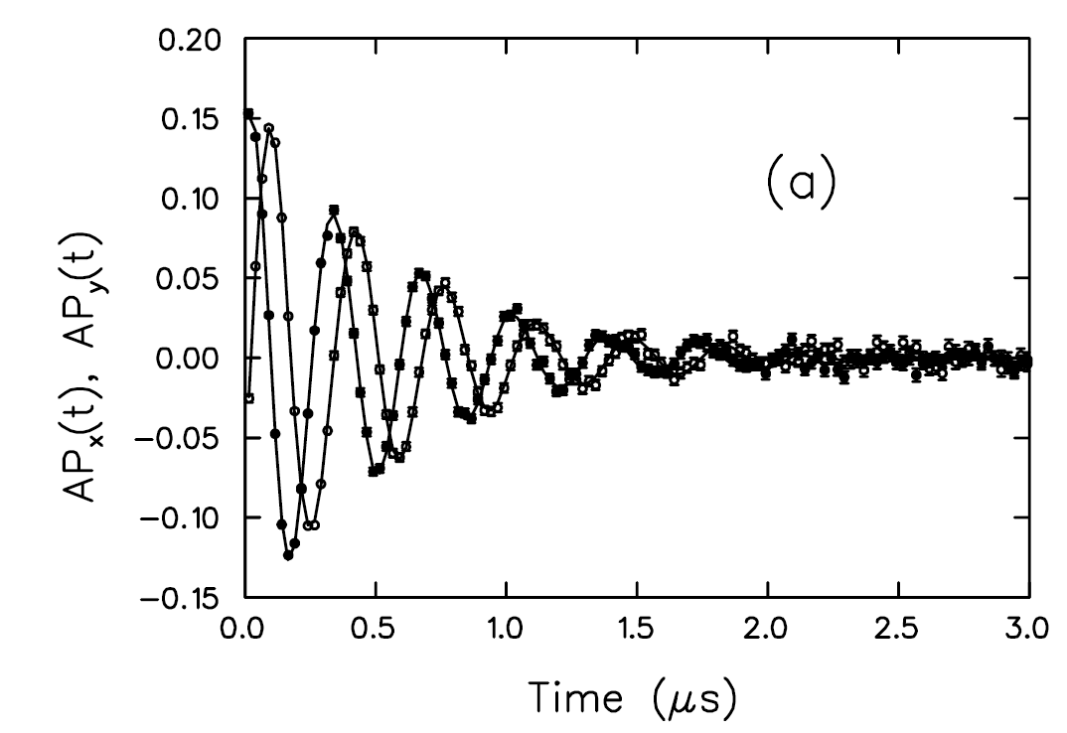
Transverse Field µSR
Amplitude: volume fraction of signal.
Frequency: local field at muon site(s): Knight shift
Field of 8T gives 1GHz precession
Max field of ~0.2T at pulsed facility due to pulse width, pion lifetime.
Damping: Field inhomogeneity: line shape gives field distribution.

Slide 23
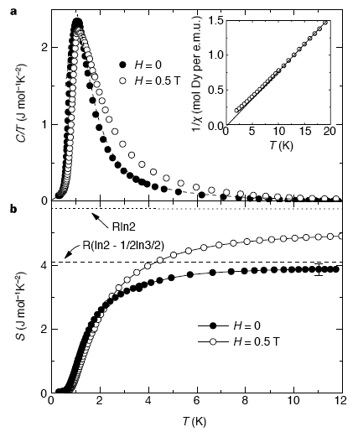
Spin Ice
Ho2Ti2O7, Dy2Ti2O7, Ho³⁺/Dy³⁺ occupy vertices of corner-sharing tetrahedra in pyrochlore lattice.
Strong crystal field anisotropy results in “Ising”-spins, either in or out along local <111>.
Ferromagnetic interactions give “ice-rules” - 2 in / 2 out. 6-fold degeneracy for each tetrahedron.
macroscopic degeneracy, corresponding to water ice.
Ramirez et al., Nature 399, 333 (1999).
Bramwell & Gingras, Science 294, 1495 (2001).

Slide 24
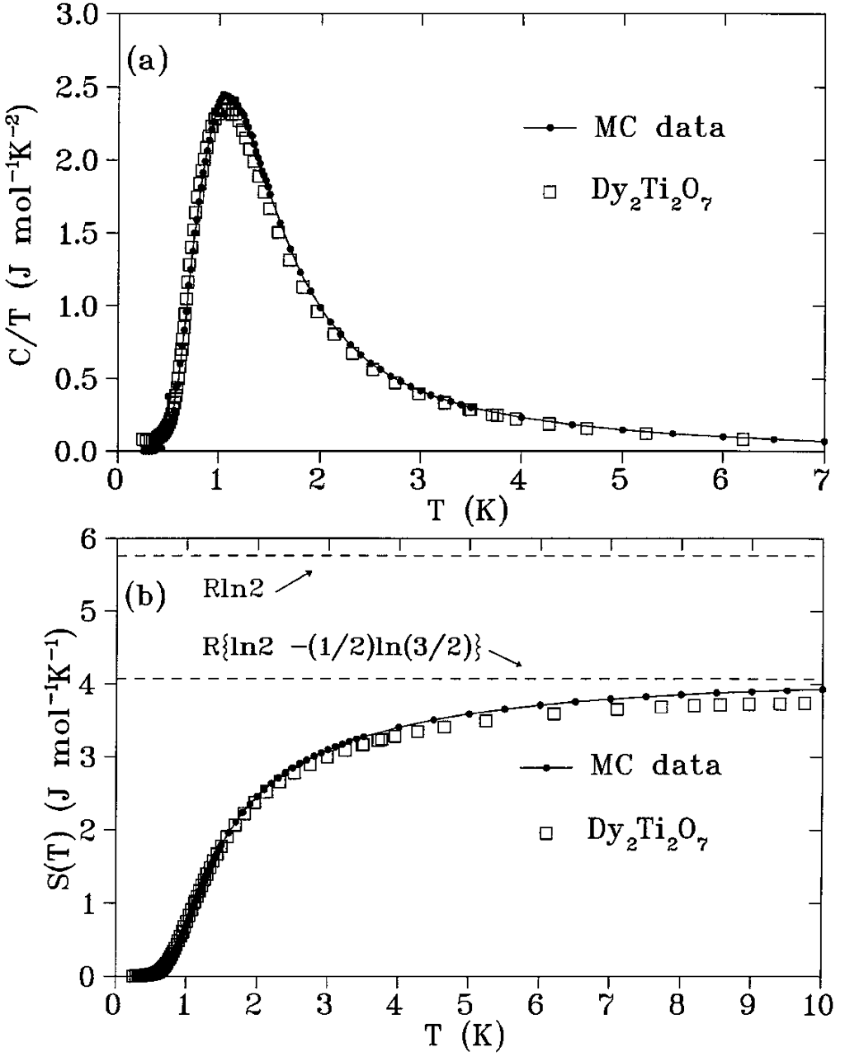
Spin Ice
Ho³⁺ and Dy³⁺ have large magnetic moment ∼10μB.
Dipole interactions large Dnn∼1K.
Exchange Jnn: Need Jeff=Jnn+Dnn>0.
Upon cooling, spin configurations which don’t obey ice rules freeze out.
gives a crossover in Cp.
Spin ice state should have extremely slow dynamics due to Ising nature precluding classical flips or tunneling.
den Hertog & Gingras, Phys. Rev. Lett. 84, 3430 (2000).

Slide 25
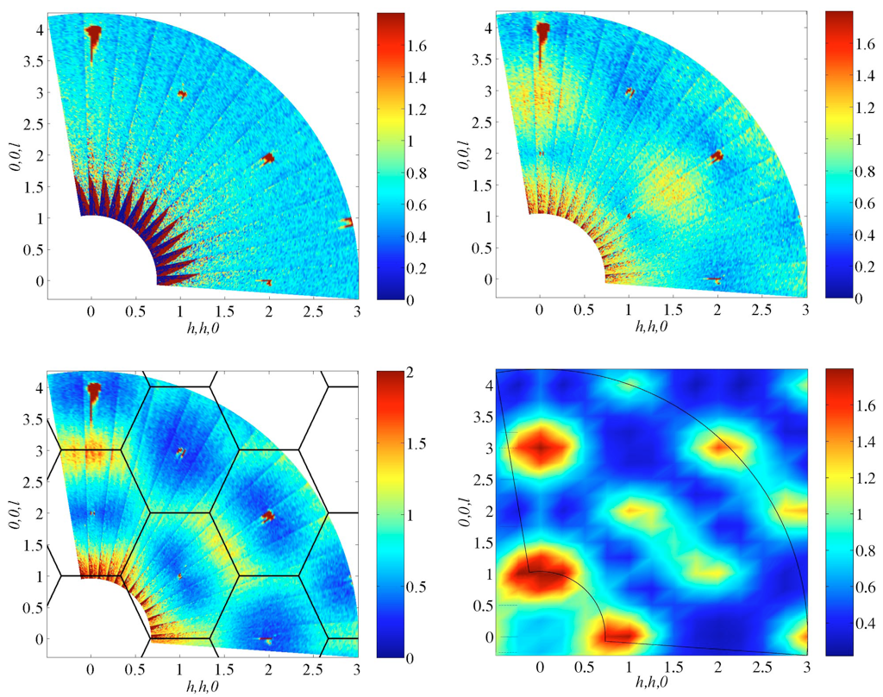
Spin Ice - No Long Range Order
Only diffuse magnetic peaks seen.
Short range FM correlations.
Fennell et al., Phys. Rev. B 70, 134408 (2004).

Slide 26
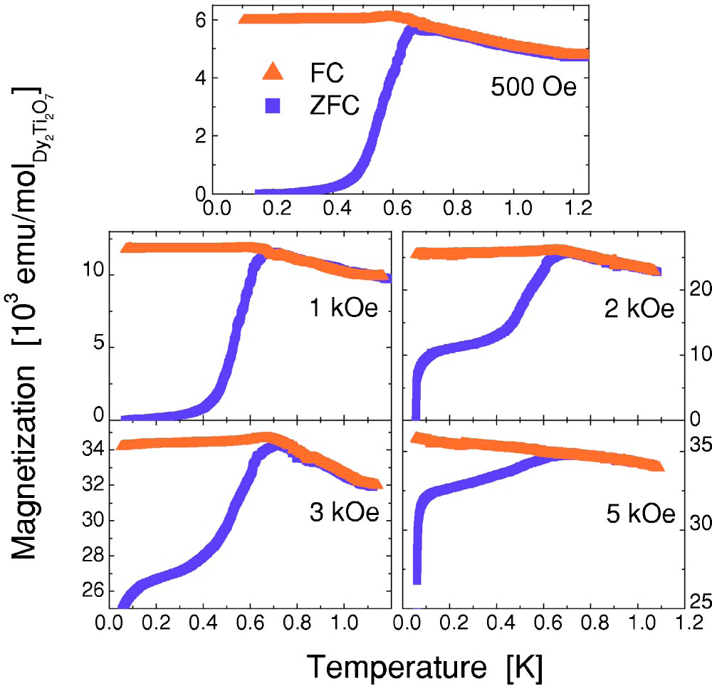
Dy2Ti2O7 Low Temperature Irreversibility
Snyder et al., Phys. Rev. B 69, 064414 (2004).

Slide 27
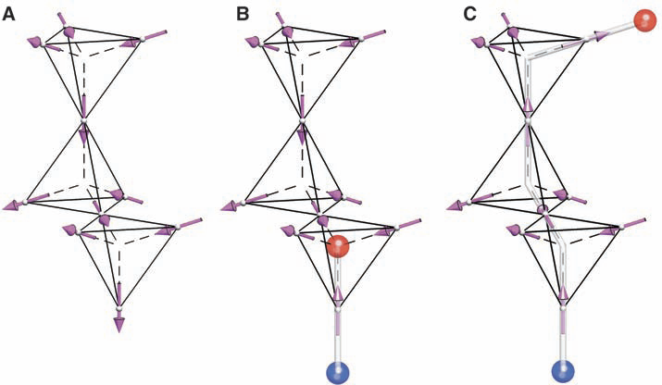
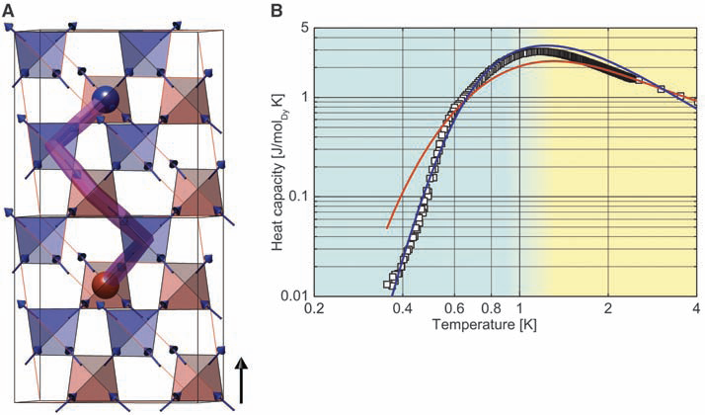
Magnetic Monopoles?
Spin flip excitations from ground state create magnetic dipoles which can separate with minimal energy cost.
Separated excitations correspond to magnetic monopoles.
Interact via Coulomb potential

Slide 28
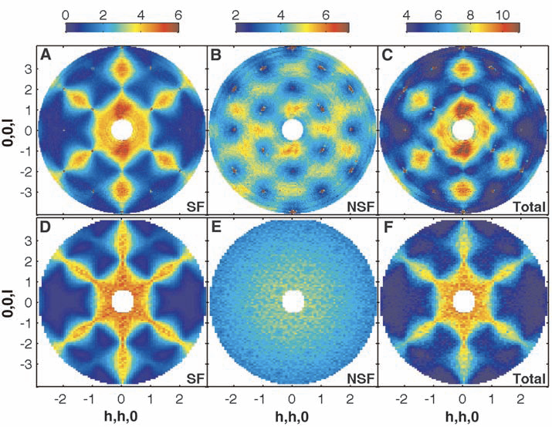
Ho2Ti2O7 Magnetic Neutron Scattering
Data
MC Simulation
Fennell et al., Science 415, 1177582 (2009).

Slide 29
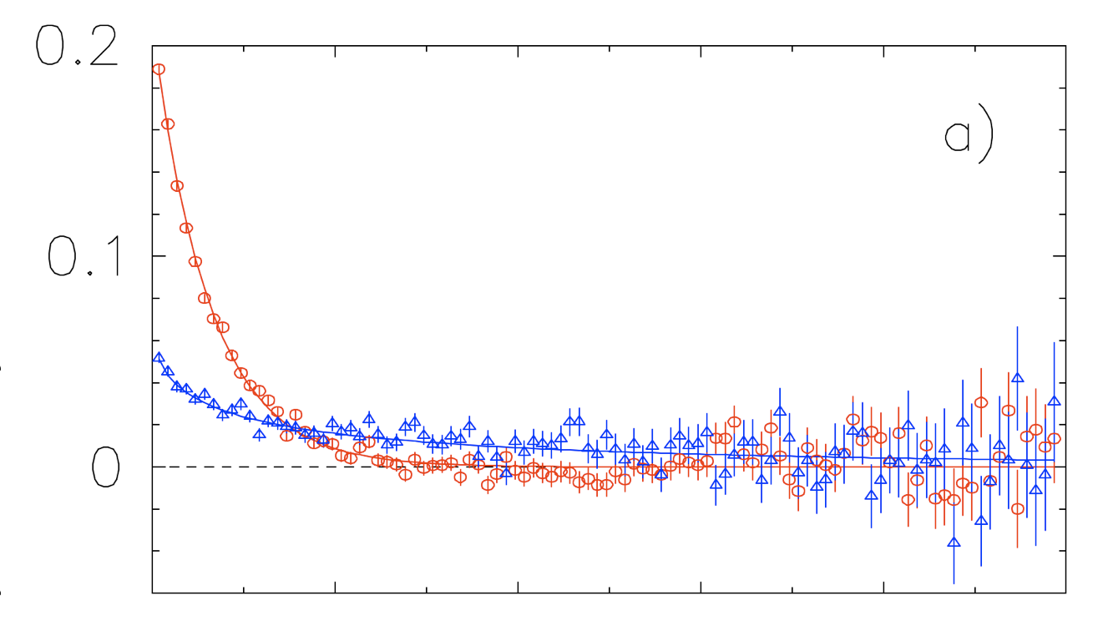
Dy2Ti2O7 Zero Field μSR
200K
Large internal quasi-static magnetic field
2K
0
2
4
6
8
10
High (200K) temperature: full signal relaxes due to T1.
Low (2K) temperature: 1/3 tail relaxes slowly from T1.

Slide 30
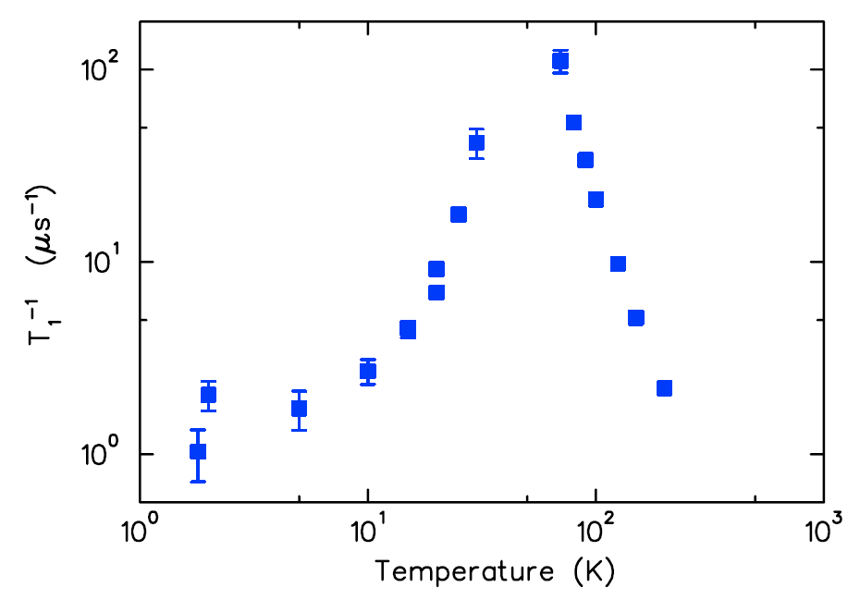
Dy2Ti2O7 Zero Field μSR
Above 70K full amplitude, below 70K, 1/3 only.
Maximum 1/T1 where moments slow, crystal field levels depopulated.
T1 minimum - slow dynamics at low temperature.

Slide 31
Quantum Spin Ice
Classical spin ice has frozen spin configurations, whereas QSI has quantum fluctuations between different spin configurations.
QSI is a type of U(1) quantum spin liquid- collective paramagnetic phase with fractionalized gapless excitations at low energy.
linear dispersion analogous to photons (spin 1 excitation like a magnon).
Vison is a topological excitation that disrupts the local spin configuration: analogous to a flux vortex in a superconductor
Gingras and McClarty, Rep. Prog. Phys. 77, 056501 (2014)
Smith et al., Phys. Rev. Lett. 122, 187201 (2019)

Slide 32
Ce2Zr2O7 Quantum Spin Ice Candidate
No order/frozen moments to 20mK
Strong temperature independent fluctuations below 4K
Beare et al., Phys. Rev. B 108, 174411 (2023)

Slide 33
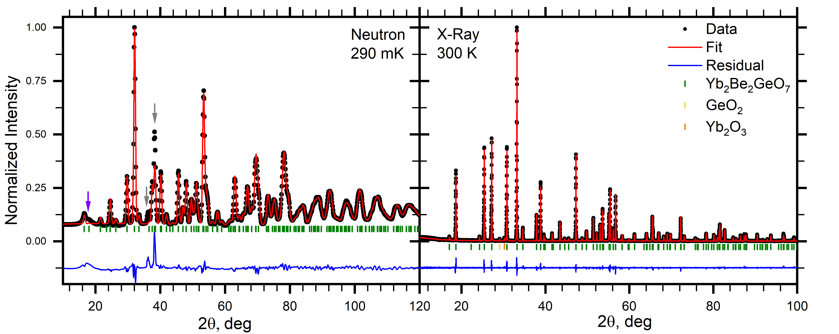
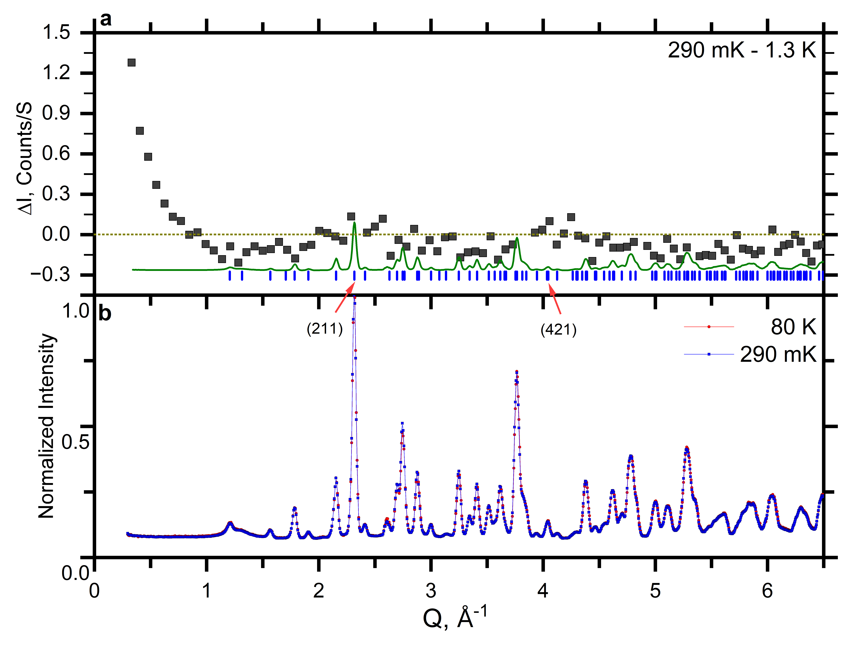
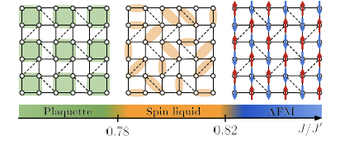
Quantum Spin Liquid Ground State in Shastry-Sutherland Lattice Material: Yb2Be2GeO7
J>J’: local singlet dimer state
J’>J: AFM order (Neel)
spin plaquette singlet and quantum spin liquid states near border between dimer/AFM.
Viteritti et al.,arXiv:2311.16899 (2024).

Slide 34
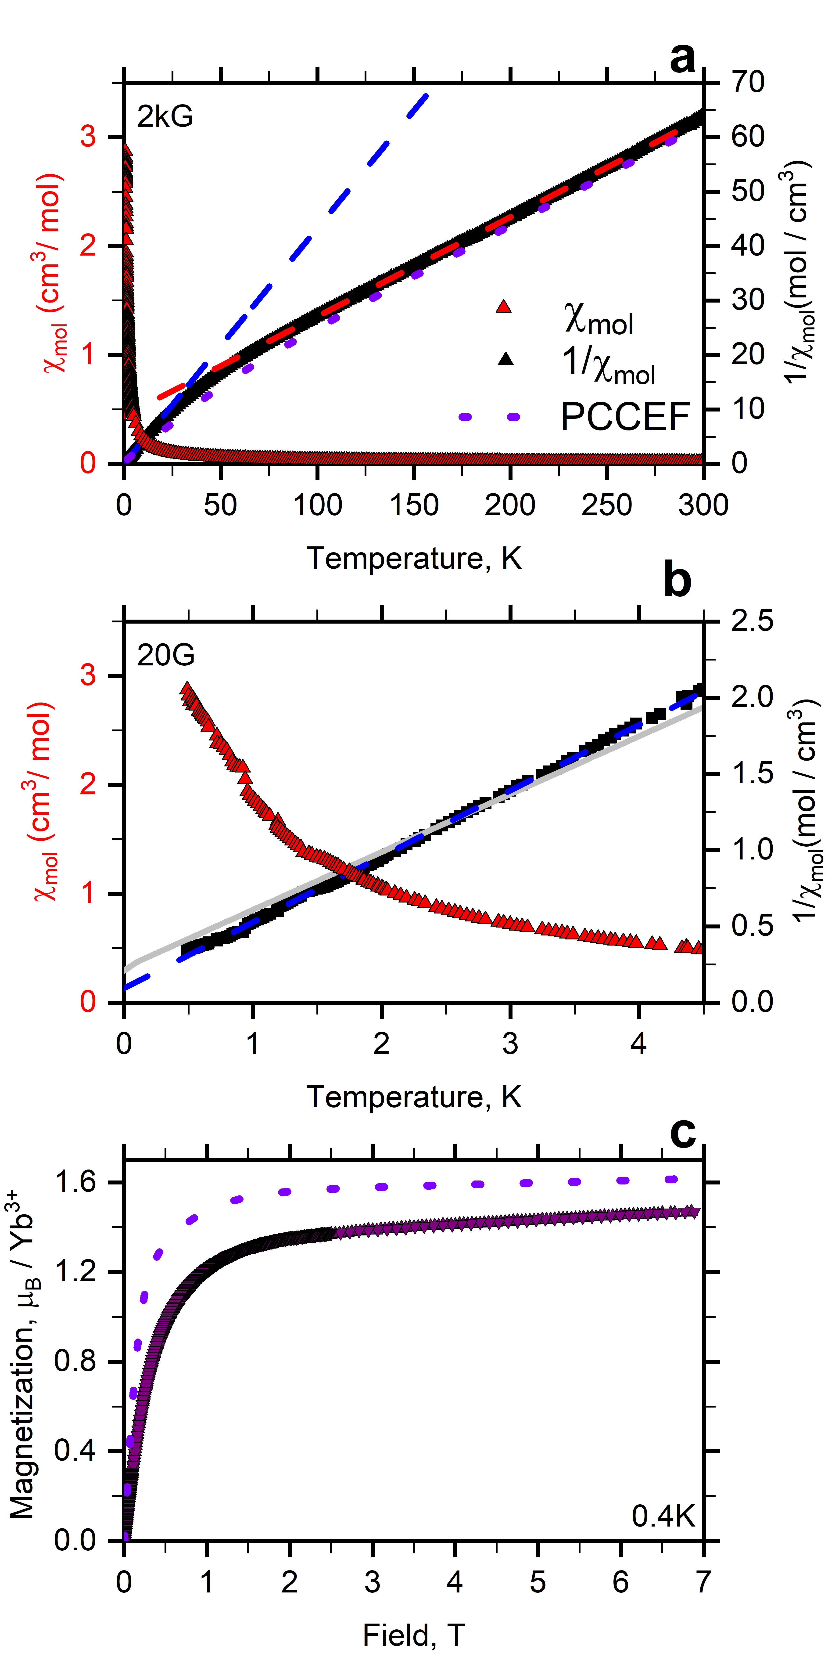
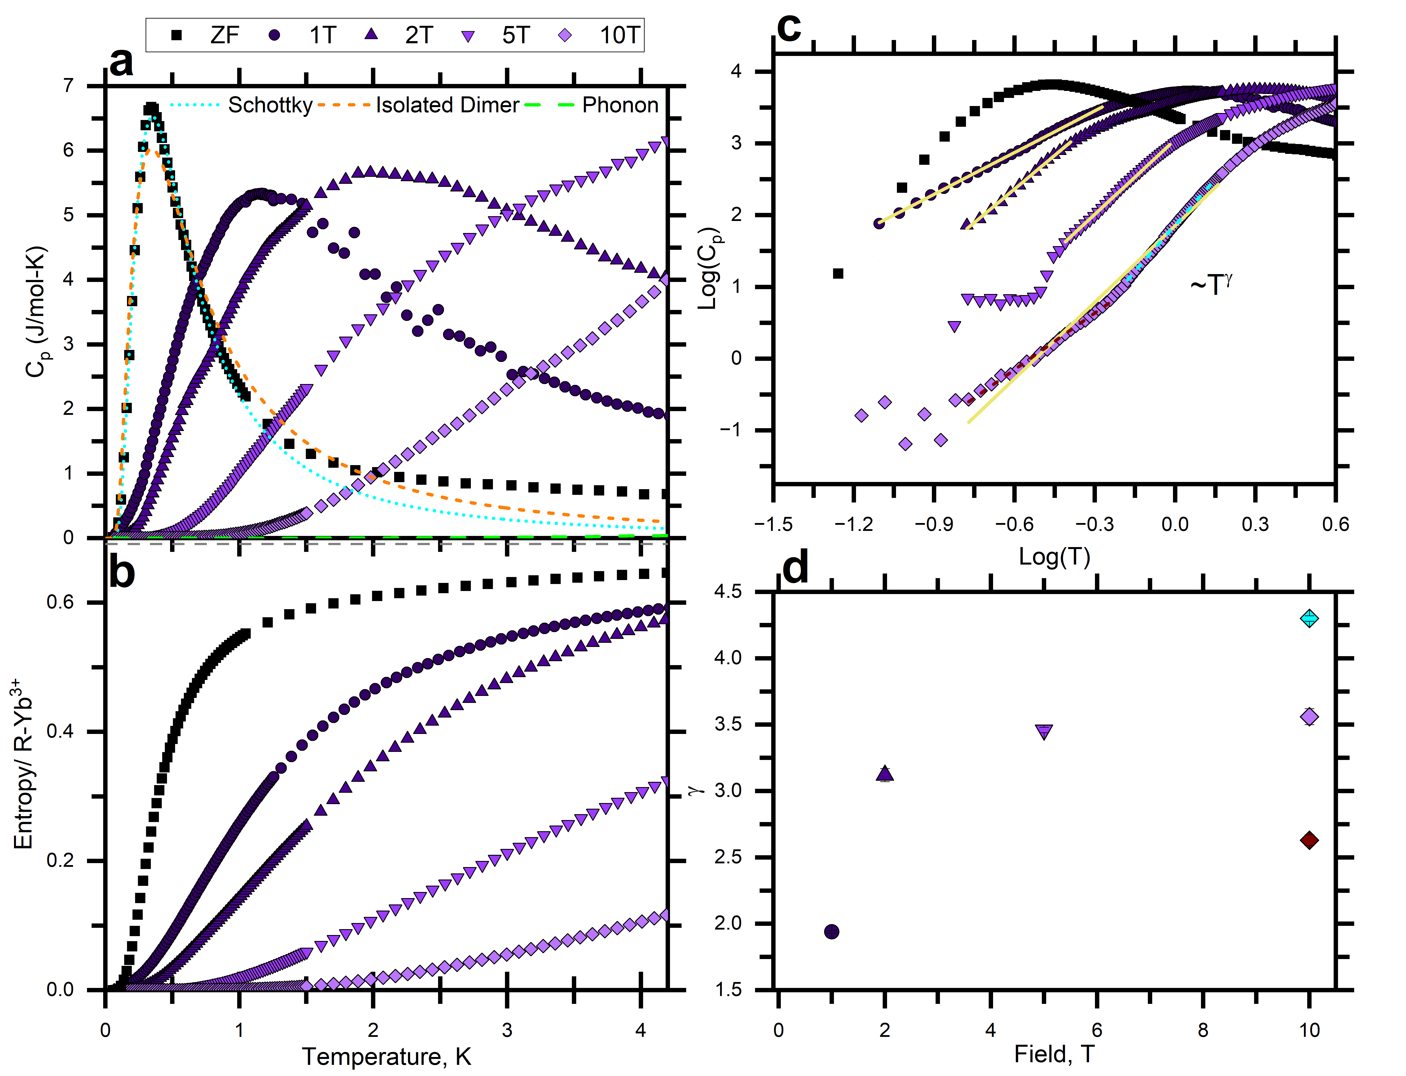
Quantum Spin Liquid Ground State in Yb2Be2GeO7
Heat Capacity
Magnetic Susceptibility

Slide 35
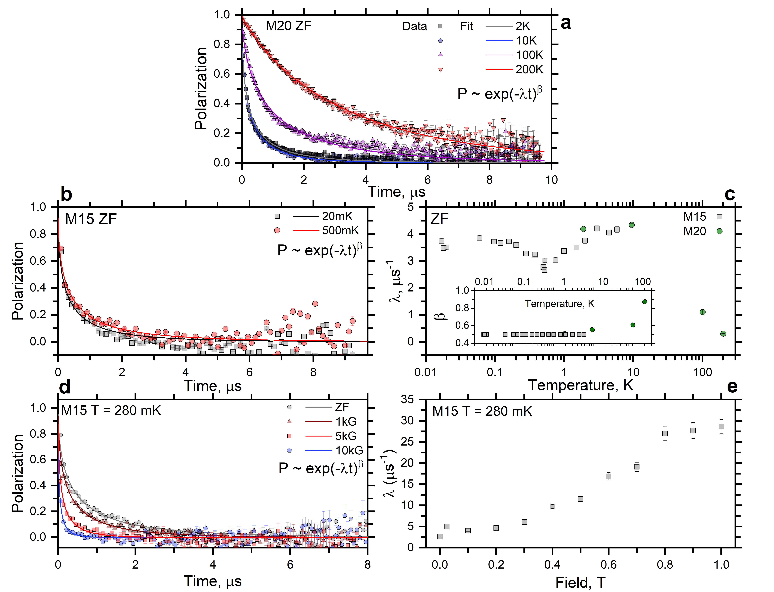
Muon Spin Relaxation in Yb2Be2GeO7
No precession seen at any temperatures
Increasing relaxation with decreasing temperature
depopulating crystal field levels
slowing down of spin fluctuations.
Relaxation essentially plateaued below 10K.
At low temperature, LF relaxation rate increases with increasing field indicating increased low frequency spin fluctuations present.
Closing of gap with field above 0.2T.
Yb2Be2GeO7 is a gapped quantum spin liquid candidate
Pula et al., Phys. Rev. B 110, 014412 (2024). (1 week ago!)

Slide 36
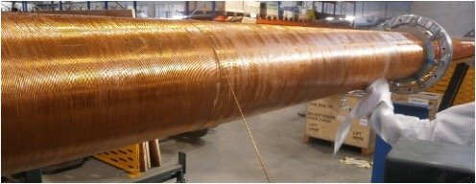
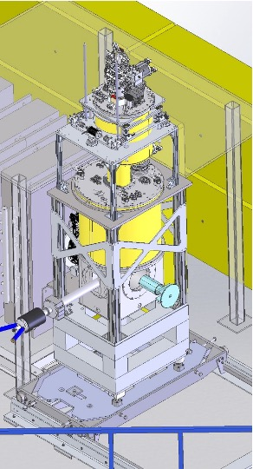
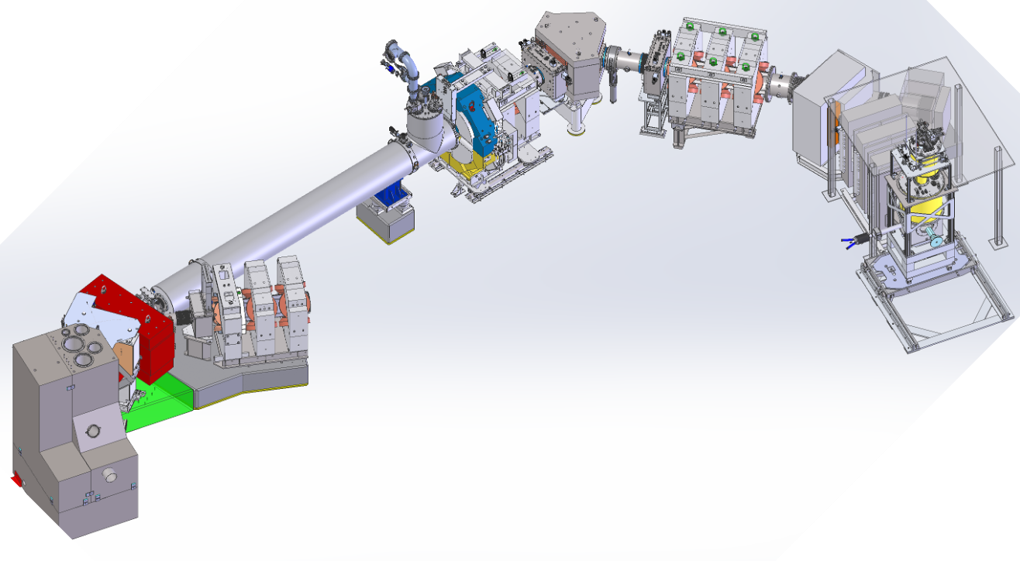
Coming Soon: TRIUMF M9H
4T 6 port magnet with DR,SiPM spectrometer
First muon decay channel explicitly designed for delivery of transversely spin polarized beams.
High energy decay muons (µ⁺/µ⁻), suitable for pressure cells, muonic x-rays for elemental analysis.

Slide 37
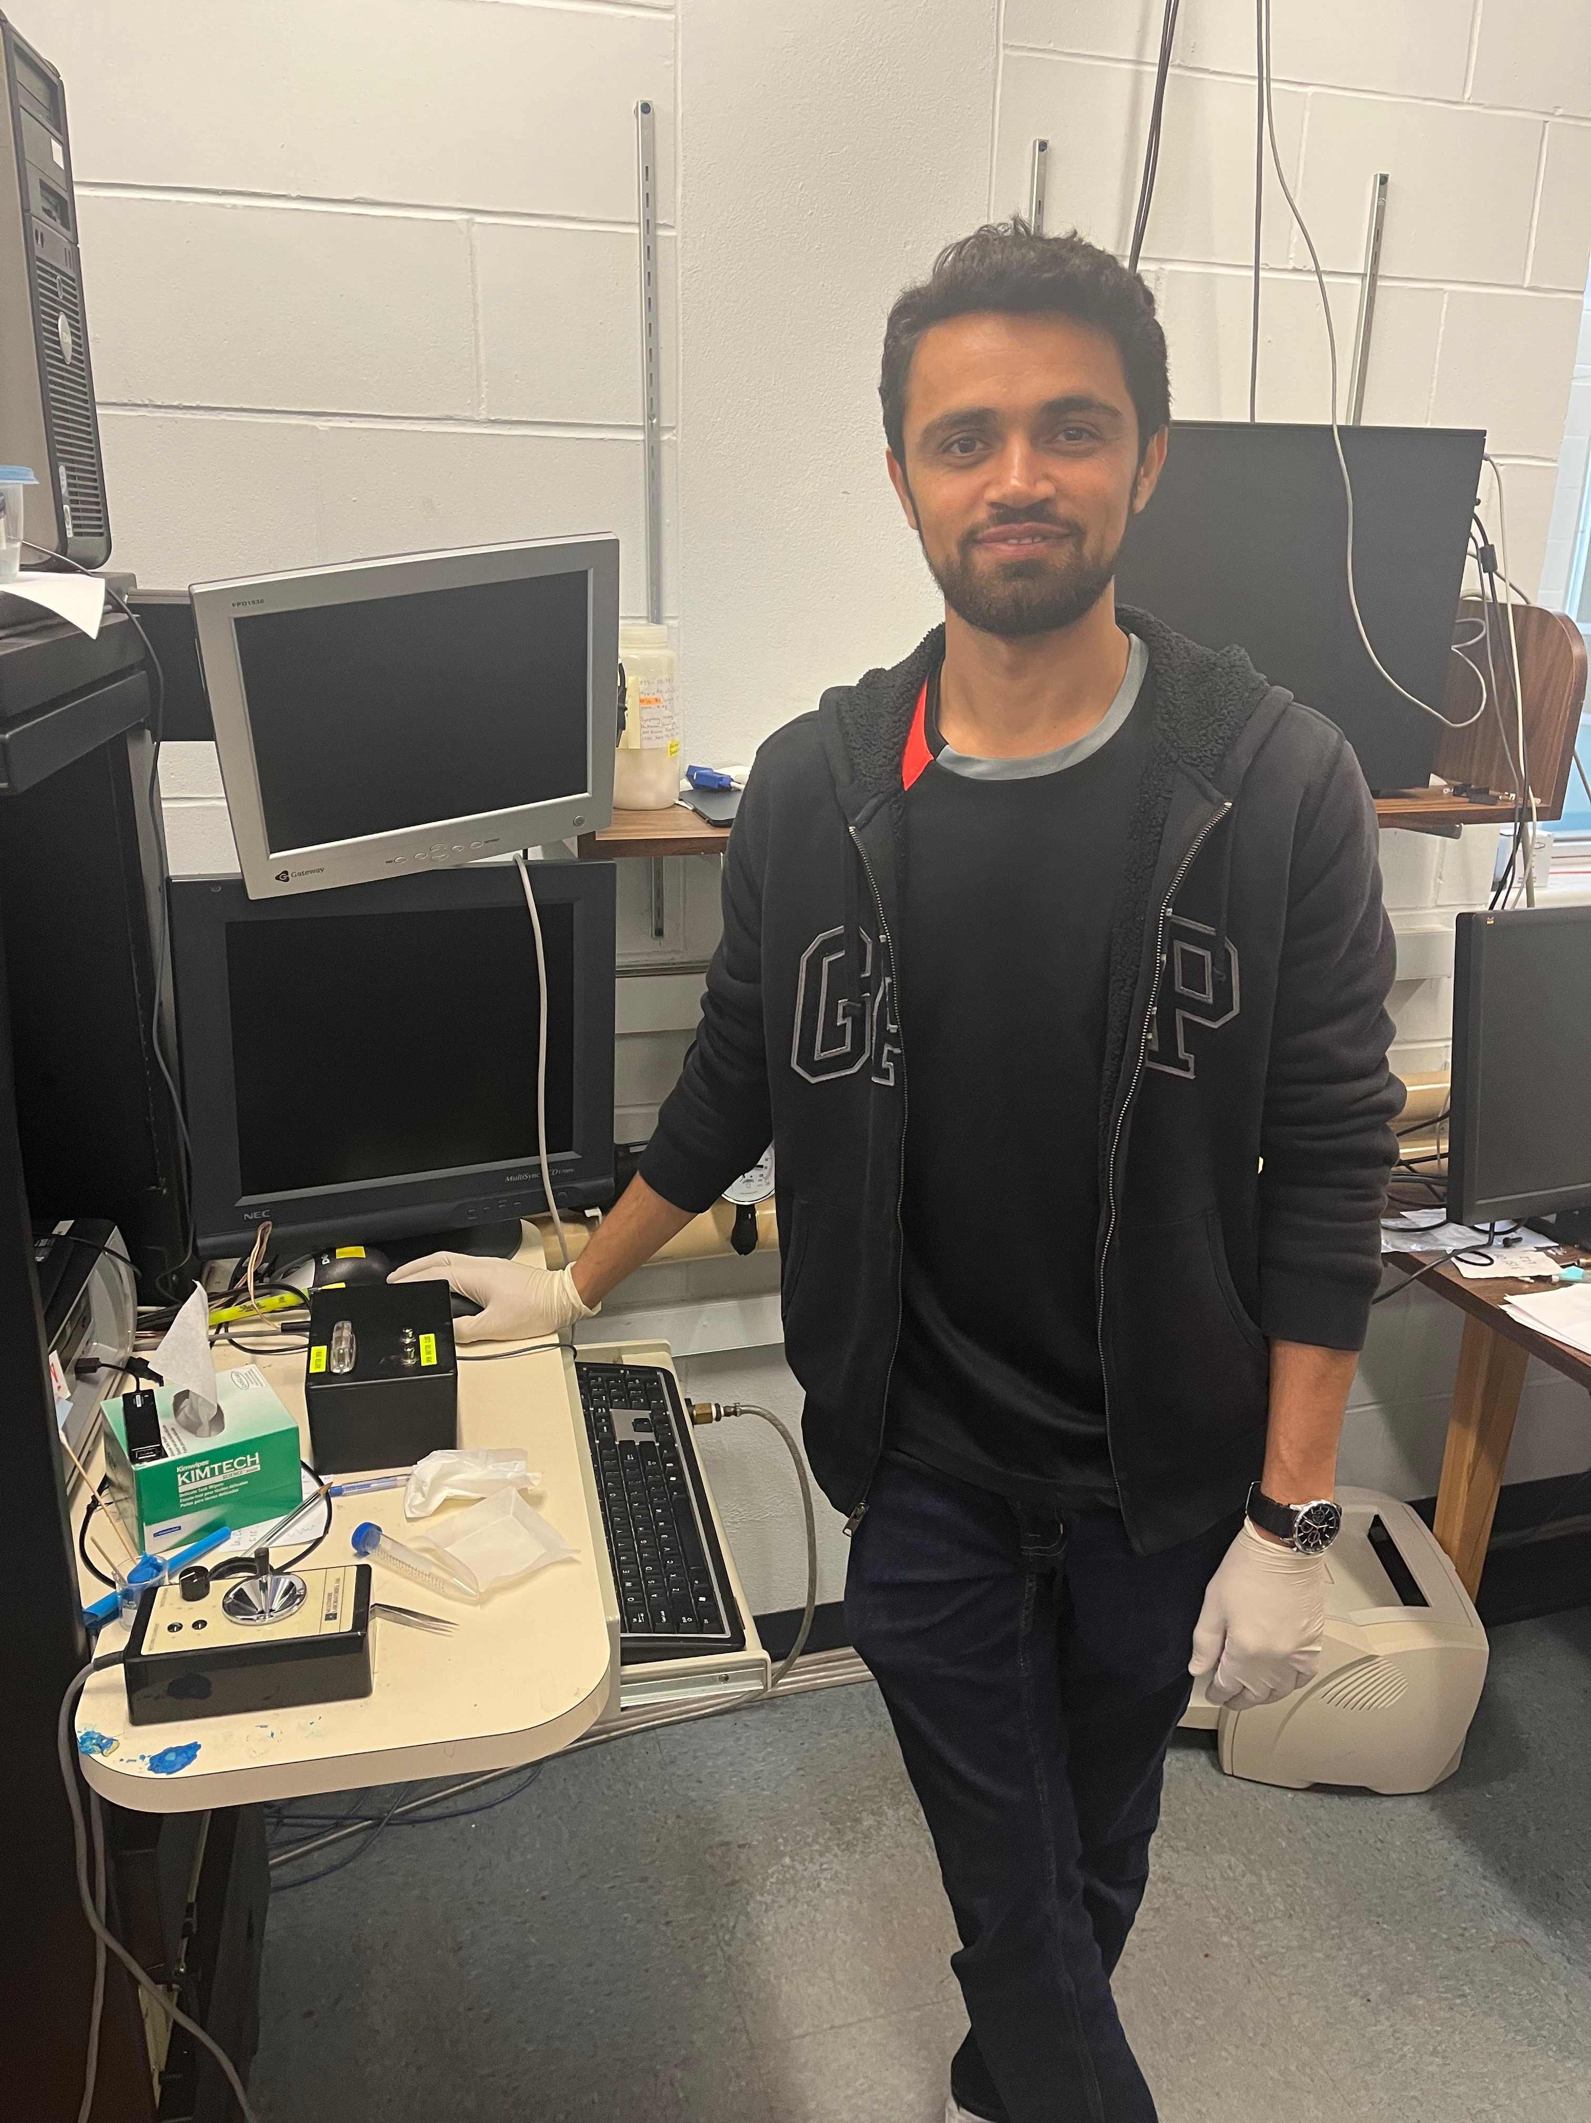
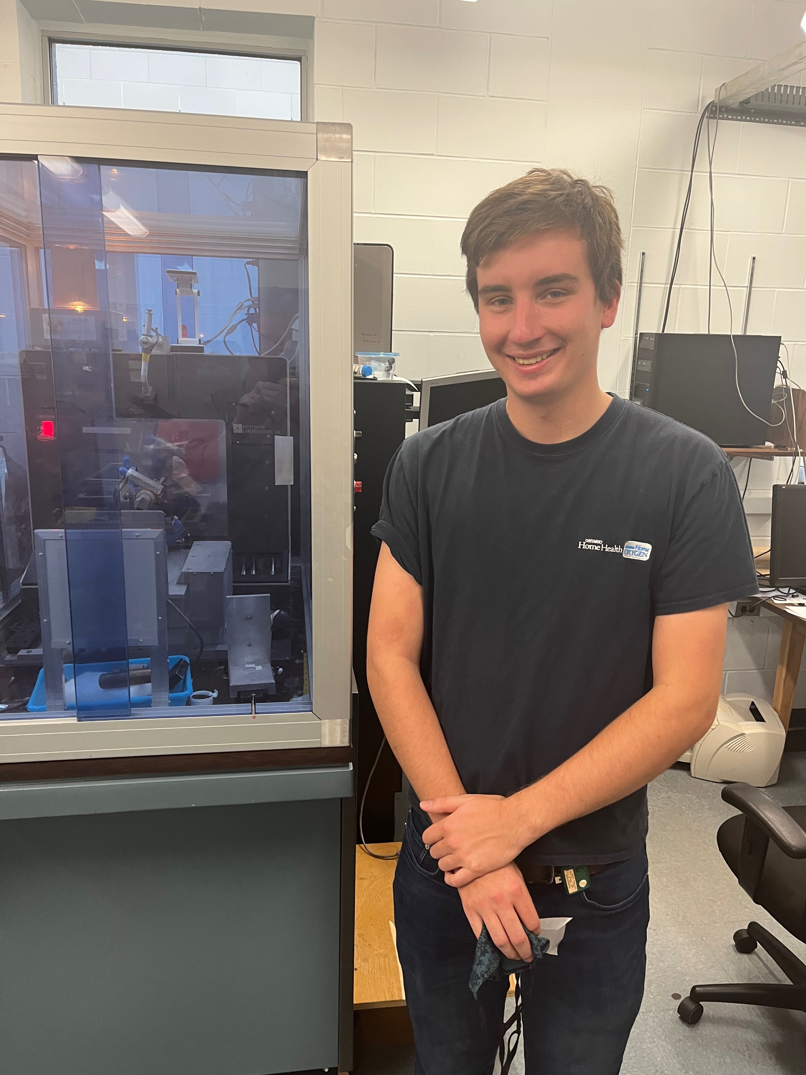
Quantum Materials: Emergent States and Excitations
Synthesis, Characterization & Identification
Quantum spin liquids: elusive, need for multiple complementary probes
Muons provide a real space/volume sensitive probe with relevant frequency window.
Thanks for your attention!

