Slide 1
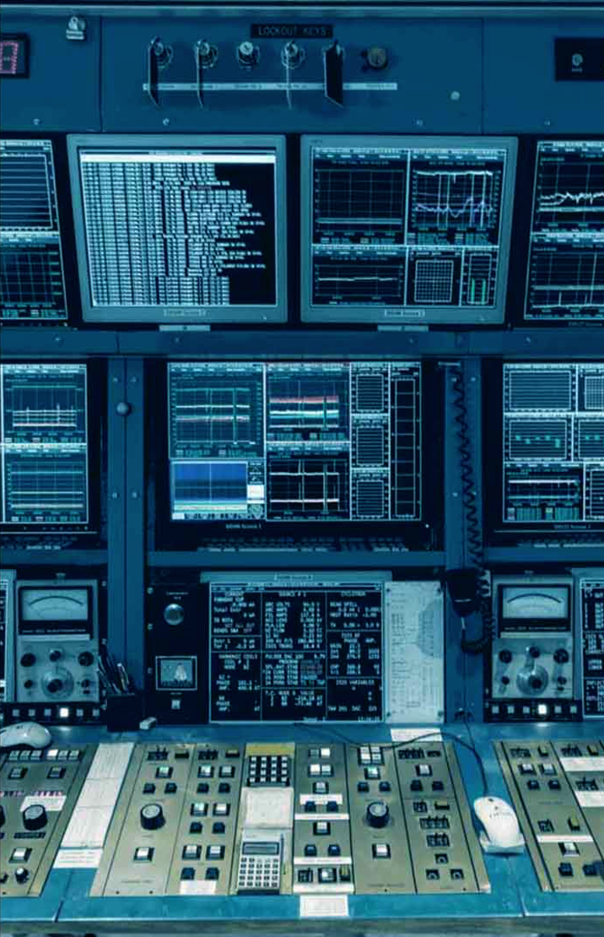


ML-Driven Tuning of Beamlines at TRIUMF
Introduction to Bayesian Optimization
Defne Tanyer, University of Waterloo
with W. Fedorko, D. Wang, H. Koay, O. Shelbaya, C. Charles, P. Jung
Discovery,
accelerated
Notes:
TRIUMF is Canada’s particle accelerator centre conducting research in physics.

Slide 2
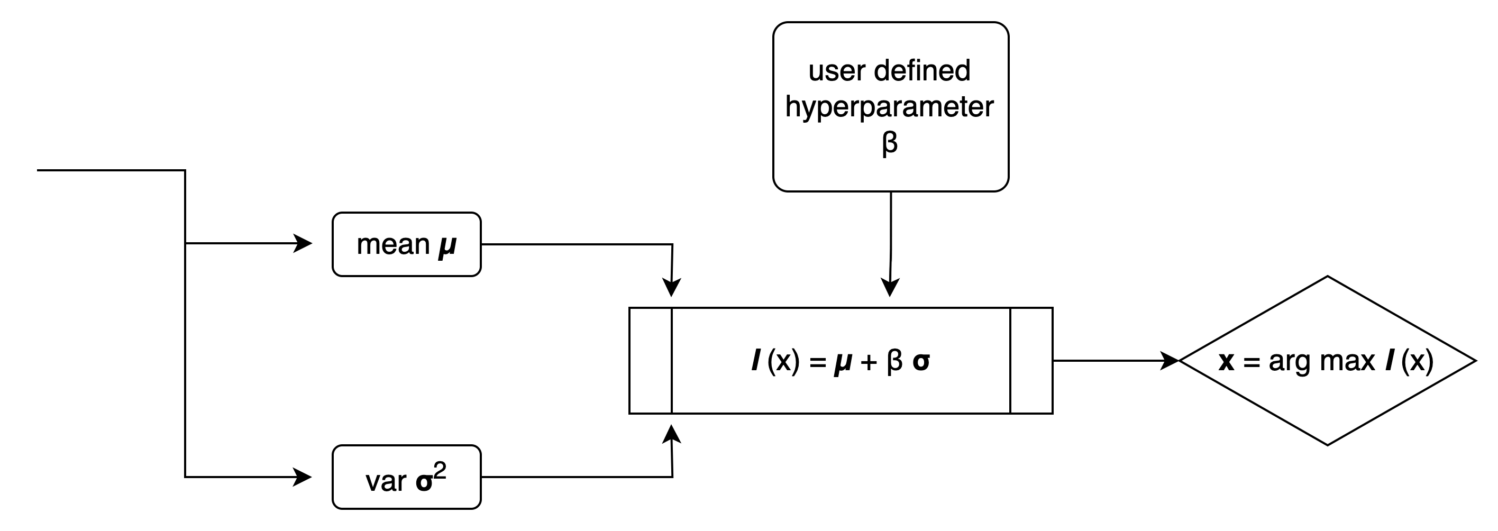
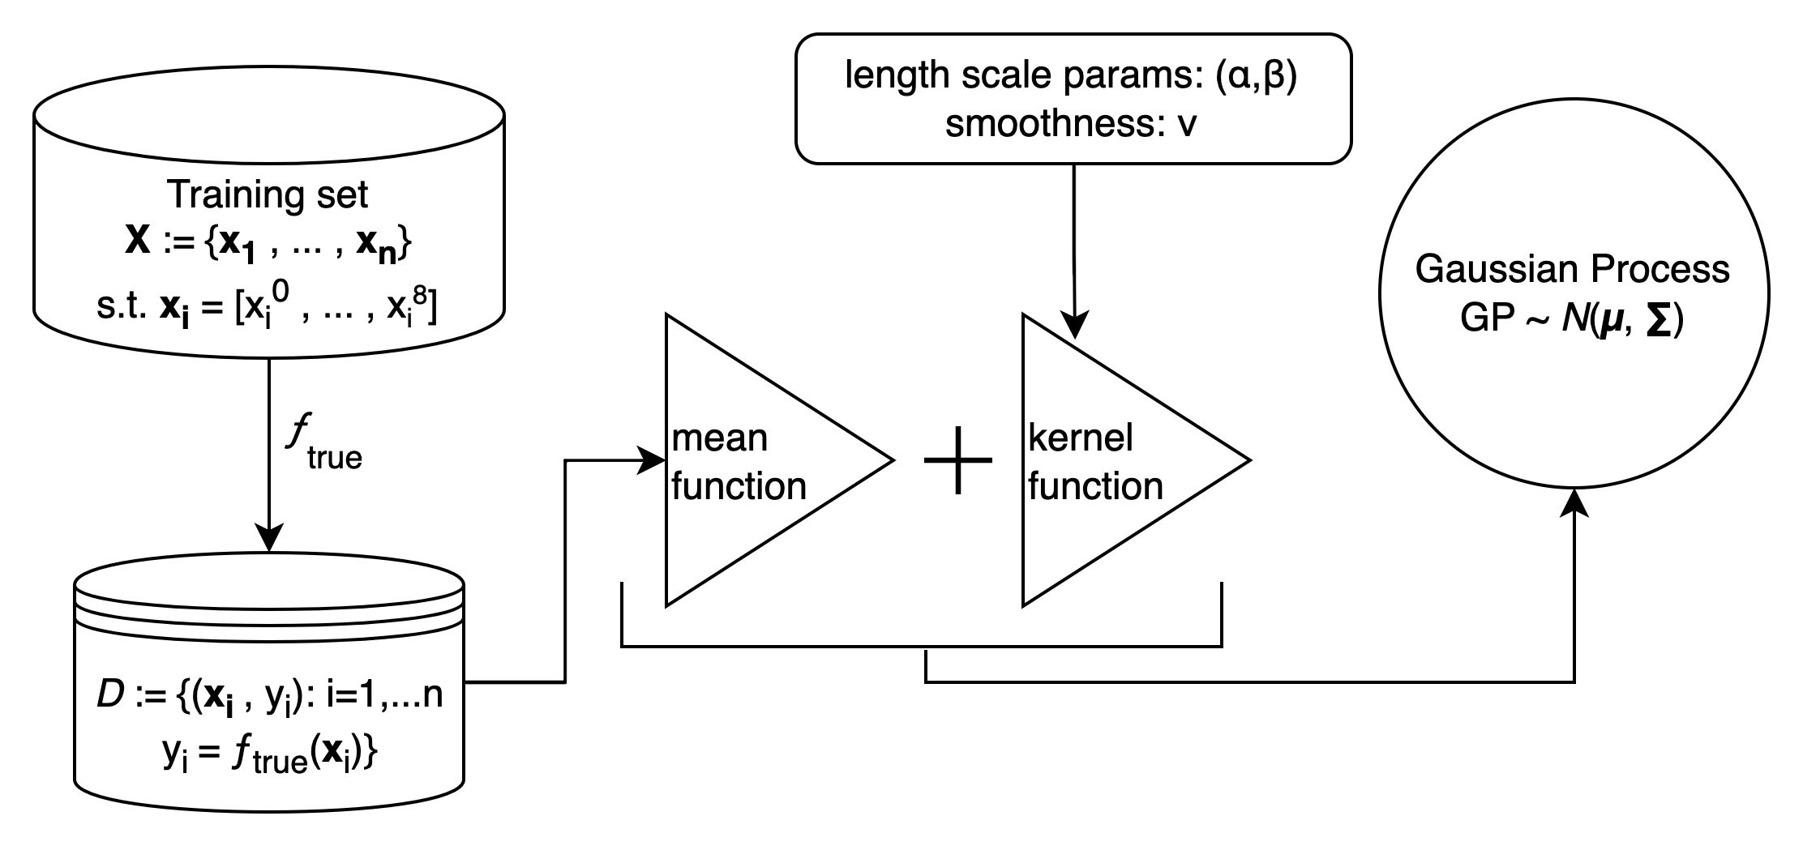
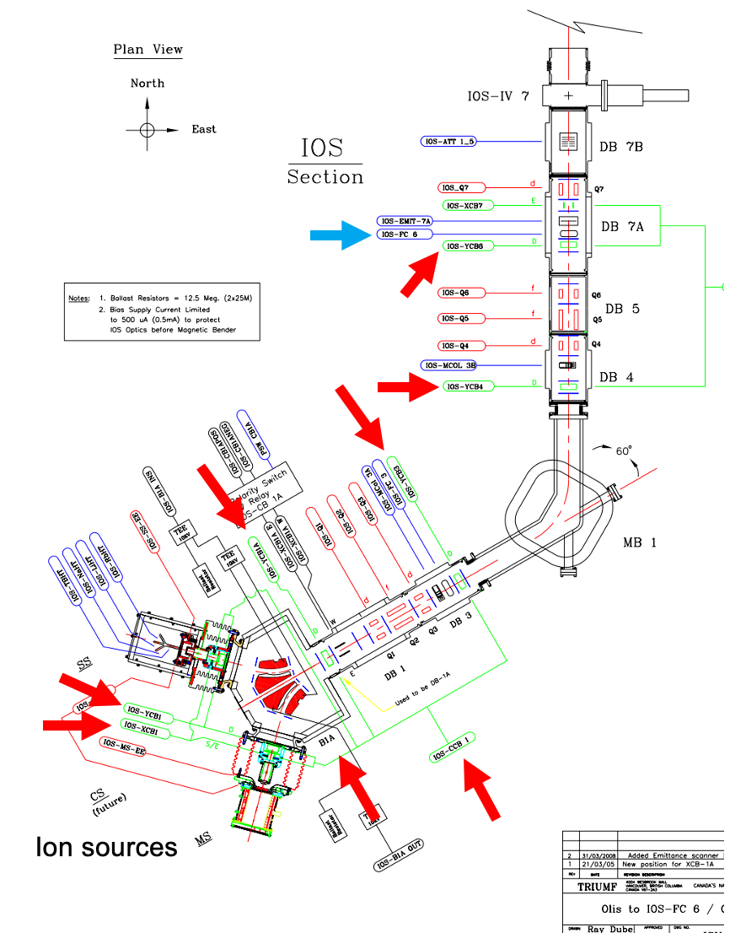
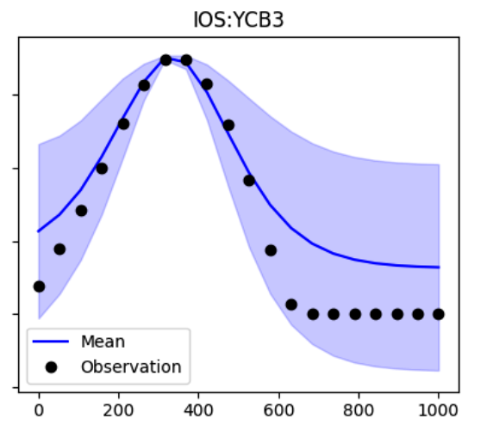

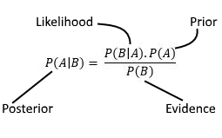
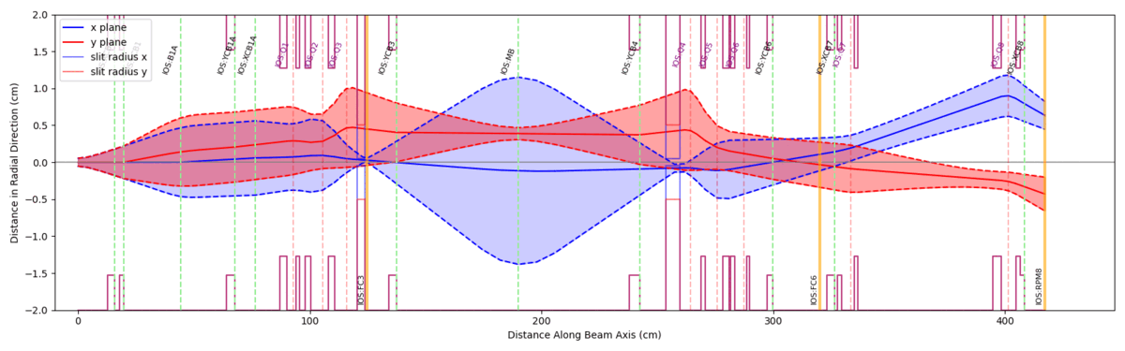
Steerer Value, V
Notes:
What is machine tuning?
process of adjusting the settings of various components along the beamline for desired performance
Why not use simulation and model the beam to calculate the theoretical values the beamline should be set to?
Problem
Unknowns make values for steerers and quads unpredictable using theory alone
Unknown misalignments
Ambient temperature and pressure
Changes in source emittance

