Slide 1




Collinear Laser Spectroscopy performed in a 30 keV MR-ToF device
L. Croquette
McGill University

Slide 2
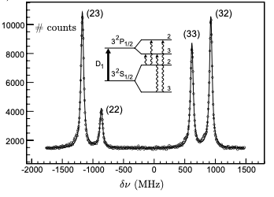
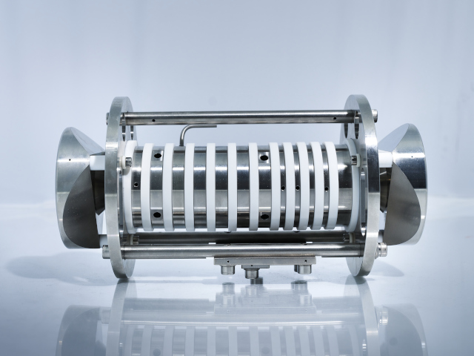

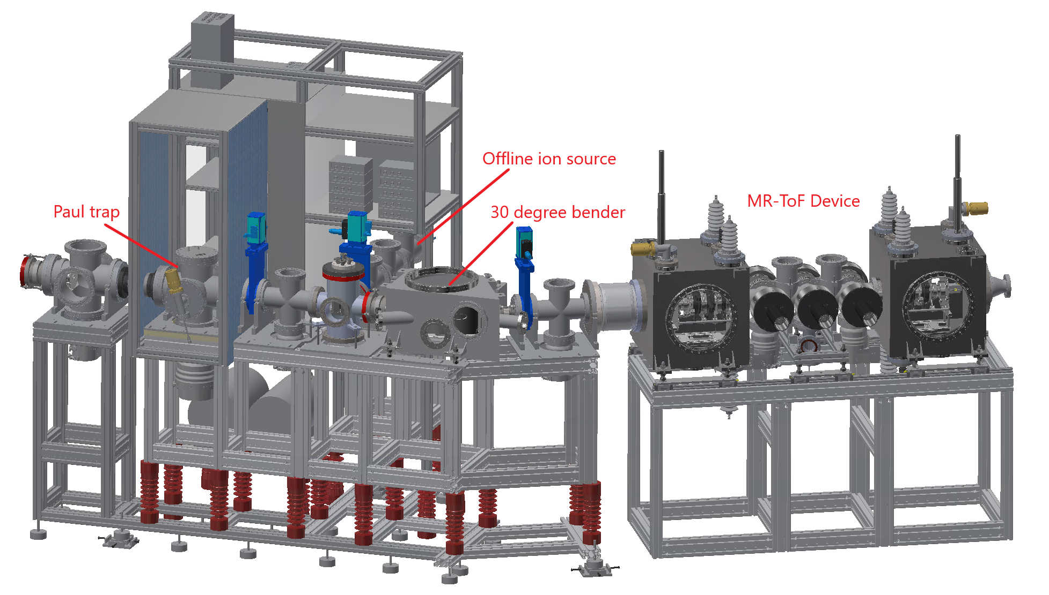
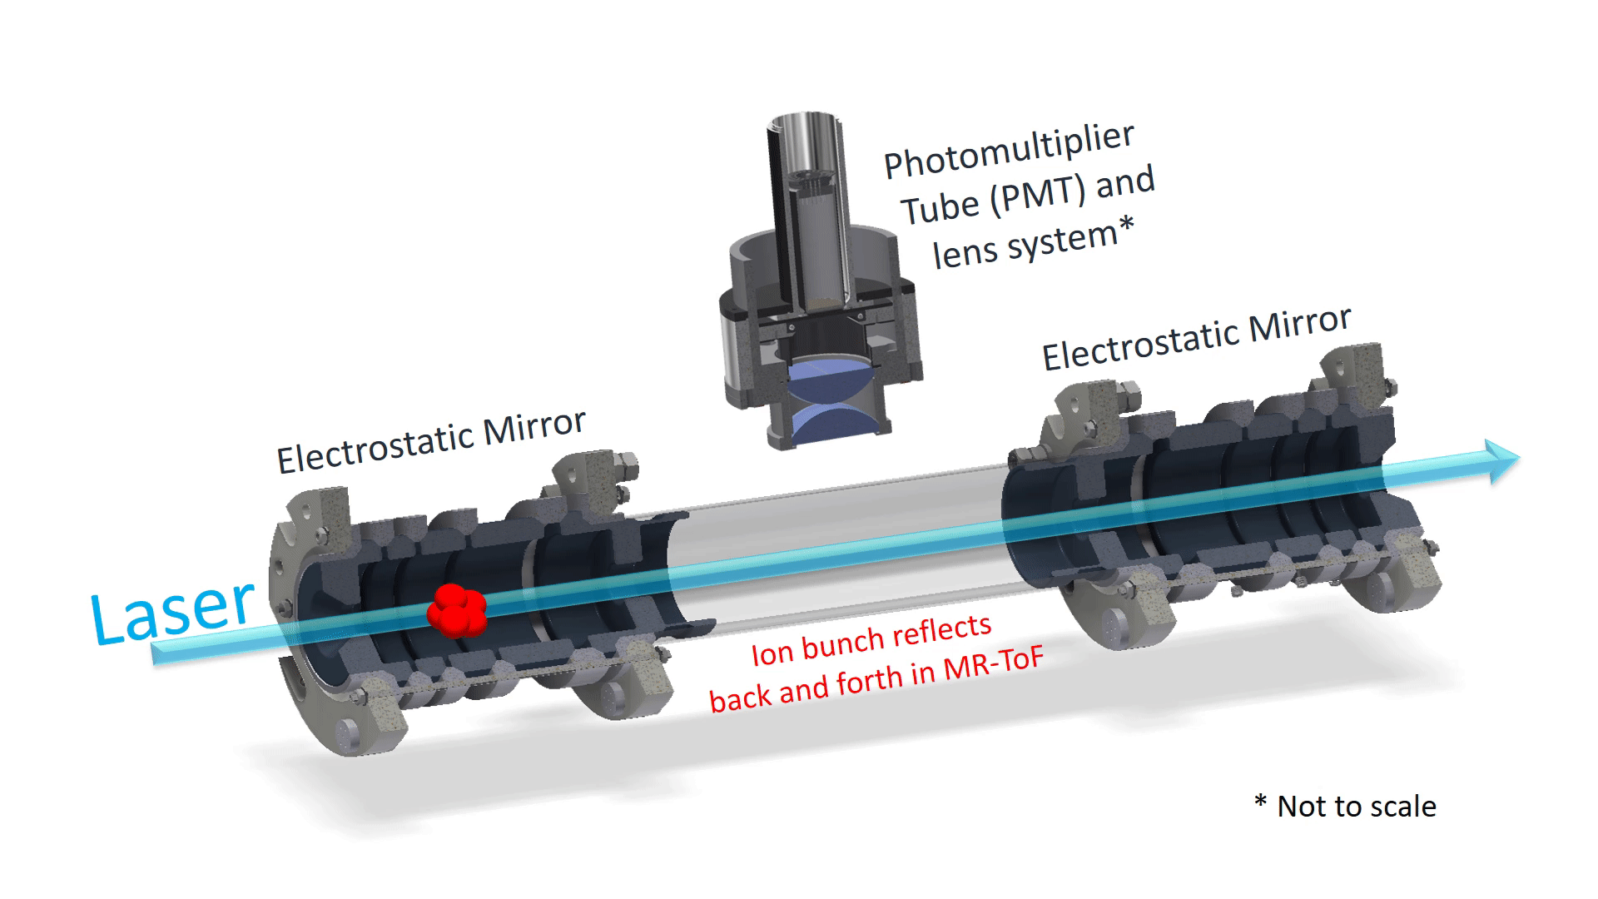

[Yordanov 2007]
$$σ_{ν}\sim \frac{σ_{E}}{\sqrt{E}}$$

Slide 4
