Slide 1




2024 Triumf Science Week, Vancouver, Canada
The Radiochemistry Lab of the Future
Prof. Peter J. H. Scott, PhD
Professor (Radiology, Medicinal Chemistry and Pharmacology)
Faculty Scientist (Rogel Cancer Center)
Division Director of Nuclear Medicine; Director of the PET Center
The University of Michigan, Ann Arbor MI, USA
@Scott_LabUM
pjhscott@umich.edu

Slide 2
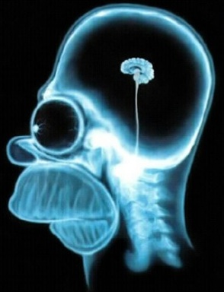
Anatomical vs. Functional Imaging
Anatomical
(X-ray, CT, MRI)

Slide 3
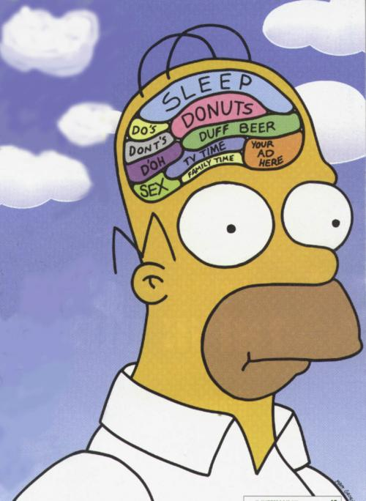
Anatomical vs. Functional Imaging
Anatomical
(X-ray, CT, MRI)
Functional
(PET, SPECT)

Slide 4
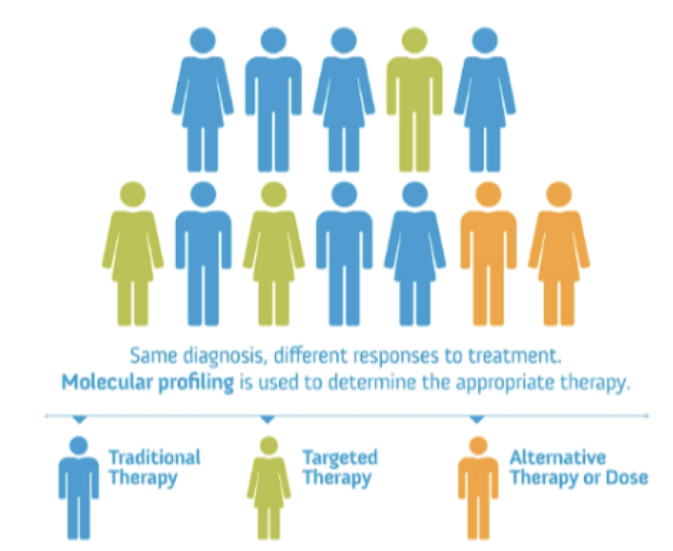
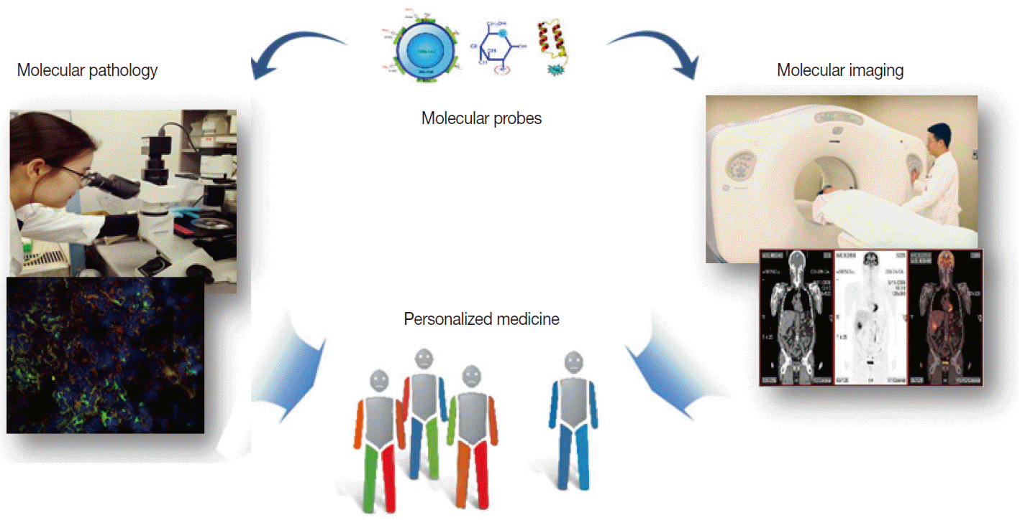
Molecular Imaging is Enabling Personalized Medicine
https://funginstitute.berkeley.edu/news/op-ed-the-need-for-personalized-healthcare/
https://www.jpatholtm.org/journal/view.php?number=5805&view=citations

Slide 5
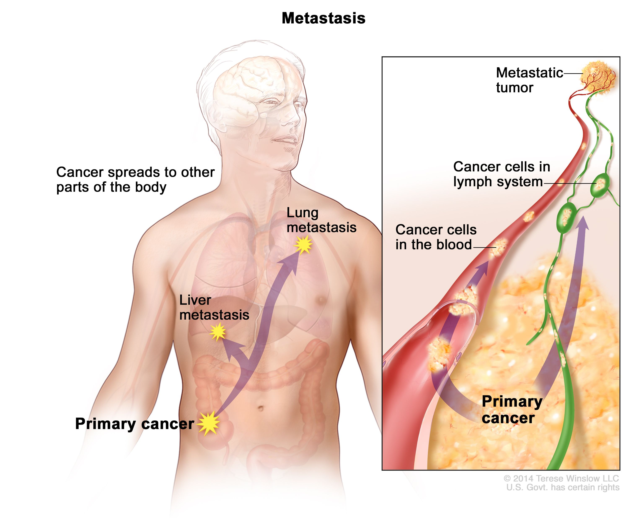

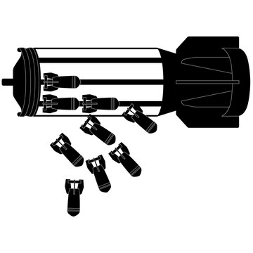
1. Treating Cancer in Nuclear Medicine
Key innovations:
A homing beacon to non-invasively detect primary cancer and any circulating metastases.
A homing missile that can destroy most cancers and mets, with minimal collateral damage to surrounding healthy tissue.
https://www.cancer.gov/publications/dictionaries/cancer-terms/def/metastasis

Slide 6
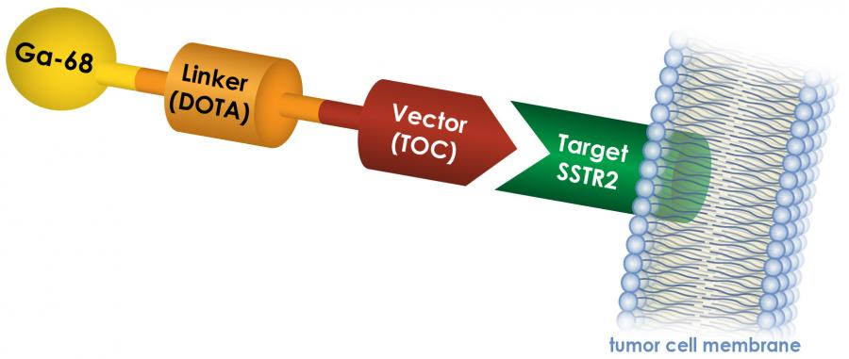

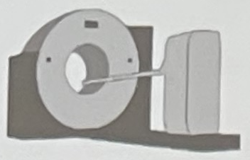

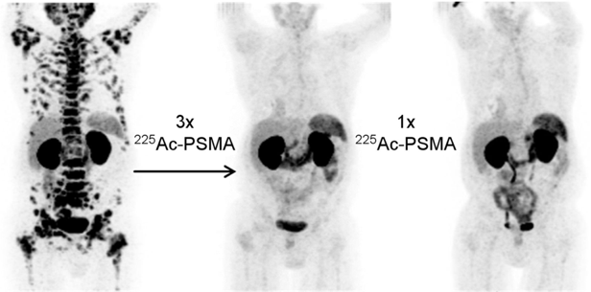
Theranostics
Theranostics
  one radioactive drug is used to identify (diagnostic), and a second radioactive drug is used to treat (therapeutic) cancerous tumors and/or metastases.
Treat what we see, see what we treat.
Dx
Tx

Slide 7
Alpha therapy with ²²⁵Ac-PSMA-617 in patients with advanced prostate cancer
Advanced theranostic clinical trials ongoing around the world, including at UM Radiology
Therapy image from: Sathekge et al., Eur J Nucl Med Mol Imaging. 2019;46:129-138.

Slide 8
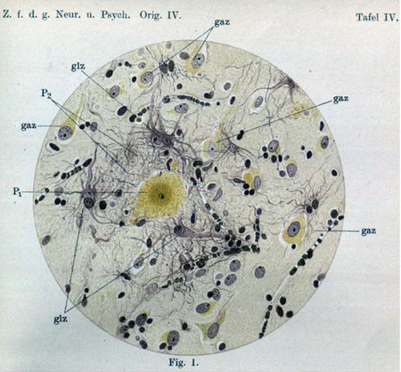
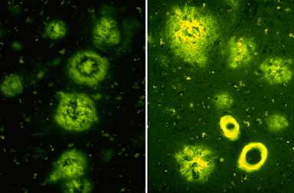
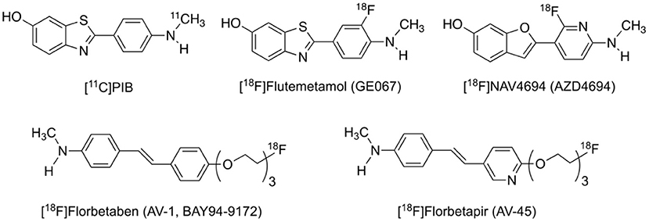
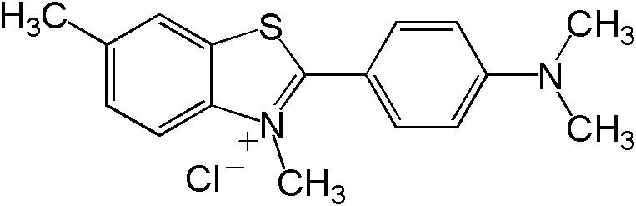
2. Amyloid PET for diagnosis and treatment monitoring of dementia
Thioflavin S
Amyloid PET Agents
• Definitive diagnosis of Alzheimer’s was historically made post-mortem;
Nature Reviews Neurology volume 12, page 555 (2016)

Slide 9
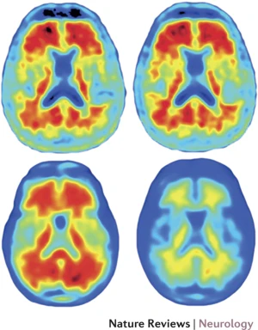
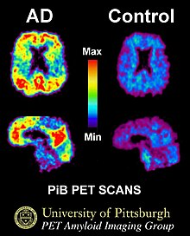
2. Amyloid PET for diagnosis and treatment monitoring of dementia
Placebo
Aducanumab
• Definitive diagnosis of Alzheimer’s was historically made post-mortem;
• Amyloid PET enables early and accurate diagnosis of disease in living patients;
• Monitoring response to therapy, adjusting dose and/or treatment as needed.
Nature Reviews Neurology volume 12, page 555 (2016)

Slide 10
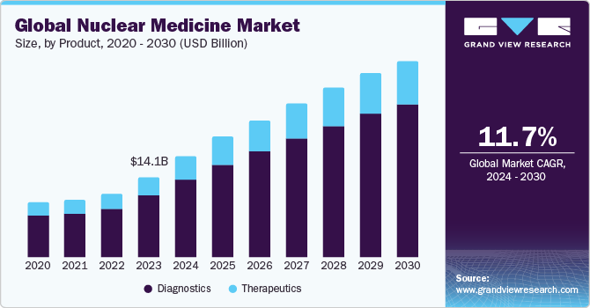

Slide 11
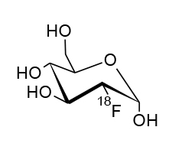
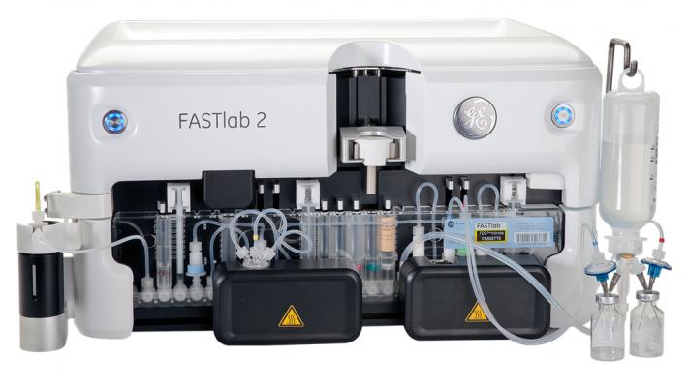




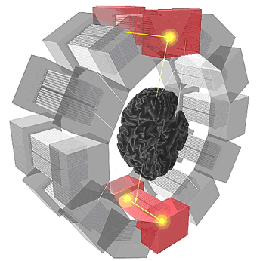

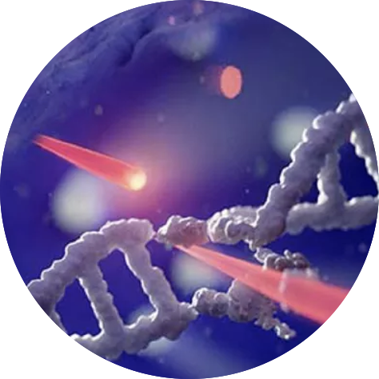
Radiopharmaceuticals – from Radionuclide to Clinic in just a few hours!
Production of radionuclide (e.g. cyclotron or generator)
Radiochemistry (synthesis modules)
PET Scan
QC Analysis
Radiotherapy
Dispensing (e.g. Intego)
Distribution (DOT Courier)

Slide 12
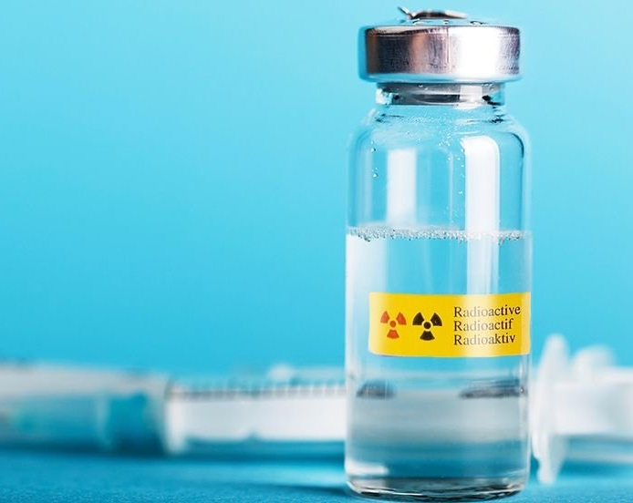
Challenges for Radiopharmaceutical Manufacturers in 2024
A number of challenges face PET drug manufacturers given the rapid growth in nuclear medicine (→ $30b by 2030):
15+ new tracers have garnered FDA approval, including ¹¹C, ¹⁸F, ⁶⁴Cu and ⁶⁸Ga tracers, mandating increased numbers of more diverse radiosyntheses per day;
Demand for PET drugs is increasing overall (e.g. clinical throughput has doubled at UM in the last 5 years);
There is a need to label more complex molecules (e.g. labeling tracers for new imaging targets, as well as complex drugs);
Many PET Labs being asked to also make therapeutics;
cGMP is increasing regulatory burden (and cost) associated with radiopharmaceutical manufacture;
Growth in clinical utilization is overwhelming resources and tying up personnel that might otherwise be doing R&D… a new paradigm is urgently needed!
Notes:
Scott’s basic science is focused in 2 areas – the first is development, preclinical evaluation and translation of new PET radiotracers, such as his work with Allen Brooks and Ben Viglianit on development of FNP-59 for cholesterol trafficking.

Slide 13
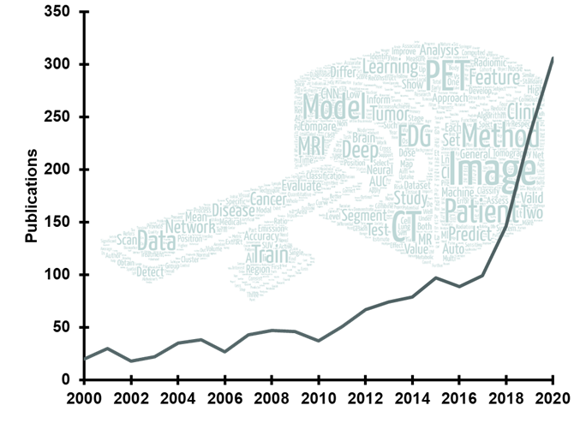
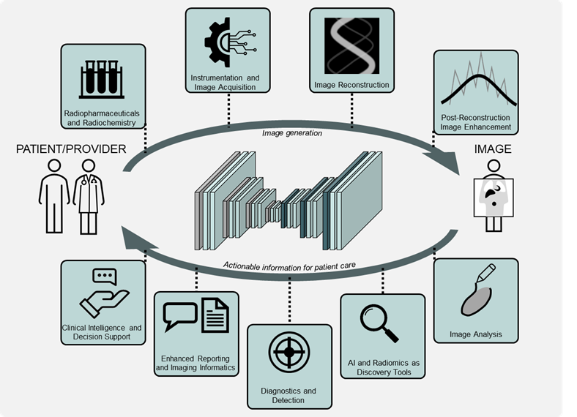
What does the future of tracer design and synthesis look like?
Trend in publications on artificial intelligence within nuclear medicine
Applications of AI span the gamut of nuclear medicine subspecialties
Journal of Nuclear Medicine, 2022, 63 (4) 500-510 and 2023, 64 (2) 188-196

Slide 14
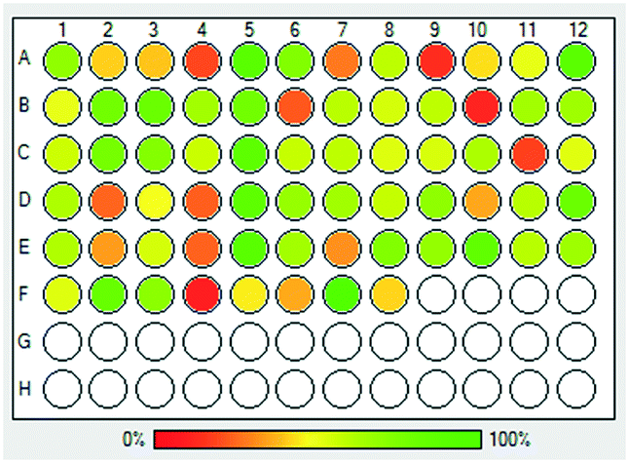
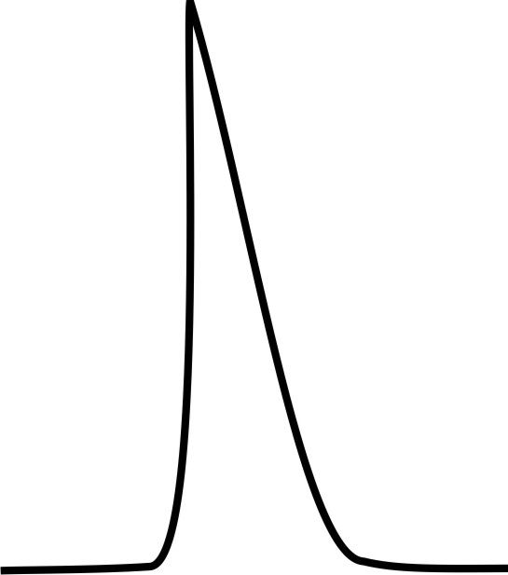
What can AI do for radiotracer design / synthesis?
Reaction Screening (Historical)
O Limited throughput
O Trial and error
❌ Resource intensive (e.g. S_{N}Ar, CMRF precursors need to be synthesized, reaction conditions screened)
❌ Time consuming
❌ Non-obvious trends missed
2. How should we prepare them (minimize resource intensive synthesis failures)?
1. Which radiotracers should we develop (minimize costly clinical failures)?
Webb EW, Scott PJH, PET Clinics, 2021; Jackson et al., ACS Chem Neurosci, 2022

Slide 15
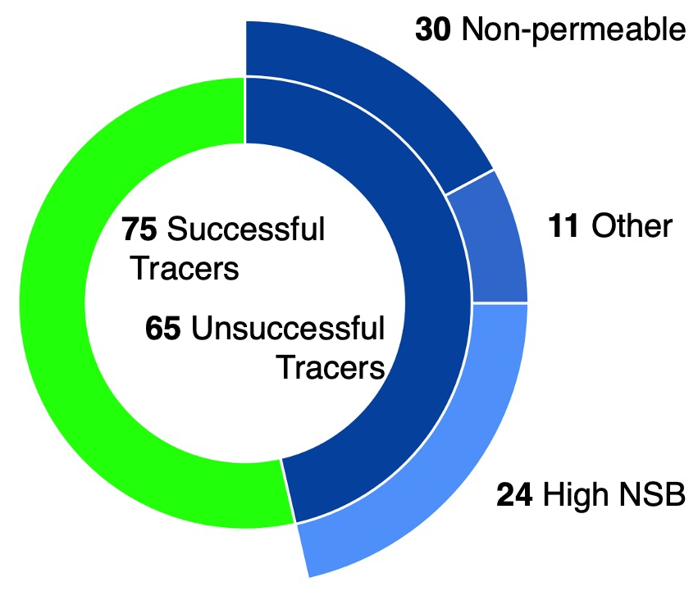
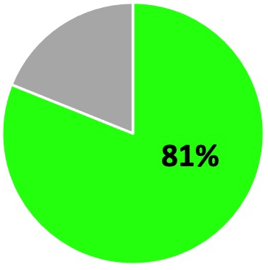
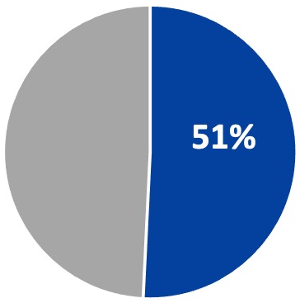
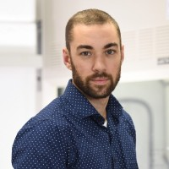

A Computational Approach to Novel Tracer Development (with Michelle James)
Predicting in vivo success of CNS PET tracers prior time and resource intensive imaging studies remains a significant challenge
1.
2.
3.
4.
Proof-of-Concept method development
Assemble control library of well characterized successful, failed CNS tracers
Quantify and Interpret panel of physiochemical parameters
Ongoing work and Future Directions
Average ClogP of a Successful Tracer: 2.7
Preferred Range: 1.25-4.25
Successful Unsuccessful
Literature evidence
Peak CNS Uptake (SUV, %ID/g)
Binding Potential
Metabolic Stability
ClogP
ClogD
tPSA
MW
H-bond donor count
pKa
Net charge pH 7.4
+ 62 other properties, variants
Jackson et al., NMB. eSRS Virtual Meeting, Nucl. Med. Biol., 96-97, S24-S25, 2021
Isaac Jackson
Notes:
Automated, high throughput computational methods
Analysis of 15 supervised machine learning methods
Manual statistical analysis
Correlation matrix for parameters properties
Statistical analysis of optimal relative weighting
Library is different= more positives and negatives than anyone has compiled.
80 positive controls
68 negative controls (27 non-permeable, 24 high NSB)
We took alot of care to include diverse negatives.
First thing: applied it to our prelim modified algorithm (that arose in context of GPR84). Promising, but not perfect. gave us hope we could
Intuitively, seemed that wiggling the cutoffs could help. Thought alot about this, realized: We had this awesome collection of molecules, let's let the data tell us.

Slide 16


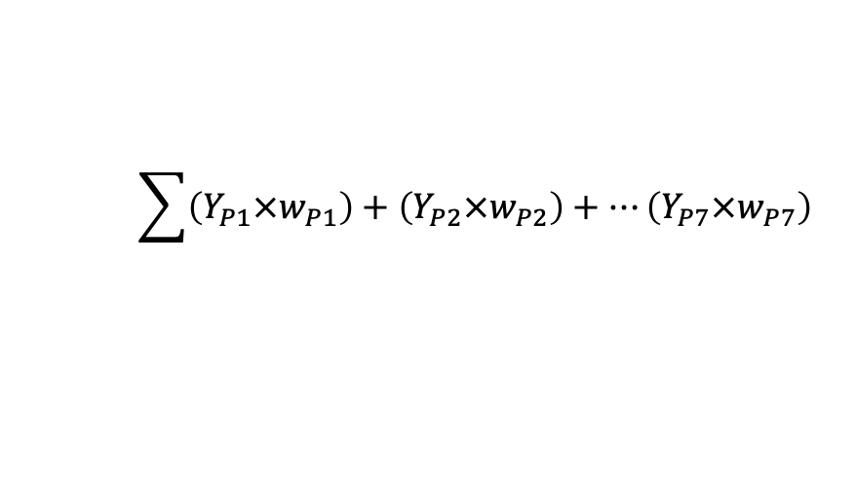
Physicochem Properties Distinguish Successful vs Nonpermeable Tracers
Validate
Bump Functions and Formulae for Conversion of Parameter Values to a Weighted Score
Property (Px) | Weight (w) | More Desirable Y=1 | Less Desirable 0≤Y≤1 | Undesirable Y=0
ClogP | 1 | 2.4≤Px≤3.0 | 1.25≤Px≤2.4 3.0≤ Px≤ 4.25 | Px≤1.25 4.25≤Px
ClogD | 1 | 1.92≤Px≤2.56 | 1.75≤Px≤1.92 2.56≤ Px≤ 4.25 | Px≤1.75 4.25≤Px
tPSA | 1 | 42.78≤ Px≤51.22 | 22.6≤ Px≤ 42.7851.22≤ Px≤ 62.5 | Px≤22.6 62.5≤Px
MW | 1 | Px ≤ 475 | N/A | 475<Px
pKa | 0.33 | 7.63≤ Px≤9.95 | 5≤ Px≤ 7.63 9.95≤ Px≤ 11 | Px≤5 62.5≤11
wHBD | 0.33 | Px ≤ 2.2 | N/A | 2.2<Px
Charge | 0.33 | Px = 0 0.75≤Px | 0 < Px < 0.75 | Px<0
2.40
3.00
1
51%
60%
40%
Score
1.25
4.25
0
ClogP
$$\sum{\left(Y_{P1}×w_{P1}\right)+\left(Y_{P2}×w_{P2}\right)+…\left(Y_{P7}×w_{P7}\right)}$$
16
Jackson et. al, Manuscript in Preparation, 2024
Notes:
Functions to capture positives but not negatives
Bump functions to quantify the degree to which a variable, in this case a given parameter, aligned with the property distribution of successful tracers as described bt
Applied scoring tool to 140 known PET tracers and assessed ability to separate successful from unsuccessful tracers.
Functions for 7 of the calculated physicochemical properties
Summed, weighted overall scoring function gave a score from 0-5.
Assessed this scoring function, alongside ML (relative pros and cons)

Slide 17
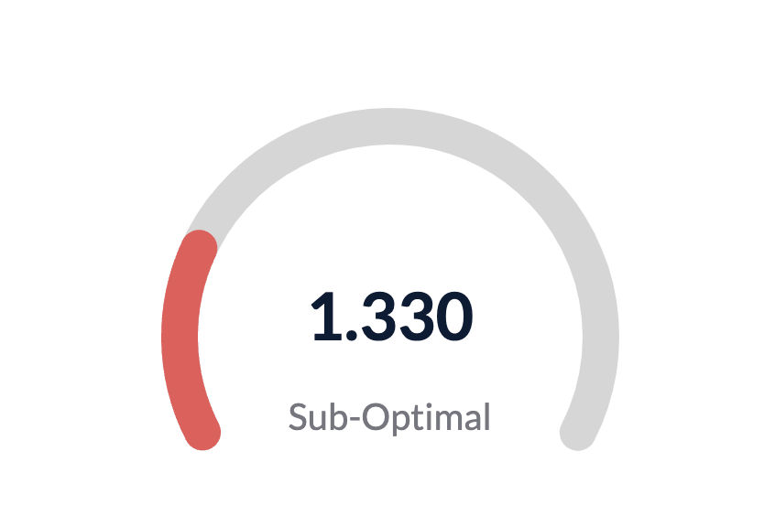
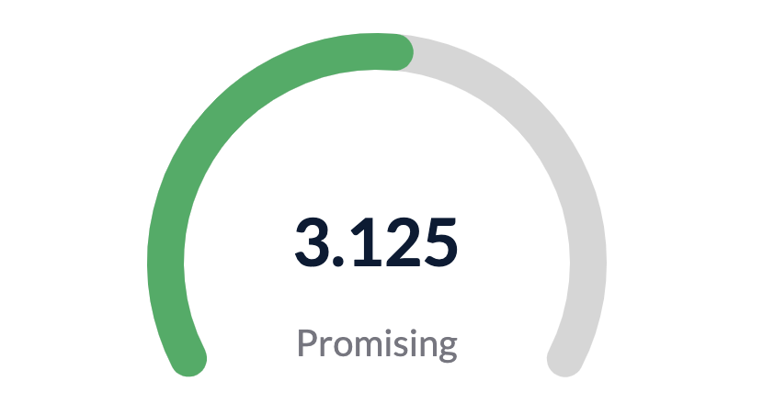
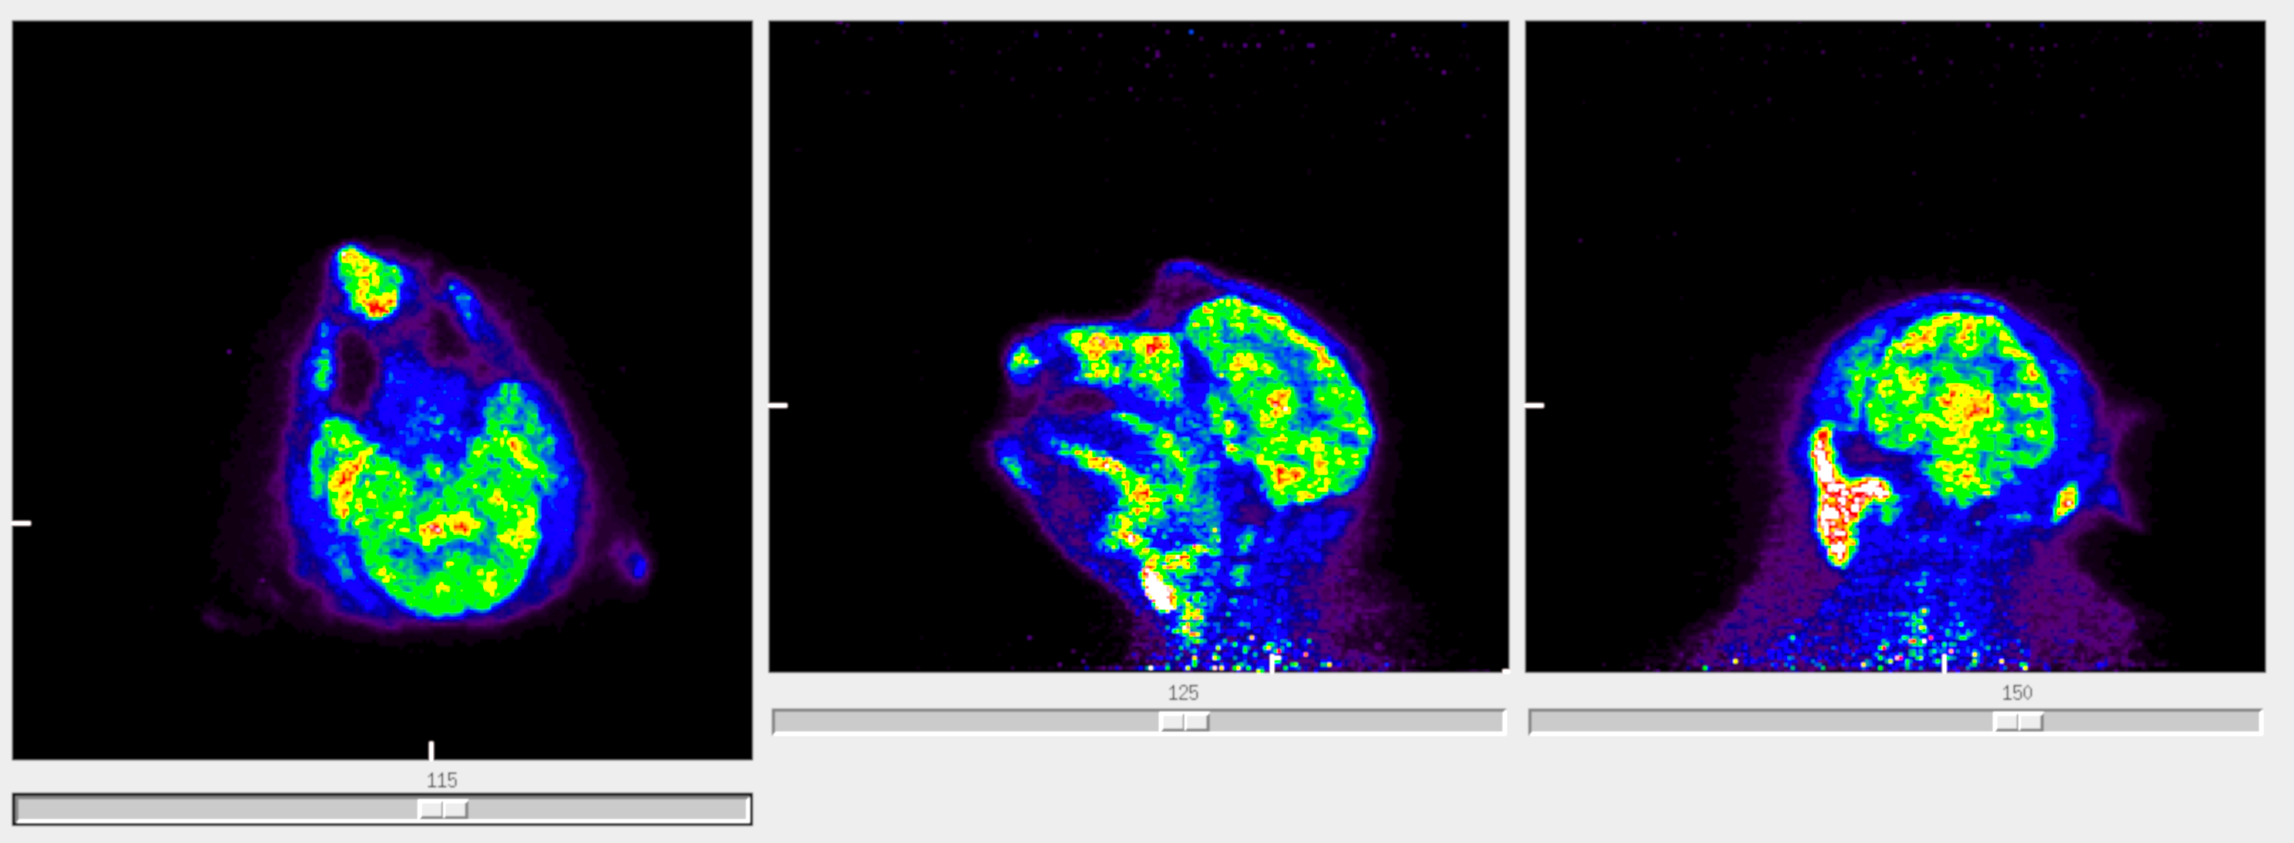
Second Generation Radiotracer
[¹¹C]GLPG38
Radiotracer
Our CNS POP Algorithm
Rhesus Imaging Results
Overall
Score
healthy adult rhesus
1.2
Property | Calculated Value | Unweighted Score
ClogP | 1.020
ClogD | 1.491
tPSA | 129.93
MW | 470.54
pKa | 1.920
wHBD | 0.040
Charge | -.9996
First
Generation Radiotracer
[¹¹C]AZD1283
0.000
SUV
0.000
0.6
0.000
1.000
0.000
1.000
0.000
0
Overall
Score
1.2
healthy adult rhesus
Property | Calculated Value | Unweighted Score
ClogP | 2.398
ClogD | 1.686
tPSA | 57.230
MW | 371.43
pKa | 0
wHBD | 0
Charge | 0
0.998
SUV
0.000
0.6
0.467
1.000
0.000
1.000
1.000
0
Jackson et. al, Manuscript in Preparation, 2023
Notes:
Hindsight is 20/20 say the words!!!!

Slide 18
Machine Learning for Radiochemistry
Methodology Development
Complex Drug Application
Disconnect
The disconnect between application and method requires a great deal of time and resources
Webb EW, Scott PJH, PET Clinics, 2021; Jackson et al., ACS Chem Neurosci, 2022

Slide 19
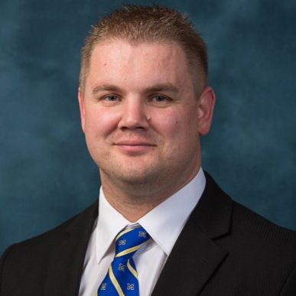
Machine Learning for Radiochemistry
Methodology Development
Ask Peter
Complex Drug Application
AI and ML can bridge the gap between method development and application
Webb EW, Scott PJH, PET Clinics, 2021; Jackson et al., ACS Chem Neurosci, 2022
Notes:
Make sure to fix characteristic #4 in Methodology development

Slide 20
Machine Learning for Radiochemistry
Methodology Development
AI and ML
Complex Drug Application
AI and ML can bridge the gap between method development and application
Webb EW, Scott PJH, PET Clinics, 2021; Jackson et al., ACS Chem Neurosci, 2022
Notes:
Make sure to fix characteristic #4 in Methodology development

Slide 21
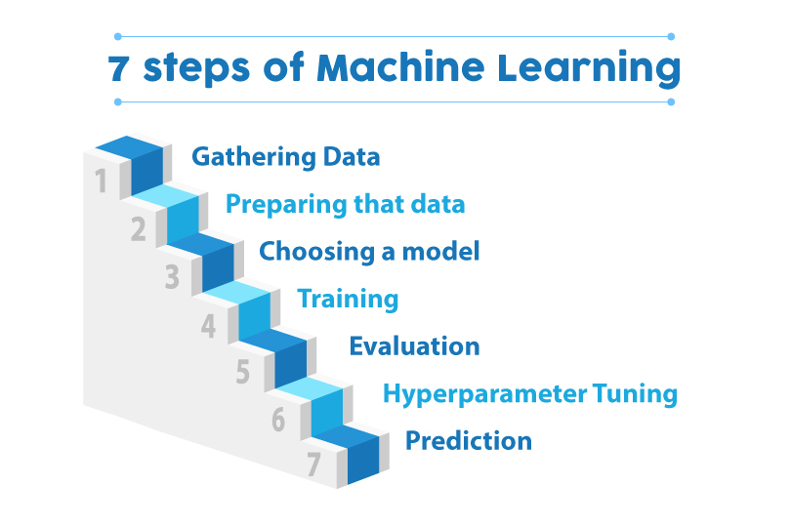
What the hell is machine learning anyway?!

Slide 22
Workflow for Preliminary ML
Webb EW, Scott PJH, PET Clinics, 2021.

Slide 23
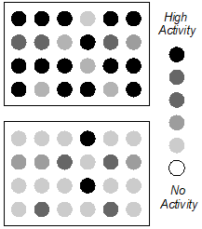
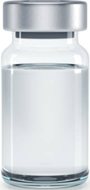

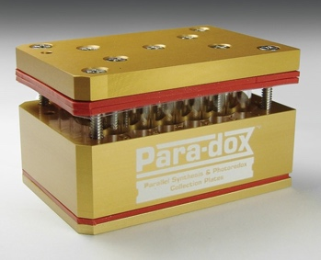
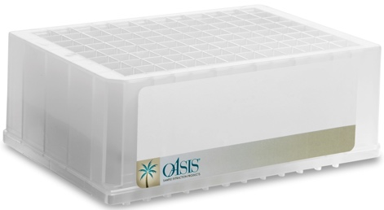
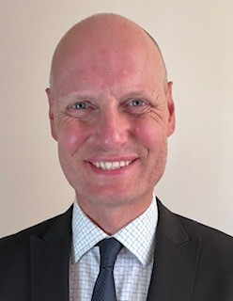
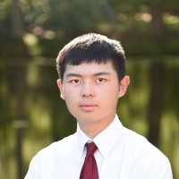
Going forward, how do we rapidly gather big data to populate Machine Learning algorithms? HTE for Radiochemistry enables Parallel Reactions
Innovative techniques for HTE radiochemistry have been pioneered by the van Dam group^{1,2} and others³ but, to date, tend to rely heavily on custom-built apparatus for both synthesis and analysis. No general radiochemistry HTE available.
This work describes parallel radiochemistry techniques using commercially available HTE platforms.
Analysis
(Gamma counter / PET scanner)
Use analytical techniques with high sensitivity and fast analysis time to enable high throughput
High Throughput Radiosynthesis Workflow
Aqueous soluble activity
Arrays for 24 or 96 reactions
Solid Phase Extraction
Azeotropically dried
and resolubilized
[¹⁸F]F⁻
8x30mm vial (1 mL)
Reaction scale < 1 mL (1 – 10 μmol)
Separation of inorganic and organic radioactivity
(multi-well SepPak)
Stefan
Verhoog
Eric
Webb
Kevin
Cheng
Organic soluble activity
Parallel reactions in 24- or 96 well format have the potential to significantly accelerate radiotracer development and aid exploration of radiochemical space
Webb et al. JACS, 2024

Slide 24
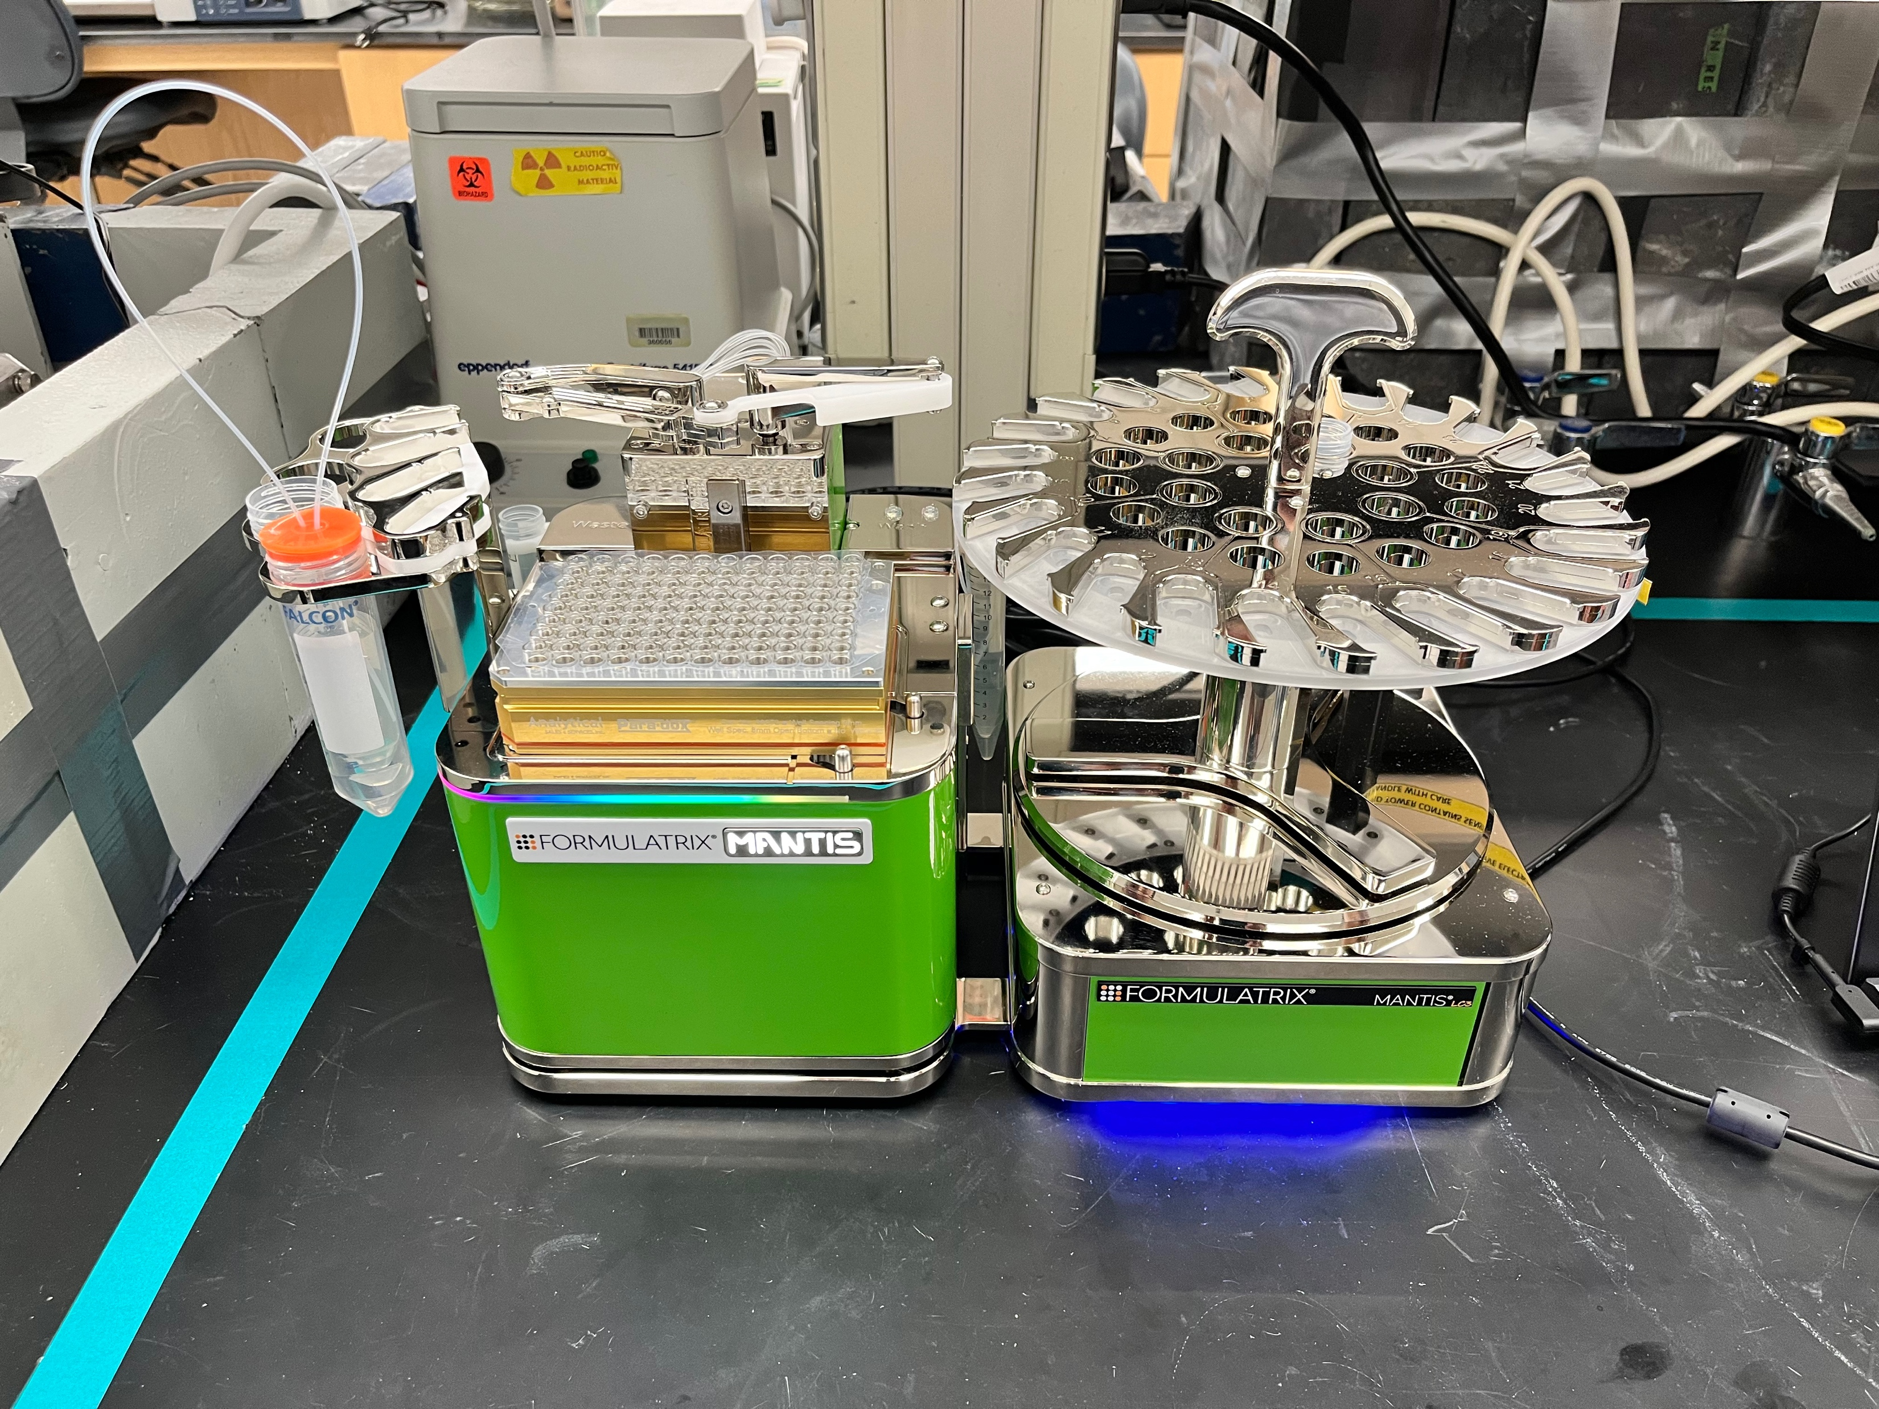
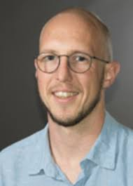
Use Design of Experiments (DoE) to determine reaction conditions that maximize ROI when screening new substrate sets
DoE can be used to select an optimal set of experiments to acquire reaction data efficiently!
Dispensing of DoE plates can be automated to avoid pipetting 96 well plates. Results from one plate feed forward into the design of the next plate to rapidly optimize conditions.
Identify Substrates of
Interest
Build DoE Studies: Map Reaction Space For Interesting Molecules
Learn From Resulting Response
Surface Models
Greg Bowden
Bowden et al. Org. Biomol. Chem. (2021)

Slide 25
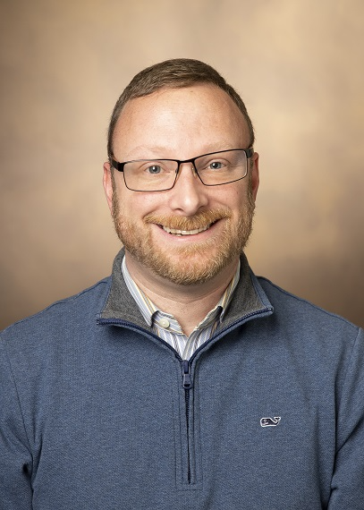
[¹⁸F]Crizotinib: The Perfect Challenge for HTE with DoE
Challenging radiosynthesis (1 reaction had worked in ~6 months)
Adam had a low amount of precious precursor left (58 µmol)
Goals:
  Find conditions that work
  Validate
  Automate
  Tech transfer to Vanderbilt for production.
Adam Rosenberg
Bowden et al., SNMMI 2024 Abstract
Notes:
This is an amazing capability, but how do we leverage it to its full extent? How to choose the

Slide 26
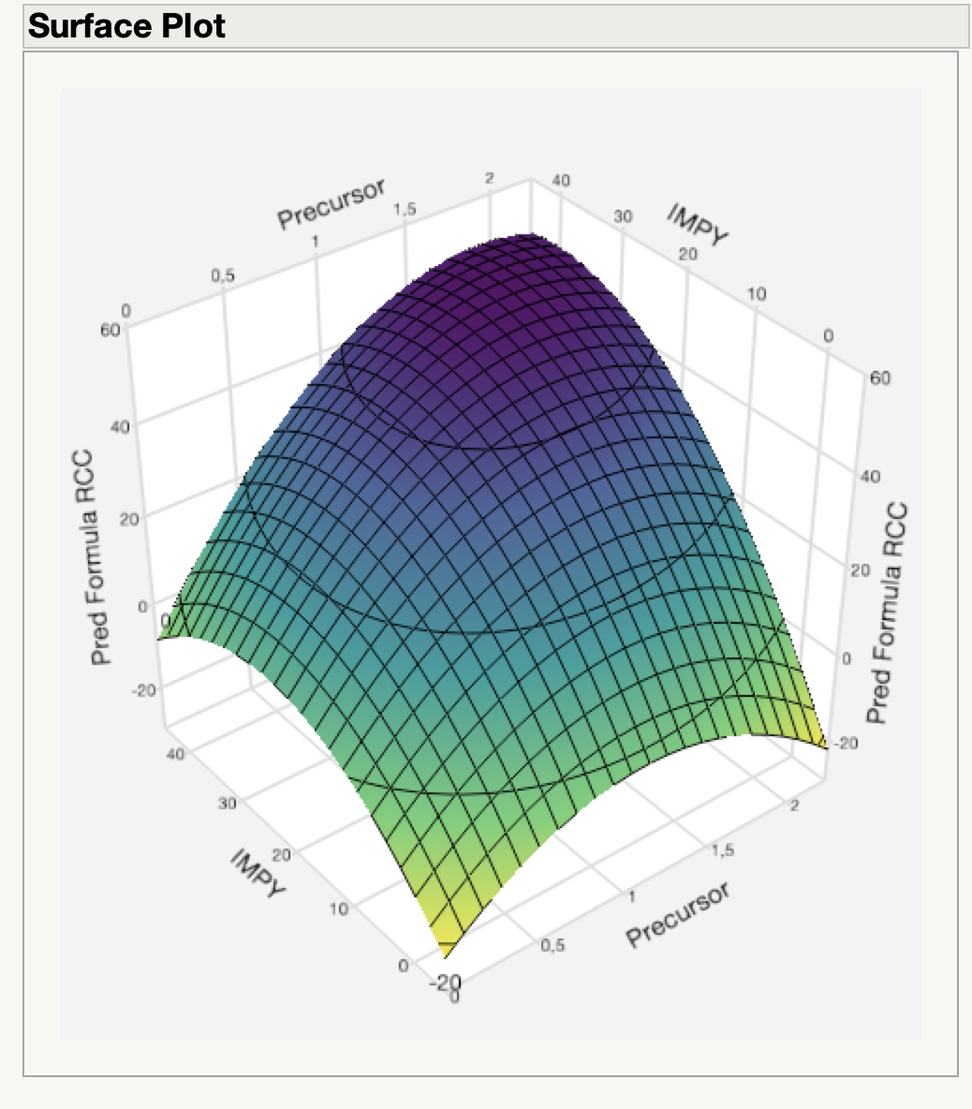
[¹⁸F]Crizotinib: The Perfect Challenge for HTE with DoE
Validation “Full-scale” (manual):
Optimal Conditions:
Predicted: 55 %RCC
Observed: 57 %RCC
“Low Precursor” Conditions:
Predicted: 36 %RCC
Observed: 39 %RCC
Conditions for DoE optimization
Precursor Loading (Minimization)
Copper Loading
IMPY Loading
n-BuOH co-solvent?
Reaction Conditions:
DMI, 120 °C, 20 min
DoE Designed as a “custom” Design (D-Optimal) in JMP
Bowden et al., SNMMI 2024 Annual Meeting
Notes:
This is an amazing capability, but how do we leverage it to its full extent? How to choose the

Slide 27
[¹⁸F]Crizotinib: Automation and Tech Transfer
¹⁸F Processing
QMA plus light (46 mg) (Conditions: 10 ml KOTf 0.5 M)
Vial 1: TBAOTf (10 mg in 1.5 ml MeOH)
Dry down at 100 °C for 5 min
Addition of reagents and reaction:
Vial 3: Cu(OTf)₂ (28 µmol, 14 mg), IMPY (175 µmol, 21 mg), DMI (240 µl), n-BuOH (60 µl)
Vial 2: BPin-Boc-Criz (6.9 mg, 16 µmol) pulled through with a vacuum to pull air into the reactor.
Reaction run at 120 ℃, 20 min.
Vial 4: HCl 3M 250 µl
Reaction run at 120 ℃, 10 min.
Quench and HLB clean up (pre HPLC)
Vial 5: Ammonium Acetate (25 mM, 10 ml)
HLB SPE Trapping: (Will also work for re-formulation).
Vial 6: MeCN 3 ml
• 27 mCi from a 5 min Beam (AY approx = 15%) – tech transferred back to Vanderbilt and validated there too!
• Reduced optimization workflow from several months to just a couple of days!!!!!
Notes:
This is an amazing capability, but how do we leverage it to its full extent? How to choose the

Slide 28
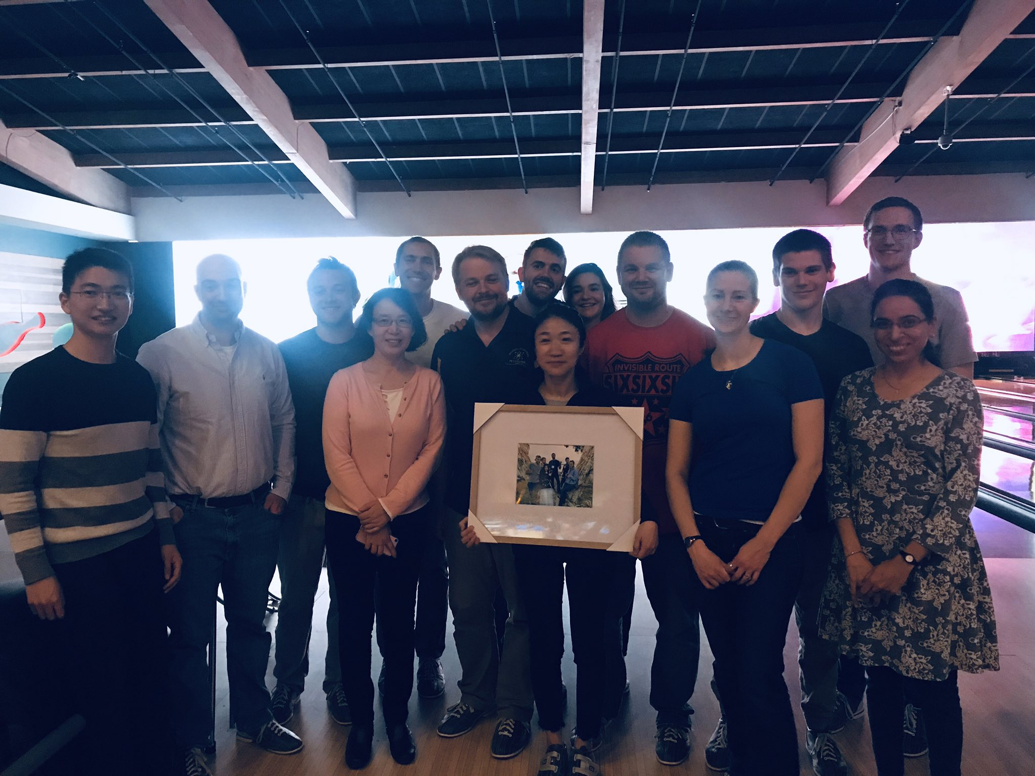



Acknowledgments
Post-doctoral Fellows
Raphael Hoareau, Ph.D.
Ryan Littich, Ph.D.
Melissa Rodnick, Ph.D.
Allen Brooks, Ph.D.
Kuhn-Sam Jang, Ph.D.
Erin Cole, Ph.D.
Andrew Mossine, Ph.D.
So-Jeong Lee, Ph.D.
Matthew McCammant, Ph.D.
Stephen Thompson, Ph.D.
Stefan Verhoog, Ph.D.
Ryan Pakula, Ph.D*
Tanpreet Kaur, Ph.D
Eric Webb, Ph.D*
Jay Wright, Ph.D*
Jason Witek, Ph.D*
Josh Priest, Ph.D*
Greg Bowden, Ph.D*
Staff
Phillip Sherman
Jenelle Stauff*
Janna Arteaga
Carole Quesada
Louis Tluczek
Surekha Patel*
Brian Hockley*
Charlie Schneider*
Brad Henderson*
Timothy Desmond*
Mara Clark*
Alexandra Sowa Dumond, Ph.D*
Melissa Rodnick, Ph.D
Laura Bruton
Sean Preshlock, Ph.D (RIP)
Tanpreet Kaur, Ph.D*
Wade Winton*
Luke Morrissette*
Elena Della Valle, Ph.D
Undergraduates
Daniel Mason
Garrett Carpenter
Adam Runkle
Merissa Zeman
Adam Ziolkowski
Stacy Monk
Andrew Glatz
Renee Veresh
Joseph Casamento
Brian Cary
Isaac Jackson
Dale Mallette
Anthony Mufarreh
Austin Zhao
Jonathan Pham
Wade Winton
Nicholas Wiesner
Alex Lapsys
Hailey Gross
Richard Ma*
Kevin Cheng*
Katie Liddell*
Wendy Liu*
Dre Hubers*
Graduate Students
Megan Stewart
Alexandra Sowa
Lindsey Drake
Jason Miller
Sean Tanzey
Jonathan Godinez
Ivan Wang*
Madison Frazier*
Gina Kaup*
Casey McCarthy*
Helen SaTsu*
Faculty
Xia Shao, Ph.D.*
Allen Brooks, Ph.D.*
Yong-Woon Jung, Ph.D.
Collaborators
Prof. Melanie Sanford (UM)
Dr. Katarina Makaravage (UM)
Dr. Naoko Ichiishi (UM)
Dr. Liam Sharninghausen (UM)
Dr. Joseph Topcsewski (UM)
Prof. Ralf Schirrmacher (Alberta)
Dr. Shane Krska (Merck)
Dr. Eric Hostetler (Merck)
Dr. Wenping Li (Merck)
Dr. David Donnelly (BMS)
Dr. Marc Skaddan (AbbVie)
Dr. Tony Giamis (AbbVie)
Prof. Michelle James (Stanford)
Prof. Neil Vasdev (Toronto/CAMH)
Dr. Katie Gagnon (GE)
Dr. Chris Parr (GE)
Dr. Jens Frigell
Dr. Carina Sollert (GE)
Brian Prejna (GE)
Joanna Suan (GE)
* = current group member
Valuable Assistance
University of Heidelberg (⁶⁸Ga PSMA-11 regulatory), MSKCC, BNL (Ac225 advice), ToD (motivation)
Funding
NIH, DOE, Alzheimer’s Association, Merck,
AbbVie, RJS, BMS, Corvus, Weston Brain Institute
@Scott_LabUM

