Slide 1

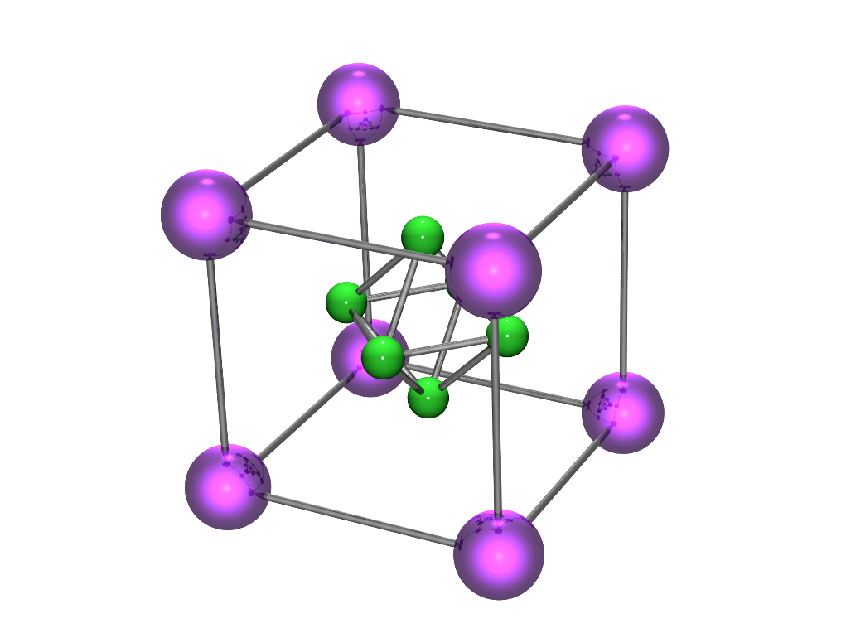
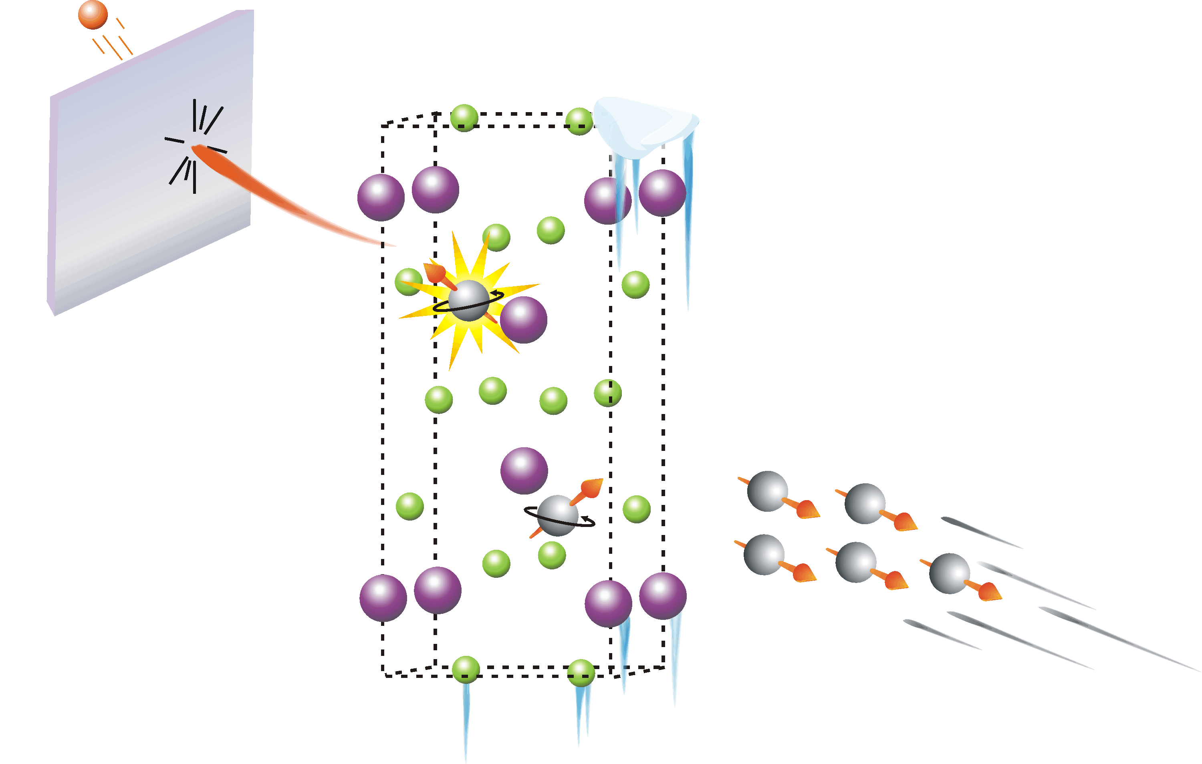
μSR studies of rare candidate spin-triplet superconductors wanted for spintronics and quantum computing applications
Jeff Sonier

Slide 2
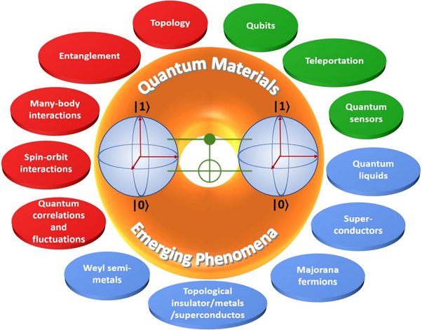
Quantum Materials
Materials that do not behave according to the laws of classical physics
Will serve as the platform for the operation of quantum technology and quantum computation, akin to the role of semiconductors in today’s computers and electronic devices
Rao, Bhallamudi & Hammel, J. Phys. D: Applied Physics

Slide 3
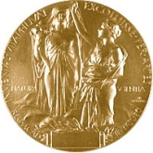
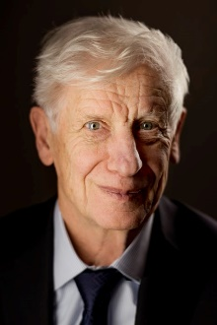
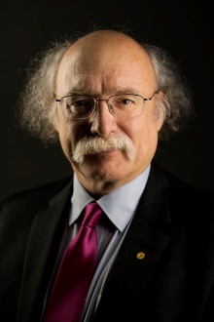
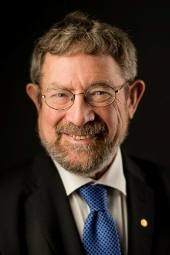
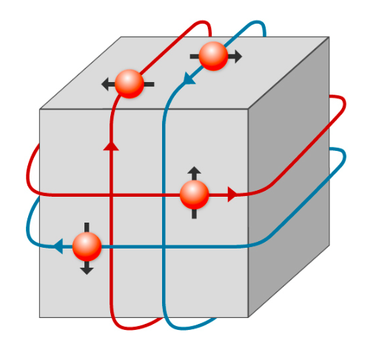
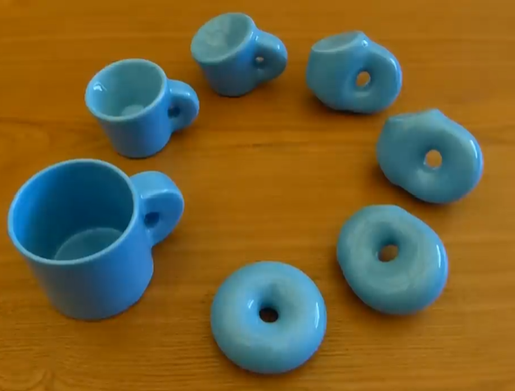
Topological Materials
The Nobel Prize in Physics 2016
A major development of quantum materials has been the discovery of topological materials. This field has exploded and now includes materials that host massless helical Dirac fermions, Weyl fermions, axions, and Majorana fermions.
David J.
Thouless
F. Duncan M. Haldane
J. Michael Kosterlitz
e.g., Topological insulator
"for theoretical discoveries of topological phase transitions and topological phases of matter."
Paul Scherrer Institute/Mahir Dzambegovic

Slide 4
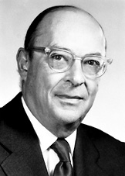
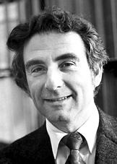
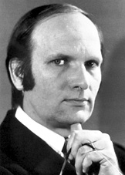
BCS Theory of Superconductivity
Nobel Prize in Physics 1972
General idea - Electrons pair up (“Cooper pairs”) and form a coherent quantum state, making it impossible to deflect the motion of one pair without involving all the others.
J. Bardeen L.N. Cooper J.R. Schrieffer
Zero resistance and the Meissner effect require that the Cooper pairs share the same phase ⇒ “quantum phase coherence”
The superconducting state is characterized by a complex macroscopic wave function (order parameter):
Amplitude
Phase

Slide 5
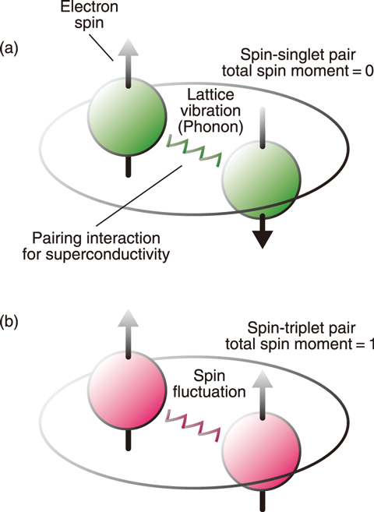
Two kinds of superconducting electron pairs
Y. Tokunaga et al., JPSJ 88, 073701 (2019)

Slide 6
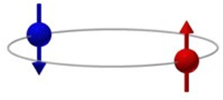
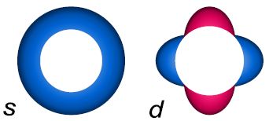
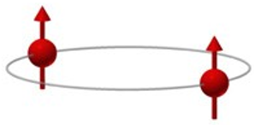
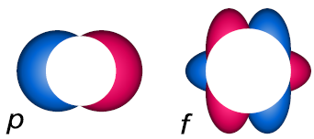
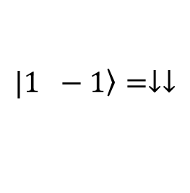

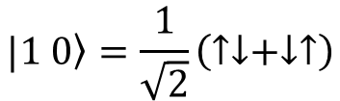
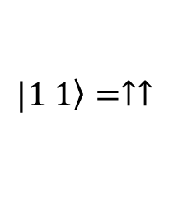
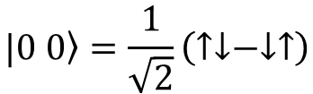


The pair wavefunction:
$$Ψ_{k}=Φ\left(k\right)χ_{αβ}$$
orbital
spin
$$\left.|0 0\right\rangle =\frac{1}{\sqrt{2}}\left(↑↓−↓↑\right)$$
Singlet state (S = 0)
$$Φ\left(−k\right)=Φ\left(k\right)$$
Even Parity (L = 0, L = 2, …)
$$\left.|1 1\right\rangle =↑↑$$
$$\left.|1 0\right\rangle =\frac{1}{\sqrt{2}}\left(↑↓+↓↑\right)$$
Triplet states (S =1)
$$\left.|1 −1\right\rangle =↓↓$$
$$Φ\left(−k\right)=−Φ\left(k\right)$$
Odd Parity (L = 1, L = 3, …)

Slide 7

… but candidate spin-triplet superconductors are extremely rare.
Credit: N. Hanacek/NIST

Slide 8
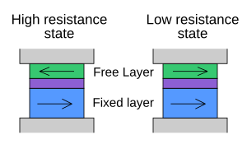
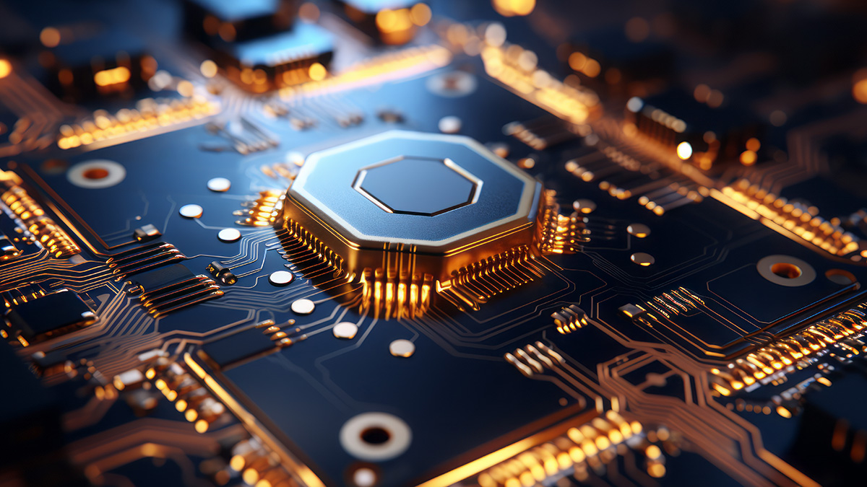
Spintronics = Spin + Electronics
Rapidly growing multidisciplinary field that utilizes the spin, rather than just the charge of electrons for electronic devices.
Enhanced functionality
Higher speed
Reduced size
Lower power consumption
e.g., Spin valves used in magnetic sensors, magnetic hard disk read heads and magnetic random-access memories (MRAM).
How MRAM enables secure data capture in IIoT systems (iotinsider.com)
Exploitation of spintronic technology requires the development of new functional materials, facilitated by theoretical and experimental realization of new materials and the discovery of various physical phenomena.

Slide 9
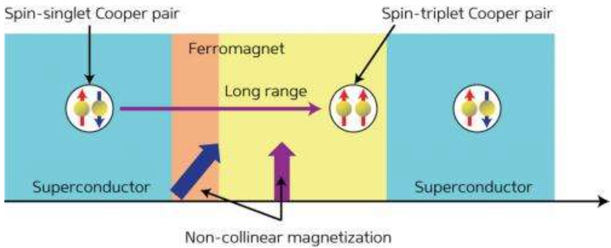
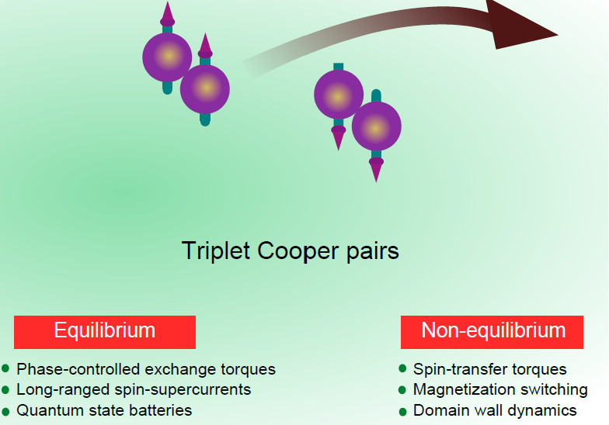
Superconducting Spintronics
- characterized by a non-dissipative spin current
Engineered Devices
New Materials
Proximity-induced spin-triplet supercurrents at SC/FM interfaces
Spin-triplet (odd-parity) superconductors
naturally possess what is needed
J. Linder & J. W. A. Robinson, Nat. Phys. 11, 307 (2015)

Slide 10
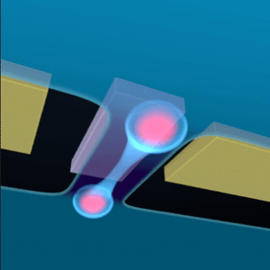
Quantum Computing
In condensed matter physics, Majorana fermions emerge as zero-energy quasi-particles, i.e., Majorana zero modes (MZMs), at topological defects, where they possess non-abelian exchange statistics (non-abelian braiding).
Due to their nonlocal character, MZMs may be used to make a quantum computer with robust quantum bits (qubits), eliminating the noise-induced decoherence problem.
Engineered Devices
New Materials
p-wave chiral superconductor (with spin-selective point nodes) can naturally harbour MZMs
Materials for Majorana-based Topological Qubits - TQT (uwaterloo.ca)

Slide 11
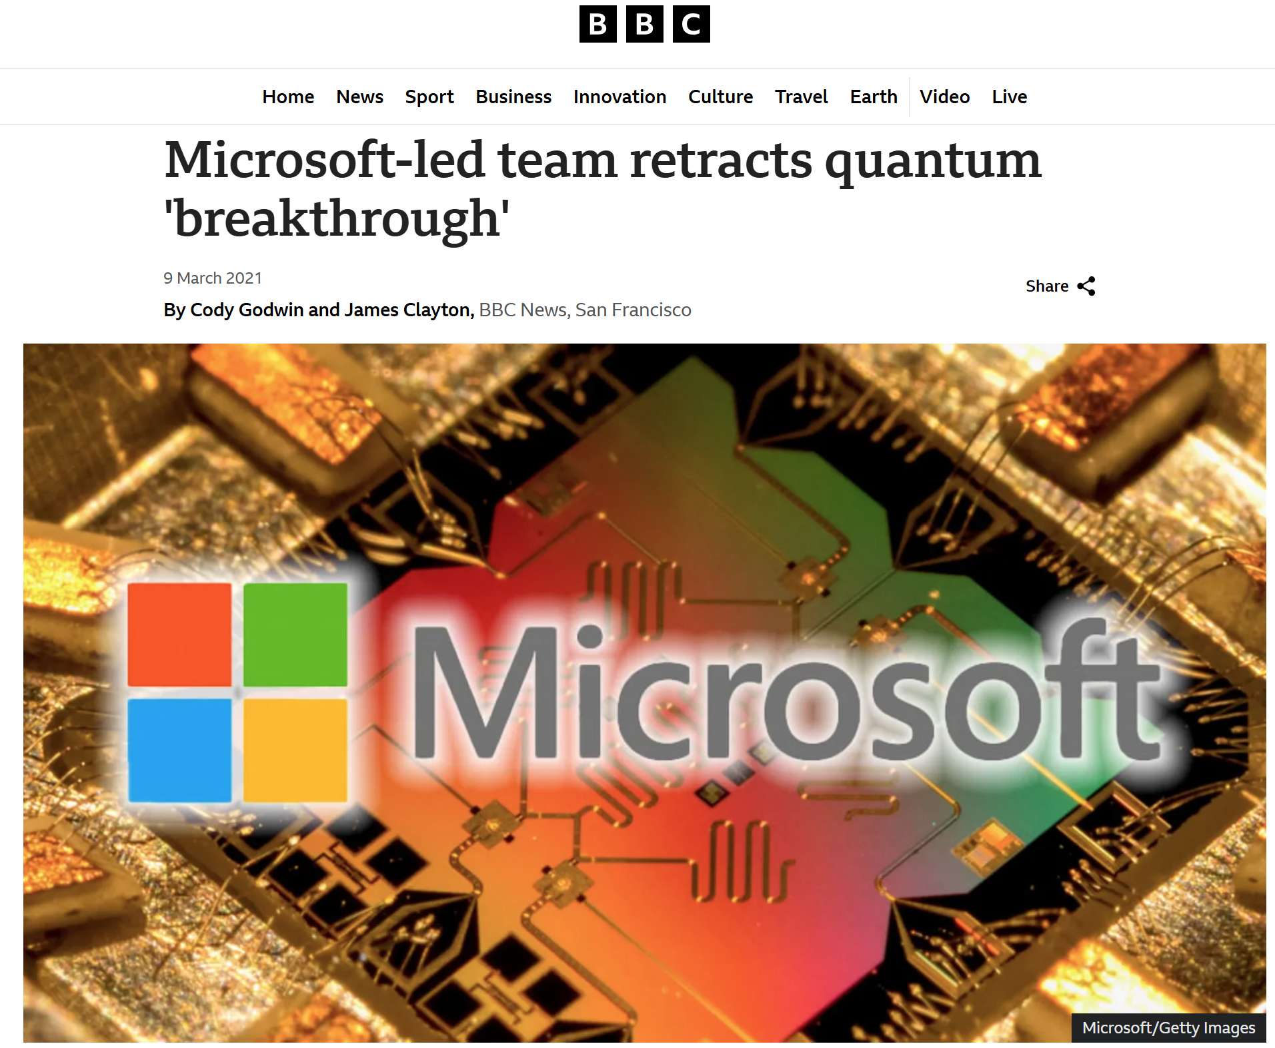
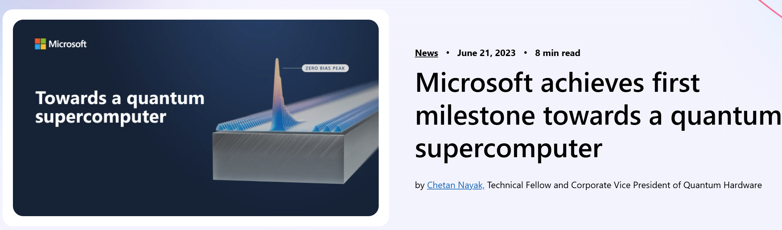

Slide 12
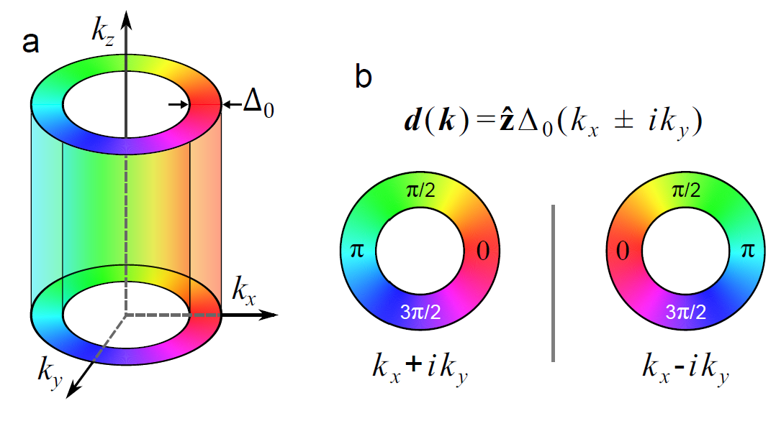
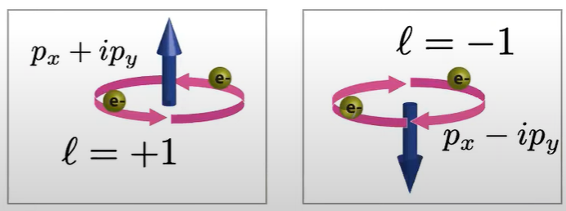

Chiral Superconductors
Exhibit Cooper pairing carrying a finite orbital angular momentum due to the phase winding of a two-component order parameter with a relative phase that breaks time-reversal symmetry.
$$∝e^{iθ_{k}}$$
K. Lahabi, Doctoral Thesis (2018)

Slide 13
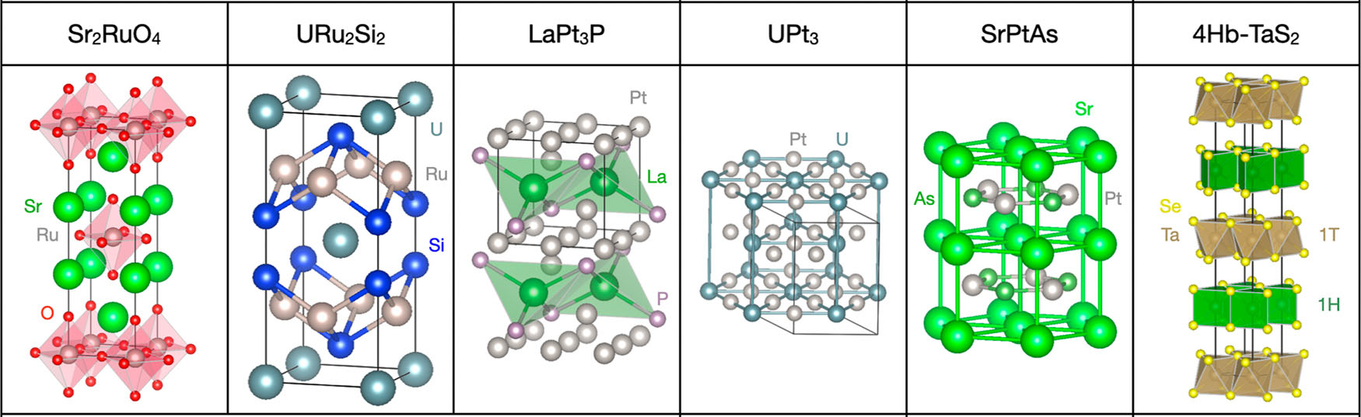
Chiral Superconductors
Chiral superconductivity is a topologically non-trivial state which supports distinctive topological modes at surfaces and defects.
Materials proposed to host chiral superconductivity based on direct experimental evidence of TRSB – A. Ramires, Contemporary Physics 63, 71 (2022)
p + ip d + id d + id f + if d + id ? + i?

Slide 14
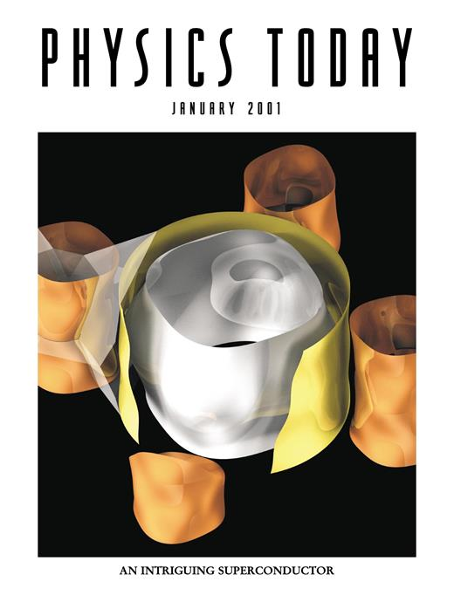
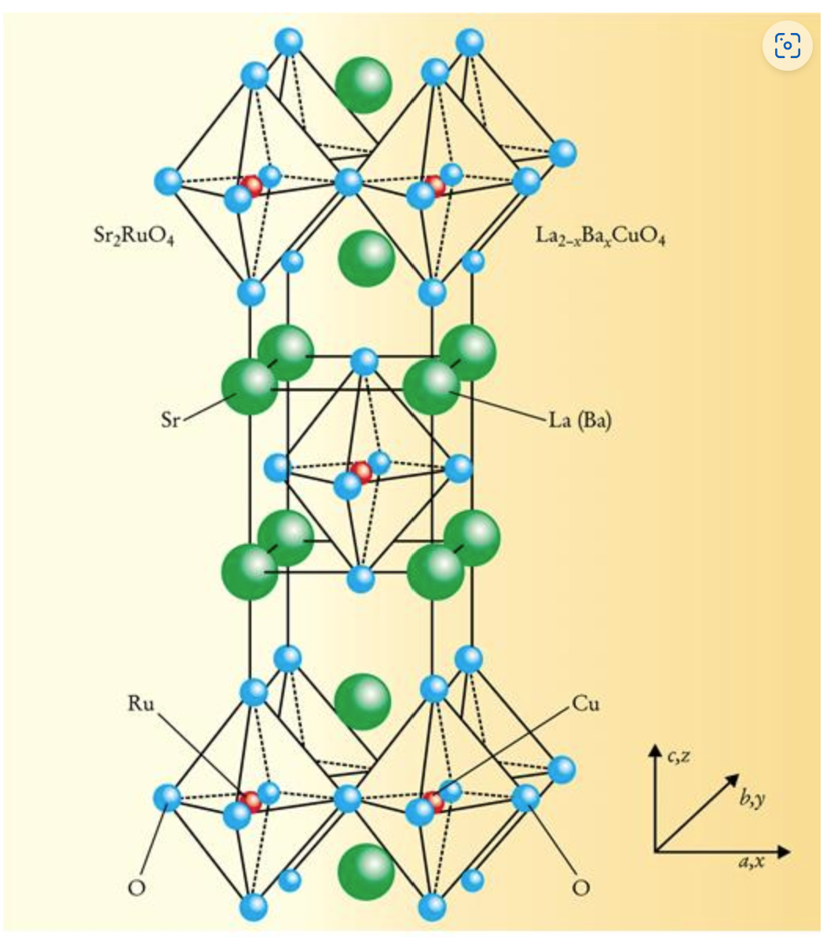
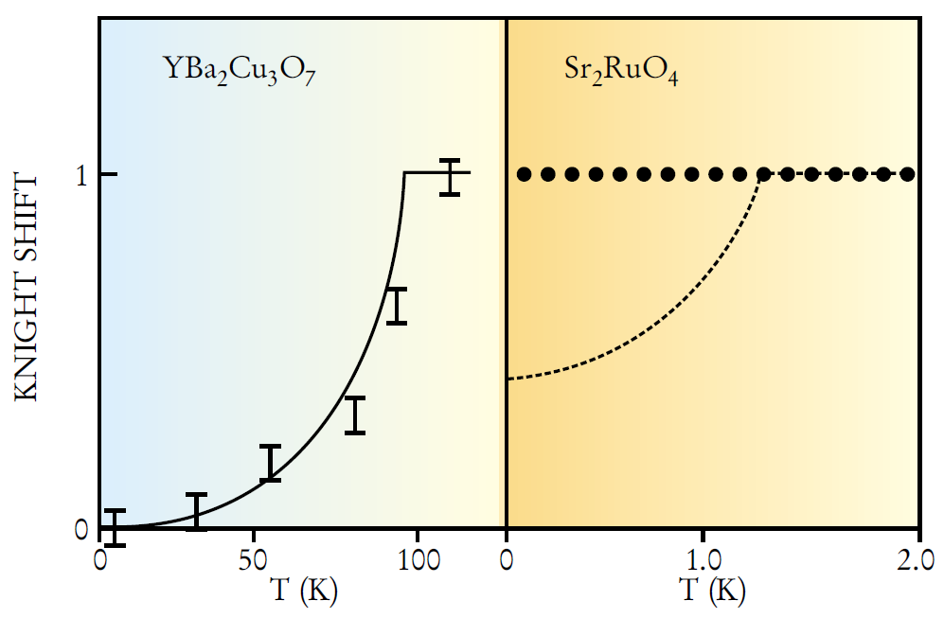
Sr₂RuO₄
Superconductivity discovered below T_{c} = 0.93 K in 1994.
Y. Maeno et al., Nature 372, 532-534 (1994) ~ 3,000 citations
For the past 26 years Sr₂RuO₄ has widely been considered to be a long sought odd-parity, spin-triplet superconductor.
K. Ishida et al., Nature 396, 658 (1998)
Y. Maeno, T.M. Rice & M. Sigrist, Physics Today 54, 42 (2001)

Slide 15
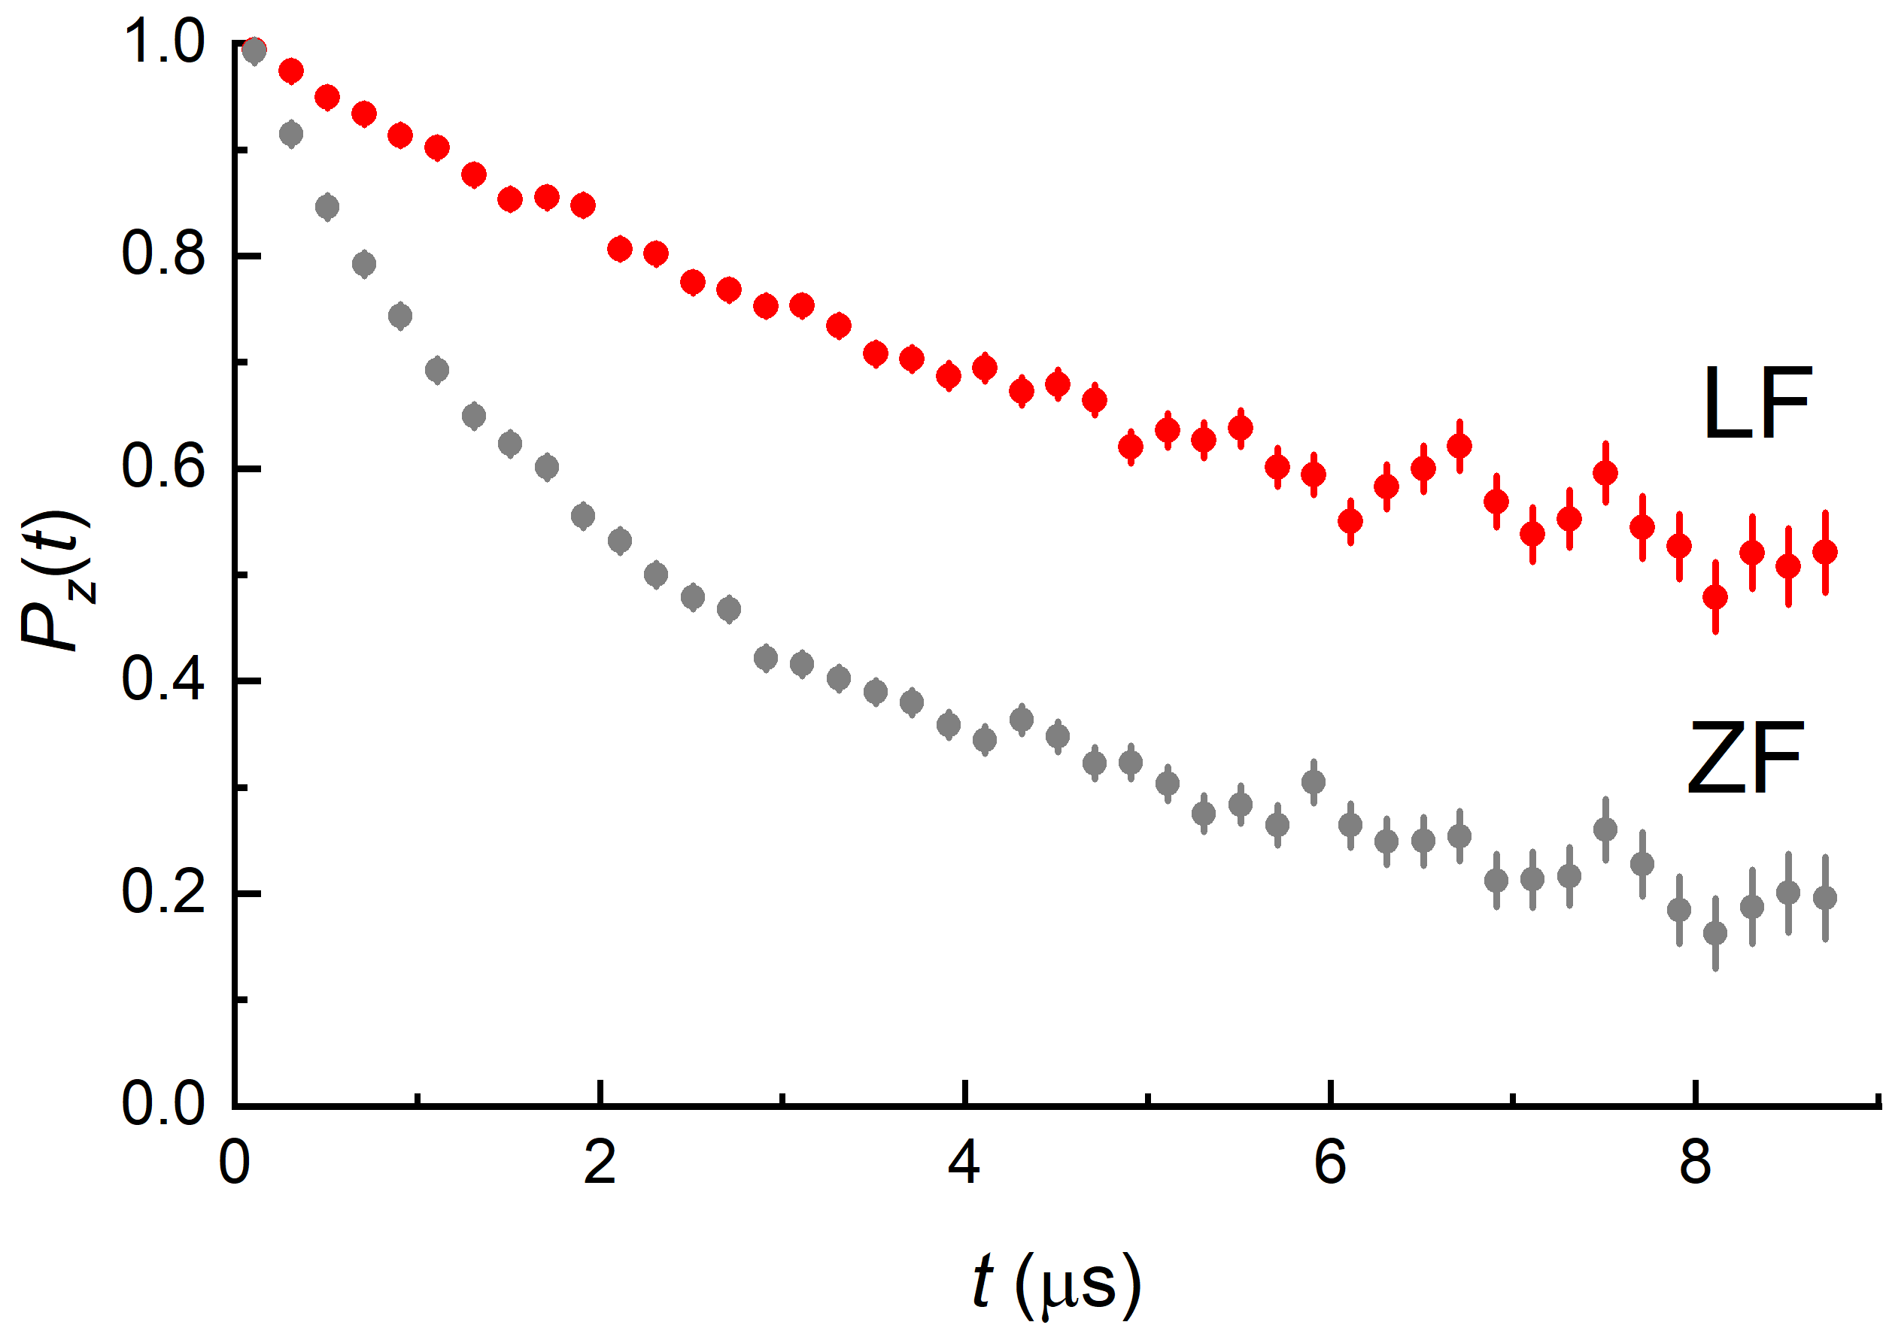
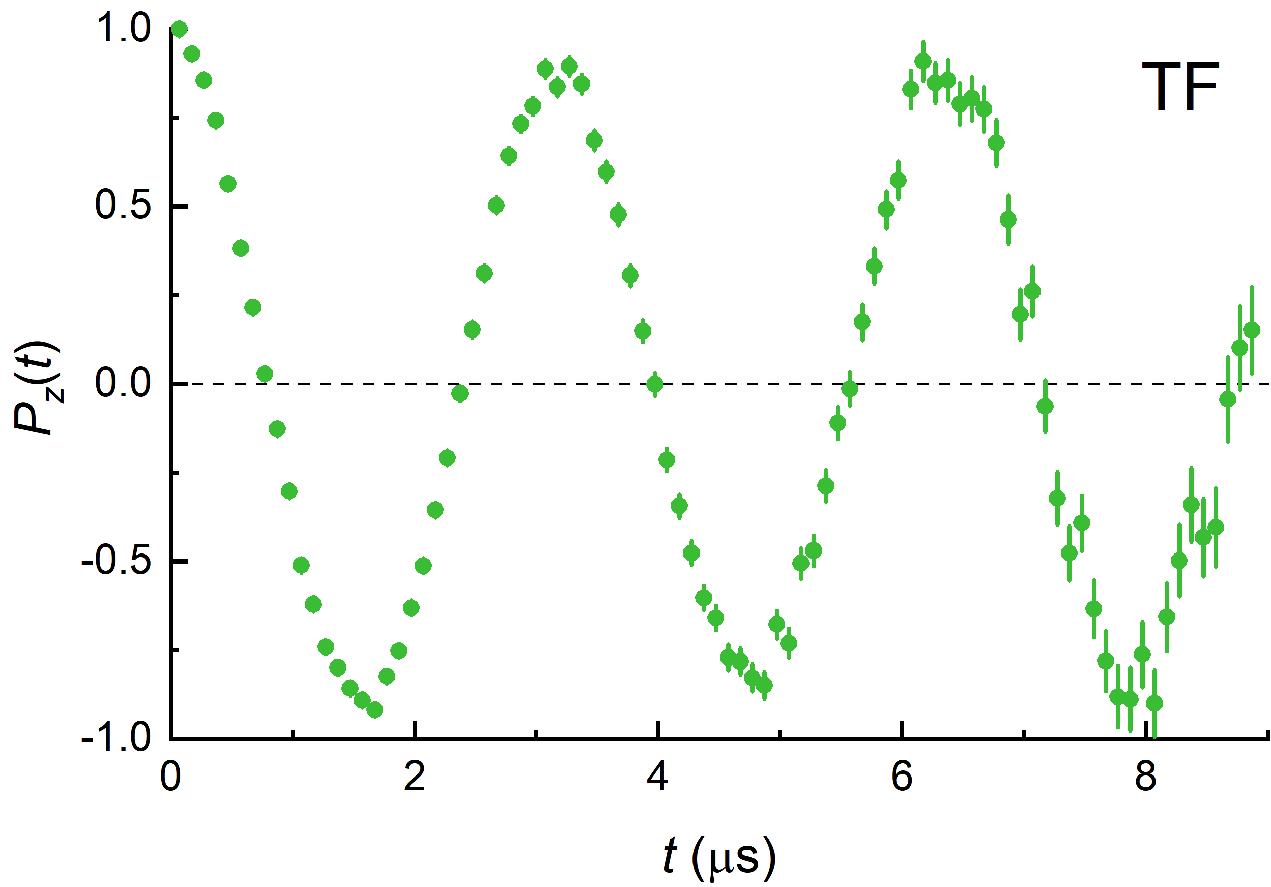
Muon Spin Relaxation/Rotation (μSR)
pure local magnetic probe
integrates over all q space (loss of information)
measures at ω → 0 (i.e., sensitive to slow correlated/uncorrelated spin fluctuations)
H_{LF}
H_{TF}
“Zero field (ZF)” H = 0
“Longitudinal field (LF)” H_{LF} || P(0)
“Transverse field (TF)” H_{TF} ⊥ P(0)

Slide 16
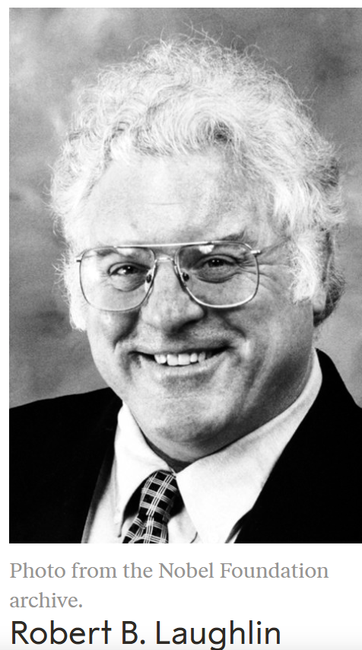
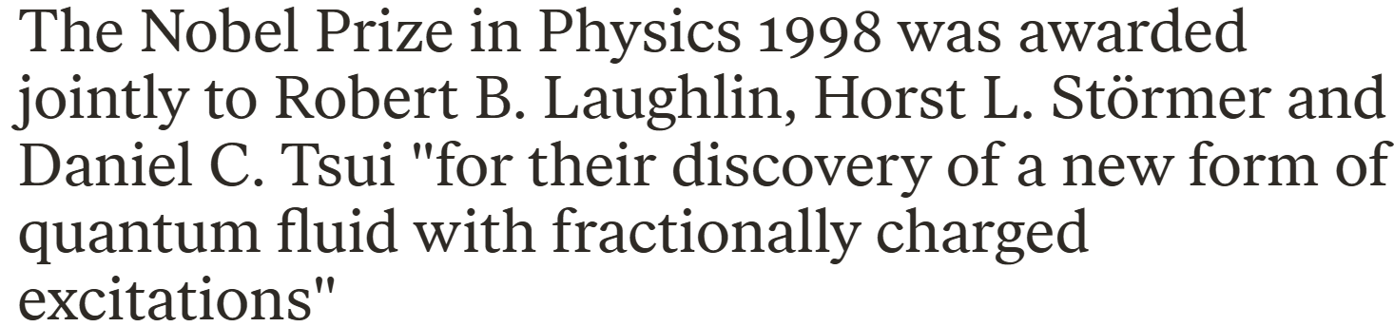

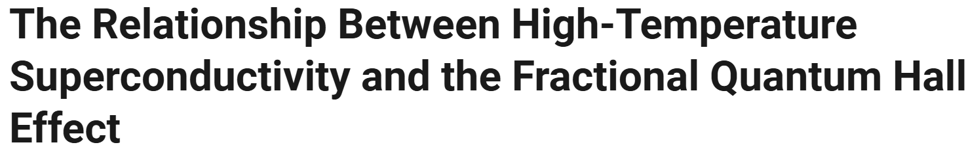
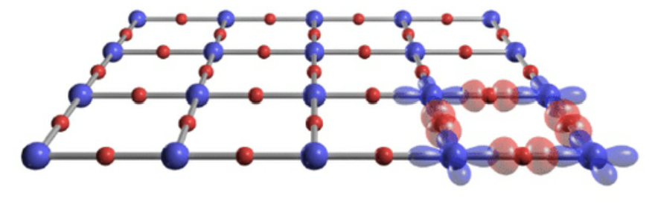
R.B. Laughlin
Science 242, 525-533 (1988)
Proposed that anyons may provide the mechanism for high-temperature cuprate superconductivity.

Slide 17
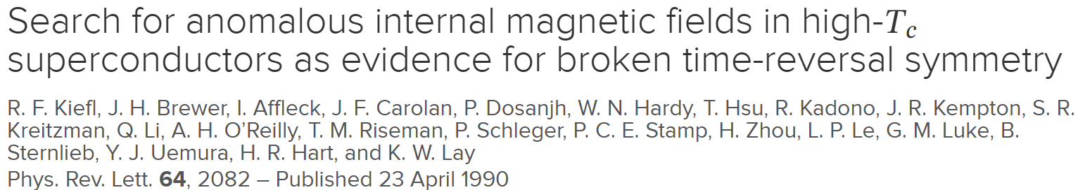
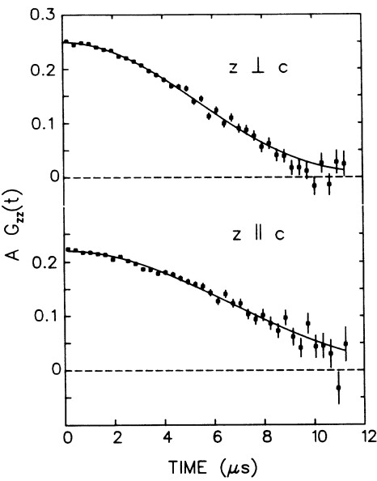
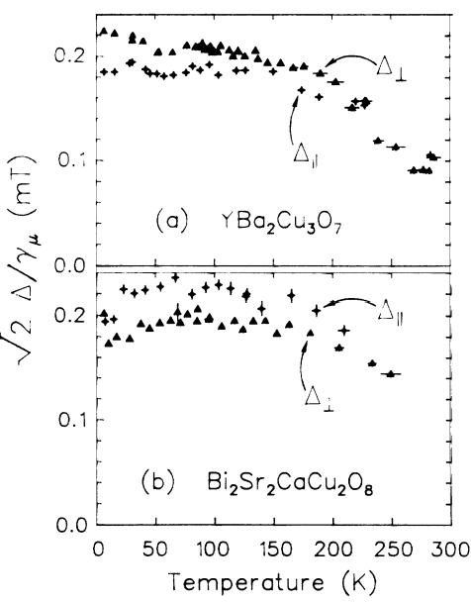
No observed increase in the ZF-μSR relaxation rate below T_{c} ~ 90 K.

Slide 18

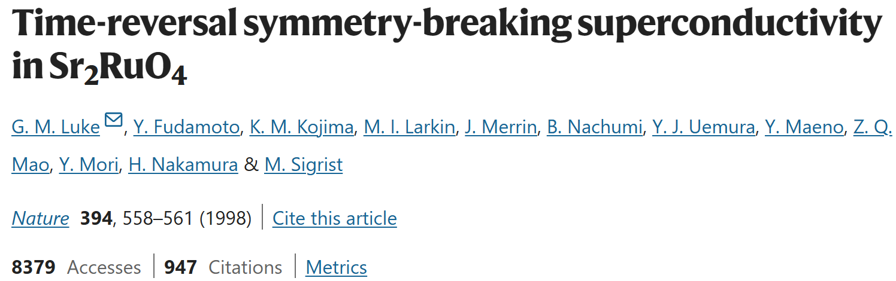
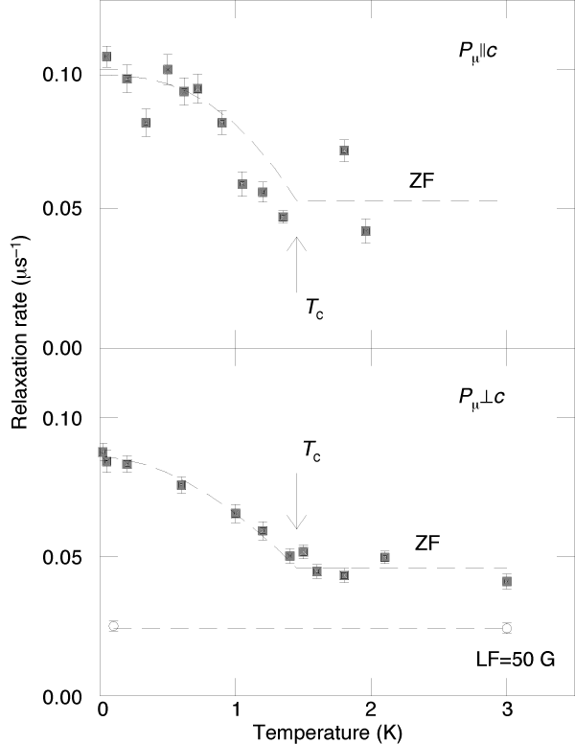
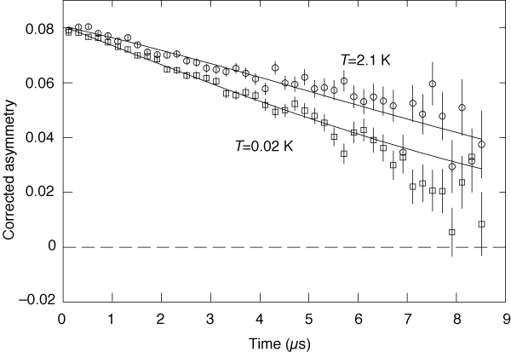

Slide 19
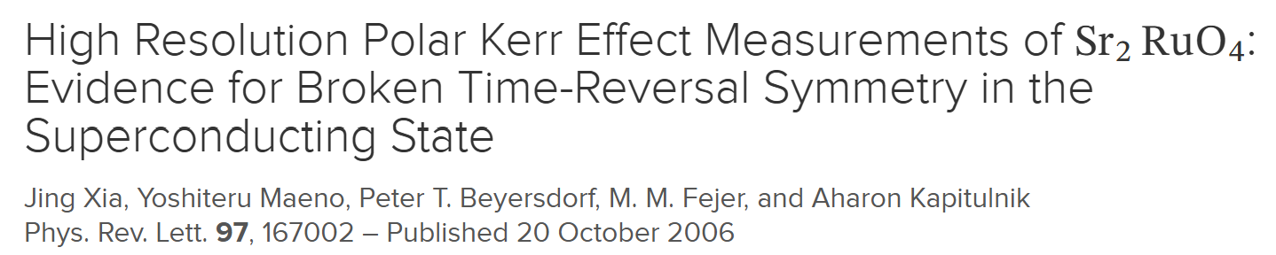
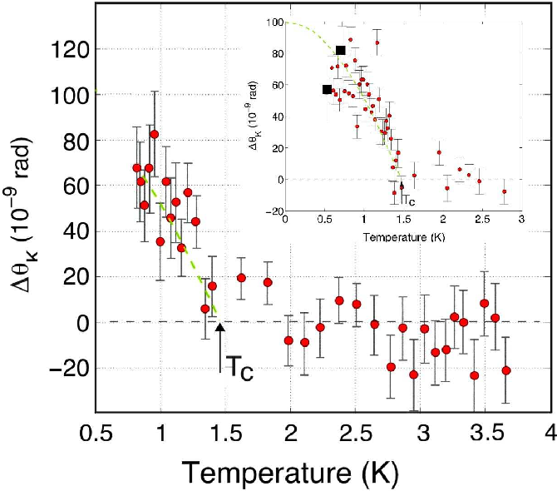
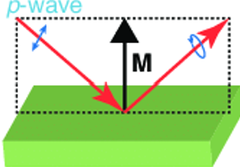
Linearly-polarized light becomes elliptically polarized after reflection from a magnetized material with magnetization (M).

Slide 20
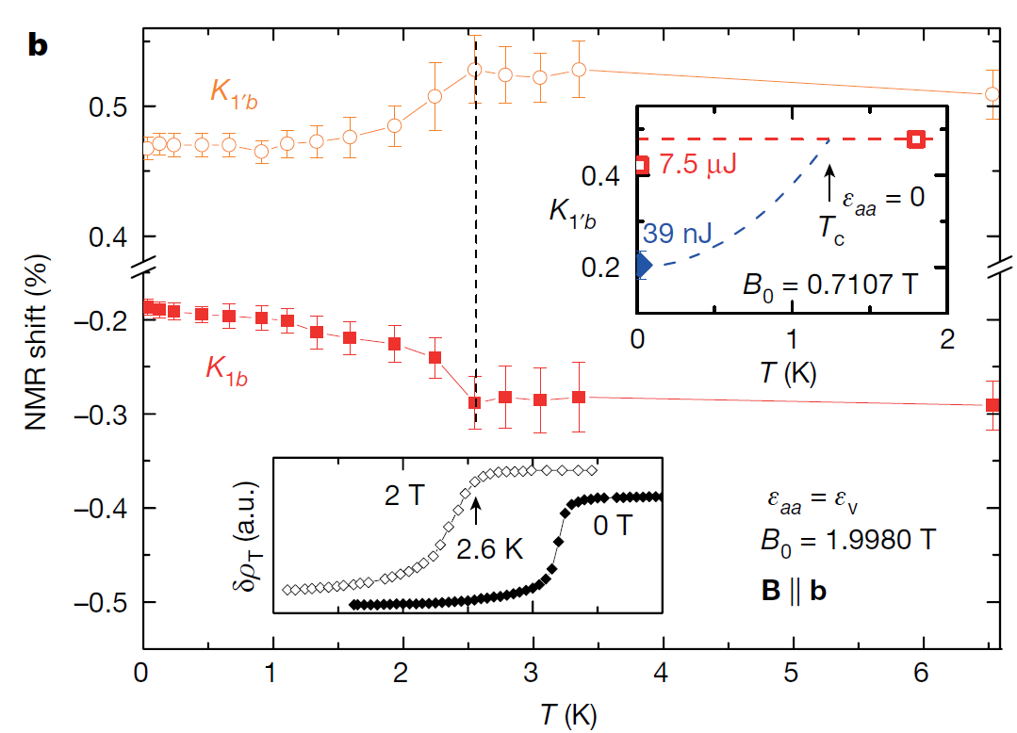

Sr₂RuO₄
Turns out Sr₂RuO₄ is not a spin triplet odd-parity superconductor!
Letter https://doi.org/10.1038/s41586-019-1596-2
Constraints on the superconducting order parameter in
Sr2RuO4 from oxygen-17 nuclear magnetic resonance
A. Pustogow1,8*, Yongkang Luo1,2,8*, A. Chronister1, Y.-S. Su1, D. A. Sokolov3, F. Jerzembeck3, A. P. Mackenzie3,4, C. W. Hicks3,
N. Kikugawa5, S. Raghu6, E. D. Bauer7 & S. E. Brown1*
Nature 574, 72-75 (2019)
Evidence for even parity unconventional superconductivity in Sr₂RuO₄
Aaron Chronister^{a,1,2}, Andrej Pustogow^{a,1,2,3} , Naoki Kikugawa^{b}, Dmitry A. Sokolov^{c}, Fabian Jerzembeck^{c} , Clifford W. Hicks^{c,d} , Andrew P. Mackenzie^{c,e} , Eric D. Bauer^{f}, and Stuart E. Brown^{a,2}
PNAS 118, e2025313118 (2021)

Slide 21


UTe₂
Nearly ferromagnetic
spin-triplet superconductivity
Sheng Ran^{1,2}*, Chris Eckberg², Qing-Ping Ding³, Yuji Furukawa³, Tristin Metz², Shanta R. Saha^{1,2}, I-Lin Liu^{1,2,4}, Mark Zic², Hyunsoo Kim²,
Johnpierre Paglione^{1,2}, Nicholas P. Butch^{1,2}*
Science 365, 684-687 (2019)
Saxena et al. Nature 406, 587 (2020)
Spin-triplet ferromagnetically-mediated superconductivity
Uranium chains

Slide 22
UTe₂ – Reentrant superconductivity near 60 T!
Ran et al., Nat. Phys. 15, 1250 (2019)

Slide 23

UTe₂ - hfSC
UTe₂ - lfSC
A. Gurevich et al., Nat. Mat. 10, 255 (2011)

Slide 24



Science 373, 797 (2021)
Spontaneous polar Kerr effect suggests broken time-reversal symmetry superconductivity.

Slide 25



No long-range magnetic order detected.

Slide 26




Commun. Phys. 6, 24 (2023)
“Magnetic Clusters”
H = 23 Oe

Slide 27



Slide 28




Slide 29



Sci. Adv. 6, 8709 (2020)

Slide 30



TRIUMF - M9H Muon Beam Line
5 T solenoid coil being wound at TESLA UK.
New Solenoid
DQ345
Compact slits /w
beam profile detector
SC 4T 6-port magnet
In bore SiPM spectrometer
70uW DR with large sample space
Retractable/ rotating slit
(design by MK, JL)
The M9H Muon Spectrometer End Station: 4 T / 50 mK / 2.5 GPa pressure cells
First muon decay channel explicitly designed for delivery of transversely spin polarized beams.

Slide 31



TRS breaking unconventional superconductivity or the occurrence of a SDW due to some other effect?

Slide 32




Science 345, 190 (2014)
G. M. Luke et al., Phys. Rev. Lett. 71, 1466 (1993)

Slide 33





Slide 34



Summary
μSR is widely recognized as an essential method for verifying bulk broken time-reversal symmetry in unconventional superconductors
The expanding μSR capabilities at TRIUMF come at an exciting time in the exploding fields of quantum materials and technologies

