Slide 1
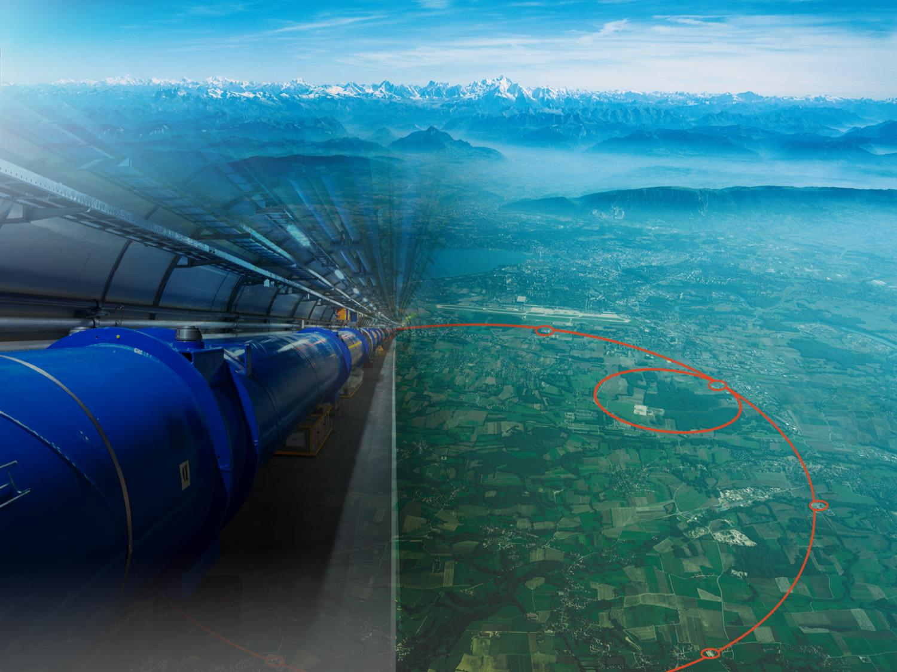

TRIUMF at 50, CERN at 70
Lyn Evans CERN and Imperial College London
Vancouver 25th July 2024
Notes:
1

Slide 2
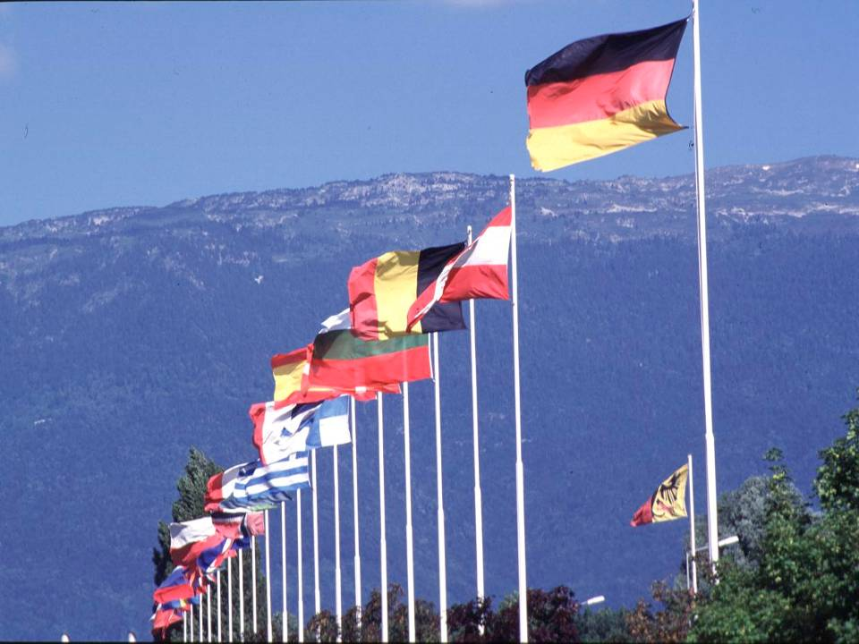

CERN was founded 1954: 12 European States
“Science for Peace”
Today: 23 Member States
~ 2300 staff
~ 1000 other paid personnel
> 11000 users
Budget (2013) ~1000 MCHF
Member States: Austria, Belgium, Bulgaria, Czech Republic, Denmark, Finland, France, Germany, Greece, Hungary, Israel, Italy, the Netherlands, Norway, Poland, Portugal, Romania,Serbia,Slovakia, Spain, Sweden, Switzerland and the United Kingdom
Brazil, Cyprus (awaiting ratification), Russia, Slovenia, Turkey, Ukraine
Observers to Council: India, Japan, Russia (suspended), Turkey, United States of America; European Commission and UNESCO
2
Notes:
2
----- Meeting Notes (09/01/2013 14:16) -----
nnn

Slide 3

Science for peace
CERN was founded in 1954 with 12 European Member States
CERN’s annual budget
is 1200 MCHF (equivalent
to a medium-sized European university)
23 Member States
Austria – Belgium – Bulgaria – Czech Republic
Denmark – Finland – France – Germany – Greece Hungary – Israel – Italy – Netherlands – Norway
Poland – Portugal – Romania – Serbia – Slovakia Spain – Sweden – Switzerland – United Kingdom
As of 31 December 2023
Employees:
2666 staff, 1002 graduates
Associates:
12 370 users, 1513 others
3 Associate Member States
in the pre-stage to membership
Cyprus – Estonia – Slovenia
8 Associate Member States
Brazil – Croatia – India – Latvia – Lithuania – Pakistan
Türkiye – Ukraine
6 Observers
Japan – Russia (suspended) – USA
European Union – JINR (suspended) – UNESCO
Around 50 Cooperation Agreements
with non-Member States and Territories
Albania – Algeria – Argentina – Armenia – Australia – Azerbaijan – Bangladesh – Bolivia – Bosnia and Herzegovina
Canada – Chile – Colombia – Costa Rica – Ecuador – Egypt – Georgia – Honduras – Iceland – Iran – Jordan
Kazakhstan – Lebanon – Malta – Mexico – Mongolia – Montenegro – Morocco – Nepal – New Zealand
North Macedonia – Palestine – Paraguay – People's Republic of China – Peru – Philippines – Qatar – Republic of Korea
Saudi Arabia – Sri Lanka – South Africa – Thailand – Tunisia – United Arab Emirates – Vietnam
Notes:
The speaker can highlight CERN’s second mission as stated when it was established: to foster peaceful collaborations between nations that had recently been at war.
Additional information (OPTIONAL)
More than 40% of CERN’s budget is returned to industry through materials, utilities and services

Slide 4
A laboratory for people around the world
Distribution of all CERN Users by the country of their home institutes as of 31 December 2023
Geographical & cultural diversity
Users of 110 nationalities
22.5 % women
Member States 7438
Austria 86 – Belgium 129 – Bulgaria 46 – Czech Republic 252
Denmark 47 – Finland 88 – France 842 – Germany 1296
Greece 112 – Hungary 80 – Israel 74 – Italy 1609 – Netherlands 167 Norway 77 – Poland 322 – Portugal 105 – Romania 113
Serbia 38 – Slovakia 67 – Spain 413 – Sweden 106
Switzerland 419 – United Kingdom 950
Associate Member States
in the pre-stage to membership 69
Cyprus 14 – Estonia 29 – Slovenia 26
Associate Member States 541
Brazil 135 – Croatia 37 – India 145 – Latvia 21 – Lithuania 17 – Pakistan 30 Türkiye 129 – Ukraine 27
Observers 3005
Japan 219 – Russia (suspended) 779 – United States of America 2007
Non-Member States and Territories 1317
Algeria 2 – Argentina 16 – Armenia 16 – Australia 26 – Azerbaijan 3 – Bahrain 3 – Belarus 14 – Canada 206
Chile 45 – China 414 – Colombia 24 – Costa Rica 3 – Cuba 3 – Ecuador 4 – Egypt 24 – Georgia 34 – Hong Kong 15 Iceland 3 – Indonesia 7 – Iran 14 – Ireland 4 – Jordan 3 – Kazakhstan 3 – Kuwait 2 – Lebanon 7 – Madagascar 1
Malaysia 4 – Malta 1 – Mexico 56 – Montenegro 3 – Morocco 18 – New Zealand 2 – Nigeria 2 – Oman 1
Palestine 1 – Peru 3 – Philippines 1 – Republic of Korea 168 – Saudi Arabia 6 – South Africa 61 – Sri Lanka 10
Taiwan 52 – Thailand 17 – Tunisia 4 – United Arab Emirates 10 – Vietnam 1
Notes:
THIS SLIDE WILL INCLUDE THE NUMBER OF MEMBERS OF PERSONNEL OF THE VISITORS’ COUNTRY OF ORIGIN

Slide 5
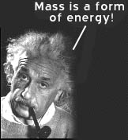
When one accelerates a particle…
It does not necesserily go much faster
Its mass increases
  E = m c²
In an interaction, it can transform its energy into massive particles
…one transforms energy into mass

Slide 6
Energy, mass and temperature
1 electron Volt (eV) = 1.8 x 10⁻³⁶ kG
= 11.600 ºC
1 Tera electron Volt (TeV) = 10¹⁶ ºC

Slide 7
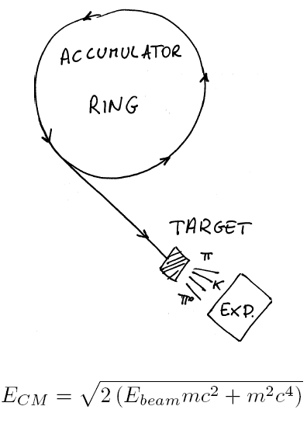
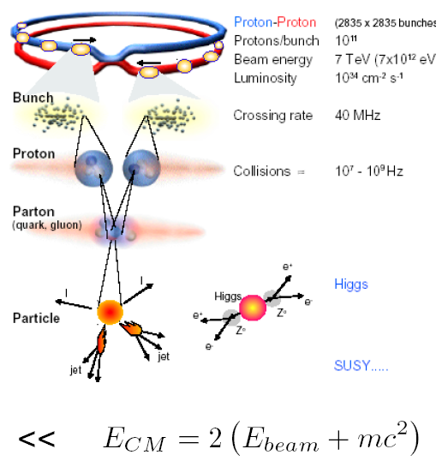
Different approaches fixed target vs collider
Fixed target
Storage ring/collider
7

Slide 8
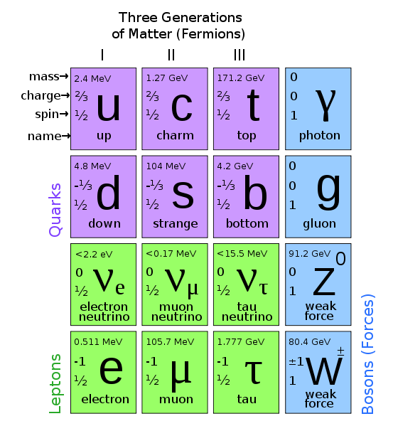
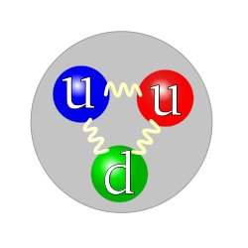
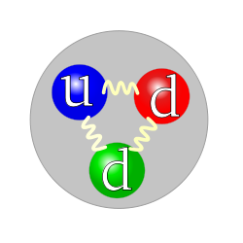
The standard model
Proton
Neutron

Slide 9
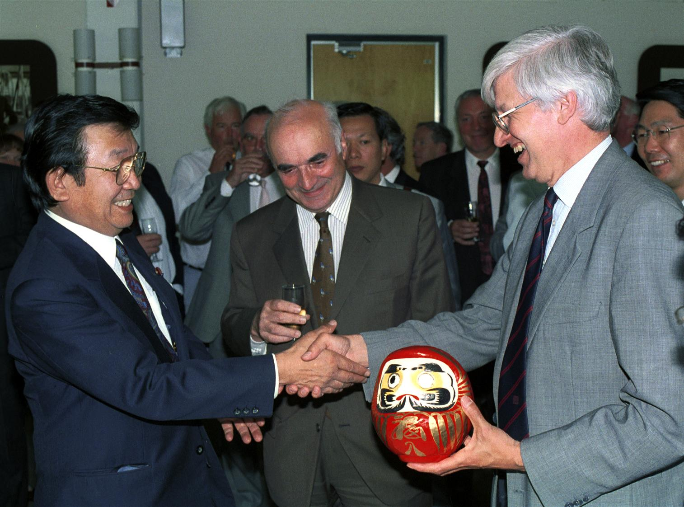
Japan becomes an Observer
June 1995
Japan becomes an Observer of CERN and announces a financial contribution to the LHC.
The Japanese Minister for Education, Sciences and Culture offers a Daruma doll to CERN’s Director-General. According to Japanese tradition, an eye is painted on the doll to mark the beginning of the LHC project and the second eye must be drawn at the time of its completion.
Japan makes two other major financial contributions to the LHC project in 1996 and 1998.
Notes:
9

Slide 10
1996
March
  India makes a financial contribution to the construction of the LHC.
  And in June, Russia announces a financial contribution to the project.
December
  Canada announces a financial contribution for the LHC, while a protocol of co-operation is defined for participation of the United States.
  In December 1997, the US declares a contribution.
Notes:
10

Slide 11
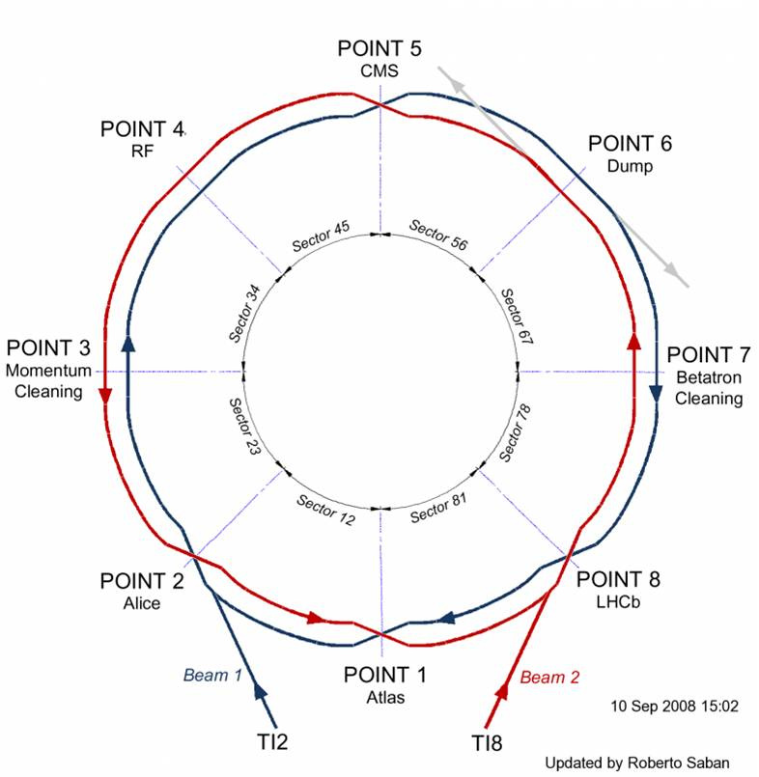
Colliding counter-rotating beams of hadrons
11

Slide 12
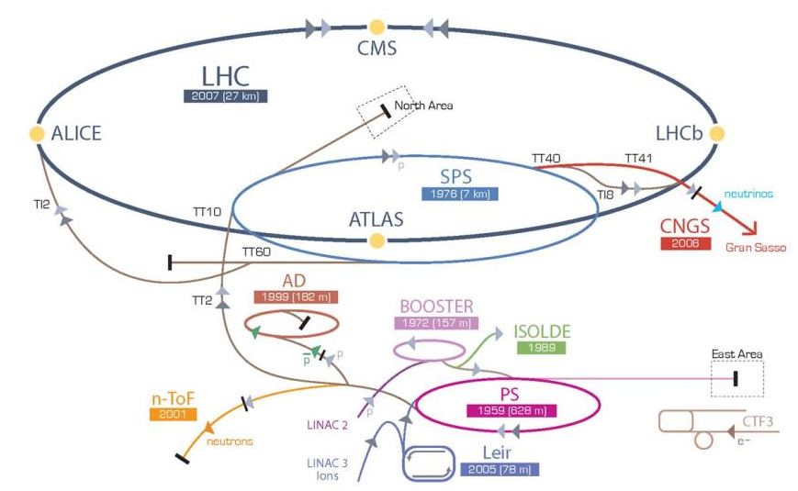
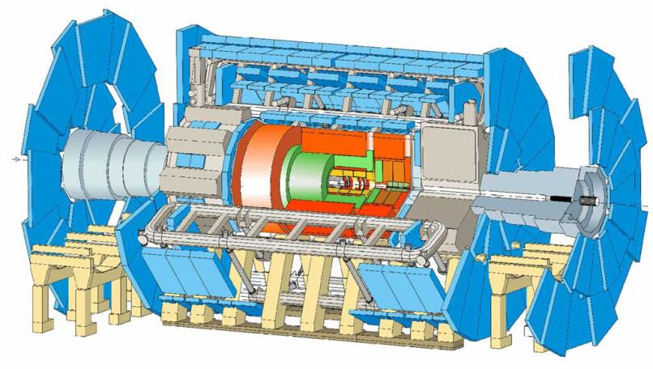
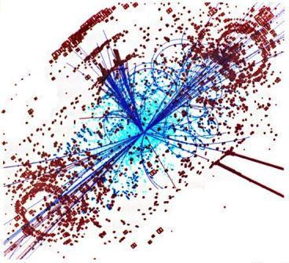
CERN’s particle accelerator chain
12
12

Slide 13
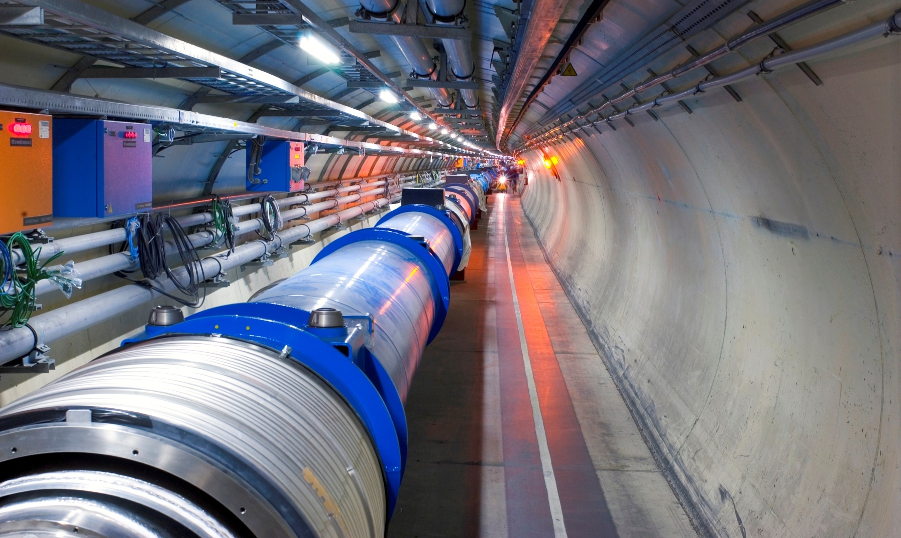
23 km of superconducting magnets

Slide 14
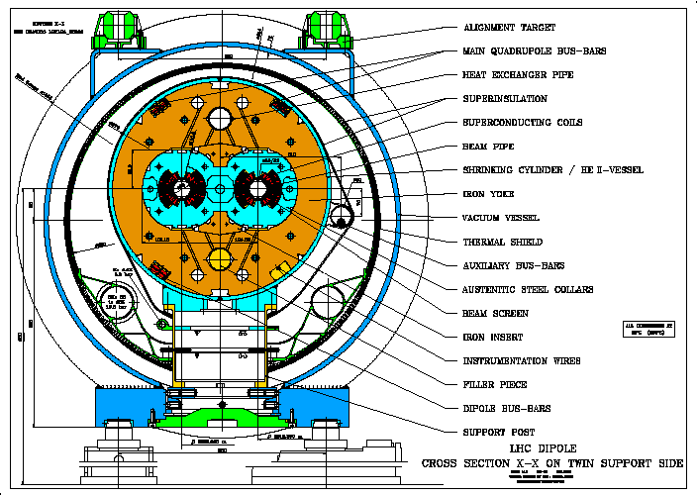
Cryodipole cross-section

Slide 15
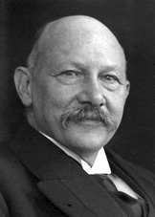
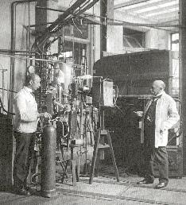
…at the physics laboratory of Leyden, helium was first liquified
Heike Kamerlingh Onnes
“Door meten tot weten”
To knowledge through measurement

Slide 16
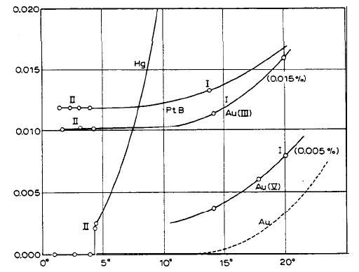
Discovery of superconductivity (1911)

Slide 17
Hint of a quantum effect…?

Slide 18
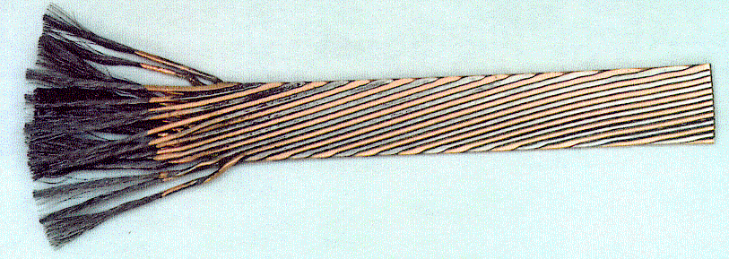
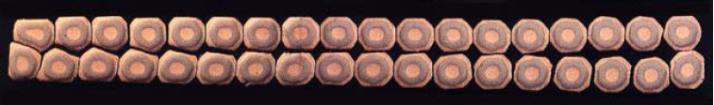
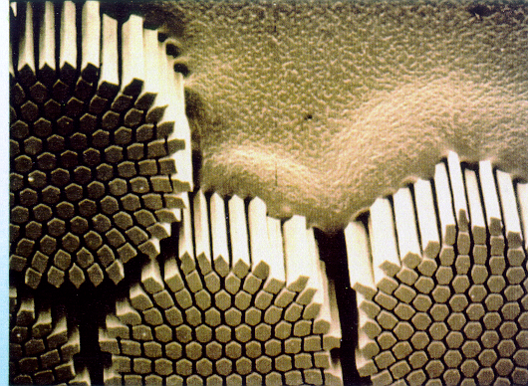
7000 km of superconducting cable Nb-Ti

Slide 19
Critical current density of technical superconductors

Slide 20
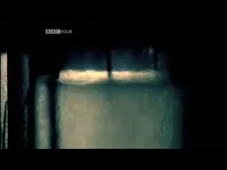
Superfluid Helium
2.3K
2.17K

Slide 21
J. F. Allen
« In my PhD work in Toronto on superconductivity, I had often seen the sudden cessation of boiling at the lambda temperature T_{λ} but had paid it no particular attention. It never occured to me that it was of fundamental significance. »
J. Allen, Physics World, November 1988, p 29.

Slide 22
equivalent thermal conductivity of He II
Helium II
OFHC copper

Slide 23
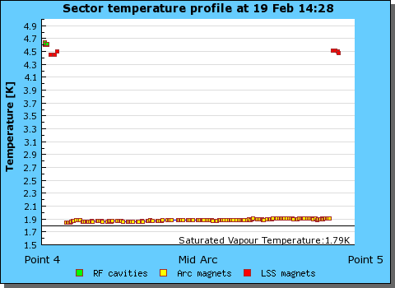
Cryogenic operation of LHC sector
3.3 km

Slide 24
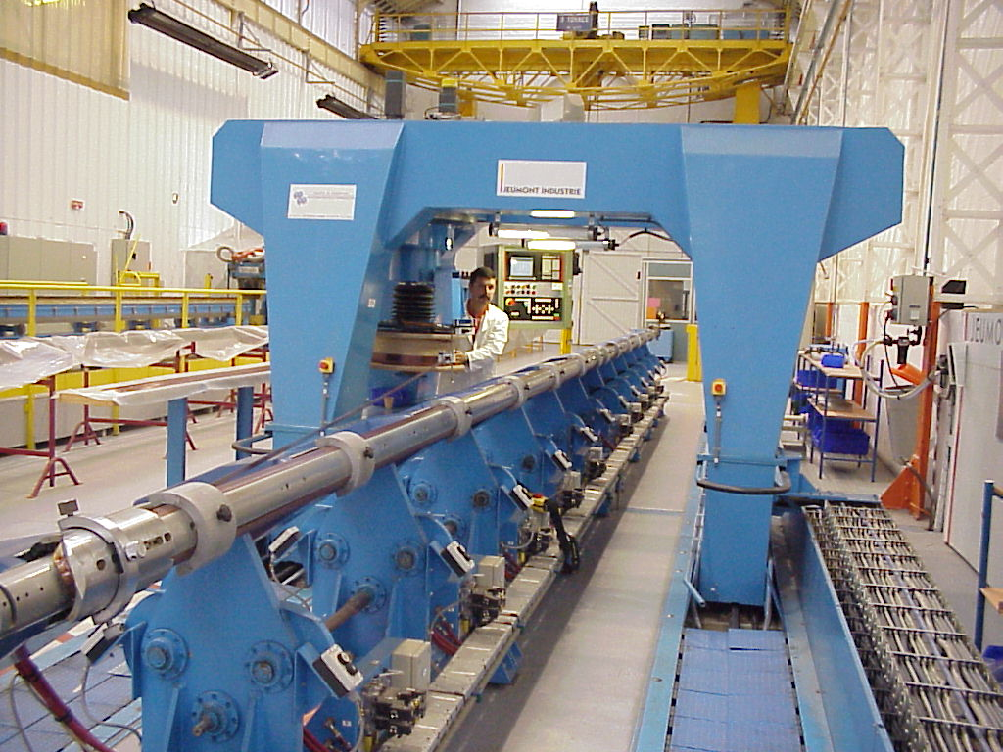
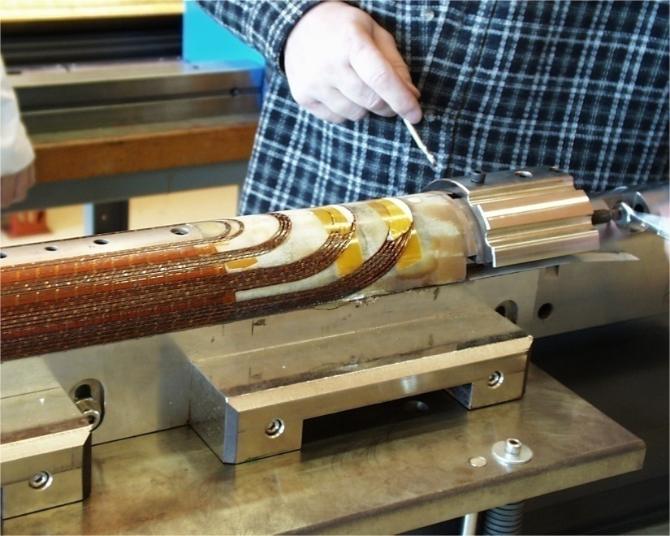
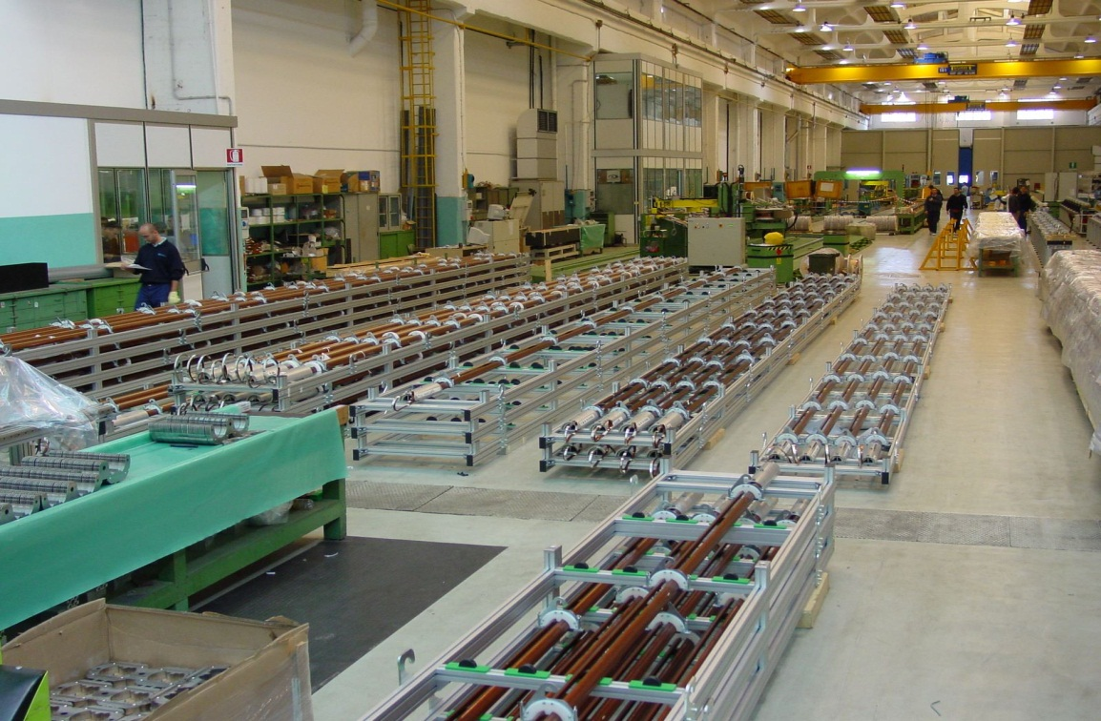
Manufacturing of superconducting coils

Slide 25
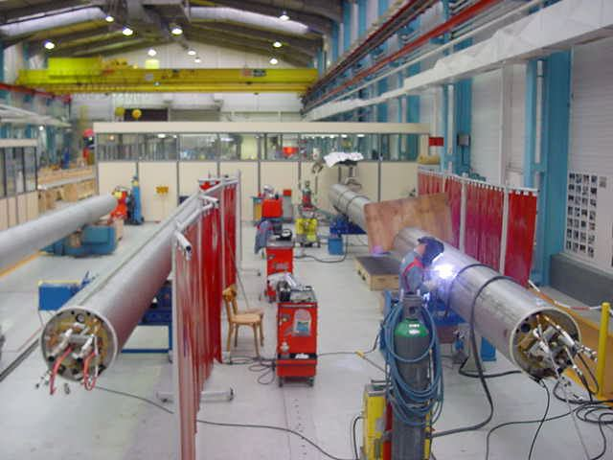
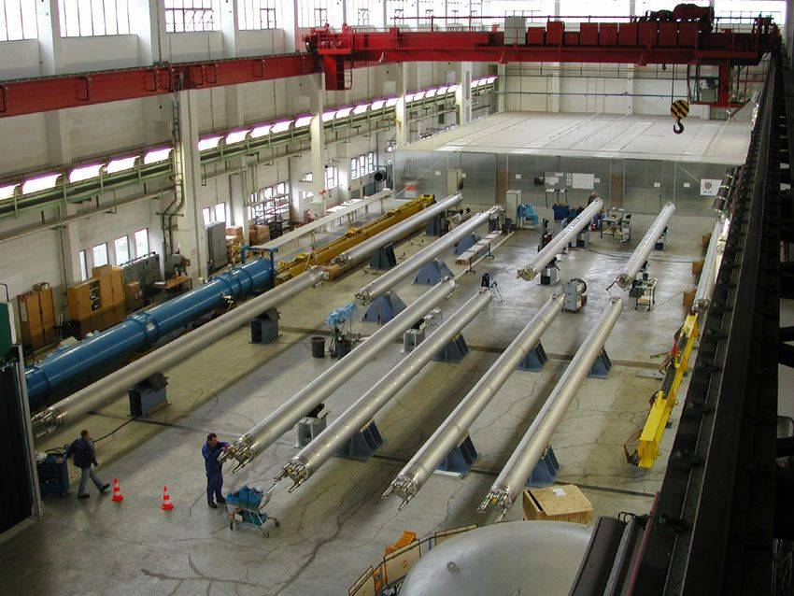
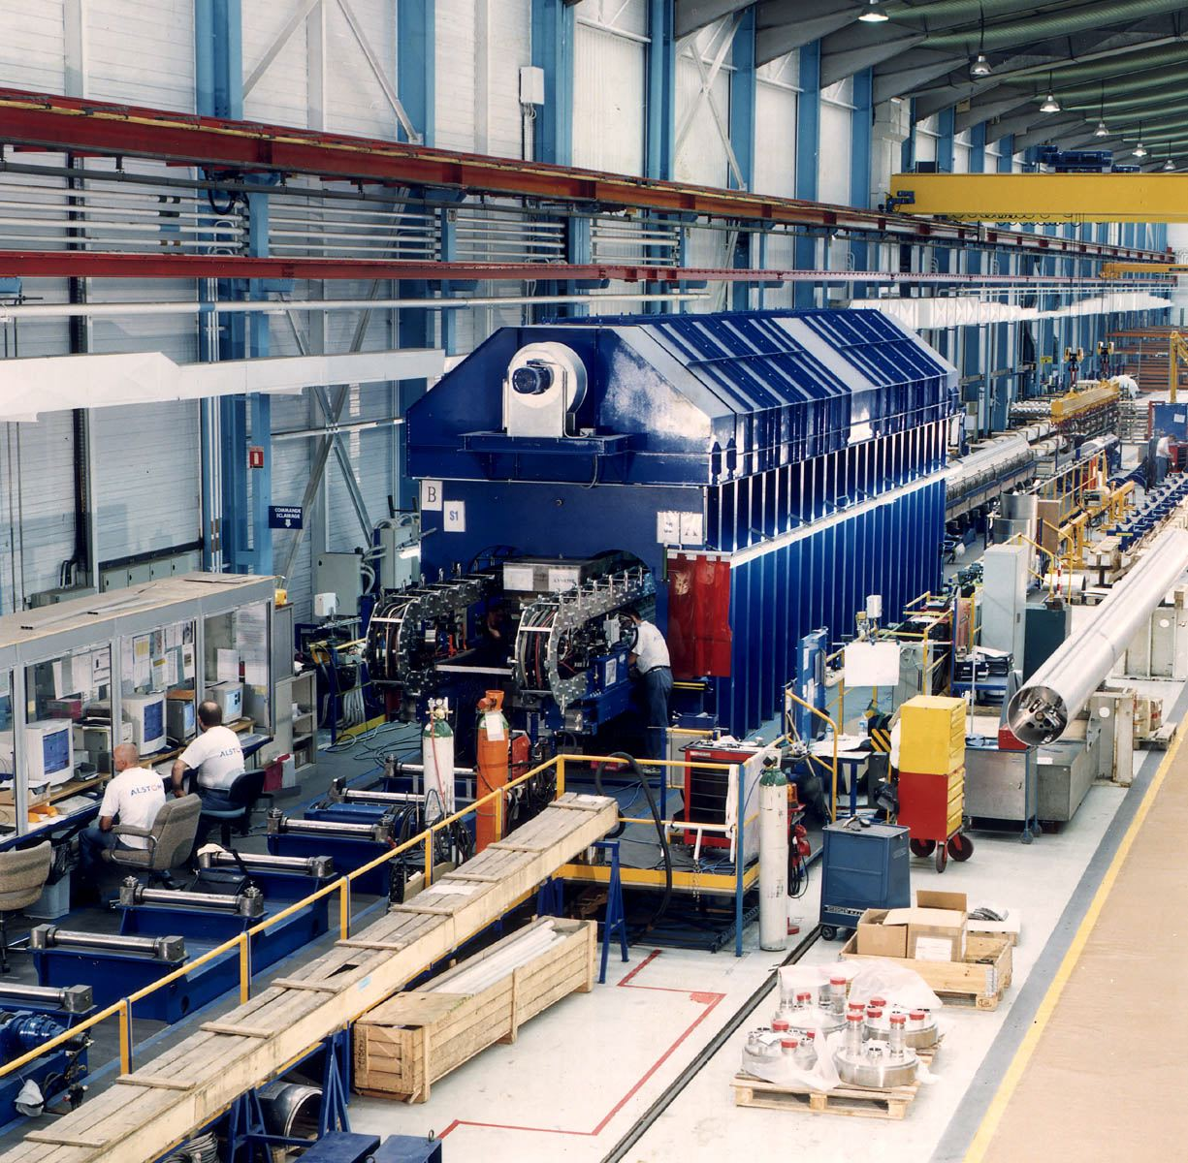
Assembly of dipole cold masses

Slide 26
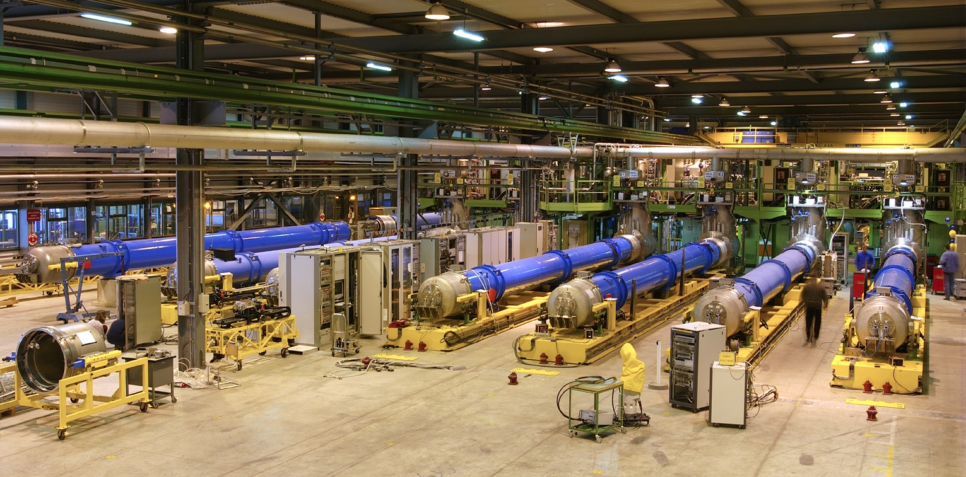

Cryogenic test benches

Slide 27
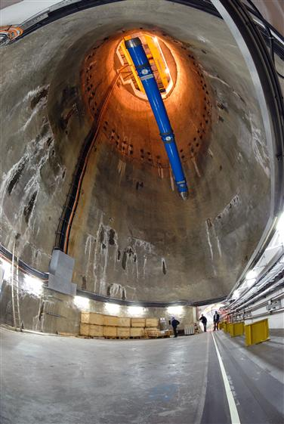
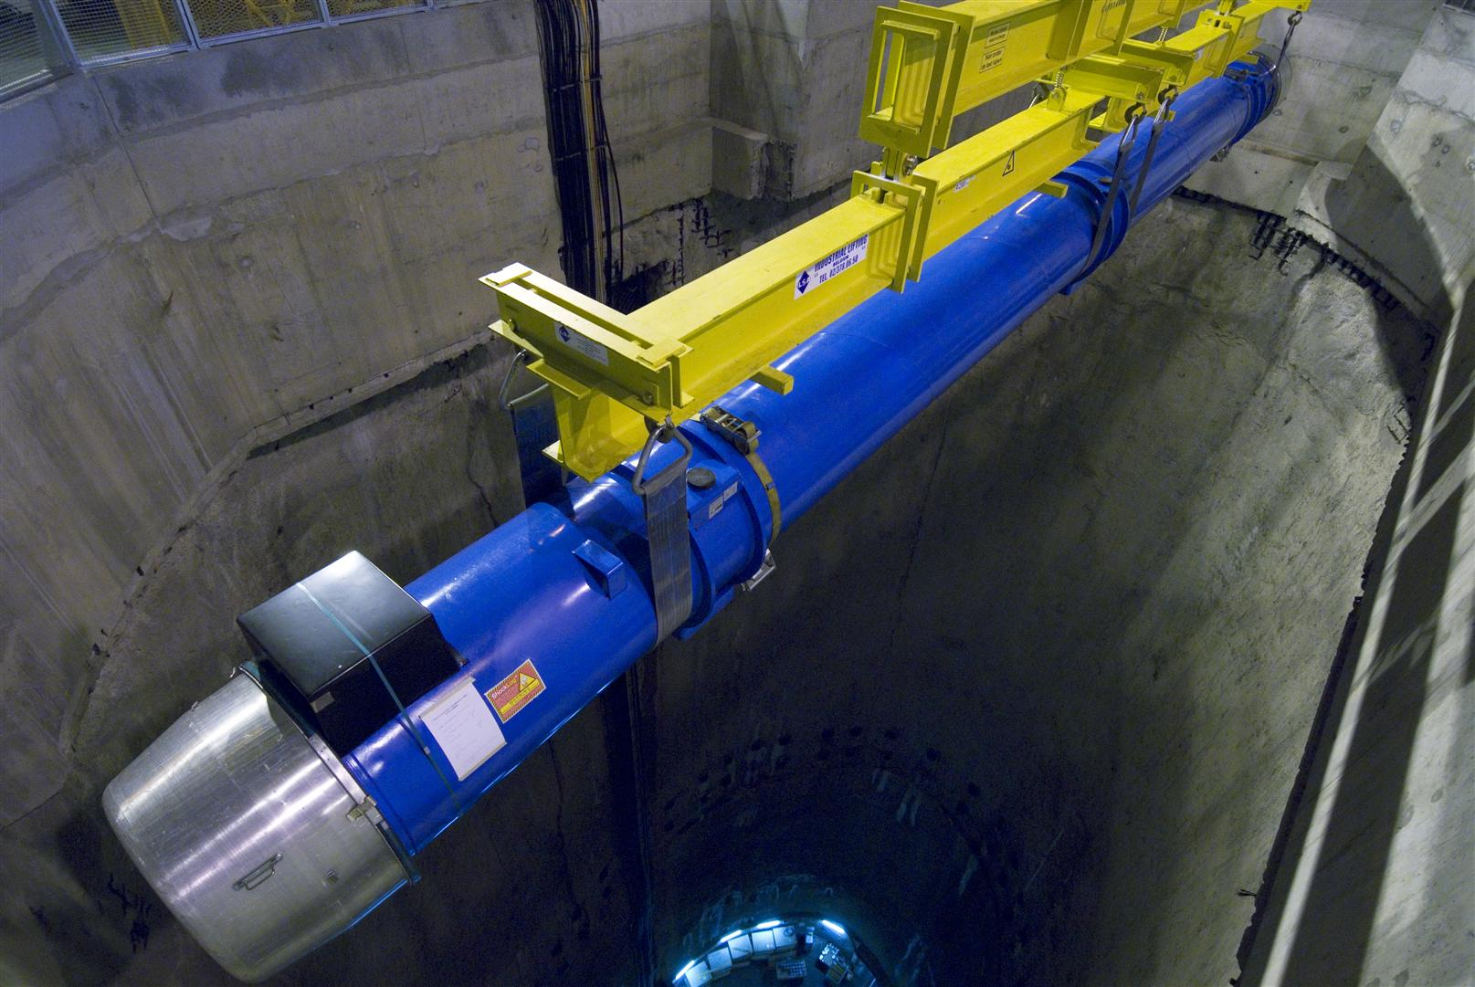
Magnet descent into the tunnel

Slide 28
Transport in the tunnel with an optical guided vehicle

Slide 29
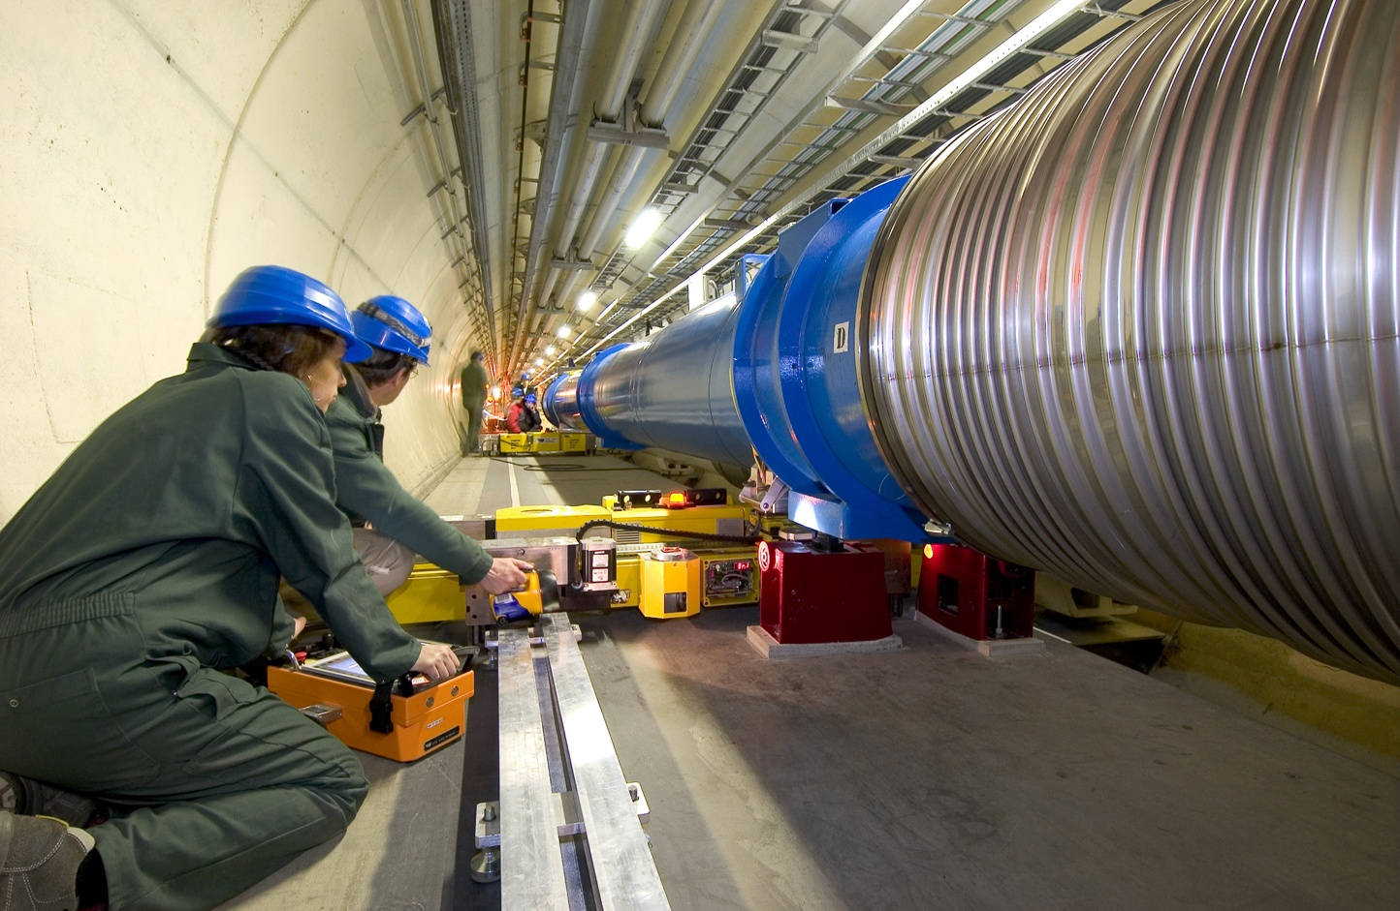
Transfer on jacks

Slide 30
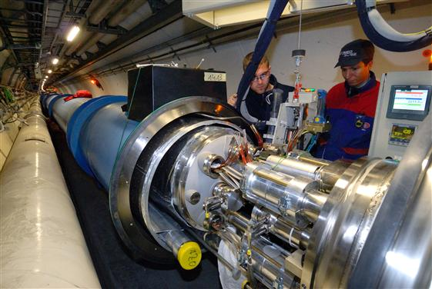
Electrical splice

Slide 31
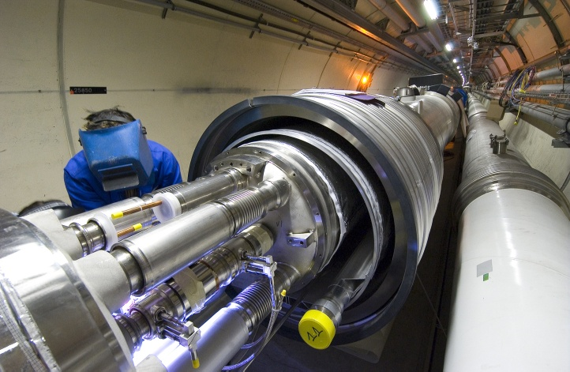
Dipole dipole interconnect

Slide 32
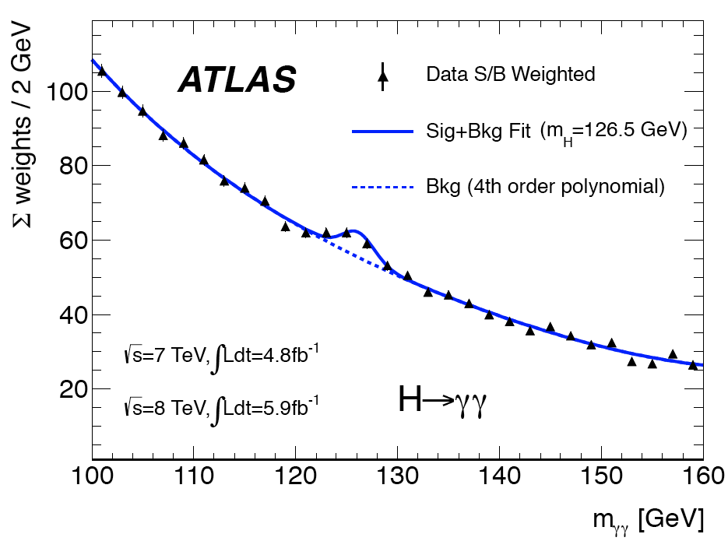
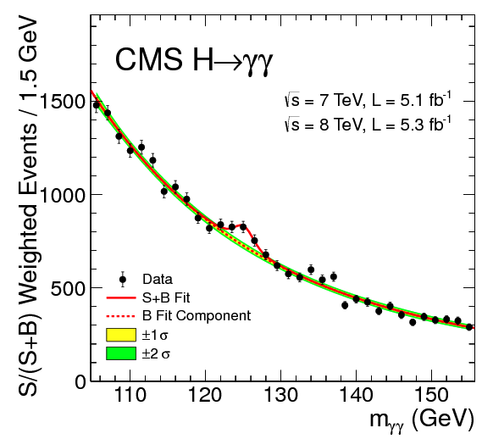
Two photon spectrum

Slide 33
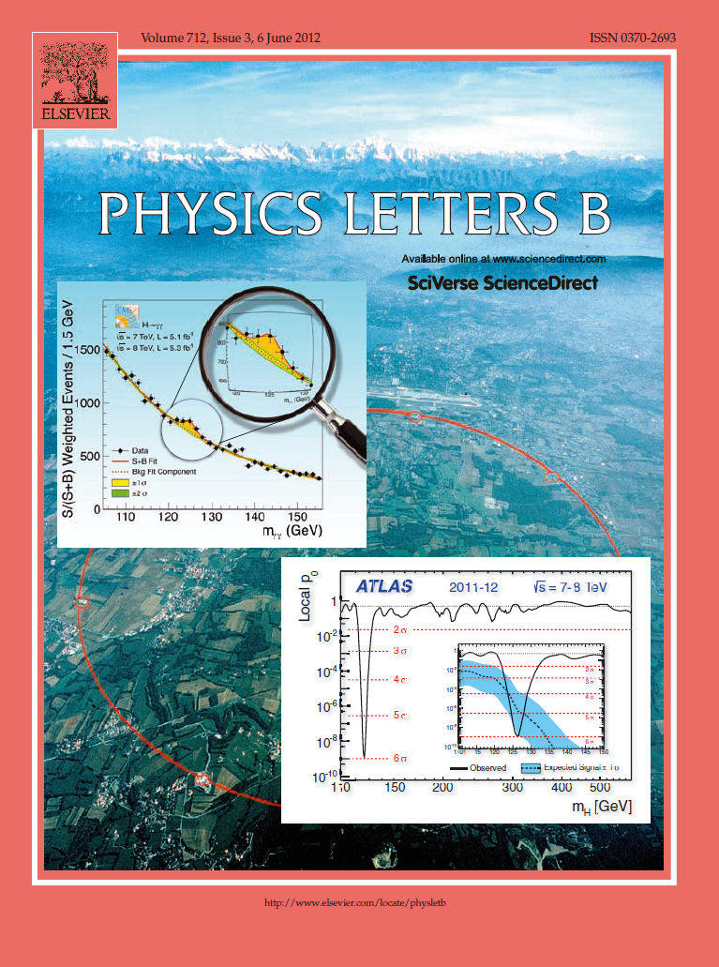

The highlight of a remarkable year 2012

Slide 34
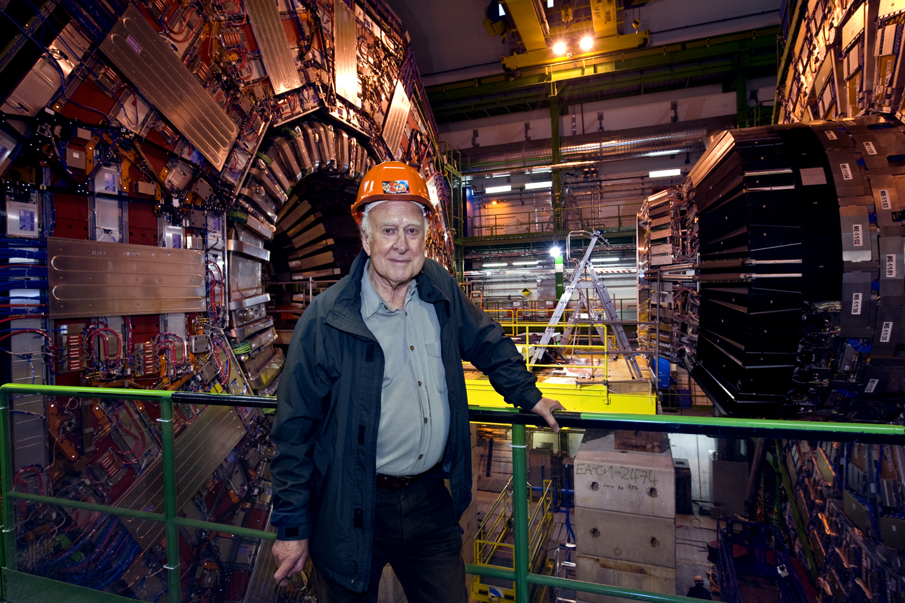
Higgs has been seen in CMS

Slide 35

Bringing nations together
“…the promotion of contacts between, and
the interchange of, scientists…”

