Slide 1
McDermott + Bull
Executive Search That Empowers Change.

Slide 2
HOW TO WRITE A RESUME
+

Slide 3
HOW TO WRITE A RESUME
+

Slide 4
WHAT IS A RESUME?
ACCORDING TO CHATGPT
A resume is a document that provides a concise summary of a person’s skills, work experience, education, and accomplishments.
WHAT IS THE PURPOSE OF A RESUME?
For You:
Summary of Qualifications: Provides potential employers with a quick overview of your suitability for a role.
First Impression: Is a first impression for hiring managers, showcasing your professionalism, attention to detail, and organizational skills.
Highlighting Relevant Experience: Allows you to emphasize the experiences and skills that are most relevant to the job you are applying.
?
For the Employer:
Screening Tool: To screen candidates and shortlist those who meet the basic qualifications and requirements for a job.
Basis for Interviews: Provides a foundation for interview discussions/questions about your background and experiences.

Slide 5
PURPOSE OF A RESUME
TO END UP IN THE “YES” OR “MAYBE” PILE.
?

Slide 6
RESUME BASICS
FONT
STYLE
NUMBER
OF PAGES
FONT
COLOUR
LOGOS
Millions of Templates Online
Pick one that is easy to read, and professional.
One Page
Later in your career,
three pages, max
Do Not Use Comic Sans
Pick one that is easy to read, and professional. Size = 12 pts.
Limit Use
Resume style only.
Text should be in black.
Not Recommended

Slide 7
CONTENT
DO NOT INCLUDE
Your Marital Status
Your Maiden Name
Number of Children
Work Permit Number
Social Insurance Number
Face Pic
OPTIONAL
Mission
Skills + Attributes: Make sure you know the difference.
Key Words for CRMs
Ability to Work in Canada
Hobbies
Equity Deserving Status

Slide 8
MANDATORY CONTENT
Contact Information | Your name, phone number, email address, and your LinkedIn profile or personal website.
Professional Summary | Brief statement that highlights your experience and what you bring to the position.
Education | Information about your educational background, including the institutions you attended, the degrees you earned, and the dates of attendance.
Certifications and Licenses | Any relevant certifications or licenses you hold.
Work Experience | A list of your previous jobs, including the company name, your job title, the dates you were employed, and bullet points describing your responsibilities and achievements.

Slide 9
MANDATORY CONTENT
Awards & Honours | Relevant awards or honours.
Professional Affiliations | Memberships in professional organizations.
Publications & Presentations | Maximum of three (3) publications or presentations you have authored or contributed to. This can be followed up with “A full publications and presentations list is available upon request”.
Volunteer Work | Any volunteer experience you have.
Languages | Any additional languages you speak and your proficiency level in each.
References | “References available upon request.”

Slide 10
LIMITED EXPERIENCE
HIGHLIGHT
Your major project work.
Your thesis.
What were you working on?
What role did you play in the research work?
Try and talk about your accomplishments, while you were getting a degree.
Some accomplishments, internships or co-op work is a good place to start.

Slide 11
CONTENT CREATION AND A.I.
Can be a great starting point.
HOWEVER:
Does not have additional personalization and is recognizable.
May detail experiences or skills that you may not be able to fully explain in an interview.
May also neglect to focus on key skills that differentiate you.

Slide 12
READY TO WRITE
YOU HAVE DECIDED
Font
Skills & Attributes
Education
Work Experience
Professional Affiliations
Publications
Awards & Honours
Volunteer Work
Hobbies
References
THINGS TO CONSIDER
Will this be printed?
What does it look like in black and white?
What if this is dropped?
Include page numbers and headers.

Slide 13
HEADER

Slide 14
HEADER
averdecchia@mbexec.ca
778.388.2722
www.linkedin.com/in/alexverdecchia

Slide 15
EXPERIENCE
COMPANY NAME:
TITLE:
Timeline:
One sentence as to what the company does, its size, etc. One sentence on your role.
Your role and responsibilities
What you have done in the role

Slide 16
EXPERIENCE
MCDERMOTT + BULL
Principal
Timeline: Sept. 2019 to Present
McDermott + Bull is a full-service, international executive search firm. Alex leads Canada’s public-sector practice, with a focus on post-secondary education.
Responsible for Business Development & Client Relationship Management.
Appointed to lead McDermott +Bull’s (M+B) North American Diversity, Equity, Inclusion and Belonging (DEIB).
Completed over 60 search assignments for universities, colleges and polytechnics.
86% of Alex’s placements have been, women, Indigenous, or other equity-deserving hires.

Slide 17
DO NOT
CHANGE THE FONT SIZE
CHEAT THE MARGINS
DELIVER THE BRICK

Slide 18
Alex Verdecchia averdecchia@mbexec.ca 778.388.2722. inkedin.com/in/alexverdecchia
Credentials: 250+ searches successfully completed for leading Canadian Post-Secondar institutions, with roles ranging from Deans to Presidents and Board Chairs; 20yrs experience in Executive Search, delivering results for clients across a range of industries and geographies. Skilled at understanding unique dynamics of institutions; coaching executive hiring managers, decision makers and panels on effective interviews and candidate selection. Negotiates with candidates to align expectations, resulting in a 100% retention rate for placements; Diversity, equity and Inclusion expert who promotes best practices to expand candidate pools, generating 89% female and diverse hires over the last five years. Experience: McDermott + Bull Principal, 2019 to present. International executive search firm that values a personalized service model while having global resources and capabilities. Includes McDermott + Bull Interim Leaders and the McDermott + Bull Executive Network. Alex leads Canada’s public-sector practice with a particular focus on post-secondary education, healthcare crown corporation, NPOs, and municipalities. International executive search firm that values a personalized service model while having global resources and capabilities. Includes McDermott + Bull Interim Leaders and the McDermott + Bull Executive Network. Alex leads Canada’s public-sector practice with a particular focus on post-secondary education, healthcare crown corporation, NPOs, and municipalities. Business Development & Client Relationship Management: Seasoned partner to decision makers, facilitating a smooth and informed search process. Brings notable expertise in assessing clients’ needs and candidates’ expectations in order to bring alignment. Candidate Procurement & Cultivation: Initiates first contact to procure candidates and cultivates ongoing relationships with hundreds of local, national, and international candidates. Search Administration: Oversees marketing channels; directs placement of all advertising materials within the designated budgets and timeframes. Ensures, where necessary, advertising adhering to Canadian Federal and Provincial immigration standards (LMIA, PNP etc.). Other Contributions: Appointed to lead McDermott +Bull’s (M+B) North American Diversity, Equity, Inclusion and Belonging (DEIB) committee of eight. The committee is responsible for ongoing training and the development of learning tools to advance DEIB topics and priorities.
THE BRICK

Slide 19
PROOF READING TOOLS
SPELL CHECK
Spill chuck well knot clutch very thong.
GRAMMARLY
Will make suggestions that aren’t always
appropriate in context; occasionally struggles with
sentence structure.
THE HUMAN
Have your resume read by at least 2 people.

Slide 20
CONSIDER A RESUME WRITING SERVICE
https://www.junipercareerservices.ca/

Slide 21
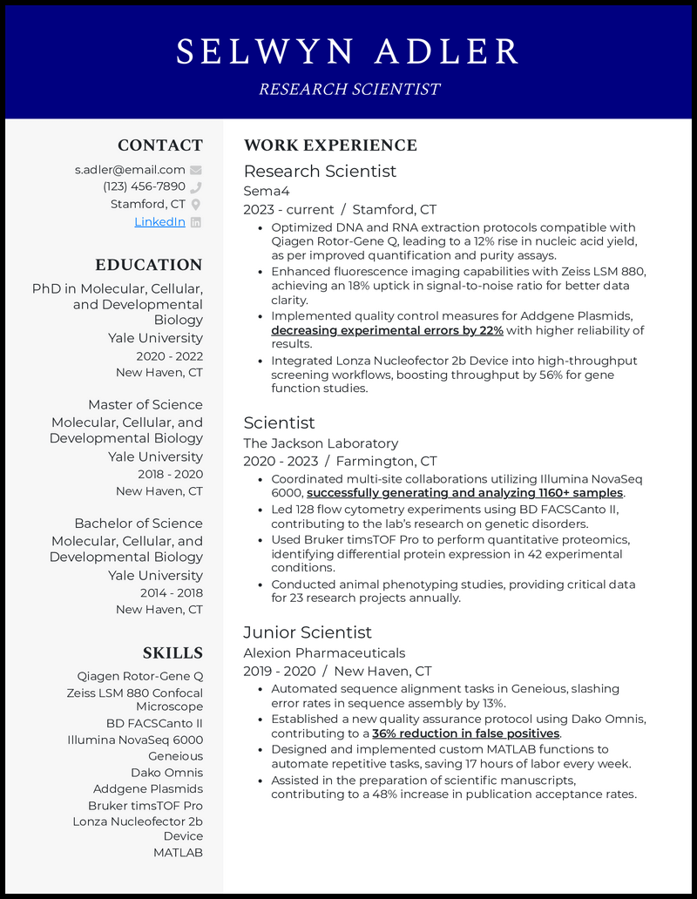
SAMPLE ONE-PAGE RESUME

Slide 22
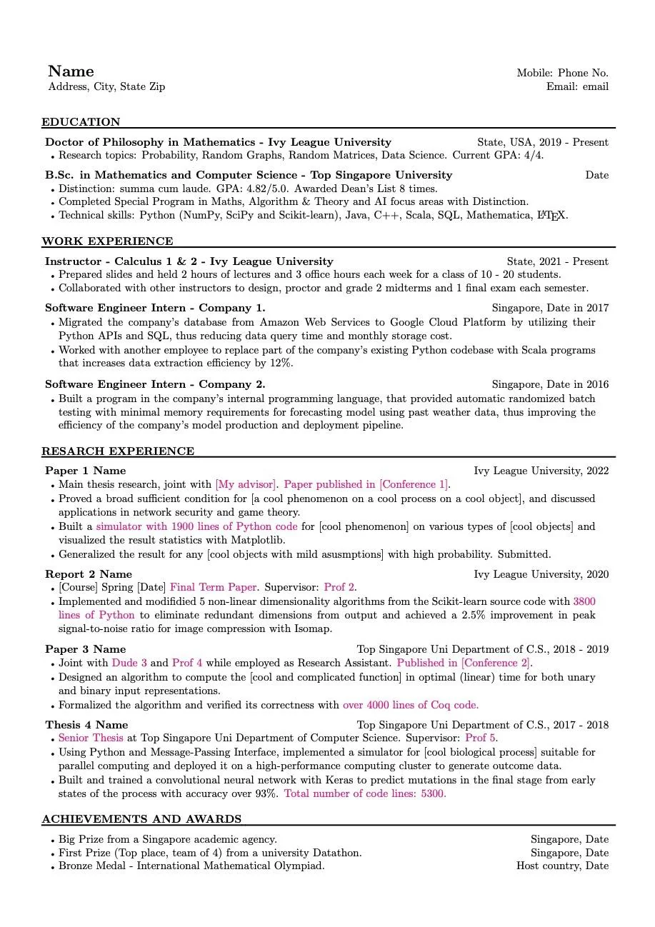
SAMPLE ONE-PAGE RESUME

Slide 23
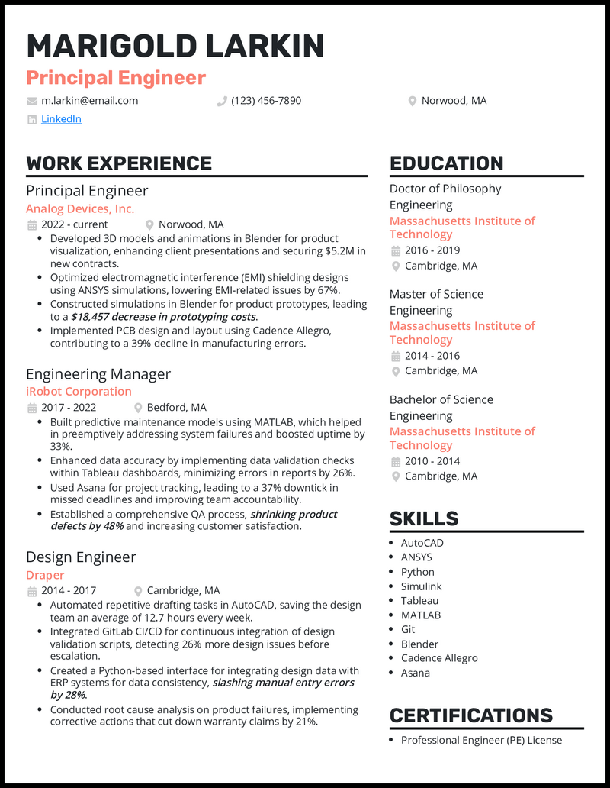
SAMPLE ONE-PAGE RESUME

Slide 24
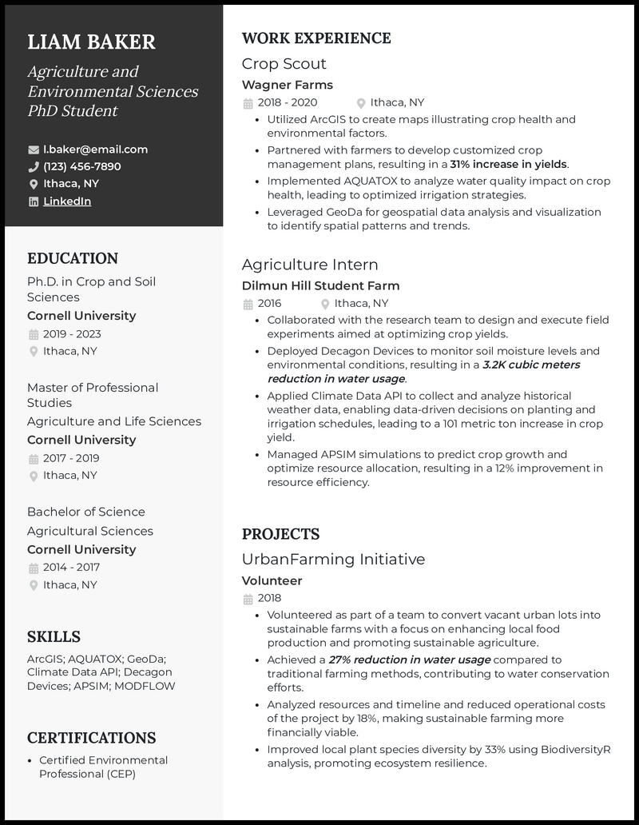
SAMPLE ONE-PAGE RESUME

Slide 25
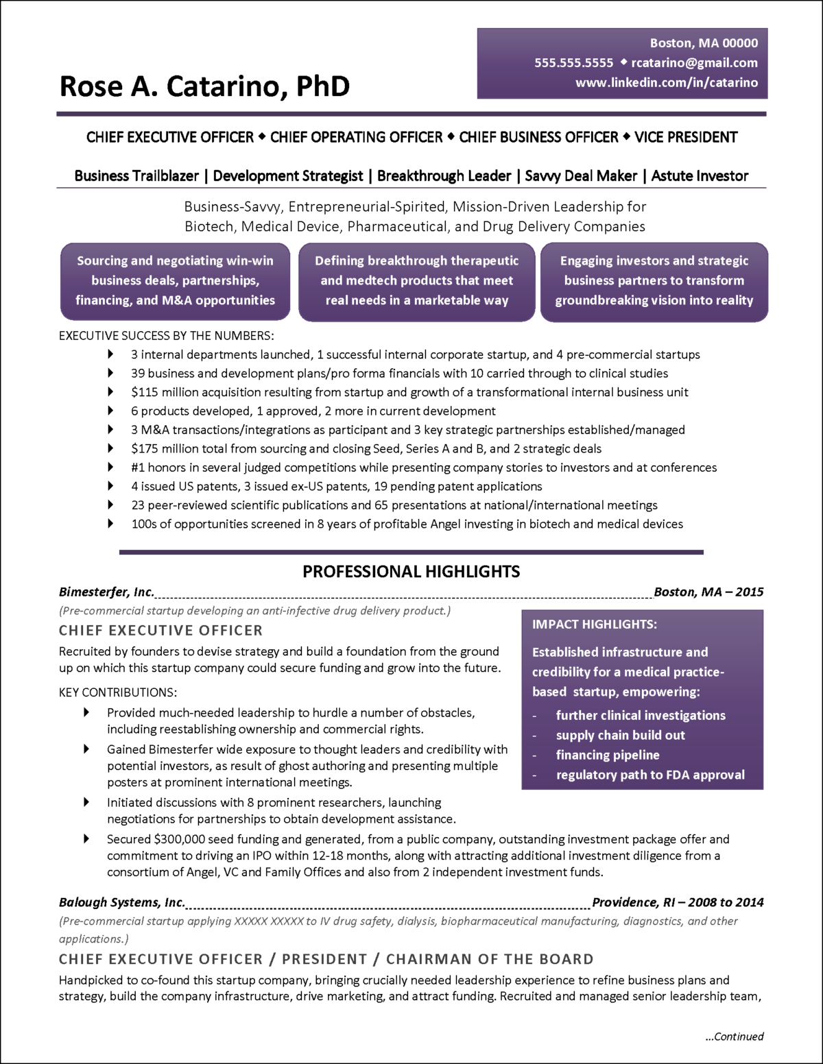
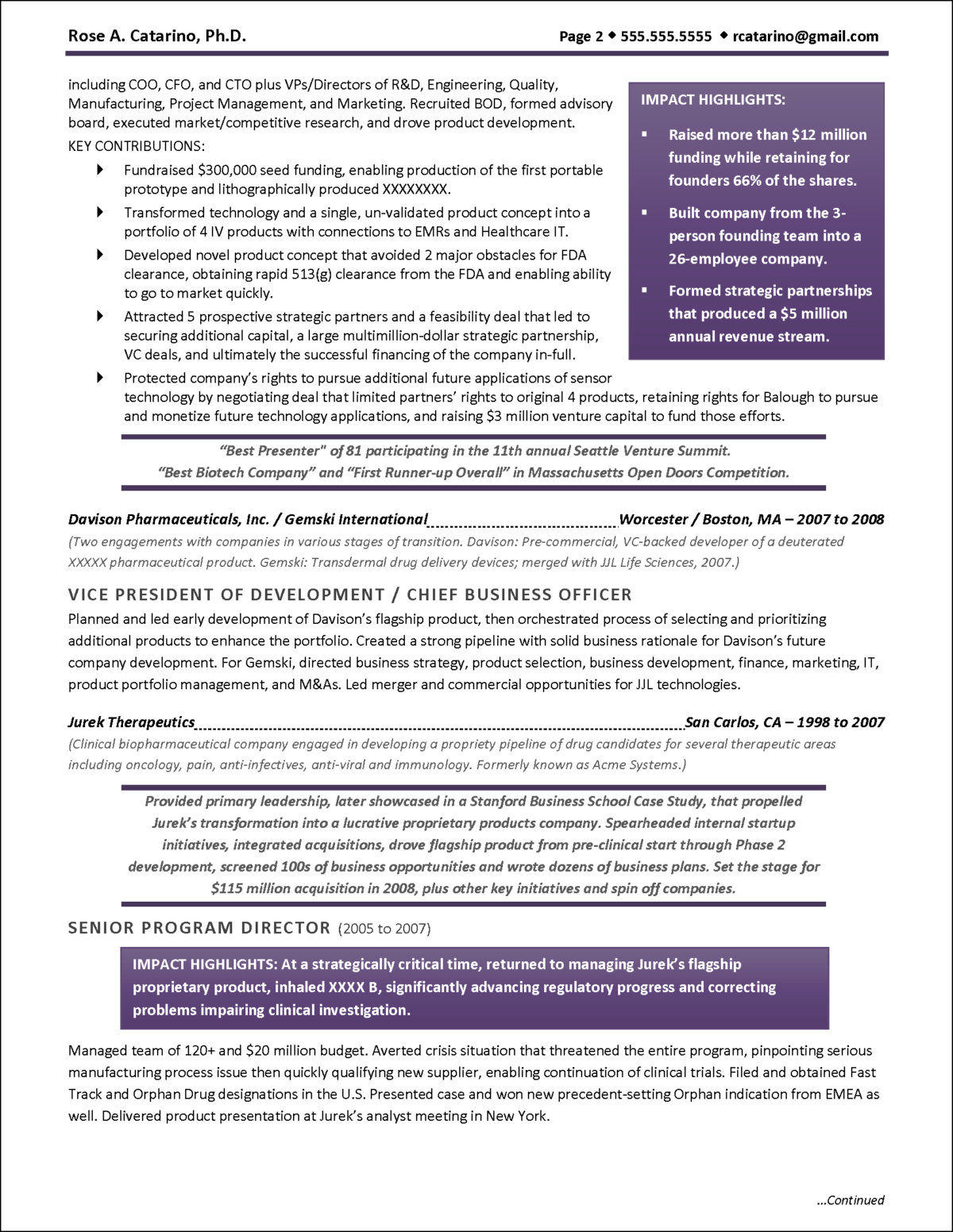
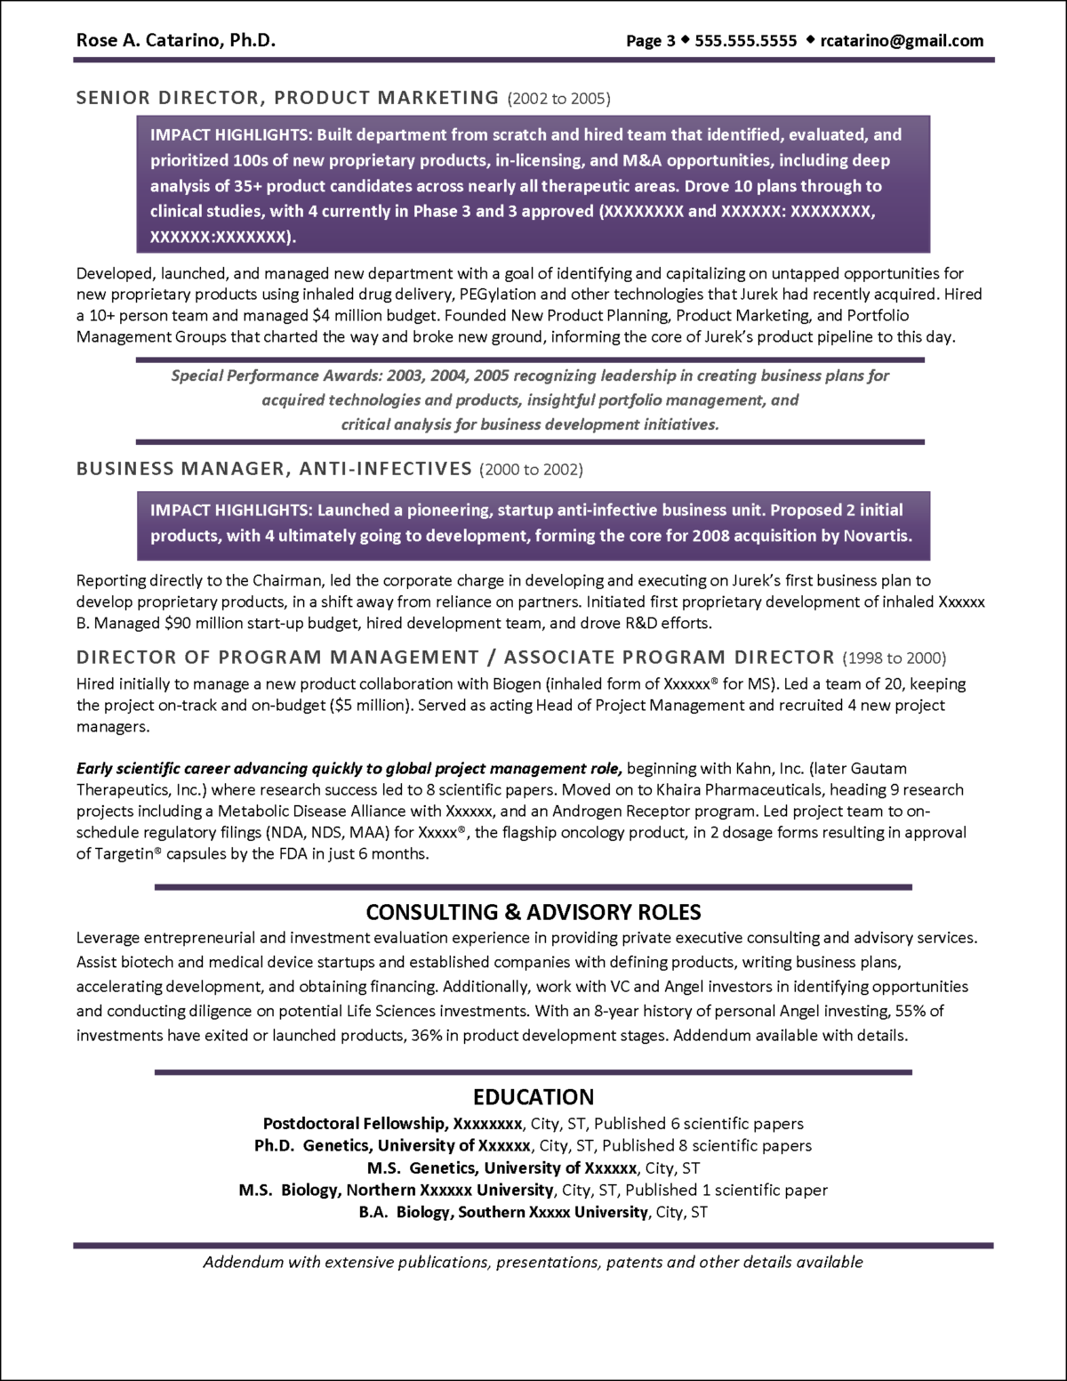
THREE-PAGE RESUME SAMPLE

Slide 26
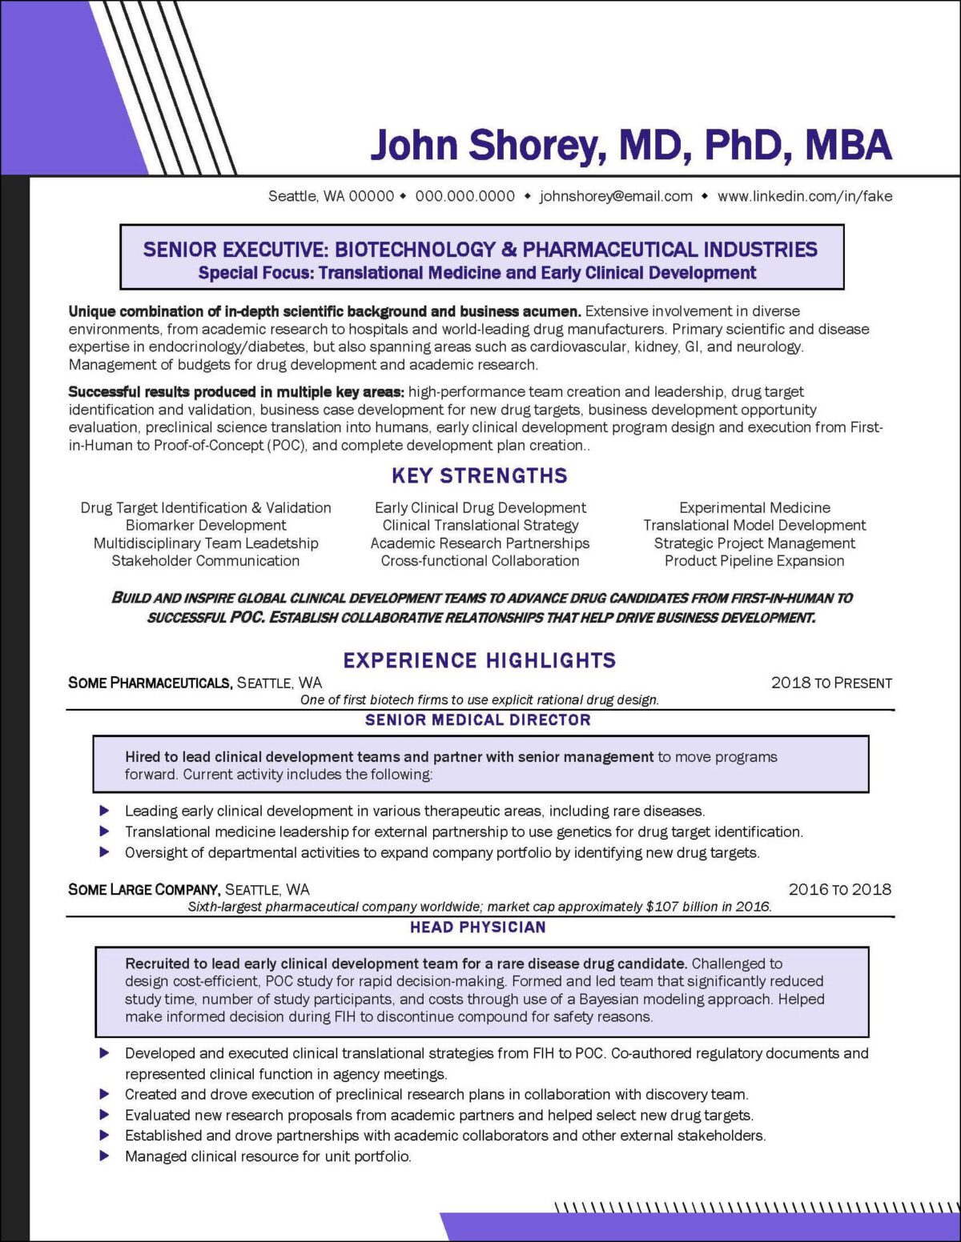
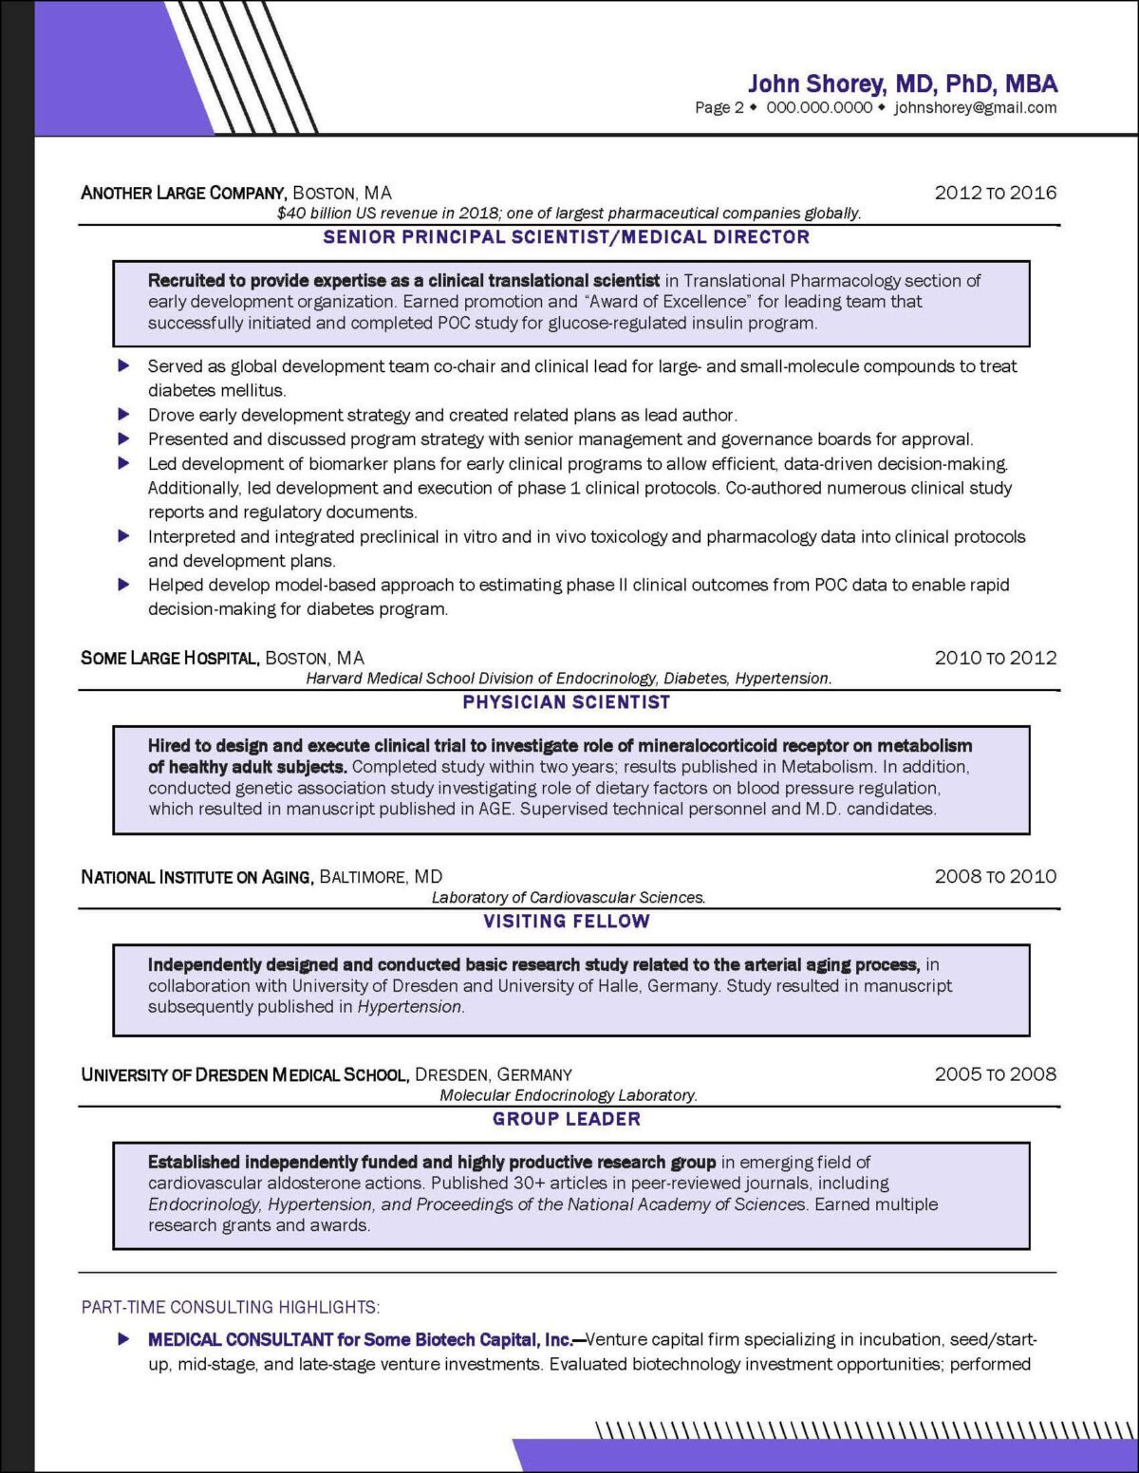
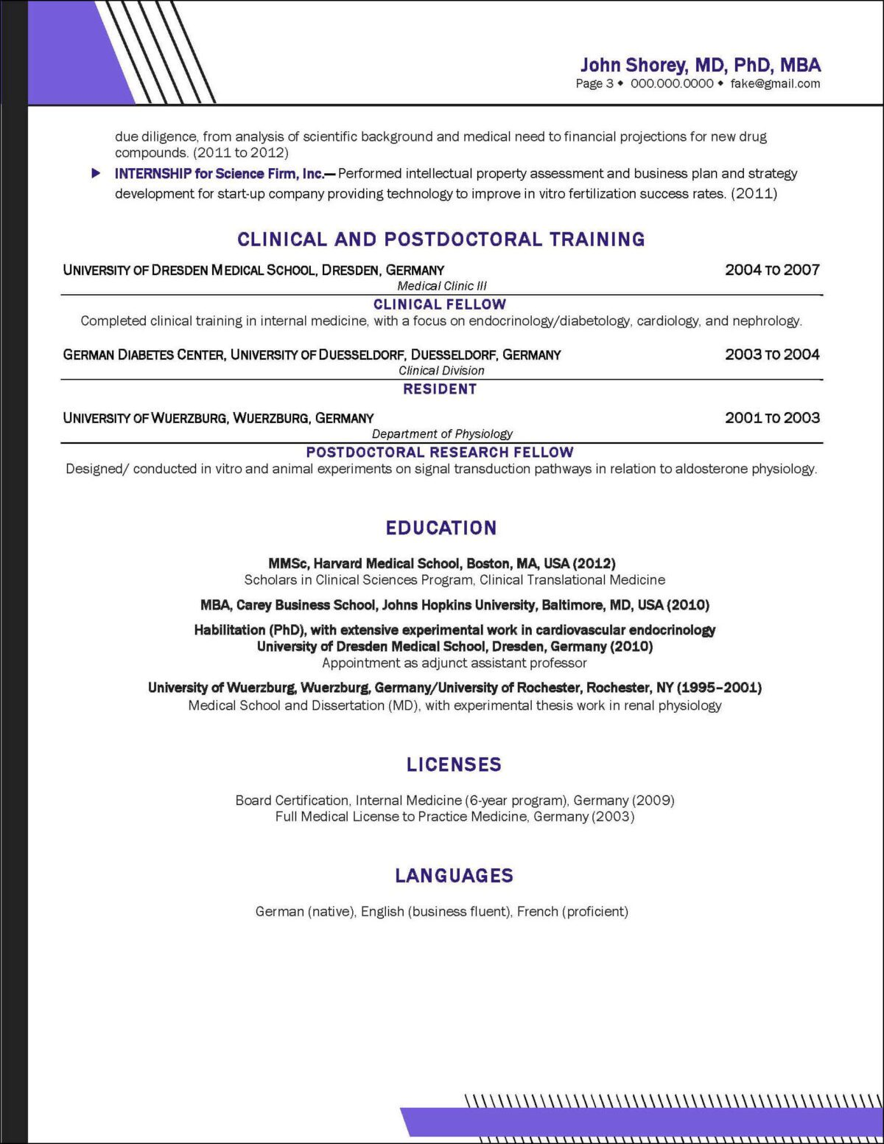
THREE-PAGE RESUME SAMPLE

Slide 27
SOURCES
https://www.distinctiveweb.com/project-examples/pharma-biotech-resume-example/
https://www.resumebuilder.com/resume-examples/phd-for-industry-and-non-academic-jobs/
https://www.beamjobs.com/resumes/phd-resume-examples

Slide 28
FINAL THOUGHTS
Easy to read, clean, and professional.
Customize for every application.
Make it easy for the hiring manager,
and pleasant to look at.

Slide 29
Thank You

