Slide 1
The Role of Policy, Business, and Technology in the Decarbonization Challenge: From the Global to the Local (Laboratory) Scale
Dr. Sara Hastings-Simon
Department of Earth, Energy, and Environment and School of Public Policy

Slide 2
Outline
Understanding the forces driving and blocking decarbonization
The role of policy in transforming energy systems
Levers in transportation emission reduction
Notes:
The global energy systems are entering a period of dramatic change. The global push for decarbonization along with concerns around energy security and technological developments are accelerating the pace of change. In this talk I will introduce the global context of decarbonization, the current state of play and the role of policy, technology, and economic and energy security concerns in the energy transition. I will discuss different types of policies available to policy makers and how policies can be best designed to target different points in technology development and deployment. This global picture will be connected to the more local picture of policies that might be used in a laboratory context including an overview of key levers for transportation emission reductions.

Slide 3
Underlying drivers of energy transition are mutually reinforcing…
Commitment to reduce carbon emissions and other pollutants
Desire to reduce exposure to global fossil markets due to concerns regarding security and inflation
Changing technological landscape
Notes:
Concept: Pace of energy transition is determined by 3 factors, and each is reinforcing and accelerating the change

Slide 4
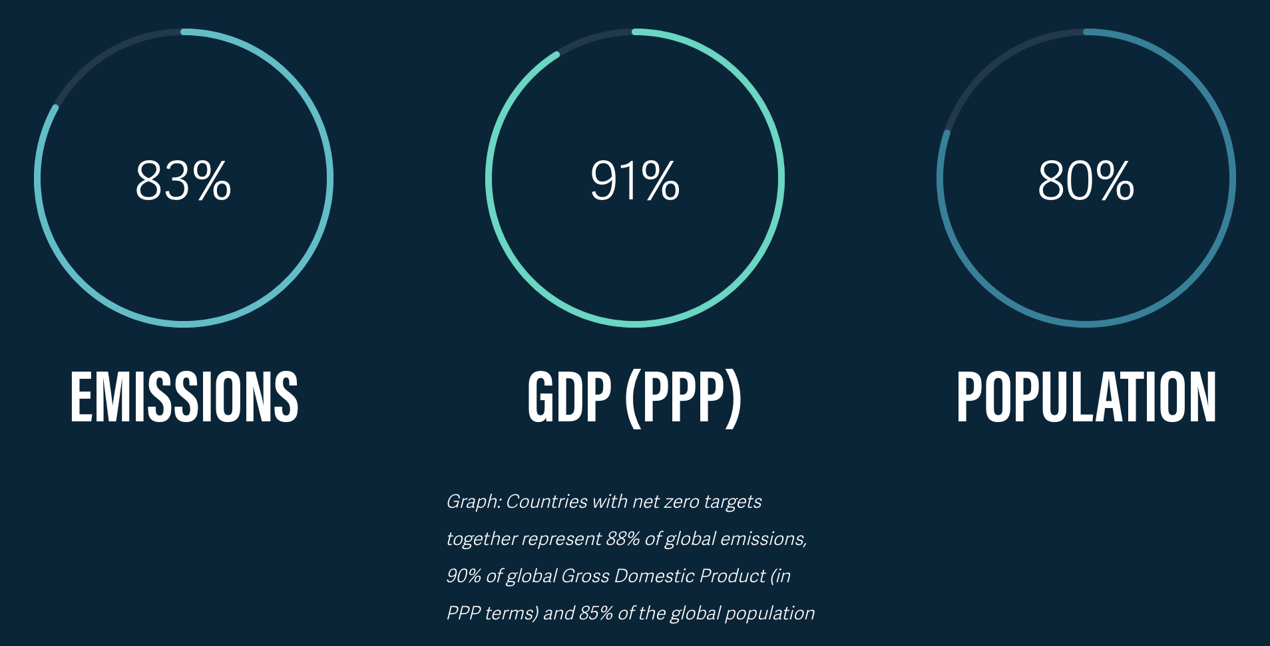
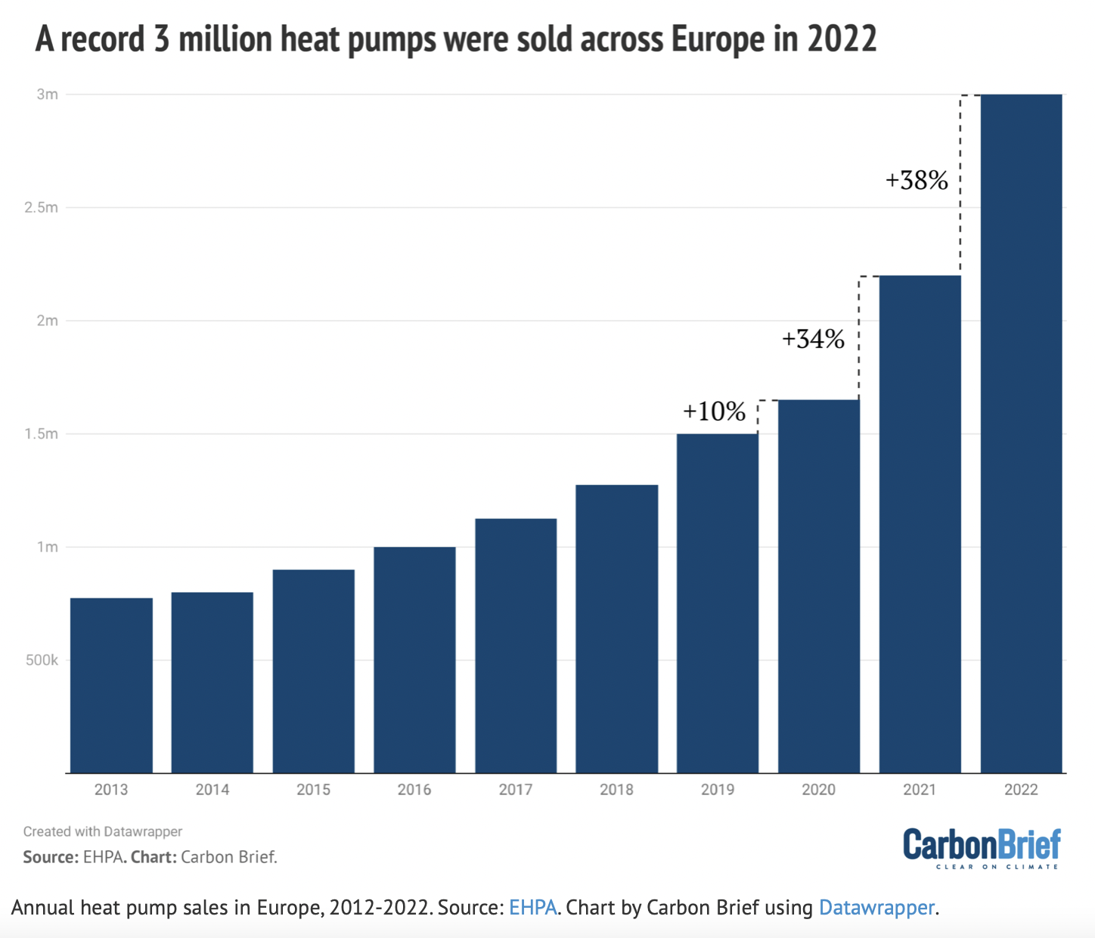
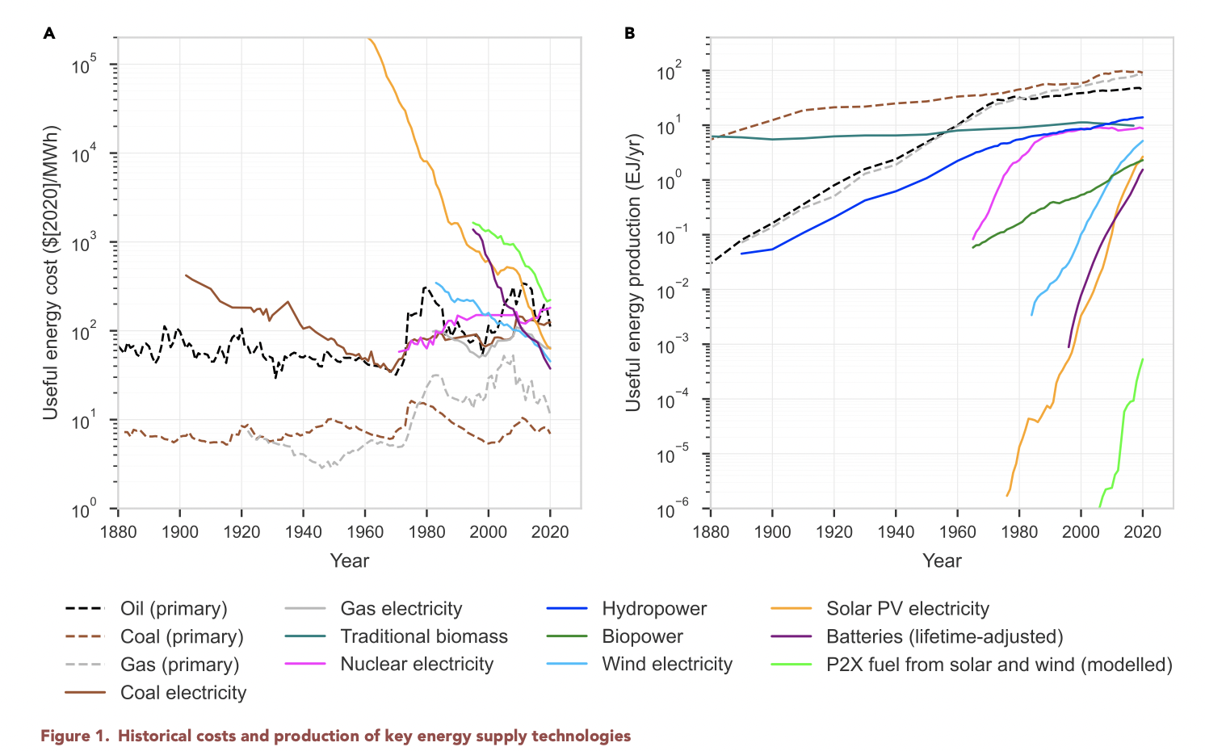
..and these drivers are accelerating
Net zero goals
Commitment to reduce emissions
Desire to reduce exposure to global fossil markets
Changing technological landscape
Way et al., Joule 6, 2057–2082 September 21, 2022; https://doi.org/10.1016/j.joule.2022.08.009

Slide 5
Key milestones in climate policy
1988 Establishment of the Intergovernmental Panel on Climate Change (IPCC)
1992 Establishment of the United Nations Framework Convention on Climate Change
1997 Kyoto Protocol
2009 Copenhagen Summit
2015 Paris Agreement
2015-2024 Net zero commitments
Notes:
UNFCC - The treaty called for ongoing scientific research and regular meetings, negotiations, and future policy agreements designed to allow ecosystems to adapt naturally to climate change, to ensure that food production is not threatened and to enable economic development to proceed in a sustainable manner
Kyoto - Established legally binding obligations under international law, for developed countries to reduce their greenhouse gas emissions in the period 2008–2012: Canada (which withdrew from the Kyoto Protocol in 2012)^{[21]} and the United States.

Slide 6
Technological landscape: something is different with these new technologies
Way et al., Joule 6, 2057–2082 September 21, 2022; https://doi.org/10.1016/j.joule.2022.08.009

Slide 7
Unstoppable force meets an immovable object: these drivers of change meet real world energy systems
Should we do this?
(The Feasible)
Socio-Techno-Economic systems
Will we do this?
(The Acceptable)
Can we do this?
(The Possible)

Slide 8




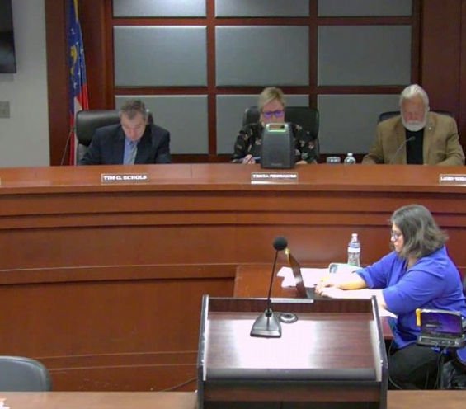
Carbon lock in
A special form of path dependency where the outcome is increasing GHG emissions
An “inertia” that limits systemic transformations from a combination of technologies, institutions, and behaviours
Technologies and infrastructure
Institutions and governance
Behaviors, habits, and norms
Notes:
as inter-related components connected
in a network or infrastructure that includes physical,
social and informational elements.

Slide 9
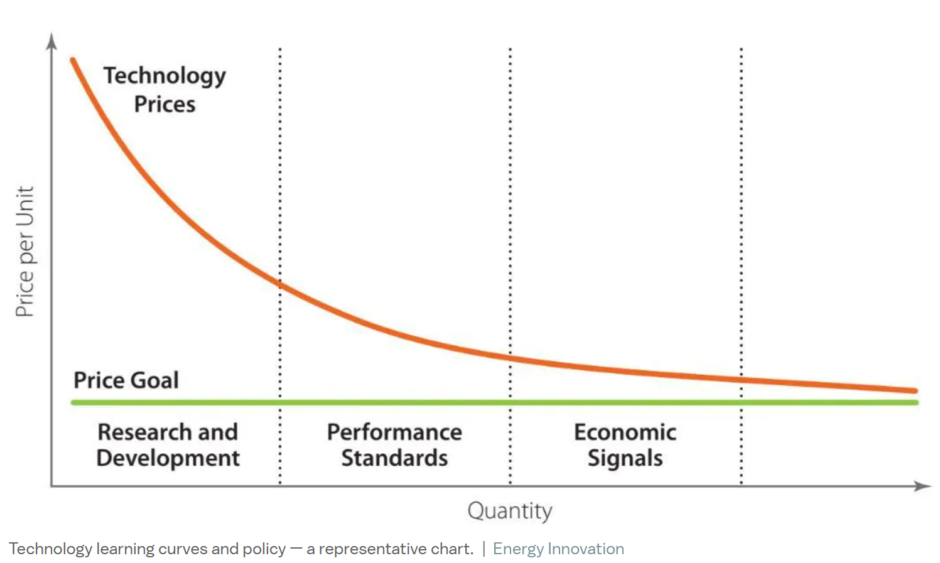
Ideal policy types vary across the technology learning curve and barriers to implementation
Harvey, Hal, Robbie Orvis, Jeffrey Rissman, Michael O´Boyle, Chris Busch, and Sonia Aggarwal. Designing Climate Solutions: A Policy Guide for Low-Carbon Energy. Washington Covelo London: Island Press, 2018.
Notes:
Performance standards much better than economic signals for addressing lock in

Slide 10
There are a broad range of well understood policy tools
Research and Development
  Direct funding
  Matching funds
Performance standards
  Market responsive
  Prescribe outcomes not approaches
  Address knowledge gaps and lock in mechanisms
Economic Signals/Market based mechanisms
  Carbon pricing (cap and trade, carbon tax)
    Key design considerations: Treatment of energy intensive trade exposed industries, protecting low income consumers, providing long term certainty, use of revenue
  Leveling the playing field – removing current subsidies
  Electricity market pricing – reflecting true cost of electricity
Additional policy support to manage disruption
  Just Transition e.g., Retraining/reskilling/infrastructure availability
  Ensuring equal access to opportunities including benefits (e.g., Energy efficiency, Investment opportunities)

Slide 11
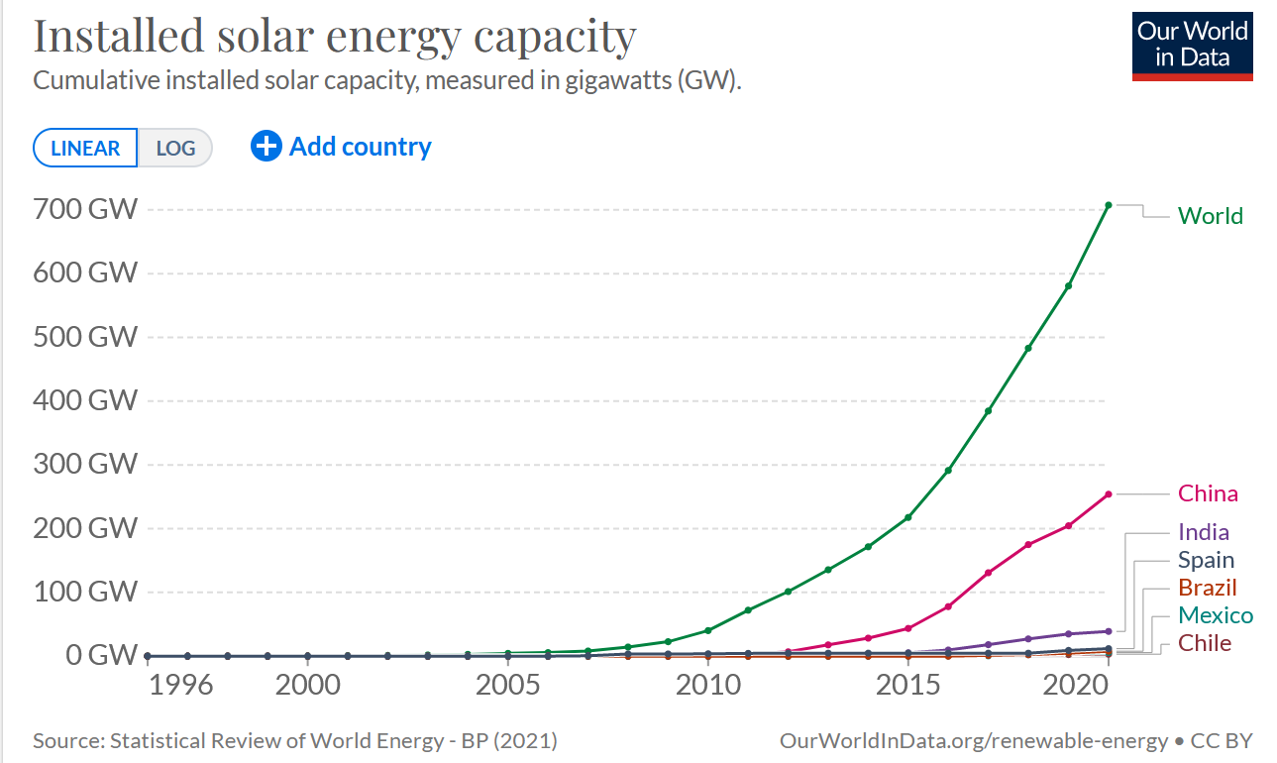
Policy in practice – solar PV: An (abbreviated) history from R&D to performance standards and economic signals
1905 - Albert Einstein published his paper on the photoelectric effect.
1916 - Robert Millikan provided experimental proof of the photoelectric effect.
1932 - Audobert and Stora discover the photovoltaic effect in cadmium sulfide (CdS).
1954 first silicon photovoltaic (PV) cell at Bell Labs capable of generating enough electricity to run equipment.
1958 The Vanguard I space satellite used a small (less than one watt) array to power its radios.
1964 NASA launches the first Nimbus spacecraft—a satellite powered by a 470-watt photovoltaic array.
US Public Utility Regulatory Policies Act of 1978 (PURPA) created a market for power from non-utility power producers.
1977 The U.S. Department of Energy launches the Solar Energy Research Institute, later “National Renewable Energy Laboratory”, a federal facility dedicated to harnessing power from the sun. Total global manufacturing production exceeds 500 kilowatts.
1984 The Sacramento Municipal Utility District commissions its first 1-megawatt photovoltaic electricity generating facility.
2000, Germany enacted a national Feed in Tariff
2000s US states introduce renewable portfolio standards
2005 US introduces solar investment tax credit
2018 Alberta government creates electricity wide price on carbon
2019 Alberta government procures solar electricity
https://www1.eere.energy.gov/solar/pdfs/solar_timeline.pdf

Slide 12
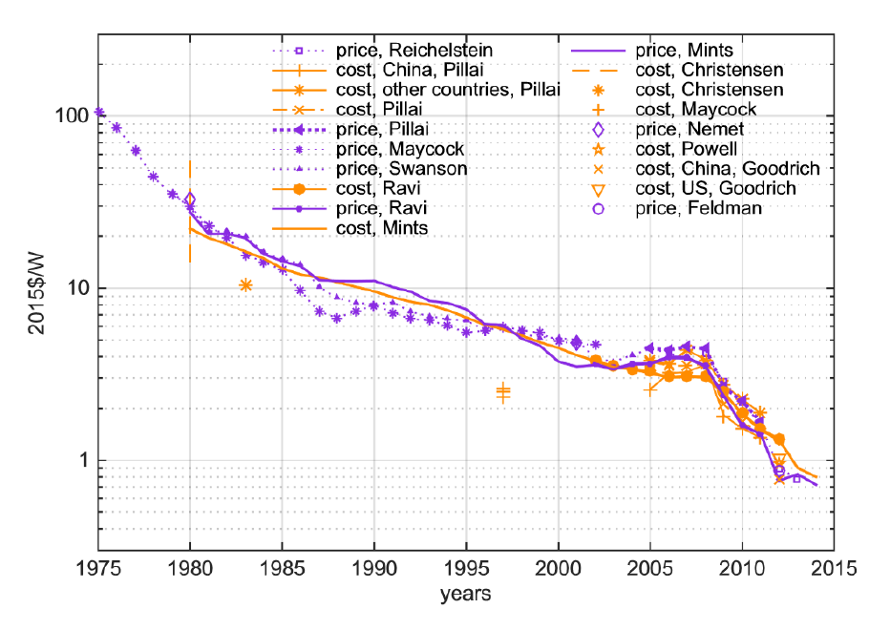
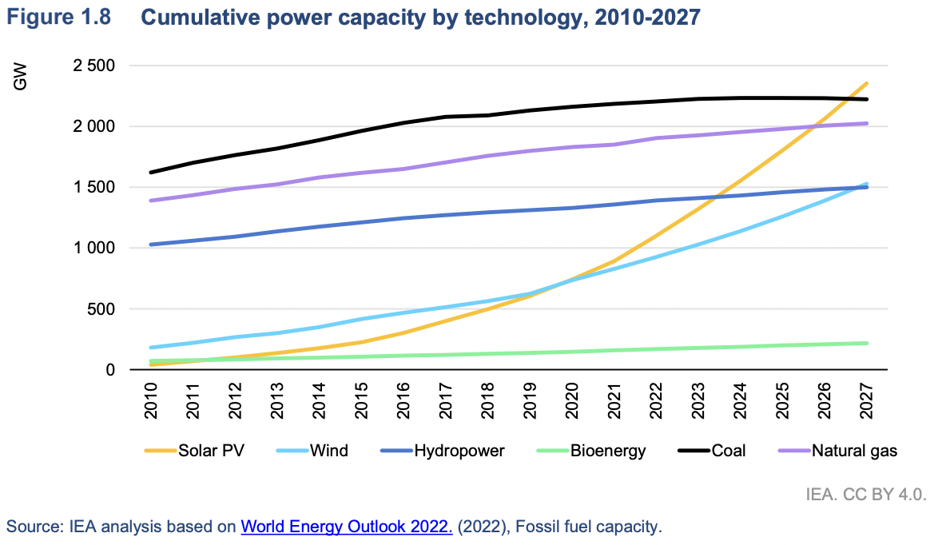
Policies have enabled cost reductions directly and through deployment
Costs for technologies like solar PV have fallen…
…And deployment rates are increasing
Kavlak, G., McNerney, J., & Trancik, J. E. (2018). Evaluating the causes of cost reduction in photovoltaic modules. Energy Policy, 123, 700–710. https://doi.org/10.1016/j.enpol.2018.08.015

Slide 13
Reducing transportation emissions
90% of decarbonization is electrify uses of energy, supply that energy from low carbon sources, and use less of it.
IEA Net Zero Scenario transportation decarbonization includes electric vehicle adoption, electric 2 and 3 wheel vehicles, limited aviation growth and low carbon fuels.
Path forward requires action at multiple levels. Some steps include:
  Identify barriers to adoption (carbon lock in)
  Determine which policies can be implemented locally, and how actions can influence policies at other levels

Slide 14

For more on this and other topics – Energy vs Climate
How the climate challenge is shaping our energy systems
Live webinar and podcast series ~2x/month
Co-hosted by David Keith, Ed Whittingham, and me
Find it at EnergyVsClimate.com or in your podcast player

