Slide 1
Lessons Learned from Project Management POV
Estimating Novel Technology Projects
July 25, 2024
Chris Gibson

Slide 2
Contents
Topic of lesson learned: estimating for complex/novel tech projects
A UCN overview picture
“classic” steps to make a budget
Problem statement
Root cause diagrams (Ishikawa)
Labour estimating discussion
Duration estimating discussion
Adding iterations to plan
Rolling wave approach
Summary

Slide 3
Which Lesson(s) Will We Discuss Today (Topic)?
From UCN Source Gate 2:
What could be improved | Recommendation on how to improve for next time
Ability to estimate Effort and Duration to do a concept design for a novel, complex system (much longer than initial estimates!) | See detailed lessons-learned* in following slides
The UCN-lessons learned had several things that went well, but we are not here to talk about that today
* Modified from a UCN lessons-learned to make it more generally applicable

Slide 4
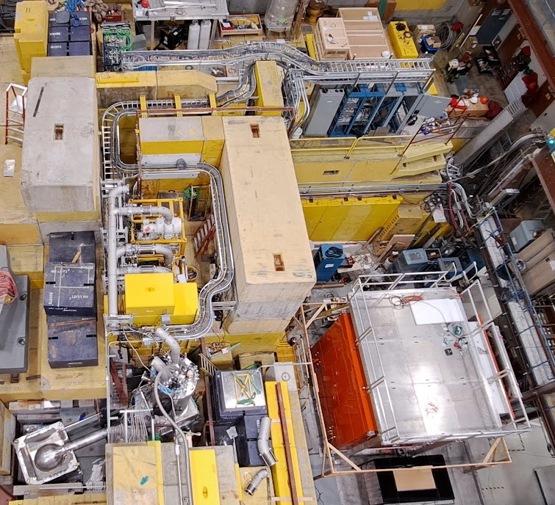
UCN Source Complexity: Installed Hardware
3He/Isopure He gas handling system
CNSC and TSBC approval of UCN Source design
Control racks (100’s of inputs and outputs)
3He and natural Helium pumping subsystem
Large Deuterium and Isopure He tanks outside
4He/3He/Isopure He cryostat
Deuterium cryostat and gas handling still to be built and installed
6-layer tail vessel above target. Surrounded by other moderators incl. D2O

Slide 5
“Classic” Planning Sequence
Budget
7) Cost estimates
6) Estimate activity durations and develop schedule
5) Estimate activity resources and durations
4) Sequence activities (identify dependencies)
3) Define activities for each deliverable
2) Create Work Breakdown Structure (decompose deliverables), including documents
1) Collect requirements and define scope
$
CONTINGENCIES
CONTINGENCIES
Schedule Baseline
project
Subsystem 1
Part 1
Part 2
Subsystem 2
Part 3
Part 4
Scope Baseline

Slide 6
Problem Statement for Root Cause Analysis
For P407 UCN Electric Dipole Moment CFI Project, the UCN Source Concept Design was taking approximately 5x longer than initial estimates and 2.5x longer than the 2nd iteration of estimates
Other TRIUMF projects have had similar estimation errors

Slide 7
Root Cause Diagram for Concept Design Stage 2 Longer Than Expected
Estimating Processes
Labour-related
System Complexity
Did not formally include risk and monte-carlo based schedule contingencies
Actual Labour >> Estimated (see Labour root cause analysis)
Relied on too few sources for “gut checks” of stage 2 duration
No benchmark available for similary-complex system stage 2 duration
Conflict between early interface stabilization and performance
WBS skeleton not optimized to reflect nature and number of iterations
Limits to amount of available labour result in load-leveling = longer duration
Stage 2 Longer than Expected
PM did not obtain commitments for completion dates when re-forecasting slipping tasks
Work request process does not always enforce duration estimate and does not close loop to result in change to budget and schedule + no updates on overages
High number of active tasks per owner was overwhelming
For complex system, Stage 2 is lengthy, difficult, and unpredictable, which is not acknowledged in TSOP-15.
No contributing root causes identified
Major contributor. See next slide.
Tracking meetings not frequent enough to keep schedule up-to-date
Other TRIUMF Process/Org issues
Communication
Progress-tracking processes

Slide 8
Root Cause Diagram for Labour Cost Over Budget
Estimating Processes
Lack of Knowledge and Training
System Complexity
Contingency “carve-out” only took place AFTER CFI proposal
Junior personnel assigned to complex jobs with inadequate support and guidance
No benchmark available for similary-complex system
Relied on too few sources for initial estimates
WBS skeleton not optimized to reflect nature and number of iterations
No wide knowledge of System Engineering practices
Conflict between early interface stabilization and performance
No consistent skills level rating system (e.g. E1, E2)
Labour cost over budget
Engineers and Designers are in multiple groups (decentralized, harder to enforce standards)
Only 1 timesheet code for entire project = unable to link lower-level WBS estimates to actuals
Work request process does not always enforce labor quote and does not close loop to result in change to budget and schedule + no updates on overages
Dedicated resources – same issue as timesheets
For complex system, Stage 2 is lengthy, difficult, and unpredictable, which is not acknowledged in TSOP-15.
Other TRIUMF Process/Org issues
TRIUMF labour tracking processes

Slide 9
Estimating Processes for Labour Effort
Contingency “carve-out” only took place AFTER CFI proposal
  Applies to expenses and labour
  CFI apparently does not allow explicit project contingencies, despite this being best practice
  After proposal, Monte Carlo analysis of budget resulted in >2M recommended contingency; we eventually had to remove scope to create contingency
  Recommendation: Perform Monte Carlo analysis, or using recommended contingencies from Accounting Module (WBS) template prior to CFI proposal submission
UCN group relied on too few sources for initial estimates
  4 possible sources are: Project Engineer, Line Managers, Assignees, Subject Matter Experts. Most accurate estimates come from consulting all 4.

Slide 10
Estimating Processes for Duration
Did not formally include risk and Monte-Carlo based schedule contingencies
  There are tools that can do this.
Relied on too few sources for “gut checks” of stage 2 duration
  A recommended practice is to gather a cross functional team of people who have worked on a project of similar complexity to do a high-level extrapolation for stage durations based on the similar-project benchmark.
WBS skeleton not optimized to reflect nature and number of iterations
  Further discussion of this in the following slides

Slide 11
WBS Skeleton for Estimating Complex System Stage 1-2
The WBS and Gantt Chart skeleton on which the estimates are based should be appropriate for the complexity of the system
  Iterations should be assumed and built-in to the skeleton

Slide 12
A Possible Skeleton – “Rolling Wave” Iterations

Slide 13
Notes on Rolling Wave Proposal
First need to decide what Subsystems should be developed in parallel
  Changes to closely coupled subsystems will impact interfaces and impact each other’s designs. These are best developed in parallel unless interfaces can be completely fixed prior to detailed concept development
  Groups of subsystems with longer expected development and build times should be developed prior to shorter-lead-time groups IF resource loading is a constraint.
Why are the “waves” 60 days?
  This is a natural timeframe for a team to understand and work towards; everyone knows there will be a review and adjustments every 3 months
  The 3-month review should be informal but be focused on all requirements
  Possible to increase duration (and reduce number) of waves – up to 6 months
How to determine number of iterations / total Stage 2 duration:
  This is the tricky part. We need TRIUMF baselines for efforts for several resource types
  Then we can scale required labour effort by:
    General comparison to development of similar subsystems from the past and/or:
    Total expected component count (try to estimate # of parts per subsystem and scale effort accordingly)
    Load level for typical bottleneck resources (designer, cryogenic engineer, etc.)
    A “difficulty” multiplication factor (0.5x to 2x?)
In UCN, we ended up using a rolling wave approach for incremental install/test waves, so it is not just for design iterations

Slide 14
Summary of Recommended Actions
# | Recommendation | Categories
1 | Perform Monte Carlo analysis, or using recommended contingencies from Accounting Module template prior to CFI proposal submission | Estimating Processes for labour and expenses
2 | Use risk and Monte-Carlo based schedule estimation tools | Estimating processes
3 | Do proper consultation with Design Office to get better-defined scope of work, to enable labor quotation, better chance of accurate labor forecast, possible Estimate to Actual comparison | Estimating and Progress tracking processes
4 | Use larger cross functional team to assess high-level schedule in comparison to historically similar subsystems. | Estimating processes
5 | Every usable account to have an owner/approver (now implemented with Workday) | TRIUMF labour tracking
6 | PMs to use either scaled component-count-based or scaled similar-subsystem-based estimating techniques to estimate labour to complete Concept design (esp. designer and engineer labour) (requires benchmark database) | Estimating processes for duration and labour
7 | PMs to use “rolling wave” WBS and Gantt chart skeleton to drive iterative progress (where suitable) | Estimating and Progress tracking processes
8 | Better, easier to use Timesheet systems (starting point Agresso), able to track work on specific jobs | TRIUMF labour Tracking
9 | Add TSOP-15 Gate 1 requirement to rate Subsystems “high-risk” or “low risk” based on novelty and complexity (somewhat implemented with Accounting Module | Estimating processes for duration and labour + Other TRIUMF Processes

Slide 15
References and Links
Project Management Toolkit
  Has several templates including budget spreadsheet with contingencies (Template for WBS)
TSOP-15 Project Governance
TSOP-06 Engineering, Design, Manufacture and Assembly

