Slide 1
Engineering Practice at TRIUMF
Presented to: Science Week
By: Bill Richert, P. Eng.
July 25, 2024

Slide 2
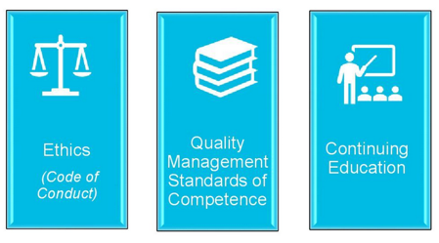
Engineering at TRIUMF
Regulatory Framework
Professional Governance Act (BC)
Establishes the Office of the Superintendent of Professional Governance to provide government oversight over the Regulator
Establishes Engineers and Geoscientists British Columbia (EGBC) as the Regulator for the practice of engineering, with general duties to:
Serve and protect the public interest with respect to professional governance and the conduct of Registrants
Exercise its powers and discharge its responsibilities in the public interest
Engineers and Geoscientists Regulation (BC)
Establishes the practice of professional engineering as a practice Reserved for Registrants (i.e. Firms and P.Engs).
Legally defines the scope included in the “practice of professional engineering”
EGBC Bylaws
Identifies the specific requirements related to the three pillars of professional practice

Slide 3
Engineering at TRIUMF
BC Premier
Regulatory Framework
Which Professions are Regulated by the PGA ?
Engineering (EGBC)
Architecture (AIBC)
Applied Science Technology (ASTTBC)
Applied Biology (CAB)
Agrology (BCIA)
Forestry (ABCFP)
Ministry of the Attorney General
Office of the
Superintendent
Professional Governance Act
PGA sets consistent standards for all 6 Regulators:
Ethical principles, duties and responsibilities and
governance structure
EGBC
ASTTBC
AIBC
CAB
BCIA
ABCFP
Bylaws
Each regulatory body has their own by-laws
that set out the specific standards, requirements, processes and procedures that apply to that
regulatory body and their registrants.
EGBC By-Laws: Identify the specific requirements related to the three pillars of professional practice

Slide 4
Engineering at TRIUMF
What’s “new” in the Legislation:
Added government oversight of EGBC: Office of the Superintendent of Professional Governance
Establishment of EGBC as a Regulator: With Government Oversight.
Establishes Reserved Practice: Practice of engineering is Reserved for Registrants of EGBC
Goal: Enhance public safety by ensuring that qualified people carry out work that requires the skills of a professional
Who Needs to be a Registrant:
Individual Professional Registrants (P. Eng’s)
Firms (TRIUMF Inc.). TRIUMF is an Engineering Firm, registered with EGBC requiring consolidated Policies and Procedures related to professional practice.
Specific duties defined: EGBC has the authority to regulate Firms and Individual Registrants:
Goal: Improve public safety through strong regulation, establishing standards of practice and robust auditing of Firms and individuals. Highly likely that TRIUMF will be audited within the next 12 months.

Slide 5
Engineering at TRIUMF
Why Did They Change the Regulatory Requirements?
Mount Polley Copper Mine Disaster (Aug. 2014)
Worst environmental mining disaster in Canadian history
Independent inquiry recommendations included improvements to Professional Governance including Regulation of individuals and Firms that perform Professional Engineering
EGBC Disciplinary Proceedings (Mar. 2022):
Former senior geotech Engineer Todd Martin: $94,000 in fines and legal fees and resignation: Unprofessional conduct; failure to document Field Reviews, failure to exercise good engineering judgement by not drilling to establish existing soil conditions
Former engineer Stephen Rice: $132,000 in fines and legal fees and resignation: Unprofessional conduct; Failure to fulfill role as review engineer and allowing a junior engineer with little experience to act as Engineer of Record
Engineer of Record Laura Fidel, P.Eng. Suspension for unprofessional conduct; failure to ensure adequate Field Review and monitoring of conditions and sealing drawings to build on a design done by others that she did not adequately review.

Slide 6
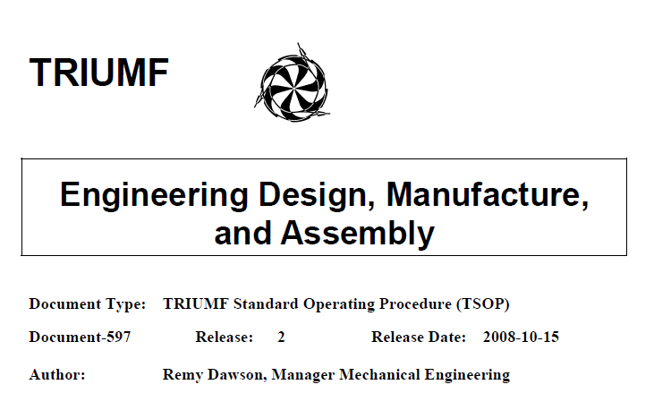
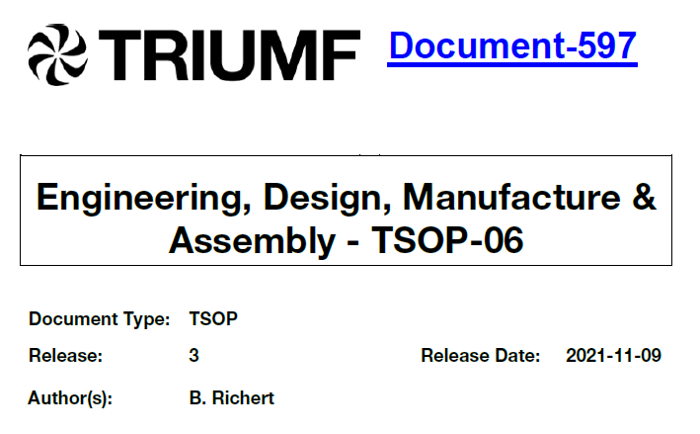
Engineering at TRIUMF
What’s “new” at TRIUMF ?
TSOP-06 – Engineering, Design, Manufacture & Assembly

Slide 7
Engineering at TRIUMF
Why Was TSOP-06 Changed ?
To align with CSA N286-12: Management System Requirements for Nuclear Facilities
Terminology/Definitions (Section 3)
Design Management and Construction Management Requirements (Parts 8.3 and 8.6)
To bring TRIUMF closer to complying with the Professional Governance Act (BC) and Engineers Geoscientists British Columbia Bylaws by:
Identifying Professionals of Record, ensuring Direct Supervision of non-registrants;
Authenticating Engineering Documents;
Affixing TRIUMF’s Permit To Practice number to all authenticated documents;
Documenting scope of individual practitioner’s design responsibility and commitment to field reviews;
Documenting Field Reviews;
Engineering Record must contain all evidence of professional practice (not just design outputs)
Putting into motion TRIUMF’s commitment to the EGBC Code of Ethics, By-Laws, continuing education requirements and regard for Practice Guidelines and Advisories which are mandatory requirements for any employer/Firm engaged in the practice of professional engineering.
Prepare for the implementation of a Professional Practice Management Plan (PPMP)
Consolidated Policies and Procedures related to professional practice.

Slide 8
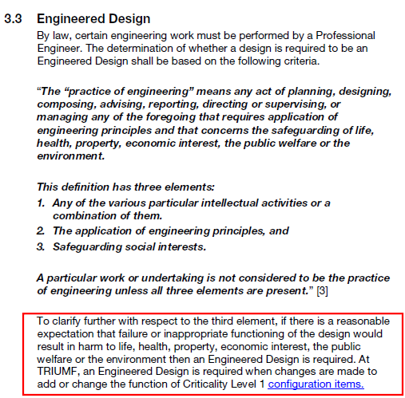
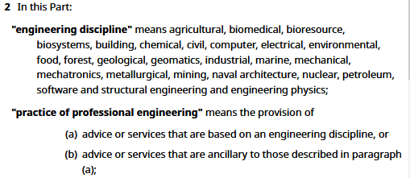
Engineering at TRIUMF
At TRIUMF - TSOP-06
(From Engineers Canada):
When is a Professional Engineer Required ?
By Law
From the Engineers And Geoscientists Regulation:

Slide 9
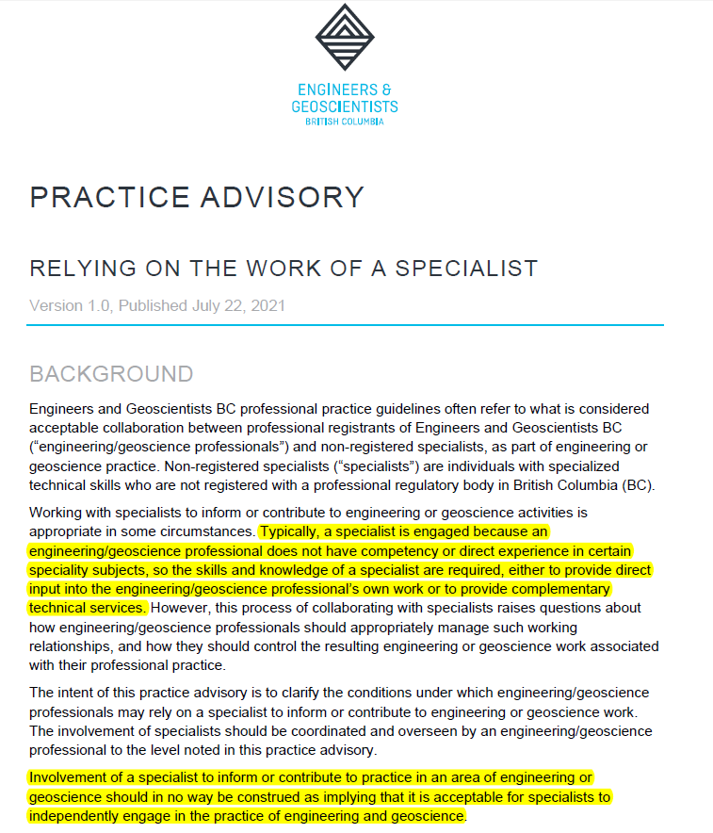
Engineering at TRIUMF
EGBC Practice Advisory: Work of a Specialists:
Typically occurs when P.Eng. does not have competency or experience in specialty area (eg. Shielding Calcs, Cryogenics,)
Specialist work overseen by P.Eng
Not construed to mean Specialist can independently engage in the practice of engineering in British Columbia.
P.Eng. Due Diligence:
Monitor outputs.
Establish reasonable level of confidence that Specialist is competent. (eg. Education, Training, Experience, Registration in another jurisdiction)
Only seal outputs produced under engineer's "Direct Supervision"

Slide 10
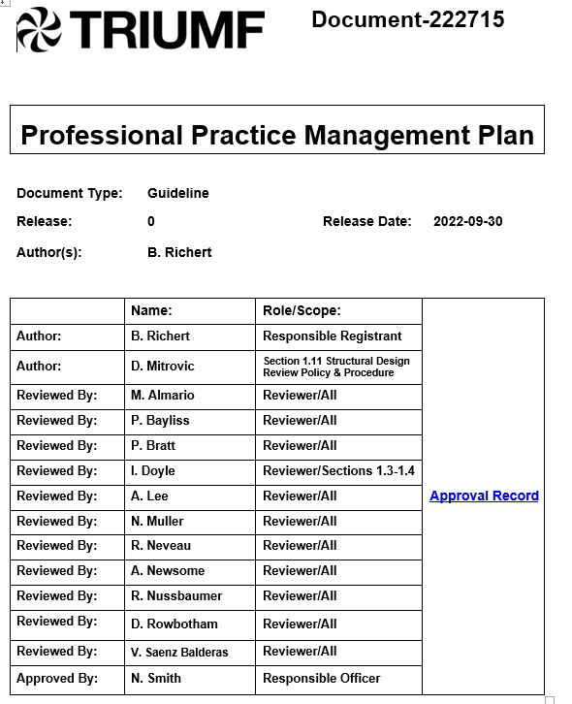
Engineering at TRIUMF
Professional Practice
Professional Practice Management Plan (PPMP): Documents policies and procedures related to the 3 pillars of professional practice.
Quality Management Standards of Competence
EGBC practice guidelines and advisories: Bylaws require that engineering assignments meet these standards. Departures must be documented with the rationale. There are >20 EGBC Guidelines applicable to TRIUMFs Engineering Practice:
Retention of documentation that shows evidence of engineering practice (i.e. not just output and records);
Checking of engineering work and independent review of structural and high risk work;
Authentication of documents – Electronic Seals;
Direct Supervision;
Professional Field Reviews;
Relying on the work of a Specialist
Equity, Diversity and Inclusion
Others applicable to specific Areas of Practice

Slide 11
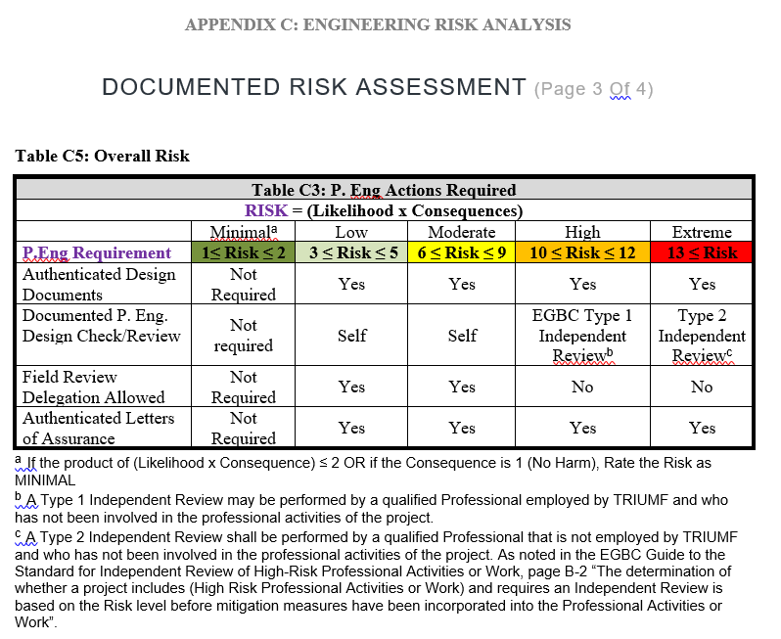
Engineering at TRIUMF
When is a Professional Engineer Required ?
When are Professional Field Reviews Required ?
When are documented design checks required?
When is self-check acceptable?
When is independent design review required?
It’s all based on risk
EGBC Bylaw excerpt:

Slide 12
Engineering at TRIUMF
Role and Responsibilities:
Chief Engineer:
Shall, Provide training to professionals Registrants, Leadership and Project Managers on the PPMP
Design Lead (WBS Leaders):
Shall, Determine whether an Engineered Design is required (part of Gate 2 report)
Shall, Attempt to Identify Professionals of Record.
Should, Request engineering work through the Work Request system.
Professionals of Record:
Shall, guide non-Registrants that support the Regulated practice through these requirments
Shall, Authenticate Engineering Documents after all Docushare or PDM Approvals are completed (Guide to the Standard for the Authentication of Documents, Section 3.2.2)
Shall, Affix TRIUMF’s Permit To Practice Number to authenticated documents
(By-Law 7.3.7.(15)(b))
Shall, Document Field Reviews (By-Law 7.3.3)
Shall, Document the checking of engineering work (By-Law 7.3.4)
Shall, Provide Direct Supervision to EITs and Specialists
Shall, Follow TRIUMF’s Professional Practice Management Plan (PPMP);
Shall, Document a pre-Design Risk Analysis to establish rigour of post-design checking;
Shall, Document scope of individual practitioner’s design field review responsibility;
Shall, Compile an Engineering Record for each engineering assignment. The filing structure should be standardized throughout the firm and contain all evidence of the practice of engineering

Slide 13
Engineering at TRIUMF
Take Aways for Non-Registrants
Does the PGA and PPMP requirements apply to me?
These are regulatory requirements that apply to TRIUMF Inc. and to all employees that support the Regulated practice of Professional Engineering
Early in Project/Assignment or when planning changes to commissioned systems ask yourself:
“is there a reasonable expectation that its failure or inappropriate functioning following Turnover would result in harm to health or the environment” ?
If yes,
Have a Professional Engineer document a risk analysis to confirm and to help guide you through the regulatory requirements.

Slide 14
Engineering at TRIUMF
Possible Consequences of Failure to Comply
Firm:
EGBC Disciplinary Action. (Suspension, Fine up to $250,000)
Individual Registrants:
EGBC Disciplinary Action (Suspension, Fine up to $100,000)
Could be evidence of: incompetence, negligence, unprofessional conduct
Willful negligence could affect indemnity under HR Policy 35

Slide 15
Thank you Merci
www.triumf.ca
Follow us @TRIUMFLab
Discovery,
accelerated

